Slide 1
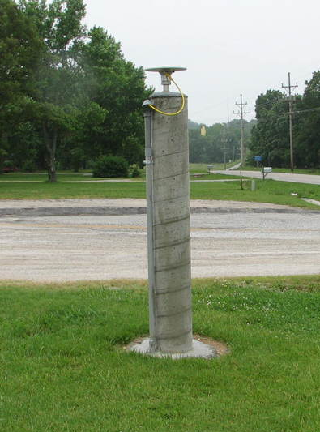
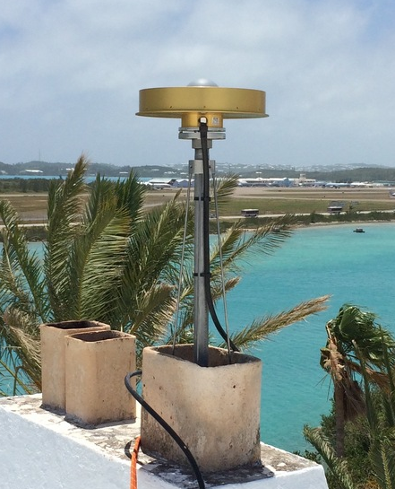
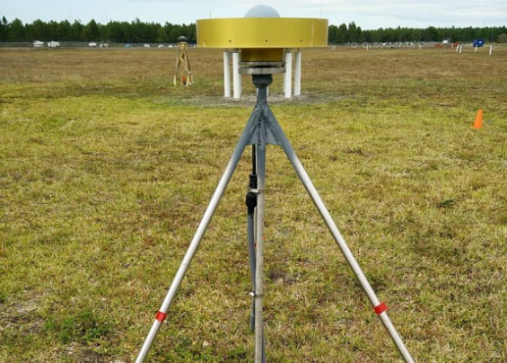
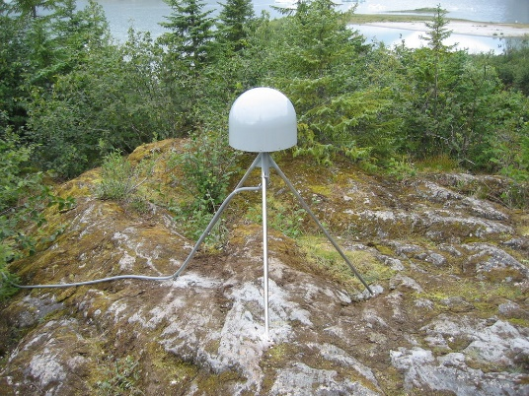
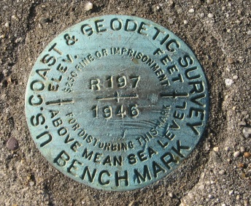
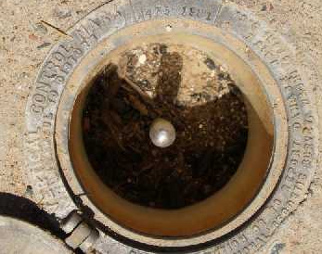
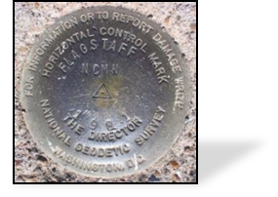
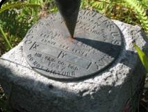
Modernization of the NSRS
5
Continuously Operating Reference Stations (CORS)—Active Control
Benchmarks—Passive Control

Slide 2
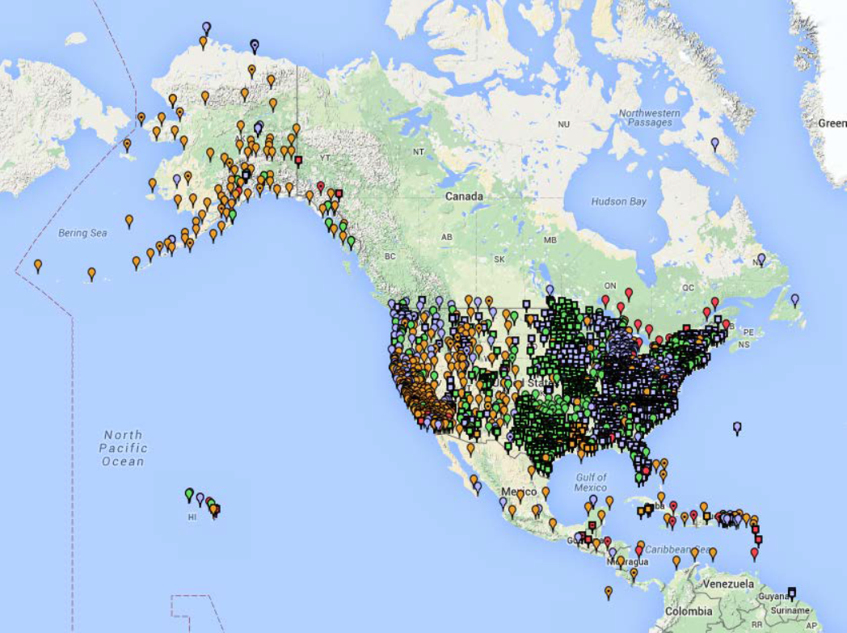
Continuously Operating Reference Stations (CORS)
11
  ~1800 Continuously Operating Reference Stations
  Run by more than 200 organizations (various government, academic, and private organizations)
  Provide access to the
  U.S. National Spatial Reference System

Slide 3
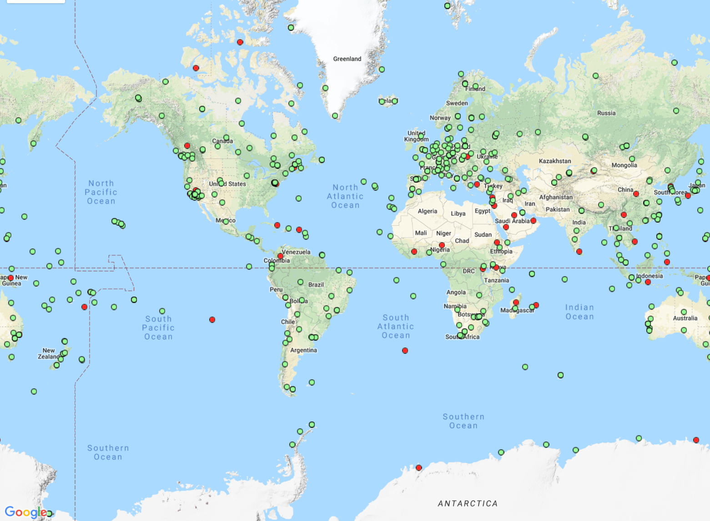
10
International GNSS Service (IGS) Network
The IGS is a component of
the Global Geodetic Observing System. The IGS operates a global network of GNSS ground stations,
data centers, and data analysis
centers to provide data, and derived
data products, essential for Earth
science research.
The IGS Reference Frame Coordinator determines tracking
site coordinates and velocities in
the International Terrestrial Reference Frame (ITRF) and organizes the IGS’ contribution to
the ITRF.

Slide 4
Guiding Principles for
Continuously Operating Reference Stations
9
By 2022, the National Spatial Reference System (NSRS) will be
modernized, with CORS becoming a more foundational component.
The International Earth Rotation and Reference Systems Service (IERS) International Terrestrial Reference System (ITRF) will continue to be
the worldwide standard reference system.
NGS will continue to support the ITRF through International GNSS Service (IGS) reference sites—or “Foundation CORS.”
The NSRS will continue to be defined in relation to the ITRF.

Slide 5
Foundation CORS Requirements
13
Baseline Foundation CORS
Network:
Collocate:
All sites within the Foundation CORS
target area of the United States,
with existing space geodetic techniques
(SLR, VLBI or DORIS), will have
a collocated Foundation CORS.
  Additional Desired Foundation CORS Network Requirements:
  Density: Install or adopt new stations within the Foundation CORS target area of the United States. (Fulfill the spacing criteria of 800 kilometers within the Foundation CORS target area.)
  Plate Rotation (Euler Pole): Install or adopt new stations within the U.S. Foundation CORS target area to raise the minimum number of Foundation CORS to three on each of the four plates of interest, once the above criteria are met.
  Additional (Gap Filling): Install or adopt new stations, on a case-by-case basis, once the above criteria is met (*).

Slide 6
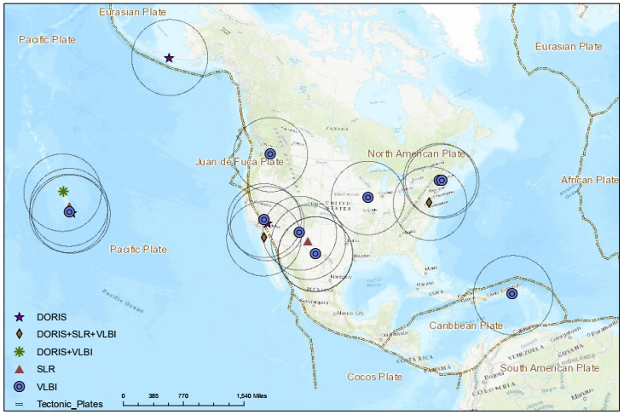
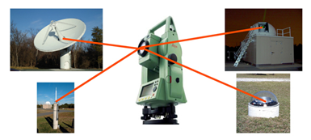
Collocated w/ NASA Spaced-Based Technology (SBT)
14
DORIS = Doppler Orbitography and Radiopositioning Integrated by Satellite
SLR = Satellite Laser Ranging
VLBI = Very Long Baseline Interferometry

Slide 7
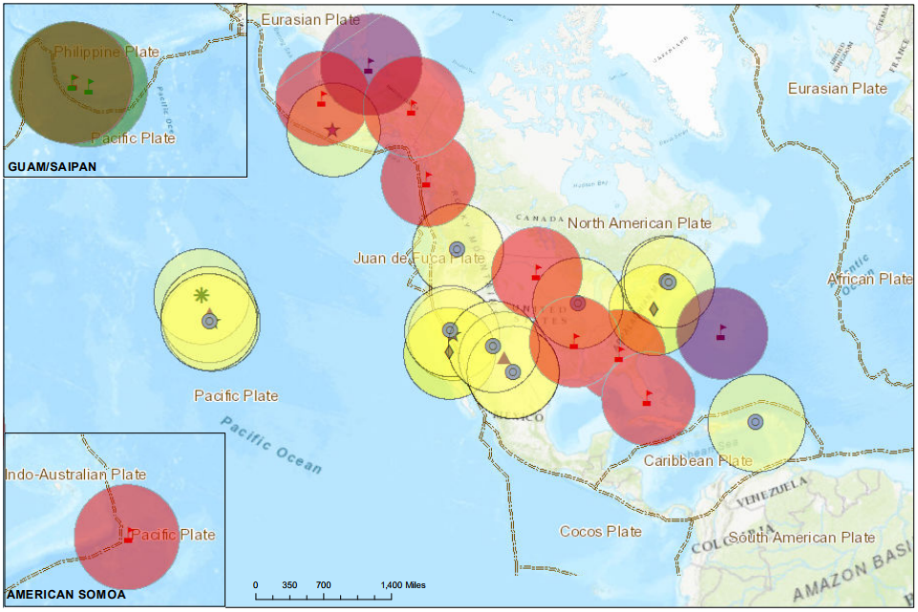
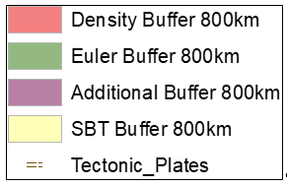
Collocated + Density + Plate Rotation + Additional
15

Slide 8
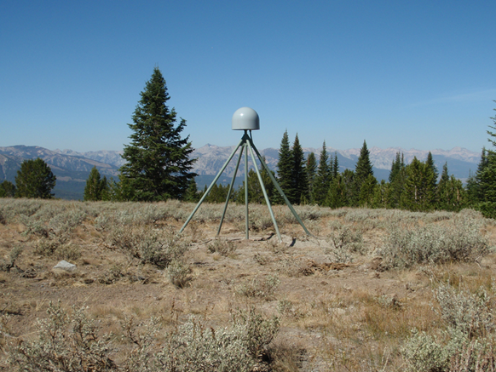

16
Foundation CORS Development Phases
Phase 1: Incorporate ~28
existing NASA and NSF partner stations and NGS stations into the Foundation CORS network.
Phase 2: Upgrade existing CORS to GNSS to meet Foundation CORS requirements
Phase 3: Construct ~8 new Foundation CORS

