Slide 1
NOAA CORS Network Stakeholder Meeting
17 November 2021
Presenters: Panelists: Moderator:
Dr. Theresa Damiani
Phillip McFarland
John Galetzka
Will Freeman
Christine Gallagher

Slide 2
Meeting Purpose
Status of the Current NOAA CORS Network
Current Services of NCN
Drivers of Change for the NOAA CORS Network
Future Mission of the NCN
Gather Feedback and Discuss Stakeholder Needs

Slide 3
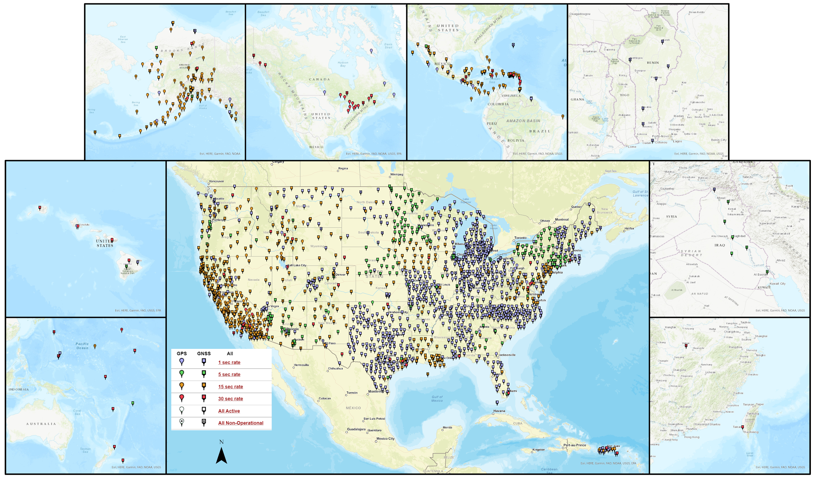
Status of the NOAA CORS Network
Notes:
Interactive https://www.ngs.noaa.gov/CORS_Map/

Slide 4
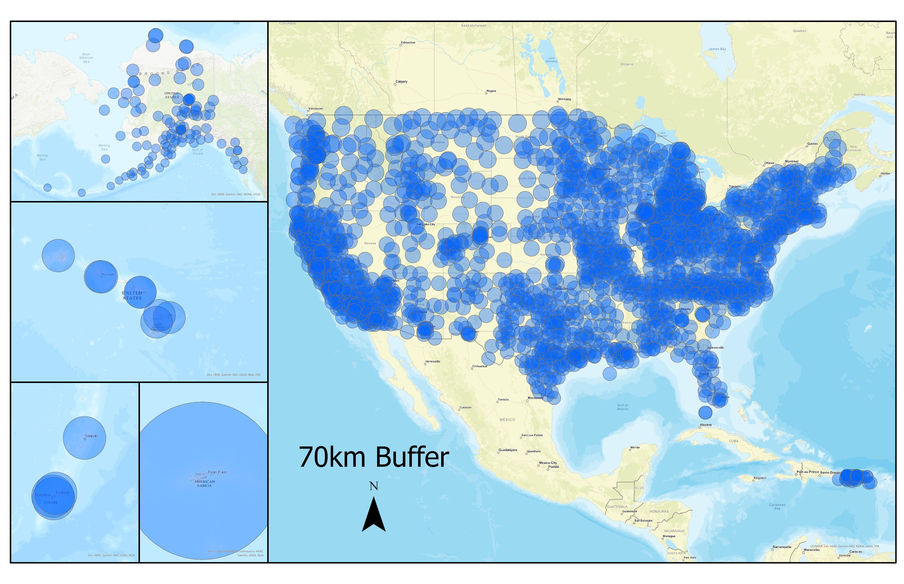
Geographic Distribution
- CORS Guidelines currently require stations to be at least 70 km apart from each other
- Requirements for updates to the CORS Guidelines are being gathered from stakeholders right now
- Contact john.galetzka@noaa.gov or don.haw@noaa.gov to discuss your plans before building new CORS
Notes:
https://geodesy.noaa.gov/CORS/Establish_Operate_CORS.shtml
Guidelines for Establishing and Operating CORS
If you go to our website or access the pdf Guidelines directly, you will see a notice there alerting you to the revision status of the guidelines.

Slide 5
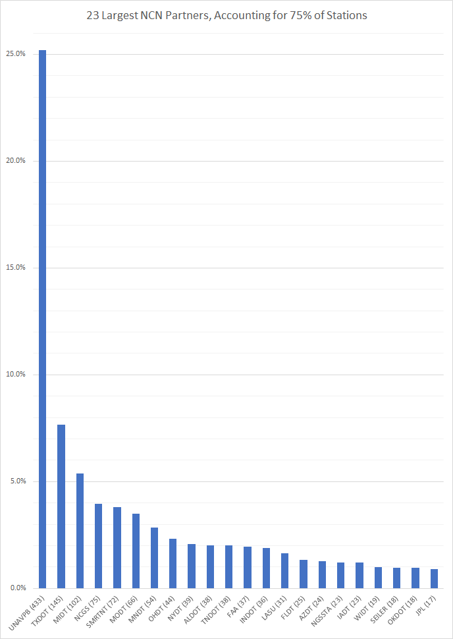
Partners
25% of the NCN data comes from the National Science Foundation (NSF via UNAVCO)
75% of NCN data comes from the top 23 largest partners
Remaining 25% of data comes from 133 partners
Notes:
NSF’s stations are in the Network of the Americas (NOTA), formerly called PBO

Slide 6
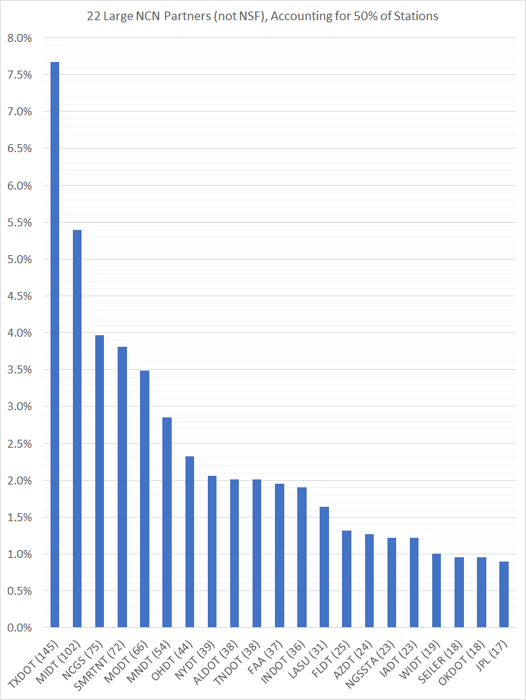
Partners
25% of the NCN data comes from the National Science Foundation (NSF via UNAVCO)
75% of NCN data comes from the top 23 largest partners
Remaining 25% of data comes from 133 partners

Slide 7
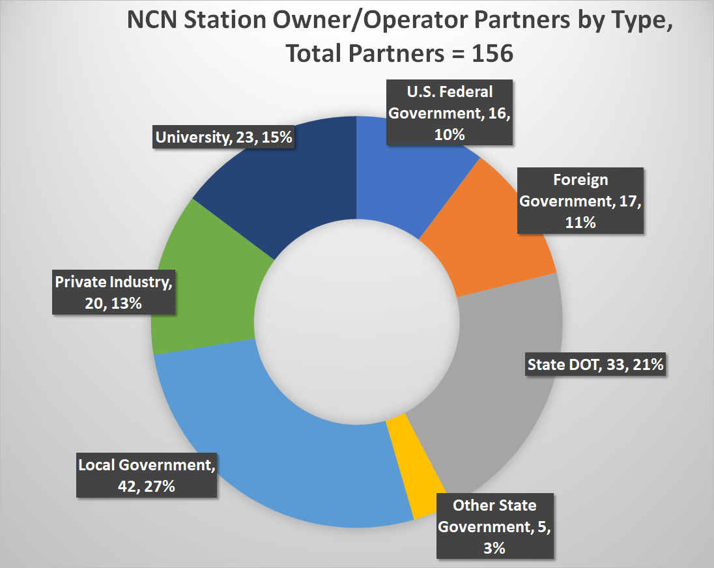
Partners and Stations by the Numbers
Notes:
911 CORS have been decommissioned since the start of the NOAA CORS Network in early 1990s
All-Time totals: 2820 CORS from 239 partners

Slide 8
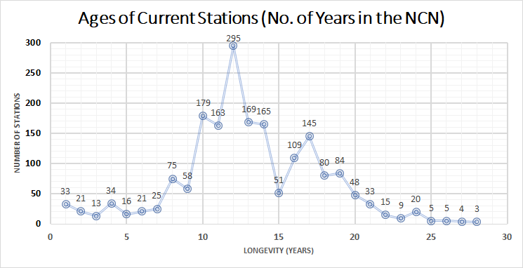
Notes:
Age is not a good correlation to performance. Sometimes older stations have long, reliable time series (many are IGS stations) and some older stations experience monumentation degradation, vegetation encroachment, human encroachment, maintenance problems, or other issues.

Slide 9
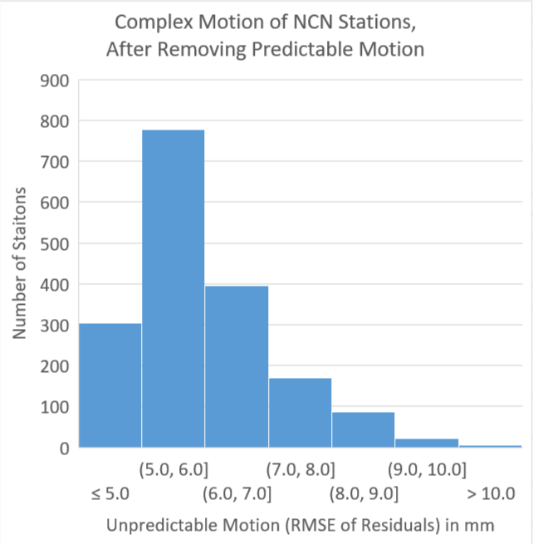
Multi-Year CORS Reprocessing (MYCS2)
Re-processed all NCN stations’ data, 1996-2016, with data > 3 yrs
Why?
New ITRF version
Hundreds of new CORS installed since MYCS1 in 2011
Obtain:
Precise 2016 position and velocity
Coordinate function (i.e. past coordinates and velocity)
Station quality
Reveals Complex Motion
Notes:
https://geodesy.noaa.gov/CORS/news/mycs2/mycs2.shtml

Slide 10
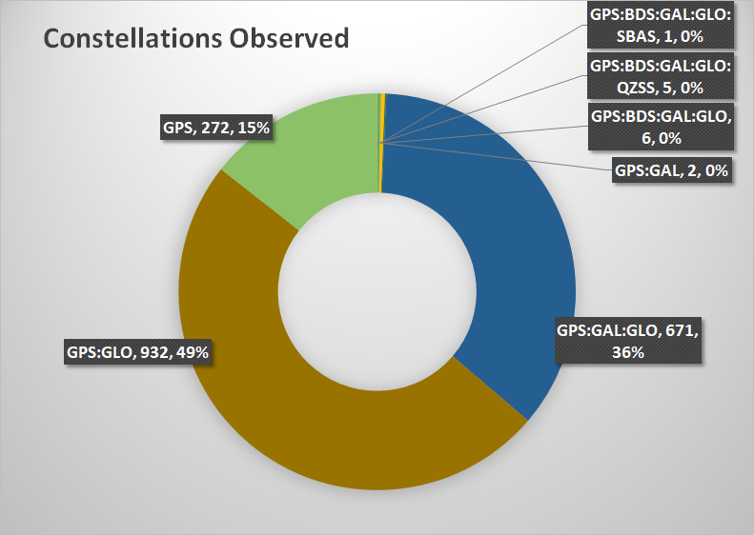
Station GNSS Equipment
Abbr. | Country | Constellation
GPS | United States | Global Positioning System
GLO | Russia | GLONASS
GAL | E.U. | Galileo
BDS | China | BeiDou
QZSS | Japan | Quazi-Zenith Satellite System
NavIC | India | Navigation India Constellation
SBAS | U.S., Japan, Europe, India | Space-Based Augmentation System
Notes:
The vast majority of GPS-only stations are owned by U.S. federal government partners.
https://www.gps.gov/systems/gnss/
https://www.gps.gov/systems/augmentations/

Slide 11
Multi-GNSS: RINEX and M-PAGES
Current: 100% of NCN Stations’ observations are stored in RINEX v2.11
NCN stored its first BETA data in RINEX3 on May 10, 2021
Now testing a handful of stations with RINEX3 data flows
Probable RINEX3 operational in 2022
Sunset of RINEX2 afterwards (date TBD)
NGS is near BETA version of a new software package to process multi-GNSS files and handle RINEX3, named M-PAGES.
IGS announced that RINEX4 is in early development
Notes:
In the near future M-PAGES will be used to provide GNSS positioning results in OPUS

Slide 12
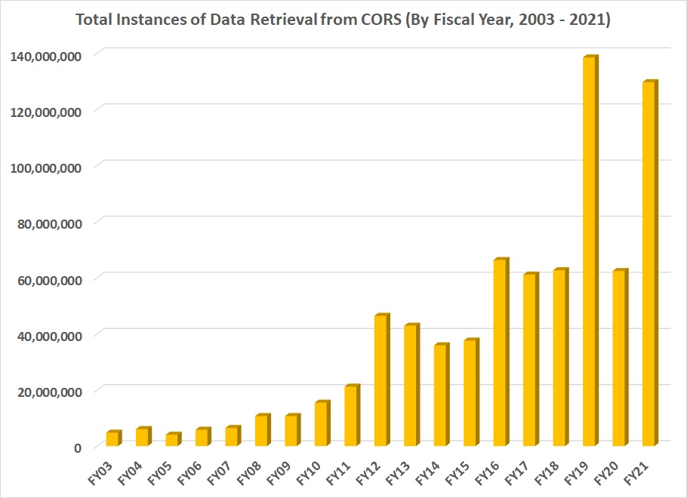
Users- OPUS and File Downloads
Demand for CORS products continues to grow
98.5% of usage is RINEX downloads
0.5% usage is UFCORS
1% usage is OPUS-S and OPUS-RS
Dip in FY20 usage may be due to COVID-19

Slide 13
Services provided by NGS for each CORS

Slide 14
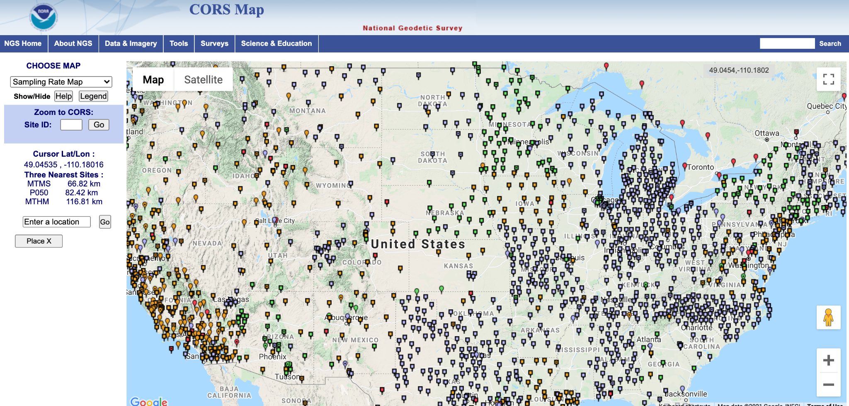
Services provided by NGS for each CORS
Station
information
page
https://www.ngs.noaa.gov/CORS_Map/

Slide 15
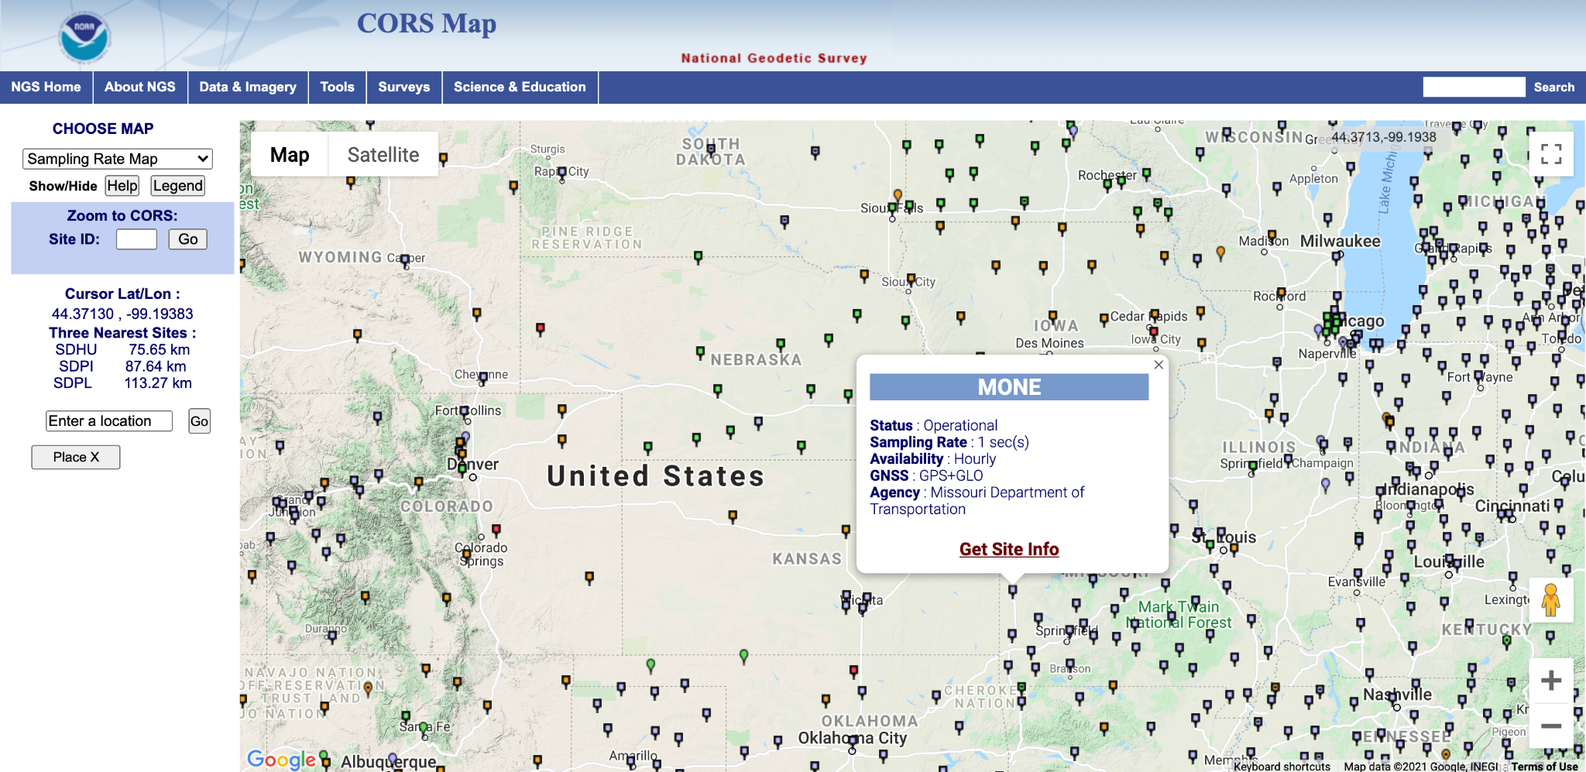
Services provided by NGS for each CORS
Station
information
page
https://www.ngs.noaa.gov/CORS_Map/

Slide 16
Services provided by NGS for each CORS
Station
information
page
https://www.ngs.noaa.gov/cgi-cors/corsage.prl?site=MONE

Slide 17
Services provided by NGS for each CORS
Data ingest, QC, archive, and distribution
https://www.ngs.noaa.gov/UFCORS/

Slide 18
Services provided by NGS for each CORS
Data ingest, QC, archive, and distribution
From NOAA-NCN AWS:
curl -O https://noaa-cors-pds.s3.amazonaws.com/rinex/YYYY/DDD/ssss/ssssDDD0.YYd.gz
From NGS servers:
curl -O https://geodesy.noaa.gov/corsdata/rinex/YYYY/DDD/ssss/ssssDDD0.YYd.gz
YYYY - 4-digit year
YY - 2-digit year
DDD - 3-digit day of year
ssss - 4-character station ID

Slide 19
Services provided by NGS for each CORS
Official NSRS coordinate function
https://www.ngs.noaa.gov/cgi-cors/corsage.prl?site=MONE

Slide 20
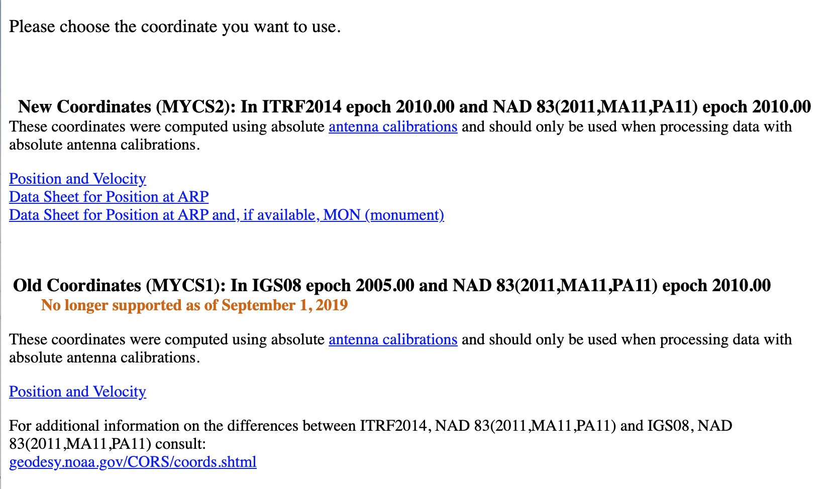
Services provided by NGS for each CORS
Official NSRS coordinate function

Slide 21
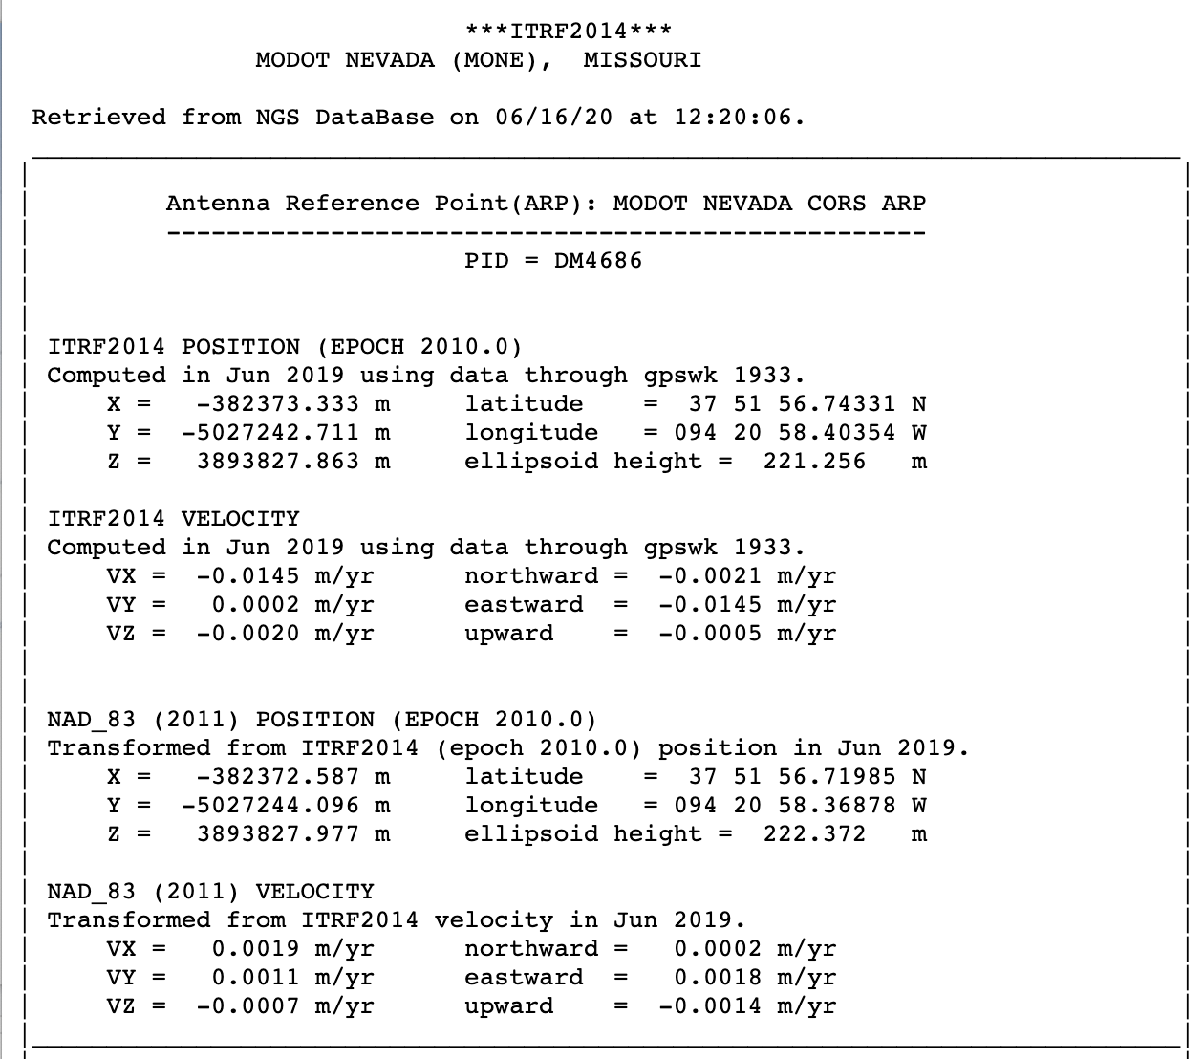
Services provided by NGS for each CORS
Official NSRS coordinate function

Slide 22
Services provided by NGS for each CORS
Official NSRS coordinate function

Slide 23
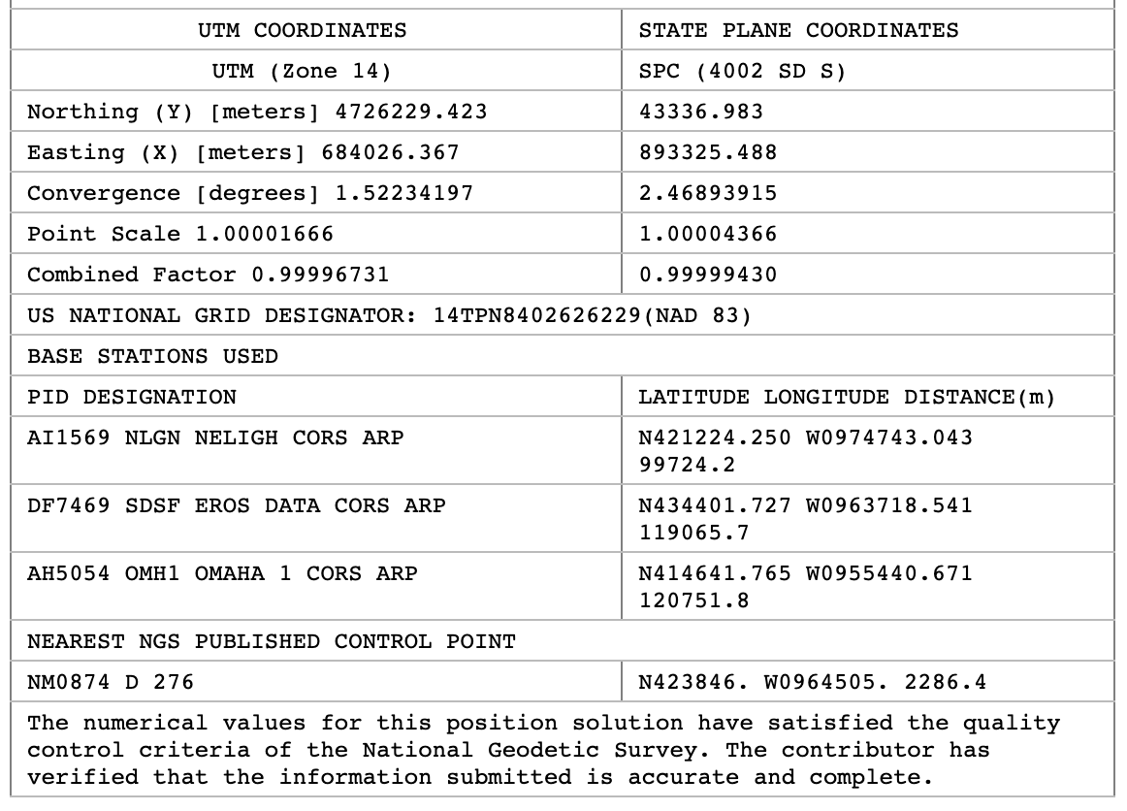
Services provided by NGS for each CORS
Available in OPUS for use as control

Slide 24
Services provided by NGS for each CORS
Available in OPUS for use as control

Slide 25
Services provided by NGS for each CORS
Available in OPUS for use as control

Slide 26
Services provided by NGS for each CORS
Daily coordinates and station monitoring
https://www.ngs.noaa.gov/cgi-cors/corsage.prl?site=MONE

Slide 27
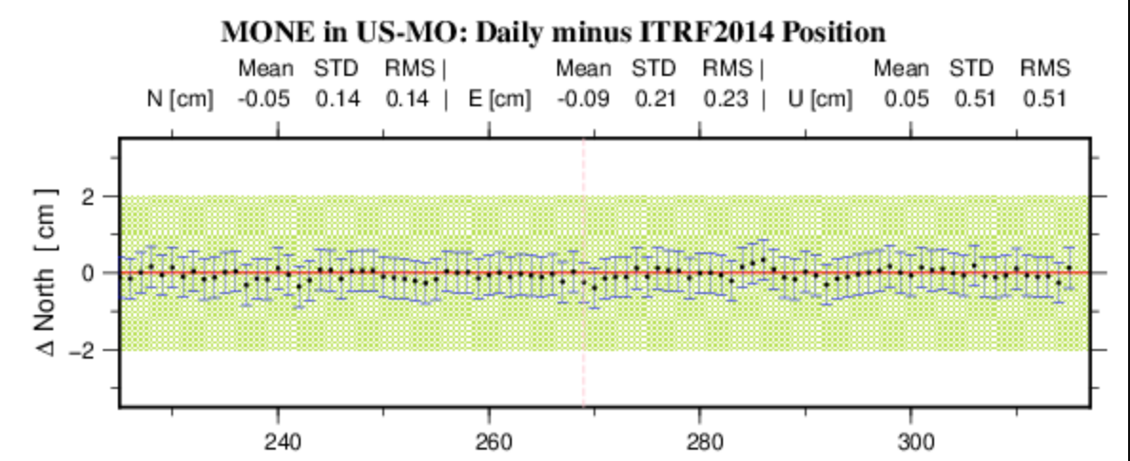
Services provided by NGS for each CORS
Daily coordinates and station monitoring

Slide 28
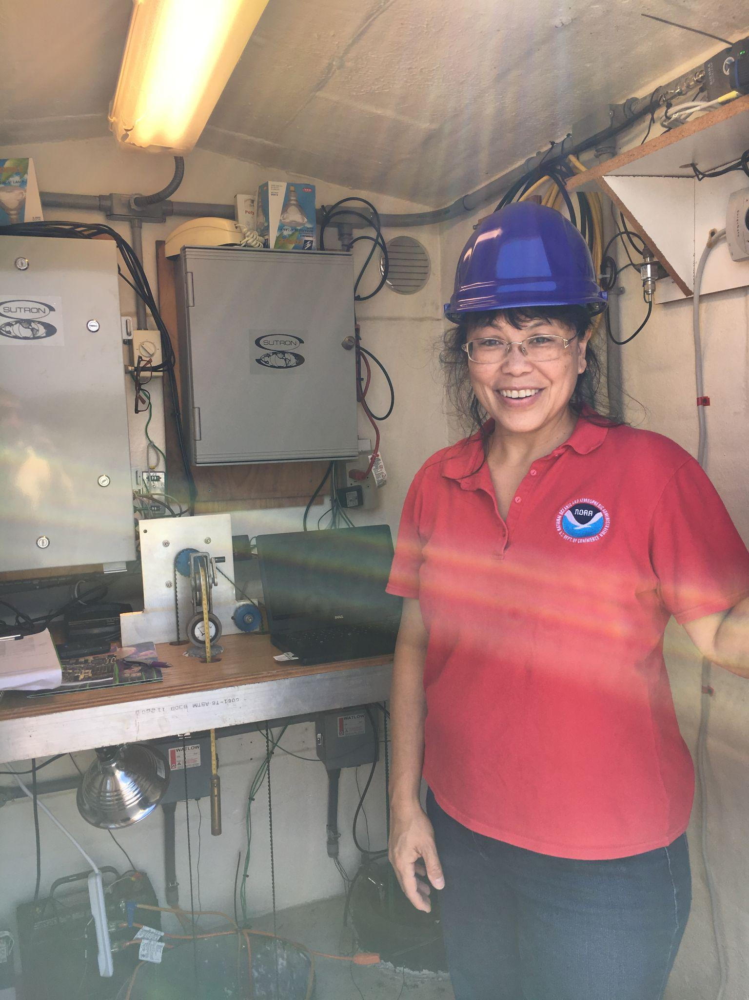
Services provided by NGS for each CORS
Technical support for station operators
Assistance with:
Receiver / antenna changes
Firmware updates
Connectivity issues
Troubleshooting other issues
Photo: Francine Coloma helping out at station OHMH

Slide 29
Poll Questions
The following poll questions will ask you to rank services that NGS currently provides for all stations in the NCN.
Please rank the NCN service from 1 (do not value) to 4 (value greatly).
Services to be ranked in upcoming polls:
Data Ingest, quality control and distribution
Official NSRS coordinate function (position and velocity)
Availability for use as control in OPUS
Technical support for station operators
Daily coordinate computation and monitoring.

Slide 30
External Drivers of Change for the NCN
Development | Benefits | Challenges | Major Policies, Reports, Guidelines
Multi-GNSS | Increased accuracy/availability | Authenticity, new hardware, new data standards, coverage across states and nations, bigger files | E.O. 13905 on PNT Resilience (White House, 2020), National Space Policy (White House, 2020), National R&D Plan for PNT Resilience (White House, 2021)
International Reference Frame | U.N. international cooperation, common standards, accuracy | Need to keep regional and national networks aligned, station longevity, scientific modeling | Sustaining the Global Geodetic Reference Frame (UN-GGIM, 2020), Evolving Geodetic Infrastructure… (U.S. National Academies, 2020), Pending updates to the IGS Station Guidelines
Increased Amount of High-Accuracy Geospatial Data | Mapping, geospatial industry, science applications | Disparate sources, Curate geospatial info for everyone, Time-dependencies | Geospatial Data Act (U.S. Congress, 2018), National Spatial Data Infrastructure Strategic Plan (FGDC, 2020)
Lower Latency | Real time or near real time applications | IT Security, alignment of coordinates, interference | Report to Congress on Complementary PNT and GPS Backup Technologies Demonstration (DOT, 2021)
Internal Drivers: NSRS Modernization, Cybersecurity, High Quality Services
Notes:
The geodesy, surveying, mapping, and positioning community is no stranger to change. As one new positioning capability is developed to address a community need, it creates benefits and policy changes and further development to address new challenges. This chart illustrates some recent examples of NCN-related changes
GNSS = Global Navigation Satellite Systems
Internal driver of change is the NSRS Modernization, which you can learn more about on our website’s materials and through past presentations/webinars posted there.

Slide 31
Mission of the Future CORS Program
The NOAA CORS Network must transform to meet our NGS mission for the next decade
Used to define (ITRF/IGS and U.S. TRFs), maintain (geometric coordinate updates and IFVM), and provide access (via OPUS and alignment service) to meet national needs.
Vision:
Define: High quality stations must comprise the NCN to achieve excellence on critical geodetic tasks.
Maintain: Create a sustainable CORS Program system: people, data, hardware, software, computing
Provide Access: Provide automated, fast, and reliable coordinates to a high volume of stations for NSRS adoption, service to the nation, and prestige.
Meet National Needs: Serve surveyors and a broader base of stakeholders needing geodetic control such as transportation and commerce across federal/state governments (DOC, DOT, USACE, USGS, more); geospatial industry; and scientific users.

Slide 32
Open Discussion

Slide 33
Extra Slides for Discussion

Slide 34
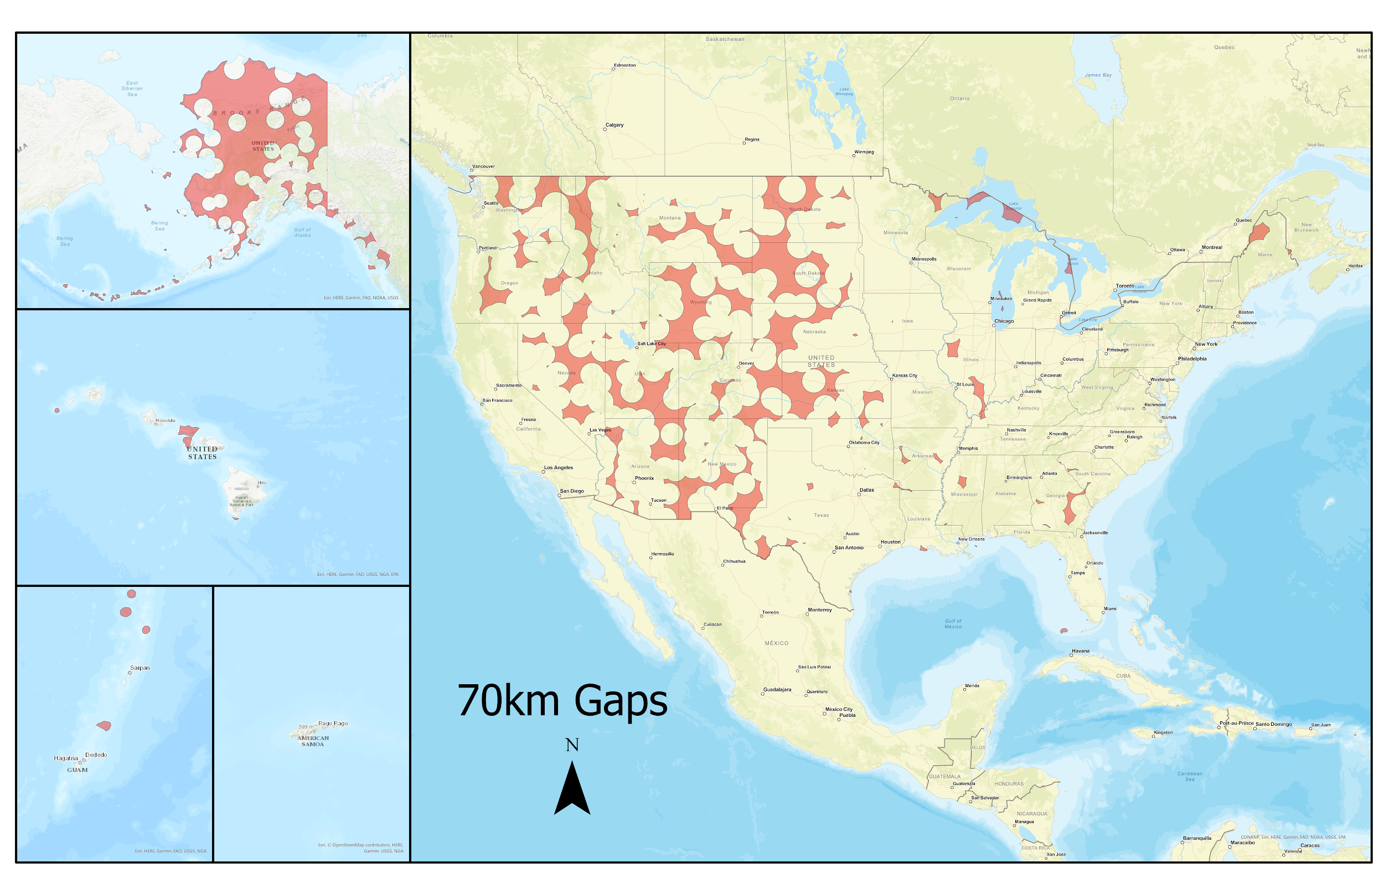
NCN Coverage by State/Territory Area
100% Covered
Alabama
California
Connecticut
Delaware
Indiana
Maryland
Massachusetts
Missouri
New Hampshire
New Jersey
New York
North Carolina
Ohio
Pennsylvania
Puerto Rico
Rhode Island
Tennessee
Vermont
Virgin Islands
Virginia
Washington D.C.
West Virginia
Gaps assume CORSs adequately “cover” a 70 km radius circle around them.
Notes:
With 70 km restriction, 100% coverage in 19 states, 2 territories, and the District of Columbia

Slide 35
NCN Gaps by State/Territory Area
American Samoa | 54.55%
Alaska | 47.79%
South Dakota | 32.85%
Wyoming | 32.13%
Utah | 28.55%
Kansas | 28.04%
New Mexico | 23.32%
North Dakota | 23.31%
Colorado | 22.50%
Nevada | 18.80%
Nebraska | 18.17%
Idaho | 17.23%
Arizona | 16.21%
Hawaii | 15.90%
Washington | 15.25%
Montana | 12.52%
Oregon | 12.34%
Illinois | 8.59%
Maine | 7.62%
Georgia | 6.44%
Michigan | 4.47%
Texas | 3.90%
Oklahoma | 2.73%
Arkansas | 2.37%
Mississippi | 2.19%
< 2% Gap
Minnesota
South Carolina
Kentucky
Louisiana
Florida
Wisconsin
Iowa
Gaps assume CORSs adequately “cover” a 70 km radius circle around them.
Notes:
With 70 km restriction, 33 states and territories with gaps in coverage.

