Slide 1
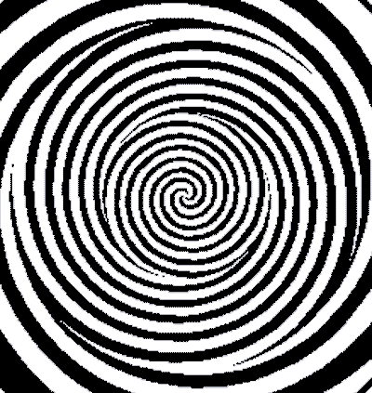
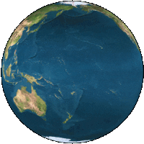
Welcome to the Alpha Zone
A Preview of
State Plane 2022
Michael Dennis
Krishna Tadepalli
NGS Webinar Series
July 20, 2023
Notes:
You are about to enter another dimension, a dimension where the curved surface of the earth is made flat, where coordinates are distorted and distances are not what they seem. Welcome, to the Alpha Zone!

Slide 2
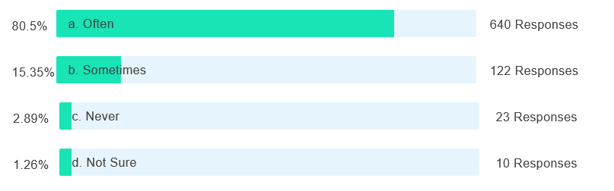
Poll question
Do you use the State Plane Coordinate System?
795 of 1311 attendees responded

Slide 3
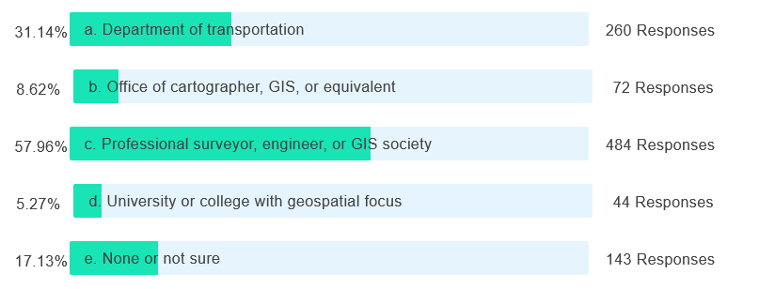
Poll question
Are you associated with any of the following SPCS2022 stakeholder groups in your state? (select all that apply)
835 of 1311 attendees responded

Slide 4
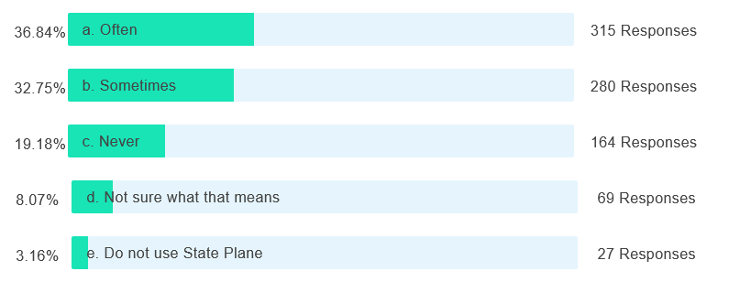
Poll question
Do you scale State Plane coordinates to bring them “to ground” (i.e., to reduce linear distortion at the topographic surface)?
855 of 1311 attendees responded

Slide 5
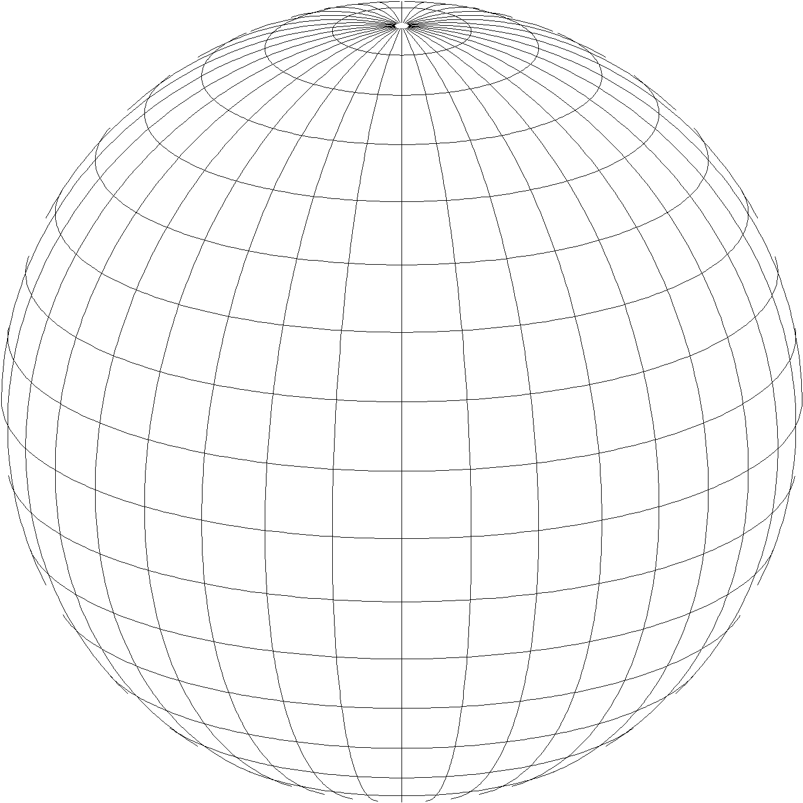
State Plane Coordinate System of 2022 (SPCS2022)
Part of modernizing the National Spatial Reference System (NSRS)
Third generation of State Plane
  First in 1930s (SPCS 27), second in 1980s (SPCS 83)
  Same 3 map projection types
  Same ellipsoid as SPCS 83 (GRS 80)
Same as existing State Plane, but different…
  Based on new terrestrial reference frames instead of NAD 83
  More zones, most designed by state stakeholders
  Designed to reduce linear distortion at topographic surface
  (i.e., reduce difference between “grid” and “ground” distances)
Lambert Conformal Conic
Transverse Mercator
Hotine Oblique Mercator

Slide 6
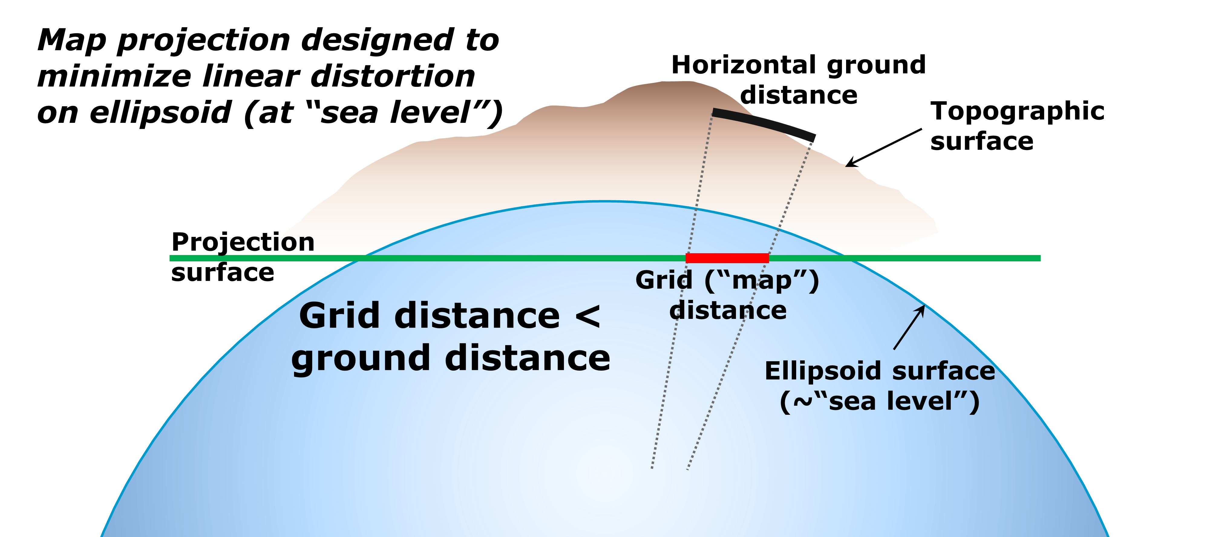
State Plane Coordinate System of 1983

Slide 7
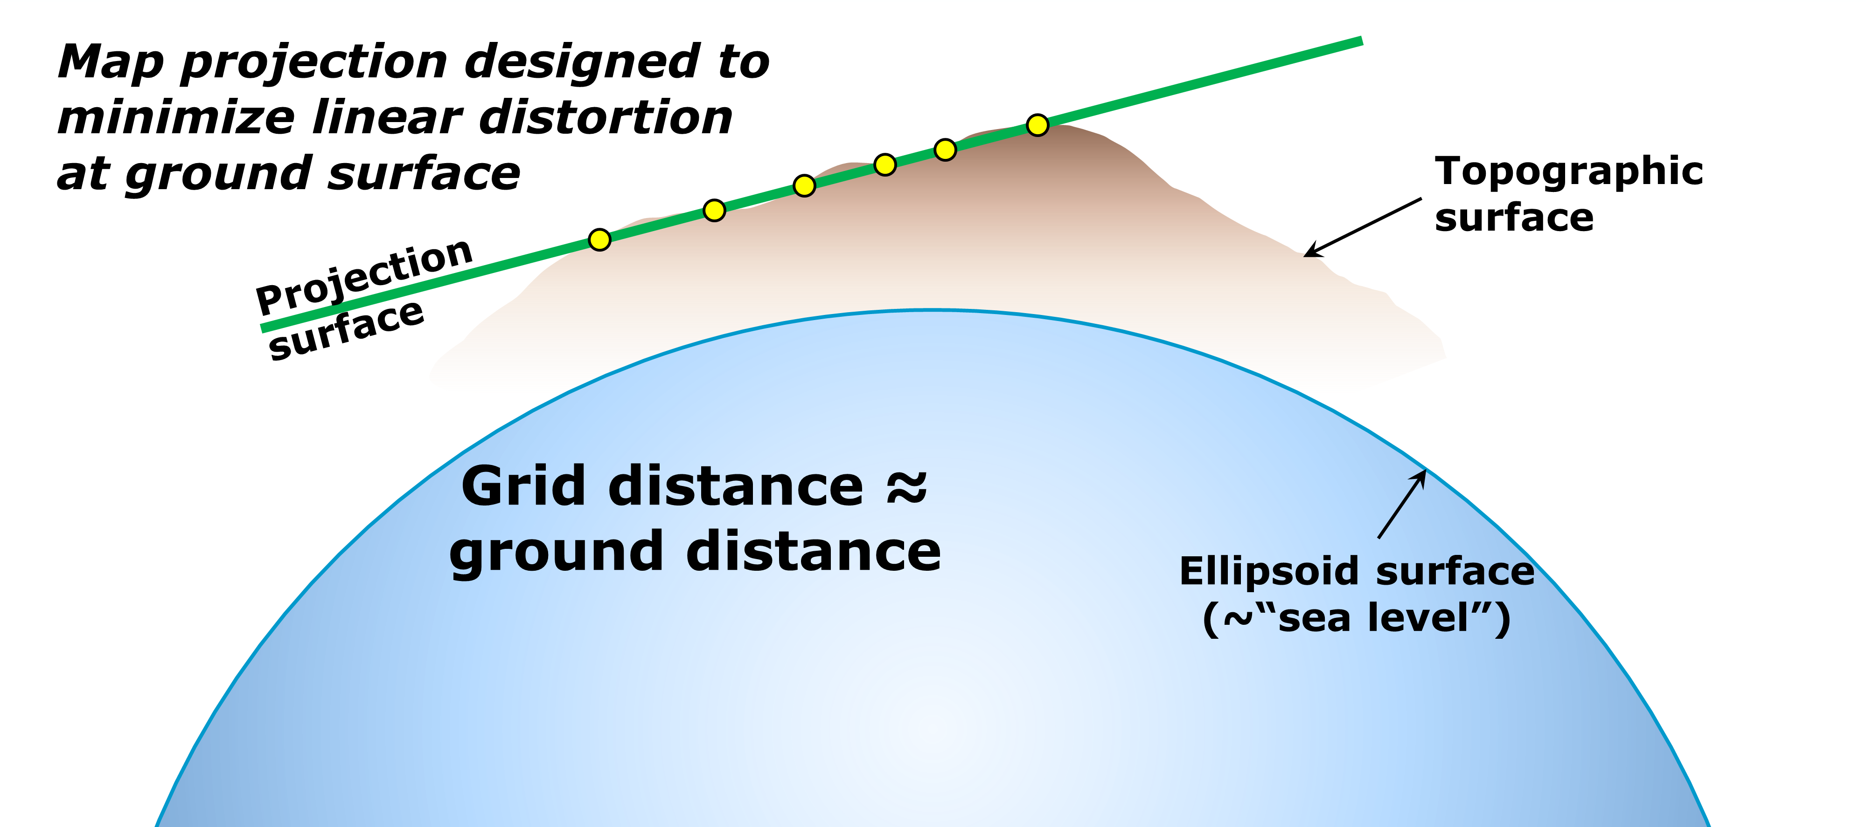
State Plane Coordinate System of 2022

Slide 8
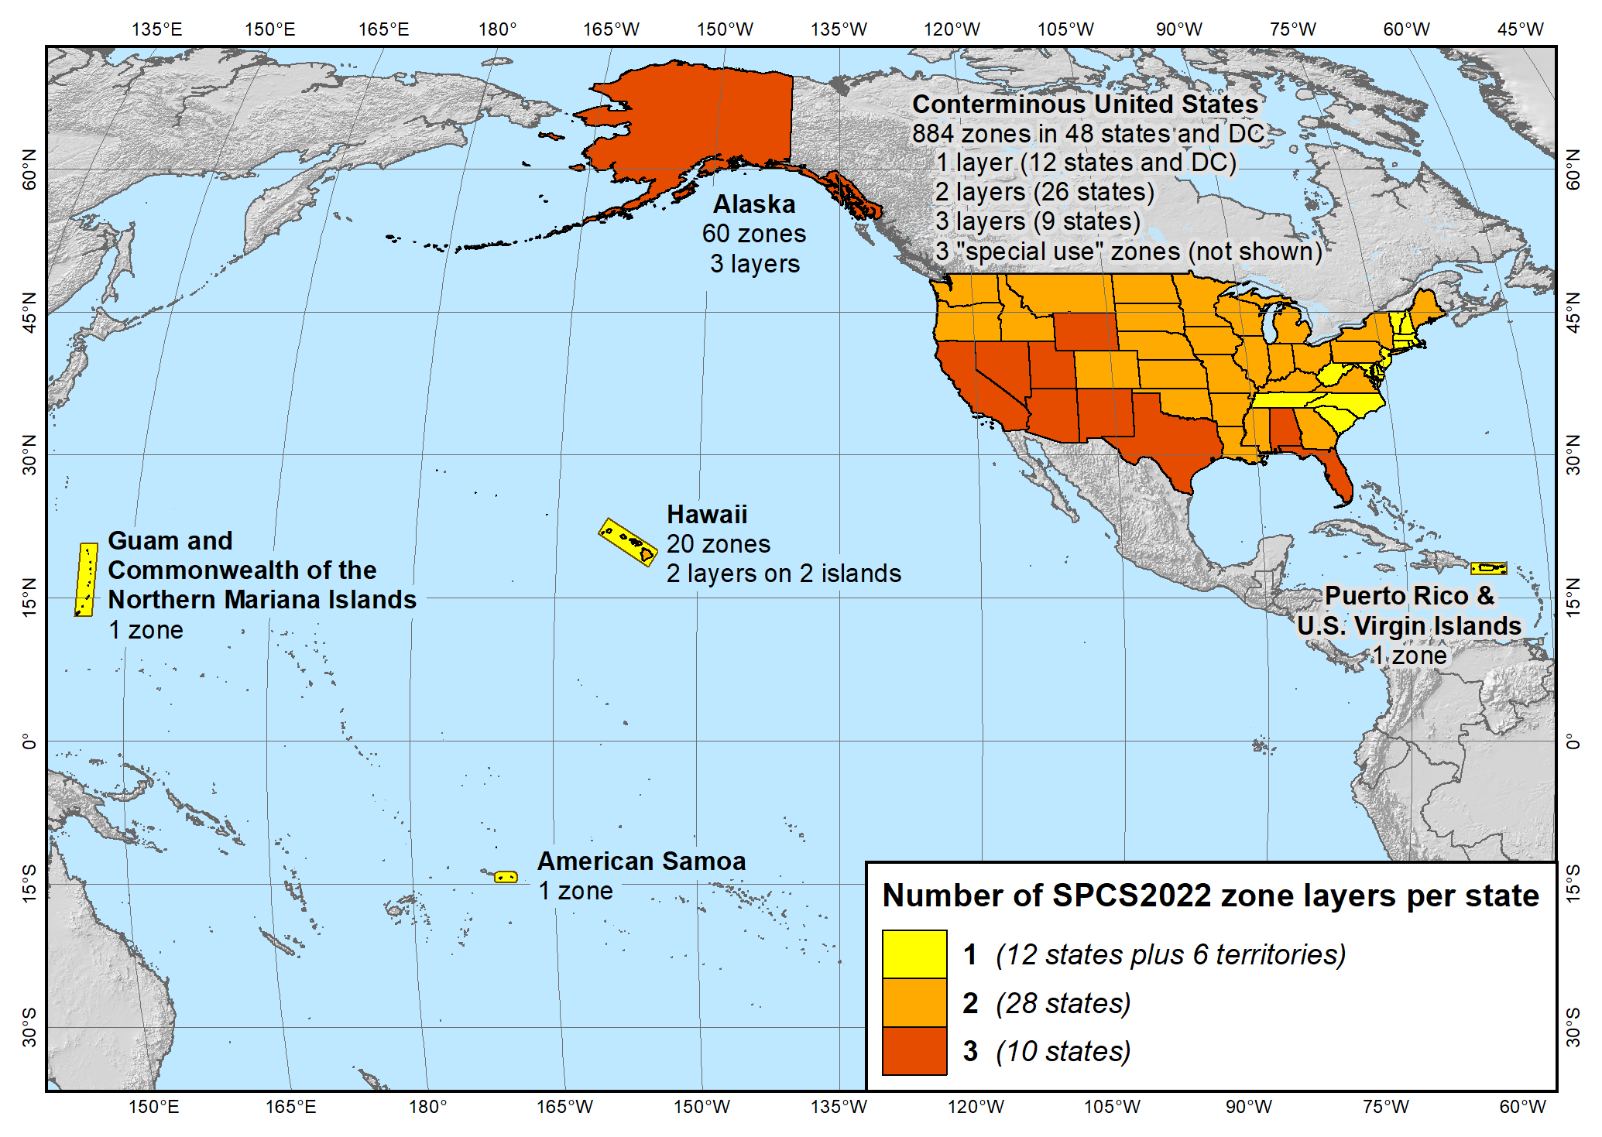
SPCS2022 zone layers
1 layer: 12 states plus 6 territories
2 layers: 28 states
3 layers: 10 states

Slide 9
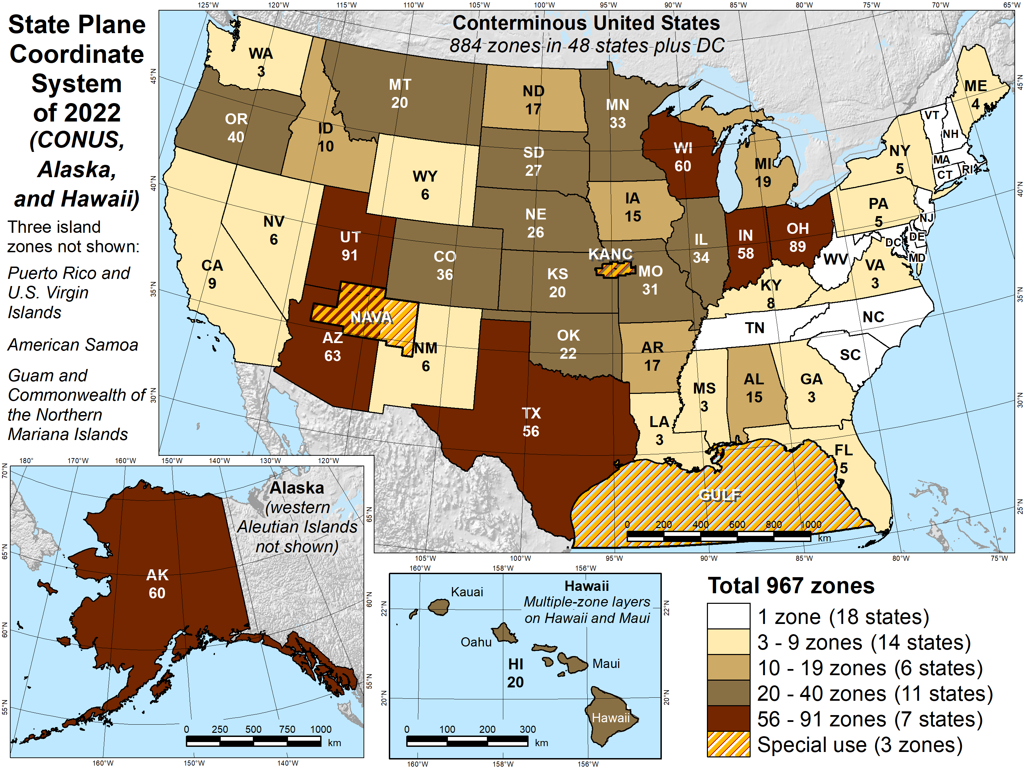
Number of SPCS2022 zones (preliminary)
Designs by NGS
  165 zones
  Includes 54 statewide zones…
  …and 3 “special use” zones
  (in more than one state)
Designs by state stakeholders
  802 zones in 28 states
Total = 967 zones
for 56 states
and territories
Compare to 125
zones in existing
State Plane

Slide 10
SPCS2022 distortion design philosophy
Linear distortion minimized at topographic surface (not ellipsoid surface)
  Purpose: reduce difference between projected “grid” and actual “ground” distances
  Population distribution also taken into account in NGS designs
What is linear distortion?
  Map projection “scale error” at topographic surface
  Unique (i.e., same in every direction) only for conformal projections
  Given here in parts per million (ppm) = mm of distortion per km
Linear distortion | = | Projected minus actual distance
 |  | Actual distance

Slide 11
Linear distortion magnitudes
Parts per million | Centimeters per kilometer | Feet per mile | Dimensionless ratio | Examples
20 ppm | 2 cm/km | 0.11 ft/mile | 1:50,000 | Typical “low distortion projection” limit
50 ppm | 5 cm/km | 0.26 ft/mile | 1:20,000 | Minimum distortion for designs by NGS
100 ppm | 10 cm/km | 0.53 ft/mile | 1:10,000 | Historic State Plane distortion design limit
400 ppm | 40 cm/km | 2.11 ft/mile | 1:2,500 | UTM distortion design limit

Slide 12
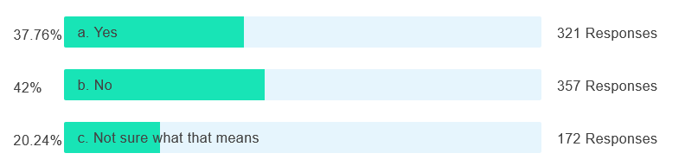
Poll question
Do you use “low distortion projections” (LDPs)?
850 of 1311 attendees responded

Slide 13
Distortion design performance
Performance is range of ±distortion for a zone (e.g., ±50 ppm)
Range must include at least all of the following:
  90% of population
  75% of cities and towns (by location only, not by population)
  50% of total zone area
Following ranges used by NGS for distortion design criteria (in ppm):
  ±5, ±10, ±20, ±30, ±40, ±50, ±75, ±100, ±150, ±200, ±300, ±400 ppm, etc.
  Performance is actual value for zone or group of zones
Zones designed by NGS typically limited to ±50 ppm design criterion
  “Low distortion projection” (LDP) zones (e.g., ±20 ppm) designed by stakeholders

Slide 14
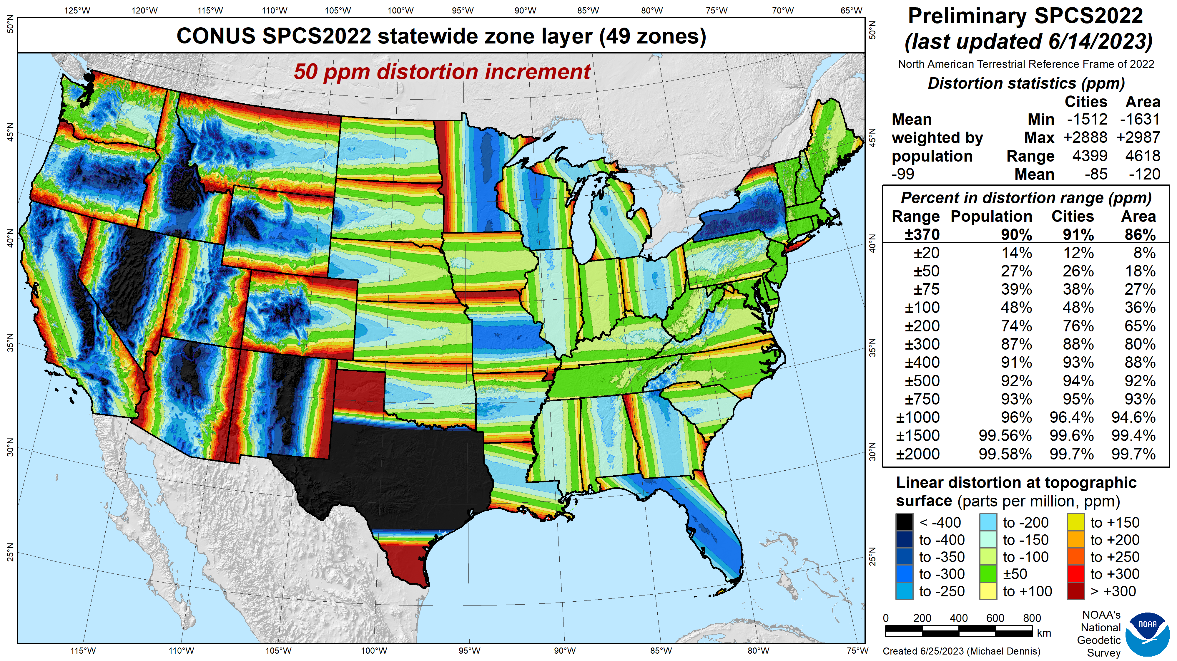
SPCS2022
linear distortion (preliminary)
Green is ±50 ppm (±0.26 ft/mile)
Distortion performance:
±370 ppm
Performance percentages:
90% population
91% cities & towns
86% total area
Mean weighted by population: -99 ppm
Grid versus ground distance
BLUE: grid SHORTER than ground
RED: grid LONGER than ground
GREEN: grid = ground (within ±50 ppm or ±0.26 ft/mile)

Slide 15
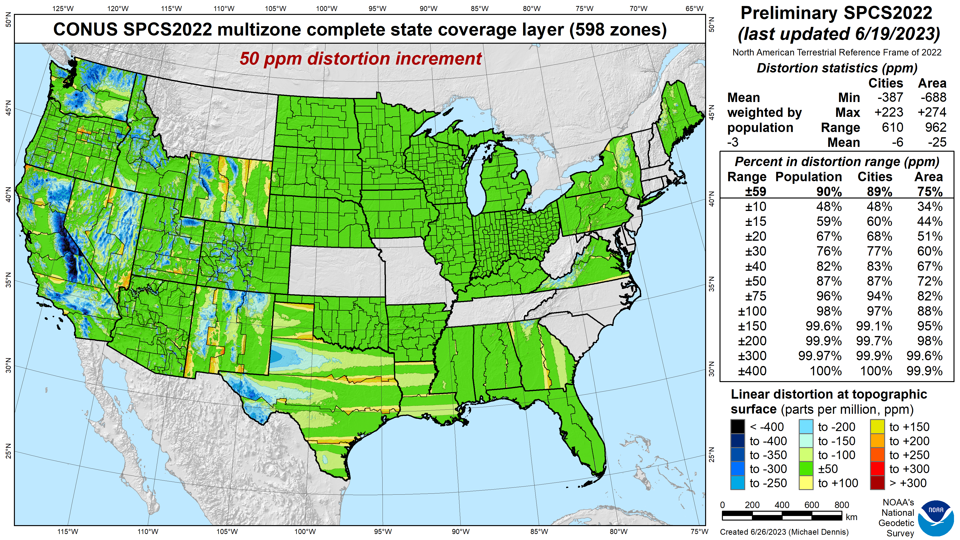
SPCS 83
linear distortion (existing)
Green is ±50 ppm (±0.26 ft/mile)

Slide 16
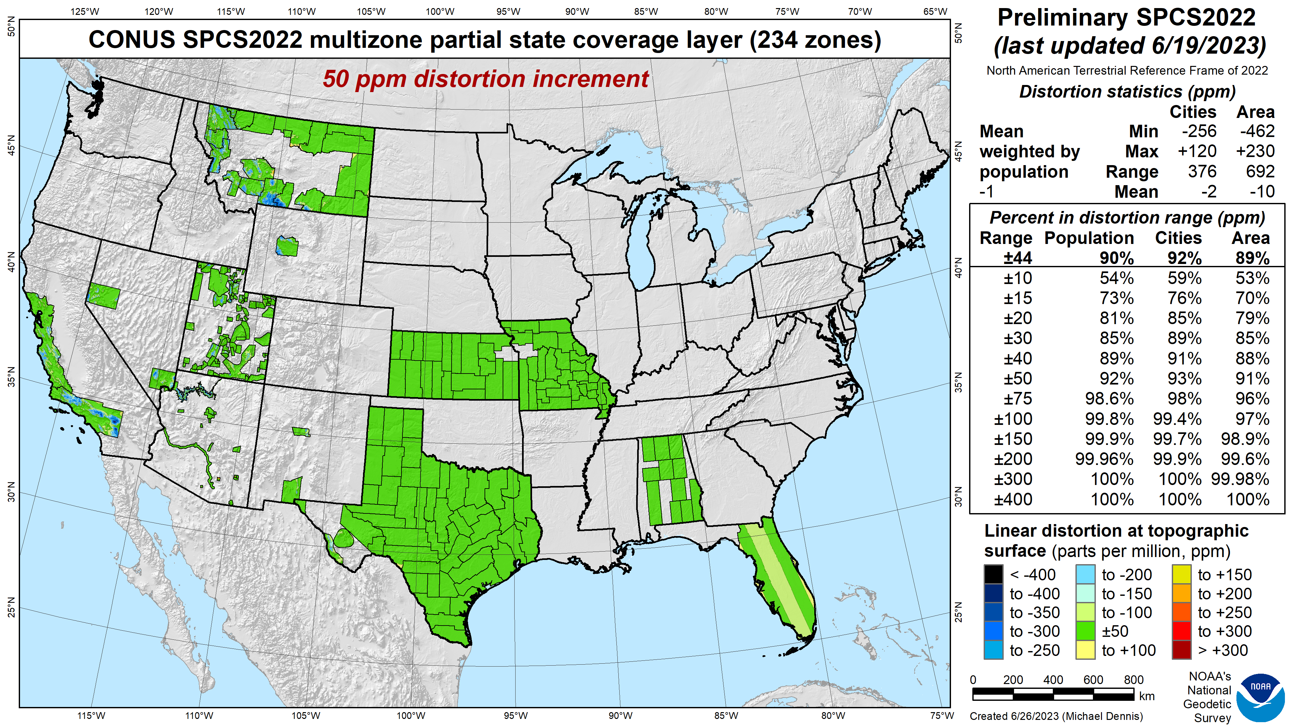
SPCS 83
linear distortion (existing)
Green is ±50 ppm (±0.26 ft/mile)

Slide 17
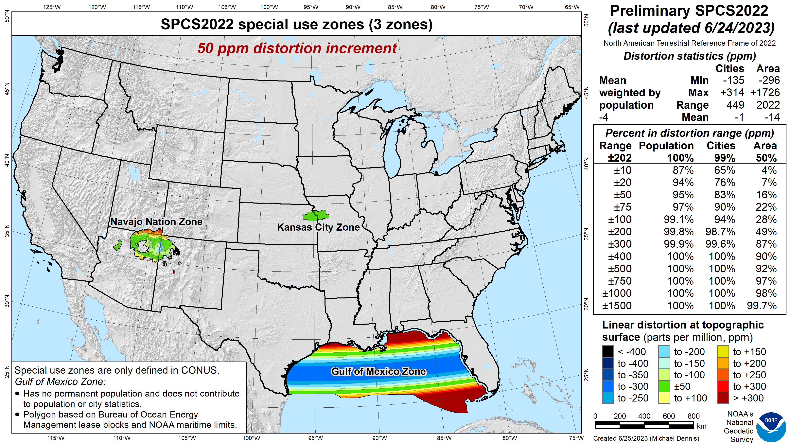
SPCS 83
linear distortion (existing)
Green is ±50 ppm (±0.26 ft/mile)

Slide 18
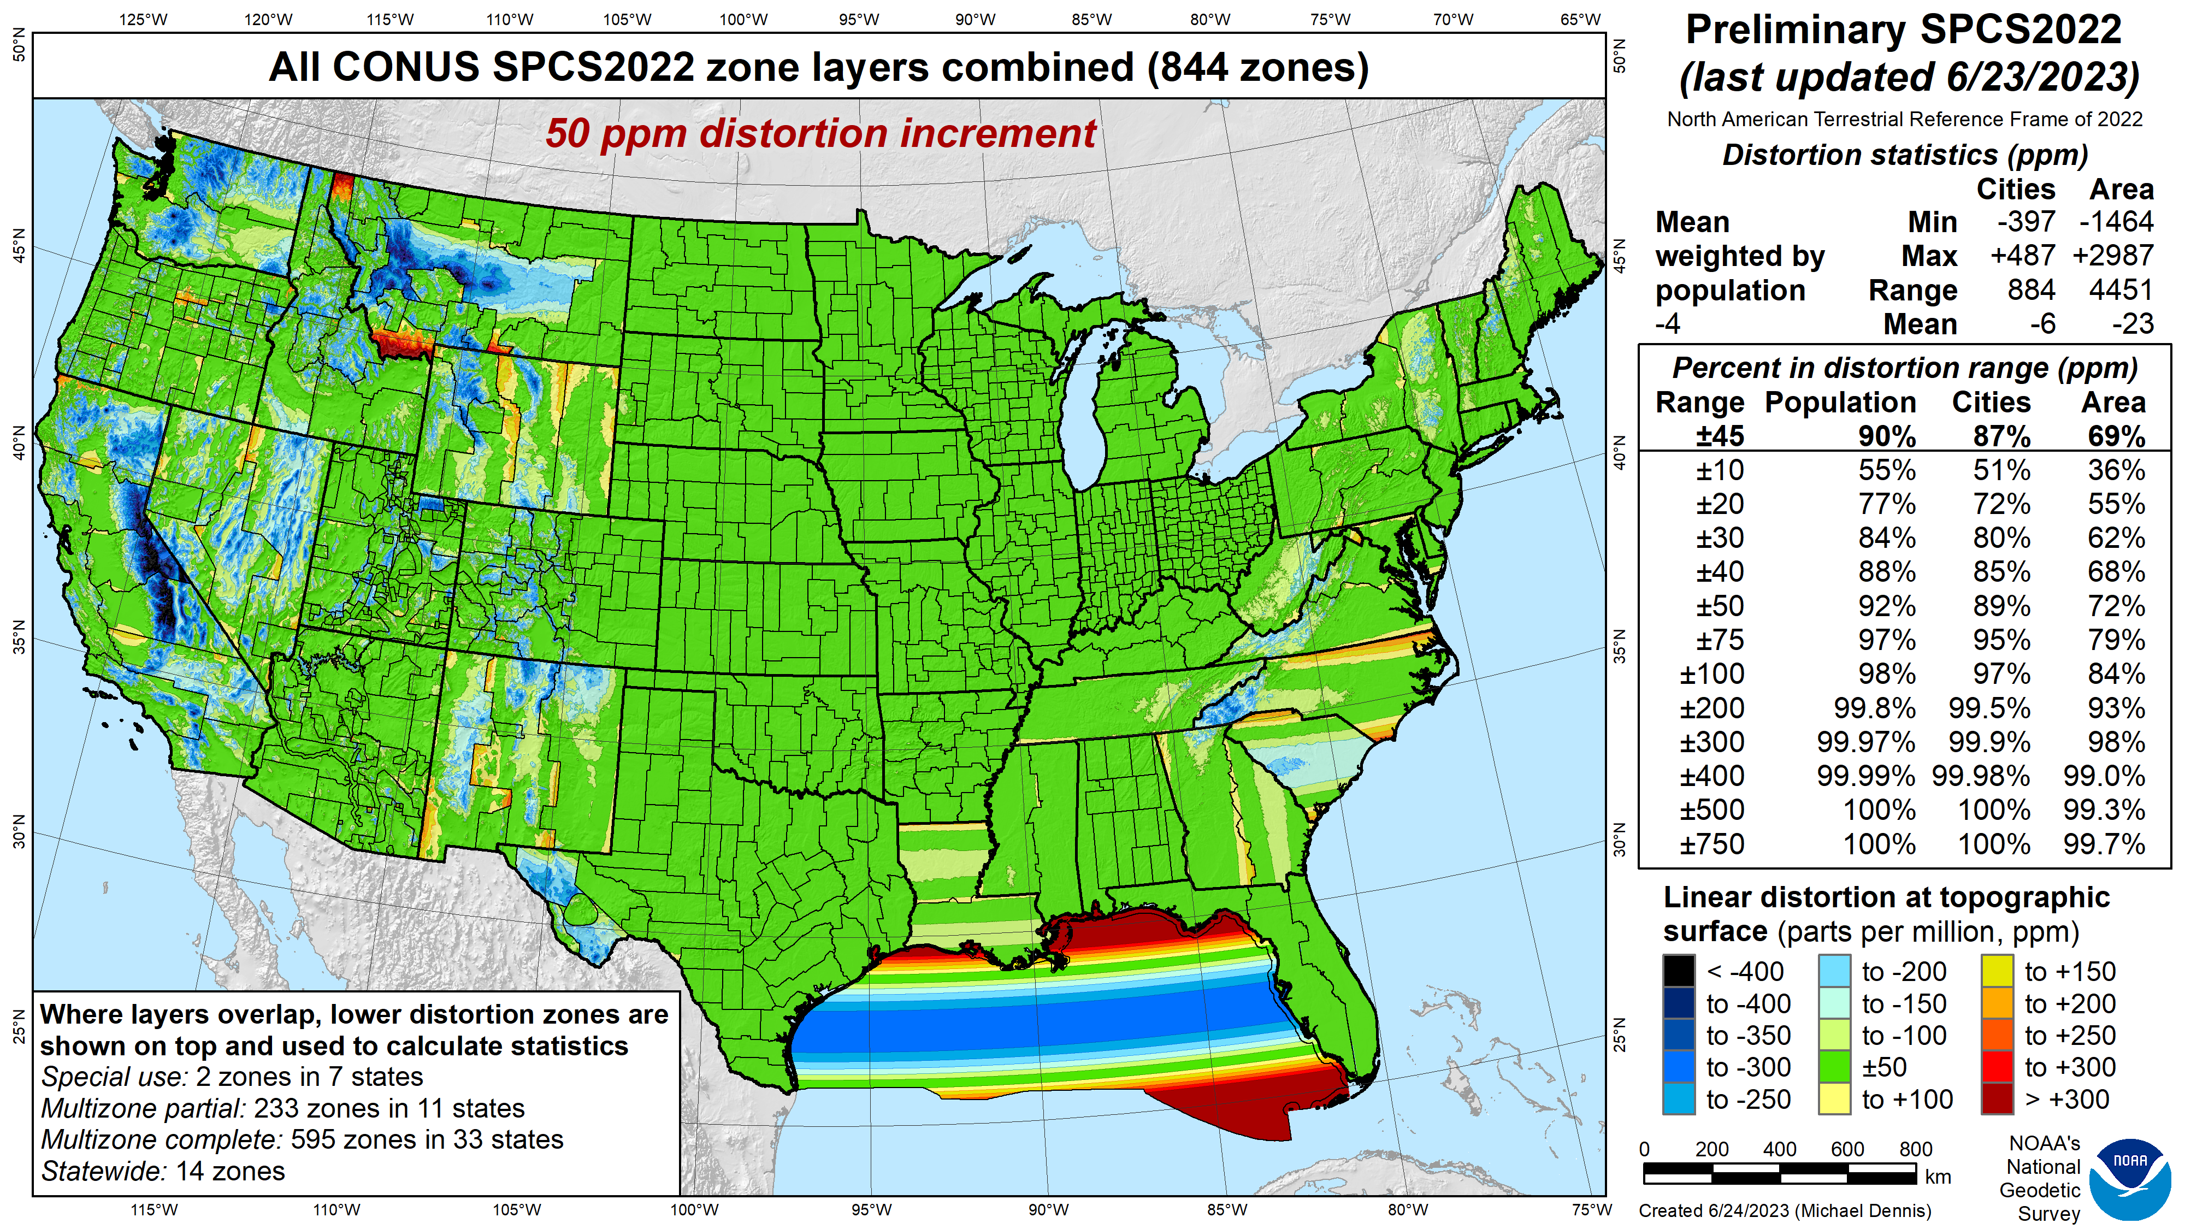
SPCS2022
linear distortion (preliminary)
Green is ±50 ppm (±0.26 ft/mile)
Distortion performance:
±45 ppm
Performance percentages:
90% population
87% cities & towns
69% total area
Mean weighted by population: -4 ppm

Slide 19
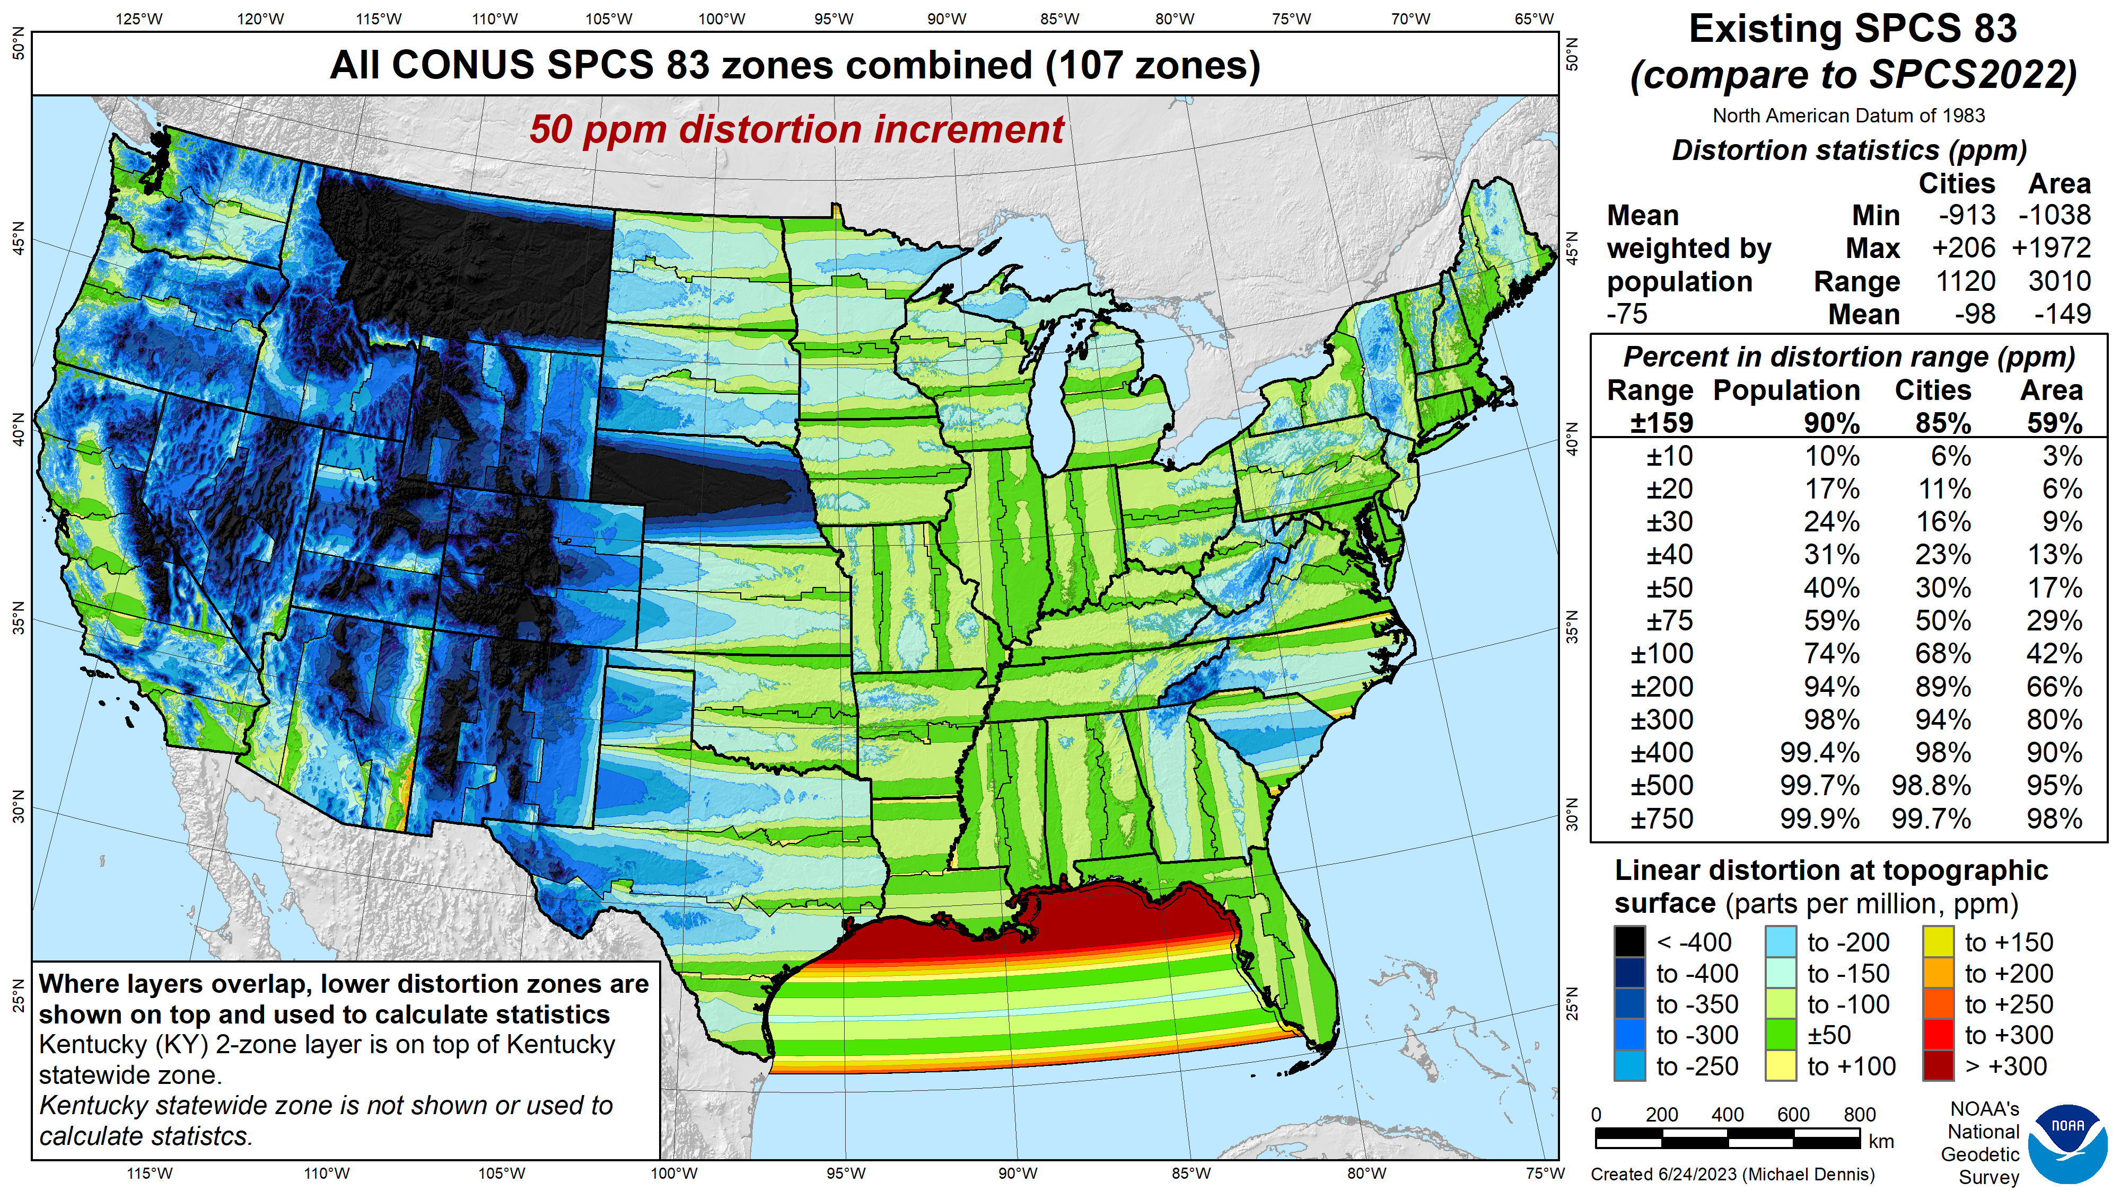
SPCS 83
linear distortion (existing)
Green is ±50 ppm (±0.26 ft/mile)
Distortion performance:
±159 ppm
Performance percentages:
90% population
85% cities & towns
59% total area
Mean weighted by population: -75 ppm

Slide 20
SPCS2022
linear distortion (preliminary)
Green is ±50 ppm (±0.26 ft/mile)
Distortion performance:
±45 ppm
Performance percentages:
90% population
87% cities & towns
69% total area
Mean weighted by population: -4 ppm

Slide 21

When will SPCS2022 be done?

Slide 22



Alpha preliminary products

Slide 23
Alpha preliminary release
Public release of preliminary Modernized NSRS products and services
  Preview of Modernized NSRS for NGS partners and customers
  ONLY used for Modernized NSRS
SPCS2022 is first alpha product
  Possible because SPCS2022 design is nearly done
  More coming as modernization products get closer to completion
Web pages
  Alerts on various production NGS pages (New Datums page, SPCS pages)
  Overall alpha Modernized NSRS page
  SPCS2022 alpha web pages

Slide 24
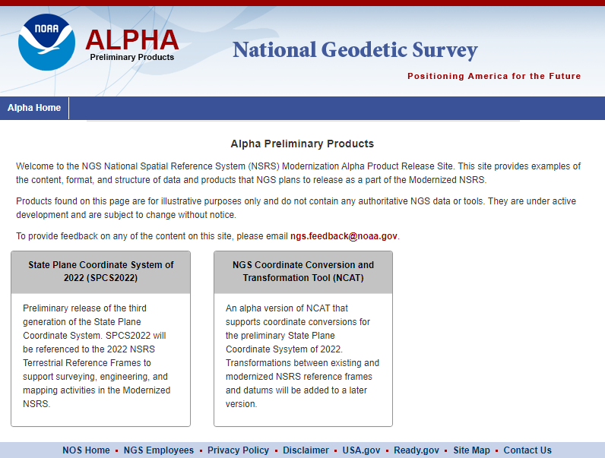


Alpha products are NOT final products!
https://alpha.ngs.noaa.gov/index.shtml
Preliminary
For illustrative
purposes only
Not authoritative
Under active development
Subject to change without notice
Feedback to: ngs.feedback@noaa.gov

Slide 25
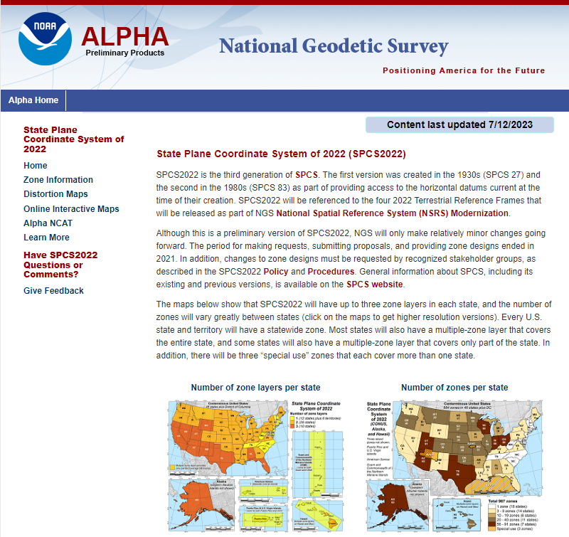

Alpha SPCS2022 Home
https://alpha.ngs.noaa.gov /SPCS/index.shtml
Gives date last updated
(on all SPCS2022 pages)
Links to other SPCS2022 pages
Link to online interactive maps (SPCS2022 Experience)
Link to alpha NCAT
Link for providing feedback

Slide 26
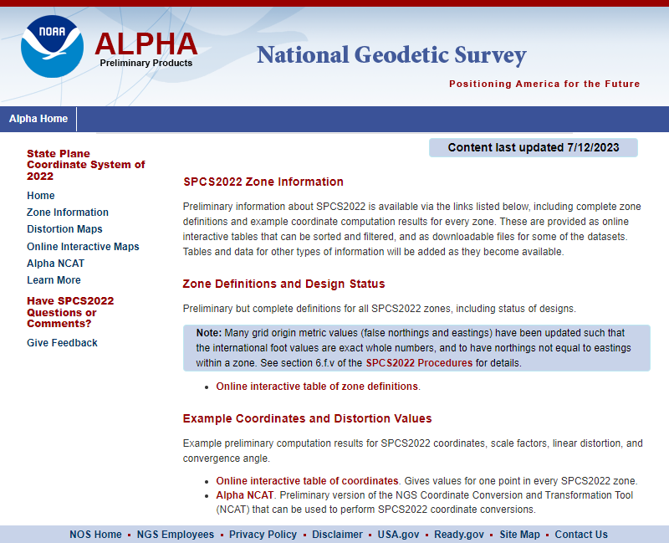
Zone Information
Interactive tables
  Zone definitions
  Example coordinates
Downloadable data and other tables will be added later
Note new protocol for grid origins
  Metric with exact whole number inter-national foot value
  Specified in SPCS2022 Procedures
  Stakeholder can adopt values they prefer

Slide 27
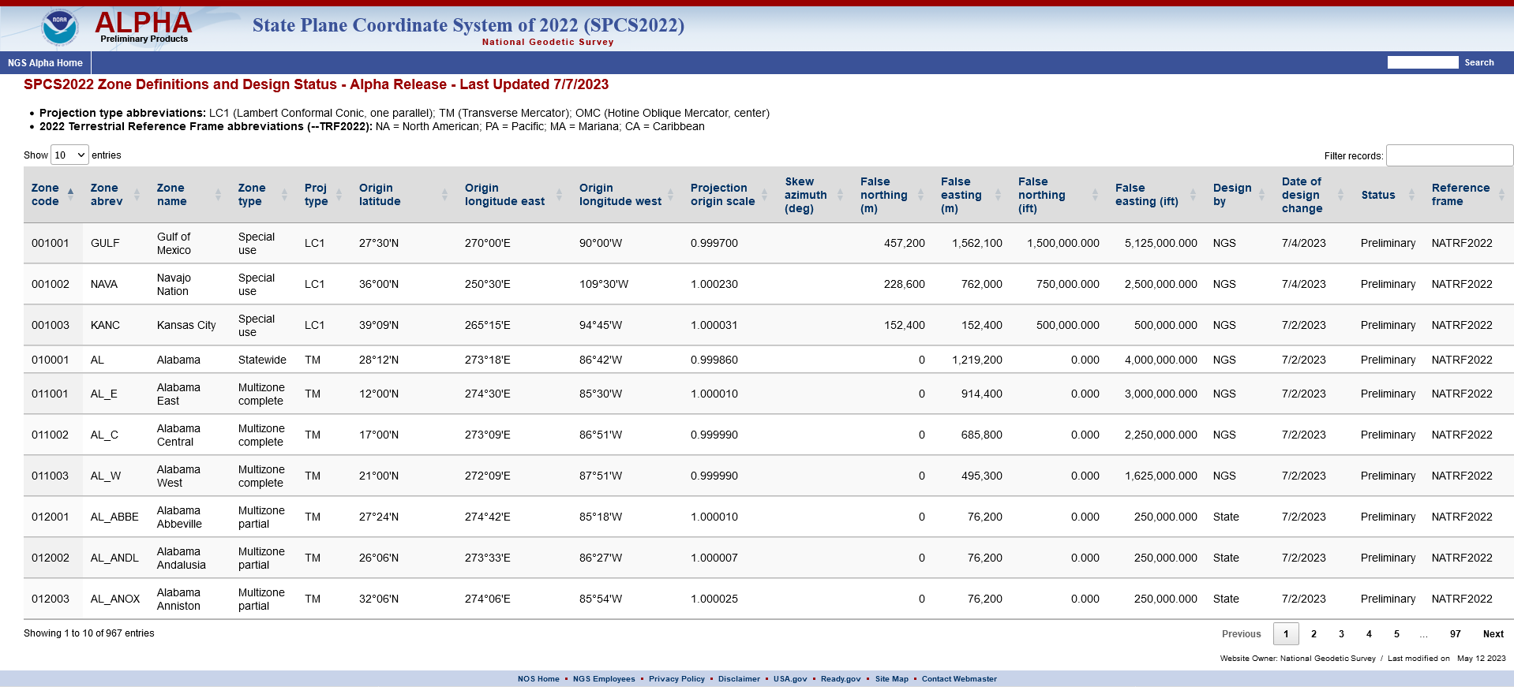
Zone definitions and design status

Slide 28
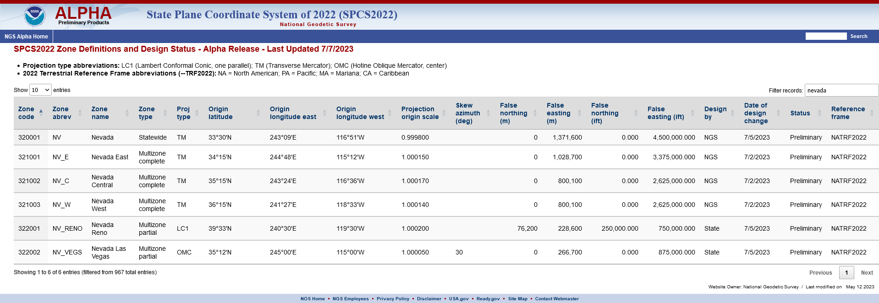
Zone definitions and design status

Slide 31
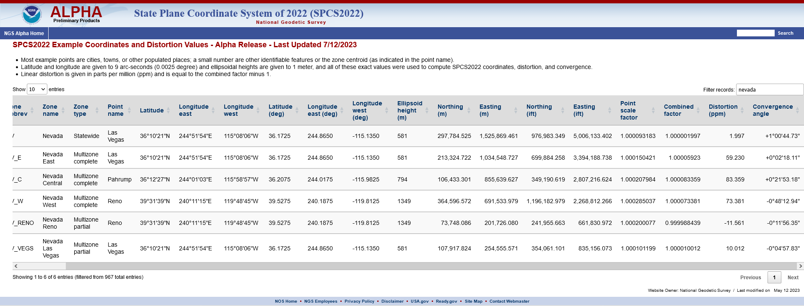
Example coordinates and distortion values

Slide 32
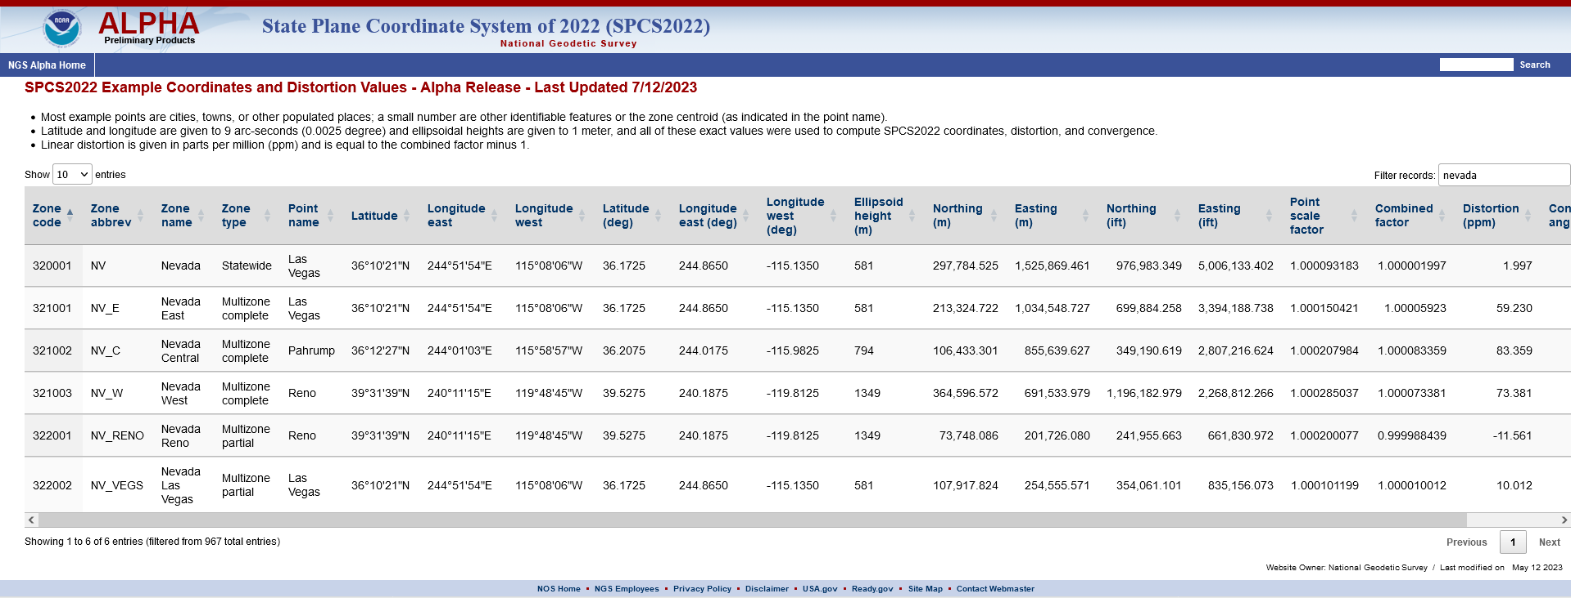

Slide 35
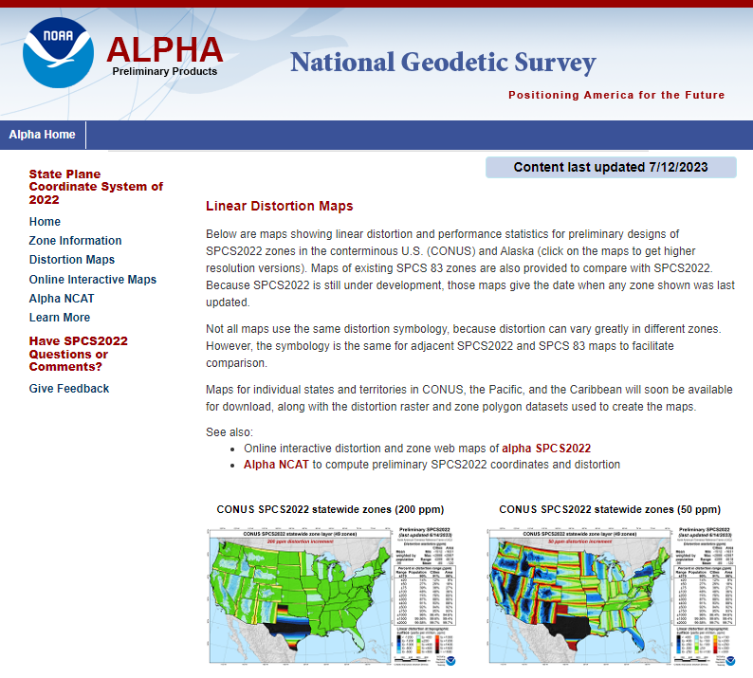
Linear Distortion Maps
Static map images
  Include performance statistics
  Includes SPCS 83 for comparison
Only CONUS and Alaska
  These and other areas will be on future “Download Maps
  & Data” page
  Will include data used to create maps
Links to online interactive maps and alpha NCAT
High resolution images when click on thumbnail

Slide 36
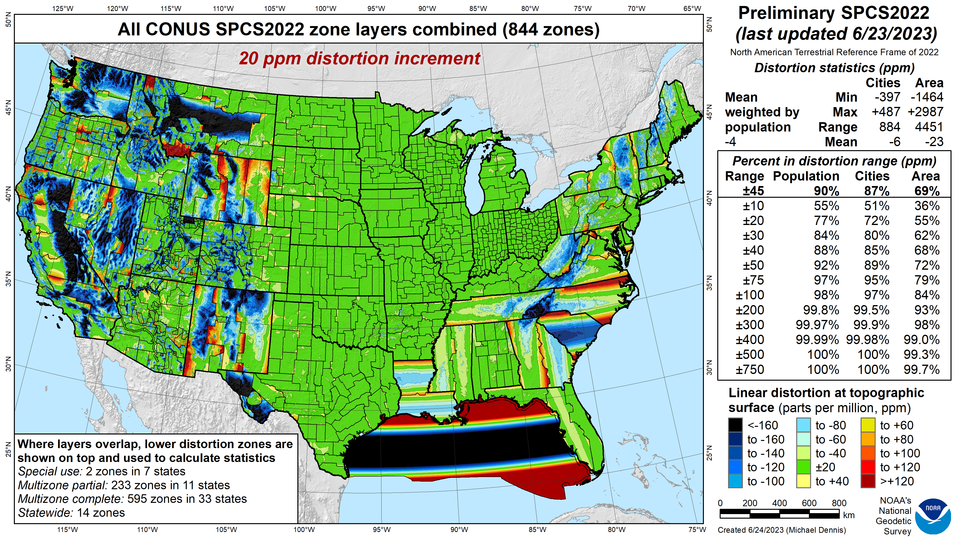

Slide 38
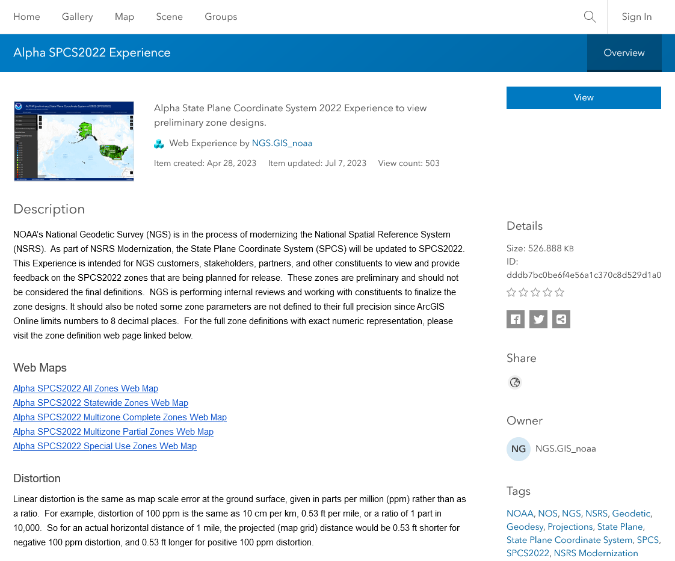
ArcGIS Online SPCS2022 Experience
Online interactive maps
Shows distortion and gives projection definitions
  Zone parameters not all given to full precision
  Cannot get distortion values from maps
Plan to create SPCS 83 version for comparison (maybe UTM, too)

Slide 39
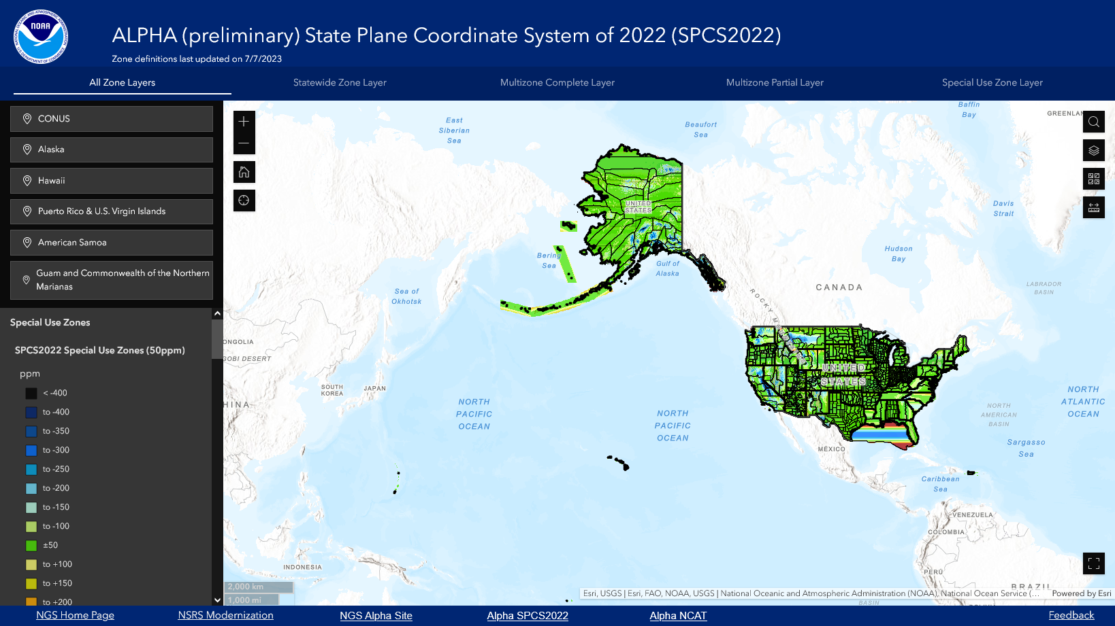
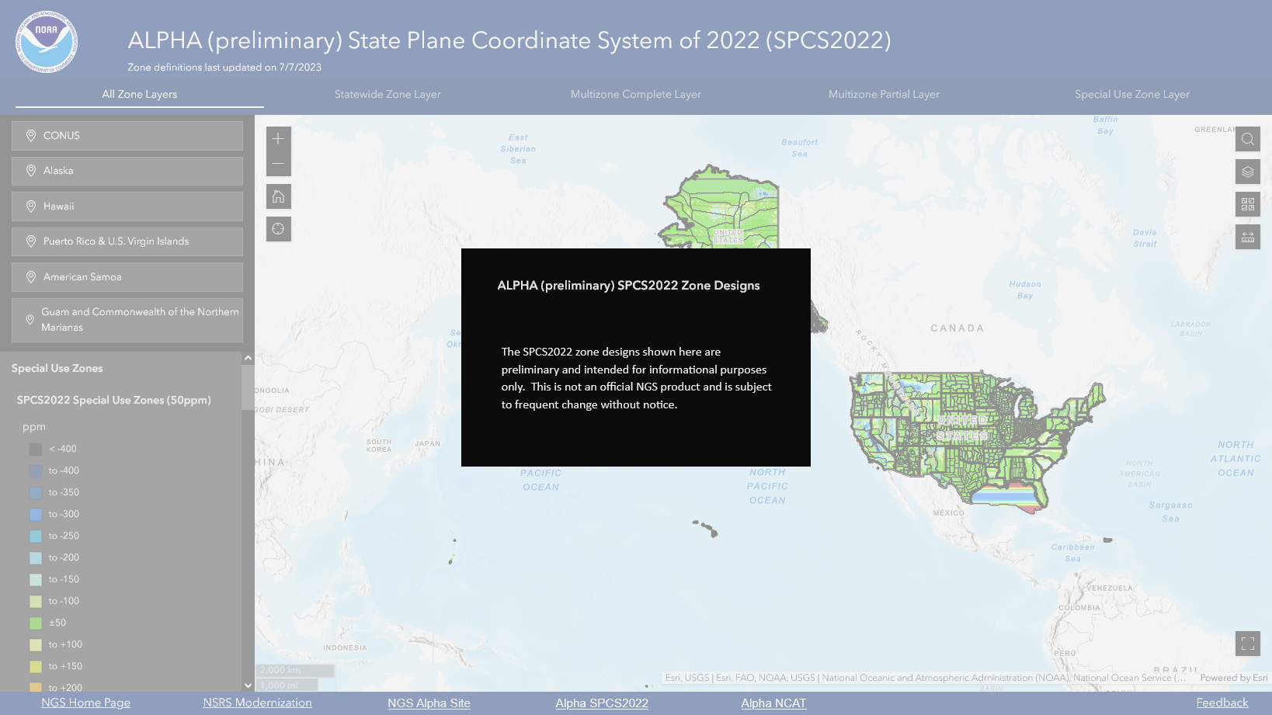

Slide 40
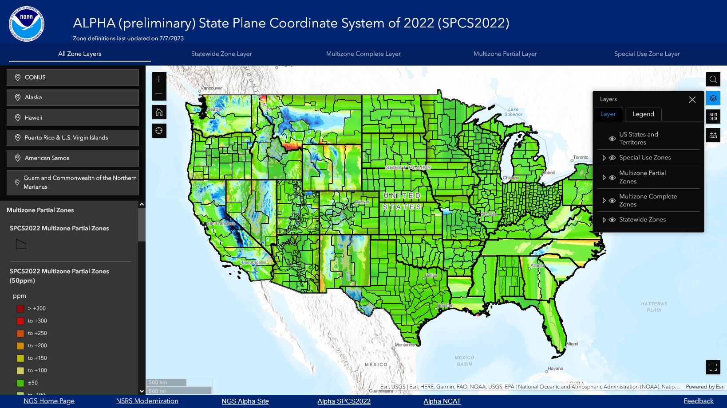
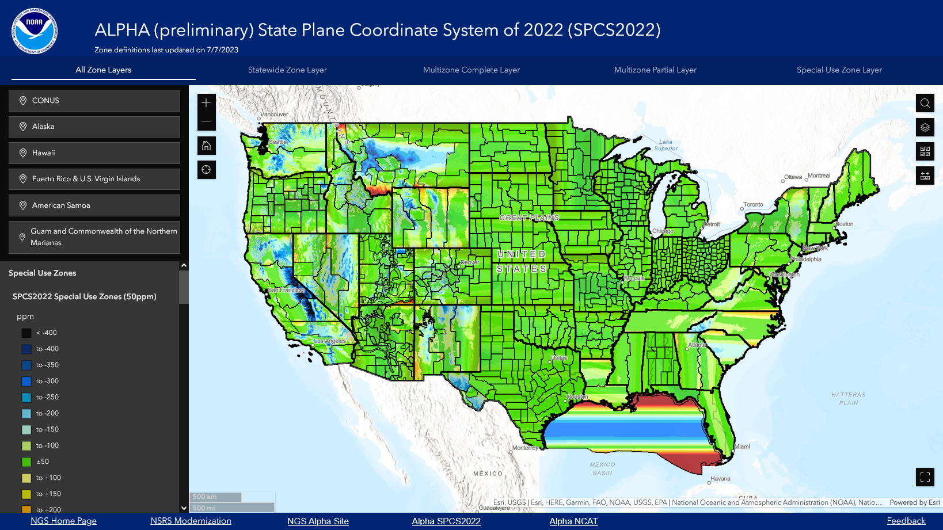
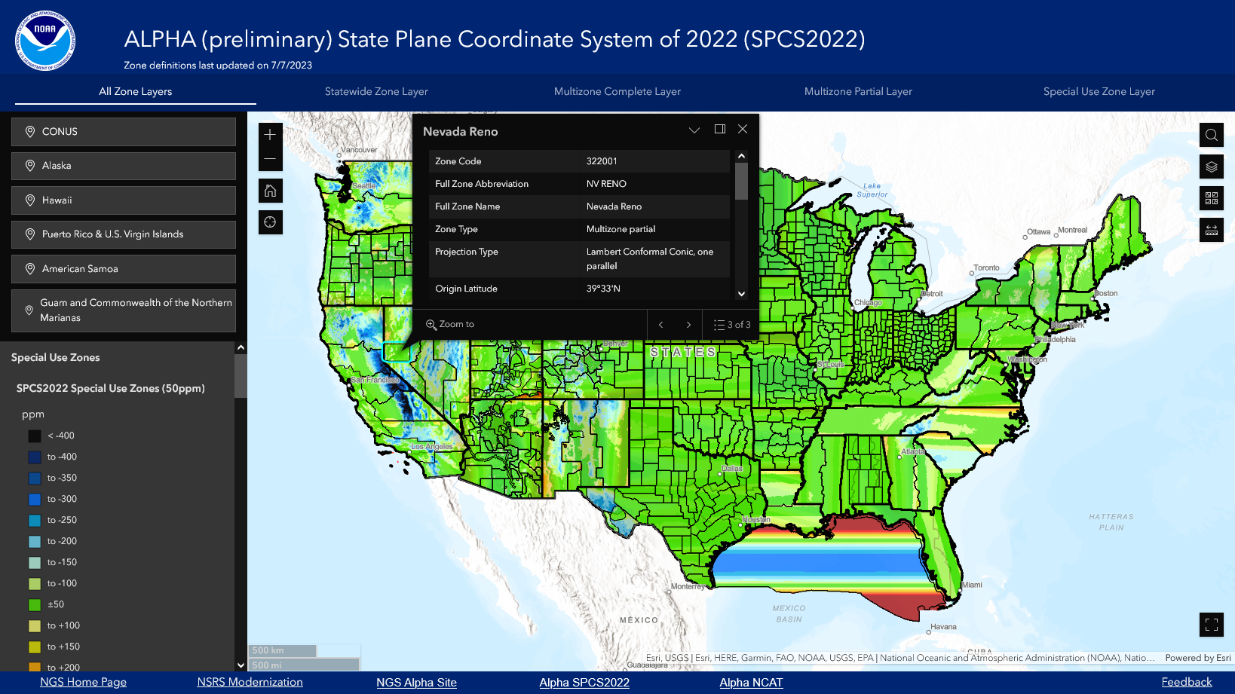
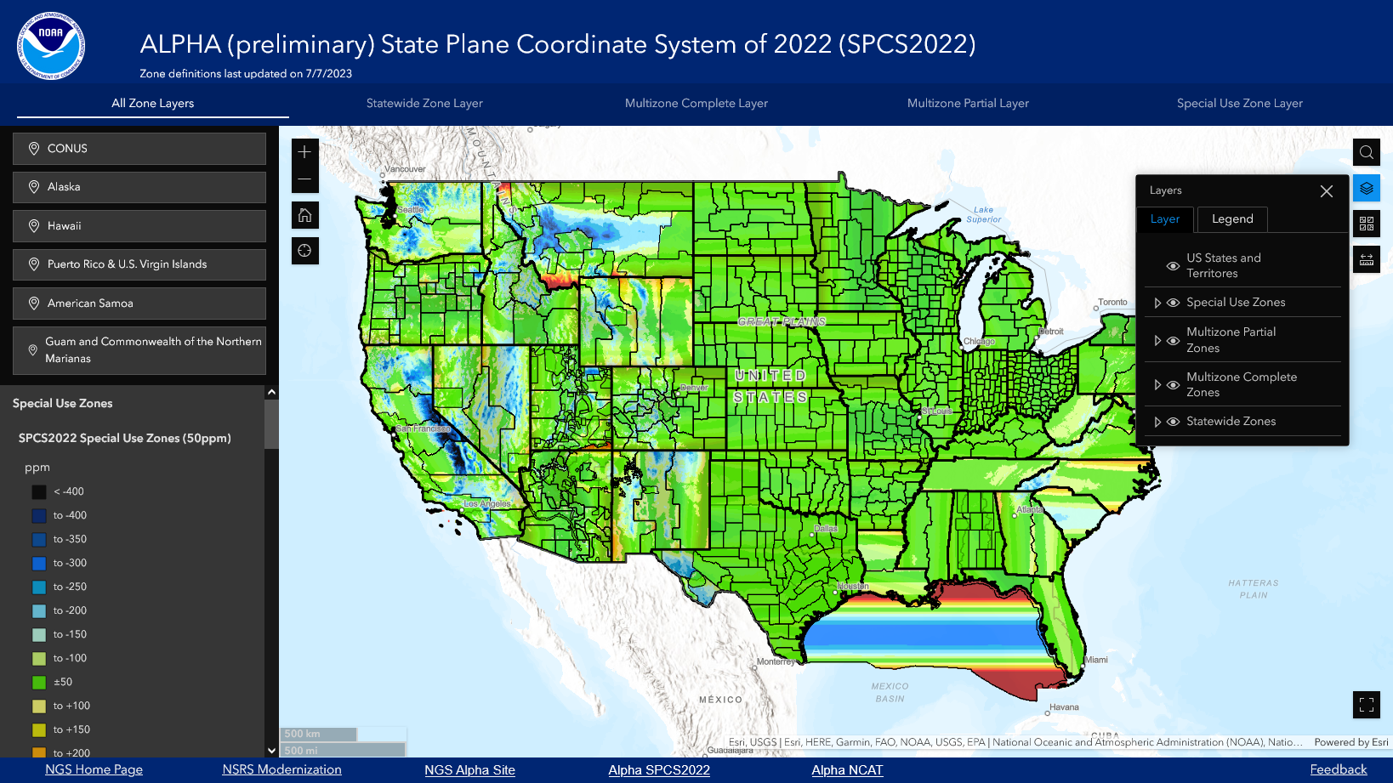
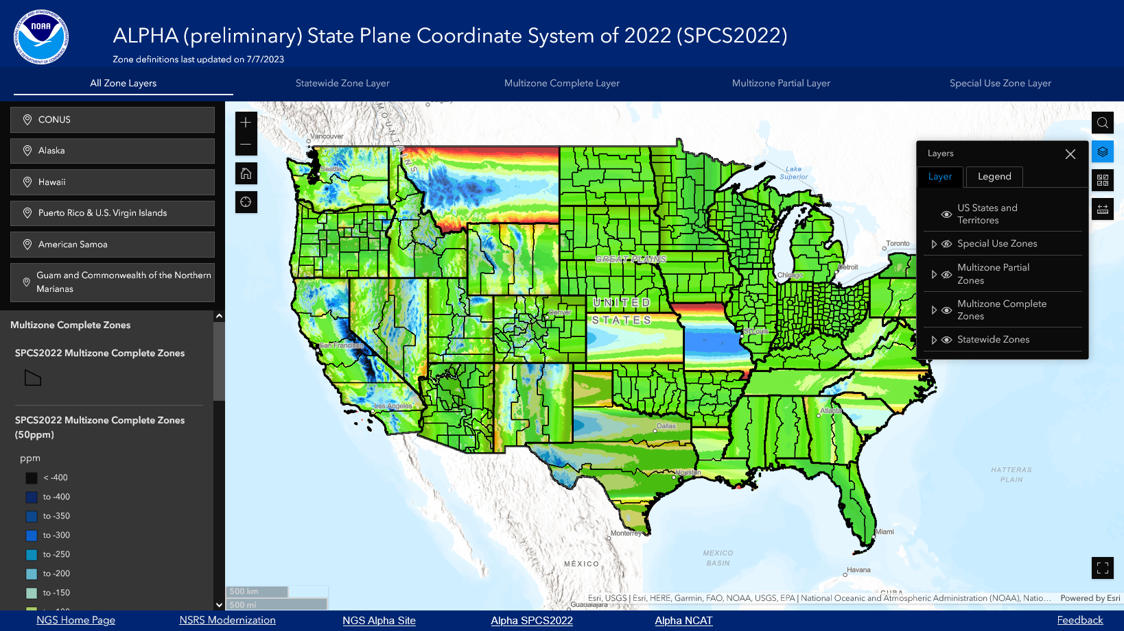
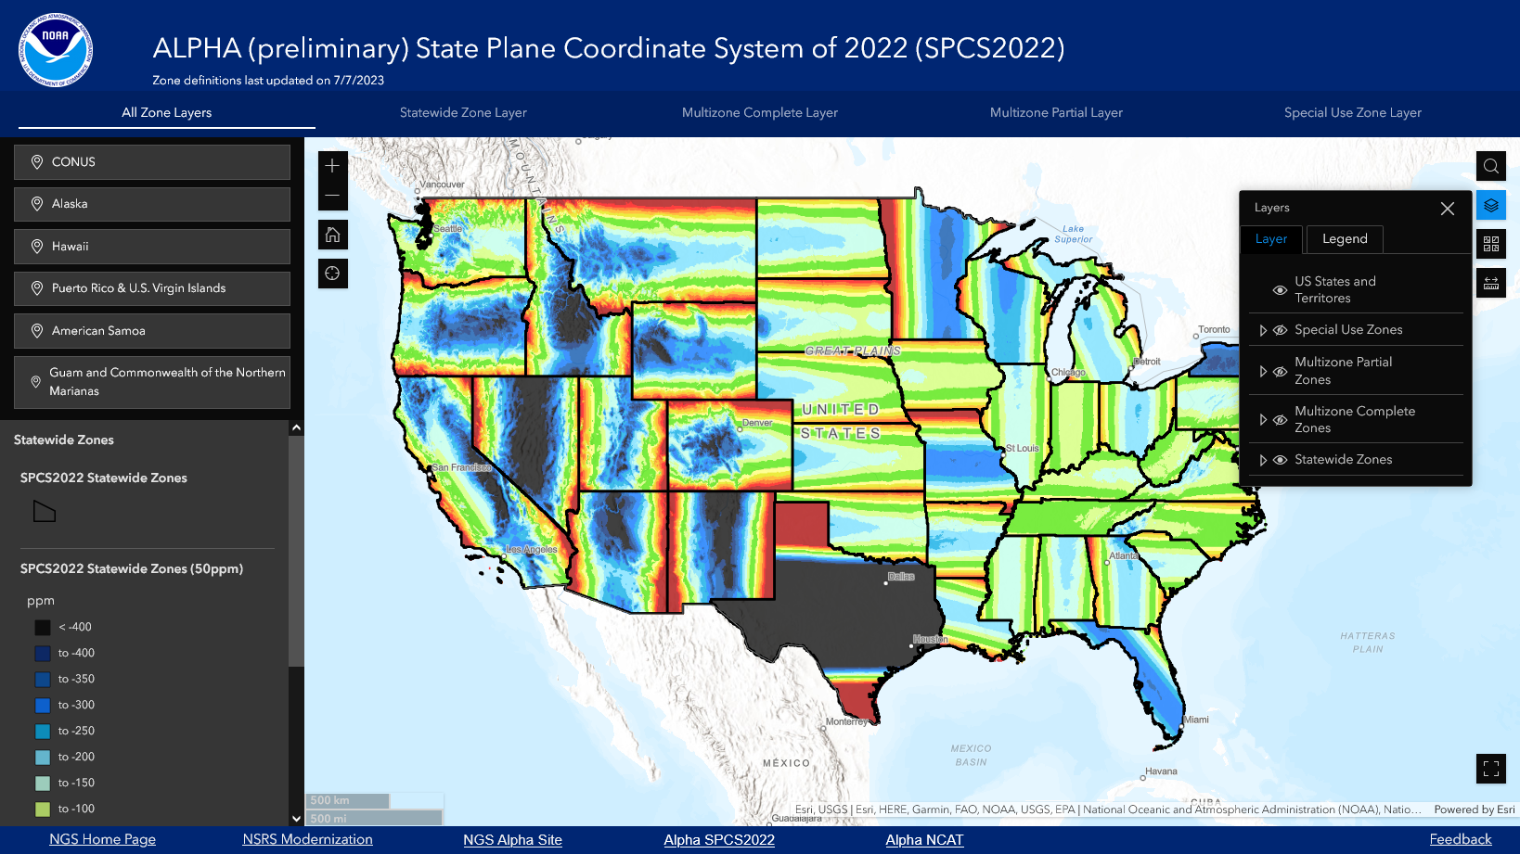

Slide 41
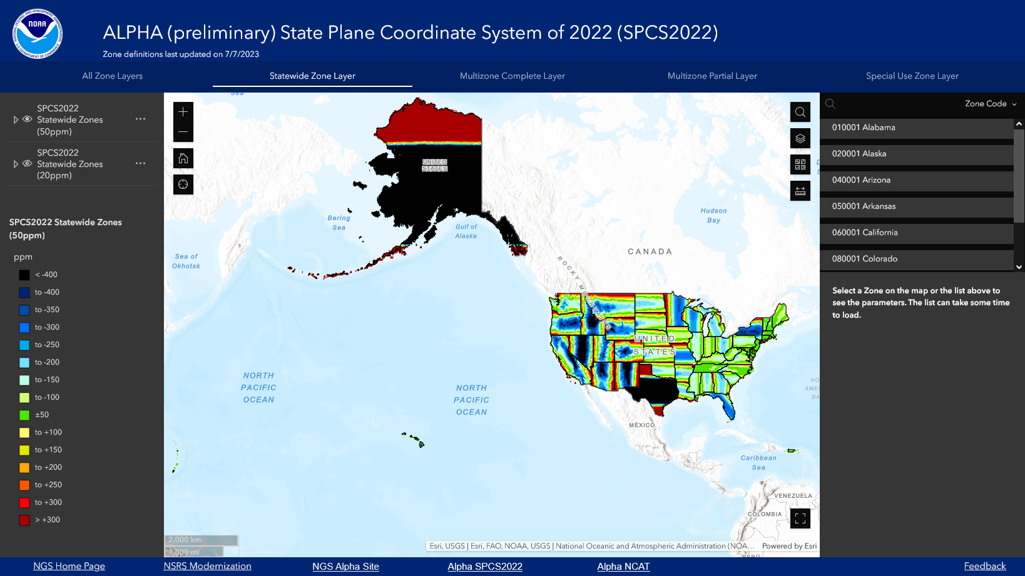

Slide 42
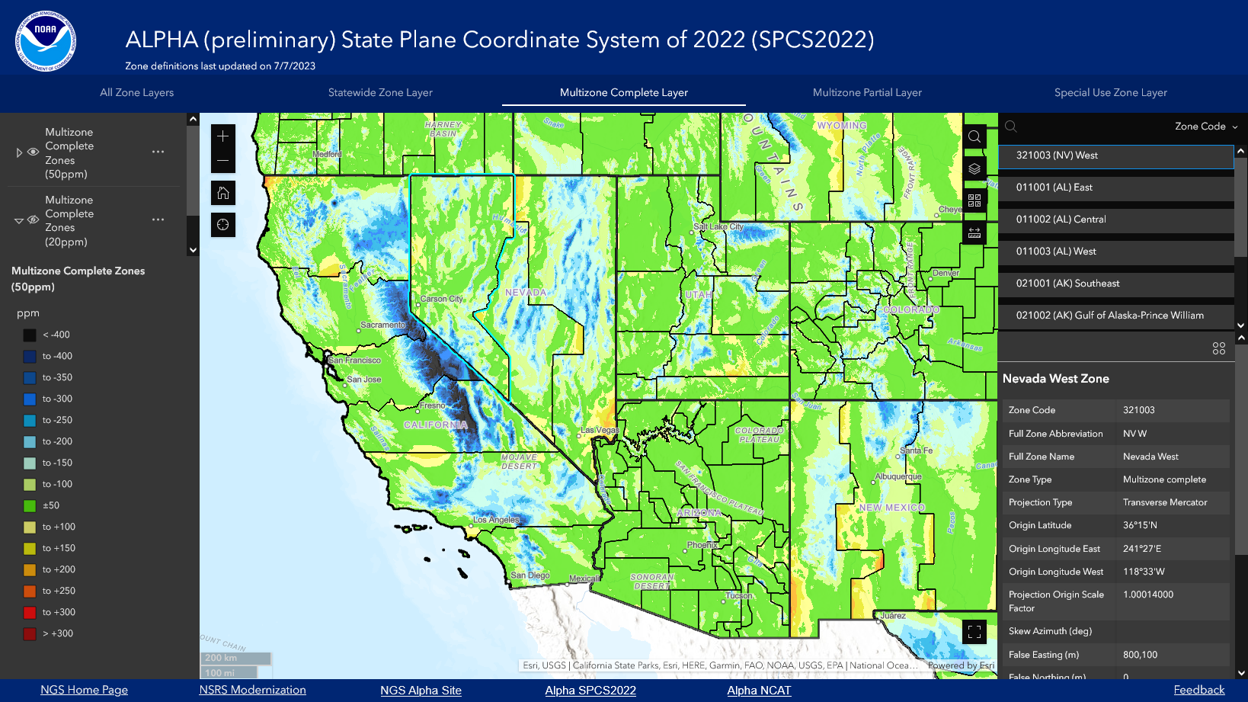
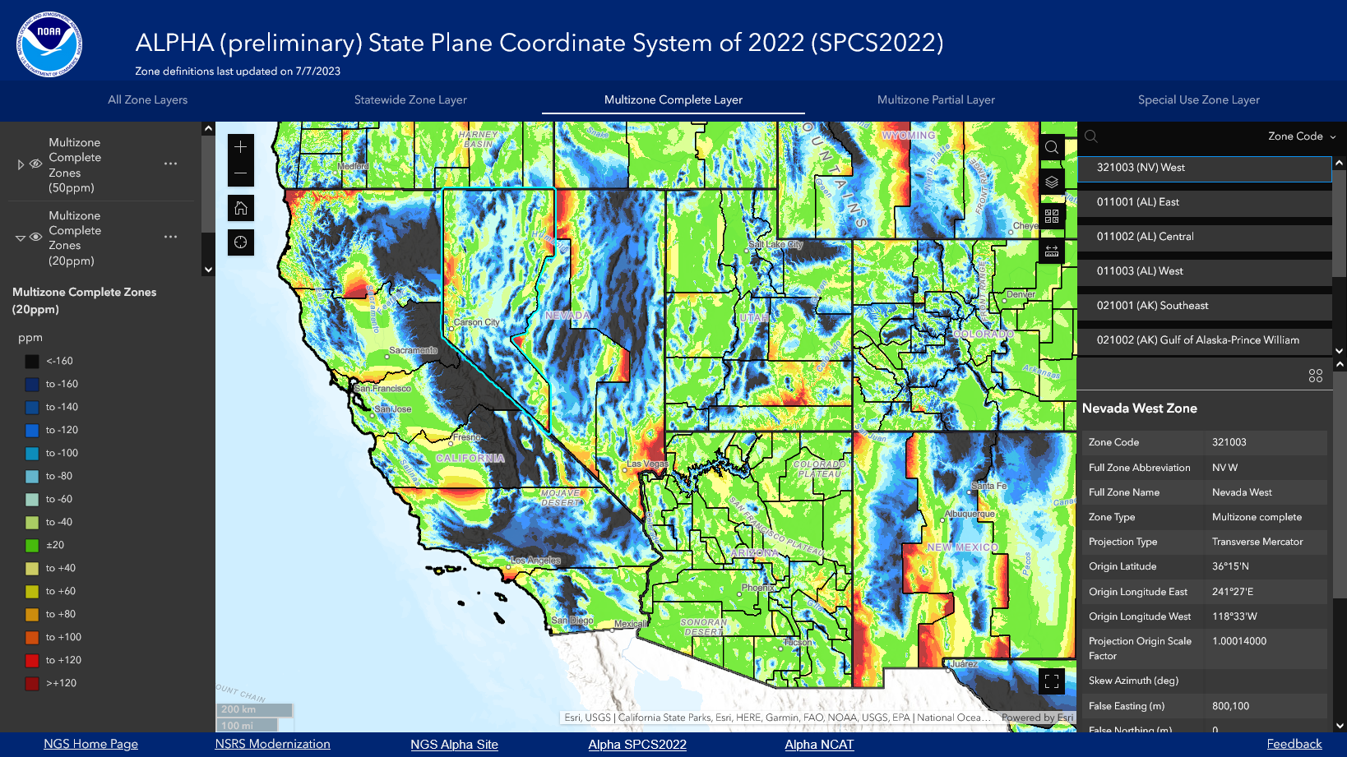
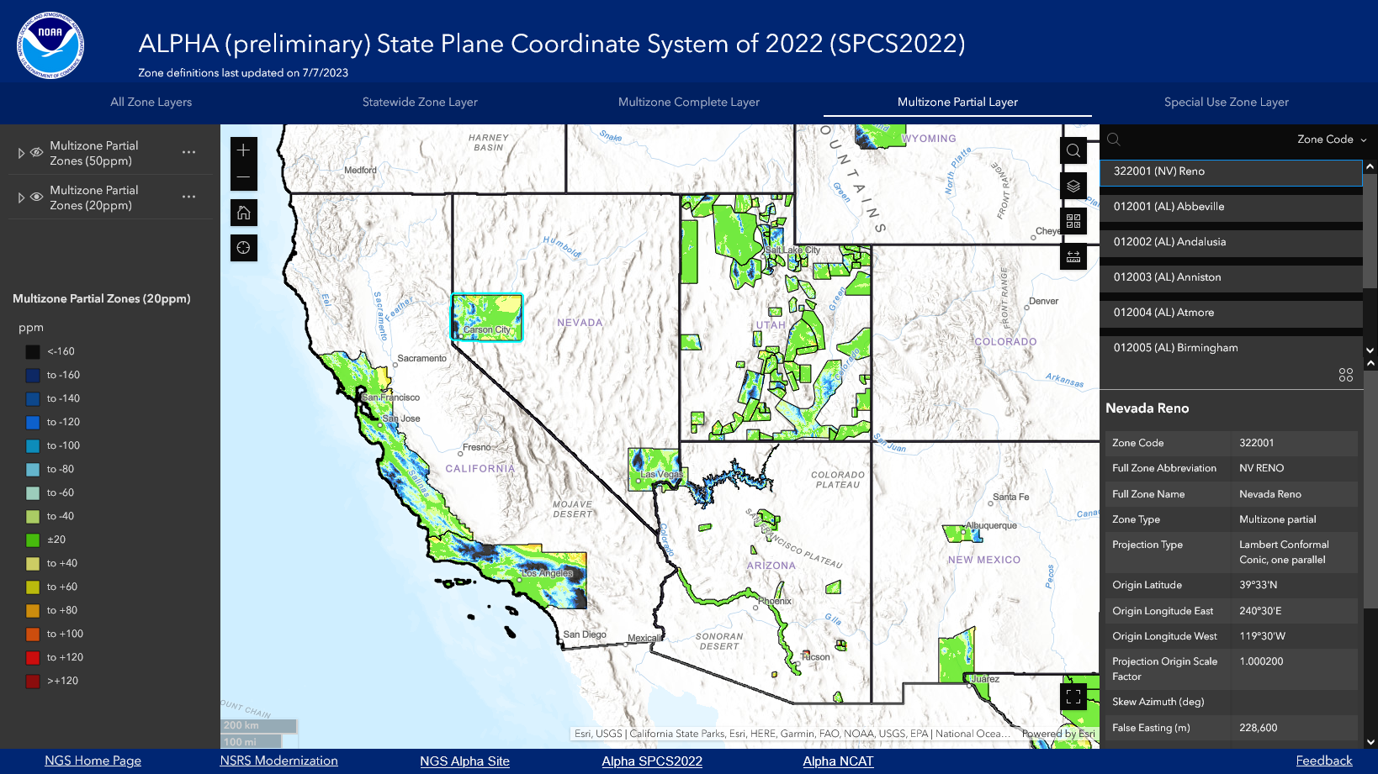
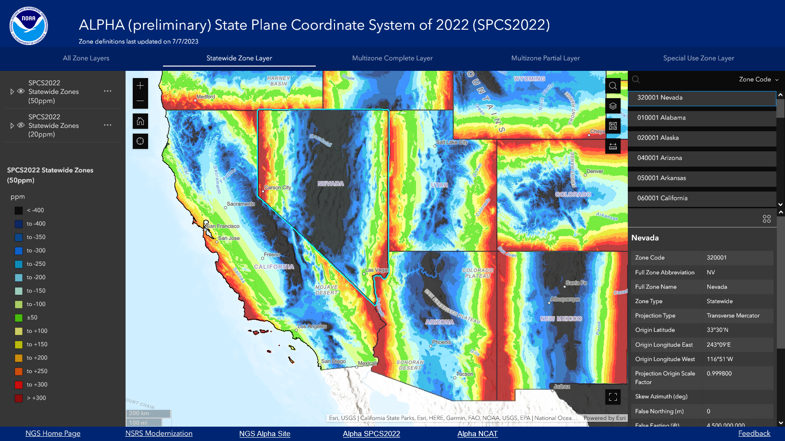
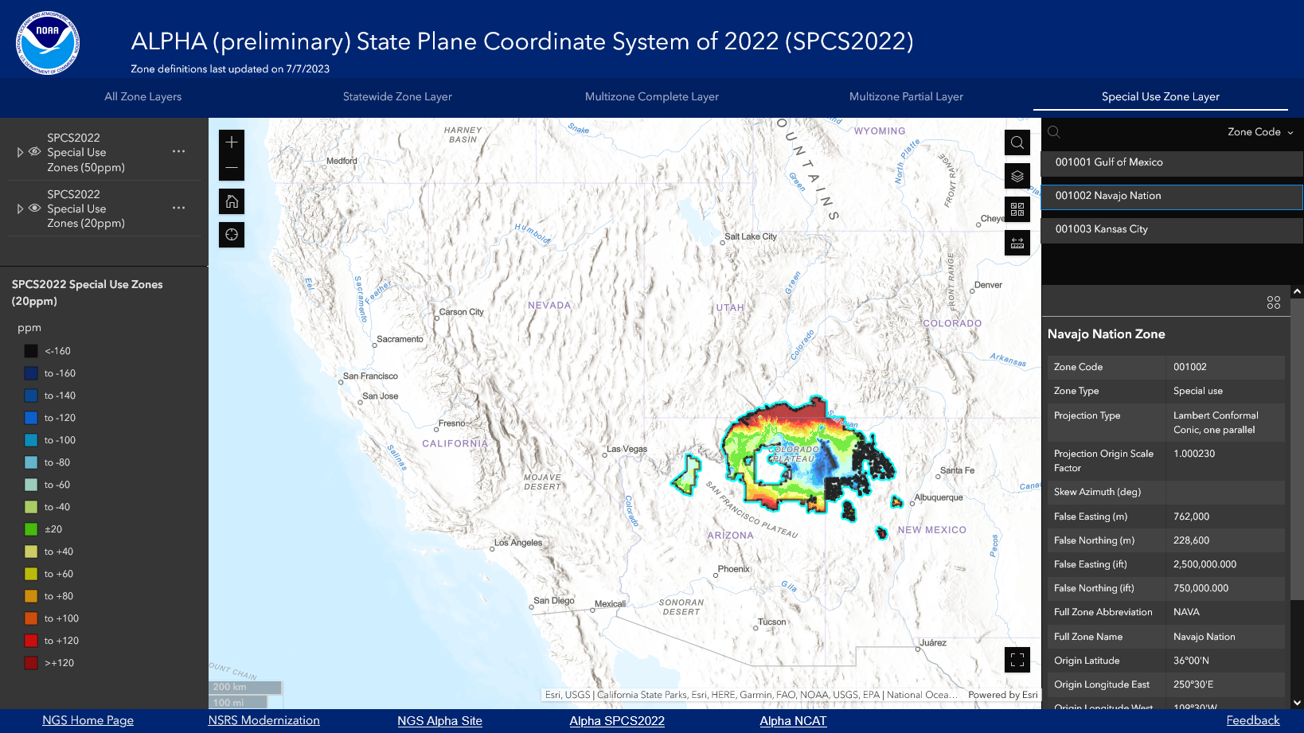

Slide 43
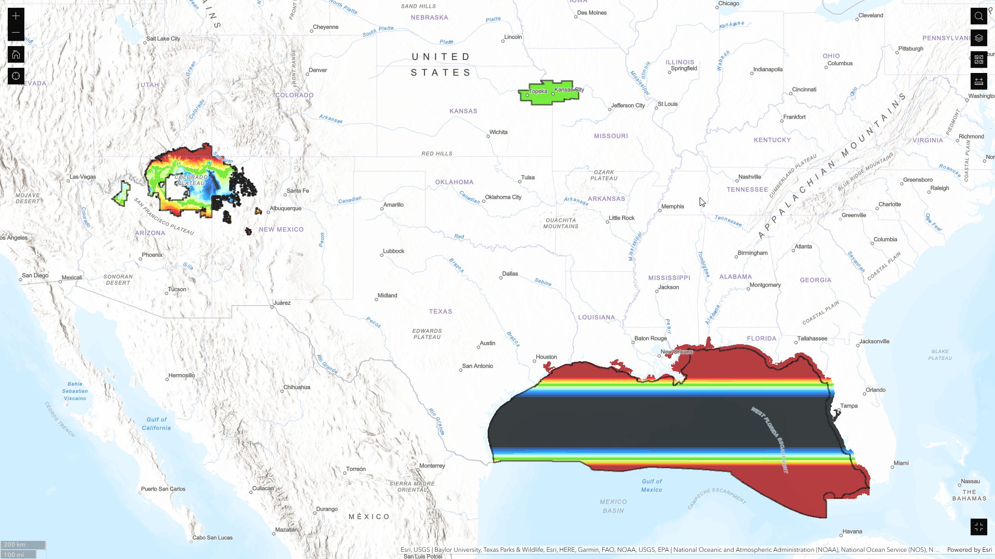
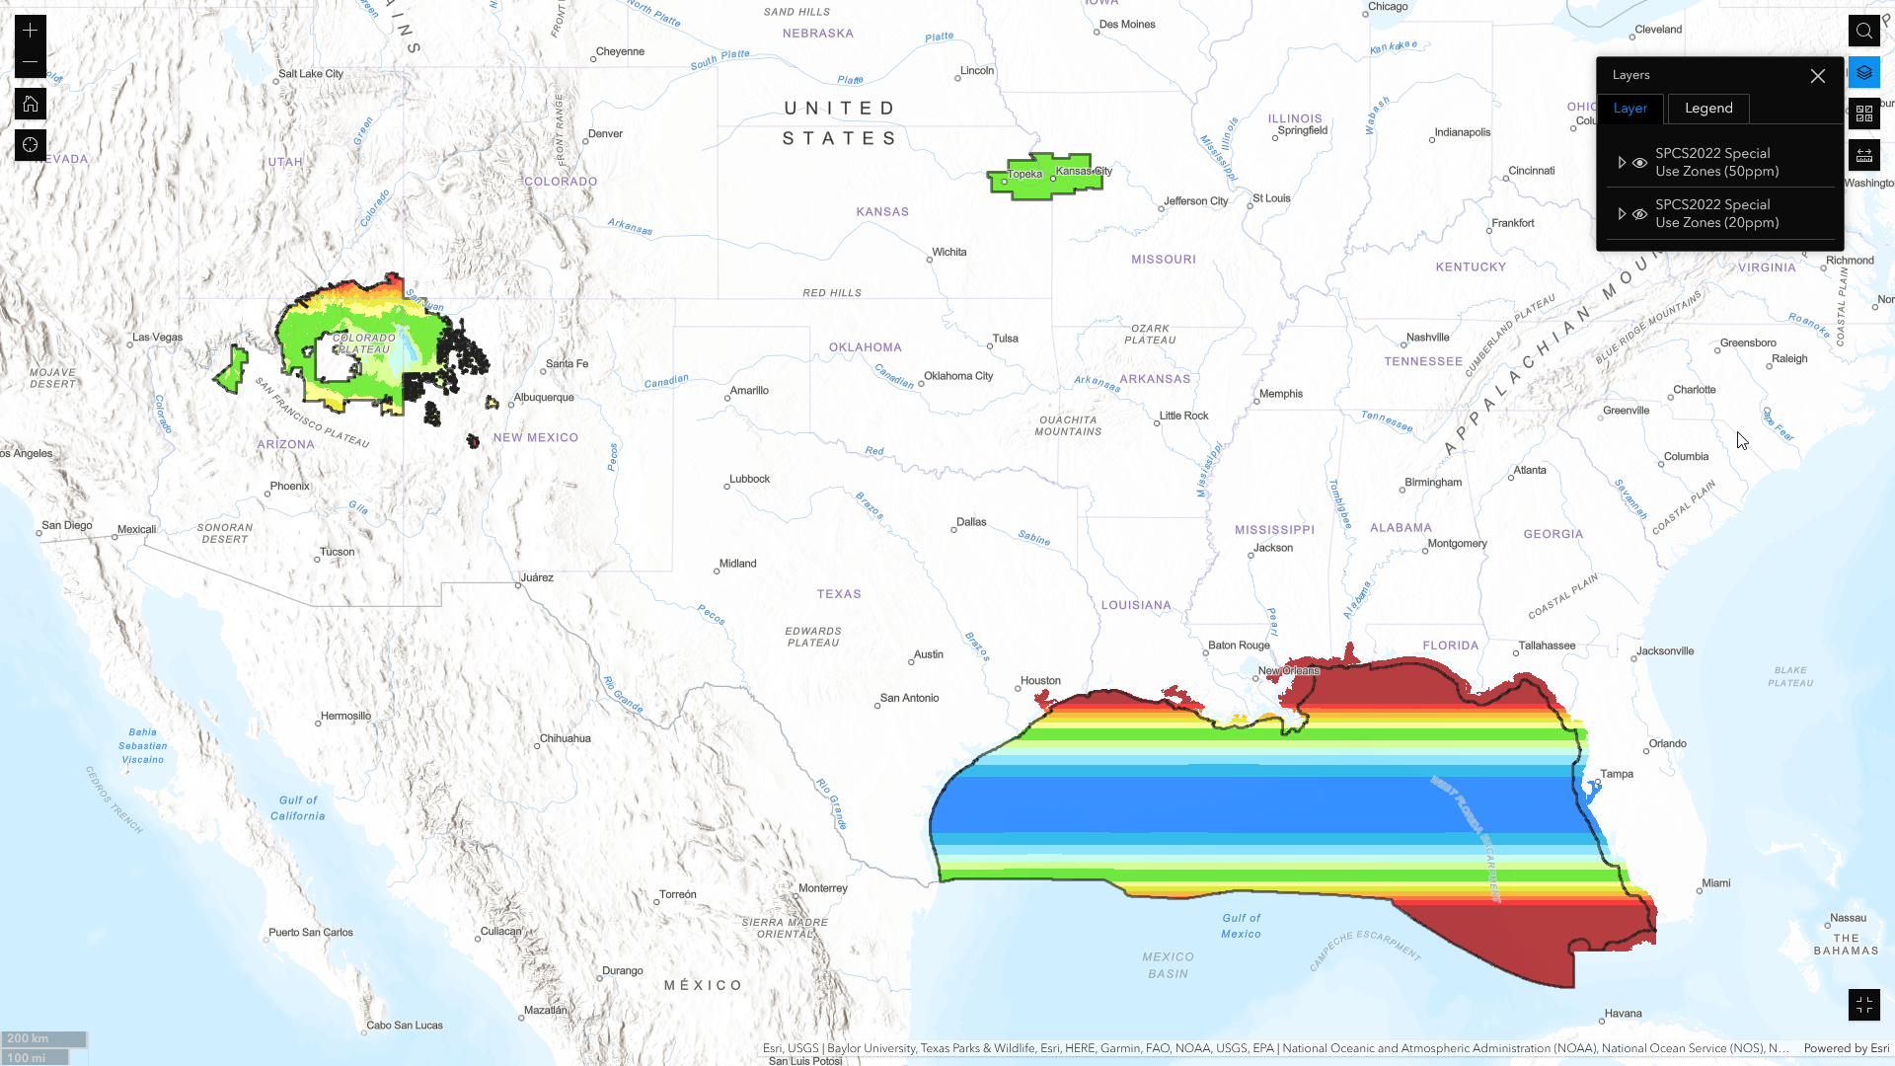

Slide 45
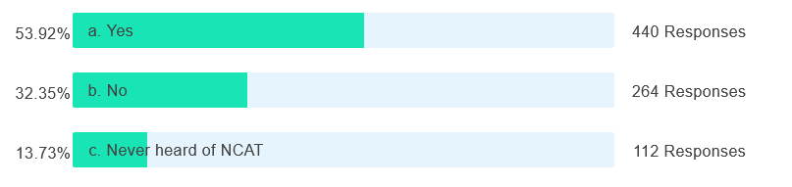
Poll question
Do you use the NGS Coordinate Conversion and Transformation Tool (NCAT)?
816 of 1311 attendees responded

Slide 46

NGS Coordinate Conversion and Transformation Tool
(NCAT)
Alpha

Slide 47
NCAT
A one-stop solution for coordinate conversion and transformation
Revamps and modernizes Geodetic Toolkit
Toolkit modernization is an integral part of NSRS modernization

Slide 48
NCAT
Multiple ways of access:
Single point conversion/transformation
Multi-point conversion/transformation
NCAT download (for conversions only)
NCAT + grids download (for conversions and transformations)
NCAT API
Grids download ( for custom software)

Slide 49
NCAT
API vs Download
API | Download
Platform independent | Platform independent
Internet access required | No internet access required
Updates are automatic | Updates are manual
Command line access | Command line access
Access is through API calls | Access is through library calls
Backward compatibility | Backward compatibility may not be guaranteed

Slide 50
NCAT Conversion
Supports geodetic to projected coordinate (SPC,UTM,USNG,XYZ) conversion and vice versa
Supports conversion between two SPC zones or two UTM zones for all access modes
Allows override to auto picked zones
Auto pick of SPC zone option is not available from the download package

Slide 51
NCAT Transformation
Uses Nadcon 5.0 for horizontal and Vertcon 3.0 for vertical transformation
Transformation only available for supported regions
Visit Nadcon 5.0, Vertcon 3.0, or NCAT API pages to learn more

Slide 52
NCAT API
Delivered in JSON format
Easy to consume and parse
An API link for metadata available for keys used in JSON
Rate limits apply

Slide 53
NCAT Web Interface
Dynamic user interface, responsive design
Supports multiple export formats
Simple format for upload
Custom format for export

Slide 54
NCAT Tutorial
Available under the “About..” tab
Part 1- NCAT Conversions
Part 2- NCAT Transformations

Slide 55
NCAT Live Demo

Slide 57
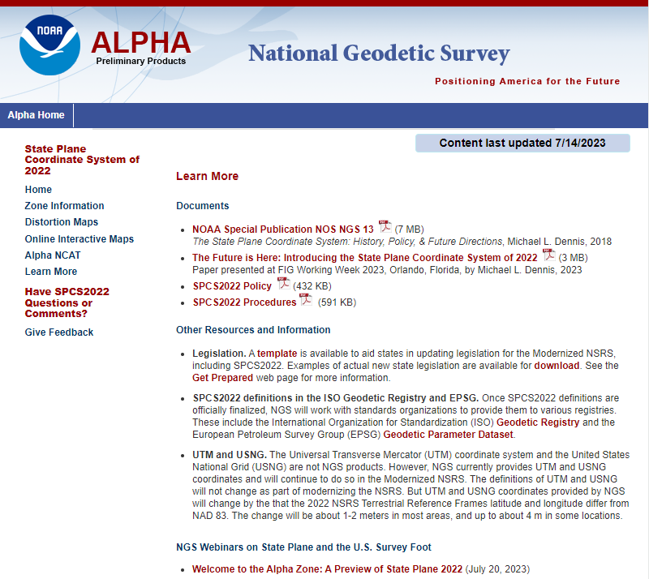
Learn More
NOAA Special Pub NOS NGS 13
Paper on SPCS2022
Updated SPCS2022 Policy and Procedures
Other information and resources
  Legislation
  SPCS2022 definitions in registries
  UTM and USNG
Webinars

Slide 58
NSRS Modernization
Alpha site is ONLY for NSRS Modernization
Rollout 2025
More to it than just SPCS2022…
  Deprecation of U.S. survey foot
  Terrestrial reference frames
  Geopotential datum
  Time-dependence
  Reference and survey epoch coordinates
  And more…
PRELIMINARY

Slide 59
That’s great, but when will SPCS2022 be done?
SPCS2022 Rollout of Modernized NSRS in 2025
But SPCS2022 design will be done sooner
  Getting feedback now from stakeholders and others now
  In process of updating projection algorithms
  Finalize designs by end of 2023 or shortly after
  Get Federal Geodetic Control Subcommittee approval in early 2024
Provide final completed designs to the world in 2024!

Slide 60


Where to learn more…
geodesy.noaa.gov
Thank you!

Slide 61
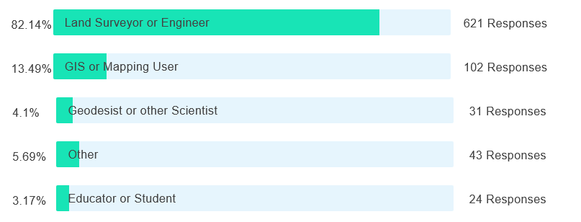
Poll question
What is your profession?
756 registrants responded

