Slide 1

The Modernized
National Spatial Reference System
Dru Smith
NSRS Modernization Manager
NOAA’s National Geodetic Survey

Slide 2
Outline
BLUF
Refresher on NSRS Modernization
Magnitudes and Transformations
Timeline
Rollout/testing/replacement

Slide 3
Bottom Line, Up Front

Slide 4
BLUF
In 2026, the coordinates of every point on every map, chart, airport survey or other geospatial data set will change.
  Every latitude, longitude and ellipsoid height will change from its current values by +/- 2 meters (median) with extremes up to 4 meters
  Every orthometric (“Mean Sea Level”) height will change from its current values by +/-2 meters (median) with an unknown limit on change due to (as yet) unquantified subsidence impacts

Slide 5
Refresher on NSRS Modernization

Slide 6
The National Spatial Reference System
The NSRS
Official coordinate system for the USA
Defined by the National Geodetic Survey (NGS)
  Approved by the Federal Geodetic Control Subcommittee (FGCS)
    The FAA is a member
Required to be used by all civilian Federal Government agencies
  OMB A-16
  Geospatial Data Act
Often used by many state and local government agencies or private surveyors

Slide 7
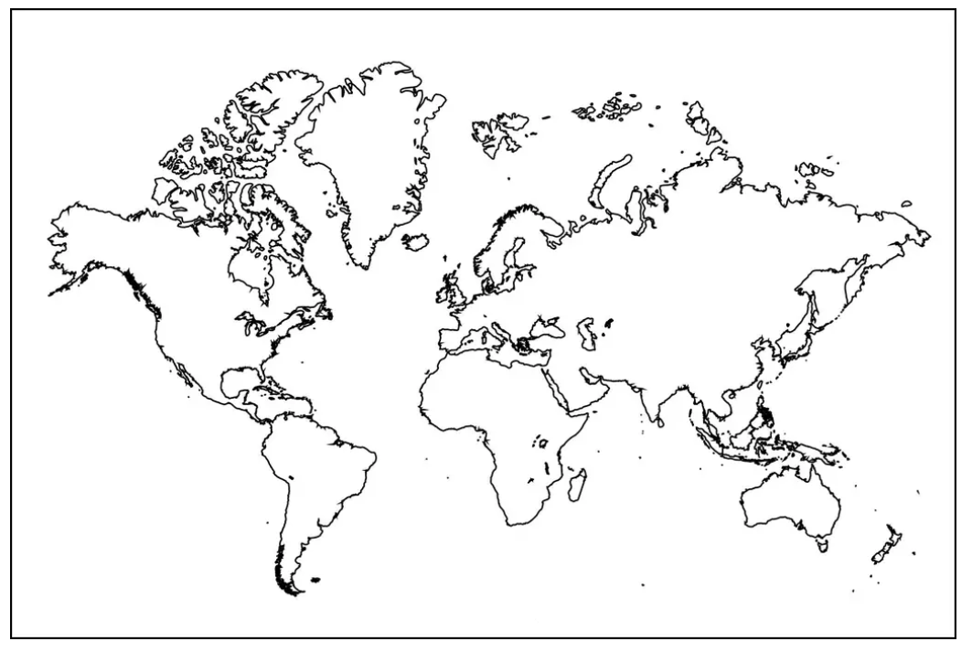
Extent of the current NSRS
Geometric Reference Frames:
NAD 83(2011)
NAD 83(PA11)
NAD 83(MA11)
Truly global but used regionally
Geoid models/Vertical Datums:
Regional
  Conterminous US (CONUS; “Lower 48”)
  Alaska
  Hawaii
  Territories: Puerto Rico, U.S. Virgin Islands, American Samoa, Guam, CNM

Slide 8
What about WGS 84?
WGS 84 is not part of the NSRS
  WGS 84 is a military system, with their own rules.
  No civilian agency (including the FAA) should be using WGS 84.
  However, NGS recognizes the appeal of WGS 84:
    Global
    Geocentric / aligned with GPS
  For these very reasons, the Modernized NSRS will also be global and geocentric / aligned with GPS.
    A proposal is provided at the end of this briefing

Slide 9
NSRS Modernization
Has been ongoing since 2007
This talk presumes some existing knowledge of NSRS Modernization. For finer details look here:
  NGS Presentation Library (https://geodesy.noaa.gov/web/science_edu/presentations_library/)
  NGS New Datums Page (https://geodesy.noaa.gov/datums/newdatums/index.shtml)
  The Blueprint Documents (https://geodesy.noaa.gov/datums/newdatums/policy.shtml)

Slide 10
Preeminence of ITRF
Remove the rotation of the North American Plate
North American Terrestrial Reference Frame of 2022 (NATRF2022)
Caribbean Terrestrial Reference Frame of 2022 (CATRF2022)
Pacific Terrestrial Reference Frame of 2022 (PATRF2022)
Mariana Terrestrial Reference Frame of 2022 (MATRF2022)
Why 5 frames?
The ITRF is the international gold standard, and is fixed to no particular plate (latitude/longitude will drift ~ few cm/year). It is global and geocentric.
The USA has population centers on four plates, and many users wish to see the drift of latitude and longitude “hidden” over time, so we fix the frames to those four plates. They will also be global (but meant to be used on one plate) and geocentric.
Remove the rotation of the Caribbean Plate
ITRF2020
Remove the rotation of the Pacific Plate
Remove the rotation of the Mariana Plate
EPP2022
EPP for “Euler pole parameters”
(a way of describing a plate’s rotation)

Slide 11
NSRS Modernization in (very) brief
ITRF2020
NAD 83(2011)
NATRF2022
NAD 83(PA11)
Hybrid geoids
GEOID2022
PATRF2022
NAD 83(MA11)
CATRF2022
MATRF2022
NAVD 88
ASVD 02
PRVD 02
NAPGD2022
Bluebooking
FORTRAN
Disparate tools
Outdated manuals
GVX / OPUS
Modern coding
Integrated tools
Updated manuals
NMVD 03
GUVD 04
VIVD 09

Slide 12
Magnitudes and Transformations

Slide 13
Magnitudes
When should the FAA care about this?
  When accuracy needs are around 4 meters or smaller
    No: Barometrically determined altitudes
    Yes: Cat III ILSs, Airport surveys

Slide 14
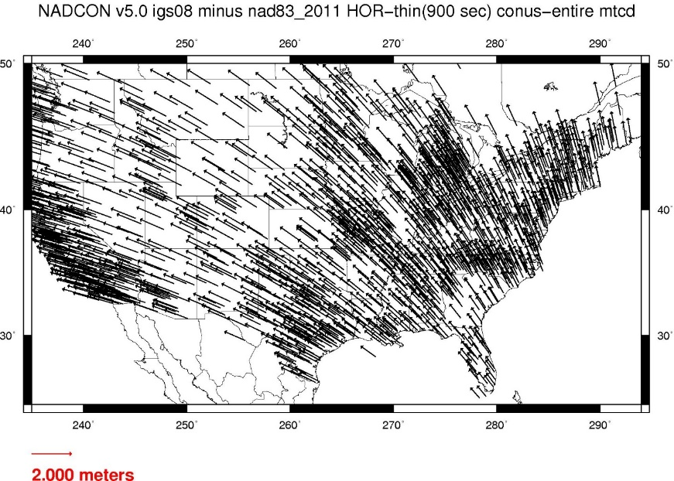
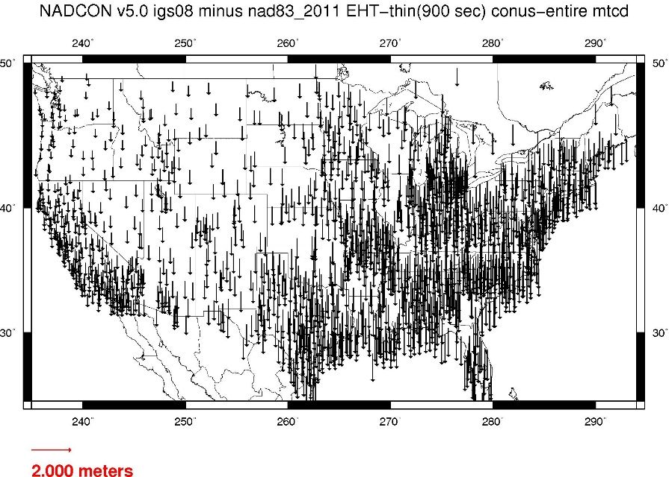
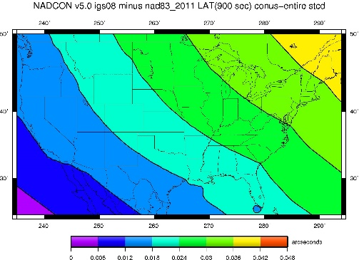
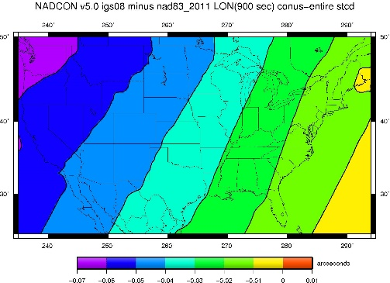
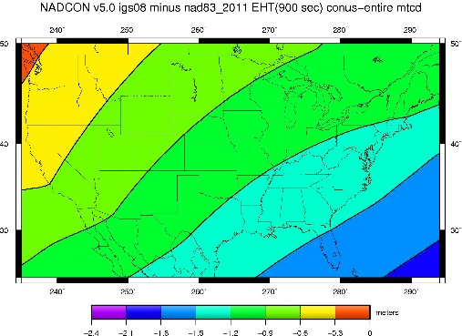
Changes from NAD 83 to NATRF2022

Slide 15
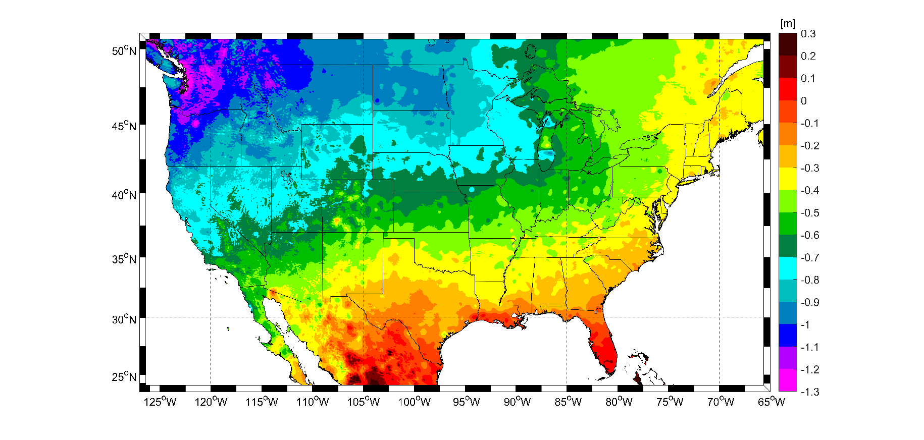
Changes from NAVD 88 to NAPGD2022

Slide 16
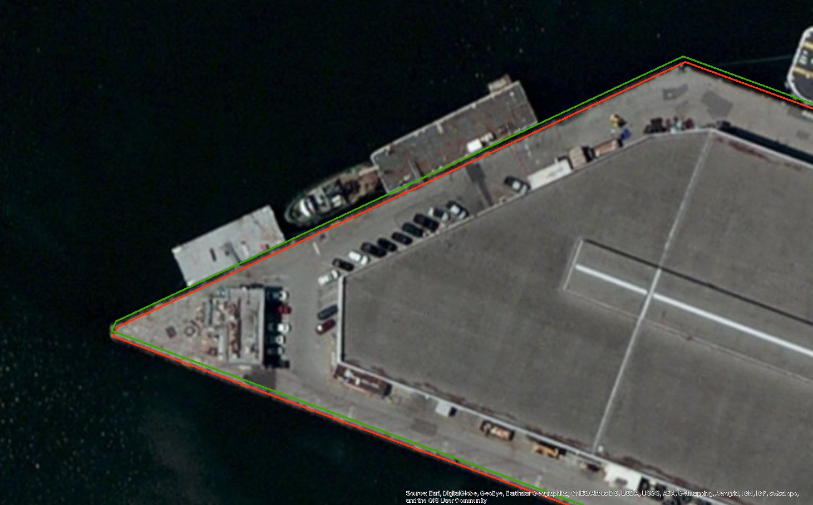
Everything must shift

Slide 17
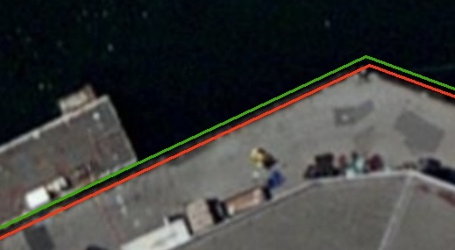
Everything must shift
Shifts ~1 meter
RED: NAD 83 coastline against NAD 83 imagery
GREEN: Coastline shifted into NATRF2022 but
the imagery remains on NAD 83

Slide 18
Transformation tools
NADCON
  Latitudes, longitudes, ellipsoid heights
  NAD 83 to ITRF2020, NATRF2022, PATRF2022, MATRF2022, CATRF2022
VERTCON
  Orthometric (“MSL”) heights
  NAVD 88 (and others) to the NAPGD2022
Both of these tools are built into NGS’s flagship product NCAT
  NCAT : NGS Coordinate Conversion and Transformation Tool

Slide 19
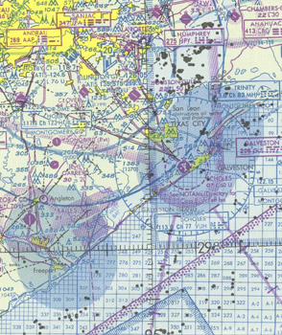
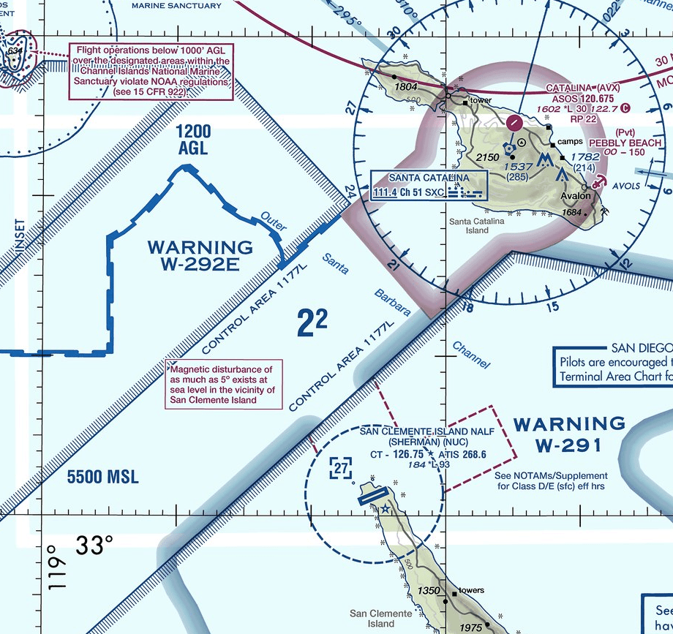
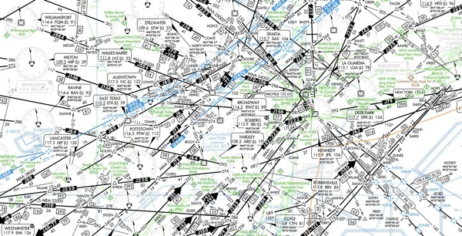
What to do with historic charts?
Is the accuracy expected to be better than a few meters?
No
Yes
Stop. You won’t likely gain much by transforming
Do you have trusted metadata which puts the chart in the NSRS? (Note, WGS 84 is not part of the NSRS)
Yes
No
Stop. Transformation tools only work in the NSRS and only if you trust the metadata
Use NCAT to update the datums (available for testing in late 2025)

Slide 20
Timeline

Slide 21
Timeline
In 2022, NGS diverted resources from tool-building to data assurance
  “Limited tools, excellent coordinates”
  Set a goal of roll-out by 2025
NGS is on-track to roll out the modernized NSRS by the middle of 2025.
Work on additional tools will continue in the out-years

Slide 22
Rollout, Testing, Replacement

Slide 23
Rollout, Testing, Replacement
NGS will roll out components of the modernized NSRS over time (2024-2025)
As each component is rolled out, it can be tested
Once the final component (likely VERTCON) is rolled out (likely late 2025), testing will continue for at least 6 months
Once enough testing is done, and all modernized NSRS components seem stable and correct, the FGCS will vote (likely 2026)
If affirmative, the modernized NSRS will replace the current NSRS

Slide 24
Rollout: Alpha, Beta, Live
NGS will use three different websites (URLs) as we roll-out the modernized NSRS:
  Live: www.ngs.noaa.gov
    Will hold the current NSRS until the modernized NSRS has been fully tested and the FGCS has voted to replace the current NSRS with the modernized NSRS
  Beta: beta.ngs.noaa.gov
    Soon to be re-designed to hold modernized NSRS products only
    Every component of the modernized NSRS will be placed here
    Products assumed to be complete and correct
    For testing
    Subject to change or deletion
  Alpha: alpha.ngs.noaa.gov
    “Incomplete, early, possibly incorrect”
    Not everything will go on alpha

Slide 25
Current NSRS during rollout and testing
While the modernized NSRS is being rolled out and tested, the current NSRS will remain the official NSRS of the United States
  This will not change until the FGCS vote (probably 2026)
URL www.ngs.noaa.gov will only hold current NSRS

Slide 26
Testing into replacement
From late 2025 into sometime in 2026, all modernized NSRS components on Beta will go through testing and feedback
After the FGCS vote, a few months of work remain:
  The FGCS will issue an FRN officially announcing the adoption of the modernized NSRS
  The beta website may be wiped of submitted data*
  All modernized NSRS components moved to the Live website
    Submissions will then begin in earnest and won’t be deleted
  All current NSRS components moved “elsewhere”
    No further submissions to the NGS IDB will be allowed at this point
Notes:
Notes: NGS is considering what to do with data submitted during testing. The cleanest solution is to delete it as “test data” and not attempt to move it onto the Live website. If we were to consider moving it to Live, we would need to re-submit the data to ourselves, which is a tremendous amount of work. It is best to assume that NGS will ask submitters to re-submit after the switch.

Slide 27
After testing and the FGCS vote
geodesy.noaa.gov:
ITRF2020 on NCN
SPCS 83
NAVD 88
OPUS-Share
NADCON 5
OPUS-S (GNSS)
NAD 83
GEOID18
OPUS-RS (GPS)
VERTCON 3
“Elsewhere”
OPUS-Projects (GPS)
(Bluebooking, HTDP, ADJUST, NGS IDB, Datasheets)
DEFLEC18
beta.ngs.noaa.gov:
ITRF2020 on NCN
EPP2022
Geometric RECs
in N/P/C/MATRF2022
N/P/C/MATRF2022
NADCON 6?
SPCS2022
IFDM2022
GM2022
Orthometric RECs
in N/P/C/MATRF2022
VERTCON 4?
GEOID2022
GRAV2022
NAPGD2022
DEM2022
DEFLEC2022
OPUS-Projects (GPS)
(GDX, SPROCCET, LASER, NSRS DB, New Datasheets)
OPUS-S (GNSS)
All submissions provided during testing may get deleted

Slide 28
After testing and the FGCS vote
geodesy.noaa.gov:
ITRF2020 on NCN
EPP2022
Geometric RECs
in N/P/C/MATRF2022
N/P/C/MATRF2022
NADCON 6?
SPCS2022
IFDM2022
GM2022
Orthometric RECs
in N/P/C/MATRF2022
VERTCON 4?
GEOID2022
GRAV2022
NAPGD2022
DEM2022
DEFLEC2022
OPUS-Projects (GPS)
(GDX, SPROCCET, LASER, NSRS DB, New Datasheets)
OPUS-S (GNSS)
All submissions from this point forward get saved
“Elsewhere”
ITRF2020 on NCN
SPCS 83
NAVD 88
OPUS-Share
NADCON 5
OPUS-S (GNSS)
NAD 83
GEOID18
OPUS-RS (GPS)
VERTCON 3
OPUS-Projects (GPS)
(Bluebooking, HTDP, ADJUST, NGS IDB, Datasheets)
DEFLEC18
No submissions to the NGS IDB allowed any longer

Slide 29
A radical idea…
The FAA should consider abandoning the plate fixed components of the NSRS
  This obviously means updating OMB A-16…(see earlier)
  In favor of the global, plate-independent ITRF2020 frame
  NGS will support ITRF2020 positioning as well as four “plate fixed” frames
  The ITRF2020 and WGS 84 are actually closely aligned to each other
Why?
  Consider flying from Denver to Honolulu
    In Denver, the NATRF2022 latitude/longitude will look constant in time
    In Honolulu, the PATRF2022 latitude/longitude will look constant in time
      But they don’t look constant when compared to each other
      Why not just switch to a system which accepts and embraces the dynamic earth? : ITRF2020

Slide 30
Summary
The modernized NSRS is coming soon!
  Starting this year!
All components should be on Beta by 2025
  For testing only!
It won’t replace the current NSRS until an FGCS vote (2026)
NGS will continue to support the current NSRS through the rollout and testing of the modernized NSRS
We encourage you to test each component as it is released

Slide 31
Thank you!

Slide 32
Questions?

