Slide 1

Incorporating Real-Time GNSS Data Into OPUS Projects
OPUS User Forum
September 2024
Jeff Jalbrzikowski, P.S., GISP, CFS
Appalachian Regional Geodetic Advisor
jeff.jalbrzikowski@noaa.gov
240-988-5486

Slide 2
Any references to any commercially available hardware or software do not constitute an endorsement or a disapproval of any manufacturers, developers, dealers, or suppliers.

Slide 3
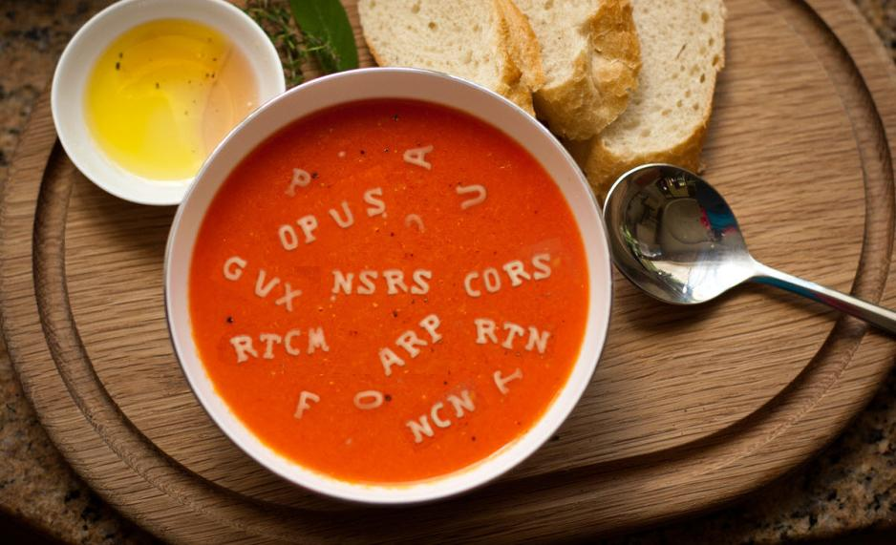
Let’s start with some alphabet soup

Slide 4
SRTK – Single-base RTK
aka RTK
Base sending corrections to Rover
  Radio broadcasting corrections
  Cell modem sending corrections
In context of today’s talk, your must be logging data at your Base (to tie it to NCN)

Slide 5
NRTK – Network RTK
aka RTN - Real Time Network
A group of CORS that collect data and send it to server(s), which then deliver corrections to users
Different principles, but all are NRTK methods:
  VRS - Virtual Reference Station
  MAC - Master-Auxiliary Concept (2 types of corrections possible)
    MAX – Master-Auxiliary Corrections
    i-MAX - Individualized Master-Auxiliary Corrections
  FKP - Flächen Korrektur Parameter

Slide 6
RINEX file format
Receiver INdependent EXchange
We are concerned with the Observation data
  Some day “O-file” (because extension is .YYo)
    mark254q.24o
  Some tools use the extension “.obs”
This is what OPUS processes
  OPUS currently accepts other formats
    Future versions of OPUS will be RINEX only

Slide 7
RINEX file format
“Now Jeff, I upload .tps files all the time…”
Yes, there are other file types you can upload
  Translated to RINEX v2.11 by OPUS servers
    TEQC + GFZRNX + custom coding
For smoothest OPUS experience, use the equipment brand’s RINEX converter
  TPS2RIN; ConvertToRINEX; iGx Download; mdb2rinex

Slide 8
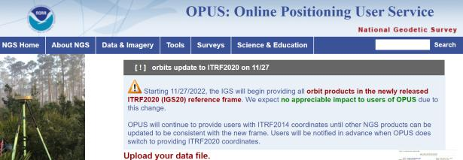
NGS Mission
To define, maintain and provide access to the National Spatial Reference System (NSRS) to meet our Nation’s economic, social, and environmental needs.
access… ? = traditionally → marks/disks/objects
= modern and future → NOAA CORS Network (NCN)
via OPUS
Notes:
Follow up thought
-like it or not, we know that the vast majority of our users are obtaining NSRS coordinates via OPUS
-while that is our plan for the future of primary access, modernized NSRS, as of now the official form of access (specifically to NAVD88) truly is to “touch brass” as they say → meaning occupy a benchmark

Slide 9
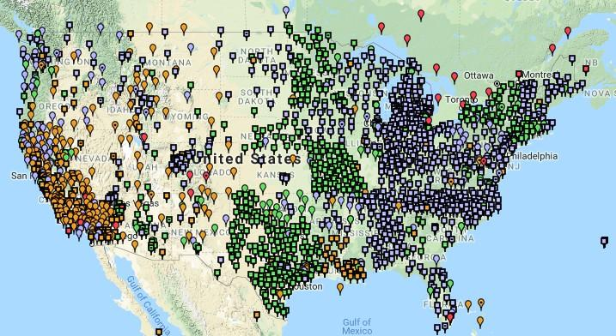
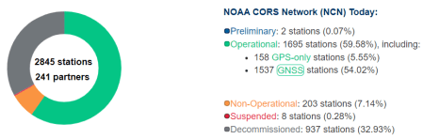
NCN - NOAA CORS Network
Notes:
What does that mean?
Please don’t think of this as us here at NGS being some pointy-haired semantics. We need to make distinctions about CORS when talking about all this. If you haven’t already realized this, you’ll start to catch on today.

Slide 10
Why design a new file format?
Users have spoken
  You want to be able to submit RT-GNSS data
NGS has researched
  We want to be able to ingest RT-GNSS data
No existing format fit the requirements…

Slide 11
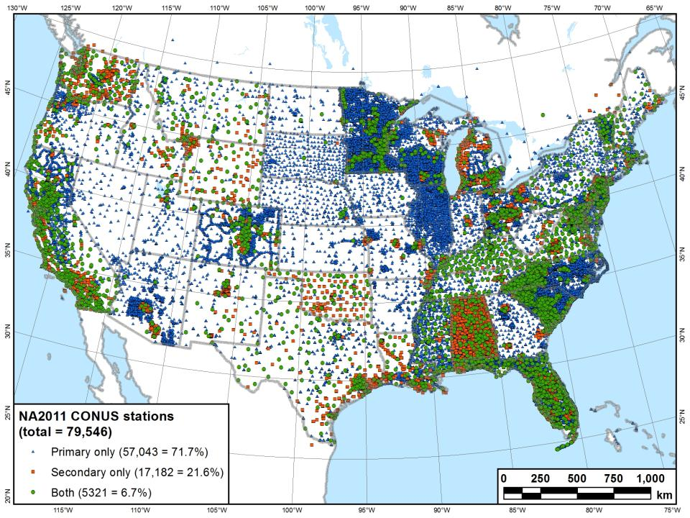
What you see in a map of NSRS control…

Slide 12
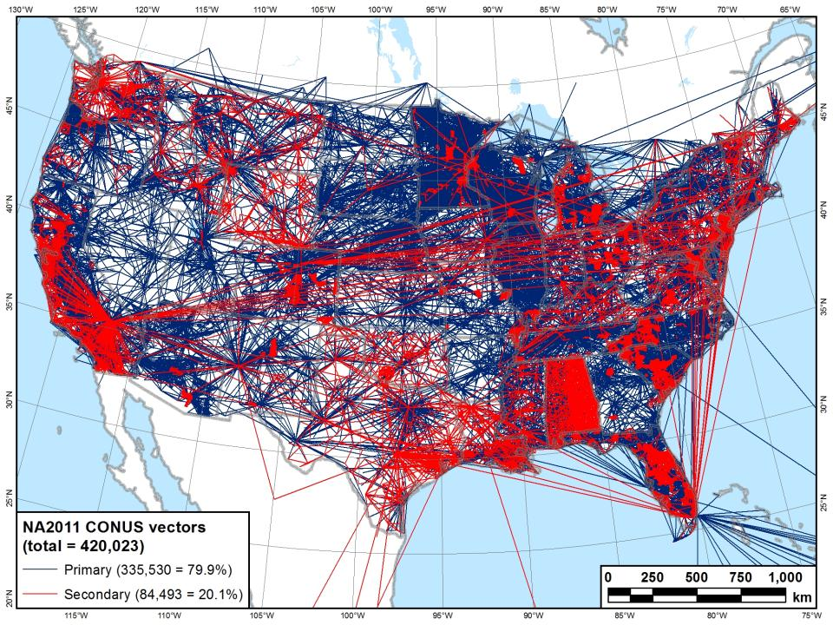
What we see in a map of NSRS control…

Slide 13
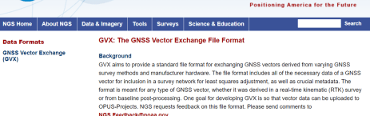
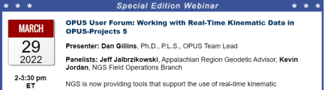
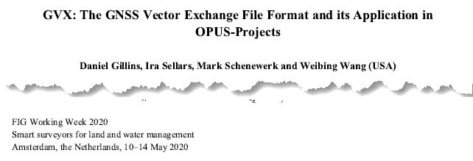
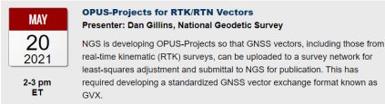
GNSS Vector eXchange (GVX)
Hyperlink to GVX Info Page
Detailed documentation, Schema, and Example File available
Any major search engine: “ngs gvx file format”
Open standard for anyone to use or integrate
GVX is sort of like… RINEX for RTK/RTN data
GVX details?
Check out:

Slide 14
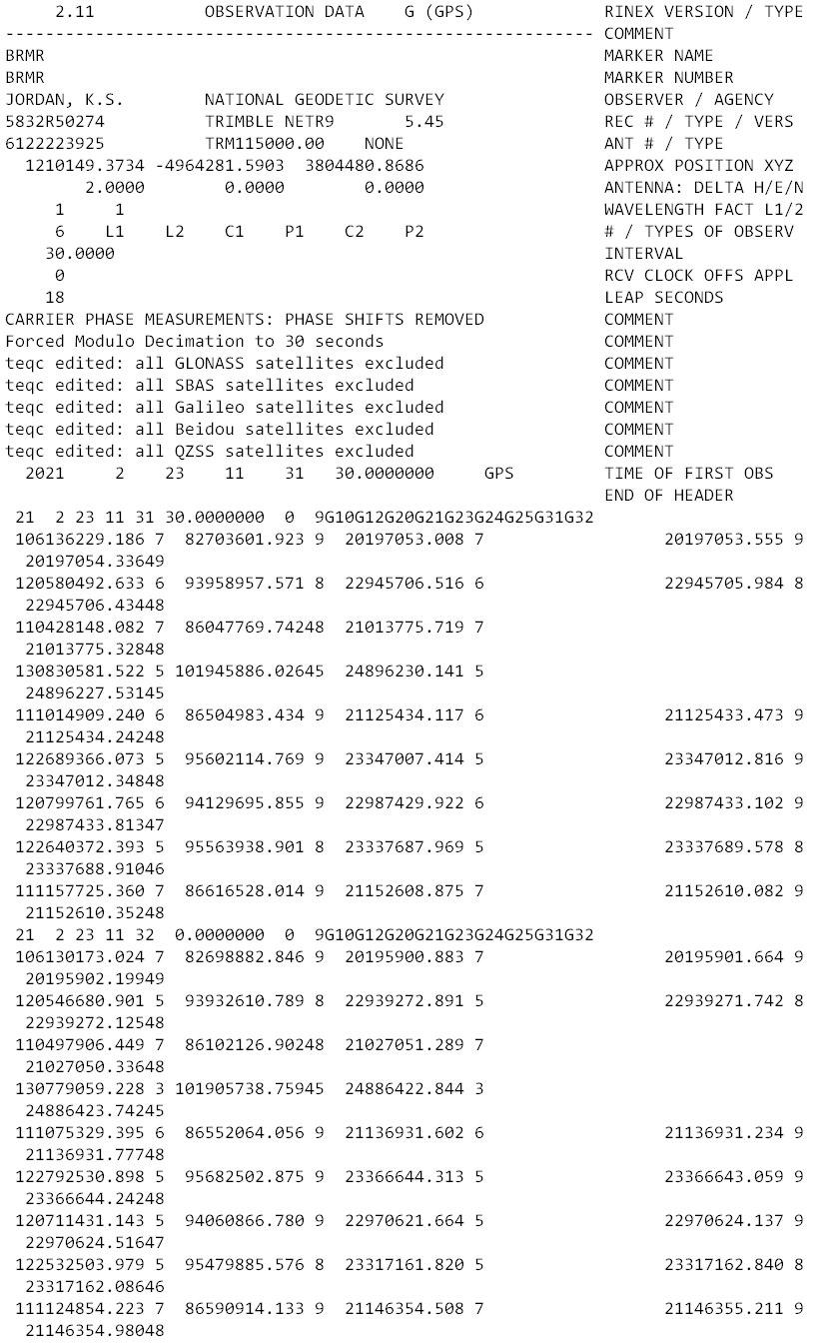
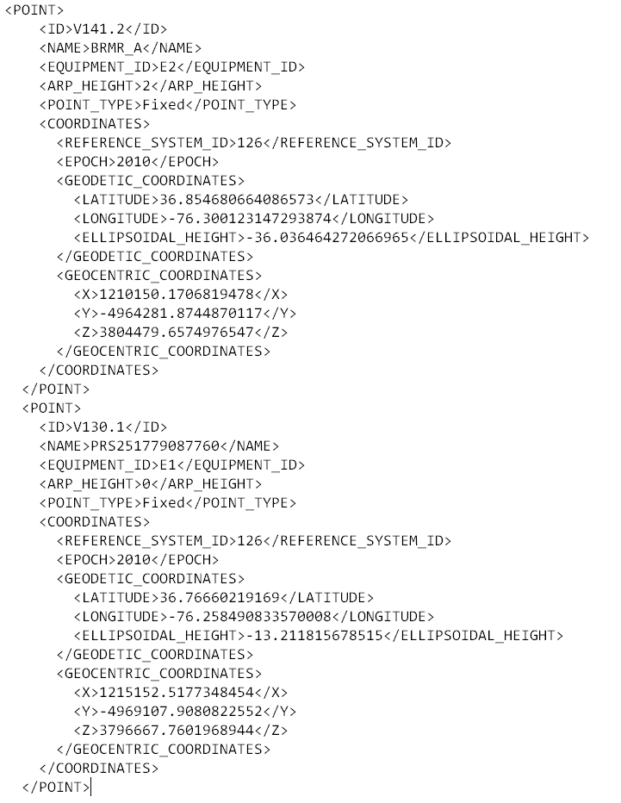
GVX ≈ RINEX for RTK/RTN data
RINEX
GVX

Slide 15
GVX ≈ RINEX for RTK/RTN data
RINEX
GVX
Uncorrected Observations
That’s why we post-process them
Static Observations
One observation per file
Proprietary Format → Open Standard
Export RINEX using your COTS software
Metadata
Antenna, Rx, HI, Point Name, Start Time, SVs at each epoch
Based on ASCII Text File Format
Longtime industry standard
  Way too many to list!
Corrected/Processed Positions
And the Vectors used to create them
RTN, RTK, PP Static, even PPK
Many observations, any mix of above
Proprietary Format → Open Standard
Export GVX using your COTS software
Metadata - same as RINEX, plus…
Project Info, Solution Types, PDOP, Mount Points, Correlation Matrices, QC data
Based on XML File Format
Longtime industry standard
  e.g. LandXML, JXL, MAXML, KML/KMZ

Slide 16



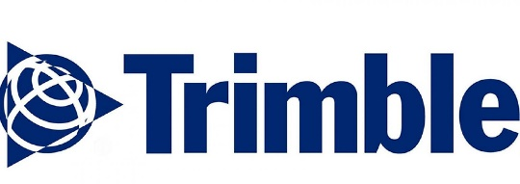



How can I get my data into GVX?
Carlson
Emlid
iGage
JAVAD (J-field)
Leica (Infinity)
Topcon (MAGNET Field & Office)
Trimble (TBC & Access)
These are the companies we are aware of who have implemented GVX or have said that they are working on it.
Please reach out to your tech support POCs if you want GVX.
NGS will work with any company that reaches out with questions.
Notes:
-Please note that this information here can only reflect what we know. If you are a developer working on incorporating GVX into your software… reach out to us! We would be happy to assist you, just as we have assisted some of our other commercial partners named here.
-What would make us happiest is if the list got so long we couldn’t fit in on this slide.
-Oh, and hey, you customers out there… express your desire for GVX to your suppliers/dealers or Support team

Slide 17
GVX Scenarios in OPUS Projects
CORS + RTN
  CORS are not in NCN
  CORS are not in NCN but are in IDB (have PID/Datasheet)
  CORS are in NCN
Static Base + RTK
  Base (positioned via OPUS) sending RTK corrections to rover
Static Post-Processed
  Corrected positions determined with your software
  Results (vectors and points) exported to GVX
Any network method is compatible (e.g. VRS, MAC, FKP)
Notes:
-What makes the difference is that depending on which network station(s) were used in your survey, you will encounter one or more of these scenarios.

Slide 18
GVX Scenarios in OPUS Projects
What’s the difference?
Your workflows in OPUS Projects.
What’s the same?
Your workflows in the field.

Slide 19
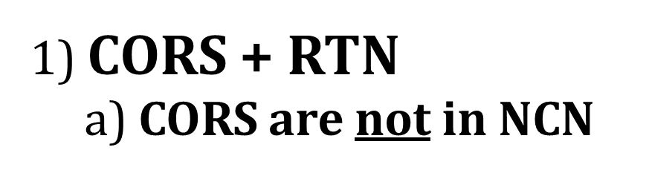

Slide 20
1) CORS + RTN a) CORS are not in NCN
Collect field data with Rover(s)
Download non-NCN CORS data
  From your network provider
Upload WinDesc files
Upload non-NCN CORS data to OPUS Projects
  Using OPUS Static and Project ID
Create GVX in your software and upload it
Session Processing
  Aligns your CORS (RTN Base) to NCN
Network Adjustment
  Constrain to NCN CORS
Notes:
Some of you may be thinking though… what does this even mean that the CORS are not in the NCN?
Let’s look at the example of the WVDOT’s Real Time Network

Slide 21
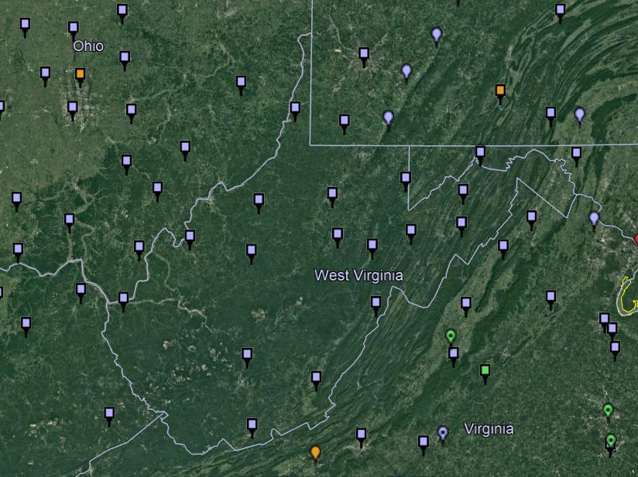
NOAA CORS Network (NCN) in WV

Slide 22
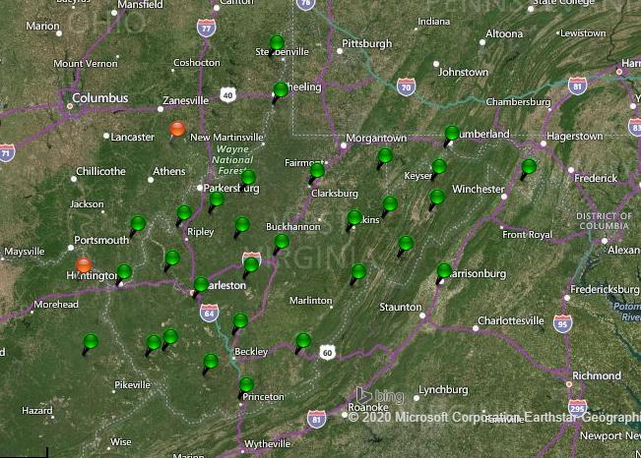
WVDOT CORS Network (and RTN)
Notes:
Just for the sake of discussion, I will point out that the WVDOT’s real time network is based on VRS method

Slide 23
NOAA CORS Network (NCN) in WV

Slide 24
WVDOT CORS Network (and RTN)
non-NCN CORS
Notes:
And now by me flipping back and forth between these, you’ve likely caught on that the stations in red are non-NCN CORS

Slide 25
1) CORS + RTN
a) CORS are not in NCN
Network users typically have access to non-NCN CORS data
  Sometimes called the “Reference Data Shop”
Some network providers do not provide long-term user access
  Anywhere from just 45 days to 365 days
Investigate this during Project Planning
  If non-NCN CORS data is not available…
    NGS cannot help with that
    Contact your network provider for possible access to their archived data
Download non-NCN CORS data
  From your network provider

Slide 26
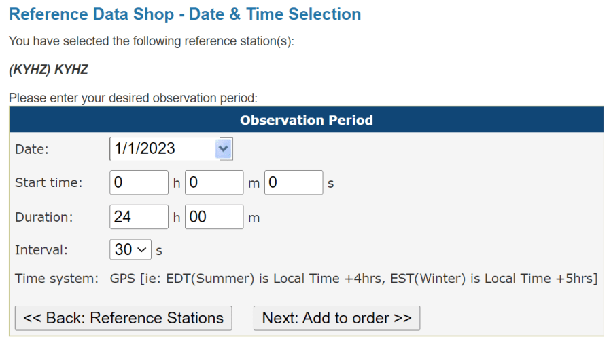
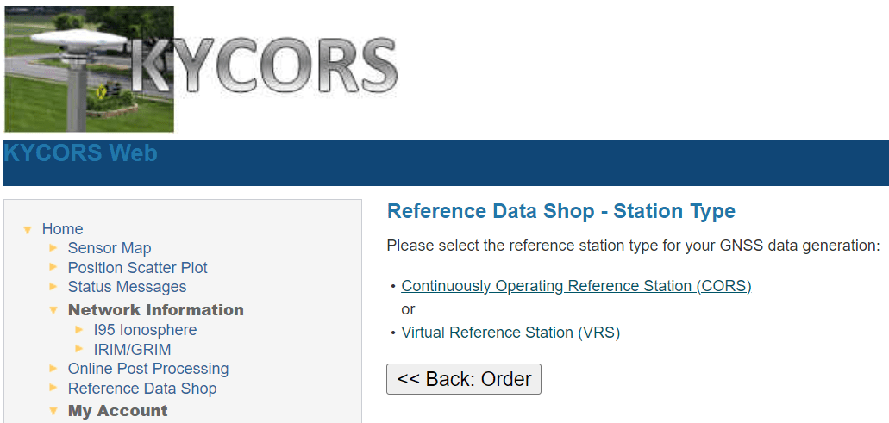
1) CORS + RTN
a) CORS are not in NCN
Notes:
Now we’re looking here not at the WVDOT but the Kentucky Transportation Cabinet network.
This is their web interface, and if I wanted to download some non-NCN CORS data from their network, I’d go into the Reference Data Shop.
For many of the networks, you’ll see both a CORS and a VRS option.
What you want is the CORS data, and the interface will walk thru the rest of the options, you’ll be asked which station(s) you want data from, for date(s), observation interval (HINT… 30 seconds for OPUS!)

Slide 27
1) CORS + RTN
a) CORS are not in NCN
Think of this as…
Your GVX will have the CORS-Rover vectors, but non-NCN CORS.
You are tying to the NCN by way of a CORS-CORS vector via OPUS Static.

Slide 28
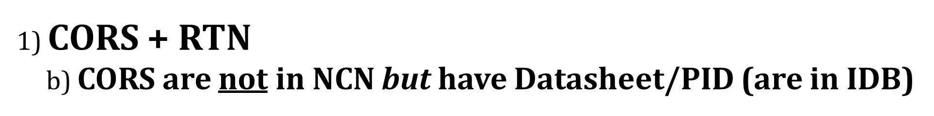

Slide 29
1) CORS + RTN b) CORS are not in NCN but have Datasheet/PID (are in IDB)
Collect field data with Rover(s)
Download non-NCN CORS data
  From your network provider
Upload WinDesc files
Upload non-NCN CORS data to OPUS Projects
  Using OPUS Static and Project ID
Create GVX in your software and upload it
Session Processing
  Aligns your CORS (RTN Base) to NCN
Network Adjustment
  Select Constraints (NCN or non-NCN CORS Datasheet)

Slide 30
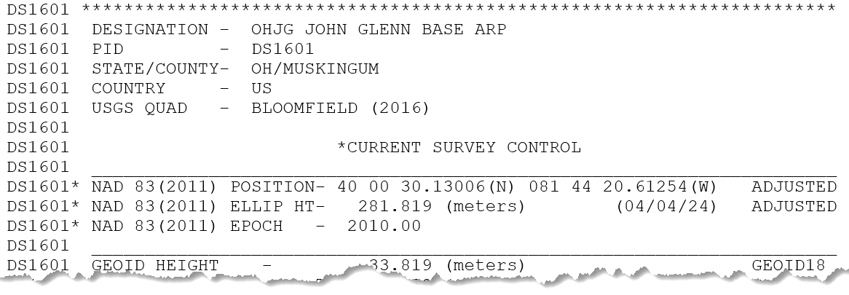
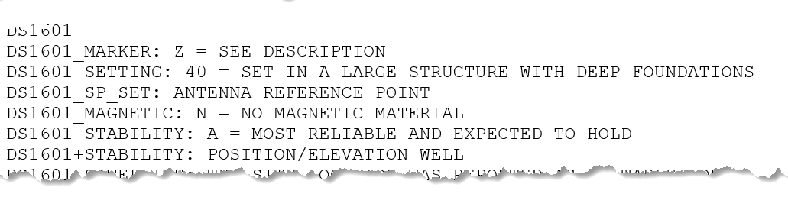
1) CORS + RTN
b) CORS are not in NCN but have Datasheet/PID (are in IDB)
What does that look like?
How do I know?
Consult the NGS Map
and Datasheet
IDB = Intergrated DataBase

Slide 31
1) CORS + RTN b) CORS are not in NCN but have Datasheet/PID (are in IDB)
Think of this as…
Same as previous, but with convenient NSRS constraints available.

Slide 32
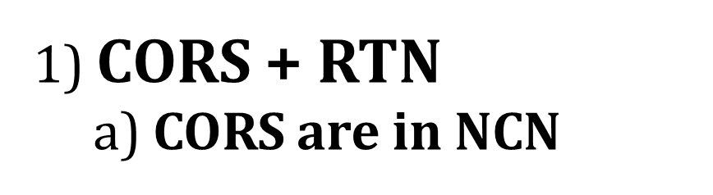

Slide 33
1) CORS + RTN
a) CORS are in NCN
Collect field data with Rover(s)
Create GVX in your software
  Using your field or office software
Upload WinDesc files
Upload GVX to OPUS Projects
  Using OPUS Static and Project ID
  Vectors are automatically linked to NCN CORS
Network Adjustment
    Constrain NCN CORS

Slide 34
1) CORS + RTN
a) CORS are in NCN
Think of this as…
Direct tie to the NSRS via active control.
No need to perform post-processing, only any Network Adjustments.

Slide 35
CORS + RTN
Regardless of CORS used, whether NCN or non-NCN…
If RTN uses Trimble® VRS™ method, you must log vectors
  VRS = Virtual Reference Station
For GVX to work in OP, vectors must be tied to a PRS/PBS
  PRS = Physical Reference Station
  PBS = Physical Base Station
Should not be a concern for MAC or FKP methods
  Vectors will be tied to PRS/PBS by default
No vectors = No GVX = No OPUS Projects

Slide 36
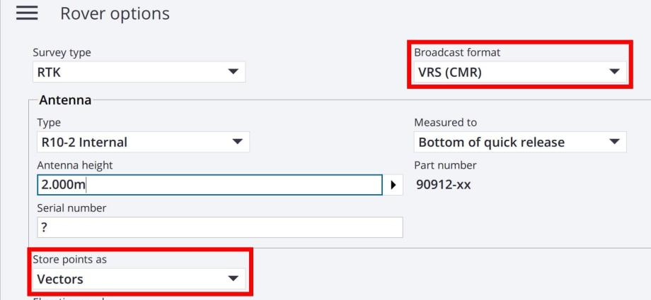
CORS + RTN
Regardless of CORS used, whether NCN or non-NCN…
If RTN uses Trimble® VRS™ method, you must log vectors
GNSS Vector eXchange with VRS means you must:
Store points as Vectors

Slide 37
2) Static Base + RTK
- Base (positioned via OPUS) sending corrections to Rover
Setup Base
  Must log data during all Rover occupations
Collect field data with Rover(s)
Upload WinDesc files
Upload Base data to OPUS Projects
  Using OPUS Static and Project ID
Create GVX in your software and upload it
Session Processing
  Aligns your Base to NCN
Network Adjustment
  Constrain to NCN CORS

Slide 38
CORS + RTN for GPSonBM
Regardless of CORS used, whether NCN or non-NCN…
Minimum of 5 minutes mark occupation time
Total of 3 independent occupations
Must agree by 3 cm Horizontal and 5 cm Ellipsoid Height
Must be separated by at least 3 hours
  Yes, even if occupied on different days
Your marks will be included in the NGS IDB → Datasheets
  So long as you results meet requirements and all metadata is included

Slide 39
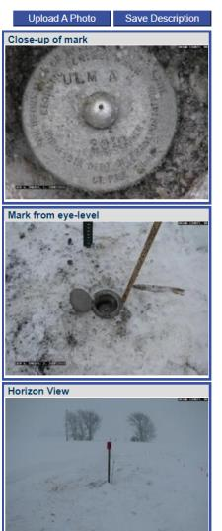
Required Metadata for GVXonBM
WinDesc Files → 1 each of .dsc, .des, .err, .dis, .nbr
  Yes, for the foreseeable future you will need to download, install, and learn how to use WinDesc
3 photos per mark → uploaded to Marks Pages
  close-up
  downward from eye-level
  horizon/setup
Project Report (PDF)
Observation Logs (single PDF)

Slide 40
Closing Thoughts
Redundancy is Your Friend
  Whether Static or Real-Time GNSS data collection, your “total time on mark” is the key to accuracy (not longer necessarily occupations)
Soon to be finalized document will provide updated standards
  NOAA Technical Memorandum NOS NGS 92 - Classifications, Standards, and Specifications for GNSS Geodetic Control Surveys using OPUS Projects
    Currently in draft status
    April 2023 Monthly Webinar by Dave Zenk

Slide 41

Closing
RTK/RTN is now an option, not a requirement
Redundancy is your friend
Surveying is still surveying
Notes:
Just because OP opens the door to RTK/RTN, doesn’t mean it is required
Surveying is still surveying

