Slide 1
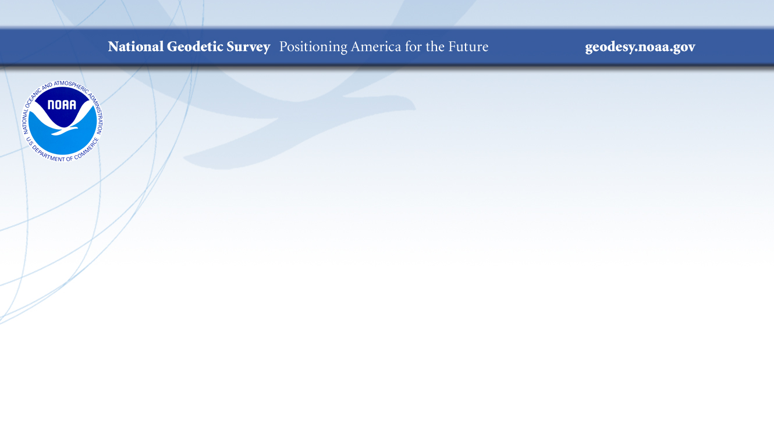
NOAA’s National Geodetic Survey Webinar Series
Web Maps and Online Tools:
The Latest Updates From NGS
Brian Shaw
brian.shaw@noaa.gov
Jay Howard
jay.howard@noaa.gov
August 15, 2024

Slide 2

Presentation Outline
Alpha SPCS2022 Experience
Calibration Baselines (CBL) Web Map
Beta NGS NCN Station Pages
DSWorld Web
NGS Map
Feature Services and Views
Passive Marks Page
Leveling Projects Page
Datasheet shape files

Slide 3
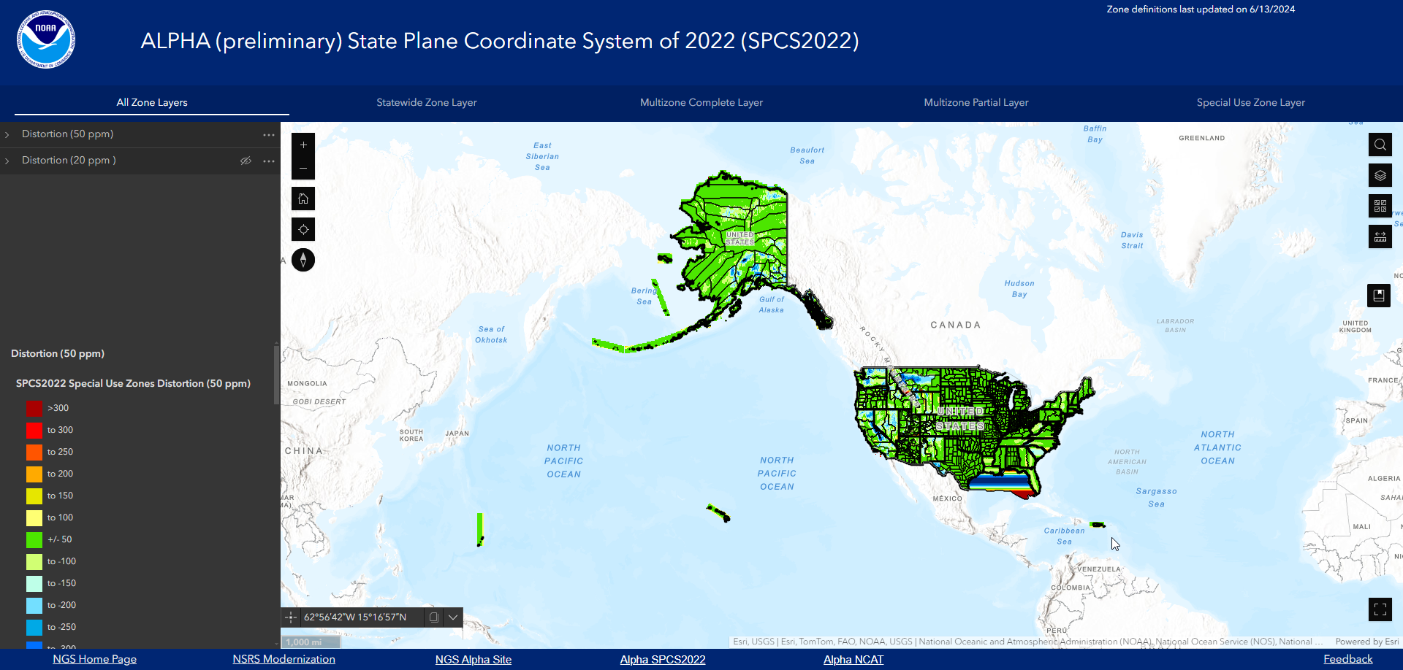
Alpha SPCS2022 Experience
Alpha SPCS2022 Experience

Slide 4
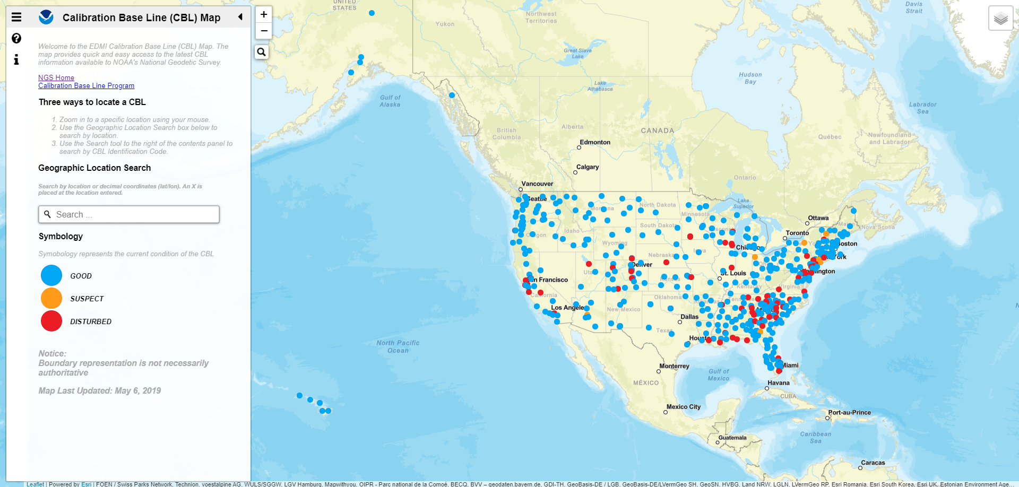
Calibration Baselines (CBL) Web Map
Calibration Baselines (CBL) Web Map

Slide 5
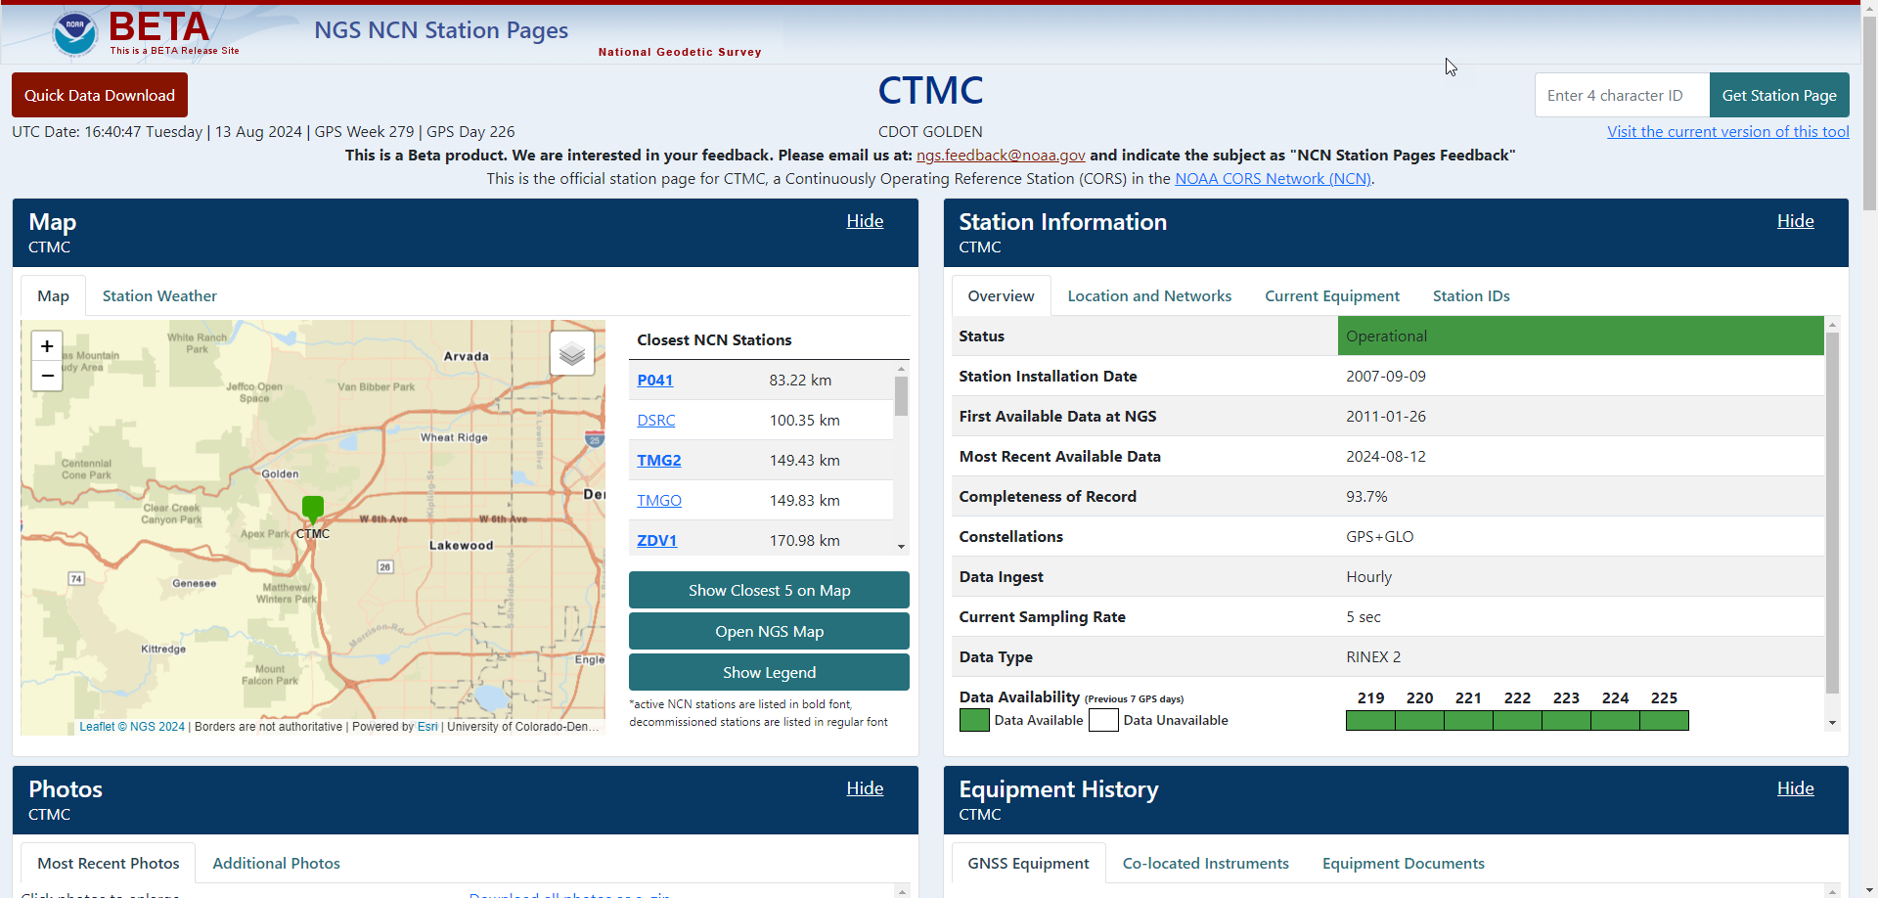
Beta NGS NCN Station Pages
Beta NGS NCN Station Pages

Slide 6
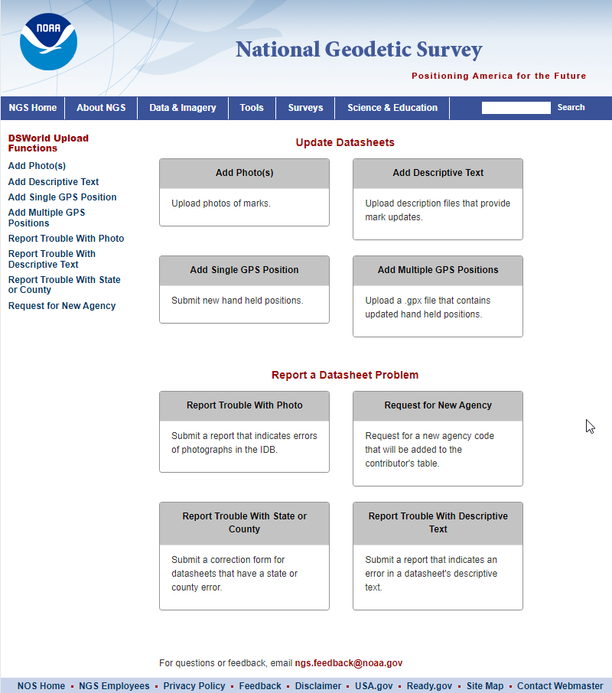
DSWorld Web
DSWorld Web

Slide 7
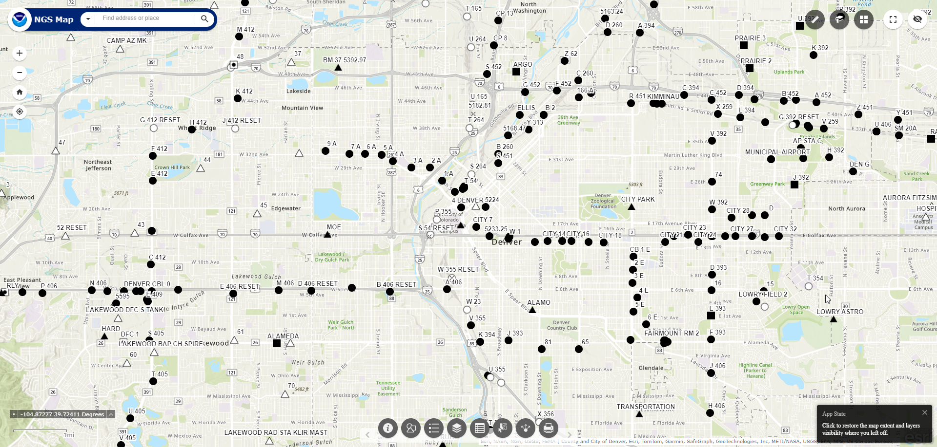
NGS Map
NGS Map

Slide 8
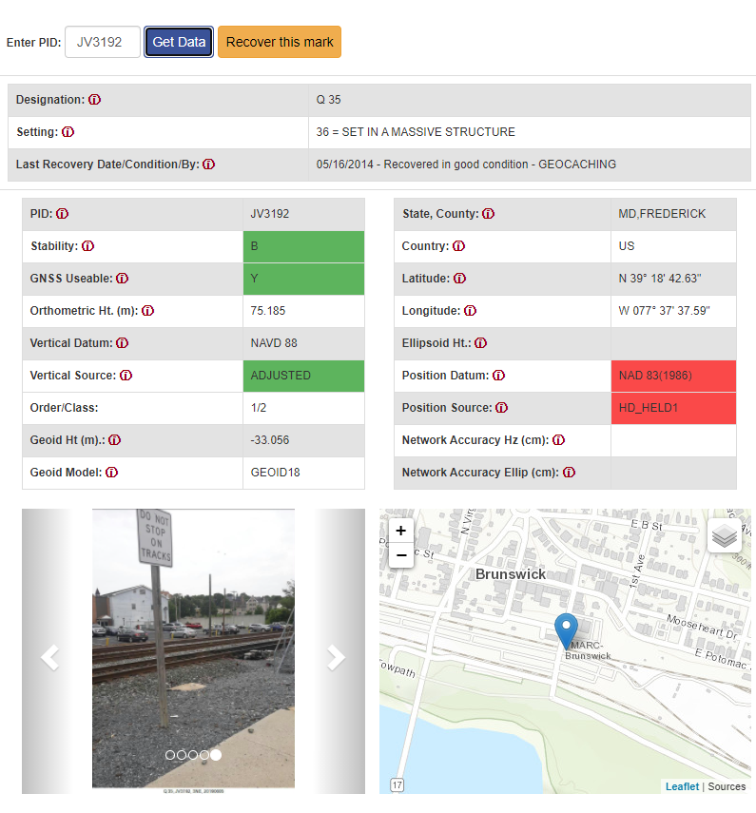
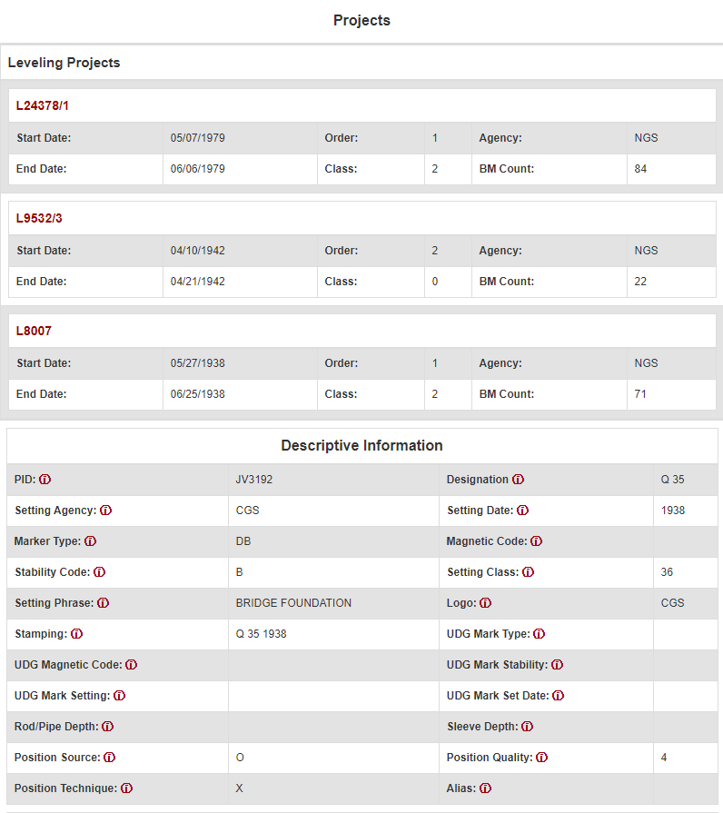
Passive Marks Page
Passive Marks Page

Slide 9
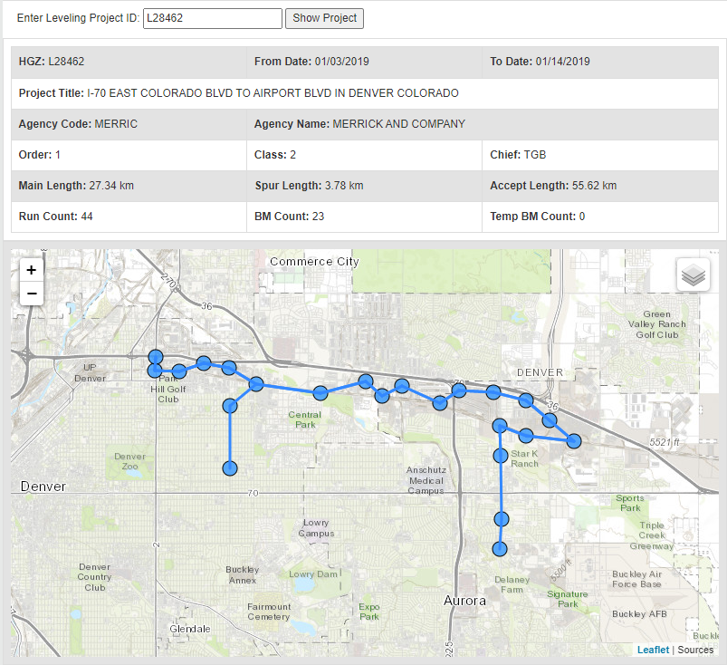
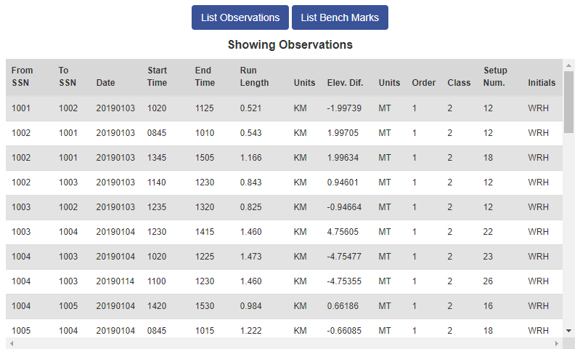
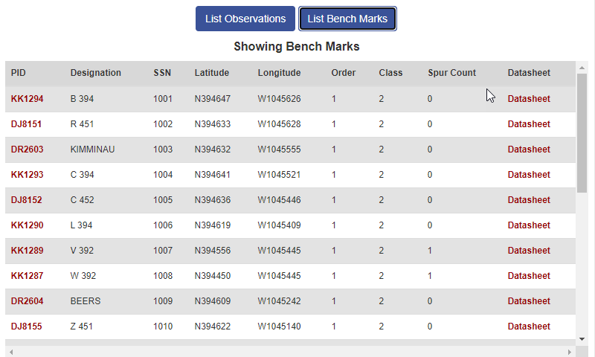
Leveling Projects Page
Leveling Projects Page

Slide 10
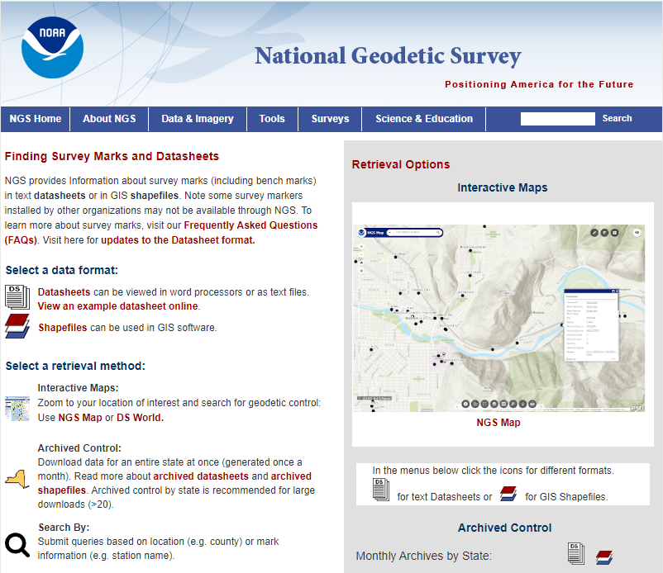
Datasheet shape files
Datasheet shape files

Slide 11
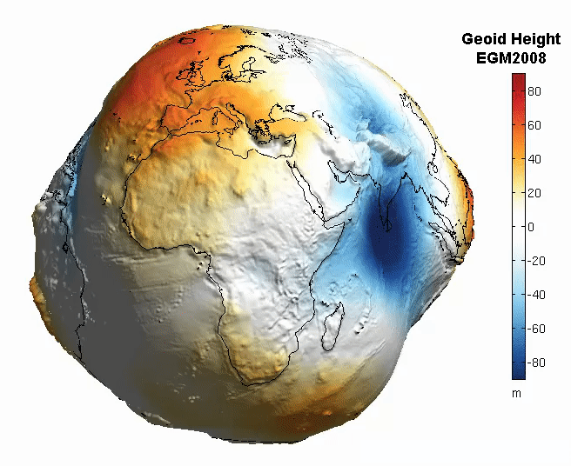
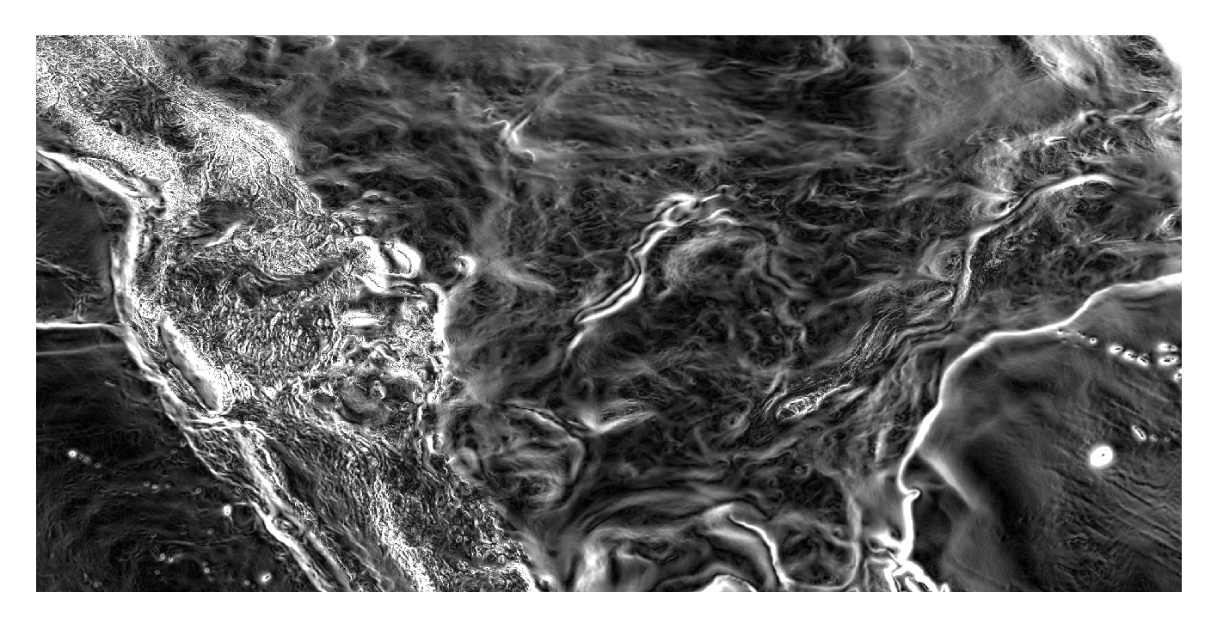
Magnitude of the Deflection of the Vertical
Questions?
Brian Shaw
brian.shaw@noaa.gov
Jay Howard
jay.howard@noaa.gov

