Slide 1

State Plane Coordinate System
Making Earth Flat… One Zone at a Time!
WV GeoCon
May 2024
Jeff Jalbrzikowski, P.S., GISP, CFS
Appalachian Regional Geodetic Advisor
jeff.jalbrzikowski@noaa.gov
240-988-5486

Slide 2



Organizational Structure
  -Department of Commerce (DoC)
  (~47,000 employees)
  -National Oceanic and Atmospheric Administration (NOAA)
  -National Ocean Service (NOS)
  -National Geodetic Survey (NGS)
  (~175 employees)
Notes:
-We are the Federal Government’s oldest scientific agency.
-part of the Executive Branch
-I know it can seem kind of strange that NGS is part of the NOS, but the origins of NGS lie with the C&GS.
-we are a “Program Office” of the NOS
Survey of the Coast – 1807
Coast Survey – 1836
Coast and Geodetic Survey – 1878
NGS since 1970

Slide 3


Organizational Structure
We’re not USGS, we’re NGS
  -Department of Commerce (DoC)
  (~47,000 employees)
  -National Oceanic and Atmospheric Administration (NOAA)
  -National Ocean Service (NOS)
  -National Geodetic Survey (NGS)
  (~175 employees)
≠
Notes:
-as you can read my slide, I like to point that out because over my 2 years at NGS I’ve seen and heard this misunderstanding quite a bit
-don’t worry! it doesn’t offend us! and we do work closely with USGS, but we are separate agencies within totally different departments of the federal government

Slide 4
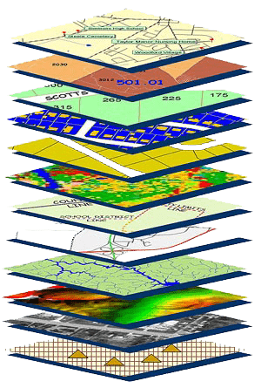
NGS Mission
To define, maintain and provide access to the National Spatial Reference System (NSRS) to meet our Nation’s economic, social, and environmental needs.
NSRS
Notes:
NGS develops and maintains the National Spatial Reference System, a national coordinate system that provides the foundation for transportation, navigation, land record systems, mapping and charting efforts, and a multitude of scientific and engineering applications
CLICK
You’ve all seen this or some similar graphic I’m sure. That bottom layer… that’s our baby, the NSRS.

Slide 5
Modernizing the NSRS
Updating all NSRS coordinates
  Replace existing datums with new datums
  Replacing existing SPCS83 with new SPCS2022
  Accounting for coordinates changing with time
Improving NGS products and services
Simplifying customer contributions
Making the NSRS:
  More accurate
  More accessible
  More efficient
begins
Rollout in
2025

Slide 6
What’s going to stay the same?
  NSRS Modernization
What’s going to be different?
Notes:
-so you’ve probably seen that phrase that I have front and center here, NSRS Modernization
-that’s the blanket term we use to refer to not just the new datums but other updates

Slide 7
National Spatial Reference System
A common and consistent geospatial framework to meet the economic, social, and environmental positioning needs of our Nation.
Foundational elements include:
Latitude
Longitude
Height
Gravity
Shoreline Position
…how these change over time
Horizontal Datums | Vertical Datums
NAD83 | NAVD88
NAD27 | NGVD29
Elevation
Great Lakes Datums | Geoid Models
IGLD85 | GEOID18
IGLD55 | GEOID12B
Notes:
The primary mission of NGS is, “to define, maintain, and provide access to the NSRS to meet our nations economic, social, and environmental needs”.
NSRS is a consistent geospatial framework, common to all Federal agencies and other users
NSRS supports informed decision-making for mapping and charting, navigation, flood risk determination, transportation, land management, and more
Elements of NSRS include (but are not limited to): latitude, longitude, elevation, gravity, shoreline position + their changes over time …other elements include scale, earth orientation parameters and others
The vertical component of the NSRS currently utilizes the North American Vertical Datum of 1988 (NAVD88)

Slide 8
Positional Components of
the NSRS
Geometric
aka “Horizontal”
Latitude, Longitude, Ellipsoid Height
Geopotential
aka Orthometric Height
aka “Elevation”
NAD83
NAVD88
Notes:
-geometric component is latitude, longitude, and ellipsoid height
-geopotential component is combined with the geometric components to calculate an ortho height or capital H

Slide 9
North American Datum
of 1983
NAD83
will be replaced by

Slide 10
North American Terrestrial Reference Frame of 2022
NATRF2022
(pronounced: nat-ref)

Slide 11
Terrestrial Reference Frame?
Existing, accepted terminology
  International TRF
  first realization of the ITRF was 1992
  NATRF2022 will be based on ITRF2020
Horizontal Datum – misnomer for NAD83
Notes:
-Where do you see an Epoch right now in NGS data?
CLICK
Datasheets! there you see the epoch of 2010.0
and of course OPUS Solution Reports!
note that in blue over there on the right you’ll see another epoch, in the ITRF, which I will explain later on

Slide 12
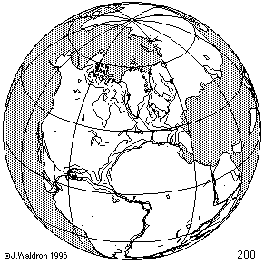
ITRF concept
Watch the grid!
Drift…
Epoch:
Notes:
Ok, now ITRF mentioned a couple slides ago.
Most simplistic way to explain ITRF is to watch this animation.
This is a very loose representation/visualization of what the ITRF is, a characterization only.

Slide 13
Plate-Fixed NSRS TRFs
ITRF
Frame = constant
NA Plate = rotating
NATRF
Frame = rotating
(relative to ITRF)
NA Plate = constant
(relative to NATRF2022)
Notes:
We say “NATRF2022” is “fixed” to the N.A. Plate, making it a “plate fixed” frame
-the frame is constant to itself, but rotating within ITRF, and moving in a different direction than the other 3 frames

Slide 14
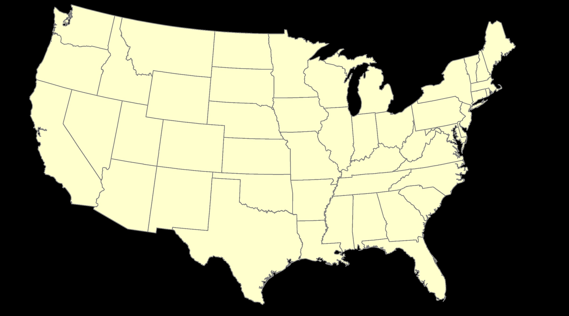
ITRF – constant frame, rotating plate

Slide 15
Plate-Fixed
NATRF – rotating frame, constant with plate

Slide 16
if you know epoch
ITRF or NATRF – your choice if you know epoch

Slide 17
Terminology - Changing Coordinates
Conversion
    change the type of coordinate
    NAD83(2011) latitude & longitude → NAD83(2011) SPCS
  Transformation
    change the datum of coordinate
    NGVD29 height → NAVD88 height
    NAD 27 latitude & longitude → NAD 83(2011) latitude & longitude
Propagation
    change the epoch of coordinate
    NATRF2022 epoch 2020.00 to NATRF2022 epoch 2023.243
Notes:
Historically NGS has been inconsistent with these top two words.
Going forward, we will use them as:
Conversion: Meaning to change the type of coordinate without changing the datum or frame
Transformation: Meaning to change the datum or frame, without changing the type of coordinate

Slide 18
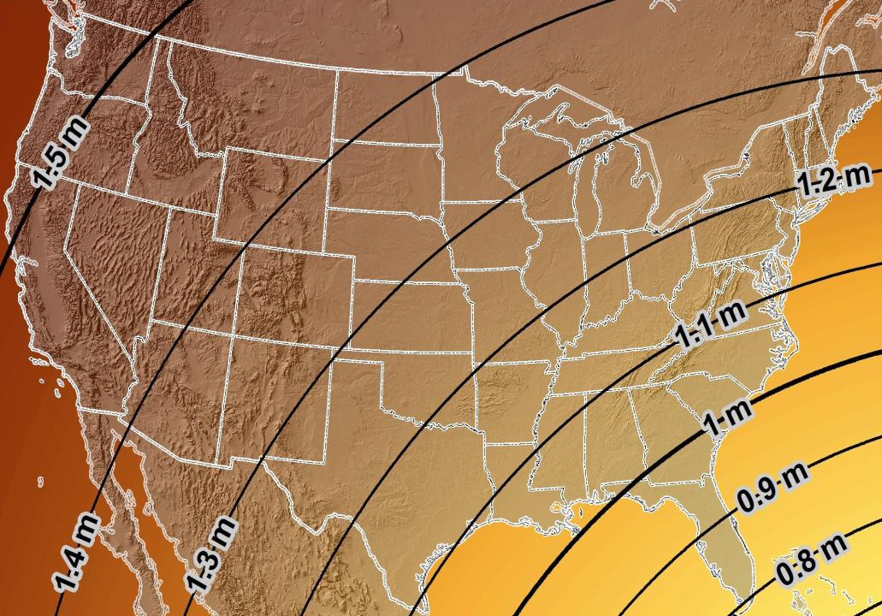
Estimated Geometric Change - Horizontal
NAD83 (2011) → NATRF2022
4.6 ft
Direction of Shift
4.3 ft
3.9 ft
3.6 ft
3.0 ft
Notes:
What’s the magnitude of the horizontal datum shift across Pennsylvania?
Minimum Shift ~3.75 feet
Maximum Shift ~3.97
Remember this is just an estimation, don’t hold me to the numbers please

Slide 19
Remember…
  What’s the goal of NATRF2022?
    Give you the stability in positions that you expect
  That’s the point of Reference Epochs (REs)
    Akin to the different realizations of NAD83
    REs will be published every 5 or 10 years
      you choose when you update
      we expect many users will adopt our first Reference Epoch Coordinates (RECs), then stay there long term
aka versions
Notes:
REs will be published every 5 or 10 years
-you choose when you update
-in a perfect world, everyone would stay current, but we expect many users will adopt first RE and stay ther

Slide 20
Preparing for New Datums
  Two factors will dictate your frequency of coordinate updates
    Your accuracy needs
    The region you work in → tectonic motion
      Do manholes need cm-level updates annually?
      We accommodate that… you choose
      Just because we’re chasing the millimeter… it doesn’t mean you need to.
Notes:
What’s the goal of the way NATRF2022 was designed, by including EPP2022 and IFVM2022
For a database of features in PA
Does a database of manholes in PA need cm-level coordinate updates on an annual basis? Probably not.

Slide 21
Preparing for New Datums
  Know the epoch of your data/datasets
    consider how you will track this
      full to-the-second timestamp on every feature?
      labeling a year for each dataset?
      something in-between that works for your needs?

Slide 22
Preparing for New Datums
  Reprocessing your data
    in a perfect world, everyone would reprocess
      What does this really mean?
        consider a hydro-enforced DEM
          start over with the raw flight data (GNSS/IMU)
          generate new point clouds
          recreate all the drainage features in new datum
      Unrealistic for vast majority
Notes:
this is totally unrealistic → both from a financial and programmatic perspective

Slide 23

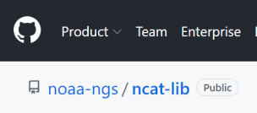
Preparing for New Datums
  Transforming your data
    NGS Coordinate Conversion and Transformation Tool
      ASCII up/download, Web Services, or Download
      Source code on GitHub → github.com/noaa-ngs
      ask your software provider(s) about integration
        we envision COTS integrations as most popular method of access
Notes:
Transforming your data
NCAT - NGS Coordinate Conversion and Transformation Tool
available now: ASCII upload and Web Services
ask your software providers about integration
we envision this as most popular method of access
Industry Workshops - May 2021 and August 2022
-Esri, Trimble, Blue Marble, etc… all the well known names attended
Geospatial Software Developers’ Summit – Nov/Dec
- International & Virtual → US NGS and NRCan CGS

Slide 24
NCAT will allow you to propagate new field data from
Survey Epoch to Reference Epoch

Slide 25
New Lat/Long = New XY
With a new horizontal datum…
  NAD 83 to be replaced by NATRF2022
There comes a new set of State Plane Coordinate System zones
  SPCS 83 to be replaced by SPCS2022

Slide 26

A “flat” Earth for the future
State Plane Coordinate System of 2022 (SPCS2022)
Similar to existing State Plane…
  Same 3 map projection types
  Same ellipsoid (GRS 80)
But different…
  Based on new datums instead of NAD 83
  Designed to reduce difference between “grid” and “ground”
  Many more “zones”
  Zones “layers” will exist in most states
Lambert Conformal Conic (LCC)
Transverse Mercator (TM)
Oblique Mercator (OM)

Slide 27
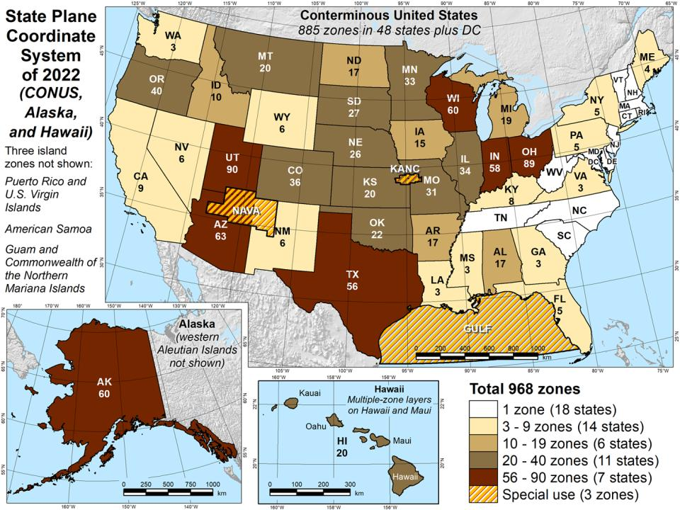

Slide 28
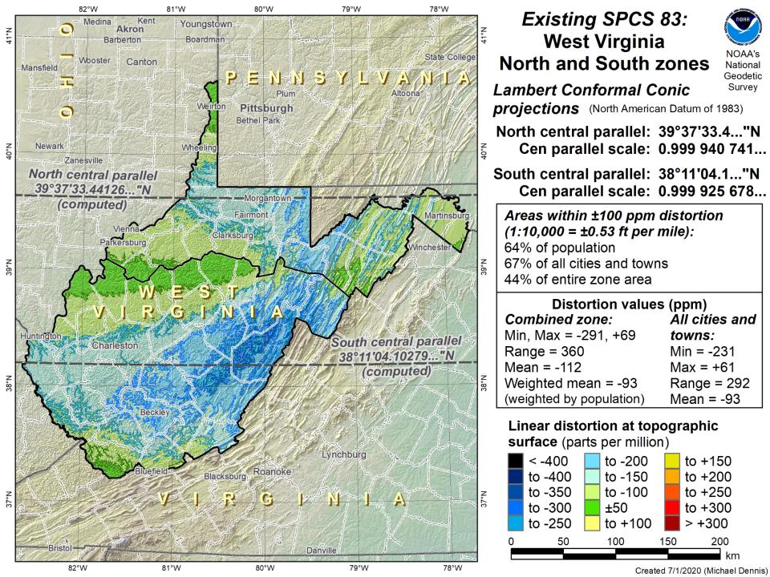

Slide 29
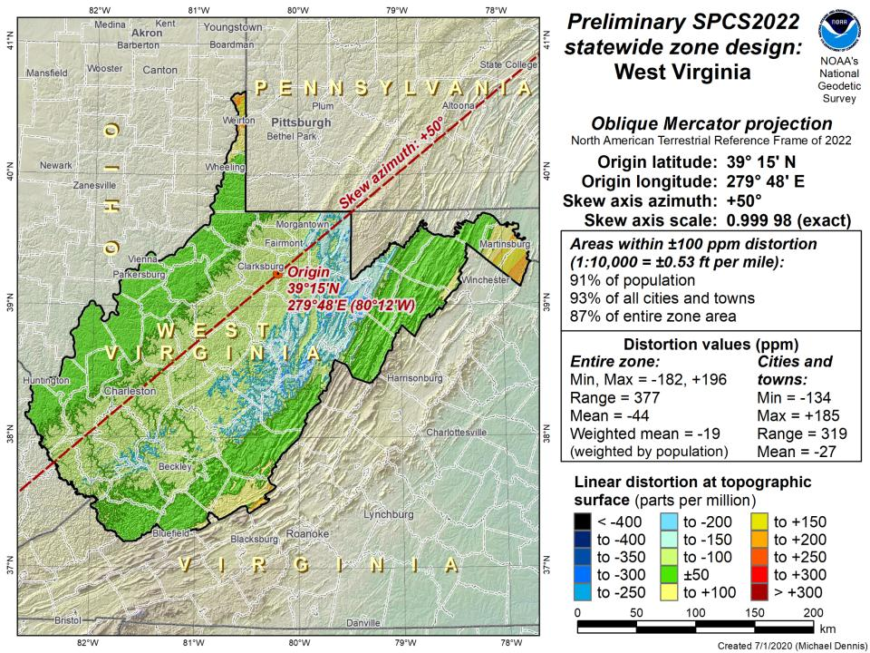
Northings are still North
Eastings are still East

Slide 30
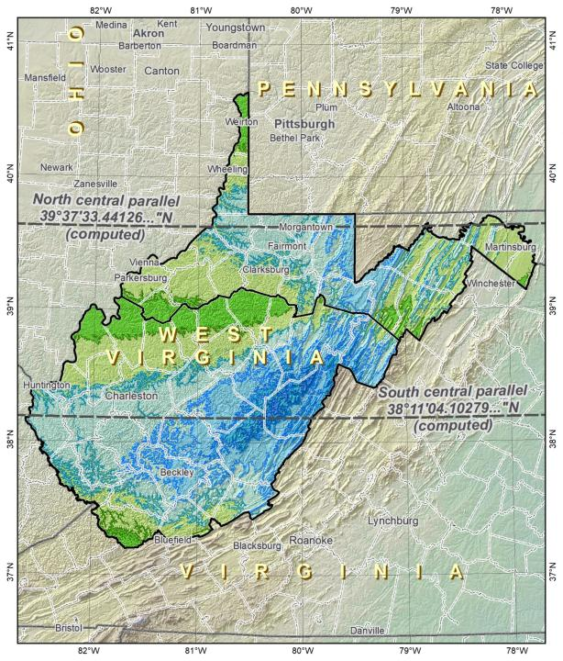
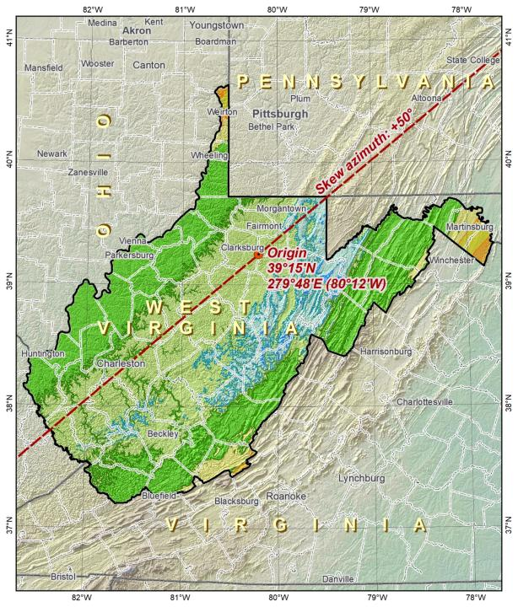
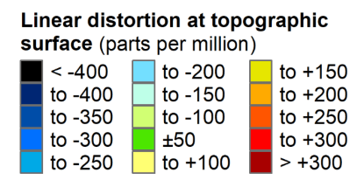
SPCS83
SPCS2022

Slide 31
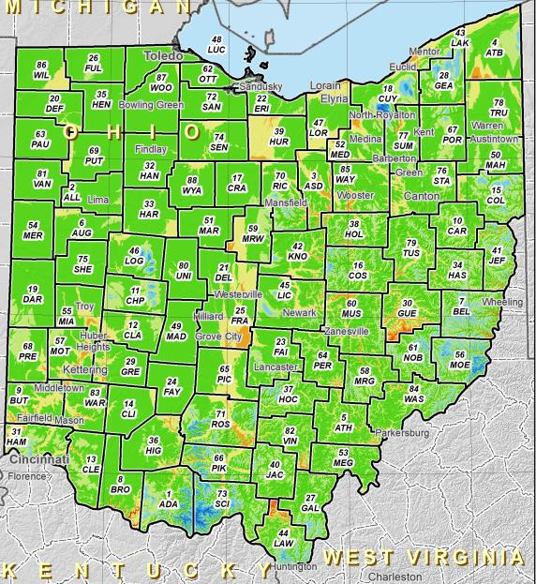
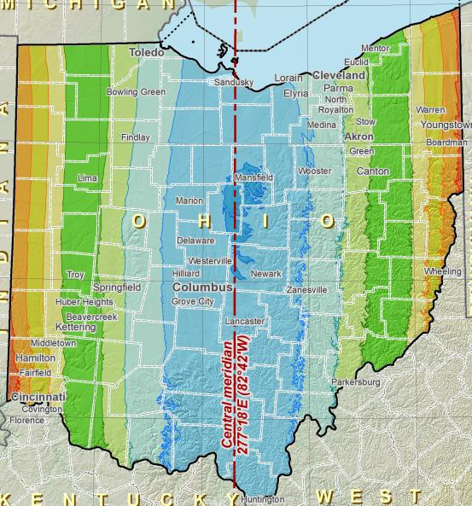
SPCS2022 Zone Layers in Ohio
Both Single Statewide and Multi-Zone Layers will coexist
Think about your data, your goals, your customers
  Remember that geographic coordinates are your friend!
Smaller zones not “the best” … it all depends on usage & goals

Slide 32
The Survey Foot is dead!
Long live the Survey Foot!
US Survey Foot was deprecated 31 December 2022…
But will always be available in NGS tools for NAD83 and NAD27
Notes:
We start with the SPCS83 zones as a frame of reference
NOTE that the color shading of these zones is matched to that of the Preliminary SPCS2022 Zones that follow

Slide 33
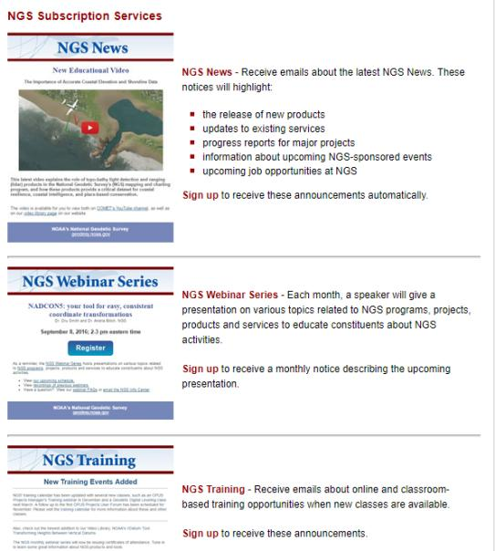

Email Subscriptions
*Only 1-2 messages per month*
NGS News
  Includes quarterly NSRS Modernization newsletter
Webinar Series
Training
GPS on Benchmarks
Click this icon on homepage
Notes:
Stay abreast of any new information coming from us via Email Subscription –
Sign up for notifications about News, webinars, and training opportunities with NGS.
We also use our News subscription list to send out our quarterly NSRS Modernization Newsletter.

Slide 34

Jeff Jalbrzikowski, P.S., GISP, CFS
Appalachian Regional Geodetic Advisor
jeff.jalbrzikowski@noaa.gov
240-988-5486
https://www.ngs.noaa.gov/ADVISORS/
or search: “NGS advisors”
Scan the QR code to save my contact info to your phone

