Slide 1

NSRS Modernization An Update from NGS
CEC Geospatial Summit
March 2024
Jeff Jalbrzikowski, P.S., GISP, CFS
Appalachian Regional Geodetic Advisor
jeff.jalbrzikowski@noaa.gov
240-988-5486

Slide 2
Any references to any commercially available hardware or software do not constitute an endorsement or a disapproval of any manufacturers, developers, dealers, or suppliers.
Thanks.

Slide 3



Organizational Structure
-Department of Commerce (DoC)
(~47,000 employees)
-National Oceanic and Atmospheric Administration (NOAA)
-National Ocean Service (NOS)
-National Geodetic Survey (NGS)
(~175 employees)
Notes:
-We are the Federal Government’s oldest scientific agency.
-part of the Executive Branch
-I know it can seem kind of strange that NGS is part of the NOS, but the origins of NGS lie with the C&GS.
-we are a “Program Office” of the NOS
Survey of the Coast – 1807
Coast Survey – 1836 → in 1871 the agency was tasked by Congress with responsibility to carry geodetic control inland (>150 years)
Coast and Geodetic Survey – 1878
NGS since 1970

Slide 4


Organizational Structure
We’re not USGS, we’re NGS
-Department of Commerce (DoC)
(~47,000 employees)
-National Oceanic and Atmospheric Administration (NOAA)
-National Ocean Service (NOS)
-National Geodetic Survey (NGS)
(~175 employees)
≠

Slide 5
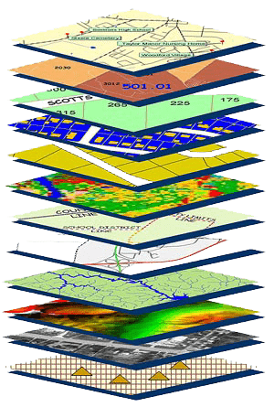
NGS Mission
To define, maintain and provide access to the National Spatial Reference System (NSRS) to meet our Nation’s economic, social, and environmental needs.
NSRS
Notes:
NGS develops and maintains the National Spatial Reference System, a national coordinate system that provides the foundation for transportation, navigation, land record systems, mapping and charting efforts, and a multitude of scientific and engineering applications
CLICK
You’ve all seen this or some similar graphic I’m sure. That bottom layer… that’s our baby, the NSRS.

Slide 6
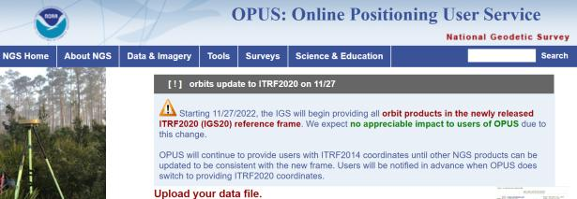
NGS Mission
To define, maintain and provide access to the National Spatial Reference System (NSRS) to meet our Nation’s economic, social, and environmental needs.
access… ? = traditionally → marks/disks/objects
= modern and future → NOAA CORS Network (NCN)
via OPUS
Notes:
Follow up thought
-like it or not, we know that the vast majority of our users are obtaining NSRS coordinates via OPUS
-while that is our plan for the future of primary access, modernized NSRS, as of now the official form of access (specifically to NAVD88) truly is to “touch brass” as they say → meaning occupy a benchmark

Slide 7
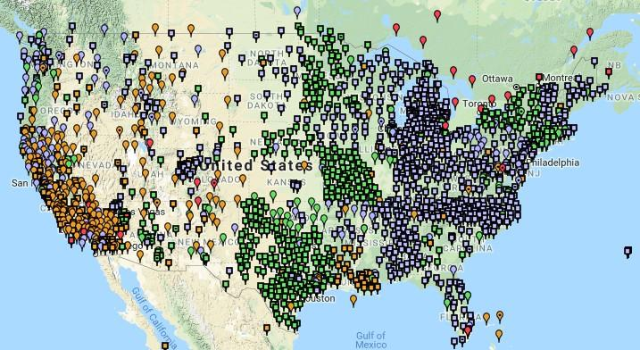
NOAA CORS Network (NCN)
Notes:
-I would like to point out we have a new, official name for the network you see represented on this map,
-The NOAA CORS Network, or NCN
CLICK
-this is neat little graphic with some stats on teh NCN you can find on our website
-below the gaphic youll find a search bar with more information

Slide 8
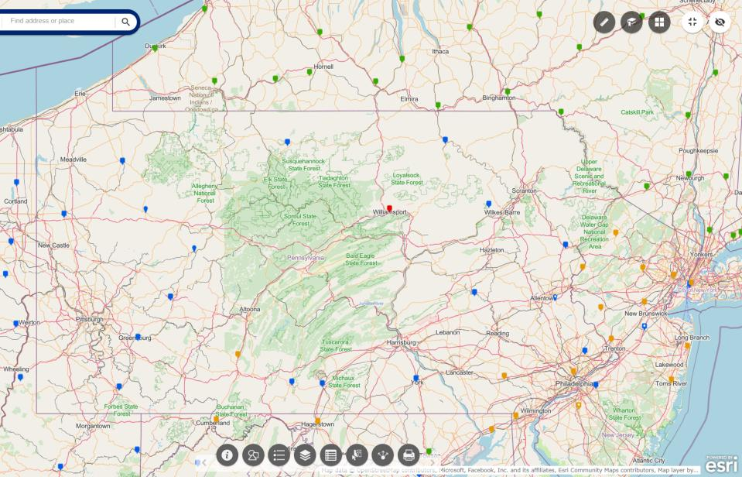
NOAA CORS Network (NCN) in PA
Notes:
where else but the federal government are you going to see two acronyms within one acronym?

Slide 9
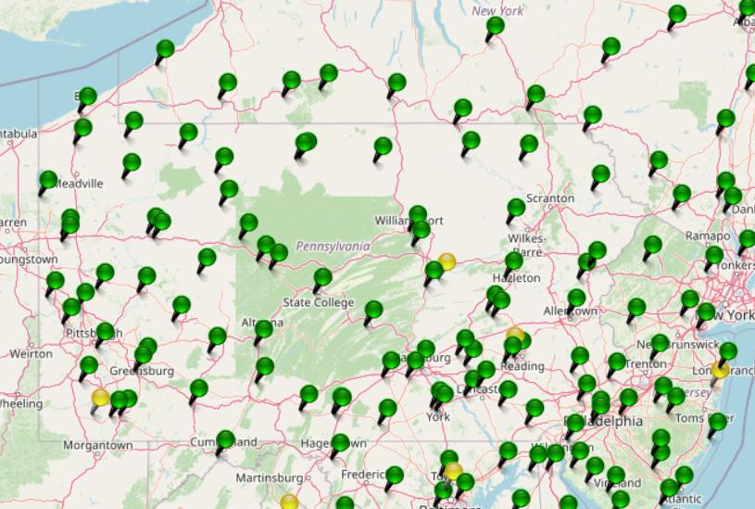
KeyNetGPS CORS Network
Notes:
where else but the federal government are you going to see two acronyms within one acronym?

Slide 10
NOAA CORS Network (NCN) in PA
Notes:
where else but the federal government are you going to see two acronyms within one acronym?

Slide 11
KeyNetGPS CORS Network
non-NCN CORS
Notes:
where else but the federal government are you going to see two acronyms within one acronym?

Slide 12
Online Positioning User Service
dual frequency receiver
static observations (via RINEX → ABCD123x.24o)
30 seconds epoch/logging rate aka recording interval
OPUS Rapid Static (OPUS-RS)
15 minutes to 2 hours of GPS data
OPUS Static (OPUS-S)
same requirements as above
2 to 48 hours of GPS data
OPUS Projects (OP)
adds session processing and network adjustment
training by NGS currently required (~12 hours)
Also Beta OPUS-S
Multi-constellation
More CORS checking

Slide 13
NGS Products and Services
Not just OPUS
All exist in three environments:
Development (DEV) - internal testing and development
same as when you hear a company talk about an “Alpha” product
Beta - continued internal testing, open for public testing
key features have already been vetted/tested
Production - final product, open to public use
this is what you see first when navigating our website
Notes:
I’ll be talking about OPUS today, but I need to clarify one of our processes for this to all be clear. I will also mention that this is a new-ish workflow for NGS, began in the past 8 or so years.
So all NGS Products & Services go thru this process as they are created, tested internally, open for testing by you our constituents, and then rolled out as final products.
CLICK
There’s three environments that products will exist in, listed here in the order they occur
First, a tool will be created on the “DEV” servers for internal NGS-only development, testing, and otherwise “working the bugs out”
→this is the same phase as when you hear a software company or video game maker talk about their alpha products
CLICK
Next, after some level of confidence in the product is gained, it will be migrated to the Beta servers, thereby open to the public for their own testing
→it’s important to note that when a product is available via our Beta page, when you use it you are indeed now a “beta tester”
key features will have already been tested in the Development environment, but it is still a beta, so as a beta tester please let us know if you have issues/complications/struggles or the like
CLICK
At some point, when all I’s are dotted and T’s crossed, the thing will be moved to the Production environment.
→ by then, the tool is integrated into others, has been vetted with 2 testing phases and functions as expected, but may still continue to receive version updates by repeating this process

Slide 14
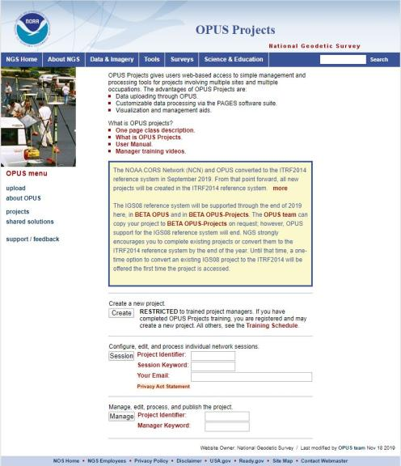
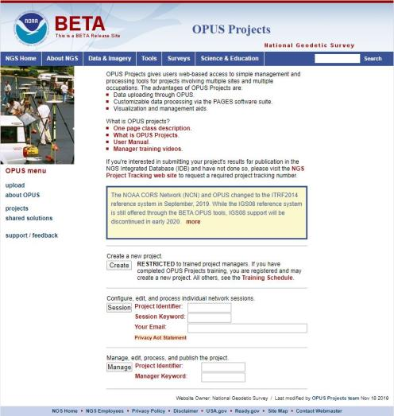
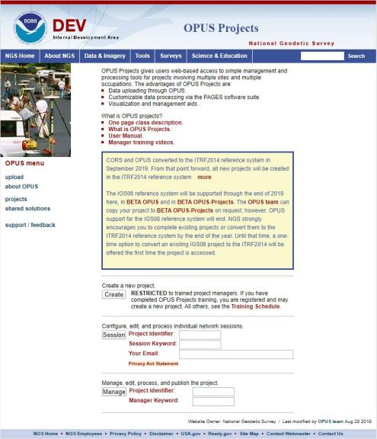
www.ngs.noaa.gov
beta.ngs.noaa.gov
Remember, you won’t see the DEV environment…
Notes:
So here we have 3 screenshots, first here showing the Production OPUS Projects gateway page
CLICK
Second is the Beta page, with the text here showing the URL for our Beta homepage
-How do you find that beta page? substitute “beta” for “www”
-or most tools that have a beta will have a link to that beta platform
CLICK
Last is the Development or DEV example, which again you will not see unless via a demo from NGS personnel

Slide 15
Wait… how do I get to the NGS Beta site?

Slide 16
www.ngs.noaa.gov
beta.ngs.noaa.gov

Slide 17
OPUS only processes every 30s
You can upload 5s interval data
But OPUS will trim/decimate to 30s interval
And this may result in error messages
You can even upload 1s interval data
But only shorter files, or OPUS will abort
For static, 30s yields good results
If using your commercial software, 15s can be advantageous
Notes:
Even if you’re running RTK…
You can setup your base to only log @ 30s rate
Know your equipment

Slide 18
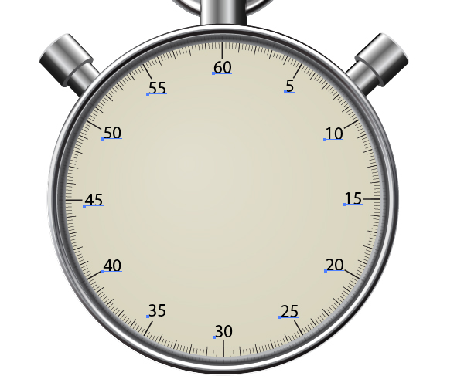
OPUS processes every 30s
20s decimates to 60s

Slide 19
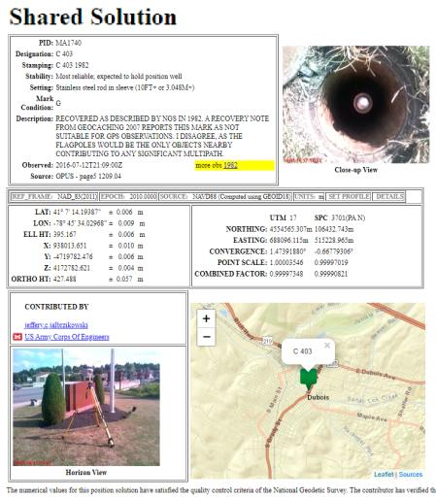
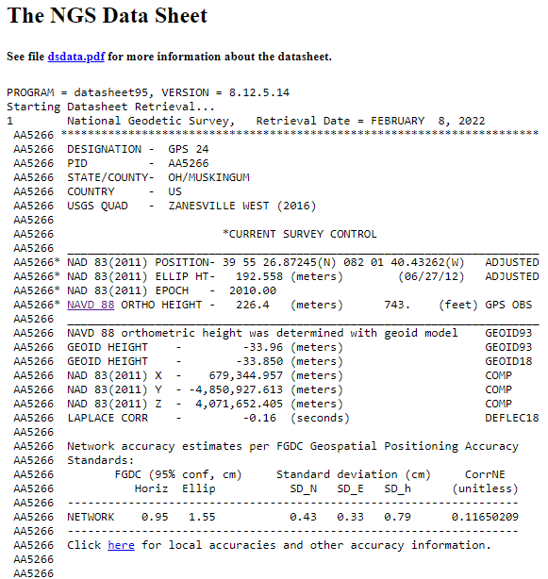
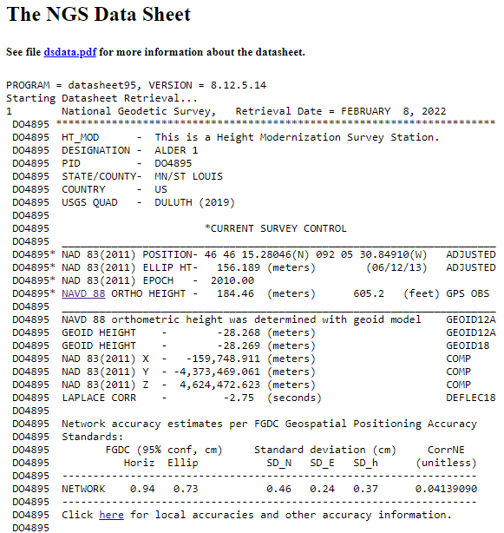
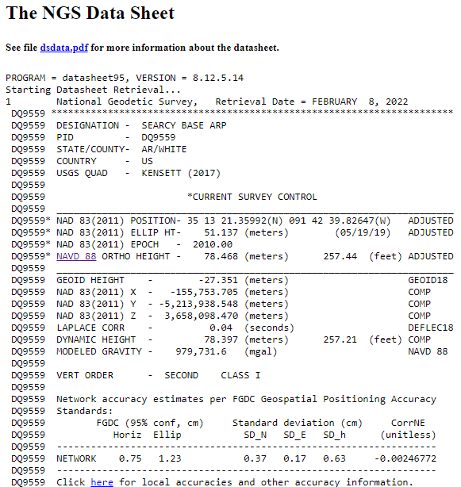
OPUS Shared vs. OPUS Projects
 | OPUS Shared | OPUS Projects (RINEX) | OPUS Projects (GVX)
Minimum Occupations | 4 hours At least 1, maybe 2* | 2 hours At least 2 | 5 minutes At least 3
Processing | OPUS-S (sequential) | PAGES (simultaneous) | Real Time (RTN/NRTK)
Adjustment | None | Least Squares Network | Least Squares Network
Metadata | 2 photos Brief Description | 3 photos, WinDesc files, Logs, & Report | 3 photos, WinDesc files, Logs, & Report
*Need 2 or more GPS datasets in our database, existing data holdings count toward that.

Slide 20
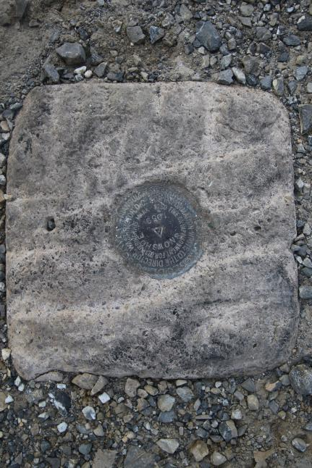
Passive Control
Geodetic Control – Terminology
All marks are passive—they sit there and hold a point
Notes:
All marks are passive!—in that they sit there doing nothing in and of themselves besides holding a point
This includes the fixed antenna mount that is a part of a CORS.
But, some marks have permanently installed equipment that enable nearly continuous observations and these are called “active” stations.

Slide 21
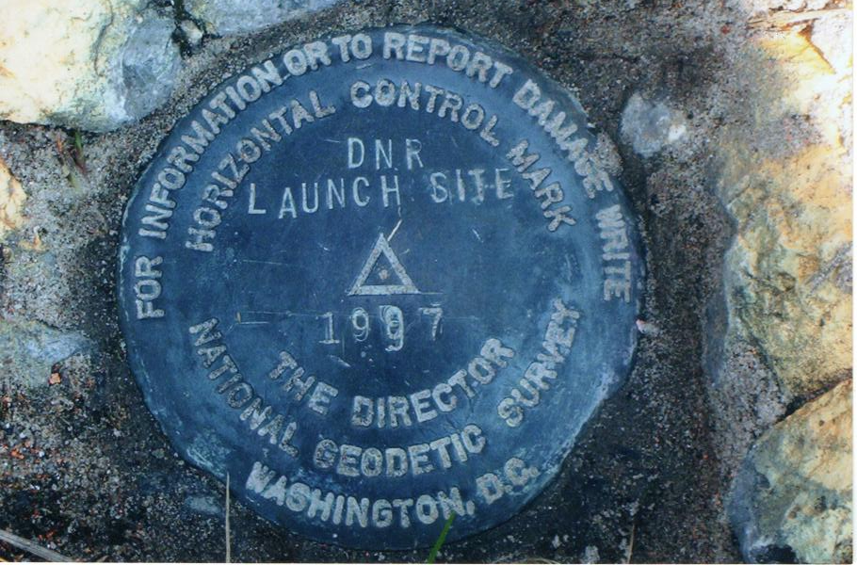
Passive Control

Slide 22
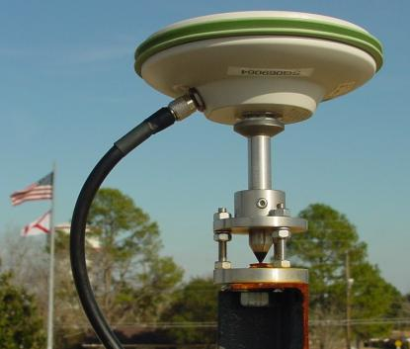
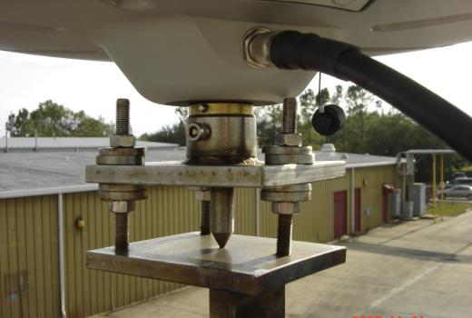
Active Control
Geodetic Control – Terminology
Some marks have permanently installed equipment that enables nearly continuous observations
(they still sit there and hold a point)
Notes:
All marks are passive!—in that they sit there doing nothing in and of themselves besides holding a point
This includes the fixed antenna mount that is a part of a CORS.
But, some marks have permanently installed equipment that enable nearly continuous observations and these are called “active” stations.

Slide 23
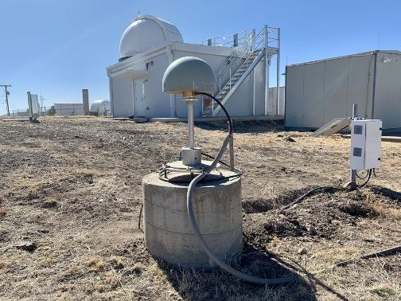
Active Control

Slide 24
Active vs. Passive Control
Geodetic Control – Terminology
Passive – setting up your RTK Base on existing geodetic control (e.g. Datasheet) while collecting with RTK Rover
Active – setting up your RTK Base to log data while collecting with RTK Rover then processing Base data via OPUS; or collecting with RTN/NRTK Rover
My point: surveying is still surveying
Notes:
Often the term active geodetic control has been used to mean some equipment is continuously or at least frequently collecting observations at or near a point
Yet those observations are often used to compute coordinates (often time-dependent) at a point on a mark, which, by its nature is passive

Slide 25
Yes, we are delayed.
NSRS Modernization
Notes:
So remember, today’s presentation is not JUST about new datums, it is about modernizing the NSRS as a whole.
You don’t know what the NSRS is? Stay tuned, we’ll get there as we go along.

Slide 26
Delayed Release of the Modernized NSRS
How long will the delay be?
Our website or newsletter is best source of projected timeframe, current estimate is middle of 2025.
Will the names stay the same?
Yes, terms containing “2022” such as “NATRF2022” and “NAPGD2022” will remain the same.
Will all previously proposed products be released along with the new datums?
No, they will not. Check out our June 2022 webinar.
hyperlink to the Track Our Progress homepage
June 2022 webinar
hyperlink to the full FAQ

Slide 27
Modernizing the NSRS
Updating all NSRS coordinates
Replace existing datums with new datums
Replacing existing SPCS83 with new SPCS2022
Accounting for coordinates changing with time
Improving NGS products and services
Simplifying customer contributions
Making the NSRS:
More accurate
More accessible
More efficient
begins
Rollout in
2025

Slide 28
Positional Components of
the NSRS
Geometric
aka “Horizontal”
Latitude, Longitude, Ellipsoid Height
Geopotential
aka Orthometric Height
aka “Elevation”
NAD83
NAVD88
Notes:
-geometric component is latitude, longitude, and ellipsoid height
-geopotential component is combined with the geometric components to calculate an ortho height or capital H

Slide 29
NATRF2022
North American Terrestrial Reference Frame of 2022
will replace
NAD83
North American Datum of 1983
Technically, not just NATRF2022 but also its 3 sister TRFs…

Slide 30
Four TRFs for Modernized NSRS
North American Terrestrial Reference Frame of 2022
(NATRF2022)
Pacific Terrestrial Reference Frame of 2022
(PATRF2022)
Caribbean Terrestrial Reference Frame of 2022
(CATRF2022)
Mariana Terrestrial Reference Frame of 2022
(MATRF2022)

Slide 31
Terrestrial Reference Frame?
Existing, accepted terminology
International TRF
first realization of the ITRF was 1992
NATRF2022 will be based on ITRF2020
“Horizontal Datum” - misnomer for NAD83
Really is a Geometric Reference Frame
Notes:
-Where do you see an Epoch right now in NGS data?
CLICK
Datasheets! there you see the epoch of 2010.0
and of course OPUS Solution Reports!
note that in blue over there on the right you’ll see another epoch, in the ITRF, which I will explain later on

Slide 32
International Terrestrial Reference Frame
(ITRF)
Is native coordinate system for NCN.
Is what OPUS uses.
Is what most of world uses.
Is what NGA aligns WGS-84 to.
Notes:
So what is that acronym, ITRF?
-it is a global reference frame, the most widely adopted one, or the “gold standard” or the “Cadillac” or what-have-you
-ITRF is the internationally recognized standard
-who realizes the ITRF? well, NGS contributes to the realization but
CLICK
-The IERS is in responsible charge of defining, realizing and promoting the ITRF
-and the ITRF was formally adopted by the…yes, more acronyms
CLICK
IUGG some years ago

Slide 33
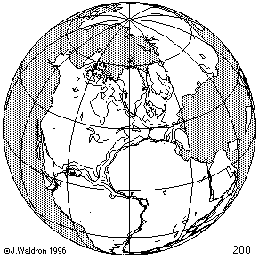
ITRF concept
Watch the grid!
Epoch:
Notes:
Ok, now ITRF mentioned a couple slides ago.
Most simplistic way to explain ITRF is to watch this animation.
This is a very loose representation/visualization of what the ITRF is, a characterization only.

Slide 34
Four TRFs for Modernized NSRS
North American Terrestrial Reference Frame of 2022
(NATRF2022)
Pacific Terrestrial Reference Frame of 2022
(PATRF2022)
Caribbean Terrestrial Reference Frame of 2022
(CATRF2022)
Mariana Terrestrial Reference Frame of 2022
(MATRF2022)

Slide 35
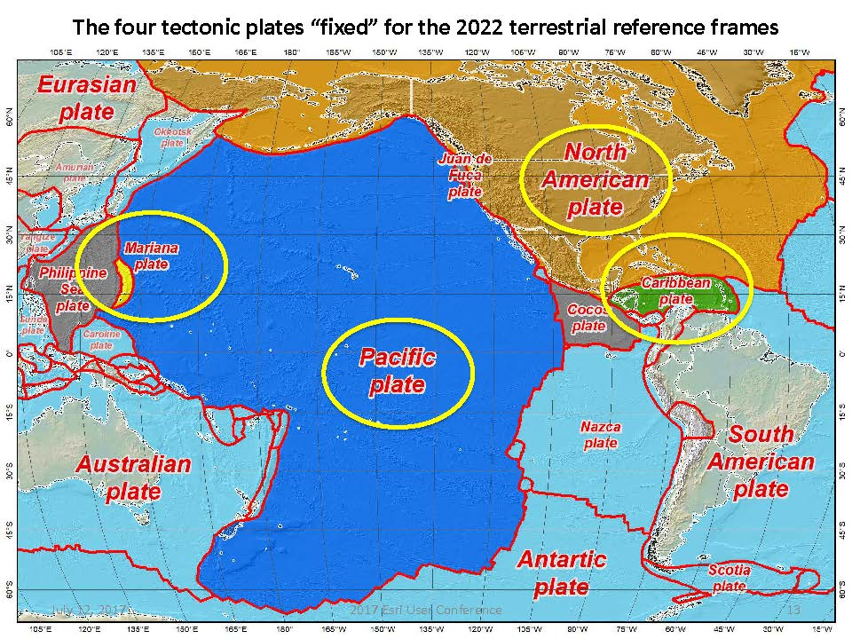
Plate Rotation visualized
Drift…
Notes:
-these are ground-level horizontal velocities
-the arrows illustrate the positions and velocities of CORS plotted in ITRF2014
-our scale is on the left there, with that arrow representing 20mm of motion per year
-so right thru Ohio it’s a little cluttered but we’re seeing arrows about that length so about 2cm/20mm per yr
-what do we notice about the direction of these arrows?
-they look rotational, don’t they?
CLICK HERE
-Note the arrows in California do not conform to the rotation… those are CORS on a different PLATE which is moving in a different direction
CLICK HERE
-so when you look at those arrows you can see the rotation, but the point of rotation is obviously off the map, way down below the screen right?
-that point is what’s known as an Euler Pole

Slide 36
Plate-Fixed NSRS TRFs
ITRF
Frame = constant
NA Plate = rotating
NATRF
Frame = rotating
(relative to ITRF)
NA Plate = constant
(relative to NATRF2022)
Notes:
We say “NATRF2022” is “fixed” to the N.A. Plate, making it a “plate fixed” frame
-the frame is constant to itself, but rotating within ITRF, and moving in a different direction than the other 3 frames

Slide 37
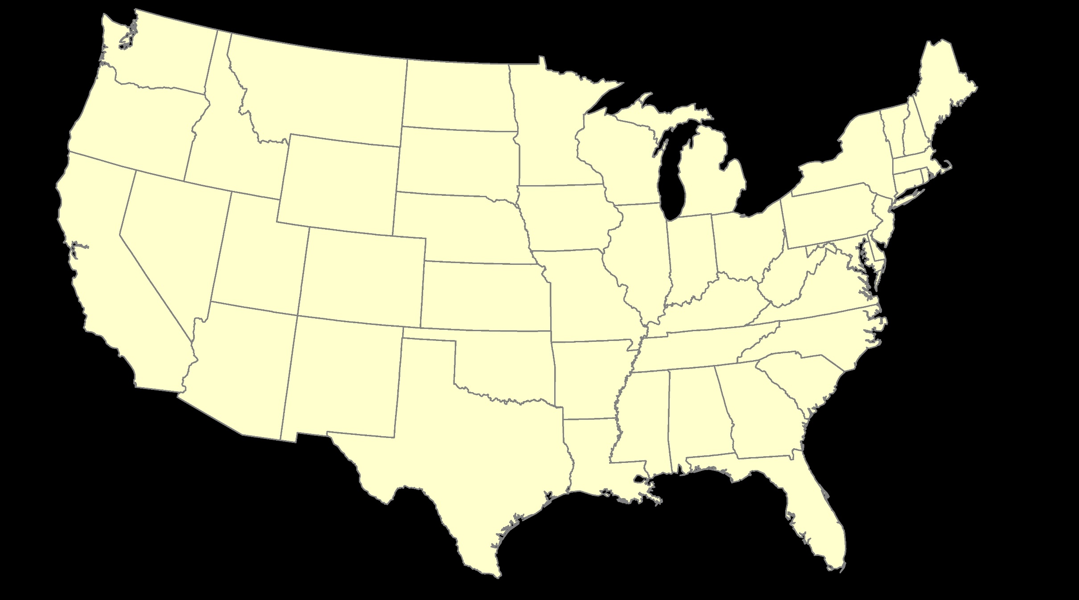
ITRF – constant frame, rotating plate

Slide 38
Plate-Fixed
NATRF – rotating frame, constant with plate

Slide 39
if you know epoch
ITRF or NATRF – your choice if you know epoch

Slide 40
Decades of continuously logged GPS data from the NOAA CORS Network (NCN).
But how?

Slide 41
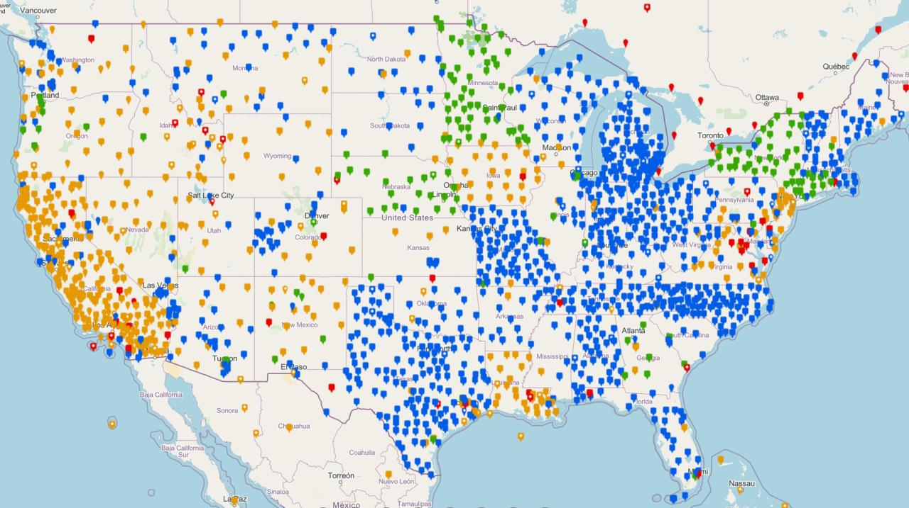
NOAA CORS Network (NCN)

Slide 42

Plate-Fixed
NATRF – rotating frame, constant with plate
= CORS

Slide 43
Plate-Fixed
ITRF or NATRF
= CORS
Notes:
ITRF is independent of any plates, tied to the layer below,
-”plate-agnostic” if we want to sound all silicon valley ish
-the plates go down about 200 km (125 mi) deep below our feet right now, as we’re on a continental plate
--(oceanic plates are roughly half the thickness, like 100 km)
-→ but thickness of the tectonic plates varies greatly, from down to 15 km up over the 200 km I mentioned earlier

Slide 44
Terminology – Time/4D
Epoch
eh-puck? ee-pock? … to-may-to, to-mah-to
an instant of time; a moment in time
astronomy & geodesy use a decimal date
2021.4762 = 23 June 2021 @ 19:16:00
using epochs is important, not your format
start preparing to assign epochs to your data
Notes:
-Where do you see an Epoch right now in NGS data?
CLICK
Datasheets! there you see the epoch of 2010.0
and of course OPUS Solution Reports!
note that in blue over there on the right you’ll see another epoch, in the ITRF, which I will explain later on

Slide 45
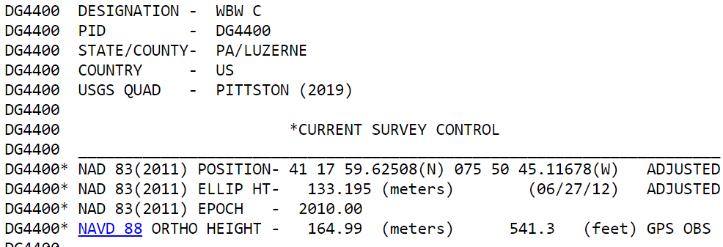
Notes:
-Where do you see an Epoch right now in NGS data?
Datasheets! there you see the epoch of 2010.0
and of course OPUS Solution Reports!
note that in blue over there on the right you’ll see another epoch, in the ITRF, which I will explain later on

Slide 46
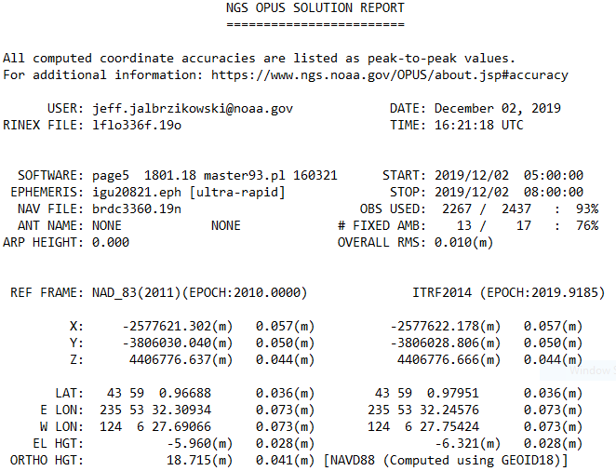
Reference Epoch
Survey Epoch
Notes:
-Where do you see an Epoch right now in NGS data?
and of course OPUS Solution Reports!
note that in blue over there on the right you’ll see another epoch, in the ITRF, which I will explain later on

Slide 47
What is a Reference Epoch?
If you use NAD83 you’re already using one, but perhaps unaware.
First let’s look at complete nomenclature…

Slide 48
Complete NAD83 Nomenclature
NAD83(2011) epoch 2010.00
Geometric
Datum
Realization
(aka Datum Tag)
Epoch
(in the case of NAD83, a Reference Epoch)
Other NAD83 Reference Epochs
NAD83(1986) epoch 1984.00
NAD83(HARN) epoch 1993.62
NAD83(CORS96) epoch 2002.00
NAD83(2007) epoch 2007.00
NAD83(2011) epoch 2010.00
ITRF2014 epoch 2019.9185
IGS08 epoch 2005.00
NATRF2022 epoch 2020.00
NAD83(1986) epoch 1984.00
NAD83(HARN) epoch 1993.62
NAD83(CORS96) epoch 2002.00
NAD83(2007) epoch 2007.00

Slide 49
Epoch
Reference Epoch
Survey Epoch
eh-puck? ee-pock? … to-may-to, to-mah-to
an instant of time, or a date selected as a point of reference
Notes:
-Some communities/countries will refer to the Survey Epoch as the Continuous Epoch or the Dynamic Epoch
*****for 2022, everywhere I use the term ITRF2014 may end up being ITRF2020*****
-we’re aligning to 2020.000 because the goal is to finalize the datum for 2022, and it takes time to process the data and run the calculations, hence aligned to the 2020.000 epoch

Slide 50
What is a Survey Epoch?
If you use OPUS you’re already using one, but perhaps unaware.

Slide 51
Complete ITRF Nomenclature
ITRF2014 (epoch 2021.0276)
Geometric
Datum
Epoch
(in the above example, a Survey Epoch)
ITRF Reference Epochs
NAD83(1986) epoch 1984.00
NAD83(HARN) epoch 1993.62
NAD83(CORS96) epoch 2002.00
NAD83(2007) epoch 2007.00
NAD83(2011) epoch 2010.00
ITRF2014 epoch 2019.9185
IGS08 epoch 2005.00
NATRF2022 epoch 2020.00
Examples of ITRF Survey Epoch
ITRF92 epoch 1988.0
ITRF2000 epoch 1997.0
ITRF2005 epoch 2000.0
ITRF2008 epoch 2005.0
ITRF2014 epoch 2010.0
ITRF2008 epoch 2012.2011
IGS08 epoch 2006.7572
ITRF2014 epoch 2017.4457
ITRF2014 epoch 2019.9185
ITRF2014 epoch 2021.0276

Slide 52
Epochs in Current NSRS
Survey Epoch (SE)
Reference Epoch (RE)
Position at the moment of survey data collection
Seen on OPUS Solution
Necessary for ITRF
Ground movement will be illustrated
Position after propagated back in time from SE to RE
Seen on OPUS Solution
Used in NAD 83
Ground movement will be hidden

Slide 53
Epochs in Modernized NSRS
Survey Epoch (SE)
Reference Epoch (RE)
Position at the moment of survey data collection
Used in NATRF2022
SEC = SE Coordinate
Ground movement will be illustrated
Position after propagated back in time from SE to RE
Used in NATRF2022
REC = RE Coordinate
Ground movement will be hidden

Slide 54
4D alignment – Epochs
One epoch in which ITRF2020 will be equal to NATRF2022…
At 00:00 on January 01, 2020 any given coordinates in
ITRF2020 (epoch 2020.0) = NATRF2022 (epoch 2020.0)
Notes:
After that, they diverge and continue to do so, we’ll visualize that soon

Slide 55
Terminology - Changing Coordinates
Conversion
change the type of coordinate
NAD83(2011) latitude & longitude → NAD83(2011) SPCS
Transformation
change the datum of coordinate
NGVD29 height → NAVD88 height
NAD 27 latitude & longitude → NAD 83(2011) latitude & longitude
Propagation
change the epoch of coordinate
NATRF2022 epoch 2020.00 to NATRF2022 epoch 2023.243
Notes:
Historically NGS has been inconsistent with these top two words.
Going forward, we will use them as:
Conversion: Meaning to change the type of coordinate without changing the datum or frame
Transformation: Meaning to change the datum or frame, without changing the type of coordinate

Slide 56
NCAT
How will you do that?
NGS Coordinate Conversion And Transformation Tool (NCAT)
Epochs/Time/4D
Notes:
-so you’ve probably seen that phrase that I have front and center here, NSRS Modernization
-that’s the blanket term we use to refer to not just the new datums but other updates

Slide 57
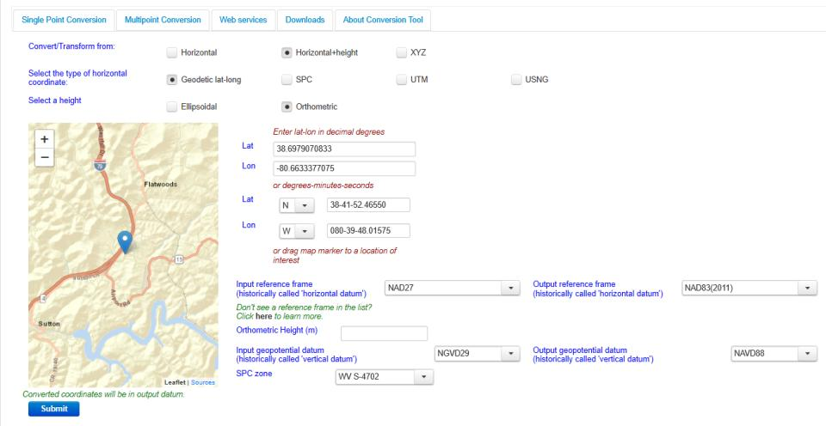
NGS Coordinate Conversion And Transformation Tool (NCAT)
Notes:
NCAT includes the functionality of previous NGS tools:
NADCON 5.0
XYZWIN 2.0
UTMS 2.1
SPC83 2.1
USNG 2.3
Includes error estimate of transformation per point.
Available as the single-point graphic seen here, multi-point upload/download, as a downloadable executable fie to run from the DOS prompt, and as web services for inclusion in your own
It’s a great tool. Anyone using

Slide 58
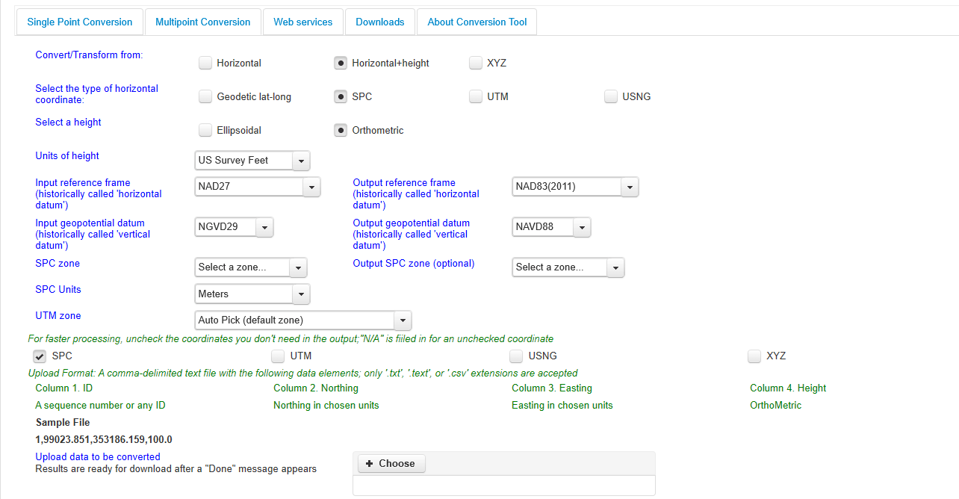
NGS Coordinate Conversion And Transformation Tool (NCAT)
Notes:
NCAT includes the functionality of previous NGS tools:
NADCON 5.0
XYZWIN 2.0
UTMS 2.1
SPC83 2.1
USNG 2.3
Includes error estimate of transformation per point.
Available as the single-point graphic seen here, multi-point upload/download, as a downloadable executable fie to run from the DOS prompt, and as web services for inclusion in your own
It’s a great tool. Anyone using

Slide 59
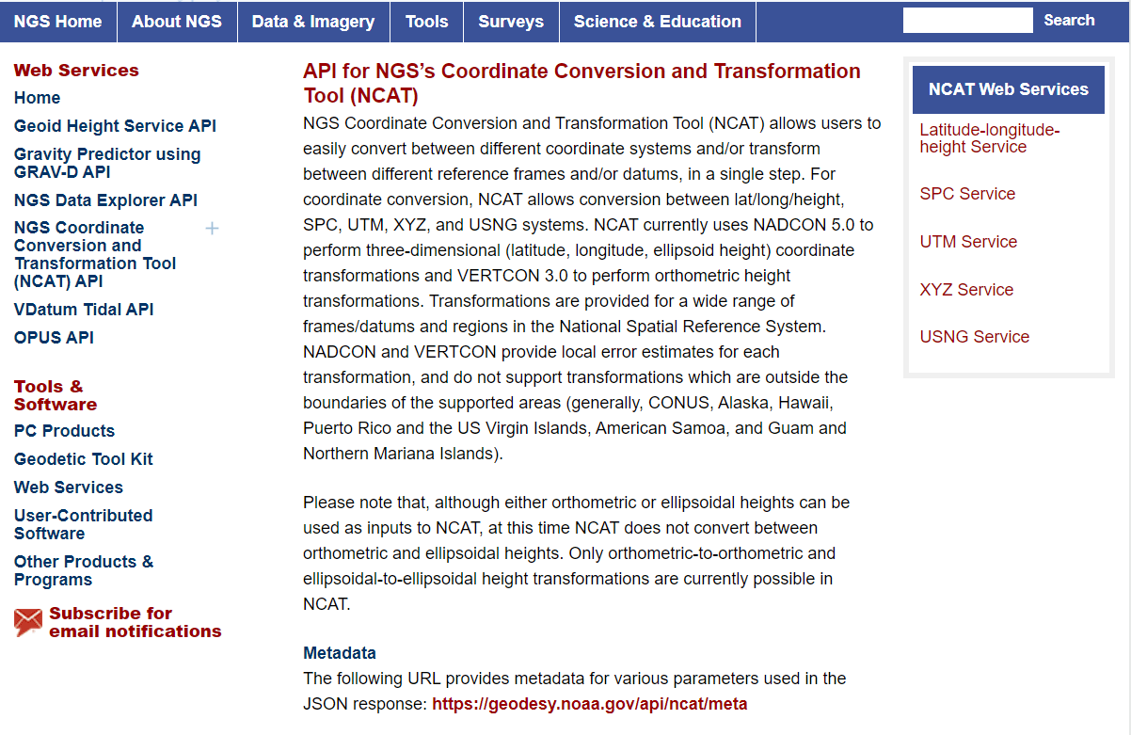
NCAT is available via web services

Slide 60
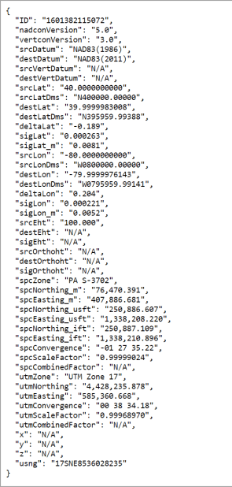
NCAT is available via web services
Note that each operation is a separate service
Struggling?
Contact us.
We can help!

Slide 61
NGS Coordinate Conversion And Transformation Tool (NCAT)
Notes:
NCAT includes the functionality of previous NGS tools:
NADCON 5.0
XYZWIN 2.0
UTMS 2.1
SPC83 2.1
USNG 2.3
Includes error estimate of transformation per point.
Available as the single-point graphic seen here, multi-point upload/download, as a downloadable executable fie to run from the DOS prompt, and as web services for inclusion in your own
It’s a great tool. Anyone using

Slide 62
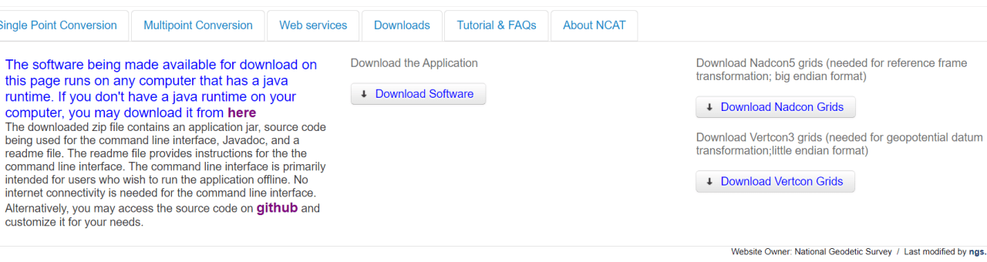
NGS Coordinate Conversion And Transformation Tool (NCAT)
Notes:
NCAT includes the functionality of previous NGS tools:
NADCON 5.0
XYZWIN 2.0
UTMS 2.1
SPC83 2.1
USNG 2.3
Includes error estimate of transformation per point.
Available as the single-point graphic seen here, multi-point upload/download, as a downloadable executable fie to run from the DOS prompt, and as web services for inclusion in your own
It’s a great tool. Anyone using

Slide 63
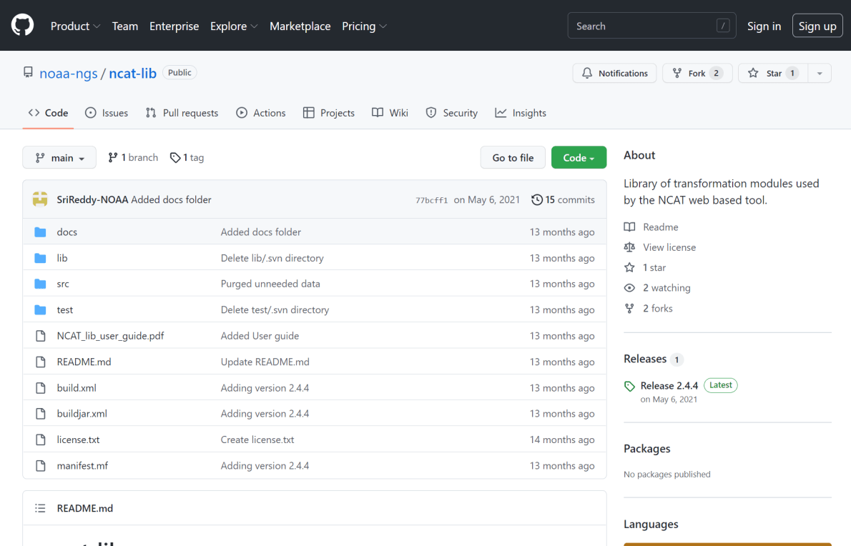
NCAT source code is on GitHub

Slide 64
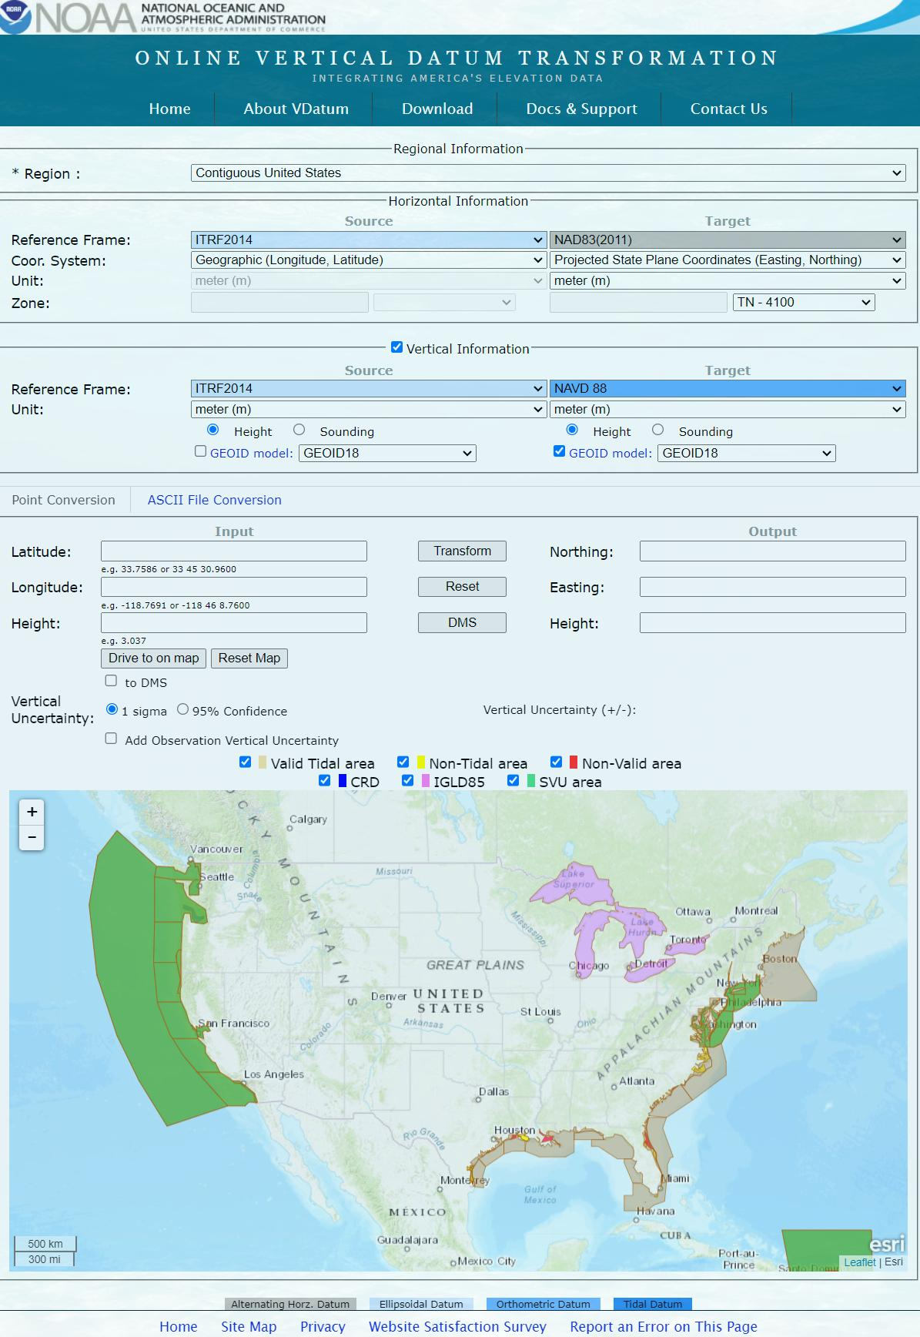

Slide 67
What’s the difference?
NCAT
VDatum
NSRS Datums
NAD 27
NAD 83
NGVD 29
NAVD 88
PRVD 02
ASVD 02
NMVD 03
GUVD 04
VIVD 09
NSRS Datums
Geoid Models
Add/Subtract from Ellipsoid
Tidal Datums
MHW, MLLW, MTL
Great Lakes Datum
IGLD85
ITRF#### ≈ WGS84
Local Tidal (LT)

Slide 68
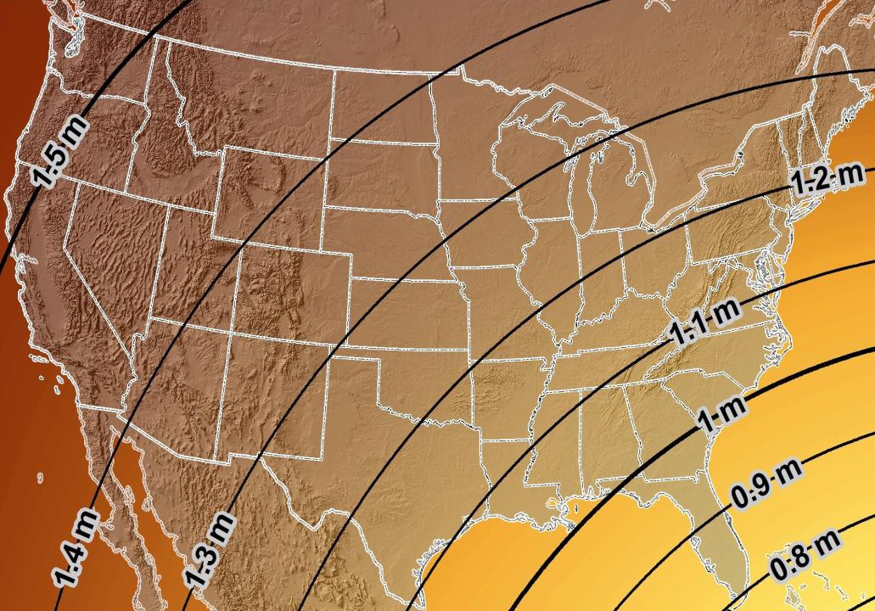
Estimated Geometric Change - Horizontal
NAD83 (2011) → NATRF2022
4.6 ft
Direction of Shift
4.3 ft
3.9 ft
3.6 ft
3.0 ft
Notes:
What’s the magnitude of the horizontal datum shift across Pennsylvania?
Minimum Shift ~3.75 feet
Maximum Shift ~3.97
Remember this is just an estimation, don’t hold me to the numbers please

Slide 69


Slide 70
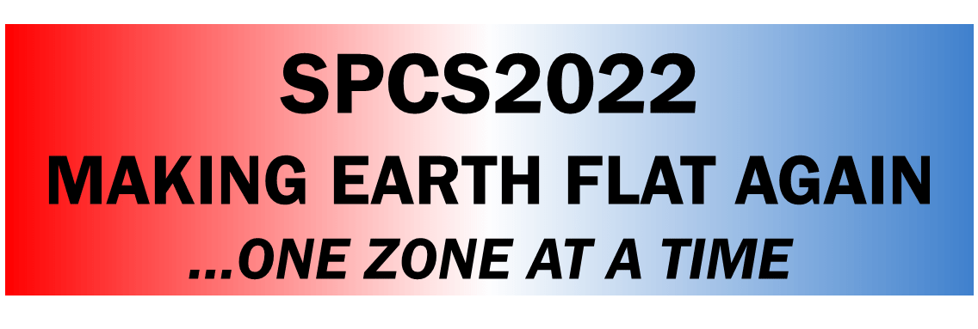

New Lat/Long = New XY
With a new horizontal datum…
There comes a new set of SPCS zones

Slide 71
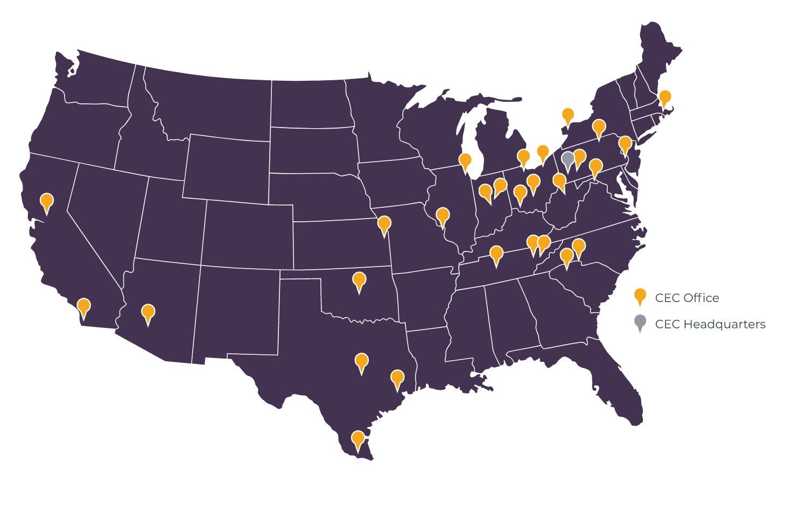
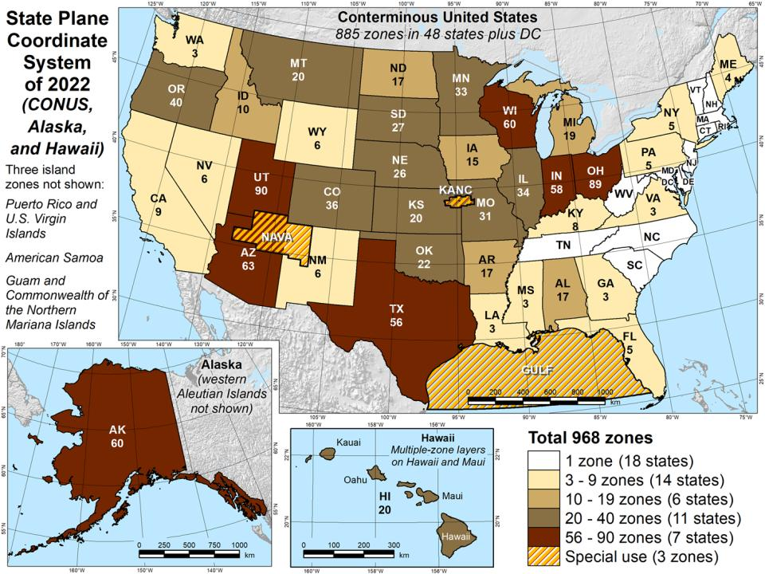

Slide 72
State Plane Coordinate System of 1983
SPCS83
North and South Zones as they exist now
Notes:
We start with the SPCS83 zones as a frame of reference
NOTE that the color shading of these zones is matched to that of the Preliminary SPCS2022 Zones that follow

Slide 73
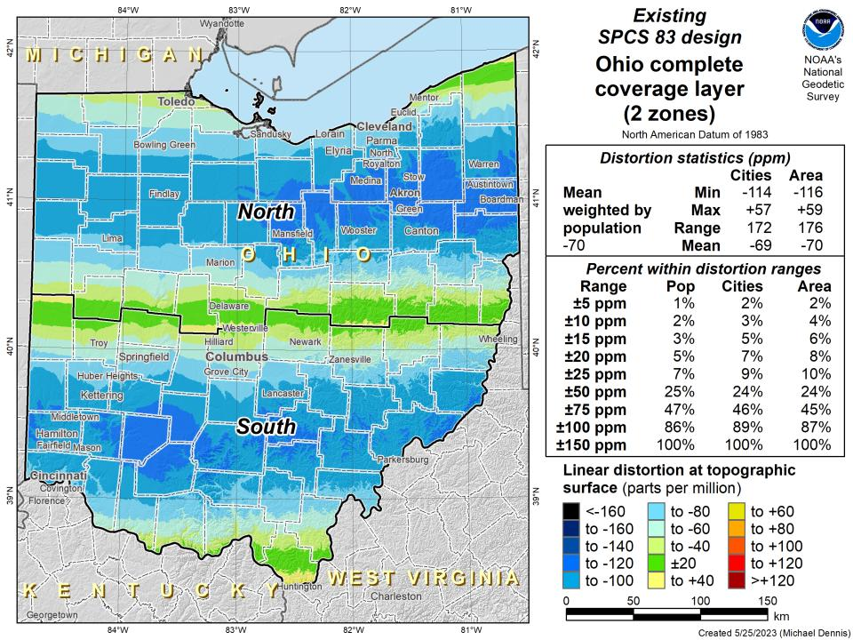

Slide 74
State Plane Coordinate System of 2022
SPCS2022
NGS designed a Single Statewide Zone for every State

Slide 75
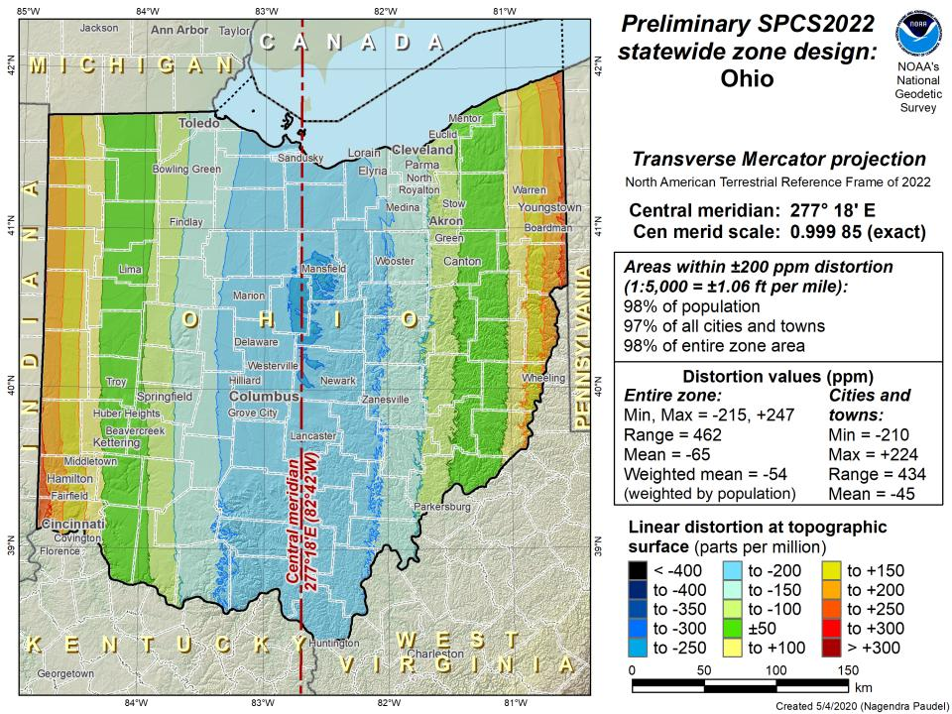

Slide 76
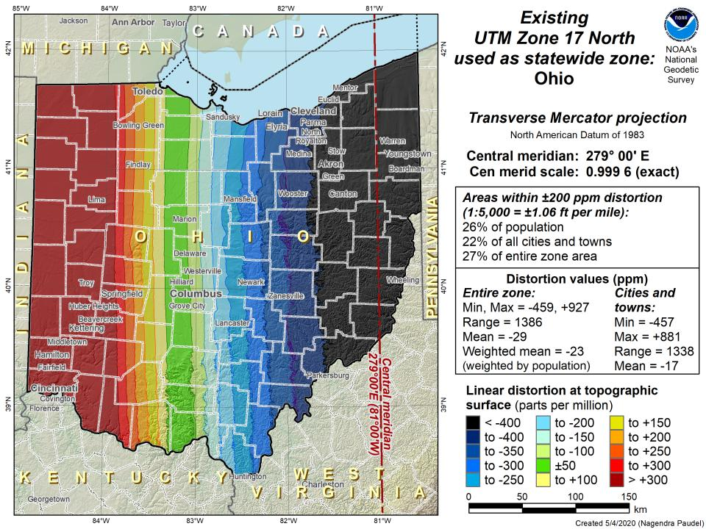

Slide 77
State Plane Coordinate System of 2022
SPCS2022
Ohio stakeholders designed 88 zones
Notes:
The following section illustrates the preliminary SPCS2022 zones
There are 4 zones in the NGS design, per request that we design “4-5 zones required to meet the minimum distortion acceptable” set by our design criteria of 50ppm
NOTE the request also included wording: “It is also requested that PennDOT districts be divded into no more than two zones”

Slide 78
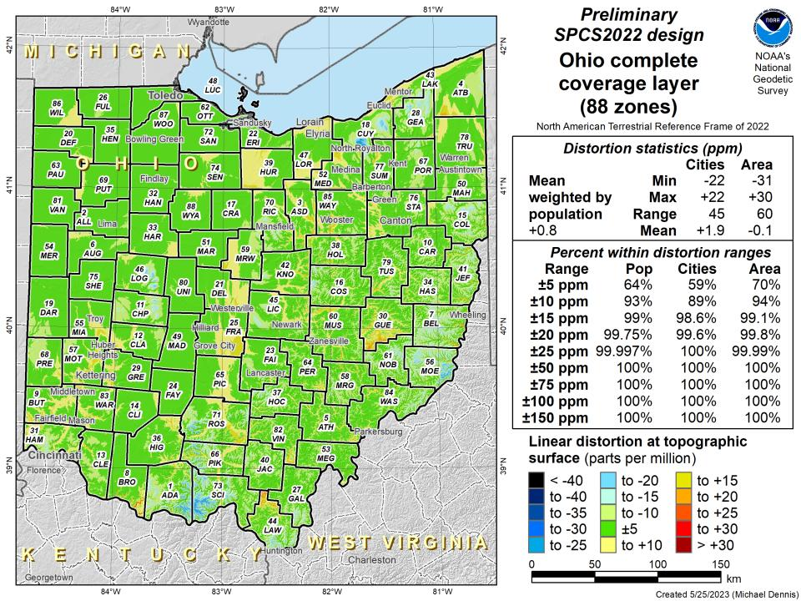

Slide 79
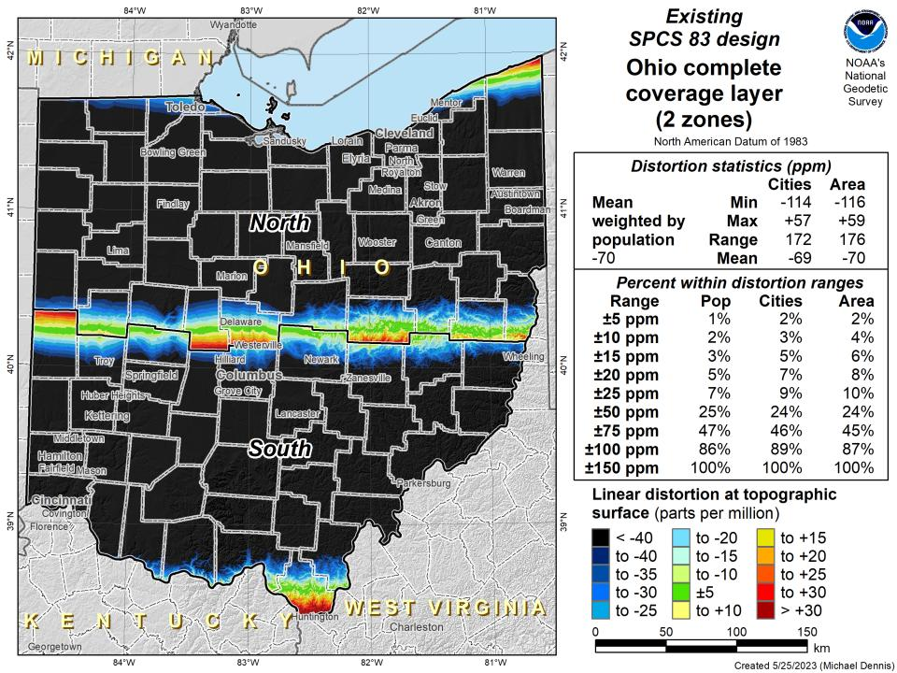

Slide 80
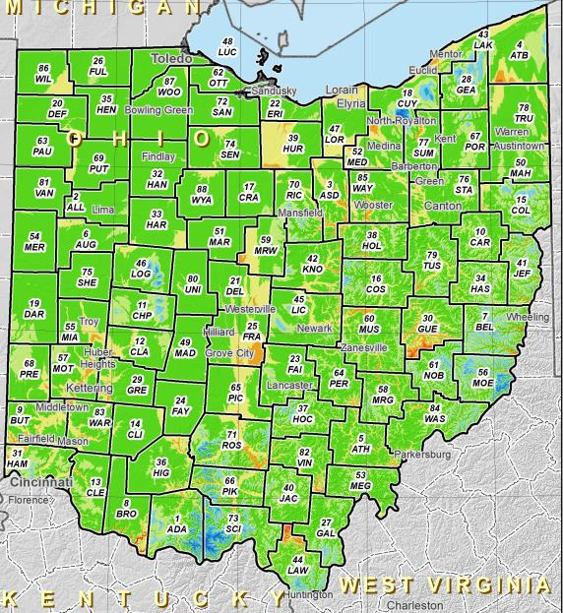
SPCS2022 Zone Layers in Ohio
Both Single Statewide and Multi-Zone Layers will coexist
Think about your data, your goals, your customers
Remember that geographic coordinates are your friend!
Smaller zones not “the best” … it all depends on usage & goals

Slide 81
SPCS2022 Zone Layers and LDPs
Each state may have max of 3 zone “layers”
One layer must be statewide zone
Single Statewide Zone
Other layers have two or more zones
Multi-Zone
A third layer can exist, but must be discontinuous coverage
Left open for possibilities in many states
Notes:
(Cleveland Regional Geodetic Survey)

Slide 82
Which is best?
Each has strengths and each has weaknesses.

Slide 83

Do you really need to…?
Notes:
Reminder that you don’t have to cutoff data at any SPCS zone extent → just need to understand that they’re designed with certain extents in mind

Slide 84
State Plane Coordinate System of 2022
SPCS2022
Not just Ohio
Notes:
The following section illustrates the preliminary SPCS2022 zones
There are 4 zones in the NGS design, per request that we design “4-5 zones required to meet the minimum distortion acceptable” set by our design criteria of 50ppm
NOTE the request also included wording: “It is also requested that PennDOT districts be divded into no more than two zones”

Slide 85

Number of SPCS2022 zones (preliminary)
CONUS, Alaska, and Hawaii
Three island zones not shown:
Puerto Rico and U.S. Virgins Islands
American Samoa
Guam and the Commonwealth of the Northern Mariana Islands

Slide 86
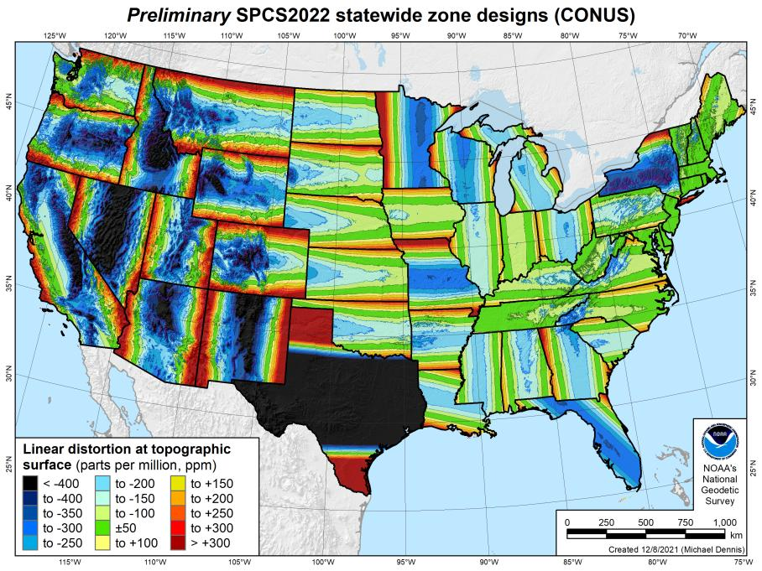
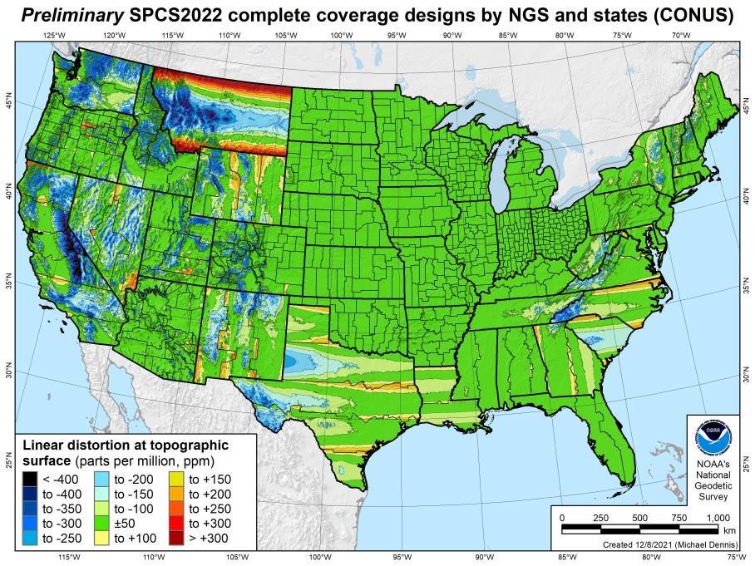
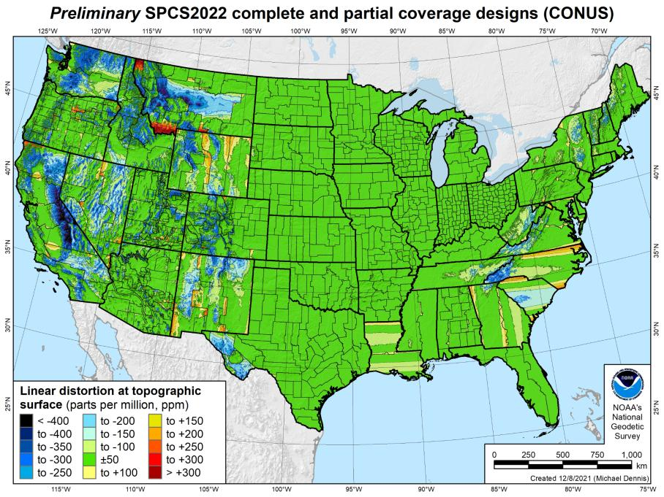
SPCS2022 linear distortion (prelim)
846 zones (CONUS)
Percent within distortion (ppm):
Distor | Pop | Cities | Area
±20 | 76% | 71% | 58%
±50 | 92% | 89% | 76%
±100 | 98% | 97% | 89%
±400 | 100% | 100% | 99.9%
City and area statistics (ppm):
 | Min | -407 | -1438
 | Max | +486 | +2624
 | Range | 893 | 4062
 | Mean | -6 | -23
Mean weighted by pop = -4

Slide 87
The Survey Foot is dead!
Long live the Survey Foot!
US Survey Foot was deprecated 31 December 2022… now what?!?
Notes:
We start with the SPCS83 zones as a frame of reference
NOTE that the color shading of these zones is matched to that of the Preliminary SPCS2022 Zones that follow

Slide 88

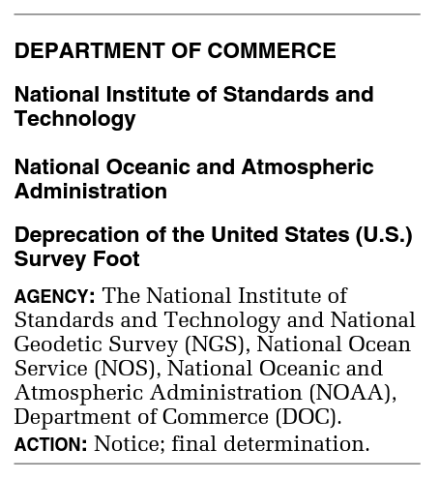
What happened to the US Survey Foot?
Deprecated 31 December 2022
Which begs the question
What should you be doing now?

Slide 89
What should you be doing now?
Ask the right questions
Does state law specify US Foot for SPCS83?
40 states do that we know of
Does it specify US Foot for boundary surveys? (Does that matter?)
We’re not tracking that, it’s not NSRS-related
Prepare for this along with new datums
GeoBoard Geodetic Working Group
Anyone always welcome to any meeting/discussion
Update Monday evening is that it will likely be un-opposed

Slide 90
What should you be doing now?
Prepare for this along with new datums
Understand the difference between sft and ift
2 parts per million
Understand this is not enforced
Neither NIST or NGS are a regulatory agency
We support education/outreach of course
But OPUS, NCAT, etc. will not have US Survey Foot options for output in SPCS2022 zones

Slide 91
2 parts per million (ppm)?
1,000,000.00 sft = 999,998.00 ift
10,000,000.00 sft = 9,999,980.00 ift
1,000.00 sft = 999.998 ift (can you measure that?)
International → 1 ft = .3048 m
US → 1 ft = .30480061 m (approx.)

Slide 92
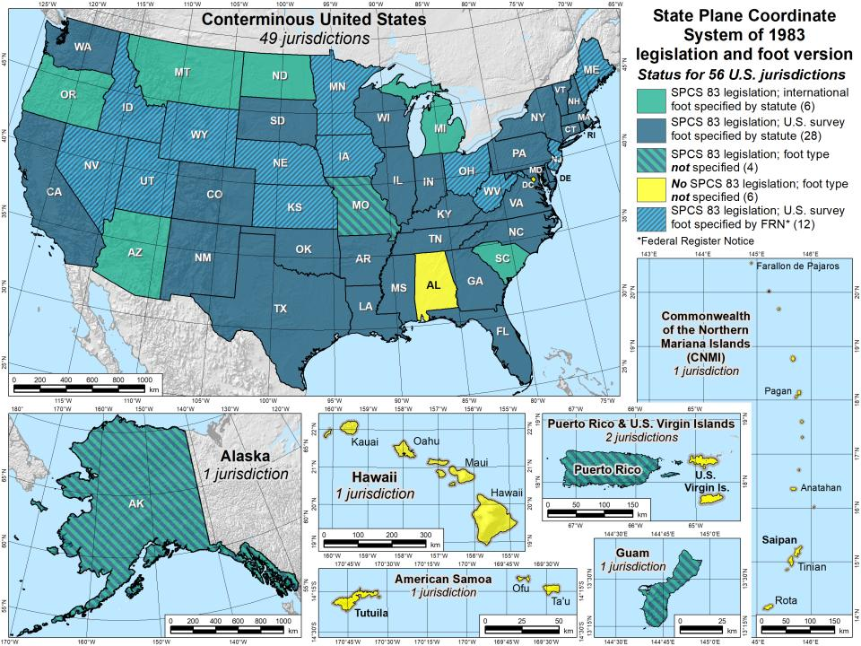

Slide 93
The Survey Foot is dead!
Long live the Survey Foot!
US Survey Foot was deprecated 31 December 2022…
But it will always be available in NGS tools for NAD83 and NAD27 coordinates

Slide 94
Positional Components of
the NSRS
Geometric
aka “Horizontal”
Latitude, Longitude, Ellipsoid Height
Geopotential
aka Orthometric Height
aka “Elevation”
NAD83
NAVD88
Notes:
-geometric component is latitude, longitude, and ellipsoid height
-geopotential component is combined with the geometric components to calculate an ortho height or capital H

Slide 95
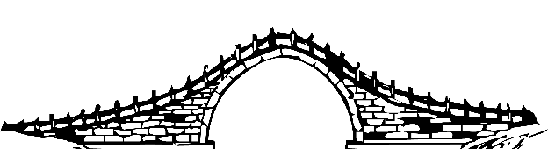
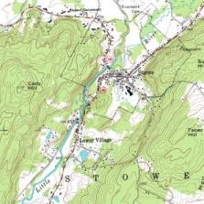
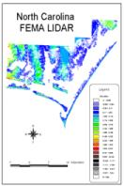
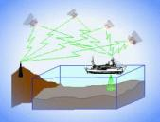






Three types of heights in NSRS
Ellipsoidal
geoid
Orthometric
Raw Hydrographic Surveys
USGS
Topography
NAD83
NAVD88
NGVD29
FEMA NFIP Data & Maps
Engineering and Construction Surveys
Raw GPS Observations
Raw Lidar Data
Water Level or Tidal
NOAA and USACE Hydrography
Shoreline Mapping and Regulatory Boundaries at the Coast
Daily and Extreme Water Levels (Gage)
Notes:
This slide illustrates the 3 categories of vertical datums and examples of where each is directly used They are project and application dependent.
First, we have ellipsoidal datums. Examples include WGS84 and NAD83 (North American Datum of 1983). You will encounter these datums frequently in hydrographic surveys that are vertically referenced with RTK-GPS; any native GPS measurements; and even raw lidar datasets.
Next, we have orthometric datums. These datums are very important because height differences referenced to orthometric datums will allow us to know the direction water will flow, because they have been “gravity-corrected”. The North American Vertical Datum of 1988 (or NAVD 88) is an orthometric datum, which you will see on USGS topographic maps, engineering and development site surveys, and FEMA Flood Insurance Rate Maps.
Finally, we have Tidal Datums, which are derived from water level measurements. They have extremely important applications including daily and extreme water levels; NOAA nautical charts, and shoreline mapping or boundaries along the coast.
*NOAA provides tools (like NCAT and Vdatum) to transform between these different height systems.
The Bridge

Slide 96
Orthometric
Notes:
This slide illustrates the 3 categories of vertical datums and examples of where each is directly used They are project and application dependent.
First, we have ellipsoidal datums. Examples include WGS84 and NAD83 (North American Datum of 1983). You will encounter these datums frequently in hydrographic surveys that are vertically referenced with RTK-GPS; any native GPS measurements; and even raw lidar datasets.
Next, we have orthometric datums. These datums are very important because height differences referenced to orthometric datums will allow us to know the direction water will flow, because they have been “gravity-corrected”. The North American Vertical Datum of 1988 (or NAVD 88) is an orthometric datum, which you will see on USGS topographic maps, engineering and development site surveys, and FEMA Flood Insurance Rate Maps.
Finally, we have Tidal Datums, which are derived from water level measurements. They have extremely important applications including daily and extreme water levels; NOAA nautical charts, and shoreline mapping or boundaries along the coast.
*NOAA provides tools (like NCAT and Vdatum) to transform between these different height systems.

Slide 97
North American Vertical Datum
of 1988
NAVD88
will be replaced by

Slide 98
North American-Pacific Geopotential Datum of 2022
NAPGD2022
(pronounced: nap-jee-dee)

Slide 99
NAVD88 geoids
versus
NAPGD2022 geoids

Slide 100
Two types of geoid models
Gravimetric
Hybrid
Notes:
-believe it or not there’s more than 2 types, but the 2 types you’ll see NGS publish are…

Slide 101
Gravimetric → Hybrid
Gravimetric geoid is created from “scratch” with various types of gravity data
USGG2003, USGG2009, USGG2012, xGEOID19
Hybrid geoid is simply a gravimetric geoid then best fit some vertical datum… like NAVD88
GEOID03, GEOID09, GEOID12B, GEOID18
Notes:
So… all the geoids you’re using to get elevations from your GNSS data

Slide 102
Gravimetric → Hybrid
USGG2003, USGG2009, USGG2012, xGEOID19
GEOID03, GEOID09, GEOID12B, GEOID18
best fit to NAVD88
best fit to NAVD88
best fit to NAVD88
best fit to NAVD88
Notes:
So… all the geoids you’re using to get elevations from your GNSS data

Slide 103

Gravimetric vs. Hybrid Geoid
topographic surface
gravimetric geoid
hybrid
geoid
datum zero
surface
Concept
Notes:
-importantly, the height chosen was to minimize 29→88 differences on USGS topo maps in the eastern U.S. … thus, the “zero height surface” of NAVD 88 was NOT chosen for its closeness to the geoid (but it was close…few decimeters)

Slide 104
NAVD88 uses a Hybrid Geoid
topographic surface
gravimetric geoid
hybrid
geoid
datum zero
surface
Concept
Notes:
-importantly, the height chosen was to minimize 29→88 differences on USGS topo maps in the eastern U.S. … thus, the “zero height surface” of NAVD 88 was NOT chosen for its closeness to the geoid (but it was close…few decimeters)

Slide 105
NAPGD2022 uses a Gravimetric Geoid
topographic surface
gravimetric geoid
datum zero
surface
Datum zero surface aligned to Global Mean Sea Level (GMSL)
Concept
Notes:
-importantly, the height chosen was to minimize 29→88 differences on USGS topo maps in the eastern U.S. … thus, the “zero height surface” of NAVD 88 was NOT chosen for its closeness to the geoid (but it was close…few decimeters)

Slide 106
Sea Level Change and the Geoid
H_{2020.000}
H_{2085.000}
Threshold Level
-Threshold Level is published as 20 cm
-Process is repeated as GMSL changes
Geoid
GMSL
Notes:
The illustrated strategy will be adopted at NGS. An animated characterization of this approach
What this means is that NGS will decouple the geoid from GMSL, until they have diverged by some threshold amount, currently defined as 20cm.
When that threshold is reached a new geoid will be defined and held fixed until reaching next threshold. In this way, the impact of the change of GMSL is accounted for in the heights of the NSRS, while the appearance of stability is maintained for “decades at a time” (BP2 Section 14).
If we calculate how long that might be based on existing rates of sea level rise of 3ish mm/yr then we’re talking over 50 years

Slide 107

Why leveling is not part of NAPGD2022
…but will still be important for you.
ground surface
equipotential surfaces
(equal gravity)
Geoid at Site Scale

Slide 108
Why leveling is not part of NAPGD2022
…but will still be important for you.
ground surface
equipotential surfaces
(equal gravity)
Geoid at Continental Scale

Slide 109

Estimated change in orthometric heights from NAVD88 to NAPGD2022
(NAPGD2022 approximated using xGEOID16B)

Slide 110

Estimated change in orthometric heights from NAVD88 to NAPGD2022
OPUS Extended Solution Report

Slide 111

Estimated change in orthometric heights from NAVD88 to NAPGD2022
OPUS Extended Solution Report
Scroll all the way to the bottom…

Slide 112
Preparing
Inventory heights in your data/datasets
Have you mix & matched geoid models?
Are you tracking levees or other flood control?
Are you managing subsurface utilities?
Access covers, junction boxes, cleanouts, etc.
Maybe geoid differences aren’t even significant?
VADOT story…
Know your goals, know your data.

Slide 113

Preparing
Know the epoch of your data/datasets
consider how you will track this
full to-the-second timestamp on every feature?
Modern survey equipment makes this possible
labeling a year for each dataset?
Easy to add to workflows, datasets/databases, folders
something in-between that works for your needs?
2023.1957
2023:27
20230127
Epoch nomenclature is your choice

Slide 114
Preparing
Reprocessing your data
perfect world = everyone reprocesses everything
what does this mean?
consider an ALTA w/topo
start over with the onsite GNSS-based control
reorient all your shots/ties (hopefully linked)
recreate all the drainage features in new datum
unrealistic! … and unnecessary for majority users
Notes:
Reprocessing your data
in a perfect world, everyone would reprocess data
consider a final product like you use everyday - a hydro-enforced DEM
starting fresh with the raw GNSS/IMU processing
generate new ellipsoid height point clouds
recreate all the drainage features in new datum
this is totally unrealistic → both from a financial and programmatic perspective

Slide 115
Preparing
Transforming your data
NCAT - NGS Coordinate Conversion and Transformation Tool
ASCII up/download, Web Services, Download, GitHub
ask your software provider(s) about integration
we envision COTS integrations as most popular method of access
Industry Workshops - May 2021 and August 2022
Esri, Trimble, Blue Marble, etc… all the well known names attended
Geospatial Software Developers’ Summit – Nov/Dec
International & Virtual → US NGS and NRCan CGS
Notes:
Transforming your data
NCAT - NGS Coordinate Conversion and Transformation Tool
available now: ASCII upload and Web Services
ask your software providers about integration
we envision this as most popular method of access
Industry Workshop held this year – esri, trimble, bluemarble, all the major well known names were represented
labeling a year for each dataset?
something in-between that works for your needs

Slide 116
Preparing
What can you do to ensure your control will get coordinates in the new datums on rollout?
Re-observe and submit the data to NGS
must be submitted by 29 February 2024
Options to submit your data:
OPUS Share → 4+ hrs static data; 2 photos; mark ties
rinse & repeat … as we need redundancy
OPUS Projects → 2+ hrs static GPS data
→ 5+ minutes RTN-GNSS data, 3x per mark
Also: photos, field logs, descriptions, survey report
Notes:
-OPUS Share requires 4+ hrs static data; 2 photos; and a brief description of reference ties (not a full IDB “from the post office”)
→ NOTE THAT OPUS SHARE OPTION REQUIRES 2 OBSERVATIONS
→ WHY? WE REQUIRE REDUNDANCY FOR ANY OBS THAT GO INTO OUR DATABASE
-OPUS Projects → 2+ hrs data; photos; full IDB style descriptions via WinDesc (*MUST USE WINDESC*)

Slide 117
Remember…
What’s the goal of NATRF2022?
Give you the stability in positions that you expect
That’s the point of Reference Epochs (REs)
Akin to the different realizations of NAD83
REs will be published every 5 or 10 years
you choose when you update
in a perfect world, everyone would stay current
aka versions
Notes:
What’s the goal of the way NATRF2022 was designed, by including EPP2022 and IFVM2022
Does a database of manholes in PA need cm-level coordinate updates on an annual basis? Probably not.

Slide 118
Additional Resources

Slide 119

Regional Geodetic Advisor Program
geodesy.noaa.gov/ADVISORS/
14 RGAs across country
We are here to support:
You
Your constituents
Our Federal Partners
Questions about
NSRS Modernization?
Reach out now
Be prepared

Slide 120

Educational Videos
<5 minutes
Online Lesson
(via MetEd/COMET)
~1 hour
NGS homepage: geodesy.noaa.gov
Notes:
Educational videos and online tutorials –
Our library of lessons and videos are great resources, and will reinforce a lot of information we covered today.
The videos are just 3-5 minutes long.
the lesson is a deeper dive but still only takes an hour.

Slide 121


Email Subscriptions
*Only 1-2 messages per month*
NGS News
Includes quarterly NSRS Modernization newsletter
Webinar Series
Training
GPS on Benchmarks
Click this icon on homepage

Slide 122
https://geodesy.noaa.gov/ADVISORS/
-use any major search engine: “NGS advisors”
Jeff Jalbrzikowski, P.S., GISP, CFS
Appalachian Regional Geodetic Advisor
jeff.jalbrzikowski@noaa.gov
240-988-5486

Slide 123

Scan to save my contact info on your phone

