Slide 1

Geodetic Control Theme Update: The “GEO” in Geospatial
Dr. Daniel Roman
Senior Advisor on Geodesy
Geodetic Control Theme Lead

Slide 2
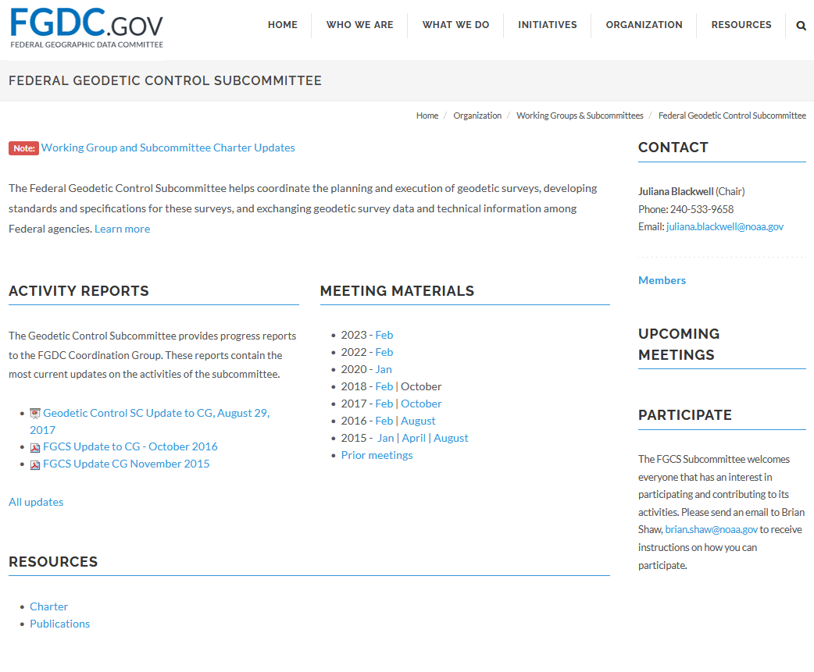
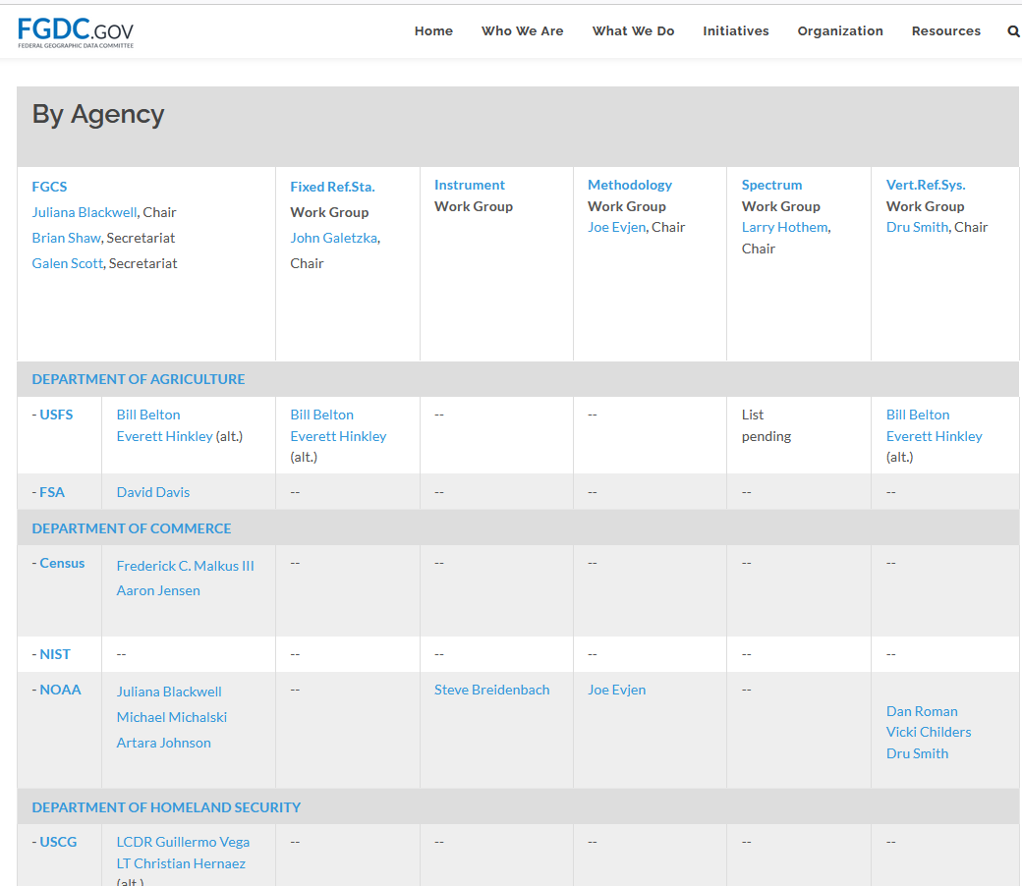
The Federal Geodetic Control Subcommittee
Notes:
First thing to note is the relationship between the Geodetic Control Theme and the Federal Geodetic Control Subcommittee
The first relates to the data used to access the NSRS
The second relates to the education and collaboration of other US Agencies to use the data to access the NSRS
Both support the NSRS
Pending FGDC decisions regarding all subcommittees have left FGCS in somewhat of a limbo
The expectation is that the FGCS (and other subcommittees) will be reconfirmed, and the structure and membership of the FGCS will then be reinvigorated

Slide 3
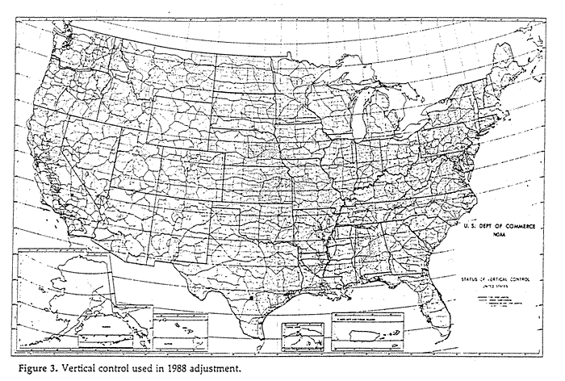
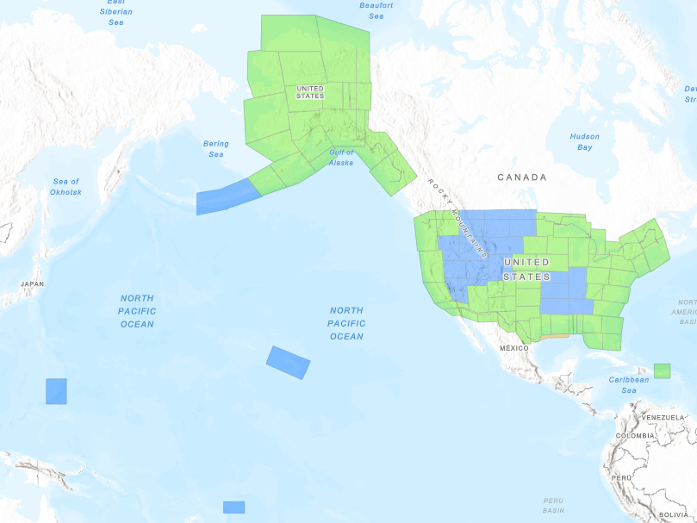
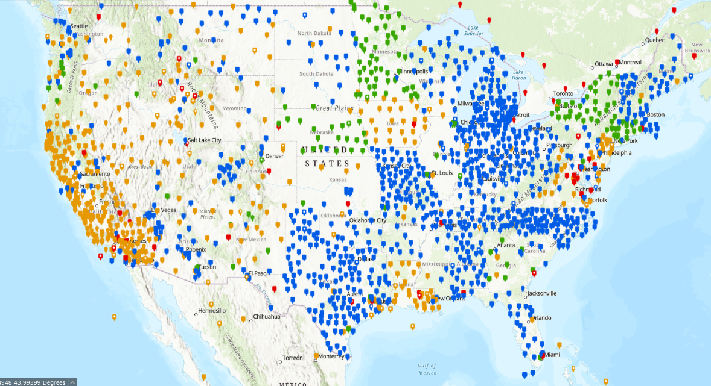
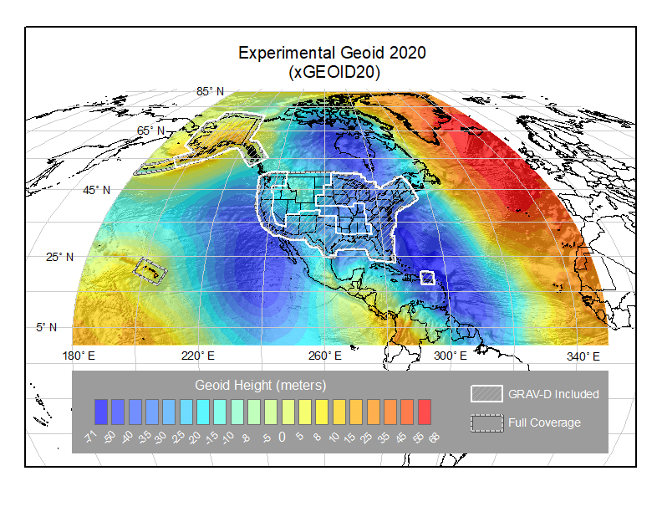
Geodetic Control Theme and NGDAs
NAD 83/NAVD 88
Passive
Control
(BMs)
Airborne
Gravity
(GRAV-D)
Geoid
Heights
DoVs
NOAA
CORS
Network
Notes:
Introduce theme NGDAs
Passive Control is what we have traditionally provided – bench marks
The NOAA CORS Network now provides the modern means of accessing the NSRS using GNSS (GPS)
Airborne gravity helps to refine the gravity values we determine in the U.S. and are also used in geoid modeling
Geoid height models will now replace NAVD 88 heights on bench marks as definitive vertical control
Note at first blush This theme and NGDA’s are like any other
However, these NGDA’s are not only geospatial data themselves but provide geodetic control doe defining other geospatial data

Slide 4
Mission of the National Geodetic Survey
The mission of the National Geodetic Survey (NGS) is to define, maintain and provide access to the National Spatial Reference System (NSRS).
The NSRS provides a consistent coordinate system that defines latitude, longitude, height, scale, gravity, and orientation throughout the United States and its territories.
Current NSRS realized at passive control (BMs) and extends from them
Modernized NSRS realized through active control and exists everywhere
Modern Positioning satellites orbit the Earth – not the United States
NAD 83 (ITRF96)
(phi, lamda … h)
NAVD 88
(H)
NGSGN/IGSN 71
(g)
Current NSRS
N/C/P/MATRF (ITRF2020)
(phi, lamda, h)
GEOID2022
(H = h – N)
ICAG/Abs Gravity (IGRF)
(g)
Modernized NSRS
Notes:
The current NSRS was initially developed as separate horizontal (NAD 83) and vertical (NAVD 88) datums.
With the advent of GNSS(GPS), geometric heights were determined to provide three coordinates (latitude, longitude, height)
Orthometric heights (H) still remain distinct but related through a geoid model (h= = H + N)
Access to the NSRS was realized through the bench marks. It only existed there and needed to be transferred to where needed
Gravity was realized from determined from absolute gravity marks determined using painstaking efforts
The modernized NSRS will evolve beyond access at passive control to active control accessible and valid everywhere
Ties to the ITRS will be updated to the most recent realization – ITRF2020, which will define geometric coordinates where GNSS is available
Additionally, other technologies will be examined to define geometric coordinates in other denied or obscure environments – underground, urban canyons, inside buildings, etc.
Physical heights will be determined *exactly* from the relationship between heights (h=H+N)
With the advent of (relatively) cheap absolute gravity meters, determination of gravity control is much more uniform and standardized by such events as an International Comparison of Absolute Gravity (ICAG)
For most access though, GNSS will provide the primary tools for access
This requires adoption and modernization, since the GNSS satellites orbit the Earth – not the United States.
As do all other satellites, such as Landsat and various altimeter missions. Providing a consistent reference system will integrate these various data – making them interoperable.
Global positioning systems are required to achieve local accuracy

Slide 5
Basis for Usage of the NSRS How did we get here and where are we going?
Current NSRS
Modernized NSRS
Passive Control
1807 - Survey of the Coast
ESSA/USC&GS => NOAA/NOS, 1970
Authorities
Coast and Geodetic Survey Act, 1947 focused on geodetic control surveys
The Hydrographic Services Improvement Act of 1998 (reauth 2002, amended 2008)
Office of Management and Budget (OMB) Circular No. A-16 Rev., August 19, 2002
Currently in revision pend significant rewrite
Active Control
GPS/GNSS era => CORS roughly 1990’s
Regional Datums => Global Ref Frames
Authorities
Geospatial Data Act of 2018 advocated for use of International standards and norms
NSDI Strategic Plan (What) –Expires in 2024 – now in revision (2025-2034). Informs geospatial strategies and strategic plans in U.S. Agencies.
Follow-on Implementation plan (How)
Geodesy CoP (NASA, NOAA, USGS, NGA)
Paradigm Shift
Notes:
The only authority for the NSRS that I am aware of OMB Circular A-16. The C&GSA and HSIA do not specifically talk about the NSRS, but rather to authorize us to conduct geodetic surveys to the best of my knowledge.
The three we usually cite are:
1) Coast and Geodetic Survey Act, Public Law 80-373, 33 U.S.C. 883a et seq., 1947. Defines the functions and duties of the Coast and Geodetic Survey (predecessor to NOAA’s National Ocean Service). This act authorized the Department of Commerce to conduct geodetic control surveys; field surveys for [Federal Aviation Administration (FAA)] aeronautical charts; developmental work for the improvement of surveying and cartographic methods, instruments, and equipment; and investigations and research in geophysical sciences, including geodesy and seismology.
(2) The Hydrographic Services Improvement Act of 1998, Public Law 107-372 reauthroized 2002 and amended/reauthorized 2008, 33 U.S.C. 892 et seq. Directs NOAA to manage, maintain, interpret, certify, and disseminate geodetic information. The 2008 amended HSIA changed the definition of "hydrographic data" to include information acquired through hydrographic, bathymetric, photogrammetric, lidar, radar, remote sensing, shoreline and other ocean- and coastal-related surveying, and water level observations and is used to provide hydrographic services. It revises the definition of "hydrographic services" to include shoreline and water level information. - See more at:http://www.profsurv.com/magazine/article.aspx?i=2203#sthash.XgJ5YN97.dpuf
(3) Office of Management and Budget (OMB) Circular No. A-16 Revised, August 19, 2002 Coordination of Geographic Information and Related Spatial Data Activities. Provides direction for federal agencies that produce, maintain or use spatial data either directly or indirectly in the fulfillment of their mission. The Circular establishes the Federal Geographic Data Committee, and assigns NOAA as the Federal Geodetic Control theme lead (and subcommittee chair), and identifies the (NOAA managed) National Spatial Reference System as the fundamental geodetic control for the United States.

Slide 6
Standards
Current NSRS
Modernized NSRS
FGDC-STD-014.4-2008
NSRS usage covered in Geographic Information Framework Data Content Standard, Part 4: Geodetic Control
FGCS Bluebook (1994)
Standard method for geodetic data
User guide specifies all critical elements and files required for preparing and submitting geodetic data to NGSIDB to become part of the NSRS.
ISO 19111:2003/07 no dynamic datums
GDA passage in 2018
All existing FGDC Standards revoked
ISO 19161-1:2020 - Geodetic References
Part 1: International terrestrial reference system (ITRS) => IERS with IAG support
Global standard for terrestrial reference frames – separate from space-based
ISO 19111:2019/? Dynamic frames
ISO 19135:2015/? – Procedures for item registration — Part 1: Fundamentals
Ensuring Interoperability of geospatial data

Slide 7
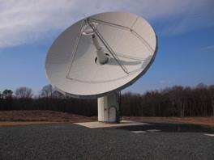
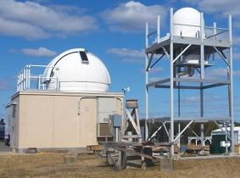
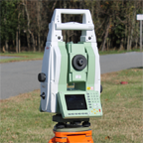
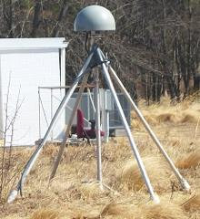
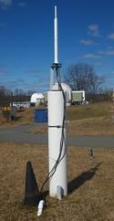
The Geodetic Measurement System => ITRS
CRS | SYSTEM
WGS-84 | GPS (USA)
PZ-90 | GLONASS (Russia)
BDC | BeiDou-2 (China)
GTRF | Galileo (EU)
 | NavIC/IRNSS (India)
JGS | QZSS (Japan)
Very Long Baseline Interferometry (VLBI)
Orientation of ITRF with respect to ICRF
ITRF Scale
Satellite Laser Ranging (SLR)
Origin of ITRF (Earth’s CM)
ITRF Scale
Position spacecraft in ITRF (“Orbits”)
Global Navigation Satellite System (GNSS)
Precise monitoring of Polar Motion and Rotation Rate
Position spacecraft in ITRF (“Orbits”)
Position instruments on Land and Sea (Tide Gauges and Buoys, Geodetic Instruments)
Technique Connectivity (Station Co-Location)
DORIS
Position spacecraft in ITRF (“Orbits”)
Enhances global distribution of ITRF Station positions and velocities
Fully Define ITRF
VTS: ITRF Performance Improvement
Low-Density Global Distribution
High-Density Global Distribution
Origin, Scale, Orientation
Courtesy Stephen Merkowitz (NASA GSFC)
Notes:
So … don’t let this slide overwhelm you.
The intent is merely to highlight why Nations including the U.S. are moving to adopt the ITRS
The Earth is a very complex system spinning irregularly under a cloud of satellites while wobbling around the sun and the universe
These other methods provide Earth Orientation Parameters that better define all of this
Of note though, one of these techniques is GNSS – and one of the types of GNSS is GPS
Hence, WGS-84 is currently less desirable for positioning and precision navigation indicating the need for adoption of the ITRS

Slide 8
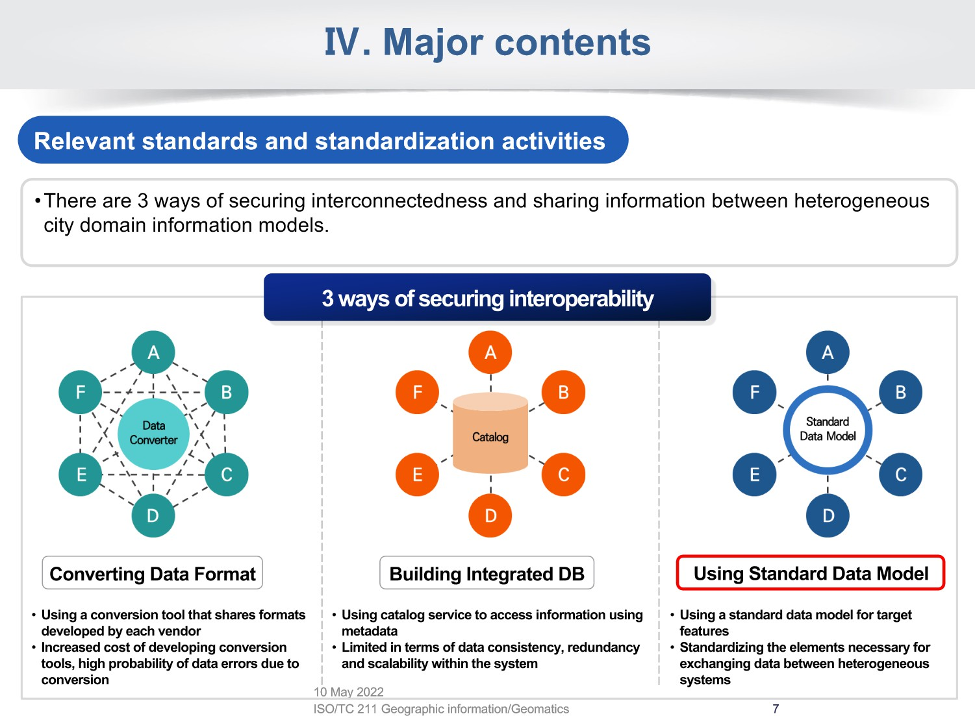
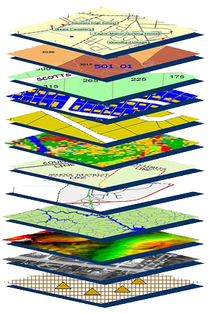
GEOPLATFORM
ISO/TC 211/WG 10
"Ubiquitous public access"
Convenorship: KATS
Convenor: Hong Sang-Ki Professor
Meeting: Vienna (Austria) 10 May 2022
F.A.I.R. – Findable, Accessible,
Interoperable, Reusable
Notes:
ISO
You probably are already using some previous Realization of the NSRS – NAD 83 and/or NAVD 88 – possibly NAD 27 and/or MGVD 29 – maybe even something older.
You need to be on the current version to ensure that your Geospatial Data are interoperable... that you can stack against other data and extract new information
Interoperablity is more than just about metadata
Optimizes data combination and better operational decisions
GDA applies to all geospatial data – not just the NGDAs (CA vs. LCA)

Slide 9
Closing Thoughts
The modernized NSRS will more closely align to the ITRS
2015 UN resolution on Global Geodetic Reference Frame
2023 UN-GGIM-Americas resolution on adoption of SIRGAS/ITRS
The NSRS will be tied regionally to SIRGAS and globally to the ITRS
Support for NSRS visibility in planning and policy documents
NSDI Strat./Impl. Plans, OMB Circ. A-16 rev., Agency Strat. Plans
Geodetic Control is not just a NOAA data set – it underpins all data
Look at your data and think about what you’ll need to migrate

Slide 10
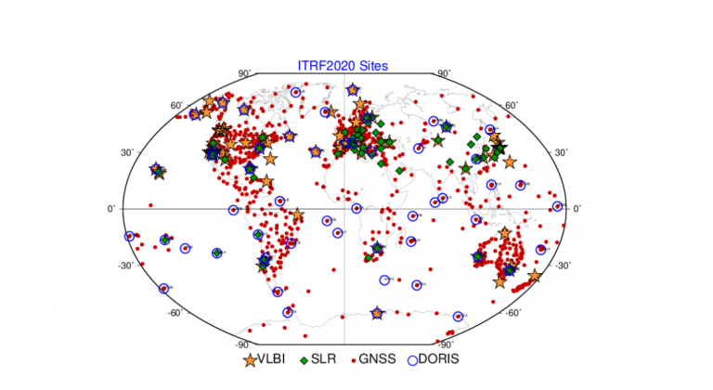
Questions?
Dataset Managers:
Passive Control:
Godfred Amponsah
NOAA CORS Network:
Will Freeman/Fran Coloma
Aerogravity:
Jeff Johnson
Geoid/Vertical Control:
Yan Wang
Geodetic Control:
Champion: Ms. Juliana Blackwell
Lead: Dr. Daniel Roman
Z Altamimi, P Rebischung, X Collilieux, L Métivier, K Chanard (2023)
ITRF2020: an augmented reference frame refining the modeling
of nonlinear station motions
Journal of Geodesy (2023) 97:47
https://doi.org/10.1007/s00190-023-01738-w

