Slide 1

Progress toward a modernized NSRS
Dru Smith
NSRS Modernization Manager
NOAA’s National Geodetic Survey

Slide 2
Outline
Overview of NSRS Modernization
Updates on:
  Foundations
  Formats
  Data
  Tools
Timeline
Rollout/testing/replacement

Slide 3
Overview of NSRS Modernization

Slide 4
The National Spatial Reference System
The “NSRS”
Official coordinate system for the USA
Defined by the National Geodetic Survey
Required to be used by all Federal Government agencies
Often used by many state and local government agencies or private surveyors

Slide 5

























Federal Users of the NSRS
Notes:
Many of these users also sit on the Federal Geodetic Control Subcommittee, so there is a feedback loop between the providers of geodetic control (NGS) and the users of that control.

Slide 6
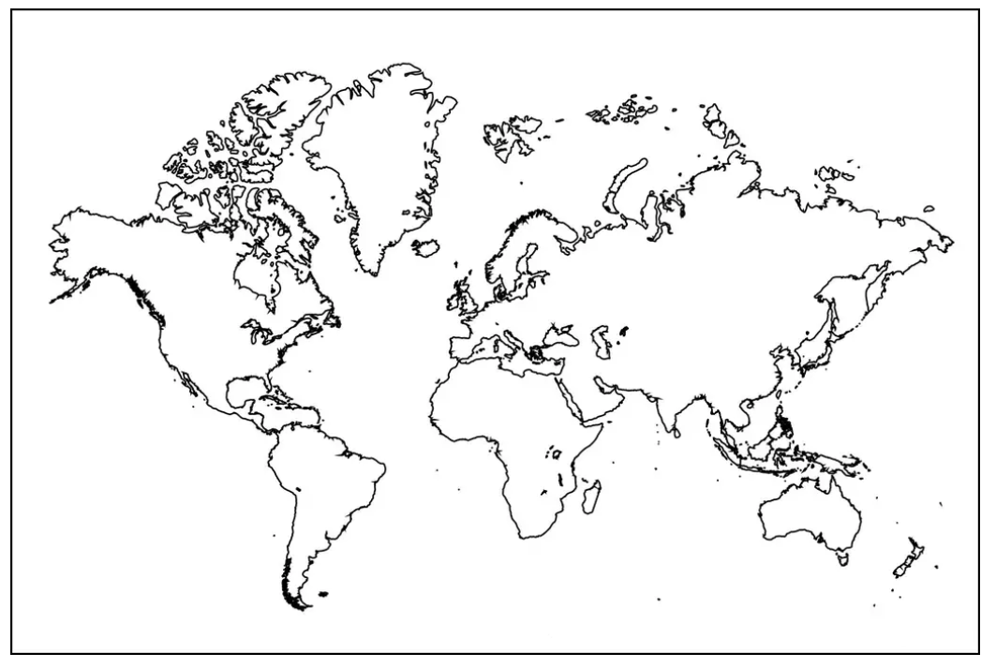
Extent of the current NSRS
Geometric Reference Frames:
NAD 83(2011)
NAD 83(PA11)
NAD 83(MA11)
Truly global but used regionally
Geoid models/Vertical Datums:
Regional
  Conterminous US (CONUS; “Lower 48”)
  Alaska
  Hawaii
  Territories: Puerto Rico, U.S. Virgin Islands, American Samoa, Guam, CNM

Slide 7
“Modernization”
There’s “Modernization” and “modernization”
  NGS has been constantly modernizing components of its mission for all of its existence
    Bilby Towers allowed long distance sights
    EDMs replaced tapes
    GPS replaced line-of-sight surveying
    NAD 83 replaced NAD 27
    NAVD 88 replaced NGVD 29
    Height Mod replaced/enhanced leveling
    The NOAA CORS Network replaced marks as primary control

Slide 8
“Modernizing the NSRS” means…
Replacing NAD 83
Replacing NAVD 88
Re-inventing Bluebooking
Improving the Geodetic Toolkit
Better Surveying Methodologies
Blueprint for the Modernized NSRS, Part 1
Blueprint for the Modernized NSRS, Part 2
Blueprint for the Modernized NSRS, Part 3
Notes:
There are actually 3 “NAD 83”s, NAD 83(2011), NAD 83(PA11) and NAD 83(MA11)
There are also many more vertical datums than NAVD 88 in the NSRS, each one for specific states or territories that have no line of sight to CONUS/Alaska

Slide 9
Replacing NAD 83
The Old:
NAD 83(2011)
NAD 83(PA11)
NAD 83(MA11)
The New:
The North American Terrestrial Reference Frame of 2022
(NATRF2022)
The Caribbean Terrestrial Reference Frame of 2022
(CATRF2022)
The Pacific Terrestrial Reference Frame of 2022
(PATRF2022)
The Mariana Terrestrial Reference Frame of 2022
(MATRF2022)

Slide 10
Replacing NAVD 88
  The Old:
  NAVD 88
  PRVD 02
  VIVD09
  ASVD02
  NMVD03
  GUVD04
  IGLD 85
  IGSN71
  GEOID12B
  DEFLEC12B
  The New:
  The North American-Pacific Geopotential Datum of 2022 (NAPGD2022)
  Will include:
  GEOID2022
  DEFLEC2022
  GRAV2022
  DEM2022
  More
Orthometric
Heights
Normal
Orthometric
Heights
A HUGE component of this
effort is GRAV-D:
Gravity for the Redefinition of
the American Vertical Datum
Dynamic
Heights
Gravity
Geoid
Undulations
Deflections of
the Vertical

Slide 11
Two types of coordinates
Reference Epoch Coordinates
Survey Epoch Coordinates
An estimated “snapshot” of entire network
Every 5 years
Similar to NAD 83(2011) epoch 2010.00
Answers: what were a mark’s coordinates when it was last surveyed?
Multiple SECs can show changes over time

Slide 12
Assume “H” was determined four different times:
1990: 2.100
1994: 2.110
2002: 2.190
2009: 2.180
2.250
2.200
H
2.150
2.100
2.050
2.000
1990
‘95
‘00
‘05
‘10
‘15
‘20
‘25
‘30
time

Slide 13
All measurements have error. Shown here are the same
Values of “H”, but with their error estimates.
1990: 2.100 +/- 0.0375 (3.75 cm)
1994: 2.110 +/- 0.0250 (2.50 cm)
2002: 2.190 +/- 0.0200 (2.00 cm)
2009: 2.180 +/- 0.0250 (2.50 cm)
2.250
2.200
H
2.150
In the modernized NSRS these time-dependent
coordinates, estimated at the actual date when
the surveys took place, will be called
“survey epoch coordinates (SECs)”
2.100
2.050
2.000
1990
‘95
‘00
‘05
‘10
‘15
‘20
‘25
‘30
time

Slide 14
In today’s NSRS, a height is held fixed until replaced.
So plotting the height as seen on a datasheet over time might look like this:
2.250
2.200
H
2.150
2.100
2.050
2.000
1990
‘95
‘00
‘05
‘10
‘15
‘20
‘25
‘30
time

Slide 15
In the modernized NSRS we will also have an estimate of
3-D mark motion and geoid change built into a tool called SPROCCET
2.250
2.200
H
2.150
2.100
2.050
Combining survey data with SPROCCET allows
NGS to estimate reference epoch coordinates (RECs)
2.000
1990
‘95
‘00
‘05
‘10
‘15
‘20
‘25
‘30
time

Slide 16
2.250
2.200
H
2.150
2.100
In the absence of new survey data, error estimates will
grow through time.
2.050
2.000
1990
‘95
‘00
‘05
‘10
‘15
‘20
‘25
‘30
time

Slide 17
The (in)ability of current approach to
properly inform users of the height of
this mark can be seen in green below.
2.250
2.200
H
2.150
2.100
2.050
2.000
1990
‘95
‘00
‘05
‘10
‘15
‘20
‘25
‘30
time

Slide 18
NSRS Modernization in summary
NATRF2022
NAD 83(2011)
NAD 83(PA11)
PATRF2022
Hybrid geoids
GEOID2022
NAD 83(MA11)
CATRF2022
MATRF2022
NAVD 88
ASVD 02
PRVD 02
NAPGD2022
Bluebooking
FORTRAN
Disparate tools
Outdated manuals
GDX / OPUS
Modern coding
Integrated tools
Updated manuals
NMVD 03
GUVD 04
VIVD 09

Slide 19
NSRS Modernization
Has been ongoing since 2007.
Lots of information out there.
For details look here:
  NGS Presentation Library (https://geodesy.noaa.gov/web/science_edu/presentations_library/)
  NGS New Datums Page (https://geodesy.noaa.gov/datums/newdatums/index.shtml)
  The Blueprint Documents (https://geodesy.noaa.gov/datums/newdatums/policy.shtml)

Slide 20
Foundations
Multi-Epoch Least Squares Adjustments (ME-LSA)
NSRS Database
Alpha, Beta, Official* websites
* AKA “Live”, AKA “Production”

Slide 21
LSA Adjustment Methodology Documented
The Multi-Epoch Least-Squares Adjustment Problem: Models Relating Estimable Parameters at a Single Epoch to Geodetic Observations, Stochastic Constraints and Fixed Constraints at Multiple Epochs
See NGS Library (https://geodesy.noaa.gov/library/):
  NOAA TR NOS NGS 79
  NOAA TR NOS NGS 80
  NOAA TM NOS NGS 95
  NOAA TM NOS NGS 96
Codifies the mathematics of national adjustments (RECs) and OPUS adjustments

Slide 22
A new database
NGS has been storing NSRS data in the same database for almost 40 years
  The NGS Integrated Database or NGS IDB
  Old technology
  Was never designed to hold time-dependent information
  Tools like OPUS-Projects and OPUS-Share were never properly integrated with it
  Not suited for metadata, like pictures, documents and other supporting material
  The NOAA CORS network was never integrated into it

Slide 23
A new database
NGS has created a new database: The NSRS DB
Can and will hold everything
Every tool in the modernized NSRS will be plugged into the NSRS DB
  Recently all passive control was copied from the NGS IDB to the NSRS DB
  Working on NCN data now

Slide 24
Alpha, Beta, Official
NGS will use three different websites (URLs) as we roll-out the modernized NSRS:
  Official: geodesy.noaa.gov
    Will hold the current NSRS until the modernized NSRS has been fully tested and the FGCS has voted to replace the current NSRS with the modernized NSRS
  Beta: beta.ngs.noaa.gov
    Soon to be re-designed to hold:
      A) Modernized NSRS products
      B) Those few remaining improvements for the current NSRS that need testing before moving to Official
    Every component of the modernized NSRS will be placed here
    Products assumed to be complete and correct
    For testing
    Subject to change or deletion
  Alpha: alpha.ngs.noaa.gov
    “Incomplete, early, possibly incorrect”
    Very few things will go on alpha

Slide 25
Formats
GDX
RINEX 3
Manufacturer-native GNSS formats

Slide 26
GDX (Geodetic Data Exchange)
NGS has developed a new data format to replace our long-standing, but seriously outdated Bluebook Format
The new format is GDX
  Geodetic Data Exchange
  GNSS vectors (RTK and post-processed)
  Classical (angles/distances)
  Leveling
  Relative gravity
GDX

Slide 27
GVX and GDX
NGS released GVX two years ago
  GNSS Vector Exchange
  Works in current version of OPUS-Projects
GDX corrects and vastly expands GVX
  And thus will replace GVX soon
NGS will be working with equipment manufacturers to ensure they can auto-create GDX files
  Much like we did with GVX
Future versions of OPUS will take in GDX only

Slide 28
RINEX
Currently allowed GPS formats in OPUS:
  RINEX 2 and manufacturer-native formats
NGS working on transition to RINEX 3
  Lynchpin is a lack of RINEX 3 QC software
  We are creating much of it from scratch
  We do have a test version of OPUS-S which works with RINEX 3
    More on that later

Slide 29
Manufacturer-native GNSS formats
Many GNSS equipment manufacturers invent their own formats
  Many of these are binary, some are proprietary
  TEQC was used by everyone to convert to RINEX
    One person. Single point of failure. Very difficult to keep up with all of the various formats.
  RINEX is the current global standard
  Starting in the modernized NSRS, the only format for sending GNSS raw data to OPUS or any NGS product will be RINEX

Slide 30
Data & Models
ITRF2020 Coordinate Functions at NCN stations
  EPP2022
IFDM2022
GRAV-D
GEOID2022
  As part of NAPGD2022
RECs
NADCON and VERTCON

Slide 31
ITRF2020 Coordinate functions
A two-phase project to switch from ITRF2014 to ITRF2020
  Phase 1 is 100% complete
  Phase 2 is underway – roughly 20% complete
When done, ITRF2020 will support:
  The current NSRS
    You’ll see it in updates to OPUS, on datasheets, etc.
  The modernized NSRS
    The foundation of everything in the modernized NSRS
    Transformed to N/P/C/MATRF2022 via EPP2022

Slide 32
Preeminence of ITRF
Remove the rotation of the North American Plate
North American Terrestrial Reference Frame of 2022 (NATRF2022)
Caribbean Terrestrial Reference Frame of 2022 (CATRF2022)
Pacific Terrestrial Reference Frame of 2022 (PATRF2022)
Mariana Terrestrial Reference Frame of 2022 (MATRF2022)
Remove the rotation of the Caribbean Plate
ITRF2020
Remove the rotation of the Pacific Plate
Remove the rotation of the
Mariana Plate
EPP2022
EPP for “Euler pole parameters”
(a way of describing a plate’s rotation)

Slide 33
IFDM2022
Intra-frame Deformation Model of 2022
A model of the East, North and Up movements of marks in the NSRS
Replaces and significantly improves upon a similar deformation model found within HTDP
  Bug fixes, vertical deformations, standard deviations on earthquake movements
IFDM2022 does not replace HTDP
  This is because HTDP consists of three components:
    A lot of file reading and bookkeeping overhead
    Deformation model (this is what IFDM2022 replaces)
    Application of 14 parameter Helmert transformations
  More on this soon

Slide 34
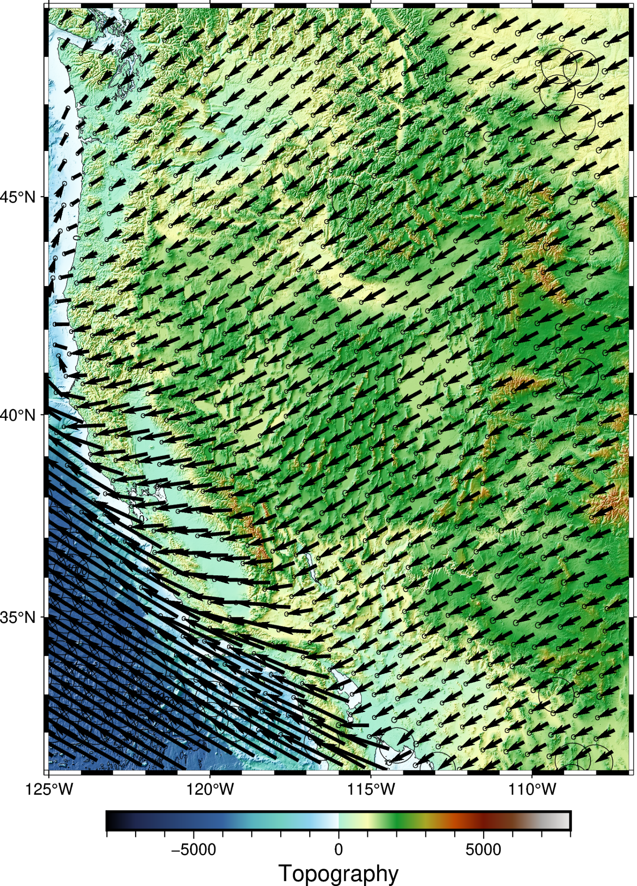
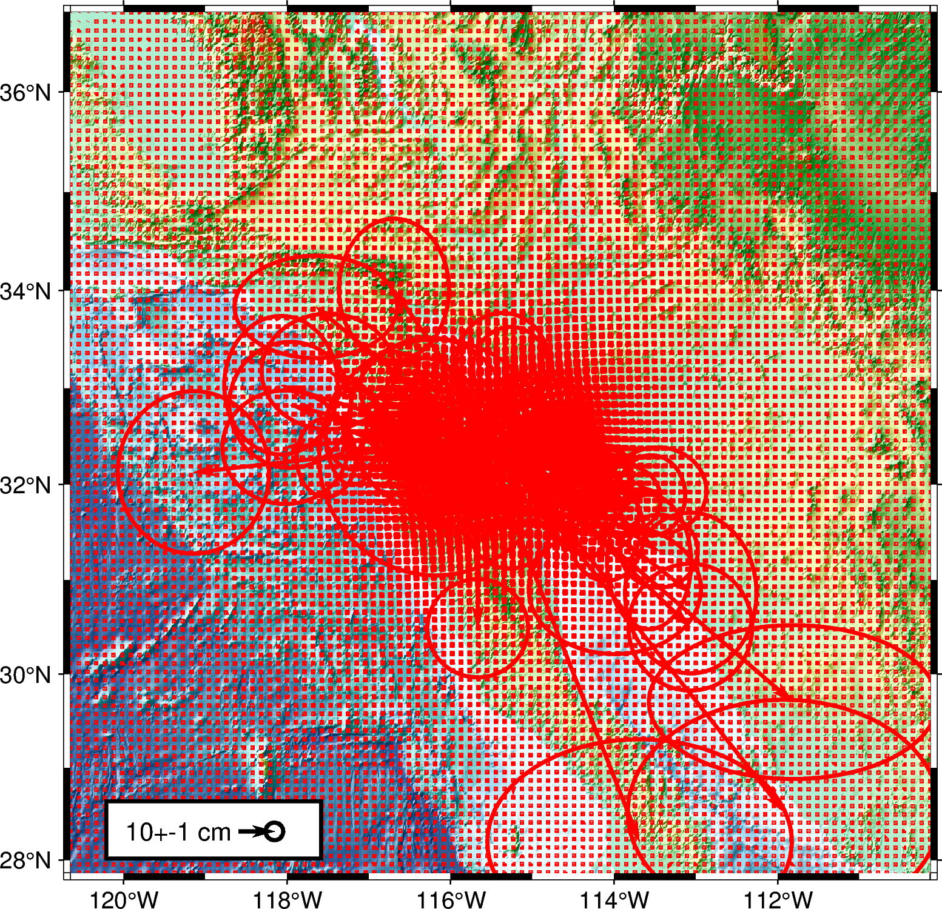
IFDM2022
Velocity grids
Earthquake displacement grids
Southwest US
2010 M7.2
El Mayor-Cucapah

Slide 35
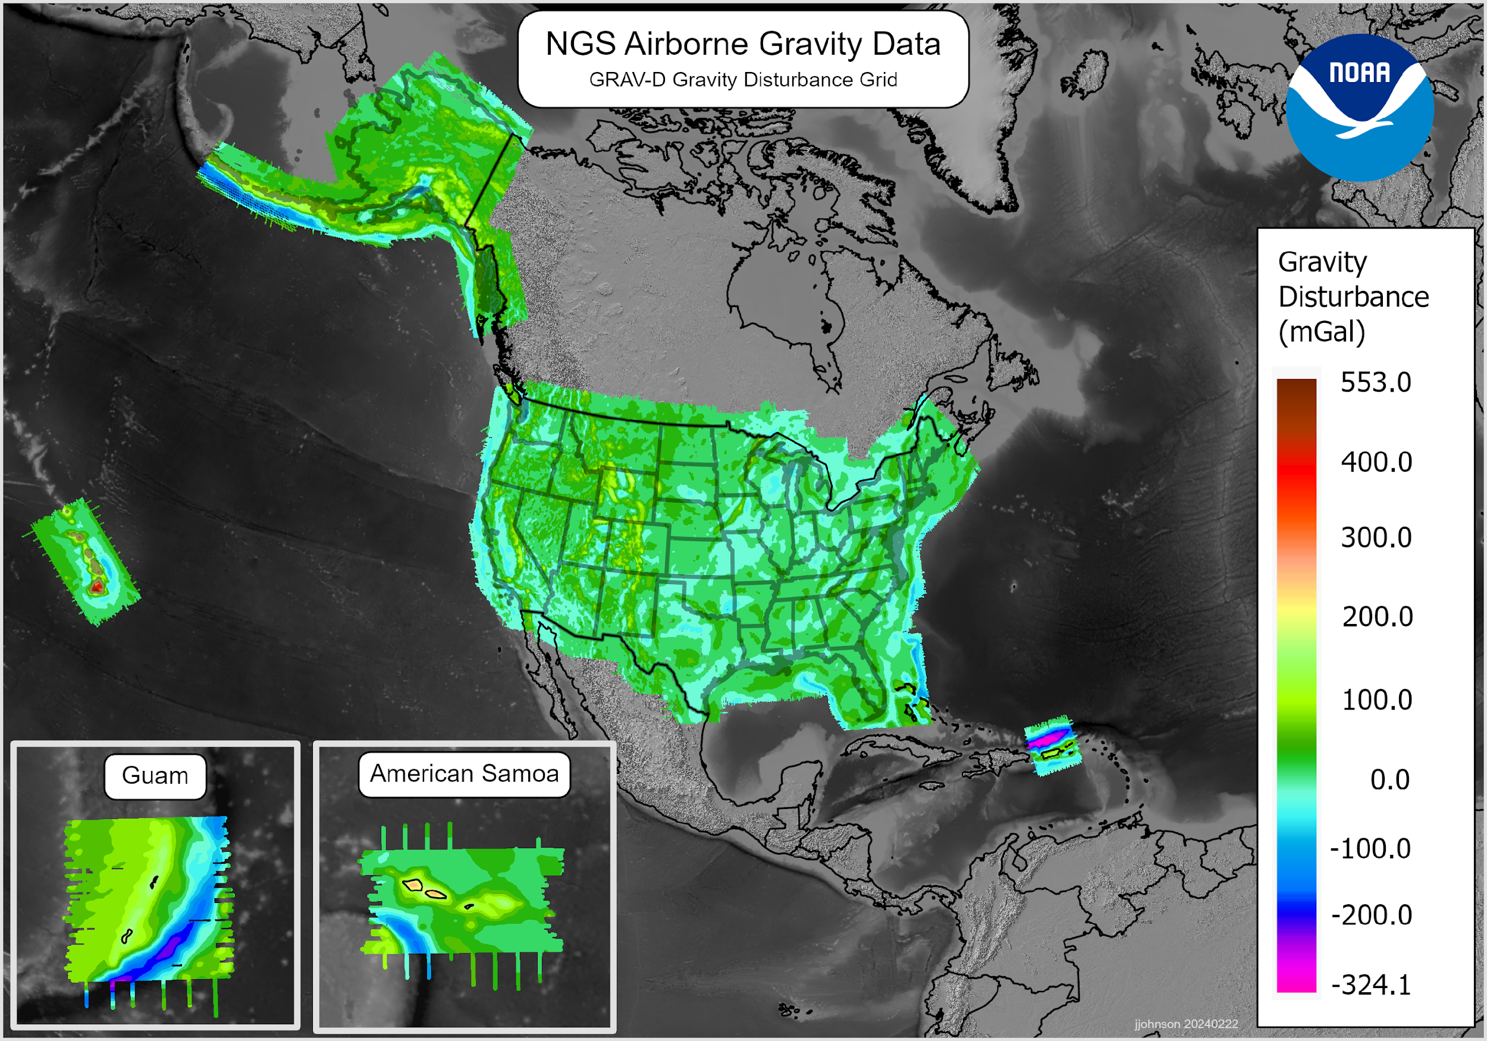
GRAV-D is 100% complete!
Our longest project – started in 2007!
15.7 million sq km
4,759 flight lines
2.3 million linear km flown
  Nearly 3 times to the moon and back!!
Final data set was sent to the geoid team in February

Slide 36
GEOID2022
A joint project between USA, Mexico and Canada since 2014
  Experimental geoid (xGEOID) models released 2014-2020
GEOID2022(alpha) was computed in 2023 and is available on the alpha site. (alpha.ngs.noaa.gov)
GRAV-D completion and GEOID2022 computation
- GEOID2022 model completion: July, 2024

Slide 37
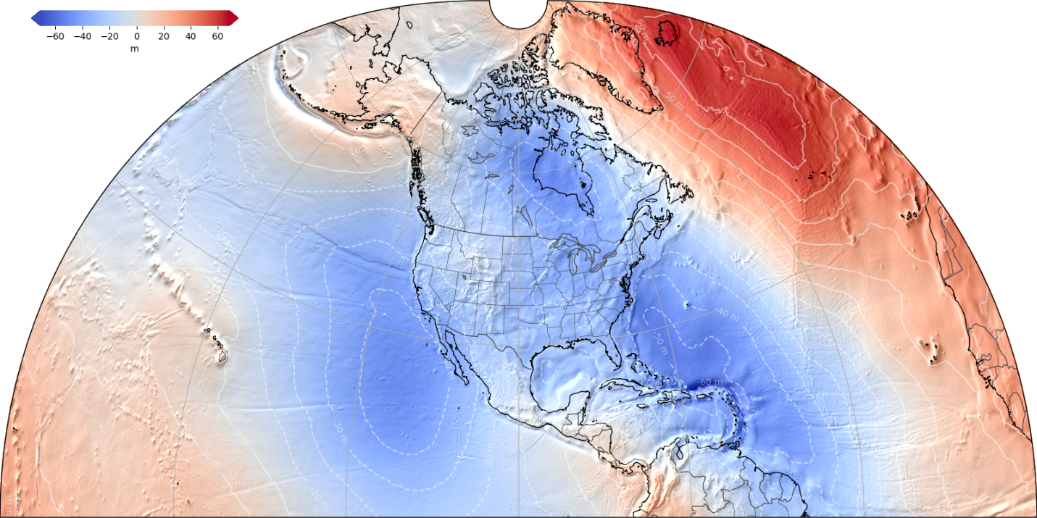
Components of NAPGD2022
GM2022 (d/o 2160)
DEM2022 (3”x3”)
SGRAV2022 (1’x1’)
SGEOID2022 (1’x1’) SGEOID2022
DGEOID2022 (1’x1’)
SDEFLEC2022 (1’x1’)
DDEFLEC2022 (1’x1’)
Uncertainty (1s) of SGEOID2022 (1’x1’)
Uncertainty (1s) of DGEOID2022 (1’x1’)
Uncertainty (1s) of SDEFLEC2022 (1’x1’)
Uncertainty (1s) of DDEFLEC2022 (1’x1’)
Gridded products will cover three areas:
North America (1/4 globe)
Guam/CNMI
American Samoa

Slide 38
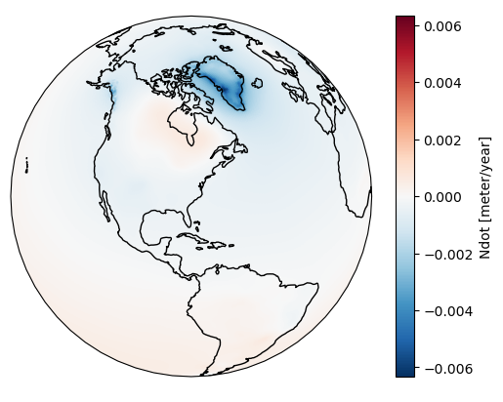
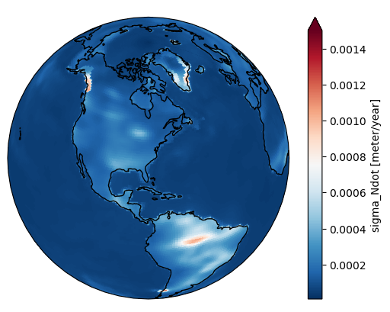
DGEOID2022 overview
  Provides GEOID undulation rates and uncertainties for orthometric projections:
  GEOID undulation rate of change
  Uncertainty in GEOID undulation rate of change

Slide 39
Reference Epoch Coordinates (RECs)
The Geometric and Orthometric REC projects are underway!
  Geometric:
    Goal: N/P/C/MATRF2022 epoch 2020.00 XYZ coordinates (=> φλh coordinates)
    About 120,000 marks
    Constrained to the NOAA CORS Network
  Orthometric
    For the first time since NAVD 88, NGS is performing a nationwide leveling adjustment!
    Goal: NAPGD2022 epoch 2020.00 orthometric heights (H)
    About 960,000 marks
    Constrained to the ellipsoid heights, h, from the geometric REC adjustment (converted to orthometric heights, H, through GEOID2022)
  Expected early results: Late 2024

Slide 40
NADCON (Not started yet)
Once the Geometric REC project is done, NADCON will be built with these transformations (φλh):
Old Datum | New Datum | Region
NAD 83(2011) epoch 2010.00 | NATRF2022 epoch 2020.00 | CONUS
NAD 83(2011) epoch 2010.00 | NATRF2022 epoch 2020.00 | ALASKA
NAD 83(PA11) epoch 2010.00 | PATRF2022 epoch 2020.00 | HAWAII
NAD 83(2011) epoch 2010.00 | CATRF2022 epoch 2020.00 | PR & VI
NAD 83(PA11) epoch 2010.00 | PATRF2022 epoch 2020.00 | AS
NAD 83(MA11) epoch 2010.00 | MATRF2022 epoch 2020.00 | GUAM & CNMI

Slide 41
VERTCON (Not started yet)
Once the Orthometric REC project is done, VERTCON will be built with these transformations (H):
Old Datum | New Datum | Region
NAVD 88 | NAPGD2022 epoch 2020.00 | CONUS
NAVD 88 | NAPGD2022 epoch 2020.00 | ALASKA
PRVD 02 | NAPGD2022 epoch 2020.00 | PR
VIVD 09 | NAPGD2022 epoch 2020.00 | VI
ASVD 02 | NAPGD2022 epoch 2020.00 | AS
NMVD 03 | NAPGD2022 epoch 2020.00 | CNMI
GUVD 04 | NAPGD2022 epoch 2020.00 | GUAM

Slide 42
Tools
LASER
M-PAGES
SPROCCET
CORS Selection tool
OPUS
DDS

Slide 43
LASER
Least-squares Adjustments: Statistics, Estimates and Residuals
Replaces all of NGS’s multiple, disconnected LSA software tools
Support for these least-squares adjustments:
  3-D geometric (GNSS + classical)
  Orthometric
  Horizontal gravimetric
  Vertical gravimetric
  Calibration baselines
Will do all of the adjustments in OPUS

Slide 44
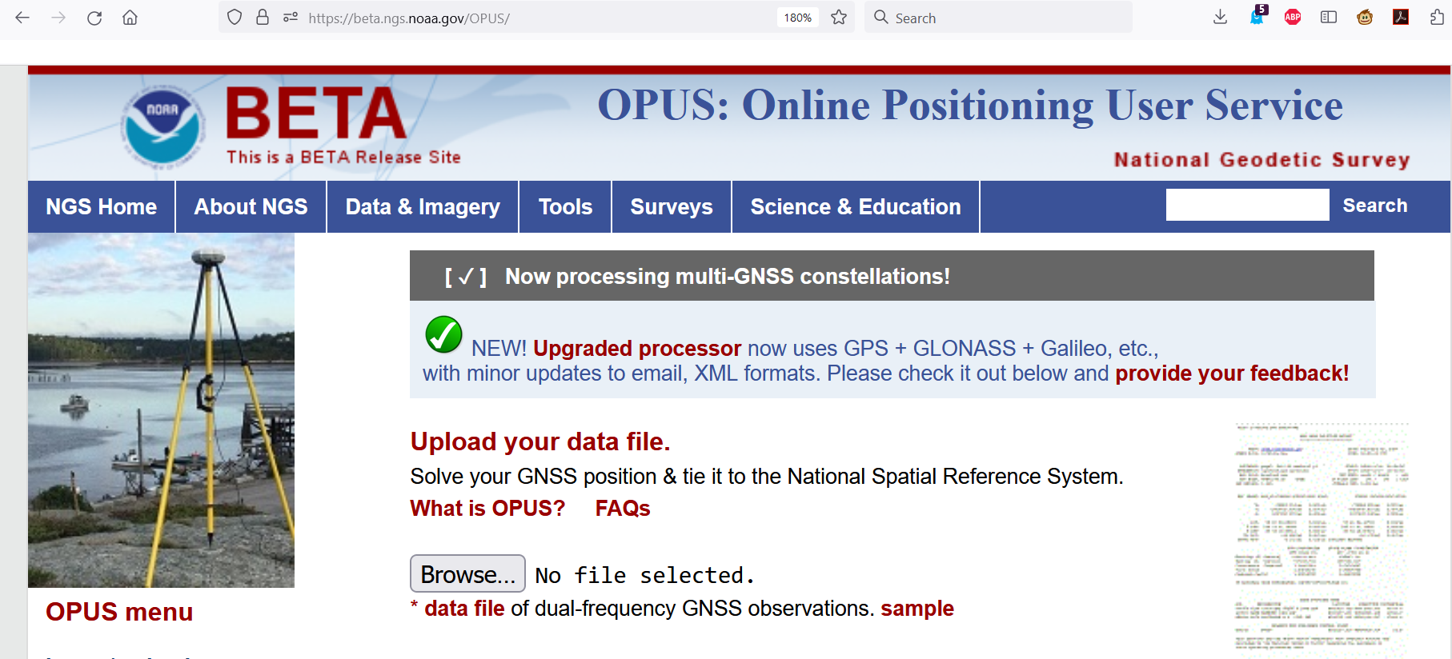
GPS/GLONASS/Galileo/Beidou/ETC
New M-PAGES software exists
  Can process any GNSS constellation with two frequencies
Can be accessed for testing through a BETA release of OPUS-S
beta.ngs.noaa.gov/OPUS

Slide 45
SPROCCET overview
Software for Projecting Observations, Constraints and Cofactor matrices/Errors through Time.
SPROCCET incorporates the following models:
  14H – 14 parameter Helmert transformations
  IFDM2022 – East, North, Up changes (velocity + displacement) of marks over time
  DGEOID2022 – Up changes (velocity) of GEOID2022 over time
Replaces HTDP
  In addition to all of the IFDM2022 improvements
  Allows projecting orthometric data through time
SPROCCET (and its 3 models) will eventually be incorporated into NCAT

Slide 46
CORS selection tool
Relies on a a daily quantitative measure (a “score”)
  How well is the given station behaving
  Data availability? Data quality?
Project Status:
  Deployed on OPUS-S 5.0 BETA in December 2023
  Will be built into every part of OPUS for the modernized NSRS

Slide 47
OPUS
OPUS-Projects updated last year
  Version 5.1: Bluebooking done for you, loads to the NGS IDB
  https://geodesy.noaa.gov/OPUS-Projects/OpusProjects.shtml
OPUS-S with M-PAGES (multi-GNSS!) on beta just released!
  https://beta.ngs.noaa.gov/OPUS

Slide 48
OPUS (Now)
geodesy.noaa.gov
OPUS-RS (GPS/MPGPS/NAD 83)
RINEX 2
(GPS)
E-mailed solution
OPUS-S (GPS/PAGES/NAD 83)
OPUS-Share
OPUS-Projects (GPS/PAGES/HTDP/ADJUST/NAD 83)
NGS IDB
GVX
(GNSS)
beta.ngs.noaa.gov
RINEX 2/3
(GNSS)
E-mailed solution
OPUS-S
(GNSS/M-PAGES/NAD 83)

Slide 49
OPUS (Soon)
geodesy.noaa.gov
OPUS-RS (GPS/MPGPS/NAD 83)
RINEX 2
(GPS)
E-mailed solution
OPUS-S (GPS/PAGES/NAD 83)
OPUS-Share
OPUS-Projects (GPS/PAGES/HTDP/ADJUST/NAD 83)
NGS IDB
GVX
(GNSS)
beta.ngs.noaa.gov
RINEX 2/3
(GNSS)
E-mailed solution
OPUS-S
(GNSS/M-PAGES/NATRF2022)

Slide 50
OPUS (By end of 2025)
geodesy.noaa.gov
OPUS-RS (GPS/MPGPS/NAD 83)
RINEX 2
(GPS)
E-mailed solution
OPUS-S (GPS/PAGES/NAD 83)
OPUS-Share
OPUS-Projects (GPS/PAGES/HTDP/ADJUST/NAD 83)
NGS IDB
GVX
(GNSS)
beta.ngs.noaa.gov
E-mailed solution
OPUS-S
(GNSS/M-PAGES/NATRF2022)
RINEX 2/3
(GNSS)
NSRS DB
Converter
(RINEX3/GNSS -> RINEX 2/GPS)
Converter
(GVX->GDX)
GVX
(GNSS)
OPUS-Projects (GPS/PAGES/SPROCCET/LASER/NATRF2022)
GDX
(GNSS)
Notes:
NATRF2022 => N/P/C/MATRF2022 plus ITRF2020
Where is OPUS-RS? That remains an open question.

Slide 51
OPUS (Out-years)
geodesy.noaa.gov
E-mailed solution
OPUS-S
(GNSS/M-PAGES/NATRF2022)
RINEX 3
(GNSS)
NSRS DB
Converter
(RINEX3/GNSS -> RINEX 2/GPS)
GDX
(GNSS)
OPUS-Projects (GPS/PAGES/SPROCCET/LASER/NATRF2022)
beta.ngs.noaa.gov
E-mailed solution
Smartphone Pictures and locations
OPUS 6
(GNSS/Classical/Leveling/Gravity)
(M-PAGES/SPROCCET/LASER/NATRF2022)
NSRS DB
RINEX 3/4
(GNSS)
GDX
(GNSS/Classical/Leveling/Gravity)
Notes:
NATRF2022 => N/P/C/MATRF2022 plus ITRF2020
Where is OPUS-RS? That remains an open question.

Slide 52
Data Delivery System
New “datasheets” for marks and stations have been designed with a common look and feel

Slide 53
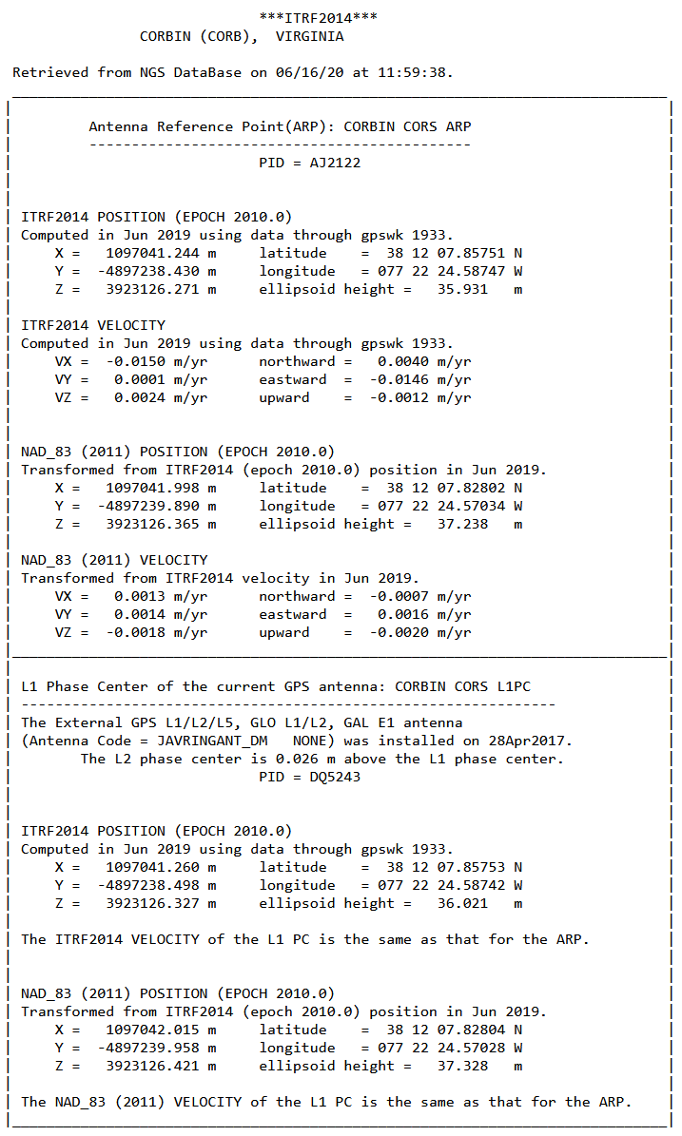
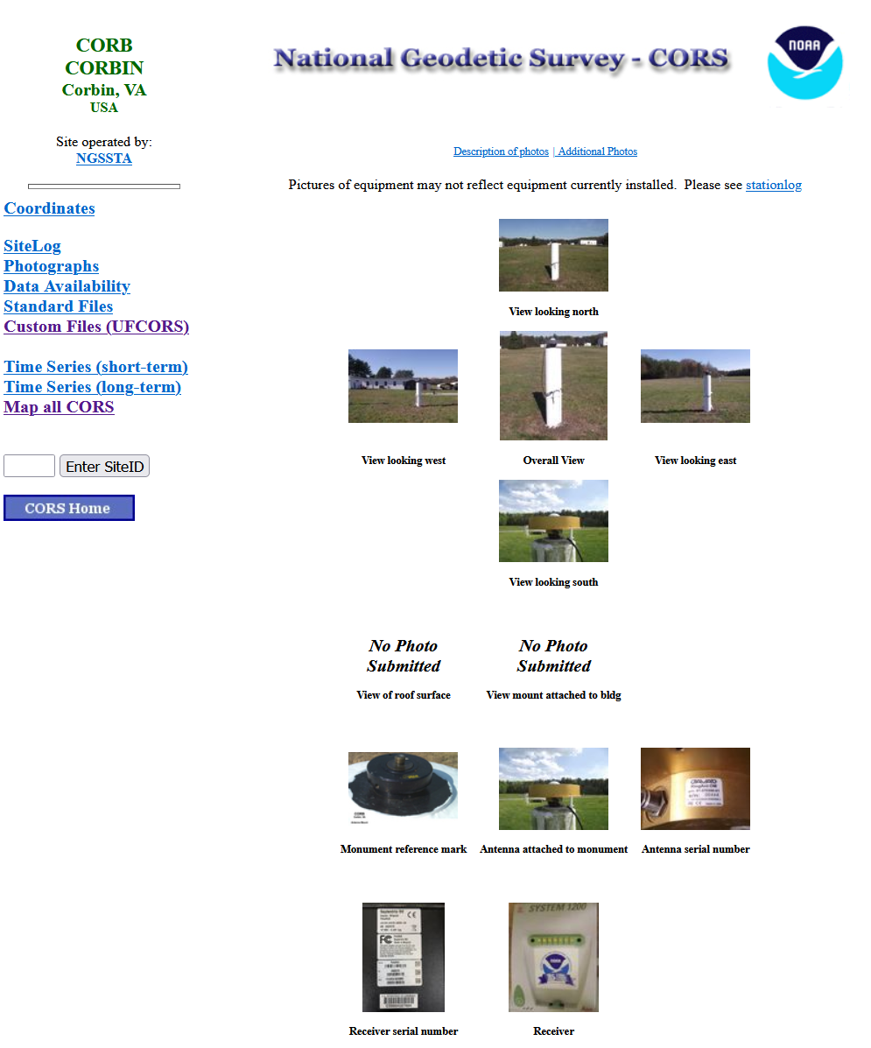
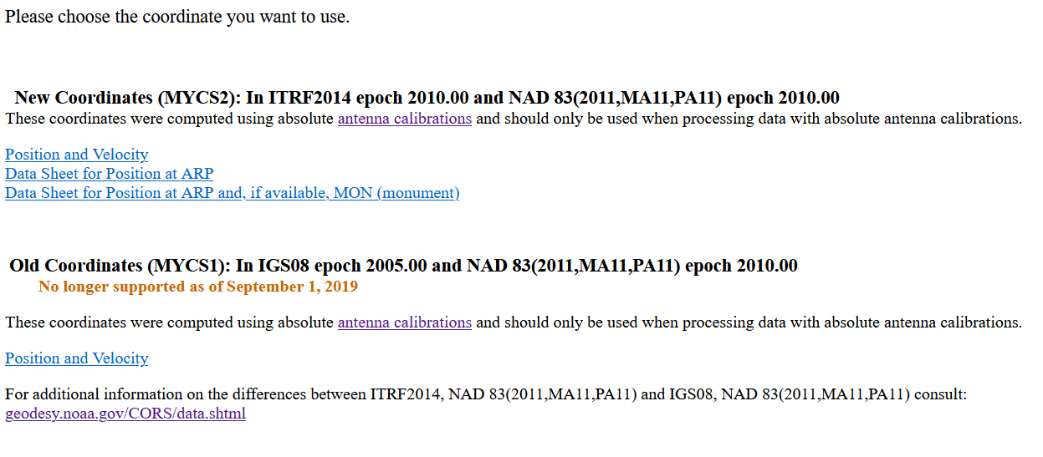
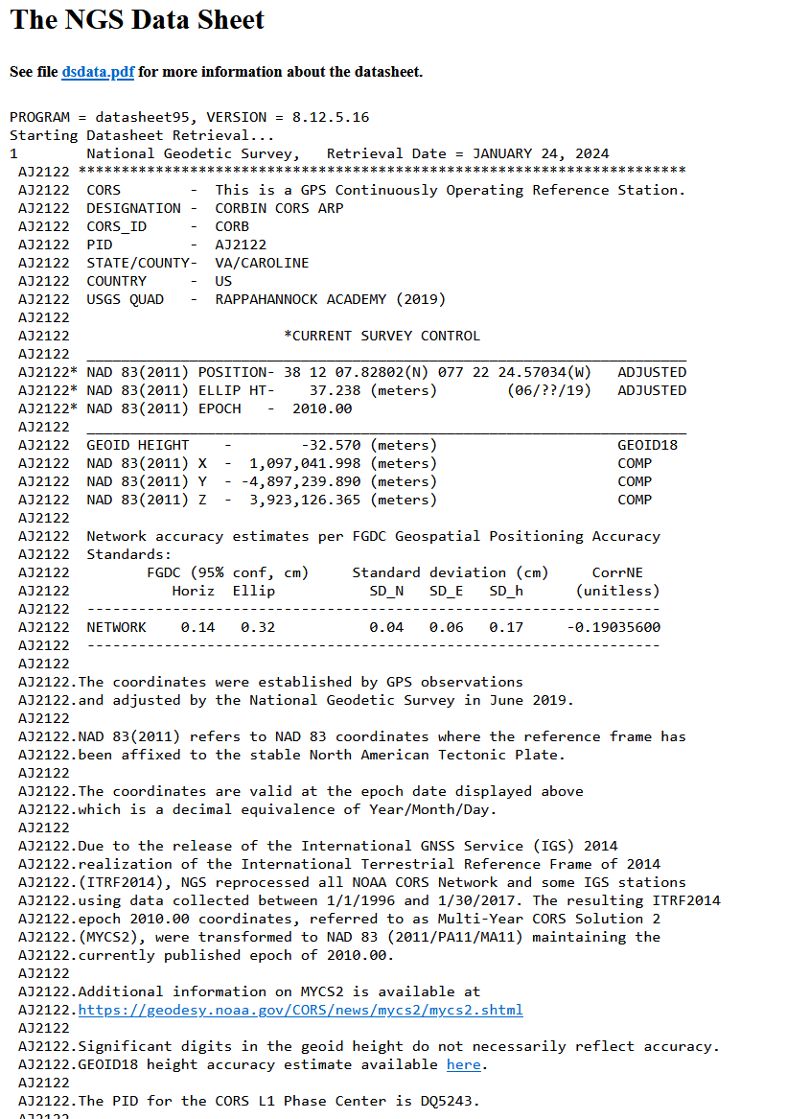
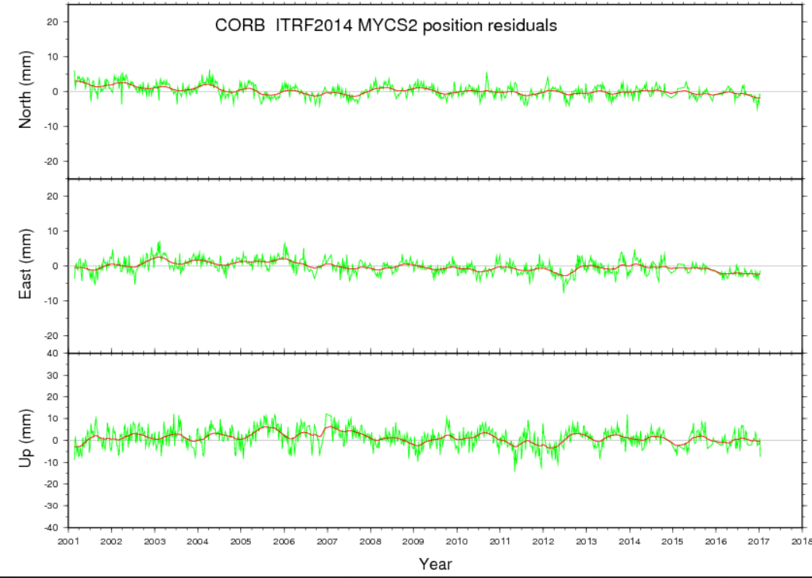
A new station “datasheet”
First, here’s what you have today:

Slide 54
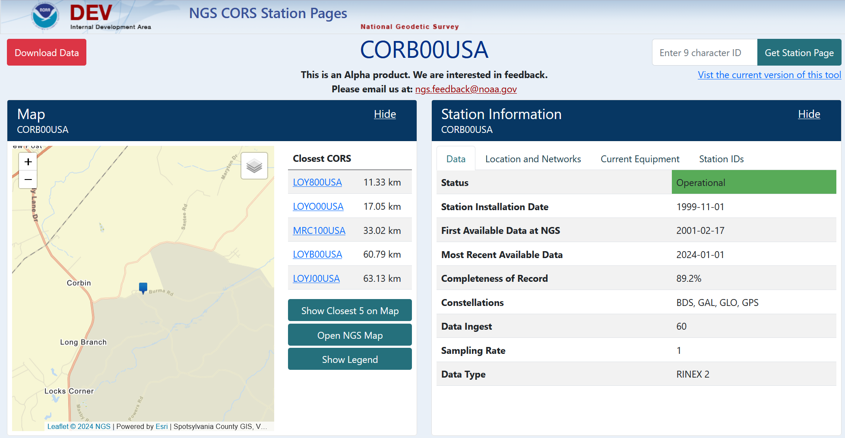
A new station “datasheet”
https://devaws.nosngs.noaa/DDS/CORS/index.html?stationID=CORB00USA

Slide 55
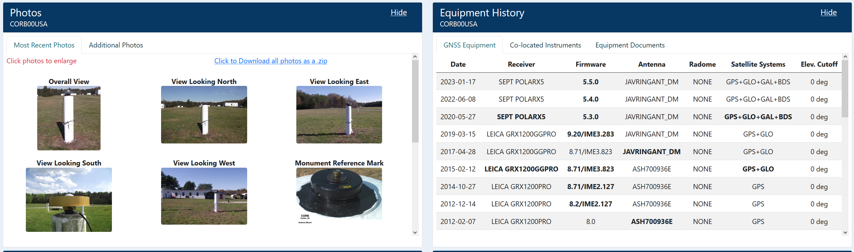
A new station “datasheet”

Slide 56
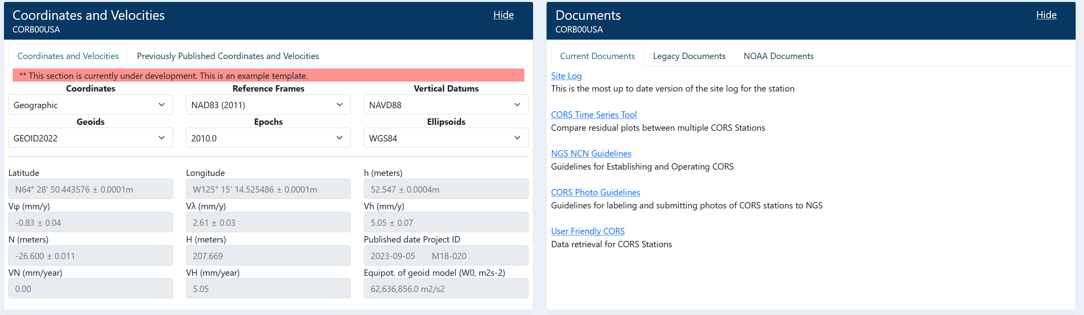
A new station “datasheet”

Slide 57
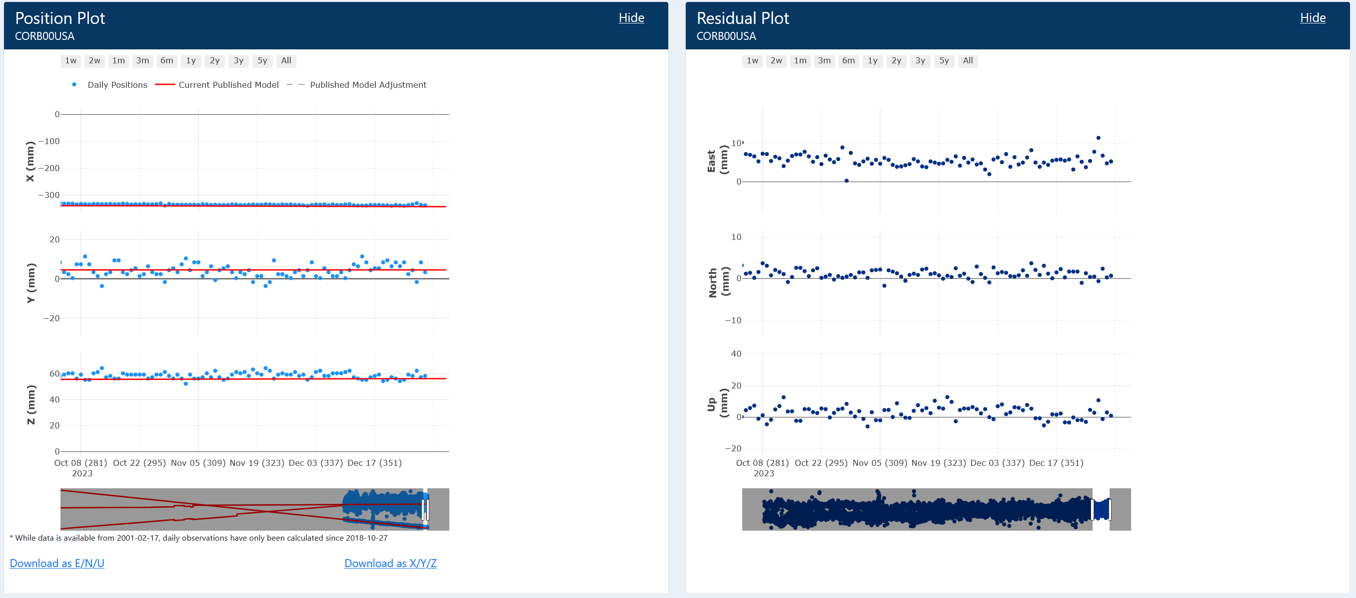
A new station “datasheet”

Slide 58
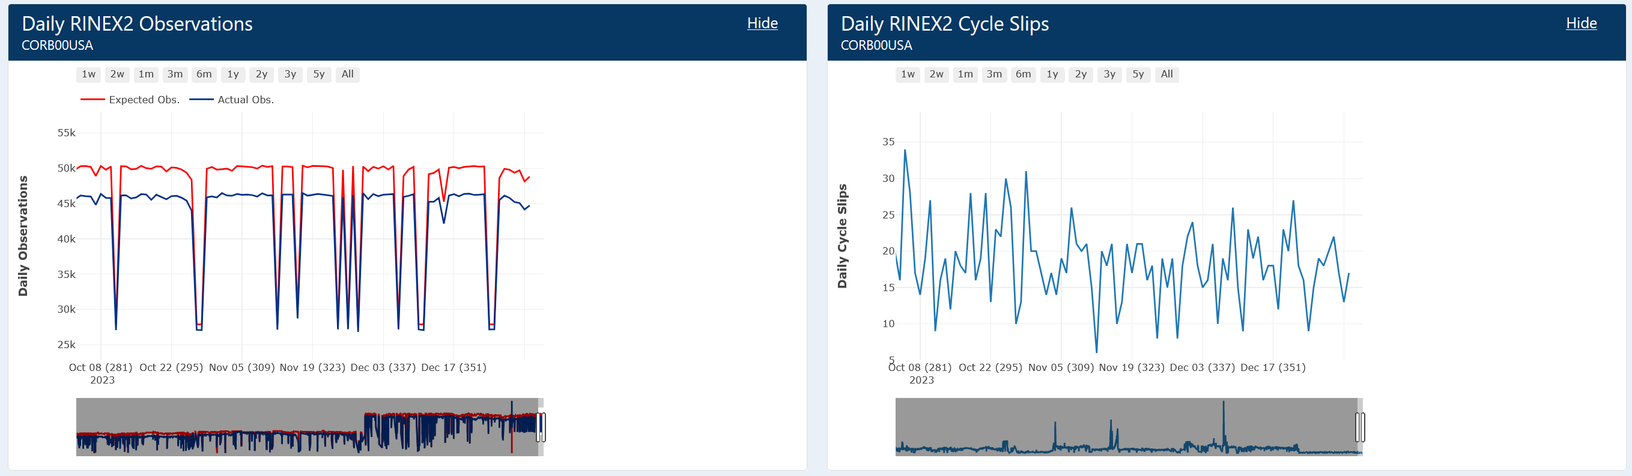
A new station “datasheet”

Slide 59
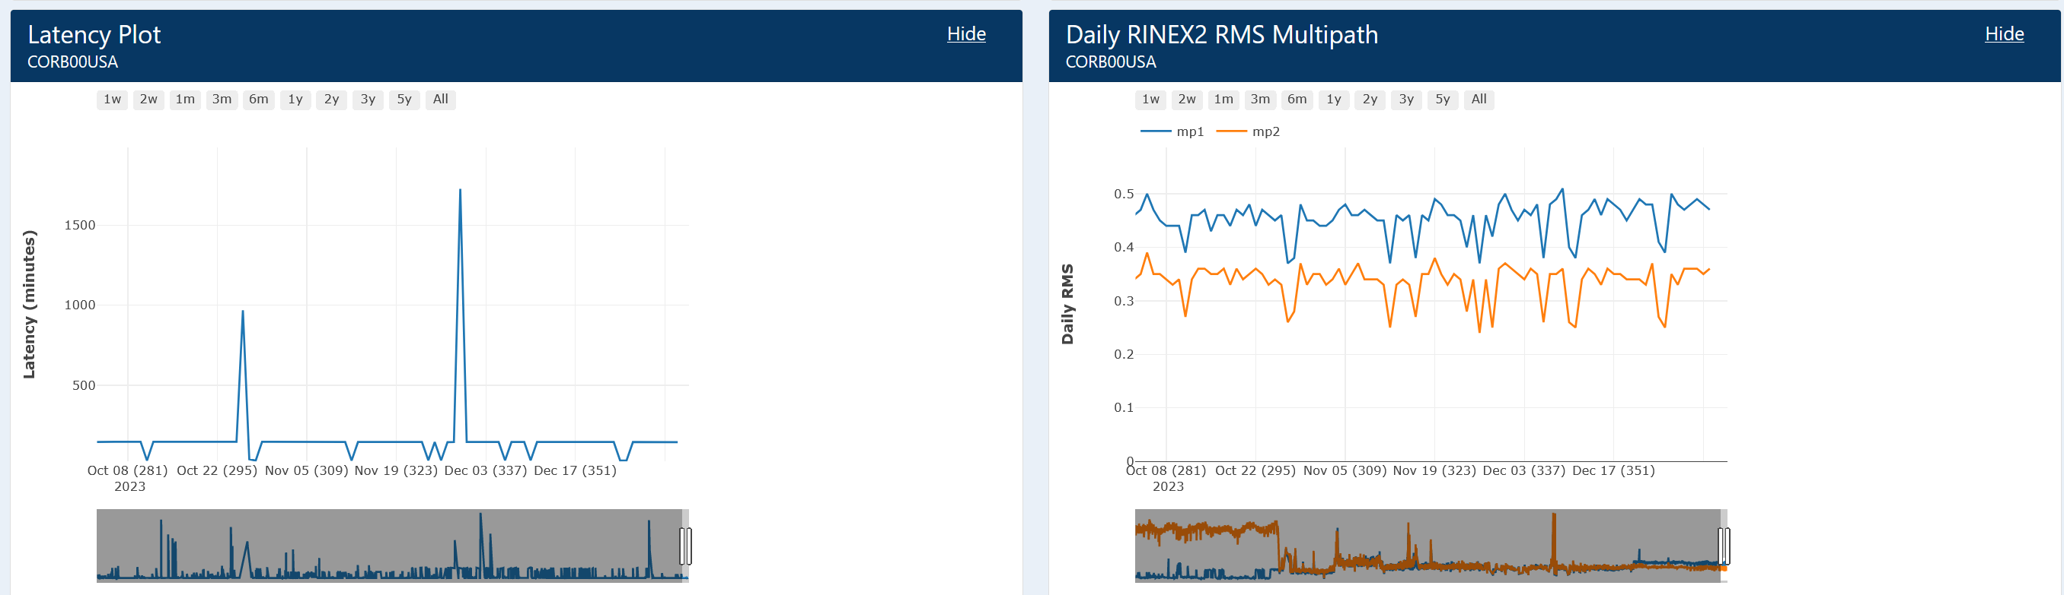
A new station “datasheet”

Slide 60
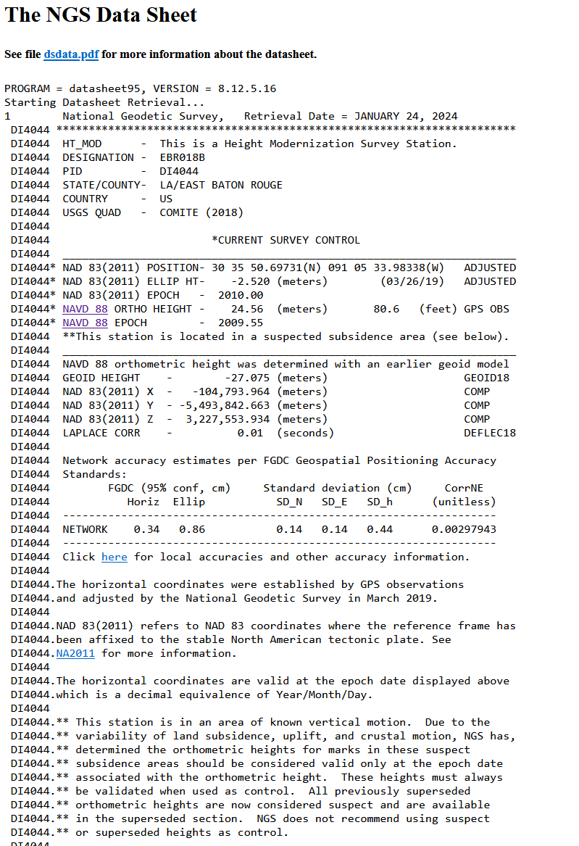
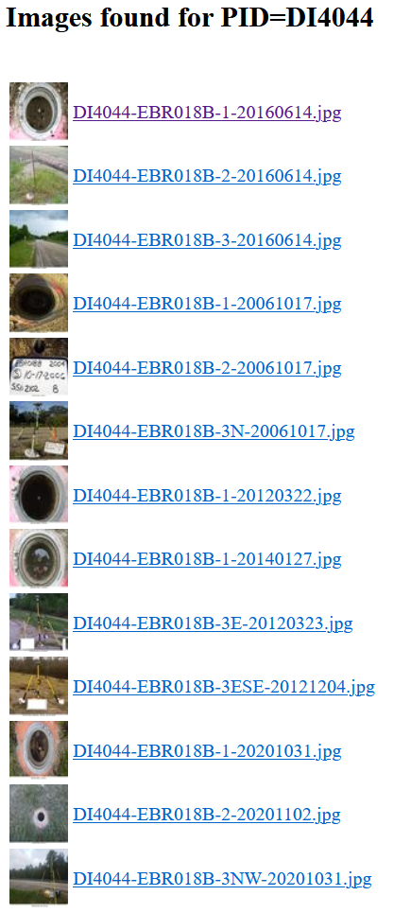
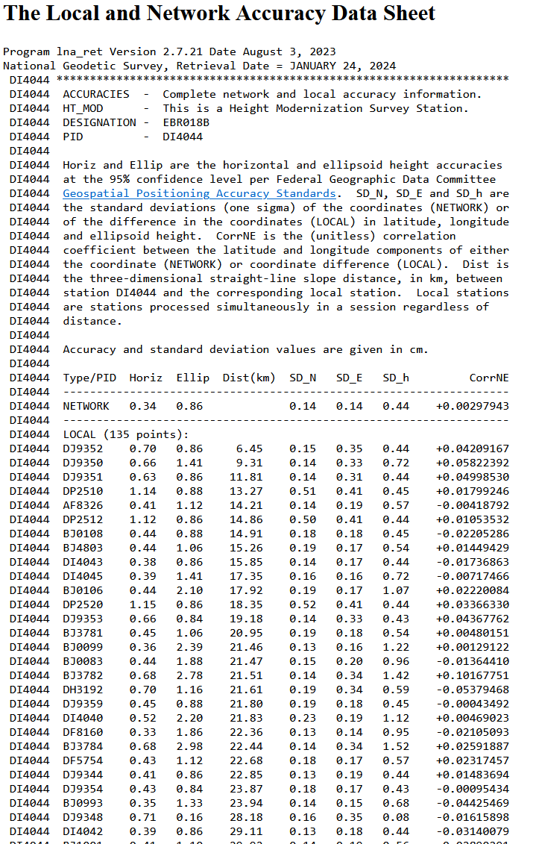
A new mark “datasheet”
First, here’s what you have today:

Slide 61
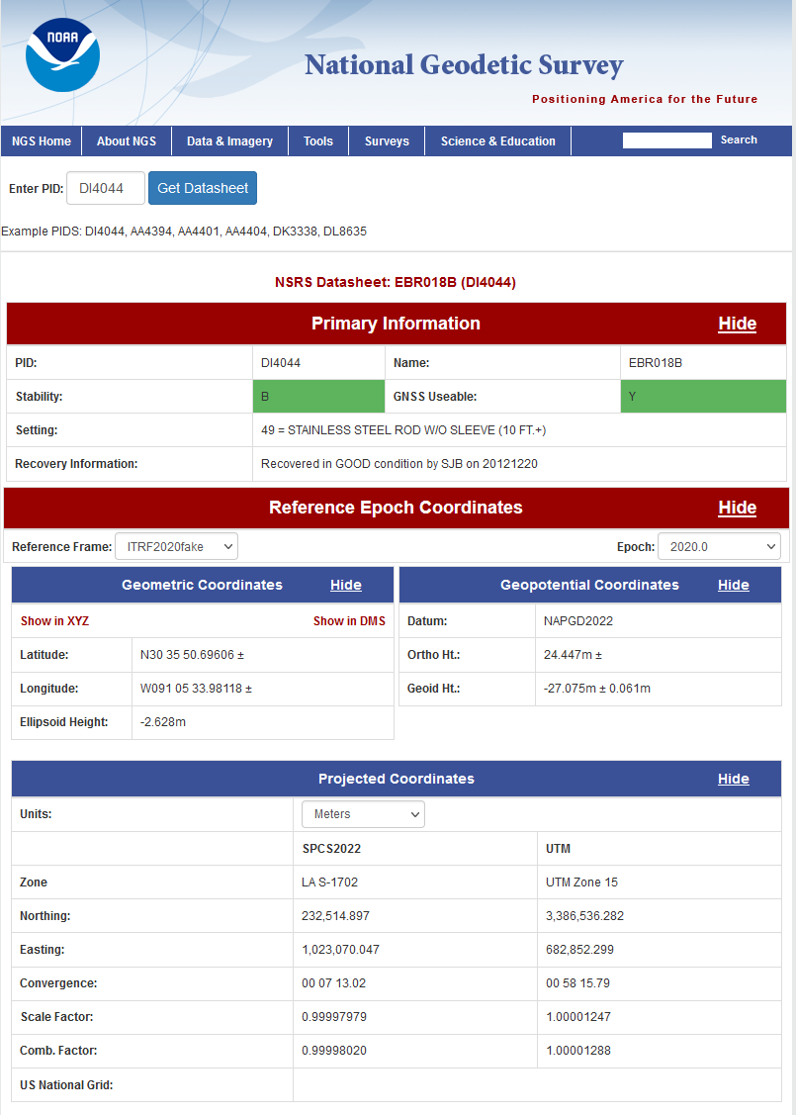
A new mark “datasheet”
https://devaws.nosngs.noaa/datasheets/new_datasheet/index.html

Slide 62
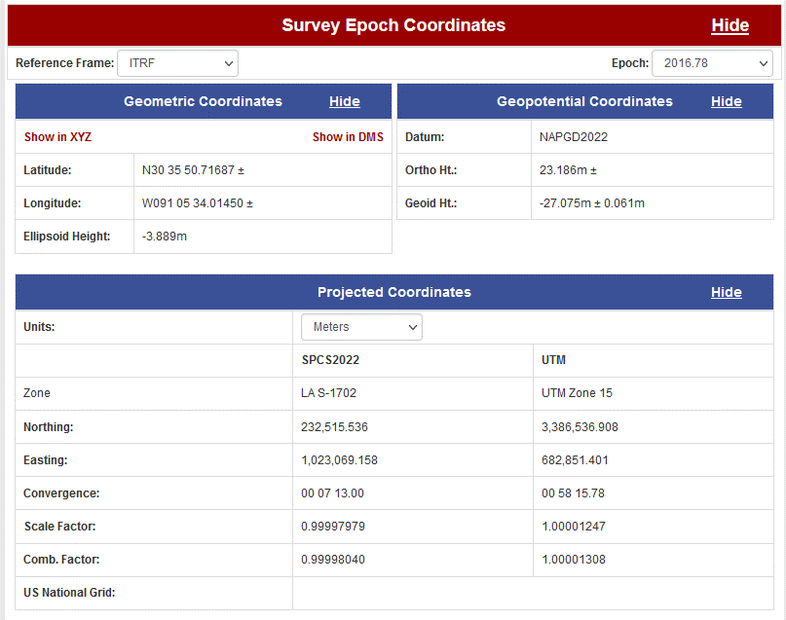
A new mark “datasheet”

Slide 63
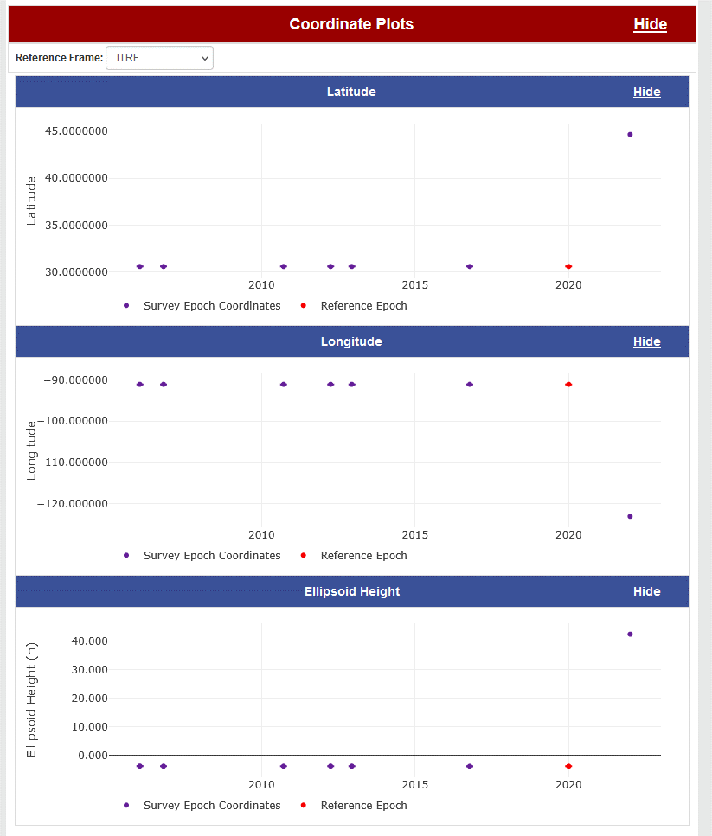
A new mark “datasheet”

Slide 64
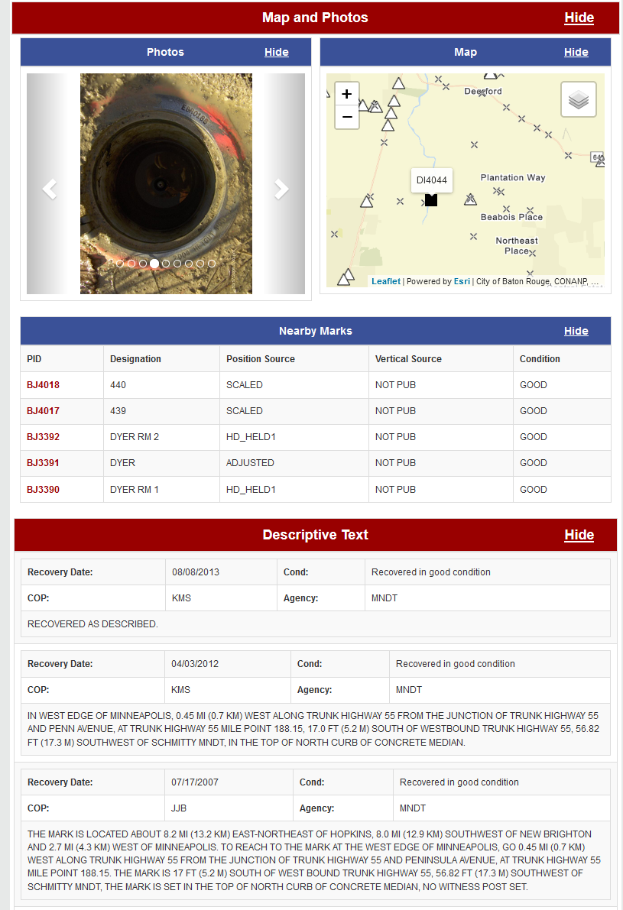
A new mark “datasheet”

Slide 65
Timeline

Slide 66
Timeline
In 2022, NGS diverted resources from tool-building to data assurance
  “Limited tools, excellent coordinates”
  Set a goal of roll-out by 2025
NGS is on-track to roll out the modernized NSRS by the middle of 2025.
Work on additional tools will continue in the out-years

Slide 67
Rollout, Testing, Replacement

Slide 68
Rollout, Testing, Replacement
NGS will roll out components of the modernized NSRS over time (2024-2025)
As each component is rolled out, it can be tested
Once the final component (likely VERTCON) is rolled out (likely late 2025), testing will continue for at least 6 months
Once enough testing is done, and all modernized NSRS components seem stable and correct, the FGCS will vote (likely 2026)
If affirmative, the modernized NSRS will replace the current NSRS

Slide 69
Current NSRS during rollout and testing
While the modernized NSRS is being rolled out and tested, the current NSRS will remain the official NSRS of the United States
  This will not change until the FGCS vote (probably 2026)
URL geodesy.noaa.gov will only hold the official NSRS
  Currently NAD 83, NAVD 88, etc.
Only one major improvement to the current NSRS is expected during this time:
  ITRF2020 in all products and services

Slide 70
Snapshot of the modernized NSRS at the end of initial rollout
Not everything promised in the Blueprint documents will be built in time for the initial rollout. But the following will be:
  ITRF2020, N/P/C/MATRF2022, NAPGD2022, SPCS2022
  NSRS Database, new datasheets for marks and stations
  RECs
  OPUS-S with multi-GNSS
  OPUS-Projects (GPS only):
    GDX, SPROCCET, LASER, NSRS DB submission
    The ability for NGS to generate RECs from OPUS submissions in a timely manner

Slide 71
Rollout onto Beta
geodesy.noaa.gov:
ITRF2020 on NCN
SPCS 83
NAVD 88
OPUS-Share
NADCON 5
OPUS-S (GNSS)
NAD 83
GEOID18
OPUS-RS (GPS)
VERTCON 3
OPUS-Projects (GPS)
(Bluebooking, HTDP, ADJUST, NGS IDB, Datasheets)
DEFLEC18
beta.ngs.noaa.gov:
ITRF2020 on NCN
EPP2022
Geometric RECs
in N/P/C/MATRF2022
N/P/C/MATRF2022
NADCON 6?
SPCS2022
IFDM2022
GM2022
Orthometric RECs
in N/P/C/MATRF2022
VERTCON 4?
GEOID2022
GRAV2022
NAPGD2022
DEM2022
DEFLEC2022
OPUS-Projects (GPS)
(GDX, SPROCCET, LASER, NSRS DB, New Datasheets)
OPUS-S (GNSS)
Mid 2024
Late 2024
Early 2025
Late 2025

Slide 72
Testing into replacement
From late 2025 into sometime in 2026, all modernized NSRS components on Beta will go through testing and feedback
After the FGCS vote, a few months of work remain:
  The FGCS will issue an FRN officially announcing the adoption of the modernized NSRS as the official NSRS
  The beta website may be wiped of submitted data*
  All modernized NSRS components moved to the Official website
    Submissions will then begin in earnest and won’t be deleted
  All current NSRS components moved….elsewhere
    No further submissions to the NGS IDB will be allowed at this point
Notes:
Notes: NGS is considering what to do with data submitted during testing. The cleanest solution is to delete it as “test data” and not attempt to move it onto the Official website. If we were to consider moving it to Official, we would need to re-submit the data to ourselves, which is a tremendous amount of work. It is best to assume that NGS will ask submitters to re-submit after the switch.

Slide 73
After testing and the FGCS vote
geodesy.noaa.gov:
ITRF2020 on NCN
SPCS 83
NAVD 88
OPUS-Share
NADCON 5
OPUS-S (GNSS)
NAD 83
GEOID18
OPUS-RS (GPS)
VERTCON 3
“Elsewhere”
OPUS-Projects (GPS)
(Bluebooking, HTDP, ADJUST, NGS IDB, Datasheets)
DEFLEC18
beta.ngs.noaa.gov:
ITRF2020 on NCN
EPP2022
Geometric RECs
in N/P/C/MATRF2022
N/P/C/MATRF2022
NADCON 6?
SPCS2022
IFDM2022
GM2022
Orthometric RECs
in N/P/C/MATRF2022
VERTCON 4?
GEOID2022
GRAV2022
NAPGD2022
DEM2022
DEFLEC2022
OPUS-Projects (GPS)
(GDX, SPROCCET, LASER, NSRS DB, New Datasheets)
OPUS-S (GNSS)
All submissions provided during testing may get deleted

Slide 74
After testing and the FGCS vote
geodesy.noaa.gov:
ITRF2020 on NCN
EPP2022
Geometric RECs
in N/P/C/MATRF2022
N/P/C/MATRF2022
NADCON 6?
SPCS2022
IFDM2022
GM2022
Orthometric RECs
in N/P/C/MATRF2022
VERTCON 4?
GEOID2022
GRAV2022
NAPGD2022
DEM2022
DEFLEC2022
OPUS-Projects (GPS)
(GDX, SPROCCET, LASER, NSRS DB, New Datasheets)
OPUS-S (GNSS)
All submissions from this point forward get saved
“Elsewhere”
ITRF2020 on NCN
SPCS 83
NAVD 88
OPUS-Share
NADCON 5
OPUS-S (GNSS)
NAD 83
GEOID18
OPUS-RS (GPS)
VERTCON 3
OPUS-Projects (GPS)
(Bluebooking, HTDP, ADJUST, NGS IDB, Datasheets)
DEFLEC18
No submissions to the NGS IDB allowed any longer

Slide 75
Summary
The modernized NSRS is coming soon!
  Starting this year!
All components should be on Beta by 2025
  For testing only!
It won’t replace the current NSRS until an FGCS vote (2026)
NGS will continue to support the current NSRS through the rollout and testing of the modernized NSRS

Slide 76
Thank you!

Slide 77
Questions?

Slide 78
Extra Slides

Slide 79
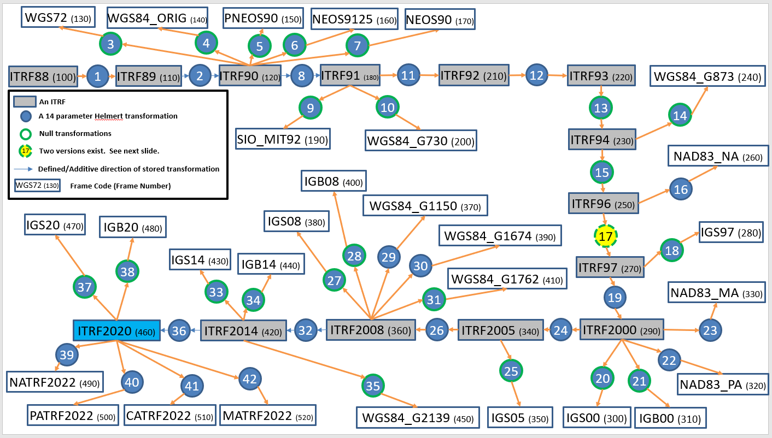
14H overview
Transforms data from one reference frame to another via a connected network:

Slide 80
Reference Epoch Coordinates (RECs)
The REC team uses LASER* for its adjustments.
Recent national adjustments have been run (LASER v 2.4.0) on LINUX:
Type | Observations | Parameters | Constraints | Time to estimate coordinates only | Time to estimate coordinates and their variances
Geometric (XYZ => φλh) | 1,891,476 (630,492 baselines) | 350,283 (116,761 marks) | 4,380 (1,460 CORS GRPs) | 10m 20s | 12h 4m
Orthometric (H) | 2,076,591 leveled height differences | 964,037 orthometric heights at marks | 46,072 orthometric heights at marks** | 3m 4s | 14h 56m
GEOID2022
* = See later in this talk
Notes:
** Marks from the geometric REC adjustment that have an estimated ellipsoid height, which is combined with GEOID2022 to yield a constrained orthometric height for this adjustment

Slide 81
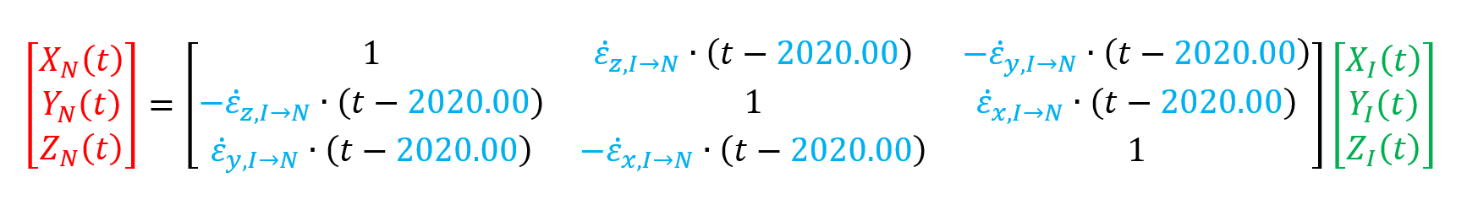
EPP2022
Relates XYZ coordinates in ITRF2020 to N/P/C/MATRF2022
Each frame has 3 values that make up its contribution to EPP2022.
With four frames, that is twelve values total in EPP2022.

Slide 82
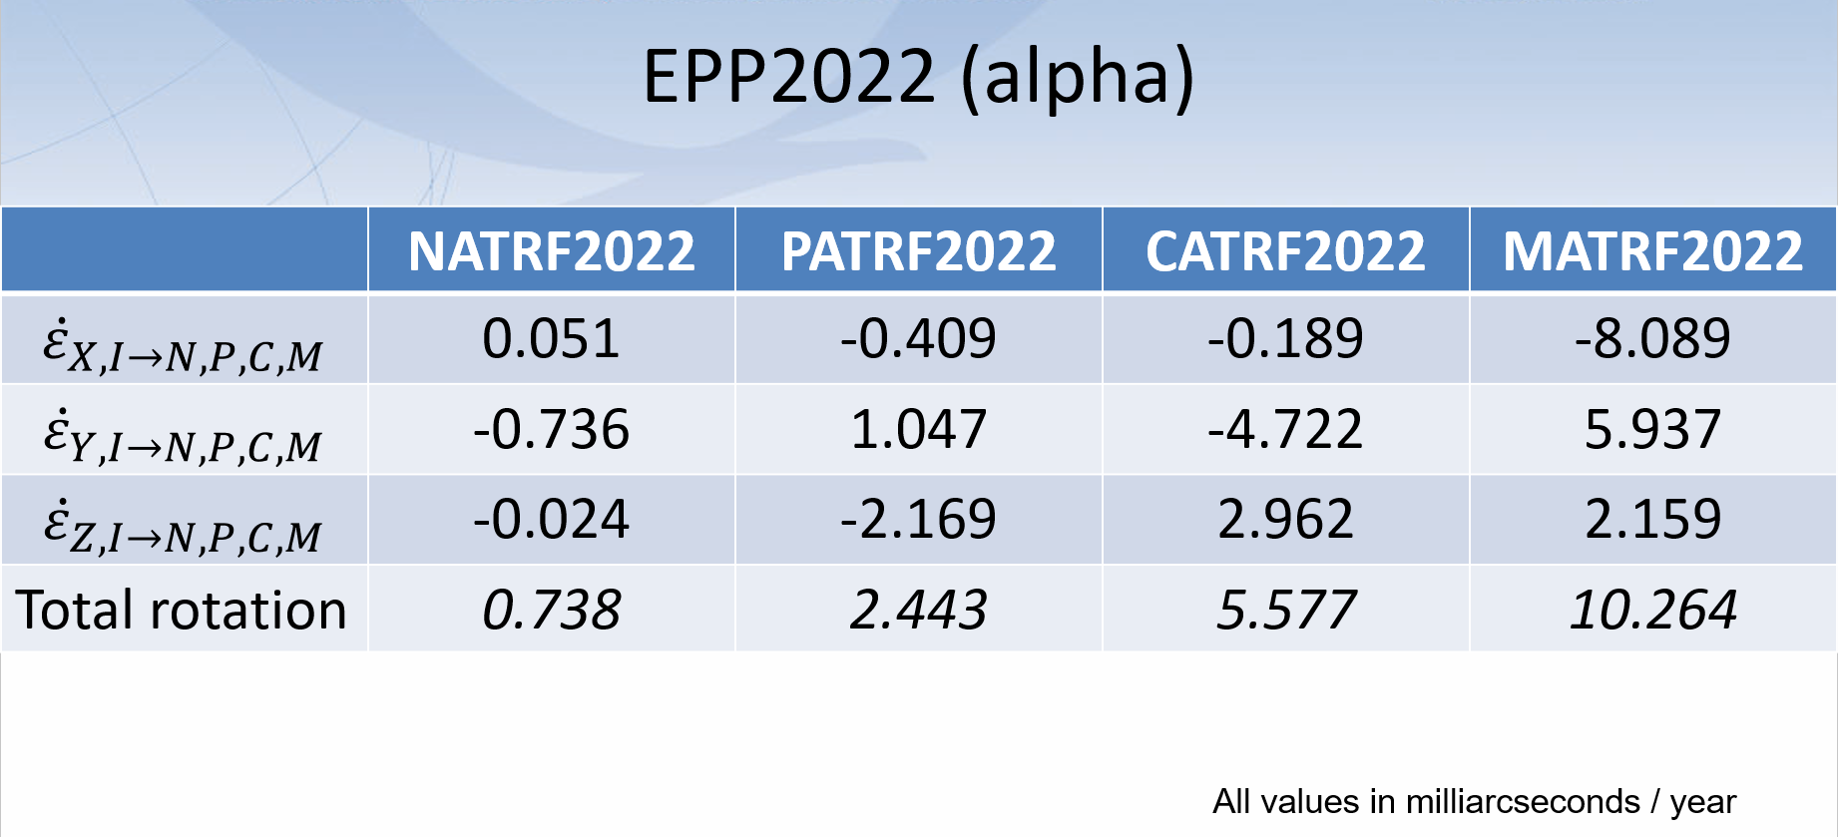
EPP 2022 alpha values released

Slide 83
Initial rollout
NGS promised many things in the three Blueprint documents
Not all can be built in a timely manner
So when we say “rollout”, we mean initial rollout, which is at least the minimum viable products needed to replace the current NSRS with the modernized NSRS
Future products and services supporting the modernized NSRS will be rolled-out after the FGCS vote

Slide 84
Less stand-alone products
NGS is building SPROCCET
  Replaces HTDP
  Contains IFDM2022, 14H, DGEOID2022
    Projects any geodetic data through time
  Will be plugged directly into the modernized OPUS-Projects
  In 2025, users will engage with it via OPUS-Projects
  Post-2025, will be incorporated into NCAT and VDatum
    Like NADCON, VERTCON, UTMS, USNG, SPCS2022, GEOID2022
    This is a non-trivial change, but can be done correctly

Slide 85
Official, Beta and Alpha
Websites
Work performed
by NGS employees,
not on any web site:
www.ngs.noaa.gov
beta.ngs.noaa.gov
SPCS2022
SPCS2022 (incomplete)
alpha.ngs.noaa.gov
Notes:
Only occasional products, not yet complete, will be put on Alpha.
Nothing will move from Alpha to Beta. Rather, work will continue on the incomplete product. When it is ready(complete), the Alpha version will be deleted and the complete version will be loaded onto Beta.

Slide 86
Official, Beta and Alpha
Websites
Work performed
by NGS employees,
not on any web site:
www.ngs.noaa.gov
ITRF2020 coordinate functions on NCN stations
beta.ngs.noaa.gov
SPCS2022
alpha.ngs.noaa.gov
Notes:
Most products will not be released in an incomplete state. Therefore they will be loaded directly onto Beta.

Slide 87
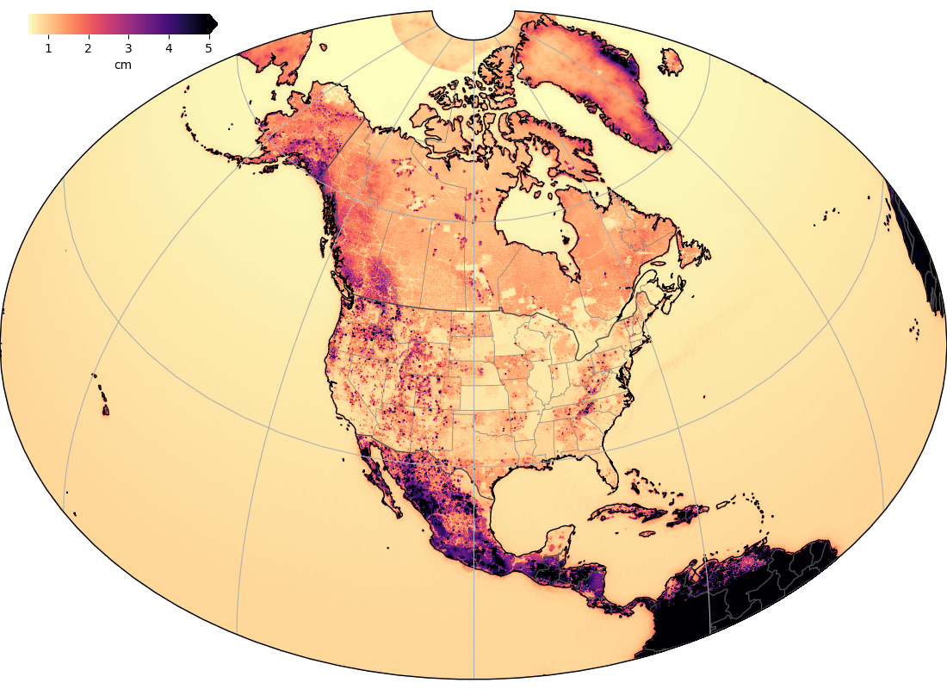
Components of GEOID2022

Slide 88

CORS RINEX3 Project Update and Progress
Sarah Conway - March 2024
Current Status of RINEX3 CORS Project:
Operational CORS RINEX2 RINEX3
(*Test Ingest of R3 only data) 1749 63*
Current State of Ingest:
Change in PRB Project Manager to Sarah Conway.
  New project plan will be submitted in time.
Scaled down RINEX3 Ingest as we develop new tools and expand programming.
Only ingesting stations that provide RINEX3 only and convert to RINEX2.
  This is currently 63* sites. Mostly FLDOT, IGS, Mesa CO, + few others.
  Purpose: We currently have no QA/QC for RINEX3 data.
Shutting off public access to RINEX3 for now (* If this is an issue please email CORS! *)
Obtained new development servers to use and separate tasks from operational CORS
2 contract programmers to help develop RINEX3 and MMT* simultaneously. Starting date TBD.
Working on looking at our programs to help (ANUBIS PRO and GIPSYX)
Possible Scope Change: We are discussing incorporating RINEX2 ingest into the project as the IDB is scheduled to be shutdown.
* = See later in this talk

Slide 89
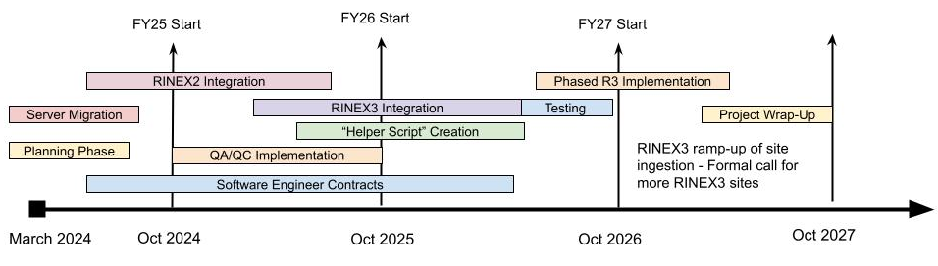
CORS RINEX3 Project Update and Progress
Sarah Conway - March 2024
Project Tasks:
Migrate to new developmental servers.
Develop new data standards and structure and communicate with contract programmers.
Start with RINEX2 Ingest & testing before phasing into RINEX3.
Create QA/QC standards and program for Ingest
Develop scripts to help with Ingest tasks (“Helper Scripts”)
Test, Test, Test
Integrate into CORS Workflow (Daily PPP, Weekly Network Solutions, & MMT)
*Test some more*
Discuss internally with NGS then send out a public notice.
Phased RINEX3 Implementation with different data providers at different times.
Future Data Requirements:
RINEX3 with exceptions for legacy sites for a certain period of time.
9-character IDs will be required.
No more RAW data, only RINEX.
Certain data requirements (i.e. L1/L2)
Phased approach with more quality control metrics on rinex files.
Goal: >90% CORS stations providing RINEX3

Slide 90
Recent Accomplishments/Deliverables
GRAV-D: DONE!
  After 16 years, the GRAV-D flights are 100% done!!
  Final gravity set was delivered to the geoid team 2 days ago!!
OPUS-Projects updated
  Version 5.1: Bluebooking done for you, loads to the NGS IDB
New Least-squares adjustment software: DONE
  LASER version 2.4.0
  Support for 3-D geometric (GNSS + classical), orthometric, horizontal gravimetric, vertical gravimetric and calibration baselines

Slide 91
GPS/GLONASS/Galileo/Beidou/ETC
New M-PAGES software exists
  Can process any GNSS constellation with two frequencies
Can be accessed for testing through a BETA release of OPUS-S
beta.ngs.noaa.gov/OPUS

Slide 92
Alpha site launched
alpha.ngs.noaa.gov
First product: SPCS2022
More products coming soon
Not everything will go on Alpha
  “Incomplete, early, possibly incorrect”

Slide 93
SPROCCET: Replacing HTDP
Software for PRojecting Observations, Constraints and Cofactor matrices/Errors through Time
  Replaces HTDP
  Expands functionality:
    Geometric and orthometric
    Error propagation through time
    Modularization
    Earthquake error displacement estimates
    Bug fixes
Will be built into OPUS and all REC adjustments
Expected completion: Autumn 2024

Slide 94
Coming soon

Slide 95
Promises…
I’m not a fan of promising what is coming “soon”
  Few things in life go on schedule
  Still, the next few things are happening and are expected to be done in the next few months

Slide 96
Coming Soon
GDX
  Geodetic Data Exchange format
  Expands/improves/replaces GVX (GNSS Vector Exchange format)
  Replaces “Bluebooking”
  Will be the official format for data submissions to OPUS in the modernized NSRS
  Spring 2024?

Slide 97
Coming Soon
GEOID2022
  The official NGS/Canada/Mexico geoid model for North America
    Plus USA-only models for American Samoa and the Guam/CNMI region
    Will be up on beta.ngs.noaa.gov
  Summer 2024?
    Don’t be confused! An early-release will be posted on alpha.ngs.noaa.gov, however it will not contain the final GRAV-D datasets

Slide 98
The National Spatial Reference System
The NSRS
Official coordinate system for the USA
Defined by the National Geodetic Survey
Required to be used by all civilian federal government agencies
Often used by many state and local government agencies or private surveyors

Slide 99
Extent of the current NSRS
Geometric Reference Frames:
NAD 83(2011)
NAD 83(PA11)
NAD 83(MA11)
Truly global but used regionally
Geoid models/Vertical Datums:
Regional
  Conterminous US (CONUS; “Lower 48”)
  Alaska
  Hawaii
  Territories: Puerto Rico, U.S. Virgin Islands, American Samoa, Guam, CNM

Slide 100
NSRS Modernization
Has been ongoing since 2007
This talk presumes some existing knowledge of NSRS Modernization. For finer details look here:
  NGS Presentation Library (https://geodesy.noaa.gov/web/science_edu/presentations_library/)
  NGS New Datums Page (https://geodesy.noaa.gov/datums/newdatums/index.shtml)
  The Blueprint Documents (https://geodesy.noaa.gov/datums/newdatums/policy.shtml)

Slide 101
NSRS Modernization in (very) brief
NATRF2022
NAD 83(2011)
NAD 83(PA11)
PATRF2022
Hybrid geoids
GEOID2022
NAD 83(MA11)
CATRF2022
MATRF2022
NAVD 88
ASVD 02
PRVD 02
NAPGD2022
Bluebooking
FORTRAN
Disparate tools
Outdated manuals
GDX / OPUS
Modern coding
Integrated tools
Updated manuals
NMVD 03
GUVD 04
VIVD 09

Slide 102
Recent Progress

Slide 103
Quick diversion: why is incorporating SPROCCET into NCAT and Vdatum so complicated?
NADCON: connects one datum (or realization) to another
  May or may not be epoch-specific
14H: connects one datum to another
  Must be a 3-D Cartesian datum (or “frame”)
  Without changing the epoch
IFDM2022: connects one epoch to another
  Within ITRF2020 only
  Geometric only. To deform orthometric quantities over time requires the addition of DGEOID2022

Slide 104
WGS72 (130)
WGS84_ORIG (140)
PNEOS90 (150)
NEOS9125 (160)
NEOS90 (170)
3
4
5
6
7
ITRF88 (100)
1
ITRF89 (110)
2
ITRF90 (120)
8
ITRF91 (180)
11
ITRF92 (210)
12
ITRF93 (220)
WGS84_G873 (240)
An ITRF
9
10
13
A 14 parameter Helmert transformation
14
Null transformations
SIO_MIT92 (190)
WGS84_G730 (200)
ITRF94 (230)
17
Two versions exist. See next slide.
NAD83_NA (260)
Defined/Additive direction of stored transformation
15
Frame Code (Frame Number)
IGB08 (400)
16
WGS72 (130)
WGS84_G1150 (370)
ITRF96 (250)
IGS20 (470)
IGB20 (480)
IGS08 (380)
WGS84_G1674 (390)
17
IGS97 (280)
28
29
18
IGS14 (430)
IGB14 (440)
30
ITRF97 (270)
38
WGS84_G1762 (410)
37
27
33
34
31
19
NAD83_MA (330)
ITRF2020 (460)
36
ITRF2014 (420)
32
ITRF2008 (360)
26
ITRF2005 (340)
24
ITRF2000 (290)
23
39
22
42
25
20
NATRF2022 (490)
40
41
35
21
NAD83_PA (320)
PATRF2022 (500)
CATRF2022 (510)
MATRF2022 (520)
WGS84_G2139 (450)
IGS05 (350)
IGS00 (300)
IGB00 (310)

Slide 105
Region: CONUS
NADCON 5 connections in GREEN
φ, λ, h
USSD
(195)
NATRF2022_2025?
(802?)
UTM
φ, λ
SPC
A,B,C = lat, lon, eht grid transformations, respectively
X, Y, Z
A horizontal datum (lat,lon only)
1A,1B
A 3-D geometric datum (lat, lon, eht)
USNG
UTM
Intersection point with 14H
Defined/Additive direction of stored grid transformation
Frame: NATRF2022
Time: 2025?
USSD
(195)
USNG
φ, λ
NAD27
(205)
Datum Code
(Datum Number)
?A,?B,?C
φ, λ, h
UTM
SPC
NATRF2022_2020
(801)
2A,2B
X, Y, Z
SPC
φ, λ
USNG
UTM
USNG
NAD83_1986
(215)
7A,7B,7C
Frame: NATRF2022
Time: 2020
UTM
SPC
NAD83_2011
(255)
3A,3B
φ, λ, h
NAD83_FBN
(235)
NAD83_NSRS2007
(245)
NAD83_HARN
(225)
6A,6B,6C
X, Y, Z
SPC
φ, λ, h
φ, λ, h
φ, λ, h
4A,4B,4C
5A,5B,5C
USNG
UTM
X, Y, Z
SPC
X, Y, Z
SPC
X, Y, Z
SPC
Frame: NAD83_NA
Time: 2010
USNG
UTM
USNG
UTM
USNG
UTM

Slide 106
(Earlier datums)
Region: CONUS
= NADCON grid
transformation #5
IFDM
t1=2010
t2=2020
= IFDM2022 between
2010 and 2020
14H
16
t=2010.00
= 14 parameter Helmert
transformation #16, at t=2010
NAD83_FBN
(235)
N
5
N
5
NAD83_NSRS2007
(245)
P1=P6+P7
P8+P9=P10
Path 1
Realization of
NAD83_NA
at t=2010.00
N
6
Realization of NATRF2022
at t=2020.00
Realization of NATRF2022
at t=2025.00?
NAD83_2011
(255)
N
7
NATRF2022_2020
(801)
N
TBD
NATRF2022_2025?
(TBD)
14H
16
t=2010.00
NATRF2022 (490)
t=2023.00
14H
39
t=2023
14H
39
t=2020
14H
39
t=2025?
ITRF96 (250)
t=2010.00
Path 6
Path 7
14H
(many)
t=2010.00
ITRF2020 (460)
t=2023.00
IFDM
t1=2020
t2=2023
IFDM
t1=2023
t2=2025?
Path 8
Path 9
ITRF2020 (460)
t=2010.00
IFDM
t1=2010
t2=2020
ITRF2020 (460)
t=2020.00
IFDM
t1=2020
t2=2025?
ITRF2020 (460)
t=2025.00?
Path 10

Slide 107
NSRS Modernization in (very) brief – Why?
The current NSRS was:
  Defined in the pre-GPS era
    Without GPS, the Earth’s center (frame origin) was very hard to detect
  Defined without aid of gravity-mission satellites
    Leveling, terrestrial gravity, disconnected from the geometric frame
  Defined right after punch-cards went away
    Tools relied upon 80-character ASCII files and FORTRAN
  Defined without a long-term strategy to acknowledge Earth’s dynamics
In short, the current NSRS has failed to keep up with emerging needs
  Sea level rise, floodplain mapping, coastal geohazards

Slide 108
The path to full roll-out
The next few slides show key elements, and their roll-out order, though with a purposefully vague timeline to allow some flexibility
To aid in readability, some details are omitted, but can be inferred, such as:
  All data will be loaded in the NSRS database
  A data delivery system will exist
  All tools will be incorporated into NCAT

Slide 109
The path to full roll-out: Frames
NCN
w/ ITRF2020
EPP2022
SPCS2022
2023
2024
2025
IFDM2022

Slide 110
The path to full roll-out: Geopotential
GRAV-D
Complete
(including
re-flights)
DEFLEC2022 Alpha
GM2022
DEFLEC2022
2023
2024
2025
GEOID2022 Alpha
GEOID2022

Slide 111
The path to full roll-out: OPUS
OPUS-Projects
w/ M-PAGES
OPUS-Projects
w/ LASER and
new adjustment
procedures
OPUS-S
w/ M-PAGES
OPUS-S
w/ ITRF2020
OPUS-Projects
w/ ITRF2020
OPUS-S
w/ EPP2022
Initial GDX
release
2023
LASER
completed
2024
2025
OPUS-S
w/ Simultaneous
Processing
OPUS-S
w/ replacement
for HTDP
OPUS-Projects
w/ replacement
for HTDP
OPUS-Projects
w/ IFDM2022
(not HTDP)

Slide 112
The path to full roll-out: Passive control
NCN
w/ ITRF2020
DEFLEC2022 Alpha
EPP2022
DEFLEC2022
Geometric RECs
SPCS2022
NADCON
VERTCON
LASER
completed
Orthometric RECs
2023
2024
2025
IFDM2022
GEOID2022

Slide 113
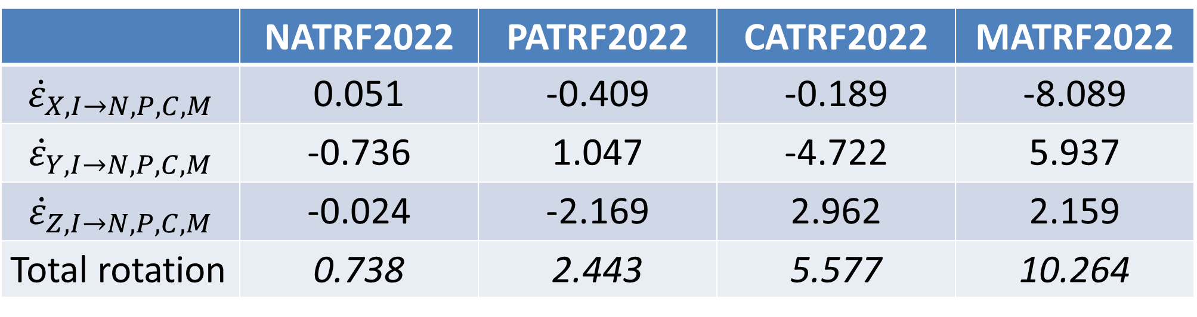
EPP2022 (alpha)
 | NATRF2022 | PATRF2022 | CATRF2022 | MATRF2022
$${\dot{ε}}_{X,I→N,P,C,M}$$ | 0.051 | -0.409 | -0.189 | -8.089
$${\dot{ε}}_{Y,I→N,P,C,M}$$ | -0.736 | 1.047 | -4.722 | 5.937
$${\dot{ε}}_{Z,I→N,P,C,M}$$ | -0.024 | -2.169 | 2.962 | 2.159
Total rotation | 0.738 | 2.443 | 5.577 | 10.264
All values in milliarcseconds / year

Slide 114
A Little Terminology…
Background Info!
A site is the smallest location name where station(s) are located
  e.g. Goddard Space Flight Center
A station is a collection of equipment for one geodetic purpose
  e.g. CORSs GODE00USA and GODN00USA
A mark is a stable physical structure attached to the crust. Only marks get PIDs
  e.g. AF9647 (GRP of GODE00USA) and JF5875 (REF pt for GODE00USA and GODN00USA)
  A mark’s job is to hold 1 point
  Some stations might share a mark
  Some marks might not be part of a station, but might be on a site
+
STATIONS
SITE
+
+
+
+
MARKS
+
Notes:
A site can contain 1 or more stations.
At a CORS, the “GRP” is the “point” and the “mark” is the permanent, physical part of the CORS which holds the GRP. The “ARP” is attached to the antenna, which can come and go and is therefore not a permanent part of the station. Therefore the ARP is not a mark and does not get a PID, despite decades of this terminology.

Slide 115
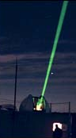
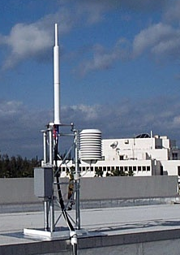
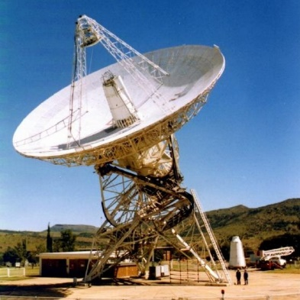
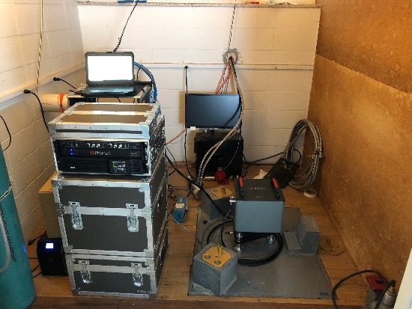
Geodetic Stations
Background Info!
SLR
DORIS
VLBI
Gravity
GNSS (CORS)

Slide 119
Recent Accomplishments/Deliverables
GRAV-D: DONE!
  After 16 years, the GRAV-D flights are 100% done!!
  Final gravity set was delivered to the geoid team 2 days ago!!
OPUS-Projects updated
  Version 5.1: Bluebooking done for you, loads to the NGS IDB
New Least-squares adjustment software: DONE
  LASER version 2.4.0
  Support for 3-D geometric (GNSS + classical), orthometric, horizontal gravimetric, vertical gravimetric and calibration baselines

Slide 120
GPS/GLONASS/Galileo/Beidou/ETC
New M-PAGES software exists
  Can process any GNSS constellation with two frequencies
Can be accessed through a BETA release of OPUS-S
beta.ngs.noaa.gov/OPUS

Slide 121
LSA Adjustment Methodology Documented
The Multi-Epoch Least-Squares Adjustment Problem: Models Relating Estimable Parameters at a Single Epoch to Geodetic Observations, Stochastic Constraints and Fixed Constraints at Multiple Epochs
See NGS Library (https://geodesy.noaa.gov/library/):
  NOAA TR NOS NGS 79
  NOAA TR NOS NGS 80
  NOAA TM NOS NGS 95
  NOAA TM NOS NGS 96
Codifies the mathematics of national adjustments (RECs) and OPUS adjustments

Slide 122
Alpha site launched
alpha.ngs.noaa.gov
First product: SPCS2022
More products coming soon
Not everything will go on Alpha
  “Incomplete, early, possibly incorrect”

Slide 123
Preeminence of ITRF
Background Info!
Rotation of the
North American Plate
North American Terrestrial Reference Frame of 2022 (NATRF2022)
Caribbean Terrestrial Reference Frame of 2022 (CATRF2022)
Pacific Terrestrial Reference Frame of 2022 (PATRF2022)
Mariana Terrestrial Reference Frame of 2022 (MATRF2022)
EPP2022 is the set of four 14-parameter Helmert transformations which relates ITRF2020 to N/P/C/MATRF2022
Rotation of the
Caribbean Plate
ITRF2020
Each 14-parameter Helmert transformation inside EPP2022 consists of:
11 zero-value coefficients
3 non-zero coefficients
1 reference epoch (2020.00)
Rotation of the
Pacific Plate
Rotation of the
Mariana Plate
EPP2022
EPP for “Euler pole parameters”
(a way of describing a plate’s rotation)

Slide 124
EPP2022 (alpha)
 | NATRF2022 | PATRF2022 | CATRF2022 | MATRF2022
$${\dot{ε}}_{X,I→N,P,C,M}$$ | 0.051 | -0.409 | -0.189 | -8.089
$${\dot{ε}}_{Y,I→N,P,C,M}$$ | -0.736 | 1.047 | -4.722 | 5.937
$${\dot{ε}}_{Z,I→N,P,C,M}$$ | -0.024 | -2.169 | 2.962 | 2.159
Total rotation | 0.738 | 2.443 | 5.577 | 10.264
All values in milliarcseconds / year

Slide 125
A Little Terminology…
Background Info!
A site is the smallest location name where station(s) are located
  e.g. Goddard Space Flight Center
A station is a collection of equipment for one geodetic purpose
  e.g. CORSs GODE00USA and GODN00USA
A mark is a stable physical structure attached to the crust. Only marks get PIDs
  e.g. AF9647 (GRP of GODE00USA) and JF5875 (REF pt for GODE00USA and GODN00USA)
  A mark’s job is to hold 1 point
  Some stations might share a mark
  Some marks might not be part of a station, but might be on a site
+
STATIONS
SITE
+
+
+
+
MARKS
+
Notes:
A site can contain 1 or more stations.
At a CORS, the “GRP” is the “point” and the “mark” is the permanent, physical part of the CORS which holds the GRP. The “ARP” is attached to the antenna, which can come and go and is therefore not a permanent part of the station. Therefore the ARP is not a mark and does not get a PID, despite decades of this terminology.

Slide 126
Geodetic Stations
Background Info!
SLR
DORIS
VLBI
Gravity
GNSS (CORS)

Slide 127
Data Delivery System
New “datasheets” for Marks and Stations have been designed with a common look and feel
  Datasheets for Sites and other well-defined geodetic categories will come later

Slide 128
A new station “datasheet” (specific to CORS)
First, here’s what you have today:

Slide 129
A new station “datasheet” (specific to CORS)

Slide 130
A new station “datasheet” (specific to CORS)

Slide 131
A new station “datasheet” (specific to CORS)

Slide 132
A new station “datasheet” (specific to CORS)

Slide 133
A new station “datasheet” (specific to CORS)

Slide 134
A new station “datasheet” (specific to CORS)

Slide 135
A new mark “datasheet”
First, here’s what you have today:

Slide 136
A new mark “datasheet”

Slide 137
A new mark “datasheet”

Slide 138
A new mark “datasheet”

Slide 139
A new mark “datasheet”

Slide 140
Reference Epoch Coordinates (RECs)
The Geometric and Orthometric REC projects are underway!
  Geometric:
    N/P/C/MATRF2022 epoch 2020.00 XYZ coordinates
    About 120,000 passive marks
  Orthometric
    NAPGD2022 epoch 2020.00 orthometric heights
    About 950,000 passive marks
  Final data pull: April 2024
  Expected early results: Late 2024

Slide 141
SPROCCET: Replacing HTDP
Software for PRojecting Observations, Constraints and Cofactor matrices/Errors through Time
  Replaces HTDP
  Expands functionality:
    Geometric and orthometric
    Error propagation through time
    Modularization
    Earthquake error displacement estimates
    Bug fixes
Will be built into OPUS and all REC adjustments
Expected completion: Autumn 2024

Slide 142
Coming soon

Slide 143
Promises…
I’m not a fan of promising what is coming “soon”
  Few things in life go on schedule
  Still, the next few things are happening and are expected to be done in the next few months

Slide 144
Coming Soon
GDX
  Geodetic Data Exchange format
  Expands/improves on GVX (GNSS Vector Exchange format)
  Replaces “Bluebooking”
  Will be the official format for data submissions to OPUS in the modernized NSRS
  Spring 2024?

Slide 145
Coming Soon
GEOID2022
  The official NGS/Canada/Mexico geoid model for North America
    Plus USA-only models for American Samoa and the Guam/CNMI region
  Summer 2024?

Slide 146
Timeline

Slide 147
Timeline
In 2022, NGS diverted resources from tool-building to data assurance
  “Limited tools, excellent coordinates”
  Set a goal of roll-out by 2025
NGS is on-track to roll out the modernized NSRS by the middle of 2025.
Work on additional tools will continue in the out-years

Slide 148
Rollout, Testing, Replacement

Slide 149
Rollout, Testing, Replacement
NGS will roll out components of the modernized NSRS over time (2024-2025)
As each component is rolled out, it can be tested
Once the final component (likely VERTCON) is rolled out (likely late 2025), testing will continue for at least 6 months
Once enough testing is done, and all modernized NSRS components seem stable and correct, the FGCS will vote (likely 2026)
If affirmative, the modernized NSRS will replace the current NSRS

Slide 150
Initial rollout
NGS promised many things in the three Blueprint documents
Not all can be built in a timely manner
So when we say “rollout”, we mean initial rollout, which is at least the minimum viable products needed to replace the current NSRS with the modernized NSRS
Future products and services supporting the modernized NSRS will be rolled-out after the FGCS vote

Slide 151
Rollout: Alpha, Beta, Live
NGS will use three different websites (URLs) as we roll-out the modernized NSRS:
  Live: www.ngs.noaa.gov
    Will hold the current NSRS until the modernized NSRS has been fully tested and the FGCS has voted to replace the current NSRS with the modernized NSRS
  Beta: beta.ngs.noaa.gov
    Soon to be re-designed to hold modernized NSRS products only
    Every component of the modernized NSRS will be placed here
    Products assumed to be complete and correct
    For testing
    Subject to change or deletion
  Alpha: alpha.ngs.noaa.gov
    “Incomplete, early, possibly incorrect”
    Not everything will go on alpha

Slide 152
Current NSRS during rollout and testing
While the modernized NSRS is being rolled out and tested, the current NSRS will remain the official NSRS of the United States
  This will not change until the FGCS vote (probably 2026)
URL www.ngs.noaa.gov will only hold current NSRS
Only two major improvements to the current NSRS are expected during this time:
  Multi-GNSS support within OPUS-S
  ITRF2020 in all products and services

Slide 153
Snapshot of the modernized NSRS at the end of initial rollout
Not everything promised in the Blueprint documents will be built in time for the initial rollout. But the following will be:
  ITRF2020, N/P/C/MATRF2022, NAPGD2022, SPCS2022
  NSRS Database, new datasheets for marks and stations
  RECs
  OPUS-S with multi-GNSS
  OPUS-Projects (GPS only):
    GDX, SPROCCET, LASER, NSRS DB submission
    The ability for NGS to generate RECs from OPUS submissions in a timely manner

Slide 154
Less stand-alone products
NGS is building SPROCCET
  Replaces HTDP
  Contains IFDM2022, 14H, DGEOID2022
    Projects any geodetic data through time
  Will be plugged directly into the modernized OPUS-Projects
  In 2025, users will engage with it via OPUS-Projects
  Post-2025, will be incorporated into NCAT and Vdatum
    Like NADCON, VERTCON, UTMS, USNG, SPCS2022, GEOID2022
    This is a non-trivial change, but can be done correctly

Slide 155
Rollout onto Beta
www.ngs.noaa.gov:
ITRF2020 on NCN
SPCS 83
NAVD 88
OPUS-Share
NADCON 5
OPUS-S (GNSS)
NAD 83
GEOID18
OPUS-RS (GPS)
VERTCON 3
OPUS-Projects (GPS)
(Bluebooking, HTDP, ADJUST, NGS IDB, Datasheets)
DEFLEC18
beta.ngs.noaa.gov:
ITRF2020 on NCN
EPP2022
Geometric RECs
in N/P/C/MATRF2022
N/P/C/MATRF2022
NADCON 6?
SPCS2022
IFDM2022
GM2022
Orthometric RECs
in N/P/C/MATRF2022
VERTCON 4?
GEOID2022
GRAV2022
NAPGD2022
DEM2022
DEFLEC2022
OPUS-Projects (GPS)
(GDX, SPROCCET, LASER, NSRS DB, New Datasheets)
OPUS-S (GNSS)
Mid 2024
Late 2024
Early 2025
Late 2025

Slide 156
Testing into replacement
From late 2025 into sometime in 2026, all modernized NSRS components on Beta will go through testing and feedback
After the FGCS vote, a few months of work remain:
  The FGCS will issue an FRN officially announcing the adoption of the modernized NSRS
  The beta website may be wiped of submitted data*
  All modernized NSRS components moved to the Live website
    Submissions will then begin in earnest and won’t be deleted
  All current NSRS components moved to the Beta website
    No further submissions to the NGS IDB will be allowed at this point
Notes:
Notes: NGS is considering what to do with data submitted during testing. The cleanest solution is to delete it as “test data” and not attempt to move it onto the Live website. If we were to consider moving it to Live, we would need to re-submit the data to ourselves, which is a tremendous amount of work. It is best to assume that NGS will ask submitters to re-submit after the switch.

Slide 157
After testing and the FGCS vote
www.ngs.noaa.gov:
ITRF2020 on NCN
SPCS 83
NAVD 88
OPUS-Share
NADCON 5
OPUS-S (GNSS)
NAD 83
GEOID18
OPUS-RS (GPS)
VERTCON 3
OPUS-Projects (GPS)
(Bluebooking, HTDP, ADJUST, NGS IDB, Datasheets)
DEFLEC18
beta.ngs.noaa.gov:
ITRF2020 on NCN
EPP2022
Geometric RECs
in N/P/C/MATRF2022
N/P/C/MATRF2022
NADCON 6?
SPCS2022
IFDM2022
GM2022
Orthometric RECs
in N/P/C/MATRF2022
VERTCON 4?
GEOID2022
GRAV2022
NAPGD2022
DEM2022
DEFLEC2022
OPUS-Projects (GPS)
(GDX, SPROCCET, LASER, NSRS DB, New Datasheets)
OPUS-S (GNSS)
All submissions provided during testing get deleted

Slide 158
After testing and the FGCS vote
www.ngs.noaa.gov:
ITRF2020 on NCN
EPP2022
Geometric RECs
in N/P/C/MATRF2022
N/P/C/MATRF2022
NADCON 6?
SPCS2022
IFDM2022
GM2022
Orthometric RECs
in N/P/C/MATRF2022
VERTCON 4?
GEOID2022
GRAV2022
NAPGD2022
DEM2022
DEFLEC2022
OPUS-Projects (GPS)
(GDX, SPROCCET, LASER, NSRS DB, New Datasheets)
OPUS-S (GNSS)
All submissions from this point forward get saved
beta.ngs.noaa.gov:
ITRF2020 on NCN
SPCS 83
NAVD 88
OPUS-Share
NADCON 5
OPUS-S (GNSS)
NAD 83
GEOID18
OPUS-RS (GPS)
VERTCON 3
OPUS-Projects (GPS)
(Bluebooking, HTDP, ADJUST, NGS IDB, Datasheets)
DEFLEC18
No submissions to the NGS IDB allowed any longer

Slide 159
Summary
The modernized NSRS is coming soon!
  Starting this year!
All components should be on Beta by 2025
  For testing only!
It won’t replace the current NSRS until an FGCS vote (2026)
NGS will continue to support the current NSRS through the rollout and testing of the modernized NSRS
We encourage you to test each component as it is released

Slide 160
Thank you!

Slide 161
Questions?

Slide 162
Extra Slides

Slide 163
Quick diversion: why is incorporating SPROCCET into NCAT and Vdatum so complicated?
NADCON: connects one datum (or realization) to another
  May or may not be epoch-specific
14H: connects one datum to another
  Must be a 3-D Cartesian datum (or “frame”)
  Without changing the epoch
IFDM2022: connects one epoch to another
  Within ITRF2020 only
  Geometric only. To deform orthometric quantities over time requires the addition of DGEOID2022

Slide 164
WGS72 (130)
WGS84_ORIG (140)
PNEOS90 (150)
NEOS9125 (160)
NEOS90 (170)
3
4
5
6
7
ITRF88 (100)
1
ITRF89 (110)
2
ITRF90 (120)
8
ITRF91 (180)
11
ITRF92 (210)
12
ITRF93 (220)
WGS84_G873 (240)
An ITRF
9
10
13
A 14 parameter Helmert transformation
14
Null transformations
SIO_MIT92 (190)
WGS84_G730 (200)
ITRF94 (230)
17
Two versions exist. See next slide.
NAD83_NA (260)
Defined/Additive direction of stored transformation
15
Frame Code (Frame Number)
IGB08 (400)
16
WGS72 (130)
WGS84_G1150 (370)
ITRF96 (250)
IGS20 (470)
IGB20 (480)
IGS08 (380)
WGS84_G1674 (390)
17
IGS97 (280)
28
29
18
IGS14 (430)
IGB14 (440)
30
ITRF97 (270)
38
WGS84_G1762 (410)
37
27
33
34
31
19
NAD83_MA (330)
ITRF2020 (460)
36
ITRF2014 (420)
32
ITRF2008 (360)
26
ITRF2005 (340)
24
ITRF2000 (290)
23
39
22
42
25
20
NATRF2022 (490)
40
41
35
21
NAD83_PA (320)
PATRF2022 (500)
CATRF2022 (510)
MATRF2022 (520)
WGS84_G2139 (450)
IGS05 (350)
IGS00 (300)
IGB00 (310)

Slide 165
Region: CONUS
NADCON 5 connections in GREEN
φ, λ, h
USSD
(195)
NATRF2022_2025?
(802?)
UTM
φ, λ
SPC
A,B,C = lat, lon, eht grid transformations, respectively
X, Y, Z
A horizontal datum (lat,lon only)
1A,1B
A 3-D geometric datum (lat, lon, eht)
USNG
UTM
Intersection point with 14H
Defined/Additive direction of stored grid transformation
Frame: NATRF2022
Time: 2025?
USSD
(195)
USNG
φ, λ
NAD27
(205)
Datum Code
(Datum Number)
?A,?B,?C
φ, λ, h
UTM
SPC
NATRF2022_2020
(801)
2A,2B
X, Y, Z
SPC
φ, λ
USNG
UTM
USNG
NAD83_1986
(215)
7A,7B,7C
Frame: NATRF2022
Time: 2020
UTM
SPC
NAD83_2011
(255)
3A,3B
φ, λ, h
NAD83_FBN
(235)
NAD83_NSRS2007
(245)
NAD83_HARN
(225)
6A,6B,6C
X, Y, Z
SPC
φ, λ, h
φ, λ, h
φ, λ, h
4A,4B,4C
5A,5B,5C
USNG
UTM
X, Y, Z
SPC
X, Y, Z
SPC
X, Y, Z
SPC
Frame: NAD83_NA
Time: 2010
USNG
UTM
USNG
UTM
USNG
UTM

Slide 166
(Earlier datums)
Region: CONUS
= NADCON grid
transformation #5
IFDM
t1=2010
t2=2020
= IFDM2022 between
2010 and 2020
14H
16
t=2010.00
= 14 parameter Helmert
transformation #16, at t=2010
NAD83_FBN
(235)
N
5
N
5
NAD83_NSRS2007
(245)
P1=P6+P7
P8+P9=P10
Path 1
Realization of
NAD83_NA
at t=2010.00
N
6
Realization of NATRF2022
at t=2020.00
Realization of NATRF2022
at t=2025.00?
NAD83_2011
(255)
N
7
NATRF2022_2020
(801)
N
TBD
NATRF2022_2025?
(TBD)
14H
16
t=2010.00
NATRF2022 (490)
t=2023.00
14H
39
t=2023
14H
39
t=2020
14H
39
t=2025?
ITRF96 (250)
t=2010.00
Path 6
Path 7
14H
(many)
t=2010.00
ITRF2020 (460)
t=2023.00
IFDM
t1=2020
t2=2023
IFDM
t1=2023
t2=2025?
Path 8
Path 9
ITRF2020 (460)
t=2010.00
IFDM
t1=2010
t2=2020
ITRF2020 (460)
t=2020.00
IFDM
t1=2020
t2=2025?
ITRF2020 (460)
t=2025.00?
Path 10

Slide 167
NSRS Modernization in (very) brief – Why?
The current NSRS was:
  Defined in the pre-GPS era
    Without GPS, the Earth’s center (frame origin) was very hard to detect
  Defined without aid of gravity-mission satellites
    Leveling, terrestrial gravity, disconnected from the geometric frame
  Defined right after punch-cards went away
    Tools relied upon 80-character ASCII files and FORTRAN
  Defined without a long-term strategy to acknowledge Earth’s dynamics
In short, the current NSRS has failed to keep up with emerging needs
  Sea level rise, floodplain mapping, coastal geohazards

Slide 168
The path to full roll-out
The next few slides show key elements, and their roll-out order, though with a purposefully vague timeline to allow some flexibility
To aid in readability, some details are omitted, but can be inferred, such as:
  All data will be loaded in the NSRS database
  A data delivery system will exist
  All tools will be incorporated into NCAT

Slide 169
The path to full roll-out: Frames
NCN
w/ ITRF2020
EPP2022
SPCS2022
2023
2024
2025
IFDM2022

Slide 170
The path to full roll-out: Geopotential
GRAV-D
Complete
(including
re-flights)
DEFLEC2022 Alpha
GM2022
DEFLEC2022
2023
2024
2025
GEOID2022 Alpha
GEOID2022

Slide 171
The path to full roll-out: OPUS
OPUS-Projects
w/ M-PAGES
OPUS-Projects
w/ LASER and
new adjustment
procedures
OPUS-S
w/ M-PAGES
OPUS-S
w/ ITRF2020
OPUS-Projects
w/ ITRF2020
OPUS-S
w/ EPP2022
Initial GDX
release
2023
LASER
completed
2024
2025
OPUS-S
w/ Simultaneous
Processing
OPUS-S
w/ replacement
for HTDP
OPUS-Projects
w/ replacement
for HTDP
OPUS-Projects
w/ IFDM2022
(not HTDP)

Slide 172
The path to full roll-out: Passive control
NCN
w/ ITRF2020
DEFLEC2022 Alpha
EPP2022
DEFLEC2022
Geometric RECs
SPCS2022
NADCON
VERTCON
LASER
completed
Orthometric RECs
2023
2024
2025
IFDM2022
GEOID2022

