Slide 1

Geodesy and Datums for the Floodplain Manager
Ohio Statewide Floodplain Management Conference
July 2023
Jeff Jalbrzikowski, P.S., GISP, CFS
Appalachian Regional Geodetic Advisor
jeff.jalbrzikowski@noaa.gov
240-988-5486

Slide 2
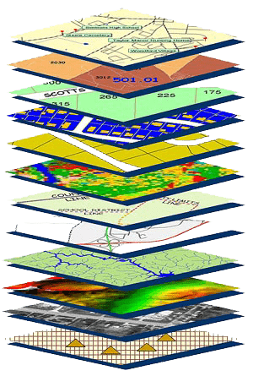
Mission of National Geodetic Survey
To define, maintain and provide access to the National Spatial Reference System (NSRS) to meet our Nation’s economic, social, and environmental needs.
NSRS
Notes:
NGS develops and maintains the National Spatial Reference System, a national coordinate system that provides the foundation for transportation, navigation, land record systems, mapping and charting efforts, and a multitude of scientific and engineering applications.
But there are many ancillary programs and products we will also discuss.

Slide 3
Not just new datums…
  NSRS Modernization
Also software/tools, processes, standards, terminology, etc.
Notes:
-so you’ve probably seen that phrase that I have front and center here, NSRS Modernization
-that’s the blanket term we use to refer to not just the new datums but other updates

Slide 4
National Spatial Reference System
A common and consistent geospatial framework to meet the economic, social, and environmental positioning needs of our Nation.
Foundational elements include:
Latitude
Longitude
Height
Gravity
Shoreline Position
…how these change over time
Horizontal Datums | Vertical Datums
NAD83 | NAVD88
NAD27 | NGVD29
Elevation
Great Lakes Datums | Geoid Models
IGLD85 | GEOID18
IGLD55 | GEOID12B
Notes:
The primary mission of NGS is, “to define, maintain, and provide access to the NSRS to meet our nations economic, social, and environmental needs”.
NSRS is a consistent geospatial framework, common to all Federal agencies and other users
NSRS supports informed decision-making for mapping and charting, navigation, flood risk determination, transportation, land management, and more
Elements of NSRS include (but are not limited to): latitude, longitude, elevation, gravity, shoreline position + their changes over time …other elements include scale, earth orientation parameters and others
The vertical component of the NSRS currently utilizes the North American Vertical Datum of 1988 (NAVD88)

Slide 5
Positional Components of
the NSRS
Geometric
aka “Horizontal”
Latitude, Longitude, Ellipsoid Height
Geopotential
aka Orthometric Height
aka “Elevation”
NAD83
NAVD88
Notes:
-geometric component is latitude, longitude, and ellipsoid height
-geopotential component is combined with the geometric components to calculate an ortho height or capital H

Slide 6
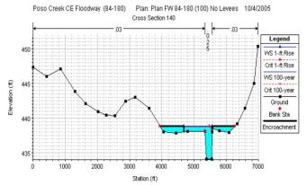
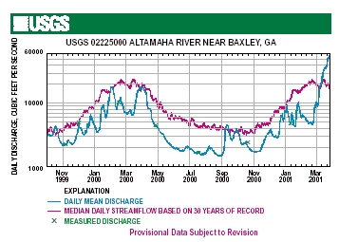

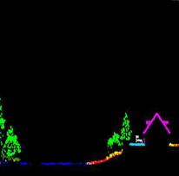
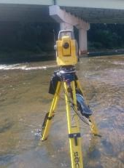
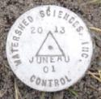
Why does the NSRS matter to me?
Orthometric Datum
Water Level Datum
Ellipsoidal Datum
+
+
Aerial LiDAR/Mapping
Historic Water Levels and Flow Rates
Terrestrial Survey/Cross-Sections
FIRMs require data from disconnected sources.
Dates and datums must be consistently aligned.
Notes:
Example of why we need consistent coordinates (illustrated):
Just in the making of a single FIRM, data collected at different points in time using different methods:
-aerial lidar
-x-section and structure data via survey
-streamflow data/hydrographs
All of these must be reliably aligned and combined with historical data, in both the horizontal and vertical components, to produce a final product in which all of this information is available in one place, to assist professionals like yourselves in appropriate flood mitigation.
→Therefore, Reliable Flood Rate Insurance products rely on the NSRS
In a perfect world…
datums would be parallel and smooth
Surface of Earth would not move

Slide 7
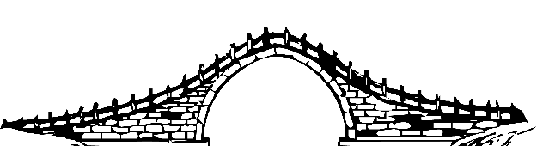
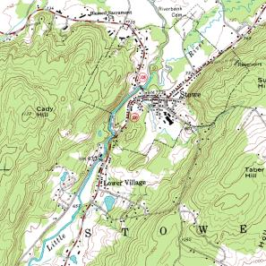
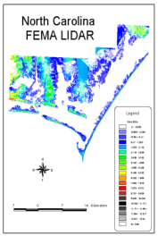
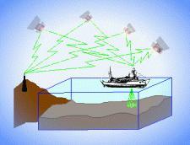
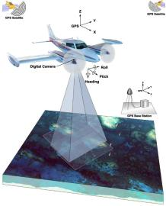
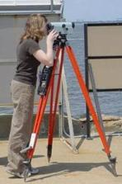
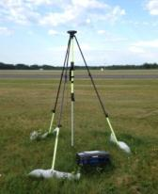
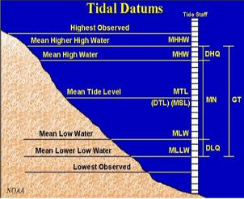
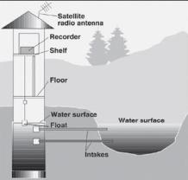
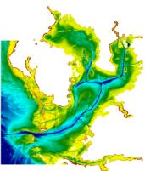
Three types of heights in NSRS
Ellipsoidal
geoid
Orthometric
Raw Hydrographic Surveys
USGS
Topography
NAD83
NAVD88
NGVD29
FEMA NFIP Data & Maps
Engineering and Construction Surveys
Raw GPS Observations
Raw Lidar Data
Water Level or Tidal
NOAA and USACE Hydrography
Shoreline Mapping and Regulatory Boundaries at the Coast
Daily and Extreme Water Levels (Gage)
Notes:
This slide illustrates the 3 categories of vertical datums and examples of where each is directly used They are project and application dependent.
First, we have ellipsoidal datums. Examples include WGS84 and NAD83 (North American Datum of 1983). You will encounter these datums frequently in hydrographic surveys that are vertically referenced with RTK-GPS; any native GPS measurements; and even raw lidar datasets.
Next, we have orthometric datums. These datums are very important because height differences referenced to orthometric datums will allow us to know the direction water will flow, because they have been “gravity-corrected”. The North American Vertical Datum of 1988 (or NAVD 88) is an orthometric datum, which you will see on USGS topographic maps, engineering and development site surveys, and FEMA Flood Insurance Rate Maps.
Finally, we have Tidal Datums, which are derived from water level measurements. They have extremely important applications including daily and extreme water levels; NOAA nautical charts, and shoreline mapping or boundaries along the coast.
*NOAA provides tools (like NCAT and Vdatum) to transform between these different height systems.
The Bridge

Slide 8
Orthometric
Notes:
This slide illustrates the 3 categories of vertical datums and examples of where each is directly used They are project and application dependent.
First, we have ellipsoidal datums. Examples include WGS84 and NAD83 (North American Datum of 1983). You will encounter these datums frequently in hydrographic surveys that are vertically referenced with RTK-GPS; any native GPS measurements; and even raw lidar datasets.
Next, we have orthometric datums. These datums are very important because height differences referenced to orthometric datums will allow us to know the direction water will flow, because they have been “gravity-corrected”. The North American Vertical Datum of 1988 (or NAVD 88) is an orthometric datum, which you will see on USGS topographic maps, engineering and development site surveys, and FEMA Flood Insurance Rate Maps.
Finally, we have Tidal Datums, which are derived from water level measurements. They have extremely important applications including daily and extreme water levels; NOAA nautical charts, and shoreline mapping or boundaries along the coast.
*NOAA provides tools (like NCAT and Vdatum) to transform between these different height systems.

Slide 9
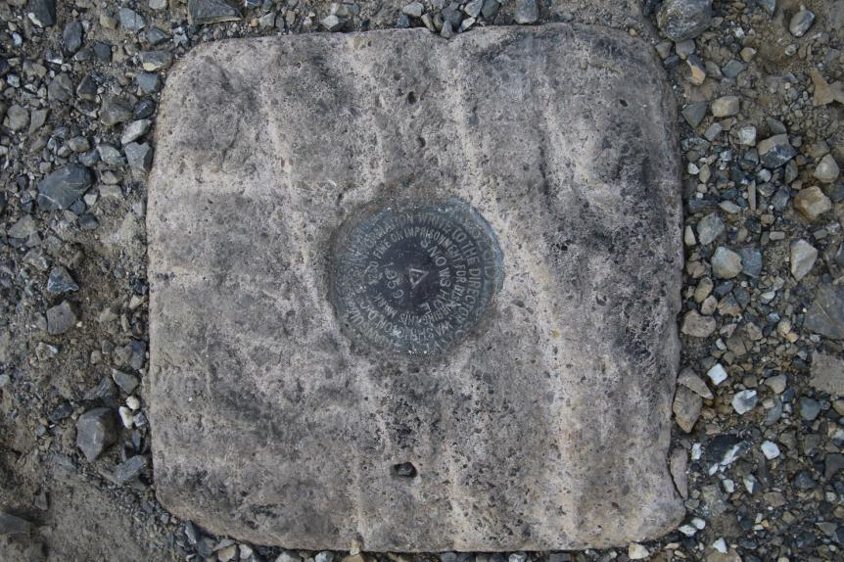
Passive Control
Geodetic Control – Terminology
All marks are passive—they sit there and hold a point
Notes:
All marks are passive!—in that they sit there doing nothing in and of themselves besides holding a point
-This is the only way to tie your data to NGVD29 is to find one of these marks and start a survey from it.
-Primary way to to tie your data toi NAVD88, but GNSS ties are popular
Calibration sites for GNSS technology, Real Time Network validation, and verification of datum transformation tool results.
Monitoring Sites for to enhance velocity models (via repeat/campaign GNSS occupations)
Convenience for local project control, in areas with limited GNSS coverage (e.g. cities, forests), or in the event of GNSS failure (e.g. geomagnetic storms)

Slide 10
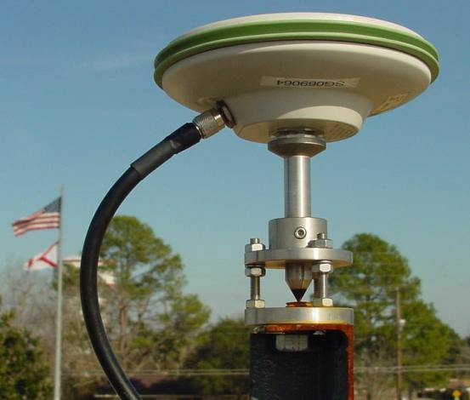
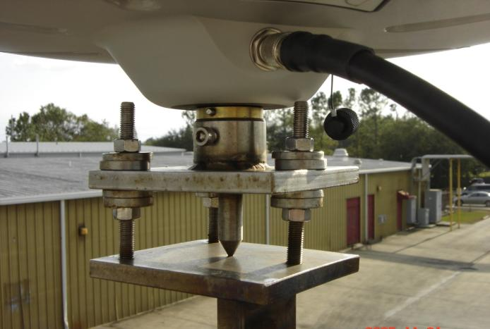
Active Control
Geodetic Control – Terminology
Some marks have permanently installed antennas above that single point which enable continuously logged observations
Notes:
All marks are passive!—in that they sit there doing nothing in and of themselves besides holding a point
This includes the fixed antenna mount that is a part of a CORS.
But, some marks have permanently installed equipment that enable nearly continuous observation and these are called “active” stations.
Access to NAPGD2022 and NATRF2022 for anyone with a GNSS receiver.
More Efficient than conventional leveling for determining orthometric heights.
Convenience in that no need to recover passive control, rather set one’s own and collect GNSS data on it.
So, GPS/GNSS technologies simplify and improve access to, and the accuracy of, our spatial reference system.
→ By adding a 4th dimension to all coordinates (time), marks can serve as more faithful access points.

Slide 11
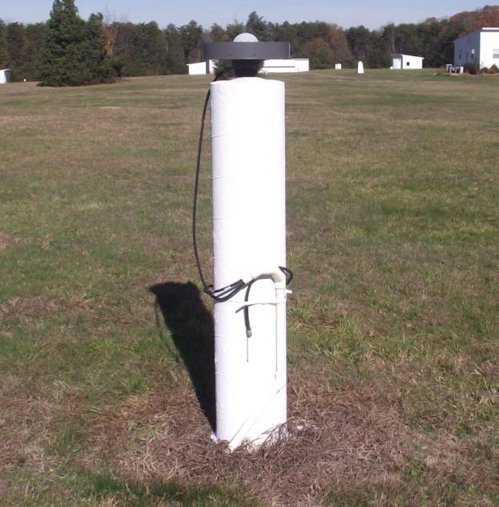
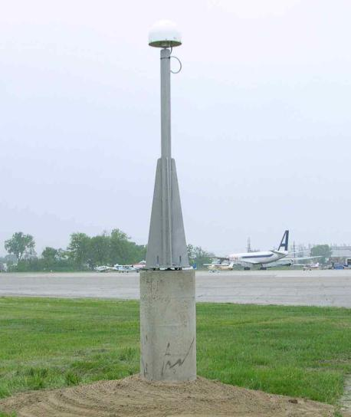
CORS
Geodetic Control – Terminology
Continuously Operating Reference Station
GNSS ANTENNA
RECEIVER
POWER
DATA STORAGE
COMMUNICATIONS
Notes:
Note that the whole pillar could be considered a type of “mark”, being a passive do-nothing structure that holds a “point”, the GRP of this CORS.
But the point, given coordinates computed from all the data collected by that antenna, is probably in here somewhere, as a part of this huge pillar which is effectively one big mark, passive as can be….

Slide 12
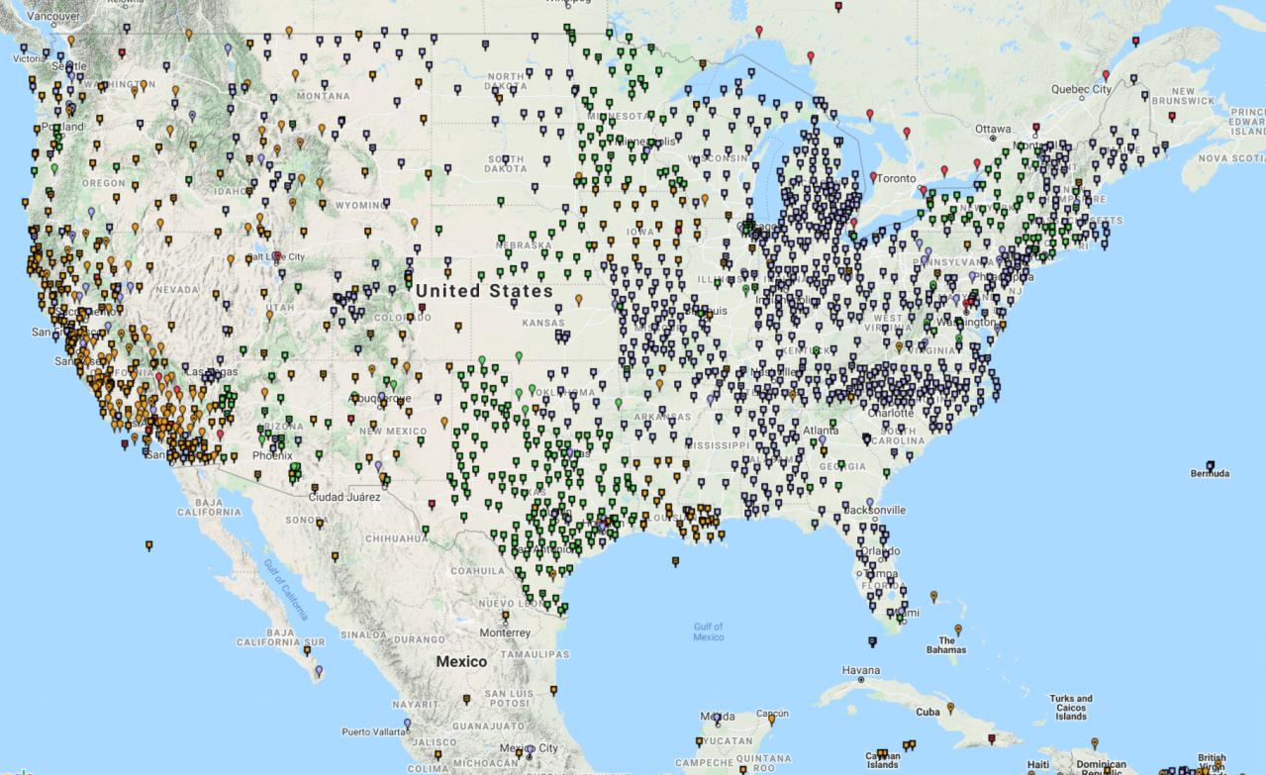
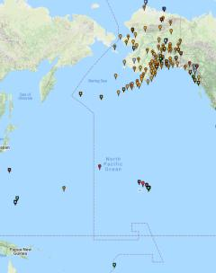
Continuously Operating Reference Stations (CORS)
2000+ sites
200+ organizations
Notes:
-I would like to point out we have a new, official name for the network you see represented on this map,
-The NOAA CORS Network, or NCN
CLICK
-this is neat little graphic with some stats on teh NCN you can find on our website
-below the gaphic youll find a search bar with more information

Slide 13
NOAA CORS Network (NCN)
2000+ sites
200+ organizations
Notes:
-I would like to point out we have a new, official name for the network you see represented on this map,
-The NOAA CORS Network, or NCN
CLICK
-this is neat little graphic with some stats on teh NCN you can find on our website
-below the gaphic youll find a search bar with more information

Slide 14
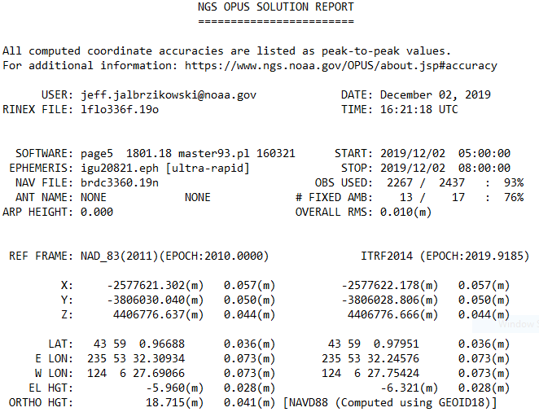
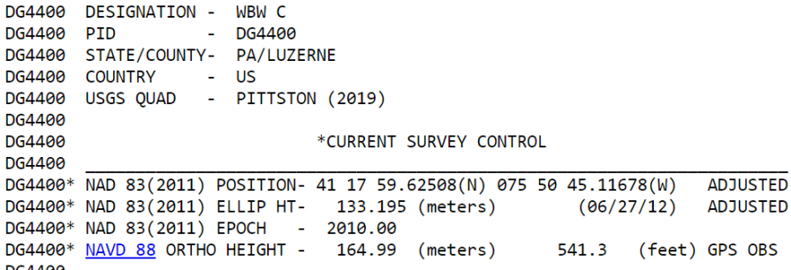
Geodetic Control – Terminology
Epoch
eh-puck? ee-pock? … to-may-to, to-mah-to
an instant of time
NGS – typically expressed as a year with a decimal like this:
  2021.0276
  2019.4457
It doesn’t have to be in decimal years… just start assigning dates to your data
Notes:
-Where do you see an Epoch right now in NGS data?
CLICK
Datasheets! there you see the epoch of 2010.0
and of course OPUS Solution Reports!
note that in blue over there on the right you’ll see another epoch, in the ITRF, which I will explain later on

Slide 15
National Geodetic Vertical Datum
of 1929
NGVD29
was replaced by

Slide 16
North American Vertical Datum
of 1988
NAVD88

Slide 17
A very brief history of (the most prevalent) U.S. vertical datums

Slide 18
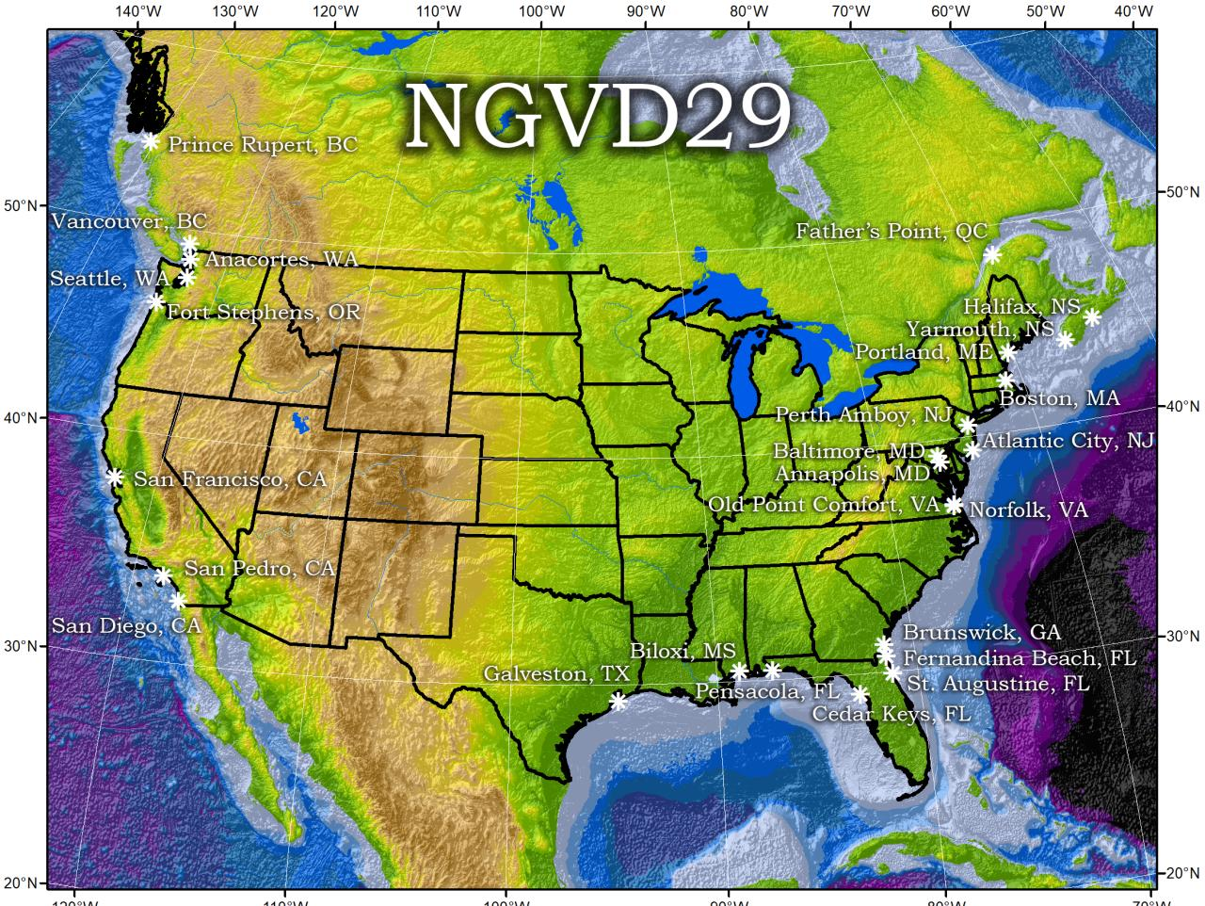
Referenced to 26 tide gauges in the US and Canada
Notes:
It turns out that MSL is a close approximation to another surface, defined by gravity, called the geoid, which is the true zero surface for measuring elevations. Because we cannot directly see the geoid surface, we cannot actually measure the heights above or below the geoid surface. We must infer where this surface is by making gravity measurements and by modeling it mathematically. For practical purposes, we assume that at the coastline the geoid and the MSL surfaces are essentially the same. Nevertheless, as we move inland we measure heights relative to the zero height at the coast, which in effect means relative to MSL.
Definition: NGVD29 – The National Geodetic Vertical Datum of 1929…
The Sea Level Datum of 1929 was the vertical control datum established for vertical control surveying in the United States of America by the General Adjustment of 1929. The datum was used to measure elevation or altitude above, and depression or depth below, mean sea level (MSL).
Mean sea level was measured at 26 tide gauges: 21 in the United States and 5 in Canada. The datum was defined by the observed heights of mean sea level at the 26 tide gauges and by the set of elevations of all bench marks resulting from the adjustment. The adjustment required a total of 66,315 miles (106,724 km) of leveling with 246 closed circuits and 25 circuits at sea level.
Since the Sea Level Datum of 1929 was a hybrid model, it was not a pure model of mean sea level, the geoid, or any other equipotential surface. Therefore, it was renamed the National Geodetic Vertical Datum of 1929 (NGVD 29) in 1973. The NGVD 29 was subsequently replaced by the North American Vertical Datum of 1988 (NAVD 88) based upon the General Adjustment of the North American Datum of 1988.

Slide 19
NGVD29 – based on 26 tide gauges
topographic surface
datum zero
surface
  Local Mean Sea Level differs at tide stations due to prevailing winds, ocean current, salinity, seabed topography, etc.
Concept

Slide 20
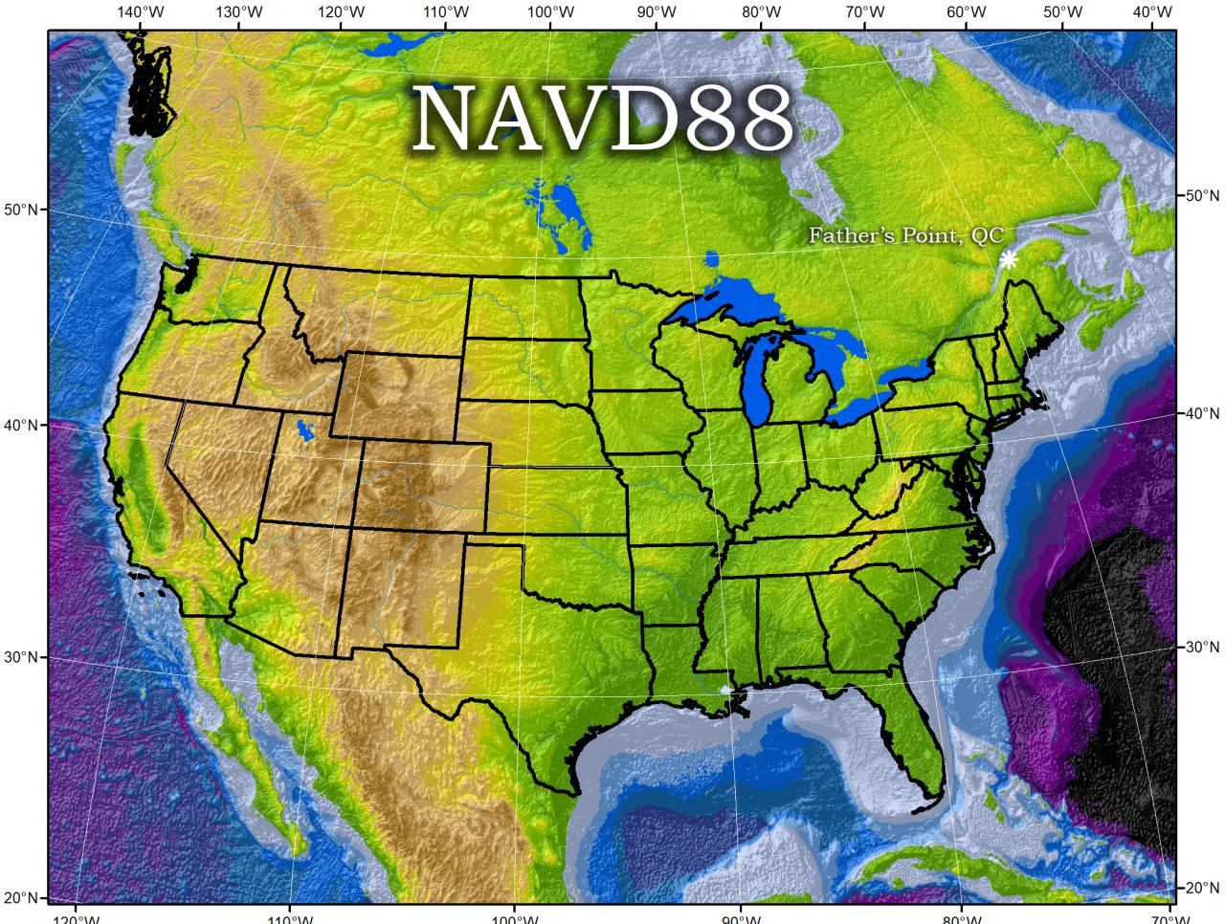
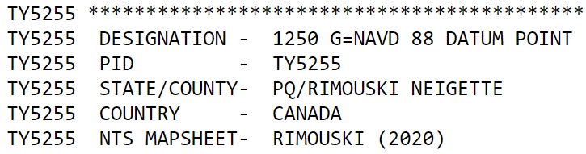
Why one site this time?
removed local sea level variation problem of NGVD29
Referenced to one tidal bench mark in Canada
Notes:
Definition: The surface of equal gravity potential to which orthometric heights shall refer in North America
One height held fixed [at 6.271 meters along the plumb line below the geodetic mark] at “Father Point” (Rimouski, Canada).
By fixing the geopotential value at the origin point, it was possible to ensure that the origins of IGLD 85 and NAVD 88 aligned.
**But perhaps more importantly, the height chosen was to minimize 29→88 differences on USGS topo maps in the eastern U.S. … thus, the “zero height surface” of NAVD 88 was NOT chosen for its closeness to the geoid (but it was close…few decimeters)
Use of one fixed height removed local sea level variation problem of NGVD 29
*It should be pointed out that while the datum was defined in such a way as to be usable on the North American continent, it was never actually adopted in Canada. It can be used there, but it’s not their official civilian datum.
Note that the designation of the vertical control point at Father Point is “1250 G=NAVD 88 DATUM POINT” for PID# TY5255 and is not available from the publicly accessible NGSIDB.

Slide 21
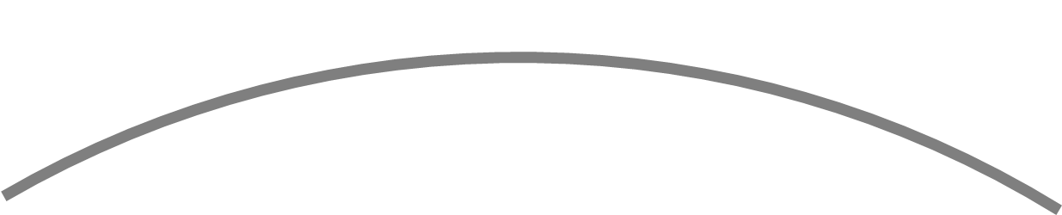
NAVD88 – based on single benchmark
topographic surface
datum zero
surface
Concept
Notes:
-

Slide 22
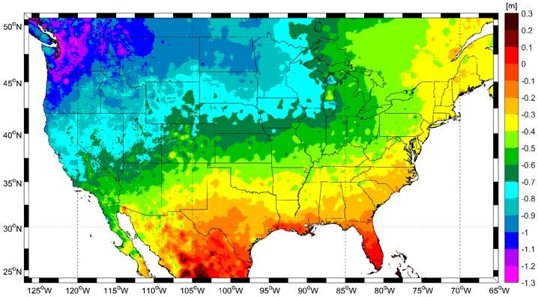
Approximate Error in NAVD88 zero surface
Map is the H=0 surface differenced from satellite gravity data
Notes:
Map highlights the tilt/bias to the zero reference surface, that’s another item that was discovered later on with the advent and proliferation of satellite positioning and remote sensing technology.
How was the map created, that is the NAVD88 zero surface (H=0) overlaid onto a satellite based geoid model, then color shaded by vertical difference

Slide 23
NAVD88 – based on single benchmark
topographic surface
datum zero
surface
  Most, if not all, of this error in alignment was intentional.
  Huh?! It was chosen to minimize the change to contours in USGS quadrangles.
Concept
Notes:
-importantly, the height chosen was to minimize 29→88 differences on USGS topo maps in the eastern U.S. … thus, the “zero height surface” of NAVD 88 was NOT chosen for its closeness to the geoid (but it was close…few decimeters)

Slide 24

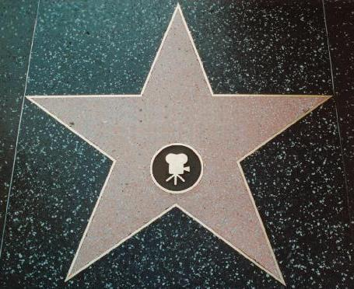
NOAA NGS
and
FEMA NFIP
Hello, we’re NGS.
You may remember us from such documents as …
NATIONAL GEODETIC SURVEY
Section 6.1 of FIS Reports
Your favorite FIRM/DFIRM
CRS Coordinator’s Manual
Notes:
“Hello, we’re NGS. You may remember us from such appearances as section 6.1 of Template: Flood Insurance Study (FIS) Report (Nov 2016)

Slide 25
NOAA NGS
and
FEMA NFIP

Slide 26
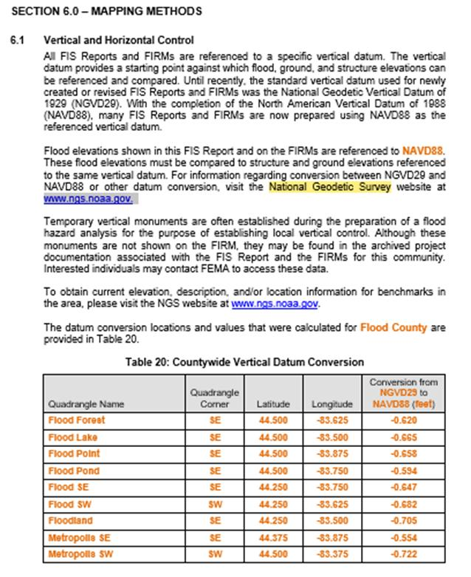
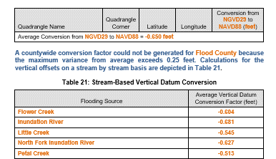
Template FIS Report (Nov 2016)
NOAA NGS
and
FEMA NFIP
Section 6.1 of FIS Report
States the requirement to know the datum for the FIRM and to consult NGS for datum conversion if needed.
Notes:
-Section 6.1 is intended to provide some information on vertical datums
-it should include, if necessary, a table detailing values used to determine either:
a countywide vertical datum “conversion”
or a stream-based vertical datum “conversion”
-NOTE the recommendation to consult NGS for info on transforming between NGVD29 and NAVD88

Slide 27
NOAA NGS
and
FEMA NFIP

Slide 28
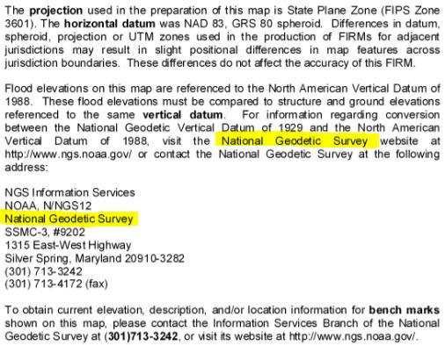
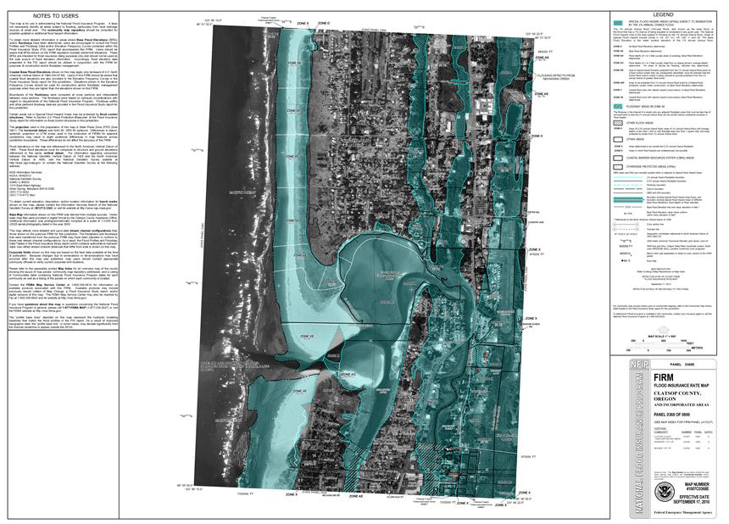
FIRM from Clatsop County, OR
NOAA NGS
and
FEMA NFIP
NOTES TO USERS
Notes:
or the “NOTES TO USERS” section of your favorite FIRM

Slide 29
NOAA NGS
and
FEMA NFIP

Slide 30
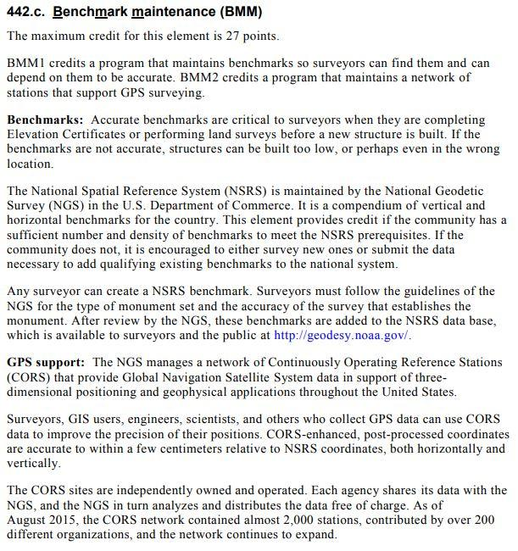
NFIP CRS Coordinator’s Manual
NOAA NGS
and
FEMA NFIP
Why highlight BMM?
Already includes provisions for CORS network to replace conventional disks in the ground.
Notes:
…or even from the FEMA CRS Coordinator’s manual
-specifically Activity 440 (Flood Data Maintenance), Element 442.c (Benchmark Maintenance)
-full discount is 27 points… I don’t know exactly what that means, that’s out of my wheelhouse but if anyone wants to speak from experience, feel free
-why am i brining this up?
- to highlight that the CRS program already includes provisions for CORS network to replace conventional disks in the ground, or what we call passive control because a surveyor sets the mark surveys it in and then … nothing further

Slide 31
NOAA NGS
and
FEMA NFIP

Slide 32
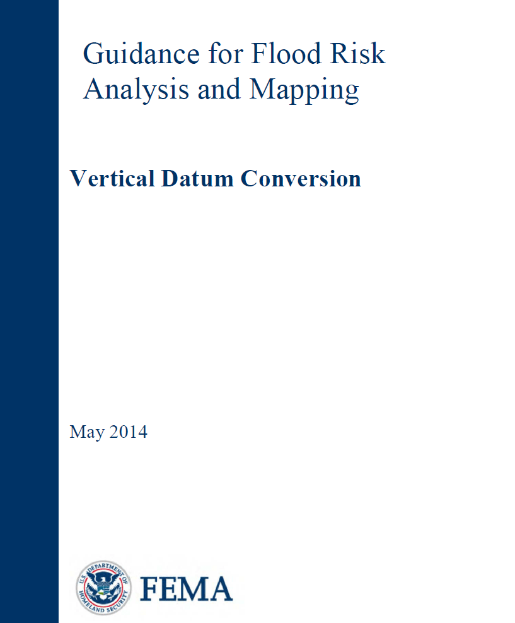
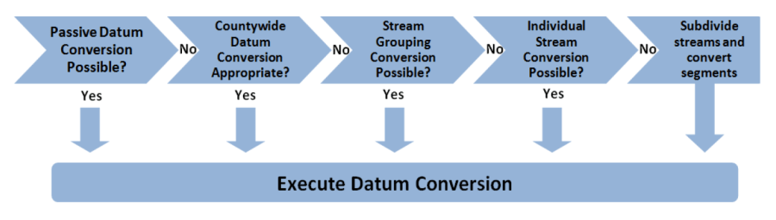
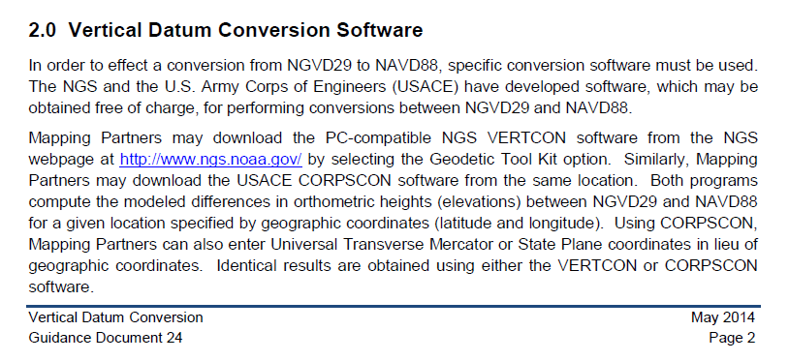
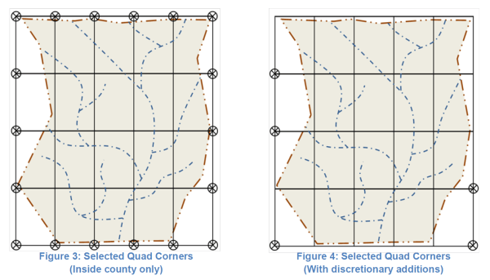
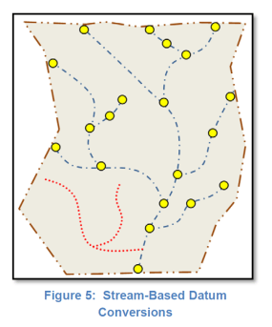
NOAA NGS
and
FEMA NFIP
Notes:
FEMA Vertical Datum Conversion Guidance → find it on their Floods & Maps page
-primary guiding principle in executing vertical datum conversions for unrevised flood elevations is to ensure that no more than a 0.25 foot variance from the average conversion factor exists at any point

Slide 33
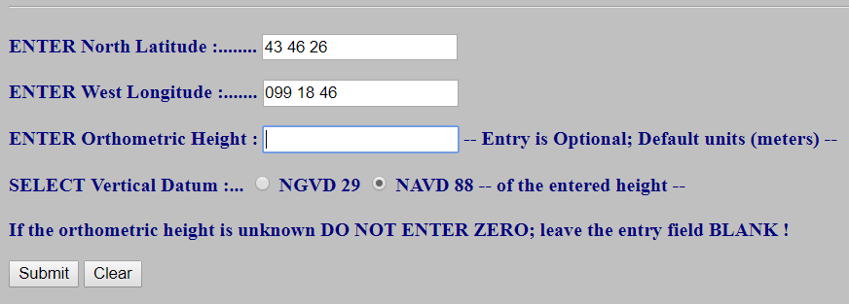
NGS tool – VERTCON
INPUT to VERTCON
Questions concerning the VERTCON process may be mailed to NGS
Latitude: 43 46 26
Longitude: 099 18 46
NAVD 88 height:
Datum shift(NAVD 88 minus NGVD 29): 0.343 meter
Actual OUTPUT from VERTCON

Slide 34
VERTCON is dead…
long live VERTCON!
VERTCON 3.0 is within NCAT
Notes:
NGS develops and maintains the National Spatial Reference System, a national coordinate system that provides the foundation for transportation, navigation, land record systems, mapping and charting efforts, and a multitude of scientific and engineering applications.
But there are many ancillary programs and products we will also discuss.

Slide 35
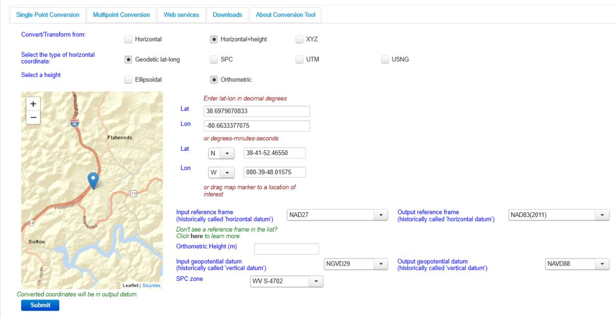
NGS Coordinate Conversion And Transformation Tool (NCAT)
Notes:
NCAT includes the functionality of previous NGS tools:
NADCON 5.0
XYZWIN 2.0
UTMS 2.1
SPC83 2.1
USNG 2.3
Includes error estimate of transformation per point.
Available as the single-point graphic seen here, multi-point upload/download, as a downloadable executable fie to run from the DOS prompt, and as web services for inclusion in your own
It’s a great tool. Anyone using

Slide 36
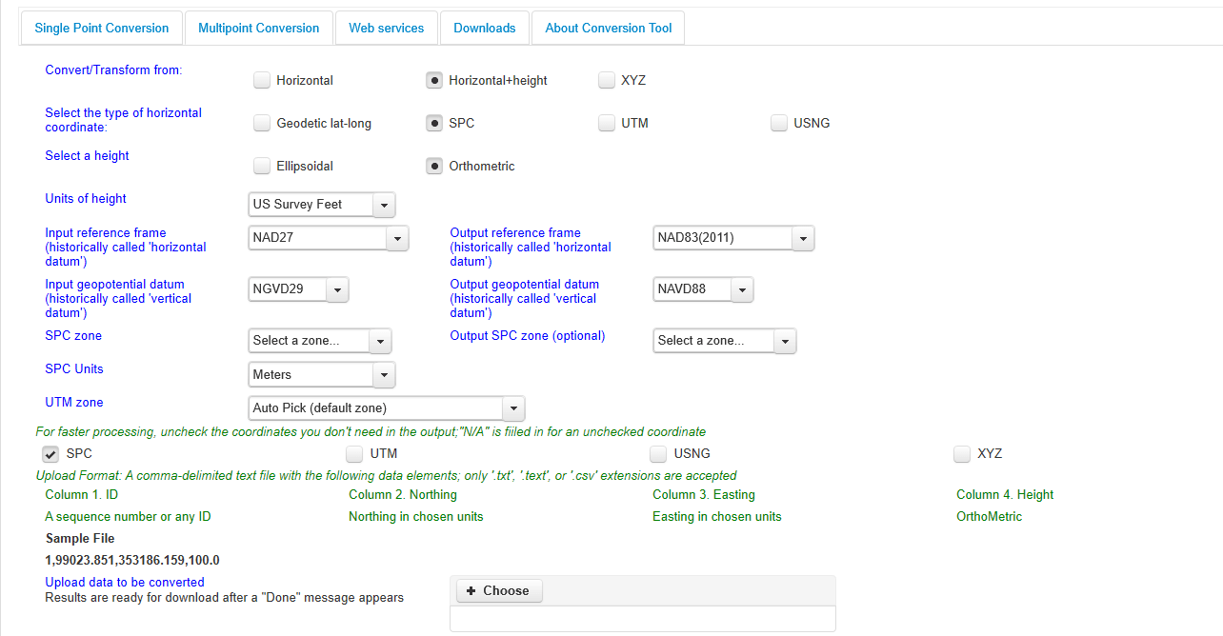
NGS Coordinate Conversion And Transformation Tool (NCAT)
Notes:
NCAT includes the functionality of previous NGS tools:
NADCON 5.0
XYZWIN 2.0
UTMS 2.1
SPC83 2.1
USNG 2.3
Includes error estimate of transformation per point.
Available as the single-point graphic seen here, multi-point upload/download, as a downloadable executable fie to run from the DOS prompt, and as web services for inclusion in your own
It’s a great tool. Anyone using

Slide 37
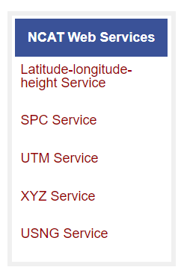

NGS Coordinate Conversion and Transformation Tool (NCAT)
  available now: ASCII upload, Web Services, GitHub
  ask your software provider(s) about integration
      we envision this as most popular method of access
      Industry Workshops held in 2021 and 2022
        All the well known commercial names attended
        Plus some open-source advocates

Slide 38
Comparing Heights
or …“digging for datums”

Slide 39

Vertical Datum Visualized
A reference surface that can be used to measure heights in a uniform way.
How much taller is Sally than Jane?
Could measure directly from top of head to top of head.
Or, from floor up to tops of heads and then subtract!
Sally
Jane
X= ?
That’s a relative height, or height difference.
Datum
X = (h Sally) – (h Jane)
That’s a difference in heights above a datum.
Notes:
A vertical reference system is a reference surface that can be used to measure heights in a uniform way.
So, how much taller is Sally?

Slide 40
Datum Difference Visualized
Can still calculate X with a relative height… but it is not accurate, as our reference surface is not the same.
How much taller is Sally than Jane?
Need to know what they’re standing on!
We cannot compare heights that are measured from different reference surfaces.
Sally
Jane
X= ?
NAVD88
Datum 1
NGVD29
Datum 2
X ≠ (h Sally) – (h Jane)
Notes:
-Well, we need to know how tall, or the slope of the hill.
-You cannot compare heights that are measured from different planes of reference.
*If we replace Sally and Jane with an example more related to floodplains:
What if we want to compare a BFE height in 1990 and a BFE height 2010
what if the land has subsided under that base flood elevation over time?
…hold that thought.

Slide 41
Ok Jeff, how do I do that?
…we call that a datum transformation
Notes:
-note that’s the proper technical term, but I’m not going to hound someone who says “conversion”… I slip sometimes too

Slide 42
Changing Coordinates - Terminology
Conversion
    change the type of coordinate
    e.g. latitude & longitude → State Plane Coordinate System (SPCS)
  Transformation
    change the datum of coordinate
    e.g. NGVD29 height → NAVD88 height
    e.g. NAD 27 latitude & longitude → NAD 83 latitude & longitude
Propagation
    change the epoch of coordinate
    e.g. NAPGD2022 epoch 2020.00 to NAPGD2022 epoch 2087.2570
Notes:
Historically NGS has been inconsistent with these top two words.
Going forward, we will use them as:
Conversion: Meaning to change the type of coordinate without changing the datum or frame
e.g. change NAD 83(1986) latitude and longitude to NAD 83(1986) State Plane Coordinates
Transformation: Meaning to change the datum or frame, without changing the type of coordinate
e.g. changing an NAD 27 latitude & longitude to an NAD 83(1986) latitude & longitude
So, “NADCON” which transforms coordinates between datums could have been called “NADTRAN.” C’est la vie.

Slide 43
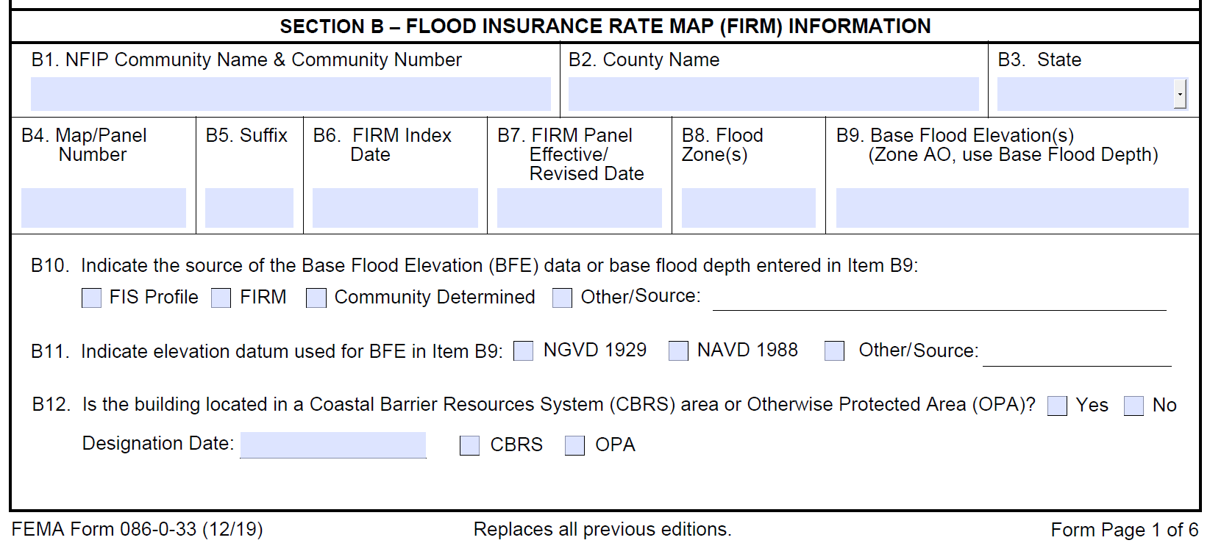
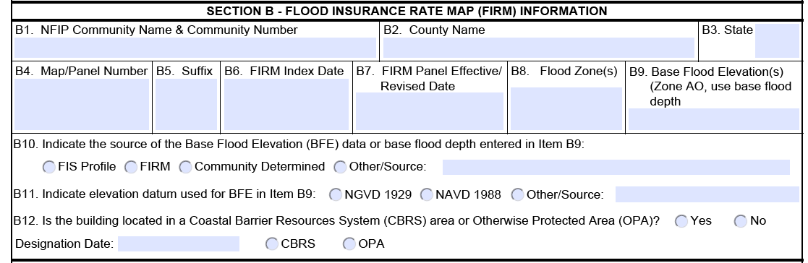
Elevation Certificate - Section B
Request more details if there’s not enough for you to re-create/follow
Notes:
On the new elevation certificate documents:
There is extra space to add information about the source.
If you look in the instructions, licensed professionals completing this form are not restricted to just this space, and they may provide attachments if extra explanation is necessary.

Slide 44
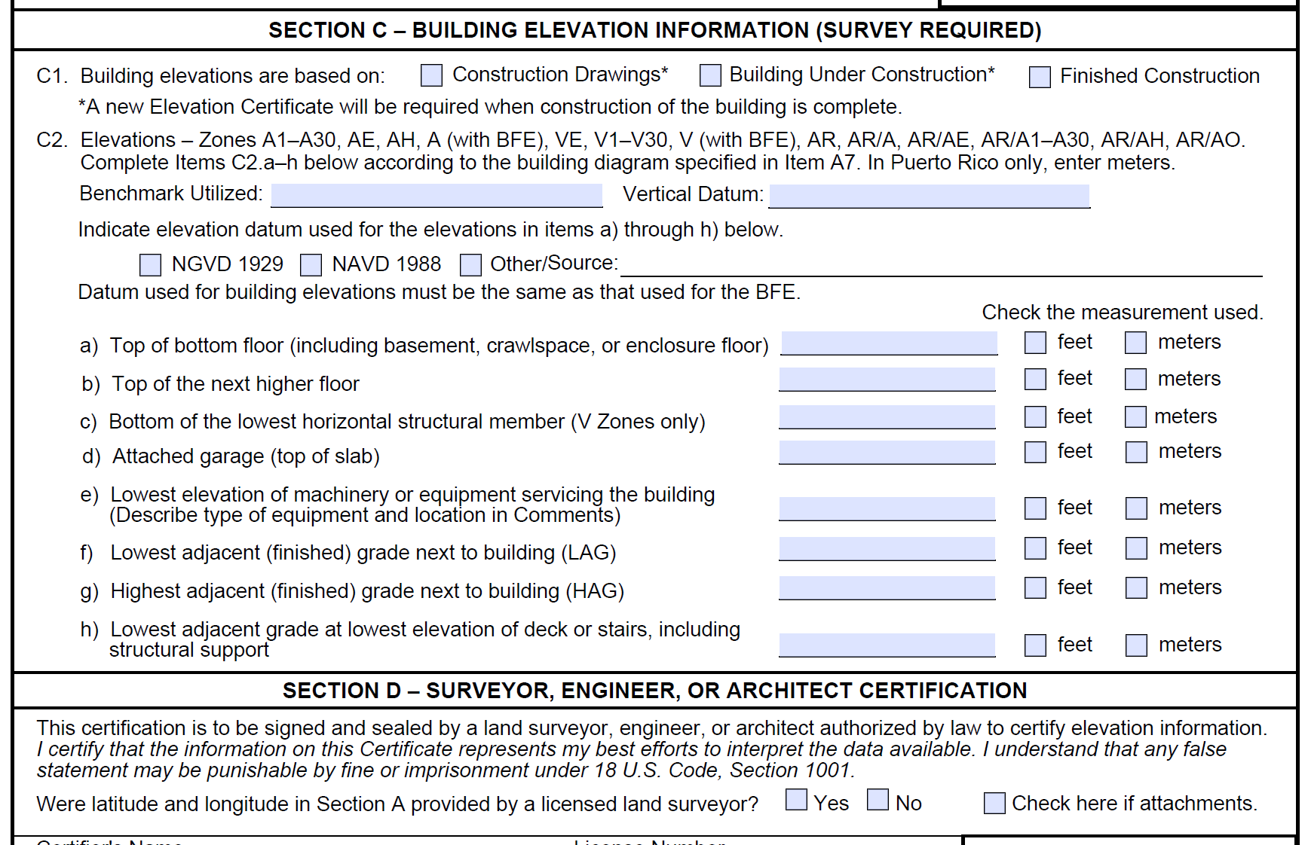
Elevation Certificate - Section C
Notes:
On the new elevation certificate documents:
There is extra space to add information about the source.
If you look in the instructions, licensed professionals completing this form are not restricted to just this space, and they may provide attachments if extra explanation is necessary.

Slide 45
North American Vertical Datum
of 1988
NAVD88
will be replaced by

Slide 46
North American-Pacific Geopotential Datum of 2022
NAPGD2022
(pronounced: nap-jee-dee)

Slide 47
Geopotential → Gravity → Geoid
You’ve all used a DEM.
(Digital Elevation Model)
Picture a geoid model as a DGM.
(Digital Gravity Model)
-both raster cells of height values
→but represent different things

Slide 48
Geoid - my favorite definition
  “The geoid is the equipotential surface that most closely coincides with the undisturbed mean sea level (and its continuation through the continents).”
    - Sjöberg, L. E., & Bagherbandi, M. (2017). Gravity Inversion and Integration, Theory and Applications in Geodesy and Geophysics. Springer.
  equipotential → equal potential
  potential → as in energy… or gravitational pull

Slide 49
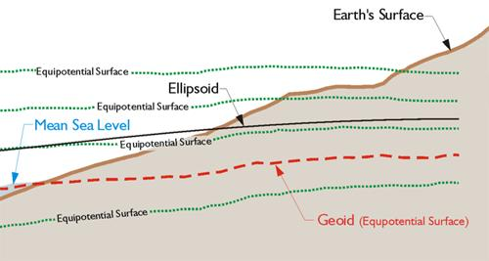
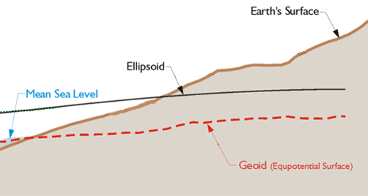
Equipotential Surface
-GPS for Land Surveyors, by Jan Van Sickle, 4th ed., CRC Press, Taylor & Francis Group, 2015, p. 180. (slightly edited)
NAPGD2022 defined by a specific strength of gravity → W₀
Notes:
Recall our ol’ buddy W sub-naught (W₀)

Slide 50
NAVD88 geoids
versus
NAPGD2022 geoids

Slide 51
Two types of geoid models
  Gravimetric
  Hybrid
Notes:
-believe it or not there’s more than 2 types, but the 2 types you’ll see NGS publish are…

Slide 52
Gravimetric → Hybrid
  Gravimetric geoid is created from “scratch” with various types of gravity data
      USGG2003, USGG2009, USGG2012, xGEOID19
  Hybrid geoid is simply a gravimetric geoid then best fit some vertical datum… like NAVD88
      GEOID03, GEOID09, GEOID12B, GEOID18
Notes:
So… all the geoids you’re using to get elevations from your GNSS data

Slide 53
Gravimetric → Hybrid
      USGG2003, USGG2009, USGG2012, xGEOID19
      GEOID03, GEOID09, GEOID12B, GEOID18
best fit to NAVD88
best fit to NAVD88
best fit to NAVD88
best fit to NAVD88
Notes:
So… all the geoids you’re using to get elevations from your GNSS data

Slide 54
Gravimetric vs. Hybrid Geoid
topographic surface
gravimetric geoid
hybrid
geoid
datum zero
surface
Concept
Notes:
-importantly, the height chosen was to minimize 29→88 differences on USGS topo maps in the eastern U.S. … thus, the “zero height surface” of NAVD 88 was NOT chosen for its closeness to the geoid (but it was close…few decimeters)

Slide 55
NAVD88 uses a Hybrid Geoid
topographic surface
gravimetric geoid
hybrid
geoid
datum zero
surface
Concept
Notes:
-importantly, the height chosen was to minimize 29→88 differences on USGS topo maps in the eastern U.S. … thus, the “zero height surface” of NAVD 88 was NOT chosen for its closeness to the geoid (but it was close…few decimeters)

Slide 56
NAPGD2022 uses a Gravimetric Geoid
topographic surface
gravimetric geoid
datum zero
surface
  Datum zero surface aligned to Global Mean Sea Level (GMSL)
Concept
Notes:
-importantly, the height chosen was to minimize 29→88 differences on USGS topo maps in the eastern U.S. … thus, the “zero height surface” of NAVD 88 was NOT chosen for its closeness to the geoid (but it was close…few decimeters)

Slide 57
Sea Level Change and the Geoid
H_{2087.257}
H_{2020.000}
Threshold Level
-Threshold Level is published as 20 cm
-Process is repeated as GMSL changes
Geoid
GMSL
Notes:
The illustrated strategy will be adopted at NGS. An animated characterization of this approach
What this means is that NGS will decouple the geoid from GMSL, until they have diverged by some threshold amount, currently defined as 20cm.
When that threshold is reached a new geoid will be defined and held fixed until reaching next threshold. In this way, the impact of the change of GMSL is accounted for in the heights of the NSRS, while the appearance of stability is maintained for “decades at a time” (BP2 Section 14).
If we calculate how long that might be based on existing rates of sea level rise of 3ish mm/yr then we’re talking over 50 years

Slide 58

Estimated change in orthometric heights from NAVD88 to NAPGD2022
Change in OH:
Smallest = ~1 foot
Largest = almost 2 feet
(NAPGD2022 approximated using xGEOID16B)
Notes:
In Ohio, from just under a foot to almost 2 feet
Quite a bit of variation, but average of 1.5 foot shift down

Slide 59
What can you do?
Help spread the word
  Engage agencies, surveyors, engineers in your circles
Reach out to NGS for support
Follow best metadata practices
Educate others
  Share our links and info
Notes:
Coordinate -Spread the word and tell others about NSRS Modernization
→ Ask the agencies, surveyors, and engineers you work with about the preparations they are taking to learn about the upcoming changes
Educate
-Review materials and ask for support from NGS
Prepare
-Lead by example and use the best metadata practices

Slide 60

additional Resources
Notes:
This presentation is intended to raise awareness about the upcoming changes and what they mean for floodplain mapping, but you probably have lots of remaining questions and we have a lot of resources online at our website
Please spread the word, and
make an effort to keep yourself and your colleagues informed.
Tell us what content is missing or how we can make it better!

Slide 61


Resources at geodesy.noaa.gov
Educational Videos
<5 minutes
Online Lesson
(via MetEd/COMET)
~1 hour
Notes:
Educational videos and online tutorials –
Our library of lessons and videos are great resources, and will reinforce a lot of information we covered today.
The videos are just 3-5 minutes long.
the lesson is a deeper dive but still only takes an hour.

Slide 62


Email Subscriptions
NGS News
  Includes quarterly NSRS Modernization newsletter
Webinar Series
Training
Only 1-2 messages per month
Click this icon
on homepage
Notes:
Stay informed via Email Subscription –
Sign up for notifications about News, webinars, and training opportunities with NGS.
We also use our News subscription list to send out our quarterly NSRS Modernization Newsletter.

Slide 63
geodesy.noaa.gov/ADVISORS/
-use any major search engine: “NGS advisors”
Jeff Jalbrzikowski, P.S., GISP, CFS
Appalachian Regional Geodetic Advisor
jeff.jalbrzikowski@noaa.gov
240-988-5486

