Slide 1

NSRS Modernization Updates
CEAO Land Records Conference
June 2023
Jeff Jalbrzikowski, P.S., GISP, CFS
Appalachian Regional Geodetic Advisor
jeff.jalbrzikowski@noaa.gov
240-988-5486

Slide 2



Organizational Structure
-Department of Commerce (DoC)
(~47,000 employees)
-National Oceanic and Atmospheric Administration (NOAA)
-National Ocean Service (NOS)
-National Geodetic Survey (NGS)
(~175 employees)
Notes:
-We are the Federal Government’s oldest scientific agency.
-part of the Executive Branch
-I know it can seem kind of strange that NGS is part of the NOS, but the origins of NGS lie with the C&GS.
-we are a “Program Office” of the NOS
Survey of the Coast – 1807
Coast Survey – 1836
Coast and Geodetic Survey – 1878
NGS since 1970

Slide 3


Organizational Structure
We’re not USGS, we’re NGS
-Department of Commerce (DoC)
(~47,000 employees)
-National Oceanic and Atmospheric Administration (NOAA)
-National Ocean Service (NOS)
-National Geodetic Survey (NGS)
(~175 employees)
≠
Notes:
-as you can read my slide, I like to point that out because over my 2 years at NGS I’ve seen and heard this misunderstanding quite a bit
-don’t worry! it doesn’t offend us! and we do work closely with USGS, but we are separate agencies within totally different departments of the federal government

Slide 4
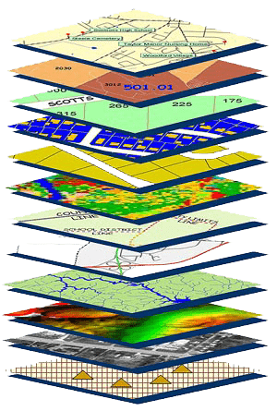
NGS Mission
To define, maintain and provide access to the National Spatial Reference System (NSRS) to meet our Nation’s economic, social, and environmental needs.
NSRS
Notes:
NGS develops and maintains the National Spatial Reference System, a national coordinate system that provides the foundation for transportation, navigation, land record systems, mapping and charting efforts, and a multitude of scientific and engineering applications
CLICK
You’ve all seen this or some similar graphic I’m sure. That bottom layer… that’s our baby, the NSRS.

Slide 5
Yes, we are delayed.
NSRS Modernization
Notes:
So remember, today’s presentation is not JUST about new datums, it is about modernizing the NSRS as a whole.
You don’t know what the NSRS is? Stay tuned, we’ll get there as we go along.

Slide 6
Delayed Release of the Modernized NSRS
How long will the delay be?
Our website or newsletter is best source of projected timeframe, current estimate is middle of 2025.
Will the names stay the same?
Yes, terms containing “2022” such as “NATRF2022” and “NAPGD2022” will remain the same.
Will all previously proposed products be released along with the new datums?
No, they will not. Check out our June 2022 webinar.
hyperlink to the Track Our Progress homepage
June 2022 webinar
hyperlink to the full FAQ

Slide 7
Modernizing the NSRS
Updating all NSRS coordinates
Replace existing datums with new datums
Replacing existing SPCS83 with new SPCS2022
Accounting for coordinates changing with time
Improving NGS products and services
Simplifying customer contributions
Making the NSRS:
More accurate
More accessible
More efficient
Rollout in
2025

Slide 8
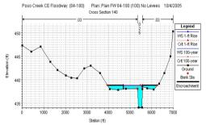

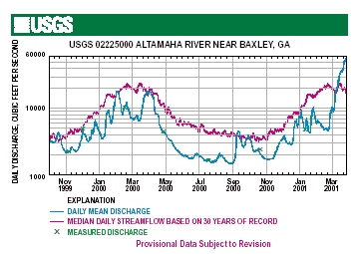
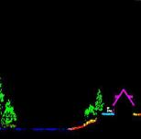
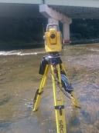

Why does the NSRS matter to me?
Ellipsoidal Datum
Water Level Datum
(and Flow Rates)
Orthometric Datum
+
+
Historic Water Levels and Flow Rates
Aerial LiDAR/Mapping
Survey/Cross-Sections
Notes:
Example of why we need consistent coordinates (illustrated):
Just in the making of a single FIRM, data collected at different points in time using different methods:
-aerial lidar
-x-section and structure data via survey
-streamflow data/hydrographs
All of these must be reliably aligned and combined with historical data, in both the horizontal and vertical components, to produce a final product in which all of this information is available in one place, to assist professionals like yourselves in appropriate flood mitigation.
→Therefore, Reliable Flood Rate Insurance products rely on the NSRS
In a perfect world…
datums would be parallel and smooth
Surface of Earth would not move

Slide 9
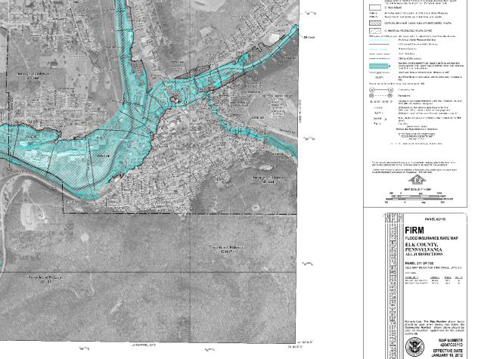
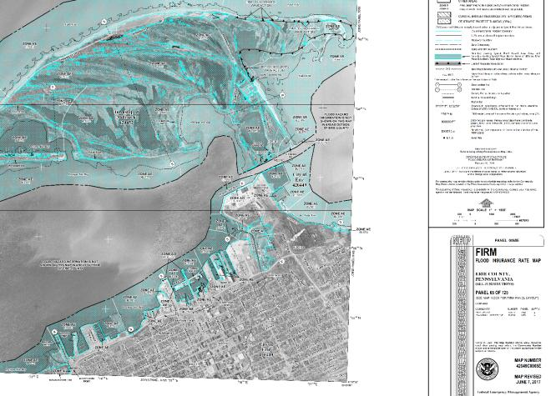
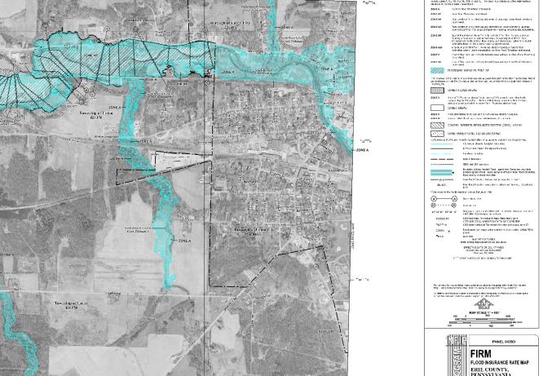
Why does the NSRS matter to me?
=
FIRMs require data from disconnected sources.
Datums must be consistently aligned.
Notes:
All of these must be reliably aligned and combined with historical data, in both the horizontal and vertical components, to produce a final product in which all of this information is available in one place, to assist professionals like yourselves in appropriate risk mitigation.
→Therefore, Reliable Flood Rate Insurance products rely on the NSRS
In a perfect world…
datums would be parallel and smooth
Surface of Earth would not move

Slide 10
Positional Components of
the NSRS
Geometric
aka “Horizontal”
Latitude, Longitude, Ellipsoid Height
Geopotential
aka Orthometric Height
aka “Elevation”
NAD83
NAVD88
Notes:
-geometric component is latitude, longitude, and ellipsoid height
-geopotential component is combined with the geometric components to calculate an ortho height or capital H

Slide 11
NATRF2022
North American Terrestrial Reference Frame of 2022
will replace
NAD83
North American Datum of 1983
Technically, not just NATRF2022 but also its 3 sister TRFs…

Slide 12
Terrestrial Reference Frame?
Existing, accepted terminology
International TRF
first realization of the ITRF was 1992
NATRF2022 will be based on ITRF2020
“Horizontal Datum” - misnomer for NAD83
Really is a Geometric Reference Frame
Notes:
-Where do you see an Epoch right now in NGS data?
CLICK
Datasheets! there you see the epoch of 2010.0
and of course OPUS Solution Reports!
note that in blue over there on the right you’ll see another epoch, in the ITRF, which I will explain later on

Slide 13
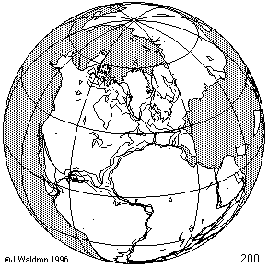
ITRF concept
Watch the grid!
Epoch:
Notes:
Ok, now ITRF mentioned a couple slides ago.
Most simplistic way to explain ITRF is to watch this animation.
This is a very loose representation/visualization of what the ITRF is, a characterization only.

Slide 14
Four TRFs for Modernized NSRS
North American Terrestrial Reference Frame of 2022
(NATRF2022)
Pacific Terrestrial Reference Frame of 2022
(PATRF2022)
Caribbean Terrestrial Reference Frame of 2022
(CATRF2022)
Mariana Terrestrial Reference Frame of 2022
(MATRF2022)

Slide 15
Plate-Fixed NSRS TRFs
ITRF
Frame = constant
NA Plate = rotating
NATRF
Frame = rotating
(relative to ITRF)
NA Plate = constant
(relative to NATRF2022)
Notes:
We say “NATRF2022” is “fixed” to the N.A. Plate, making it a “plate fixed” frame
-the frame is constant to itself, but rotating within ITRF, and moving in a different direction than the other 3 frames

Slide 16
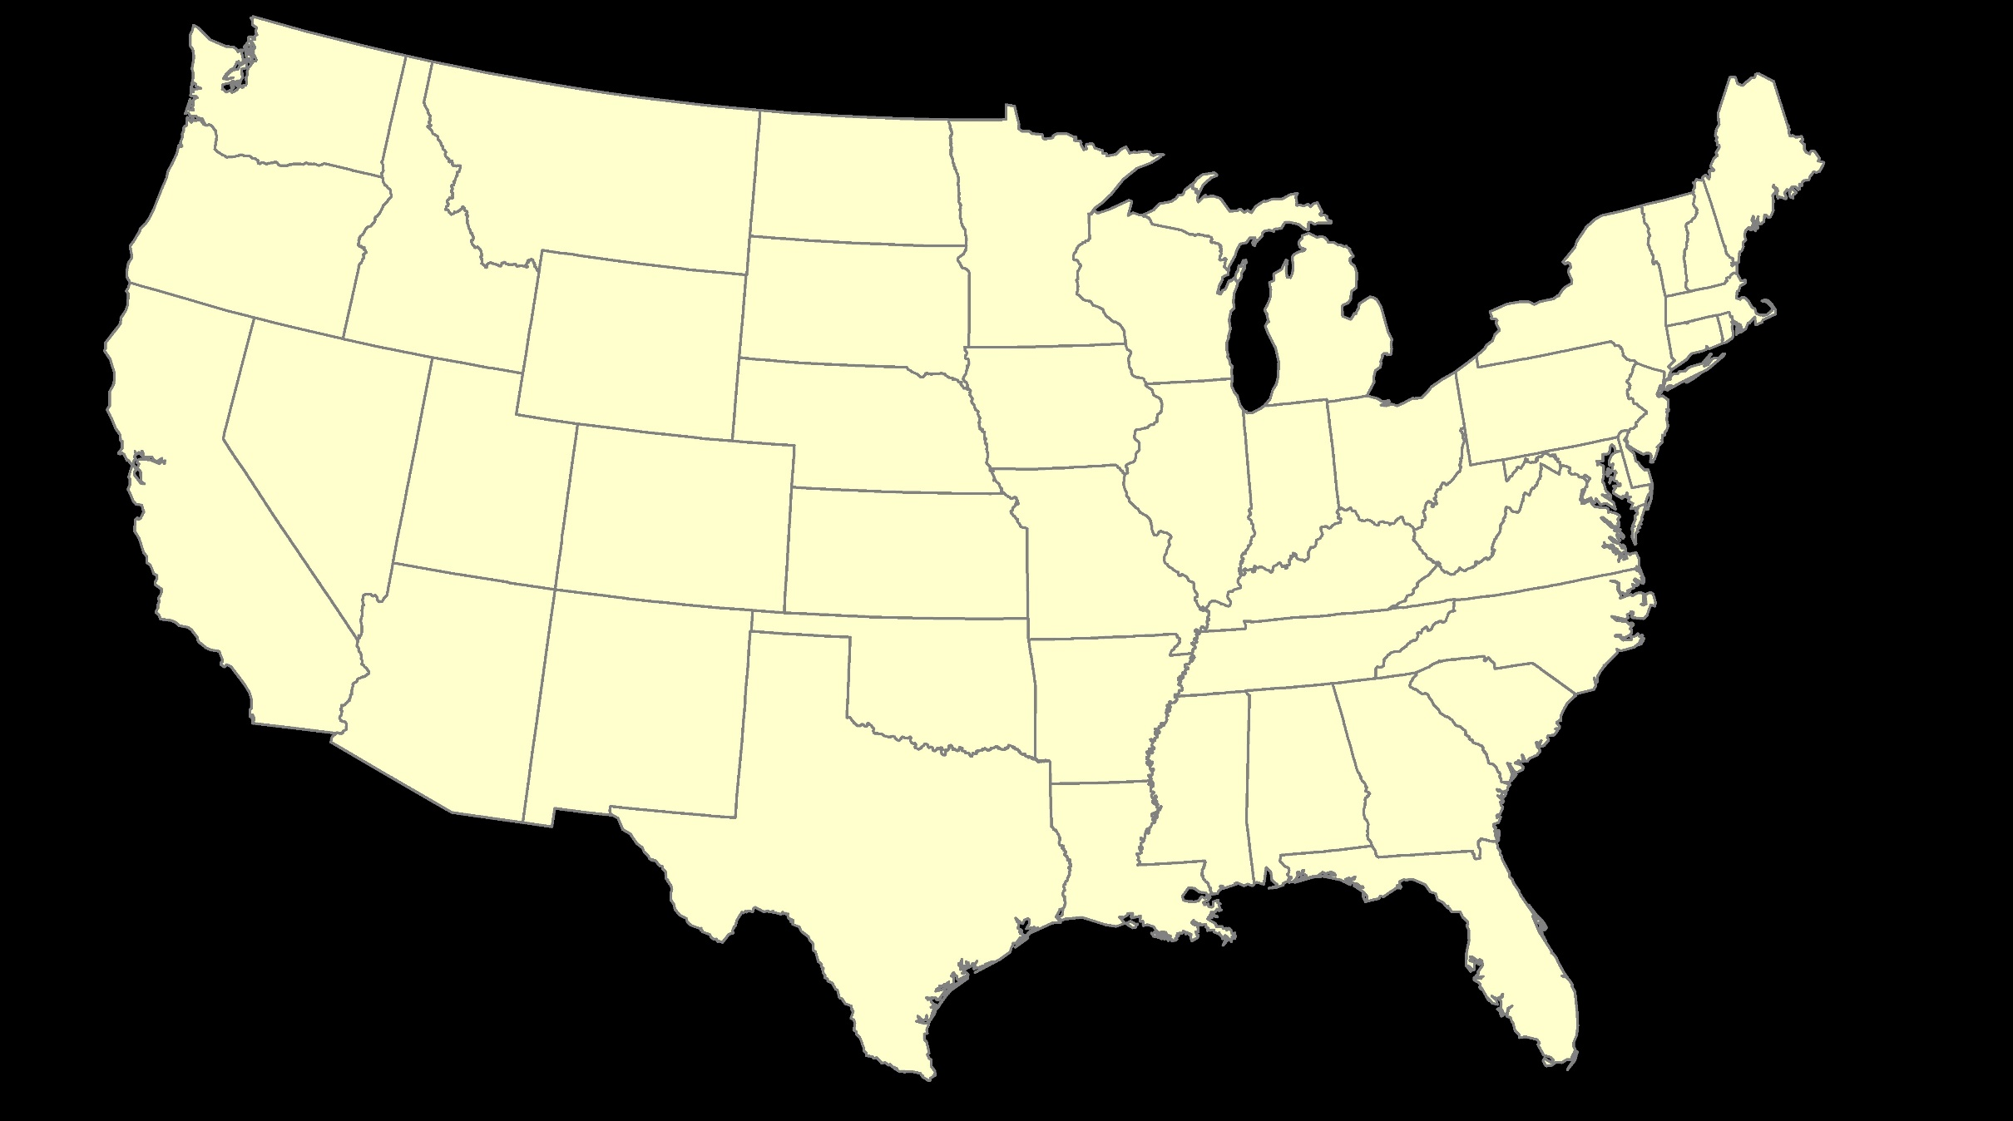
ITRF – constant frame, rotating plate

Slide 17
Plate-Fixed
NATRF – rotating frame, constant with plate

Slide 18
if you know epoch
ITRF or NATRF – your choice if you know epoch

Slide 19
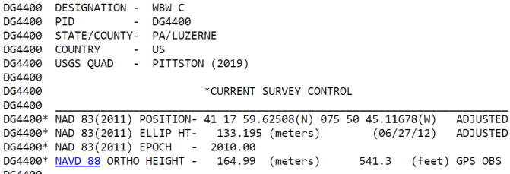
Terminology – Time/4D
Epoch
eh-puck? ee-pock? … to-may-to, to-mah-to
an instant of time
astronomy & geodesy use a decimal date
e.g. 2021.0276 or 2020.0000 or 2022.8205
doesn’t have to be
incorporating epochs is important, not format
others may use day-of-year = 2021:131
calendar date is sufficient
Notes:
-Where do you see an Epoch right now in NGS data?
CLICK
Datasheets! there you see the epoch of 2010.0
and of course OPUS Solution Reports!
note that in blue over there on the right you’ll see another epoch, in the ITRF, which I will explain later on

Slide 20
4D alignment – Epochs
One epoch where ITRF2020 coordinates will be equivalent to NATRF2022
January 01, 2020
ITRF2020 (epoch 2020.0) = NATRF2022 (epoch 2020.0)
Notes:
After that, they diverge and continue to do so, we’ll visualize that soon

Slide 21
Terminology - Changing Coordinates
Conversion
change the type of coordinate
NAD83(2011) latitude & longitude → NAD83(2011) SPCS
Transformation
change the datum of coordinate
NGVD29 height → NAVD88 height
NAD 27 latitude & longitude → NAD 83(2011) latitude & longitude
Propagation
change the epoch of coordinate
NATRF2022 epoch 2020.00 to NATRF2022 epoch 2023.243
Notes:
Historically NGS has been inconsistent with these top two words.
Going forward, we will use them as:
Conversion: Meaning to change the type of coordinate without changing the datum or frame
Transformation: Meaning to change the datum or frame, without changing the type of coordinate

Slide 22
NCAT
How will you do that?
NGS Coordinate Conversion And Transformation Tool (NCAT)
Epochs/Time/4D
Notes:
-so you’ve probably seen that phrase that I have front and center here, NSRS Modernization
-that’s the blanket term we use to refer to not just the new datums but other updates

Slide 23
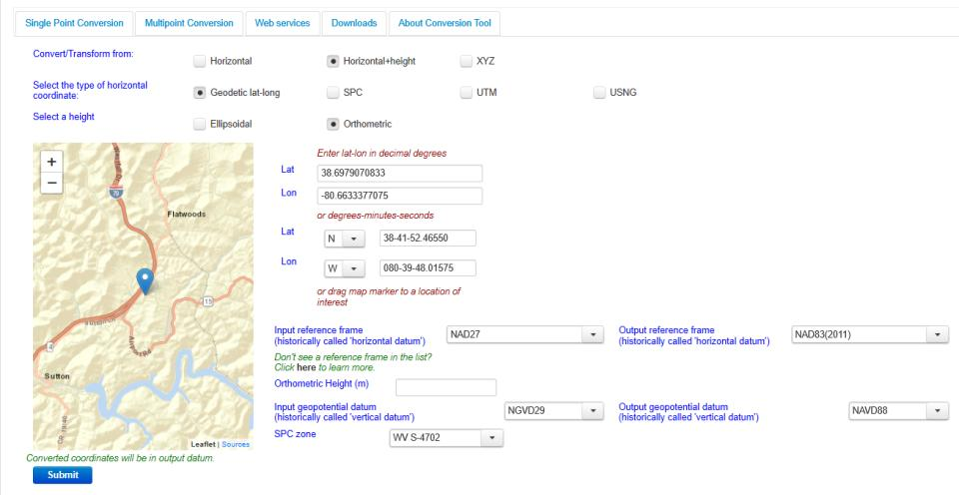
NGS Coordinate Conversion And Transformation Tool (NCAT)
Notes:
NCAT includes the functionality of previous NGS tools:
NADCON 5.0
XYZWIN 2.0
UTMS 2.1
SPC83 2.1
USNG 2.3
Includes error estimate of transformation per point.
Available as the single-point graphic seen here, multi-point upload/download, as a downloadable executable fie to run from the DOS prompt, and as web services for inclusion in your own
It’s a great tool. Anyone using

Slide 24
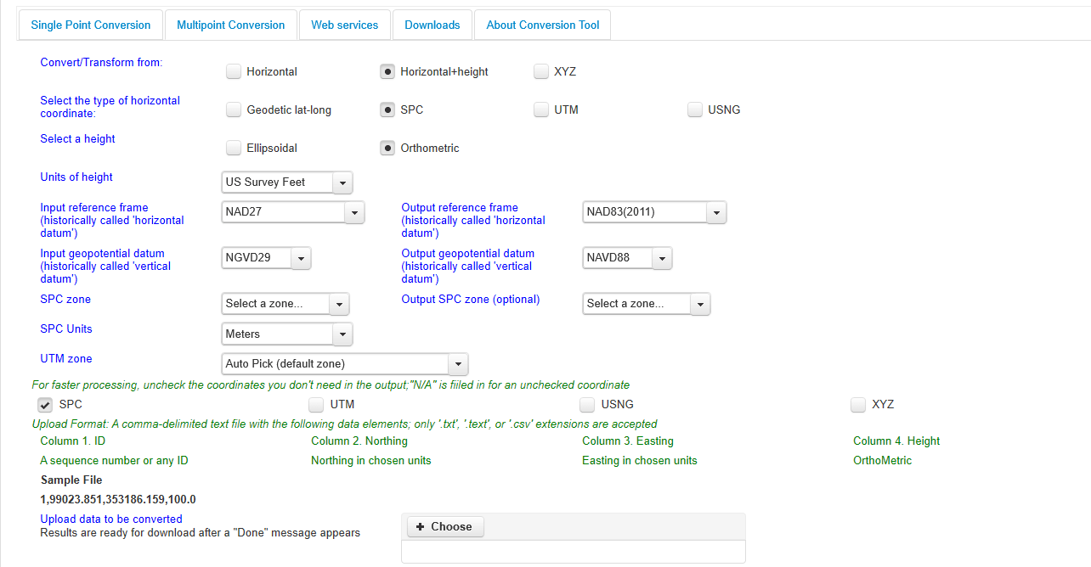
NGS Coordinate Conversion And Transformation Tool (NCAT)
Notes:
NCAT includes the functionality of previous NGS tools:
NADCON 5.0
XYZWIN 2.0
UTMS 2.1
SPC83 2.1
USNG 2.3
Includes error estimate of transformation per point.
Available as the single-point graphic seen here, multi-point upload/download, as a downloadable executable fie to run from the DOS prompt, and as web services for inclusion in your own
It’s a great tool. Anyone using

Slide 25
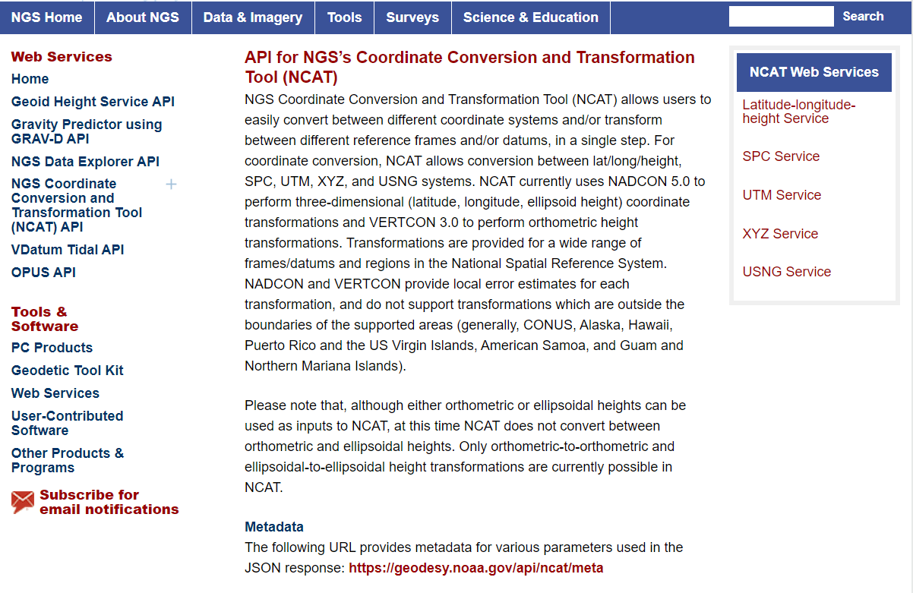
NCAT is available via web services

Slide 26
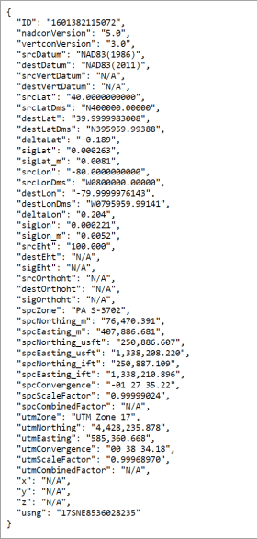
NCAT is available via web services
Note that each operation is a separate service
Struggling?
Contact us.
We can help!

Slide 27
NGS Coordinate Conversion And Transformation Tool (NCAT)
Notes:
NCAT includes the functionality of previous NGS tools:
NADCON 5.0
XYZWIN 2.0
UTMS 2.1
SPC83 2.1
USNG 2.3
Includes error estimate of transformation per point.
Available as the single-point graphic seen here, multi-point upload/download, as a downloadable executable fie to run from the DOS prompt, and as web services for inclusion in your own
It’s a great tool. Anyone using

Slide 28
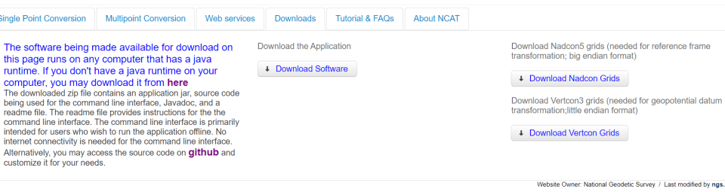
NGS Coordinate Conversion And Transformation Tool (NCAT)
Notes:
NCAT includes the functionality of previous NGS tools:
NADCON 5.0
XYZWIN 2.0
UTMS 2.1
SPC83 2.1
USNG 2.3
Includes error estimate of transformation per point.
Available as the single-point graphic seen here, multi-point upload/download, as a downloadable executable fie to run from the DOS prompt, and as web services for inclusion in your own
It’s a great tool. Anyone using

Slide 29
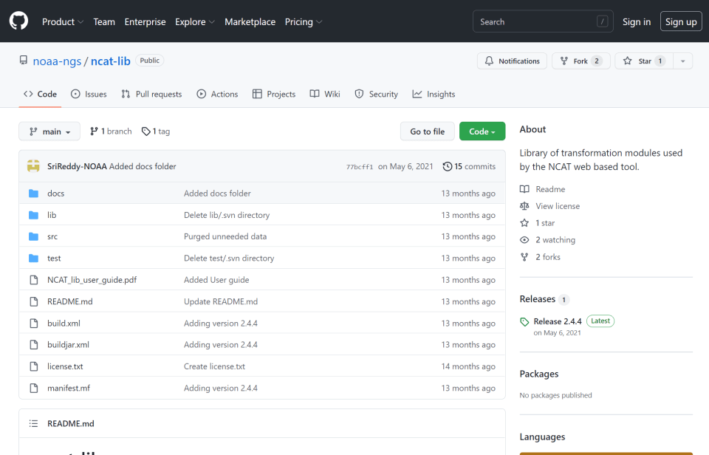
NCAT source code is on GitHub

Slide 30
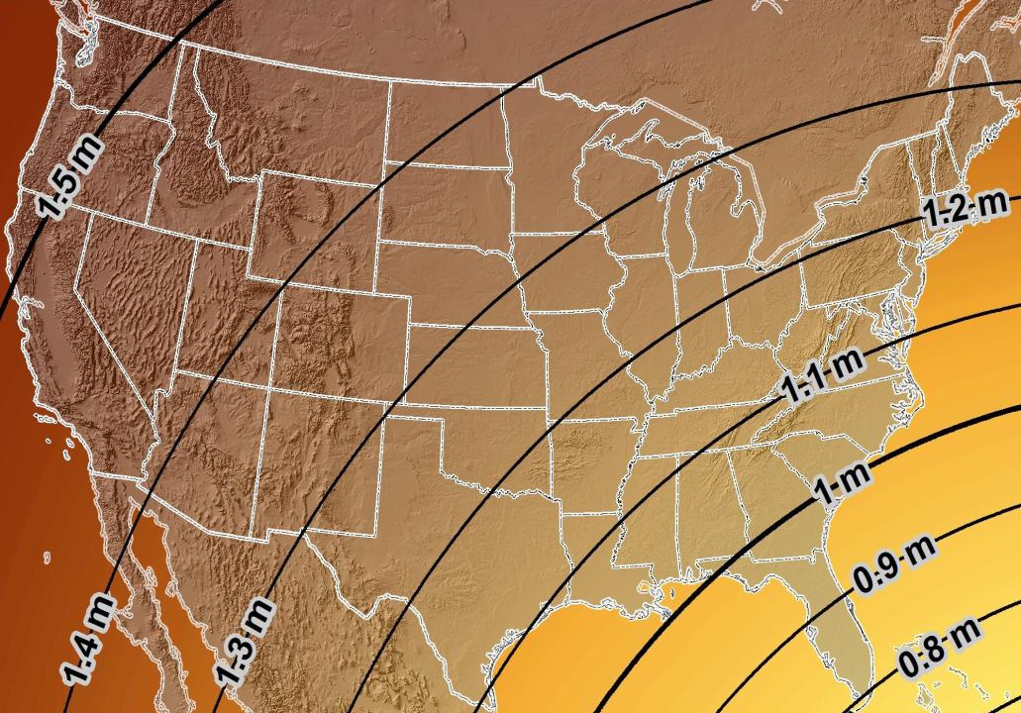
Estimated Geometric Change - Horizontal
NAD83 (2011) → NATRF2022
4.6 ft
Direction of Shift
4.3 ft
3.9 ft
3.6 ft
3.0 ft
Notes:
What’s the magnitude of the horizontal datum shift across Pennsylvania?
Minimum Shift ~3.75 feet
Maximum Shift ~3.97
Remember this is just an estimation, don’t hold me to the numbers please

Slide 31
New Lat/Long = New XY
With a new horizontal datum…
There comes a new set of State Plane Coordinate System zones

Slide 32

SPCS2022
MAKING EARTH FLAT AGAIN
…ONE ZONE AT A TIME
I’m selling these bumper stickers on LinkedIn…
Really?
No… not really!

Slide 33
State Plane Coordinate System of 1983
SPCS83
North and South Zones as they exist now
Notes:
We start with the SPCS83 zones as a frame of reference
NOTE that the color shading of these zones is matched to that of the Preliminary SPCS2022 Zones that follow

Slide 34
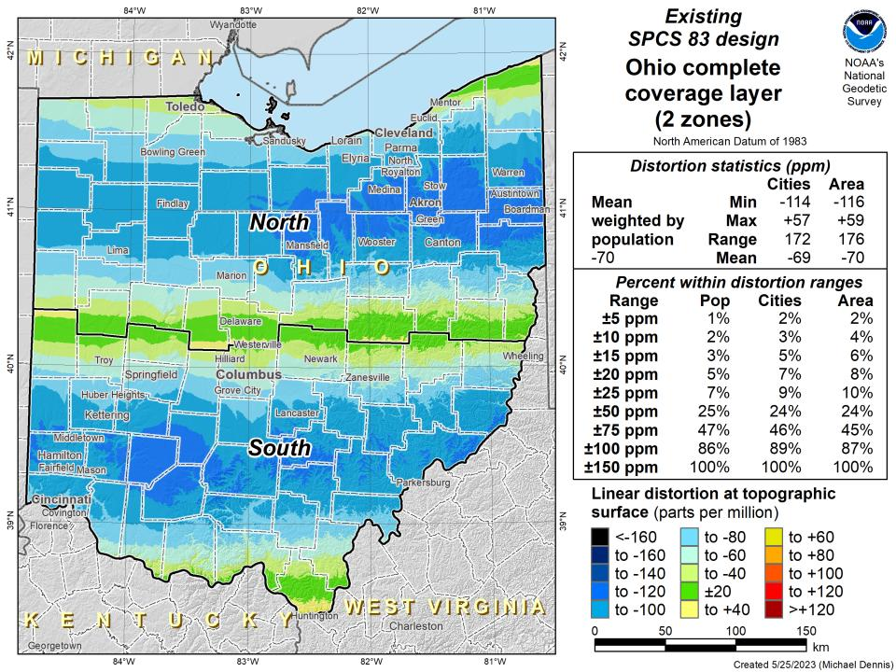

Slide 35
State Plane Coordinate System of 2022
SPCS2022
NGS designed a Single Statewide Zone for every State

Slide 36
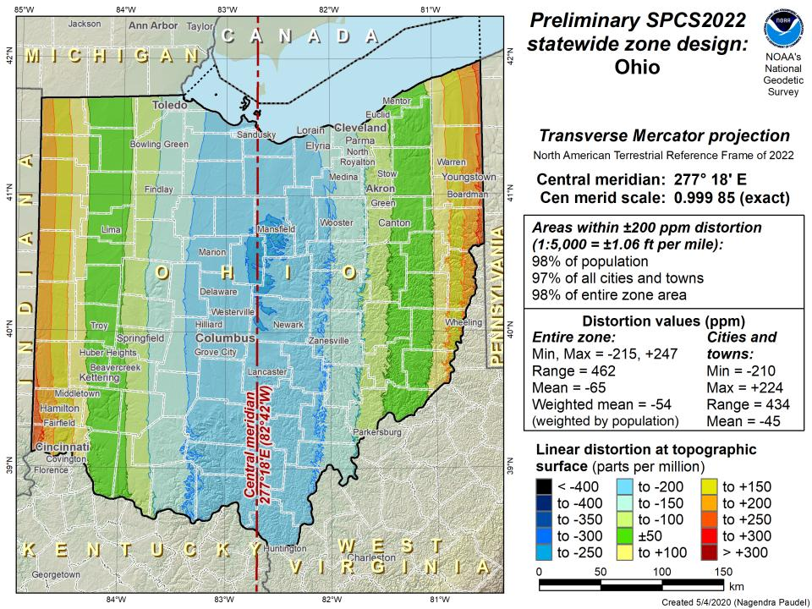

Slide 37
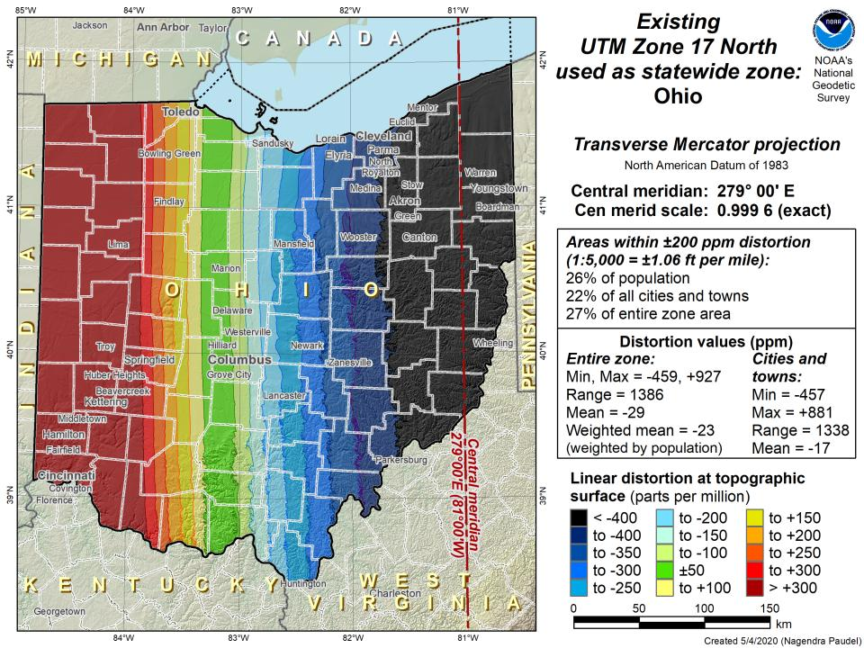

Slide 38
State Plane Coordinate System of 2022
SPCS2022
Ohio stakeholders designed 88 zones
Notes:
The following section illustrates the preliminary SPCS2022 zones
There are 4 zones in the NGS design, per request that we design “4-5 zones required to meet the minimum distortion acceptable” set by our design criteria of 50ppm
NOTE the request also included wording: “It is also requested that PennDOT districts be divded into no more than two zones”

Slide 39
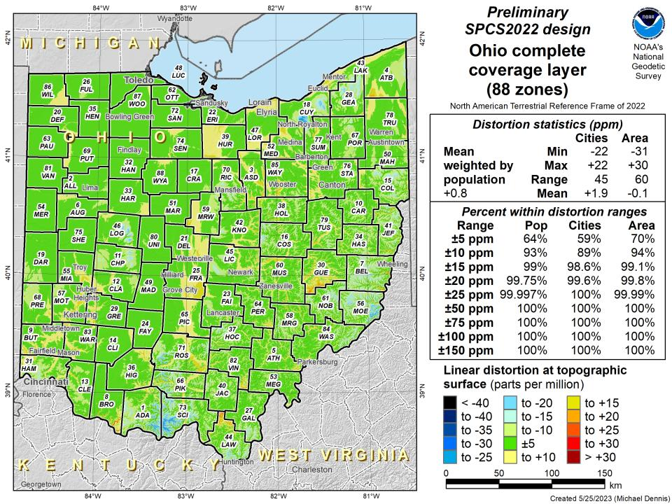

Slide 40
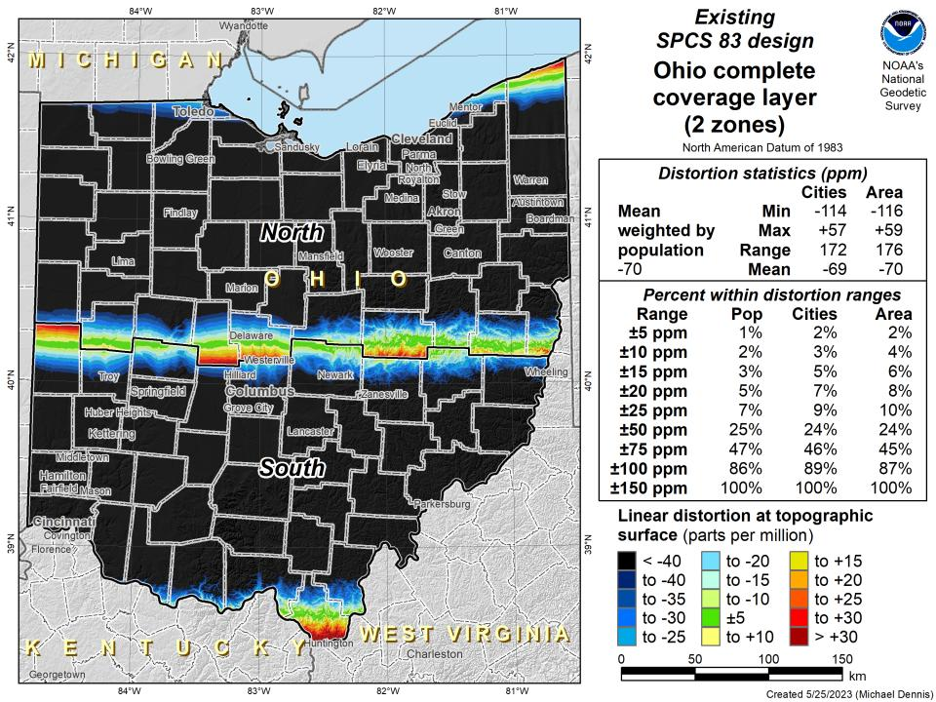

Slide 41
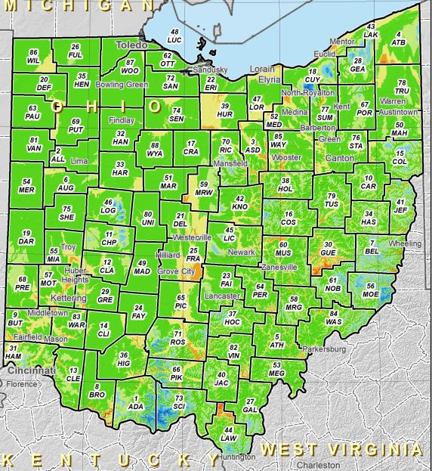
SPCS2022 Zone Layers in Ohio
Both Single Statewide and Multi-Zone Layers will coexist
Think about your data, your goals, your customers
Remember that geographic coordinates are your friend!
Smaller zones not “the best” … it all depends on usage & goals

Slide 42
Which is best?
Each has strengths and each has weaknesses.

Slide 43
SPCS2022 Zone Layers and LDPs
Each state may have max of 3 zone “layers”
One layer must be statewide zone
Ohio Single Statewide
Other layers have two or more zones
Ohio County Coordinate System (designed by ODOT)
A third layer can exist, but must be discontinuous coverage
Left open for possibilities

Slide 44
Points to ponder…
What to do with the existing tiling scheme in NATRF2022?
Maintain same footprints, so uneven coordinates at corners?
New footprints, but cleaner coordinates? Both options?

Slide 45
State Plane Coordinate System of 2022
SPCS2022
Not just Ohio!
Notes:
The following section illustrates the preliminary SPCS2022 zones
There are 4 zones in the NGS design, per request that we design “4-5 zones required to meet the minimum distortion acceptable” set by our design criteria of 50ppm
NOTE the request also included wording: “It is also requested that PennDOT districts be divded into no more than two zones”

Slide 46
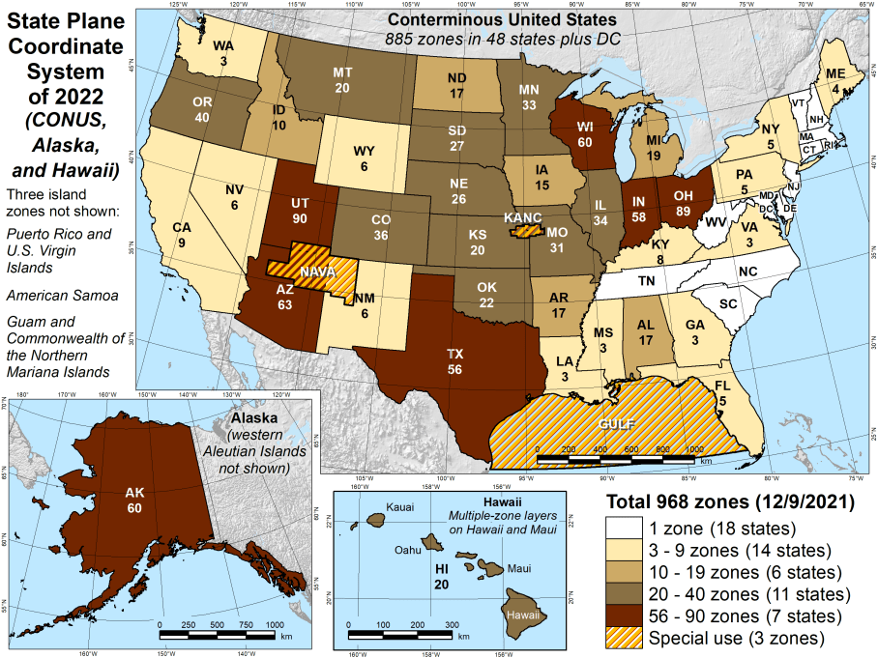
Number of SPCS2022 zones (preliminary)
CONUS, Alaska, and Hawaii
Three island zones not shown:
Puerto Rico and U.S. Virgins Islands
American Samoa
Guam and the Commonwealth of the Northern Mariana Islands

Slide 47
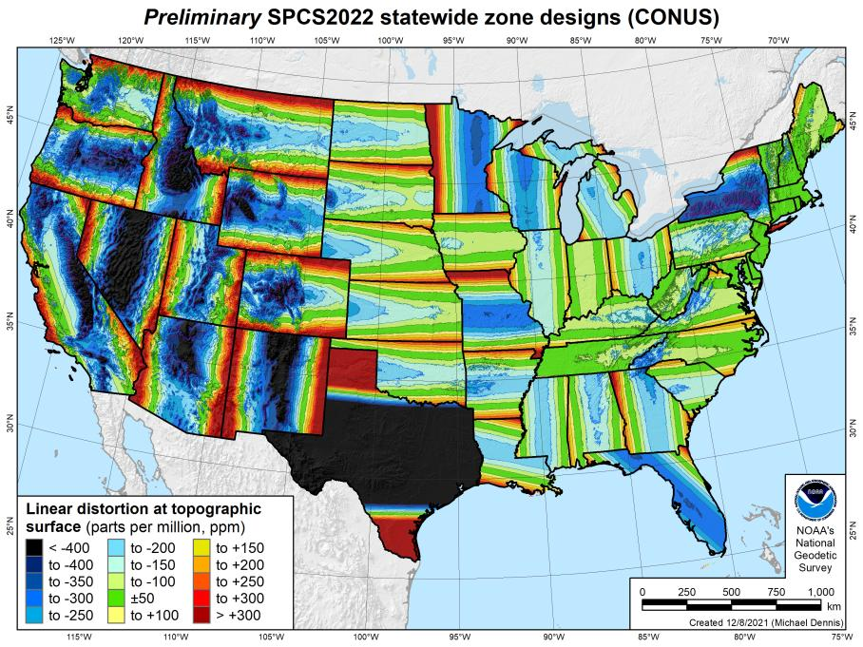
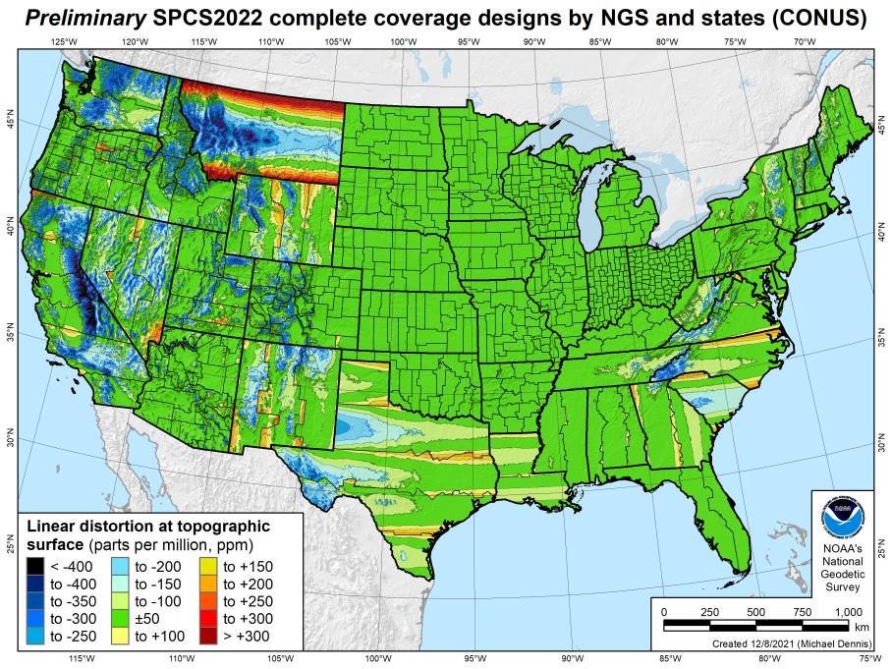
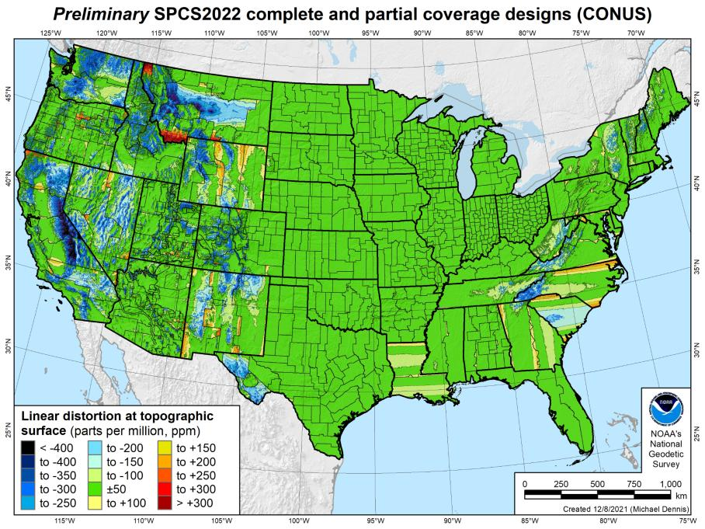
SPCS2022 linear distortion (prelim)
846 zones (CONUS)
Percent within distortion (ppm):
Distor | Pop | Cities | Area
±20 | 76% | 71% | 58%
±50 | 92% | 89% | 76%
±100 | 98% | 97% | 89%
±400 | 100% | 100% | 99.9%
City and area statistics (ppm):
 | Min | -407 | -1438
 | Max | +486 | +2624
 | Range | 893 | 4062
 | Mean | -6 | -23
Mean weighted by pop = -4

Slide 48
The Survey Foot is dead!
Long live the Survey Foot!
US Survey Foot was deprecated 31 December 2022… now what?!?
Notes:
We start with the SPCS83 zones as a frame of reference
NOTE that the color shading of these zones is matched to that of the Preliminary SPCS2022 Zones that follow

Slide 49

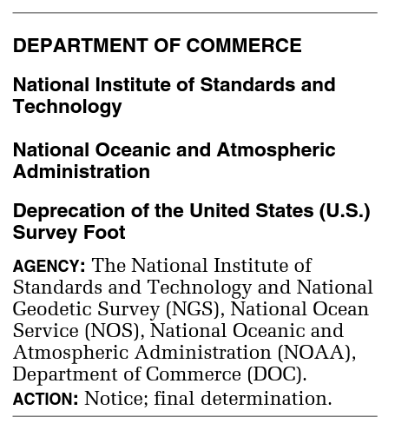
What happened to the US Survey Foot?
Deprecated 31 December 2022
Which begs the question
What should you be doing now?

Slide 50
The Issue at Hand…
Two versions of same unit in current use
“New” international foot and “old” U.S. survey foot
Intl. shorter than US by 2 ppm (0.01 ft per mile)
What’s in a name?
“U.S. survey” versus “international”
Who is using U.S. survey feet?
Surveyors exclusively… also the users of their data.
Derivative products
So… this impacts everyone here.
Notes:
It’s likely everyone watching this webinar knows about the problem: there are two nearly identical versions of the foot in current use in the U.S.;
They differ by 2 parts per million (ppm), or only 0.01 ft per mile, or slightly more than a tenth of an inch in a mile.
Despite (or actually because of) the very small difference, it has become a REAL problem with REAL costs.
What’s in a name? That which we call a “foot” by any other word would smell as… sweet? Maybe that’s not he best analogy for the foot…
“U.S. survey foot” sounds patriotic, is surveyor-centric…
“International foot” sounds like a New World Order, UN sanctioned sort of thing, with perhaps a whiff of socialism…
Is the name really part of the problem? I hope not, but emotion does play a role. We are not entirely rational creatures after all (myself included).
Surveyors are really the only users of the U.S. survey foot (sft). They are also among the very few who even know of its existence. In schools and colleges they only teach students about the official international foot (ift). However, because people use the products created by surveyors, they end up using the sft without even knowing it.
Want to have a conversation about this, get all of us on the same page. So I will present facts to facilitate informed discussion (sprinkled with some opinions…)

Slide 51
What’s impacted?
When does this matter?
Not typically in lengths/distances
Published planar coordinate systems
Why? → large false eastings and northings
Like what?
SPCS and UTM are very popular
both fall victim to mix-ups
due to… the large false E/N in their zones
Notes:
It’s likely everyone watching this webinar knows about the problem: there are two nearly identical versions of the foot in current use in the U.S.;
They differ by 2 parts per million (ppm), or only 0.01 ft per mile, or slightly more than a tenth of an inch in a mile.
Despite (or actually because of) the very small difference, it has become a REAL problem with REAL costs.
What’s in a name? That which we call a “foot” by any other word would smell as… sweet? Maybe that’s not he best analogy for the foot…
“U.S. survey foot” sounds patriotic, is surveyor-centric…
“International foot” sounds like a New World Order, UN sanctioned sort of thing, with perhaps a whiff of socialism…
Is the name really part of the problem? I hope not, but emotion does play a role. We are not entirely rational creatures after all (myself included).
Surveyors are really the only users of the U.S. survey foot (sft). They are also among the very few who even know of its existence. In schools and colleges they only teach students about the official international foot (ift). However, because people use the products created by surveyors, they end up using the sft without even knowing it.
Want to have a conversation about this, get all of us on the same page. So I will present facts to facilitate informed discussion (sprinkled with some opinions…)

Slide 52
2 parts per million (ppm)?
1,000,000.00 sft = 999,998.00 ift
10,000,000.00 sft = 9,999,980.00 ift
1,000.00 sft = 999.998 ift (can you measure that?)
International → 1 ft = .3048 m
US → 1 ft = .30480061 m (approx.)

Slide 53
What should you be doing now?
Prepare for this along with new datums
Understand the difference between sft and ift
2 parts per million
Understand this is not enforced
Neither NIST or NGS are a regulatory agency
We support education/outreach of course
But OPUS, NCAT, etc. will not have US Survey Foot options for output in SPCS2022 zones

Slide 54
The Survey Foot is dead!
Long live the Survey Foot!
US Survey Foot was deprecated 31 December 2022…
But it will always be available in NGS tools for NAD83 and NAD27 coordinates

Slide 55
Remember…
What’s the goal of NATRF2022?
Give you the stability in positions that you expect
That’s the point of Reference Epochs (REs)
Akin to the different realizations of NAD83
REs will be published every 5 or 10 years
you choose when you update
in a perfect world, everyone would stay current
aka versions
Notes:
What’s the goal of the way NATRF2022 was designed, by including EPP2022 and IFVM2022
Does a database of manholes in PA need cm-level coordinate updates on an annual basis? Probably not.

Slide 56
Preparing for NATRF2022
Two factors will dictate your frequency of coordinate updates
Your accuracy needs
The region you work in → tectonic motion
Do manholes need cm-level updates annually?
We accommodate that… you choose
Just because we’re chasing the millimeter… it doesn’t mean you need to.
Notes:
What’s the goal of the way NATRF2022 was designed, by including EPP2022 and IFVM2022
For a database of features in PA
Does a database of manholes in PA need cm-level coordinate updates on an annual basis? Probably not.

Slide 57
Preparing for NATRF2022
Know the epoch of your data/datasets
consider how you will track this
full to-the-second timestamp on every feature?
labeling a year for each dataset?
something in-between that works for your needs?

Slide 58
Preparing
Reprocessing your data
in a perfect world, everyone would reprocess
What does this really mean?
consider a hydro-enforced DEM
start over with the raw flight data (GNSS/IMU)
generate new point clouds
recreate all the drainage features in new datum
unrealistic! … and unnecessary for majority users
Notes:
Reprocessing your data
in a perfect world, everyone would reprocess data
consider a final product like you use everyday - a hydro-enforced DEM
starting fresh with the raw GNSS/IMU processing
generate new ellipsoid height point clouds
recreate all the drainage features in new datum
this is totally unrealistic → both from a financial and programmatic perspective

Slide 59
Preparing
Transforming your data
NCAT - NGS Coordinate Conversion and Transformation Tool
ASCII up/download, Web Services, Download, GitHub
ask your software provider(s) about integration
we envision COTS integrations as most popular method of access
Industry Workshops - May 2021 and August 2022
Esri, Trimble, Blue Marble, etc… all the well known names attended
Geospatial Software Developers’ Summit – Nov/Dec
International & Virtual → US NGS and NRCan CGS
Notes:
Transforming your data
NCAT - NGS Coordinate Conversion and Transformation Tool
available now: ASCII upload and Web Services
ask your software providers about integration
we envision this as most popular method of access
Industry Workshop held this year – esri, trimble, bluemarble, all the major well known names were represented
labeling a year for each dataset?
something in-between that works for your needs

Slide 60

additional Resources
Notes:
This presentation is intended to raise awareness about the upcoming changes and what they mean for floodplain mapping, but you probably have lots of remaining questions and we have a lot of resources online at our website
Please spread the word, and
make an effort to keep yourself and your colleagues informed.
Tell us what content is missing or how we can make it better!

Slide 61
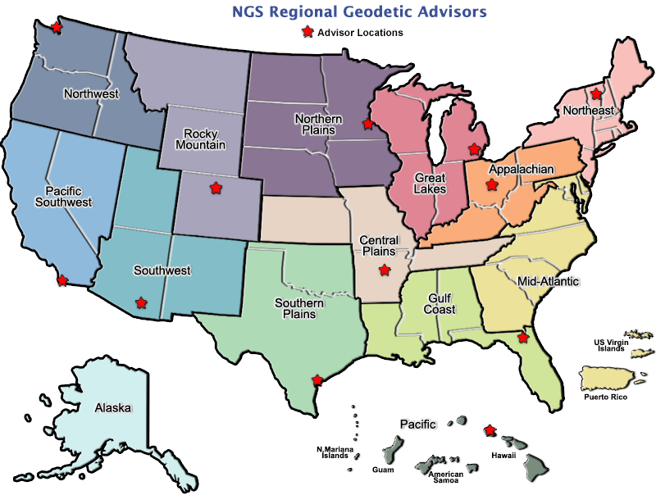
Regional Geodetic Advisor Program
geodesy.noaa.gov/ADVISORS/
14 RGAs across country
We are here to support:
You
Your constituents
Our Federal Partners
Questions about
NSRS Modernization?
Reach out now
Be prepared
Notes:
-14 Regional Advisors, we’ve transitioned from a State-based to a Regional Program
-our advisors homepage up there at the top, also easy to find us by querying any major search engine for “ngs advisors”
-if you know Ross Mackay, he is our Chief Advisor, I report to him…
**ya know, I don’t know why they don’t make him put his photo up here
-we do have one vacant advisor position, that was recently advertised and John up there in Wisconsin is officially retired in oh… 18 days

Slide 62
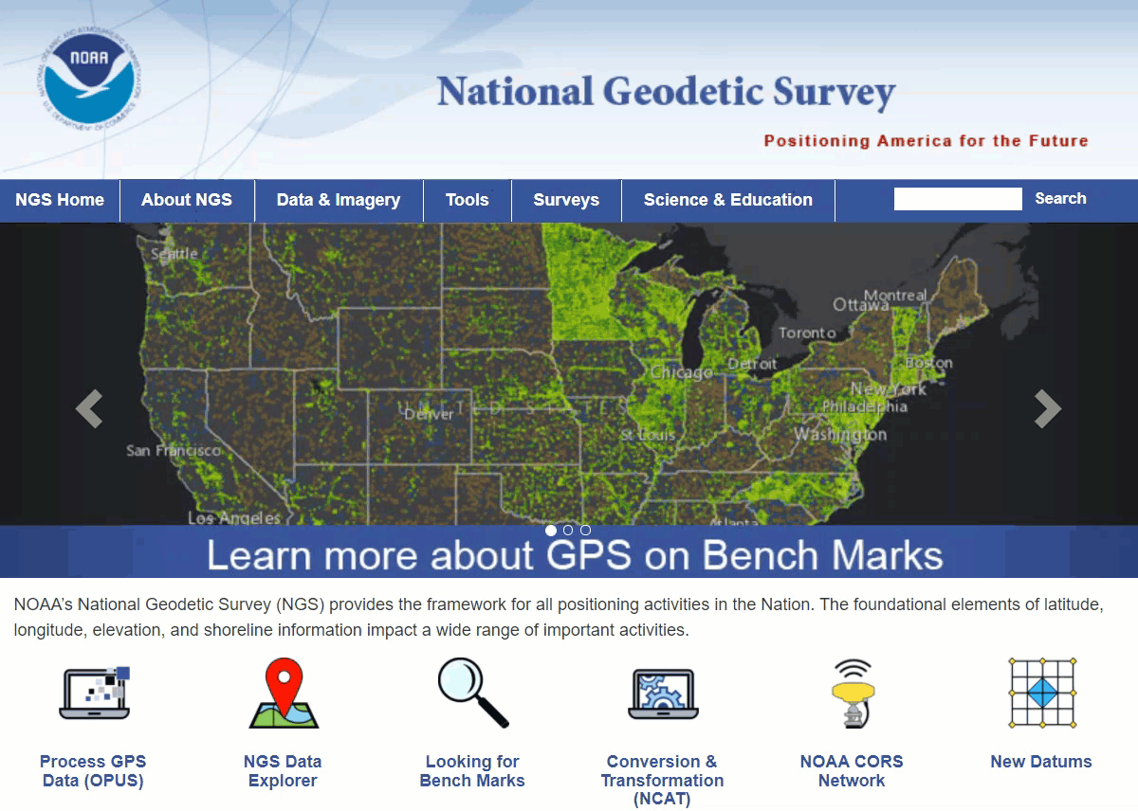
Educational Videos
<5 minutes
Online Lesson
(via MetEd/COMET)
~1 hour
NGS homepage: geodesy.noaa.gov
Notes:
Educational videos and online tutorials –
Our library of lessons and videos are great resources, and will reinforce a lot of information we covered today.
The videos are just 3-5 minutes long.
the lesson is a deeper dive but still only takes an hour.

Slide 63
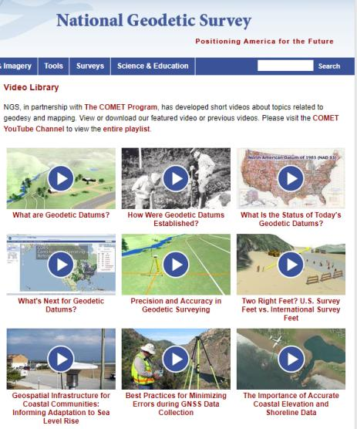

Resources at geodesy.noaa.gov
Educational Videos
<5 minutes
Online Lesson
(via MetEd/COMET)
~1 hour
Notes:
Educational videos and online tutorials –
Our library of lessons and videos are great resources, and will reinforce a lot of information we covered today.
The videos are just 3-5 minutes long.
the lesson is a deeper dive but still only takes an hour.

Slide 64
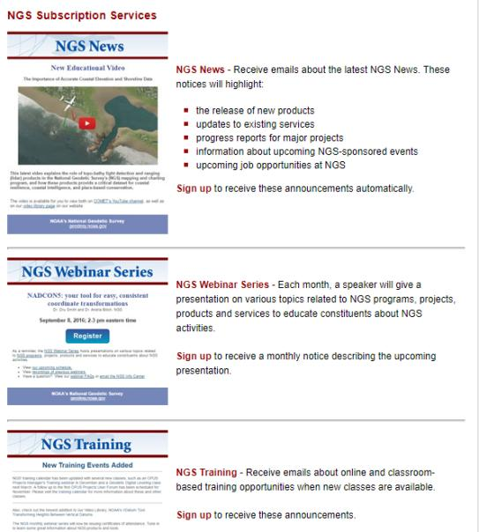

Email Subscriptions
*Only 1-2 messages per month*
NGS News
Includes quarterly NSRS Modernization newsletter
Webinar Series
Training
Primarily surveyor focused
GPS on Benchmarks
Click this icon on homepage
Notes:
Stay abreast of any new information coming from us via Email Subscription –
Sign up for notifications about News, webinars, and training opportunities with NGS.
We also use our News subscription list to send out our quarterly NSRS Modernization Newsletter.

