Slide 1
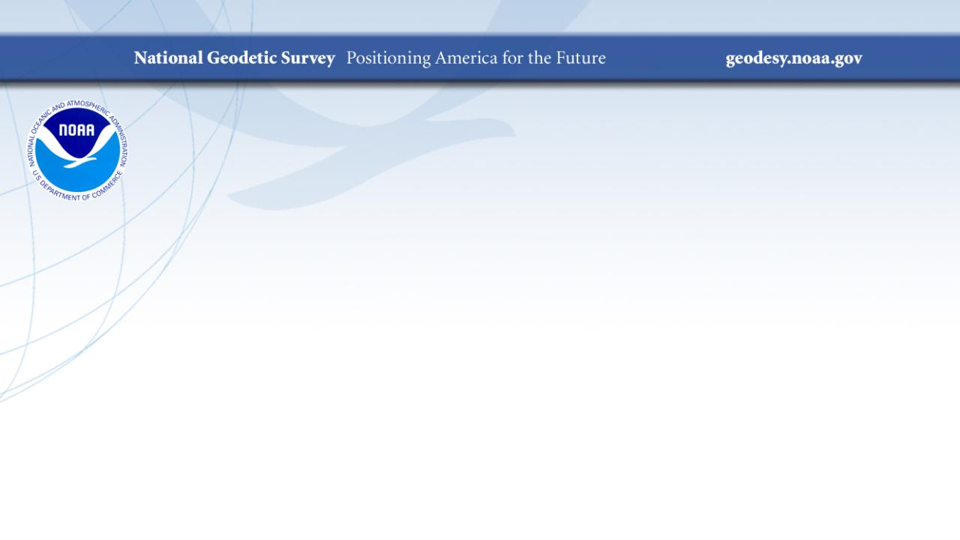
SPCS2022
Making Earth Flat Again... One Zone at a Time!
NEOGEO Symposium
May 2023
Jeff Jalbrzikowski, P.S., GISP, CFS
Appalachian Regional Geodetic Advisor
jeff.jalbrzikowski@noaa.gov
240-988-5486

Slide 2



Organizational Structure
  -Department of Commerce (DoC)
  (~47,000 employees)
  -National Oceanic and Atmospheric Administration (NOAA)
  -National Ocean Service (NOS)
  -National Geodetic Survey (NGS)
  (~175 employees)
Notes:
-We are the Federal Government’s oldest scientific agency.
-part of the Executive Branch
-I know it can seem kind of strange that NGS is part of the NOS, but the origins of NGS lie with the C&GS.
-we are a “Program Office” of the NOS
Survey of the Coast – 1807
Coast Survey – 1836
Coast and Geodetic Survey – 1878
NGS since 1970

Slide 3


Organizational Structure
We’re not USGS, we’re NGS
  -Department of Commerce (DoC)
  (~47,000 employees)
  -National Oceanic and Atmospheric Administration (NOAA)
  -National Ocean Service (NOS)
  -National Geodetic Survey (NGS)
  (~175 employees)
≠
Notes:
-as you can read my slide, I like to point that out because over my 2 years at NGS I’ve seen and heard this misunderstanding quite a bit
-don’t worry! it doesn’t offend us! and we do work closely with USGS, but we are separate agencies within totally different departments of the federal government

Slide 4
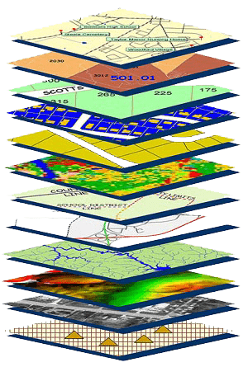
NGS Mission
To define, maintain and provide access to the National Spatial Reference System (NSRS) to meet our Nation’s economic, social, and environmental needs.
NSRS
Notes:
NGS develops and maintains the National Spatial Reference System, a national coordinate system that provides the foundation for transportation, navigation, land record systems, mapping and charting efforts, and a multitude of scientific and engineering applications
CLICK
You’ve all seen this or some similar graphic I’m sure. That bottom layer… that’s our baby, the NSRS.

Slide 5
Modernizing the NSRS
Updating all NSRS coordinates
  Replace existing datums with new datums
  Replacing existing SPCS83 with new SPCS2022
  Accounting for coordinates changing with time
Improving NGS products and services
Simplifying customer contributions
Making the NSRS:
  More accurate
  More accessible
  More efficient
Rollout in
2025

Slide 6
NATRF2022
North American Terrestrial Reference Frame of 2022
will replace
NAD83
North American Datum of 1983
Technically, not just NATRF2022 but also its 4 sister TRFs…

Slide 7
Four TRFs for Modernized NSRS
North American Terrestrial Reference Frame of 2022
(NATRF2022)
Pacific Terrestrial Reference Frame of 2022
(PATRF2022)
Caribbean Terrestrial Reference Frame of 2022
(CATRF2022)
Mariana Terrestrial Reference Frame of 2022
(MATRF2022)

Slide 8
Plate-Fixed NSRS TRFs
ITRF
Frame = constant
NA Plate = rotating
NATRF
Frame = rotating
(relative to ITRF)
NA Plate = constant
(relative to NATRF2022)
Notes:
We say “NATRF2022” is “fixed” to the N.A. Plate, making it a “plate fixed” frame
-the frame is constant to itself, but rotating within ITRF, and moving in a different direction than the other 3 frames

Slide 9
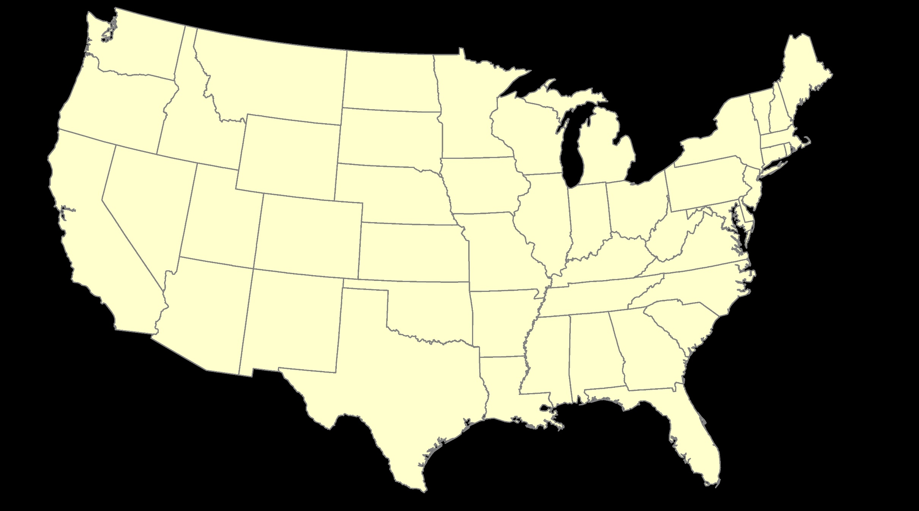
ITRF – constant frame, rotating plate

Slide 10
Plate-Fixed
NATRF – rotating frame, constant with plate

Slide 11
if you know epoch
ITRF or NATRF – your choice if you know epoch

Slide 12
Terminology - Changing Coordinates
Conversion
    change the type of coordinate
    NAD83(2011) latitude & longitude → NAD83(2011) SPCS
  Transformation
    change the datum of coordinate
    NGVD29 height → NAVD88 height
    NAD 27 latitude & longitude → NAD 83(2011) latitude & longitude
Propagation
    change the epoch of coordinate
    NATRF2022 epoch 2020.00 to NATRF2022 epoch 2023.243
Notes:
Historically NGS has been inconsistent with these top two words.
Going forward, we will use them as:
Conversion: Meaning to change the type of coordinate without changing the datum or frame
Transformation: Meaning to change the datum or frame, without changing the type of coordinate

Slide 13
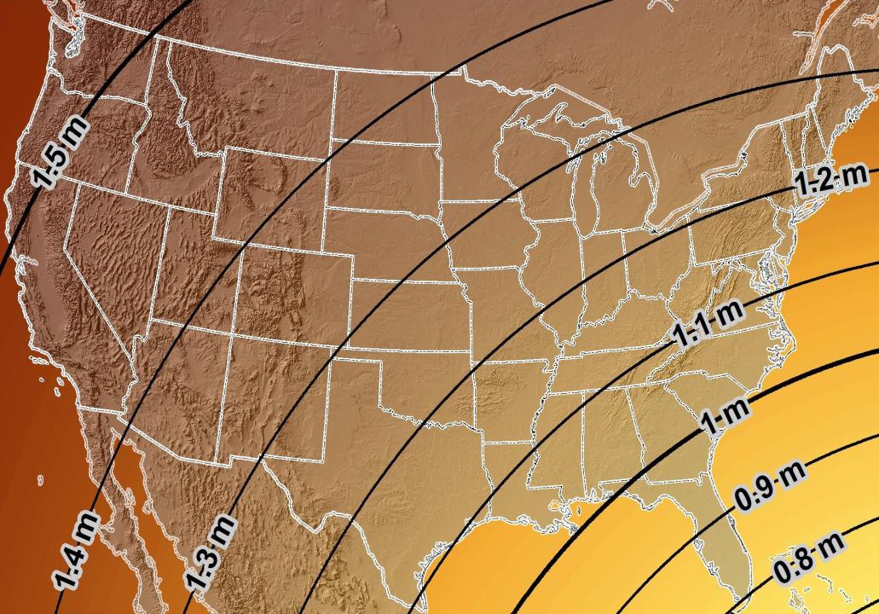
Estimated Geometric Change - Horizontal
NAD83 (2011) → NATRF2022
4.6 ft
Direction of Shift
4.3 ft
3.9 ft
3.6 ft
3.0 ft
Notes:
What’s the magnitude of the horizontal datum shift across Pennsylvania?
Minimum Shift ~3.75 feet
Maximum Shift ~3.97
Remember this is just an estimation, don’t hold me to the numbers please

Slide 14
New Lat/Long = New XY
With a new horizontal datum…
There comes a new set of State Plane Coordinate System zones

Slide 15

I’ll be selling these bumper stickers on LinkedIn…
SPCS2022
MAKING EARTH FLAT AGAIN
…ONE ZONE AT A TIME
Really?
No… not really!

Slide 16
State Plane Coordinate System of 1983
SPCS83
North and South Zones as they exist now
Notes:
We start with the SPCS83 zones as a frame of reference
NOTE that the color shading of these zones is matched to that of the Preliminary SPCS2022 Zones that follow

Slide 17
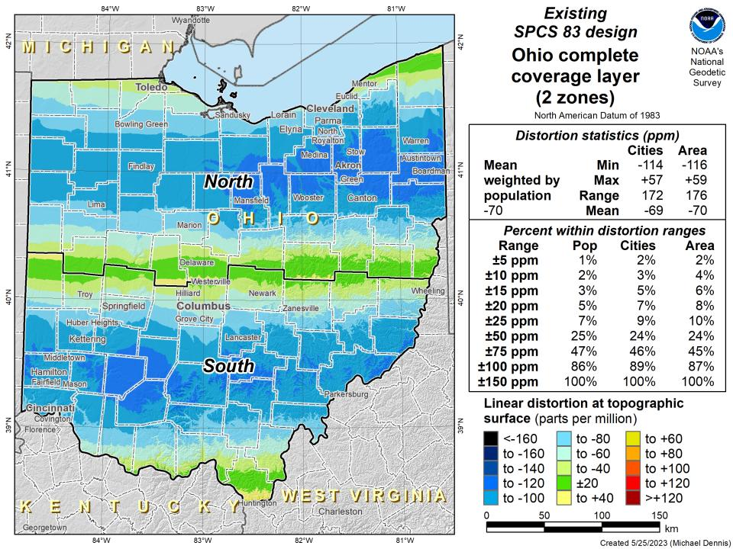

Slide 18
State Plane Coordinate System of 2022
SPCS2022
NGS designed a Single Statewide Zone for every State

Slide 19
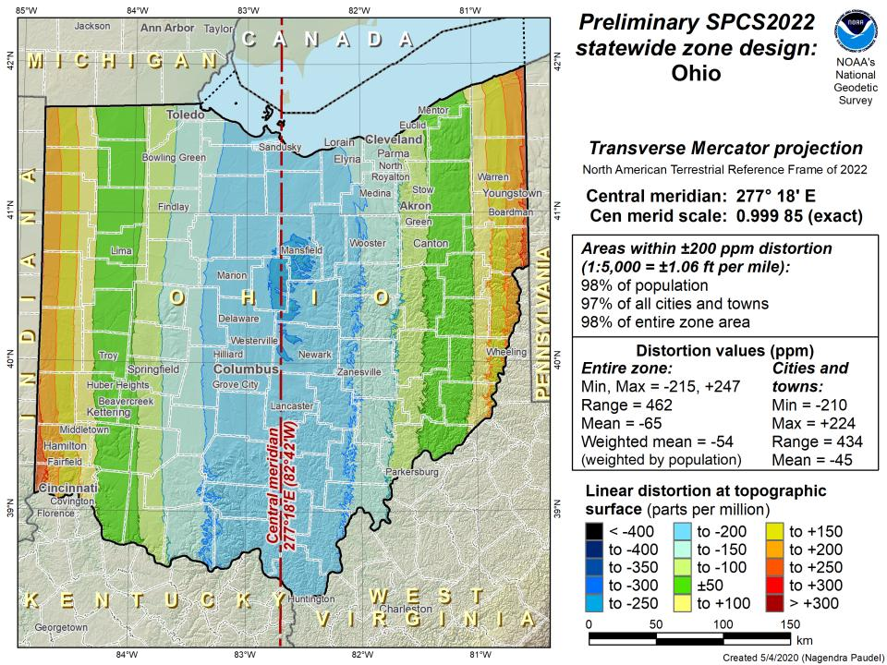

Slide 20
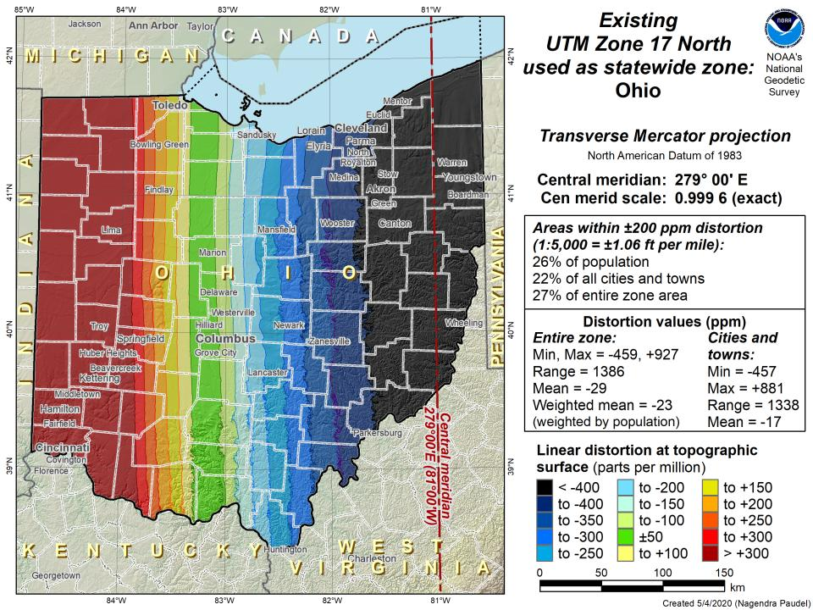

Slide 21
State Plane Coordinate System of 2022
SPCS2022
Ohio stakeholders designed 88 zones
Notes:
The following section illustrates the preliminary SPCS2022 zones
There are 4 zones in the NGS design, per request that we design “4-5 zones required to meet the minimum distortion acceptable” set by our design criteria of 50ppm
NOTE the request also included wording: “It is also requested that PennDOT districts be divded into no more than two zones”

Slide 22
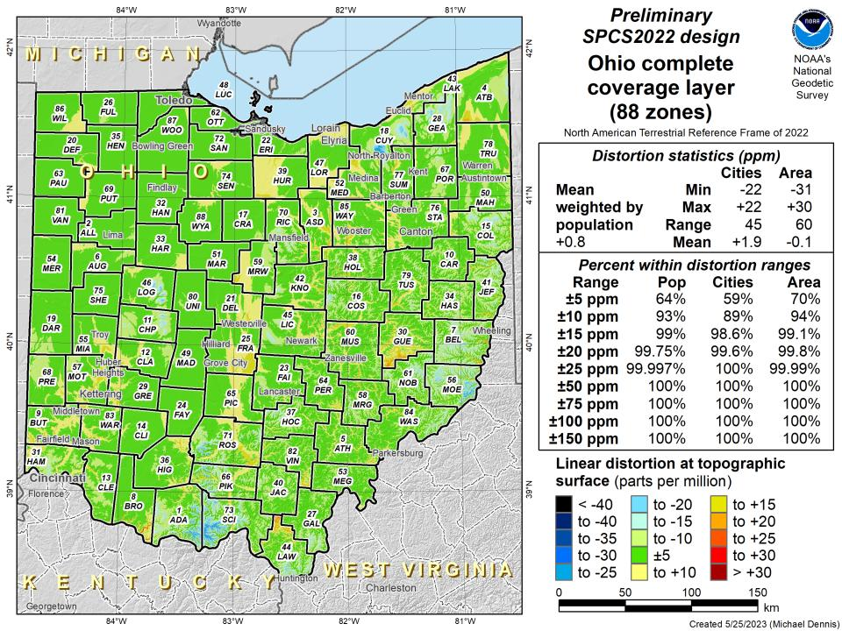

Slide 23
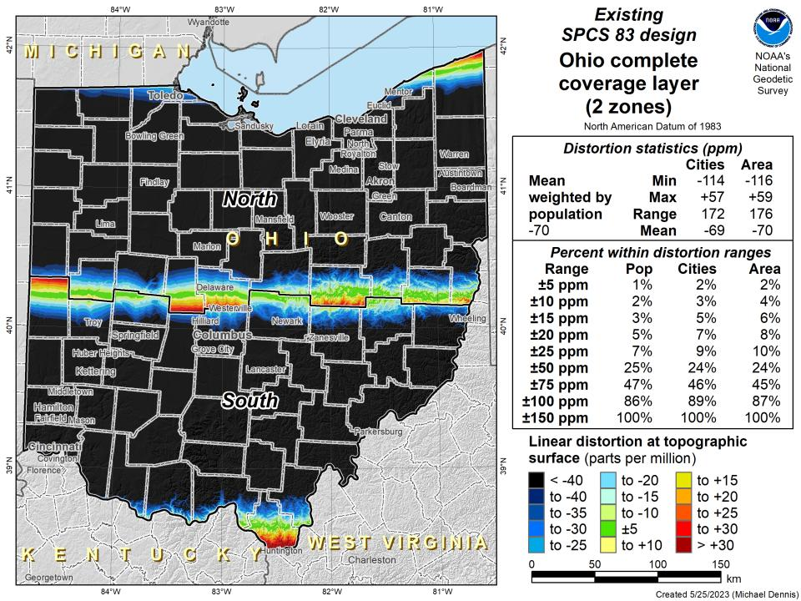

Slide 24
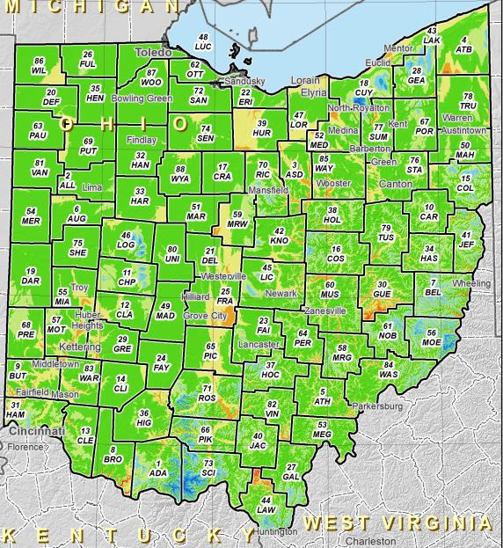
SPCS2022 Zone Layers in Ohio
Both Single Statewide and Multi-Zone Layers will coexist
Think about your data, your goals, your customers
  Remember that geographic coordinates are your friend!
Smaller zones not “the best” … it all depends on usage & goals

Slide 25
SPCS2022 Zone Layers and LDPs
Each state may have max of 3 zone “layers”
  One layer must be statewide zone
    Ohio Single Statewide
  Other layers have two or more zones
    Ohio County Coordinate System (designed by ODOT)
  A third layer can exist… but must be discontinuous coverage
    Left open for possibilities… CRGS2022 anyone?

Slide 26
Points to ponder…
What to do with the existing tiling scheme in NATRF2022?
Maintain same footprints, so uneven coordinates at corners?
New footprints, but cleaner coordinates? Both options?

Slide 27
State Plane Coordinate System of 2022
SPCS2022
Not just Ohio!
Notes:
The following section illustrates the preliminary SPCS2022 zones
There are 4 zones in the NGS design, per request that we design “4-5 zones required to meet the minimum distortion acceptable” set by our design criteria of 50ppm
NOTE the request also included wording: “It is also requested that PennDOT districts be divded into no more than two zones”

Slide 28
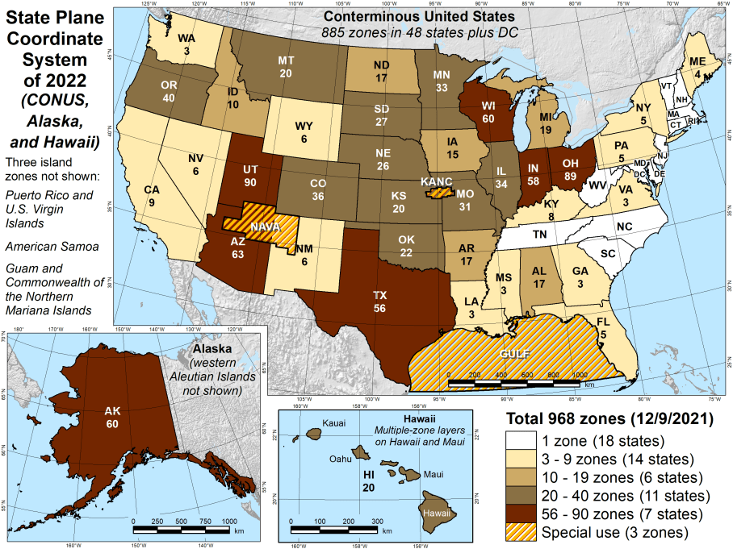
Number of SPCS2022 zones (preliminary)
CONUS, Alaska, and Hawaii
Three island zones not shown:
Puerto Rico and U.S. Virgins Islands
American Samoa
Guam and the Commonwealth of the Northern Mariana Islands

Slide 29
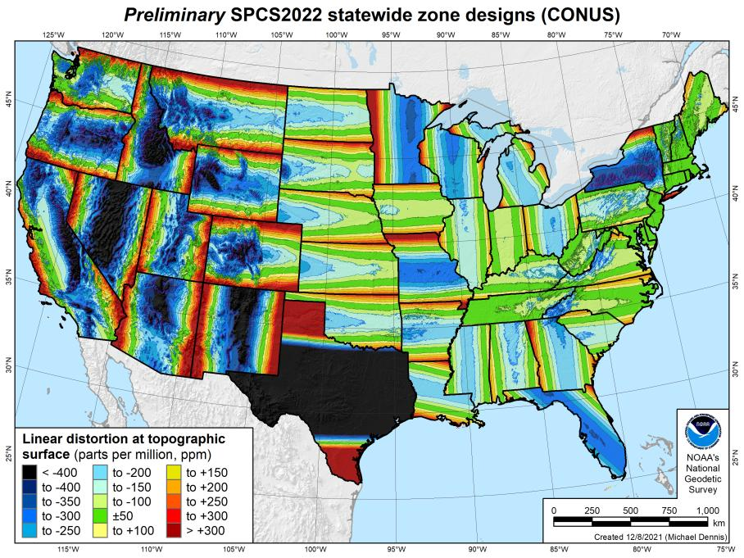
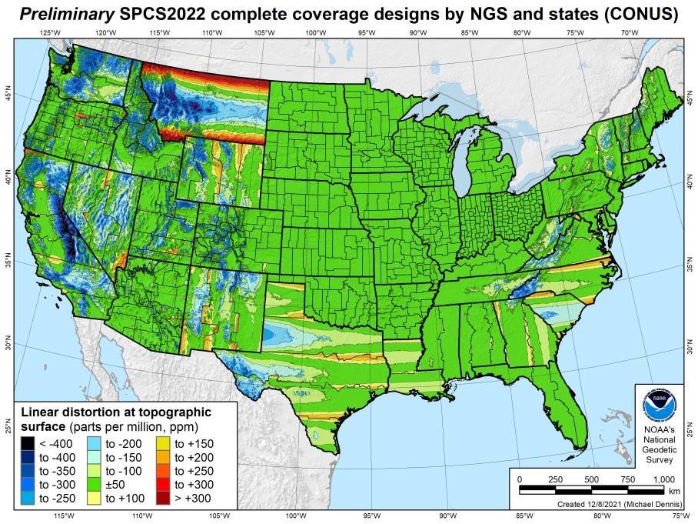
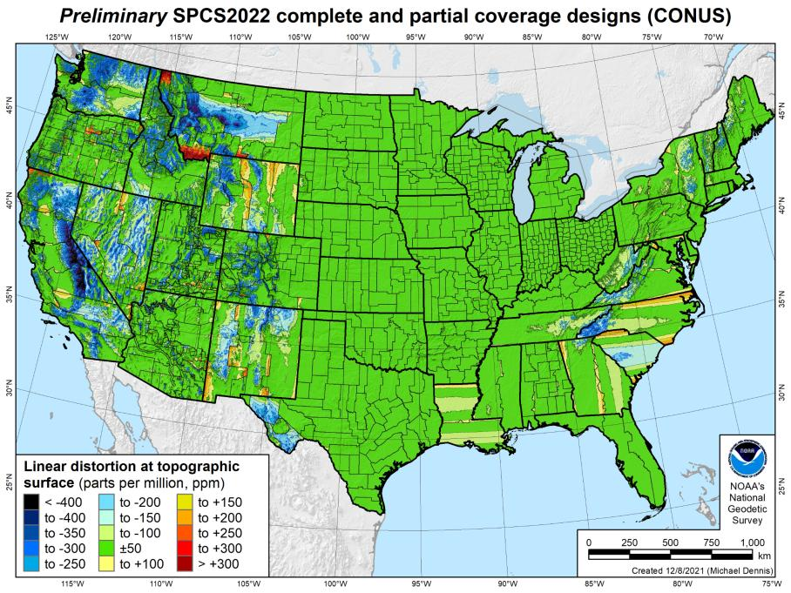
SPCS2022 linear distortion (prelim)
846 zones (CONUS)
Percent within distortion (ppm):
Distor | Pop | Cities | Area
±20 | 76% | 71% | 58%
±50 | 92% | 89% | 76%
±100 | 98% | 97% | 89%
±400 | 100% | 100% | 99.9%
City and area statistics (ppm):
 | Min | -407 | -1438
 | Max | +486 | +2624
 | Range | 893 | 4062
 | Mean | -6 | -23
Mean weighted by pop = -4

Slide 30
The Survey Foot is dead!
Long live the Survey Foot!
US Survey Foot was deprecated 31 December 2022… now what?!?
Notes:
We start with the SPCS83 zones as a frame of reference
NOTE that the color shading of these zones is matched to that of the Preliminary SPCS2022 Zones that follow

Slide 31

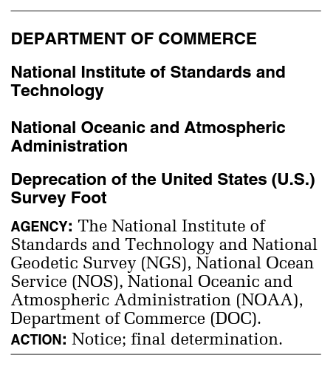
What happened to the US Survey Foot?
Deprecated 31 December 2022
Which begs the question
  What should you be doing now?

Slide 32
What should you be doing now?
Prepare for this along with new datums
Understand the difference between sft and ift
  2 parts per million
Understand this is not enforced
  Neither NIST or NGS are a regulatory agency
  We support education/outreach of course
  But OPUS, NCAT, etc. will not have US Survey Foot options/output in SPCS2022 zones

Slide 33
2 parts per million (ppm)?
1,000,000.00 sft = 999,998.00 ift
10,000,000.00 sft = 9,999,980.00 ift
1,000.00 sft = 999.998 ift (can you measure that?)
International → 1 ft = .3048 m
US → 1 ft = .30480061 m (approx.)

Slide 34
The Survey Foot is dead!
Long live the Survey Foot!
US Survey Foot was deprecated 31 December 2022…
But it will always be available in NGS tools for NAD83 and NAD27 coordinates

Slide 35
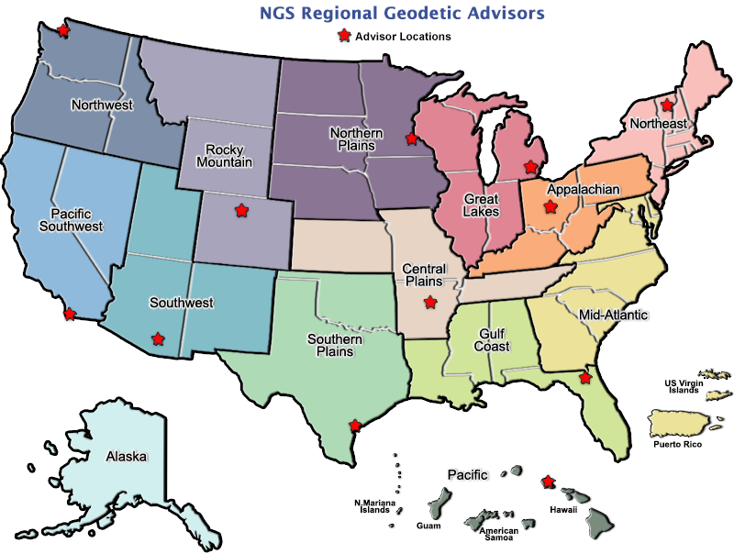
Regional Geodetic Advisor Program
geodesy.noaa.gov/ADVISORS/
14 RGAs across country
We are here to support:
  You
  Your constituents
  Our Federal Partners
Questions about
NSRS Modernization?
  Reach out now
  Be prepared
Notes:
-14 Regional Advisors, we’ve transitioned from a State-based to a Regional Program
-our advisors homepage up there at the top, also easy to find us by querying any major search engine for “ngs advisors”
-if you know Ross Mackay, he is our Chief Advisor, I report to him…
**ya know, I don’t know why they don’t make him put his photo up here
-we do have one vacant advisor position, that was recently advertised and John up there in Wisconsin is officially retired in oh… 18 days

