Slide 1

Preparing for New Datums and New SPCS
PSLS Wednesday Webinar
March 2023
Jeff Jalbrzikowski, P.S., GISP, CFS
Appalachian Regional Geodetic Advisor
jeff.jalbrzikowski@noaa.gov
240-988-5486

Slide 2



Organizational Structure
  -Department of Commerce (DoC)
  (~47,000 employees)
  -National Oceanic and Atmospheric Administration (NOAA)
  -National Ocean Service (NOS)
  -National Geodetic Survey (NGS)
  (~175 employees)
Notes:
-We are the Federal Government’s oldest scientific agency.
-part of the Executive Branch
-I know it can seem kind of strange that NGS is part of the NOS, but the origins of NGS lie with the C&GS.
-we are a “Program Office” of the NOS
Survey of the Coast – 1807
Coast Survey – 1836
Coast and Geodetic Survey – 1878
NGS since 1970

Slide 3


Organizational Structure
We’re not USGS, we’re NGS
  -Department of Commerce (DoC)
  (~47,000 employees)
  -National Oceanic and Atmospheric Administration (NOAA)
  -National Ocean Service (NOS)
  -National Geodetic Survey (NGS)
  (~175 employees)
≠
Notes:
-as you can read my slide, I like to point that out because over my 2 years at NGS I’ve seen and heard this misunderstanding quite a bit
-don’t worry! it doesn’t offend us! and we do work closely with USGS, but we are separate agencies within totally different departments of the federal government

Slide 4
NGS Mission
To define, maintain and provide access to the National Spatial Reference System (NSRS) to meet our Nation’s economic, social, and environmental needs.
Notes:
NGS develops and maintains the National Spatial Reference System, a national coordinate system that provides the foundation for transportation, navigation, land record systems, mapping and charting efforts, and a multitude of scientific and engineering applications.
But there are many ancillary programs and products we will also discuss.

Slide 5
“Modernizing” the NSRS means:
Updating all NSRS coordinates
  Replace existing datums with new datums
  Replacing existing State Plane with new State Plane
  Accounting for coordinates changing with time
Improving NGS products and services
Simplifying customer contributions
Making the NSRS:
  More accurate
  More accessible
  More efficient
Rollout in
2025
5

Slide 6
National Spatial Reference System (NSRS)
A consistent coordinate system that defines:
latitude
longitude
height
scale
orientation
gravity
throughout the United States.
…and their time variants
Notes:
Let’s talk about the NSRS some more before we move on to looking at all of NGS.
This system defines position (latitude, longitude, and elevation), distances and directions between points, strength and direction of gravity (no, it is not simply “straight down”), shoreline, and their “time variants”.
Or how these change over time.
Some documents will reference the National Shoreline as a component of the NSRS., we’ll briefly look at that later.

Slide 7
National Spatial Reference System (NSRS)
These items ARE part of the NSRS
Horizontal Datums (aka Geometric Reference Frames) | Vertical Datums | Great Lakes Datums | Geoid Models | Transformations and Conversions
NAD83 | NAVD88 | IGLD85 | GEOID18 | NADCON
NAD27 | NGVD29 | IGLD55 | GEOID12B | VERTCON
USSD | VIVD09 |  | GEOID09
 | GUVD04 |  | GEOID06 | SPCS83
 | NMVD03 |  | GEOID03 | SPCS27
 | ASVD02 |  | GEOID99
 | PRVD02 |  | GEOID96
 |  |  | ALASKA94
 |  |  | GEOID93
 |  |  | GEOID90
Notes:
Note the US Standard Datum, anyone done any work in the old USSD?
Good example highlighting that the term “NSRS” is used to encompass all historic datums of NGS and its predecessors.
Saw one project during my work with the USACE, in Johnstown, PA, that had original survey records in what turned out to be US Standard Datum.
All those vertical datums below NGVD29, I greyed them out slightly because those are all Caribbean and Pacific Island datums, so in CONUS it’s just those two that you hopefully already use… and hopefully are mostly using NAVD88.

Slide 8
National Spatial Reference System (NSRS)
These items are NOT part of the NSRS
Horizontal Datums (aka Geometric Reference Frames) | Vertical Datums | Geoid Models | Transformations and Conversions
WGS84 | IHRS (by IAG) | OSU91A | CorpsCon
WGS72 |  | EGM96 | Appendix B.6 of DMA TR 8350.2 (WGS 84)
ITRF (Intl. Terrestrial Reference Frame) |  | EGM2008 | Oregon Coordinate Reference System (ORCS)
IGS (Intl. GNSS Service reference frame) |  |  | Kansas Regional Coordinate System
Hyperlink to ITRF station map
Notes:
WGS is a DoD system. Yes, that is the system native to the Global Positioning System, but it isn’t true that you “have to” work in WGS84 to get the most accurate coordinates. I’ve heard people say that.
The Intl. Terrestrial Ref. Frame is a product of the Intl. Earth Rotation and Reference Systems Service. More on that later.
The Intl. GNSS Service Ref. Frame is, well, it’s a reference frame based on that ITRF just mentioned, but with improvements, like a more dense network of stations and is more easily accessible.
The IHRS is an International Height Reference System, which is a product that was formally adopted by the IAG (Intl. Association of Geodesy) in 2015. Not an NGS product but folks from NGS were involved.
OSU geoid, it was a research thing and I don’t know much about it.
The Earth Gravity Models are DoD products just like the WGS products, used around the world by our Nation’s military (I used EGM based height sin Iraq and Afghanistan)… but are not at all tied to NSRS geoids. Future DoD geoid models may have a closer tie to future NGS geoid models.
CorpsCon. Ah yes, Corpscon. Everyone loves Corpscon, unfortunately as convenient as it is it isn’t truly an NGS product and has not been updated in well, a long time, and there are no plans to update it in the future. (confirmed via phone call to AGC personnel on 20FEB2019)
I like Mark Huber, awesome dude, I spent some time with him surveying on some god-forsaken island in the Indian Ocean, but the USACE doesn’t seem to want to support him in funding an update to Corpscon. So it is what it is.
Those regional coordinates systems, like the ORCS in Oregon and that one in Kansas, although they have rigorously defined transformations to the NSRS (which is great, they did it right) they are not part of the NSRS.

Slide 9
Maintaining the NSRS
NSRS does get updated over the years.
  NAD27→NAD83 … NGVD29→NAVD88
Federal Register (federalregister.gov)
  official indication of changes and updates
  via a Federal Register Notice (FRN)
  FRN affirmed NAD 83 in 1989 (54 FR 25318)
    Federal Register Vol 58, No. 120
  FRN affirmed NAVD 88 in 1993 (58 FR 34245)
    Federal Register Vol 54, No. 113
  Same for forthcoming new datums
Notes:
The NSRS does get updated over the years.
somewhat obvious right, I mean we went from NAD27→NAD83 and from NGVD29→NAVD88
The Federal Register is the official indication of any changes and updates.
Key here is within the Register agencies the Federal Register Notice
Release of NAVD 88:
Federal Register (Vol. 58, No. 120, 1993)
Affirms “NAVD 88 as the official civilian vertical datum for surveying and mapping activities in the United States performed or financed by the Federal Government.”
“To the extent practicable, legally allowable, and feasible, require that all Federal agencies using or producing vertical height information undertake an orderly transition to NAVD 88.”

Slide 10
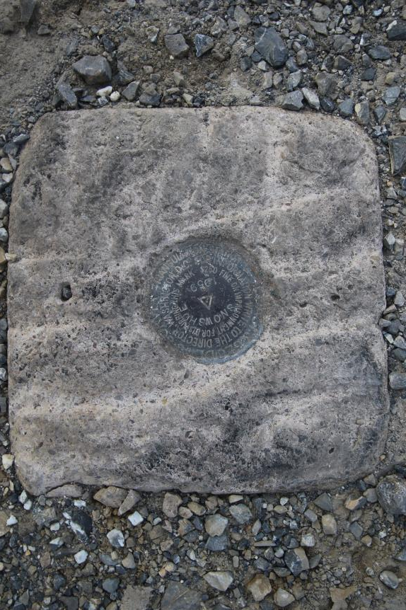
Passive Control
Geodetic Control – Terminology
All marks are passive—they sit there and hold a point
Notes:
All marks are passive!—in that they sit there doing nothing in and of themselves besides holding a point
This includes the fixed antenna mount that is a part of a CORS.
But, some marks have permanently installed equipment that enable nearly continuous observations and these are called “active” stations.

Slide 11
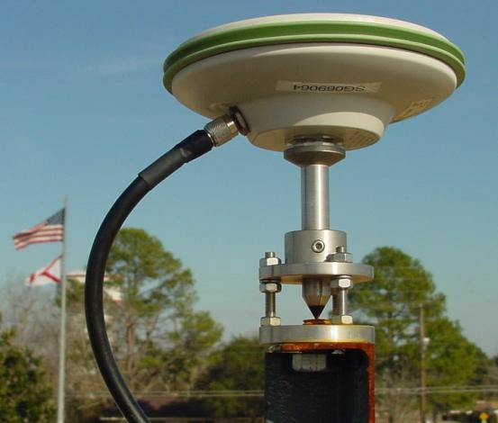
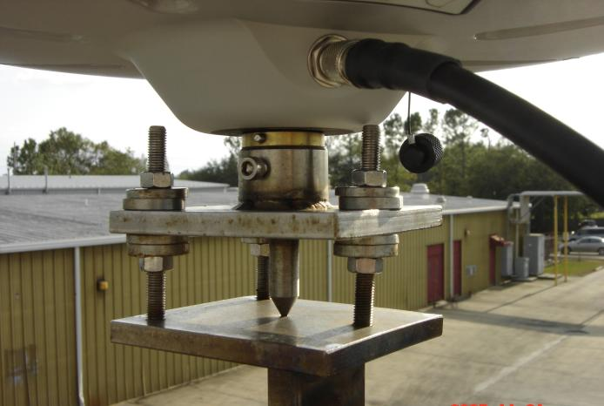
Active Control
Geodetic Control – Terminology
Some marks have permanently installed equipment that enables nearly continuous observations
(they still sit there and hold a point)
Notes:
All marks are passive!—in that they sit there doing nothing in and of themselves besides holding a point
This includes the fixed antenna mount that is a part of a CORS.
But, some marks have permanently installed equipment that enable nearly continuous observations and these are called “active” stations.

Slide 12
Active vs. Passive Control
Geodetic Control – Terminology
Passive – setting up your RTK Base on existing geodetic control (e.g. Datasheet) while collecting with RTK Rover
Active – setting up your RTK Base to log data while collecting with RTK Rover then processing Base data via OPUS; or collecting with RTN Rover
My point: surveying is still surveying
Notes:
Often the term active geodetic control has been used to mean some equipment is continuously or at least frequently collecting observations at or near a point
Yet those observations are often used to compute coordinates (often time-dependent) at a point on a mark, which, by its nature is passive

Slide 13
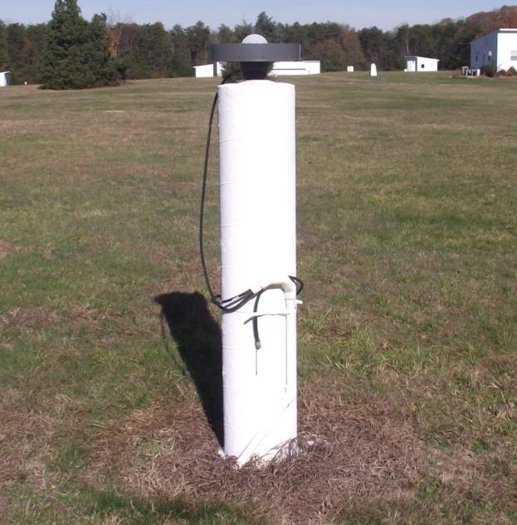
CORS
Active Control
Continuously Operating Reference Station
GNSS ANTENNA
RECEIVER
POWER
DATA STORAGE
COMMUNICATIONS
Notes:
Note that the whole pillar could be considered a type of “mark”, being a passive do-nothing structure that holds a “point”, the GRP of this CORS.
But the point, given coordinates computed from all the data collected by that antenna, is probably in here somewhere, as a part of this huge pillar which is effectively one big mark, passive as can be….

Slide 14
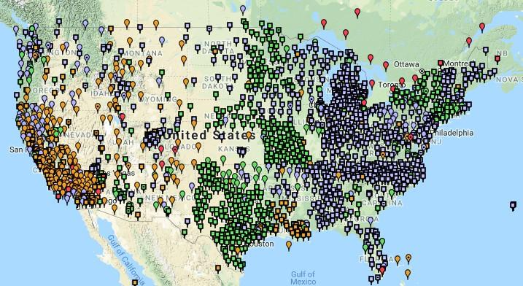
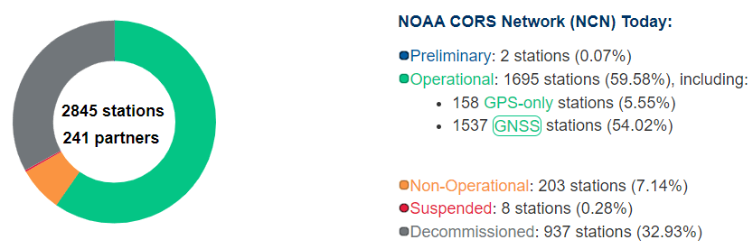
NOAA CORS Network (NCN)
1695 sites
241 organizations
Notes:
-I would like to point out we have a new, official name for the network you see represented on this map,
-The NOAA CORS Network, or NCN
CLICK
-this is neat little graphic with some stats on teh NCN you can find on our website
-below the gaphic youll find a search bar with more information

Slide 15
CORS Networks
Global: International GNSS Service (IGS) Network
NSRS: NOAA CORS Network (NCN)
Regional: State or Private CORS Networks
They’re all semi-coupled, not 100% overlap.
Notes:
Global: International GNSS Service (IGS) Network
The international standard since mid-1990s
Supported by IGS Analysis Centers (ACs) → NGS is one AC of seven total
Overall system sponsored by NASA
NSRS: NOAA CORS Network (NCN)
NGS processes/distributes data, but few are NGS-operated
Subset of NGS-operated CORS comprise the under construction NOAA Foundation CORS Network (NFCN)
Regional/State/Commonwealth/Local Networks
Real-Time Networks (RTN… aka “VRS”)
Currently semi-coupled to the NCN
NGS sees the future as a close coupling of other networks with the NCN so users can seamlessly and confidently work in the NSRS using their favorite regional/local CORS network

Slide 16
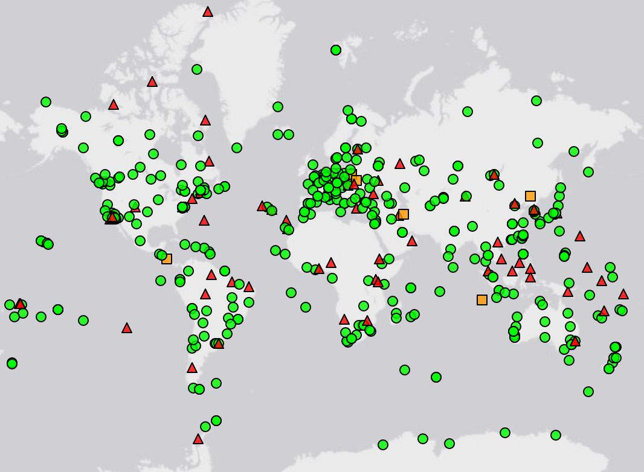
IGS Network
Source: https://www.igs.org/maps/#station-map
Notes:
There are several CORS Networks.
The Global Standard is the IGS Network
IGS = International GNSS Service
The NOAA CORS Network (NCN) which consists of:
The NOAA Foundation CORS Network (NFCN), a sub-network being installed, owned, and operated by NGS
and 2,000+ stations managed, but rarely owned by NGS
Other Regional/Local Networks (RTNs, etc.)
Currently semi-coupled to the NCN
NGS sees the future as a close coupling of these other networks with the NCN so users can seamlessly and confidently work in the NSRS using their favorite regional/local CORS network.

Slide 17
NOAA CORS Network (NCN)
Notes:
-I would like to point out we have a new, official name for the network you see represented on this map,
-The NOAA CORS Network, or NCN
CLICK
-this is neat little graphic with some stats on teh NCN you can find on our website
-below the gaphic youll find a search bar with more information

Slide 18
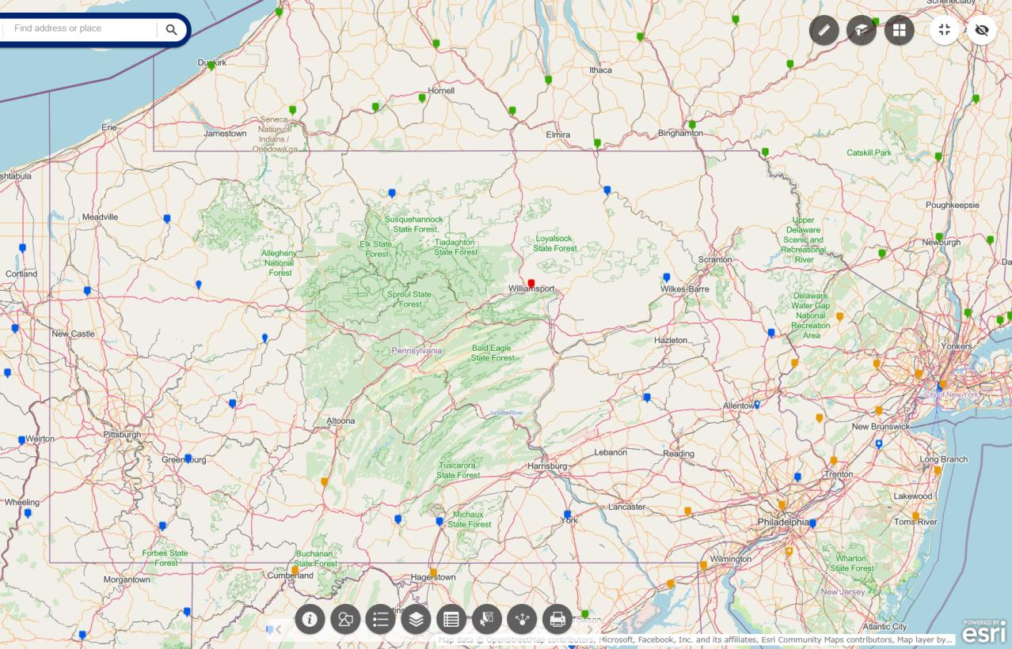
NOAA CORS Network (NCN) in PA
Notes:
where else but the federal government are you going to see two acronyms within one acronym?

Slide 19
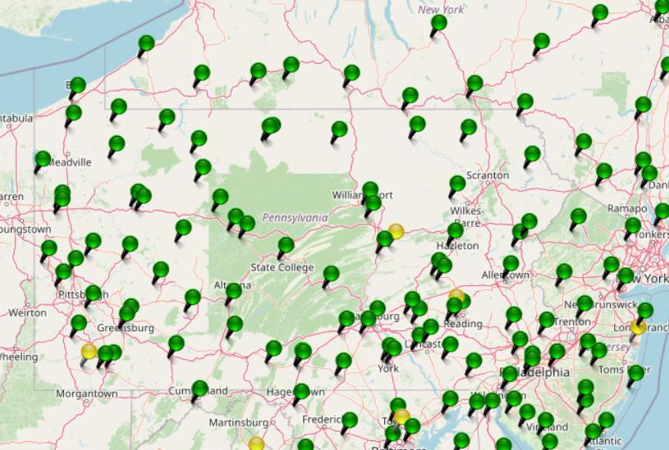
KeyNetGPS CORS Network
Notes:
where else but the federal government are you going to see two acronyms within one acronym?

Slide 20
NOAA CORS Network (NCN) in PA
Notes:
where else but the federal government are you going to see two acronyms within one acronym?

Slide 21
KeyNetGPS CORS Network
non-NCN CORS
Notes:
where else but the federal government are you going to see two acronyms within one acronym?

Slide 22
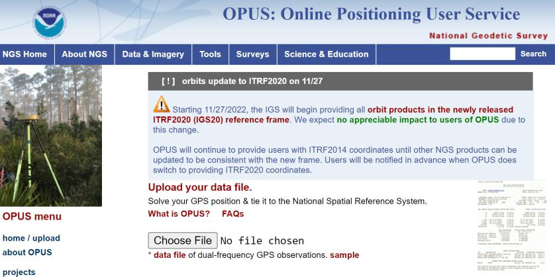
NGS Mission
To define, maintain and provide access to the National Spatial Reference System (NSRS) to meet our Nation’s economic, social, and environmental needs.
access… ? = traditionally → passive control (marks/disks/objects)
= modern and future → active control (NCN CORS)
via OPUS

Slide 23
North American Vertical Datum
of 1988
NAVD88
will be replaced by

Slide 24
North American-Pacific Geopotential Datum of 2022
NAPGD2022
(pronounced: nap-jee-dee)

Slide 25
NAVD88 geoids
versus
NAPGD2022 geoids

Slide 26
Two types of geoid models
  Gravimetric
  Hybrid
Notes:
-believe it or not there’s more than 2 types, but the 2 types you’ll see NGS publish are…

Slide 27
Gravimetric → Hybrid
  Gravimetric geoid is created from “scratch” with various types of gravity data
      USGG2003, USGG2009, USGG2012, xGEOID19
  Hybrid geoid is simply a gravimetric geoid then best fit some vertical datum… like NAVD88
      GEOID03, GEOID09, GEOID12B, GEOID18
Notes:
So… all the geoids you’re using to get elevations from your GNSS data

Slide 28
Gravimetric → Hybrid
      USGG2003, USGG2009, USGG2012, xGEOID19
      GEOID03, GEOID09, GEOID12B, GEOID18
best fit to NAVD88
best fit to NAVD88
best fit to NAVD88
best fit to NAVD88
Notes:
So… all the geoids you’re using to get elevations from your GNSS data

Slide 29
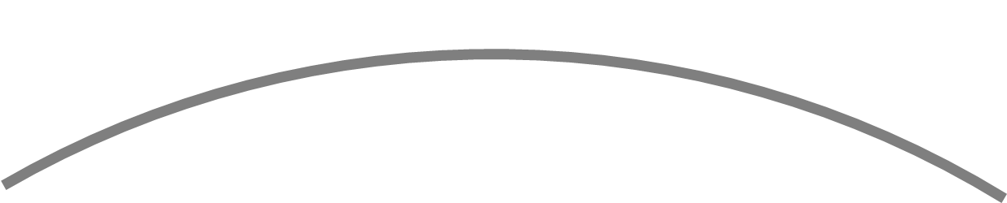
Gravimetric vs. Hybrid Geoid
topographic surface
gravimetric geoid
hybrid
geoid
datum zero
surface
Concept

Slide 30
NAVD88 uses a Hybrid Geoid
topographic surface
gravimetric geoid
hybrid
geoid
datum zero
surface
Concept

Slide 31
NAPGD2022 uses a Gravimetric Geoid
topographic surface
gravimetric geoid
datum zero
surface
  Datum zero surface aligned to Global Mean Sea Level (GMSL)
Concept

Slide 32
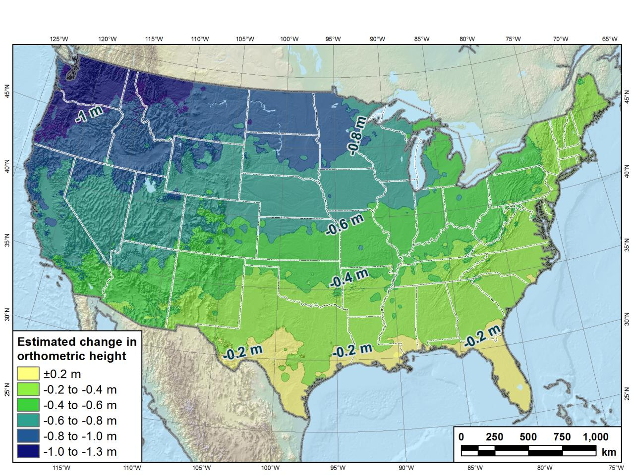
Estimated change in orthometric heights from NAVD88 to NAPGD2022
Change in Pennsylvania:
At least -0.6 feet
At most -2.0 feet
(NAPGD2022 approximated using xGEOID16B)

Slide 33
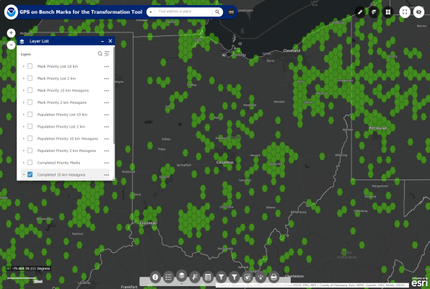
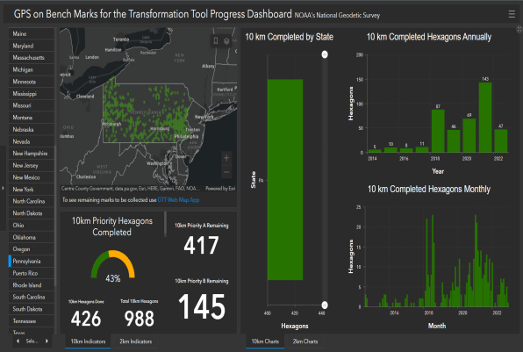

Quality of vertical datum transformation?
GPS on Bench Marks (GPSonBM)
Anyone can collect and provide:
  2 OPUS-Static solutions
    ≥4 hours each
  2 photos of each setup
  Brief Description w/Ties
  Deadline = 30 September 2023
  Results increase accuracy of NAVD88<->NAPGD2022 transformation.
Web Map Application
Progress Dashboard

Slide 34
North American Datum
of 1983
NAD83
will be replaced by

Slide 35
North American Terrestrial Reference Frame of 2022
NATRF2022
(pronounced: nat-ref)

Slide 36
Datum Defined
“The adopted standard latitude and longitude of a given station, together with the adopted standard azimuth of a line from that station.”
e.g. NAD27
  station Meade’s Ranch and it’s azimuth mark Waldo
Source: Proceedings of the 14th General Conference of the International Geodetic Association (IAG) - ”Report on Geodetic Operations in the United States”, O.H. Tittmann, Superintendent of the USC&GS
Notes:
--Also table/podium example
-this is how things have been done historically, so let’s look closer at the example

Slide 37
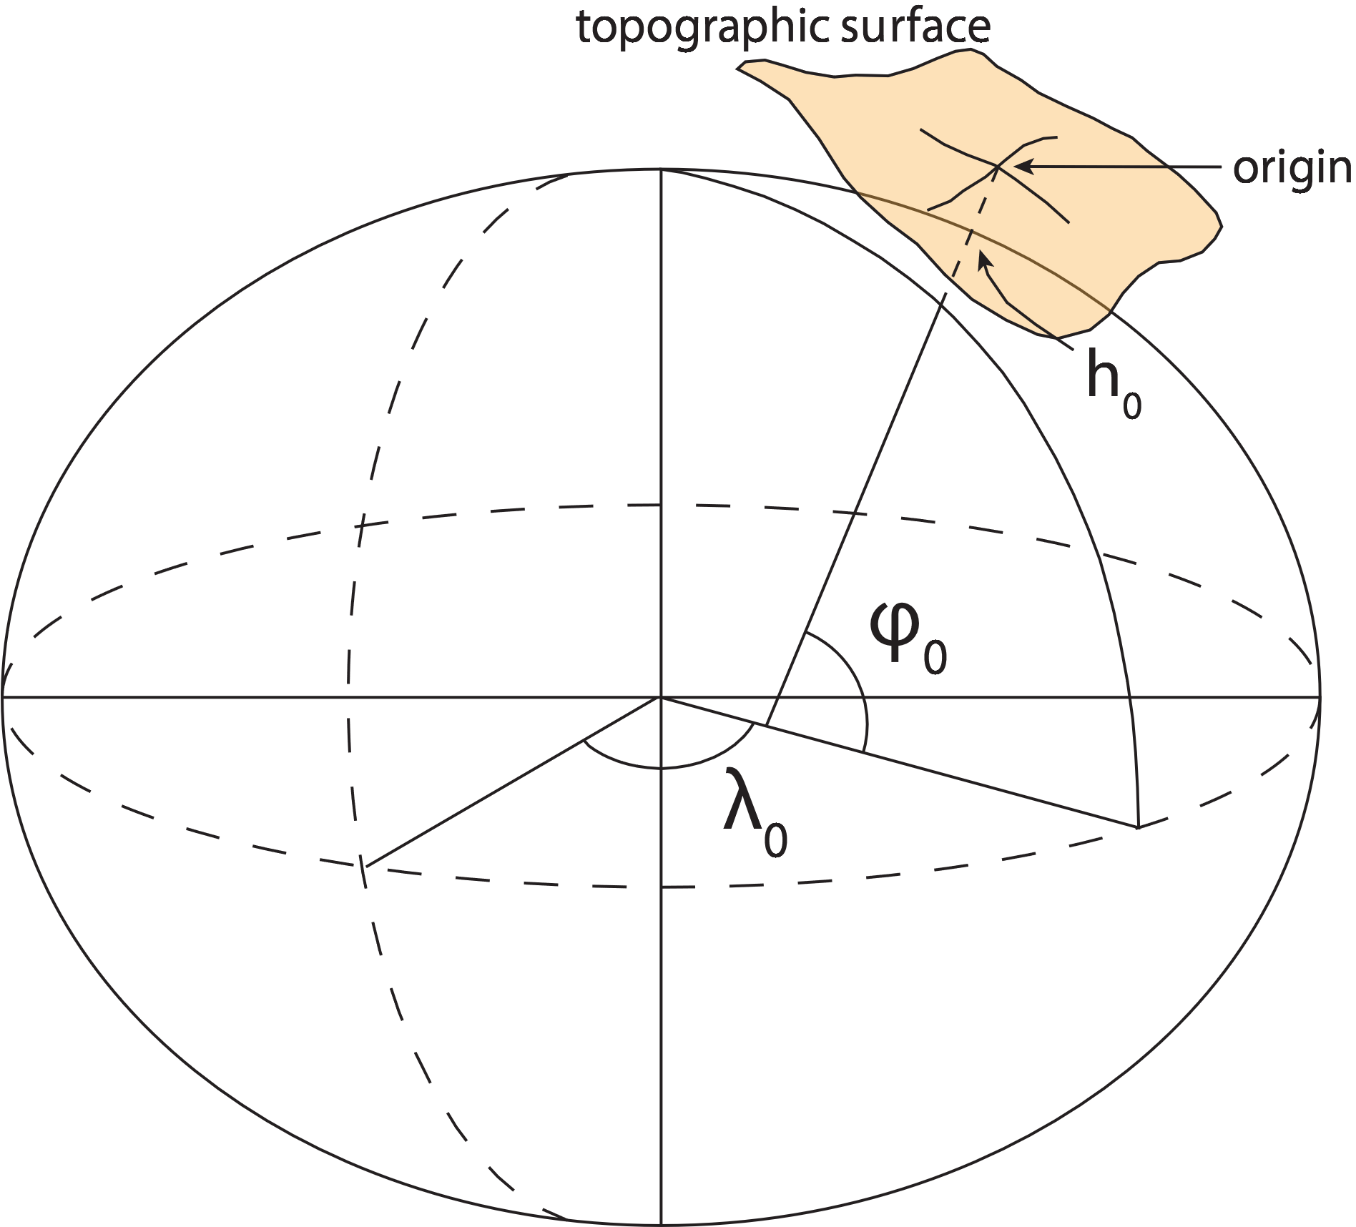
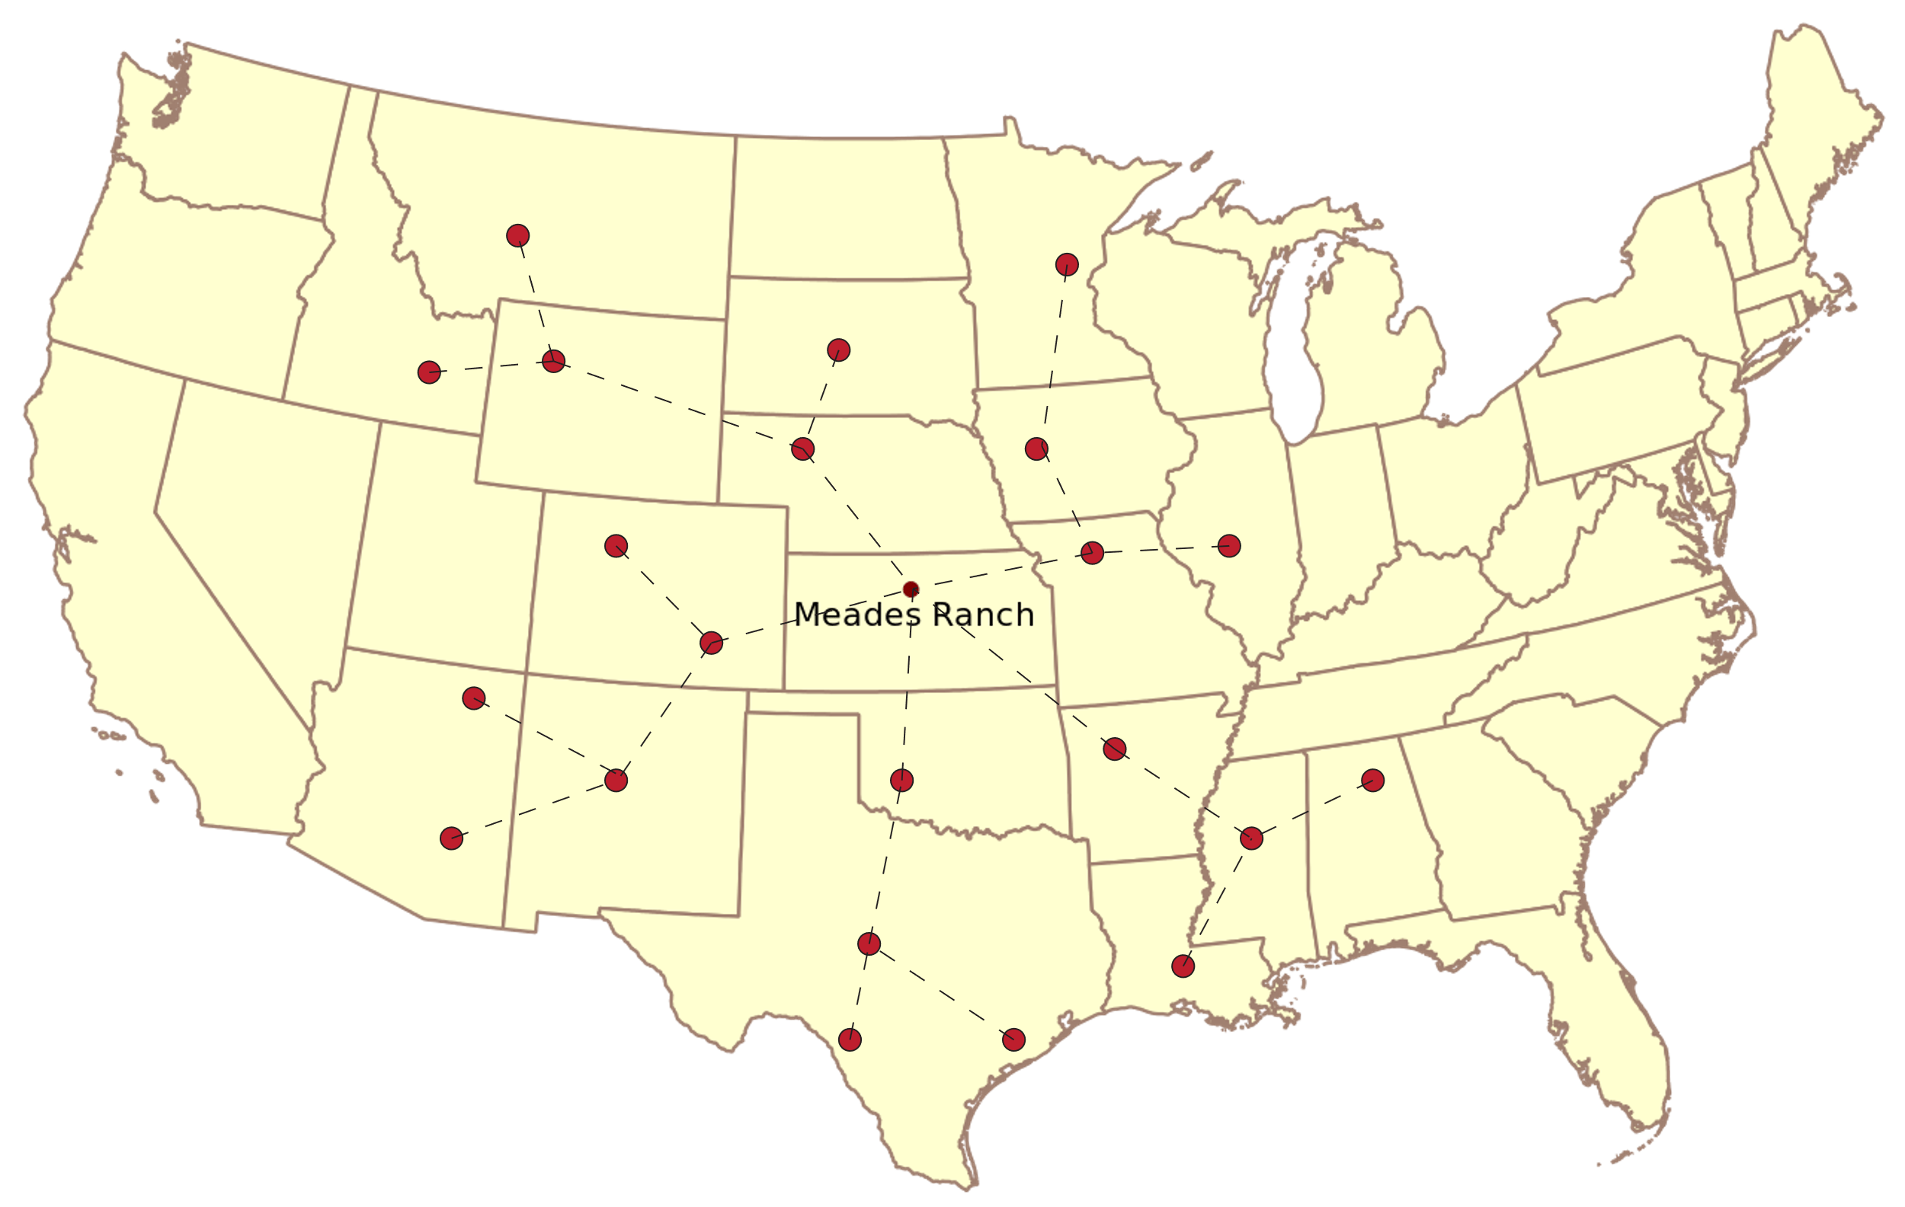
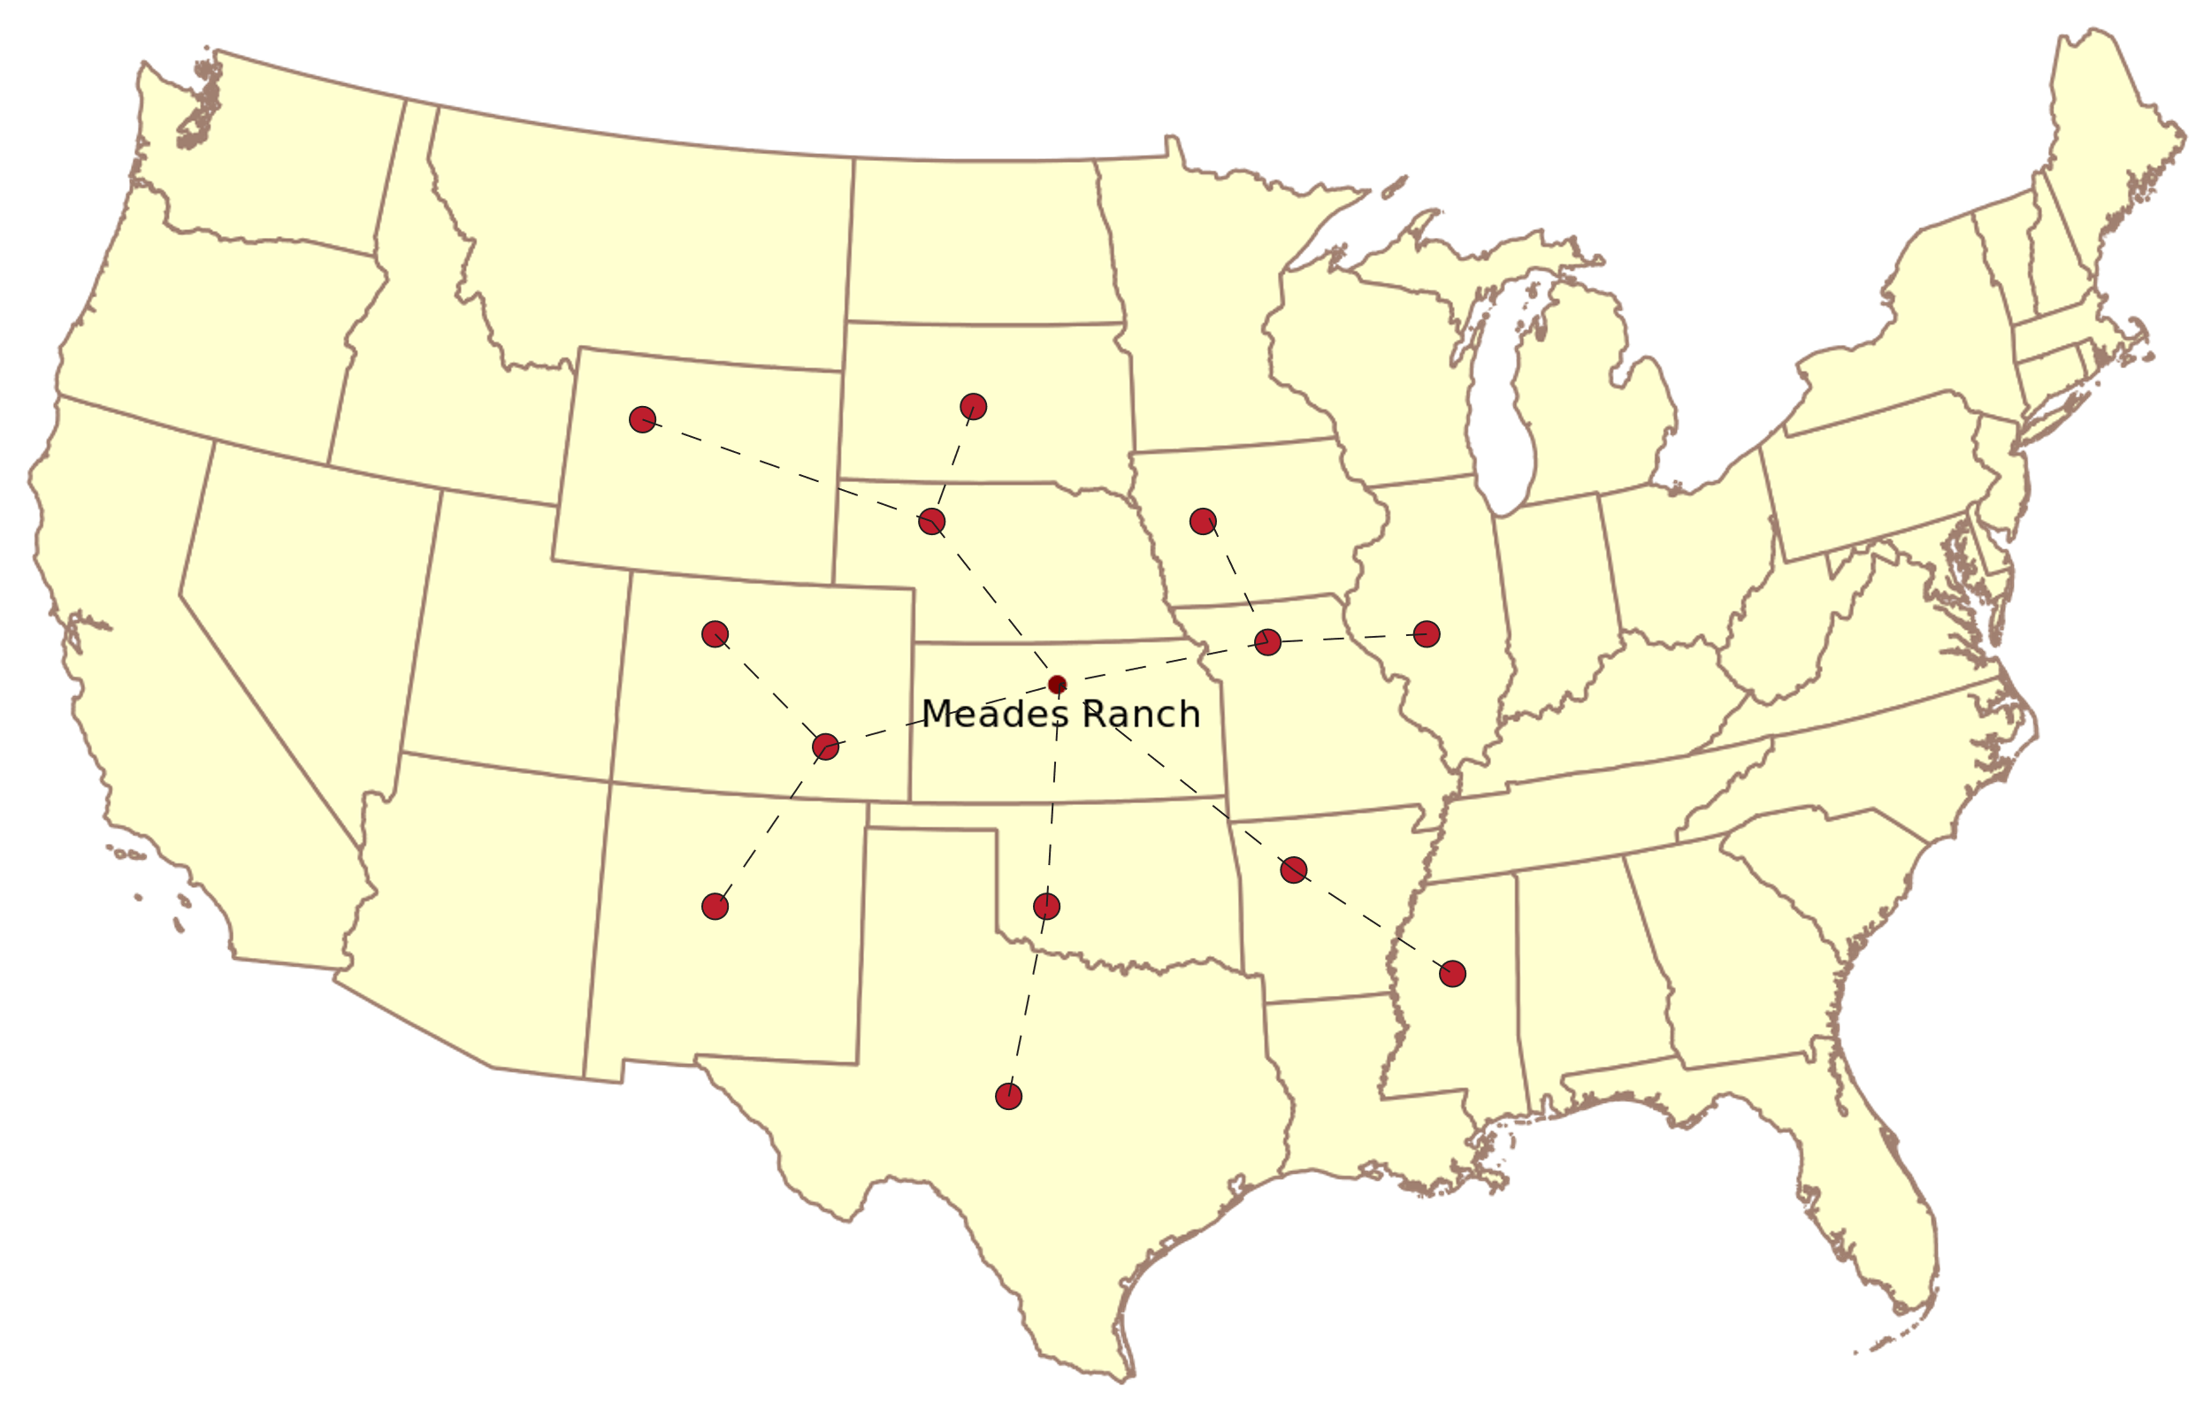


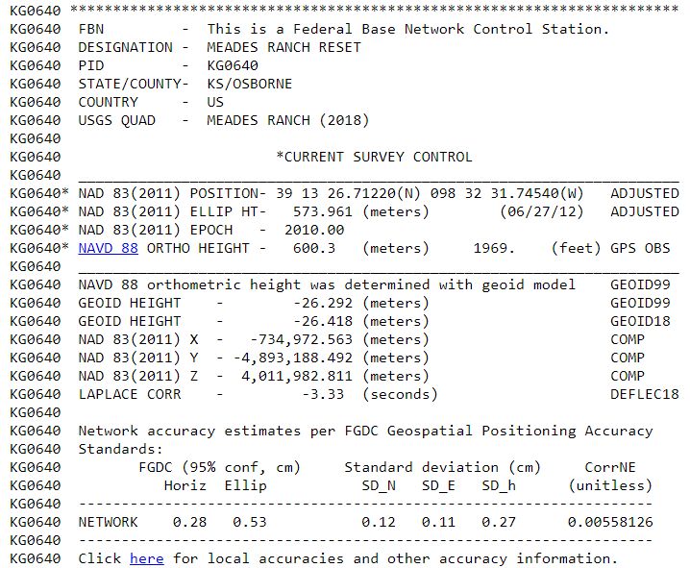
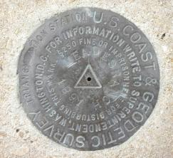
Datum – Traditional Horizontal
North American Datum of 1927 (NAD27)
Notes:
-a great example to share is the North Ameiccan Datumof 1927
-what was selected as the Origin? a specific mark, that of PID KG0640
-it’s a triangulation station now on the property of one Kyle Brant.
-his contact info is in the datasheet and do give him a call a day in advance
--STORY: was passing by once on a return trip from CO to see family
-anyway, we define that mark as the origin and…
CLICK

Slide 38
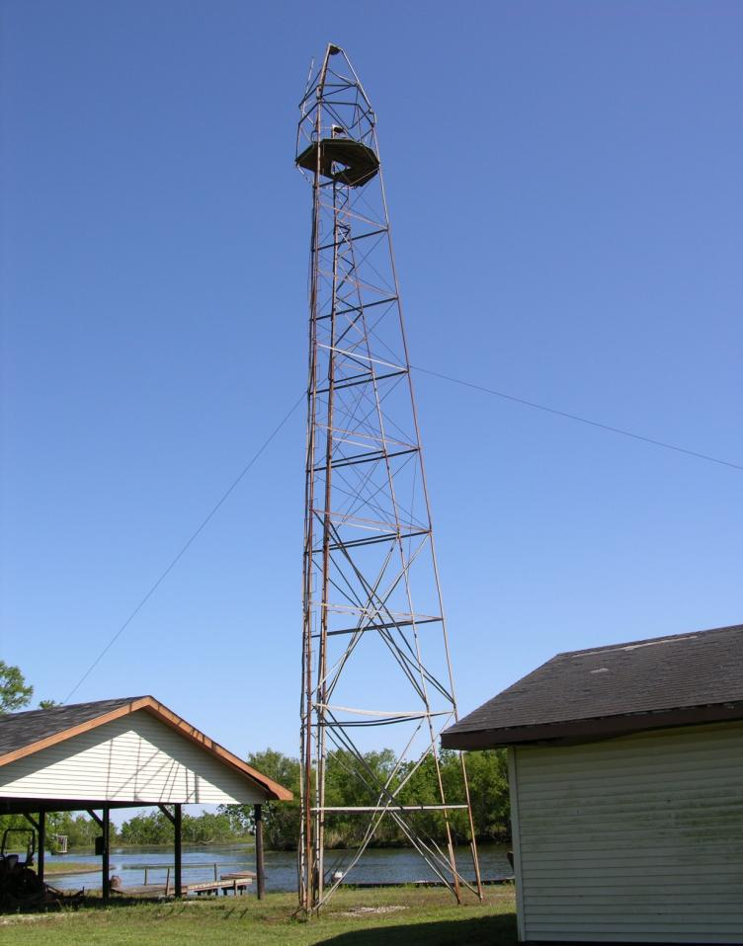
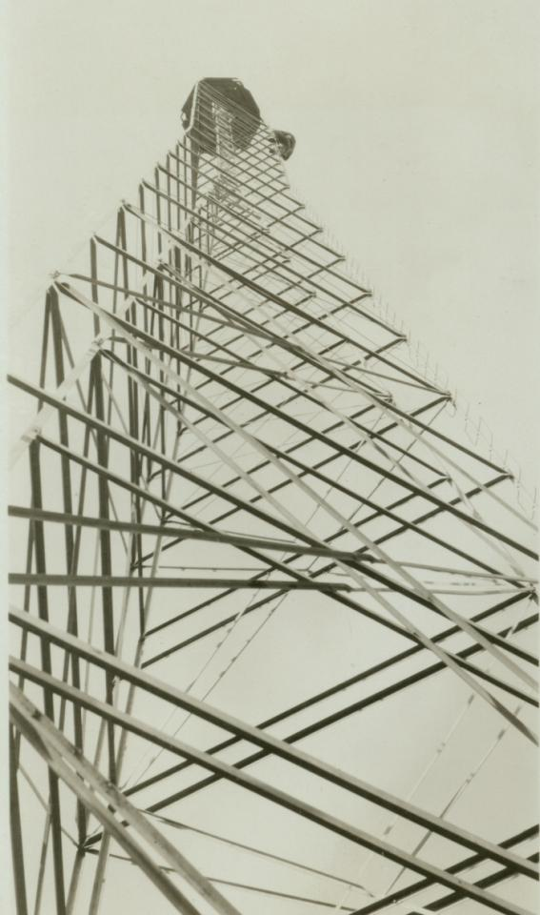

Slide 39
Reference Frame Defined
“A system of graduated lines symbolically attached to a body that serve to describe the position of points relative to the body.”
Source: Encyclopaedia Brittanica – Reference Frame (Physics), The Editors of the Encyclopaedia Brittanica, April 08, 2016.
Notes:
--Also table/podium example

Slide 40
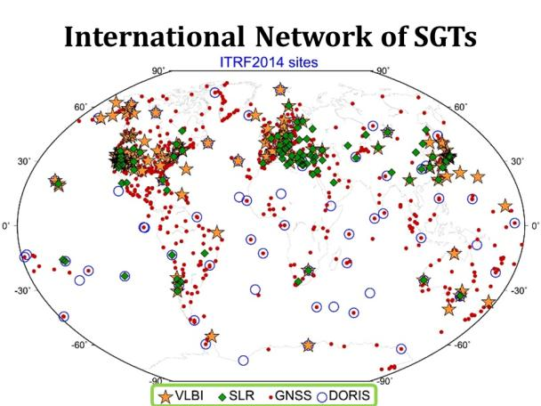
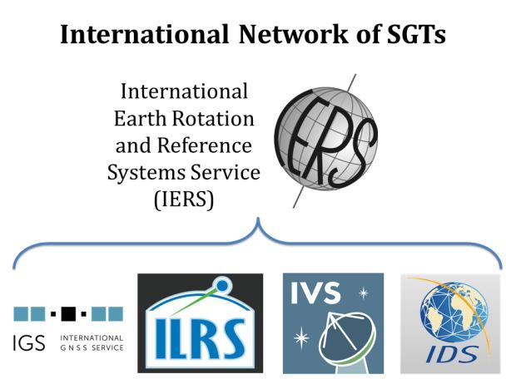


International Terrestrial Reference Frame
(ITRF)
International Earth Rotation and Reference Systems Service (IERS)
International Union of Geodesy and Geophysics (IUGG)
Notes:
-so I mentioned global reference frames
-ITRF is the internationally recognized standard
-who realizes the ITRF? well, NGS contributes to the realization but
CLICK
-The IERS is in responsible charge of defining, realizing and promoting the ITRF
-and the ITRF was formally adopted by the…yes, more acronyms
CLICK
IUGG some years ago

Slide 41
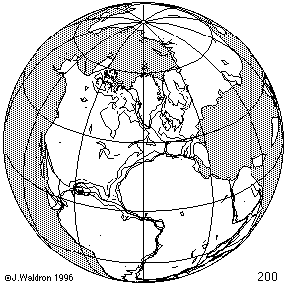
ITRF concept
Watch the grid!
Drift…
Epoch:
Notes:
Ok, now ITRF mentioned a couple slides ago.
Most simplistic way to explain ITRF is to watch this animation.
This is a very loose representation/visualization of what the ITRF is, a characterization only.

Slide 42
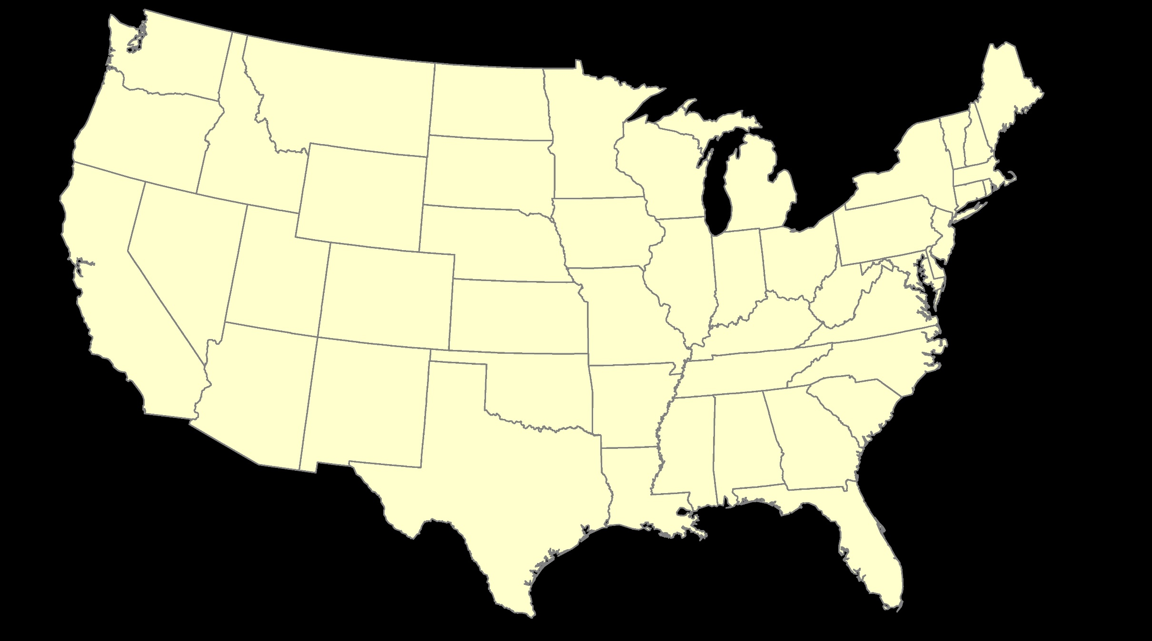
ITRF – constant frame, rotating plate

Slide 43
Plate-Fixed
NATRF – rotating frame, constant with plate

Slide 44
if you know epoch
ITRF or NATRF – your choice if you know epoch

Slide 45
Terminology - Changing Coordinates
Conversion
    change the type of coordinate
    NAD83(2011) latitude & longitude → NAD83(2011) SPCS
  Transformation
    change the datum of coordinate
    NGVD29 height → NAVD88 height
    NAD 27 latitude & longitude → NAD 83(2011) latitude & longitude
Propagation
    change the epoch of coordinate
    NATRF2022 epoch 2020.00 to NATRF2022 epoch 2023.243
Notes:
Historically NGS has been inconsistent with these top two words.
Going forward, we will use them as:
Conversion: Meaning to change the type of coordinate without changing the datum or frame
Transformation: Meaning to change the datum or frame, without changing the type of coordinate

Slide 46
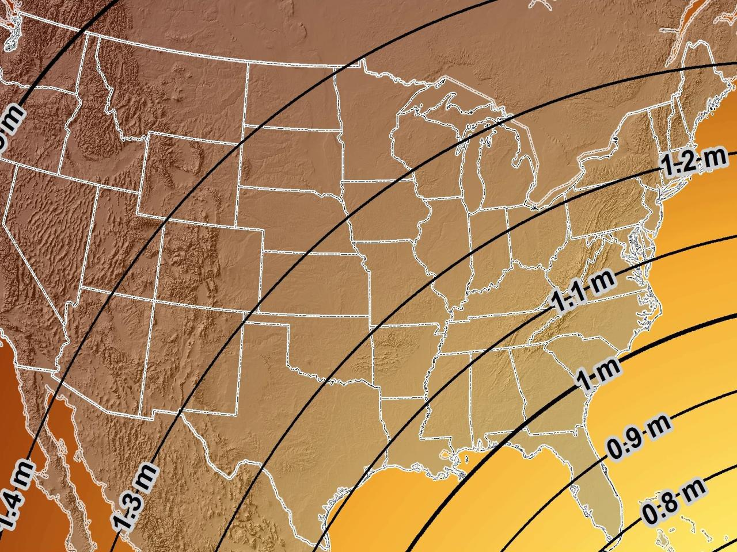
Estimated Geometric Change - Horizontal
NAD83 (2011) → NATRF2022
4.6 ft
Direction of Shift
4.3 ft
3.9 ft
3.6 ft
3.0 ft
Notes:
What’s the magnitude of the horizontal datum shift across Pennsylvania?
Minimum Shift ~3.75 feet
Maximum Shift ~3.97
Remember this is just an estimation, don’t hold me to the numbers please

Slide 47

I’ll be selling these bumper stickers on LinkedIn…
SPCS2022
MAKING EARTH FLAT AGAIN
…ONE ZONE AT A TIME
Really?
No… not really!

Slide 48
State Plane Coordinate System of 1983
SPCS83

Slide 49
Pennsylvania Coordinate System Law
Act of Dec. 16, 1992, P.L. 1224, No. 161
Problems
Designates specific zones
Parameters of projections included
Restricts datum usage to 1983 or 1927
Unit of measure designated as Survey Foot
What’s the deal with the requirement to certify SPCS coordinates in recorded land records?
PSLS Geospatial Committee and Pennsylvania GeoBoard have been working on this for ~3 years now.
In agreement how to proceed, it’s all about timing at this point.
Notes:
-co-location and good distribution
-teamwork with other agencies like the IERS, the IUGG mentioned earlier

Slide 50
State Plane Coordinate System of 2022
SPCS2022

Slide 51
Stakeholders Involved in PA SPCS2022
PennDOT
PTC
PSLS
PSPE
PA Geospatial Coordinating Board (GeoBoard)
  Geodetic Working Group
County GIS Professionals Association of PA
PA-MAGIC (now Keystone GIS)
PA-MAPPS
Notes:
A major component of SPCS2022 are stakeholders
Stakeholders have a role in helping define (and maintain) SPCS2022
Pennsylvania Department of Transportation
Pennsylvania Turnpike Commission
PSLS of course
PSPE – Society of Professional Engineers
The GeoBoard
County GIS Professionals Association of Pennsylkvania
PA Mapping & Geographic Information Consortium
Your State chapter of the Management Association for Private Photogrammetric Surveyors

Slide 52
State Plane Coordinate System of 1983
SPCS83
North and South Zones as they exist now
Notes:
We start with the SPCS83 zones as a frame of reference
NOTE that the color shading of these zones is matched to that of the Preliminary SPCS2022 Zones that follow

Slide 53
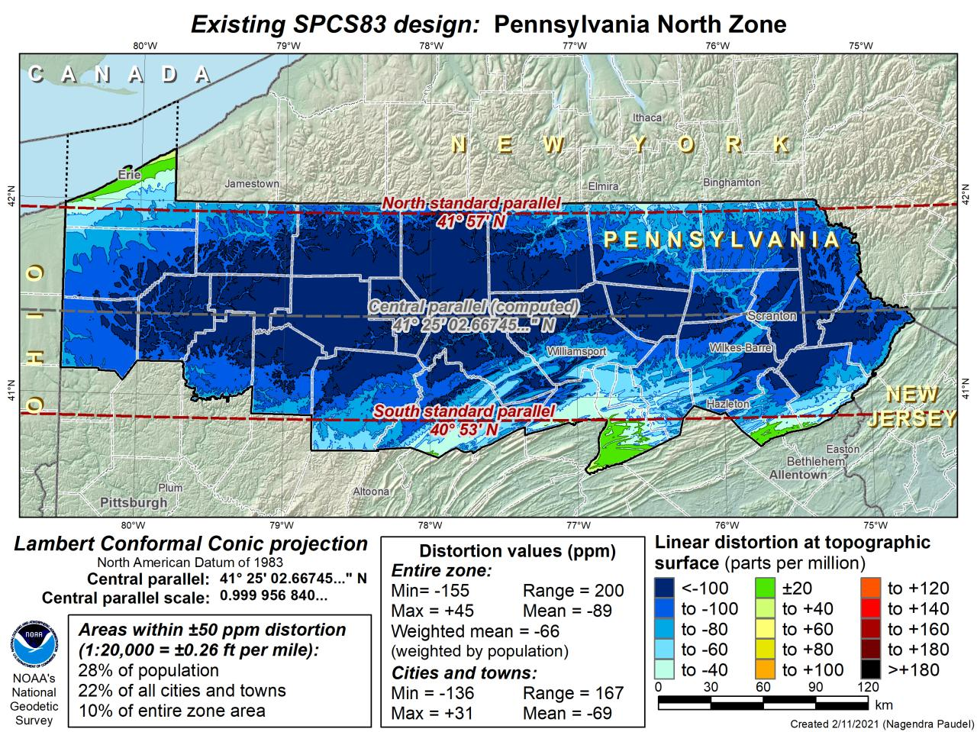
DRAFT

Slide 54
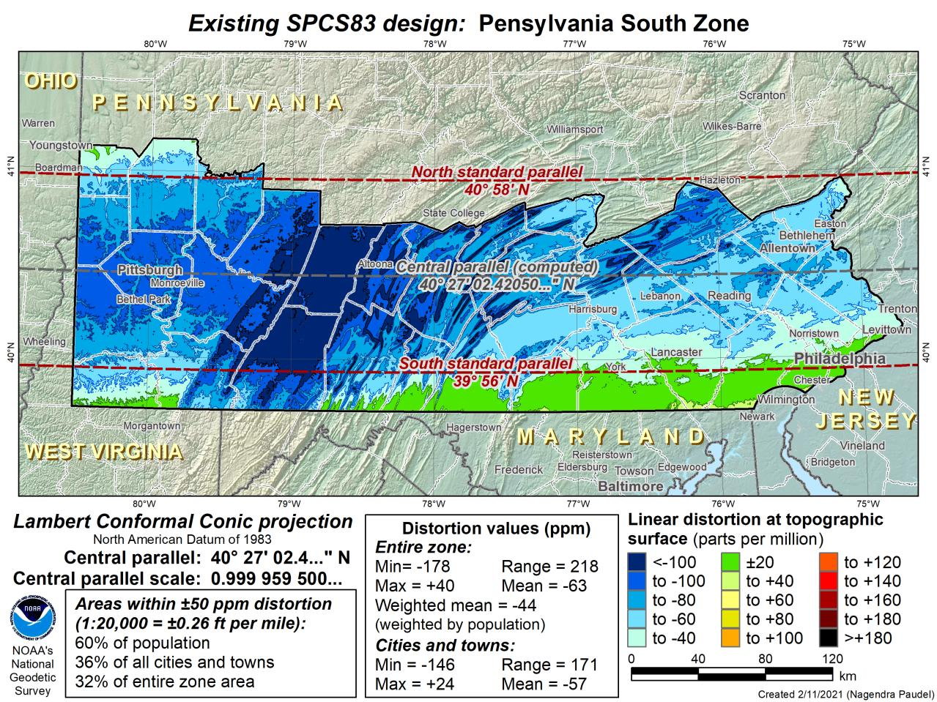
DRAFT

Slide 55
State Plane Coordinate System of 2022
SPCS2022
PA stakeholders requested 4-5 zones, which NGS designed, the following are Preliminary maps
Notes:
The following section illustrates the preliminary SPCS2022 zones
There are 4 zones in the NGS design, per request that we design “4-5 zones required to meet the minimum distortion acceptable” set by our design criteria of 50ppm
NOTE the request also included wording: “It is also requested that PennDOT districts be divded into no more than two zones”

Slide 56
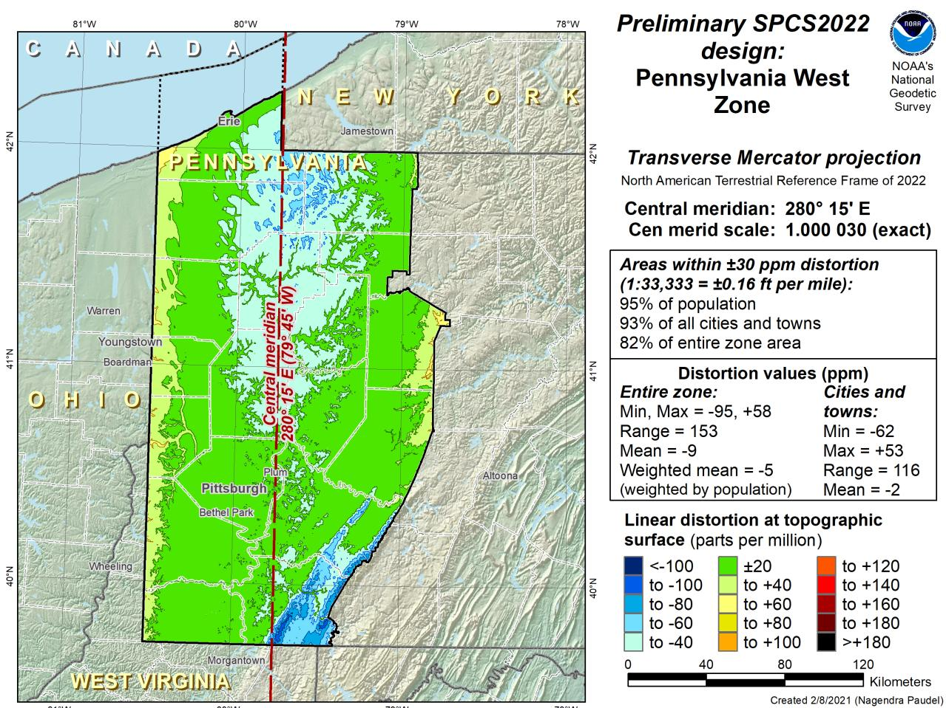
Notes:
NOTE that the West Zone far surpasses the NGS design criteria of 50ppm

Slide 57
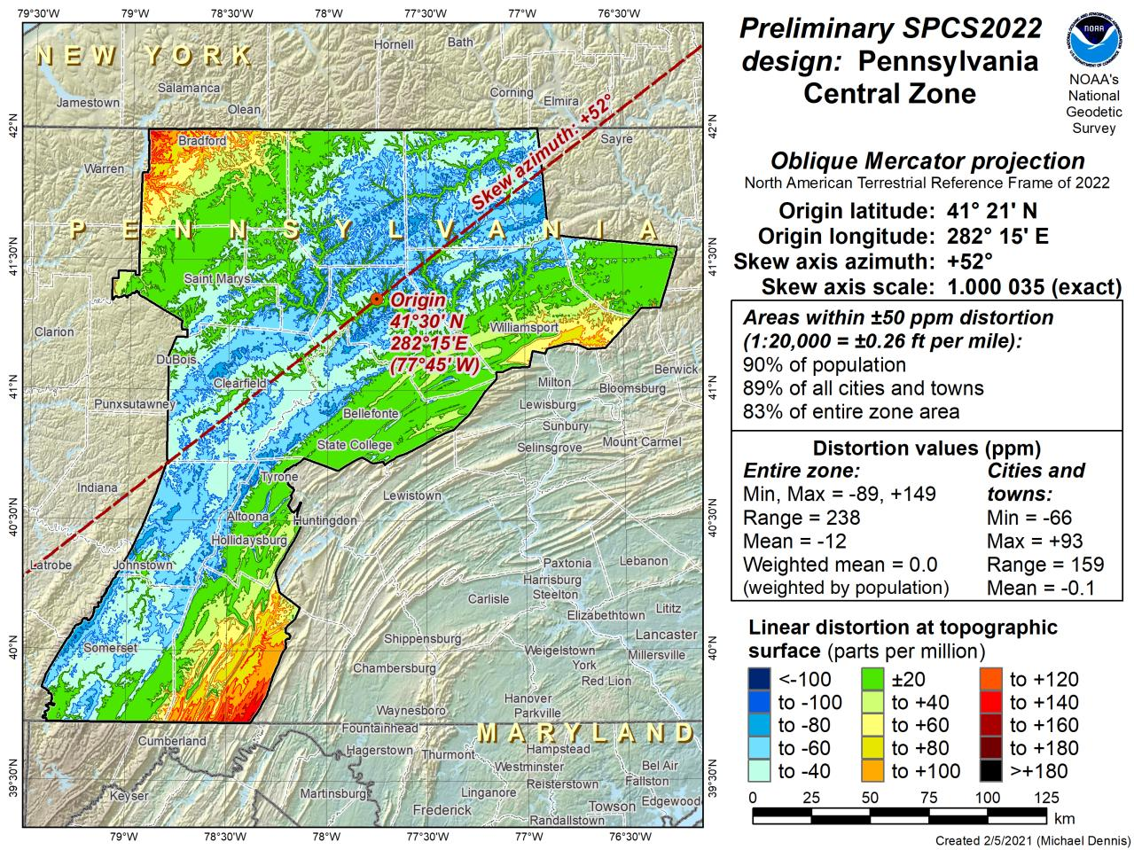
Notes:
This is the first, and likely final, draft of an Oblique Mercator projection for the Preliminary Central Zone
NOTE that even with the

Slide 58
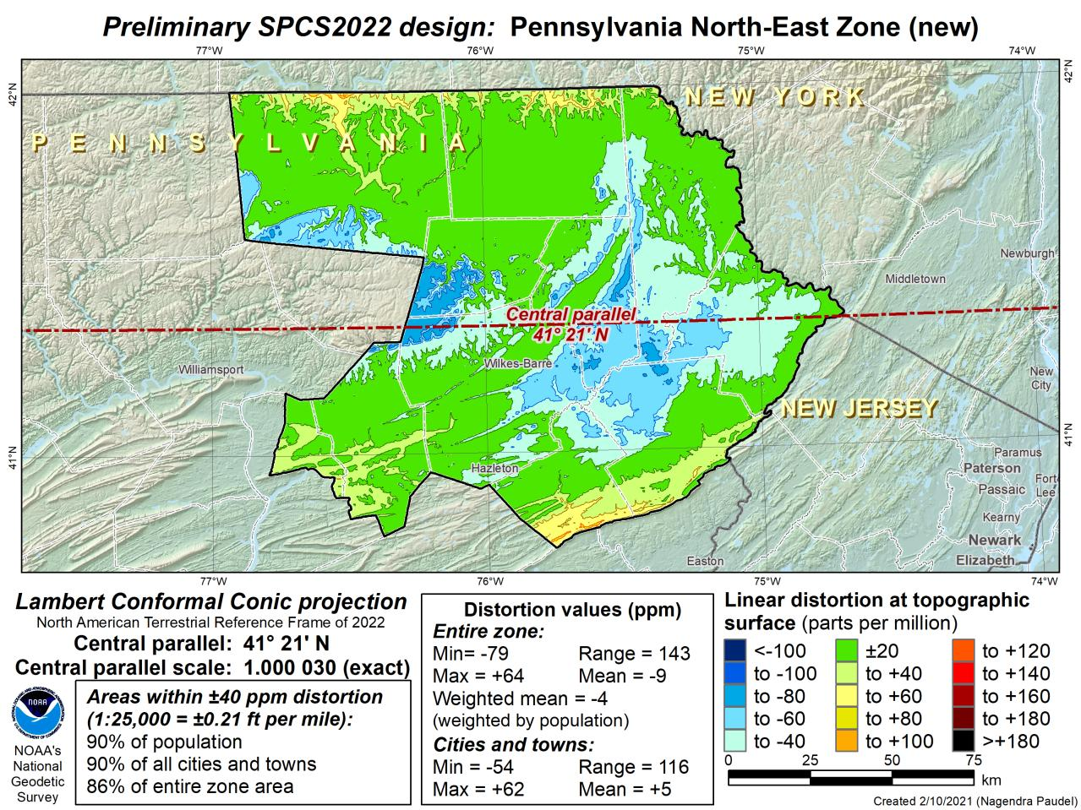
Notes:
This is the second draft of a Preliminary North East Zone
NOTE this includes Columbia and Montour Counties, and the animation highlights the comparison between having these counties in the SE or NE Zone

Slide 59
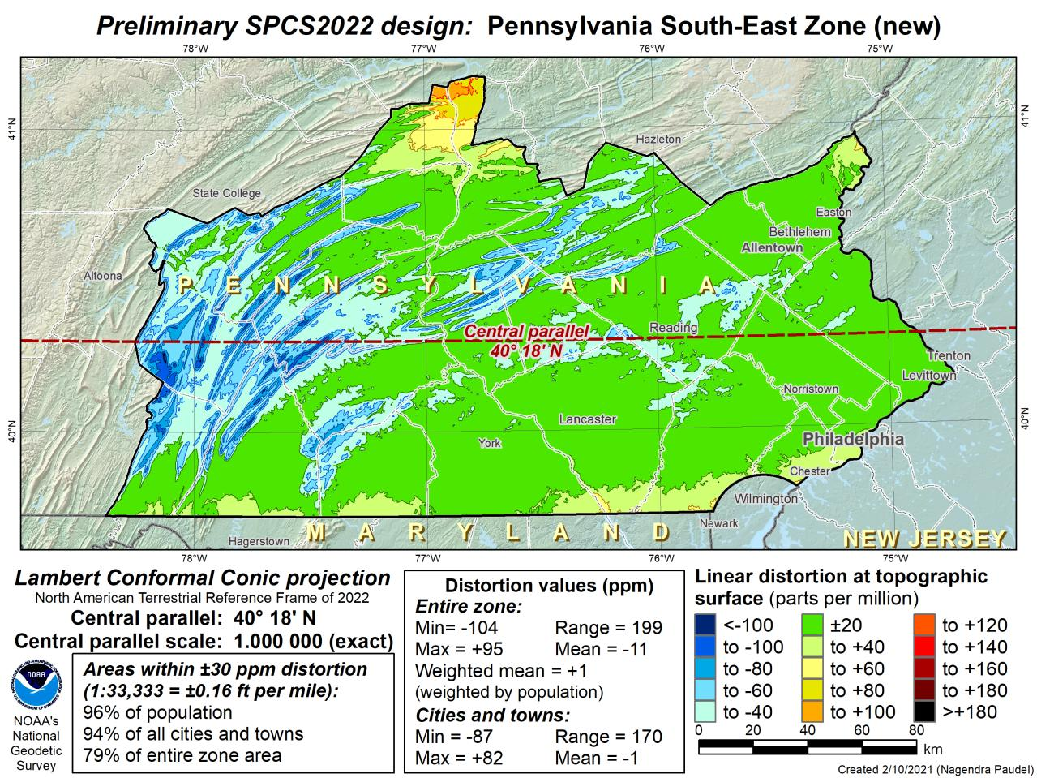
Notes:
This is the second draft of a Preliminary South East Zone
NOTE this excludes Columbia and Montour Counties (they would fall in SE Zone)

Slide 60
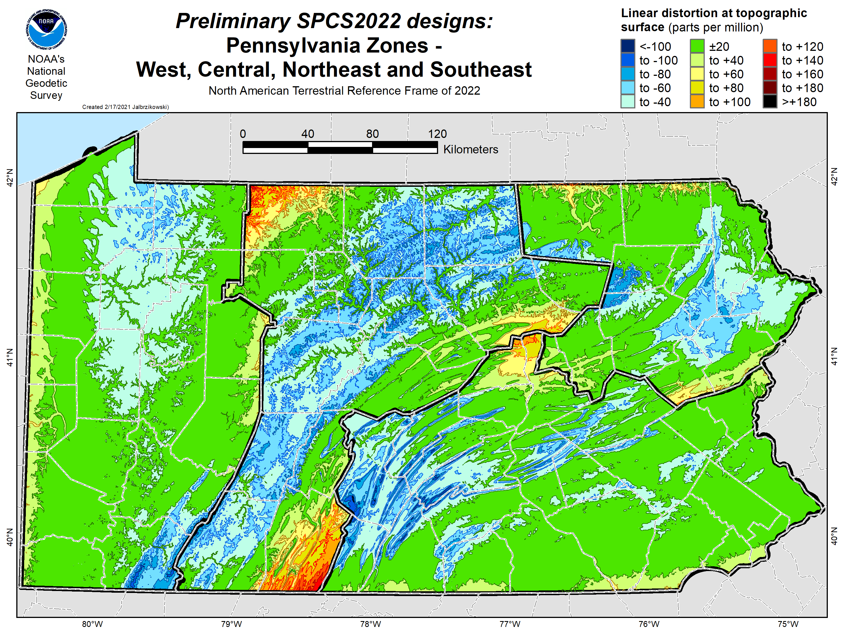

Slide 61
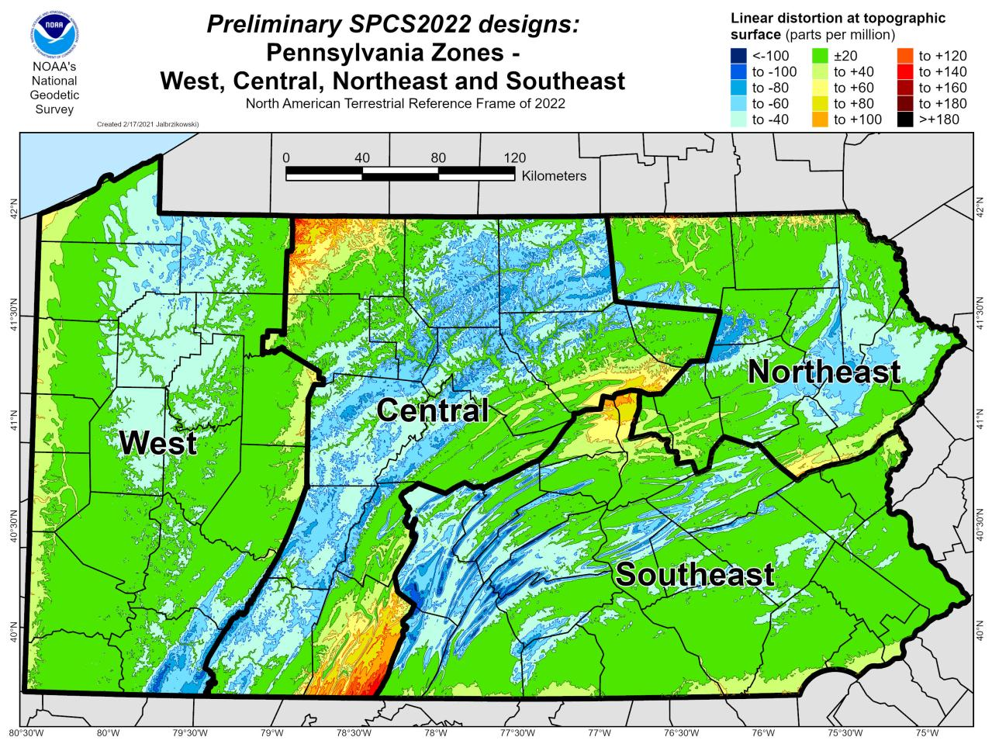

Slide 62
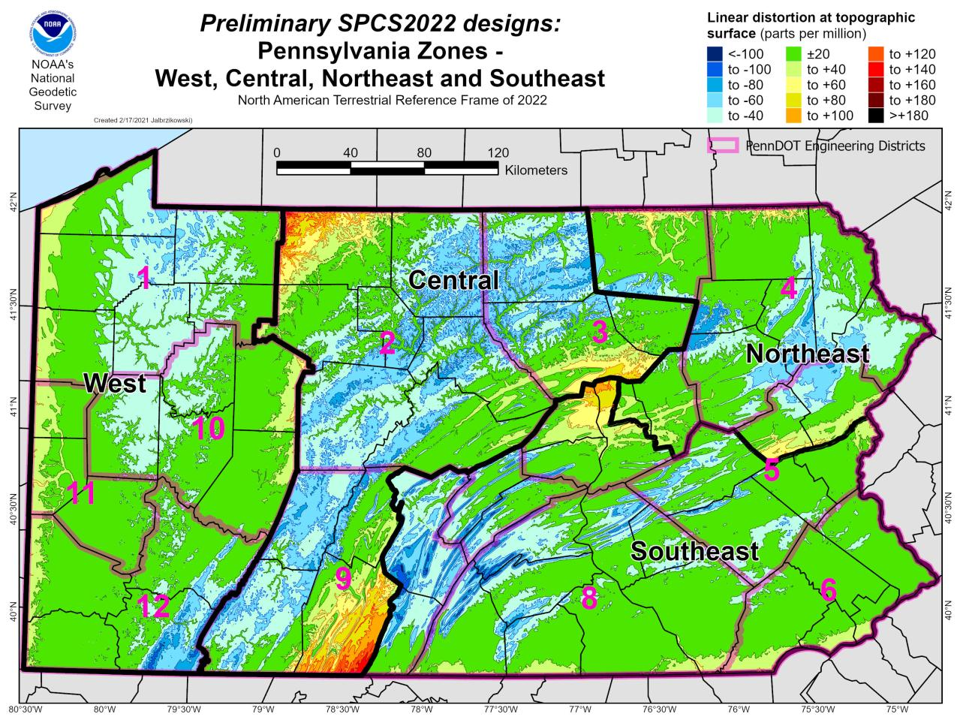

Slide 63
State Plane Coordinate System of 2022
SPCS2022
NGS will create a Single Statewide Zone for every State, the following is a Preliminary map

Slide 64
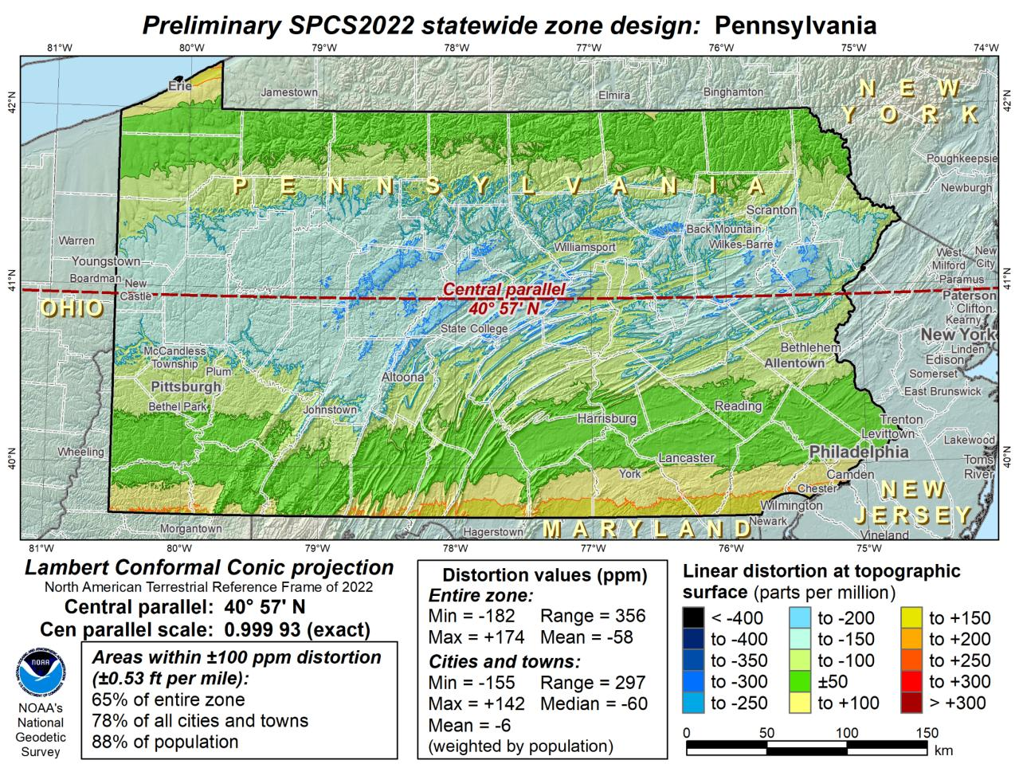
Notes:
This Single Statewide Zone designed by NGS is color shaded to match the following section of slides that show UTM Zones linear distortion values
It is known that some user communities with large areas of responsibility choose to maintain geospatial data and work in UTM
This graphic as compared to the UTM serves to highlight in SPCS2022, users will see better performance (lower linear distortion) if they choose to work in the SPCS2022 Single Statewide Zone rather than one of the UTM Zones that fall within Pennsylvania

Slide 65
UTM (NAD83) Zones as
UTM
The following are maps using existing UTM zones as a Single Statewide Zone
(included to highlight the lower performance as compared to Preliminary NGS Zone)

Slide 66
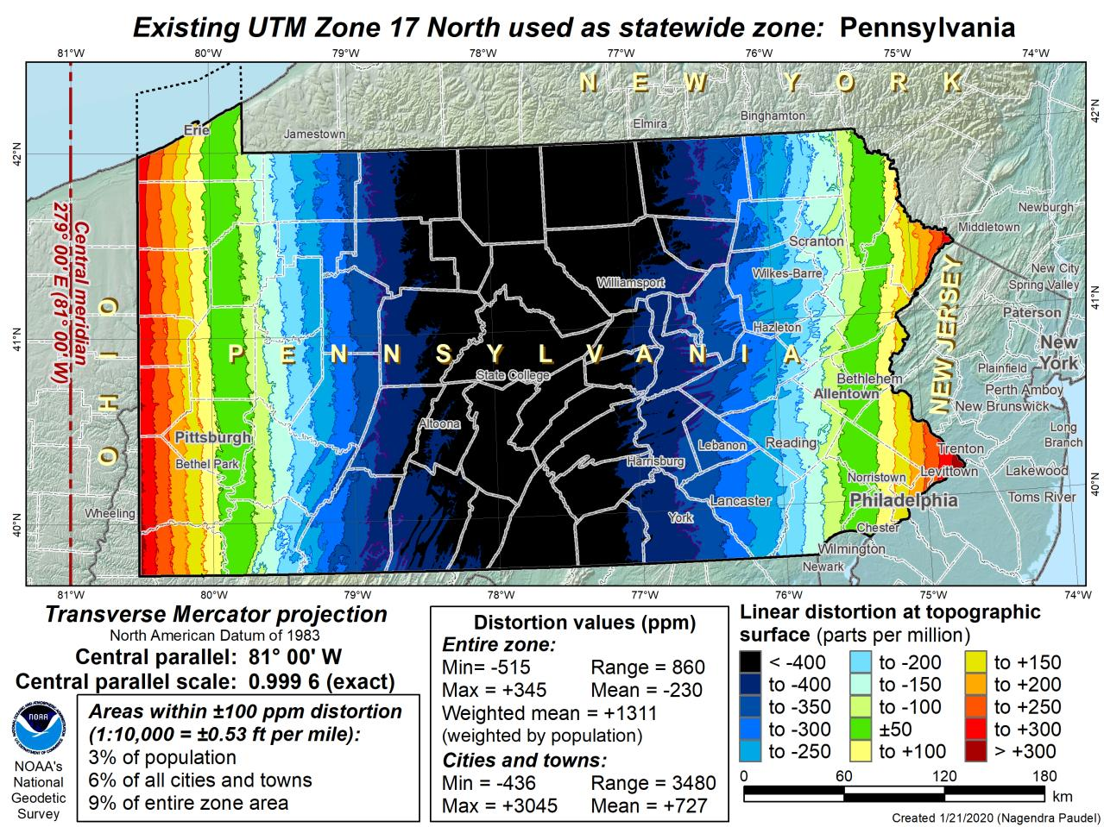

Slide 67
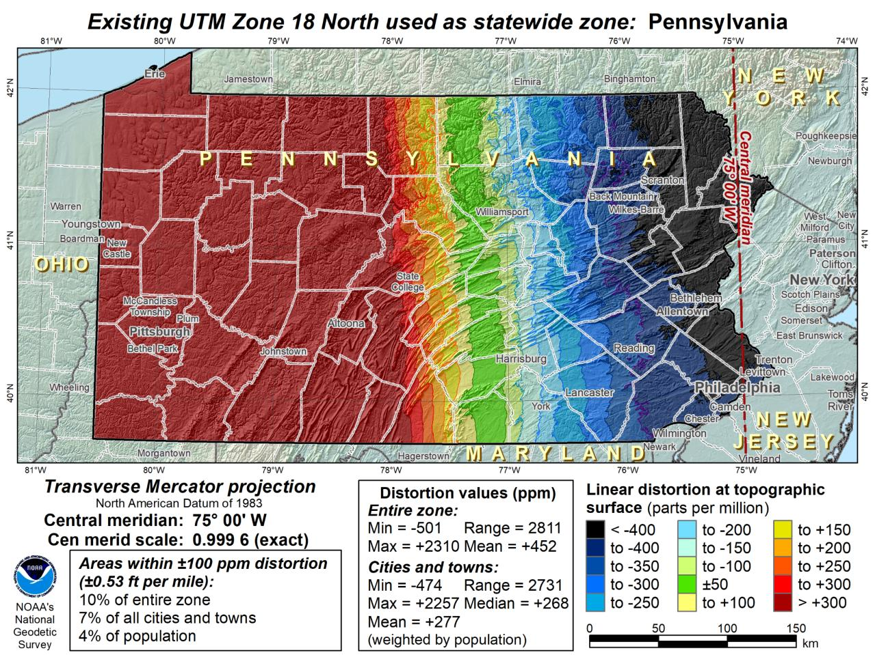

Slide 68
Notes:
The NGS designed preliminary single statewide zone is included again here at the end for easier visual comparisons.

Slide 69
SPCS2022 Zone Layers in PA
Both Single Statewide and Multi-Zone Layers will coexist
Think about your data, your goals, your customers
  Remember that geographic coordinates are your friend!
Smaller zones not “the best” … it all depends on usage & goals

Slide 70
SPCS2022 Zone Layers and LDPs
Each state may have max of 3 zone “layers”
  One layer must be statewide zone
    PA Single Statewide
  Other layers have two or more zones
    PA Multi-Zone (West, Central, Northeast, Southeast)
  Only one layer can have discontinuous coverage
    Left open for possibilities
Multi-zone layer can consist of LDPs
  Designed by stakeholder “contributing partners”
    NGS will not do this for stakeholders
  LDP coverage can be discontinuous

Slide 71
The Survey Foot is dead!
Long live the Survey Foot!
US Survey Foot was deprecated 31 December 2022… now what?!?
Notes:
We start with the SPCS83 zones as a frame of reference
NOTE that the color shading of these zones is matched to that of the Preliminary SPCS2022 Zones that follow

Slide 72
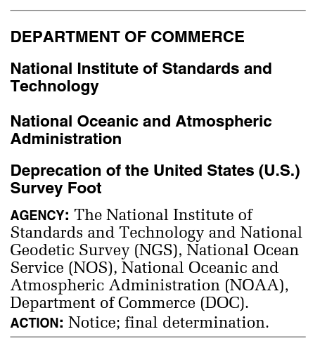
What happened to the US Survey Foot?
Deprecated 31 December 2022
Which begs the question
  What should you
  be doing now?

Slide 73
What should you be doing now?
Prepare for this along with new datums
Understand this is not enforced
  Neither NIST or NGS are a regulatory agency
  We support education/outreach of course
  But OPUS, NCAT, etc. will not have US Survey Foot options/output in SPCS2022 zones

Slide 74
2 parts per million (ppm)?
1,000,000.00 sft = 999,998.00 ift
10,000,000.00 sft = 9,999,980.00 ift
1,000.00 sft = 999.998 ift (can you measure that?)
International → 1 ft = .3048 m
US → 1 ft = .30480061 m (approx.)

Slide 75
The Survey Foot is dead!
Long live the Survey Foot!
US Survey Foot was deprecated 31 December 2022…
But will always be available in NGS tools for NAD83 and NAD27

Slide 76
additional Resources
Notes:
This presentation is intended to raise awareness about the upcoming changes and what they mean for floodplain mapping, but you probably have lots of remaining questions and we have a lot of resources online at our website
Please spread the word, and
make an effort to keep yourself and your colleagues informed.
Tell us what content is missing or how we can make it better!

Slide 77
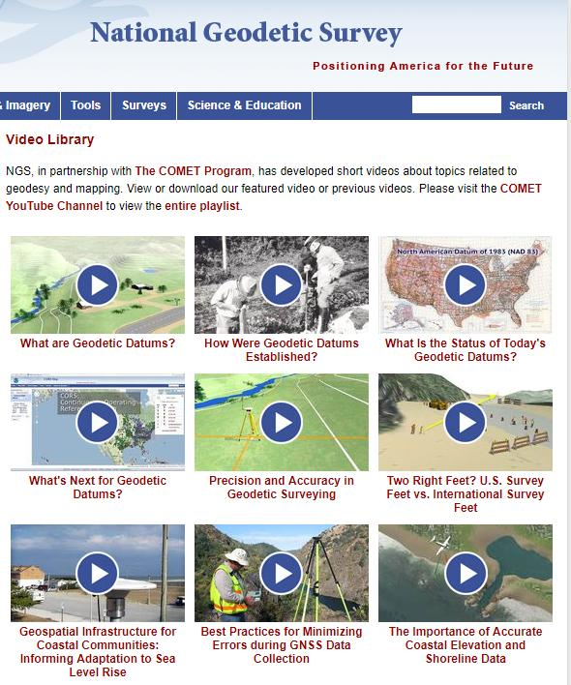

Resources at geodesy.noaa.gov
Educational Videos
<5 minutes
Online Lesson
(via MetEd/COMET)
~1 hour
Notes:
Educational videos and online tutorials –
Our library of lessons and videos are great resources, and will reinforce a lot of information we covered today.
The videos are just 3-5 minutes long.
the lesson is a deeper dive but still only takes an hour.

Slide 78
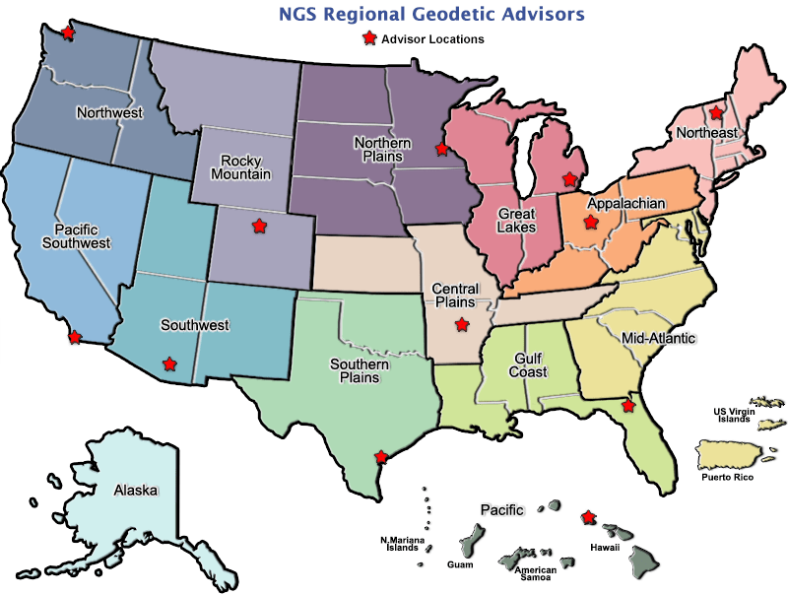
geodesy.noaa.gov/ADVISORS/
Notes:
-14 Regional Advisors, we’ve transitioned from a State-based to a Regional Program
-our advisors homepage up there at the top, also easy to find us by querying any major search engine for “ngs advisors”
-if you know Ross Mackay, he is our Chief Advisor, I report to him…
**ya know, I don’t know why they don’t make him put his photo up here
-we do have one vacant advisor position, that was recently advertised and John up there in Wisconsin is officially retired in oh… 18 days

Slide 79

Regional Geodetic Advisor Program
geodesy.noaa.gov/ADVISORS/
query any major search engine: “ngs advisors”
Notes:
Transitioned from a State to a Regional program in 2016. States no longer provide funding if they desire to have an Advisor, but NGS reorganized the personnel to support regions rather than single States.
Kentucky has appointed a State Geodetic Coordinator

Slide 80
Jeff Jalbrzikowski, P.S., GISP, CFS
Appalachian Regional Geodetic Advisor
jeff.jalbrzikowski@noaa.gov
240-988-5486
https://www.ngs.noaa.gov/ADVISORS/
use any major search engine: “NGS advisors”

