Slide 1
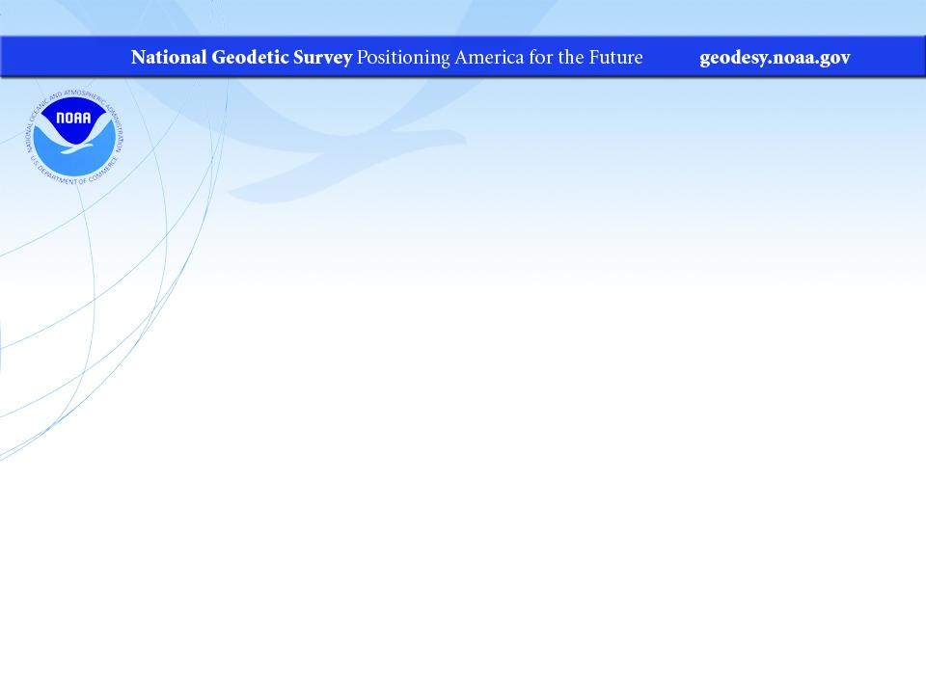
Interpreting NGS Datasheets
… or is it Data Sheets? Did someone say Sheetz?
PLSO Annual Conference
February 2023
Jeff Jalbrzikowski, P.S., GISP, CFS
Appalachian Regional Geodetic Advisor
jeff.jalbrzikowski@noaa.gov
240-988-5486

Slide 2


We will do a few audience polls today.
To participate…
Or use the QR code

Slide 3
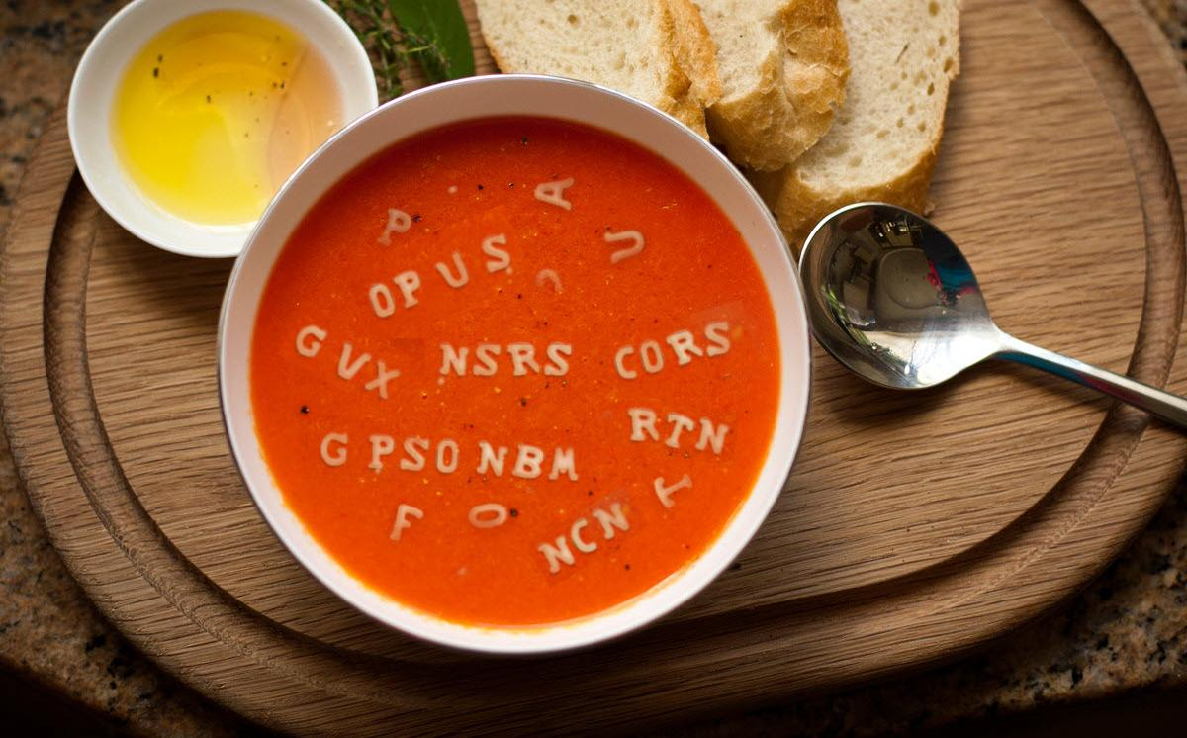

Slide 4



Organizational Structure
  -Department of Commerce (DoC)
  (~47,000 employees)
  -National Oceanic and Atmospheric Administration (NOAA)
  -National Ocean Service (NOS)
  -National Geodetic Survey (NGS)
  (~175 employees)
Notes:
-We are the Federal Government’s oldest scientific agency.
-part of the Executive Branch
-I know it can seem kind of strange that NGS is part of the NOS, but the origins of NGS lie with the C&GS.
-we are a “Program Office” of the NOS
Survey of the Coast – 1807
Coast Survey – 1836
Coast and Geodetic Survey – 1878
NGS since 1970

Slide 5


Organizational Structure
We’re not USGS, we’re NGS
  -Department of Commerce (DoC)
  (~47,000 employees)
  -National Oceanic and Atmospheric Administration (NOAA)
  -National Ocean Service (NOS)
  -National Geodetic Survey (NGS)
  (~175 employees)
≠
Notes:
-as you can read my slide, I like to point that out because over my 2 years at NGS I’ve seen and heard this misunderstanding quite a bit
-don’t worry! it doesn’t offend us! and we do work closely with USGS, but we are separate agencies within totally different departments of the federal government

Slide 6
NGS Mission
To define, maintain and provide access to the National Spatial Reference System (NSRS) to meet our Nation’s economic, social, and environmental needs.
Notes:
NGS develops and maintains the National Spatial Reference System, a national coordinate system that provides the foundation for transportation, navigation, land record systems, mapping and charting efforts, and a multitude of scientific and engineering applications.
But there are many ancillary programs and products we will also discuss.

Slide 7
Modernizing the NSRS means:
Updating all NSRS coordinates
  Replace existing datums with new datums
  Replacing existing State Plane with new State Plane
  Accounting for coordinates changing with time
Improving NGS products and services
Simplifying customer contributions
Making the NSRS:
  More accurate
  More accessible
  More efficient
Rollout in
2025
7

Slide 8
National Spatial Reference System (NSRS)
Geometric Geodesy
Physical Geodesy
Horizontal Datums
Geometric Reference Frames
Latitude & Longitude
Ellipsoid Height
State Plane Coordinates
Geopotential Datums
Orthometric Height
Dynamic Height
Surface Gravity
Leveling
To get to these “final products” we use a multitude of scientific methods, including Space Geodesy and Astronomical Geodesy.
And since we’re the Government… don’t forget Political Geodesy!
Notes:
All the facets of the NSRS fall into one of the two parts or fields of geodesy shown here.
CLICK
Geometric Geodesy
includes
Horizontal Datums
Geometric Reference Frames
Latitude & Longitude
Ellipsoid Height
State Plane Coordinates
or…..
CLICK
Physical Geodesy
Geopotential Datums
Orthometric Height
Dynamic Height
Surface Gravity
Leveling
And as we look at those together, it should be duly noted that to get to these final products we we use a multitude of scientific applications and methods, including Space Geodesy and Astronomical Geodesy.
CLICK
And since we’re the Government… don’t forget Political Geodesy!
We can’t accomplish what we do without funding, if the politicians see this science as a black box or have the “google earth” misconception… then

Slide 9
National Spatial Reference System (NSRS)
A consistent coordinate system that defines:
latitude
longitude
height
scale
orientation
gravity
throughout the United States.
…and their time variants
Notes:
Let’s talk about the NSRS some more before we move on to looking at all of NGS.
This system defines position (latitude, longitude, and elevation), distances and directions between points, strength and direction of gravity (no, it is not simply “straight down”), shoreline, and their “time variants”.
Or how these change over time.
Some documents will reference the National Shoreline as a component of the NSRS., we’ll briefly look at that later.

Slide 10
National Spatial Reference System (NSRS)
These items ARE part of the NSRS
Horizontal Datums (aka Geometric Reference Frames) | Vertical Datums | Great Lakes Datums | Geoid Models | Transformations and Conversions
NAD83 | NAVD88 | IGLD85 | GEOID18 | NADCON
NAD27 | NGVD29 | IGLD55 | GEOID12B | VERTCON
USSD | VIVD09 |  | GEOID09
 | GUVD04 |  | GEOID06 | SPCS83
 | NMVD03 |  | GEOID03 | SPCS27
 | ASVD02 |  | GEOID99
 | PRVD02 |  | GEOID96
 |  |  | ALASKA94
 |  |  | GEOID93
 |  |  | GEOID90
Notes:
Note the US Standard Datum, anyone done any work in the old USSD?
Good example highlighting that the term “NSRS” is used to encompass all historic datums of NGS and its predecessors.
Saw one project during my work with the USACE, in Johnstown, PA, that had original survey records in what turned out to be US Standard Datum.
All those vertical datums below NGVD29, I greyed them out slightly because those are all Caribbean and Pacific Island datums, so in CONUS it’s just those two that you hopefully already use… and hopefully are mostly using NAVD88.

Slide 11
National Spatial Reference System (NSRS)
These items are NOT part of the NSRS
Horizontal Datums (aka Geometric Reference Frames) | Vertical Datums | Geoid Models | Transformations and Conversions
WGS84 | IHRS (by IAG) | OSU91A | CORPSCON
WGS72 |  | EGM96 | Appendix B.6 of DMA TR 8350.2 (WGS 84)
ITRF (Intl. Terrestrial Reference Frame by IERS) |  | EGM2008 | Oregon Coordinate Reference System (ORCS)
IGS (Intl. GNSS Service reference frame) |  |  | The Kansas Regional Coordinate System
Hyperlink to ITRF station map
Notes:
WGS is a DoD system. Yes, that is the system native to the Global Positioning System, but it isn’t true that you “have to” work in WGS84 to get the most accurate coordinates. I’ve heard people say that.
The Intl. Terrestrial Ref. Frame is a product of the Intl. Earth Rotation and Reference Systems Service. More on that later.
The Intl. GNSS Service Ref. Frame is, well, it’s a reference frame based on that ITRF just mentioned, but with improvements, like a more dense network of stations and is more easily accessible.
The IHRS is an International Height Reference System, which is a product that was formally adopted by the IAG (Intl. Association of Geodesy) in 2015. Not an NGS product but folks from NGS were involved.
OSU geoid, it was a research thing and I don’t know much about it.
The Earth Gravity Models are DoD products just like the WGS products, used around the world by our Nation’s military (I used EGM based height sin Iraq and Afghanistan)… but are not at all tied to NSRS geoids. Future DoD geoid models may have a closer tie to future NGS geoid models.
CorpsCon. Ah yes, Corpscon. Everyone loves Corpscon, unfortunately as convenient as it is it isn’t truly an NGS product and has not been updated in well, a long time, and there are no plans to update it in the future. (confirmed via phone call to AGC personnel on 20FEB2019)
I like Mark Huber, awesome dude, I spent some time with him surveying on some god-forsaken island in the Indian Ocean, but the USACE doesn’t seem to want to support him in funding an update to Corpscon. So it is what it is.
Those regional coordinates systems, like the ORCS in Oregon and that one in Kansas, although they have rigorously defined transformations to the NSRS (which is great, they did it right) they are not part of the NSRS.

Slide 12
NSRS … do I have to use it?
Not necessarily, but it’s a great idea!
States may mandate use of NSRS
All Federal spatial data and GIS activities financed directly or indirectly, in whole or in part, by Federal funds are required to be tied to the NSRS
If you want to get involved in contracted work with the Federal Government it’s a necessity
Notes:
-We give you efficient ways to check the accuracy of GNSS surveys, via the CORS and OPUS.
-but we’re not the datum police!
-Aerial imagery overlays, doesn’t it make you feel good when a topo lines up pretty well with statewide imagery & lidar?
- all the FEMA/USGS/NRCS 3DEP lidar, all that data will be out there in SPCS, tied to the NSRS via GPS tied to multiple CORS
CLICK
-interesting tidbit I picked up from a meeting on Friday: for anyone who’s been paying attention to the politics & bureaucracy of government geospatial efforts, the Geospatial Data Act of 2018 includes provisions for “repercussions” for agencies who do not comply with this requirement
**-important though that will not be enforced until 5 years after the GDA, so late 2023
PREPARE NOW!

Slide 13
The US Survey Foot is dead!
Long live the US Survey Foot!
US Survey Foot is officially deprecated
  As of 31 December 2022
So now what do we do?
  Nothing!
  Do not change anything you do until you are working in the new datums.
Notes:
It’s likely everyone watching this webinar knows about the problem: there are two nearly identical versions of the foot in current use in the U.S.;
They differ by 2 parts per million (ppm), or only 0.01 ft per mile, or slightly more than a tenth of an inch in a mile.
Despite (or actually because of) the very small difference, it has become a REAL problem with REAL costs.
What’s in a name? That which we call a “foot” by any other word would smell as… sweet? Maybe that’s not he best analogy for the foot…
“U.S. survey foot” sounds patriotic, is surveyor-centric…
“International foot” sounds like a New World Order, UN sanctioned sort of thing, with perhaps a whiff of socialism…
Is the name really part of the problem? I hope not, but emotion does play a role. We are not entirely rational creatures after all (myself included).
Surveyors are really the only users of the U.S. survey foot (sft). They are also among the very few who even know of its existence. In schools and colleges they only teach students about the official international foot (ift). However, because people use the products created by surveyors, they end up using the sft without even knowing it.
Want to have a conversation about this, get all of us on the same page. So I will present facts to facilitate informed discussion (sprinkled with some opinions…)

Slide 14
What’s impacted?
When does this matter?
  Not typically in lengths/distances
  Published planar coordinate systems
    Why? → large false eastings and northings
Like what?
  SPCS and UTM are very popular and both fall victim to mix-ups
    due to… the large false E/N in their zones
Notes:
It’s likely everyone watching this webinar knows about the problem: there are two nearly identical versions of the foot in current use in the U.S.;
They differ by 2 parts per million (ppm), or only 0.01 ft per mile, or slightly more than a tenth of an inch in a mile.
Despite (or actually because of) the very small difference, it has become a REAL problem with REAL costs.
What’s in a name? That which we call a “foot” by any other word would smell as… sweet? Maybe that’s not he best analogy for the foot…
“U.S. survey foot” sounds patriotic, is surveyor-centric…
“International foot” sounds like a New World Order, UN sanctioned sort of thing, with perhaps a whiff of socialism…
Is the name really part of the problem? I hope not, but emotion does play a role. We are not entirely rational creatures after all (myself included).
Surveyors are really the only users of the U.S. survey foot (sft). They are also among the very few who even know of its existence. In schools and colleges they only teach students about the official international foot (ift). However, because people use the products created by surveyors, they end up using the sft without even knowing it.
Want to have a conversation about this, get all of us on the same page. So I will present facts to facilitate informed discussion (sprinkled with some opinions…)

Slide 15
2 parts per million (ppm)?
1,000,000.00 sft = 999,998.00 ift
10,000,000.00 sft = 9,999,980.00 ift
1,000.00 sft = 999.998 ift (can you measure that?)
International → 1 ft = .3048 m
US → 1 ft = .30480061 m (approx.)
approx 0.02 ft in about 2 miles
Notes:
It’s likely everyone watching this webinar knows about the problem: there are two nearly identical versions of the foot in current use in the U.S.;
They differ by 2 parts per million (ppm), or only 0.01 ft per mile, or slightly more than a tenth of an inch in a mile.
Despite (or actually because of) the very small difference, it has become a REAL problem with REAL costs.
What’s in a name? That which we call a “foot” by any other word would smell as… sweet? Maybe that’s not he best analogy for the foot…
“U.S. survey foot” sounds patriotic, is surveyor-centric…
“International foot” sounds like a New World Order, UN sanctioned sort of thing, with perhaps a whiff of socialism…
Is the name really part of the problem? I hope not, but emotion does play a role. We are not entirely rational creatures after all (myself included).
Surveyors are really the only users of the U.S. survey foot (sft). They are also among the very few who even know of its existence. In schools and colleges they only teach students about the official international foot (ift). However, because people use the products created by surveyors, they end up using the sft without even knowing it.
Want to have a conversation about this, get all of us on the same page. So I will present facts to facilitate informed discussion (sprinkled with some opinions…)

Slide 16
US Survey Foot is officially deprecated
  As of 31 December 2022
So now what do we do?
  Nothing!
  Do not change anything you do until you are working in the new datums.
Notes:
It’s likely everyone watching this webinar knows about the problem: there are two nearly identical versions of the foot in current use in the U.S.;
They differ by 2 parts per million (ppm), or only 0.01 ft per mile, or slightly more than a tenth of an inch in a mile.
Despite (or actually because of) the very small difference, it has become a REAL problem with REAL costs.
What’s in a name? That which we call a “foot” by any other word would smell as… sweet? Maybe that’s not he best analogy for the foot…
“U.S. survey foot” sounds patriotic, is surveyor-centric…
“International foot” sounds like a New World Order, UN sanctioned sort of thing, with perhaps a whiff of socialism…
Is the name really part of the problem? I hope not, but emotion does play a role. We are not entirely rational creatures after all (myself included).
Surveyors are really the only users of the U.S. survey foot (sft). They are also among the very few who even know of its existence. In schools and colleges they only teach students about the official international foot (ift). However, because people use the products created by surveyors, they end up using the sft without even knowing it.
Want to have a conversation about this, get all of us on the same page. So I will present facts to facilitate informed discussion (sprinkled with some opinions…)

Slide 17
The Survey Foot is dead!
Long live the Survey Foot!
US Survey Foot was deprecated 31 December 2022…
But will always be available in NGS tools for NAD83 and NAD27
Notes:
We start with the SPCS83 zones as a frame of reference
NOTE that the color shading of these zones is matched to that of the Preliminary SPCS2022 Zones that follow

Slide 18
Terminology - Changing Coordinates
Conversion
    change the type of coordinate
    eNAD83(2011) latitude & longitude → NAD83(2011) SPCS
  Transformation
    change the datum of coordinate
    NGVD29 height → NAVD88 height
    NAD 27 latitude & longitude → NAD 83(2011) latitude & longitude
Propagation
    change the epoch of coordinate
    NAPGD2022 epoch 2020.00 to NAPGD2022 epoch 2087.2570
    NATRF2022 epoch 2020.00 to NATRF2022 epoch 2023.243
Notes:
Historically NGS has been inconsistent with these top two words.
Going forward, we will use them as:
Conversion: Meaning to change the type of coordinate without changing the datum or frame
e.g. change NAD 83(1986) latitude and longitude to NAD 83(1986) State Plane Coordinates
Transformation: Meaning to change the datum or frame, without changing the type of coordinate
e.g. changing an NAD 27 latitude & longitude to an NAD 83(1986) latitude & longitude
So, “NADCON” which transforms coordinates between datums could have been called “NADTRAN.” C’est la vie.

Slide 19
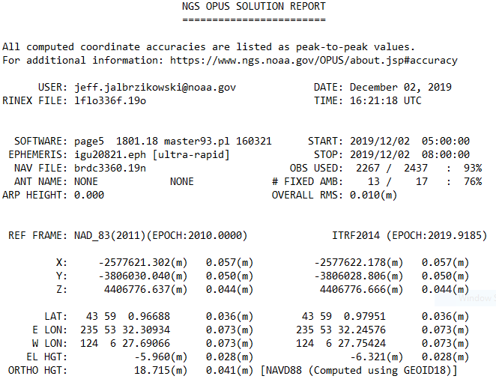
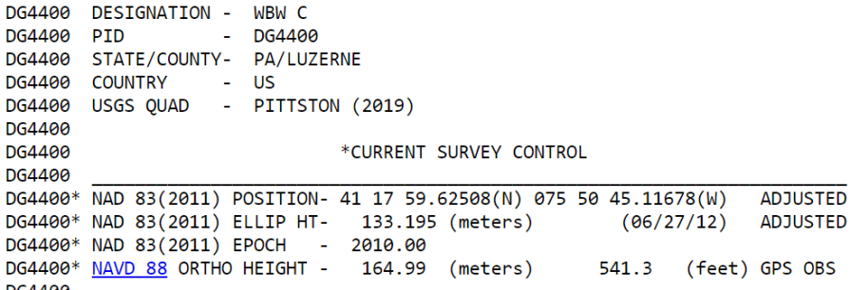
Terminology – Time/4D
Epoch
eh-puck? ee-pock? … to-may-to, to-mah-to
an instant of time
astronomy & geodesy use a decimal date
  2021.4762 = 23 June 2021
  doesn’t have to be!
  using epochs is important, not format
    It doesn’t have to be in decimal years… just start assigning dates to your data
  Here above we’re looking at a
  Transformation and Propagation
  Transform from ITRF2014 to NAD83(2011)
  Propagate from survey epoch 2019.9185 to reference epoch 2010.0000
Notes:
-Where do you see an Epoch right now in NGS data?
CLICK
Datasheets! there you see the epoch of 2010.0
and of course OPUS Solution Reports!
note that in blue over there on the right you’ll see another epoch, in the ITRF, which I will explain later on

Slide 20
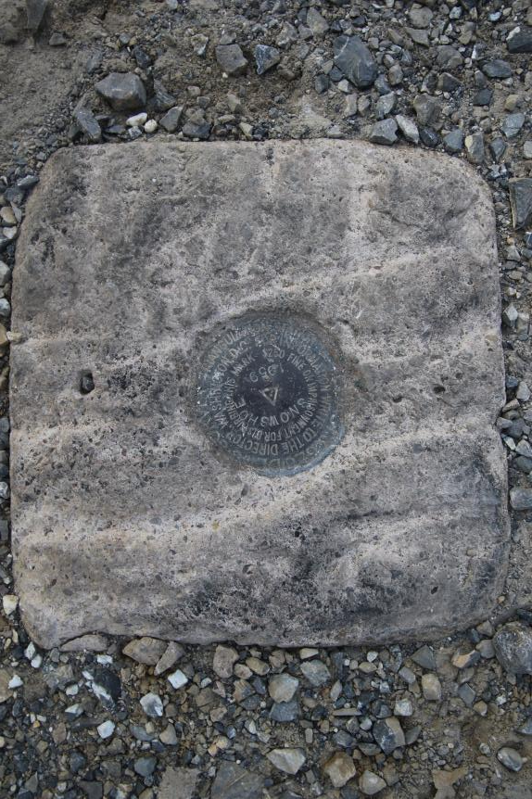
Passive Control
Geodetic Control – Terminology
All marks are passive—they sit there and hold a point
Notes:
All marks are passive!—in that they sit there doing nothing in and of themselves besides holding a point
This includes the fixed antenna mount that is a part of a CORS.
But, some marks have permanently installed equipment that enable nearly continuous observations and these are called “active” stations.

Slide 21
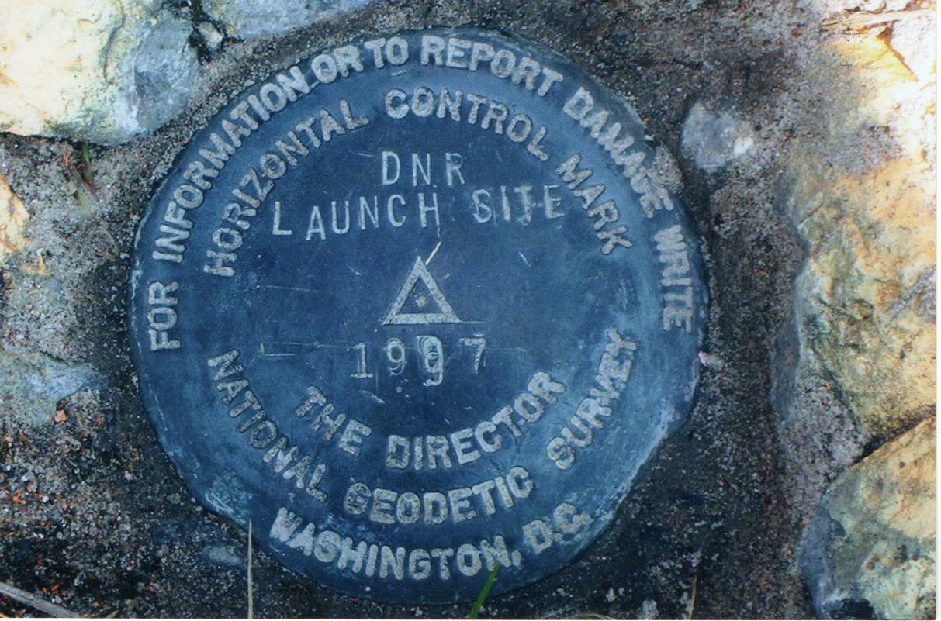
Passive Control

Slide 22
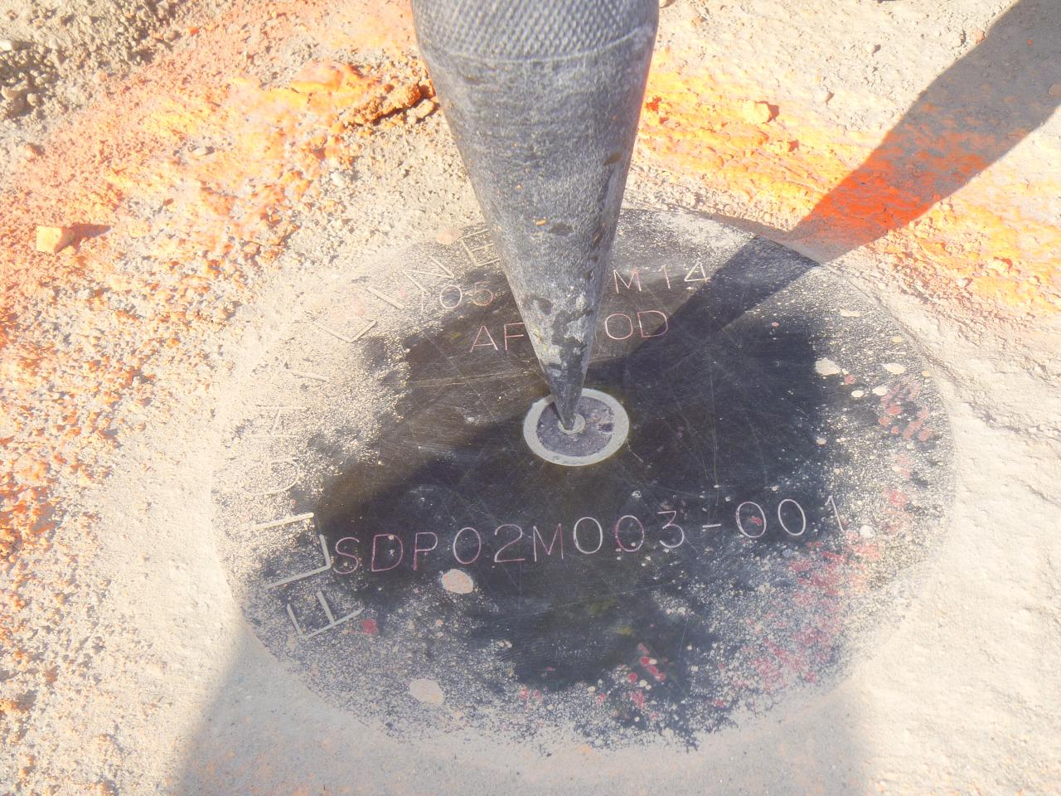
Terminology - Passive Control

Slide 23
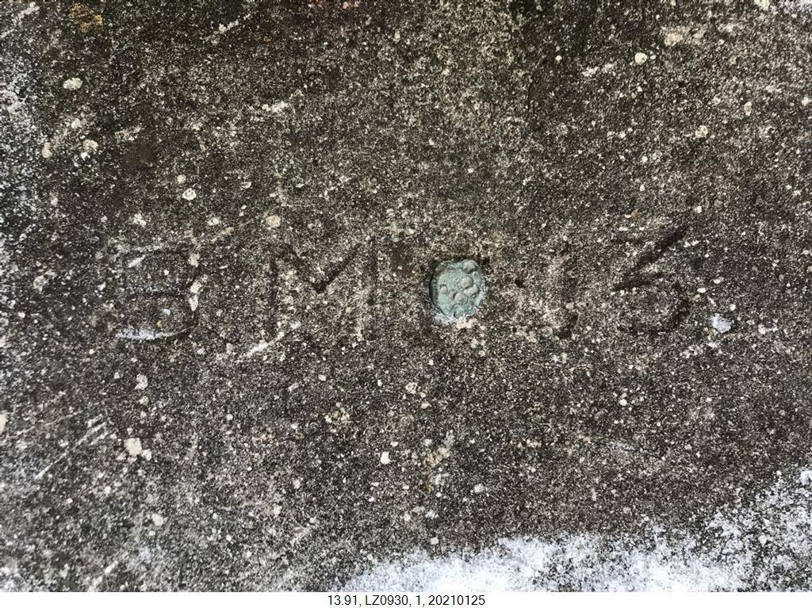
Terminology - Passive Control

Slide 24
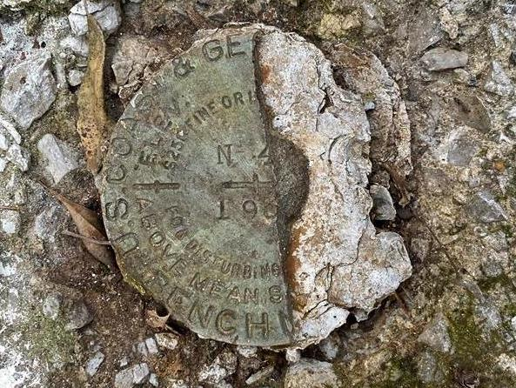
Terminology - Passive Control
Notes:
KW0392 –
https://www.ngs.noaa.gov/cgi-bin/ds_mark.prl?PidBox=KW0392
COLUMBIA COUNTY, PA, NEAR READING COMPANY REAILROAD STATION

Slide 25

Notes:
KR1724 - https://www.ngs.noaa.gov/cgi-bin/ds_mark.prl?PidBox=kr1724
Set 1946 → Washoe County, NV, about 4 miles southwest of Reno
Recovery 1958 → THE STATION MARK WILL BE PRESERVED BY MR. GARCIA, AND WILL BE IN THE CENTER OF HIS LIVING ROOM. - -> BUILT AS A BROKEN WAGON WHEEL WITH THE TRIANGULATION STATION THE HUB THERE-OF.
A STANDARD DISK STAMPED WHEELER 1946, 1958 IS BEING PROVIDED MR. GARCIA, TO PLACE IN THE FLOOR.

Slide 26
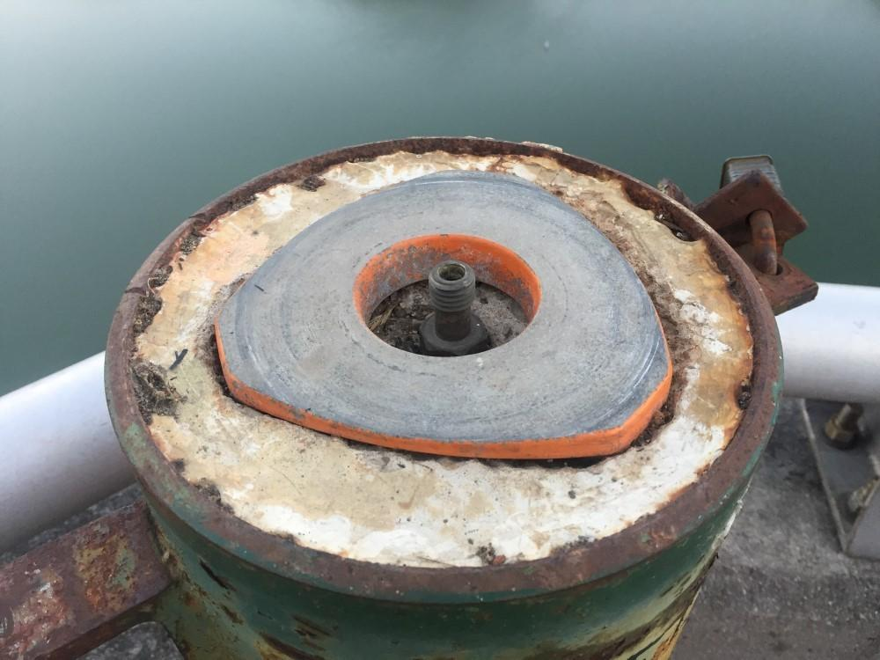
Terminology - Passive Control

Slide 27
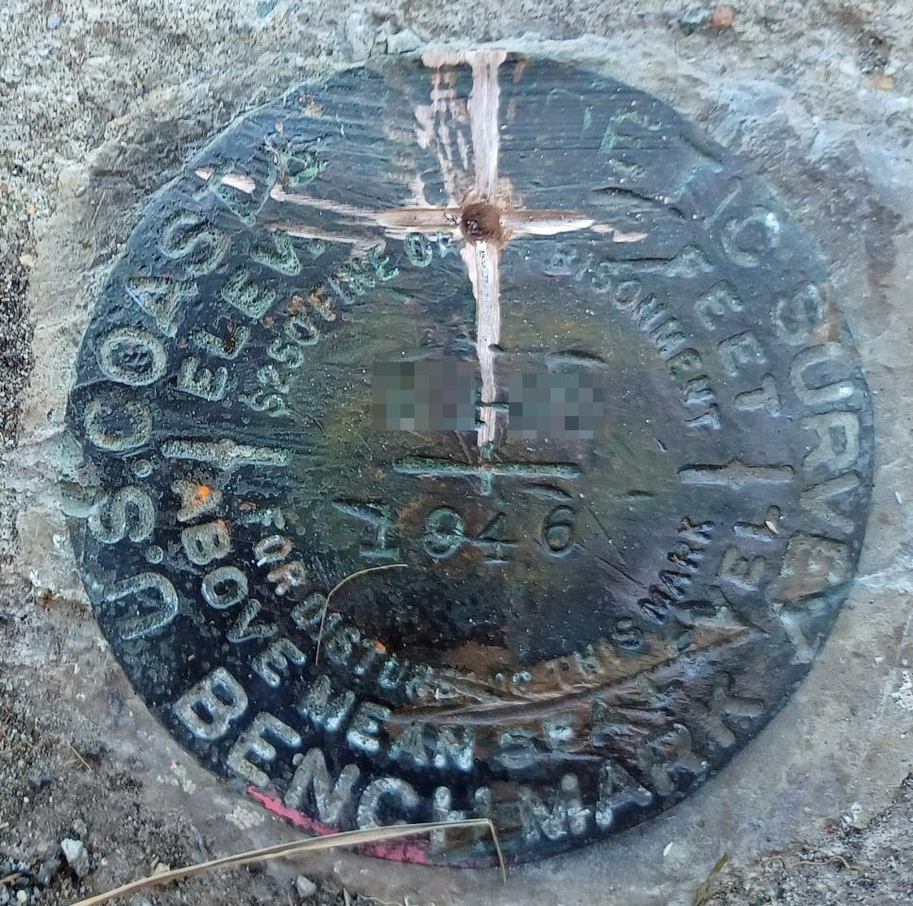
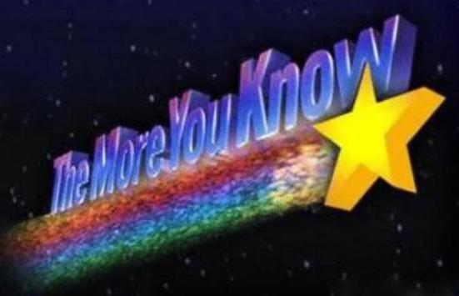
Please … do not add a new dimple

Slide 28
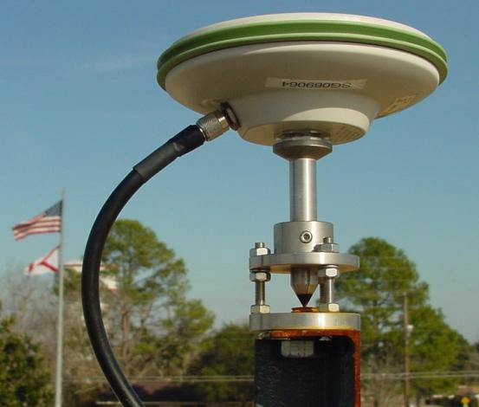
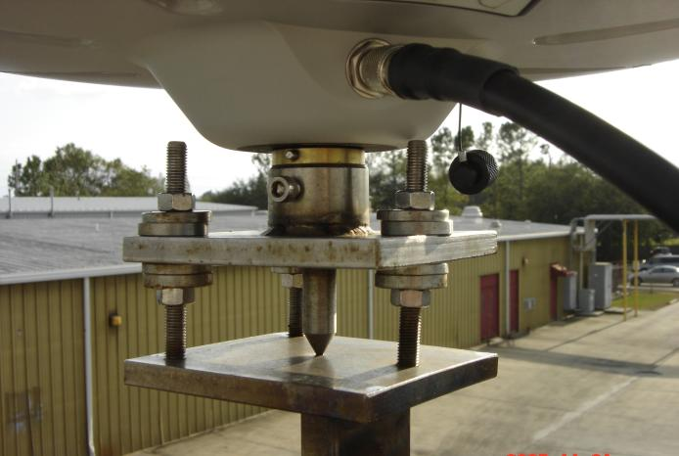
Active Control
Geodetic Control – Terminology
Some marks have permanently installed equipment (e.g. CORS) that enables continuous observations
But they still sit there and hold a point…
Notes:
All marks are passive!—in that they sit there doing nothing in and of themselves besides holding a point
This includes the fixed antenna mount that is a part of a CORS.
But, some marks have permanently installed equipment that enable nearly continuous observations and these are called “active” stations.

Slide 29
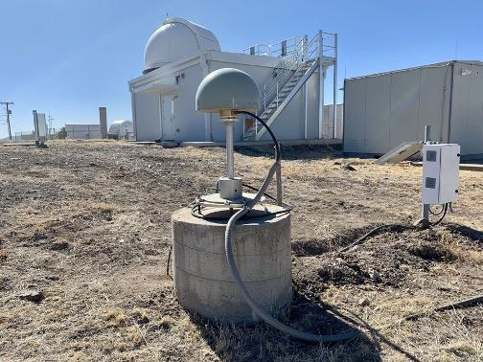
Active Control

Slide 30
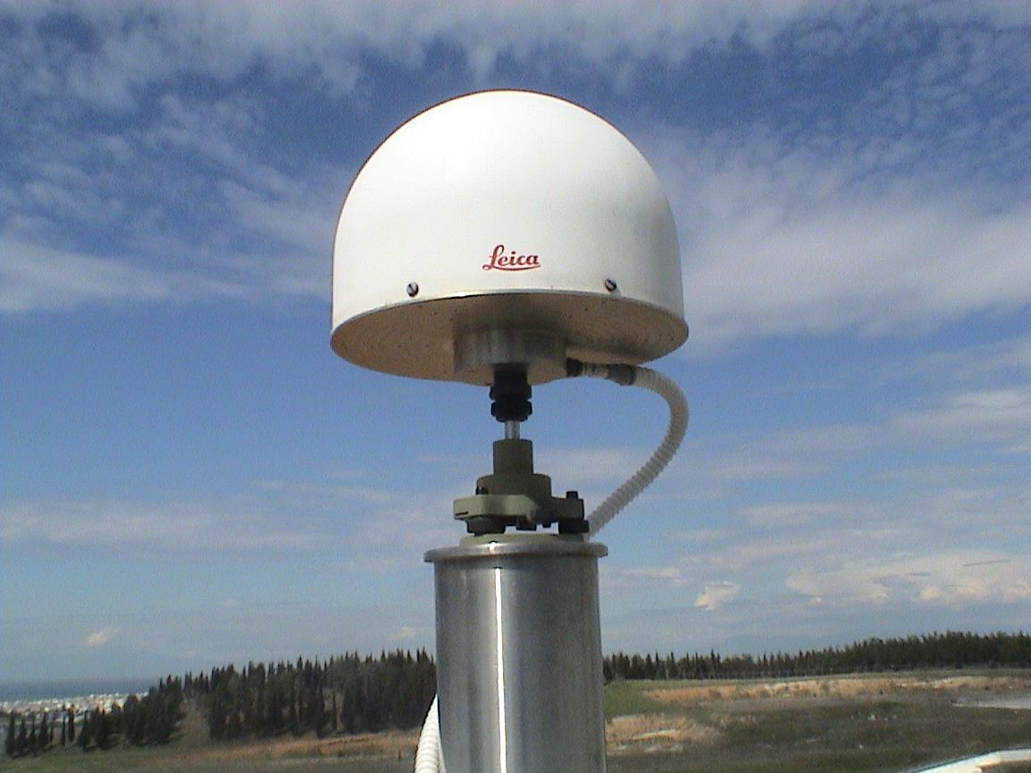
Active Control

Slide 31
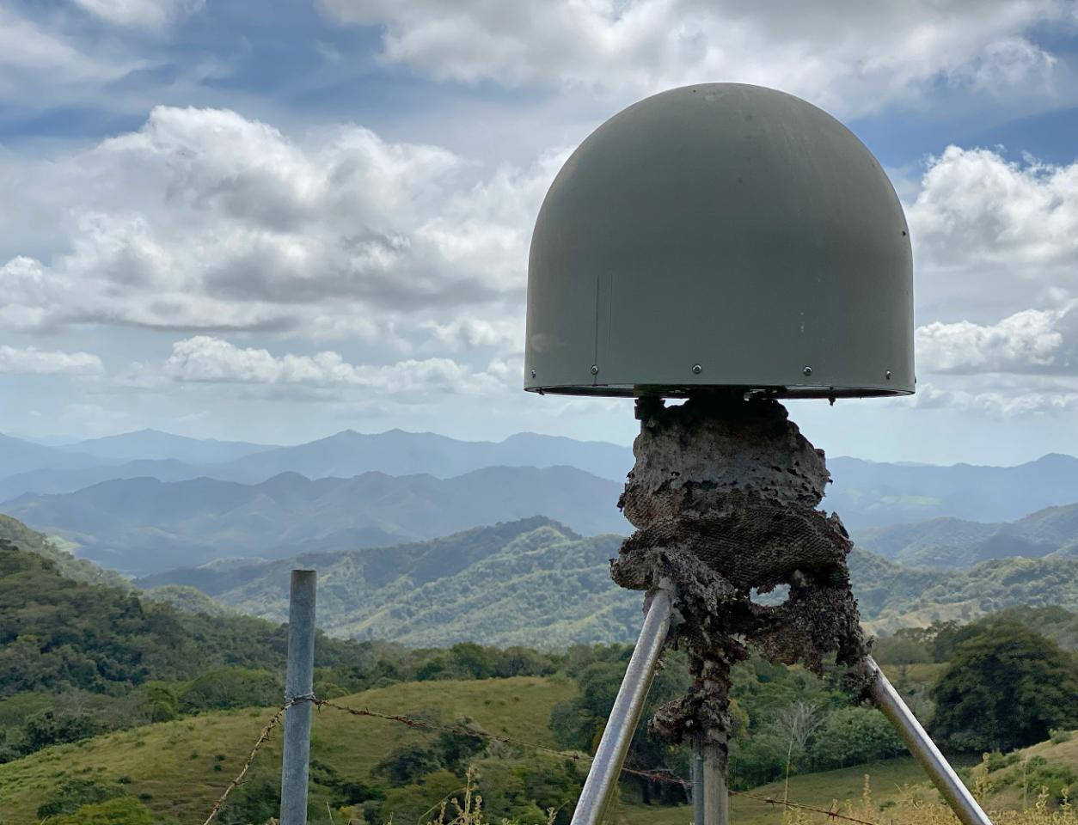
Active Control
Active Control

Slide 32
Active vs. Passive Control
Geodetic Control – Terminology
Passive – some sort of mark with a defined point
Active – some equipment continuously collecting observations on a point
In the modernized NSRS, our emphasis will be to provide accurate coordinates on Active Control… so that you can go out and set your own Passive Control
My point: surveying is still surveying
Notes:
Often the term active geodetic control has been used to mean some equipment is continuously or at least frequently collecting observations at or near a point
Yet those observations are often used to compute coordinates (often time-dependent) at a point on a mark, which, by its nature is passive

Slide 33
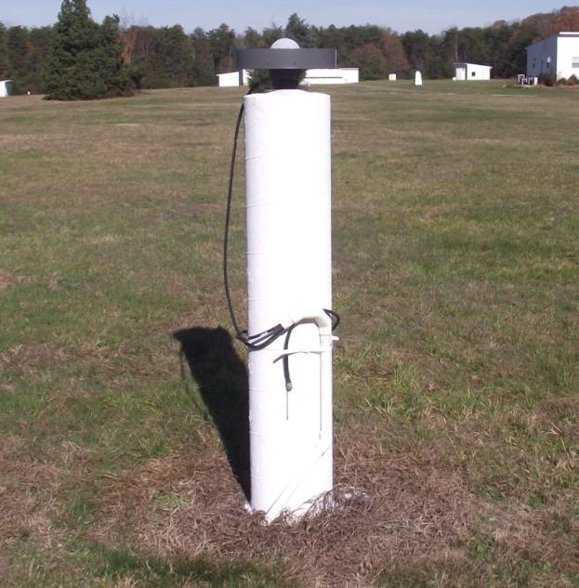
CORS
Active Control
Continuously Operating Reference Station
GNSS ANTENNA
RECEIVER
POWER
DATA STORAGE
COMMUNICATIONS
Notes:
Note that the whole pillar could be considered a type of “mark”, being a passive do-nothing structure that holds a “point”, the GRP of this CORS.
But the point, given coordinates computed from all the data collected by that antenna, is probably in here somewhere, as a part of this huge pillar which is effectively one big mark, passive as can be….

Slide 34
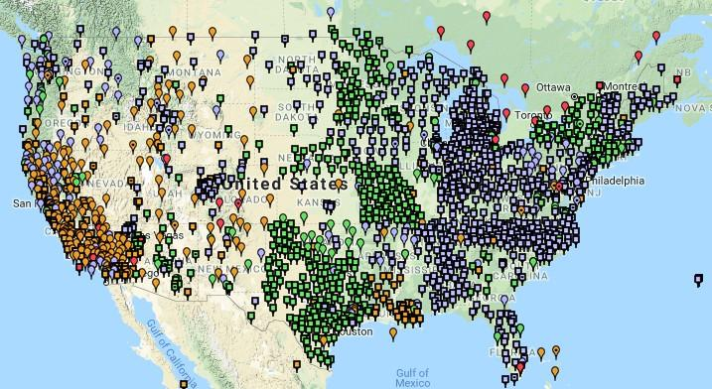
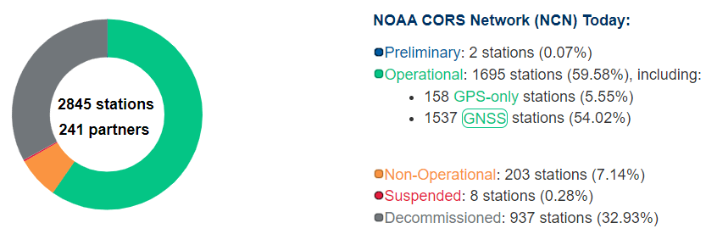
NOAA CORS Network (NCN)
1695 sites
241 organizations
Notes:
-I would like to point out we have a new, official name for the network you see represented on this map,
-The NOAA CORS Network, or NCN
CLICK
-this is neat little graphic with some stats on teh NCN you can find on our website
-below the gaphic youll find a search bar with more information

Slide 35
CORS Networks
Global = International GNSS Service (IGS) Network
  The world standard since mid-1990s
  Supported by IGS Analysis Centers (ACs) → NGS is 1 of 7
  Overall system sponsored by NASA
NSRS = NOAA CORS Network (NCN)
  NGS processes/distributes data, but few are NGS-operated
  Currently semi-coupled to the IGS Network
Regional = WVDOT Real Time Network (WVRTN)
  Most regional CORS networks are also RTNs
    Log data, but also deliver corrections to users like you all
    Note that not all RTNs use “VRS” method
  Currently semi-coupled to the NCN
Notes:
Global: International GNSS Service (IGS) Network
The international standard since mid-1990s
Supported by IGS Analysis Centers (ACs) → NGS is one AC of seven total
Overall system sponsored by NASA
NSRS: NOAA CORS Network (NCN)
NGS processes/distributes data, but few are NGS-operated
Subset of NGS-operated CORS comprise the under construction NOAA Foundation CORS Network (NFCN)
Regional/State/Commonwealth/Local Networks
Real-Time Networks (RTN… aka “VRS”)
Currently semi-coupled to the NCN
NGS sees the future as a close coupling of other networks with the NCN so users can seamlessly and confidently work in the NSRS using their favorite regional/local CORS network

Slide 36
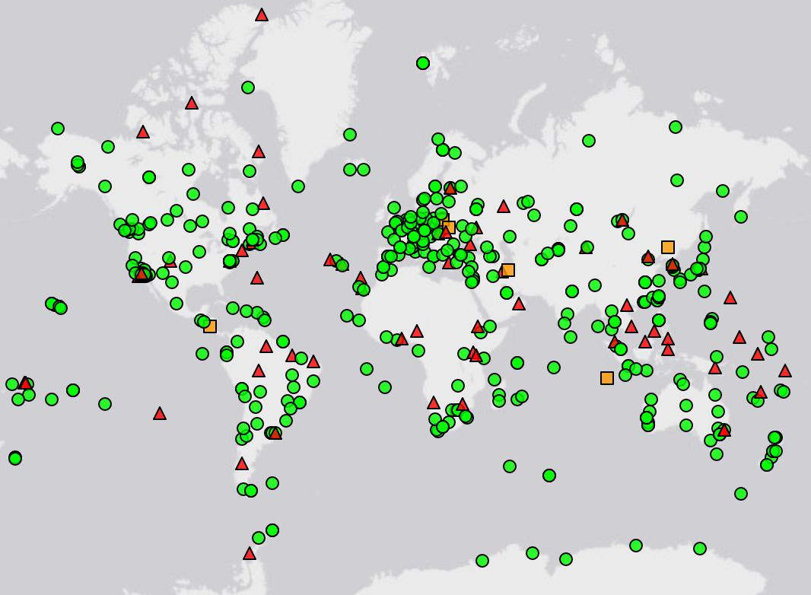
IGS Network
Source: https://www.igs.org/maps/#station-map
Notes:
There are several CORS Networks.
The Global Standard is the IGS Network
IGS = International GNSS Service
The NOAA CORS Network (NCN) which consists of:
The NOAA Foundation CORS Network (NFCN), a sub-network being installed, owned, and operated by NGS
and 2,000+ stations managed, but rarely owned by NGS
Other Regional/Local Networks (RTNs, etc.)
Currently semi-coupled to the NCN
NGS sees the future as a close coupling of these other networks with the NCN so users can seamlessly and confidently work in the NSRS using their favorite regional/local CORS network.

Slide 37
NOAA CORS Network (NCN)
Notes:
-I would like to point out we have a new, official name for the network you see represented on this map,
-The NOAA CORS Network, or NCN
CLICK
-this is neat little graphic with some stats on teh NCN you can find on our website
-below the gaphic youll find a search bar with more information

Slide 38
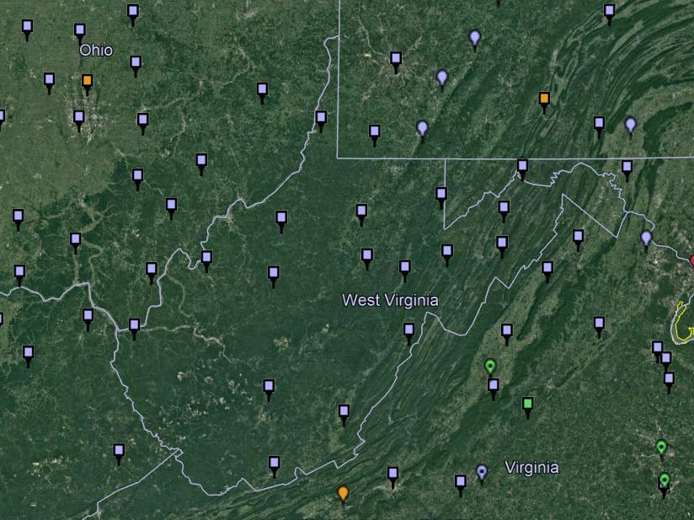
NOAA CORS Network (NCN) in WV

Slide 39
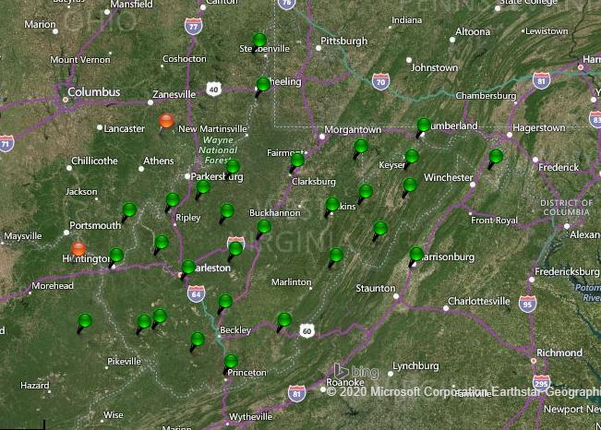
WVDOT CORS Network

Slide 40
NOAA CORS Network (NCN) in WV

Slide 41
WVDOT CORS Network
non-NCN CORS

Slide 42
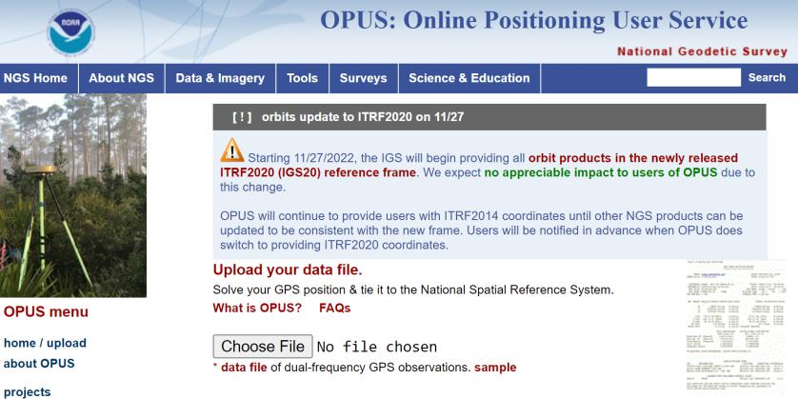
NGS Mission
To define, maintain and provide access to the National Spatial Reference System (NSRS) to meet our Nation’s economic, social, and environmental needs.
access… ? = traditionally → passive control (marks/disks/objects)
= modern and future → active control (NCN CORS)
via OPUS

Slide 43
Reference System & Frame
International Terrestrial Reference System (ITRS)
  IERS’s recipe
International Terrestrial Reference Frame
  Realized by the ITRF Network (the SGT stations)
True for any System and Frame
  Not just the ITRF
National Spatial Reference System
  NGS’s recipe
North American Terrestrial Reference Frame
  Realized by the NOAA CORS Network
  Accessible easily with GPS, by using OPUS
Notes:
Global: International GNSS Service (IGS) Network
The international standard since mid-1990s
Supported by IGS Analysis Centers (ACs) → NGS is one AC of seven total
Overall system sponsored by NASA
NSRS: NOAA CORS Network (NCN)
NGS processes/distributes data, but few are NGS-operated
Subset of NGS-operated CORS comprise the under construction NOAA Foundation CORS Network (NFCN)
Regional/State/Commonwealth/Local Networks
Real-Time Networks (RTN… aka “VRS”)
Currently semi-coupled to the NCN
NGS sees the future as a close coupling of other networks with the NCN so users can seamlessly and confidently work in the NSRS using their favorite regional/local CORS network

Slide 44
Online Positioning User Service
      dual frequency receiver
      static observations (via RINEX → ______.23o)
      30 seconds epoch/logging rate aka recording interval
  OPUS Rapid Static (OPUS-RS)
      15 minutes to 2 hours of GPS data
  OPUS Static (OPUS-S)
      same requirements as above
      2 to 48 hours of GPS data
  OPUS Projects (OP) → also Beta OPUS Projects
      adds session processing and network adjustment
      training by NGS currently required (~12 hours)
Notes:
Currently 4 types of OPUS.
*OPUS only supports GPS constellation data, last I talked to the OPUS developer the plan for incorporation of other constellations is Jan 2021.
Rapid Static – files uploaded that are 15 minutes to 2 hours in duration are processed using an NGS software called “RSGPS”
Static - files that are 2 to 48 hours in duration are processed using an NGS software called PAGES Your coordinates are the average of three independent, single-baseline solutions,
OP and Beta OP - these are not a different processing software, just a way to tie multiple OPUS-Static solutions together and use least squares methods to adjust them all as a coherent network
**the Beta serves as a testing bed for the developers to roll out new features or improvements and get feedback from users

Slide 45
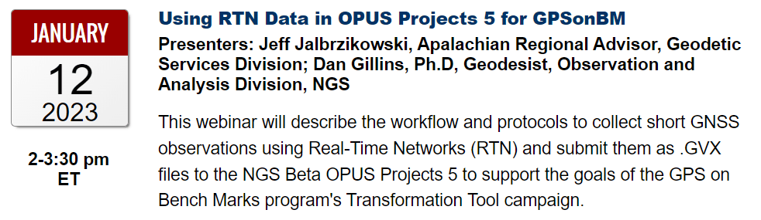
GVX in OPUS Projects
Why would I want to do this?
You can use it for GPSonBM right now.
  Hyperlink to January 2023 webinar

Slide 46
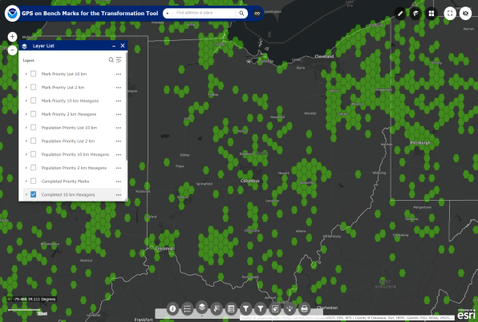
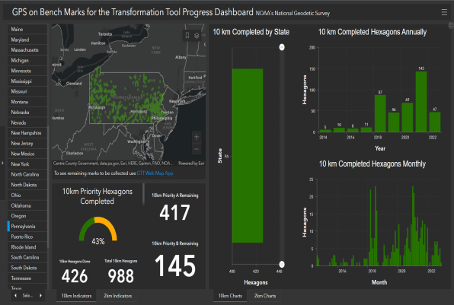

What’s the deal with GPSonBM?
Deadline = 30 September 2023
OPUS Shared Solutions
  2 OPUS-Static, ≥4 hours each
  2 photos of each setup
  Brief Description w/Ties
Web Map Application
Progress Dashboard
The struggle is real.
“too much field time”
“we don’t do static”
“poor site, if only we had multi-GNSS”
Notes:
Note here that the Dashboard map is separate from the Web Map Application.
CLICK They are linked, but different tools.
If you got mixed up about this at some point, no worries, you were not the only one.
If we have had this process to submit GPSonBM for years now… why are we now putting out this option for OPUS Projects via GVX?
CLICK

Slide 47
What’s the deal with GPSonBM?
Important to note that GVX is a supplement to OPUS Shared Solutions
OPUS Shared Solutions
  primary mechanism for GPSonBM
  still good for GPSonBM
OPUS Projects
  has been a secondary option for years
  now includes ability to use GVX
    GVX opens the door to using RTN (like WVDOT’s)
Notes:
Note here that the Dashboard map is separate from the Web Map Application.
CLICK They are linked, but different tools.
If you got mixed up about this at some point, no worries, you were not the only one.
If we have had this process to submit GPSonBM for years now… why are we now putting out this option for OPUS Projects via GVX?
CLICK

Slide 48
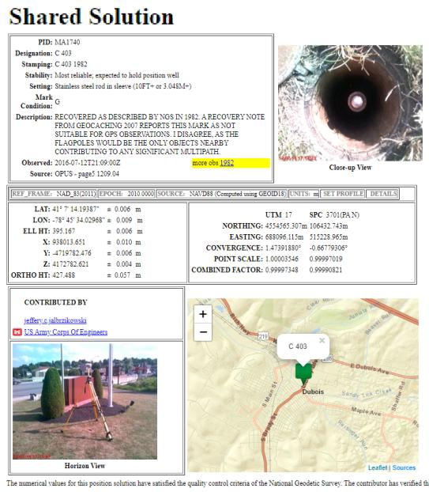
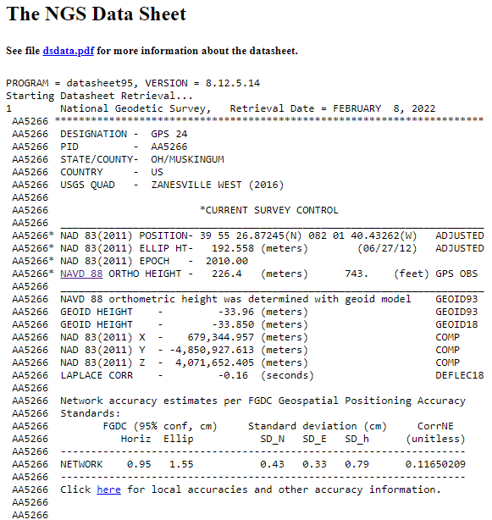
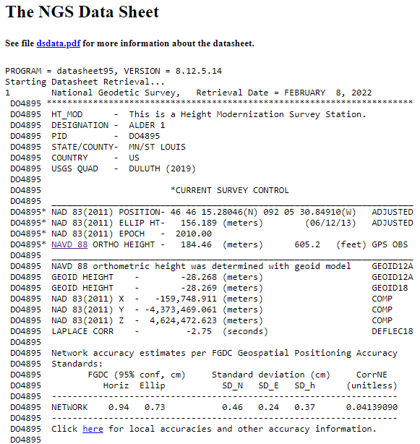
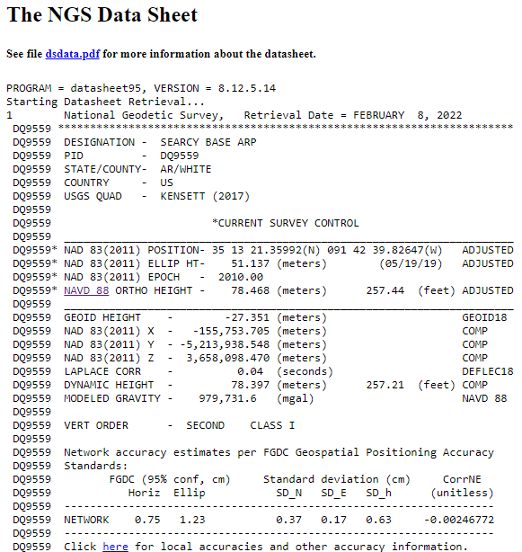
OPUS Shared vs. OPUS Projects
 | OPUS Shared | OPUS Projects (RINEX) | OPUS Projects (GVX)
Minimum Occupations | 4 hours At least 1, maybe 2* | 2 hours At least 2 | 5 minutes At least 3
Processing | OPUS-S (sequential) | PAGES (simultaneous) | Real Time (RTN/NRTK)
Adjustment | None | Least Squares Network | Least Squares Network
Metadata | 2 photos Brief Description | 3 photos, WinDesc files, Logs, & Report | 3 photos, WinDesc files, Logs, & Report
*Need 2 or more GPS datasets in our database, existing data holdings count toward that.

Slide 49

additional Resources
Notes:
This presentation is intended to raise awareness about the upcoming changes and what they mean for floodplain mapping, but you probably have lots of remaining questions and we have a lot of resources online at our website
Please spread the word, and
make an effort to keep yourself and your colleagues informed.
Tell us what content is missing or how we can make it better!

Slide 50
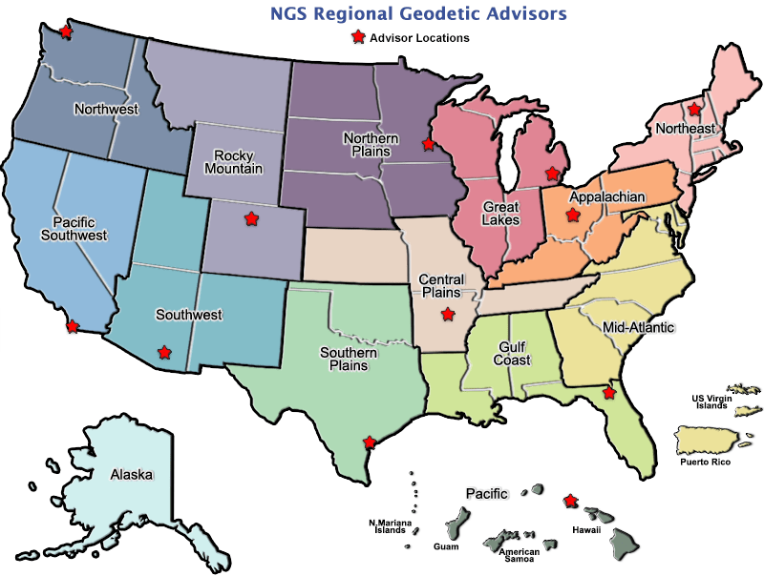
geodesy.noaa.gov/ADVISORS/
Notes:
-14 Regional Advisors, we’ve transitioned from a State-based to a Regional Program
-our advisors homepage up there at the top, also easy to find us by querying any major search engine for “ngs advisors”
-if you know Ross Mackay, he is our Chief Advisor, I report to him…
**ya know, I don’t know why they don’t make him put his photo up here
-we do have one vacant advisor position, that was recently advertised and John up there in Wisconsin is officially retired in oh… 18 days

Slide 51


Regional Geodetic Advisor Program
geodesy.noaa.gov/ADVISORS/
query any major search engine: “ngs advisors”
SCAN
QR CODE
TO EMAIL ME
Notes:
Transitioned from a State to a Regional program in 2016. States no longer provide funding if they desire to have an Advisor, but NGS reorganized the personnel to support regions rather than single States.
Kentucky has appointed a State Geodetic Coordinator

Slide 52

State Geodetic Coordinators
Not an NGS employee
Serves as a liaison between the State’s geospatial community and the NGS
Erik Baldwin over at Bluefield State College
Notes:
-The State Geodetic Coordinator is not employed by NGS and is typically assigned by a state government agency or university.
-Wes Virginia we’ve got Eric over at Bluefield --- contact info.

Slide 53
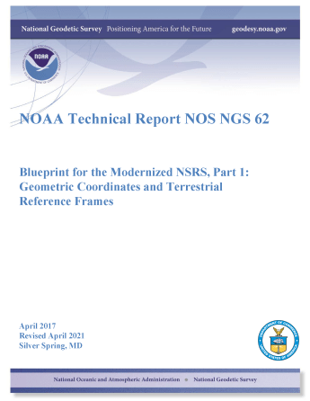
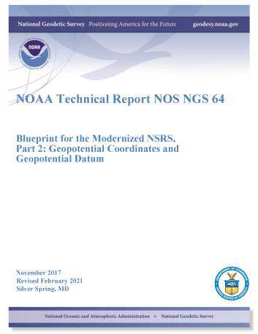
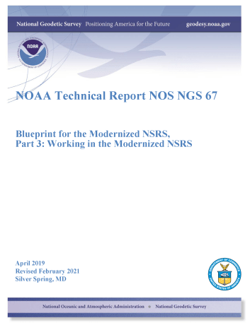
Blueprints for the Modernized NSRS
…your best source for information on modernization
All three were revised in 2021
Geometric
Sep 2017; Rev. Apr 2021
NOAA TR NOS NGS 62
Geopotential
Nov 2017; Rev. Feb 2021
NOAA TR NOS NGS 64
Working in the modernized NSRS
Apr 2019; Rev. Feb 2021
NOAA TR NOS NGS 67
Notes:
Here’s the front cover of the three blueprint documents, and know that for each given topic these are your best source for information on modernization.
They’ve been written by teams, reviewed, re-written, re-reviewed, and ...
CLICK
…all three will have been re-released, with new titles, in 2021. The revisions were to solidify some items originally called out as To Be Determined, and the rename was to make it clear that 2022 would no longer be the target date.
*Blueprint Part 1 re-release may nor may not have been published by the time of this webinar, but it will be soon. I’ll show you how to find these at the end of today’s webinar.

Slide 54
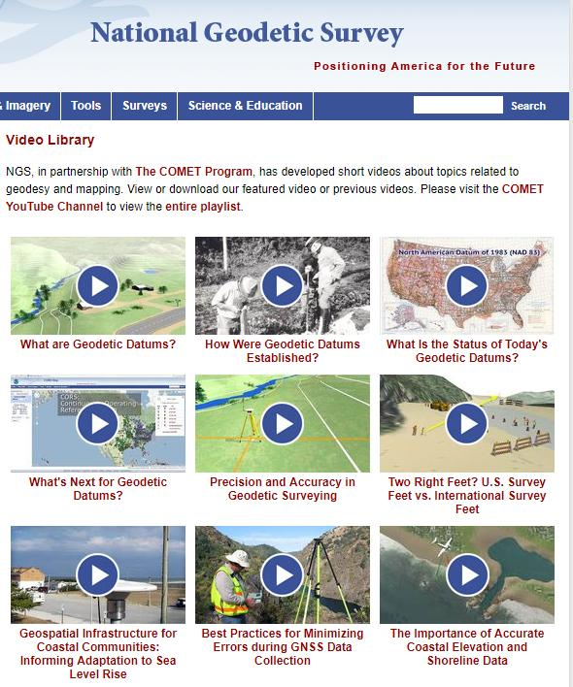

Resources at geodesy.noaa.gov
Educational Videos
<5 minutes
Online Lesson
(via MetEd/COMET)
~1 hour
Notes:
Educational videos and online tutorials –
Our library of lessons and videos are great resources, and will reinforce a lot of information we covered today.
The videos are just 3-5 minutes long.
the lesson is a deeper dive but still only takes an hour.

Slide 55
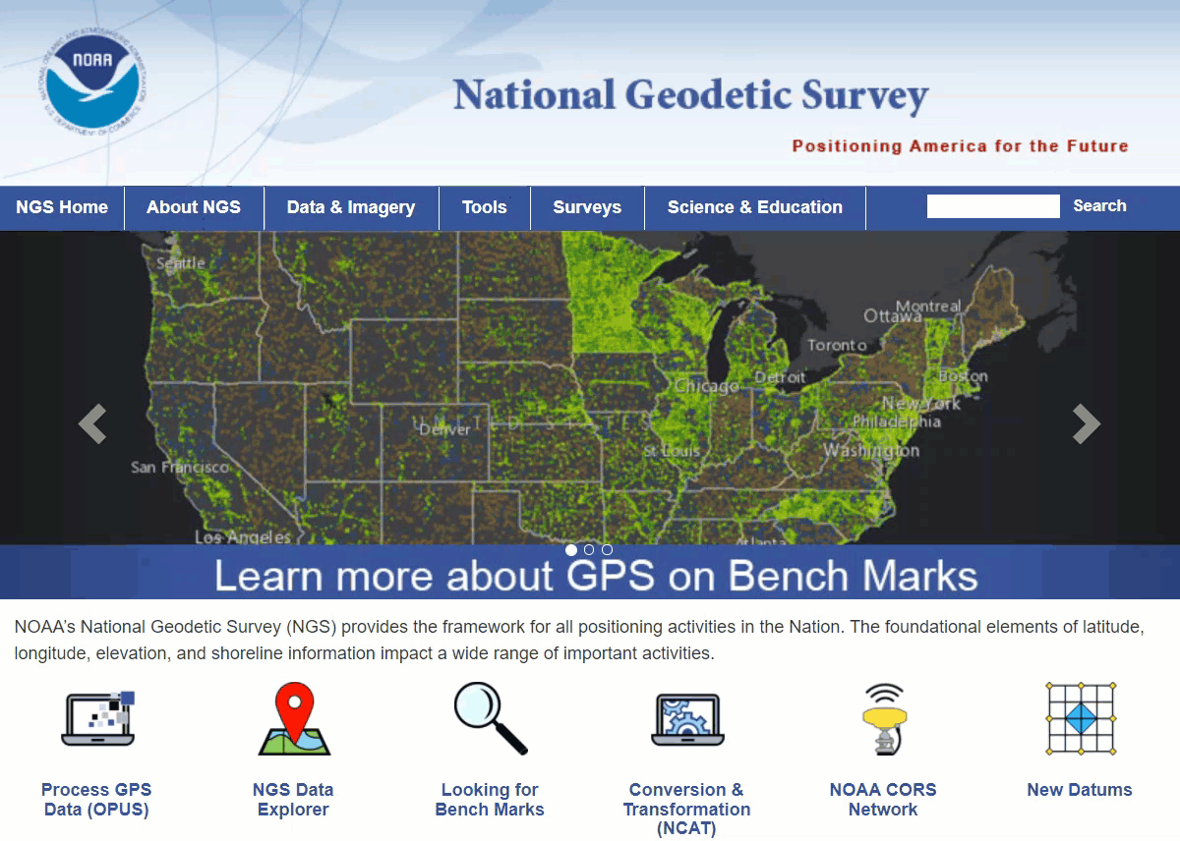
Educational Videos
<5 minutes
Online Lesson
(via MetEd/COMET)
~1 hour
NGS homepage: geodesy.noaa.gov
Notes:
Educational videos and online tutorials –
Our library of lessons and videos are great resources, and will reinforce a lot of information we covered today.
The videos are just 3-5 minutes long.
the lesson is a deeper dive but still only takes an hour.

Slide 56
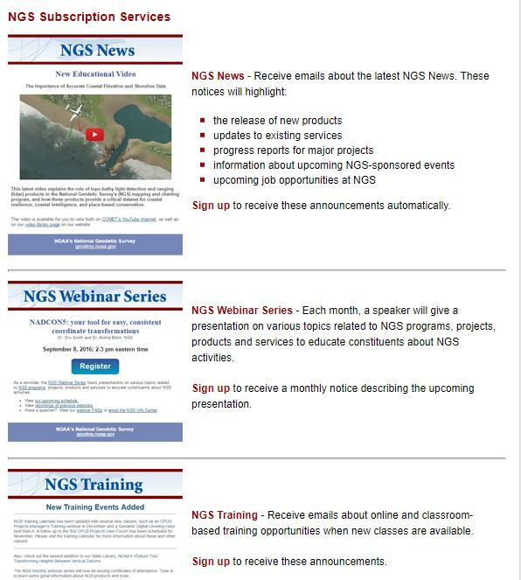

Email Subscriptions
*Only 1-2 messages per month*
NGS News
  Includes quarterly NSRS Modernization newsletter
Webinar Series
Training
GPS on Benchmarks
Click this icon on homepage
Notes:
Stay abreast of any new information coming from us via Email Subscription –
Sign up for notifications about News, webinars, and training opportunities with NGS.
We also use our News subscription list to send out our quarterly NSRS Modernization Newsletter.

Slide 57
Jeff Jalbrzikowski, P.S., GISP, CFS
Appalachian Regional Geodetic Advisor
jeff.jalbrzikowski@noaa.gov
240-988-5486
https://www.ngs.noaa.gov/ADVISORS/
use any major search engine: “NGS advisors”

