Slide 1
A Deep Dive into Geodetic Surveying Vertical Datums, Geoids, OPUS, NCAT, and more
WVSPS Annual Convention
February 2023
Jeff Jalbrzikowski, P.S., GISP, CFS
Appalachian Regional Geodetic Advisor
jeff.jalbrzikowski@noaa.gov
240-988-5486

Slide 2
We will do a few audience polls today.
To participate…
Or use the QR code

Slide 3
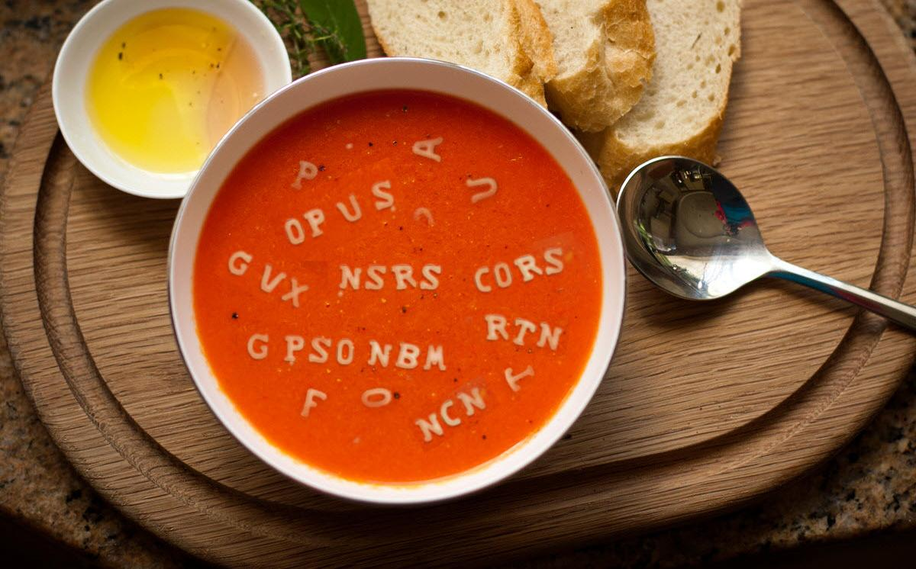

Slide 4
Organizational Structure
-Department of Commerce (DoC)
(~47,000 employees)
-National Oceanic and Atmospheric Administration (NOAA)
-National Ocean Service (NOS)
-National Geodetic Survey (NGS)
(~175 employees)
Notes:
-We are the Federal Government’s oldest scientific agency.
-part of the Executive Branch
-I know it can seem kind of strange that NGS is part of the NOS, but the origins of NGS lie with the C&GS.
-we are a “Program Office” of the NOS
Survey of the Coast – 1807
Coast Survey – 1836
Coast and Geodetic Survey – 1878
NGS since 1970

Slide 5
Organizational Structure
We’re not USGS, we’re NGS
-Department of Commerce (DoC)
(~47,000 employees)
-National Oceanic and Atmospheric Administration (NOAA)
-National Ocean Service (NOS)
-National Geodetic Survey (NGS)
(~175 employees)
≠
Notes:
-as you can read my slide, I like to point that out because over my 2 years at NGS I’ve seen and heard this misunderstanding quite a bit
-don’t worry! it doesn’t offend us! and we do work closely with USGS, but we are separate agencies within totally different departments of the federal government

Slide 6
NGS Mission
To define, maintain and provide access to the National Spatial Reference System (NSRS) to meet our Nation’s economic, social, and environmental needs.
Notes:
NGS develops and maintains the National Spatial Reference System, a national coordinate system that provides the foundation for transportation, navigation, land record systems, mapping and charting efforts, and a multitude of scientific and engineering applications.
But there are many ancillary programs and products we will also discuss.

Slide 7
Modernizing the NSRS means:
Updating all NSRS coordinates
Replace existing datums with new datums
Replacing existing State Plane with new State Plane
Accounting for coordinates changing with time
Improving NGS products and services
Simplifying customer contributions
Making the NSRS:
More accurate
More accessible
More efficient
Rollout in
2025
7

Slide 8
National Spatial Reference System (NSRS)
Geometric Geodesy
Physical Geodesy
Horizontal Datums
Geometric Reference Frames
Latitude & Longitude
Ellipsoid Height
State Plane Coordinates
Geopotential Datums
Orthometric Height
Dynamic Height
Surface Gravity
Leveling
To get to these “final products” we use a multitude of scientific methods, including Space Geodesy and Astronomical Geodesy.
And since we’re the Government… don’t forget Political Geodesy!
Notes:
All the facets of the NSRS fall into one of the two parts or fields of geodesy shown here.
CLICK
Geometric Geodesy
includes
Horizontal Datums
Geometric Reference Frames
Latitude & Longitude
Ellipsoid Height
State Plane Coordinates
or…..
CLICK
Physical Geodesy
Geopotential Datums
Orthometric Height
Dynamic Height
Surface Gravity
Leveling
And as we look at those together, it should be duly noted that to get to these final products we we use a multitude of scientific applications and methods, including Space Geodesy and Astronomical Geodesy.
CLICK
And since we’re the Government… don’t forget Political Geodesy!
We can’t accomplish what we do without funding, if the politicians see this science as a black box or have the “google earth” misconception… then

Slide 9
National Spatial Reference System (NSRS)
A consistent coordinate system that defines:
latitude
longitude
height
scale
orientation
gravity
throughout the United States.
…and their time variants
Notes:
Let’s talk about the NSRS some more before we move on to looking at all of NGS.
This system defines position (latitude, longitude, and elevation), distances and directions between points, strength and direction of gravity (no, it is not simply “straight down”), shoreline, and their “time variants”.
Or how these change over time.
Some documents will reference the National Shoreline as a component of the NSRS., we’ll briefly look at that later.

Slide 10
National Spatial Reference System (NSRS)
These items ARE part of the NSRS
Horizontal Datums (aka Geometric Reference Frames) | Vertical Datums | Great Lakes Datums | Geoid Models | Transformations and Conversions
NAD83 | NAVD88 | IGLD85 | GEOID18 | NADCON
NAD27 | NGVD29 | IGLD55 | GEOID12B | VERTCON
USSD | VIVD09 |  | GEOID09
 | GUVD04 |  | GEOID06 | SPCS83
 | NMVD03 |  | GEOID03 | SPCS27
 | ASVD02 |  | GEOID99
 | PRVD02 |  | GEOID96
 |  |  | ALASKA94
 |  |  | GEOID93
 |  |  | GEOID90
Notes:
Note the US Standard Datum, anyone done any work in the old USSD?
Good example highlighting that the term “NSRS” is used to encompass all historic datums of NGS and its predecessors.
Saw one project during my work with the USACE, in Johnstown, PA, that had original survey records in what turned out to be US Standard Datum.
All those vertical datums below NGVD29, I greyed them out slightly because those are all Caribbean and Pacific Island datums, so in CONUS it’s just those two that you hopefully already use… and hopefully are mostly using NAVD88.

Slide 11
National Spatial Reference System (NSRS)
These items are NOT part of the NSRS
Horizontal Datums (aka Geometric Reference Frames) | Vertical Datums | Geoid Models | Transformations and Conversions
WGS84 | IHRS (by IAG) | OSU91A | CORPSCON
WGS72 |  | EGM96 | Appendix B.6 of DMA TR 8350.2 (WGS 84)
ITRF (Intl. Terrestrial Reference Frame by IERS) |  | EGM2008 | Oregon Coordinate Reference System (ORCS)
IGS (Intl. GNSS Service reference frame) |  |  | The Kansas Regional Coordinate System
Hyperlink to ITRF station map
Notes:
WGS is a DoD system. Yes, that is the system native to the Global Positioning System, but it isn’t true that you “have to” work in WGS84 to get the most accurate coordinates. I’ve heard people say that.
The Intl. Terrestrial Ref. Frame is a product of the Intl. Earth Rotation and Reference Systems Service. More on that later.
The Intl. GNSS Service Ref. Frame is, well, it’s a reference frame based on that ITRF just mentioned, but with improvements, like a more dense network of stations and is more easily accessible.
The IHRS is an International Height Reference System, which is a product that was formally adopted by the IAG (Intl. Association of Geodesy) in 2015. Not an NGS product but folks from NGS were involved.
OSU geoid, it was a research thing and I don’t know much about it.
The Earth Gravity Models are DoD products just like the WGS products, used around the world by our Nation’s military (I used EGM based height sin Iraq and Afghanistan)… but are not at all tied to NSRS geoids. Future DoD geoid models may have a closer tie to future NGS geoid models.
CorpsCon. Ah yes, Corpscon. Everyone loves Corpscon, unfortunately as convenient as it is it isn’t truly an NGS product and has not been updated in well, a long time, and there are no plans to update it in the future. (confirmed via phone call to AGC personnel on 20FEB2019)
I like Mark Huber, awesome dude, I spent some time with him surveying on some god-forsaken island in the Indian Ocean, but the USACE doesn’t seem to want to support him in funding an update to Corpscon. So it is what it is.
Those regional coordinates systems, like the ORCS in Oregon and that one in Kansas, although they have rigorously defined transformations to the NSRS (which is great, they did it right) they are not part of the NSRS.

Slide 12
NSRS … do I have to use it?
Not necessarily, but it’s a great idea!
States may mandate use of NSRS
All Federal spatial data and GIS activities financed directly or indirectly, in whole or in part, by Federal funds are required to be tied to the NSRS
If you want to get involved in contracted work with the Federal Government it’s a necessity
Notes:
-We give you efficient ways to check the accuracy of GNSS surveys, via the CORS and OPUS.
-but we’re not the datum police!
-Aerial imagery overlays, doesn’t it make you feel good when a topo lines up pretty well with statewide imagery & lidar?
- all the FEMA/USGS/NRCS 3DEP lidar, all that data will be out there in SPCS, tied to the NSRS via GPS tied to multiple CORS
CLICK
-interesting tidbit I picked up from a meeting on Friday: for anyone who’s been paying attention to the politics & bureaucracy of government geospatial efforts, the Geospatial Data Act of 2018 includes provisions for “repercussions” for agencies who do not comply with this requirement
**-important though that will not be enforced until 5 years after the GDA, so late 2023
PREPARE NOW!

Slide 13
The US Survey Foot is dead!
Long live the US Survey Foot!
US Survey Foot is officially deprecated
As of 31 December 2022
So now what do we do?
Nothing!
Do not change anything you do until you are working in the new datums.
Notes:
It’s likely everyone watching this webinar knows about the problem: there are two nearly identical versions of the foot in current use in the U.S.;
They differ by 2 parts per million (ppm), or only 0.01 ft per mile, or slightly more than a tenth of an inch in a mile.
Despite (or actually because of) the very small difference, it has become a REAL problem with REAL costs.
What’s in a name? That which we call a “foot” by any other word would smell as… sweet? Maybe that’s not he best analogy for the foot…
“U.S. survey foot” sounds patriotic, is surveyor-centric…
“International foot” sounds like a New World Order, UN sanctioned sort of thing, with perhaps a whiff of socialism…
Is the name really part of the problem? I hope not, but emotion does play a role. We are not entirely rational creatures after all (myself included).
Surveyors are really the only users of the U.S. survey foot (sft). They are also among the very few who even know of its existence. In schools and colleges they only teach students about the official international foot (ift). However, because people use the products created by surveyors, they end up using the sft without even knowing it.
Want to have a conversation about this, get all of us on the same page. So I will present facts to facilitate informed discussion (sprinkled with some opinions…)

Slide 14
What’s impacted?
When does this matter?
Not typically in lengths/distances
Published planar coordinate systems
Why? → large false eastings and northings
Like what?
SPCS and UTM are very popular and both fall victim to mix-ups
due to… the large false E/N in their zones
Notes:
It’s likely everyone watching this webinar knows about the problem: there are two nearly identical versions of the foot in current use in the U.S.;
They differ by 2 parts per million (ppm), or only 0.01 ft per mile, or slightly more than a tenth of an inch in a mile.
Despite (or actually because of) the very small difference, it has become a REAL problem with REAL costs.
What’s in a name? That which we call a “foot” by any other word would smell as… sweet? Maybe that’s not he best analogy for the foot…
“U.S. survey foot” sounds patriotic, is surveyor-centric…
“International foot” sounds like a New World Order, UN sanctioned sort of thing, with perhaps a whiff of socialism…
Is the name really part of the problem? I hope not, but emotion does play a role. We are not entirely rational creatures after all (myself included).
Surveyors are really the only users of the U.S. survey foot (sft). They are also among the very few who even know of its existence. In schools and colleges they only teach students about the official international foot (ift). However, because people use the products created by surveyors, they end up using the sft without even knowing it.
Want to have a conversation about this, get all of us on the same page. So I will present facts to facilitate informed discussion (sprinkled with some opinions…)

Slide 15
2 parts per million (ppm)?
1,000,000.00 sft = 999,998.00 ift
10,000,000.00 sft = 9,999,980.00 ift
1,000.00 sft = 999.998 ift (can you measure that?)
International → 1 ft = .3048 m
US → 1 ft = .30480061 m (approx.)
approx 0.02 ft in about 2 miles
Notes:
It’s likely everyone watching this webinar knows about the problem: there are two nearly identical versions of the foot in current use in the U.S.;
They differ by 2 parts per million (ppm), or only 0.01 ft per mile, or slightly more than a tenth of an inch in a mile.
Despite (or actually because of) the very small difference, it has become a REAL problem with REAL costs.
What’s in a name? That which we call a “foot” by any other word would smell as… sweet? Maybe that’s not he best analogy for the foot…
“U.S. survey foot” sounds patriotic, is surveyor-centric…
“International foot” sounds like a New World Order, UN sanctioned sort of thing, with perhaps a whiff of socialism…
Is the name really part of the problem? I hope not, but emotion does play a role. We are not entirely rational creatures after all (myself included).
Surveyors are really the only users of the U.S. survey foot (sft). They are also among the very few who even know of its existence. In schools and colleges they only teach students about the official international foot (ift). However, because people use the products created by surveyors, they end up using the sft without even knowing it.
Want to have a conversation about this, get all of us on the same page. So I will present facts to facilitate informed discussion (sprinkled with some opinions…)

Slide 16
US Survey Foot is officially deprecated
As of 31 December 2022
So now what do we do?
Nothing!
Do not change anything you do until you are working in the new datums.
Notes:
It’s likely everyone watching this webinar knows about the problem: there are two nearly identical versions of the foot in current use in the U.S.;
They differ by 2 parts per million (ppm), or only 0.01 ft per mile, or slightly more than a tenth of an inch in a mile.
Despite (or actually because of) the very small difference, it has become a REAL problem with REAL costs.
What’s in a name? That which we call a “foot” by any other word would smell as… sweet? Maybe that’s not he best analogy for the foot…
“U.S. survey foot” sounds patriotic, is surveyor-centric…
“International foot” sounds like a New World Order, UN sanctioned sort of thing, with perhaps a whiff of socialism…
Is the name really part of the problem? I hope not, but emotion does play a role. We are not entirely rational creatures after all (myself included).
Surveyors are really the only users of the U.S. survey foot (sft). They are also among the very few who even know of its existence. In schools and colleges they only teach students about the official international foot (ift). However, because people use the products created by surveyors, they end up using the sft without even knowing it.
Want to have a conversation about this, get all of us on the same page. So I will present facts to facilitate informed discussion (sprinkled with some opinions…)

Slide 17
Terminology - Changing Coordinates
Conversion
change the type of coordinate
eNAD83(2011) latitude & longitude → NAD83(2011) SPCS
Transformation
change the datum of coordinate
NGVD29 height → NAVD88 height
NAD 27 latitude & longitude → NAD 83(2011) latitude & longitude
Propagation
change the epoch of coordinate
NAPGD2022 epoch 2020.00 to NAPGD2022 epoch 2087.2570
NATRF2022 epoch 2020.00 to NATRF2022 epoch 2023.243
Notes:
Historically NGS has been inconsistent with these top two words.
Going forward, we will use them as:
Conversion: Meaning to change the type of coordinate without changing the datum or frame
e.g. change NAD 83(1986) latitude and longitude to NAD 83(1986) State Plane Coordinates
Transformation: Meaning to change the datum or frame, without changing the type of coordinate
e.g. changing an NAD 27 latitude & longitude to an NAD 83(1986) latitude & longitude
So, “NADCON” which transforms coordinates between datums could have been called “NADTRAN.” C’est la vie.

Slide 18
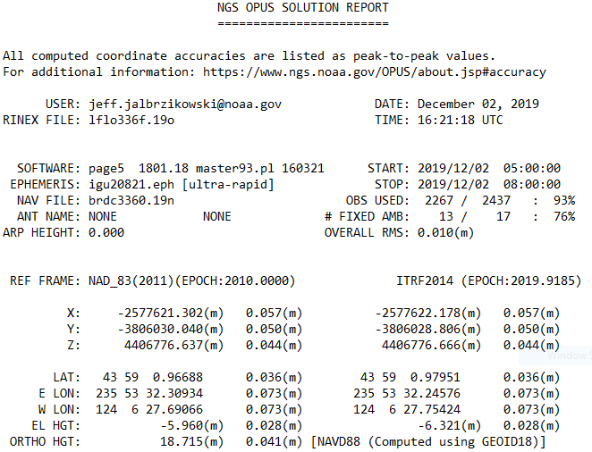
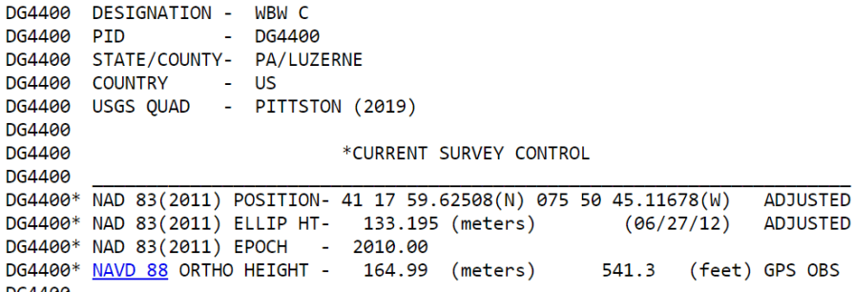
Terminology – Time/4D
Epoch
eh-puck? ee-pock? … to-may-to, to-mah-to
an instant of time
astronomy & geodesy use a decimal date
2021.4762 = 23 June 2021
doesn’t have to be!
using epochs is important, not format
It doesn’t have to be in decimal years… just start assigning dates to your data
Here above we’re looking at a
Transformation and Propagation
Transform from ITRF2014 to NAD83(2011)
Propagate from survey epoch 2019.9185 to reference epoch 2010.0000
Notes:
-Where do you see an Epoch right now in NGS data?
CLICK
Datasheets! there you see the epoch of 2010.0
and of course OPUS Solution Reports!
note that in blue over there on the right you’ll see another epoch, in the ITRF, which I will explain later on

Slide 19
NGS Coordinate Conversion And Transformation Tool (NCAT)
Notes:
NCAT includes the functionality of previous NGS tools:
NADCON 5.0
XYZWIN 2.0
UTMS 2.1
SPC83 2.1
USNG 2.3
Includes error estimate of transformation per point.
Available as the single-point graphic seen here, multi-point upload/download, as a downloadable executable fie to run from the DOS prompt, and as web services for inclusion in your own
It’s a great tool. Anyone using

Slide 20
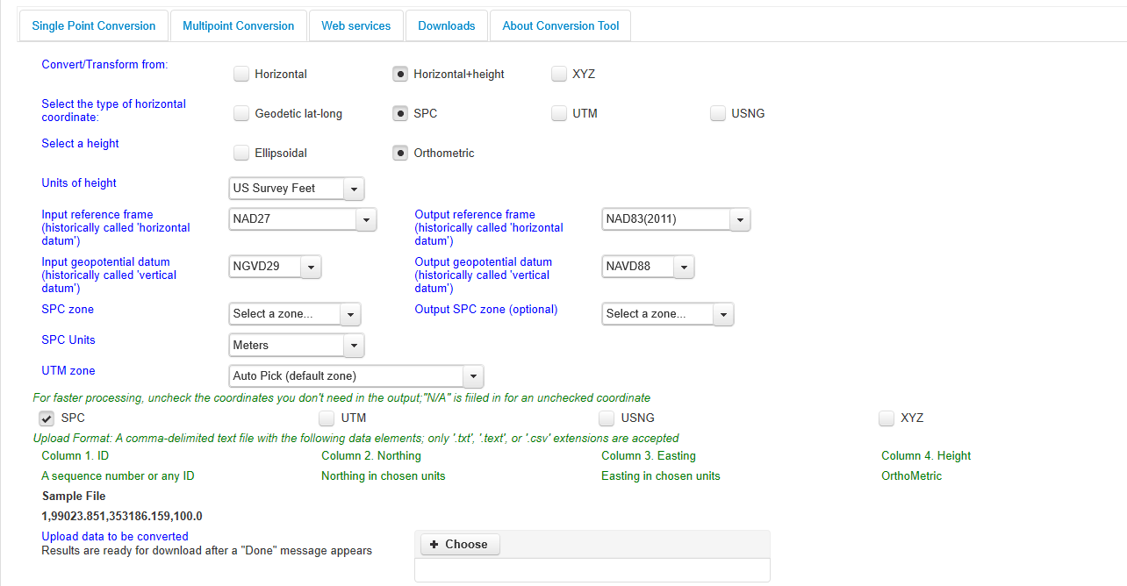
NGS Coordinate Conversion And Transformation Tool (NCAT)
Notes:
NCAT includes the functionality of previous NGS tools:
NADCON 5.0
XYZWIN 2.0
UTMS 2.1
SPC83 2.1
USNG 2.3
Includes error estimate of transformation per point.
Available as the single-point graphic seen here, multi-point upload/download, as a downloadable executable fie to run from the DOS prompt, and as web services for inclusion in your own
It’s a great tool. Anyone using

Slide 21
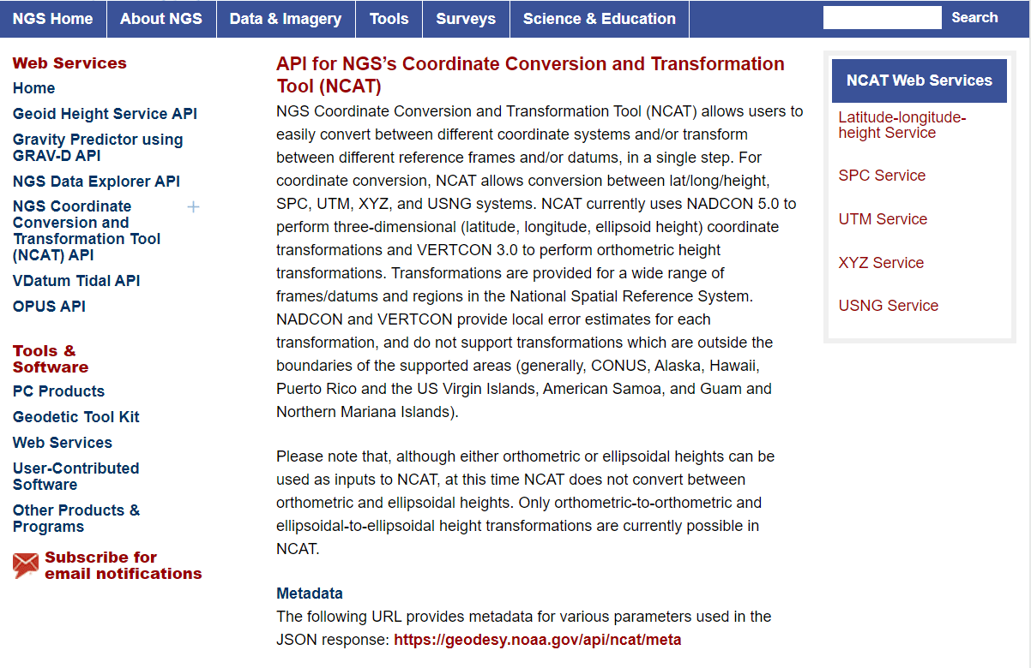
NCAT is available via web services

Slide 22
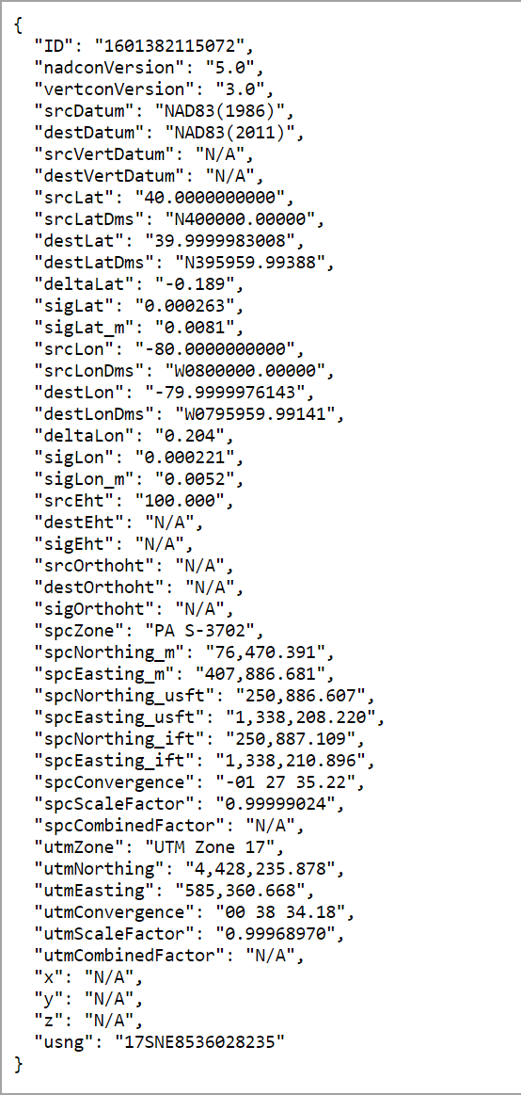
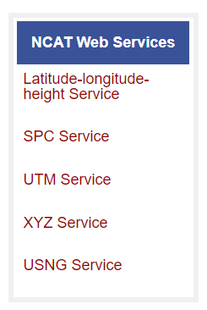
NCAT is available via web services
Note that each operation is a separate service
Struggling?
Contact us.
We can help!

Slide 23
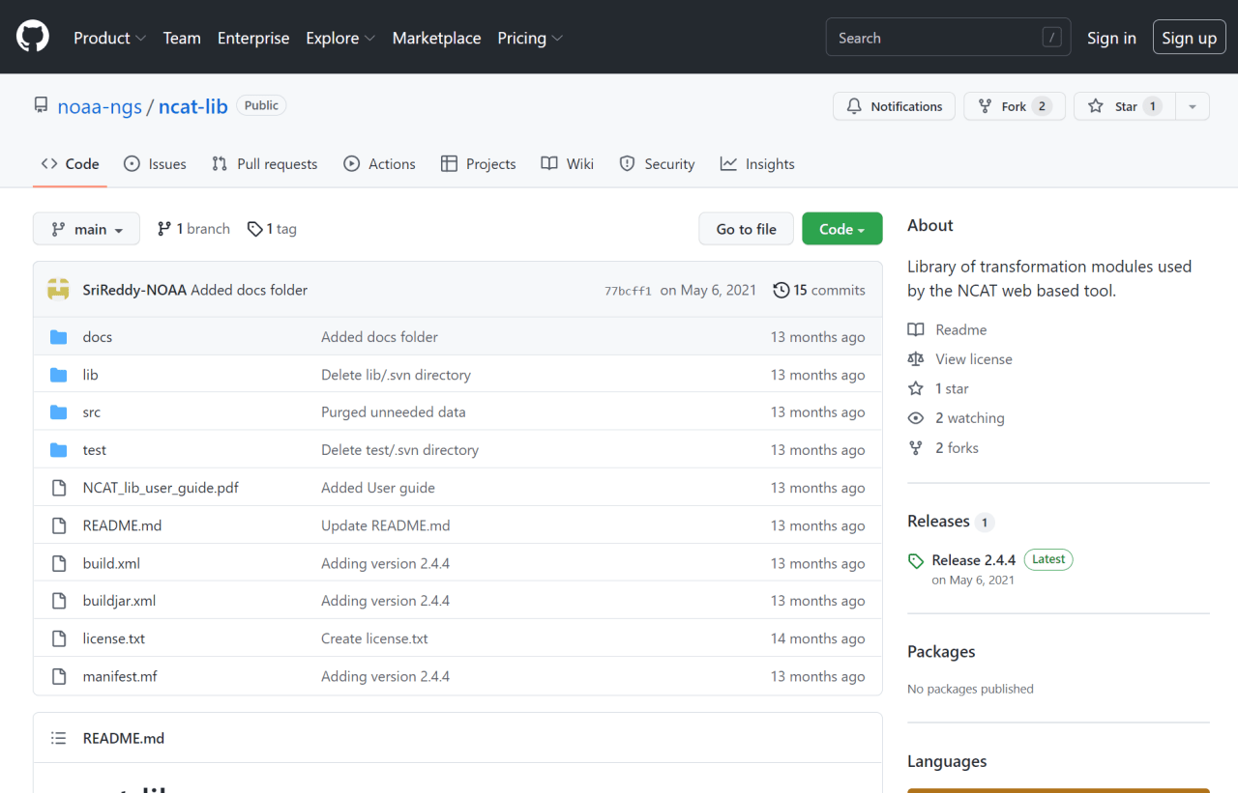
NCAT source code is on GitHub

Slide 24
NGS Coordinate Conversion and Transformation Tool (NCAT)
NGVD29
Please… don’t continue to use NGS VERTCON or USACE CorpsCon
transformation
transformation
NAVD88
NAPGD2022
transformation
NCAT is a container for newest version of VERTCON
It will be upgraded to include NAPGD2022
Notes:
NCAT incorporates the functionality of the old software VERTCON to transform NSRS heights.
NCAT is a container for newest version of VERTCON (v3.0)
It will be upgraded, after the release of the new datums, to include NAPGD2022

Slide 25
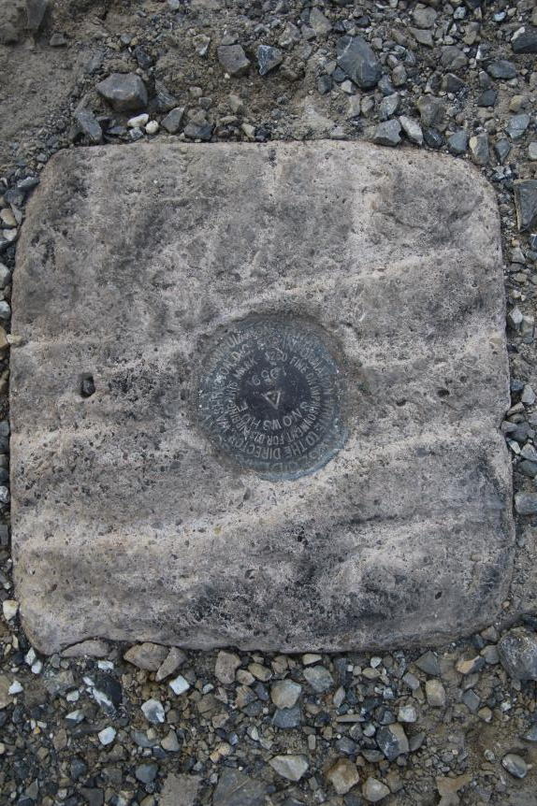
Passive Control
Geodetic Control – Terminology
All marks are passive—they sit there and hold a point
Notes:
All marks are passive!—in that they sit there doing nothing in and of themselves besides holding a point
This includes the fixed antenna mount that is a part of a CORS.
But, some marks have permanently installed equipment that enable nearly continuous observations and these are called “active” stations.

Slide 26
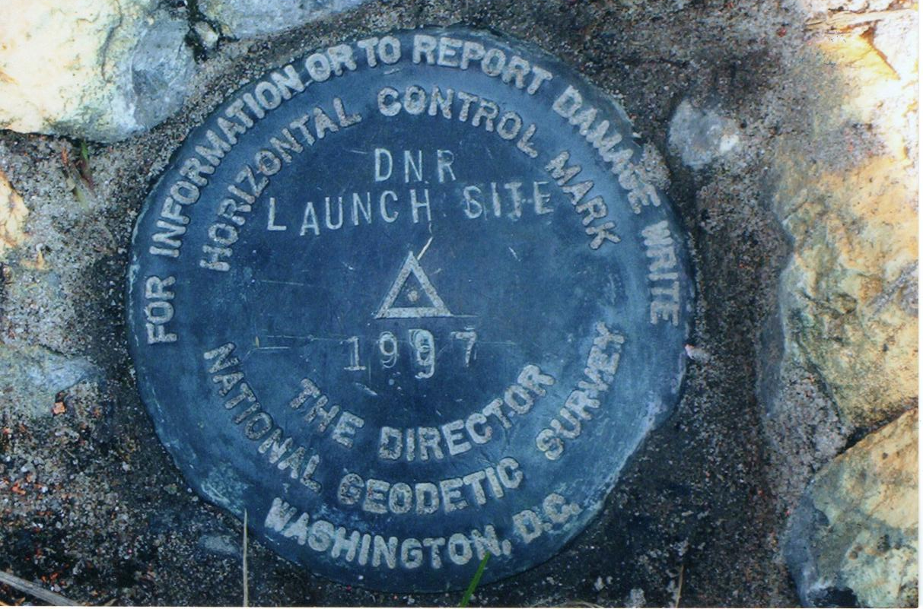
Passive Control

Slide 27
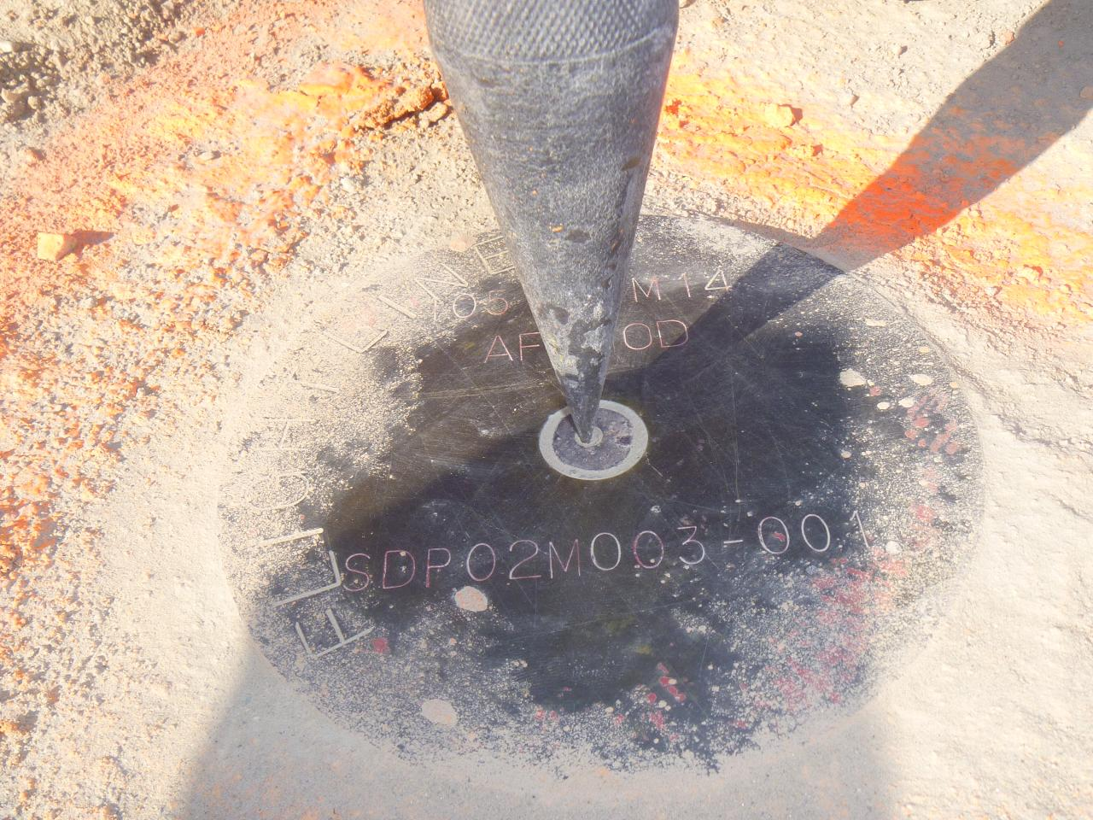
Terminology - Passive Control

Slide 28
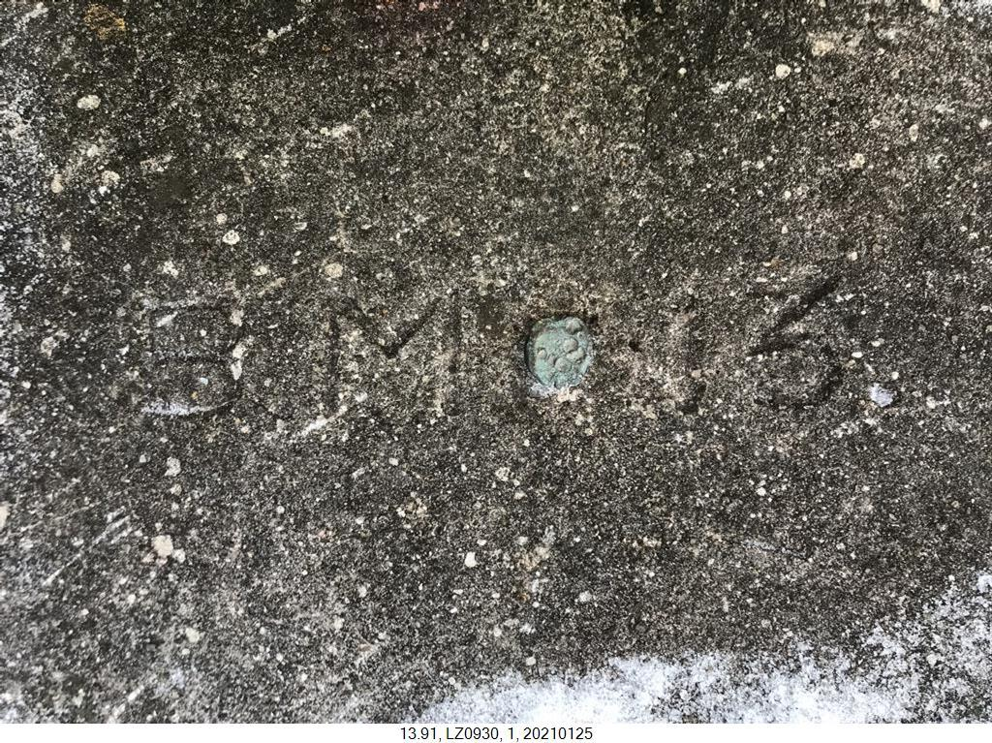
Terminology - Passive Control

Slide 29
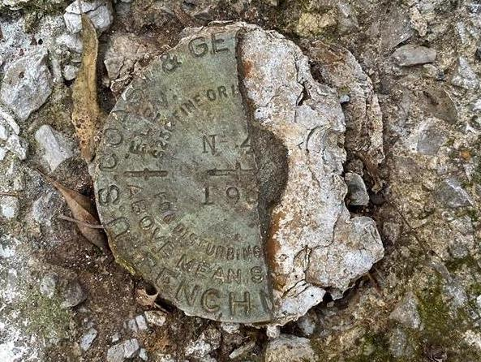
Terminology - Passive Control
Notes:
KW0392 –
https://www.ngs.noaa.gov/cgi-bin/ds_mark.prl?PidBox=KW0392
COLUMBIA COUNTY, PA, NEAR READING COMPANY REAILROAD STATION

Slide 30
Notes:
KR1724 - https://www.ngs.noaa.gov/cgi-bin/ds_mark.prl?PidBox=kr1724
Set 1946 → Washoe County, NV, about 4 miles southwest of Reno
Recovery 1958 → THE STATION MARK WILL BE PRESERVED BY MR. GARCIA, AND WILL BE IN THE CENTER OF HIS LIVING ROOM. - -> BUILT AS A BROKEN WAGON WHEEL WITH THE TRIANGULATION STATION THE HUB THERE-OF.
A STANDARD DISK STAMPED WHEELER 1946, 1958 IS BEING PROVIDED MR. GARCIA, TO PLACE IN THE FLOOR.

Slide 31
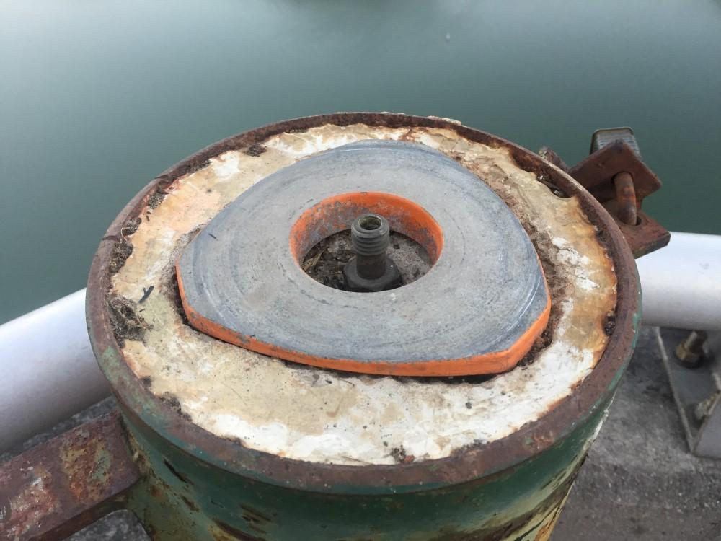
Terminology - Passive Control

Slide 32
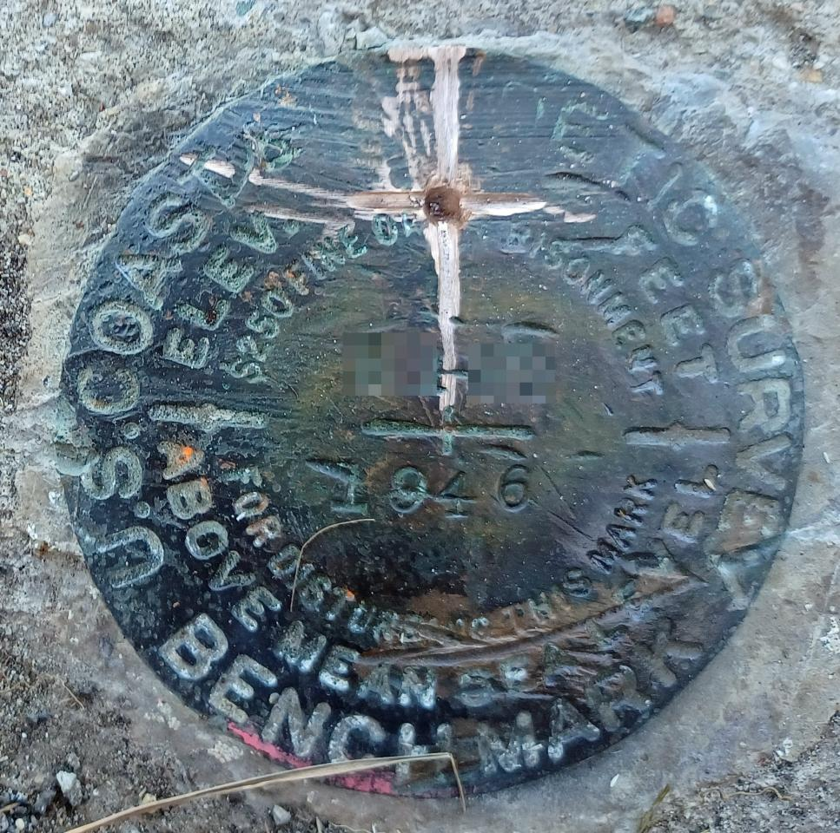
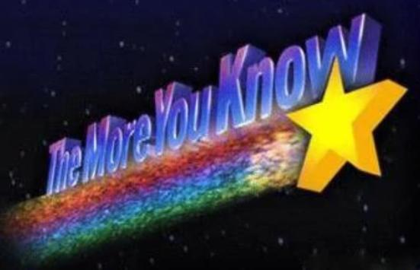
Please … do not add a new dimple

Slide 33
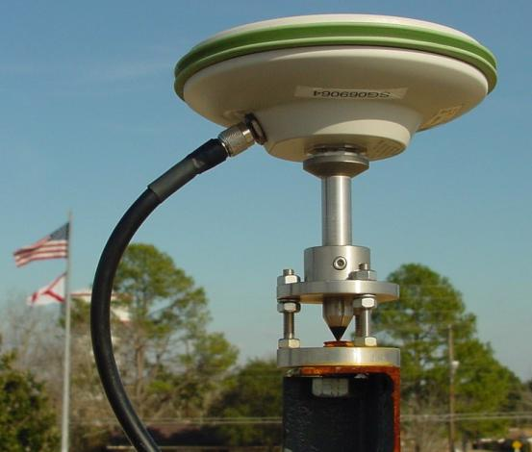
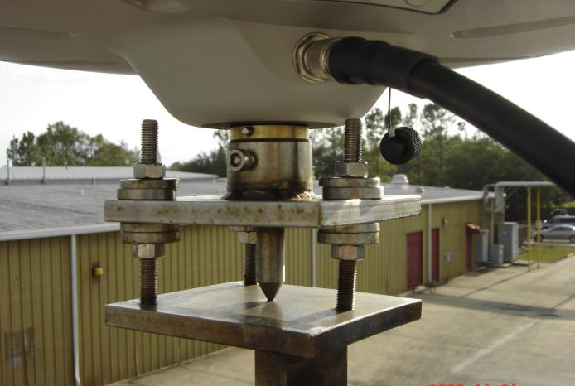
Active Control
Geodetic Control – Terminology
Some marks have permanently installed equipment (e.g. CORS) that enables continuous observations
But they still sit there and hold a point…
Notes:
All marks are passive!—in that they sit there doing nothing in and of themselves besides holding a point
This includes the fixed antenna mount that is a part of a CORS.
But, some marks have permanently installed equipment that enable nearly continuous observations and these are called “active” stations.

Slide 34
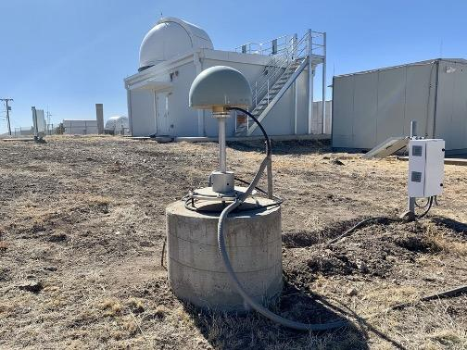
Active Control

Slide 35
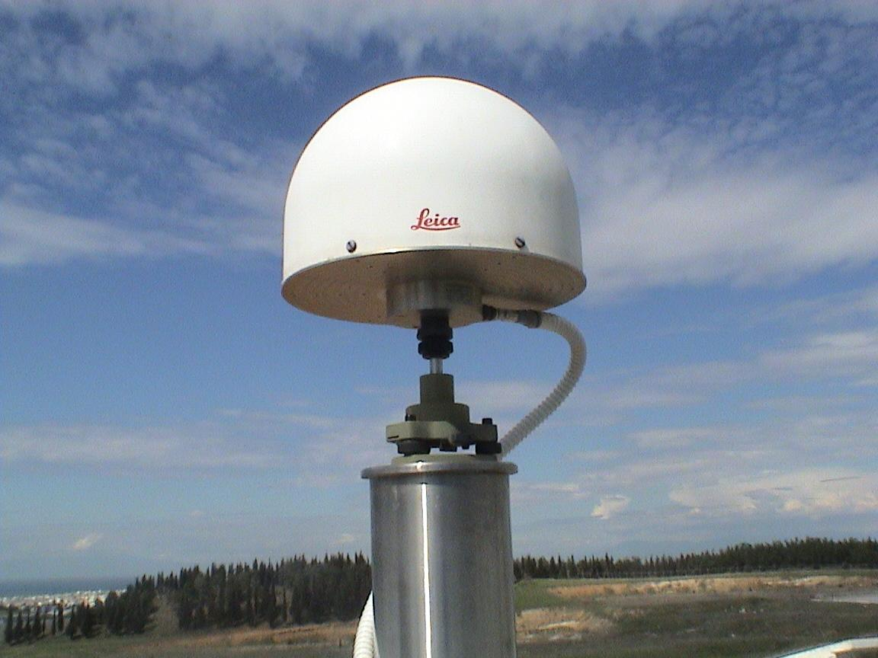
Active Control

Slide 36
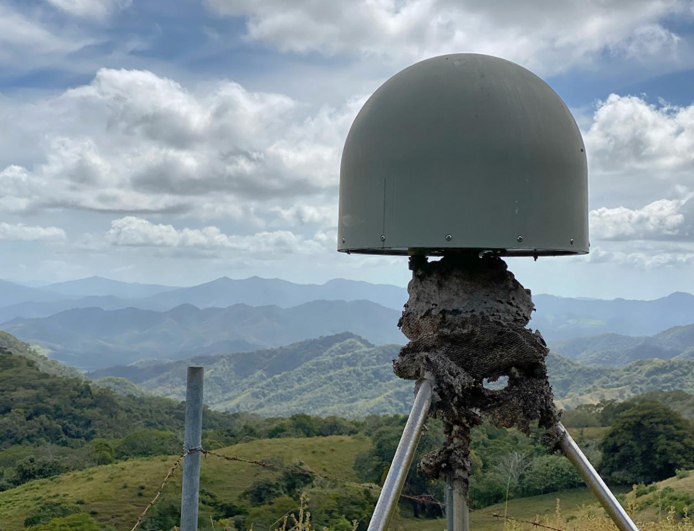
Active Control
Active Control

Slide 37
Active vs. Passive Control
Geodetic Control – Terminology
Passive – some sort of mark with a defined point
Active – some equipment continuously collecting observations on a point
In the modernized NSRS, our emphasis will be to provide accurate coordinates on Active Control… so that you can go out and set your own Passive Control
My point: surveying is still surveying
Notes:
Often the term active geodetic control has been used to mean some equipment is continuously or at least frequently collecting observations at or near a point
Yet those observations are often used to compute coordinates (often time-dependent) at a point on a mark, which, by its nature is passive

Slide 38
CORS
Active Control
Continuously Operating Reference Station
GNSS ANTENNA
RECEIVER
POWER
DATA STORAGE
COMMUNICATIONS
Notes:
Note that the whole pillar could be considered a type of “mark”, being a passive do-nothing structure that holds a “point”, the GRP of this CORS.
But the point, given coordinates computed from all the data collected by that antenna, is probably in here somewhere, as a part of this huge pillar which is effectively one big mark, passive as can be….

Slide 39
NOAA CORS Network (NCN)
1695 sites
241 organizations
Notes:
-I would like to point out we have a new, official name for the network you see represented on this map,
-The NOAA CORS Network, or NCN
CLICK
-this is neat little graphic with some stats on teh NCN you can find on our website
-below the gaphic youll find a search bar with more information

Slide 40
CORS Networks
Global = International GNSS Service (IGS) Network
The world standard since mid-1990s
Supported by IGS Analysis Centers (ACs) → NGS is 1 of 7
Overall system sponsored by NASA
NSRS = NOAA CORS Network (NCN)
NGS processes/distributes data, but few are NGS-operated
Currently semi-coupled to the IGS Network
Regional = WVDOT Real Time Network (WVRTN)
Most regional CORS networks are also RTNs
Log data, but also deliver corrections to users like you all
Note that not all RTNs use “VRS” method
Currently semi-coupled to the NCN
Notes:
Global: International GNSS Service (IGS) Network
The international standard since mid-1990s
Supported by IGS Analysis Centers (ACs) → NGS is one AC of seven total
Overall system sponsored by NASA
NSRS: NOAA CORS Network (NCN)
NGS processes/distributes data, but few are NGS-operated
Subset of NGS-operated CORS comprise the under construction NOAA Foundation CORS Network (NFCN)
Regional/State/Commonwealth/Local Networks
Real-Time Networks (RTN… aka “VRS”)
Currently semi-coupled to the NCN
NGS sees the future as a close coupling of other networks with the NCN so users can seamlessly and confidently work in the NSRS using their favorite regional/local CORS network

Slide 41
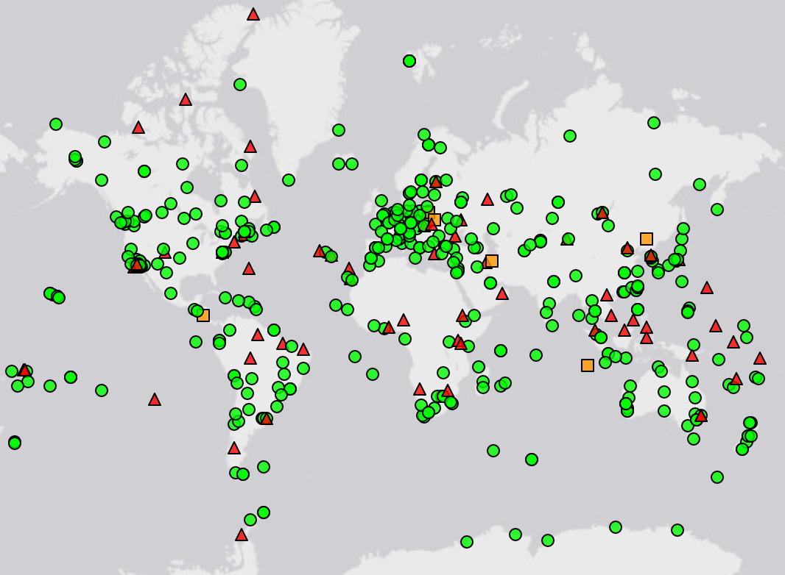
IGS Network
Source: https://www.igs.org/maps/#station-map
Notes:
There are several CORS Networks.
The Global Standard is the IGS Network
IGS = International GNSS Service
The NOAA CORS Network (NCN) which consists of:
The NOAA Foundation CORS Network (NFCN), a sub-network being installed, owned, and operated by NGS
and 2,000+ stations managed, but rarely owned by NGS
Other Regional/Local Networks (RTNs, etc.)
Currently semi-coupled to the NCN
NGS sees the future as a close coupling of these other networks with the NCN so users can seamlessly and confidently work in the NSRS using their favorite regional/local CORS network.

Slide 42
NOAA CORS Network (NCN)
Notes:
-I would like to point out we have a new, official name for the network you see represented on this map,
-The NOAA CORS Network, or NCN
CLICK
-this is neat little graphic with some stats on teh NCN you can find on our website
-below the gaphic youll find a search bar with more information

Slide 43
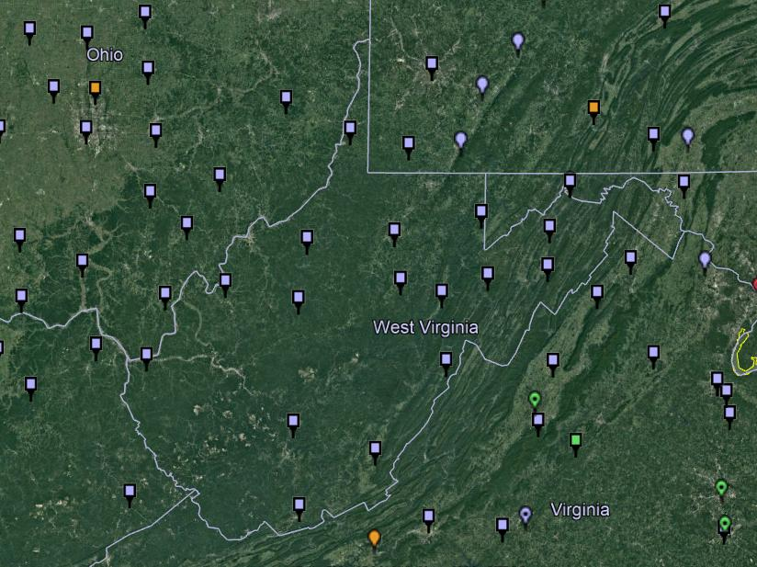
NOAA CORS Network (NCN) in WV

Slide 44
WVDOT CORS Network

Slide 45
NOAA CORS Network (NCN) in WV

Slide 46
WVDOT CORS Network
non-NCN CORS

Slide 47
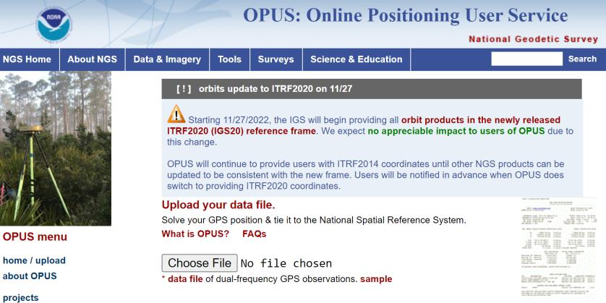
NGS Mission
To define, maintain and provide access to the National Spatial Reference System (NSRS) to meet our Nation’s economic, social, and environmental needs.
access… ? = traditionally → passive control (marks/disks/objects)
= modern and future → active control (NCN CORS)
via OPUS

Slide 48
International Terrestrial Reference Frame
(ITRF)
Is native coordinate system for NCN.
Is what OPUS uses.
Is what most of world uses.
Is what NGA aligns WGS-84 to.
Notes:
So what is that acronym, ITRF?
-it is a global reference frame, the most widely adopted one, or the “gold standard” or the “Cadillac” or what-have-you
-ITRF is the internationally recognized standard
-who realizes the ITRF? well, NGS contributes to the realization but
CLICK
-The IERS is in responsible charge of defining, realizing and promoting the ITRF
-and the ITRF was formally adopted by the…yes, more acronyms
CLICK
IUGG some years ago

Slide 49
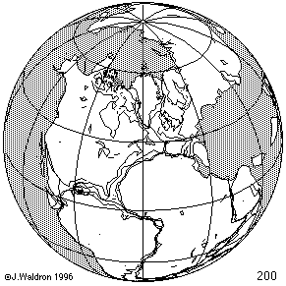
ITRF concept
Watch the grid!
Drift…
Epoch:
Notes:
Ok, now ITRF mentioned a couple slides ago.
Most simplistic way to explain ITRF is to watch this animation.
This is a very loose representation/visualization of what the ITRF is, a characterization only.

Slide 50
Euler Poles and “Plate-Fixed”
ITRF
Frame = constant
NA Plate = rotating
NATRF
Frame = rotating
(relative to ITRF)
NA Plate = constant
(relative to NATRF2022)
Notes:
We say “NATRF2022” is “fixed” to the N.A. Plate, making it a “plate fixed” frame
-the frame is constant to itself, but rotating within ITRF, and moving in a different direction than the other 3 frames

Slide 51
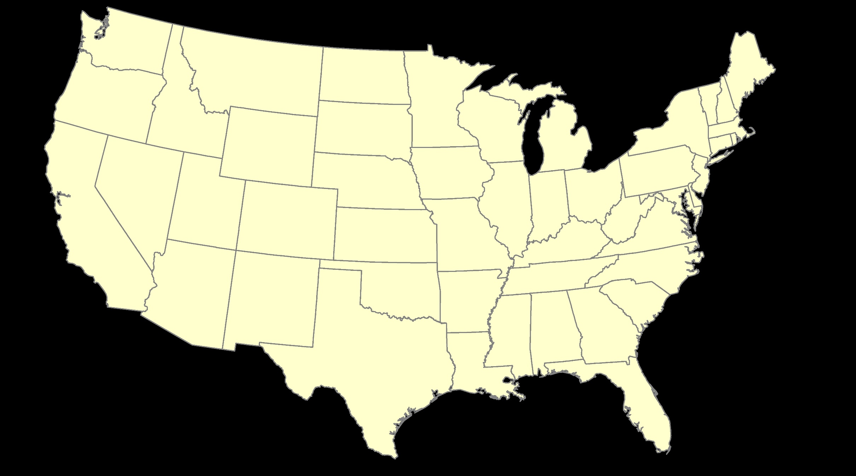
ITRF – constant frame, rotating plate

Slide 52
“Plate-Fixed”
NATRF – rotating frame, constant with plate

Slide 53
ITRF or NATRF – your choice, just use EPP

Slide 54
CORS
How?
We can use logged CORS data to propagate surveyed coordinates back in time to reference epochs.
Notes:
-so you’ve probably seen that phrase that I have front and center here, NSRS Modernization
-that’s the blanket term we use to refer to not just the new datums but other updates

Slide 55
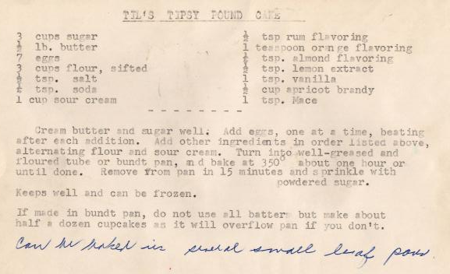
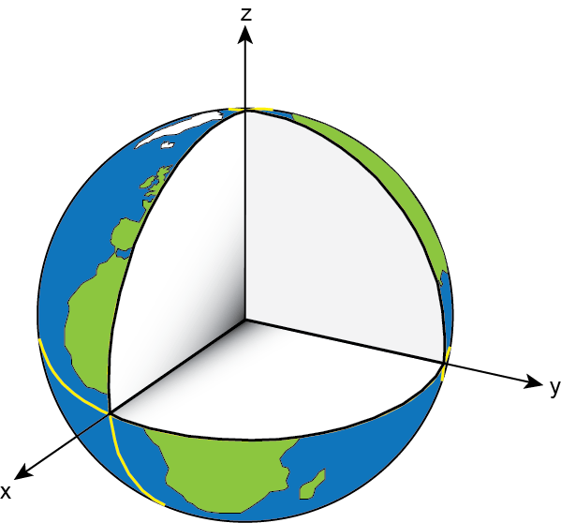
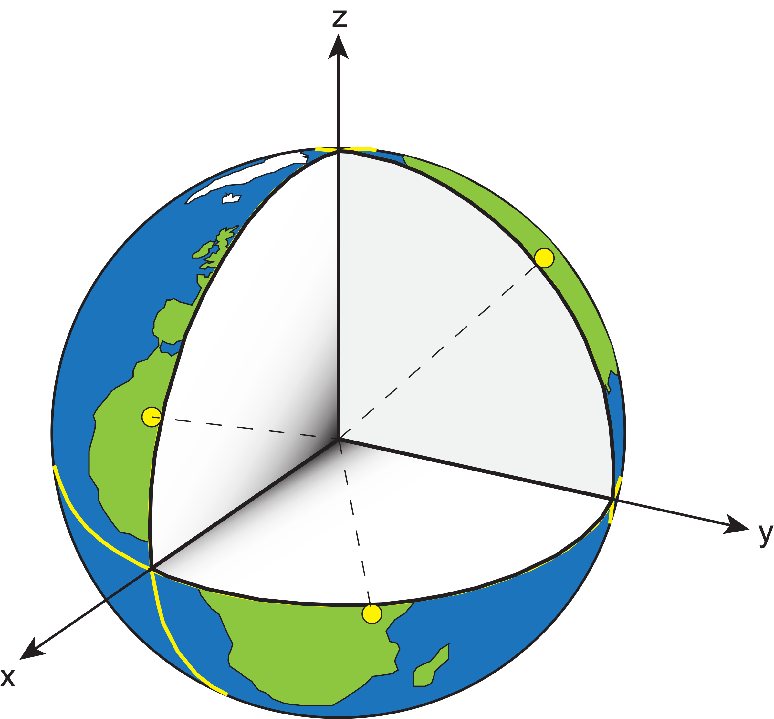
Reference System & Frame
Before you can realize a Reference Frame… you must define a Reference System
Reference System:
A set of prescriptions and conventions together with the modeling required to define a triad of coordinate axes¹
-the recipe
Reference Frame:
Realizes the system by means of coordinates of definite points that are accessible directly by occupation or observation¹
-the cake
= CORS
¹Springer Handbook of Global Navigation Satellite Systems, Ch. 2, p. 34
Notes:
An ITRS meets the following conditions: – Geocentric (origin is Earth centre of mass) – Uses the metre as the unit of length – Initial orientation given by BIH orientation at 1984 – The time evolution of the orientation is ensured by using a no-net rotation condition with regards to horizontal tectonic motions over the
whole earth.
• The ITRS is of very little use to the practitioner – we need a realisation (some coordinates)

Slide 56
Reference System & Frame
International Terrestrial Reference System (ITRS)
IERS’s recipe
International Terrestrial Reference Frame
Realized by the ITRF Network (the SGT stations)
True for any System and Frame
Not just the ITRF
Notes:
Global: International GNSS Service (IGS) Network
The international standard since mid-1990s
Supported by IGS Analysis Centers (ACs) → NGS is one AC of seven total
Overall system sponsored by NASA
NSRS: NOAA CORS Network (NCN)
NGS processes/distributes data, but few are NGS-operated
Subset of NGS-operated CORS comprise the under construction NOAA Foundation CORS Network (NFCN)
Regional/State/Commonwealth/Local Networks
Real-Time Networks (RTN… aka “VRS”)
Currently semi-coupled to the NCN
NGS sees the future as a close coupling of other networks with the NCN so users can seamlessly and confidently work in the NSRS using their favorite regional/local CORS network

Slide 57
Reference System & Frame
ITRF2020
GRS80 ellipsoid
NAD83
GRS = Geodetic Reference System
Notes:
-we’re going to back up and get to the non-egocentricity, stay with me here
-so there’s a nice little ellipse representing the shape of the GRS80 reference ellipsoid
CLICK
-what’s GRS80? well, it’s a reference system (being a reference ellipsoid, a gravity model, and more).
-GRS80 in itself is not a datum, although you will see/hear some folks misinterpret that
CLICK
-now once you take that reference system/ellipsoid and you tie it to the origin of your choice… badabing!
-now you’ve got a datum (or reference frame)
CLICK
-in this case, we’re talking about that blue which is symbolizing an ellipsoid with it’s origin locked to the Center Mass of the earth
-which represents the ITRF2020
-you may be thinking “jeff what is the ITRF?”… don’t worry we’ll get there for now the concept is more important
CLICK
-so now let’s look at how NAD83 compares, the orange there, see it’s shape is the same GRS80 ellipsoid… but with a different origin point
-not quite aligned to CM, but close… not bad, it was the 80s maaaan, they did the best they could!
-jokes aside, a pretty amazing feet to have only “missed the mark” by a few meters, they didn’t have the satellite technology or computer power we have back in the late 70s when the calcs for NAD83 were being run
-props to those folks!
CLICK

Slide 58
Reference System & Frame
ITRF2020
GRS80 ellipsoid
NAD83
Notes:
--zooming in to setup for next slide—
-Let’s zoom in a little to examine that situation

Slide 59
Update Center of Mass point of NAD83
Earth’s
Surface
h₁₄
h₈₃
NAD83
origin
ITRF2020
origin
~2.2 meters
GRS80
ellipsoid
Notes:
-so there’s one quarter of both the NAD83 and ITRF2020 ellipsoid
CLICK
-important to note that both are using the same geometry (size, shape), the GRS80 ellipsoid, just with a different origin
CLICK
-so that dark red [maroon if you will] arrow there on the bottom left, it symbolizes and greatly exaggerates the difference between those origins
CLICK

Slide 60
Update Center of Mass point of NAD83
Earth’s
Surface
h₂₂
NAD83
ITRF2020
NATRF2022
GRS80
ellipsoid
Shift…
Notes:
-and we’ll visualize the plan to remove the non-egocentricity of NAD83 with a little animation
CLICK
-our orange NAD83 ellipsoid shift over to match up with out blue ITRF ellipsoid
-and now there we see the result in red, our new NATRF2022 ellipsoid
CLICK
-what do I like to point out here?
-we’re still utilizing the GRS80 reference ellipsoid as the basis for NATRF2022
-why? because the size and shape, well the scientists nailed it on that one, like I said earlier they just didn’t quite get the CM
CLICK

Slide 61
Reference System & Frame
International Terrestrial Reference System (ITRS)
IERS’s recipe
International Terrestrial Reference Frame
Realized by the ITRF Network (the SGT stations)
True for any System and Frame
Not just the ITRF
National Spatial Reference System
NGS’s recipe
North American Terrestrial Reference Frame
Realized by the NOAA CORS Network
Accessible easily with GPS, by using OPUS
Notes:
Global: International GNSS Service (IGS) Network
The international standard since mid-1990s
Supported by IGS Analysis Centers (ACs) → NGS is one AC of seven total
Overall system sponsored by NASA
NSRS: NOAA CORS Network (NCN)
NGS processes/distributes data, but few are NGS-operated
Subset of NGS-operated CORS comprise the under construction NOAA Foundation CORS Network (NFCN)
Regional/State/Commonwealth/Local Networks
Real-Time Networks (RTN… aka “VRS”)
Currently semi-coupled to the NCN
NGS sees the future as a close coupling of other networks with the NCN so users can seamlessly and confidently work in the NSRS using their favorite regional/local CORS network

Slide 62
Online Positioning User Service
dual frequency receiver
static observations (via RINEX → ______.23o)
30 seconds epoch/logging rate aka recording interval
OPUS Rapid Static (OPUS-RS)
15 minutes to 2 hours of GPS data
OPUS Static (OPUS-S)
same requirements as above
2 to 48 hours of GPS data
OPUS Projects (OP) → also Beta OPUS Projects
adds session processing and network adjustment
training by NGS currently required (~12 hours)
Notes:
Currently 4 types of OPUS.
*OPUS only supports GPS constellation data, last I talked to the OPUS developer the plan for incorporation of other constellations is Jan 2021.
Rapid Static – files uploaded that are 15 minutes to 2 hours in duration are processed using an NGS software called “RSGPS”
Static - files that are 2 to 48 hours in duration are processed using an NGS software called PAGES Your coordinates are the average of three independent, single-baseline solutions,
OP and Beta OP - these are not a different processing software, just a way to tie multiple OPUS-Static solutions together and use least squares methods to adjust them all as a coherent network
**the Beta serves as a testing bed for the developers to roll out new features or improvements and get feedback from users

Slide 63
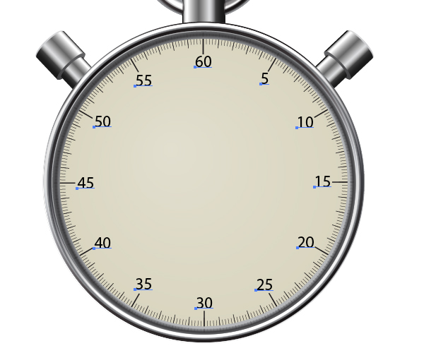
OPUS processes every 30s
20s decimates to 60s

Slide 64
OPUS only processes every 30s
You can upload 5s interval data
But OPUS will trim/decimate to 30s interval
And this may result in delays or error messages
You can even upload 1s interval data
But only shorter files, or OPUS kicks it back
Even if you’re running RTK…
You can setup your base to only log @ 30s rate
Know your equipment
For static, 30s yields good results
If using commercial software, maybe 15s

Slide 65
OPUS Rapid Static (OPUS-RS)
15 min to 2 hours
Computes atmospheric delay at up to 9 NCN CORS within 250km
Interpolates that delay to your position
Reports corrected position with standard deviation stats
5001
CORS
OPUS Solution
Notes:
-OPUS Static takes the best 3 of 5 baselines, sequentially processed, and provides you their peak-to-peak average
sidenote
-we delivered over 1.2 million solutions in 2021, compared to in 2011 when we first broke the 200,000 solutions milestone

Slide 66
OPUS Static (OPUS-S)
2 to 48 hours
Processes 5 vectors from NCN CORS, keeps best 3
Sequentially processed
Reports your peak-to-peak (P2P) average position
5001
5002
CORS
OPUS Solution
Notes:
-OPUS Static takes the best 3 of 5 baselines, sequentially processed, and provides you their peak-to-peak average
sidenote
-we delivered over 1.2 million solutions in 2021, compared to in 2011 when we first broke the 200,000 solutions milestone

Slide 67
OPUS Static (OPUS-S)
No correlation between your observed marks
Low Relative Accuracy
Even if … collected simultaneously
… and submitted to OPUS simultaneously
OPUS-S = independent solutions
5001
5002
CORS
OPUS Solution
Notes:
Point being… there is no correlation, or tie, between marks processed by OPUS Static

Slide 68
Distant CORS
~400-800 km
OPUS Projects (OP)
Simultaneous processing of your observed marks
Improved Relative Accuracy
Requires more preparations and office effort
OP = true network solutions
And of course, least squares adjustment
5001
5002
5003
5004
CORS
OPUS Solution

Slide 69
OPUS Projects (OP)
Simultaneous processing of your observed marks
Improved Relative Accuracy
Requires more preparations and office effort
OP = true network solutions
And of course, least squares adjustment
For years now, OPUS-S was the only entry point to OP
Recall that requires ≥2 hours static session
Even if NGS specs allowed <2hrs… OP didn’t support it
Now you have the ability to upload RTN, RTK, and sub-2hrs static
GNSS Vector eXchange (GVX) file format makes it possible
Currently still only in Beta OP
Development Team says → “matter of weeks” before rolled out

Slide 70
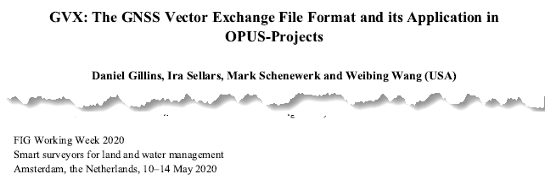
GNSS Vector eXchange (GVX)
Hyperlink to GVX Info Page
Detailed documentation, Schema, and Example File available
Any major search engine: “ngs gvx file format”
Open standard for anyone to use or integrate
GVX is sort of like… RINEX for RTK/RTN data
GVX details?
Check out:

Slide 71
GVX ≈ RINEX for RTK/RTN data
RINEX
GVX
Uncorrected Observations
That’s why we post-process them
Static Observations
One per file
Proprietary Format → Open Standard
Export RINEX using your COTS software
Metadata
Antenna, Rx, HI, Point Name, Start Time, SVs at each epoch
Based on ASCII Text File Format
Longtime industry standard
Way too many to list!
Corrected/Processed Positions
And Vectors used to create them
RTN, RTK, PP Static, even PPK
Many observations, any mix of above
Proprietary Format → Open Standard
Export GVX using your COTS software
Metadata - same as RINEX, plus…
Project Info, Solution Types, PDOP, Mount Points, Correlation Matrices, QC data
Based on XML File Format
Longtime industry standard
e.g. LandXML, JXL, MAXML, KML/KMZ

Slide 72
Status of GVX Exporters
…that we know of.
Available Now
Trimble Business Center (TBC) v5.60
Topcon MAGNET Software v7.2
Leica Infinity 4.0.0
Developers who have expressed interest to us
iGage
Carlson
Emlid
Available, but not fully functional
JAVAD J-field - onboard Triumph-LS device
Notes:
-Please note that this information here can only reflect what we know. If you are a developer working on incorporating GVX into your software… reach out to us! We would be happy to assist you, just as we have assisted some of our other commercial partners named here.
-What would make us happiest is if the list got so long we couldn’t fit in on this slide.
-Oh, and hey, you customers out there… express your desire for GVX to your suppliers/dealers or Support team

Slide 73
GVX in OPUS Projects
Why would I want to do this?
You can use it for GPSonBM right now.
Hyperlink to January 2023 webinar

Slide 74
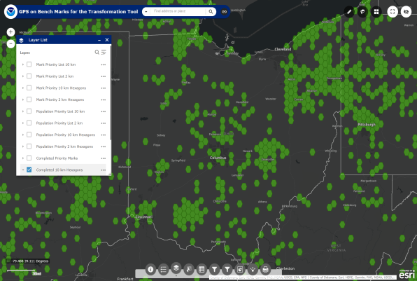
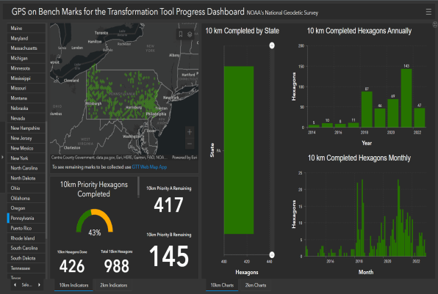
What’s the deal with GPSonBM?
Deadline = 30 September 2023
OPUS Shared Solutions
2 OPUS-Static, ≥4 hours each
2 photos of each setup
Brief Description w/Ties
Web Map Application
Progress Dashboard
The struggle is real.
“too much field time”
“we don’t do static”
“poor site, if only we had multi-GNSS”
Notes:
Note here that the Dashboard map is separate from the Web Map Application.
CLICK They are linked, but different tools.
If you got mixed up about this at some point, no worries, you were not the only one.
If we have had this process to submit GPSonBM for years now… why are we now putting out this option for OPUS Projects via GVX?
CLICK

Slide 75
What’s the deal with GPSonBM?
Important to note that GVX is a supplement to OPUS Shared Solutions
OPUS Shared Solutions
primary mechanism for GPSonBM
still good for GPSonBM
OPUS Projects
has been a secondary option for years
now includes ability to use GVX
GVX opens the door to using RTN (like WVDOT’s)
Notes:
Note here that the Dashboard map is separate from the Web Map Application.
CLICK They are linked, but different tools.
If you got mixed up about this at some point, no worries, you were not the only one.
If we have had this process to submit GPSonBM for years now… why are we now putting out this option for OPUS Projects via GVX?
CLICK

Slide 76
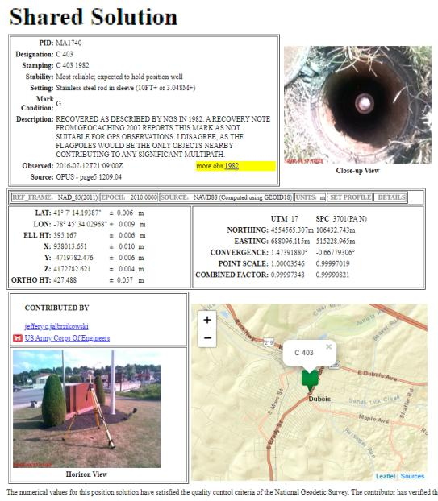
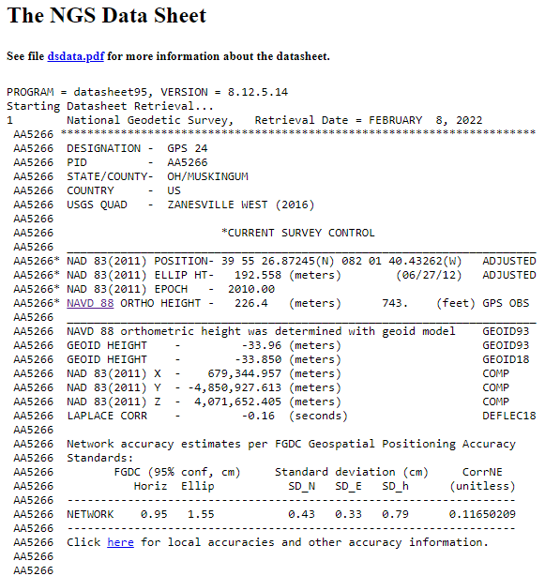
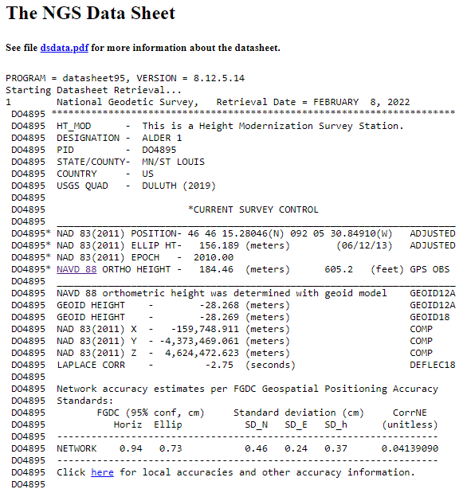
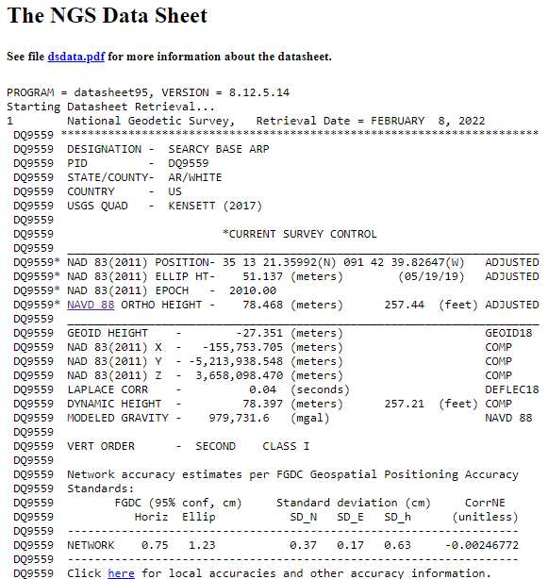
OPUS Shared vs. OPUS Projects
 | OPUS Shared | OPUS Projects (RINEX) | OPUS Projects (GVX)
Minimum Occupations | 4 hours At least 1, maybe 2* | 2 hours At least 2 | 5 minutes At least 3
Processing | OPUS-S (sequential) | PAGES (simultaneous) | Real Time (RTN/NRTK)
Adjustment | None | Least Squares Network | Least Squares Network
Metadata | 2 photos Brief Description | 3 photos, WinDesc files, Logs, & Report | 3 photos, WinDesc files, Logs, & Report
*Need 2 or more GPS datasets in our database, existing data holdings count toward that.

Slide 77
Positional Components of
the NSRS
Geometric
aka “Horizontal”
Latitude, Longitude, Ellipsoid Height
Geopotential
aka Orthometric Height
aka “Elevation”
NAD83
NAVD88
Notes:
-geometric component is latitude, longitude, and ellipsoid height
-geopotential component is combined with the geometric components to calculate an ortho height or capital H

Slide 78
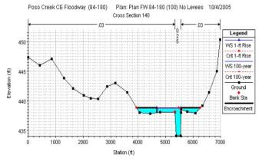
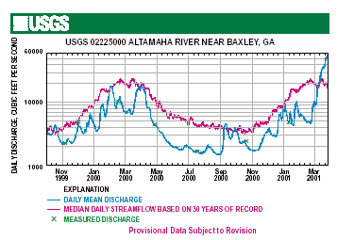
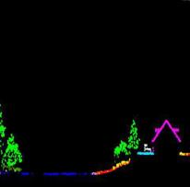
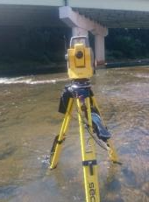
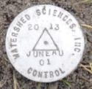
Why does the NSRS matter to me?
Orthometric Datum
Water Level Datum (and Flow Rates)
Ellipsoidal Datum
+
+
Aerial LiDAR/Mapping
Historic Water Levels and Flow Rates
Terrestrial Survey/Cross-Sections
FIRMs require data from disconnected sources.
Dates and datums must be consistently aligned.
Notes:
Example of why we need consistent coordinates (illustrated):
Just in the making of a single FIRM, data collected at different points in time using different methods:
-aerial lidar
-x-section and structure data via survey
-streamflow data/hydrographs
All of these must be reliably aligned and combined with historical data, in both the horizontal and vertical components, to produce a final product in which all of this information is available in one place, to assist professionals like yourselves in appropriate flood mitigation.
→Therefore, Reliable Flood Rate Insurance products rely on the NSRS
In a perfect world…
datums would be parallel and smooth
Surface of Earth would not move

Slide 79
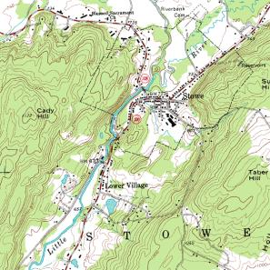
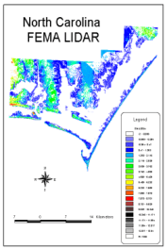
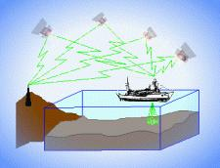
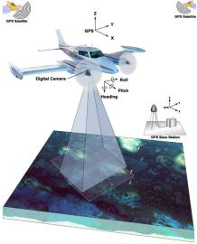
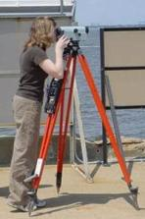
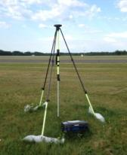
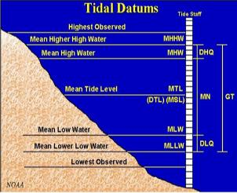
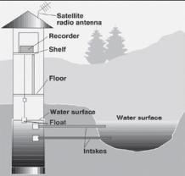
Three types of heights in NSRS
Ellipsoidal
geoid
Orthometric
Raw Hydrographic Surveys
USGS
Topography
NAD83
NAVD88
NGVD29
FEMA NFIP Data & Maps
Engineering and Construction Surveys
Raw GPS Observations
Raw Lidar Data
Water Level or Tidal
NOAA and USACE Hydrography
Shoreline Mapping and Regulatory Boundaries at the Coast
Daily and Extreme Water Levels (Gage)
Notes:
This slide illustrates the 3 categories of vertical datums and examples of where each is directly used They are project and application dependent.
First, we have ellipsoidal datums. Examples include WGS84 and NAD83 (North American Datum of 1983). You will encounter these datums frequently in hydrographic surveys that are vertically referenced with RTK-GPS; any native GPS measurements; and even raw lidar datasets.
Next, we have orthometric datums. These datums are very important because height differences referenced to orthometric datums will allow us to know the direction water will flow, because they have been “gravity-corrected”. The North American Vertical Datum of 1988 (or NAVD 88) is an orthometric datum, which you will see on USGS topographic maps, engineering and development site surveys, and FEMA Flood Insurance Rate Maps.
Finally, we have Tidal Datums, which are derived from water level measurements. They have extremely important applications including daily and extreme water levels; NOAA nautical charts, and shoreline mapping or boundaries along the coast.
*NOAA provides tools (like NCAT and Vdatum) to transform between these different height systems.
The Bridge

Slide 80
Orthometric
Notes:
This slide illustrates the 3 categories of vertical datums and examples of where each is directly used They are project and application dependent.
First, we have ellipsoidal datums. Examples include WGS84 and NAD83 (North American Datum of 1983). You will encounter these datums frequently in hydrographic surveys that are vertically referenced with RTK-GPS; any native GPS measurements; and even raw lidar datasets.
Next, we have orthometric datums. These datums are very important because height differences referenced to orthometric datums will allow us to know the direction water will flow, because they have been “gravity-corrected”. The North American Vertical Datum of 1988 (or NAVD 88) is an orthometric datum, which you will see on USGS topographic maps, engineering and development site surveys, and FEMA Flood Insurance Rate Maps.
Finally, we have Tidal Datums, which are derived from water level measurements. They have extremely important applications including daily and extreme water levels; NOAA nautical charts, and shoreline mapping or boundaries along the coast.
*NOAA provides tools (like NCAT and Vdatum) to transform between these different height systems.

Slide 81
National Geodetic Vertical Datum
of 1929
NGVD29
was replaced by

Slide 82
North American Vertical Datum
of 1988
NAVD88
will be replaced by

Slide 83
North American-Pacific Geopotential Datum of 2022
NAPGD2022
(pronounced: nap-jee-dee)

Slide 84
A very brief history of (the most prevalent) U.S. vertical datums

Slide 85
Referenced to 26 tide gauges in the US and Canada
Notes:
It turns out that MSL is a close approximation to another surface, defined by gravity, called the geoid, which is the true zero surface for measuring elevations. Because we cannot directly see the geoid surface, we cannot actually measure the heights above or below the geoid surface. We must infer where this surface is by making gravity measurements and by modeling it mathematically. For practical purposes, we assume that at the coastline the geoid and the MSL surfaces are essentially the same. Nevertheless, as we move inland we measure heights relative to the zero height at the coast, which in effect means relative to MSL.
Definition: NGVD29 – The National Geodetic Vertical Datum of 1929…
The Sea Level Datum of 1929 was the vertical control datum established for vertical control surveying in the United States of America by the General Adjustment of 1929. The datum was used to measure elevation or altitude above, and depression or depth below, mean sea level (MSL).
Mean sea level was measured at 26 tide gauges: 21 in the United States and 5 in Canada. The datum was defined by the observed heights of mean sea level at the 26 tide gauges and by the set of elevations of all bench marks resulting from the adjustment. The adjustment required a total of 66,315 miles (106,724 km) of leveling with 246 closed circuits and 25 circuits at sea level.
Since the Sea Level Datum of 1929 was a hybrid model, it was not a pure model of mean sea level, the geoid, or any other equipotential surface. Therefore, it was renamed the National Geodetic Vertical Datum of 1929 (NGVD 29) in 1973. The NGVD 29 was subsequently replaced by the North American Vertical Datum of 1988 (NAVD 88) based upon the General Adjustment of the North American Datum of 1988.

Slide 86
NGVD29 – based on 26 tide gauges
topographic surface
datum zero
surface
Local Mean Sea Level differs at tide stations due to prevailing winds, ocean current, salinity, seabed topography, etc.
Concept

Slide 87
Why one site this time?
removed local sea level variation problem of NGVD29
Referenced to one tidal bench mark in Canada
Notes:
Definition: The surface of equal gravity potential to which orthometric heights shall refer in North America
One height held fixed [at 6.271 meters along the plumb line below the geodetic mark] at “Father Point” (Rimouski, Canada).
By fixing the geopotential value at the origin point, it was possible to ensure that the origins of IGLD 85 and NAVD 88 aligned.
**But perhaps more importantly, the height chosen was to minimize 29→88 differences on USGS topo maps in the eastern U.S. … thus, the “zero height surface” of NAVD 88 was NOT chosen for its closeness to the geoid (but it was close…few decimeters)
Use of one fixed height removed local sea level variation problem of NGVD 29
*It should be pointed out that while the datum was defined in such a way as to be usable on the North American continent, it was never actually adopted in Canada. It can be used there, but it’s not their official civilian datum.
Note that the designation of the vertical control point at Father Point is “1250 G=NAVD 88 DATUM POINT” for PID# TY5255 and is not available from the publicly accessible NGSIDB.

Slide 88
NAVD88 – based on single benchmark
topographic surface
datum zero
surface
Concept
Notes:
-

Slide 89
Approximate Error in NAVD88 zero surface
Map is the H=0 surface differenced from satellite gravity data
Notes:
Map highlights the tilt/bias to the zero reference surface, that’s another item that was discovered later on with the advent and proliferation of satellite positioning and remote sensing technology.
How was the map created, that is the NAVD88 zero surface (H=0) overlaid onto a satellite based geoid model, then color shaded by vertical difference

Slide 90
NAVD88 – based on single benchmark
topographic surface
datum zero
surface
Most, if not all, of this error in alignment was intentional.
Huh?! It was chosen to minimize the change to contours in USGS quadrangles.
Concept
Notes:
-importantly, the height chosen was to minimize 29→88 differences on USGS topo maps in the eastern U.S. … thus, the “zero height surface” of NAVD 88 was NOT chosen for its closeness to the geoid (but it was close…few decimeters)

Slide 91
NAPGD2022
Geopotential
gravity based
no leveling used to define it (none!)
GNSS is your “access point”
collect data & submit it to OPUS
no leveling necessary
Global Mean Sea Level (GMSL) based
geoid change when sea level threshold crossed

Slide 92
Gravity → Geoid
You’ve all used a DEM.
(Digital Elevation Model)
Picture a geoid model as a DGM.
(Digital Gravity Model)
-both raster cells of height values
→but represent different things

Slide 93
Geoids and Gravity
or
“Ramblings on the geoid”
Notes:
-they go hand-in-hand, like peas and carrots
-the word geoid has different definitions and dates back to the 1820s, including:
--Geometric surface of the Earth which intersects the direction of gravity at right angles and from which the surface of the world ocean is a part.

Slide 94
Seen this on the internet?

Slide 95
Geoid – an incorrect definition
“The true size and physical shape of the Earth” --social media, etc.
Nope

Slide 96
One textbook geoid definition
“Equipotential surface of the Earth’s gravity field that approximates Mean Sea Level more closely.”
-GPS for Land Surveyors, by Jan Van Sickle, 4th ed., CRC Press, Taylor & Francis Group, 2015, p. 314.
equi-huh?
More closely than what?
Notes:
This is what I was introduced to in school. My point is not to say that this isn’t a solid explanation/definition here, rather to break it apart in an attempt to clarify it. This works, Jan’s book is great, and is updated regularly; I would highly recommend it to any educators or practitioners.

Slide 97
Two more geoid definitions
“The equipotential surface of the Earth's gravity field which best fits, in a least squares sense, global Mean Sea Level.”
-website of the National Geodetic Survey
A surface of constant geopotential.
-some lecture notes of mine…
Notes:
Top one is the definition adopted by NGS.
That explanation of being a least-squares best-fit to MSL helps a lot.

Slide 98
My favorite verbage
“The geoid is the equipotential surface that most closely coincides with the undisturbed mean sea level (and its continuation through the continents).”
- Sjöberg, L. E., & Bagherbandi, M. (2017). Gravity Inversion and Integration, Theory and Applications in Geodesy and Geophysics. Springer.
equipotential – equal potential
potential – as in energy… or gravitational pull
Notes:
-potential = “currently unrealized ability”

Slide 99
Gravitational Pull
It is not uniform, both strength and direction vary.
Can be defined by a vector
-distance (from ellipsoid) and direction
Notes:
-the fact that gravity varies is the reason we need to build a geoid model to calculate ortho heights from GNSS data
-if gravity didn’t vary then we could all just use ellipsoid heights

Slide 100
Equipotential Surface
A modeled surface to represent the location of equal gravitational force.
It’s an undulating surface, hence the phrase “geoid undulation” often used.
Gravity is acting perpendicular to every point on this surface.
Notes:
-undulating is a good word, because there are no “cliffs” in a geoid model, the smallest “feature” one will find in one of our geoid models is about 50km (30mi)
**much like the rolling hills of West Virginia
-Picture this surface like a DEM, but it’s cell values represent the height above or below the ellipsoid in which gravitational pull is equal.
-if that works for you, then think of a geoid model as a DGM, a Digital Gravity Model

Slide 101
Equipotential Surface
… coincides with the undisturbed mean sea level…

Slide 102
Equipotential Surface
There are an infinite number of equipotential surfaces.
We use the term geoid to refer to one of those surfaces that aligns to a best-known global mean sea level.
Notes:
-the thing to keep in mind in this concept is that there are an infinite number of such surfaces of equal gravitational pull, depending on what the strength of that pull is
-let’s visualize that

Slide 103
Equipotential Surface
-GPS for Land Surveyors, by Jan Van Sickle, 4th ed., CRC Press, Taylor & Francis Group, 2015, p. 180. (slightly edited)
NAPGD2022 defined by a specific strength of gravity → W₀
Notes:
Recall our ol’ buddy W sub-naught (W₀)

Slide 104
Geopotential
Notes:
-The lines in different shades of blue represent different equipotential surfaces, or different strengths/levels of geopotential.
-The brown line represents the topographic surface, land.
-And there’s a puddle of water there in the middle, the blue drop.
-Imagine pouring water onto a dry lake bed. If the topographic surface is flat, as it is here, the water will simply pool up.
-The water “wants” to get to the lower potential lines, but there’s that dang lake bed in the way.

Slide 105
Geopotential
Notes:
-Now we’ve tilted the lakebed, like a hill. The water has a path to move towards lower potential, so it does.
-The water appears to flow because of a difference in height.

Slide 106
Geopotential
Notes:
-Ok, so here’s our water droplet again, and back on a flat lakebed.
--But now we have this dark red circle over here, which represents a mass anomaly, perhaps an large mineral deposit of some sort.
-This resulting geopotential difference, due to the anomaly, causes water to flow towards lower potential again. This time the water appears to flow because of gravity.
-See how the blue lines, our geopotential lines, bow around the anomaly? The mineral mass increases the pull of gravity so the lines must be drawn that way if they’re drawn to represent equipotential surfaces.

Slide 107
Geopotential
In all scenarios, the water only flows when it has a path to lower geopotential – this is always a combination of gravity and height.
(-∫g dH)
Notes:
Just a reminder that the example used is just that, an example. Water is not going to “flow uphill” due to some huge mineral deposit.

Slide 108
Notes:
Nice graphic, couldn’t leave this out. Note that CONUS is all blue, thus negative geoid height values on any datasheet you look at.
Minimum undulation, the lowest point is -106m, in India
Maximum undulation, the highest point is +85m in Iceland

Slide 109
Orthometric Heights
-GPS for Land Surveyors, by Jan Van Sickle, 4th ed., CRC Press, Taylor & Francis Group, 2015, p. 180. (slightly edited)
Notes:
REPEAT GRAPHIC HERE

Slide 110
Notes:
-So there’s a classic diagram from NGS that helps illustrate the geoid and other equipotential surfaces.
-But what about reality, where we don’t know that distance, P-sub-zero to P?
-In that case, we’ll probably know some other info, so we can use a simple algebraic formula.

Slide 111
Orthometric Heights
H = h + N
Notes:
-Well, if we know lower case h, our height above ellipsoid, and we know capital N, our geoid height or separation value (the difference b/w ellipsoid and geoid surface) then we can calculate our orthometric height.
-We have to do that because we position our gravity readings relative to the NAD83 ellipsoid, typically with GPS-based methods.
-For example, the gravity readings taken during the GRAV-D flights I mentioned earlier, those are positioned with post-processed GPS data.

Slide 112
Orthometric Heights
H = h + N
Notes:
Let’s take a look at a different diagram.

Slide 113
Orthometric Heights
Deflection of the Vertical
DoV (symbolized ε)
ε
H = h + N
ε
-GPS for Land Surveyors, by Jan Van Sickle, 4th ed., CRC Press, Taylor & Francis Group, 2015, p. 180. (slightly edited)
Notes:
-That angle there, the DoV or Deflection of the Vertical, that’s the difference between a line perpendicular to the ellipsoid and a line perpendicular to gravity.
--Picture your plumb bob suspended from an instrument… never mind, nobody uses a plumb bob anymore.--
-Anyway, the plumb bob is pointing down perpendicular to the geoid (gravity at work there), but your GNSS receiver is measuring height perpendicular to the … ellipsoid.
-So we need that DoV value to get accurate GNSS-based orthometric heights.
We know that angle because we know the reciprocal angle epsilon down below, that angle between the plumb line (perpendicular to the geoid) and the line perpendicular to the ellipsoid (our ellipsoid height).

Slide 114
Notes:
-Deflections are used to relate the orientation of a leveled instrument, such as a GNSS receiver or total station, to the horizontal reference frame NAD83.
-Important uses are corrections to zenith distance (vertical angle) measurements, and the conversion between astronomic and ellipsoidal azimuths (the Laplace correction).
-DoV values are maintained in a raster format mush like the geoid models.
-You can find the Laplace correction on a datasheet, below other items like the geoid height and ECEF XYZ coordinates.

Slide 115
Notes:
The DoV is a 2D measurement, so as you can see the modelers build a layer for each direction then they’re merged into one.

Slide 116
NAVD88 geoids
versus
NAPGD2022 geoids

Slide 117
Which NAD83 with which geoid?
GEOID18
GEOID12B
NAD83(2011) →
NAD83(2007) →
NAD83(HARN/FBN)
NAD83(CORS96)
GEOID09
GEOID06 (AK only)
GEOID03
GEOID99
GEOID96
Notes:
I’ve gotten this question more than once.
-Does it matter which geoid model I use with which realization of NAD83?
-NGS Answer = yes
-Project-specific answer = maybe note
-I spoke at length with a gentlemen from the Virginia DOT about this, and he did a bunch of comparisons, saw a barely discernable difference… but still the NGS answer is going to be that for a given realization of NAD83, you should use only the corresponding geoid models for your work
-remember NGS is chasing the millimeter… but maybe you aren’t

Slide 118
Two types of geoid models
Gravimetric
Hybrid
Notes:
-believe it or not there’s more than 2 types, but the 2 types you’ll see NGS publish are…

Slide 119
Gravimetric → Hybrid
Gravimetric geoid is created from “scratch” with various types of gravity data
USGG2003, USGG2009, USGG2012, xGEOID19
Hybrid geoid is simply a gravimetric geoid then best fit some vertical datum… like NAVD88
GEOID03, GEOID09, GEOID12B, GEOID18
Notes:
So… all the geoids you’re using to get elevations from your GNSS data

Slide 120
Gravimetric → Hybrid
USGG2003, USGG2009, USGG2012, xGEOID19
GEOID03, GEOID09, GEOID12B, GEOID18
best fit to NAVD88
best fit to NAVD88
best fit to NAVD88
best fit to NAVD88
Notes:
So… all the geoids you’re using to get elevations from your GNSS data

Slide 121
Gravimetric vs. Hybrid Geoid
topographic surface
gravimetric geoid
hybrid
geoid
datum zero
surface
Concept
Notes:
-importantly, the height chosen was to minimize 29→88 differences on USGS topo maps in the eastern U.S. … thus, the “zero height surface” of NAVD 88 was NOT chosen for its closeness to the geoid (but it was close…few decimeters)

Slide 122
NAVD88 uses a Hybrid Geoid
topographic surface
gravimetric geoid
hybrid
geoid
datum zero
surface
Concept
Notes:
-importantly, the height chosen was to minimize 29→88 differences on USGS topo maps in the eastern U.S. … thus, the “zero height surface” of NAVD 88 was NOT chosen for its closeness to the geoid (but it was close…few decimeters)

Slide 123
NAPGD2022 uses a Gravimetric Geoid
topographic surface
gravimetric geoid
datum zero
surface
Datum zero surface aligned to Global Mean Sea Level (GMSL)
Concept
Notes:
-importantly, the height chosen was to minimize 29→88 differences on USGS topo maps in the eastern U.S. … thus, the “zero height surface” of NAVD 88 was NOT chosen for its closeness to the geoid (but it was close…few decimeters)

Slide 124
Why leveling is not part of NAPGD2022
…but will still be important for you.
ground surface
equipotential surfaces
(equal gravity)
Geoid at Site Scale

Slide 125
Why leveling is not part of NAPGD2022
…but will still be important for you.
ground surface
equipotential surfaces
(equal gravity)
Geoid at Continental Scale

Slide 126
Why leveling is not part of NAPGD2022
We are determining height differences across the whole continent
Large Area
Gravity varies due to: geology, water, etc.
You are determining height differences across your area/site
Small Area (comparably)
Gravity does not change that much locally

Slide 127
Why leveling is not part of NAPGD2022
…but will still be important for you.
When you’re working on a site, you need high accuracy relative height differences
Geoid model is not able to provide that
So don’t toss out your level come 2025!
What about if submitting data to NGS?
Yes, we will accept leveling, but…
GNSS ties will be required

Slide 128
How do we measure gravity?
airborne observations of relative gravity
collected in as short of a timespan as is realistic
full coverage
on-the-ground observations of absolute gravity
periodic or episodic; repeat every ___ years
large spacing, a few per state
Notes:
Two major campaigns within GRAV-D
High-resolution snapshot of gravity
airborne observations of relative gravity
collected in as short of a timespan as is realistic
full coverage
Low-resolution “movie” of gravity changes
on-the-ground observations of absolute gravity
periodic or episodic; repeat every ___ years
large spacing, a few per state

Slide 129
Sea Level Change and the Geoid
H_{2087.257}
H_{2020.000}
Threshold Level
-Threshold Level is published as 20 cm
-Process is repeated as GMSL changes
Geoid
GMSL
Notes:
The illustrated strategy will be adopted at NGS. An animated characterization of this approach
What this means is that NGS will decouple the geoid from GMSL, until they have diverged by some threshold amount, currently defined as 20cm.
When that threshold is reached a new geoid will be defined and held fixed until reaching next threshold. In this way, the impact of the change of GMSL is accounted for in the heights of the NSRS, while the appearance of stability is maintained for “decades at a time” (BP2 Section 14).
If we calculate how long that might be based on existing rates of sea level rise of 3ish mm/yr then we’re talking over 50 years

Slide 130
Estimated change in orthometric heights from NAVD88 to NAPGD2022
(NAPGD2022 approximated using xGEOID16B)

Slide 131
Preparing for NAPGD2022
Inventory heights in your data/datasets
Have you mix & matched geoid models?
Are you tracking levees or other flood control?
Are you managing subsurface utilities?
Access covers, junction boxes, cleanouts, etc.
Maybe geoid differences aren’t even significant?
VADOT story…
Know your goals, know your data.

Slide 132
Preparing for NAPGD2022
Know the epoch of your data/datasets
consider how you will track this
full to-the-second timestamp on every feature?
Modern survey equipment makes this possible
labeling a year for each dataset?
Easy to add to workflows, datasets/databases, folders
something in-between that works for your needs?
2023.1957
2023:27
20230127
Your choice

Slide 133
Preparing for NAPGD2022
Reprocessing your data
perfect world = everyone reprocesses everything
what does this mean?
consider an ALTA w/topo
start over with the onsite GNSS-based control
reorient all your shots/ties (hopefully linked)
recreate all the drainage features in new datum
unrealistic! … and unnecessary for majority users
Notes:
Reprocessing your data
in a perfect world, everyone would reprocess data
consider a final product like you use everyday - a hydro-enforced DEM
starting fresh with the raw GNSS/IMU processing
generate new ellipsoid height point clouds
recreate all the drainage features in new datum
this is totally unrealistic → both from a financial and programmatic perspective

Slide 134
Preparing for NAPGD2022
Transforming your data
NCAT - NGS Coordinate Conversion and Transformation Tool
available now: ASCII upload, Web Services, GitHub
ask your software provider(s) about integration
we envision this as most popular method of access
Industry Workshops held in 2021 and 2022
All the well known commercial names attended
Plus some open-source advocates
Notes:
Transforming your data
NCAT - NGS Coordinate Conversion and Transformation Tool
available now: ASCII upload and Web Services
ask your software providers about integration
we envision this as most popular method of access
Industry Workshop held this year – esri, trimble, bluemarble, all the major well known names were represented
labeling a year for each dataset?
something in-between that works for your needs

Slide 135
Preparing for NAPGD2022
What can you do to ensure your control will get coordinates in the new datums on rollout?
Re-observe and submit the data to NGS
must be submitted by 30 September 2023
Options to submit your data:
OPUS Share → 4+ hrs static data; 2 photos; mark ties
rinse & repeat … as we need redundancy
OPUS Projects → 2+ hrs static GPS data
→ 5+ minutes RTN-GNSS data, 3x per mark
Also: photos, field logs, descriptions, survey report
Notes:
-OPUS Share requires 4+ hrs static data; 2 photos; and a brief description of reference ties (not a full IDB “from the post office”)
→ NOTE THAT OPUS SHARE OPTION REQUIRES 2 OBSERVATIONS
→ WHY? WE REQUIRE REDUNDANCY FOR ANY OBS THAT GO INTO OUR DATABASE
-OPUS Projects → 2+ hrs data; photos; full IDB style descriptions via WinDesc (*MUST USE WINDESC*)

Slide 136
Preparing
What’s this 5 minute RTN observations deal?
Not just GPSonBM … but GVXonBM
Notes:
We can now accept RTN derived vectors in Beta OPUS Projects
https://geodesy.noaa.gov/web/science_edu/webinar_series/rtn-data-opus5.shtml

Slide 137
I’ll be selling these bumper stickers in hospitality room tonight…
SPCS2022
MAKING EARTH FLAT AGAIN
…ONE ZONE AT A TIME
Really?
No… not really!

Slide 140
Northings are still North
Eastings are still East

Slide 141
The Survey Foot is dead!
Long live the Survey Foot!
US Survey Foot was deprecated 31 December 2022…
But will always be available in NGS tools for NAD83 and NAD27
Notes:
We start with the SPCS83 zones as a frame of reference
NOTE that the color shading of these zones is matched to that of the Preliminary SPCS2022 Zones that follow

Slide 142
additional Resources
Notes:
This presentation is intended to raise awareness about the upcoming changes and what they mean for floodplain mapping, but you probably have lots of remaining questions and we have a lot of resources online at our website
Please spread the word, and
make an effort to keep yourself and your colleagues informed.
Tell us what content is missing or how we can make it better!

Slide 143
geodesy.noaa.gov/ADVISORS/
Notes:
-14 Regional Advisors, we’ve transitioned from a State-based to a Regional Program
-our advisors homepage up there at the top, also easy to find us by querying any major search engine for “ngs advisors”
-if you know Ross Mackay, he is our Chief Advisor, I report to him…
**ya know, I don’t know why they don’t make him put his photo up here
-we do have one vacant advisor position, that was recently advertised and John up there in Wisconsin is officially retired in oh… 18 days

Slide 144
Regional Geodetic Advisor Program
geodesy.noaa.gov/ADVISORS/
query any major search engine: “ngs advisors”
SCAN
QR CODE
TO EMAIL ME
Notes:
Transitioned from a State to a Regional program in 2016. States no longer provide funding if they desire to have an Advisor, but NGS reorganized the personnel to support regions rather than single States.
Kentucky has appointed a State Geodetic Coordinator

Slide 145
State Geodetic Coordinators
Not an NGS employee
Serves as a liaison between the State’s geospatial community and the NGS
Erik Baldwin over at Bluefield State College
Notes:
-The State Geodetic Coordinator is not employed by NGS and is typically assigned by a state government agency or university.
-Wes Virginia we’ve got Eric over at Bluefield --- contact info.

Slide 146
Blueprints for the Modernized NSRS
…your best source for information on modernization
All three were revised in 2021
Geometric
Sep 2017; Rev. Apr 2021
NOAA TR NOS NGS 62
Geopotential
Nov 2017; Rev. Feb 2021
NOAA TR NOS NGS 64
Working in the modernized NSRS
Apr 2019; Rev. Feb 2021
NOAA TR NOS NGS 67
Notes:
Here’s the front cover of the three blueprint documents, and know that for each given topic these are your best source for information on modernization.
They’ve been written by teams, reviewed, re-written, re-reviewed, and ...
CLICK
…all three will have been re-released, with new titles, in 2021. The revisions were to solidify some items originally called out as To Be Determined, and the rename was to make it clear that 2022 would no longer be the target date.
*Blueprint Part 1 re-release may nor may not have been published by the time of this webinar, but it will be soon. I’ll show you how to find these at the end of today’s webinar.

Slide 147
Resources at geodesy.noaa.gov
Educational Videos
<5 minutes
Online Lesson
(via MetEd/COMET)
~1 hour
Notes:
Educational videos and online tutorials –
Our library of lessons and videos are great resources, and will reinforce a lot of information we covered today.
The videos are just 3-5 minutes long.
the lesson is a deeper dive but still only takes an hour.

Slide 148
Educational Videos
<5 minutes
Online Lesson
(via MetEd/COMET)
~1 hour
NGS homepage: geodesy.noaa.gov
Notes:
Educational videos and online tutorials –
Our library of lessons and videos are great resources, and will reinforce a lot of information we covered today.
The videos are just 3-5 minutes long.
the lesson is a deeper dive but still only takes an hour.

Slide 149
Email Subscriptions
*Only 1-2 messages per month*
NGS News
Includes quarterly NSRS Modernization newsletter
Webinar Series
Training
GPS on Benchmarks
Click this icon on homepage
Notes:
Stay abreast of any new information coming from us via Email Subscription –
Sign up for notifications about News, webinars, and training opportunities with NGS.
We also use our News subscription list to send out our quarterly NSRS Modernization Newsletter.

Slide 150
Jeff Jalbrzikowski, P.S., GISP, CFS
Appalachian Regional Geodetic Advisor
jeff.jalbrzikowski@noaa.gov
240-988-5486
https://www.ngs.noaa.gov/ADVISORS/
use any major search engine: “NGS advisors”

