Slide 1



The New 2022 U.S. Datums and
Related Products
Gulf Alliance Federal Working Group
February Meeting
February 25, 2021
Denis Riordan, PSM
NOAA, National Geodetic Survey
denis.riordan@noaa.gov

Slide 2
Presentation Topics
1. New 2022 Datums for the U.S.
2. Recent Announcements for NSRS Modernization
3. State Plane Coordinate System 2022 Project
4. Deprecation of the U.S. Survey Foot
5. Preparing for the new datums and metadata

Slide 3
New 2022 U.S. Geometric Datum

Slide 4
National Spatial Reference System(NSRS)
Improvements in the Horizontal Datums
TIME NETWORK METHOD
NETWORK SPAN ACCURACY OF REFERENCE
NAD 27 1927-1986 10 meter
NAD83(86) 1986-1990 1 meter
NAD83(199x)* 1990-2007 0.1 meter
HARN
NAD83(2007) 2007 - 2011 0.01 meter
(CORS)
NAD83(2011) 2011 - 2022 0.01 meter
(CORS)
TRAVERSE & TRIANGULATION -
GROUND MARKS USED FOR REFERENCING THE NSRS.
GPS BECOMES MEANS OF POSITIONING – STILL GRND MARKS.
GNSS – CORS STATIONS ARE MEANS OF REFERENCE FOR THE NSRS.

Slide 5
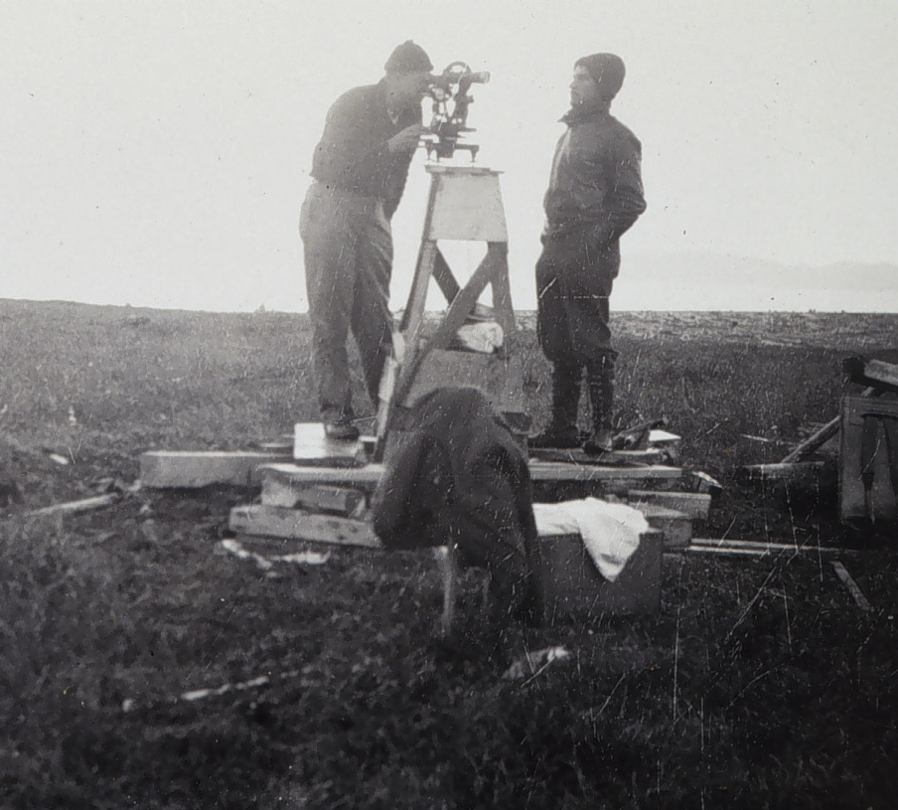
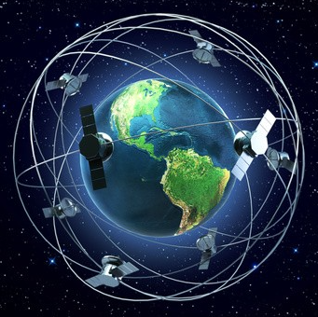
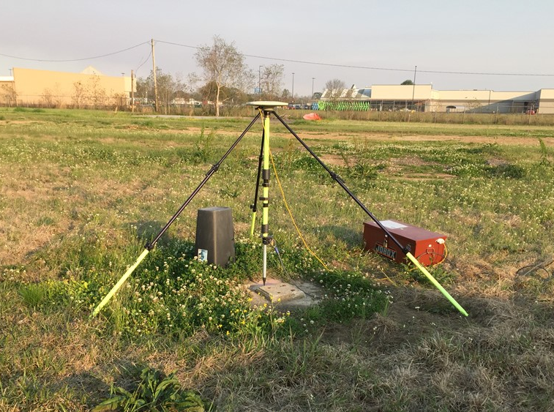
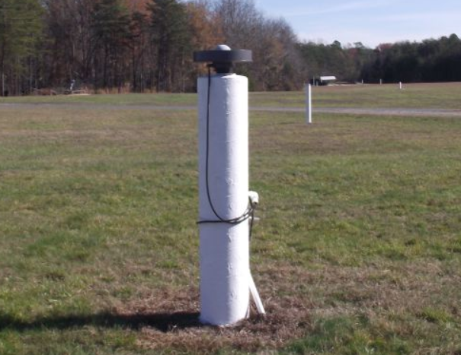
NSRS Reference Basis
New Method - GNSS Stations (CORS)
Basis of Ground Marks
Passive Control
Active Control

Slide 6
Why Replace NAD83?
Datum based on best known information about the earth’s size and shape from the early 1980’s (≈40 years old), and the terrestrial survey data of the time.
NAD83 is NON-geocentric & hence inconsistent w/GNSS .
NAD83 is now ≈2.2 m. off from currently know mass center of earth
Replacement is necessary for agreement with current / future capabilities of GNSS positioning.

Slide 7
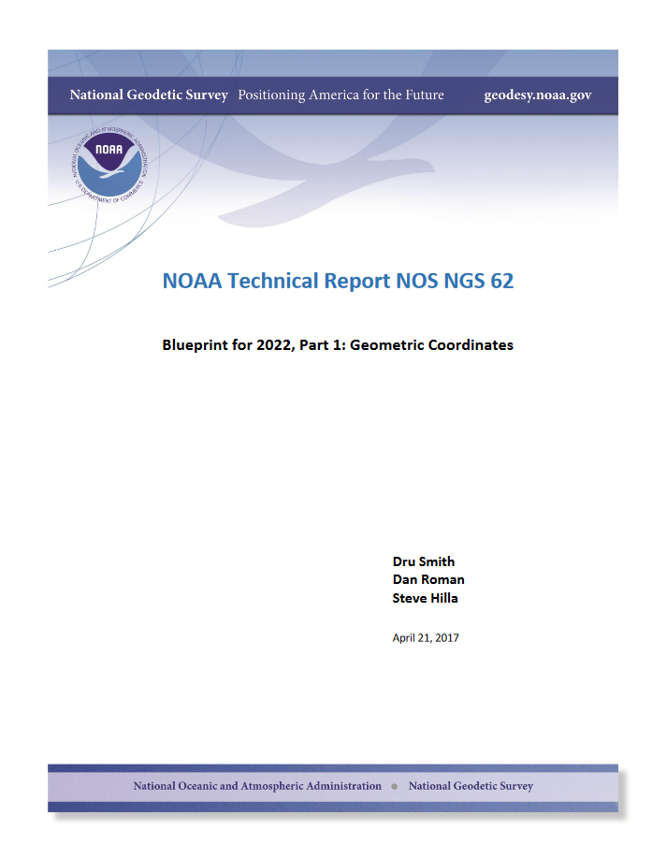

Slide 8
Future Geometric (3-D) Reference Frame
Blueprint for 2022: Part 1 – Geometric Datum
Replace NAD83 with a new geometric reference frame.
CORS-based, accessed via GNSS observations.
Coordinates & velocities in ITRF (IGS) & new US reference frame.
      (coordinates in time) (stable coordinates)
  Transformation tools will relate NAD83 to new US reference frame (NCAT with 2022 transformation).

Slide 9
Names and Reference Frames
The Old:
NAD 83(2011)
NAD 83(PA11)
NAD 83(MA11)
The New:
The North American Terrestrial Reference Frame of 2022
(NATRF2022)
The Caribbean Terrestrial Reference Frame of 2022
(CATRF2022)
The Pacific Terrestrial Reference Frame of 2022
(PATRF2022)
The Mariana Terrestrial Reference Frame of 2022
(MATRF2022)

Slide 10
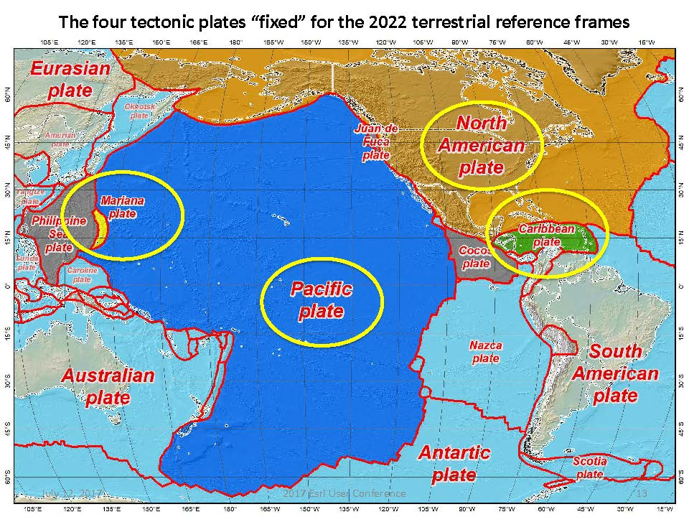
Drift…

Slide 11
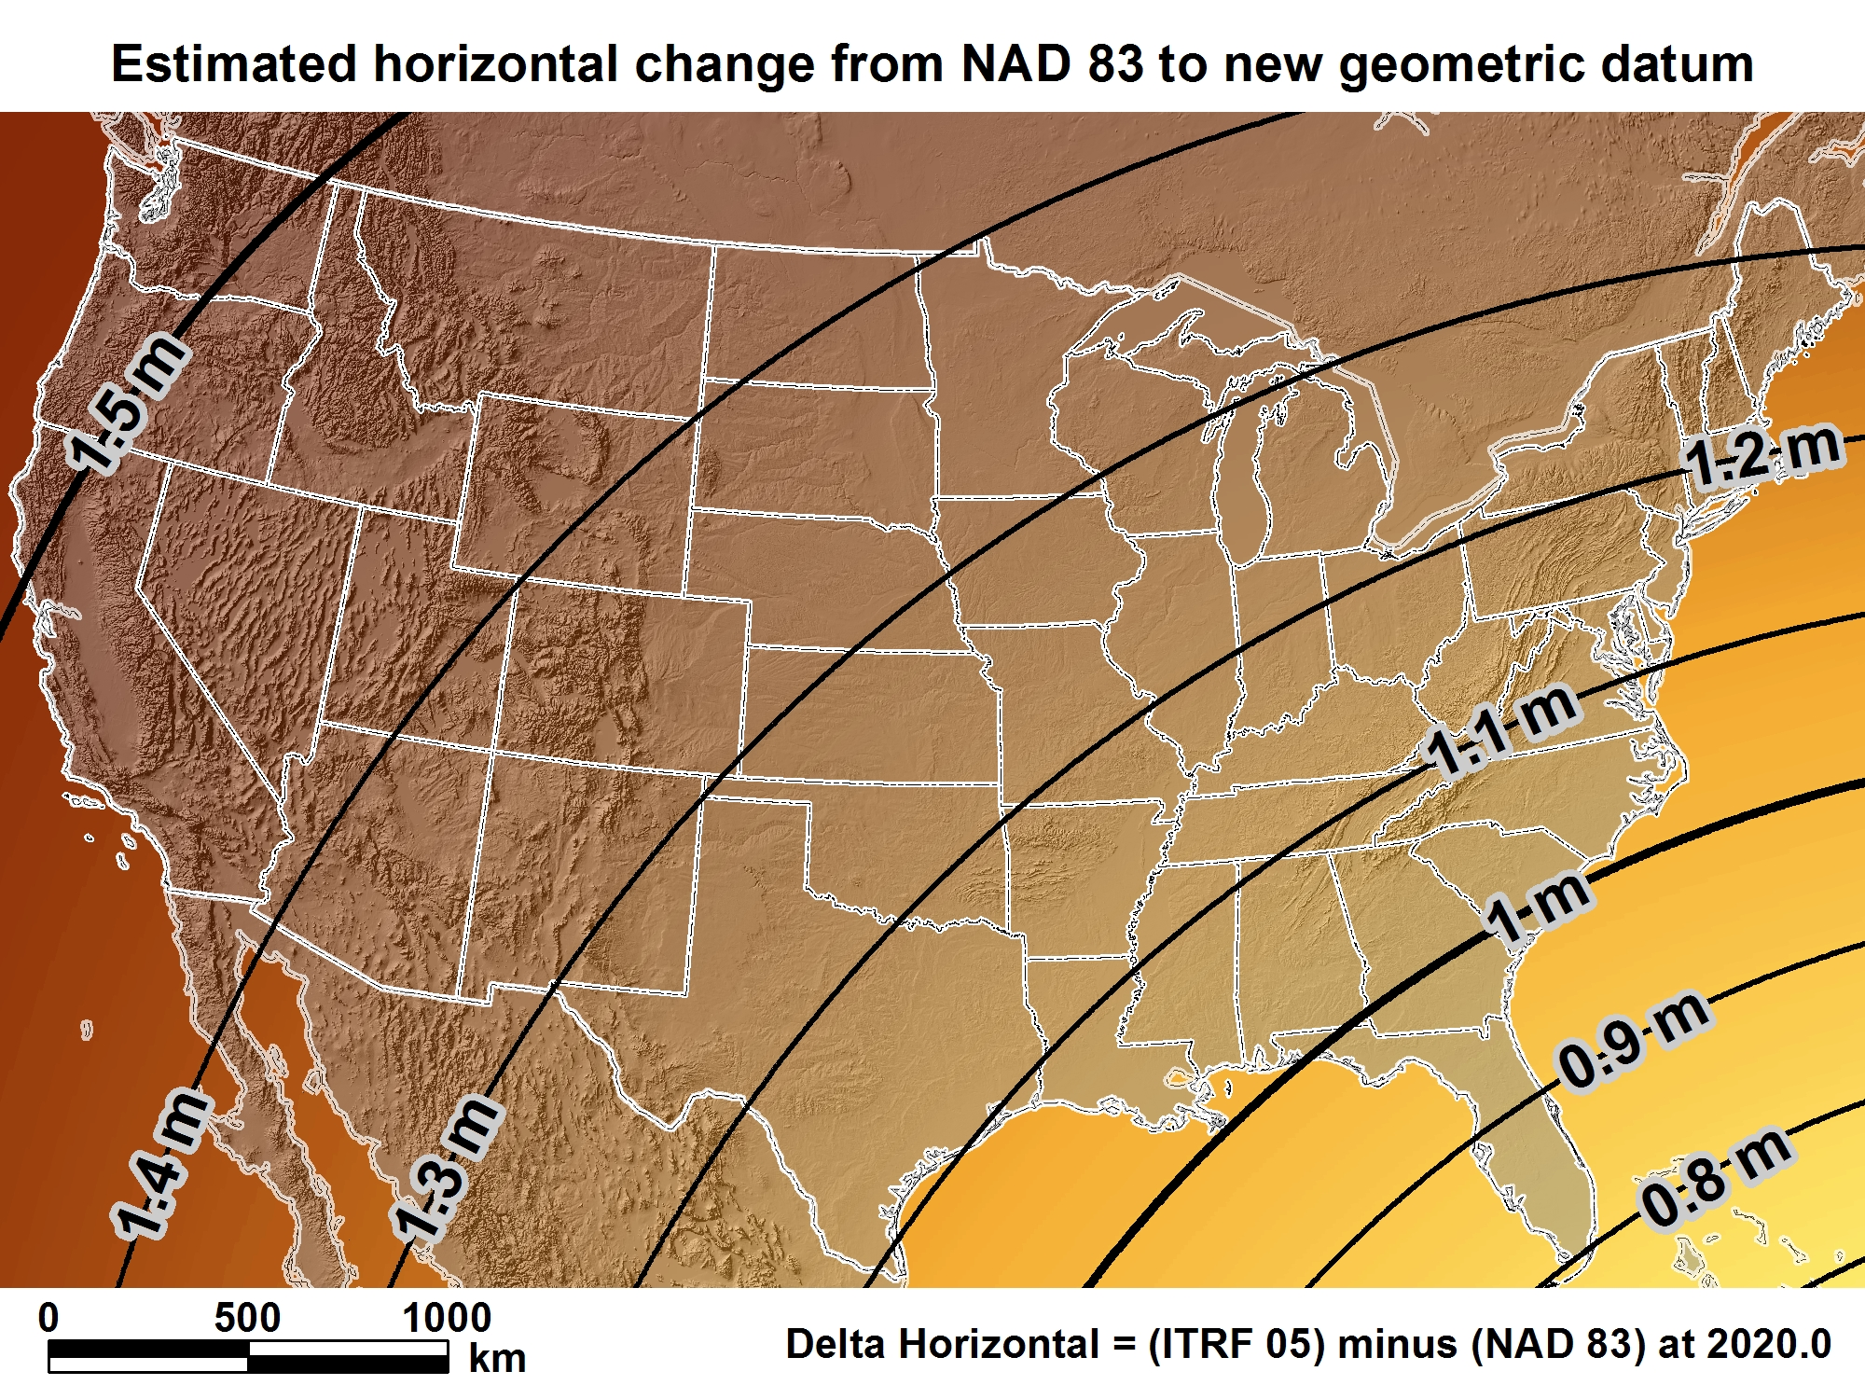
New geometric datum minus NAD 83 (horizontal)
For MS = 1.0 > 1.1 m (3.3 > 3.8 ft.)

Slide 12
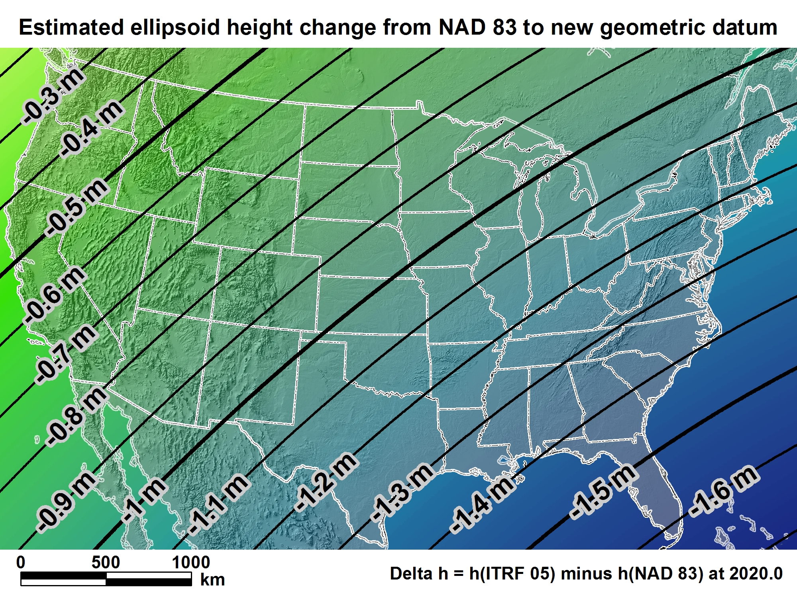
New geometric datum minus NAD 83
(ellipsoid height)
For MS = -1.4 > -1.2 m (-4.6 > -3.9 ft.)

Slide 13
New 2022 U.S. Vertical Datum

Slide 14

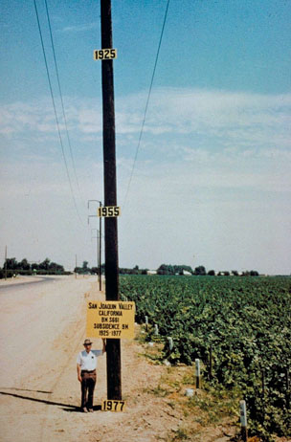
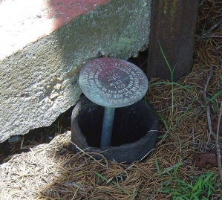
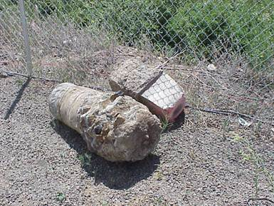
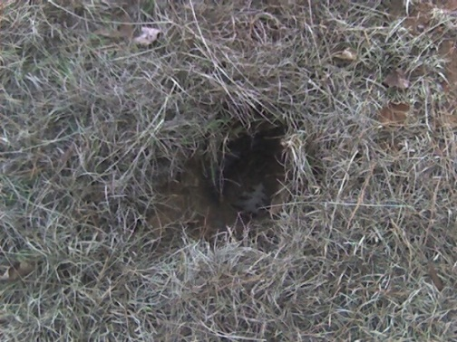
Why isn’t NAVD 88 good enough anymore?
* NAVD 88 is a terrestrial based vertical datum that changes as the land changes.
NAVD 88 suffers from use of bench marks that:
  Are almost never re-checked for movement
  Disappear by the thousands every year
  Are not funded for replacement
  Are not necessarily in convenient places
  Don’t exist in most of Alaska
  Were determined by leveling from a single point, allowing cross-country error build up

Slide 15
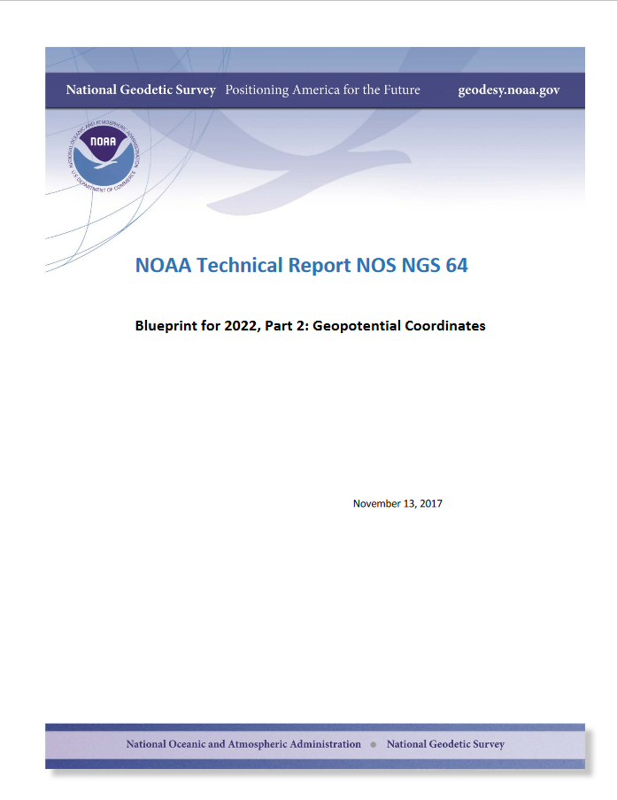

Slide 16
NEW VERTICAL DATUM (Rationale)
  A move away from differentially leveled passive control as the defining mechanism of the reference surface
  To be consistent with the shift in the geometric reference frame/ellipsoid (2022)
  Improvement in our technical abilities in reference surface realization (geopotential gravimetric reference surface - 1cm accuracy of the geoid (GNSS/GRAV-D))
  Goal - ability to establish 2cm orthometric height anywhere in U.S. using a minimum of 15 min. of GNSS data.
  The new geopotential reference surface will be aligned with the geometric reference frame/ellipsoid (i.e., no hybrid geoid)

Slide 17
Names
  The Old:
  NAVD 88
  PRVD 02
  VIVD09
  ASVD02
  NMVD03
  GUVD04
  IGLD 85
  IGSN71
  GEOID12B
  DEFLEC12B
Orthometric
Heights
  The New:
  The North American-Pacific Geopotential Datum of 2022 (NAPGD2022)
  * A gravity based datum.
Normal
Orthometric
Heights
Dynamic
Heights
Gravity
Geoid
Undulations
Deflections of
the Vertical

Slide 18
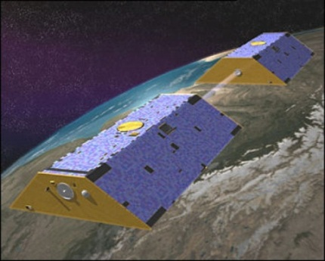
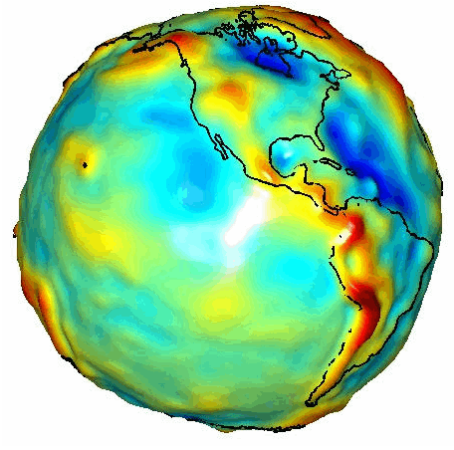
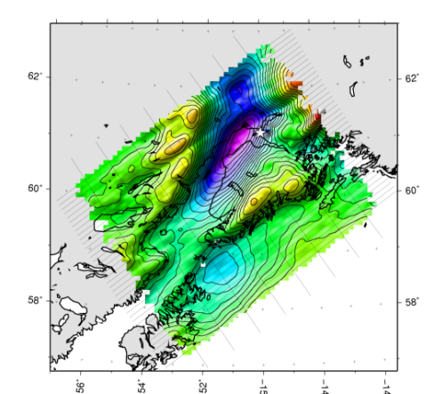

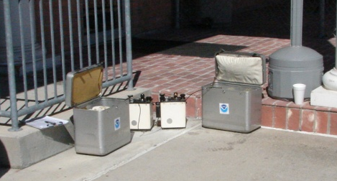
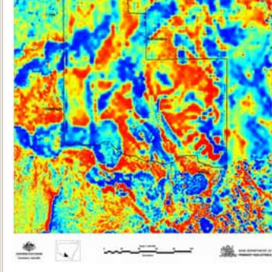
Building a Gravity Field
Long Wavelengths
(≥ 250 km)
GRACE/GOCE/Satellite Altimetry
+
Intermediate Wavelengths
(500 km to 20 km)
Airborne Measurement
+
Short Wavelengths
(< 100 km)
Surface Measurement and
Predicted Gravity from Topography
Notes:
Give example of how short wavelength information is like low altitude aerial photos (1/2” pixel accuracy) in that it provides very accurate and detailed information. The long wavelength gravity can be likened to the old LANDSAT imagery (3 meter pixel accuracy) in that it was good over large areas, but didn’t give much detail for local areas. The intermediate wavelength gravity data gives us a connection between the two (the short and long), allowing the NGS gravity team to use all available gravity information in working toward the production of a 1 cm accurate gravitational surface.

Slide 19
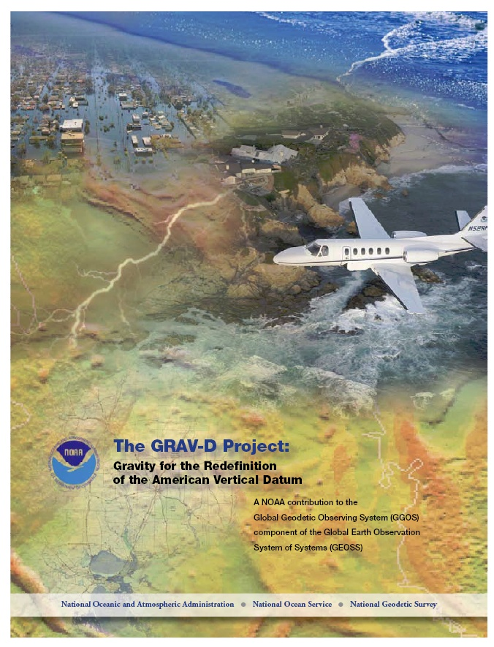
Gravity for the Redefinition of the American Vertical Datum (GRAV-D)
Replace the Vertical Datum of the USA by 2022 (at today’s funding)
GRAV-D is:
  An airborne gravity survey of the entire country and its holdings
  A 2022 gravimetric geoid accurate to 1 cm
  Long-term monitoring of geoid change over time
  Partnership surveys
Working to launch a collaborative effort with the USGS for simultaneous magnetic measurement
Acting Proj. Manager: Jeffery Johnson
Jeffery.Johnson@noaa.gov
Gravity and Heights are
inseparably connected
Notes:
GRAV-D is the NGS project designed to replace NAVD88 with a vertical datum based upon a gravimetric geoid accurate to 1 cm. Heights above this datum will be accessed via GNSS measurements. Three thrusts of project. Launch USGS collaboration for simultaneous mag measurement.

Slide 20
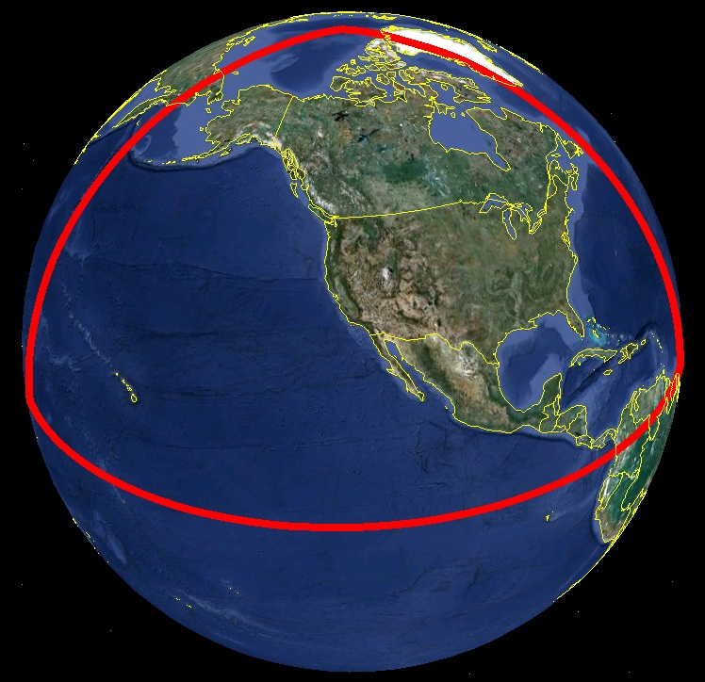
Extent of 2022 gravimetric geoid model used for NAPGD2022

Slide 21
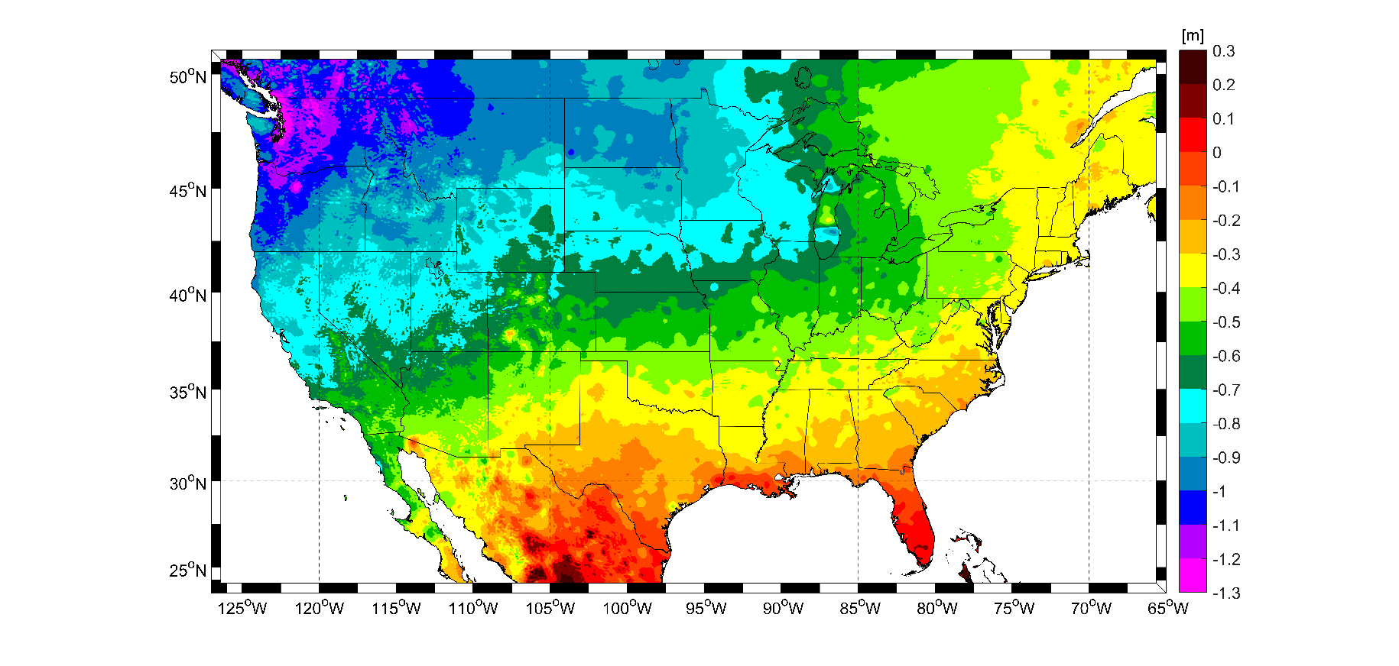
Expected Orthometric height Changes – NAVD88 – NAPGD2022
For Mississippi = -0.1 > -0.4 m (-4 > -16 in.)

Slide 22
Geoid Monitoring Service (GeMS)
Goal: Track all changes to the geoid which would prevent 1 cm accuracy
Aspects included:
  Shape, Secular: e.g. Hudson Bay
  Shape, Episodic: e.g. Massive Earthquakes
  W0, Secular: Global Sea Level Change
Examples of things excluded:
  Size, Secular: Mass quantity of Earth is effectively static
  Shape, Periodic: Seasonal glacier cycle
Bottom Line: An accurate, up-to-date, and maintainable vertical datum.

Slide 23
Delayed Release of Modernized NSRS

Slide 24
Original Timeline for “Modernized NSRS”
In 2007, NGS assumed we would be done by 2018
  Optimistic GRAV-D planning
  Incomplete picture of the entire NSRS modernization project
By 2013, a finish of 2022 seemed correct
  Still, the “big picture” wasn’t clear
  Optimism and enthusiasm within NGS was high for many years
By 2020 three issues derailed that date:
  Final clarity on the complexity of the task
  Loss of personnel without backfill
  “2020”
  * 2020 also showed that trying to finish by 2022 --- the
  “long pole in the tent” is GRAV-D and that project was
  getting further behind.
Notes:
A friend called 2020 “the longest decade of our lives”

Slide 25
Conclusion
The modernized NSRS is delayed beyond 2022
  Most likely into the 2024-2025 timeframe
There is no way to accelerate this
  Can’t make people work faster or harder when they are already at maximum capacity
  Can’t make the troubles of 2020 go away
Want release of modernized NSRS to be correct, to support related NGS Products, and to enable / support the Geospatial community.

Slide 26
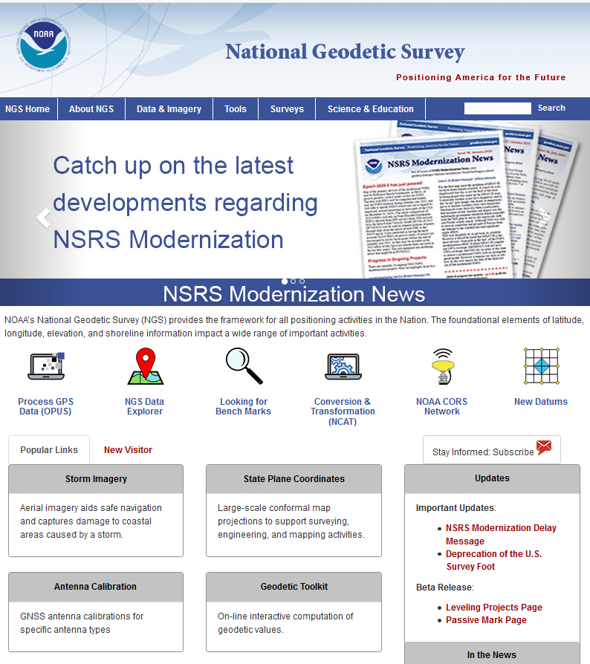

Slide 27
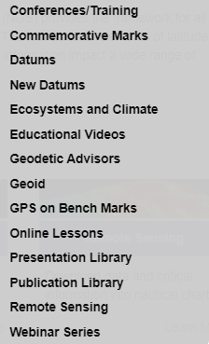
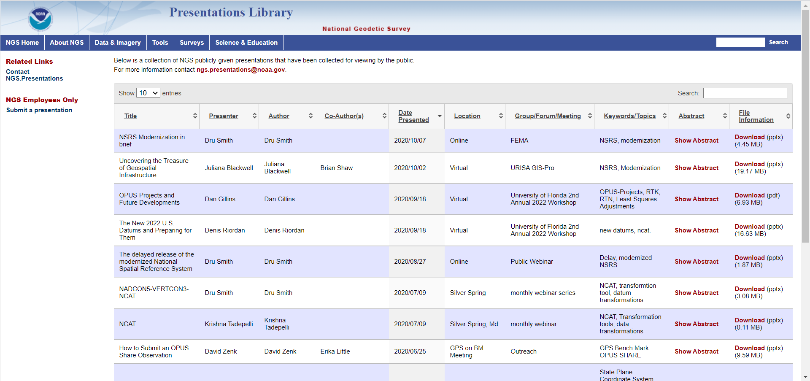
For More 2022 Datums Information, See..

Slide 28
NGS State Plane Coordinates System -
2022 Project

Slide 29
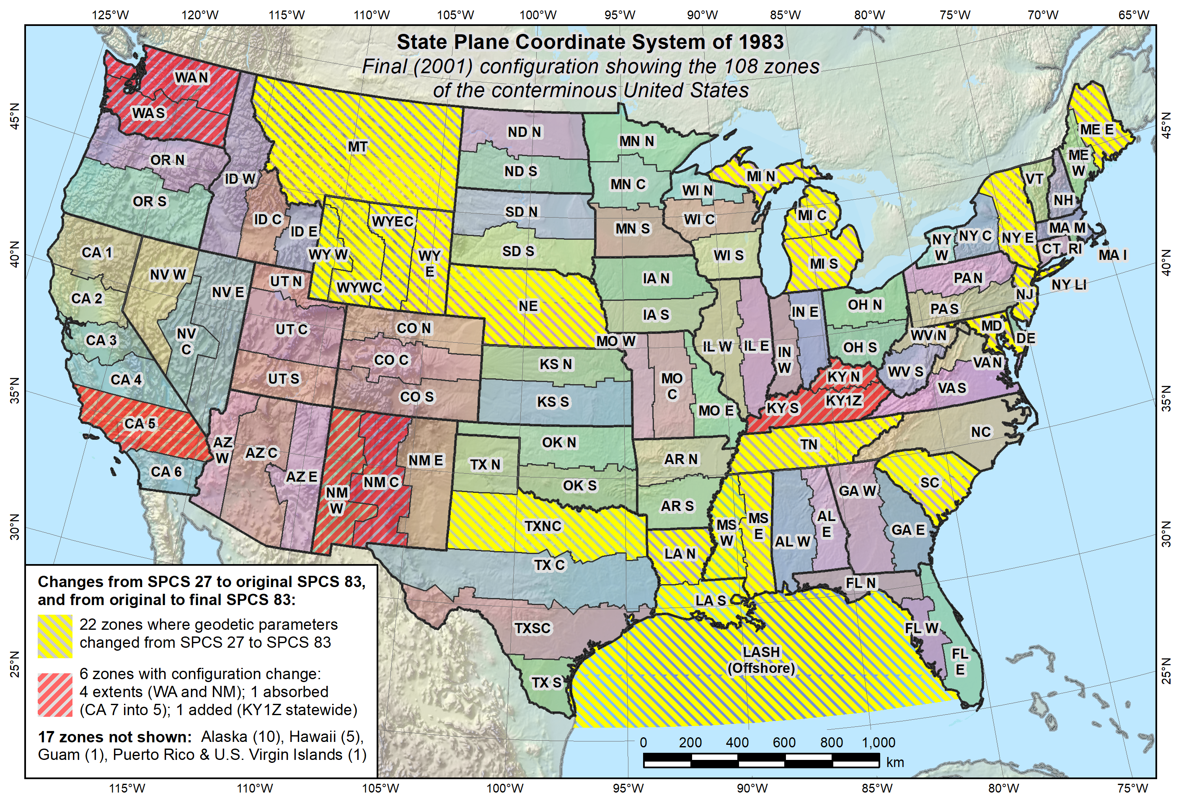
Final SPC 83 State Systems - 2001

Slide 30
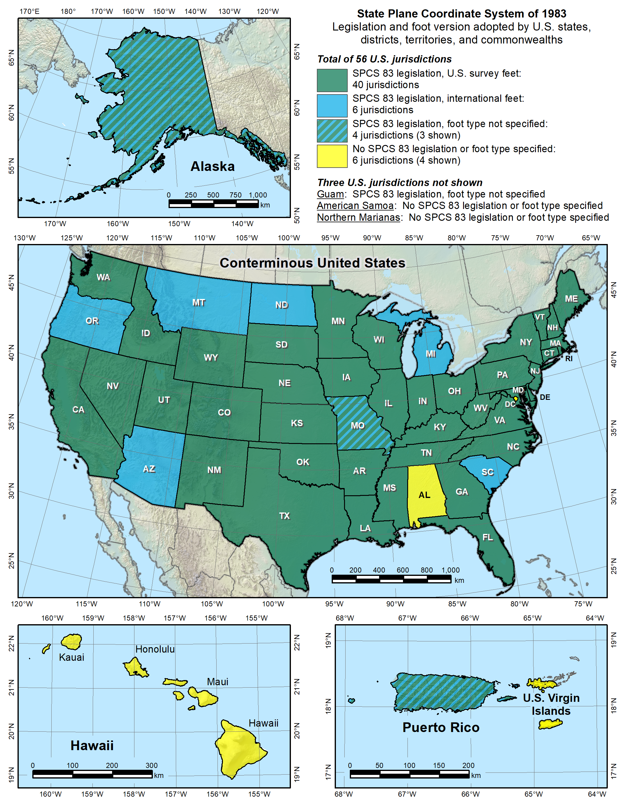
SPC 83 – Legislation & Foot Version

Slide 31

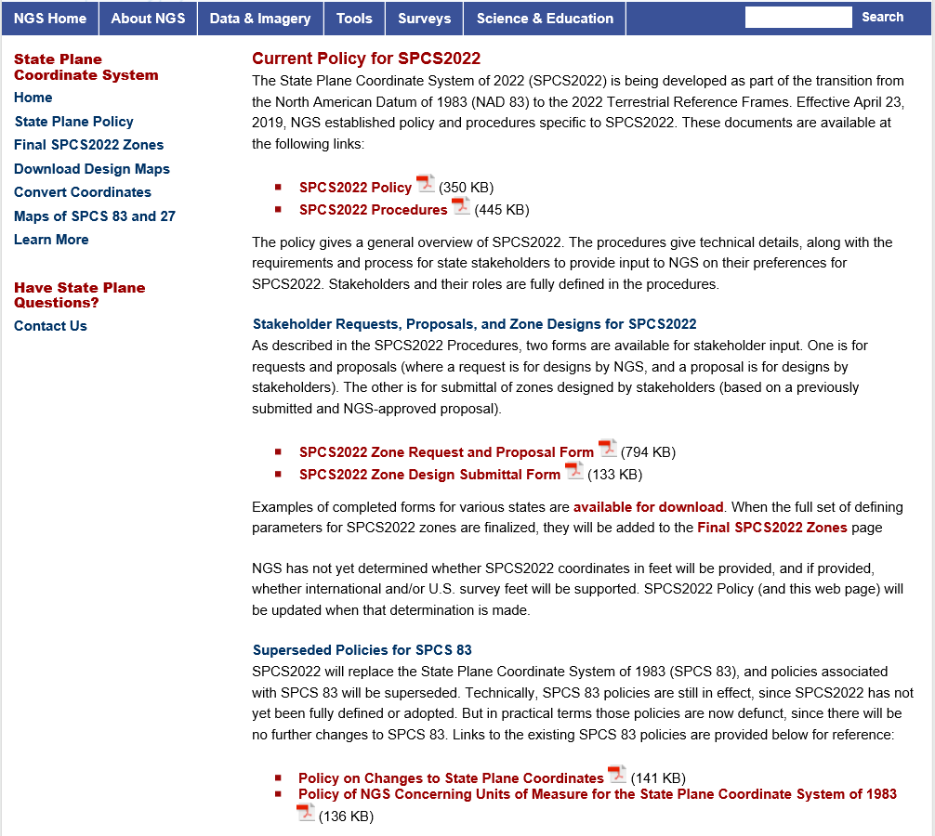

Slide 32
New State Plane Coordinate System (SPCS)
SPCS2022 characteristics different from SPCS 83:
  Minimize distortion at topo surface, not ellipsoid
  Up to 3 zone “layers” allowed (including an LDP layer)
  Coordinate changes of at least 10,000 m everywhere
  Longitudes defined as positive east (0°->360°)
    (Mobile = 360° - 88° = 272° E)
Notes:
SPCS2022 is referenced to 2022 TRFs and thus part of new “datums”, and will replace existing SPCS 83 (referenced to NAD 83)
Similar to SPCS 83 in some ways:
Designed by state, using same reference ellipsoid and same projection types
Differs from SPCS 83 in other ways:
Designs minimize distortion at topographic surface rather than ellipsoid surface (reduces distortion where system is actual used)
NGS will design default zones for every state, and default zones corresponding to existing SPCS 83 zones for states that do not request or propose something different
Can have up to 3 zone layers (where one layer must be a statewide zone). The other layers can be default zones and/or LDP zones (but not designed by NGS). Only one layer can be discontinuous (i.e., zones do not completely cover a state); it is expected that discontinuous layers will always be LDP zones.
“Special use” zones are for major urban areas, American Indian reservations, or federal jurisdictions/applications that fall in more than one state. These must eb approved by the NGS Director on a case-by-case basis.
The stakeholder role is vitally important for states that want something other than default zones. But all requests and proposals from stakeholders must be unanimous to become part of SPCS2022.

Slide 33
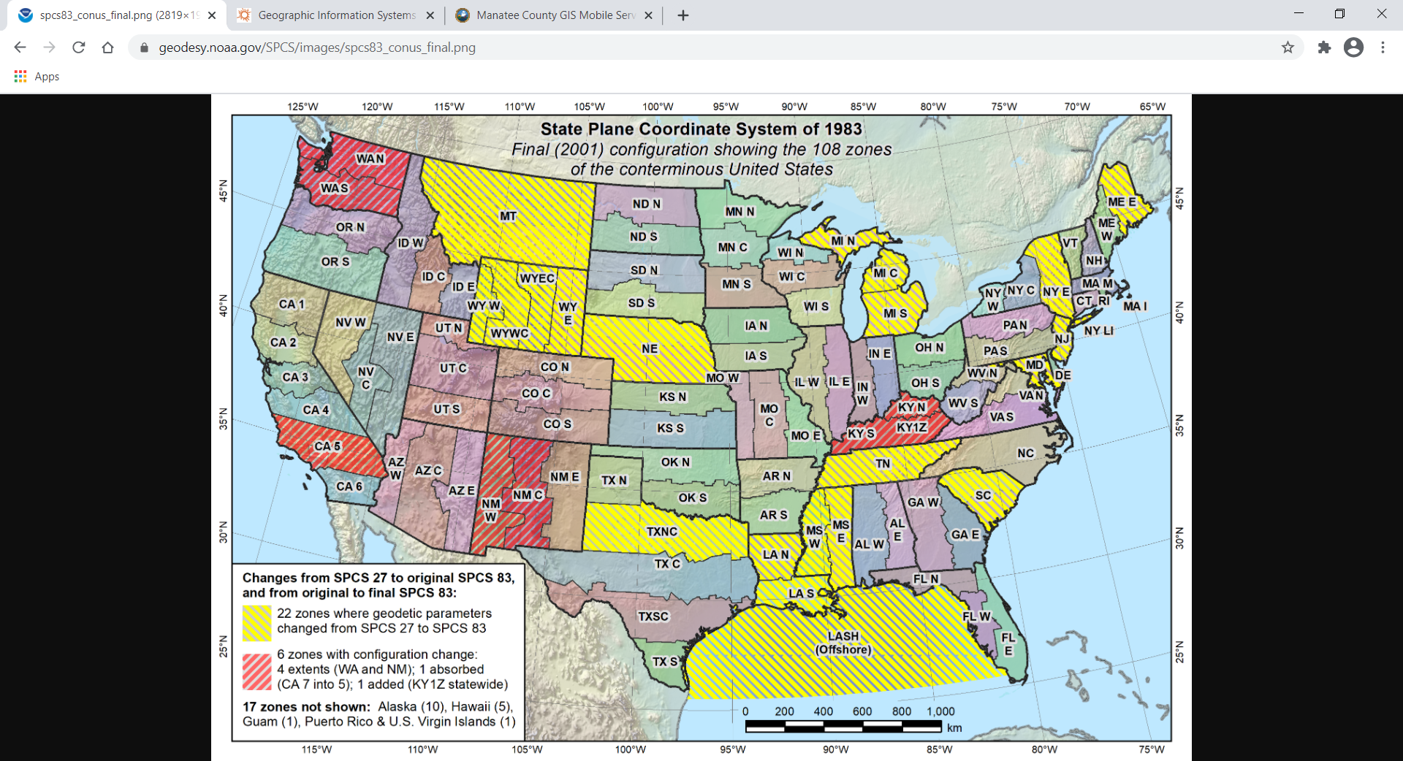

Slide 34
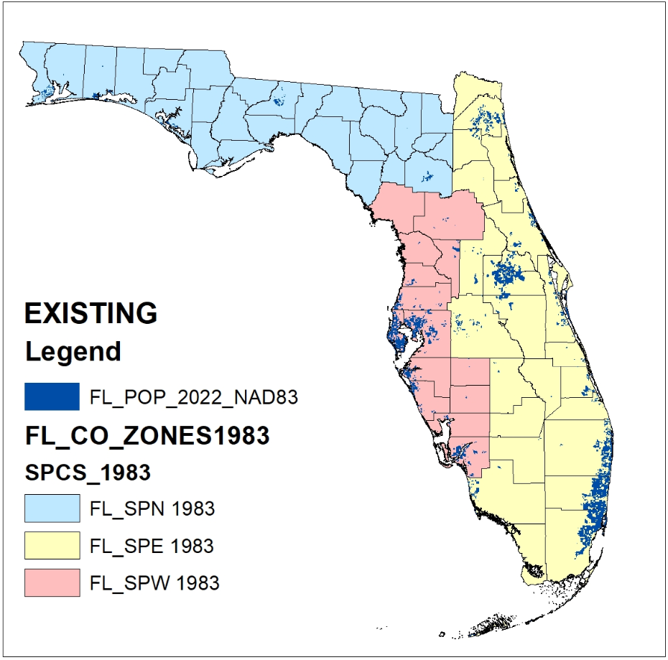
EXISTING FL
NAD83 SPCS

Slide 35
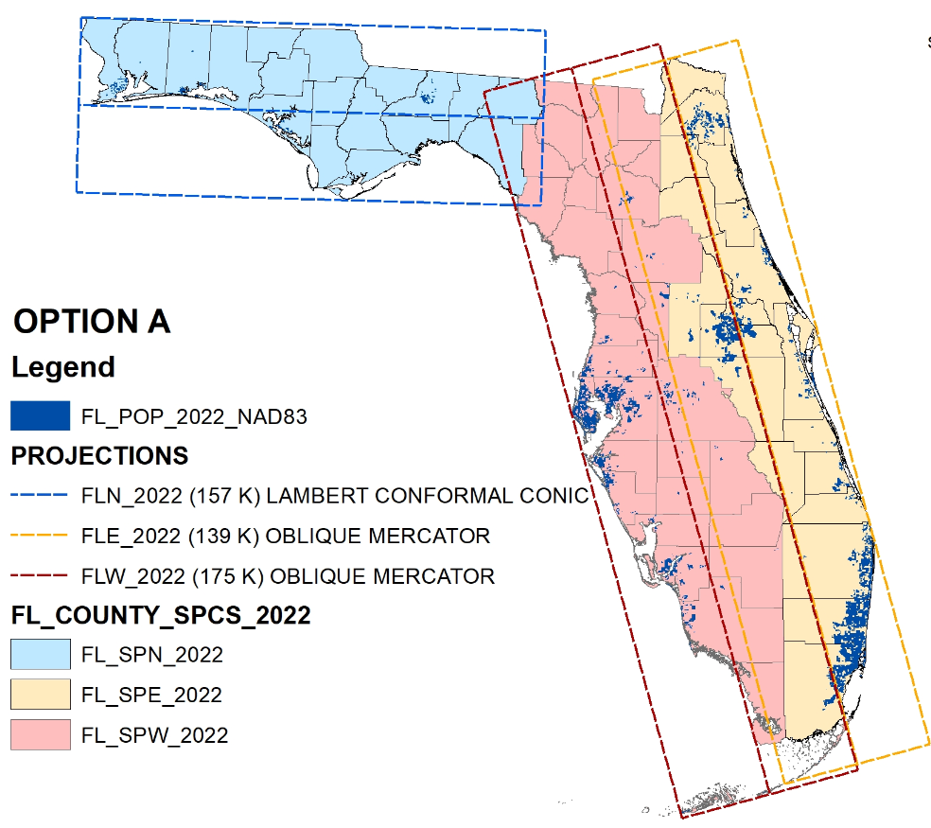
FL 2022 SPCS
MULTI-ZONE LAYER

Slide 36
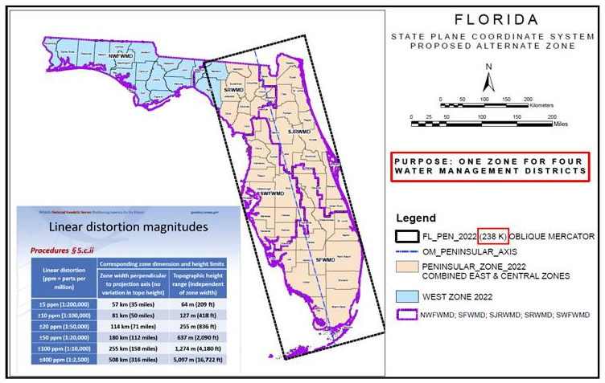
FL 2022 SPCS
PENINSULA ZONE
LAYER

Slide 37
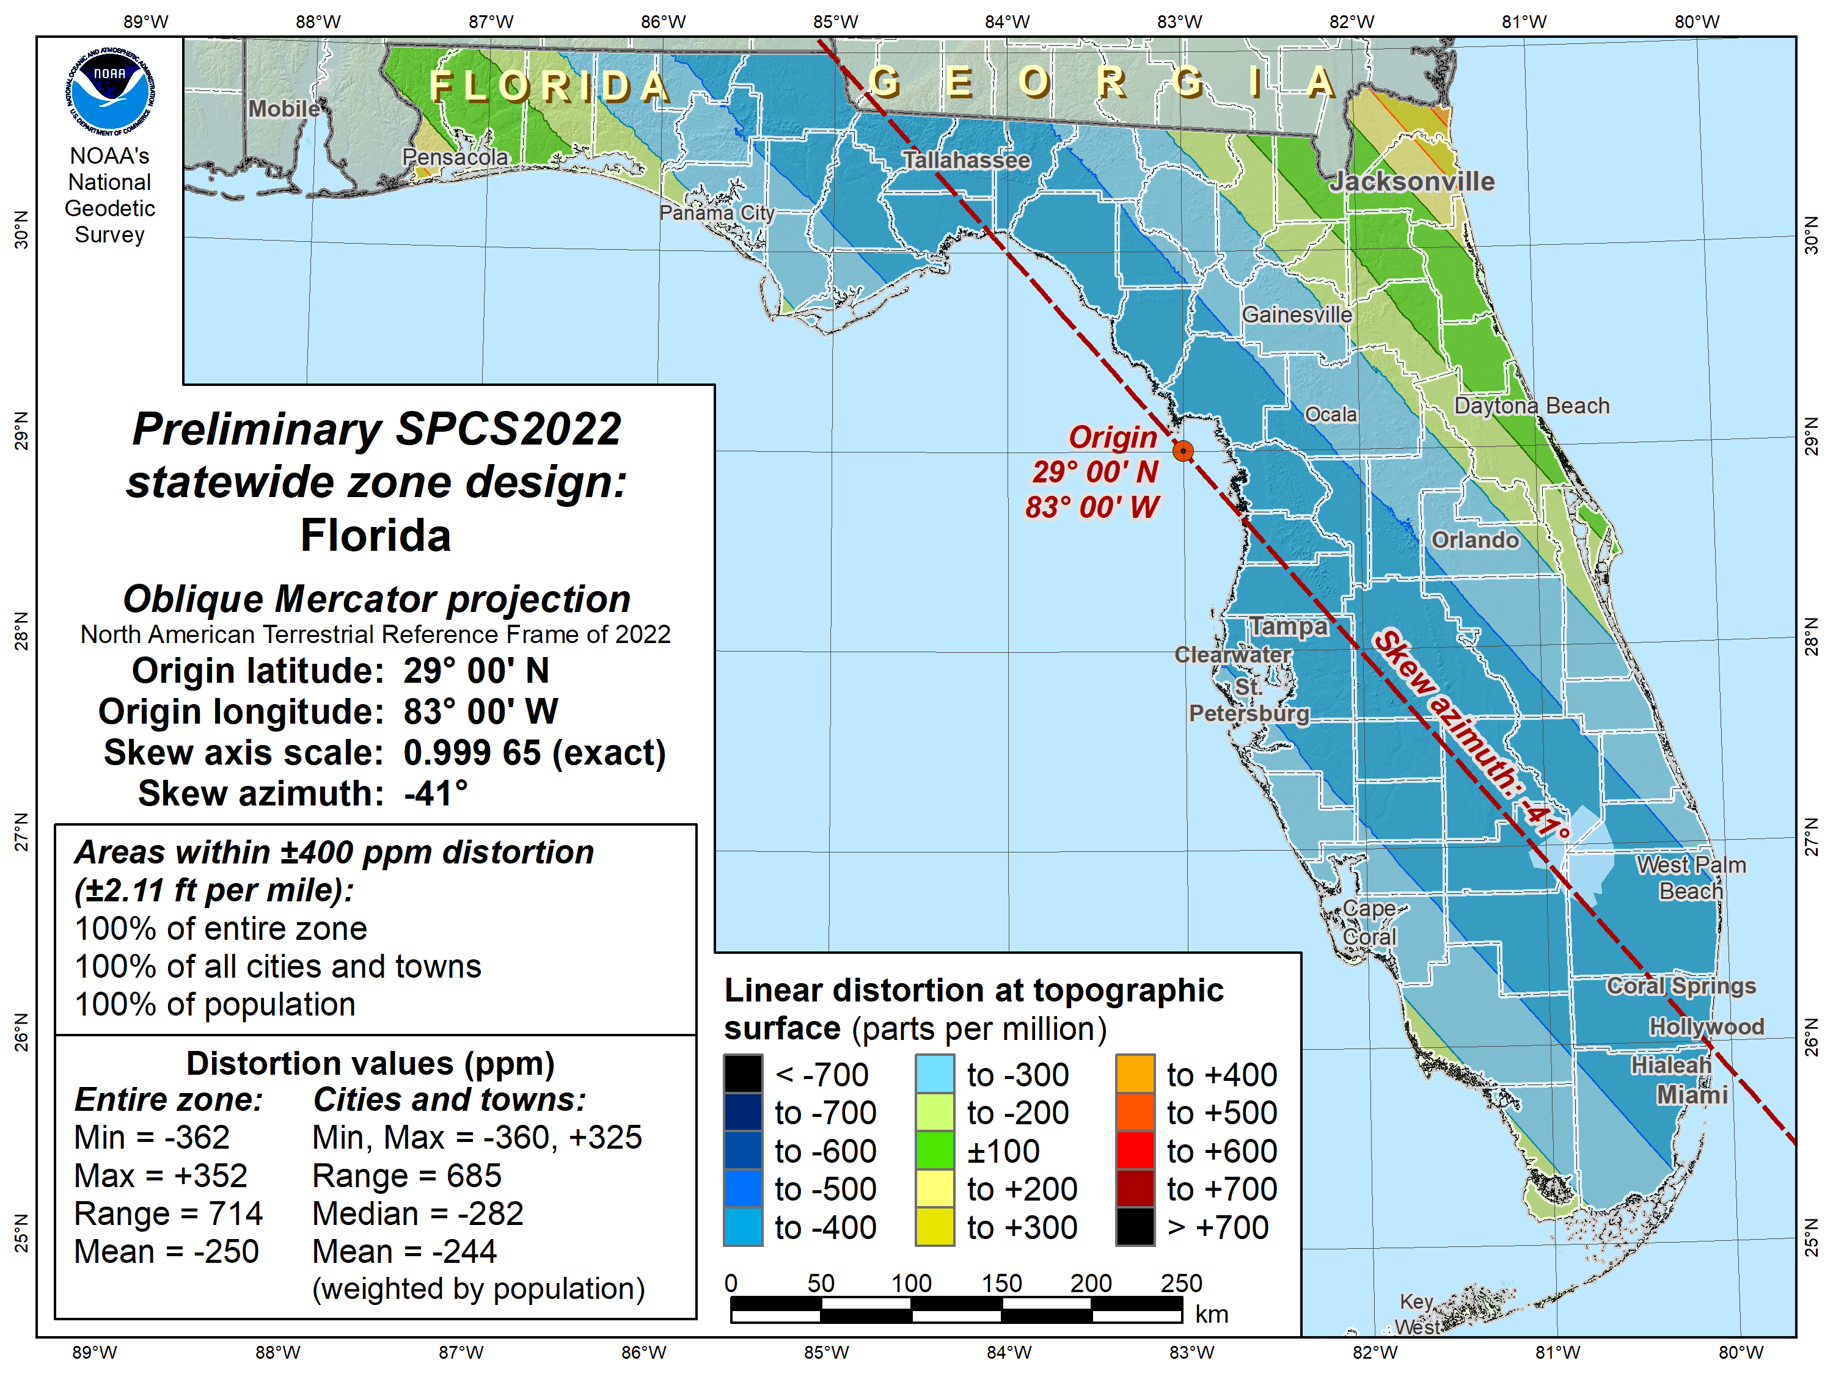

Slide 38
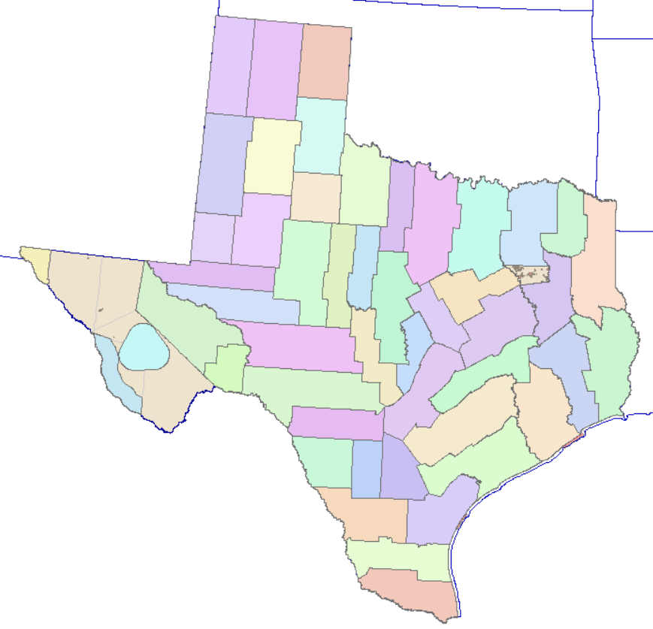
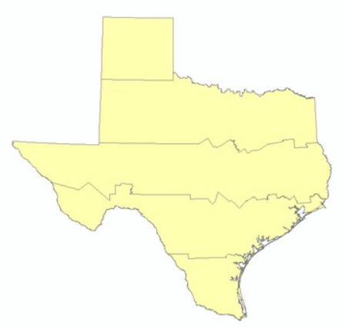
New SPCS - Proposed Texas Designs

Slide 39
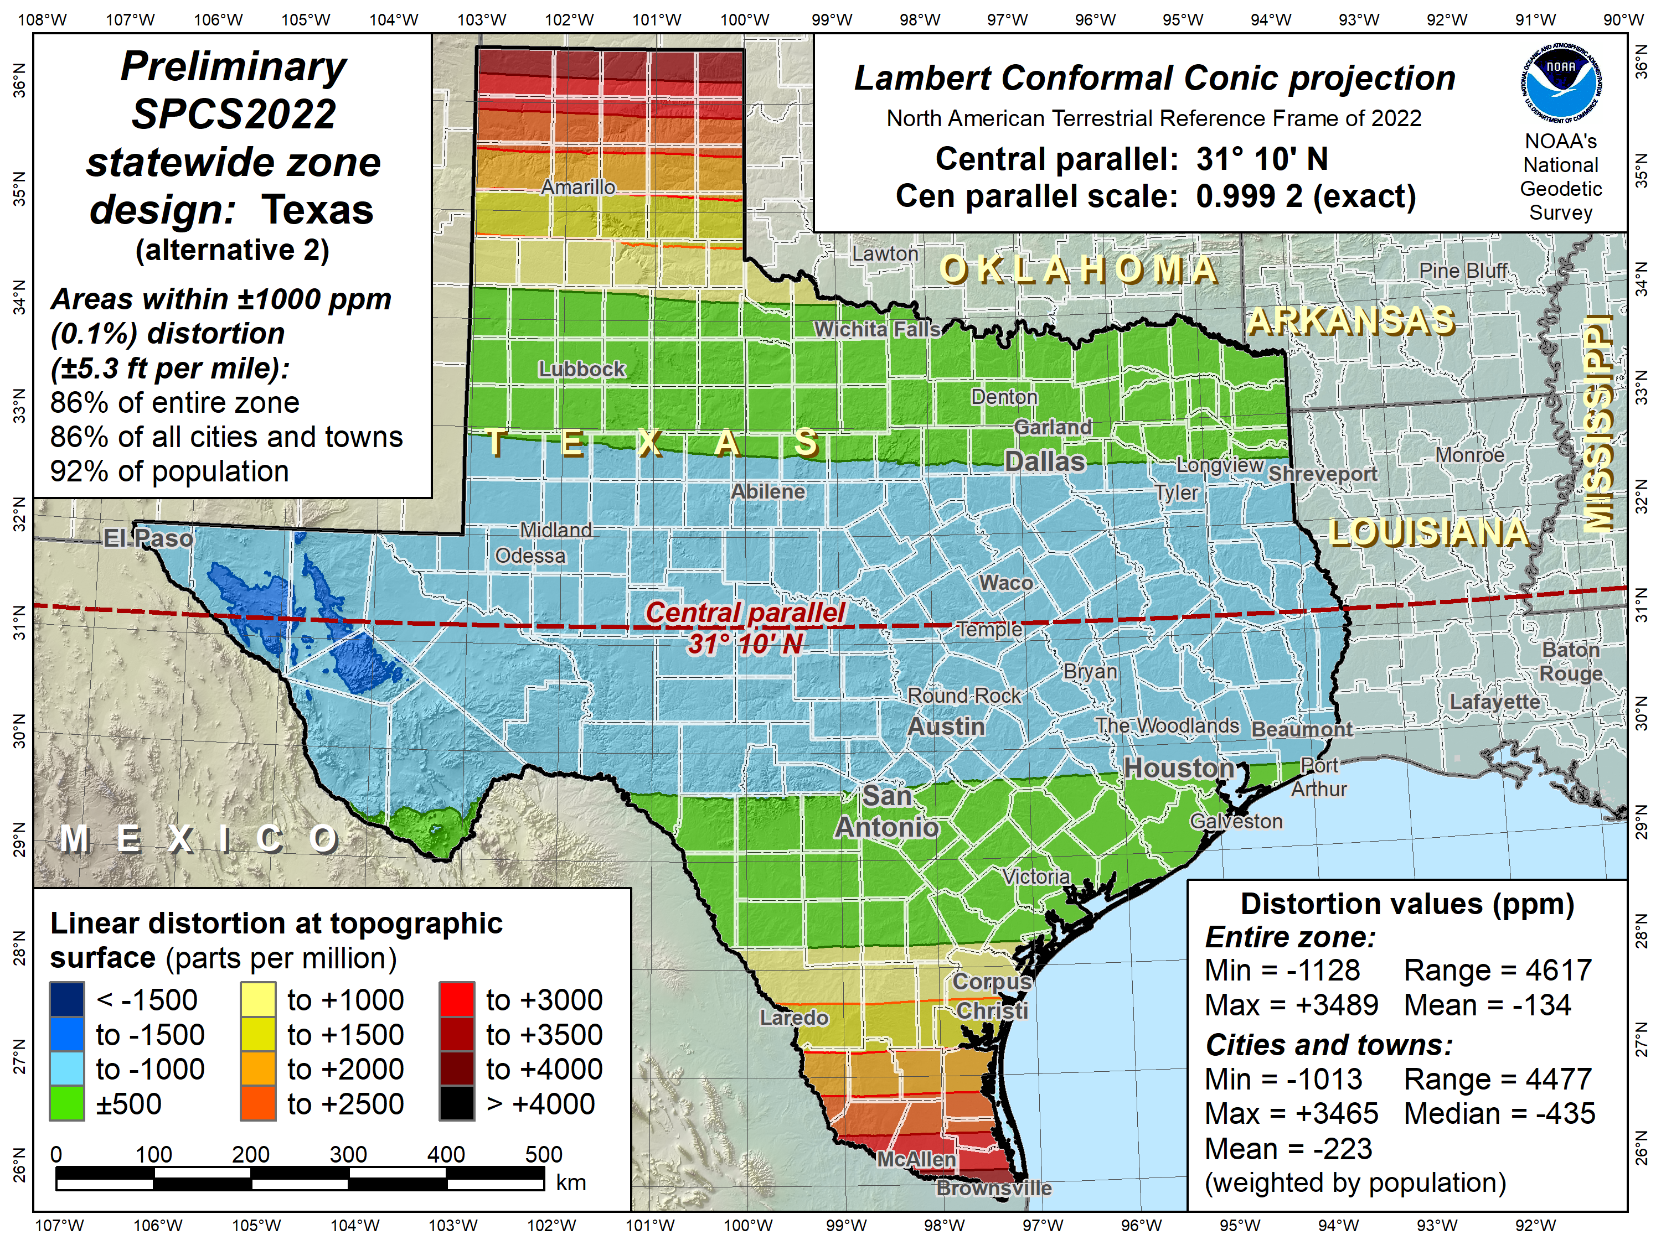

Slide 40
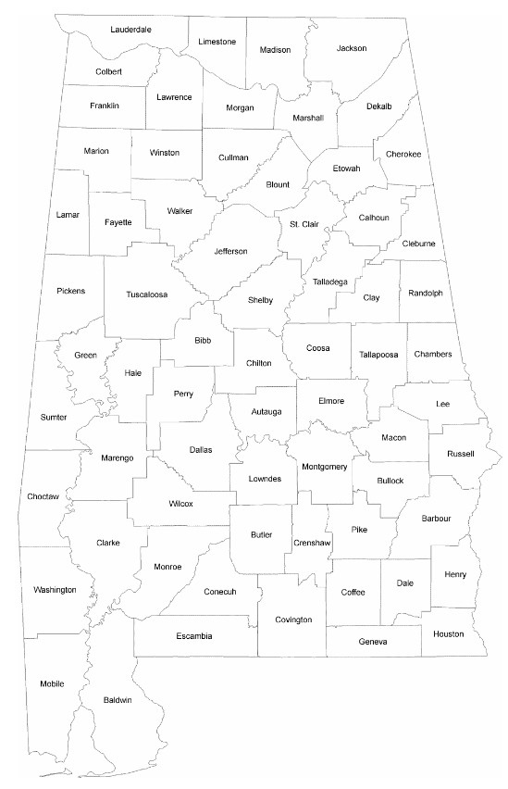
New SPCS - Proposed AL Multi-Zone Layer

Slide 41
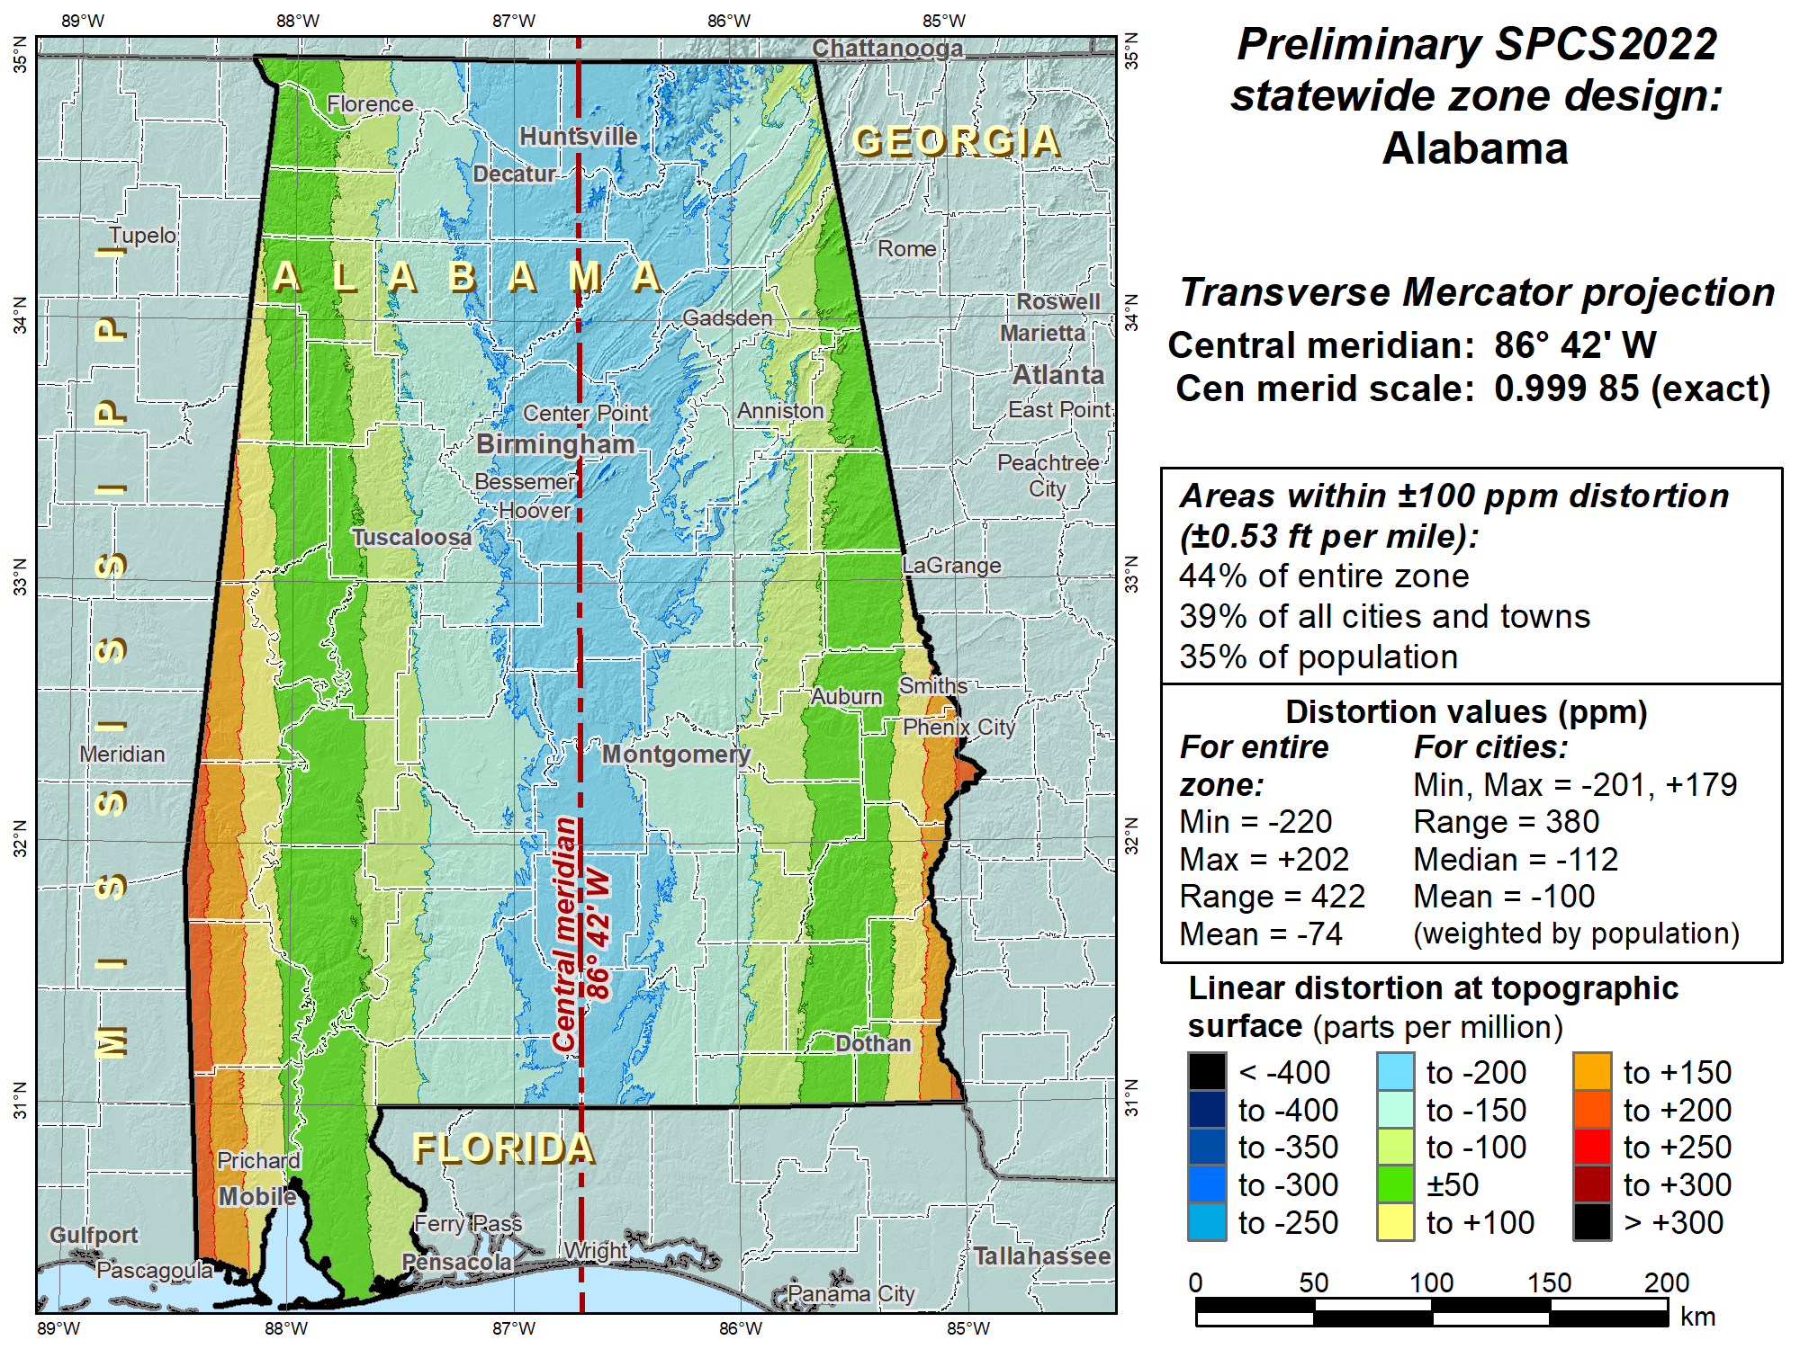

Slide 42
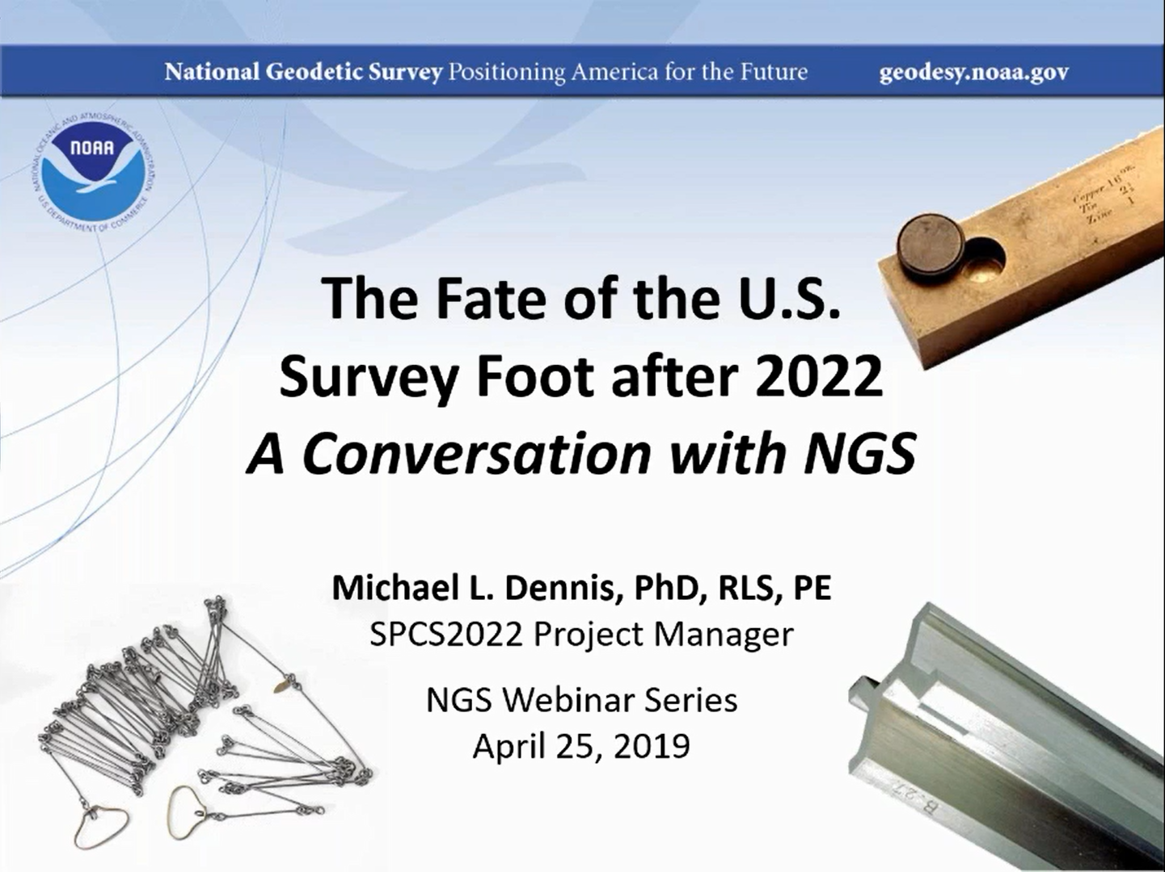

Slide 43
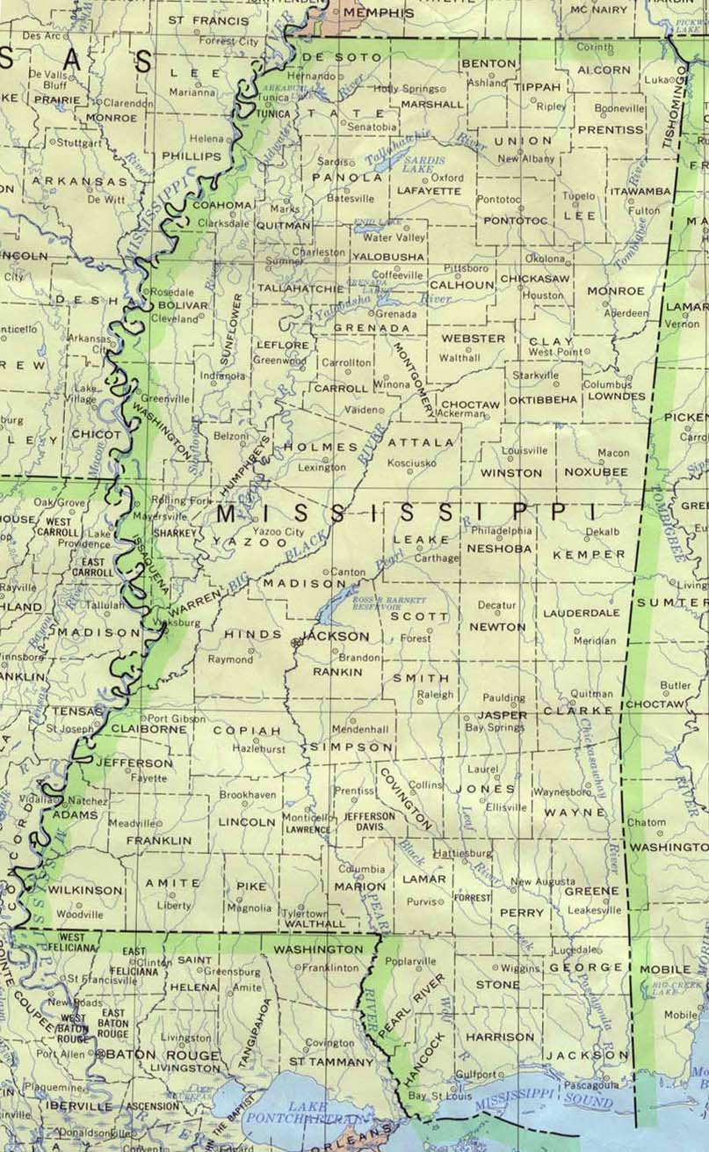
Tupelo
432,942 meters
= 1,420,413.4 iFt.
= 1,420,410.5 sFt.
Diff. = 2.9 ft.
≈ 432.942 Km
1.0 sFt = 0.3048006096… m
≈ 2 ± ppm
vs.
Will be called just “foot”
after 2022.
1.0 iFt = 0.3048 m
Gulfport

Slide 44
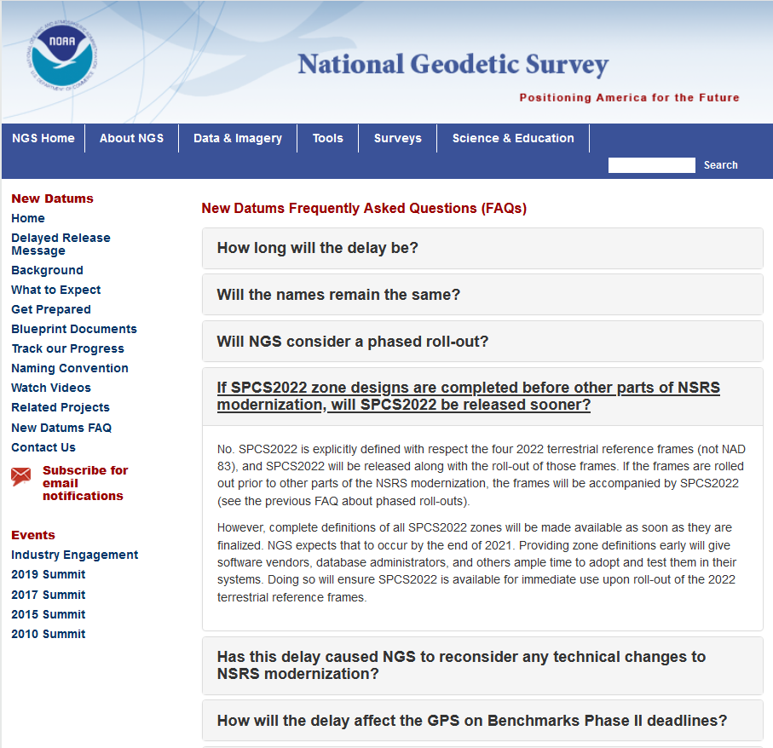
Delayed Release of the Modernized NSRS

Slide 45
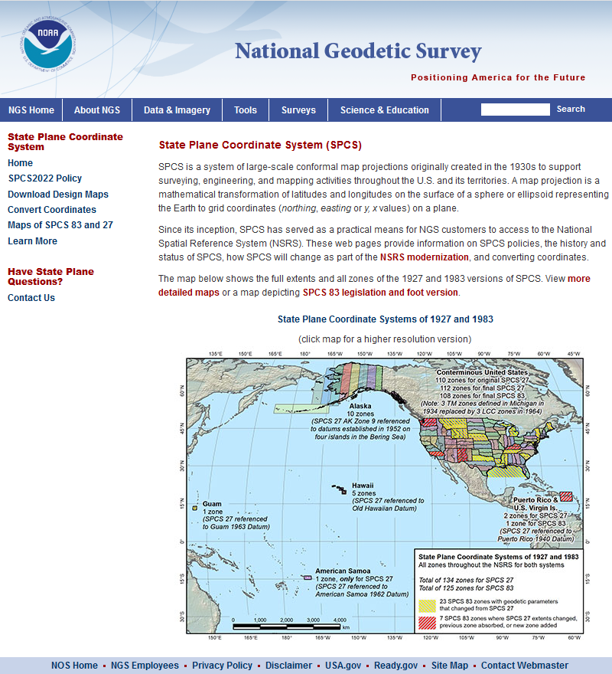
Also can find more information in the NGS presentation library or through viewing recordings of past webinars from the NGS Webinar Series.

Slide 46
How to Plan for 2022
Move to newest realizations
  NAD 83(2011) epoch 2010.00
  GEOID18 (hybrid geoid)
Move to NAVD 88
  understand the accuracy of VERTCON in your area
Utilize passive marks that are up to date
  Stay aware of what marks are included in datum updates
  Use OPUS & Hgt. Mod procedures to update mark positions
NGS Outreach Efforts
- Participate in NGS webinars, Geospatial summits, contact NGS Regional Advisor, etc.
Metadata
  Document positions in current datums to know what you have in the future.

Slide 47
Expected changes to orthometric heights – NAVD88 to NAPGD2022
For Florida = 0.1 > -0.3 m (4 > -11 in.)

Slide 48
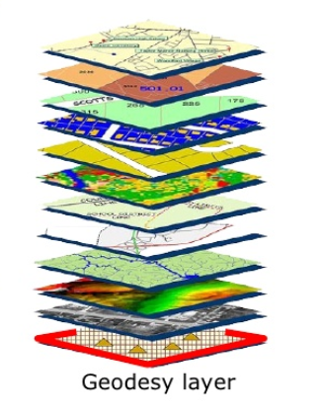
GIS Systems Use the NSRS as Base Control
The NSRS gives consistency to the references of each layer of GIS data, so the information in each layer can be queried or related in some way.
Like putting sheets in a notebook, we want to use only one “hole puncher” (the NSRS) so the sheets (layers of data) line up in our binder.

Slide 49

? ? QUESTIONS ? ?
Denis.Riordan@noaa.gov

