Slide 1
Using VRS, TBC, & OPUS Projects To Connect Your Projects to the NSRS
Jeff Jalbrzikowski, P.S., GISP, CFS

Slide 2
Who is NGS?
And what do they do?
What is the NSRS?
And why should you tie to it?

Slide 3
Our Organizational Structure
-Department of Commerce (DoC)
-National Oceanic and Atmospheric Administration (NOAA)
-National Ocean Service (NOS)
-National Geodetic Survey (NGS)
| Jalbrzikowski

Slide 4
Our Organizational Structure
We’re not USGS, we’re NGS
-Department of Commerce (DoC)
-National Oceanic and Atmospheric Administration (NOAA)
-National Ocean Service (NOS)
-National Geodetic Survey (NGS)
≠
…but hey, they’re cool too.
| Jalbrzikowski

Slide 5
NGS Mission
To define, maintain and provide access to the National Spatial Reference System (NSRS) to meet our Nation’s economic, social, and environmental needs.
access… ? = traditional → marks/disks/objects
modern and future → NOAA CORS Network (NCN)
via OPUS
| Jalbrzikowski
Notes:
-we know that the vast majority of NSRS users are accessing coordinates via OPUS, and yes as Dru explained yesterday

Slide 6
NOAA CORS Network (NCN)
1695 sites
241 organizations

Slide 7
Government Contracts for Geospatial Services
OMB Circular A-16
requires all Federal civilian agencies to utilize geodetic control for their geospatial activities
places NOAA in responsible charge of that control
NGS (as dictated by NOAA) defines that control as the NSRS
FGCS has issued requirements, via FRNs, to reference data to the most recent components of the NSRS
FRN in 1989 designated NAD 83
FRN in 1993 designated NAVD 88
| Jalbrzikowski
Hyperlink to NAVD88 FRN
Hyperlink to NAD83 FRN
Notes:
-This is an acronym heavy slide, not much I can do, that’s the government way!
-What’s the OMB Jeff?
-It’s an agency within the Executive Office of the President, they too are part of the Executive Branch of Gov’t just like us at NGS within the Dept of Commerce
-The OMB has published this document, “Circular A-16”
CLICK
-you can see the title there at the top, perhaps you’ve seen this cover before
*-those Federal folks in attendance, I sure hope you have!-*
-the overarching goal of A-16 is preventing the waste of Gov’t funds on duplication of geospatial efforts
CLICK
There’s four really important takeaways from OMB A-16.
1 - it’s Federal policy at one of the highest levels that Federal agencies (civilian agencies not the military/DoD/Intelligence) must utilize geodetic control for all geospatial activities
*Why not DoD, NGA, and the Intelligence agencies? Well, they have their own DoD Directive that requires them to tie everything to WGS84 and EGM08.*
2 – A-16 defines NOAA as being in responsible charge of geodetic control
3 - NOAA dictates NGS as the lead agency and NGS defines that control as “the NSRS” (term adopted in 1994). Why create that term? One phrase to outlive trends & technology, reduce the need to keep spending time and money re-writing policy and documentation every time we create a new datum name.
CLICK
4 – The FGCS…what’s that?, the Federal Geodetic Control Subcommittee, which is a part of the FGDC, the Federal Geographic Data Committee, and the best comparison I can make to the everyday is that it’s the organization for Federal agencies that mirrors what NSPS is to PSLS.
-…anyway, the FGCS has issued requirements via FRNs, or Federal Register Notices
CLICK
-…for agencies to reference all their geospatial data to the most recent components of the NSRS
CLICK

Slide 8
NSRS … do I have to use it?
Not necessarily, but it’s a great idea!
States may mandate use of NSRS… but none that I know of
If you want to get involved in Federal contracts… it’s a necessity!
Surveying & mapping are considered A-E Services → a QBS process
Federal Agencies – required users of NSRS
| Jalbrzikowski
Notes:
QBS or Qualification Based Selection is probably familiar to most of you, but in simplest wording it means that in Federal contracts for surveying & mapping the selection of the contract team shall be based on that teams qualifications (not bids or prices).
Thus, understanding the needs of these Federal customers, and their NSRS requirements, could get you a leg up against other competition. I’ve already seen at least 2 contract solicitations from the USACE have a requirement for OPUS Projects users.

Slide 9
NSRS … what’s the value?
Alignment of datums = geospatial data on the same page
USGS 3DEP + USACE NLD + USDA NAIP + NOAA ENC + ______ = FEMA FIRMs
Other data often included in FIRMs, may or may not be in appropriate datums
Your Data + Statewide Imagery = Quality Check
Exemplifies the value of using the NSRS
What about your data becoming part of the NSRS?
You share your data with us at NGS. If it complies with FGDC standards, we include it in one of our public databases.
IDB or OPUS Shared Solutions
| Jalbrzikowski

Slide 10
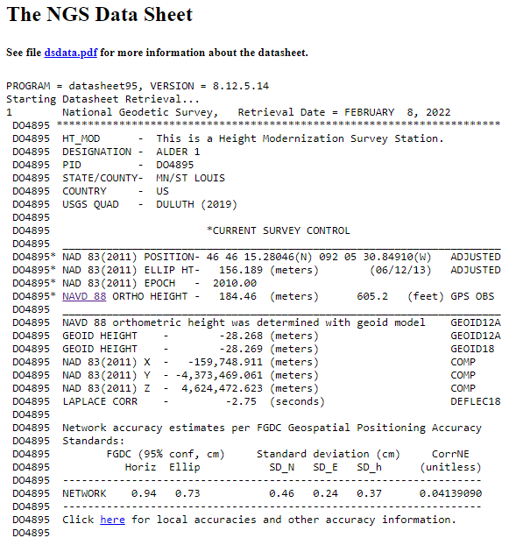
What about your data becoming part of the NSRS?
Project Plan reviewed by Regional Advisor and/or OAD
FGDC & NGS standards outline your procedures
Rigorous review by NGS Observations & Analysis Division (OAD)
Final results are input to NGS IDB
Everything in a standardized format
Coordinates publicly available via Datasheets
Authoritative data, aka “published”
Remains there in perpetuity
Updated in future adjustments, realizations
| Jalbrzikowski
Notes:
-Project Plan reviewed by Regional Advisor
-FGDC & NGS standards outline procedures to achieve required accuracies
-Rigorous review by NGS Observations & Analysis Division
-Final results are input to NGS IDB
Everything in a standardized format
-Coordinates publicly available via Datasheets
Authoritative data, aka “published”
Remains there in perpetuity
Updated in future adjustments, realizations

Slide 11
OPUS Projects
No, it’s not just “doing projects with OPUS”…

Slide 13
OPUS Rapid Static (OPUS-RS) – 15 min to 2 hours
Not integrated with OPUS Projects
| Jalbrzikowski
Notes:
OPUS-RS or Rapid Static performs two calculations.
1st - creates an atmospheric delay model from surrounding CORS data (white circle)
2nd - Your position is determined via a differential GPS static solution

Slide 14
OPUS Static (OPUS-S) – 2 to 48 hours
-Best 3 of 5 baselines
-Sequentially processed
-Reports your peak-to-peak (P2P) average position
5001
5002
| Jalbrzikowski
CORS
OPUS Solution
Notes:
-OPUS Static takes the best 3 of 5 baselines, sequentially processed, and provides you their peak-to-peak average
-we delivered over 1.2 million solutions in 2021, compared to in 2011 when we first broke the 200,000 solutions milestone
-sidenote that we’ve already broken the 1.5 million mark for 2022

Slide 15
OPUS Static (OPUS-S) – 2 to 48 hours
-No correlation between your observed marks
→Low Relative Accuracy
-Even if … collected simultaneously
… submitted to OPUS simultaneously
-OPUS-S = independent solutions
5001
5002
| Jalbrzikowski
CORS
OPUS Solution

Slide 16
OPUS Projects (OP) – 2 to 48 hours
-Simultaneous processing of your observed marks
→Improved Relative Accuracy
-Requires a little more field planning effort
-OP = true network solutions
-And of course, least squares adjustment
Distant CORS
~400-800 km
5001
5002
5003
5004
| Jalbrzikowski
CORS
OPUS Solution

Slide 17
Why OPUS Projects?
Reference Epoch Coordinates (RECs)
You’ll get coordinates in NATRF2022 and NAPGD2022 on “day one”
Only “recent” GPS data in the IDB will get RECs
Federal Register Notice – July 2020
GPS on Benchmarks (GPSonBM)
2 occupations @ 5 minutes each vs. 2 occupations @ 4 hours each
Multi-constellation aka “GNSSonBM”
| Jalbrzikowski
Notes:
Reference Epoch Coordinates (RECs)
You’ll get coordinates in NATRF2022 and NAPGD2022 on “day one”
Only “recent” GPS data in the IDB will get RECs
Federal Register Notice – July 2020
CLICK … FRN POPUP … CLICK AGAIN
GPS on Benchmarks (GPSonBM)
2 occupations @ 5 minutes each vs. 2 occupations @ 4 hours each
Multi-constellation aka “GNSSonBM”

Slide 18
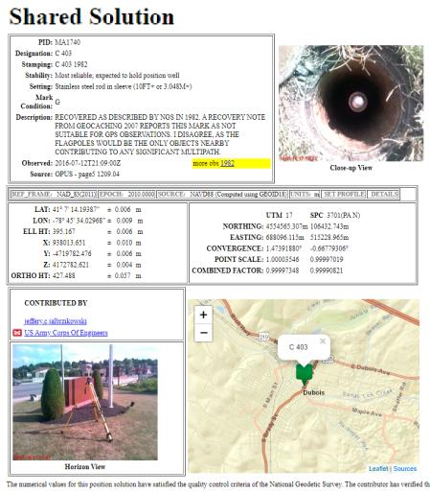
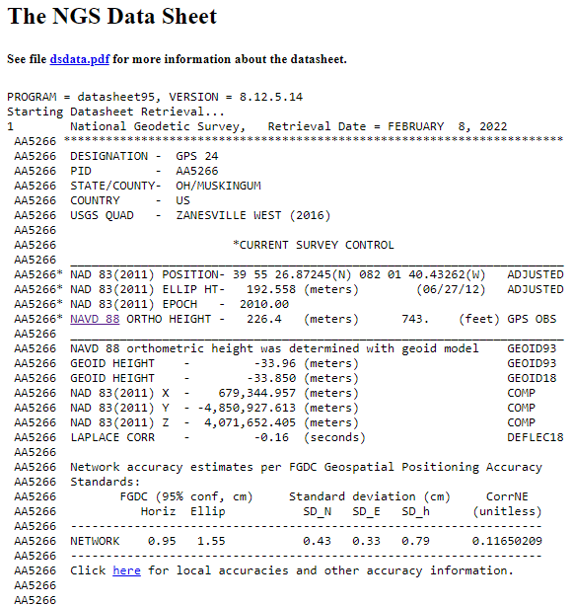
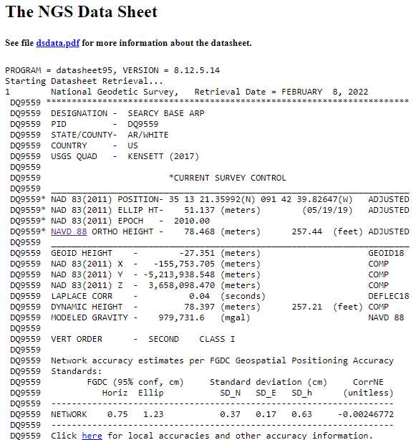
What about OPUS Shared Solutions?
 | OPUS Shared | OPUS Projects (RINEX) | OPUS Projects (GVX)
Minimum Occupations | 4 hours Only one | 2 hours At least 2 | 5 minutes At least 3
Processing | OPUS-S (sequential) | PAGES (simultaneous) | VRS
Adjustment | None | Least Squares Network | Least Squares Network
Metadata | 2 photos Brief Description | 3 photos, WinDesc files, Logs, & Report | 3 photos, WinDesc files, Logs, & Report
Outcome | Shared Solution | Datasheets | Datasheets
| Jalbrzikowski
Notes:
OPUS: Good absolute accuracy (NSRS)
Low relative accuracy (site)
Upload 1 file… get results
Share (get OPUS Shared Solution)
OPUS Projects: Great absolute accuracy (NSRS)
High relative accuracy (site)
Upload files, QC, least squares adjust
Submit to NGS (get Datasheets)

Slide 19
Bluebooking → OPUS Projects
000010*AA*HZTLOBS NGS NATIONAL GEODETIC SURVEY 20130114
000020*10*BOUNDARY MON STRICKLAND NC SC HEIGHT MODERNIZATION 2013 (OP: gps2912f)
000030*12*201301201301MS MARK SCHENEWERK 4NCAA
000040*13*NAD 83(2011) GRS 80 63781370002982572221
000050*25*0001R0143ABLUFMS 004 003
000060*26*BB 0143A -> OP 2013-014-A
000070*27*00011301141641 2000
000080*27*00011301142001 2000
⋮
001900*70*007055 Trimble NavigationDUAL CARRIER PHASE PPSNETR5 4742K10896
001910*70*008055 Trimble NavigationDUAL CARRIER PHASE PPSNETR5 4744K11096
001920*70*009055 Trimble NavigationDUAL CARRIER PHASE PPSNETR5 4829K57356
001930*72*001 AOAD/M_T NONE KW5-0201
001940*72*010 TRM57971.00 NONE 30973141
001950*72*011 TRM57971.00 NONE 30976660
⋮
002040*80*0001BLUFF 34173468578N079034455052W NC
002050*86*0001 20756G N88 -338086 -13052A ANAD_83(2011)
002060*80*0002BOUNDARY MON STRICKLAND NC SC 34173269930N079034661580W NC
002070*86*0002 20728G N88 -338076 -13071A ANAD_83(2011)
002080*80*0004GUY 34164773356N078595524668W NC
⋮
Web-based, nothing to download
Map out and Review multiple OPUS Solutions
or repeat occupations of one mark
Advantages:
Project data uploading through OPUS
Process using PAGES
…without intricacies of PAGES!
Submit directly to NGS
Datasheets Made Easy!
Bluebook Files created by OP
***CAUTION: Observations in this file have been updated to 1-01-2010 = (2010.00
***CAUTION: All GPS interstation vectors have been transformed to NAD_83(2011/CO
***CAUTION: Observations were transformed using HTDP version v3.2.7 ***
***CAUTION: All sigmas were scaled by a factor of 10.0 ***
AAA2010010120100101 ZT
B20180821000020180821235910BETA OP 1.31 IGS 234 1 2 27ARHD 20190521IFDDPF
IIGS08_1930 IGS 20170101
F10010002 -50948150 25 255943102 181 357313453 124 R2338AR2338A
F10020002 215134484 25 286299079 185 411160634 126 R2338AR2338A
F10030002 249956062 28 379806174 209 545635267 140 R2338AR2338A
F00010002 84004162 21 311025311 152 440560369 106 R2338AR2338A
F00030002 -798564478 14 -73258969 91 -124092747 66 R2338AR2338A
F00040002 709476932 14 638587836 93 940548899 66 R2338AR2338A
F00050002 290556879 14 954658802 93 1379016173 66 R2338AR2338A
F00060002 -744206897 14 309639620 92 412810167 66 R2338AR2338A
F00070002 829499347 14 -23574646 95 5080521 70 R2338AR2338A
F00080002 14935629356 31 -1680534611 107 1267073263 77 J2338AR2338A
D 1 2 221649 1 3 -709855 1 4 2434622 1 5 186848 1 6 -244245
D 1 7 2171142 1 8 186484 1 9 -243217 1 10 2496275 1 11 180813
D 1 12 -205646 1 13 2760237 1 14 360042 1 15 -333580 1 16 2683209
D 1 17 346408 1 18 -332078 1 19 2733430 1 20 355468 1 21 -345611
| Jalbrzikowski
Illustrator: Jim Haynes

Slide 20
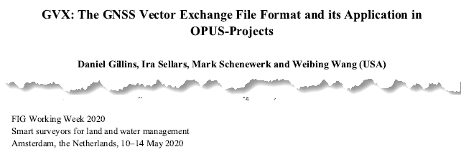
GNSS Vector eXchange (GVX)
Info Page: https://www.ngs.noaa.gov/data/formats/GVX/index.shtml
Detailed documentation, Schema, and Example File available
Any major search engine: “ngs gvx file format”
Open standard for anyone to use or integrate
GVX is sort of like… RINEX for RTK/RTN data
GVX details?
Check out:
| Jalbrzikowski

Slide 21
GVX ≈ RINEX for RTK/RTN data
RINEX
GVX
Uncorrected Observations
That’s why we post-process them
Static Observations
One observation per file
Trimble ConvertToRINEX
Been around a long time
Metadata
Antenna, Rx, HI, Point Name, Start Time, SVs at each epoch
ASCII Text File Format
Industry std. (too many to list!)
Corrected/Processed Positions
And Vectors used to create them
VRS, RTK, PP, even PPK
Many observations, any mix of above
Trimble Business Center
v5.60 and later
Metadata
RINEX + Project Info, Solution Types, PDOP, Mount Points, Correlation Matrices, QC data
XML File Format
Industry std. (JXL, LandXML, etc.)
| Jalbrzikowski

Slide 22
Using VRS for site control
Best Practices for high accuracy

Slide 23
Using VRS for Site Control
What various users have told me they do.
Take “a few” typical topo shots with rover pole
Yikes!?
Setup a rover pole w/bipod, “burn it in” for 10-15 minutes at start
Sure I guess, but where’s the redundancy?
One said “I don’t trust the VRS for control, I’ll only run static.”
OK, that’s cool, but if ya’ got it… why not use it?
What Would NGS Do to get Efficient and Accurate results?

Slide 24
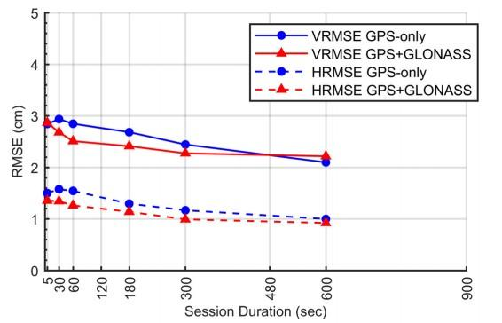
Empirical Evaluation of the Accuracy of RTNs
So in plan English…
Any VRS occupation >5 minutes isn’t doing a whole lot for you
Occupation redundancy is what works the magic
“total time on mark”
For Site Control
Get your bipod
Run 5 minute occupations
Do it more than once!
1x morning + 1x end of day; Repeat
Separation of Occupations <3 hours
Similar to accuracy of a 2 hours OPUS Static solution.
Available via the ASCE Library [Allahyari et al. 2018]
https://doi.org/10.1061/(ASCE)SU.1943-5428.0000249

Slide 25
Recommendations to Meet Ellipsoid Height Accuracy Standards at 95% Confidence Level using OPUS Projects
Ellipsoid Height Standard |  | Number of Repeat RTN/NRTK Observations |  | Observation Duration
cm | feet | GPS only | GPS + more | Minutes
3.5 | 0.11 | 2 | 2 | 5
3.0 | 0.10 | 3 | 3 | 5
2.5 | 0.08 | 4 | 3 | 5
2.0 | 0.07 | 6 | 5 | 5
Table from NGS document still in draft phase (update of NGS-58)
IMPORTANT CONSIDERATIONS:
Distance from the rover to the nearest base station in network <40 km (~25 miles)
Start time of observations differ by >3 hours

Slide 26
GVX Scenarios in OPUS Projects
CORS + VRS
PRS are not in NCN
CORS + VRS
Depending on station(s) used for your Physical Reference Station (PRS) in Trimble Access, you will encounter one or more of these scenarios.
What’s the difference?
Different workflows in OPUS Projects.
PRS are not in NCN but are in NGS IDB (have PID/Datasheet)
CORS + VRS
PRS are in NCN
Also possible, but today’s focus is VRS…
Static Base + RTK
Base (positioned via OPUS) delivering RTK corrections to rover
Static Post-Processing in TBC
Survey → GNSS → Process Baselines
| Jalbrzikowski

Slide 27
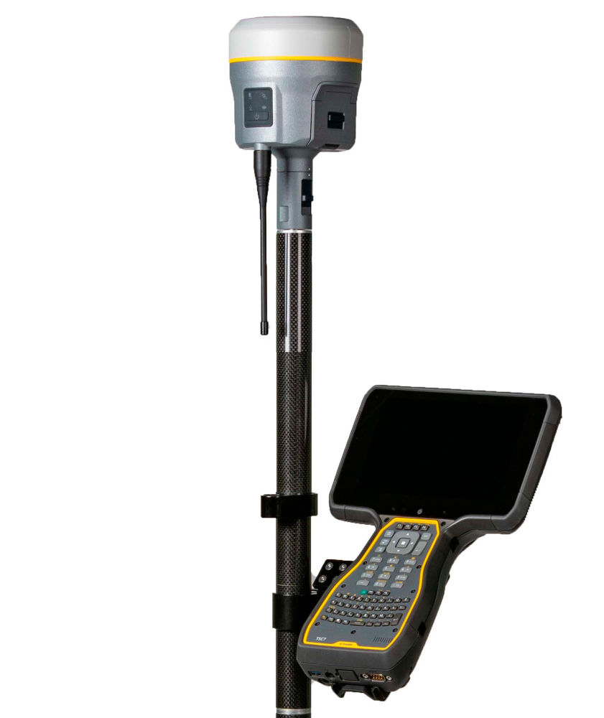
CORS + VRS PRS are not in NCN
Collect your data w/Rover(s)
Download non-NCN CORS data
Reference Data Shop
Upload CORS data to OP via OPUS-S
Download Rover data
Convert to GVX in TBC
Upload GVX to OPUS Projects
Process Sessions
Adjust Network

Slide 28
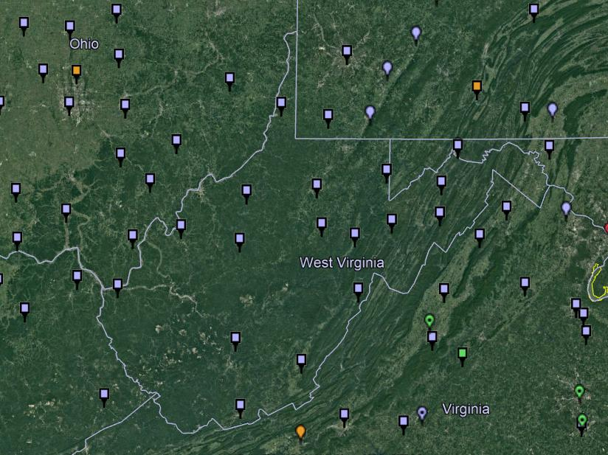
NOAA CORS Network (NCN) in WV
Notes:
where else but the federal government are you going to see two acronyms within one acronym?

Slide 29
WVDOH CORS Network
Notes:
where else but the federal government are you going to see two acronyms within one acronym?

Slide 30
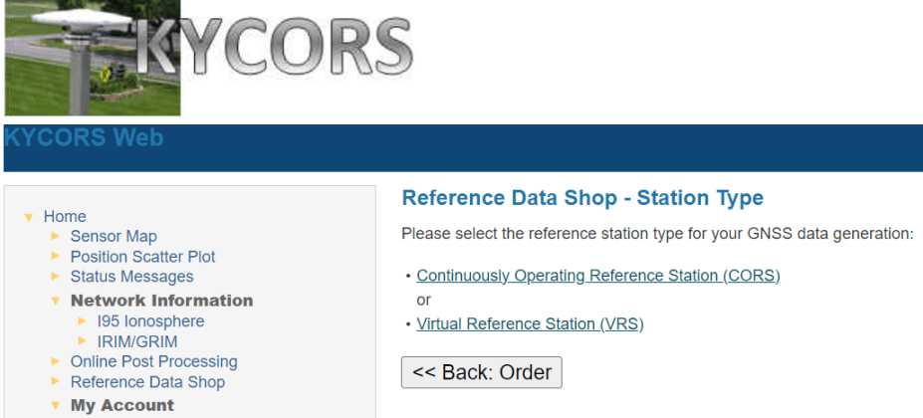
CORS + VRS PRS are not in NCN
Download non-NCN CORS data
Login to your VRS Network’s Reference Data Shop
Or use Internet Download tool to import CORS data
Notes:
TBC tool supports network logins
If you’re using a VRS network, the admins are running Trimble Pivot, so you can use this tool to streamline your workflow

Slide 31
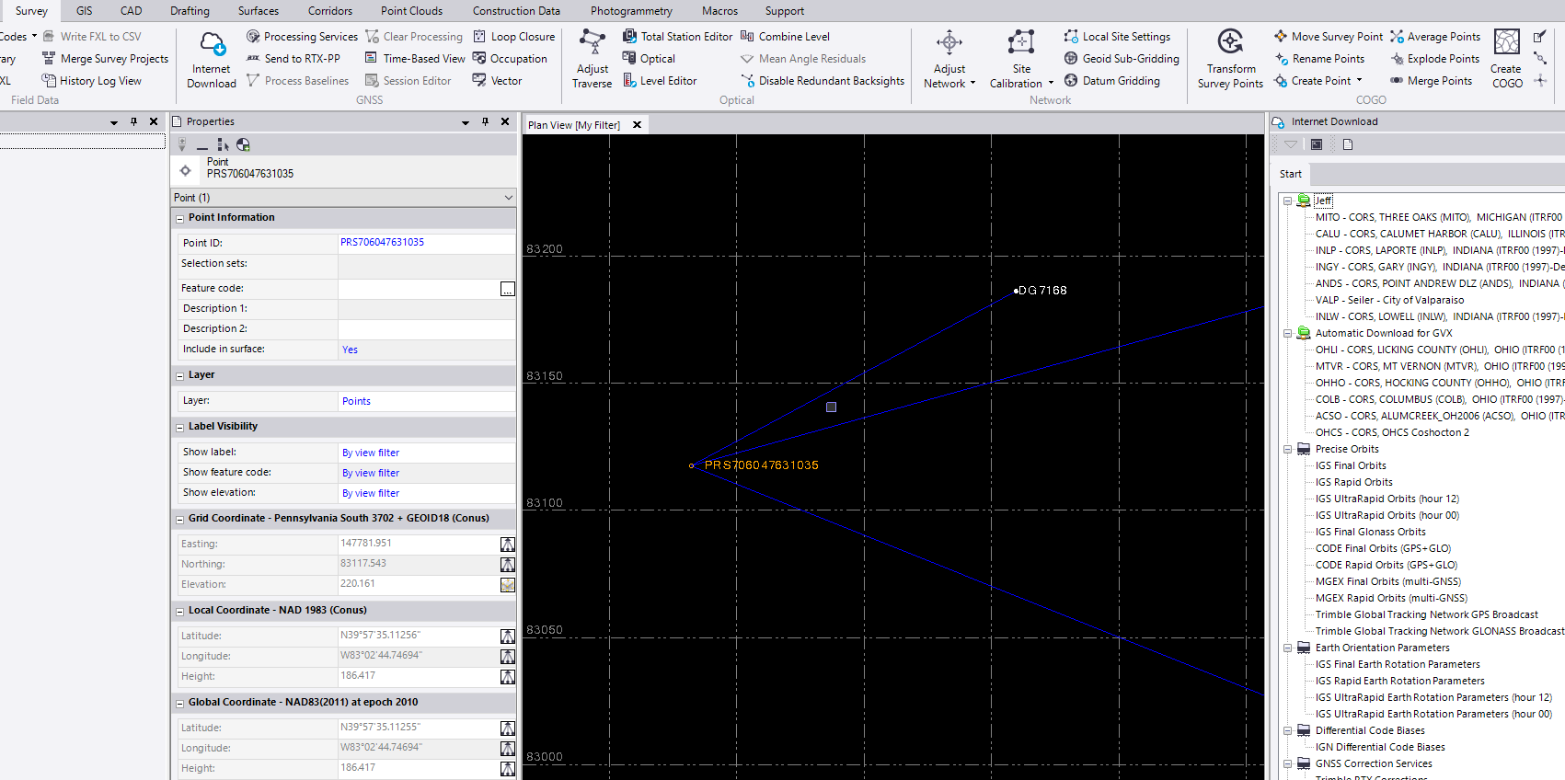
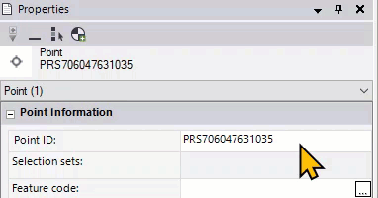
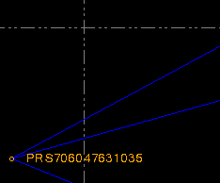
CORS + VRS PRS are not in NCN
Convert to GVX in TBC
Change Point ID for each PRS to the CORS name
Notes:
Cuz ya know, every time you import a JXL with VRS data, it has that funky Point ID
This isn’t a requirement, but it’ll make the OPUS Projects part easier for you

Slide 32
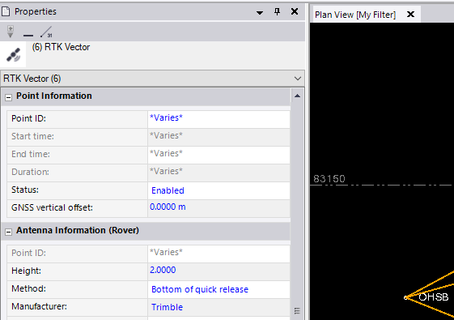
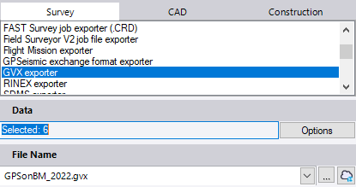
CORS + VRS PRS are not in NCN
Export GVX
Select vectors of Control before exporting GVX
Including topo shots, etc., will only unnecessarily bog down OP
Notes:
Cuz ya know, every time you import a JXL with VRS data, it has that funky Point ID
This isn’t a requirement, but it’ll make the OPUS Projects part easier for you

Slide 33
CORS + VRS PRS are not in NCN but are in NGS IDB
Collect your data w/Rover(s)
Download non-NCN CORS data
Reference Data Shop
Upload CORS data to OP via OPUS-S
Download Rover data
Convert to GVX in TBC
Upload GVX to OPUS Projects
Process Sessions
Adjust Network – constrain the NGS IDB coordinates
OP will run HTDP to model your survey epoch coordinates

Slide 34
CORS + VRS PRS are not in NCN but are in NGS IDB
Same process for most of workflow
Download non-NCN CORS data
Login to your VRS Network’s Reference Data Shop
Convert to GVX in TBC
Change Point ID for each PRS to the CORS name

Slide 35
CORS + VRS PRS are not in NCN but are in NGS IDB
have PID
have Datasheet

Slide 36
CORS + VRS PRS used are in NCN
Collect your data w/Rover(s)
Download Rover data
Convert to GVX in TBC → again…. Same process
Upload GVX to OPUS Projects
Adjust Network
Enjoy the efficiency ☺

Slide 37
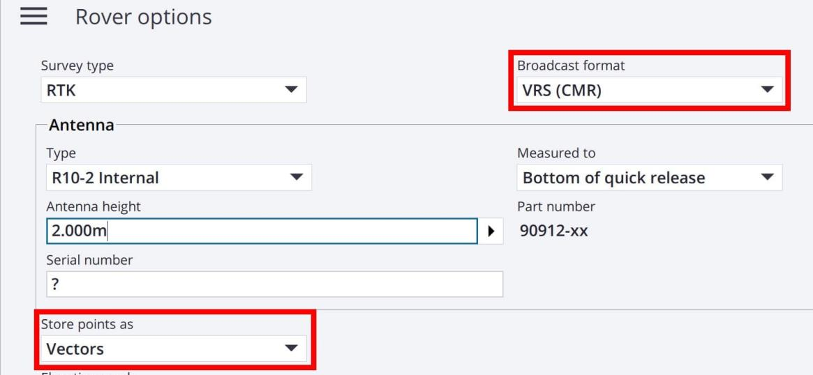
No Vectors = No GVX = No OPUS Projects
Remember!
GNSS Vector eXchange with VRS means you must:
Store points as Vectors

Slide 38
Using VRS, TBC, and OPUS Projects to connect to NSRS
Closing Thoughts and a Look Ahead…
Redundancy is Your Friend
Even with static occupations, your “total time on mark” is the key to accuracy (not longer occupations)
Beta OPUS Projects is the Path to GVX Submissions (for now)
Where is it? … instead of www.ngs.noaa.gov navigate to beta.ngs.noaa.gov
Or simply check the NGS Homepage → Beta Release (under News Bulletins)
In the near future, GNSS will become a sub-type of GDX file format
GDX = Geodetic Data eXchange
Still an XML based file format
Goal = one file format for observations from: GNSS, Total Station, Digital Level, Gravimeter
Yes, this is in conjunction with NSRS Modernization efforts
| Jalbrzikowski
Notes:
Redundancy is Your Friend
Even with static occupations, your “total time on mark” is the key to accuracy (not longer occupations)
CLICK
Beta OPUS Projects is Your Path to GVX Submissions (for now)
Where is it? … instead of www.ngs.noaa.gov navigate to beta.ngs.noaa.gov
Or simply check the NGS Homepage → Beta Release (under News Bulletins)
And if you were in Dru’s session yesterday you heard Galen mention that we’re standing up a Beta Homepage, sort of expanding the visibly of Beta products and giving them one common “home”
CLICK
In the near future, GNSS vectors will become a sub-type of GDX file format
GDX = Geodetic Data eXchange
Still an XML based file format
Goal = one file format for observations from: GNSS, Total Station, Digital Level, Gravimeter
Yes, this is in conjunction with NSRS Modernization efforts (e.g. “OPUS for Everything”)

Slide 39
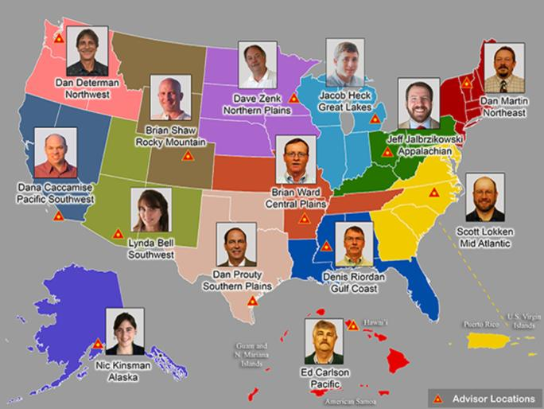
Additional Resources from NGS
Regional Geodetic Advisor Program
14 across US and Territories
Vacancy → check USAJobs for advertisement
State Geodetic Coordinators
Not NGS employees
From various organizations
Monthly Webinars
If you miss it, they’re recorded
Educational Videos
Technical Tidbits
Online Lessons
1-2 hours, sign up for account
Publication Library
TMs, Policies, Current/Historical Documents
Presentation Library
https://www.ngs.noaa.gov/ADVISORS/
Vacant USAJobs for posting
| Jalbrzikowski
Notes:
Regional Geodetic Advisor Program
State Geodetic Coordinators
Monthly Webinars - certificate of attendance provided
Online Lessons - digital correspondence courses

Slide 40
For assistance with OPUS Projects …or any NGS-related questions
First step: contact your Regional Geodetic Advisor
geodesy.noaa.gov/ADVISORS/
-or use any major search engine: “NGS advisors”
Jeff Jalbrzikowski, P.S., GISP, CFS
Appalachian Regional Geodetic Advisor
jeff.jalbrzikowski@noaa.gov
240-988-5486

