Slide 1

Navigating Federal Geospatial
Career Opportunities
  ASCE UESI Surveying & Geomatics Conference
October 2022
Jeff Jalbrzikowski, P.S., GISP, CFS
Appalachian Regional Geodetic Advisor
jeff.jalbrzikowski@noaa.gov
240-988-5486

Slide 2



Organizational Structure
  -Department of Commerce (DoC)
  (~47,000 employees)
  -National Oceanic and Atmospheric Administration (NOAA)
  -National Ocean Service (NOS)
  -National Geodetic Survey (NGS)
  (~175 employees)
Notes:
-We are the Federal Government’s oldest scientific agency.
-part of the Executive Branch
-I know it can seem kind of strange that NGS is part of the NOS, but the origins of NGS lie with the C&GS.
-we are a “Program Office” of the NOS
Survey of the Coast – 1807
Coast Survey – 1836
Coast and Geodetic Survey – 1878
NGS since 1970

Slide 3


Organizational Structure
We’re not USGS, we’re NGS
  -Department of Commerce (DoC)
  (~47,000 employees)
  -National Oceanic and Atmospheric Administration (NOAA)
  -National Ocean Service (NOS)
  -National Geodetic Survey (NGS)
  (~175 employees)
≠
Notes:
-as you can read my slide, I like to point that out because over my 2 years at NGS I’ve seen and heard this misunderstanding quite a bit
-don’t worry! it doesn’t offend us! and we do work closely with USGS, but we are separate agencies within totally different departments of the federal government

Slide 4
NGS Mission
To define, maintain and provide access to the National Spatial Reference System (NSRS) to meet our Nation’s economic, social, and environmental needs.
Notes:
NGS develops and maintains the National Spatial Reference System, a national coordinate system that provides the foundation for transportation, navigation, land record systems, mapping and charting efforts, and a multitude of scientific and engineering applications.
But there are many ancillary programs and products we will also discuss.

Slide 5
Important Info
This presentation is based on personal experiences and research, advice/info from colleagues, and is not intended to represent the policies or procedures used by the Office of Personnel Management (OPM) or any hiring agencies.
Thanks.
Notes:
-joined the NGS almost 2 years ago now
-Spent 9 years prior with USACE on topo, geodetic control, layout, boundary, deformation, lidar, GIS implementation, hydrographic/bathymetric, and contracting aerial acquisitions
-previously survey intern (private sector & BLM), GIS tech., warehouse picker/packer, busboy…
-I like Honda motorcycles, have owned a Honda Shadow, a Victory Vegas, but my favorite bike was a Honda ST1100 that I sold after my frist kid was born

Slide 6

























Agencies with Geospatial Data…
Typically employ personnel to manage that data.
Notes:
So remember, today’s presentation is not JUST about new datums, it is about modernizing the NSRS as a whole.
You don’t know what the NSRS is? Stay tuned, we’ll get there as we go along.

Slide 7
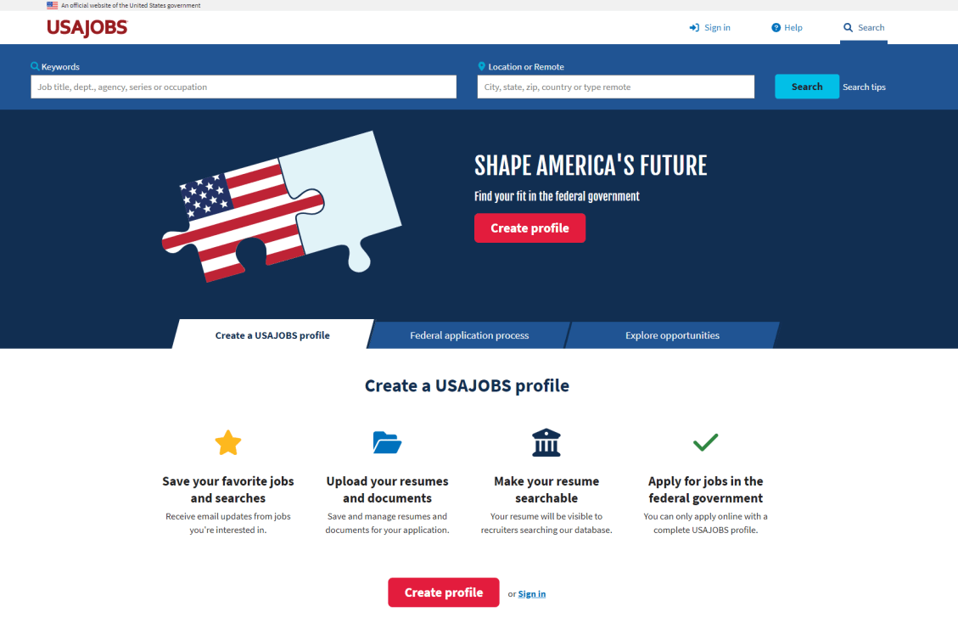
Where to start your search?
https://www.usajobs.gov

Slide 8
USAJOBS
To apply, you’re going to need a Profile
  Create one before you decide to apply
Federal Postings/Advertisements elsewhere?
  Many link over to USAJOBS (Monster, Indeed, etc.)
  Recommend using USAJOBS to conduct any search for Federal positions
Not true that all Federal positions posted on USAJOBS
  There are numerous exceptions, always changing

Slide 9
USAJOBS Profile
Build your Profile first
  Afterward can auto-populate into Resume
Then use the Resume Builder
  Standardized format
Alternatively, upload a PDF resume
  Other file formats are compatible, but…
Other Documents
  Professional License(s)
  Transcript(s)
  Military Discharge (DD-214)
For each Application you choose 1 resume to include
Notes:
Build your profile first
Items will be brought over into Resume tool → General Info, Citizenship, Experience, Education, and References, Miltary Service**make sure to include that!
Then use the Resume Builder
standardized format
Other Documents
Professional Licenses
Certifications
Military Discharge Form (DD-214)
***upload them when you’re building your profile… don’t wait until you’re filling out an application!
Also upload a PDF resume

Slide 10
USAJOBS Saved Searches
Profile Homepage → Saved Searches
  This is key. Less need to keep logging in to search
  Email notifications with results embedded
    Daily, Weekly, Monthly, or Never
    Up to 10 searches, all with varying criteria/filters
    They do “expire” after 12 months, but can “renew”
  What filters/criteria can you save?
    Anything in the Search tools
Notes:
If you want to make your search efficient, but also not miss any opportunities, you’ve gotta use a Saved Search.

Slide 11
USAJOBS Search Tips
Keywords and Location
  General keywords will work, but results can be way too broad
  Example of “surveying”
Use the OPM occupational series numbers for more pointed results from keyword search
  But know there is variation across agencies
  Regardless of Pay Scale, positions will be with a defined Series or “Job Family”
    Defined by OPM Position Classification Standards
Notes:
Keywords and Location
probably the best way to find something… but results can be way too broad
Use the OPM occupational series numbers for more pointed results
But know there is variation across agencies

Slide 12
Pay Scale
XX-1234-00
For most positions, especially in regards to those in the geospatial field
  GS – General Schedule
Yes, there are many others
  WG, IA, ZP, GG, IC, WS, NO, IM, SL, ZT…
Not important to know/decipher them all
  Potential salary will also be listed in USAJOBS
Notes:
Keywords and Location
probably the best way to find something… but results can be way too broad
Use the OPM occupational series numbers for more pointed results
But know there is variation across agencies

Slide 13
OPM Series
XX-1234-00
Series numbers are a good start
  But remember there is variation across agencies
Series with clearly defined geospatial duties
  0150 – Geographer
  1370 – Cartographer
  1371 – Cartographic Technician
  1372 – Geodesist
  1373 – Land Surveyor
  1374 – Geodetic Technician
  0817 – Surveying Technician
  I’ve started seeing 0301 used for GIS Specialist positions.
  (Miscellaneous Administration and Program Series)
But don’t stop there!
Notes:
Keywords and Location
probably the best way to find something… but results can be way too broad
Use the OPM occupational series numbers for more pointed results
But know there is variation across agencies

Slide 14
Pay Grade
XX-1234-00
Every Pay Scale can be different
  Many are very similar to GS
Again, potential salary will also be listed
If you aren’t able to find info, good question for HR or Application POC
Notes:
Keywords and Location
probably the best way to find something… but results can be way too broad
Use the OPM occupational series numbers for more pointed results
But know there is variation across agencies

Slide 15
OPM Series – things I’ve seen
0817 – Engineering Technician
  Surveyor
  GIS Technician
  Civil/Site Draftsperson
  NOTE also used for more related positions…
1311 – Physical Science Technician
  Hydrographic Surveyor → no separate series…
1301 – Physical Scientist
  All sorts of positions, many times supervisory or “interdisciplinary” roles (qualified by series)
Point Being: as much as OPM wants uniformity, which is good… there’s still a ton of variation out there.
Notes:
0817 – Engineering Technician
Surveyor
GIS Technician
Civil/Site Draftsperson
NOTE also used for more related positions…
1311 – Physical Science Technician
Hydrographic Surveyor → no separate series…
1301 – Physical Scientist
All sorts of positions, many times supervisory or “interdisciplinary” roles (qualifications to apply open to different series)

Slide 16
OPM Series – Interdisciplinary Example
Supervisory Interdisciplinary Chief Survey Section
USACE Northwest Division, Portland District
GS-_ _ _ _-13
  0810 – Civil Engineer
  1301 – Physical Scientist
  1370 – Cartographer
  1373 – Land Surveyor
It’s one position, but the duties are recognized as being interdisciplinary, so the series is a little more broad
You would apply for the series you’re qualified for
  Won’t see that until you hit the Application process itself
Why no 1372 (Geodesist)? …
Notes:
0817 – Engineering Technician
Surveyor
GIS Technician
Civil/Site Draftsperson
NOTE also used for more related positions…
1311 – Physical Science Technician
Hydrographic Surveyor → no separate series…
1301 – Physical Scientist
All sorts of positions, many times supervisory or “interdisciplinary” roles (qualifications to apply open to different series)

Slide 17
What is this DHA I see sometimes?
Direct Hire Authority
Supposed to be a tool for filling vacancies when a critical hiring need or severe shortage of candidates exists
Eliminates:
  Competitive rating and ranking
  Veterans’ Preference → does not apply in a DHA application
  “Rule of Three” procedures
Appears to me
Some Series have Governmentwide authority for DHA
  1301 – Physical Scientist (via STEM push) at Grades 11 thru 15
  0810 – Civil Engineer at Grades 11 thru 15

Slide 18
Wrapping Up
USAJOBS Profile → Saved Searches
  If you’re seriously searching, use it!
Search by OPM Series
Search by keyword, be prepared to scrub a lot
Just like you’re doing now at the conference… networking!
  My last Federal position at USACE, I applied by responding to a vague posting on a job board
  USACE Nashville District – Survey CADD Tech recently open for applications (not on USAJOBS)
Notes:
USAJOBS Profile → Saved Searches
If you’re seriously searching, use it!
Search by OPM Series
Search by keyword, be prepared to scrub a lot
Just like you’re doing now at the conference… networking!
My last Federal position at USACE, I applied by responding to a vague posting on a Ferris State University job board
USACE Nashville District – Survey CADD Tech

Slide 19

additional Resources

Slide 20

USAJOBS Help Articles → Top 3
Federal hiring myths
  Clarifies some of the things you’ve heard
Hiring Paths
  Great summary of applicant eligibilities
Application Status
  Recommendations for who to contact with which types of questions

Slide 21
Partnership for Public Service
https://gogovernment.org
Statistics available and well organized
  types of positions
  with which agencies
  where they are located
Great glossary and FAQ
  Good to jog your memory
Email Newsletter
  Best Practices, etc.

Slide 22
Thank you for your attendance and participation!
Jeff Jalbrzikowski, P.S., GISP, CFS
Appalachian Regional Geodetic Advisor
jeff.jalbrzikowski@noaa.gov
240-988-5486

