Slide 1

A Deeper Dive into NGS: Vertical Datums, Geoids, OPUS, NCAT, and more
KAPS Annual Conference
September 2022
Jeff Jalbrzikowski, P.S., GISP, CFS
Appalachian Regional Geodetic Advisor
jeff.jalbrzikowski@noaa.gov
240-988-5486

Slide 2
My Background
Licensed Surveyor in OH, PA, and WV (PS)
Certified GIS Professional (GISP)
Certified Floodplain Surveyor (CFS)
BS in Surveying & Mapping, Univ. of Akron
Came to NGS from USACE Pittsburgh District
  primary experience is engineering surveys, including structural deformation, hydrographic/bathymetric, terrestrial lidar, GNSS control, local/legacy datum resolution

Slide 3
Important Info
I am a Federal employee, please understand:
any references I make to any commercially available software do not constitute an endorsement or a disapproval of any manufacturers or vendors/suppliers.
Thanks.

Slide 4
NGS Products and Services
Not just OPUS
All exist in three environments:
  Development (DEV) - internal testing and development
    same as when you hear a company talk about an “Alpha” product
  Beta - continued internal testing, open for public testing
    key features have already been vetted/tested
  Production - final product, open to public use
    this is what you see first when navigating our website

Slide 5
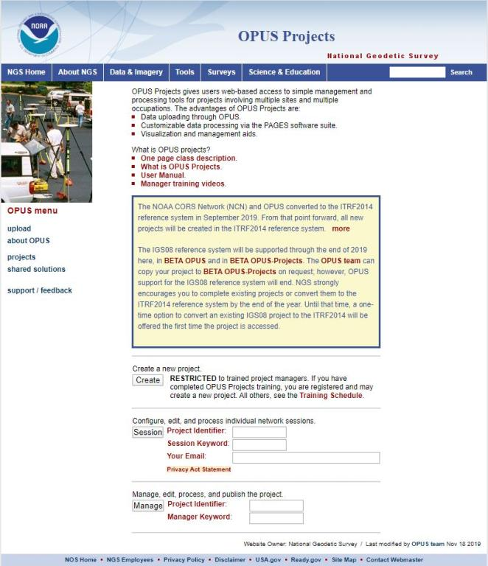
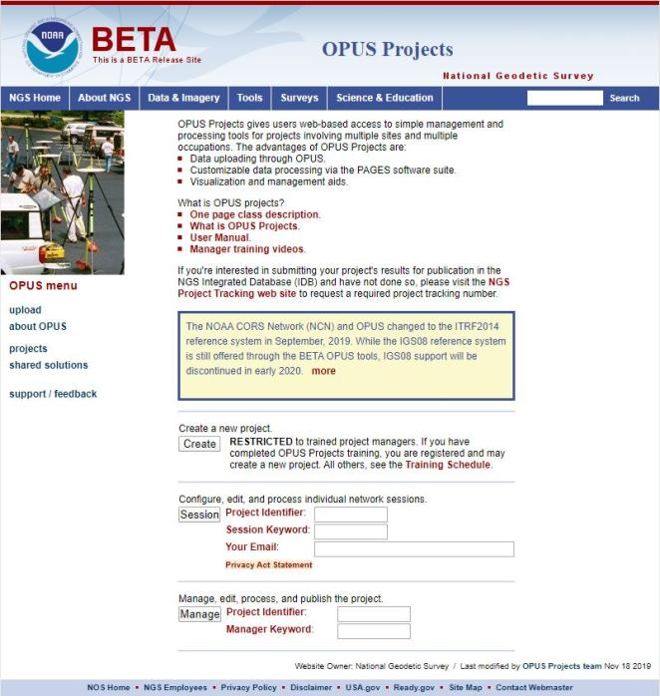
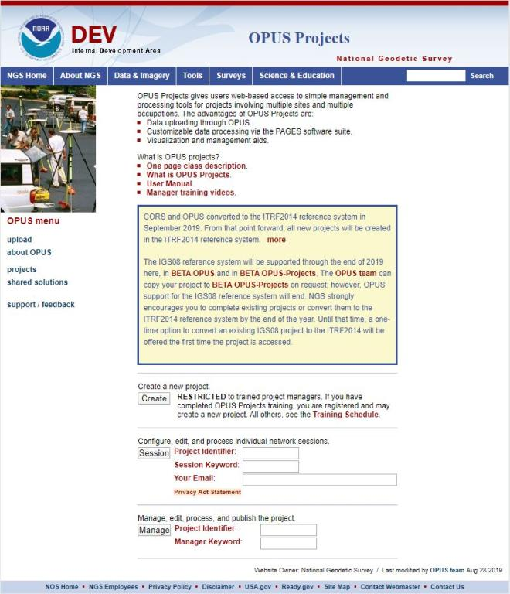
www.ngs.noaa.gov
beta.ngs.noaa.gov
Remember, you won’t see the DEV environment…

Slide 6
Wait… how do I get to the NGS Beta site?

Slide 7
www.ngs.noaa.gov
beta.ngs.noaa.gov

Slide 8
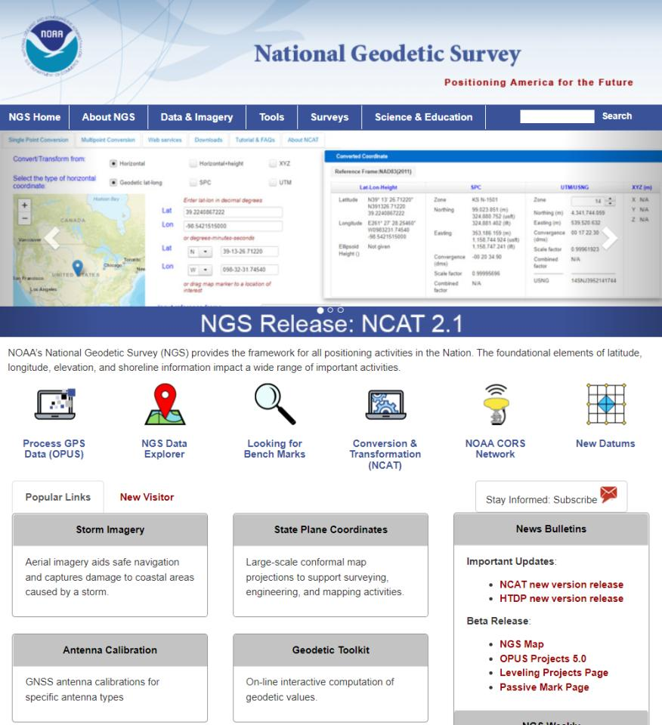

Slide 9
Using the modernized NSRS
OPUS
  Guidance (such as pre-selected CORSs and assistance in locating marks in project areas)
  Users will decide what control to hold fixed and what epochs they wish to set for the adjustment
    “Preliminary coordinates”
  If submitted to NGS (aka “Shared”), we will harvest your raw GNSS data and use it to compute Final Discrete coordinates

Slide 10
NGS Mission
To define, maintain and provide access to the National Spatial Reference System (NSRS) to meet our Nation’s economic, social, and environmental needs.

Slide 11
Not just new datums…
  NSRS Modernization
-OPUS enhancements/additions
-new types of coordinates
-new methods for establishing control
-streamlined Bluebooking
-retire the US Survey Foot

Slide 12
What can you do?
Help spread the word
  Engage your
    GIS Professionals
    Engineers
    Municipal Governments
Reach out to NGS for support
Follow best metadata practices
Educate others
  Share our links and info

Slide 13
Preparing for New Datums
  Know the epoch of your data/datasets
    consider how you will track this
      full to-the-second timestamp on every feature?
        GNSS makes this easily possible…
      labeling a year for each dataset?
      something in-between that works for your needs?

Slide 14
Preparing for New Datums
  Transforming your data
    NCAT - NGS Coordinate Conversion and Transformation Tool
      available now: ASCII upload, Web Services, GitHub
      ask your software provider(s) about integration
        we envision this as most popular method of access
        Industry Workshop held May 2021
          Esri, Trimble, Blue Marble, etc… all the well known names attended

Slide 15
Preparing for New Datums
  Reprocessing your data
    in a perfect world, everyone would reprocess
      what does this mean?
        consider an ALTA w/topo
          start over with the onsite GNSS-based control
          reorient all your shots/ties (hopefully linked)
          recreate all the drainage features in new datum
      unrealistic! … and unnecessary for majority users

Slide 16
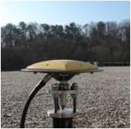
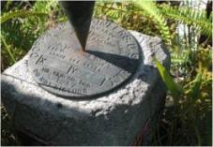

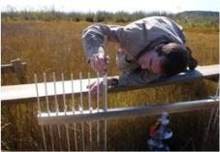
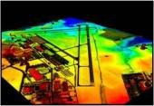
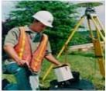
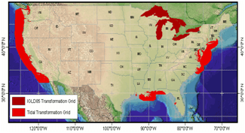
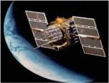
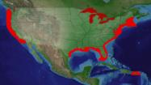
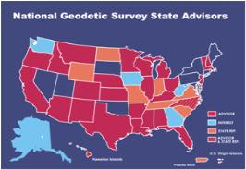
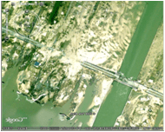

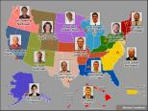
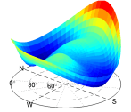
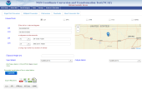

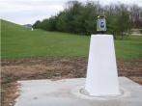
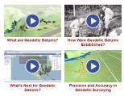
NGS Overview
Modernizing the NSRS
CORS
NHMP
GRAV-D
ECO
NGS Products and Services
ASP
OPUS
VDatum
Orbit Data
National Shoreline
Geodetic Advisors
ERI
Antenna Calibrations
NCAT
CUSP
CBL
Outreach

Slide 17
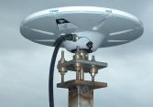
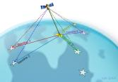
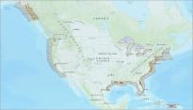
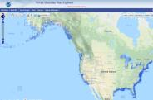
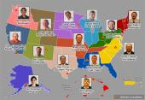

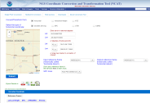
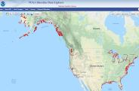
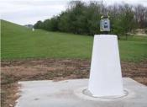

NGS Overview
Modernizing the NSRS
CORS
NHMP
GRAV-D
ECO
NGS Products and Services
ASP
OPUS
VDatum
Orbit Data
National Shoreline
Geodetic Advisors
ERI
Antenna Calibrations
NCAT
CUSP
CBL
Education

Slide 18
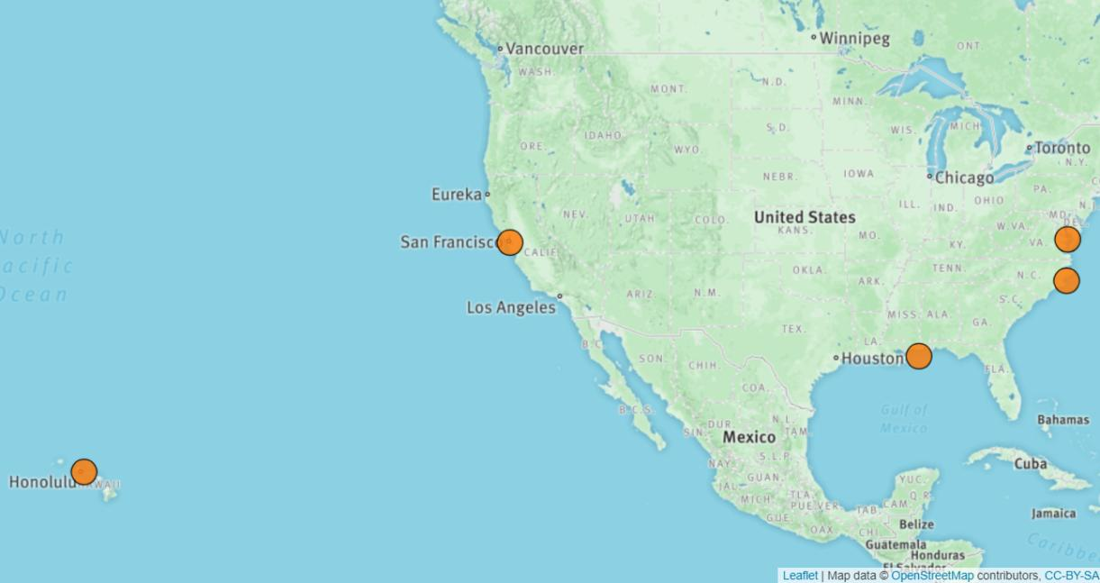
Ecosystem and Climate Operations

Slide 19
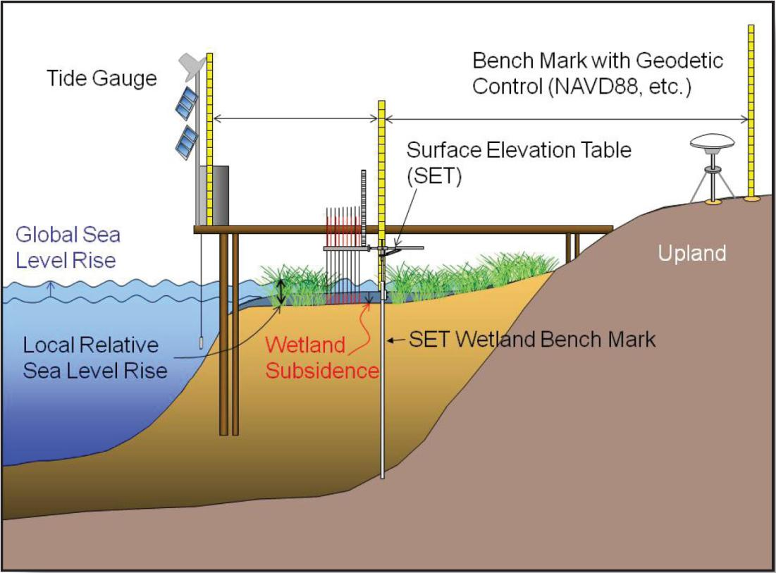
Ecosystem and Climate Operations
?

Slide 20
NGS Overview
Modernizing the NSRS
CORS
NHMP
GRAV-D
ECO
NGS Products and Services
ASP
OPUS
VDatum
Orbit Data
National Shoreline
Geodetic Advisors
ERI
Antenna Calibrations
NCAT
CUSP
CBL
Education

Slide 21
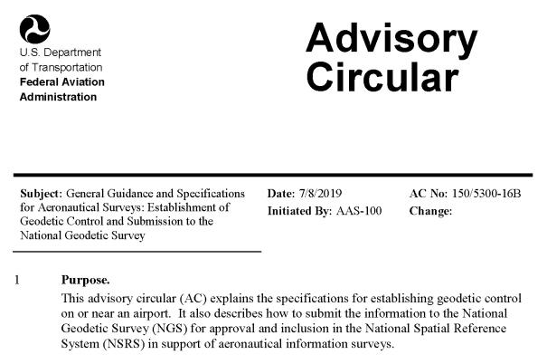
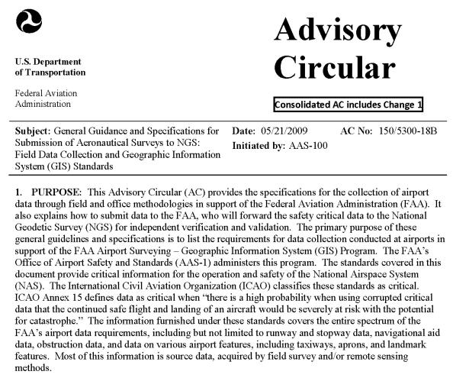
Aeronautical Survey Program
Interagency Program: FAA and NGS
  Primary Airport Control Station (PACS) and Secondary Airport Control Stations (SACS)
  Airports GIS (AGIS)
  Airport Obstruction Charts (AOC)
Primary function of NGS is to serve as QA and subject-matter expert for ASP surveys that are contracted by airports

Slide 22
NGS Overview
Modernizing the NSRS
CORS
NHMP
GRAV-D
ECO
NGS Products and Services
ASP
OPUS
VDatum
Orbit Data
National Shoreline
Geodetic Advisors
ERI
Antenna Calibrations
NCAT
CUSP
CBL
Education

Slide 23
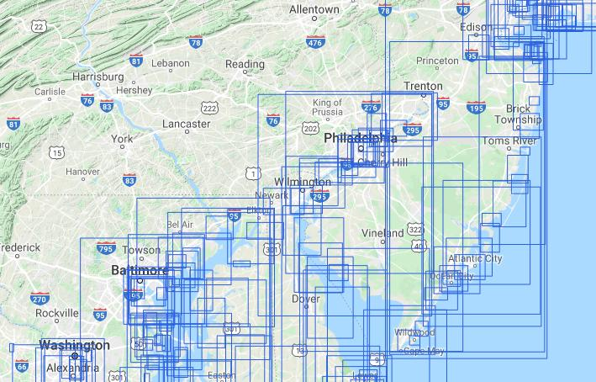
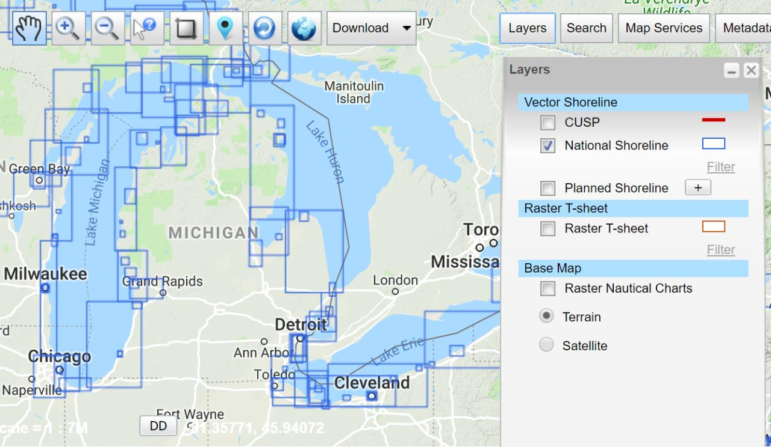
National Shoreline
The official shoreline for the Nation, in support of NOAA’s nautical charting mission
Available for download as shapefile in Mean High Water and Mean Lower Low Water datum
Organized by “Project Area” – the blue boxes
hyperlink to the National Shoreline homepage

Slide 24
NGS Overview
Modernizing the NSRS
CORS
NHMP
GRAV-D
ECO
NGS Products and Services
ASP
OPUS
VDatum
Orbit Data
National Shoreline
Geodetic Advisors
ERI
Antenna Calibrations
NCAT
CUSP
CBL
Outreach

Slide 25
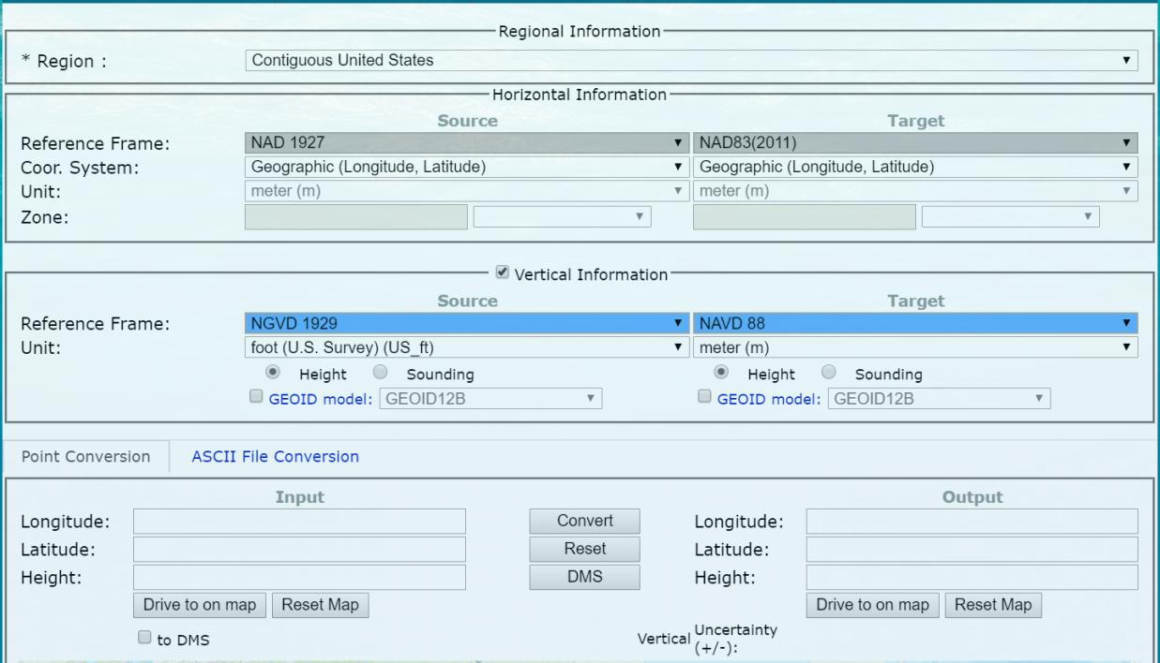
NOAA VDatum - online

Slide 26
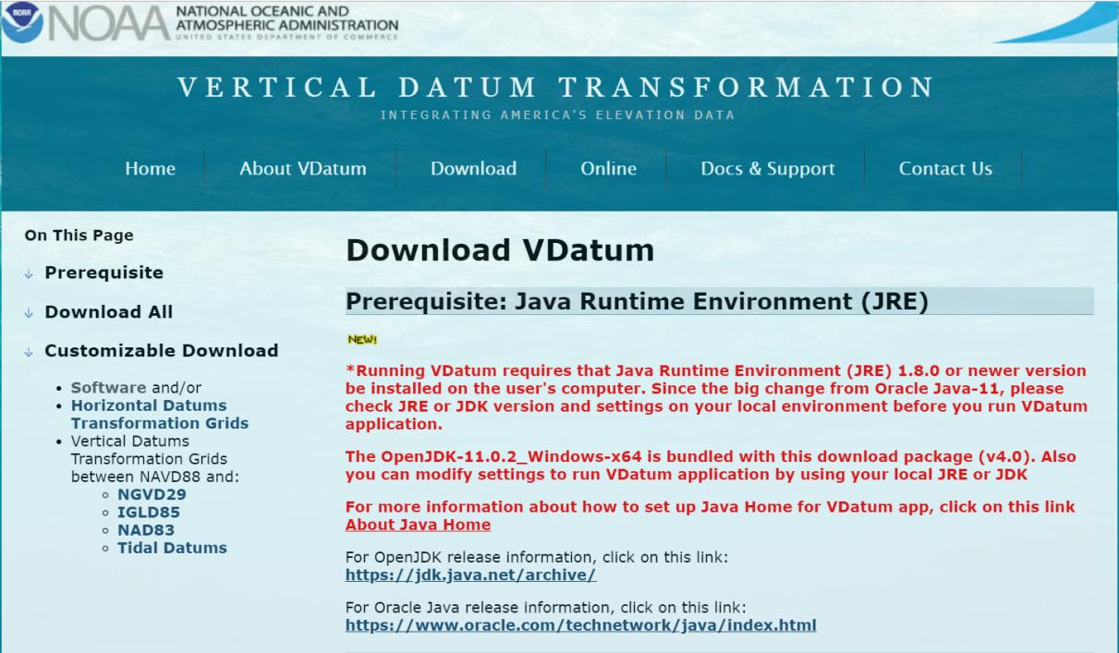
NOAA VDatum - download

Slide 27
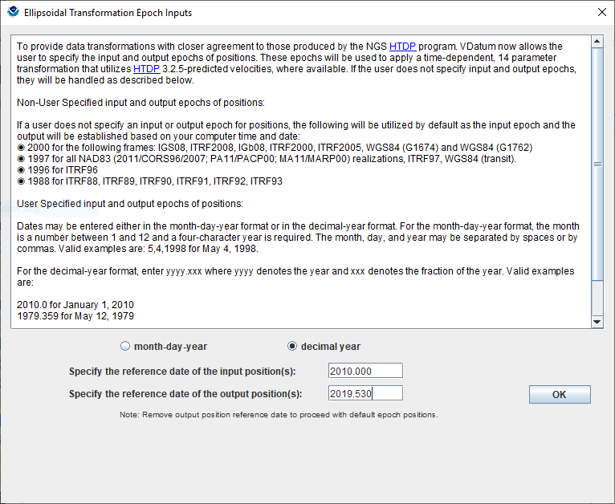
NOAA VDatum - download

Slide 28
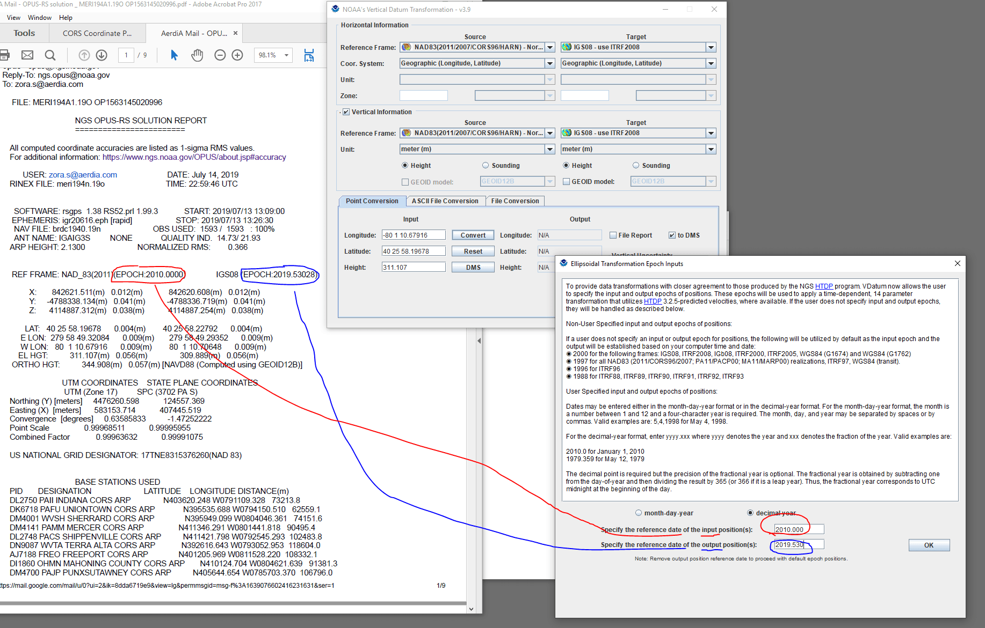

Slide 31
NOAA VDatum Website
vdatum.noaa.gov

Slide 32
NGS Overview
Modernizing the NSRS
CORS
NHMP
GRAV-D
ECO
NGS Products and Services
ASP
OPUS
VDatum
Orbit Data
National Shoreline
Geodetic Advisors
ERI
Antenna Calibrations
NCAT
CUSP
CBL
Outreach

Slide 33
National Shoreline
The official shoreline for the Nation, in support of NOAA’s nautical charting mission
Available for download as shapefile in Mean High Water and Mean Lower Low Water datum
Organized by “Project Area” – the blue boxes
hyperlink to the National Shoreline homepage

Slide 34
NGS Overview
Modernizing the NSRS
CORS
NHMP
GRAV-D
ECO
NGS Products and Services
ASP
OPUS
VDatum
Orbit Data
National Shoreline
Geodetic Advisors
ERI
Antenna Calibrations
NCAT
CUSP
CBL
Outreach

Slide 35
Emergency Response Imagery
Mission of our Remote Sensing Division
Pre-Storm and Post-Storm photos are taken mostly along the coastal CONUS, and some other disasters natural or human
Supports Dept. of Homeland Security (DHS) and other emergency management organizations (FEMA, State, local, etc.)

Slide 36
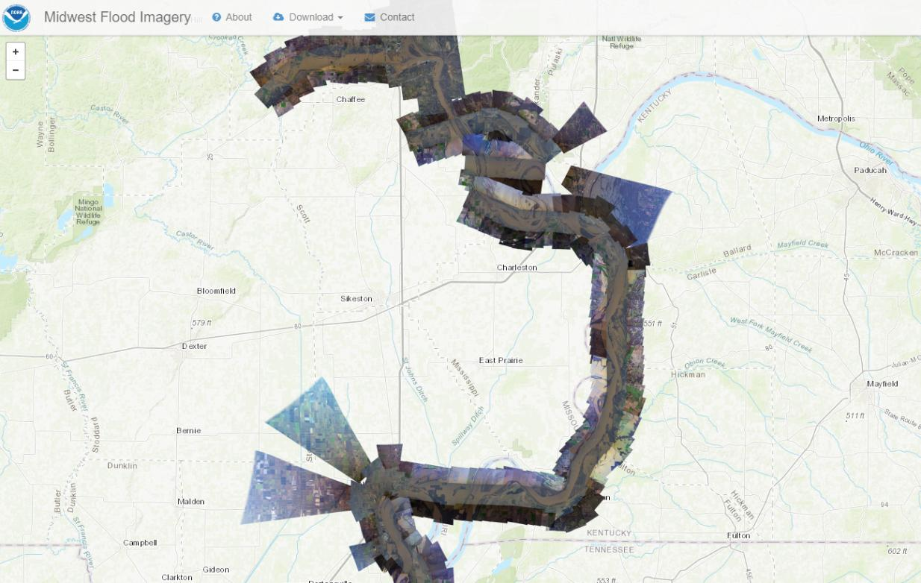
Emergency Response Imagery

Slide 37
NGS Overview
Modernizing the NSRS
CORS
NHMP
GRAV-D
ECO
NGS Products and Services
ASP
OPUS
VDatum
Orbit Data
National Shoreline
Geodetic Advisors
ERI
Antenna Calibrations
NCAT
CUSP
CBL
Outreach

Slide 38
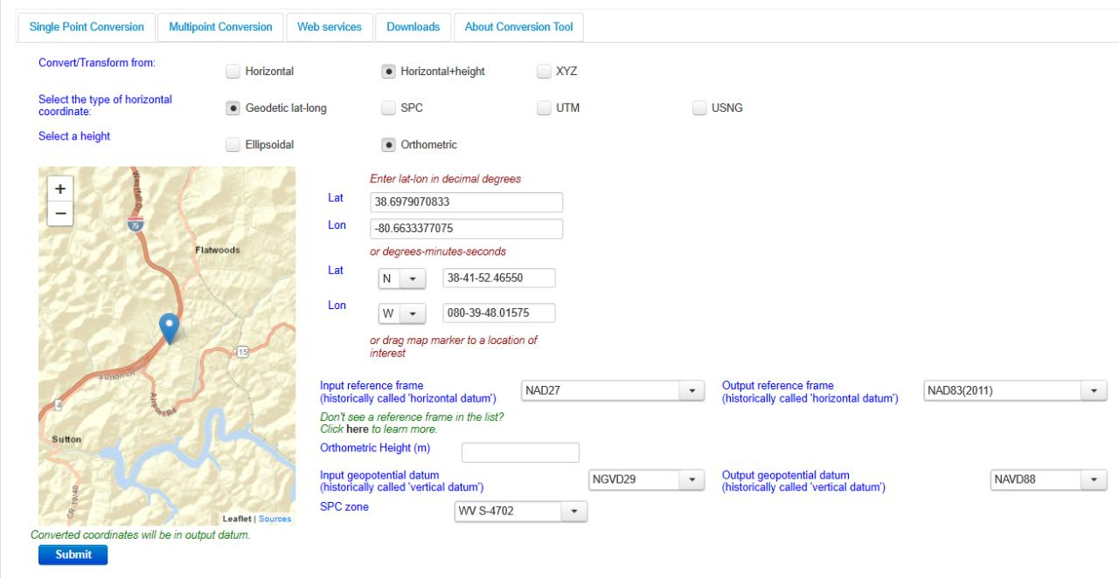
NGS Coordinate Conversion And Transformation Tool (NCAT)

Slide 39
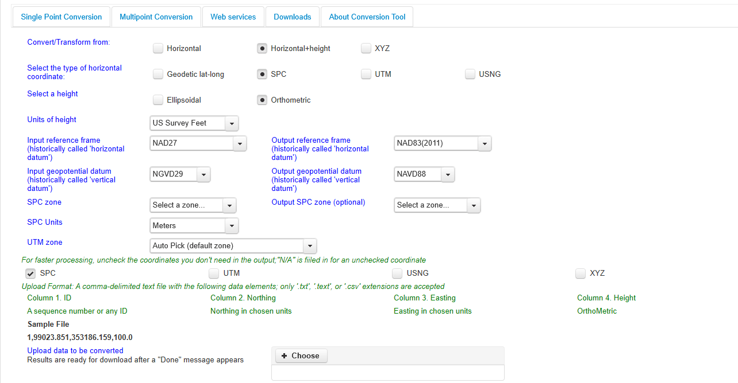
NGS Coordinate Conversion And Transformation Tool (NCAT)

Slide 40
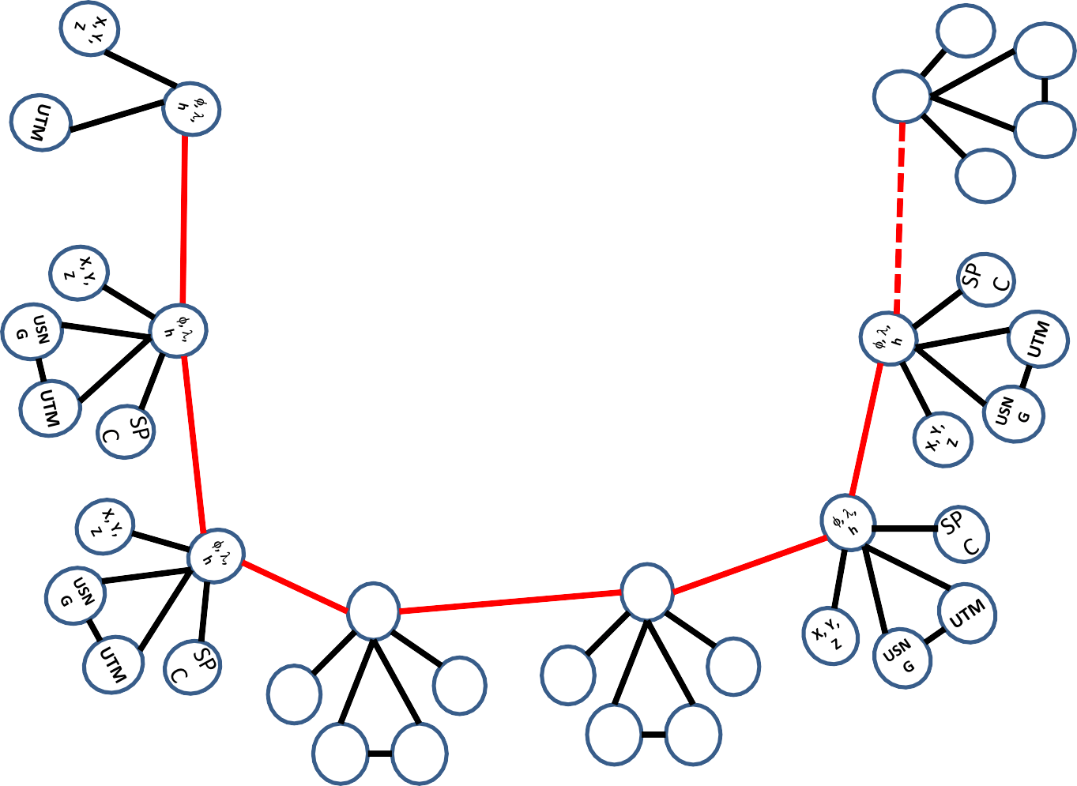
Coordinate Transformation Tool
SP
C
UTM
(NCAT / NADCON 5.0)
2022
φ, λ, h
USSD
USN
G
Relating coordinates: then & now
NAD 83 (2011)
X, Y,
Z
NAD 27
NAD 83 (NSRS2007)
NAD 83 (1986)
NAD 83 (FBN)
φ, λ, h
NAD 83 (HARN)
φ, λ, h
SP C
X, Y, Z
SP C
X, Y, Z
USN G
USN G
UTM
UTM

Slide 41
NGS Overview
Modernizing the NSRS
CORS
NHMP
GRAV-D
ECO
NGS Products and Services
ASP
OPUS
VDatum
Orbit Data
National Shoreline
Geodetic Advisors
ERI
Antenna Calibrations
NCAT
CUSP
CBL
Outreach

Slide 42
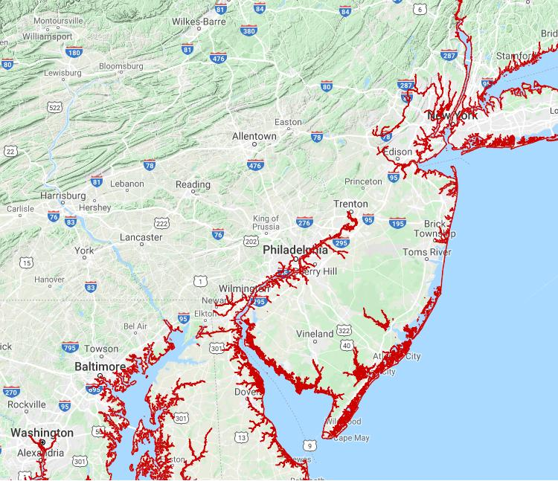
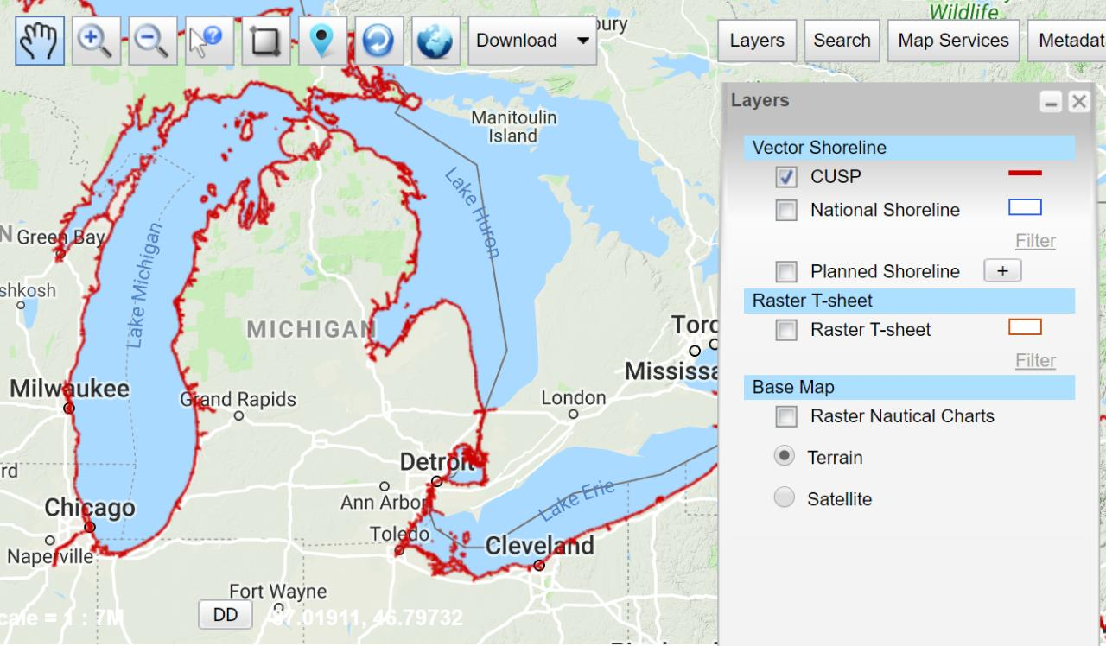
Continually Updated Shoreline Product
Just as the name says… it’s dynamic
Available for download as shapefiles
Developed by image interpretation and/or vertical modeling using water level stations (tide or lake gages)
Referenced to a computed Mean High Water
hyperlink to the CUSP homepage

Slide 43


Slide 44
Federal Register Notice summarized
NGS needs to start computing coordinates for the 2020.00 Reference Epoch in January 2022
Marks that you would like to have published in NATRF/NAPGD 2022 need “fresh” data
Why?
  Older data is of lower quality (constellation & orbits)
  Periodic re-surveys are better than decades old data
  Lower accuracy as we move further back in time
hyperlink to FRN: https://www.federalregister.gov/d/2020-16084

Slide 45
Federal Register Notice summarized
No decision has been made as to a cutoff date
  FRN says it is unlikely to be <10 years
  Discussions of regional/state-based cutoff dates have been had.
What does this mean as of now?
  Observations prior to 01 January 2010 would not get new coordinates in NATRF/NAPGD2022
What does this look like on a map?

Slide 46
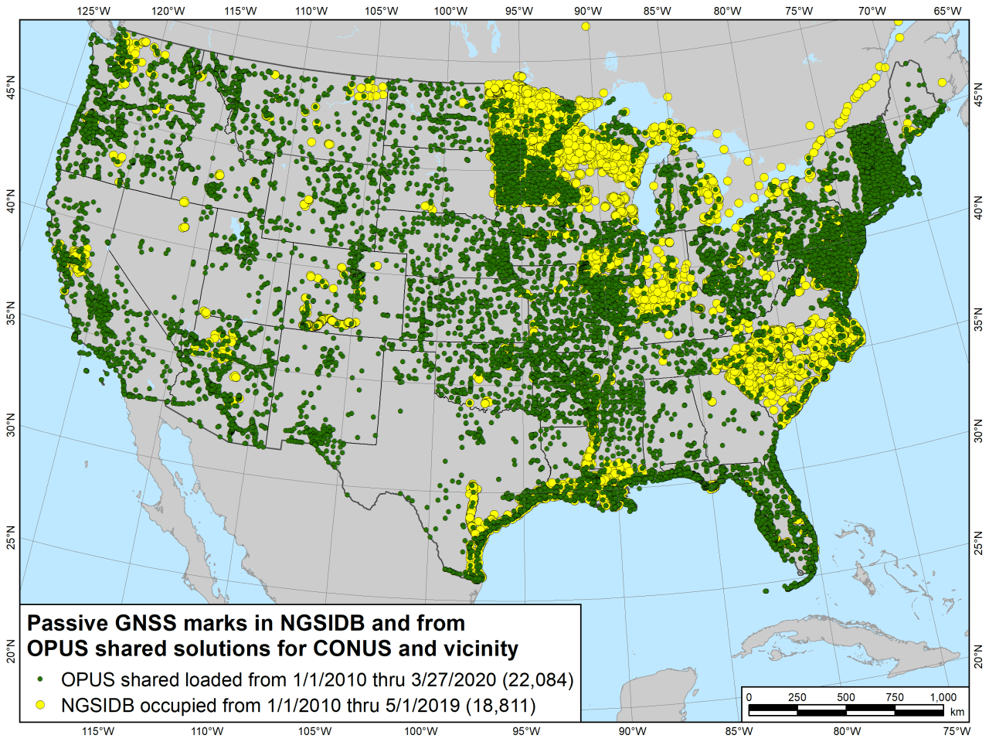

Slide 47
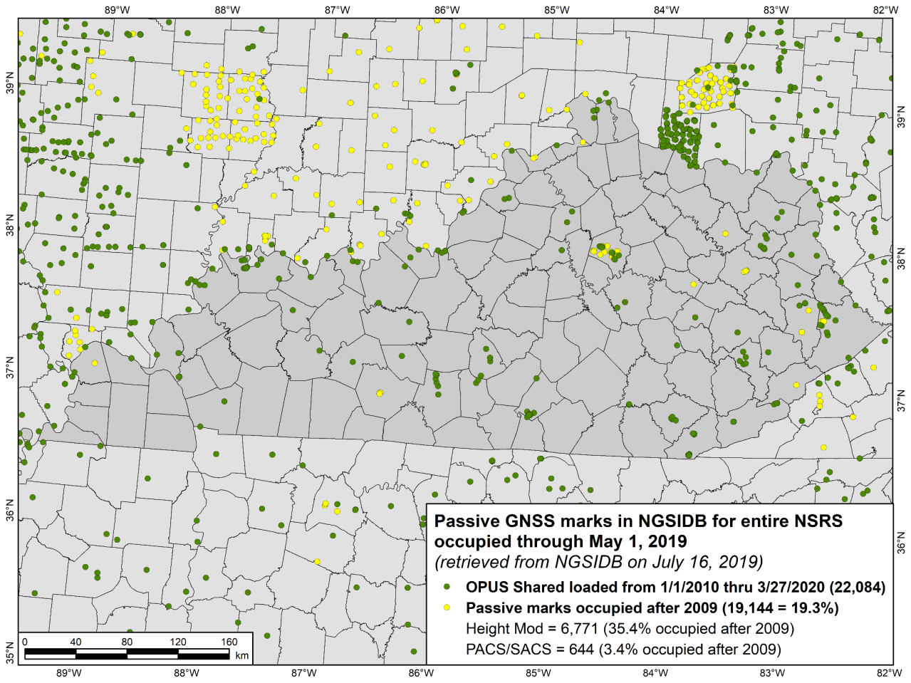

Slide 48
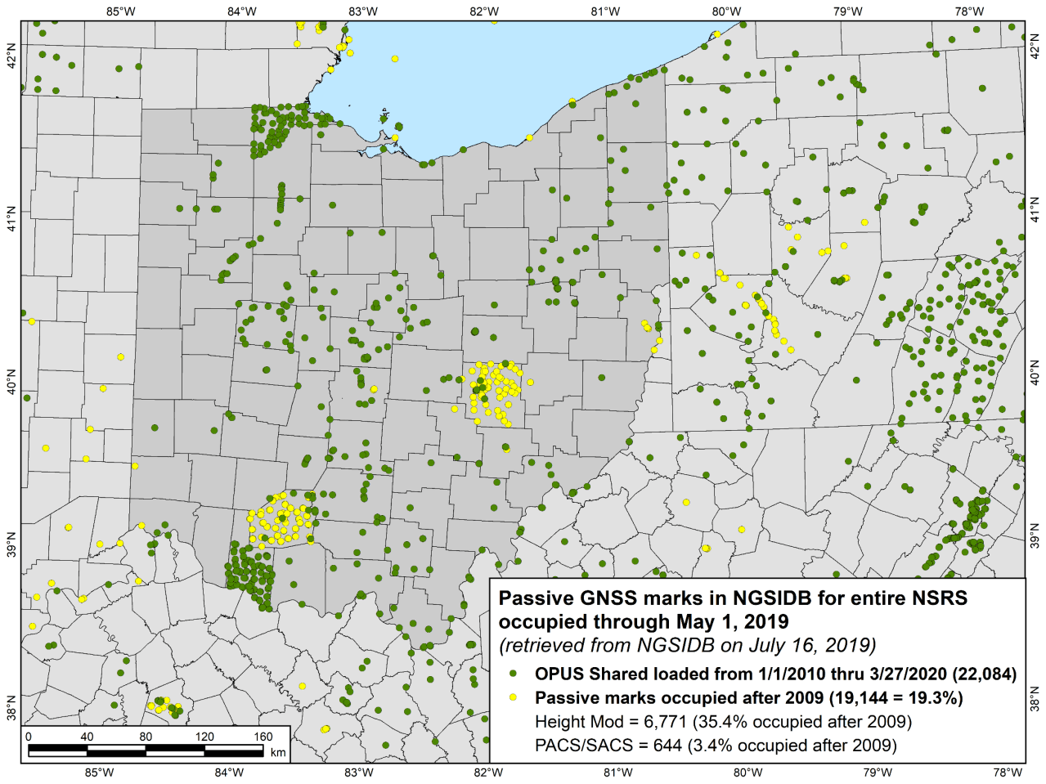

Slide 49
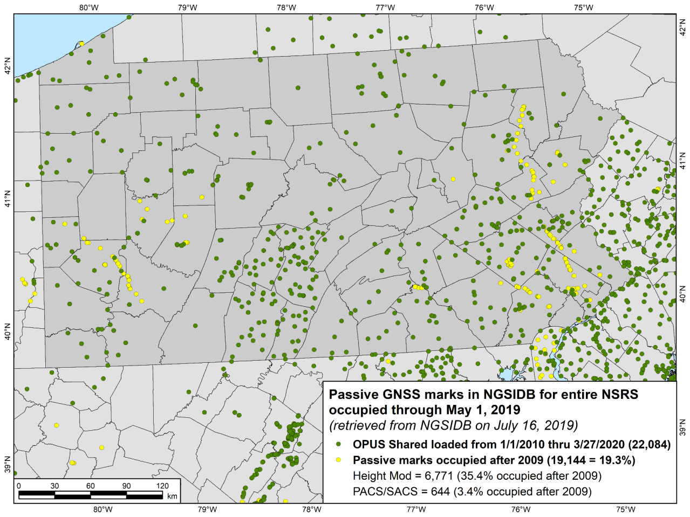

Slide 50
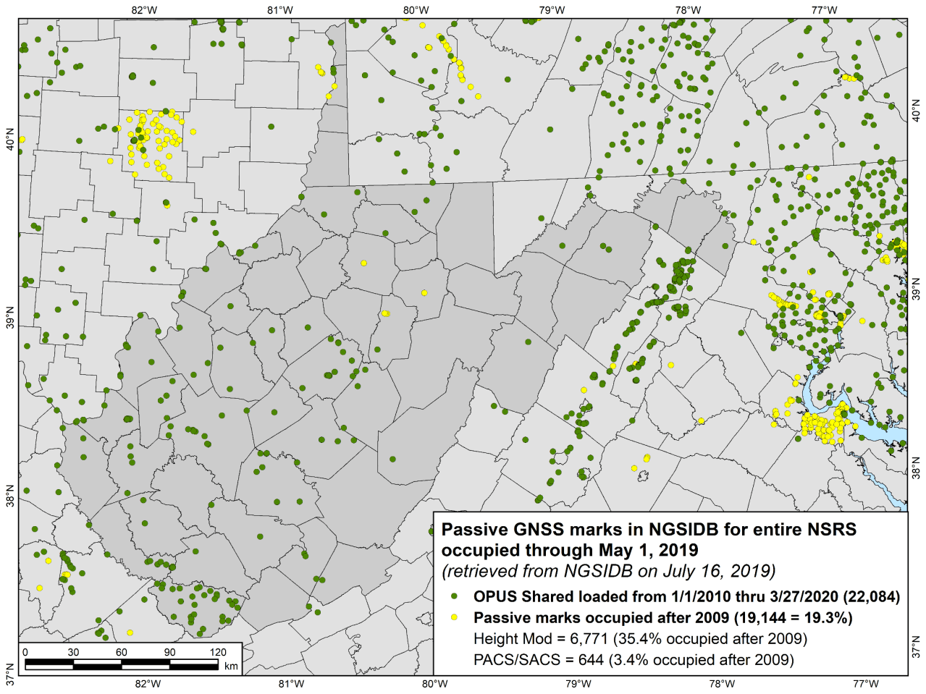

Slide 51
How can you improve your area?
What can you do to ensure your control will get coordinates in the new datums on rollout?
Re-observe and submit the data to NGS
  must be submitted by 30 September 2023
Options to submit your GNSS data:
  OPUS Share → 4+ hrs static data; 2 photos; mark ties
    rinse & repeat … as we need redundancy
  OPUS Projects → 2+ hrs data; photos; descriptions
  traditional “bluebook” submittal

Slide 52
Geodetic Control – Terminology
Site is the smallest location name where station(s) are located
Station is a collection of equipment for one geodetic purpose
Mark is a stable physical structure attached to the crust
  A mark’s job is to hold one point
  Some stations might share a mark
  Some marks might not be part of a station, but might be on a site
+
Stations
Site
+
+
+
+
Marks
+

Slide 53
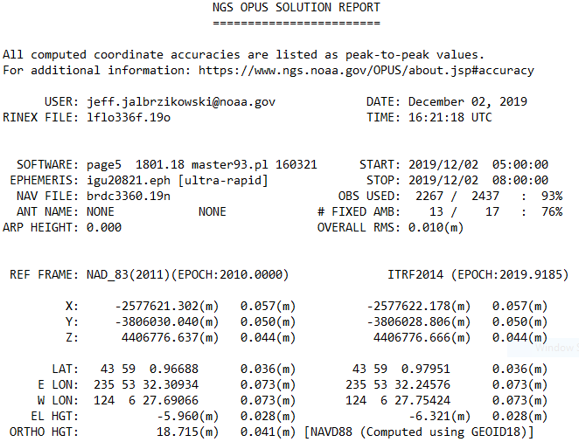
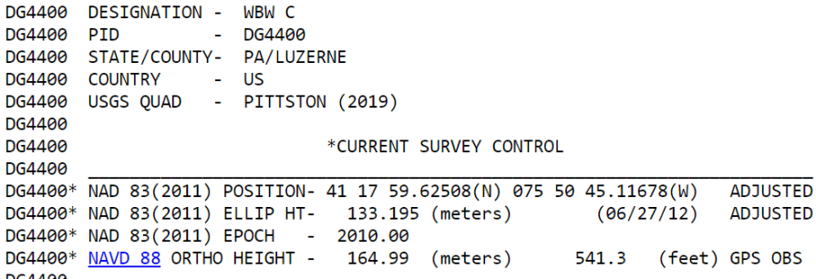
Geodetic Control – Terminology
Epoch
eh-puck? ee-pock? … to-may-to, to-mah-to
an instant of time
a date selected as a point of reference

Slide 54
Geodetic Control – Terminology
Conversion
    change the type of coordinate without changing the datum or frame
    NAD 83(1986) latitude and longitude to NAD 83(1986) State Plane
  Transformation
    change the datum or frame, without changing the type of coordinate
    NAD 27 latitude & longitude to an NAD 83(1986) latitude & longitude
Propagation
    this term is an ISO standard for IERS
    change the epoch of coordinate without changing the frame
    ITRF2014 epoch 2019.2675 to ITRF2014 epoch 2020.00
    NATRF2022 epoch 2020.00 to NATRF2022 epoch 2023.243

Slide 55

Passive Control
Geodetic Control – Terminology
All marks are passive—they sit there and hold a point

Slide 56


Active Control
Geodetic Control – Terminology
Some marks have permanently installed equipment that enables nearly continuous observations
(they still sit there and hold a point)

Slide 57

CORS
Geodetic Control – Terminology
Continuously Operating Reference Station
GNSS ANTENNA
RECEIVER
POWER
DATA STORAGE
COMMUNICATIONS

Slide 58
Terminology - Geodetic Stations
Most frequently encountered types:
CORS = Continuously Operating (GNSS) Reference Station
CORGS = Continuously Operating Relative Gravimeter Station
DORIS = Doppler Orbitography and Radiopositioning Integrated by Satellite Station
SLR = Satellite Laser Ranging Station
VLBI = Very Long Baseline Interferometry Station
All have a Geodetic Reference Point (GRP)
  “Coordinates” = “Coordinates of the GRP at that station”
  Site with multiple types = Co-location Site
  Co-location Survey = tie the Station GRPs at a given Site
    “this is where the magic happens”

Slide 59





Co-location Site
NASA Goddard Space Flight Center, Greenbelt MD, USA
  GNSS, SLR, VLBI, DORIS

Slide 60
Co-location Site
NASA Goddard Space Flight Center, Greenbelt MD, USA
  GNSS, SLR, VLBI, DORIS

Slide 61
GNSS
Global Navigation
Satellite System
via
*generic term that means any or all of:
GPS, GLONASS, Galileo, BDS, etc.

Slide 62

CORS
Continuously Operating Reference Station

Slide 63
Co-location Site
NASA Goddard Space Flight Center, Greenbelt MD, USA
  GNSS, SLR, VLBI, DORIS

Slide 64
SLR
Satellite Laser Ranging

Slide 65


  SLR
Source: NASA
Source: Geoscience Australia

Slide 66


  NASA SLR satellite LAGEOS - only 60 cm diameter!
Source: NASA
  SLR
Source: NASA, McGarry

Slide 67
Co-location Site
NASA Goddard Space Flight Center, Greenbelt MD, USA
  GNSS, SLR, VLBI, DORIS

Slide 68
VLBI
Very Long Baseline Interferometry

Slide 69

quasi-stellar object
VLBI
epoch₁
quasar
radio telescopes
baseline
epoch₂

Slide 70
Co-location Site
NASA Goddard Space Flight Center, Greenbelt MD, USA

Slide 71
DORIS
Doppler Orbitography and Radiopositioning Integrated by Satellite

Slide 72

Source: CNES, France
Doppler Orbitography and Radiopositioning Integrated by Satellite

Slide 73





Co-location Site Survey
Example of Co-located Space Geodetic Techniques (SGTs)
All four SGTs represented here.
Generic concept of “co-location survey”, typically more complex!

Slide 74


Altogether now!
Space Geodetic Techniques work together to create a well-defined, robust reference frame that improves positioning for users globally.

Slide 75



Continuously Operating Reference Station (CORS)
2000+ sites
200+ organizations

Slide 76

NOAA CORS Network (NCN)
2000+ sites
200+ organizations

Slide 77
CORS Networks
Global: International GNSS Service (IGS) Network
  The international standard since mid-1990s
  Supported by IGS Analysis Centers (ACs) → NGS is 1 of 7
  Overall system sponsored by NASA
NSRS: NOAA CORS Network (NCN)
  NGS processes/distributes data, but few are NGS-operated
  Subset of NGS-operated CORS comprise the under construction NOAA Foundation CORS Network (NFCN)
Regional/State/Commonwealth/Local Networks
  Real-Time Networks (RTN… aka “VRS”)
  Currently semi-coupled to the NCN

Slide 78

IGS Network
Source: https://www.igs.org/maps/#station-map

Slide 79
NOAA CORS Network (NCN)

Slide 80

NOAA Foundation CORS Network (NFCN)
NOAA Foundation CORS Network (NFCN)

Slide 81

NOAA CORS Network (NCN) in KY

Slide 82

KYTC CORS Network & RTN

Slide 83
NOAA CORS Network (NCN) in KY

Slide 84


International Network of SGTs
International Earth Rotation and Reference Systems Service (IERS)

Slide 85




International Network of SGTs
International Earth Rotation and Reference Systems Service (IERS)

Slide 86

Structure of the International Association of Geodesy
International Council for Science (ICSU): 142 Countries, 31 Unions
IAU
IGU
ISPRS
IUGG
IUGS
ICA
other Unions
International Union of Geodesy and Geophysics (IUGG)
IACS
IAG
IAHS
IAGA
IAMAS
IAPSO
IASPEI
IAVCEI
International Association of Geodesy (IAG)
Commissions
1 Reference Frames
2 Gravity Field
3 Earth Rotation
and Geodynamics
4 Positioning and
Applications
Inter-Commission Committee on Theory
Scientific Services
ITRF models
Geometry:
IERS
IDS
Gravity:
IGFS
BGI
Combining:
BIPM
IGS
ILRS
IVS
ICGEM
IDEMS
ISG
IGETS
PSMSL
Global Geodetic Observing System (GGOS)

Slide 87

International Terrestrial Reference Frame
(ITRF)
International Earth Rotation and Reference Systems Service (IERS)
International Union of Geodesy and Geophysics (IUGG)

Slide 88

Back to the NSRS and NCN - Future
Have a plan for maintaining accurate coordinate functions
  As they drift away from daily solutions
  As a station suffers an episodic movement
  As they show evidence of non-linear features

Slide 89

NOAA Foundation CORS Network (NFCN)
U.S. Federal Partners | GNSS Site ID | Location | Existing IGS or ITRF Site
National Science Foundation (NSF) Existing Sites Program: Network of the Americas (NOTA) | AB09 | Wales, AK
 | AB51 | Petersburg, AK
 | ATQK | Atqasuk, AK
 | P043 | New Castle, WY
 | P777 | Dennard, AR
 | P804 | The Rock, GA
NSF Existing Sites Program: COCONet | CN11 | Pedro Cay, Jamaica
 | SAN0 | San Andres Island, Colombia
National Aeronautics and Space Administration (NASA) Existing Sites Program: Global GNSS Network (GGN) | BREW | Brewster, WA | ITRF
 | CRO1 | St. Croix, VI | ITRF
 | FAIR/GCGO | Fairbanks, AK | IGS
 | GODE | Greenbelt, MD | IGS/ITRF
 | GUAM | Dededo, Guam | IGS
 | HAL1 | Haleakala, HI | IGS/ITRF
 | KOKB | Kauai, HI | IGS/ITRF
 | MDO1 | McDonald Observatory, TX | ITRF
 | MKEA | Mauna Kea, HI | IGS/ITRF
 | TBD | TBD California location | TBD
 | PIE1 | Pie Town, NM | IGS/ITRF
NOAA- National Geodetic Survey (NGS) Existing and New Sites Program: NOAA CORS Network | ASPA | Pago Pago, American Samoa | IGS
 | BRSG | St. George, Bermuda
 | CNMR | Saipan, Northern Mariana Islands | IGS
 | CORB | Woodford, VA
 | FLF1 | Richmond, FL | Proposed IGS/ITRF
 | GUUG | Mangilao, Guam | IGS/ITRF
 | TMG2 | Boulder, CO | Proposed IGS
 | WES2 | Westford, MA | IGS/ITRF
 | Future Station | Apache Point, NM | ITRF
 | Future Station | Fort Davis, TX | ITRF
 | Future Station | Fort Irwin, CA | ITRF
 | Future Station | Hancock, NH | ITRF
 | Future Station | Los Alamos, NM | ITRF
 | Future Station | Kitt Peak, AZ | ITRF
 | Future Station | Owens Valley, CA | ITRF
 | Future Station | Cold Bay, AK | ITRF
 | Future Station | North Liberty, IA | ITRF
26 in North America
4 in the Pacific
3 in the Caribbean
3 in the Marianas
A set of federally-operated, high quality, highly reliable stations with the longevity to guarantee citizens’ access to official NSRS positions, and support international positioning consistency efforts.
bolstering our Nation’s contribution to the ITRF/IGS

Slide 90

Three Ongoing Phases of NFCN
Phase 1: Incorporate partner stations
Existing NASA and NSF stations brought into the Foundation CORS network.
[NASA Agreement signed 12/18/2019.
Discussions ongoing with NSF.]
Phase 2: Upgrade existing NGS CORSs
Upgrades include fully-GNSS (“All in Sky”) capable equipment, RINEX3 support, and submission to IGS.
[RINEX3 creation, ingestion, and QC in development.
5 of 7 NGS Foundation CORS are fully-GNSS enabled]
Phase 3: Construct ~9 new stations
These NGS-owned stations will be co-located at sites with existing space geodetic techniques
Foundation CORS at NGS’ Table Mountain Geophysical Observatory in Boulder, CO, installed 2018 (ID: TMG2)

Slide 91
NGS Overview
Modernizing the NSRS
CORS
NHMP
GRAV-D
ECO
NGS Products and Services
ASP
OPUS
VDatum
Orbit Data
National Shoreline
Geodetic Advisors
ERI
Antenna Calibrations
NCAT
CUSP
CBL
Outreach

Slide 92
Online Positioning User Service
  OPUS Rapid Static (OPUS-RS)
      dual frequency receiver data
      static sessions only
      30 seconds epoch rate (aka recording interval)
      15 minutes to 2 hours of GPS data
  OPUS Static (OPUS-S)
      same requirements as above
      2 to 48 hours of GPS data
  OPUS Projects (OP) → also Beta OPUS Projects
      adds session processing and network adjustment
      training by NGS required; typically 12 hours
      upload to OPUS with a “Project ID” keyed in Options

Slide 93

30 seconds epoch rate

Slide 94



OPUS-RS – 15 min to 2 hours
Rapid-static: OPUS first creates an atmospheric delay model from surrounding CORS data.
  -Atmospheric model
  -Delivered 179,000 solutions in 2021
Not integrated with OPUS Projects

Slide 95
How does OPUS-RS work?
Selects three to nine “best” CORS based upon:
    Having common satellite visibility with the user data.
    50 < distance <250 km from the user's mark.
    Orientation relative to the user's mark.
The star represents the user’s
mark; the triangles are CORS.
No CORS farther than 250 km
from the user's mark will be
included.
A minimum of three, and
no more than nine CORS are used.
s
>250km
250km

Slide 96

How does OPUS-RS work?
In addition, user's mark must be no more than 50 km from the (convex) polygon created by the selected CORS.
If the user’s mark is more than 50 km outside this
polygon, alternate CORS will be considered.
If none can be found, the processing will abort.

Slide 97
OPUS-S – 2 to 48 hours
  -Best 3 of 5 baselines
  -Delivered 1,268,000 solutions in 2021
  206,000 solutions in 2011
baseline 5
baseline 4
baseline 1
baseline 3
baseline 2

Slide 98
“peak to peak” error ranges, explained:
LAT: 59 42 33.45847 0.003(m)
W LON: 151 27 27.92482 0.007(m)
EL HGT: 503.684(m) 0.032(m)
ORTHO HGT: 494.346(m) 0.055(m)
baseline 5
position:
averaged from the 3 most coherent baselines
ranges:
a bounding box enclosing 3 most coherent baselines
LON range
for ORTHO HGT, geoid model uncertainty is added
LAT range
ORTHO HGT range
CORS baseline 1
EL HGT range
=
baseline 3
baseline 4
baseline 2
2 outermost baselines are ignored
JGE, 2015

Slide 99
Static vs. Rapid Static
 | Static | Rapid Static
Input | 2-48 hours | 15 minutes-2 hours
Output | normal, extended, XML Shared, Projects | normal, extended, XML
Accuracy (95%confidence) | 1-2 cm horizontal 3-6 cm ellipsoidal height | 1-2 cm horizontal 4-8 cm ellipsoidal height
Network Geometry | 3 CORS, preferably within 1000 km of rover | 3-9 CORS, surrounding & within 250 km of rover
Availability | global | 90% of CONUS (subject to geometry, above)

Slide 100

RMSE of Horizontal Results

Slide 101
RMSE of Vertical Results

Slide 102


OPUS Share – 4 to 48 hours
  Based on OPUS-S
  2 photos
  Brief description
?
baseline 5
baseline 3
Shared Solution ≠ Datasheet
baseline 1

Slide 103



OPUS Projects – 2 to 48 hours
  Based on OPUS-S
  Control network
    Solutions tied together

Slide 104
OPUS Projects
Web-based access, nothing to download
Visualize/map your OPUS Solutions
Manage multiple Projects at once
Processing for multiple marks and multiple occupations, or repeat occupations of single mark
Advantages include:
Data uploading through OPUS
Process using PAGES… without learning PAGES (GUI)
Graphic visualization versus text Solution Reports
Support for Bluebooking!

Slide 105

OPUS Projects – enter a Project ID
Project ID
for OP

Slide 106
OPUS Projects – 2 to 48 hours
  Based on OPUS-S
  Control network
    Solutions tied together

Slide 107
OPUS Projects
Web-based, nothing to download
Visualize/map your OPUS Solutions
Process multiple marks and multiple occupations, or repeat occupations of single mark
Advantages include:
Data uploading through OPUS
Process using PAGES… without intricacies of PAGES
Graphic visualization versus text Solution Reports
Support for submission to NGS

Slide 108
Example of PAGES output: the b-file
000010*AA*HZTLOBS NGS NATIONAL GEODETIC SURVEY 20130114
000020*10*BOUNDARY MON STRICKLAND NC SC HEIGHT MODERNIZATION 2013 (OP: gps2912f)
000030*12*201301201301MS MARK SCHENEWERK 4NCAA
000040*13*NAD 83(2011) GRS 80 63781370002982572221
000050*25*0001R0143ABLUFMS 004 003
000060*26*BB 0143A -> OP 2013-014-A
000070*27*00011301141641 2000
000080*27*00011301142001 2000
⋮
001900*70*007055 Trimble NavigationDUAL CARRIER PHASE PPSNETR5 4742K10896
001910*70*008055 Trimble NavigationDUAL CARRIER PHASE PPSNETR5 4744K11096
001920*70*009055 Trimble NavigationDUAL CARRIER PHASE PPSNETR5 4829K57356
001930*72*001 AOAD/M_T NONE KW5-0201
001940*72*010 TRM57971.00 NONE 30973141
001950*72*011 TRM57971.00 NONE 30976660
⋮
002040*80*0001BLUFF 34173468578N079034455052W NC
002050*86*0001 20756G N88 -338086 -13052A ANAD_83(2011)
002060*80*0002BOUNDARY MON STRICKLAND NC SC 34173269930N079034661580W NC
002070*86*0002 20728G N88 -338076 -13071A ANAD_83(2011)
002080*80*0004GUY 34164773356N078595524668W NC
⋮
…so yes, OPUS Projects is a big jump into the 21st century!

Slide 109

Sequential Baseline vs. Simultaneous Processing
Sequential Baseline Processing
Commercial software
vs.
Simultaneous Session Baseline Processing
NGS software
(PAGES, OPUS Projects)

Slide 110
Why complicate OPUS?
OPUS
Session
Adjustment
CORS5
CORS2
CORS3
CORS1
CORS4
Solution BIGG
Solution SMAL

Slide 111
Why complicate OPUS?
OPUS
Session
Adjustment
CORS5
CORS2
CORS3
CORS1
CORS4
Solution BIGG
Session 228-A
Solution SMAL

Slide 112
Why complicate OPUS?
OPUS
Session
Adjustment
CORS5
CORS2
CORS3
CORS1
CORS4
Solution BIGG
Session 228-A
Solution SMAL
Session 228-B
Session 229-A
Session 229-B

Slide 113
Why complicate OPUS?
OPUS
Session
Adjustment
CORS5
CORS2
CORS3
CORS1
CORS4
Solution BIGG
Session 228-A
Solution SMAL
Session 228-B
Session 229-A
Geodetic Control Network

Slide 114
“What’s the benefit?”
OPUS Projects
OPUS: Good absolute accuracy (NSRS)
Low relative accuracy (site)
Upload 1 file… get results
Share (get OPUS Shared Solution)
OPUS Projects: Great absolute accuracy (NSRS)
High relative accuracy (site)
Upload files, QC, least squares adjust
Submit to NGS (get Datasheets)

Slide 115
Typical OP Network Diagram
CORS
CORS
"Hub” design recommended
Hub CORS to marks ≤ ~100 km
Use multiple CORS
Add one very long baseline from Hub to CORS, to improve tropospheric modeling
OPUS-Projects does session baseline processing
24hr
Hub
24hr
CORS
>2hr
>2hr
24hr
CORS

Slide 116

What’s in it for you?
OPUS solutions = pretty good… but each treated as independent and assumes “perfect” CORS
Sessions = simultaneously-observed marks processed together in sessions increases consistency
Adjustments = interlinking sessions through least squares increases accuracy

Slide 117
OPUS-Projects can’t work magic.
  does not make a project plan obsolete.
  does not make field logs obsolete.
  does not make mark descriptions obsolete.
  does not make mark photos obsolete.
  does not make remove sky obstructions.
  does not make bad data good.
  does not make processing decisions as well as you.
  does not quality control processing results as well as you, the Professional Surveyor

Slide 118

GVX – GNSS Vector eXchange
Well… how did we get here?

Slide 119
OPUS Projects with Static GPS-only
Ellipsoid Height Accuracy vs. Observation Duration

Slide 120
More Overall Important Info
OPUS Projects = OP = OP4 = OPv4.0
Beta OPUS Projects = Beta OP = OP5 = OPv5.0
We have yet to publish any 'hard and fast' rules for the process of submitting with GVX.
We don't yet have formal training on the use of GVX or Beta OP
  Nor is it discussed in OP User Guide (2021)
Just like submitting (aka "bluebooking") with OP → Beta OP requires WinDesc
  Must download the executable & run locally

Slide 121
Even More Overall Important Info
Review and Submit to IDB button in Beta OP is currently nonfunctional → this is intentional
Submit option will be enabled when OPv5.0 is transitioned from Beta to Production
  NGS Modernization Manager and GPSonBM PM: “All users who load all required data into OPv5.0 during the beta testing phase will be allowed to complete their Bluebooking submission for use in the transformation tool after that transition.”
  We are committed. We want you to use it.

Slide 122
Last Overall Important Info
GVX: test an export from your software before you jump in
GVX: we can only help so much
  May need to contact your software support resolution
GVX in Beta OP: few NGS Geodetic Advisors have had the opportunity for training
  Some have little or no experience with RTK/RTN.
  Be patient. Bear with us. Contact me or OP Team.
  We’ll get Scott trained up real soon ☺

Slide 123
OPUS Projects (OP)
OPv4.0 is current version in Production by NGS
  Static data, GPS-only
  Can submit your data to us efficiently (aka “bluebook”)
OPv5.0 is currently in Beta phase
  Supports upload of RTK, RTN, PPK, even your Post-Processed vectors from TBC, MAGNET, Infinity,
    Incumbent on software makers to provide export tools
  Your software does the processing… so any GNSS!
OPv5.1 is only internal to NGS as of now
  Per OPUS IPT → “it works!”

Slide 124
GNSS Vector EXchange (GVX)
just like RINEX…
NGS does not provide a translator/converter
      Note that we never developed a RINEX translator
      OPUS uses TEQC which was created and maintained by UNAVCO
Focus has been encouraging industry to adopt GVX
      Manufacturers provide tools to take their data formats into RINEX
        They are the most familiar with their proprietary formats
      How do you convert from proprietary static data to RINEX?
        TPS2RIN, ConvertToRINEX, JPS2RIN, HCNtoRINEX, Export from Infinity
        TEQC is currently still an option, but it is EoL
        GFZRNX provides similar functions, but it is not free

Slide 125
GNSS Vector EXchange (GVX)
unlike RINEX…
Stores corrected or processed positions
      Real-time corrections → RTK, RTN/NRTK (FKP, MAC/MAX, VRS)
      Post-processed → PPK or Static
      Or it can be a mix of all the above in one file.
Contains vector data
      This is not just ambiguous point records, like an ASCII CSV
Has more required metadata
      Variances and covariances of vector components
      Reference Frame, occupation start/stop, PDOP and other QC info

Slide 126
GNSS Vector EXchange (GVX)
Website: https://www.ngs.noaa.gov/data/formats/GVX/index.shtml
Detailed documentation, Schema, and Example File available
any major search engine: “ngs gvx file format”
Open standard, available for anyone to use or integrate
…think of GVX as RINEX for RTK/RTN data
Collect RTK, RTN, or PPK, data with your GNSS receiver and field software
      NOTE that data must be logged and stored as vectors, not points!
Use your office (or field) software to export vectors to a .gvx file
Upload .gvx to OP5.0

Slide 127





Status of GVX Exporters
…that we know of.
Available Now
Trimble Business Center (TBC) v5.60 - released Nov 2021
Topcon MAGNET Software v7.2 - released Nov 2021
Leica Infinity 4.0.0 - released May 2022
Coming Soon, per communications from their developers
iGage X-PAD - no word on timeline
Available, but not fully functional
JAVAD J-field - onboard Triumph-LS device

Slide 128
RMSE of Vertical (Ellipsoid) Results
For orthometric (NAVD88) we must account for GEOID18 uncertainty…
2 hours ≈ 6.3 cm or 0.20 feet
OPUS

Slide 129




Empirical Evaluation of the Accuracy of RTNs
95% Confidence
± 5.0 cm, vertical
± 2.5 cm, horizontal
Or similar to accuracy of a 2 hours OPUS Static solution!
[Allahyari et al. 2018]

Slide 130
Recommended Number and Duration of Observations for RTN Surveys to Meet Ellipsoid Height Accuracy Standards at 95% Confidence Level in OPUS Projects
Ellipsoid Height Standard |  | Number of Repeat RTN/NRTK Observations |  | Observation Duration
cm | feet | GPS-only | GPS + More GNSS | minutes | epochs
3.5 | 0.11 | 2 | 2 | 5 | 300
3.0 | 0.10 | 3 | 3 | 5 | 300
2.5 | 0.08 | 4 | 3 | 5 | 300
2.0 | 0.07 | 6 | 5 | 5 | 300
Table 11-2 from NGS document still in Draft stage
IMPORTANT CONSIDERATIONS:
This assumes the distance from the rover to the nearest base station in the RTN < 40 km
Start time of observations differ by >3 hours

Slide 131
Static Base + RTK
Your Base must be logging data
  Trimble Access – Survey Style→Base Options→Survey type→RTK and Data Logging; Logging interval→30s
  Leica Captivate – Base Setup→Settings→GNSS raw data logging→ Check the box; “Log data every”→30s; Log data to→ RINEX (Version 3)
Your hardware is processing the satellite data, the results are what you take to OP → yes, GNSS!
No vectors = No GVX = No OPUS Projects

Slide 132

OPUS uses a 30 seconds epoch rate
Also Known As:
logging rate
logging interval
recording interval
sample rate
Main Point:
Do not use 20 seconds
(illustrated in red)

Slide 133
Static Base + RTK
Keep your vectors under 40 km (25 miles)
Base data must be uploaded to OPUS-Static
  All the requirements (≥2 hours, RINEX, 30s interval)
  Longer occupation = better
  Redundancy → generate meaningful statistics
  Orbit/Ephemeris data from OPUS servers
    Rapid will most often provide sufficient results
      First, get the base data into your project
    Processing in OP will use best available IGS orbits
      After the data is in OP → Session Processing
No vectors = No GVX = No OPUS Projects

Slide 134
Static Base + RTK
Rover data
  RT Differential correction uses Broadcast orbits
  Does not change when you upload GVX to OP
No vectors = No GVX = No OPUS Projects

Slide 135

CORS + RTN
CORS used are not in NCN
Collect your RTN data w/Rover(s)
  In a VRS Log your vectors, not just points!
Download non-NCN CORS data
  Consult network provider for guidance/assistance
Upload CORS data to OP via OPUS-S
Download Rover data
Convert to GVX in your software
Upload GVX to OPUS Projects
  Process Sessions
  Adjust Network

Slide 136
CORS + RTN
CORS used are not in NCN
Most, but maybe not all, networks provide registered users with access to non-NCN CORS data
  aka “Reference Data Shop”
Many do not retain this for the long term!
  Varies → 45 days; 60 days; 90 days
Investigate this during Project Planning
  If non-NCN CORS data is gone… it’s gone
    NGS cannot help with that, only the network provider
No vectors = No GVX = No OPUS Projects

Slide 137
CORS + RTN
CORS used not in NCN but have a PID
Collect your RTN data w/Rover(s)
  Log your vectors, not just points!
Download non-NCN CORS data
  Consult network provider for guidance/assistance
Upload CORS data to OP via OPUS-S
Download Rover data
Convert to GVX in your software
Upload GVX to OPUS Projects
  Process Sessions
  Adjust Network – hold IDB coordinates

Slide 138


CORS + RTN
CORS used not in NCN but have a PID
but are in IDB
have a Datasheet

Slide 139
CORS + RTN
CORS used are in NCN
Collect your RTN data w/Rover(s)
  Log your vectors, not just points!
Download Rover data
Convert to GVX in your software
Upload GVX to OPUS Projects
  Adjust Network
Enjoy life ☺

Slide 140

CORS + RTN
Regardless of CORS used…
If RTN uses VRS method, ensure you log vectors
  VRS – Virtual Reference Station
For GVX to work in OP, vectors must be tied to:
  PRS – Physical Reference Station
  PBS – Physical Base Station
Should not be a concern for MAC or FKP methods
  Vectors will be tied to PRS by default
No vectors = No GVX = No OPUS Projects
Screenshot of Trimble Access

Slide 141
Beta OPUS Projects (OP)
OPv5.0 is currently in Beta phase
If you have problems, please:
  Talk to one of our Geodetic Advisors
  Send an email to OP team
  Let us know!
    We can’t address or fix problems we don’t know about

Slide 142
Demo – Time?
Beta OPUS Projects (OPv5.0)
Export GVX from TBC
Import GVX to OP

Slide 143
What happened to GPSonBM?
The program continues!
All submittals up until 30 Sep 2023 will be incorporated into the NAVD88→NAPGD2022 Transformation Tool
How do I get a mark included?
  collect/submit 2+ OPUS Shared Solutions
Tracking map (AGOL)
  NGS committed to biweekly updates

Slide 144
Mark Recovery – mobile browser compatible
use your smartphone to submit recovery
Any major search engine:
  “NGS survey mark recovery”
beta.ngs.noaa.gov/cgi-bin/recvy_entry_www.prl
Try it out! Give us feedback!
NGS.Feedback@noaa.gov

Slide 145


Mark Recovery – mobile browser compatible

Slide 146

additional Resources

Slide 147


https://www.ngs.noaa.gov/ADVISORS/

Slide 148

Regional Geodetic Advisor Program
geodesy.noaa.gov/ADVISORS/
query any major search engine: “ngs advisors”

Slide 149

State Geodetic Coordinators
Not an NGS employee
Serves as a liaison between the State’s geospatial community and the NGS
Erik Baldwin over at Bluefield State College

Slide 150


State Geodetic Coordinators
Not an NGS employee
Serves as a liaison between the State’s geospatial community and the NGS
Stepehn at PennDOT and Brian over at PSU

Slide 151

State Geodetic Coordinators
Not an NGS employee
Serves as a liaison between the State’s geospatial community and the NGS
Ray Foos over at ODOT

Slide 152

State Geodetic Coordinators
Not an NGS employee
Serves as a liaison between the State’s geospatial community and the NGS
Brian Bunch over at the Kentucky Infrastructure Authority (KIA)

Slide 153
State Geodetic Coordinators
Not an NGS employee, rather:
  State/Commonwealth government
    RTN manager
    DOT survey lead
    Geospatial Information Officer
  Academia
    Professor or Program Director
  Professional society representative
Serves as a liaison between the State’s geospatial community and the NGS

Slide 154



Blueprints for the Modernized NSRS
…your best source for information on modernization
All three were revised in 2021
Geometric
Sep 2017; Rev. Apr 2021
NOAA TR NOS NGS 62
Geopotential
Nov 2017; Rev. Feb 2021
NOAA TR NOS NGS 64
Working in the modernized NSRS
Apr 2019; Rev. Feb 2021
NOAA TR NOS NGS 67

Slide 155


Resources at geodesy.noaa.gov
Educational Videos
<5 minutes
Online Lesson
(via MetEd/COMET)
~1 hour

Slide 156

Educational Videos
<5 minutes
Online Lesson
(via MetEd/COMET)
~1 hour
NGS homepage: geodesy.noaa.gov

Slide 157


Email Subscriptions
*Only 1-2 messages per month*
NGS News
  Includes quarterly NSRS Modernization newsletter
Webinar Series
Training
GPS on Benchmarks
Click this icon on homepage

Slide 158

Closing
RTK/RTN is now an option, not a requirement
Redundancy is a surveyor’s best friend
Surveying is still surveying

Slide 159
https://www.ngs.noaa.gov/ADVISORS/
-use any major search engine: “NGS advisors”
Jeff Jalbrzikowski, P.S., GISP, CFS
Appalachian Regional Geodetic Advisor
jeff.jalbrzikowski@noaa.gov
240-988-5486

Slide 160
www.ngs.noaa.gov
beta.ngs.noaa.gov

