Slide 1
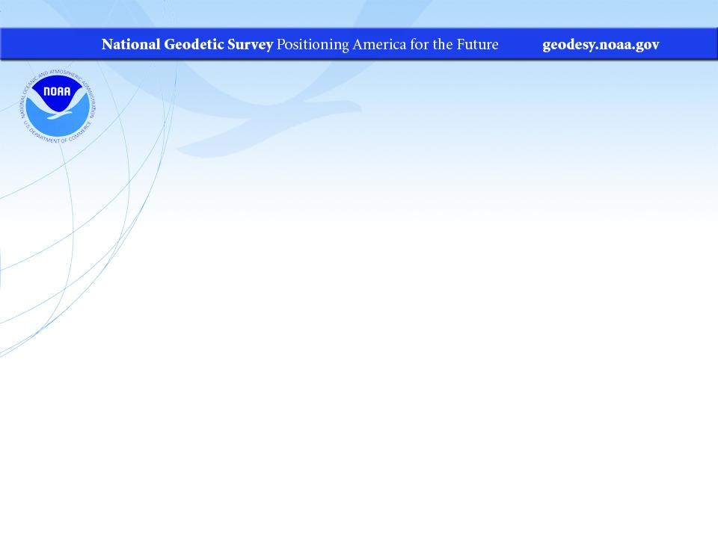
NGS Overview and Discussion of NATRF2022, NAPGD2022, and SPCS2022
KAPS Annual Conference
September 2022
Jeff Jalbrzikowski, P.S., GISP, CFS
Appalachian Regional Geodetic Advisor
jeff.jalbrzikowski@noaa.gov
240-988-5486

Slide 2
My Background
Licensed Surveyor in OH, PA, and WV (PS)
Certified GIS Professional (GISP)
Certified Floodplain Surveyor (CFS)
BS in Surveying & Mapping, Univ. of Akron
Came to NGS from USACE Pittsburgh District
  primary experience is engineering surveys, including structural deformation, hydrographic/bathymetric, terrestrial lidar, GNSS control, local/legacy datum resolution

Slide 3
So… NAD83 and NAVD88 are scheduled to be replaced
Who’s nervous?
Who’s ready?
Who’s already working in ITRF?

Slide 4



Organizational Structure
  -Department of Commerce (DoC)
  (~47,000 employees)
  -National Oceanic and Atmospheric Administration (NOAA)
  -National Ocean Service (NOS)
  -National Geodetic Survey (NGS)
  (~175 employees)

Slide 5


Organizational Structure
We’re not USGS, we’re NGS
  -Department of Commerce (DoC)
  (~47,000 employees)
  -National Oceanic and Atmospheric Administration (NOAA)
  -National Ocean Service (NOS)
  -National Geodetic Survey (NGS)
  (~175 employees)
≠

Slide 6
NGS Mission
To define, maintain and provide access to the National Spatial Reference System (NSRS) to meet our Nation’s economic, social, and environmental needs.

Slide 7
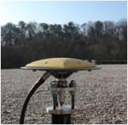
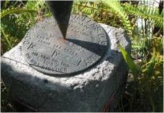

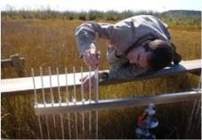
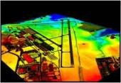
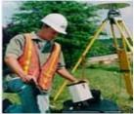
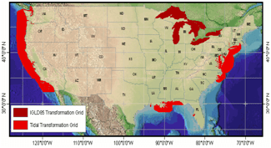
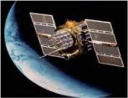
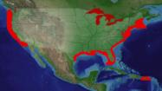
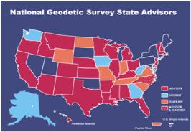
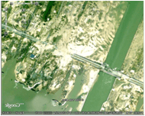

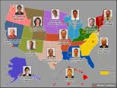
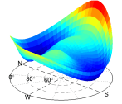
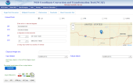

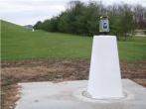
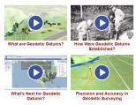
NGS Overview
Modernizing the NSRS
CORS
NHMP
GRAV-D
ECO
NGS Products and Services
ASP
OPUS
VDatum
Orbit Data
National Shoreline
Geodetic Advisors
ERI
Antenna Calibrations
NCAT
CUSP
CBL
Outreach

Slide 8
NGS Overview
Modernizing the NSRS
CORS
NHMP
GRAV-D
ECO
NGS Products and Services
ASP
OPUS
VDatum
Orbit Data
National Shoreline
Geodetic Advisors
ERI
Antenna Calibrations
NCAT
CUSP
CBL
Outreach

Slide 9
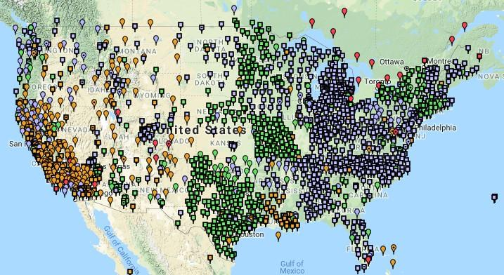
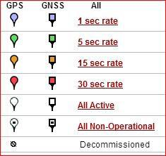
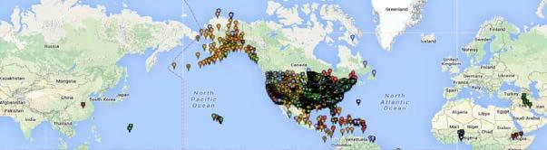
Continuously Operating Reference Station (CORS)
2000+ sites
~225 organizations

Slide 10
NOAA CORS Network (NCN)
2000+ sites
~225 organizations

Slide 11
NGS Overview
Modernizing the NSRS
CORS
NHMP
GRAV-D
ECO
NGS Products and Services
ASP
OPUS
VDatum
Orbit Data
National Shoreline
Geodetic Advisors
ERI
Antenna Calibrations
NCAT
CUSP
CBL
Outreach

Slide 12
National Height Modernization Program
“…the establishment of accurate, reliable heights using GNSS technology in conjunction with traditional leveling, gravity, and modern remote sensing information…”
propagation and long-term monitoring of control thru static GPS campaigns, GPS on BMs, and digital leveling
combined with gravity and lidar data

Slide 13
National Height Modernization Program
Funded partners
States engaged in HM without Federal funding
Spatial Reference Centers
Regional Leaders
Other funded partners

Slide 14
NGS Overview
Modernizing the NSRS
CORS
NHMP
GRAV-D
ECO
NGS Products and Services
ASP
OPUS
VDatum
Orbit Data
National Shoreline
Geodetic Advisors
ERI
Antenna Calibrations
NCAT
CUSP
CBL
Outreach

Slide 15
Gravity for the Redefinition of the American Vertical Datum
Two major campaigns within GRAV-D
High-resolution snapshot of gravity
  airborne observations of relative gravity
  collected in as short of a timespan as is realistic
  full coverage
Low-resolution “movie” of gravity changes
  on-the-ground observations of absolute gravity
  periodic or episodic; repeat every ___ years
  large spacing, a few per state

Slide 16
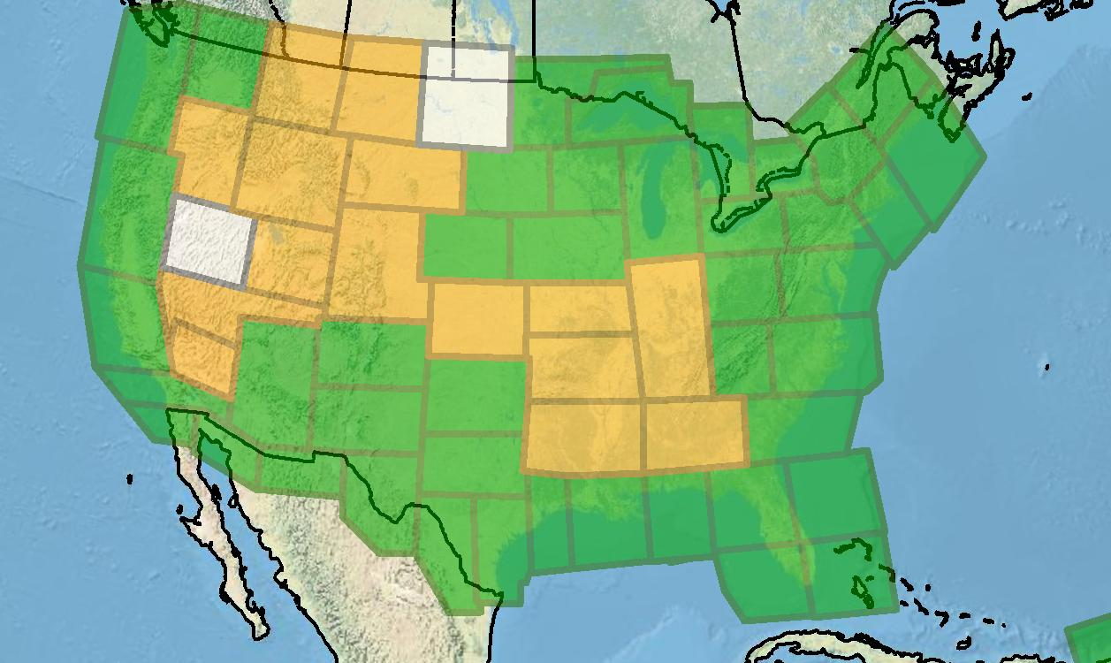
Gravity for the Redefinition of the American Vertical Datum
Green = Complete
Blue = In Processing
Yellow = Underway
White = Planned
10 km data lines
70 km cross lines
20,000 ft altitude
230 kt flight speed
As of DEC2019:
81% complete

Slide 17
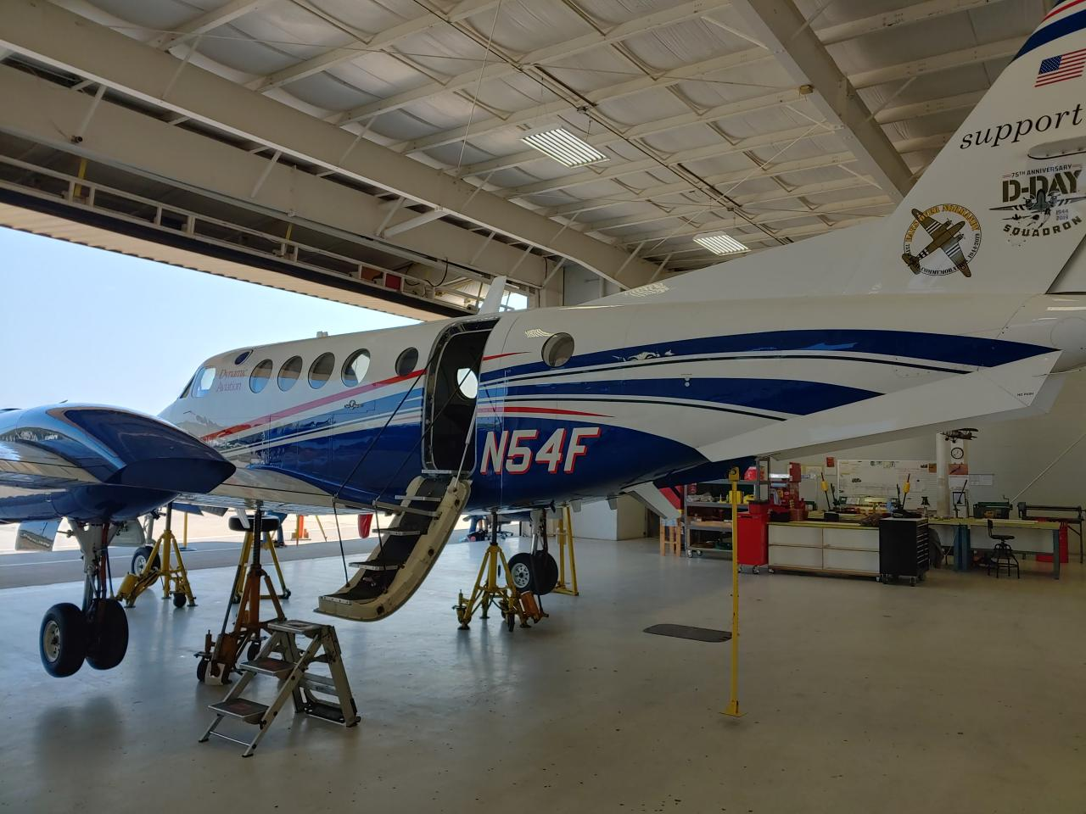
Dynamic Aviation’s King Air 200T

Slide 18

NOAA’s Gulfstream IV-SP

Slide 19
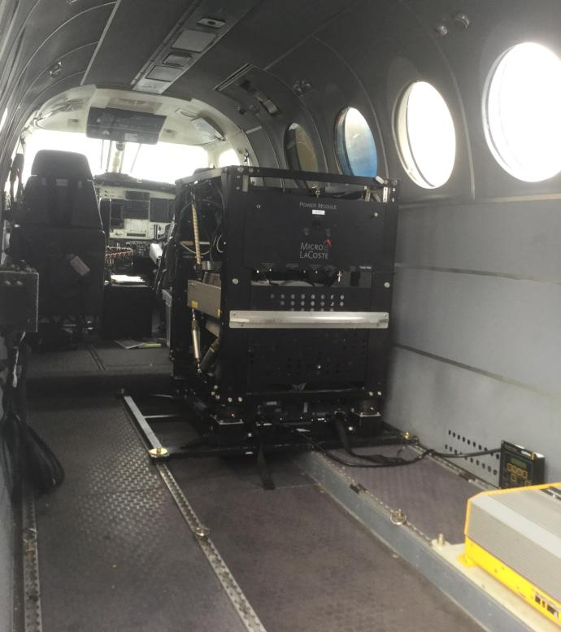
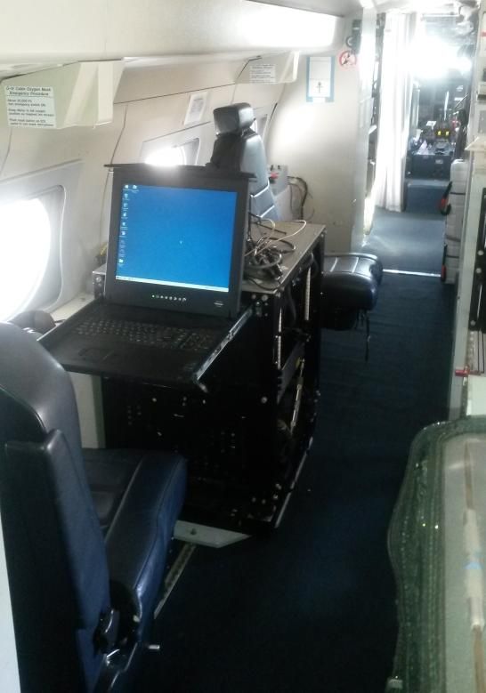
Gravimeters in the Aircraft
in the King Air
in the Gulfstream IV

Slide 20
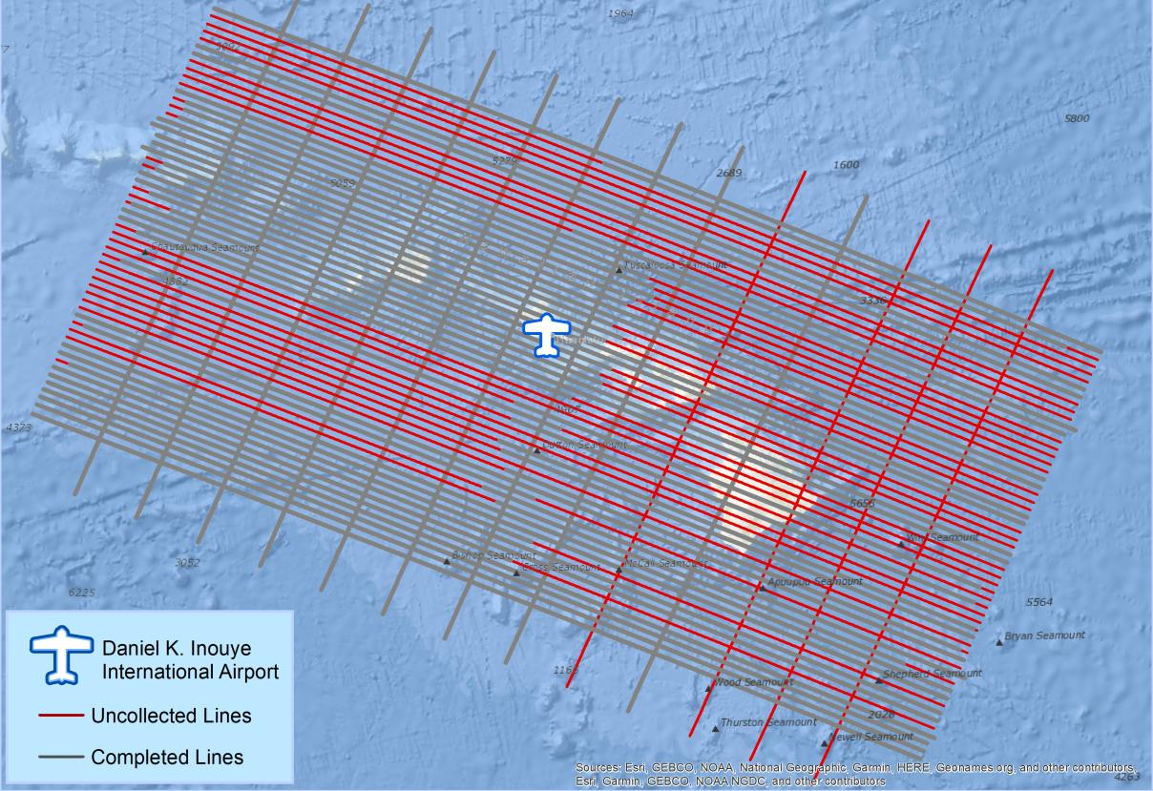
What does a flight plan look like?

Slide 21
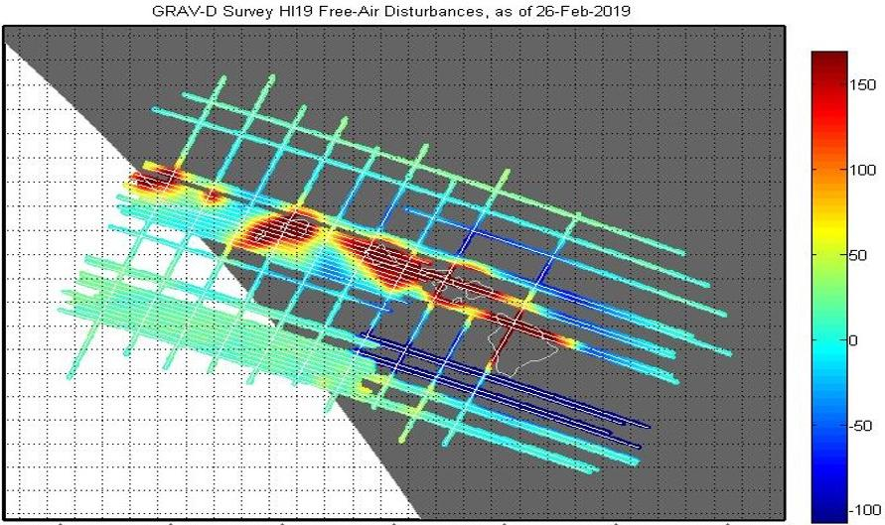
What does processed data look like?
mGal
mGal = milligal

Slide 22
NGS Overview
Modernizing the NSRS
CORS
NHMP
GRAV-D
ECO
NGS Products and Services
ASP
OPUS
VDatum
Orbit Data
National Shoreline
Geodetic Advisors
ERI
Antenna Calibrations
NCAT
CUSP
CBL
Outreach

Slide 23
Online Positioning User Service
  OPUS Rapid Static (OPUS-RS)
      dual frequency receiver data
      static sessions only
      30 seconds epoch rate (aka recording interval)
      15 minutes to 2 hours of GPS data
  OPUS Static (OPUS-S)
      same requirements as above
      2 to 48 hours of GPS data
  OPUS Projects (OP)
      adds session processing and network adjustment
      training by NGS required; typically 12 hours
      upload to OPUS with a “Project ID” keyed in Options

Slide 24
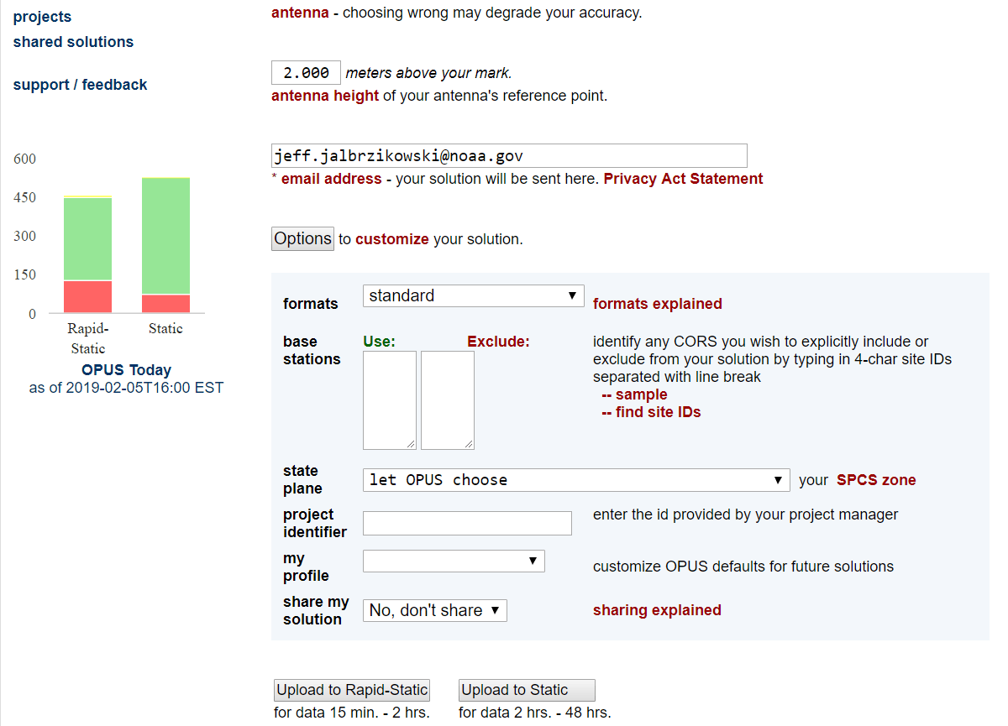
a note on OPUS “my profile”
be careful!

Slide 25
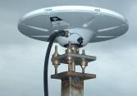
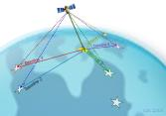
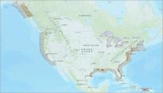
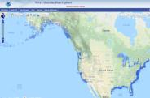
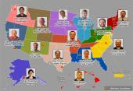

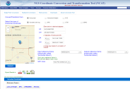
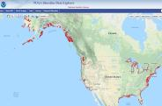
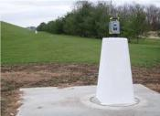

NGS Overview
Modernizing the NSRS
CORS
NHMP
GRAV-D
ECO
NGS Products and Services
ASP
OPUS
VDatum
Orbit Data
National Shoreline
Geodetic Advisors
ERI
Antenna Calibrations
NCAT
CUSP
CBL
Education

Slide 26

GPS Orbit Data aka Ephemerides
NGS orbit analysis and computation is performed together with, and as a component of, the International GNSS Service (IGS)
  IGS coordinates the collection of satellite tracking data
  these orbits are what give us post-processed accuracy
Designated with this responsibility by the Civil GPS Service Interface Committee (CGSIC)
If you’re using OPUS, it’s all behind-the-curtain!

Slide 27
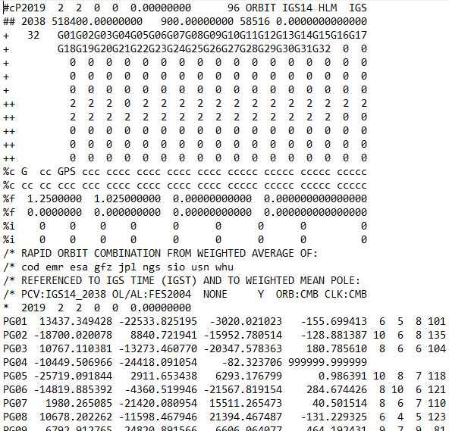
.sp3 file
Sattelite
Orbit Data
Link to NGS GPS Calendar

Slide 28
NGS Overview
Modernizing the NSRS
CORS
NHMP
GRAV-D
ECO
NGS Products and Services
ASP
OPUS
VDatum
Orbit Data
National Shoreline
Geodetic Advisors
ERI
Antenna Calibrations
NCAT
CUSP
CBL
Outreach

Slide 29
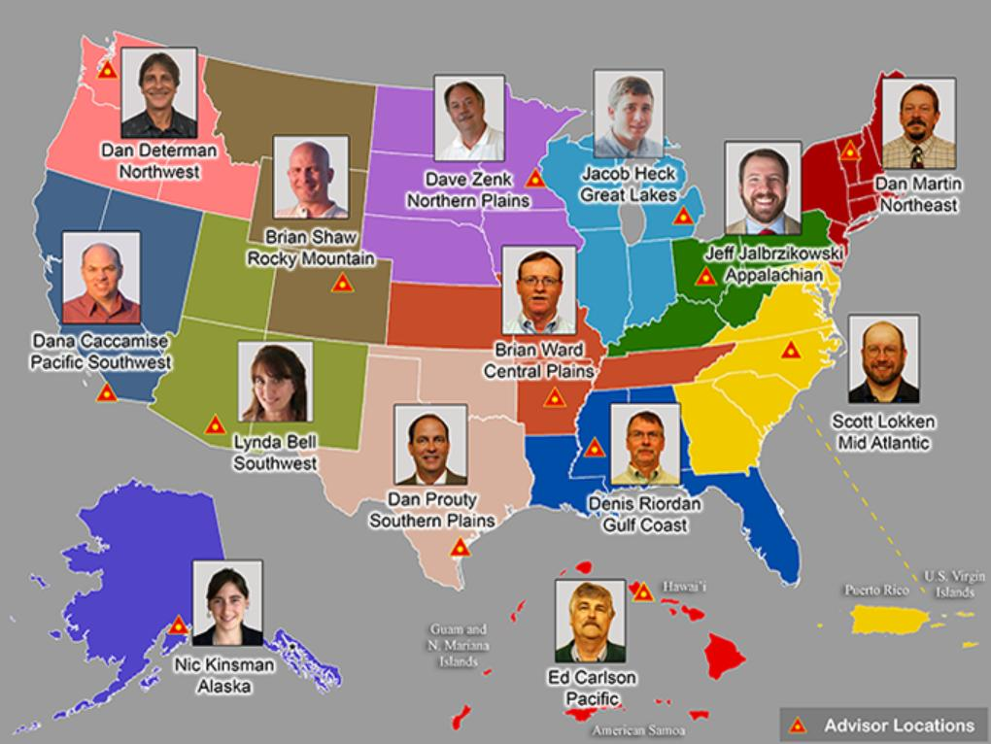




https://www.ngs.noaa.gov/ADVISORS/
RETIRES TOMORROW

Slide 30

Regional Geodetic Advisor Program
www.ngs.noaa.gov/ADVISORS/
query any major search engine: “ngs advisors”

Slide 31
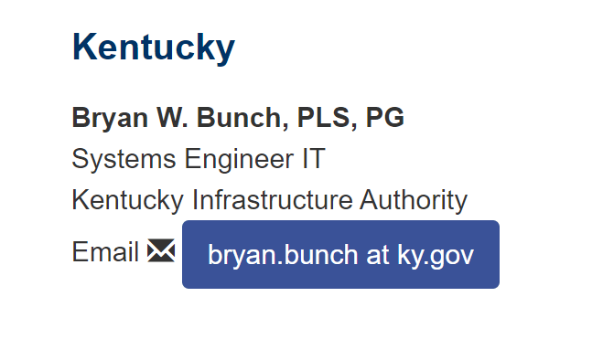
State Geodetic Coordinators
Not an NGS employee
Serves as a liaison between the State’s geospatial community and the NGS
Brian Bunch at the Kentucky Infrastructure Authority (KIA)

Slide 32
NGS Overview
Modernizing the NSRS
CORS
NHMP
GRAV-D
ECO
NGS Products and Services
ASP
OPUS
VDatum
Orbit Data
National Shoreline
Geodetic Advisors
ERI
Antenna Calibrations
NCAT
CUSP
CBL
Outreach

Slide 33
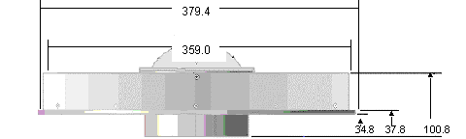
Phase Center Offset - conceptual
Orange dot = mean point of signal reception
Blue dot = Antenna Reference Point (ARP)
Red line = Phase Center Offset (PCO)

Slide 34
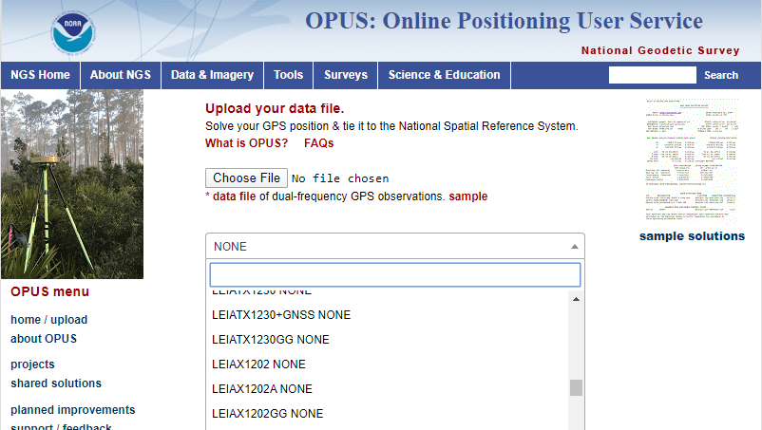
Phase Center Offset
The PCO is one reason it is important to select the correct antenna for OPUS upload!
choose
carefully!
if you have questions… drop me a line

Slide 35
NGS Overview
Modernizing the NSRS
CORS
NHMP
GRAV-D
ECO
NGS Products and Services
ASP
OPUS
VDatum
Orbit Data
National Shoreline
Geodetic Advisors
ERI
Antenna Calibrations
NCAT
CUSP
CBL
Outreach

Slide 36
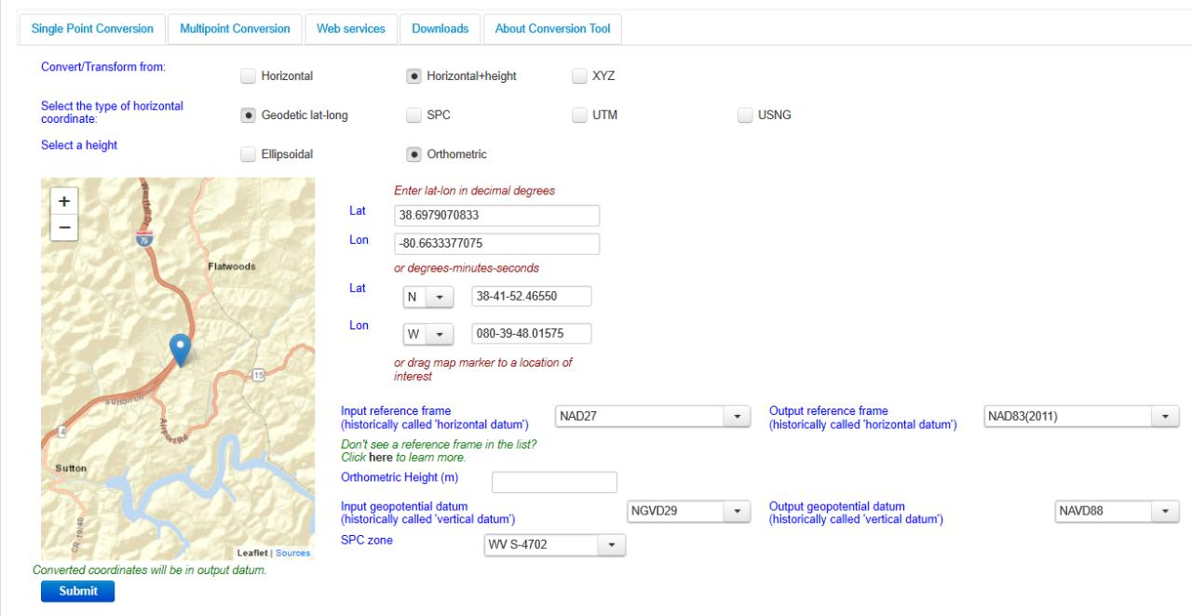
NGS Coordinate Conversion And Transformation Tool (NCAT)

Slide 37
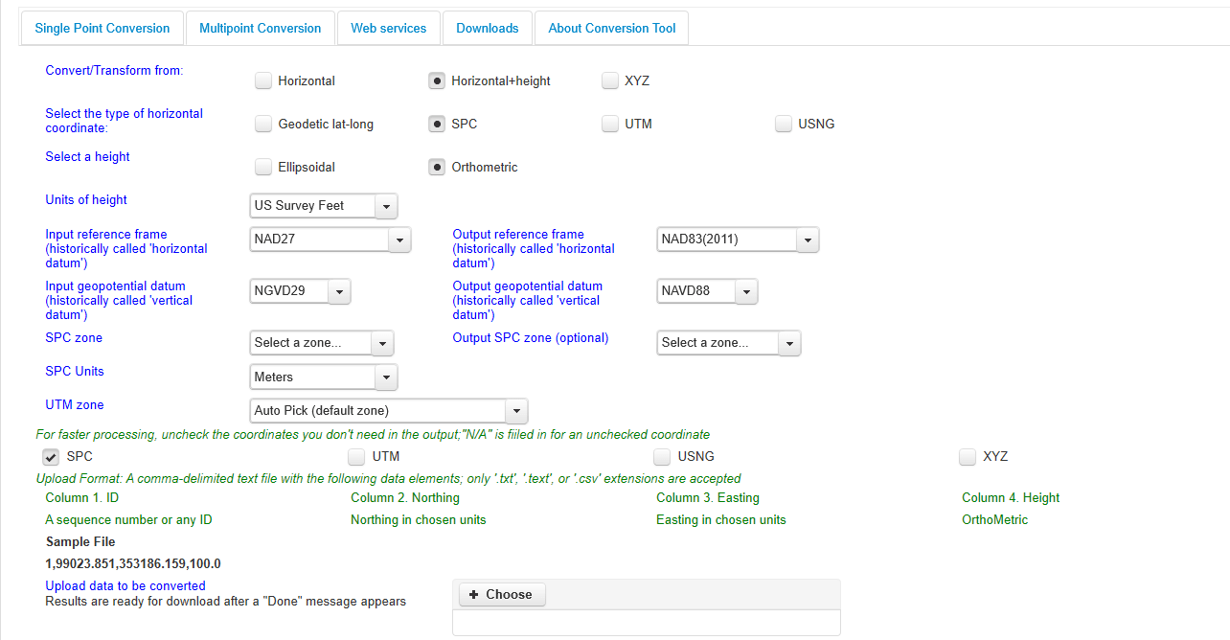
NGS Coordinate Conversion And Transformation Tool (NCAT)

Slide 38
NGS Overview
Modernizing the NSRS
CORS
NHMP
GRAV-D
ECO
NGS Products and Services
ASP
OPUS
VDatum
Orbit Data
National Shoreline
Geodetic Advisors
ERI
Antenna Calibrations
NCAT
CUSP
CBL
Outreach

Slide 39
Calibration Base Lines - CBL
Three types of CBL defined by NGS
  Primary CBL (PCBL): in Woodford, VA at NGS TTC; it is open for use to organizations like the PLSO
  Federal CBL (FCBL): established with EDM checked at the NGS PCBL and IAW NOAA TM NGS-8
      2 in West Virginia: Marshall County Airport, Byrd L&D
  Cooperative CBL (CCBL): established with EDM checked on an FCBL and IAW that same NGS-8 manual

Slide 40
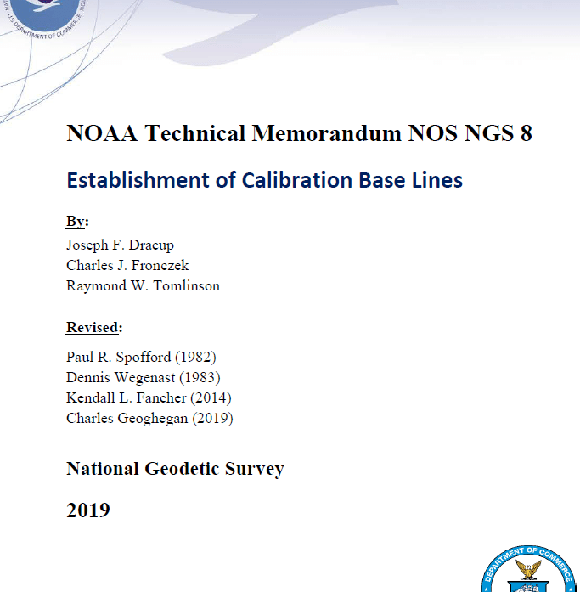
Calibration Base Lines - CBL
NGS commitment to the CBL Program:
  A minimum of one FCBL per State
  Establishment procedures document
  Public access to the CBL database
  Software to process your observations
  Verification and re-measurement data review
  Technical support (Advisors or other personnel)
https://www.ngs.noaa.gov/CBLINES/

Slide 41
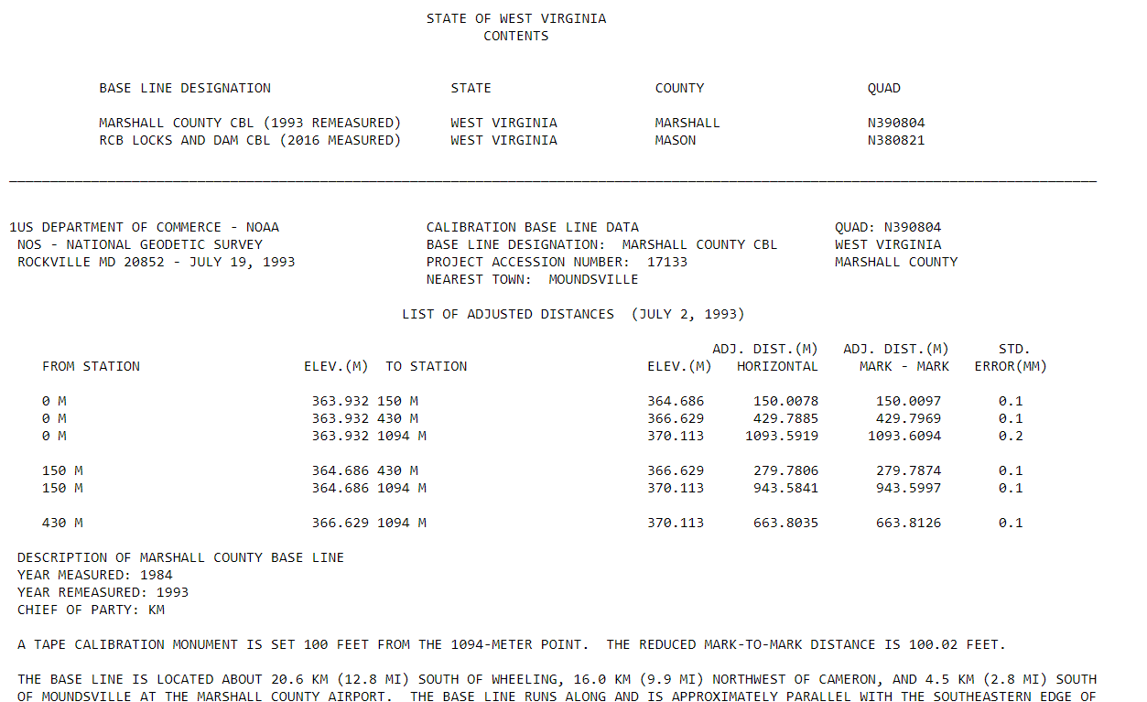
CBL Datasheets

Slide 42
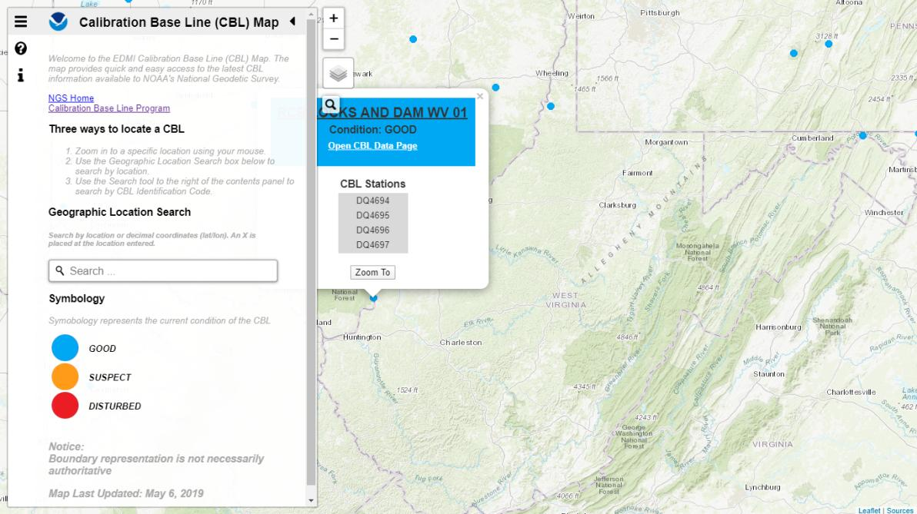
Beta CBL Map Viewer
https://www.ngs.noaa.gov/CBLINES/

Slide 43
NGS Overview
Modernizing the NSRS
CORS
NHMP
GRAV-D
ECO
NGS Products and Services
ASP
OPUS
VDatum
Orbit Data
National Shoreline
Geodetic Advisors
ERI
Antenna Calibrations
NCAT
CUSP
CBL
Outreach

Slide 44
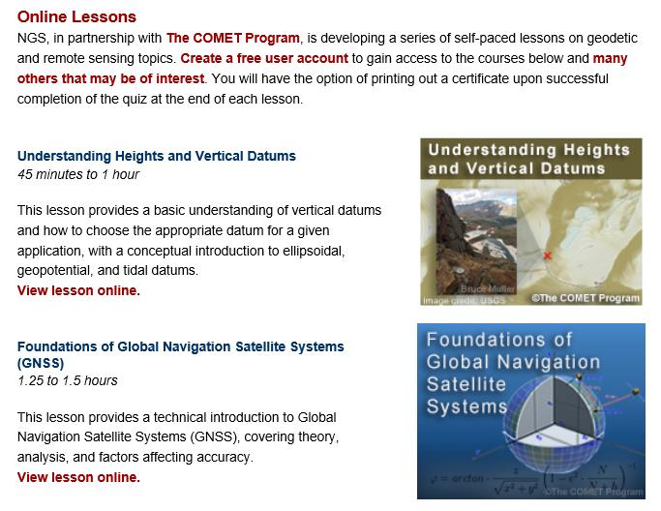
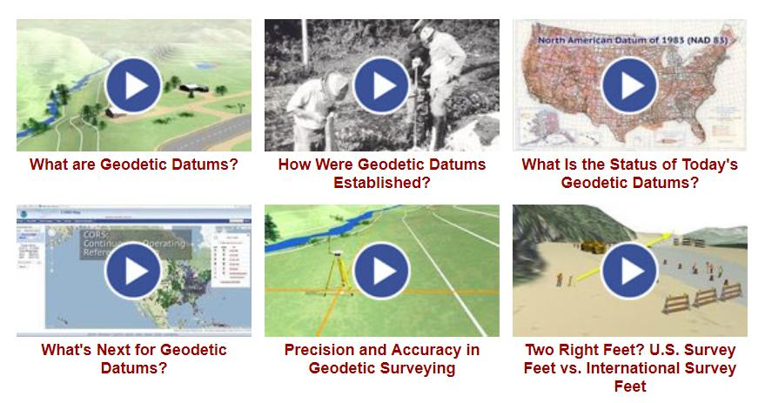
Outreach & Educational Resources

Slide 45
NGS Mission
To define, maintain and provide access to the National Spatial Reference System (NSRS) to meet our Nation’s economic, social, and environmental needs.

Slide 46
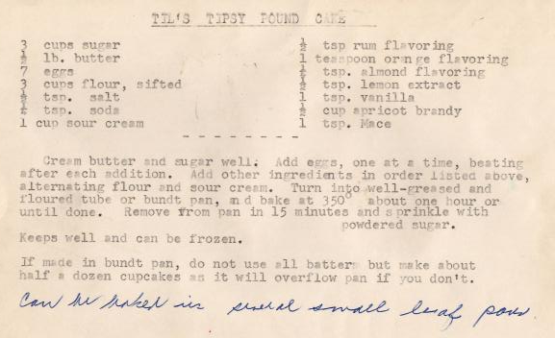
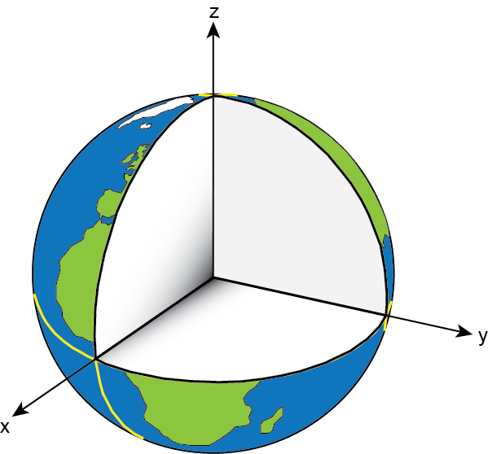
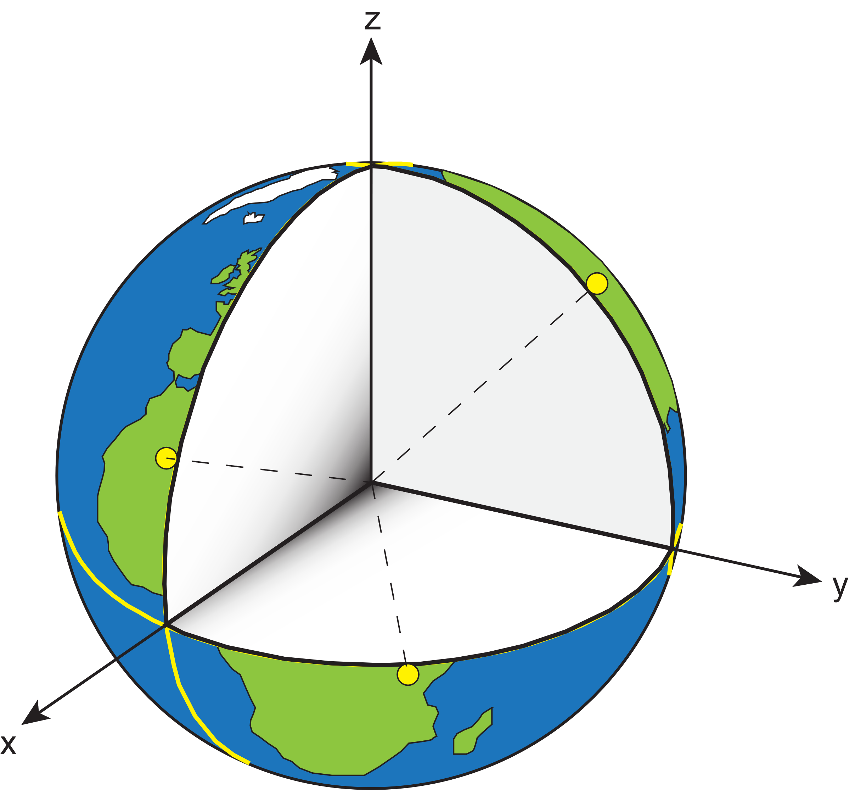
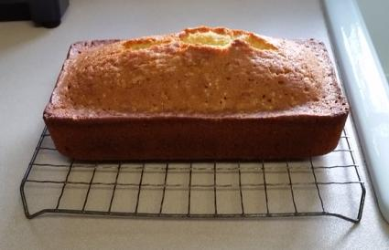
Reference System & Frame
Before you can realize a Reference Frame… you must define a Reference System
Reference System:
A set of prescriptions and conventions together with the modeling required to define a triad of coordinate axes¹
-the recipe
Reference Frame:
Realizes the system by means of coordinates of definite points that are accessible directly by occupation or observation¹
-the cake
= CORS
¹Springer Handbook of Global Navigation Satellite Systems, Ch. 2, p. 34

Slide 47
Reference System… then Frame
International Terrestrial Reference System (ITRS)
  IERS’s recipe
International Terrestrial Reference Frame
  Realized by the ITRF Network (the SGT stations)
True for any System and Frame
  Not just the ITRF
National Spatial Reference System
  NGS’s recipe
North American Terrestrial Reference Frame
  Realized by the NOAA CORS Network
  Accessible easily with GPS, by using NGS’s OPUS

Slide 48
National Spatial Reference System (NSRS)
A consistent coordinate system that defines
latitude
longitude
height
scale
orientation
gravity
throughout the United States.
…and their time variants

Slide 49
National Spatial Reference System (NSRS)
These items ARE part of the NSRS
Horizontal Datums (aka Geometric Reference Frames) | Vertical Datums | Great Lakes Datums | Geoid Models | Transformations and Conversions
NAD83 | NAVD88 | IGLD85 | GEOID18 | NADCON
NAD27 | NGVD29 | IGLD55 | GEOID12B | VERTCON
USSD | VIVD09 |  | GEOID09
 | GUVD04 |  | GEOID06 | SPCS83
 | NMVD03 |  | GEOID03 | SPCS27
 | ASVD02 |  | GEOID99
 | PRVD02 |  | GEOID96
 |  |  | ALASKA94
 |  |  | GEOID93
 |  |  | GEOID90

Slide 50
National Spatial Reference System (NSRS)
These items are NOT part of the NSRS
Horizontal Datums (aka Geometric Reference Frames) | Vertical Datums | Geoid Models | Transformations and Conversions
WGS84 | IHRS (by IAG) | OSU91A | CORPSCON
WGS72 |  | EGM96 | Appendix B.6 of DMA TR 8350.2 (WGS 84)
ITRF (Intl. Terrestrial Reference Frame by IERS) |  | EGM2008 | Oregon Coordinate Reference System (ORCS)
IGS (Intl. GNSS Service reference frame) |  |  | The Kansas Regional Coordinate System
Hyperlink to ITRF station map

Slide 51




NSRS … do I have to use it?
OMB Circular A-16
  requires all Federal civilian agencies to utilize geodetic control for their geospatial activities
  places NOAA in responsible charge of that control
  NGS has defined that control as the NSRS
  FGCS has issued requirements, via FRNs, to reference data to the most recent components of the NSRS
            1989 FRN designated NAD 83
            1993 FRN designated NAVD 88
Hyperlink to NAVD88 FRN
Hyperlink to NAD83 FRN

Slide 52
NSRS … do I have to use it?
Not necessarily, but it’s a great idea!
States may mandate use (does West Virginia?)
All Federal spatial data and GIS activities financed directly or indirectly, in whole or in part, by Federal funds are required to be tied to the NSRS
If you want to get involved in survey contracting with the Federal Government it’s a necessity

Slide 53
Not just new datums…
  NSRS Modernization
Replace NAD83
Replace NAVD88
Re-invent Bluebooking
Improve Geodetic Toolkit
Better Surveying Methods
Blueprint for 2022, Part 1
Blueprint for 2022, Part 2
Blueprint for 2022, Part 3

Slide 54



Evolution of the NSRS
NAD27
NAD83 (1986)
NAD83 (2011)

Slide 55

Modernized NSRS is our “smartphone”
You resisted it for a while…
It was a little cumbersome to get used to…
But soon you were hooked!

Slide 56
Two Major Components of
Modernized NSRS
Geometric (LLh)
Latitude, Longitude, Ellipsoid Height
Geopotential (H)
Orthometric Height

Slide 57
North American Datum
of 1983
NAD83
will be replaced by

Slide 58
North American Terrestrial Reference Frame of 2022
NATRF2022
(pronounced: nat-ref)

Slide 59
Reference Frame ≈ Datum
Reference Frame is a more scientifically appropriate way of saying “datum”
could be debated that “datum” was misused in NAD83(2011)
you will continue to see NGS use the phrase “New Datums” for 2022

Slide 60
Datum Defined
The adopted standard latitude and longitude of a given station, together with the adopted standard azimuth of a line from that station.
e.g. Meade’s Ranch and it’s azimuth mark, Waldo
Source: Proceedings of the 14th General Conference of the International Geodetic Association (IAG) - ”Report on Geodetic Operations in the United States”, O.H. Tittmann, Superintendent of the USC&GS

Slide 61
Reference Frame Defined
A point of view or a ‘frame of reference’.
If your reference frame is North America, you are standing somewhere within North America, seeing how other places move from your point of view.

Slide 62
Why replace NAD83?
Main driver: Global Navigation Satellite System (GNSS)
ACCESS
  GNSS equipment is fast, inexpensive, reliable
  Reduces reliance on physical control marks
ACCURACY
  Insensitive to distance-dependent errors
  Immune to instability; active control via CORS
CONSISTENCY
Eliminates systematic errors in current datums
Aligned with global reference frame

Slide 63







A very brief history of U.S. horizontal & geometric datums
GNSS
triangulation
NAD83(HARN/199#)
US Standard Datum
NAD83(HARN/199#)
NAD83(2007)
NATRF2022
NAD83(1986)
NAD83(2011)
NAD27
+
+
+
+
+
+
+
time
tens of meters
few 0.1m
few 0.01m
few 0.01m
<10 m
~2m
shift

Slide 64


Slide 65
Replacing NAD83
develop four "plate-fixed" reference frames
remove non-geocentricity of NAD83
align to ITRF2020 at epoch 2020.00
remove most of tectonic plate rotation from ITRF2020 via Euler Pole Parameters
Shift and Drift…

Slide 66
Replacing NAD83
develop four "plate-fixed" reference frames
remove non-geocentricity of NAD83
align to ITRF2020 at epoch 2020.00
remove most of tectonic plate rotation from ITRF2020 via Euler Pole Parameters
Shift and Drift…

Slide 67
Four “Plate-Fixed” Reference Frames
North American Terrestrial Reference Frame of 2022
(NATRF2022)
Pacific Terrestrial Reference Frame of 2022
(PATRF2022)
Caribbean Terrestrial Reference Frame of 2022
(CATRF2022)
Mariana Terrestrial Reference Frame of 2022
(MATRF2022)

Slide 68


Slide 69
Four “Plate-Fixed” Reference Frames
North American Terrestrial Reference Frame of 2022
(NATRF2022)
Pacific Terrestrial Reference Frame of 2022
(PATRF2022)
Caribbean Terrestrial Reference Frame of 2022
(CATRF2022)
Mariana Terrestrial Reference Frame of 2022
(MATRF2022)

Slide 70
Replacing NAD83
develop four "plate-fixed" reference frames
remove non-geocentricity of NAD83
align to ITRF2020 at epoch 2020.00
remove most of tectonic plate rotation from ITRF2020 via Euler Pole Parameters
Shift and Drift…

Slide 71

Non-geocentricity?
Geocentric:
  relating to, measured from, or as if observed from the earth's center of mass
The goal was to accomplish that… but didn’t.

Slide 72

Non-geocentricity of NAD83
ITRF2020
GRS80 ellipsoid
NAD83
GRS = Geodetic Reference System

Slide 73
Non-geocentricity of NAD83
ITRF2020
GRS80 ellipsoid
NAD83

Slide 74
Non-geocentricity of NAD83
Earth’s
Surface
h₁₄
h₈₃
NAD83
origin
ITRF2020
origin
~2.2 meters
GRS80
ellipsoid

Slide 75
Non-geocentricity of NAD83
Earth’s
Surface
h₂₂
NAD83
ITRF2020
NATRF2022
GRS80
ellipsoid
Shift…

Slide 76


Geometric change due to ellipsoid non-geocentricity
Horizontal (Lat, Lon)
Ellipsoidal (h)
Shift…

Slide 77
Replacing NAD83
develop four "plate-fixed" reference frames
remove non-geocentricity of NAD83
align to ITRF2020 at epoch 2020.00
remove most of tectonic plate rotation from ITRF2020 via Euler Pole Parameters
Shift and Drift…

Slide 78


International Terrestrial Reference Frame
(ITRF)
International Earth Rotation and Reference Systems Service (IERS)
International Union of Geodesy and Geophysics (IUGG)

Slide 79
International Terrestrial Reference Frame
The stable coordinate system that allows us to measure change over space, time and evolving technologies.
An accurate, stable set of station positions and velocities.
Network measurements interconnected by co-location of different space geodetic techniques.
“Approximately represents the motions of the tectonic plates with respect to the Earth's deep interior”… huh?

Slide 80

ITRF concept
Watch the grid!
Drift…

Slide 81

Epoch?
eh-puck? ee-pock? … to-may-to, to-mah-to
  an instant of time or a date selected as a point of reference

Slide 82
Replacing NAD83
develop four "plate-fixed" reference frames
remove non-geocentricity of NAD83
align to ITRF2020 at epoch 2020.00
remove most of tectonic plate rotation from ITRF2020 via Euler Pole Parameters
(pronounced: “oiler”)
Shift and Drift…

Slide 83
The wrong question, circa 2022:
“What’s the position of that point?”
The right question, circa 2022:
“What’s the position of that point, on some specific date?”
Drift…

Slide 84
Two types of drift
Tectonic Plate Rotation
    horizontal
Everything Else
    residual motions left after rotation
    regional linear motions
    localized subsidence or uplift
simple to model
complex

Slide 85
Tectonic Plate Rotation
    horizontal
simple to model

Slide 86
Euler Pole Parameters
of 2022
EPP2022

Slide 87

Plate Rotation visualized
Drift…

Slide 88

Euler Poles and “Plate-Fixed”
  In the ITRF, many tectonic plates have a dominant motion: rotation
  Euler Pole - point about which a plate rotates (yellow star)
NATRF2022 Euler Pole

Slide 89
Euler Poles and “Plate-Fixed”
ITRF
Frame = constant
NA Plate = rotating
NATRF
Frame = rotating
NA Plate = constant

Slide 90
Euler Poles and “Plate-Fixed”
ITRF
Frame = constant
NA Plate = rotating
NATRF
Frame = rotating
(relative to ITRF)
NA Plate = constant
(relative to NATRF2022)

Slide 91

ITRF – constant frame, rotating plate

Slide 92
“Plate-Fixed”
NATRF – rotating frame, constant with plate

Slide 93
ITRF or NATRF – your choice, just use EPP

Slide 94
EPP – Euler Pole Parameters
Latitude
Longitude
Rotation Speed
yellow star off west coast of S. America

Slide 95
CORS Velocities in ITRF2020
Drift…

Slide 96

CORS Velocities in NATRF2022
Think of this map as ITRF2020 + EPP2022
Still SomeDrift…

Slide 97
ITRF2020 + EPP2022 = --TRF2022
Rotation of the
North American Plate
NATRF2022
CATRF2022
PATRF2022
MATRF2022
Rotation of the
Caribbean Plate
ITRF2020
Rotation of the
Pacific Plate
Rotation of the
Mariana Plate
EPP2022

Slide 98
ITRF2020 + EPP2022 = --TRF2022
Rotation of the
North American Plate
NATRF2022
EPP2022
ITRF2020

Slide 99
Two types of drift
Tectonic Plate Rotation
    horizontal
Everything Else
    residual motions left after rotation
    regional linear motions
    localized subsidence or uplift
simple to model
complex

Slide 100
Everything Else
    residual motions left after rotation
    regional linear motions
    localized subsidence or uplift
Still SomeDrift…
complex

Slide 101
Intra-Frame Deformation Model of 2022
IFDM2022

Slide 102
Concept of goal of IFDM
Longitude (Easting) History of DI4044
Trend: -1.7 mm / year
RED IS NATRF2022
COORDINATE
Still Some Drift…
Trend: -14.3 mm / year
BLUE IS ITRF COORDINATE
2004 2006 2008 2010 2012 2014 2016 2018

Slide 103
CORS Velocities in NATRF2022
Think of this map as ITRF2020 + EPP2022
Still SomeDrift…

Slide 104

IFDM goal = model all velocities
Think of this map as ITRF2020 + EPP2022 + IFDM2022

Slide 105
Still Some Drift…
  Everything in the world moves
  Coordinates will be associated with the actual date when the data was collected!
  Velocities at all marks can be estimated using this Intra-Frame Deformation Model (IFDM)
  IFDM goal being to move collected data thru time to Reference Epochs for coordinate comparisons/analysis

Slide 106
Intra-Frame Deformation Model
A model of all residual velocities, after removal of tectonic rotation via EPP:
  Horizontal residual motion
  Total vertical motion (ellipsoid heights)
  Replaces / Improves upon HTDP
Given t₁ and t₂, compute Δλ, Δϕ, Δh at any point, accounting for all motions
Likely be built upon CORS data, geodynamic models and InSAR, but not yet finalized

Slide 107
EPP2022 – Euler Pole Parameters – Simple Rotation
  Three parameters: lat, lon, rotation speed
  Horizontal only: just latitude and longitude
  Changes the frame: ITRF2020 + EPP2022 = NATRF2022
  Does not change the epoch
IFDM2022 – Intra-Frame Deformation Model - Complex
  Complex set of parameters
  Residual horizontal motion: all the motion leftover after Euler Pole rotation
  All vertical motion: localized subsidence or uplift
  Changes the epoch
  Does not change the frame: “intra” = on the inside; within

Slide 108
EPP2022
IFDM2022
Two new tools that will make time dependent geodetic control practical
They work together to account for the Drift…

Slide 109
Example of application of EPP and IFDM
It’s 2039 and you are working in San Diego using NATRF2022
And you want to compare your work to another survey from 2028
Important: This slide only covers geometric coordinates.
…the catch is, that survey was done in PATRF2022
PATRF2022
ep. 2028.048
EPP2022
(PA)
ITRF2020
ep. 2028.048
EPP2022
(NA)
NATRF2022
ep. 2028.048
IFDM2022
(PA)
IFDM2022
(NA)
PATRF2022
ep. 2039.704
EPP2022
(PA)
ITRF2020
ep. 2039.704
EPP2022
(NA)
NATRF2022
ep. 2039.704

Slide 110
Alright Jeff... enough jibba-jabba, what’s the impact?

Slide 111


Slide 112

What’s that going to look like?
PHOTO = NAD83
RED = NAD83 shoreline data
GREEN = shoreline transformed to NATRF2022

Slide 113


If you’re only working in this region…
North American Terrestrial Reference Frame of 2022
(NATRF2022)

Slide 114
Two Major Components of
Modernized NSRS
Geometric (LLh)
Latitude, Longitude, Ellipsoid Height
Geopotential (H)
Orthometric Height

Slide 115
North American Vertical Datum
of 1988
NAVD88
will be replaced by

Slide 116
North American-Pacific Geopotential Datum of 2022
NAPGD2022
(pronounced: nap-jee-dee)

Slide 117
A brief history of (the most prevalent) U.S. vertical datums

Slide 118

NGVD29
Referenced to 26 tide gauges in the US and Canada

Slide 119
NGVD29 – based on 26 tide gauges
Concept

Slide 120

Referenced to a single tide gauge in Canada
Why one gage fixed this time?
removed local sea level variation problem of NGVD29
But it did introduce possibility of cross-continent error build-up…
Father Point Lighthouse, Quebec

Slide 121

NAVD88 – based on single tide gauge
Concept

Slide 122

Approximate Error in NAVD88 "zero elevation” (H=0)
Map is the H=0 surface overlaid onto satellite gravity data

Slide 123



Why Replace NAVD88?
tilt in the "zero surface” (intended to be flat)
subsidence, uplift, freeze & thaw of BMs
limited availability of undisturbed marks
Approximate Error in NAVD88 "zero surface”

Slide 124

Passive marks may lie still… but they still may lie!
(small instability x long time = large inaccuracy)

Slide 125
Replacing NAVD88
primary access via GNSS and geoid (think OPUS)
accurate continental gravimetric geoid (1-2 cm)
aligned with:
  NATRF2022 (or CATRF, PATRF, MATRF)
  global mean sea level (GMSL)
monitor time-varying nature of gravity (NGS Geoid Monitoring Service GeMS)

Slide 126
Two types of geoid models…
  Gravimetric
  Hybrid

Slide 127
Gravimetric → Hybrid
  Gravimetric geoid is created from “scratch” with various types of gravity data
      USGG2003, USGG2009, USGG2012, xGEOID19
  Hybrid geoid is simply a gravimetric geoid warped to fit some vertical datum… like NAVD88
      GEOID03, GEOID09, GEOID12B, GEOID18

Slide 128
Gravimetric → Hybrid
      USGG2003, USGG2009, USGG2012, xGEOID19
      GEOID03, GEOID09, GEOID12B, GEOID18
best fit to NAVD88
best fit to NAVD88
best fit to NAVD88
best fit to NAVD88

Slide 129


Slide 130

Calculating N_{g} is not easy!
First you need a gravity field
  data collected from different distances away from Earth
Next calculate gravity anomaly, or ∆g
Then, just solve Stokes’ integral!
R is the mean radius of the earth
ɣ0 is mean surface gravity on ellipsoid
S is a geometric function of position
…there’s a catch
Need to know ∆g over entire surface of the earth

Slide 131
Calculating N_{g} is not easy!
First you need a gravity field
  data collected from different distances away from Earth
Next calculate gravity anomaly, or ∆g
Then, just solve Stokes’ integral!
R is the mean radius of the earth
ɣ0 is mean surface gravity on ellipsoid
S is a geometric function of position
…there’s a catch
Need to know ∆g over entire surface of the earth

Slide 132







Building a Gravity Field Model
Long Wavelengths (> 250 km)
GRACE/GOCE/Satellite Altimetry
+
Intermediate Wavelengths (20km to 300 km)
Airborne Observations
+
Short Wavelengths (< 100 km)
Terrestrial/Surface Observations and Predicted Gravity from Topography

Slide 133

GRACE - 2 Satellites measuring separation

Slide 134

GRAV-D – airborne relative gravimeters

Slide 135

Terrestrial Gravimeter - Relative

Slide 136

Terrestrial Gravimeter - Relative

Slide 137

Terrestrial Gravimeter - Absolute

Slide 138

Terrestrial Gravimeters - Absolute and Relative

Slide 139
Individual Components of NAPGD2022
Global Model of the geopotential field
  GM2022
Geoid undulation models by region
  GEOID2022 aka “0 elevation”
Deflection of the Vertical (DoV) models by region
  DEFLEC2022
Surface Gravity models by region
  GRAV2022

Slide 140


Slide 141

Sea Level Change and the Geoid

Slide 142

Sea Level Change and the Geoid

Slide 143

Sea Level Change and the Geoid

Slide 144
Sea Level Change and the Geoid
H_{2087.257}
H_{2020.000}
Threshold Level
-Threshold Level is published as 20 cm
-Process is repeated as GMSL changes
Geoid
GMSL

Slide 145

Monitoring Sea Level Change
Source: NASA JPL

Slide 146

Estimated change in orthometric heights from NAVD88 to NAPGD2022
(NAPGD2022 approximated using xGEOID16B)

Slide 147
Estimated change in orthometric heights from NAVD88 to NAPGD2022
(NAPGD2022 approximated using xGEOID16B)
Vertical change of about -0.6 to -2.0 feet

Slide 148


North American-Pacific Geopotential Datum of 2022
(NAPGD2022)

Slide 149
How can I prepare?
Where did this all start?
What’s the benefit to me?
How is all this possible?
Well, besides learning a whole new set of terminology and methods…

Slide 150
How can surveyors prepare?
Get familiar with terms, ask now, be ready
Set/occupy RTN Validation Stations (OPUS)
Research your published control
    pre-1995 will NOT get new coordinates (GPS only)
Use OPUS Projects to re-observe/process

Slide 151

What’s the benefit?
  Reduce all definitional & access-related errors in geometric reference frame to 1 cm when using 15 min of GNSS data
  aka “Replace NAD83”
  Reduce all definitional & access-related errors in orthometric heights in geopotential datum to
  2 cm when using 15 min of GNSS data
  aka “Replace NAVD88”
https://geodesy.noaa.gov/web/about_ngs/info/tenyearfinal.shtml

Slide 152

How is all this possible?
CORS
Co-location of space geodetic instruments worldwide that feed into ITRF development
Teamwork with other geodetic organizations
Research and Development
Testing
Science, dude!

Slide 153
Terminology - Geodetic Stations
Most frequently encountered types:
CORS = Continuously Operating (GNSS) Reference Station
CORGS = Continuously Operating Relative Gravimeter Station
DORIS = Doppler Orbitography and Radiopositioning Integrated by Satellite Station
SLR = Satellite Laser Ranging Station
VLBI = Very Long Baseline Interferometry Station
All have a Geodetic Reference Point (GRP)
  “Coordinates” = “Coordinates of the GRP at that station”
  Site with multiple types = Co-location Site
  Co-location Survey = tie the Station GRPs at a given Site
    “this is where the magic happens”

Slide 154





Co-location Site
NASA Goddard Space Flight Center, Greenbelt MD, USA
  GNSS, SLR, VLBI, DORIS

Slide 155
Co-location Site
NASA Goddard Space Flight Center, Greenbelt MD, USA
  GNSS, SLR, VLBI, DORIS

Slide 156
GNSS
Global Navigation
Satellite System
via
*generic term that means any or all of:
GPS, GLONASS, Galileo, BDS, etc.

Slide 157


CORS
Continuously Operating Reference Station

Slide 158
Co-location Site
NASA Goddard Space Flight Center, Greenbelt MD, USA
  GNSS, SLR, VLBI, DORIS

Slide 159
SLR
Satellite Laser Ranging

Slide 160


  SLR
Source: NASA
Source: Geoscience Australia

Slide 161


  NASA SLR satellite LAGEOS - only 60 cm diameter!
Source: NASA
  SLR
Source: NASA, McGarry

Slide 162
Co-location Site
NASA Goddard Space Flight Center, Greenbelt MD, USA
  GNSS, SLR, VLBI, DORIS

Slide 163
VLBI
Very Long Baseline Interferometry

Slide 164

quasi-stellar object
VLBI
epoch₁
quasar
radio telescopes
baseline
epoch₂

Slide 165
Co-location Site
NASA Goddard Space Flight Center, Greenbelt MD, USA

Slide 166
DORIS
Doppler Orbitography and Radiopositioning Integrated by Satellite

Slide 167

Source: CNES, France
Doppler Orbitography and Radiopositioning Integrated by Satellite

Slide 168




Co-location Site Survey
Example of Co-located Space Geodetic Techniques (SGTs)
All four SGTs represented here.
Generic concept of “co-location survey”, typically more complex!

Slide 169


Altogether now!
Space Geodetic Techniques (SGT) work together to create a well-defined, robust reference frame that improves positioning for users globally.

Slide 170
Not just new datums…
  NSRS Modernization
-OPUS enhancements/additions
-new types of coordinates
-new methods for establishing control
-streamlined Bluebooking
-retire the US Survey Foot

Slide 171


Blueprint for 2022, Part 3

Slide 172
Let’s look at some more terminology

Slide 173
Changing Coordinates
Historically NGS has been inconsistent, going forward we will use:
Convert
    change the type of coordinate without changing the datum or frame
    NAD 83(1986) latitude and longitude to NAD 83(1986) State Plane
  Transform
    change the datum or frame, without changing the type of coordinate
    NAD 27 latitude & longitude to an NAD 83(1986) latitude & longitude
Propagate
    this is an ISO standard for IERS
    change the epoch of coordinate without changing the frame
    ITRF2014 epoch 2019.2675 to ITRF2014 epoch 2020.00
    NATRF2022 epoch 2020.00 to NATRF2022 epoch 2023.243

Slide 174
Geometric Adjustment Window
A span of four consecutive GPS weeks, where the first GPS week in window is an integer multiple of 4
  GAW 1 = GPS Weeks 0, 1, 2 and 3 (January 6, 1980)
  GAW 2 = GPS Weeks 4, 5, 6 and 7
  GAW 586 = GPS Weeks 2344, 2345, 2346, and 2347
  You get the idea…

Slide 175

Geometric Adjustment Window
12 weeks
12 weeks

Slide 176
New Types of Coordinates

Slide 177
Five types of coordinates in Modernized NSRS
Name | Generally on… | Description
Reported Coordinates | Passive | Mapping accuracy: smartphone, handheld, etc.
OPUS Coordinates | Passive | Computed by you with OPUS using your data. Unchecked by NGS.
Survey Epoch Coordinates (SECs) | Passive | Most accurate. Time-dependent. Computed by NGS every four weeks.
Reference Epoch Coordinates (RECs) | Passive and CORS | Modeled from SECs, ACs, IFVM2022 and GeMS. Computed by NGS every five years.
Active Coordinates (ACs) | CORS | Continuous time-dependent CORS coordinates. Checked by NGS every day.

Slide 178
New Types of Coordinates
Reported Coordinates
  These are from any source where the coordinate is directly reported to NGS without the data necessary for NGS to replicate the coordinate.
    Scaled from a map
    Transformed using NCAT or VDatum
    Smartphone
    Reported directly from an RTK rover without data files

Slide 179


Reported Coordinates
reported coordinates
photo

Slide 180


Speaking of Smartphones…
We have a new mobile-friendly mark recovery webpage. Please try it out!
https://www.ngs.noaa.gov/cgi-bin/mark_recovery_form.prl

Slide 181
Reported Coordinates - Buyer Beware!
Reported coordinates might be very wrong!
  Reported using incorrect datum NAD 27, NAD 83, WGS84
    Systematic Error: 2–100 meters
  Scaled off of a USGS topographic map
    Random Error: ± 600 meters
  Smartphone
    Random Error: ± 10–50 meters
NGS will show you reported coordinates
  But their function is to get you “in the neighborhood” of a mark, not to use as geodetic control!

Slide 182
New Types of Coordinates
OPUS Coordinates
  Computed by the user via OPUS.
    Will not be evaluated by anyone at NGS
    These are user-computed values, such as they might get today from either OPUS Static or OPUS Projects
    “OPUS Coordinates” are the only coordinates a user will get directly from OPUS

Slide 183
New Types of Coordinates
OPUS Coordinates may come with the label: “tied to the NSRS”
But… only if you restrict computations to OPUS-recommended constraints.

Slide 184
New Types of Coordinates
OPUS Coordinates may come with the label: “not tied to the NSRS”
Users who deviate from OPUS-recommended constraints can still perform computations and will get OPUS coordinates, but they will be labeled “not tied to the NSRS”.

Slide 185
New Types of Coordinates
However, in neither case will OPUS coordinates be considered “part of the NSRS”
  Restricted to NGS-computed coordinates:
  reference epoch coordinates (RECs)
  survey epoch coordinates (SECs)
  active coordinates (ACs)
Let’s get to the the next few slides for those…

Slide 186
New Types of Coordinates
Reference epoch coordinates (RECs)

Slide 187
What is a Reference Epoch?
If you use NAD83 you’re already using one, but perhaps unaware.
First let’s look at complete nomenclature…

Slide 188
Complete NAD83 Nomenclature
NAD83(2011) epoch 2010.00
Geometric
Datum
Realization
(aka Datum Tag)
Epoch
(in the case of NAD83, a Reference Epoch)
Other NAD83 Reference Epochs
NAD83(1986) epoch 1984.00
NAD83(HARN) epoch 1993.62
NAD83(CORS96) epoch 2002.00
NAD83(2007) epoch 2007.00
NAD83(2011) epoch 2010.00
ITRF2014 epoch 2019.9185
IGS08 epoch 2005.00
NATRF2022 epoch 2020.00
NAD83(1986) epoch 1984.00
NAD83(HARN) epoch 1993.62
NAD83(CORS96) epoch 2002.00
NAD83(2007) epoch 2007.00
NAD83(2011) epoch 2010.00

Slide 189

Epoch
Reference Epoch
Survey Epoch
eh-puck? ee-pock? … to-may-to, to-mah-to
an instant of time, or a date selected as a point of reference

Slide 190
Complete ITRF Nomenclature
ITRF2014 (epoch 2021.0276)
Geometric
Datum
Epoch
(in the above example, a Survey Epoch)
Defined Reference Epochs
NAD83(1986) epoch 1984.00
NAD83(HARN) epoch 1993.62
NAD83(CORS96) epoch 2002.00
NAD83(2007) epoch 2007.00
NAD83(2011) epoch 2010.00
ITRF2014 epoch 2019.9185
IGS08 epoch 2005.00
NATRF2022 epoch 2020.00
Survey Epochs
ITRF92 epoch 1988.0
ITRF2000 epoch 1997.0
ITRF2005 epoch 2000.0
ITRF2008 epoch 2005.0
ITRF2014 epoch 2010.0
ITRF2008 epoch 2012.2011
IGS08 epoch 2006.7572
ITRF2014 epoch 2017.4457
ITRF2014 epoch 2019.9185
ITRF2014 epoch 2021.0276

Slide 191
New Types of Coordinates
Reference epoch coordinates (RECs)
  Coordinates which have been estimated by NGS, from:
    time-dependent age-limited historic survey data
    CORS coordinate functions
    and an IFVM
  at an official NSRS reference epoch.
    NAD 83(2011) epoch 2010.00 (sort of) would’ve fallen under this category

Slide 192
New Types of Coordinates
Reference epoch coordinates (RECs)
  These will be computed by NGS every 5 or 10 years
  On a schedule 2–3 years past the reference epoch
  2020.00 coordinates would be computed in calendar year 2022, etc
  RECs are discussed in detail in Blueprint Part 3

Slide 193
How can you ensure you’ll have RECs on passive control?
Re-observe and submit the data to NGS
  must be submitted by 30 September 2023
Options to submit your GNSS data:
  OPUS Share → 4+ hrs static data; 2 photos; mark ties
    rinse & repeat … as we need redundancy
  OPUS Projects → 2+ hrs data; photos; descriptions
    NGS priority of RTN/RTK integration released in 2020
  traditional “bluebook” submittal

Slide 194
New Types of Coordinates
Survey epoch coordinates (SECs)
  Computed by NGS using submitted data and metadata, checked and adjusted and referenced to distinct epochs through time.
    These represent the best estimates NGS has of the time-dependent coordinates at any mark
    Adjusting multiple surveys in timespans called “adjustment windows”, to a single epoch within that window.
      Initial plan: 4 weeks for GNSS; 1 year for leveling

Slide 195
Pros and Cons
 | Reference epoch (RECs) | Survey epoch (SECs)
Pros | Familiarity Large point count | Shows, rather than hides, time dependency at marks Easy to compute in a post-GPS era Very accurate
Cons | Hard to compute Requires an IFVM Perpetuates old way of using geodetic control Hides time dependency of marks Inaccuracies build up based upon the large number of assumptions used | Lack of familiarity by users Will require significant effort to compute pre-GPS era absolute values

Slide 196
More on SECs and RECs
At passive control
SECs: adjusted to a midpoint epoch near the survey
  (4 weeks for GNSS; 1 year for leveling; etc.)
RECs: adjusted to a ref. epoch (2020.00, etc.)
REC adjustments will include:
  Some age-limited span of data → the FRN we discussed
    If that age-limit were 10 years prior and 2 years post R.E.
      Then 2020.00 RECs come from data spanning 2010.00 to 2021.99999
    Exact age-limit won’t be known until we start experimenting in 2022 with the 2020.00 REC adjustments

Slide 197
New Types of Coordinates
Active coordinates (ACs)
  Not discrete, but rather a function through time assigned to some point
    For CORS GRP* we will use the term coordinate function
      Will be generated by a “fit” to regularly computed coordinates on a TBD basis, perhaps daily, perhaps weekly
      These daily or weekly coordinates will not generally be used as geodetic control by themselves
* Recall that the Geodetic Reference Point (GRP) is the physical point to which coordinates refer at a station, whether it be GNSS CORS, SLR, VLBI, future instrument, etc.

Slide 198

CORS Coordinate Functions… or… Active Coordinates (ACs)
A typical “CORS coordinate file” available from NGS
Just one set of coordinates
and just one set of
velocities are given…
…while this is good and useful information, it hides the true nature of the coordinate function.

Slide 199

CORS Coordinate Functions
(Incorrectly Inferred)
That single set of coordinates and set of velocities would lead a person to believe that the “coordinate function” looks like a smooth linear function over time, but…

Slide 200

CORS Coordinate Functions
(True, but Hard to Find)
CORSs have complicated histories!
This full history will be available in the CORS section of the new “data delivery system” (think “datasheets” - but better) as well as each CORS’s web page in the new NSRS database.

Slide 201
New Database
Currently: NGS Integrated Database (IDB)
  “Integrated” because it combined the previously separate horizontal and vertical databases
  antiquated code, limited formats & data
  non-spatial
Future: NSRS Database (NSRS DB)
  Time-Dependent → epochs!
  Geospatial

Slide 202
Coordinate Types
Five new types for the future NSRS DB
  Reported: Good for finding a point somewhere on Earth.
    Not to be used as geodetic control
  OPUS: Computed by you, and as accurate or inaccurate as the choices you make
    Tied to the NSRS if you follow OPUS recommendations
  Reference Epoch: Epoch-specific coordinates
    at intervals … 2020, 2025, 2030, etc.
  Survey Epoch: Epoch-specific coordinates
    at time of survey
  Active: Continuous coordinate functions at a CORS
    CORS only, because they collect continuously

Slide 203
Daily Epochs?!?
To mitigate this dynamic, NGS will issue “snapshots” of the NSRS every five years
  We’re calling these Reference Epochs
  Estimates of coordinates at specific 5 year intervals
Beginning with 2020.00
  Each “snapshot” will be published 2-3 years after the reference epoch, so the 2020.00 Reference Epoch Coordinates get published by the end of calendar year 2022… thus the name/date of 2022
Picture this as what you’re working with now
  NAD83(2011) epoch 2010.00

Slide 204
Let’s visualize some of these new things.

Slide 205
Assume “h” was determined four different times:
1990: 2.100
1994: 2.110
2002: 2.190
2009: 2.180
h
2.250
2.200
2.150
2.100
2.050
2.000
1990
‘95
‘00
‘05
‘10
‘15
‘20
‘25
‘30
time

Slide 206
h
In today’s NSRS, a height is held fixed until replaced. So plotting the height of these coordinates as seen on an NGS Datasheet over time would look like this:
2.250
2.200
2.150
2.100
2.050
2.000
1990
‘95
‘00
‘05
‘10
‘15
‘20
‘25
‘30
time

Slide 207
All measurements have error. Shown here are the same
Values of “h”, but with their error estimates.
1990: 2.100 +/- 0.0375 (3.75 cm)
1994: 2.110 +/- 0.0250 (2.50 cm)
2002: 2.190 +/- 0.0200 (2.00 cm)
2009: 2.180 +/- 0.0250 (2.50 cm)
h
2.250
2.200
2.150
In the Modernized NSRS these time-dependent
coordinates, estimated at the actual date when
the surveys took place, will be called
Survey Epoch Coordinates (SECs)
2.100
2.050
2.000
1990
‘95
‘00
‘05
‘10
‘15
‘20
‘25
‘30
time

Slide 208
The IFVM2022 will (statistically)
align to these RECs
In the Modernized NSRS we will also have an estimate of
crustal motion from IFVM2022
h
2.250
2.200
2.150
2.100
Combining SECs with IFVM2022 allows NGS to estimate RECs
2.050
2.000
1990
‘95
‘00
‘05
‘10
‘15
‘20
‘25
‘30
time

Slide 209
h
2.250
2.200
2.150
2.100
2.050
In the absence of new survey data, error estimates will
grow through time.
2.000
1990
‘95
‘00
‘05
‘10
‘15
‘20
‘25
‘30
time

Slide 210
The (in)ability of current approach to
properly inform users of the height of
this mark can be seen in blue.
2.250
2.200
2.150
2.100
2.050
2.000
1990
‘95
‘00
‘05
‘10
‘15
‘20
‘25
‘30

Slide 211
State Plane Coordinate System of 2022
SPCS2022

Slide 212
Not just new datums…
  NSRS Modernization
Replace NAD83
Replace NAVD88
Re-invent Bluebooking
Improve Geodetic Toolkit
Better Surveying Methods
Blueprint for 2022, Part 1
Blueprint for 2022, Part 2
Blueprint for 2022, Part 3

Slide 213
I’ll be selling these bumper stickers tomorrow in the exhibit hall ☺
SPCS2022
MAKING EARTH FLAT AGAIN
…ONE ZONE AT A TIME

Slide 214
General SPCS2022 characteristics
Distortion design requirements
  Linear distortion minimized at topographic surface
  (not at ellipsoid surface)
  Purpose: to reduce difference between projected “grid” and actual “ground” distances
Other characteristics
  Default designs (if no consensus stakeholder input)
  Statewide and “layered” zones
  Positive east longitudes
  Low-distortion projections (LDPs)
  “Special use” zones

Slide 215


Linear distortion with respect to ellipsoid
Projection axis
Projection surface (secant)
Ellipsoid distance
Grid distance > ellipsoid distance
Ellipsoid distance
Ellipsoid surface
This design approach used for SPCS 27 and 83 (minimizes distortion with respect to ellipsoid)
Grid distance < ellipsoid distance

Slide 216










Changing projection axis to reduce distortion variation
Topographic surface
Grid distance = ground distance at many points
Projection axis
Ellipsoid height of surface not constant:
h₁ ≠ h₂
h₂
h₁
Only way to reduce variation in distortion is to change projection axis location.
IMPORTANT: For large areas, there is no single defining ellipsoid height, h, for scaling the projection.
Ellipsoid surface
This design approach is being used for SPCS2022 (minimizes distortion with respect to topography)

Slide 217



“Non-intersecting” conformal map projection
Topographic surface
Grid distance = ground distance at a point
Grid distance = ground distance at a point
Projection axis
Non-intersecting
Grid distance ≈ ground distance over finite distance
Purpose is to reduce linear distortion at “ground” (topographic surface).
But distortion can vary considerably across area of interest.
Ellipsoid surface

Slide 218
Default SPCS2022 zones
To ensure all states and U.S. territories covered
  For complete system if no consensus stakeholder input
  Nearly same as SPCS83 but with some changes
  Almost all zone projection types and extents the same
Modify existing zones to meet SPCS2022 policy
  Scale redefined with respect to topographic surface
  Minor changes to parameters to meet requirements
NGS will create a statewide zone for all states

Slide 219
Zone “layers” and LDPs
Each state may have max of THREE zone “layers”
  One layer must be statewide zone (designed by NGS)
  Other layers have two or more zones (“multi-zone”)
  Only one layer can have discontinuous coverage
Multi-zone layer can consist of LDPs
  Designed by stakeholder “contributing partners”
  Minimum zone width 50 km (if height range < 250 m)
OR 10 km (if height range > 250 m)
  LDP coverage can be discontinuous

Slide 220

Alaska statewide “base” layer
Alaska zone layers
1. Statewide layer

Slide 221

Alaska complete “intermediate” layer
Alaska zone layers
1. Statewide layer
2. “Intermediate” layer (complete state coverage)
221

Slide 222

Alaska with THREE SPCS2022 layers
Alaska zone layers
1. Statewide layer
2. “Intermediate” layer (complete state coverage)
3. LDP layer (partial state coverage)
222

Slide 223
SPCS2022 in Kentucky
Layer 1 – Single Statewide Zone
  Just like the current KY1Z
Layer 2 – LDP Zones
  Low Distortion Projections
  Based on Area Development Districts (ADD)
  Designed by State Geodetic Coordinator
    Bryan Bunch, PLS, PG of Kentucky Infrastructure Authority

Slide 224

Kentucky SPCS83 – KY1Z

Slide 225

Kentucky SPCS2022 – KY1Z

Slide 226

Kentucky ADDs

Slide 227

Kentucky SPCS2022 – LDP Zones

Slide 228

More info on Kentucky SPCS2022?
https://geodesy.ky.gov

Slide 229

US Survey Foot
and
International Foot
…or Feets Don’t Fail Me Now

Slide 230
The problem
Two versions of same unit in current use
  “New” international foot and “old” U.S. survey foot
  “New” shorter than “old” by 2 ppm (0.01 ft per mile)
  A real problem with real costs
What’s in a name?
  “U.S. survey” versus “international”
Who is using U.S. survey feet?
  Surveyors exclusively, in most (not all) states
  But it impacts everyone

Slide 231

2 parts per million (ppm)
1,000,000.00 sft = 999,998.00 ift
10,000,000.00 sft = 9,999,980.00 ift
International → 1 ft = .3048 m
US → 1 ft = .30480061 m (approx.)
  frequently calculated by $\frac{1200}{3937}$

Slide 232
What’s impacted?
When does this matter?
  Not typically in lengths/distances
  But in published planar coordinate systems
Like what?
  SPCS and UTM are very popular and both fall victim to mix-ups
Why?
  Large false eastings and northings

Slide 233




Who is responsible for standards?
National Institute of Standards and Technology

Slide 234
Adopted International Foot in 1959
1 foot = 0.3048 meter exactly (1 yard = 0.9144 m)
New foot definition adopted by NASA predecessor
National Bureau of Standards created
Adopted as “new” foot for entire U.S.
1901
1933
1952
1954
1959
With one little exception…
New foot definition adopted by ANSI predecessor
International nautical mile
1,852 m exact

Slide 235
With one little exception…
“Any data expressed in feet derived from and published as a result of geodetic surveys within the United States will continue to bear the following relationship as defined in 1893: 1 foot = 1200/3937 meter
The foot unit defined by this equation shall be referred to as the U.S. Survey Foot and it shall continue to be used, for the purpose given herein, until such a time as it becomes desirable and expedient to readjust the basic geodetic survey networks in the United States, after which the ratio of a yard, equal to 0.9144 meter, shall apply.”

Slide 236
More Federal Register Notices
Surveying and mapping only (pending analysis, never resolved)
Proposed permanent use of U.S. Survey Foot
Restatement that metric used for U.S.
International vs. U.S. Survey Foot
1975
1977
1988
1989
1990
NGS goes entirely metric (for NAD 83)
NAD 83 announced
International foot used for “engineering”
U.S. survey foot used for “mapping and land measurement”
We readjusted the basic geodetic network!

Slide 237

Out of order, chaos
A foot still in limbo
2008 - NIST “Guide to the
Use of the SI”
U.S. survey foot still used
  but never officially permanently adopted
Repeats 1975 FRN ideas
about the two feet:
  International ft used for engineering
  U.S. ft used for surveying & mapping
At odds with very idea of “standards”

Slide 238

Oops!
Problem created and perpetuated by NGS
In 1959. Then in 1986. And again in 2016…

Slide 239
What are the choices?
Do nothing (i.e., NGS stays “metric” only)
  States choose whatever foot they want
  Both feet will creep back into NGS products & services
Officially adopt U.S. survey foot for specific things
  U.S. survey foot for surveying and mapping
  International foot for engineering (and everything else)
Use international foot for everything
  Support only foot = 0.3048 meter after 2022
Use U.S. survey foot for everything (highly unlikely)
Go entirely metric (ideal situation, but also unlikely)

Slide 240
NGS proposal
Only one foot after 2022 (1 foot = 0.3048 meter)
  Make official through NIST
  NO option for U.S. survey foot in NATRF/SPCS2022
NGS will help with the transition
  Will fully support backward compatibility
  Use “correct” foot for SPCS83 and SPCS27
  Automatically done by NGS products and services
Guiding ideas
  Of all changes in 2022, this is the least significant
  About the future, not the past

Slide 241
Putting our best “foot” forward…
NGS created problem, will help fix it
  Fully support backward compatibility (NAD83, NAD27)
  Unit change minor compared to other 2022 changes
  Contact us at NGS.Feedback@noaa.gov
Federal Register Notice – 17 October 2019
  Deprecate US Survey Foot on 31 December 2022
  After, use International conversion (1 ft = 0.3048 m)
  Drop “International” refer to unit simply as “foot”
  Comment period open thru 02 December 2019
  Follow-up webinar was 12 December - recorded

Slide 242
Using the modernized NSRS
OPUS
  Guidance (such as pre-selected CORSs and assistance in locating marks in project areas)
  Users will decide what control to hold fixed and what epochs they wish to set for the adjustment
    “Preliminary coordinates”
  If submitted to NGS (aka “Shared”), we will harvest your raw GNSS data and use it to compute Final Discrete coordinates

Slide 243
Using the modernized NSRS
GNSS is the only entry for now
Leveling and Total Station surveys will need some GNSS if you wish to submit your survey to NGS for inclusion in the NSRS database
    Some GNSS is fine; e.g. RTK or RTN
    No decision yet on whether OPUS Projects will operate if with no GNSS in a project

Slide 244
So much more to NSRS Modernization!
New version of PAGES
  Multi-Constellation → GPS, Galileo, GLONASS, Beidou, etc.
  Target: 15 minute occupations
OPUS expansion plan
  RTK/RTN: 2020 rollout, see demo tomorrow
  Leveling, Classical (Total Station), Gravity: 2020-2025
  Ease of submission to NGS for inclusion in the NSRS
New Mark Recovery Tool
  current draft version in Beta
Fully integrate conversions and transformations
  NCAT and VDatum

Slide 245
What new tools are already live?
VERTCON 3.0 – functionality now in NCAT
Mark Recovery – mobile browser compatible
GEOID18 – latest, greatest, and last hybrid
GPSonBM – updated tracking map (AGOL)
    for NAVD88→NAPGD2022 transformation

Slide 246
Mark Recovery – mobile browser compatible
use your smartphone to submit recovery
Any major search engine:
  “NGS survey mark recovery”
beta.ngs.noaa.gov/cgi-bin/recvy_entry_www.prl
Try it out! Give us feedback!
NGS.Feedback@noaa.gov

Slide 247


Mark Recovery – mobile browser compatible

Slide 248
https://www.ngs.noaa.gov/ADVISORS/
-use any major search engine: “NGS advisors”
Jeff Jalbrzikowski, P.S., GISP, CFS
Appalachian Regional Geodetic Advisor
jeff.jalbrzikowski@noaa.gov
240-988-5486

