Slide 1
Marine to Riverine
The Role of the Modernized NSRS in Navigation Data Harmonization
Jeff Jalbrzikowski, P.S., GISP
Appalachian Regional Advisor
National Geodetic Survey
Hydrographic Services Review Panel Virtual Meeting
March 10, 2022

Slide 2
NOAA’s National Geodetic Survey
National Spatial Reference System (NSRS)
  Current Vertical Datum = NAVD 88
  Forthcoming = NAPGD2022
  Impact? heights are going to change
    Not a simple “add half a foot”
    Varies geographically
Notes:
You might note that over small geographic regions, the effect is like a bias but that rivers typically span large geographic regions.

Slide 3
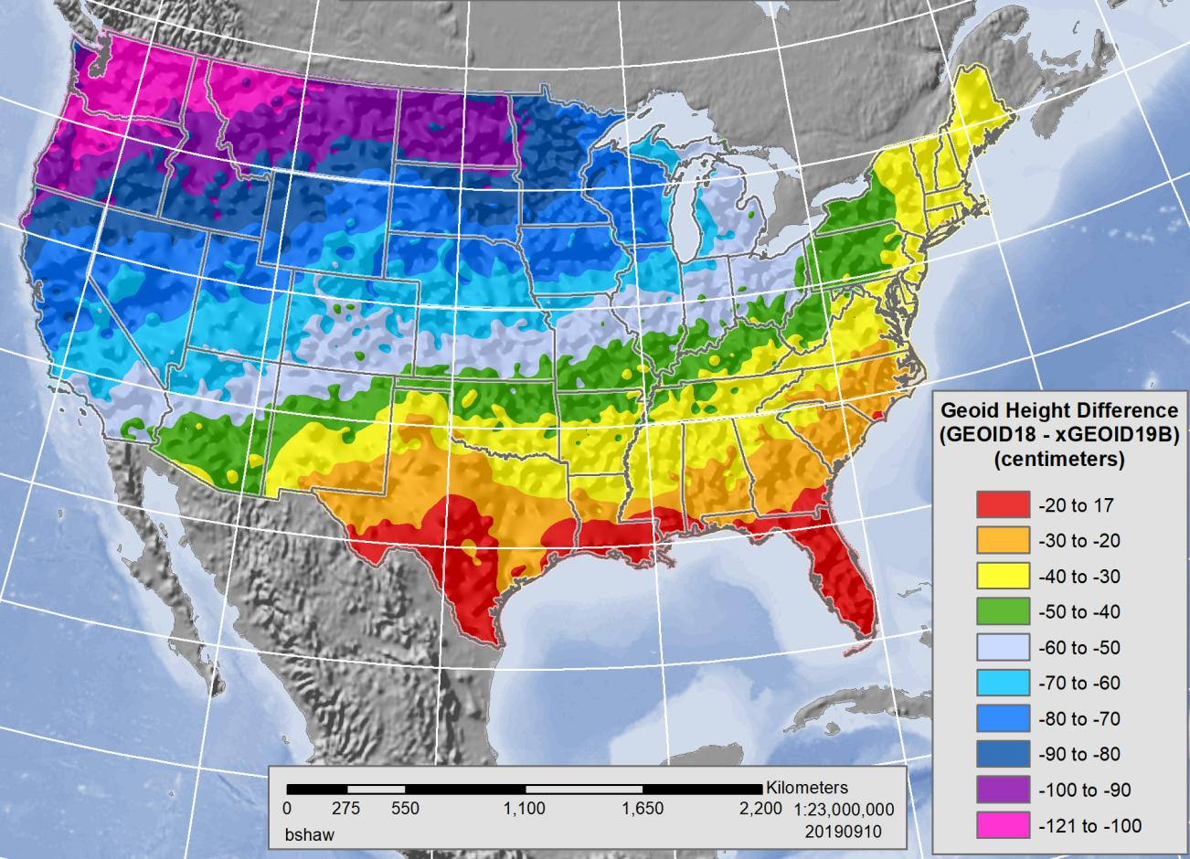
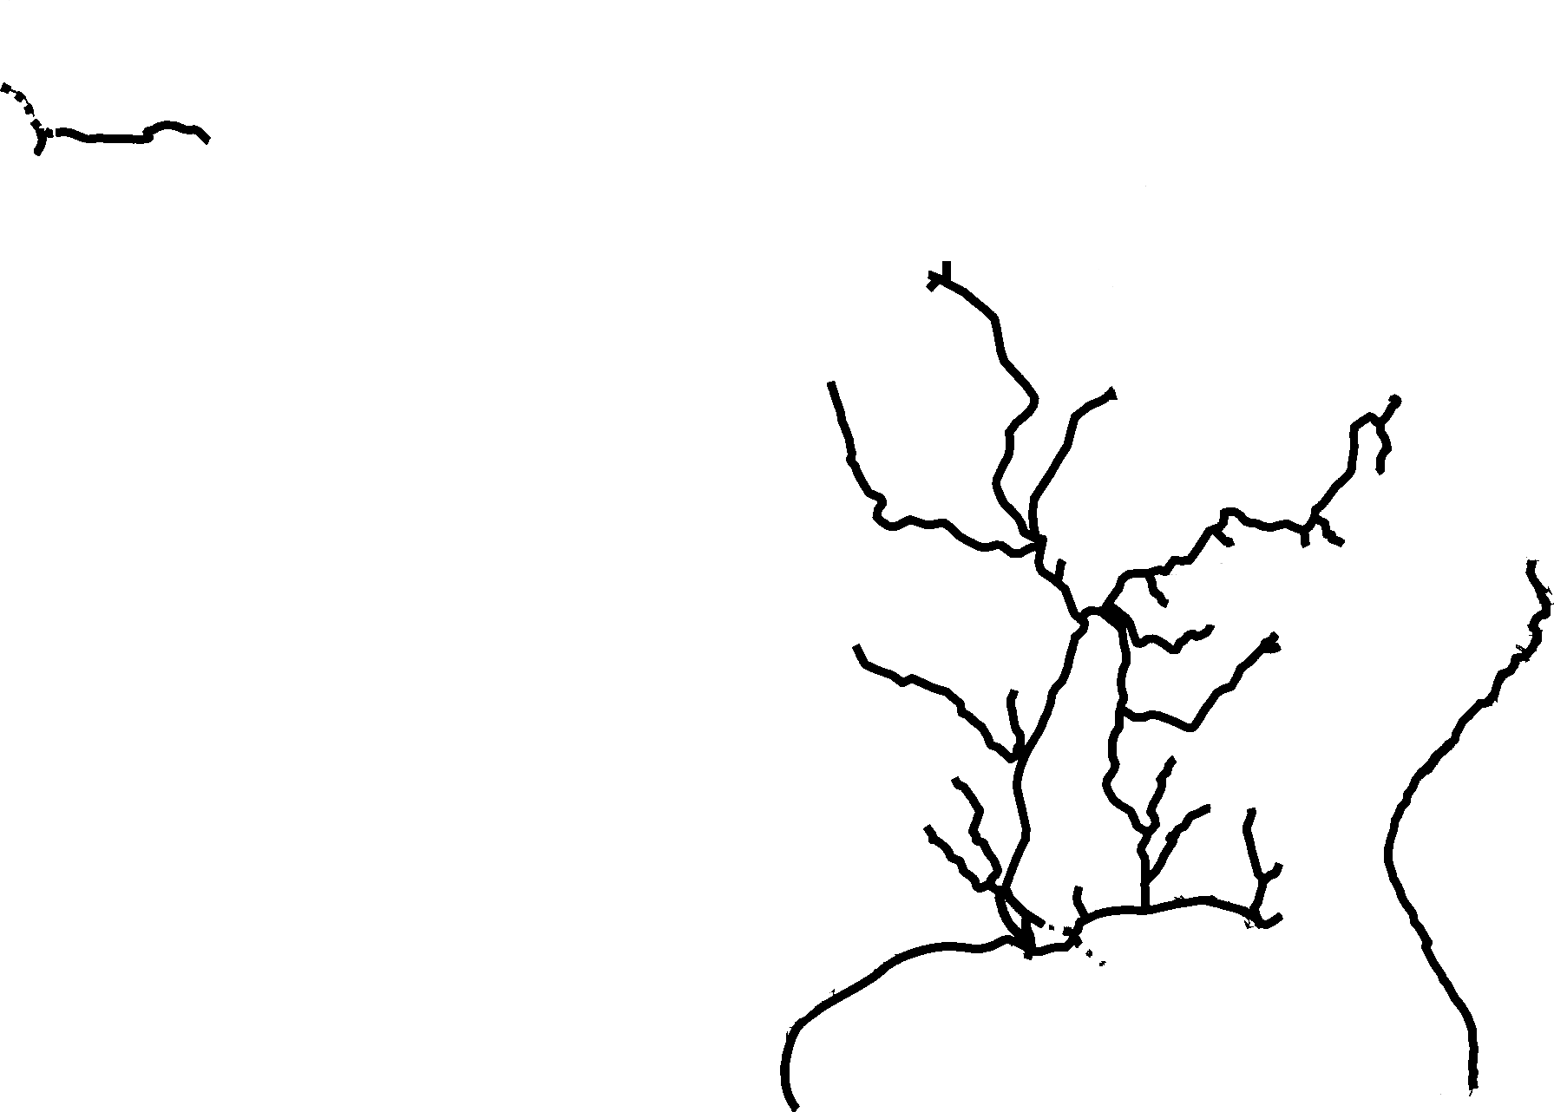
Note the color shading stops at the shoreline.
So too does the geodetic vertical datum (NAVD 88).
Colors approximate the shift from NAVD 88 to NAPGD2022
(in centimeters)
Ranges from -0.6 to -3.9 feet
Inland Waterways System overlaid with Vertical Datum Shift
Notes:
→ Briefly note This is just the fuel-taxed waterways
Note that the Mississippi River traverses through areas of significant change in datum.
And those changes vary throughout it’s length from headwaters to the Delta

Slide 4
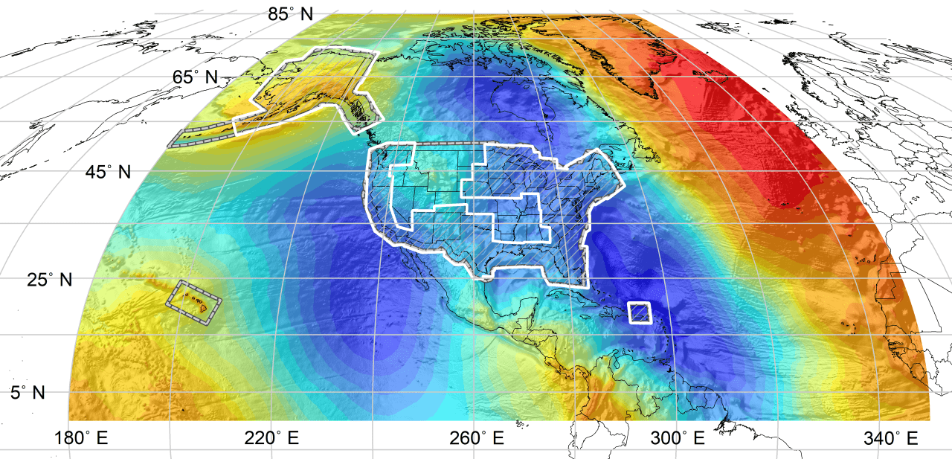
Color shaded area illustrates coverage of NAPGD2022 geoid.
Part of its value lies in its broader applicability (e.g. Pacific Islands)
Notes:
On the flip side… with NAPGD2022, the NSRS will provide consistency from not just the West Coast to East Coast but even from Puerto Rico to Alaska to Hawaii.
It also provides consistency along all the rivers as the join the ocean.

Slide 5
What’s the issue at hand?
Published data are referenced to various datums
  NOAA ENC – MLLW
  USACE IENC – MLLW, Project Pool, Normal Pool
  USCG Light List – MLW; above… normal pool, navigation pool, upper navigation pool, minimum pool, flat pool, pool stage, zero gauge, LWD, high water, low water
    “above 1937 high water”
    “above elevation 157.0 feet MSL”
    “above 2% flowline elevation 576.5 feet msl”
    “above zero on W.B. gauge at Caruthersville”
Notes:
-one of the LWD entries is listed as referenced to IGLD1955!

Slide 6
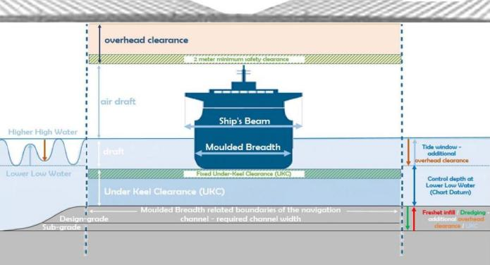
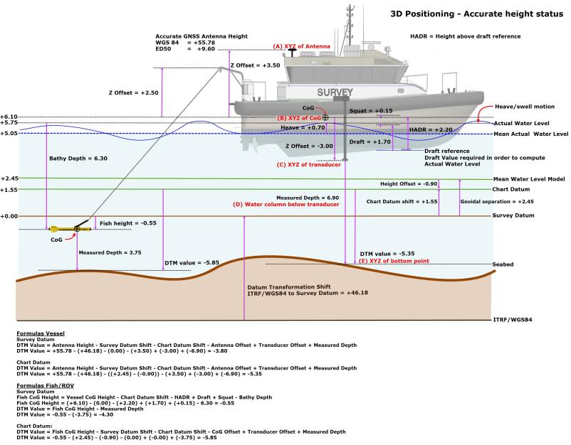
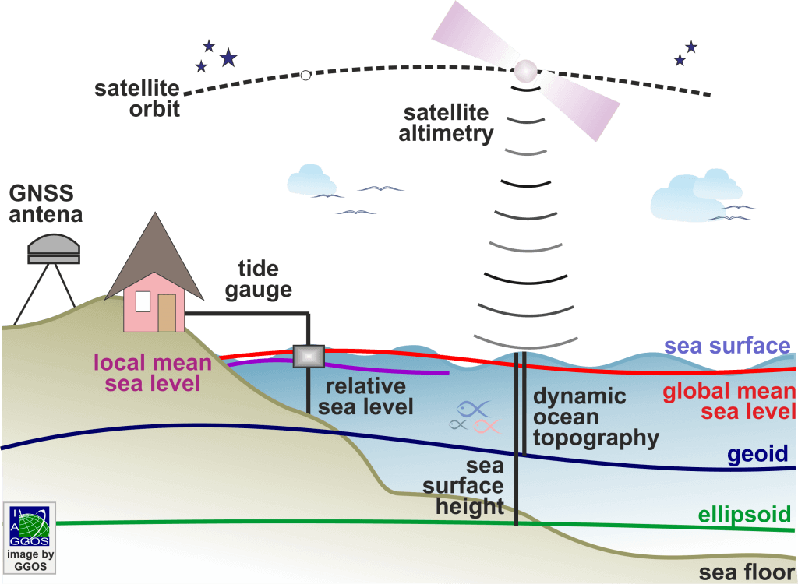
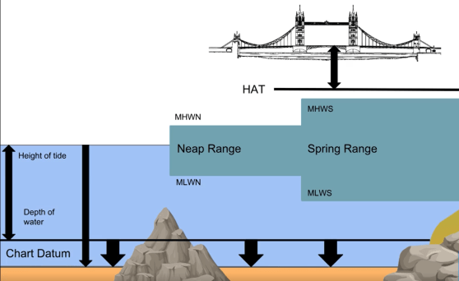
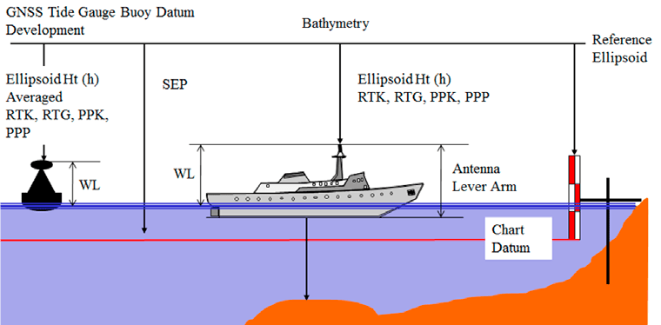
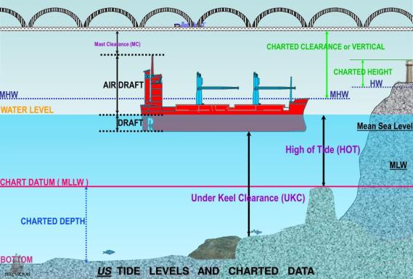
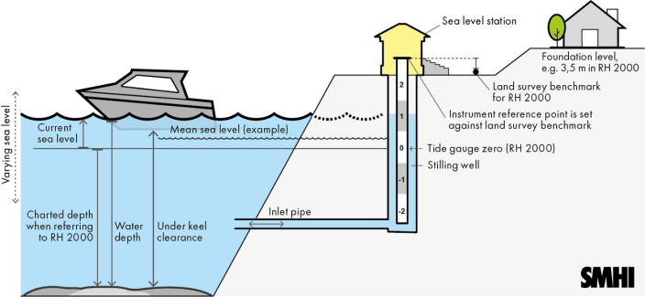
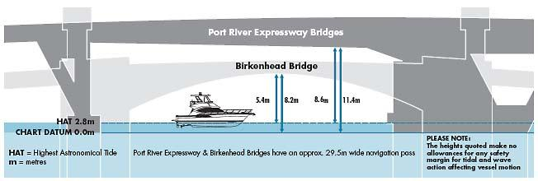
Notes:
This is not just a problem on the Mississippi River
It’s a problem in the tidal influenced portion of every navigable river
Chesapeake, Columbia, but heck not just in US waters but all over the world
Lesser so as a pilot goes further upstream/inland to controlled reaches/pools, b/c water levels are much less dynamic
But the problem is there still
The one thing that every situation has in common is the use of an Ellipsoid
Find me a pilot who is not using GNSS, and I’d be very surprised
CLICK
Now if we look at this one last graphic, it isn’t about navigation per se, it’s about different geodetic and oceanographic monitoring technology, and what I’d like you to notice is that in the same green color there, in the lower right, there you’ll see the ellipsoid

Slide 7
At first glance…
Easy answer!
  Everyone use the ellipsoid as reference surface
  Everyone convert to the same vertical datum
Not easy to implement!
  Sparse data coverage conversion from ellipsoid suffers
  Inconsistencies due to differing operational needs
  Subsidence in Gulf, Chesapeake, and elsewhere
Notes:
Easy answer!
Everyone use the ellipsoid as reference surface
Everyone convert to the same vertical datum
Not easy to implement!
Sparse data coverage → conversion from ellipsoid suffers
Inconsistencies due to differing operational needs
Subsidence in Gulf, Chesapeake, and elsewhere

Slide 8
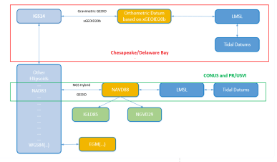
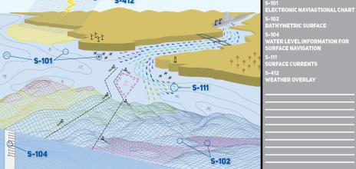
Possibility
Yes, the technology and standards exist
  NOAA VDatum
    Move bathymetric data to the same datum
  IHO S-100 Standard
    S-102 – Bathymetric Surface (soundings)
    S-104 – Water Level Surface (gage data)
Notes:
These are the layers of data in the ENC that Julia talked to us about
Could have VDatum work inland along rivers as well as ocean/shoreline.
Geometric and geopotential parts of NAPGD2022 apply *everywhere* not just at shoreline

Slide 9
Plausibility?
Not plausible with existing resources
VDatum is a big part of the answer
  But has a very small team
  Joint product of NGS, OCS, CO-OPS
    …the small team is stretched among those 3 offices
  Sparse data coverage in some areas
  Subsidence is reality (slow… but steady)
Notes:
Not plausible with existing resources
VDatum is a big part of the answer
But has a very small team
Joint product of NGS, OCS, CO-OPS
…the small team is stretched among those 3 offices
Sparse data coverage in some areas

Slide 10
Closing Thoughts
Opening talk ECDIS/user systems see liabilities
  Datum harmonization before data dissemination
“...we are calculating bridge heights the same way the Egyptians did.”
  shallow draft wooden skiffs vs. 50ft draft Post-Panamax ships
Government hydro/bathy data need a common reference surface
  Already have one… ellipsoid heights via GNSS
Notes:
Opening talk → ECDIS/user systems see liabilities
Datum harmonization before data dissemination
“…we are calculating bridge heights the same way the Egyptians did.” → quote from Sean Duffy’s recent article
They were in shallow draft wooden skiffs 4000 years ago
It’s 2022 and we’ll soon be seeing 50ft draft Post-Panamax ships
Shippers want to maximize quantities moved
Pilots want to maximize safety

Slide 11
Closing Thoughts
NOAA Blue Economy Strategic Plan 2021-2025
Goal 1 - Advance NOAA Contributions to Marine Transportation
Objective 1.2 - Optimize the safety and utility of the nation’s marine highway infrastructure
Need to accurately convert from Ellipsoid Common Water Level
  Higher density data leads to higher accuracy datum transformations
Huge investments in the physical infrastructure (MRSC≈$160m)
  What about investments in the “invisible infrastructure”?
Support for VDatum and related models/products
  GNSS on Tidal BMs, Improved TSS modeling, Monitoring of VLM
    Altogether increase accuracy
Notes:
Support for VDatum and related models/products
GNSS on Tidal BMs, Improved TSS modeling, Monitoring of VLM
Altogether contribute to lowering datum surface uncertainty
CLICK
Blue Economy Strategic Plan – Goal 1 – Advance NOAA Contributions to Marine Transportation
Objective 1.2 - : Optimize the safety and utility of the nation’s marine highway infrastructure

