Slide 1
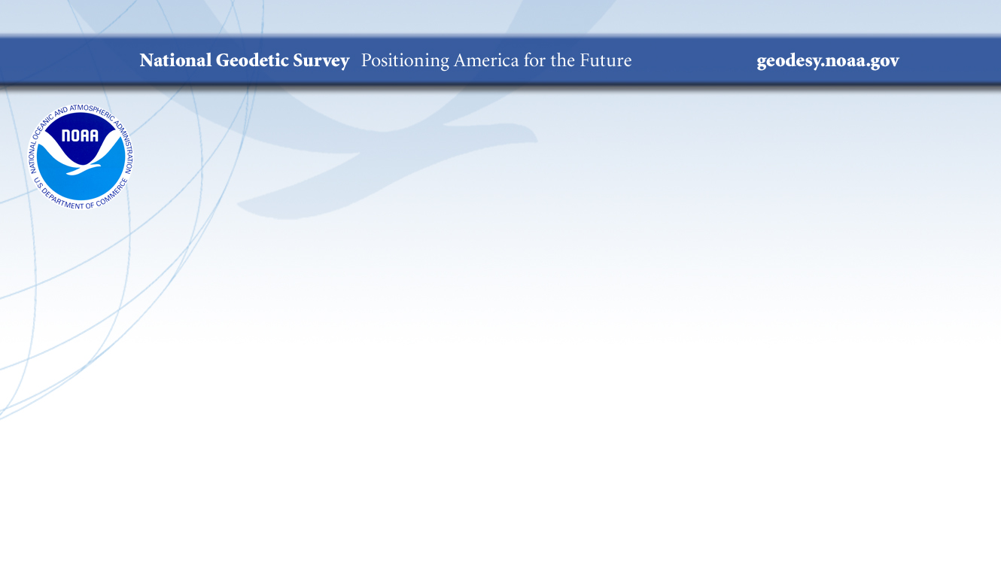
Standard Data File Formats for GNSS, Total Stations, Automatic Levels, and Relative Gravimeters
Dan Gillins, Ph.D., P.L.S.
Geodesist, National Geodetic Survey
May 5, 2021
Daniel.Gillins@noaa.gov

Slide 2
Outline
Background on why we need standard file formats
Problem statement and objectives
RINEX 3 as standard for raw GNSS data
Other XML-based file formats as standards
  GVX – GNSS vectors
  CVX – Classical (angles/distances)
  LVX – Leveling
  RGX – relative gravity

Slide 3
Why Standard File Formats?
Differing instrument manufacturers output data in varying file formats (often proprietary, closed-source)
Standardization benefits:
  Broadens use; easier to work with by others who will use the data
  Easier to share with others
  Reduces the need to convert from one format to another
  Data in proprietary format can be converted to open, standard format
  Increases likelihood critical metadata is captured and accurate; significant figures are preserved
  Lengthens the preservation of the data
  Can be made machine-readable

Slide 4
Examples of Standard File Formats
RINEX = Receiver Independent Exchange Format
  v. 1 (1989) by Werner Gurtner (University of Bern); initial proposal
  v. 2 (1990) by Gurtner and Gerald Mader (NGS); added GLONASS, SBAS, later Galileo
  v. 3 (2007) by Gurtner and Estey (UNAVCO); full support of all GNSS signals and constellations
  Aimed for the easy exchange and processing of raw GNSS data
  GNSS carrier-phase and pseudorange (code) measurements, and time
LAS = LASer format
  Proposed by the American Society of Photogrammetry and Remote Sensing (ASPRS) in 2003
  Open format used for exchanging point cloud data

Slide 5
Problem Statement
NGS is developing:
  1. M-PAGES – baseline processing engine for multi-GNSS data
    M-PAGES provides its best solutions with RINEX 3
    RINEX 3 is the international standard for raw GNSS data, and many IGS stations only provide RINEX 3 files
    But the NOAA CORS Network currently archives data in RINEX 2, and many current workflows at NGS process RINEX 2 data files
    2. OPUS – software for managing, processing, and adjusting survey data
    (Note M-PAGES will become the baseline processing engine in OPUS)
    OPUS-Projects v. 5 supports GNSS vectors, such as Real-time Kinematic (RTK) vectors
    OPUS v. 6 will support survey data from total stations, automatic levels, and relative gravimeters
    But there is a lack of a well-accepted, industry-wide standard file format for GNSS vectors, total stations, levels, and gravimeters

Slide 6
Objectives
Adopt RINEX 3 as the standard file format for raw GNSS data
  Require submission/uploading of RINEX 3 data files to NGS
Develop new standard file formats:
  GVX: GNSS Vector Exchange Format
  CVX: Classical Vector Exchange Format (angles, distances)
  LVX: Leveling Vertical Exchange Format
  RGX: Relative Gravity Exchange Format

Slide 7
RINEX 3

Slide 8
Background on RINEX 3
Originally released in 2007
The international scientific standard for exchanging raw GNSS data
Endorsed by the IGS and RTCM
Actively maintained and updated (current version is 3.05)
Supports all GNSS signals and constellations
Enables unambiguous use of all observables and application of modern GNSS products (e.g., Bias-SINEX)
M-PAGES is designed to best support RINEX 3 data files, although it can also process RINEX 2 data files.
  If you want the best multi-GNSS solution, you will want to work with RINEX 3

Slide 9
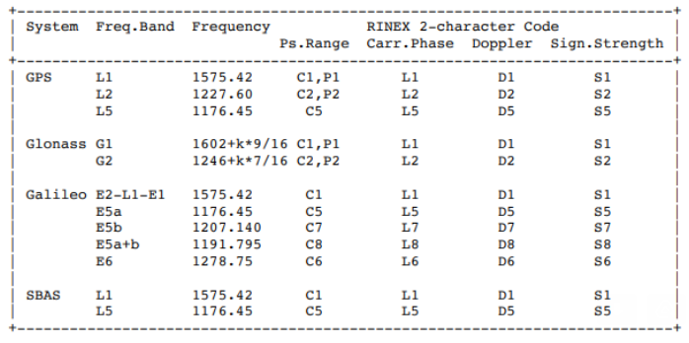
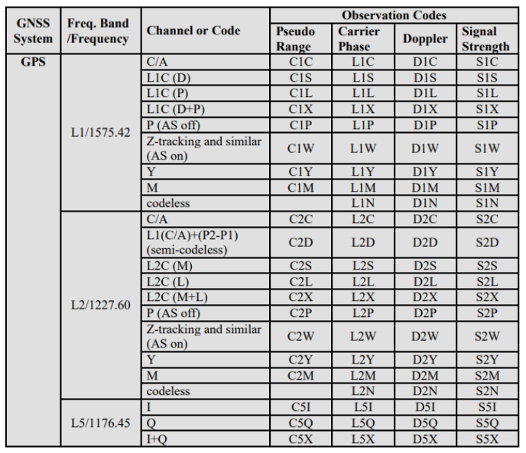
RINEX 2 versus RINEX 3
RINEX 2 Observables
RINEX 3 Observables
Notes:
In RINEX 2 when you use C2, is this actually the L2 C/A code (R3: C2C) or the L2C code (R3: C2S, C2L, or C2X)?

Slide 10
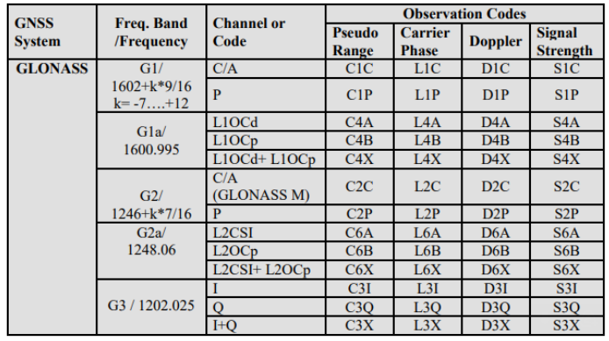
RINEX 2 versus RINEX 3
RINEX 2 Observables
RINEX 3 Observables
Notes:
For GLONASS, RINEX 2 does not support the modernized CDMA signals. Notice it only has G1 and G2.
Also worth mentioning that when presented with a RINEX 3 obs file, it can be difficult to map it back to RINEX 2. Some guesswork may be required.

Slide 11
NGS and RINEX 3
In the near future (date to be determined), NGS will only support RINEX 3 for its products and services which rely upon raw GNSS data, with some exceptions
NGS will be releasing a Federal Register Notice for notification and public commenting

Slide 12
NOAA CORS Network and RINEX 3
Each CORS must be capable of providing:
  RINEX 3 file
  Binary exchange (BINEX) file
  Raw proprietary data file
NGS will archive the RINEX 3 files at each CORS
  When necessary, NGS will convert the BINEX file to RINEX 3
  Raw GNSS data currently stored by NGS will remain in its earlier version of RINEX (no up-conversion)
For QC purposes and/or when communication link is too slow to upload RINEX 3 directly
For QC purposes

Slide 13
What is BINEX?
“BINary EXchange”
Existed since 2000
Binary standard for GNSS research and operational purposes
Collaborative format, partnering UNAVCO with numerous receiver manufacturers
Ongoing design, aims to incorporate RINEX, SINEX, IONEX, SP3, etc.
Compact and fast

Slide 14
OPUS and RINEX 3
NGS will recommend and encourage use of RINEX 3 for OPUS
  Provides the best multi-GNSS solutions
NGS will continue to allow use of RINEX 2 in OPUS for legacy data and equipment
NGS will discontinue support of non-RINEX data submissions to OPUS

Slide 15
Development of XML-Based Standard File Formats

Slide 16
XML-Based Standard File Formats
Measurement Type | File Format | File Type | Current Status | Use at NGS
Reduced GNSS data (GNSS vector) | GVX | XML | Released final version 1.0 on 2/04/2021 | OPUS-Projects v.5, OPUS v.6
Differential leveling (height differences) | LVX | XML | Under development. Version 0.3 under review | OPUS v.6
Classical (angles, distances) | CVX | XML | Under development. Version 0.3 under review | OPUS v.6
Relative gravity (gravity differences) | RGX | XML | Planned for 2022 | OPUS v.6

Slide 17
OPUS-Projects
Free, web-based software
  Online training available
Designed for managing campaign-style GPS surveys
  Multiple repeat occupations of several marks
Ability to add GPS data from NOAA CORS Network or IGS Network
Session baseline processing using PAGES
Customize tropospheric delay models, elevation cutoff masks, constraint weighting
Network least squares adjustments of multiple sessions
Choice of reference frames and geoid models
Currently requires ≥ 2-hour static GPS observation for post-processing

Slide 18
OPUS-Projects v. 5
Inclusion of previously processed GNSS vectors
  Single-base RTK vectors
  Network RTK vectors
  Vectors processed in other software
Allows QA/QC of uploaded vectors
Automatically “weights” uploaded vectors in a network least squares adjustment
Final adjustment results can be submitted to NGS for publication
Released to Beta for external testing. Available at: https://beta.ngs.noaa.gov/OPUS-Projects/OpusProjects.shtml
Webinar scheduled for May 20, 2021

Slide 19
GNSS Vector EXchange Format (GVX)
Website: https://www.ngs.noaa.gov/data/formats/GVX/index.shtml
Detailed documentation
Schema (XSD)
Example vector file
GVX is written in Extensible Markup Language (XML)
Designed to store and carry data in plain text format
Flexible representation of arbitrary data structures
Extensible – new elements can be added later without breaking applications
Both machine-readable and human-readable
Schemas can be used to define “must haves” and “should haves”

Slide 20
GNSS Vector EXchange Format (GVX)
Timeline
Solicited internal and external feedback for GVX since 8/2019
Introduced to industry in 10/2019; solicited feedback
Addressed all comments and feedback
Released version 1.0 to industry in 02/2021
Some important details:
All start and stop times must be in GPS time
Distance must be in meters
Angles must be in decimal degrees
Follow IGS naming conventions for antenna names
Follow ISO Geodetic Register for reference systems

Slide 21
GNSS Vector EXchange Format (GVX)
SOURCE_DATA (source of data file, conversion software)
PROJECT_INFORMATION (project title, agency, party chief, etc.)
REFERENCE_SYSTEM (reference frame for coordinates and orbits; IDs from ISO Geodetic Registry)
EQUIPMENT (antenna and receiver types, serial numbers, calibration metadata, firmware)
SURVEY_SETUP (solution type, processing software, corrector format, RTN IP address and port, operator)
POINT (coordinates and uncertainties, point type)
GNSS_VECTOR (differential components and correlation matrix, start and stop time, quality metrics such as mask, DOP, satellites used, orbit info.)
SESSION (intra-vector or cross-correlations matrix for simultaneous baseline processing)

Slide 22










Industry Invited to Provide Feedback
Released GVX v. 1.0 released to industry on February 4, 2021
Over 30 people attended mtg

Slide 23
How will NGS use GVX?

Slide 24
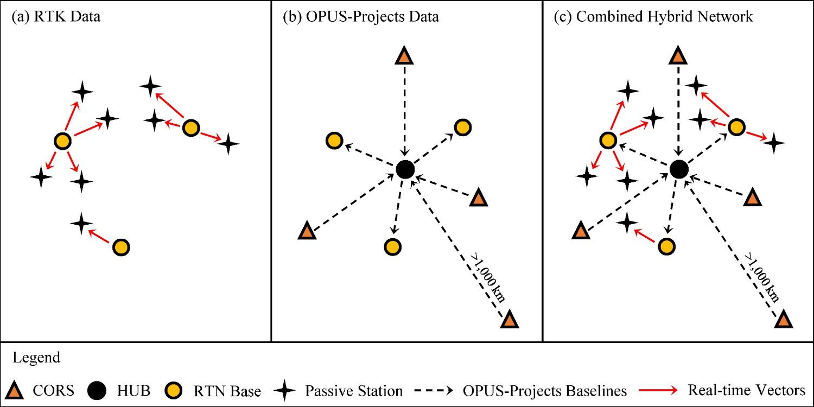
Design for OPUS-Projects and GVX
GVX file (from RTK survey or baseline processing in other software)
OPUS-Projects (from static GNSS session processing)
RTK Base or “From” Mark
RTK Rover or “To” Mark
Vector
Vector in GVX File
[Adapted from Weaver et al. 2018]

Slide 25
Other XML-based File Formats
GVX sets template for other XML standard file formats
  CVX = classical (angles/distances)
  LVX = leveling
  RGX = relative gravity
Working with industry to adopt all of these common file formats, and goal is to make OPUS v.6 capable of using them
Aim to take these files to international community for adoption or inclusion in GeodesyML

Slide 26
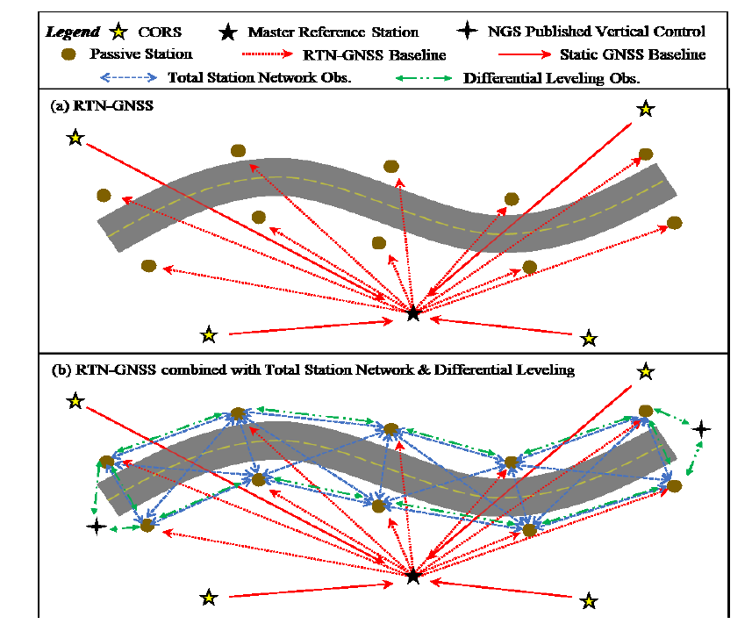
Oregon Dept. of Transportation Study
SPR304-821 -- Simpson et al. (2021)
ODOT funded study by Oregon State University
Updated survey standards and control guidance for improved operations
  RTN measurements
  Total stations
  Leveling
  Integrated networks for adjustment

Slide 27
CVX: Classical Vector Exchange
SOURCE_DATA
PROJECT_INFORMATION
REFERENCE_SYSTEM
UNITS (global definition of units in the file)
CLASSICAL_EQUIPMENT (instrument make/model, white paper specifications, target make/model)
INSTRUMENT_CORRECTIONS (compensator, vertical index, automatic pointing, collimation, etc.)
POINT
CLASSICAL_SET (weather, ppm, horizontal and vertical angles, distance, sigmas, instrument faces, target offset, measurement mode, distance type)
Notes:
For measurement mode, we define if you are using reflectorless or standard EDM settings, etc. We also define if you are using manual pointing or automatic pointing. For distance type, you can set to slope, horizontal at elevation, or horizontal at ellipsoid

Slide 28
LVX: Leveling Vertical Exchange
SOURCE_DATA
PROJECT_INFORMATION
REFERENCE_SYSTEM
VERTICAL_DATUM (datum for heights with IDs per ISO Geodetic Registry)
UNITS
LEVELING_EQUIPMENT (instrument make/model, serial number, white paper specifications, and rod(s) make/model/material, white paper specs., calibration info.)
COLLIMATION (applied collimation value from peg test)
FIELD_ACCURACY_TEST (results of a field test on accuracy of leveling equip.)
POINT
LEVELING_SECTION (elevation difference, running distance, running imbalance, operator, start and stop time, temp. probes, maximum instrument height, weather, total setups, leveling method, individual setups with backsight, foresight, stadia wires, and reading mode) ←(NOTE: supports electronic, optical, 3-wire, and micrometer)

Slide 29
Summary
NGS will adopt RINEX 3 for raw GNSS data
Other XML-based formats developed or under development
  GVX: GNSS Vectors (released in 02/2021)
  CVX: Classical (angles/distances)
  LVX: Leveling
  RGX: Relative Gravity
  Schemas will be written for all
  Feedback and ideas are welcome!
Plan to release in 2022

Slide 30
Questions?
Daniel.Gillins@noaa.gov

