Slide 1

GNSS Vector Exchange (GVX) File Format Discussion
Dan Gillins, Ph.D., P.L.S.
Geodesist, National Geodetic Survey
January 13, 2020

Slide 2
Outline
Provide background on standard file formats
Introduce new file format for GNSS Vectors (GVX)
Give direction to resources for GVX
Discuss the contents of GVX
Explain how NGS will use GVX
Show current status of developments in OPUS-Projects for ingesting GVX files
Discuss next steps going forward
Provide time for questions and answers

Slide 3










Industry Invited to Provide Feedback
Invited 34 to provide feedback and participate in web-meeting
25 individuals registered

Slide 4
Why Standard File Formats?
Differing instrument manufacturers output data in varying file formats (often proprietary, closed-source)
Standardization benefits:
Broadens use; easier to work with by others who will use the data
Easier to share with others
Reduces the need to convert from one format to another
Data in proprietary format can be converted to open, standard format
Increases likelihood critical metadata is captured and accurate; significant figures are preserved
Lengthens the preservation of the data
Can be made machine-readable

Slide 5
Examples of Standard File Formats
RINEX = Receiver Independent Exchange Format
Version 1 proposed in 1989 by Werner Gurtner (University of Bern)
Version 2 proposed in 1990 by Gurtner and Gerald Mader (NGS)
Aimed for the easy exchange and processing of raw GNSS data
GNSS carrier-phase and pseudorange (code) measurements, and time
LAS = LASer format
Proposed by the American Society of Photogrammetry and Remote Sensing (ASPRS) in 2003
Open format used for exchanging point cloud data

Slide 6
Problem Statement
NGS does not have a simple mechanism for accepting data resulting from Real-time Kinematic (RTK) surveys (whether from a single-base or from a network)
RTK surveys are very popular (more than static surveys)
RTK surveys process GNSS observables in real time
Solutions generally expressed as a vector (i.e., differential components from a “base” to a “rover” and associated error estimates and metadata)
RTK vectors and metadata are generally expressed by vendors in a proprietary format
There lacks an industry standard file format for any type of GNSS vector, whether the vector was derived in real time or by post-processing

Slide 7
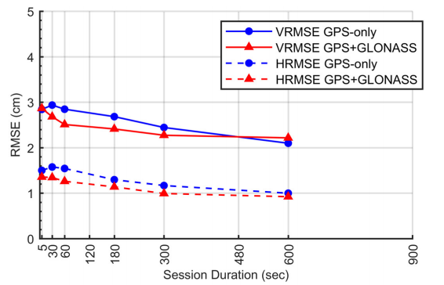
Empirical Evaluation of the Accuracy of RTNs
[Allahyari et al. 2018]

Slide 8
Our Objective
Develop a standard file format for GNSS vectors
Open-source, machine-readable, human-readable
Must include all of the necessary information for performing a least squares adjustment
Must include important metadata for quality control
Encourage industry to accept this file format and build tools to output/input vector data to this format

Slide 9
GNSS Vector EXchange Format (GVX)
Website: https://www.ngs.noaa.gov/data/formats/GVX/index.shtml
Detailed documentation
Schema (XSD)
Example vector file
GVX is written in Extensible Markup Language (XML)
Designed to store and carry data in plain text format
Flexible representation of arbitrary data structures
Extensible – new elements can be added later without breaking applications
Both machine-readable and human-readable
Schemas can be used to define “must haves” and “should haves”

Slide 10
GNSS Vector EXchange Format (GVX)
SOURCE_DATA
Information on the source of the GVX file, such as the name of the original data file, conversion software to make the GVX file, etc.
PROJECT_INFORMATION
Information on the survey project, points of contact, start and end date of the survey
REFERENCE_SYSTEM
Specifies the reference frame and units for data in the file

Slide 11
GNSS Vector EXchange Format (GVX)
EQUIPMENT
Defines all GNSS equipment utilized to create the data in the file, including all antennas and receivers, serial numbers, firmware versions, antenna phase center calibration models
SURVEY_SETUP
Information on how the vectors were collected or derived, such as settings for single-base RTK, RTN settings, post-processing settings, etc.
Operator name(s)

Slide 12
GNSS Vector EXchange Format (GVX)
POINT
Geodetic coordinates for all start and end points of every vector
Names/codes
Antenna heights
Point type (fixed/float/code/keyed-in, etc.

Slide 13
GNSS Vector EXchange Format (GVX)
GNSS_VECTOR
IDs for starting and ending points of the vector
ID for survey setup
Start and end time of the observation
Differential, mark-to-mark vector components (ECEF) or dX, dY, dZ
Variance and covariance values
QA/QC metadata
DOP, RMS, mask settings, number of satellites used by GNSS type, orbit types and sources, RTCM age

Slide 14
How will NGS use GVX?
Conduct RTK Survey
Vendor 1 GNSS Data File
Vendor 2 GNSS Data File
Vendor 3 GNSS Data File
Other Vendor GNSS Data File
GVX Data File
upload
submit
NGS Review & Publication
OPUS-Projects

Slide 15
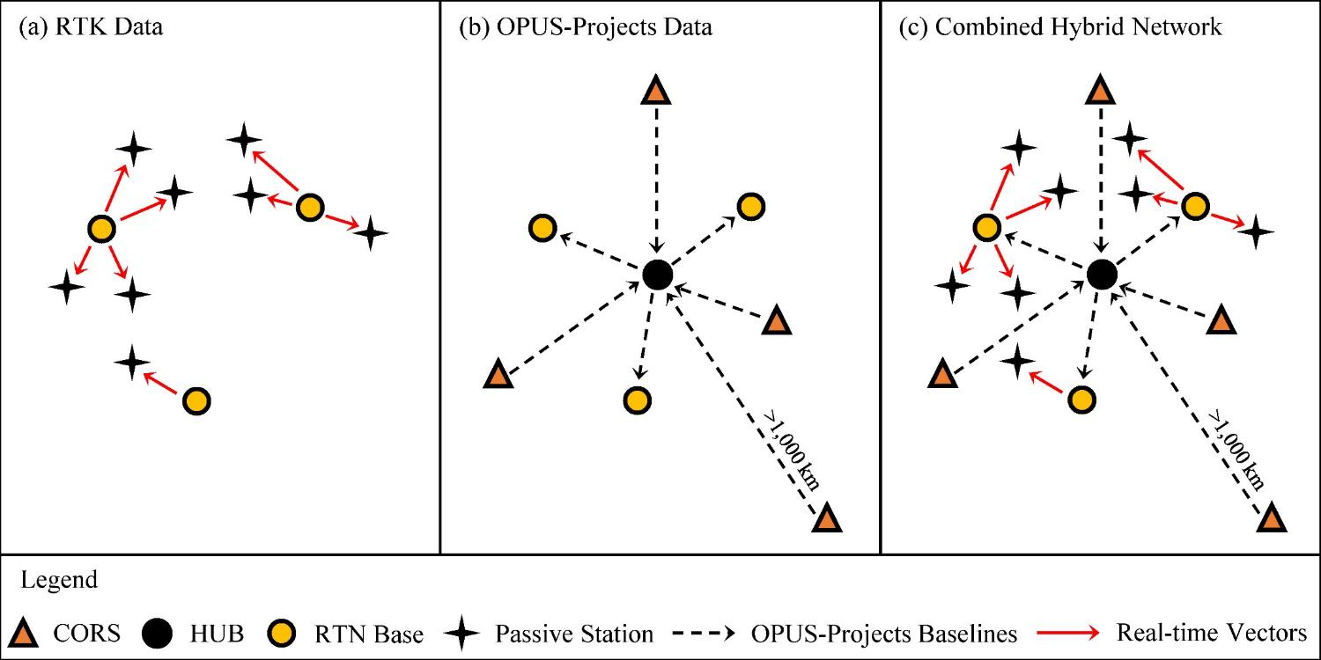
Static + RTN Survey Networks
[Weaver et al. 2018]

Slide 16
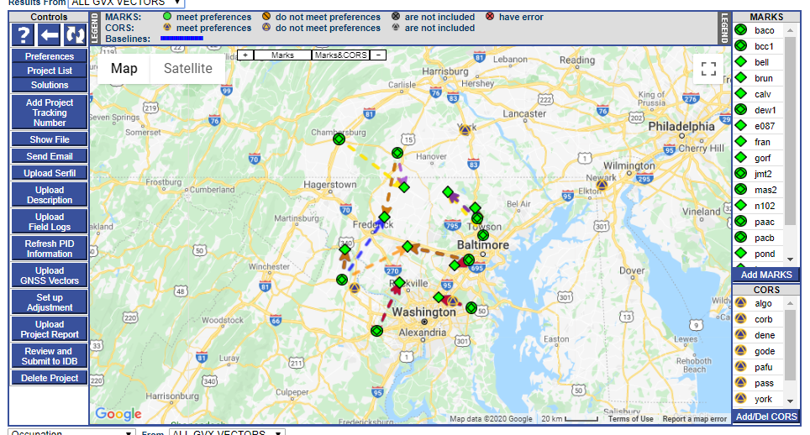
Step 1: Upload GVX Files (Vectors)

Slide 17
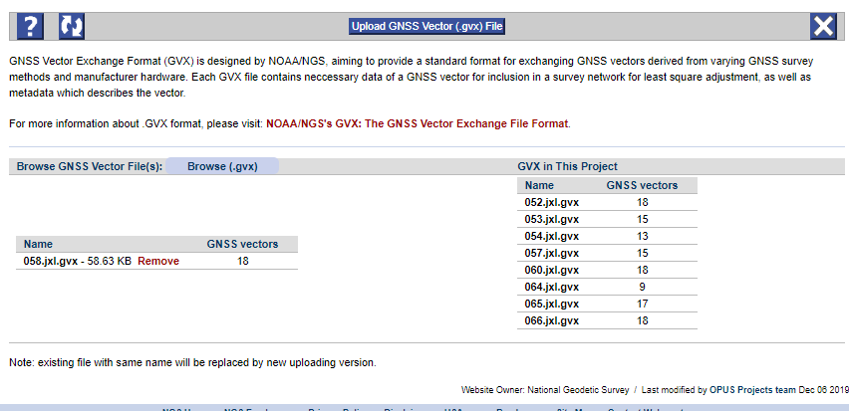
GVX File Uploader

Slide 18
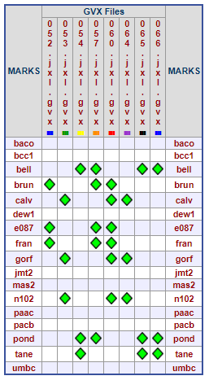
Table for Viewing GVX Files in Project

Slide 19
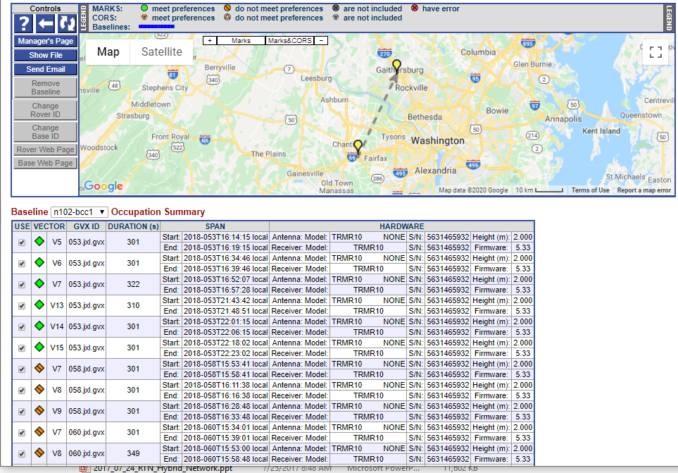

Slide 20
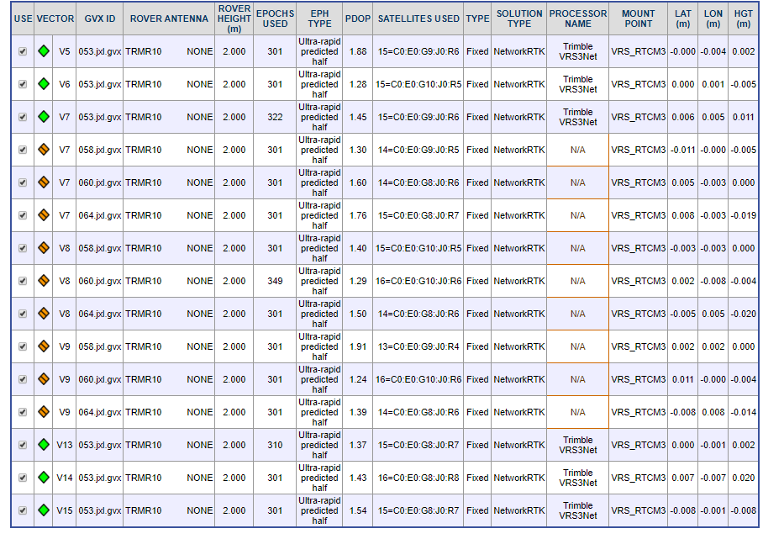

Slide 21
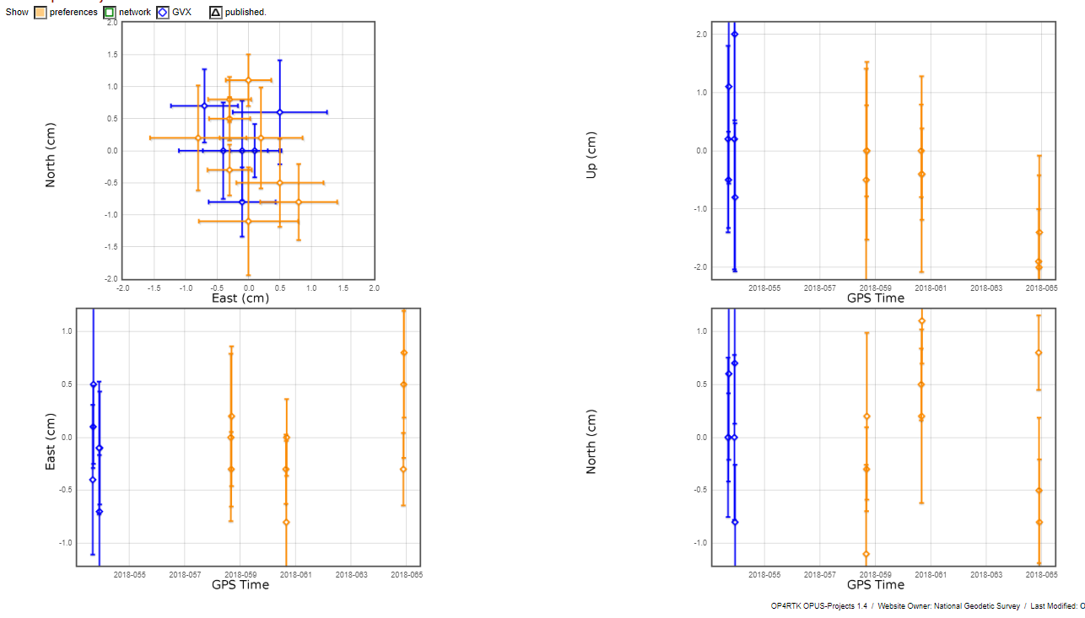

Slide 22
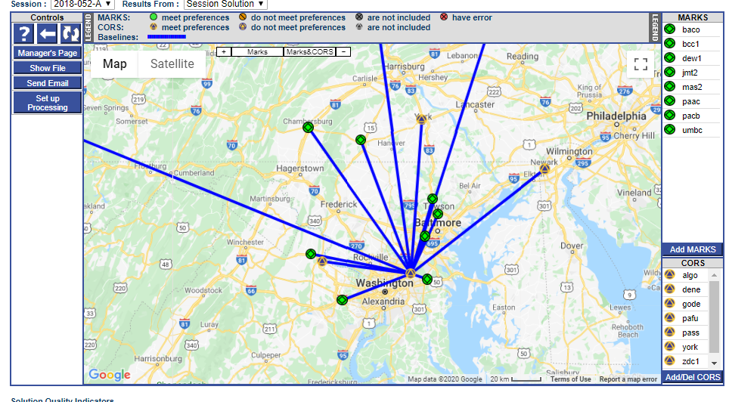
Step 2: Upload Static GNSS Data Collected at Base Stations; Post-process with CORS’ Data

Slide 23
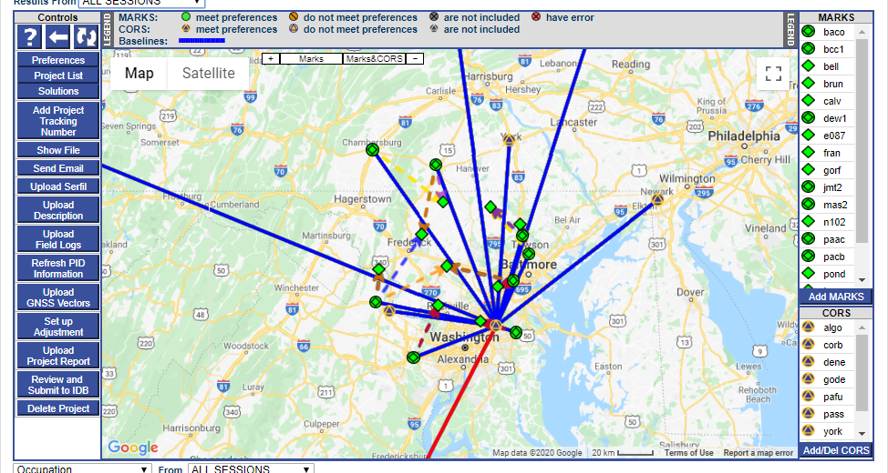
Step 3: Combine Post-processed Vectors and Uploaded Vectors (from GVX) in Survey Network for Adjustment

Slide 24
Example: Adjust Static + RTN Network
Run least squares adjustment(s) of the combined static data and RTN vectors in the survey network
Hold CORS (and possibly other published coordinates on passive marks) as control in network adjustments
Check quality of results
Submit survey project to NGS for review and publication in national database

Slide 25
How to Move Forward?
Provide feedback! Send to ngs.feedback@noaa.gov
What are we missing?
What is unnecessary?
How can GVX be improved?
Are other formats available for use?
Continue development in OPUS-Projects for ingesting GVX files
Write manual for using OPUS-Projects and GVX files
Finish survey specifications for using NRTK vectors in geodetic surveys

Slide 26
Future Standard File Formats
Total stations
Digital automatic levels

Slide 27
Questions?
Daniel.Gillins@noaa.gov

