Slide 1

NAPGD2022
A New Vertical Datum for the Future
MSFA Annual Convention
March 2020
Jeff Jalbrzikowski, P.S., GISP, CFS
Appalachian Regional Geodetic Advisor
jeff.jalbrzikowski@noaa.gov
240-988-5486
Notes:
-hi my name’s Jeff!
-so who am I?
-I’m a surveyor, NGS calls me a geodesist, and my background is in all types of surveying both land and hydrographic. I’ve been with NGS for about 2 years, came here from the USACE (Pittsburgh District), and have also worked for the Bureau of Land Management and various State & local government. Spent almost my entire career with government, and got my start surveying in the military. It’s taken me around the world, but originally I’m from SE Ohio, I’m a university of Akron graduate, and I have an older sister who lives just north up in Flint.

Slide 2



Organizational Structure
  -Department of Commerce (DoC)
  (~47,000 employees)
  -National Oceanic and Atmospheric Administration (NOAA)
  -National Ocean Service (NOS)
  -National Geodetic Survey (NGS)
  (~175 employees)
Notes:
-We are the Federal Government’s oldest scientific agency.
-part of the Executive Branch
-I know it can seem kind of strange that NGS is part of the NOS, but the origins of NGS lie with the C&GS.
-we are a “Program Office” of the NOS
Survey of the Coast – 1807
Coast Survey – 1836
Coast and Geodetic Survey – 1878
NGS since 1970

Slide 3


Organizational Structure
We’re not USGS, we’re NGS
  -Department of Commerce (DoC)
  (~47,000 employees)
  -National Oceanic and Atmospheric Administration (NOAA)
  -National Ocean Service (NOS)
  -National Geodetic Survey (NGS)
  (~175 employees)
≠
Notes:
-as you can read my slide, I like to point that out because over my 2 years at NGS I’ve seen and heard this misunderstanding quite a bit
-don’t worry! it doesn’t offend us! and we do work closely with USGS, but we are separate agencies within totally different departments of the federal government

Slide 4
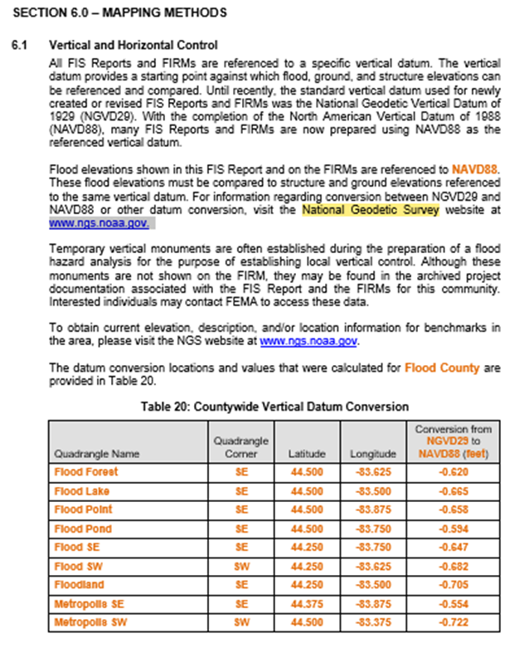
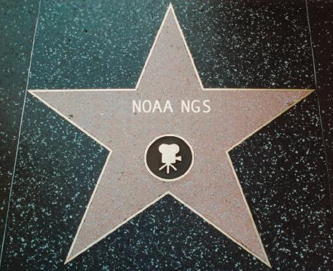
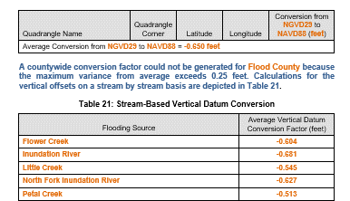
Section 6.1 of Template: Flood Insurance Study (FIS) Report (Nov 2016)
National Geodetic Survey
FIS Report (Sec 6.1) states the need to know the datum for the FIRM and to consult NGS for datum conversion if needed.
Notes:
You may recognize NGS from such prestigious appearances like section 6.1 of Template: Flood Insurance Study (FIS) Report (Nov 2016)

Slide 5
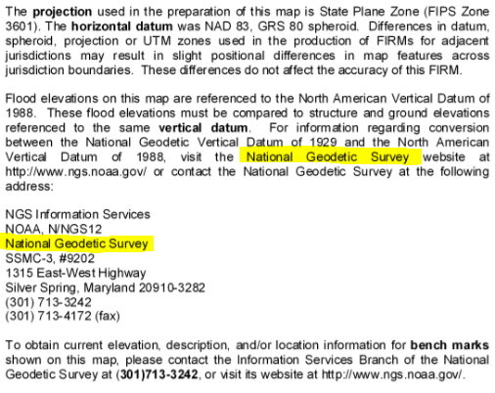
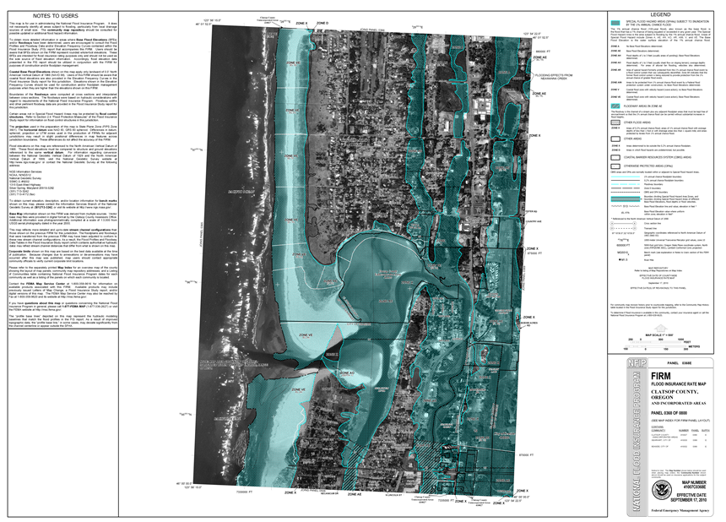
Example: FIRM of Clatsop County, OR; Effective Date of 17 September 2010
National Geodetic Survey
NOTES TO USERS
Notes:
or the “NOTES TO USERS” section of your favorite FIRM

Slide 6
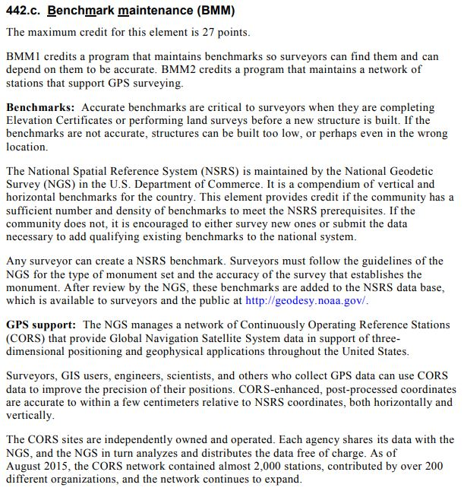
FEMA CRS Coordinator’s Manual – Activity 440 (Flood Data Maintenance)
National Geodetic Survey
Why do I mention this?
Notes:
…or even from the FEMA CRS Coordinator’s manual
-specifically Activity 440, Element 442.c
-full discount is 27 points… I don’t know exactly what that means, that’s out of my wheelhouse but if anyone wants to speak from experience, feel free

Slide 7
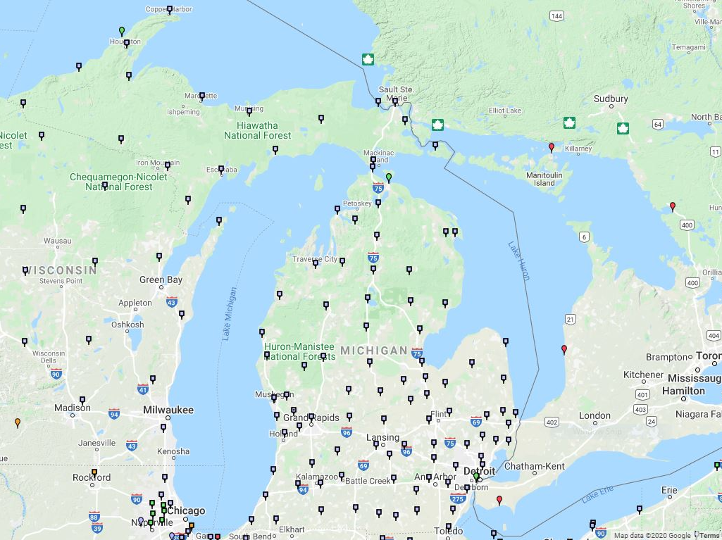
Because Michigan has lots of CORS!
Notes:
-mostly managed by MDOT

Slide 8
NGS Mission
To define, maintain and provide access to the National Spatial Reference System (NSRS) to meet our Nation’s economic, social, and environmental needs.
Notes:
NGS develops and maintains the National Spatial Reference System, a national coordinate system that provides the foundation for transportation, navigation, land record systems, mapping and charting efforts, and a multitude of scientific and engineering applications.
But there are many ancillary programs and products we will also discuss.

Slide 9
National Spatial Reference System
A common and consistent geospatial framework to meet the economic, social, and environmental positioning needs of our Nation.
Foundational elements include:
Latitude
Longitude
Elevation
Gravity
Shoreline Position
…how these change over time
Horizontal Datums | Vertical Datums
NAD83 | NAVD88
NAD27 | NGVD29
Great Lakes Datums | Geoid Models
IGLD85 | GEOID18
IGLD55 | GEOID12B
Notes:
The primary mission of NGS is, “to define, maintain, and provide access to the NSRS to meet our nations economic, social, and environmental needs”.
NSRS is a consistent geospatial framework, common to all Federal agencies and other users
NSRS supports informed decision-making for mapping and charting, navigation, flood risk determination, transportation, land management, and more
Elements of NSRS include (but are not limited to): latitude, longitude, elevation, gravity, shoreline position + their changes over time …other elements include scale, earth orientation parameters and others
The vertical component of the NSRS currently utilizes the North American Vertical Datum of 1988 (NAVD88)

Slide 10
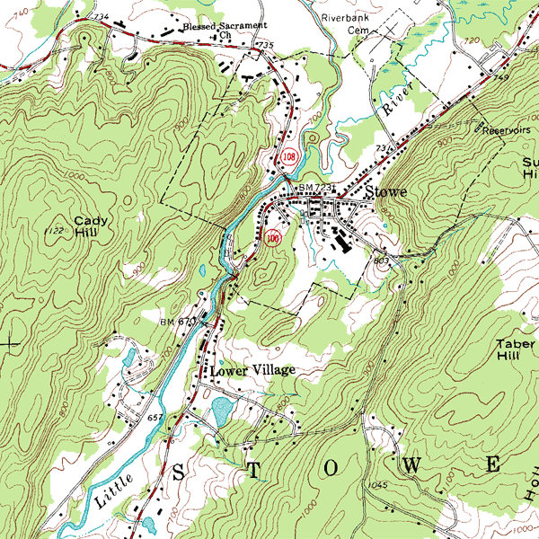
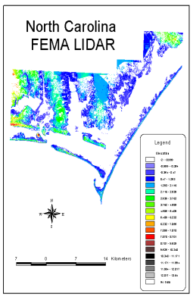
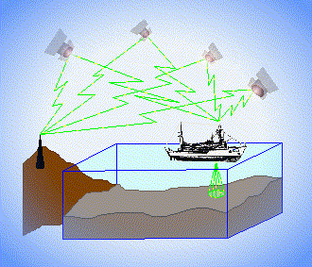
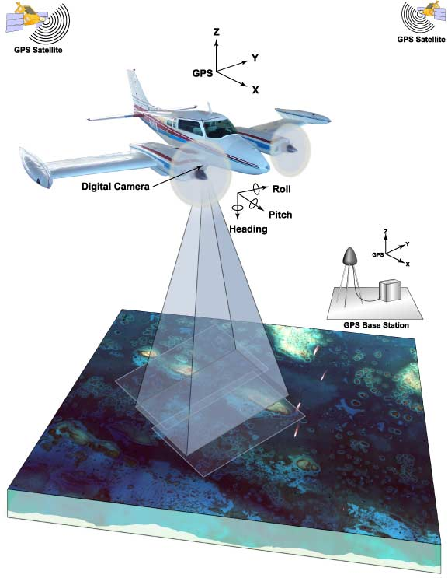
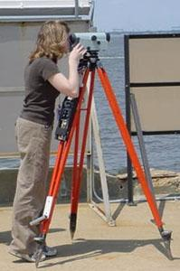
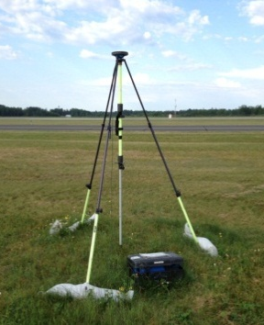
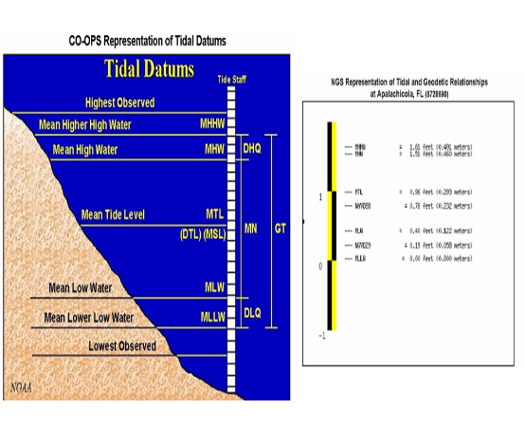
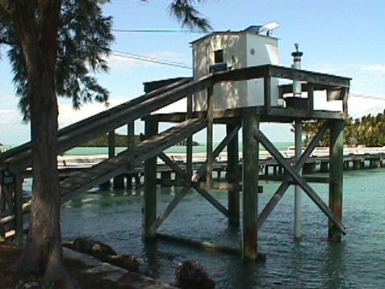
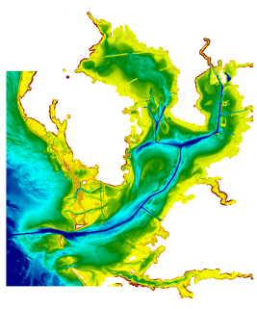
Three types of vertical datums in NSRS
Orthometric
Ellipsoidal
Raw Hydrographic Surveys vertically referenced with RTK-GPS
USGS
Topography
FEMA Flood Insurance Rate Maps
Engineering and Development Site Surveys
Native GPS measurements
Raw Lidar
Water Level / Tidal
NOAA Bathymetry (MLLW)
Shoreline Mapping (MHW) and Regulatory Boundaries at the Coast
Daily and Extreme Water Levels
Notes:
This slide illustrates the 3 categories of vertical datums and examples of where each is directly used They are project and application dependent.
First, we have ellipsoidal datums. Examples include WGS84 and NAD83 (North American Datum of 1983). You will encounter these datums frequently in hydrographic surveys that are vertically referenced with RTK-GPS; any native GPS measurements; and even raw lidar datasets.
Next, we have orthometric datums. These datums are very important because height differences referenced to orthometric datums will allow us to know the direction water will flow, because they have been “gravity-corrected”. The North American Vertical Datum of 1988 (or NAVD 88) is an orthometric datum, which you will see on USGS topographic maps, engineering and development site surveys, and FEMA Flood Insurance Rate Maps.
Finally, we have Tidal Datums, which are derived from water level measurements. They have extremely important applications including daily and extreme water levels; NOAA nautical charts, and shoreline mapping or boundaries along the coast.
*NOAA provides tools (like NCAT and Vdatum) to transform between these different height systems.

Slide 11
Orthometric
Notes:
This slide illustrates the 3 categories of vertical datums and examples of where each is directly used They are project and application dependent.
First, we have ellipsoidal datums. Examples include WGS84 and NAD83 (North American Datum of 1983). You will encounter these datums frequently in hydrographic surveys that are vertically referenced with RTK-GPS; any native GPS measurements; and even raw lidar datasets.
Next, we have orthometric datums. These datums are very important because height differences referenced to orthometric datums will allow us to know the direction water will flow, because they have been “gravity-corrected”. The North American Vertical Datum of 1988 (or NAVD 88) is an orthometric datum, which you will see on USGS topographic maps, engineering and development site surveys, and FEMA Flood Insurance Rate Maps.
Finally, we have Tidal Datums, which are derived from water level measurements. They have extremely important applications including daily and extreme water levels; NOAA nautical charts, and shoreline mapping or boundaries along the coast.
*NOAA provides tools (like NCAT and Vdatum) to transform between these different height systems.

Slide 12

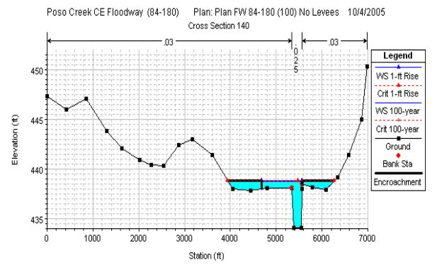
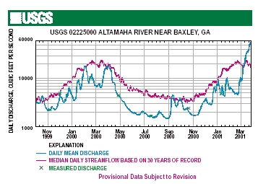
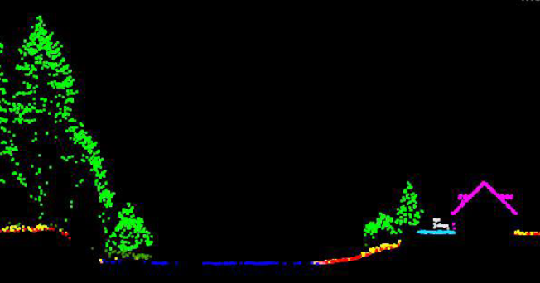
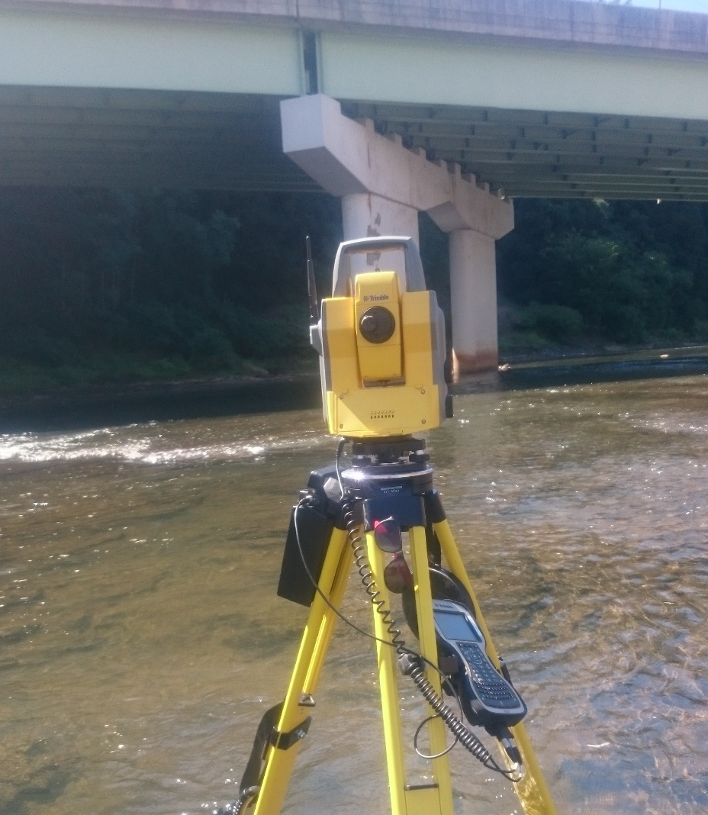
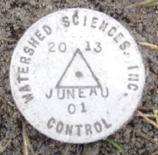
Why does the NSRS matter to me?
+
+
Reliable FIRMs require data from disconnected sources, so dates and datums must be consistently aligned.
Notes:
Example of why we need consistent coordinates (illustrated):
Just in the making of a single FIRM, data collected at different points in time using different methods:
-aerial lidar
-x-section and structure data via survey
-streamflow data/hydrographs
All of these must be reliably aligned and combined with historical data, in both the horizontal and vertical components, to produce a final product in which all of this information is available in one place, to assist professionals like yourselves in appropriate flood mitigation.
→Therefore, Reliable Flood Rate Insurance products rely on the NSRS

Slide 13
Not just new datums… but that’s the most relevant item to this audience.
  NSRS Modernization
Notes:
-so you’ve probably seen that phrase that I have front and center here, NSRS Modernization
-that’s the blanket term we use to refer to not just the new datums but other updates

Slide 14
Two Major Components of
Modernized NSRS
Geometric
aka “Horizontal”
Geopotential
aka Orthometric Height
aka “Elevation”
Notes:
-geometric component is latitude, longitude, and ellipsoid height
-geopotential component is combined with the geometric components to calculate an ortho height or capital H

Slide 15
National Geodetic Vertical Datum
of 1929
NGVD29
was replaced by

Slide 16
North American Vertical Datum
of 1988
NAVD88
will be replaced by

Slide 17
North American-Pacific Geopotential Datum of 2022
NAPGD2022
(pronounced: nap-jee-dee)

Slide 18
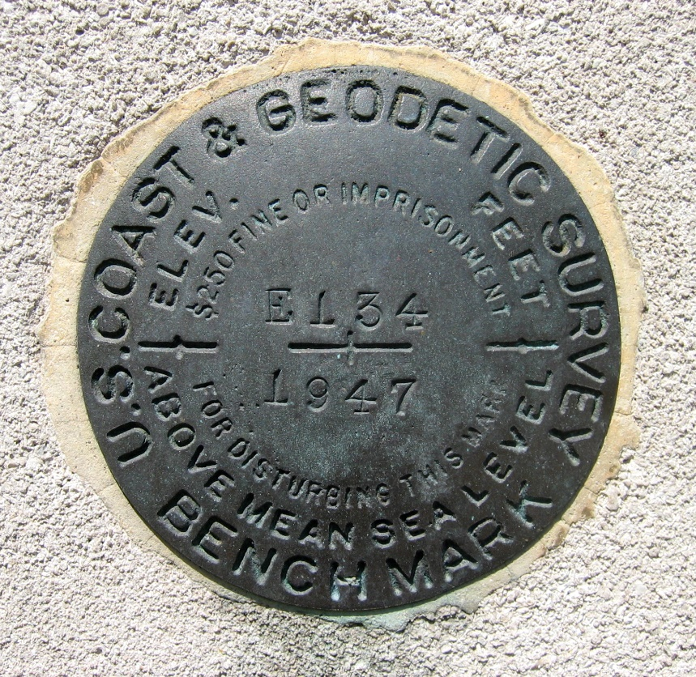
Passive Control
NGVD29 and NAVD88
Calibration sites for GNSS technology, Real Time Network validation, and verification of datum transformation tool results.
Monitoring Sites for to enhance velocity models (via repeat/campaign GNSS occupations)
Convenience for local project control, in areas with limited GNSS coverage (e.g. cities, forests), or in the event of GNSS failure (e.g. geomagnetic storms)
Notes:
So, GPS/GNSS technologies simplify and improve access to, and the accuracy of, our spatial reference system.
→ By adding a 4th dimension to all coordinates (time), marks can serve as more faithful access points.

Slide 19
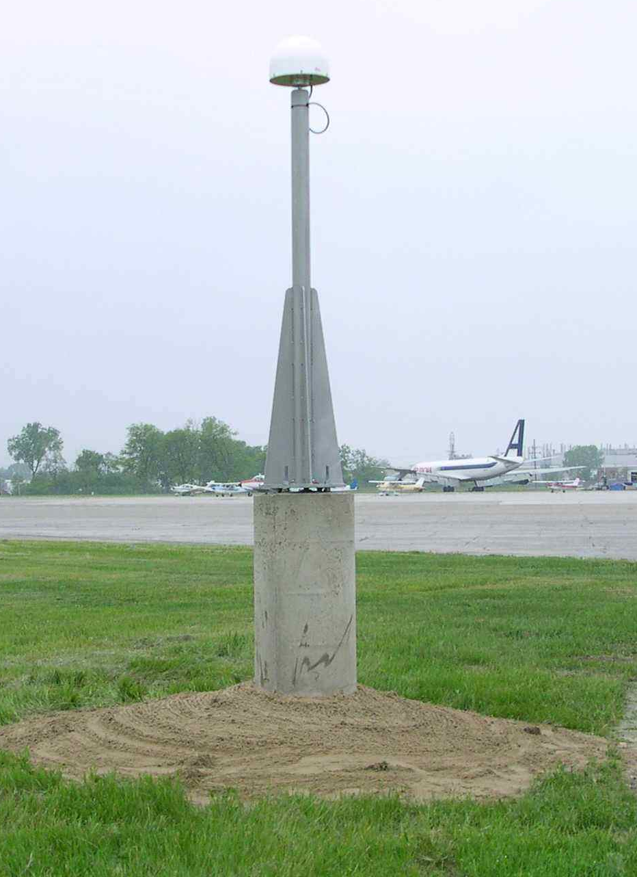
Active Control
NAPGD2022
Access to NAPGD2022 and NATRF2022 for anyone with a GNSS receiver.
More Efficient than conventional leveling for determining orthometric heights.
Convenience in that no need to recover passive control, rather set one’s own and collect GNSS data on it.
Notes:
So, GPS/GNSS technologies simplify and improve access to, and the accuracy of, our spatial reference system.
→ By adding a 4th dimension to all coordinates (time), marks can serve as more faithful access points.

Slide 20
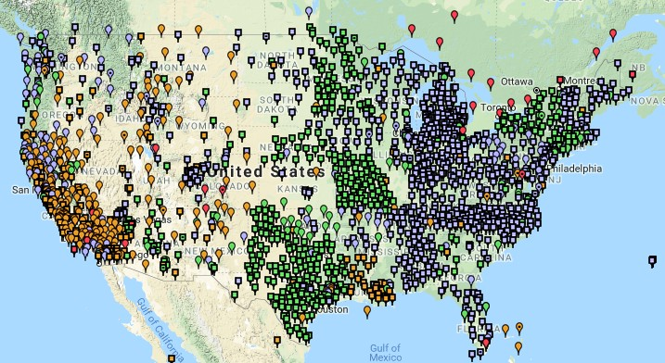
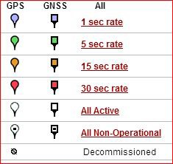
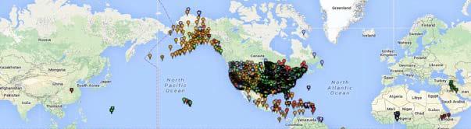
Continuously Operating Reference Station (CORS)
2000+ sites
~225 organizations
Notes:
-If you are not familiar with CORS, these are GNSS receivers that collect data 24/7, and the data is posted on NGS website for anyone to download.
-I’ve got some statistics up there, but the NOAA CORS Network is ever changing, with frequent additions and decommissionings

Slide 21
NOAA CORS Network (NCN)
2000+ sites
~225 organizations
Notes:
-I would like to point out we have a new, official name for the network you see represented on this map,
-The NOAA CORS Network, or NCN

Slide 22
In a perfect world…
Datums parallel and smooth
Measuring errors wouldn’t exist
Adjustments always agree
Nothing would move
We don’t live in a perfect world!

Slide 23
Comparing Heights

Slide 24

Vertical Datum Visualized
A reference surface that can be used to measure heights in a uniform way.
How much taller is Sally than Jane?
Could measure directly from top of head to top of head.
Or, from floor up to tops of heads and then subtract!
Sally
Jane
X= ?
That’s a relative height or height difference.
Datum
X = (h Sally) – (h Jane)
That’s a difference in heights above a datum.
Notes:
A vertical reference system is a reference surface that can be used to measure heights in a uniform way.
So, how much taller is Sally?

Slide 25
Vertical Datum Visualized
A reference surface that can be used to measure heights in a uniform way.
How much taller is Sally than Jane?
Could measure directly from top of head to top of head.
Or, from floor up to tops of heads and then subtract!
Sally
Jane
X= ?
That’s a relative height or height difference.
That’s a difference in heights above a datum.
Notes:
A vertical reference system is a reference surface that can be used to measure heights in a uniform way.
So, how much taller is Sally?

Slide 26
Datum Difference Visualized
Can still calculate X with a relative height… but it isn’t an accurate number, as our reference surface is not the same.
How much taller is Sally than Jane?
Need to know what they’re standing on!
We cannot compare heights that are measured from different reference surfaces.
Sally
Jane
X= ?
NAVD88
Datum 1
NGVD29
Datum 2
X ≠ (h Sally) – (h Jane)
Notes:
-Well, we need to know how tall, or the slope of the hill.
-You cannot compare heights that are measured from different planes of reference.
*If we replace Sally and Jane with an example more related to floodplains:
What if we want to compare a BFE height in 1990 and a BFE height 2010
what if the land has subsided under that base flood elevation over time?
…hold that thought.

Slide 27
Ok Jeff, how do I do that?
…or what we call a datum transformation
Notes:
-note that’s the proper technical term, but I’m not going to hound someone who says “conversion”… I slip sometimes too

Slide 28
NGS tool – VERTCON
Use mark OR0485 as example
1 National Geodetic Survey, Retrieval Date = DECEMBER 19, 2017
OR0485 ***********************************************************************
OR0485 DESIGNATION - C 300
OR0485 *CURRENT SURVEY CONTROL
OR0485 ______________________________________________________________________
OR0485* NAD 83(1986) POSITION- 43 46 26. (N) 099 18 46. (W) SCALED
OR0485* NAVD 88 ORTHO HEIGHT - 517.279 (meters) 1697.11 (feet) ADJUSTED
OR0485 ______________________________________________________________________
OR0485 GEOID HEIGHT - -25.673 (meters) GEOID12B
OR0485 DYNAMIC HEIGHT - 517.137 (meters) 1696.64 (feet) COMP
OR0485 MODELED GRAVITY - 980,328.6 (mgal) NAVD 88
OR0485
OR0485 VERT ORDER - SECOND CLASS 0
OR0485
OR0485 SUPERSEDED SURVEY CONTROL
OR0485
OR0485 NGVD 29 (??/??/92) 516.937 (m) 1695.98 (f) ADJ UNCH 2 0
INPUT to VERTCON
Expected OUTPUT from VERTCON

Slide 29
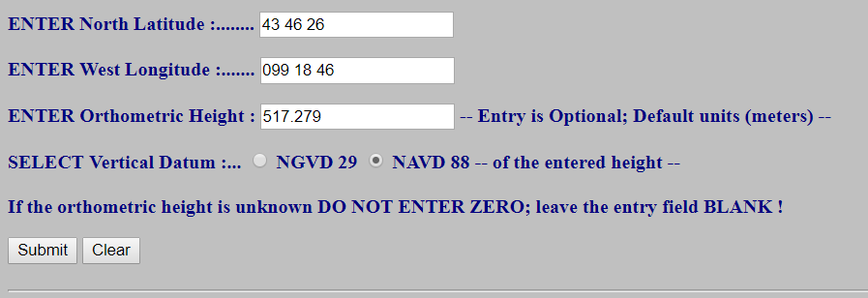
NGS tool – VERTCON
https://www.ngs.noaa.gov/cgi-bin/VERTCON/vert_con.prl
INPUT to VERTCON

Slide 30
NGS tool – VERTCON
Questions concerning the VERTCON process may be mailed to NGS
  Latitude: 43 46 26
  Longitude: 099 18 46
  NAVD 88 height: 517.279
  Datum shift(NAVD 88 minus NGVD 29): 0.343 meter
  Converted to NGVD 29 height: 516.936 meters
Actual OUTPUT from VERTCON
Note: lack of uncertainty statement (std error)
Compare Results
Expected NGVD29 Height (Datasheet) | Output NGVD29 Height (VERTCON) | Difference
516.937 meters | 516.936 meters | 0.001 meters

Slide 31
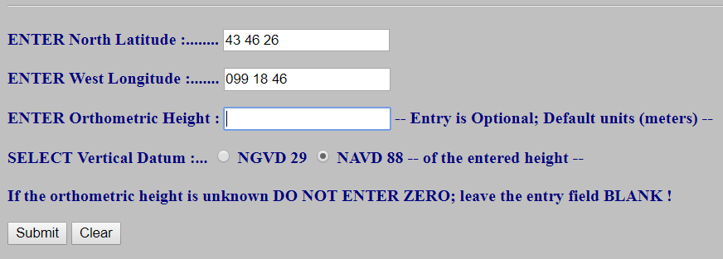
NGS tool – VERTCON
If the Orthometric Height is left blank, VERTCON will compute for you the SHIFT at that location.
INPUT to VERTCON
Questions concerning the VERTCON process may be mailed to NGS
Latitude: 43 46 26
Longitude: 099 18 46
NAVD 88 height:
Datum shift(NAVD 88 minus NGVD 29): 0.343 meter
Actual OUTPUT from VERTCON

Slide 32

But wait… there’s more!
If you call now…

Slide 33
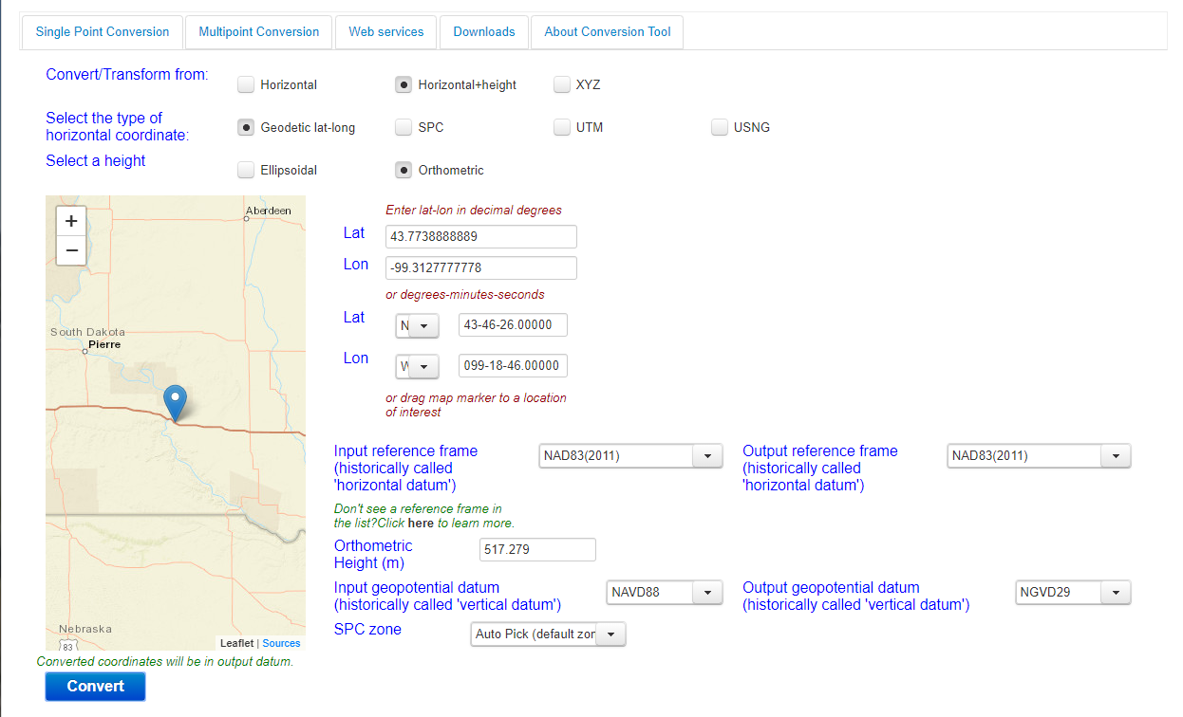
NGS Coordinate Conversion and Transformation Tool (NCAT)

Slide 34
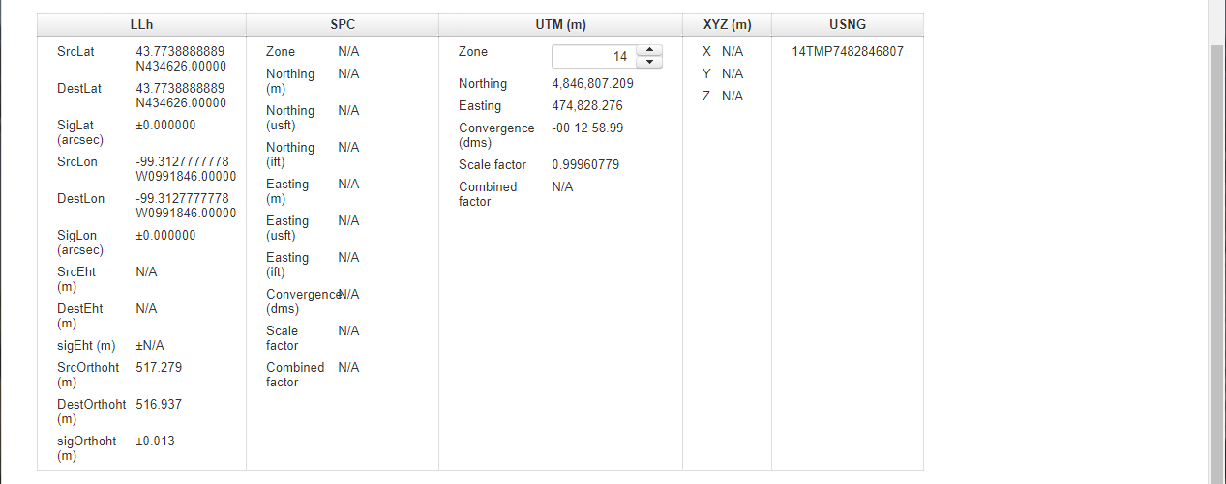
NGS Coordinate Conversion and Transformation Tool (NCAT)
Note: explicit uncertainty statement (std error)
Compare Results
Expected NGVD29 Height (Datasheet) | Output NGVD29 Height (NCAT beta) | Difference
516.937 meters | 516.937 meters | 0.000 meters

Slide 35
NCAT will be the “trifecta”
NGVD29
NAVD88
NAPGD2022
NCAT currently contains all elements of VERTCON (v3.0) and will be upgraded post-2022 to include NAPGD2022
Notes:
NCAT will incorporate the functionality of VERTCON to transform heights.

Slide 36
Datum Difference Visualized
Can still calculate X with a relative height… but it isn’t an accurate number, as our reference surface is not the same.
How much taller is Sally than Jane?
Need to know what they’re standing on!
We cannot compare heights that are measured from different reference surfaces.
Sally
Jane
X= ?
What if Sally and Jane are growing?
NAVD88
NGVD29
X ≠ (h Sally) – (h Jane)
Notes:
-Well, we need to know how tall, or the slope of the hill.
-You cannot compare heights that are measured from different planes of reference.
*If we replace Sally and Jane with an example more related to floodplains:
What if we want to compare a BFE height in 1990 and a BFE height 2010
what if the land has subsided under that base flood elevation over time?
…hold that thought.

Slide 37
What if things move?
Notes:
-by “things” we mean the objects we’re measuring
-if earth is moving, we need o account for that

Slide 38
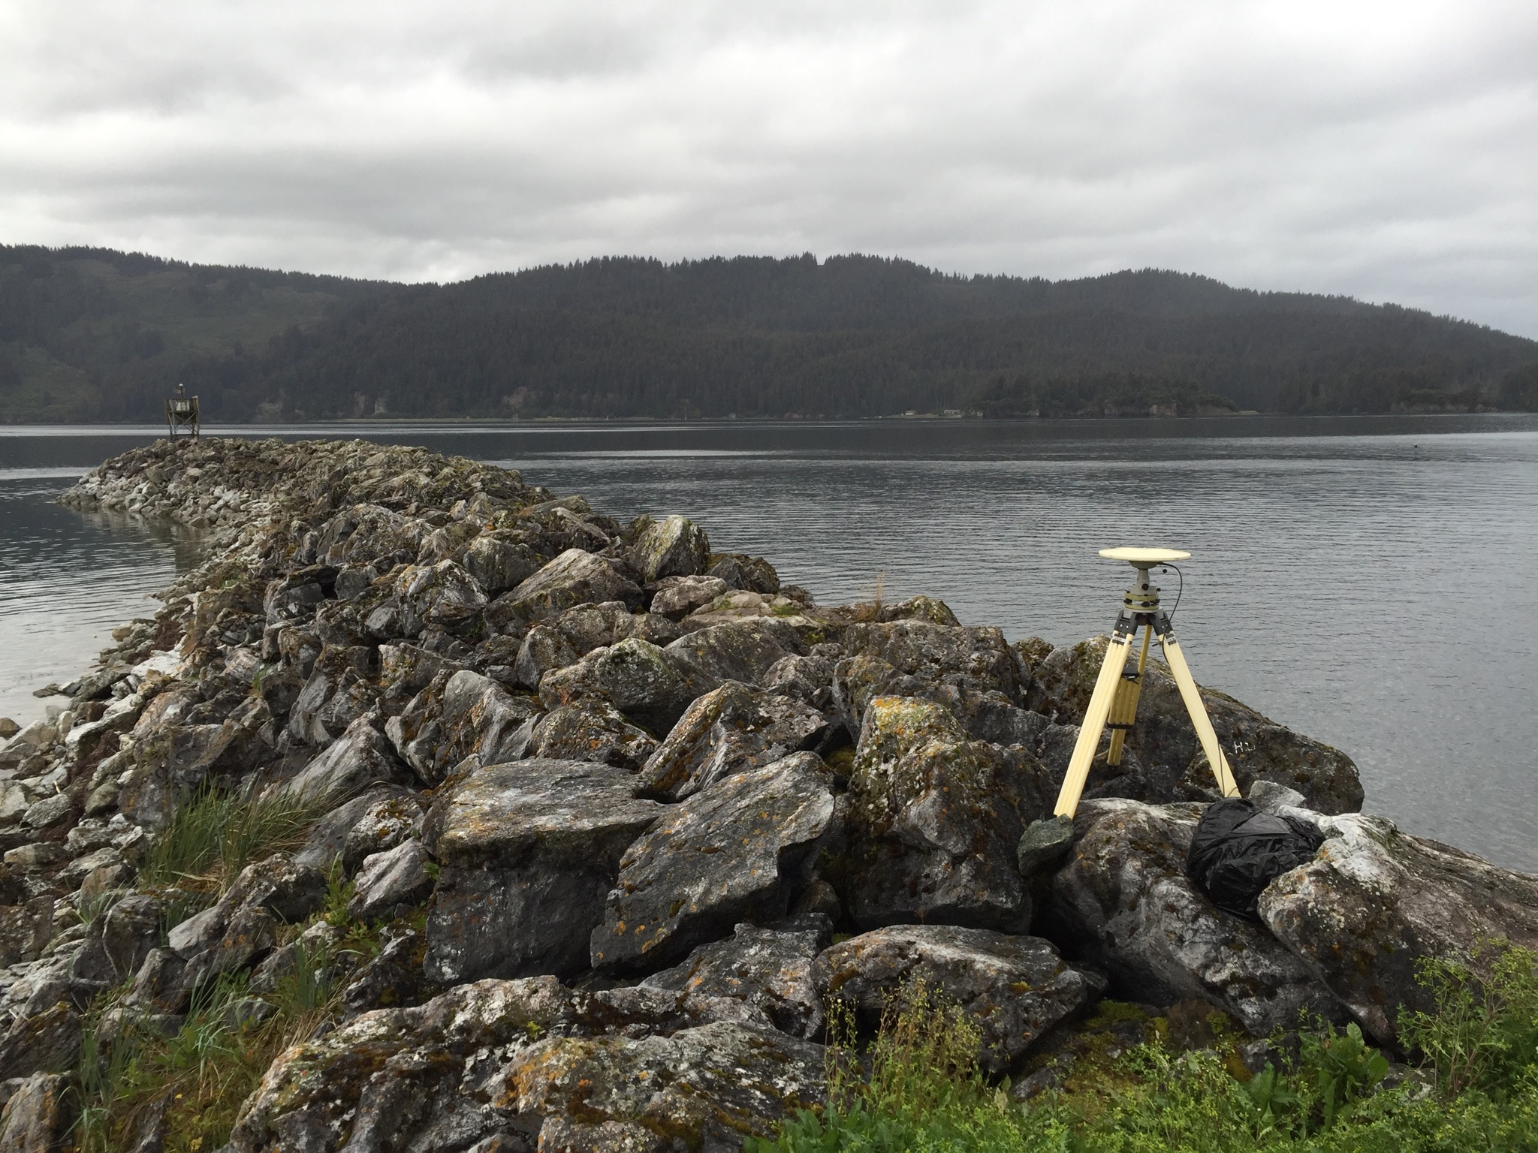
ALASKA Case Studies
Illustrative
Notes:
*** I just explained to you how we are modernizing NSRS and told you that it is a good thing for floodplain mapping, but now I am going to show you why with some case studies***
Alaska is a great illustrative end-member.
The issues posed by datums with limited time-dependency shown in the following examples are measurable and apparent, but they are relevant to areas nationwide because these changes are happening everywhere (at slower and less-apparent rates) and they reinforce why NSRS modernization is critical for improved flood mapping, particularly in areas experiencing changes in local relative sea level.

Slide 39

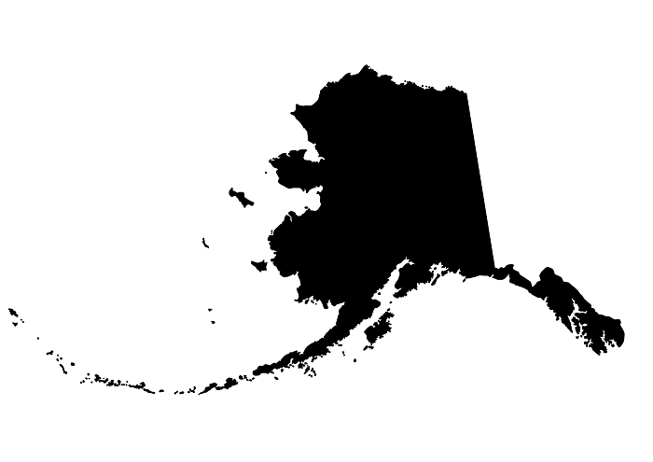
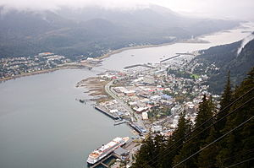
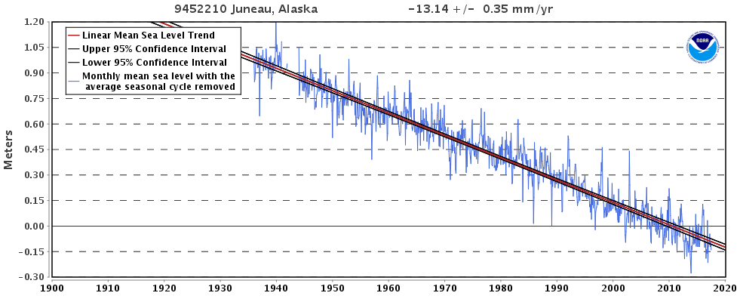
CaSe File: Juneau, AK
2015 Population:
32,756
1940
Looks like sea level is falling 13 mm/yr, but what if…
2014
Notes:
Juneau:
The bottom plot is the Negative Relative Sea Level (RSL) trend in Juneau. The sea is falling relative to the land, because, even though the sea is rising globally the land is rising even faster, and outpacing the ocean.
*The largest component is due to isostatic rebound of the crust as terrestrial glaciers melt.

Slide 40
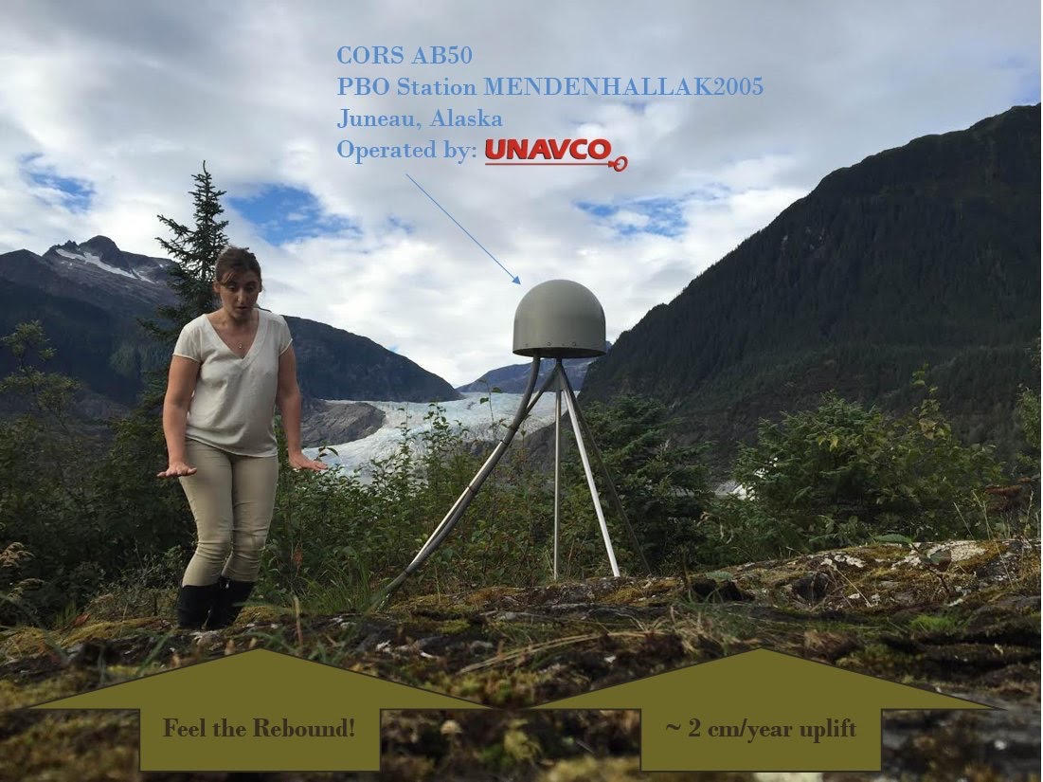
CaSe File: Juneau, AK
what if…the land is rising 15 mm/yr, and…
Notes:
-In the photo, rapid uplift is monitored with a continuous GNSS site at Mendenhall Glacier. It is a Continuously Operating Reference Station or CORS.
-The young lady you see is NGS’s Regional Geodetic Advisor for Alaska and the US Arctic, Nicole (Nic) Kinsman, who might normally have been giving this presentation, if it weren’t for her special rotational assignment within NGS.

Slide 41
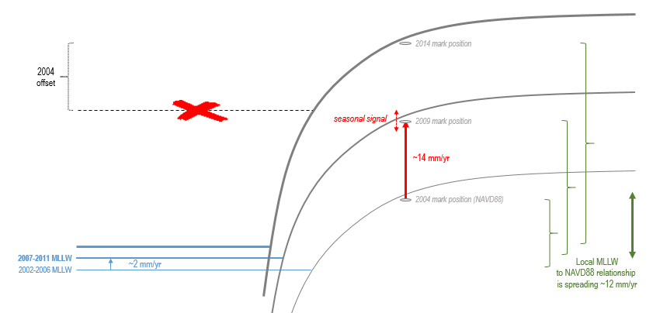
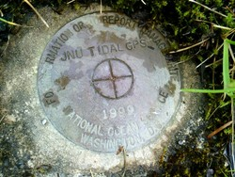
CaSe File: Juneau, AK
*** When and how you access or transform to NAVD88 matters ***
Is the flood risk changing in Juneau AK ?
…sea level is also rising by 2 mm/yr
Notes:
**Juneau rates have been generalized for illustrative purposes in this figure**
Local sea level is rising (in blue)
Land is rising faster (in red)
Vertical relationship between tidal and ‘terrestrial’ datums changes (increasing here as shown in green) through time such that if you applied the 2004 relationship 10 years later, the expected position of local MLLW would be significantly off (shown with the red x)
Thought experiment in the creation of a new FIRM:
The mark shown has an official NAVD88 height published in IDB in 2004.
→ Just 10 years later, a surveyor uses this published height value to complete a NAVD88 elevation certificate.
A lidar contractor delivers a new 2014 DEM for Juneau and uses the same mark for control with a NAVD88 height value based on a GPS occupation of the mark (processed with OPUS).
?? Are the surveyor and the lidar contractor working in a consistent vertical datum? NO. *One (the surveyor) is using a NAVD88 height published in 2004, the other (the lidar contractor) is using a current (2014) NAVD88 height, from OPUS.

Slide 42
Let’s talk about why NGS is upgrading to NAPGD2022

Slide 43
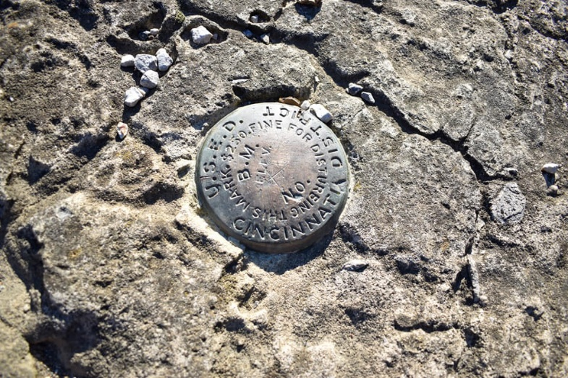
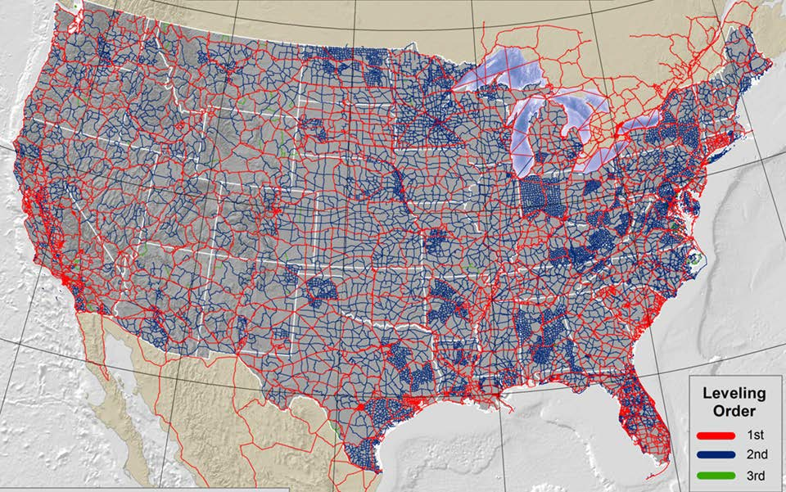
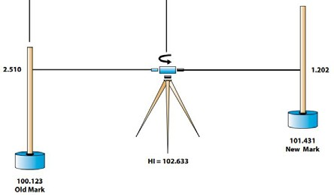
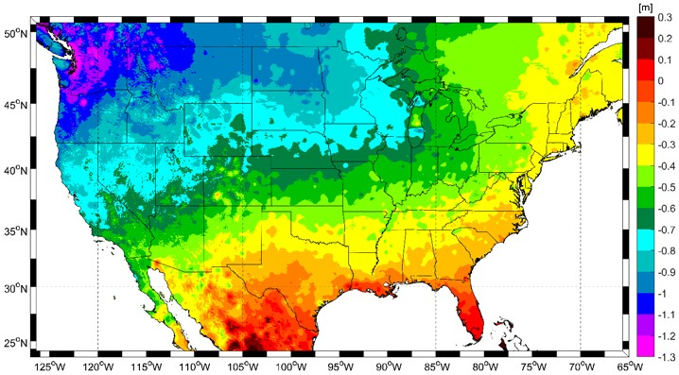
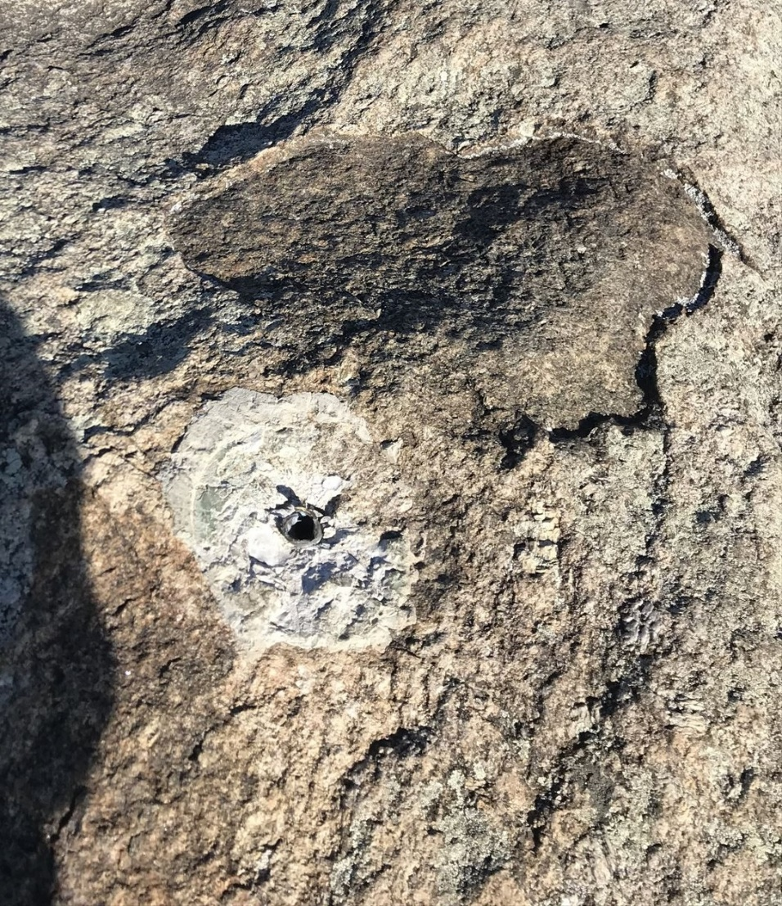
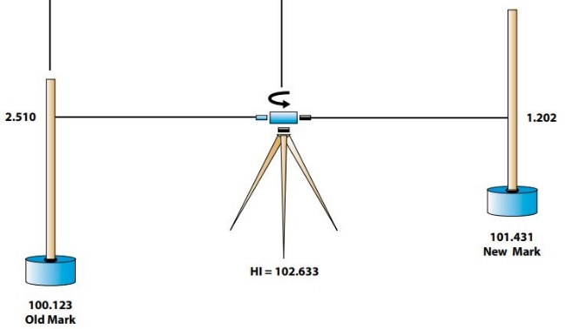
Why Replace NAVD88?
tilt in the "zero surface” (intended to be flat)
subsidence, uplift, freeze & thaw of BMs
limited availability of undisturbed marks
Approximate Error in NAVD88 "zero surface”
Notes:
-why are we replacing this wonderful network of benchmarks?

Slide 44
Approximate Error in NAVD88 "zero elevation” (H=0)
Map is the H=0 surface overlaid onto satellite gravity data
Notes:
Map highlights the tilt/bias to the zero reference surface, that’s another item that was discovered later on with the advent and proliferation of satellite positioning and remote sensing technology.
How was the map created, that is the NAVD88 zero surface (H=0) overlaid onto a satellite based geoid model, then color shaded by vertical difference

Slide 45
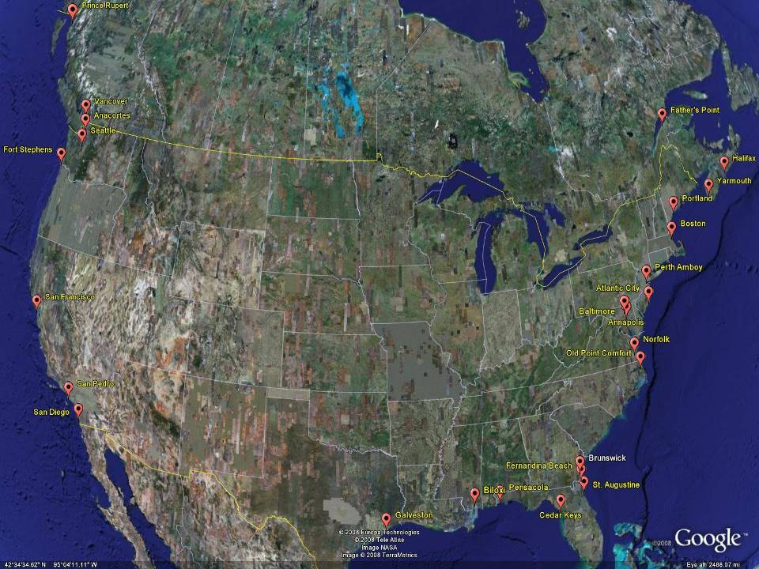
NGVD29
Referenced to 26 tide gauges in the US and Canada
Notes:
It turns out that MSL is a close approximation to another surface, defined by gravity, called the geoid, which is the true zero surface for measuring elevations. Because we cannot directly see the geoid surface, we cannot actually measure the heights above or below the geoid surface. We must infer where this surface is by making gravity measurements and by modeling it mathematically. For practical purposes, we assume that at the coastline the geoid and the MSL surfaces are essentially the same. Nevertheless, as we move inland we measure heights relative to the zero height at the coast, which in effect means relative to MSL.
Definition: NGVD29 – The National Geodetic Vertical Datum of 1929…
The Sea Level Datum of 1929 was the vertical control datum established for vertical control surveying in the United States of America by the General Adjustment of 1929. The datum was used to measure elevation or altitude above, and depression or depth below, mean sea level (MSL).
Mean sea level was measured at 26 tide gauges: 21 in the United States and 5 in Canada. The datum was defined by the observed heights of mean sea level at the 26 tide gauges and by the set of elevations of all bench marks resulting from the adjustment. The adjustment required a total of 66,315 miles (106,724 km) of leveling with 246 closed circuits and 25 circuits at sea level.
Since the Sea Level Datum of 1929 was a hybrid model, it was not a pure model of mean sea level, the geoid, or any other equipotential surface. Therefore, it was renamed the National Geodetic Vertical Datum of 1929 (NGVD 29) in 1973. The NGVD 29 was subsequently replaced by the North American Vertical Datum of 1988 (NAVD 88) based upon the General Adjustment of the North American Datum of 1988.

Slide 46
NGVD29 – based on 26 tide gauges
Concept

Slide 47
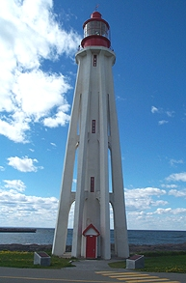
Referenced to a single tide gauge in Canada
Why one gage fixed this time?
removed local sea level variation problem of NGVD29
But it did introduce possibility of cross-continent error build-up…
Father Point Lighthouse, Quebec
Notes:
Definition: The surface of equal gravity potential to which orthometric heights shall refer in North America
One height held fixed [at 6.271 meters along the plumb line below the geodetic mark] at “Father Point” (Rimouski, Canada).
By fixing the geopotential value at the origin point, it was possible to ensure that the origins of IGLD 85 and NAVD 88 aligned.
But perhaps more importantly, the height chosen was to minimize 29→88 differences on USGS topo maps in the eastern U.S. … thus, the “zero height surface” of NAVD 88 was NOT chosen for its closeness to the geoid (but it was close…few decimeters)
Use of one fixed height removed local sea level variation problem of NGVD 29
*It should be pointed out that while the datum was defined in such a way as to be usable on the North American continent, it was never actually adopted in Canada. It can be used there, but it’s not their official civilian datum.
Note that the designation of the vertical control point at Father Point is “1250 G=NAVD 88 DATUM POINT” for PID# TY5255 and is not available from the publicly accessible NGSIDB.

Slide 48
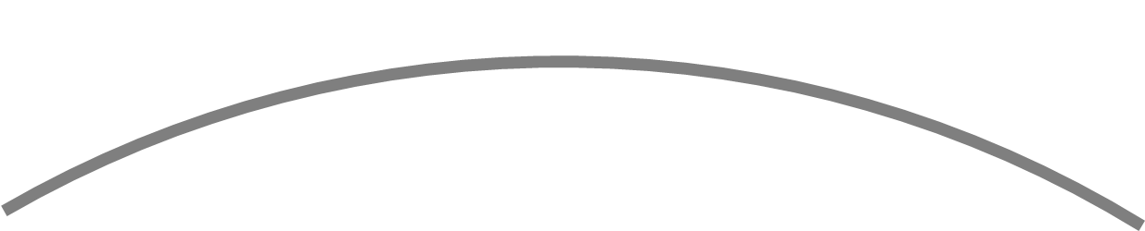
NAVD88 – based on single tide gauge
Concept
Notes:
-

Slide 49
Approximate Error in NAVD88 "zero elevation” (H=0)
Map is the H=0 surface overlaid onto satellite gravity data
Notes:
Map highlights the tilt/bias to the zero reference surface, that’s another item that was discovered later on with the advent and proliferation of satellite positioning and remote sensing technology.
How was the map created, that is the NAVD88 zero surface (H=0) overlaid onto a satellite based geoid model, then color shaded by vertical difference

Slide 50
NAVD88 – based on single tide gauge
  Most, if not all, of this error in alignment was intentional.
  Huh?! It was chosen to minimize the change to contours in USGS quadrangles.
Concept
Notes:
-

Slide 51
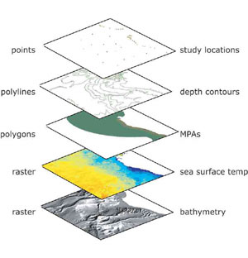
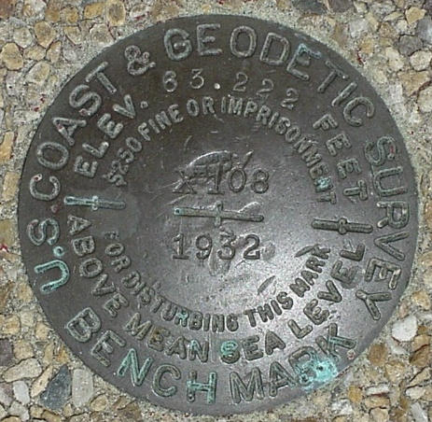
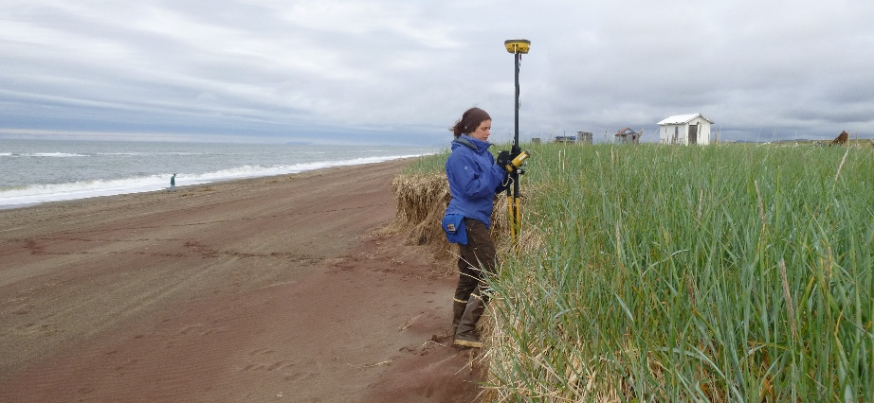
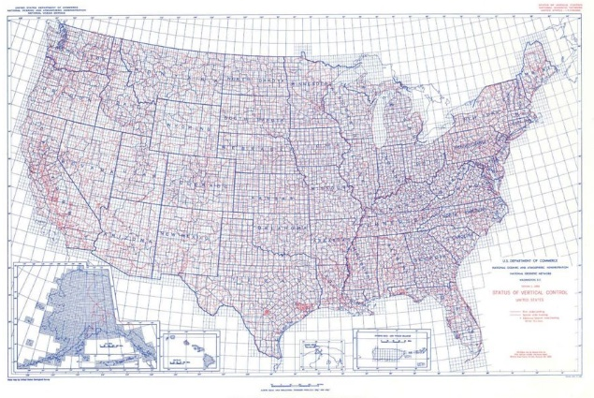


NSRS Modernization – the four C’s
Requirements
Expectations
CONSISTENCY
CONVENIENCE
Semi-CONSTANT Coordinates
COHERENCE with Sea Level
stamped with elevation
Notes:
For a reference system to be useful to the public it must be CONSISTENT, meaning it possess spaciotemporal reliability and repeatability, and CONVENIENT, meaning it is readily accessible by users.
Additionally, as a society we have also adopted an expectation that our spatial reference system is defined in a manner that provides some level of CONSTANCY, that objects considered to be stationary have fixed coordinates and/or heights. We have also come to expect that heights and depths are relative to some definition of sea level, and this COHERENCE with a natural equipotential surface also ensures that water will flow from higher to lower height values.
As NGS continues to fulfil our primary mission of defining, maintaining, and providing access to the NSRS, we have recognized the need to modernize the current NSRS in tandem with advances in geodesy, geophysics, and technology (especially GPS/GNSS); to meet evolving requirements and expectations of the NSRS. Decisions about how to best modernize the NSRS must achieve improved consistency (especially between passive and active control), and convenience - while not fully departing from expected characteristics that are part of the fabric of how our Nation uses precise positions.

Slide 52





NGS supports access to NAVD88
Passive Marks, Datasheets, and Leveling
GEOID12B,
now use
GEOID18
official path
Notes:
As I mentioned before, an important part of the NGS mission is to provides access to the NSRS.
- Accessing NSRS today - Over time, and with advances in technology, there are now two paths to access NSRS or NAVD 88 heights.
Path (1) Since the NSRS is presently defined by a network of passive control, NGS provides primary access to the NSRS at published passive control that is in the IDB – Integrated Data Base. At present, this remains the ‘official’ gateway to NSRS positions.
Path (2) NGS also supports GPS/GNSS-enabled access to the NSRS via OPUS. For GPS/GNSS-enabled access to NSRS heights, NGS maintains geoid models, which are necessary to convert GPS measurements, which are ellipsoid-based, into real-world elevations. The current geoid model (GEOID12B) that is used to access NSRS orthometric heights (NAVD88) is a hybrid geoid. This means it’s a surface of constant gravity potential that has been warped to align with published values on bench marks.
→ Because of this warping, in an ideal/static world, these two pathways lead you to the same coordinates. Unfortunately, our world is not static, which leads to discrepancies due to plate tektonics, earthquakes, uplift from iso-static rebound, aquifer recharge and mountain building processes, subsidence from petroleum and water pumping, etc…

Slide 53



NGS will support access to
NAPGD2022
Passive Marks, Datasheets, and Leveling become secondary due to motion
GEOID 2022
And transformation back to NAVD88 and NGVD29, via NCAT
official path
Notes:
In 2022 we are switching the official access path to NSRS coordinates.
Active geodetic control (CORS) and a ‘pure’ or un-warped geoid model will replace passive geodetic control, or bench marks.
GPS/GNSS will be the official gateway to the NSRS
The GRAV-D project, for a refined gravimetric geoid for the US, will enable access to orthometric heights w/in 2 cm accuracy using GPS/GNSS. There is no warping to published benchmark heights.
*While the prevalence of active control will reduce our reliance on passive control, it will still have its place.

Slide 54



Details Available in our series of “Blueprints for 2022”
Part 1:
Geometric Coordinates
Part 2:
Geopotential Coordinates
Part 3:
Working in the
Modernized NSRS
… also available as Recorded Webinars!
Notes:
Changes are still 3 years away, but users can get a sneak peak at the future in the Blueprints for 2022 Technical Report Series.
BP Part 1 = Geometric Coordinates (NATRF2022); Part 2 = Geopotential Coordinates (NAPGD2022); Part 3 = Working in the Modernized NSRS.
An informal summary of the contents is provided here to pique further interest.
Crack them open! Let NGS know what you think.

Slide 55
North American Datum
of 1983
NAD83
will be replaced by

Slide 56
North American Terrestrial Reference Frame of 2022
NATRF2022
(pronounced: nat-ref)

Slide 57

Notes:
-what’s the Magnitude of Horizontal Change?
-we will have tools online to simplify the process of estimating NAD83→NATRF2022
-see the 1.2 and 1.3m contour lines are south of MIH and just thru the UP, so you’ll see a northwesterly shift of 4 feet or more throughout Michigan
-all under 4.5 feet

Slide 58

What’s that going to look like?
PHOTO = NAD83
RED = NAD83 shoreline data
GREEN = shoreline transformed to NATRF2022
Notes:
RED: NAD 83 coastline against NAD 83 imagery
GREEN: Coastline shifted into NATRF2022 but the imagery remains on NAD 83

Slide 59
Back to vertical…
Notes:
-note that’s the proper technical term, but I’m not going to hound someone who says “conversion”… I slip sometimes too

Slide 60

Change in orthometric heights from NGVD29 to NAVD88
So in Michigan…
0.66 to -0.66 feet
Notes:
-note that the contour of zero change between NGVD29 and NAVD88 falls right thru the UP, so up there I guess it could be pretty easy to unknowingly mix datums
-overall, across the state we’re talkin about 20 to -20 cm

Slide 61

Estimated change in orthometric heights from NAVD88 to NAPGD2022
(NAPGD2022 approximated using xGEOID16B)

Slide 62
Estimated change in orthometric heights from NAVD88 to NAPGD2022
(NAPGD2022 approximated using xGEOID16B)
Vertical change of about -0.4 to -2.5 feet
Notes:
Previously estimated values are matching xGEOIDs!
I have that estimate down there, and that’s true except for that little area, not sure what that’s all about, hard to get answers from the Geoid Team since the shutdown. They’re behind schedule but working frantically to get back on track.

Slide 63

Documentation of Datums (Metadata)
Practical Guidance on

Slide 64
Use Complete Nomenclature
NAD83(2011) epoch 2010.00
Geometric
Datum
Realization
Reference Epoch
Other Examples
NAD27
NAD83
NATRF2022
(1986)
(1994)
(2007)
(2011)
Epoch 1991.0
Epoch 2010.0
Epoch 2025.0
Your report should have a paragraph describing the sources and methods used to determine the horizontal coordinate system used
Notes:
Note: The exact content and format may vary, but these general recommendations are specific to projects with a vertical emphasis.
Also, whenever possible, even before 2022:
Document equipment used, source/date of survey, any software used for conversions and/or transformations, and record their parameters and the name and version numbers.
Retain your raw GPS/GNSS files and all other raw data files and information collected.
Document any additional potentially relative information.

Slide 65
Use Complete Nomenclature
NAVD88 (ellipsoid, geoid model)
Vertical
Datum
GPS-derived:
-(NAD83(2011) epoch 2010.00, GEOID12B)
NGVD29
NAVD88
NAPGD2022
NGS-published leveling:
-PID OR0485, dated 06/15/91 (per Datasheet)
Non-published leveling:
-Your Control ID, dated per your records
For other situations:
-Specify source and method of measurement
Your report should have a paragraph describing the sources and methods used to determine the vertical heights used

Slide 66
Use Complete Nomenclature
MLLW (9452210; 1960-78 #2128)
Water Level Datum
Station/Gage ID
(USGS, USACE, etc.)
National Tidal Datum Epoch & Published Sheet Number (if applicable and available)
Your report should have a paragraph describing the sources and methods used to determine the Tidal Height System and Epoch system used

Slide 67



CaSe File: METADATA
1995 EC Form
Weak datum metadata
1981 FIRM - JUNEAU
Notes:
We have made improvements over time, as seen in the old Elevation Certificate Forms (this one is from Juneau)
The old form has issues. Not enough metadata
This is a very common issue in Alaska
The insurer takes the datum label on the EC at face value
A conversion value may not exist OR may demonstrate that datum is mis-labeled by resulting in an unreasonable elevation
In these cases, you must defer to a licensed surveyor for interpretation, or the property will require a re-survey

Slide 68


Section B & C – FIRM Information
Better datum metadata
Better datum metadata
Notes:
On the new elevation certificate documents:
There is extra space to add information about the source.
If you look in the instructions, licensed professionals completing this form are not restricted to just this space, and they may provide attachments if extra explanation is necessary.

Slide 69
Keep Complete Records
If local passive control are used in the FIS, retain a record of:
  Monument stampings/locations
  PIDs or other unique IDs
  Position at time of FIS survey (with complete metadata)
If you do any transformations, keep a record of the parameters and the name and version number if a tool was used (like Vdatum, VERTCON, NCAT, etc)
In areas of uplift/subsidence, inquire about source and ”vintage” of heights
  For NAVD88, which realization, reference epoch?
  For Tidal Datums, what tide station, tidal epoch, published sheet number?
FEMA EC guidance provides for the use of OPUS reports; OPUS solutions of 4+ hours in duration on marks of significance can be archived w/ NGS as an ‘OPUS Shared Solution’ with minimal extra effort.
Copies of NGS and MNDOT Datasheets
Notes:
Read Slide

Slide 70

Training and Resources
Additional
Notes:
This presentation is intended to raise awareness about the upcoming changes and what they mean for floodplain mapping, but you probably have lots of remaining questions and we have a lot of resources online at our website
Please spread the word, and
make an effort to keep yourself and your colleagues informed.
Tell us what content is missing or how we can make it better!

Slide 71


Resources from www.ngs.noaa.gov
Click icon on home-page
Notes:
I’m going to highlight a few online resources, beginning with our new datums web site.
Visit our site. It has information today, and we’ll continue to update it.

Slide 72

Resources from www.ngs.noaa.gov
Notes:
You can also access our science and education resources from the drop down menu on our main page

Slide 73


Resources from www.ngs.noaa.gov
Videos are ~3-5 minutes
Vertical Datums Tutorial is ~1 hour
Notes:
Educational videos and online tutorials –
Our library of lessons and videos are great resources, and will reinforce a lot of information we covered today.
The videos are just 3-5 minutes long.
the lesson is a deeper dive but still only takes an hour.

Slide 74

https://www.ngs.noaa.gov/ADVISORS/
Notes:
- 14 Regional Advisors, we’ve transitioned from a State-based to a Regional Program
-if you know Ross Mackay, he is our Chief Advisor, I report to him…
**ya know, I don’t know why they don’t make him put his photo up here
-we do have one vacant advisor position, that was recently advertised and John up there in Wisconsin is officially retired in oh… 18 days

Slide 75

State Geodetic Coordinators
not an NGS employee
a liaison between the State’s geospatial community and the NGS

Slide 76


Email Subscriptions
Stay informed
NGS News
  Includes quarterly NSRS Modernization newsletter
Webinars
Free Training
Only 1-2 messages per month
Click icon
on home-page
Notes:
Email Subscription –
Sign up for notifications about News, webinars, and training opportunities with NGS.
We also use our News subscription list to send out our quarterly NSRS Modernization Newsletter.

Slide 77
What can you do?
Be aware and help spread the word about upcoming NSRS modernization:
  Proactively ask agencies, surveyors, and engineers about what preparations they are taking to learn about and prepare for the upcoming changes
Reach out to NGS for support as needed
Lead by example and exercise best metadata practices
Notes:
Coordinate
-Spread the word and tell others about NSRS Modernization
Educate
-Review materials and ask for support from NGS
Prepare
-Lead by example and use the best metadata practices

Slide 78

Get Prepared
Utilize the NSRS for Floodplain mapping and surveying
Metadata, metadata, metadata…
Use current datums
Retain original (“raw”) GNSS observation files
Notes:
For more active NSRS users, a few points:
Metadata, metadata, metadata..
Please require and/or provide complete metadata for all mapping contracts.
How did they get the positions/heights? Document it!
Lead by example and use best metadata practices
Use current datums / realizations.
NAD 83(2011) epoch 2010.00
USGG12 (gravimetric geoid) / GEOID12B(hybrid geoid)
NAVD 88 (get off of NGVD 29)
Keep original (“raw”) GNSS observation files. This will improve the quality of future transformations.

Slide 79


Ongoing NOAA/FEMA Coordination
Feedback on the New Datums
Kimberly Pettit, FEMA GIS Coordinator
Prepared with Paul Rooney
2017 Geospatial Summit
April 24 to 25, 2017
https://www.ngs.noaa.gov/geospatial-summit/presentations/fema.shtml
Assessment
Preparations to-date
Advantages and challenges
Concerns
Necessary transition tools, products, and services
Outreach priorities
watch online
Notes:
We are coordinating with other Federal Agencies - since Federal mapping agencies must use the NSRS, we’ve made a particular effort to engage federal agencies
Our director chairs the Federal Geodetic Control subcommittee (FGCS), and they will adopt the new datums in 2022
We hosted Geospatial summits in 2010, 2015, 2017 and most recently in 2019.
We asked federal agencies to share their requirements and concerns.
Check out what FEMA shared and their cooperative agreement with North Carolina by visiting our website.

Slide 80

NOAA/FEMA Coordination
Cooperative Pilot Study (2011):
  National Geodetic Survey,
  North Carolina Floodplain Mapping Program,
  North Carolina Geodetic Survey, and
  Federal Emergency Management Agency
Key Outcomes:
Recommendation of FEMA implementation plan to account for coordinate and height shifts.
Improved relative positional accuracies and greater understanding of height uncertainties will enhance quality of flood mapping.
Notes:
NOAA/FEMA – NOAA working with FEMA to implement the new datums is incredibly important.
In 2011 we commissioned a socio-economic benefit study that found improved floodplain maps are of tremendous value to the nation.
This study was a huge driver in getting funding for our GRAVD project.
*We completed a pilot study in 2010 in North Carolina
NGS made a recommendation that FEMA create an implementation plan to account for coordinate and height shifts.
NGS and FEMA found that improved relative positional accuracies and greater understanding of height uncertainties will enhance the quality of flood mapping.
**We recognize there will be challenges, but we really are looking forward to working with FEMA and all of you, to make the transition work as well as possible.

Slide 81

Floodplain Mapping Webinar
Recording of one in a webinar series
  15 November 2018
  https://www.ngs.noaa.gov/web/science_edu/webinar_series/2018-webinars.shtml
Follow up FAQ posted:
  https://www.ngs.noaa.gov/web/science_edu/webinar_series/Responses_webinar_2018-11-15.pdf

Slide 82
https://www.ngs.noaa.gov/ADVISORS/
-use any major search engine: “NGS advisors”
Jeff Jalbrzikowski, P.S., GISP, CFS
Appalachian Regional Geodetic Advisor
jeff.jalbrzikowski@noaa.gov
240-988-5486
Notes:
NGS is not pulling the rug out from under you, we are re-leveling and bracing the subfloor for longevity.
Geodesy and the NSRS are critical to floodplain mapping
Ellipsoidal, orthometric, and tidal vertical datums each have a role…
NAVD 88 is going to be replaced in 2022
By NAPGD 2022, part of larger NSRS Modernization effort (2022).
Replacement is in 2022, but the time to prepare is now.
The tools you use today will be expanded for 2022
Tools for accessing NSRS (OPUS, CORS, Data Explorer)
Tools for transformations (NCAT and VDATUM)
This ALL requires good metadata, so lead by example!
THANK YOU!!

Slide 83


CaSe File: Cordova, AK
2010 Population: 2,239
Prior FIS: 1979-2015
New FIS Effective: 12/16/2015
Land is falling and sea level is rising
1964
1979
Notes:
Cordova, AK:
Complex RSL trend, positive to steady… why?
Note: record starts in 1964 (see next slide for answer).

Slide 84

CaSe File: Cordova, AK
USGS Professional Paper 531-I
Notes:
Alaska Earthquake happened March 27, 1964. The barnacle line clearly marked by the upper limit of light-gray barnacles and desiccated rockweed in dark patches, and by the lower growth limit of dark-gray encrusting lichens of the splash zone. There was uplift of 3.2 feet in Whale Bay in western Prince William Sound (not far from Cordova).
This photo was taken at 3-foot tide stage. June 22, 1964. Figure 6, U.S. Geological Survey Professional paper 543-I.
= Cordova experienced post-seismic adjustment following the 1964 quake = accelerated RSL rise (unfortunately coinciding with a period of major development in Cordova).

Slide 85


CaSe File: Cordova, AK
BFE in 1979 FIS/FIRM: “18 feet relative to MLLW”
(illustration not to scale)
Fred
Local MLLW in 1994 (1960-78 NTDE)
Fred obtains an Elevation Certificate in Cordova in 1994:
18.1’ MLLW (1960-78 tidal epoch) ← Above BFE
Notes:
Here is an Experiment:
*******NOTE: BFE in Cordova is relative to local MLLW, not NAVD88***********
BFE in 1979 FIS/FIRM = 18 feet relative to MLLW
And Fred obtains an Elevation Certificate (EC) in Cardova in 1994 that determines he is 18.1 ft above MLLW.

Slide 86
CaSe File: Cordova, AK
BFE in 1979 FIS/FIRM: “18 feet relative to MLLW”
(illustration not to scale)
Susan
Fred
Local MLLW in 2004 (1983-2001 NTDE)
Fred obtains an Elevation Certificate in Cordova in 1994:
18.1’ MLLW (1960-78 tidal epoch) ← Above BFE
A decade later (2004), his next door neighbor Susan hires a surveyor to get an Elevation Certificate:
17.9’ MLLW (1983-2001 tidal epoch) ← Below BFE?
Notes:
Talk about Susan, 10 years later (water is up and land down in this time → risk of flood is increasing for both houses)
Note: Susan’s house is actually up small hill from Fred’s, but in 2004 her EC determines she’s at 17.9 feet above MLLW.
*Is her EC correct?

Slide 87
CaSe File: Cordova, AK
BFE in 1979 FIS/FIRM: “18 feet relative to MLLW”
(illustration not to scale)
Susan
Fred
Local MLLW in 2004 (1983-2001 NTDE)
Is the flood risk changing in Cordova AK ?
Fred obtains an Elevation Certificate in Cordova in 1994:
18.1’ MLLW (1960-78 tidal epoch) ← Above BFE
A decade later (2004), his next door neighbor Susan hires a surveyor to get an Elevation Certificate:
17.9’ MLLW (1983-2001 tidal epoch) ← Below BFE?
Notes:
So, Fred is “out” of flood zone due to his grandfathered elevation, but Susan in “in” (she is not really, because these elevations are not relative to the same FIS datum)
→ No one in this scenario paid attention to the tidal epoch of the MLLW datum
*FEMA guidance says that “BFE stays fixed even if there is subsidence.” (a bit ambiguous if BFE is relative to a non-fixed datum)
Susan’s EC is NOT to the same datum as the BFE, but perhaps Susan’s EC reflects her true risk, and Fred just got lucky with timing?
→ This is not how we want to be calculating elevations for the purposes of informed flood preparedness.

Slide 88

CaSe File: Cordova, AK
2015 FIS
Based on NOAA tidal BM records; this conversion value is for NAVD88 to Local MLLW (1983-2001)
Can this equation be used to update all Cordova MLLW Elevation Certificates to NAVD88?
Notes:
The Cordova 1979 FIS was updated in 2015.
The FIS was updated for BFEs relative to NAVD88, and a conversion value was provided that does not specify tidal epoch.
If this equation is used on Susan’s EC, her elevation is now ‘correct’?
*Without a NTDE defined, can we know for sure? -NO
If this equation is applied to Fred’s EC, does he now have a NAVD88 EC compliant with the new FIS? NO
How would the local Flood Plain Manager know the difference when going through the process of Elevation Certificate updates?
*This example is one of many that REINFORCES THE IMPORTANCE OF METADATA!!!!!

