Slide 1


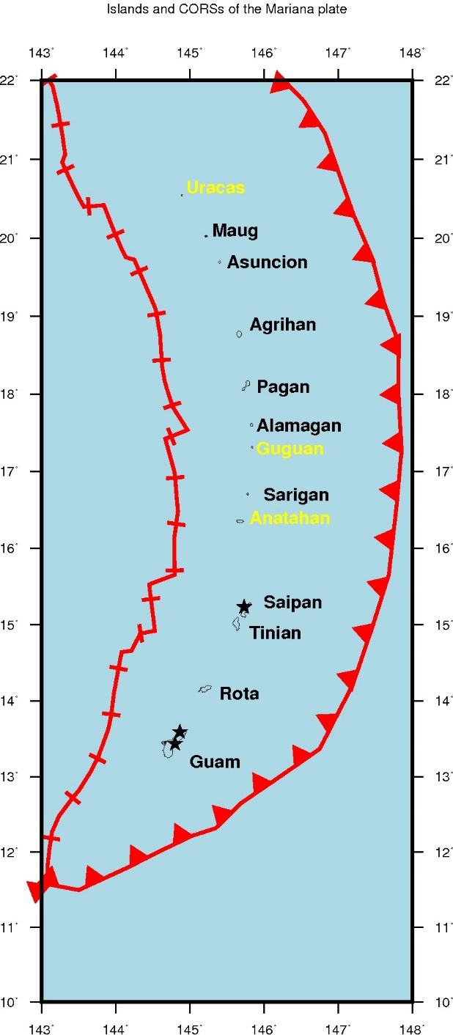
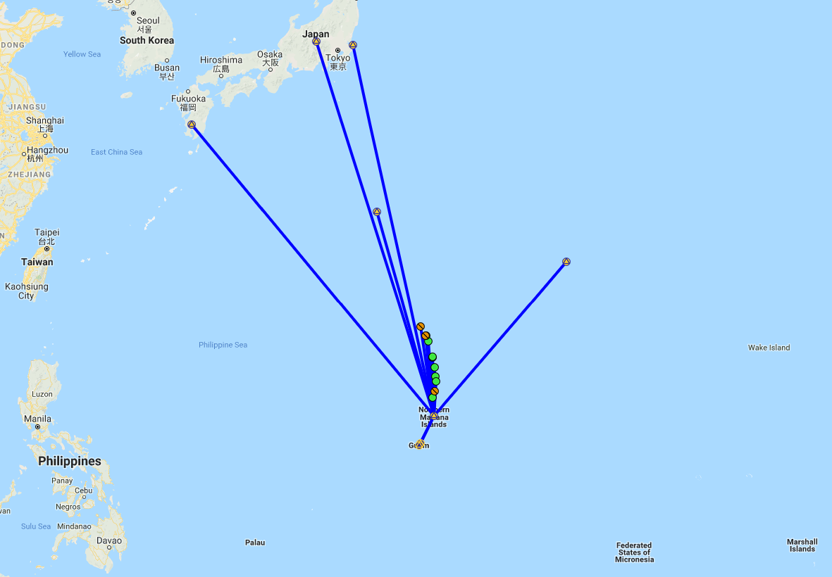
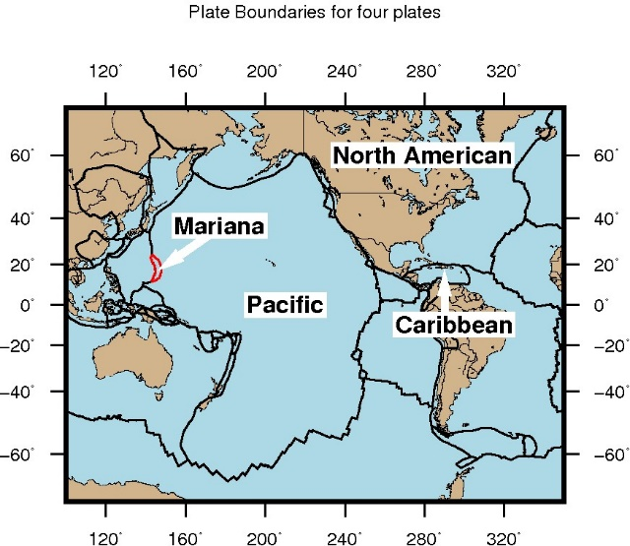
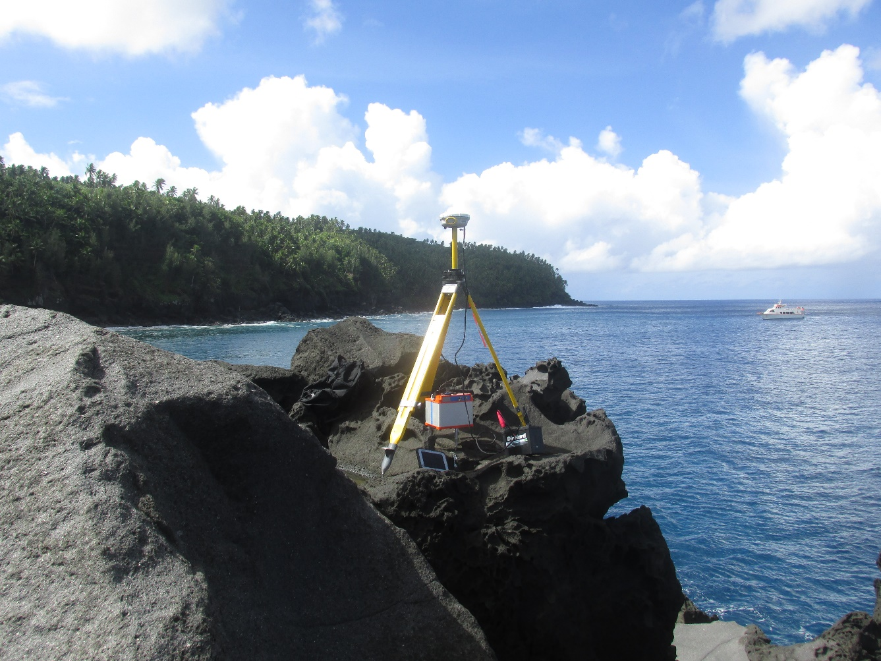
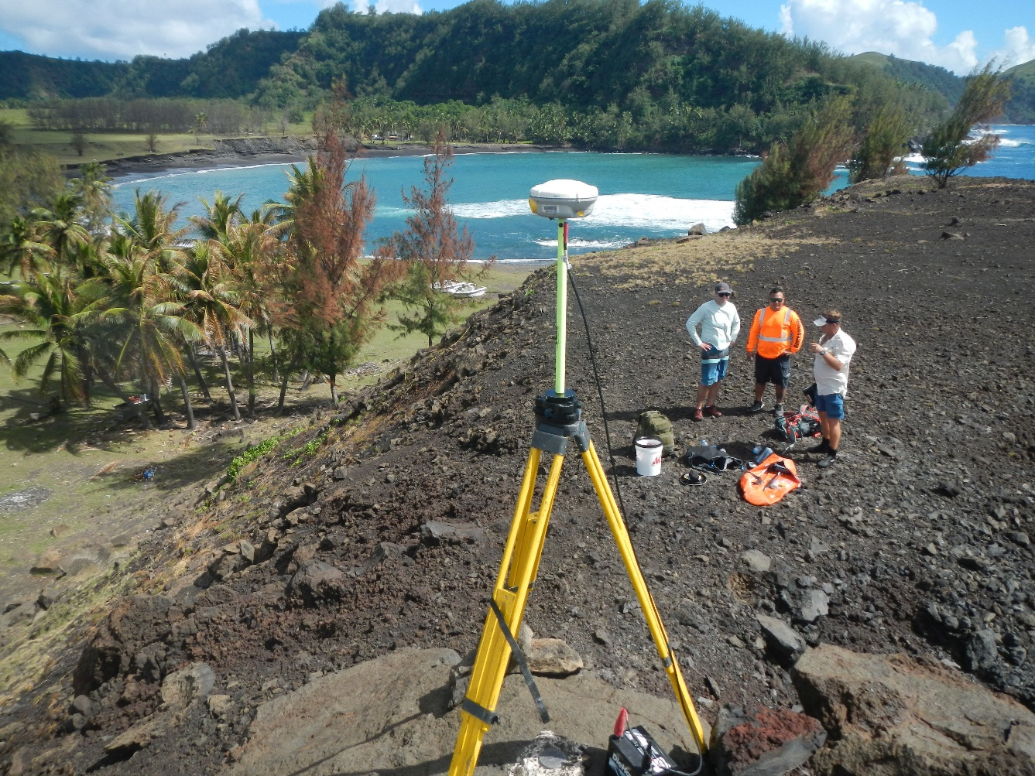
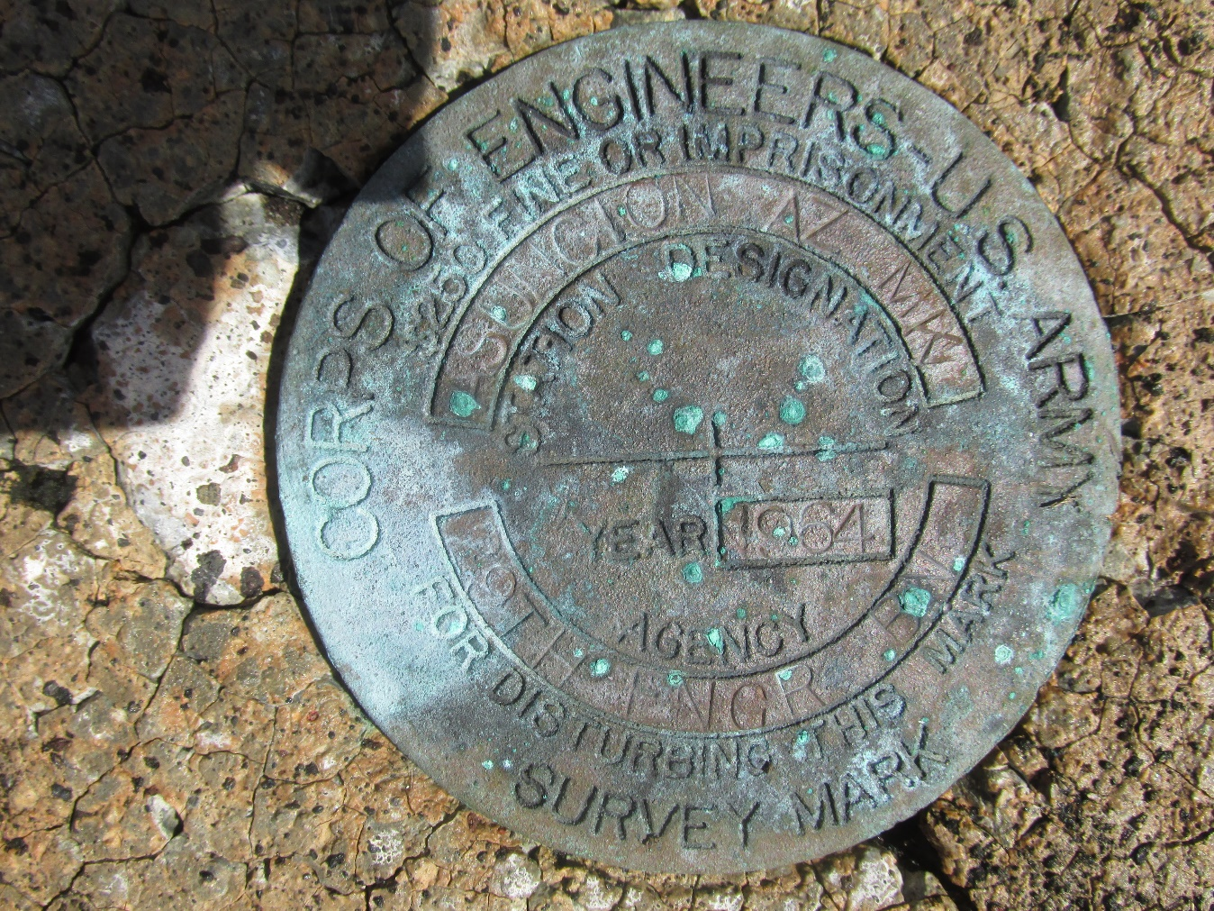
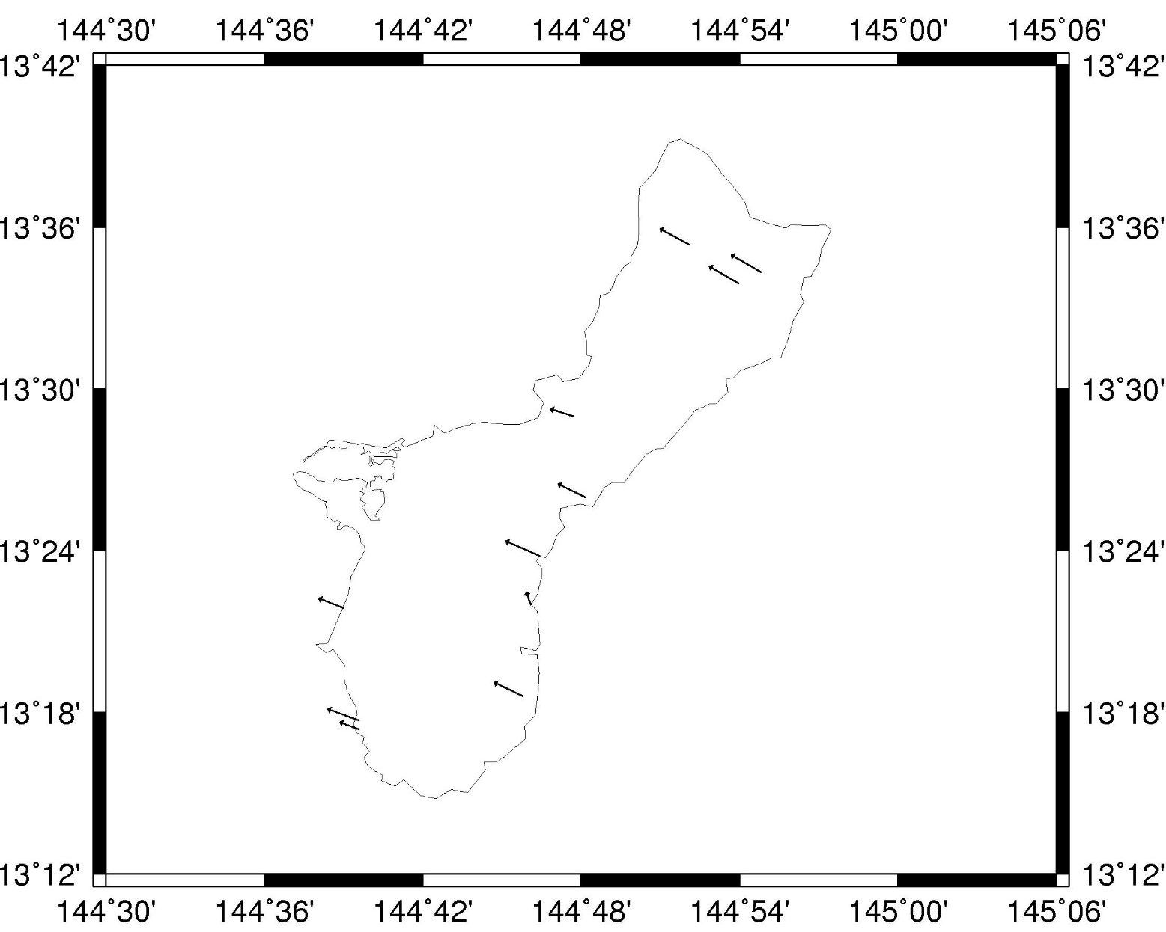
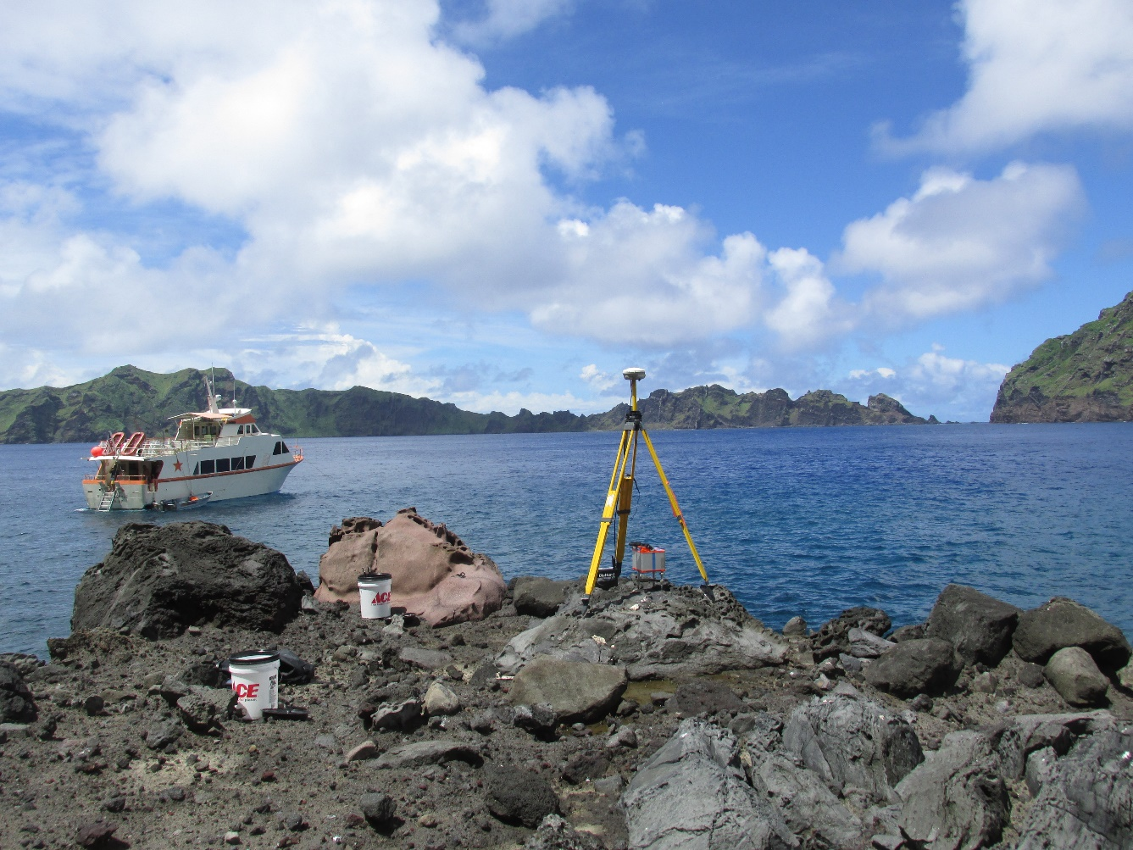
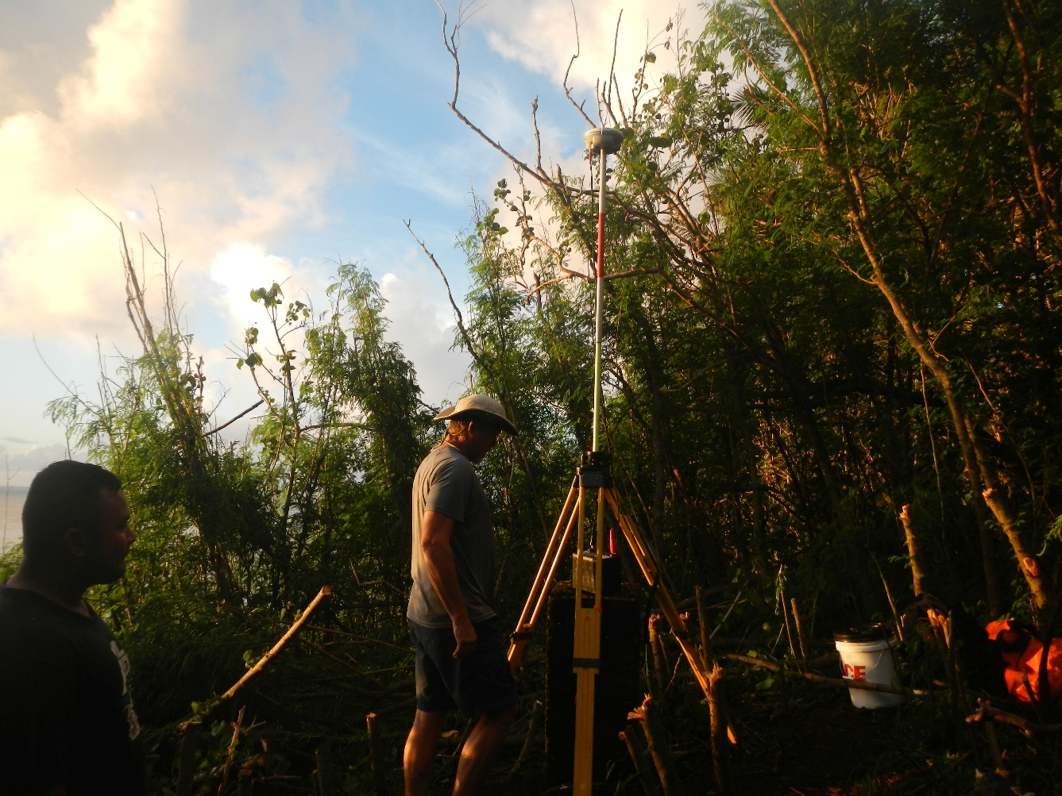
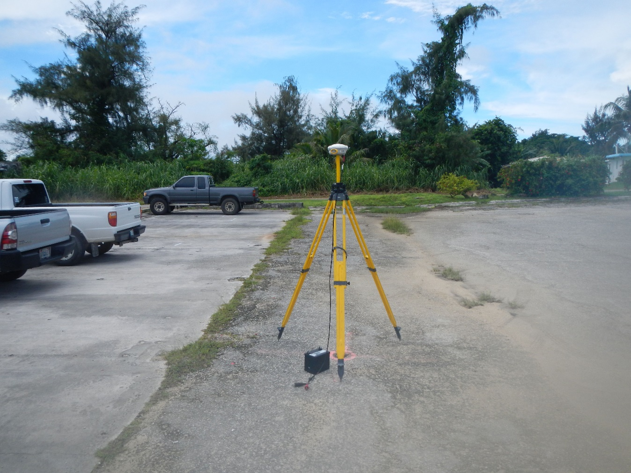
How IGS Products Enabled the Determination of the
Rotational Behavior of the Mariana Tectonic Plate
G43D-2312
DA Smith (dru.smith@noaa.gov)
NOAA / National Geodetic Survey
Dec 13, 2018 AGU Fall Meeting
Abstract
In 2017, the National Geodetic Survey (NGS) performed a GPS survey of 33 passive geodetic control points on ten islands on the Mariana tectonic plate. Of those 33 points, 29 had already been surveyed at least one time in the past by NGS sometime between 1997 and 2013.
The IGS provides a consistent set of station coordinates and orbits, dating back before 1997, which enabled a re-processing of all old and new GPS files to compute mutually consistent time-dependent IGS08 coordinates at the stations. By comparing the old and new coordinates, a set of linear velocities were determined. These 29 velocities were added to three existing CORS-based velocities in the region to determine the Euler pole location and rotation rate of the Mariana plate in the IGS08 frame. This plate rotation model will serve as the mathematical foundation for the upcoming Mariana Terrestrial Reference Frame of 2022 (MATRF2022), part of NGS’s efforts to replace NAD 83 and modernize the NSRS. Without the IGS products, this effort would have been extraordinarily difficult, if not impossible.
A severe lack of data
IGS Products
The underlying requirement which led to this survey and its EPP determination was that all GPS data could be processed in a single reference frame, at the epoch of the observations. Only in that way could it be assured that any coordinate differences would actual be due to true movement of the mark.
The IGS offered just such a frame, with IGS08 coordinates on stations and IGS08 final orbits available back to 1997. Although NGS had some GPS data earlier than 1997, they limited this study to post-1997 GPS so that the use of the IGS08 frame would provide consistency across all data sets, both historic and recent.
Each historic survey was processed in NGS’s software OPUS-Projects, using IGS08 coordinates and IGS08 orbits. Below is one such survey (GPS1837, in 2003).
The 2017 survey was also processed in IGS08, and then coordinate changes were used to infer linear velocities at 29 geodetic control points across 9 islands from Guam through Asuncion. These were combined with the velocities from the four CORSs in The CORS Network for a total of 33 velocities. These velocities were then inverted to determine the Euler Pole Parameters for the Mariana plate. The consistency in velocities was striking, even on Guam where multiple historic surveys existed. This consistency would not have been possible without the IGS, and through it, outliers could be detected and removed.
A paper reporting the results of this study is forthcoming.
One of the primary problems with this plate is the lack of data. Only five continuously operating GNSS reference stations have ever been operated on the plate. Of those five, one is defunct and one is not part of The CORS Network, operated by NGS. All five stations are clustered on only two islands, Guam and Saipan, both of which lie in the southern 1/3 the plate, leaving no continuous GNSS data at all on the northern 2/3 of the plate.
In order to fill that gap in data, a survey was designed and executed by NGS in 2017 to collect GPS data on geodetic control marks which had been occupied at some point in the past by NGS. The intent was to re-process the old GPS data into IGS08 coordinates, compare them with the 2017 data, also in the IGS08 frame, compute linear velocities, and use them to compute the rotational parameters of the Mariana plate.
The image at right shows the islands of the Mariana plate, and the three active CORSs within The CORS Network (black stars). Islands listed in black are those that were visited by NGS sometimes between 1997 and 2017, and where geodetic quality GPS data was collected on at least one geodetic control point. Those islands in yellow have no such historic data.
The best available historic data, to which NGS hoped to compare the 2017 new data was:
Background
The Mariana plate is a “micro plate”, located between the Pacific and Philippine plates. It is one of the four tectonic plates upon which the United States has territory and hosts a substantial civilian population. The other three are the North American plate, the Pacific plate and the Caribbean plate. Each of these tectonic plates will have a reference frame developed by the National Geodetic Survey (NGS) for the 2022 modernization of the National Spatial Reference System (NSRS).
As part of that modernization, each frame will be defined relative to the ITRF2014 reference frame by the three Euler Pole Parameters (EPPs) which define the rotation of the rigid part of each plate in the ITRF2014 frame. Unfortunately, the Mariana plate is so small, with so little data, that the rotation of the plate has rarely been studied. It is not included in the ITRF2014 Plate Motion Model (PMM; Altamimi et al 2017). Only once before has anyone tried to compute the rotation of the plate in an ITRF frame, but that study only used four points (one CORS and three campaign GPS sites, spanning only 7 years (Kreemer et al, 2014)
Shown above are the boundaries of the four tectonic plates for the modernized NSRS. The four reference frames which will be based upon the rotation of the stable part of each of these plates are:
North American Terrestrial Reference Frame of 2022 (NATRF2022)
Pacific Terrestrial Reference Frame of 2022 (PATRF2022)
Caribbean Terrestrial Reference Frame of 2022 (CATRF2022)
Mariana Terrestrial Reference Frame of 2022 (MATRF2022)
Island | Year(s) visited | Total Number of points
Guam | 1997,2004,2007,2013 | 33
Rota | 2003 | 11
Tinian | 2003 | 37
Saipan | 2003 | 11
Sarigan | 2003 | 1
Alamagan | 2003 | 1
Pagan | 2003 | 1
Agrihan | 2003 | 2
Ascuncion | 2003 | 1
Maug | 2003 | 1
The 2017 Survey
NGS carefully collected up historic GPS data and metadata and embarked on a combined GPS and gravity survey of ten of the islands on the Mariana plate in the summer of 2017. The goal was to find 33 of the historic marks, collect GPS data on them, and return. The trip from Saipan to Maug required a charter boat, as the islands north of Saipan are effectively unpopulated wilderness. All marks on the target list were successfully found except the one on Maug, though other existing marks on Maug were found and occupied. In total 33 marks were occupied, of which 29 were points where NGS had historic GPS data somewhere from 4 to 20 years prior to 2017. The photos below highlight the survey.
Collecting GPS and Gravity on Alamagan
Collecting GPS on PAGAN
The Ascuncion
mark was set in
1964
Outliers detected and
removed prior to determining
Euler Pole Parameters
Note consistency between
2 CORS velocities and
the campaign GPS
velocities
Collecting GPS and Gravity on Maug
The jungle of Sarigan!
At least they had roads in Saipan
Bibliography
Kreemer, C., G. Blewitt and E.C. Klein (2014) A geodetic plate motion and Global Strain Rate Model. Geochemistry, Geophysics, Geosystems 15: 3849-3889.
Altamimi, Z., P. Rebischung, L. Metivier, and X. Collilieux (2016) ITRF2014: A new release of the International Terrestrial Reference Frame modeling nonlinear station motions. Journal of Geophysical Research: Solid Earth 121: 6109-6131. doi:10.1002/2016JB013098.

