Slide 1
Modernizing the National Spatial Reference System
Dru Smith
NSRS Modernization Manager
NOAA’s National Geodetic Survey

Slide 2
“Modernizing the NSRS” means…
Replacing NAD 83
Replacing NAVD 88
Re-inventing Bluebooking
Improving the Geodetic Toolkit
Better Surveying Methodologies
Notes:
There are actually 3 “NAD 83”s, NAD 83(2011), NAD 83(PA11) and NAD 83(MA11)
There are also many more vertical datums than NAVD 88 in the NSRS, each one for specific states or territories that have no line of sight to CONUS/Alaska

Slide 3
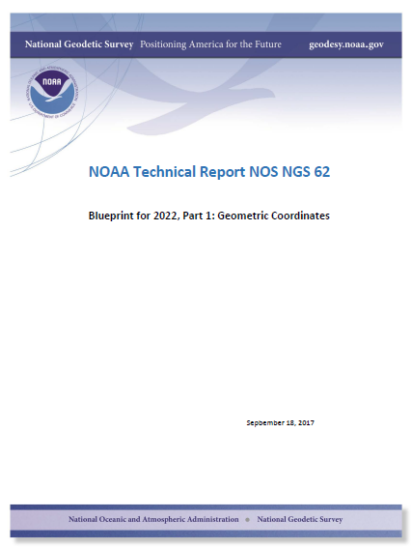
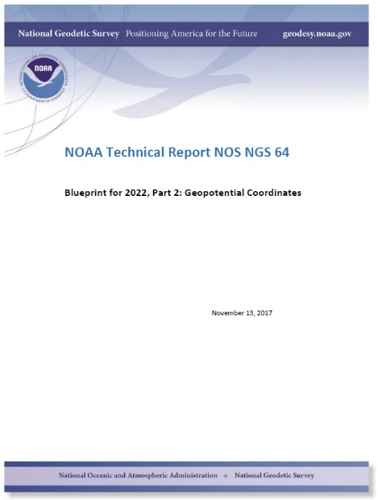
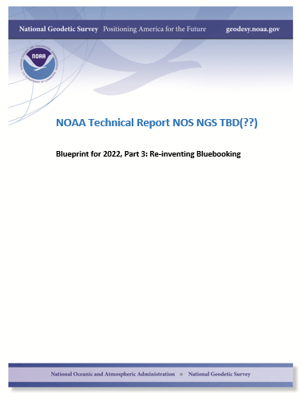
Modernizing the NSRS
The “blueprint” documents: Your best source for information
Geometric:
May 2017
(minor update Sep 2017)
Geopotential:
Nov 2017
Using the new frames/datum:
Sep(?) 2018

Slide 4
Latitude, Longitude
& Ellipsoid Heights

Slide 5
Replacing the NAD 83’s
The Old:
NAD 83(2011)
NAD 83(PA11)
NAD 83(MA11)
The New:
The North American Terrestrial Reference Frame of 2022
(NATRF2022)
The Caribbean Terrestrial Reference Frame of 2022
(CATRF2022)
The Pacific Terrestrial Reference Frame of 2022
(PATRF2022)
The Mariana Terrestrial Reference Frame of 2022
(MATRF2022)

Slide 6
Replacing the NAD 83’s
Three plate-(pseudo)fixed frames will be replaced with four plate-fixed reference frames
N. Amer., Pacific, Mariana, Caribbean(new!)
Fixed: NAD 83 isn’t geocentric
Fixed: NAD 83 doesn’t rotate properly with its plates
Method: Define each of the 4 new frames equal to IGS14 @ 2020
Define each frame’s movement by a plate rotation only
Put another way: “The frame rotates so your coordinates don’t have to”

Slide 7
The relation of five global reference
frames through time.
NATRF2022
MATRF2022
Rotations are not to scale
CATRF2022
Rotation of North American Plate
PATRF2022
Rotation of Pacific Plate
IGS frame
IGS frame through time
IGS frame
Rotation of Caribbean Plate
PATRF2022
CATRF2022
Rotation of Mariana Plate
NATRF2022
Time “t ” when
all four TRFs and the
IGS are identical.
(maybe 2020.0?)
MATRF2022
0
t=t - Δt
(“the past”)
t=t + Δt
(“the future”)
0
0

Slide 8
What does it mean to provide time-dependent coordinates in 5 frames?

Slide 9
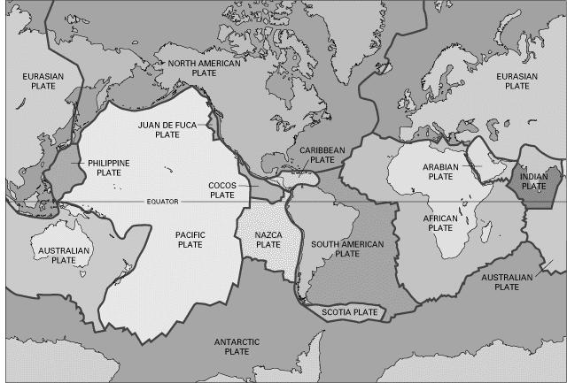
BSMK (North Dakota)

Slide 10
BSMK (North Dakota)
NATRF2022 Latitude is CONSTANT over time
Let’s set t to 2005.0 for now…
0

Slide 11
BSMK (North Dakota)
NATRF2022 Longitude is constant over time

Slide 12
BSMK (North Dakota)
No matter WHAT frame, the ellipsoid height is dropping over time

Slide 13
PIN1 (S. California)

Slide 14
PIN1 (S. California)
Latitude in NATRF2022 and PATRF2022 change over time

Slide 15
PIN1 (S. California)
Longitude in NATRF2022 and PATRF2022 change over time

Slide 16
PIN1 (S. California)
No matter WHAT frame, the ellipsoid height is rising over time

Slide 17
Orthometric Heights
(“Sea Level Heights”) and other
gravity-related quantities

Slide 18
Replacing NAVD 88
The Old:
NAVD 88
PRVD 02
VIVD09
ASVD02
NMVD03
GUVD04
IGLD 85
IGSN71
GEOID12B
DEFLEC12B
Orthometric
Heights
The New:
The North American-Pacific Geopotential Datum of 2022 (NAPGD2022)
- Will include GEOID2022
Normal
Orthometric
Heights
Dynamic
Heights
Gravity
Geoid
Undulations
Deflections of
the Vertical

Slide 19
Geopotential Basics
Why isn’t this a vertical datum?
Because it contains more than heights
And therefore NGS wants to be accurate in its name

Slide 20
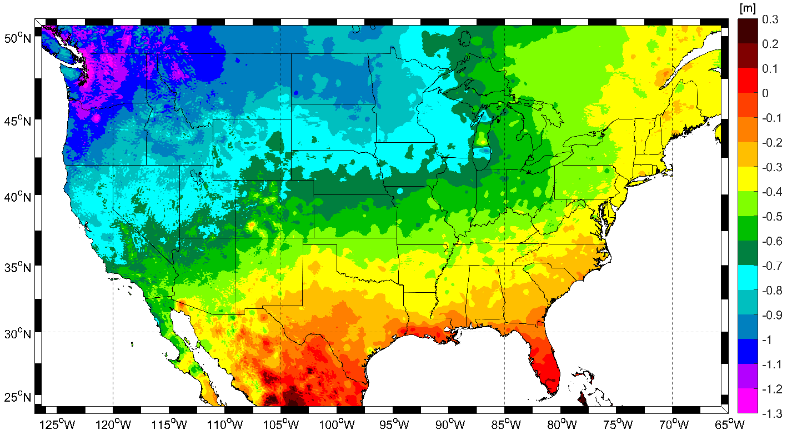
Expected changes to orthometric heights

Slide 21
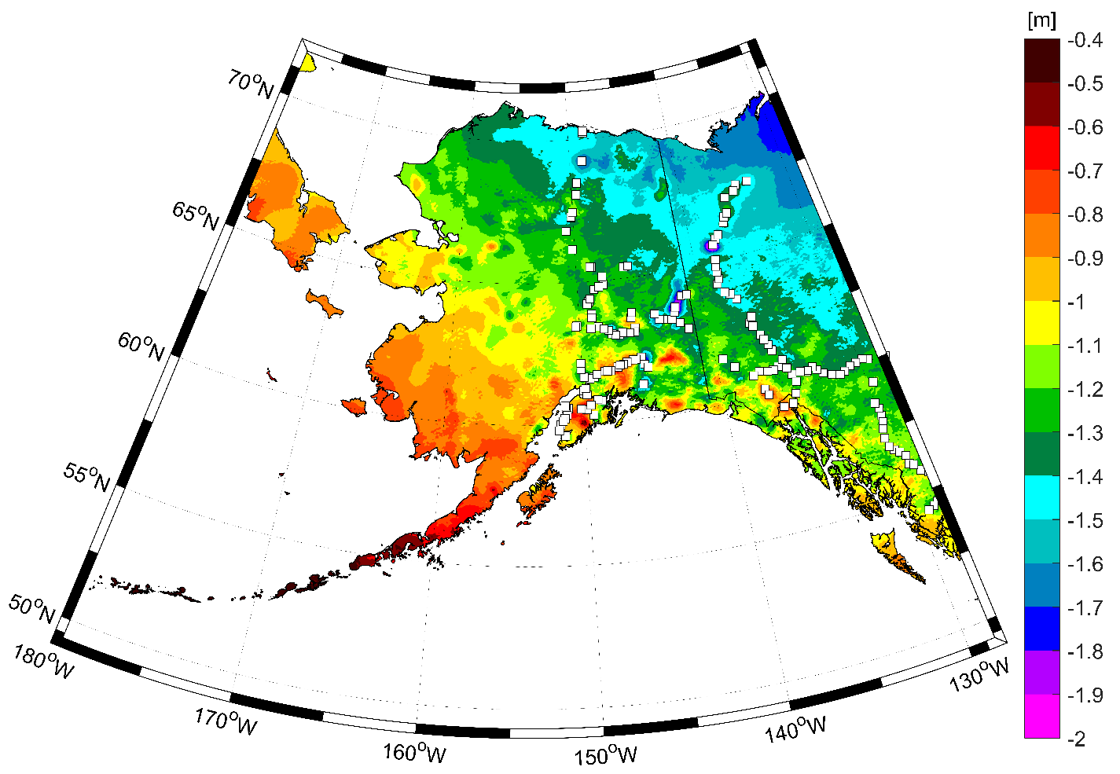
Expected changes to orthometric heights

Slide 22
Definitional Relationship
$H_{NAPGD2022}(t)≡h_{∗TRF2022}(t)−N_{GEOID2022}(t)$
Time-dependent ellipsoid heights
come from time-dependent
CORS coordinates which serve as control for
your time-dependent GNSS survey.
They will be modeled in the IFVM
Time-dependent geoid undulations
are modeled in the dynamic component
of GEOID2022 (“DGEOID2022”), which
will come from the geoid monitoring
service, or GeMS.

Slide 23
Geoid Monitoring Service
Goal: Track all changes to the geoid which would prevent 1 cm accuracy
Three major aspects:
Secular Shape: Hudson Bay
Episodic Shape: Massive Earthquakes
Geoid relation to Sea level: Global Sea Level Change

Slide 24
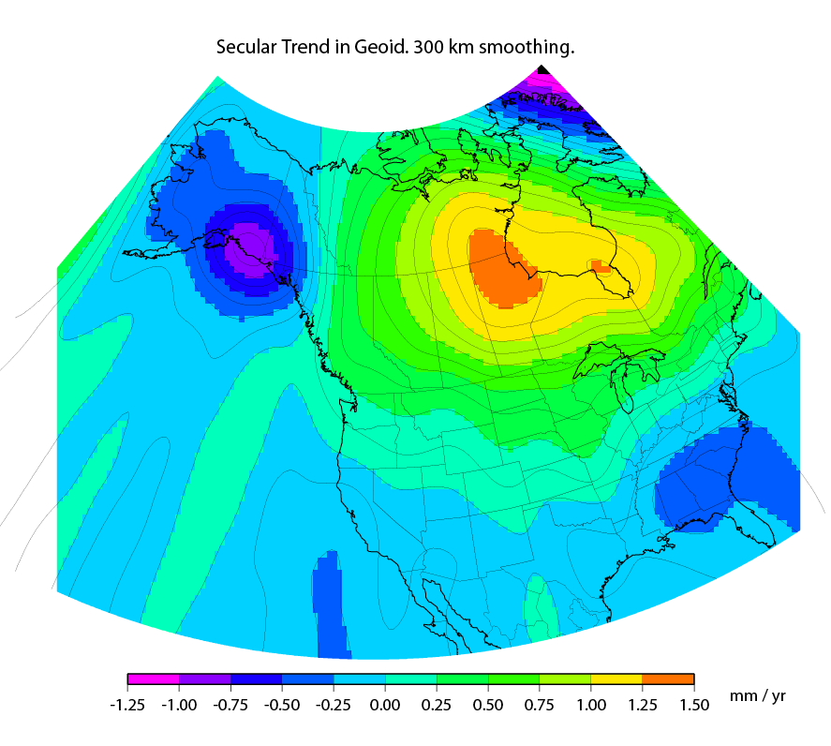
Secular Mass Movement
Notes:
There are two manifestations of the growing mass in the deep mantle under Hudson Bay:
Geometric – a GPS receiver will see the crust uplifting as the increase in mantle mass pushes the crust up in a displacement.
Geopotential – a gravimeter on the surface will sense the growing mass as an increase in the acceleration of gravity, BUT this will be slightly tempered by a reduction in gravity as well (because the gravimeter on the surface is getting farther from the Earth’s center). Still, the gain (from mass increase) is larger than the loss (from geometric movement) for a net gain. Because the net gain in gravity is not caused purely by being at a new crustal height, this translates into an increase in geoid undulations, or a “swelling” of the geoid in this region.
This is different than a purely geometric change caused by a compression of the crust. In that case, no significant mass is entering or leaving the region so, while GPS might sense a subsidence and a surface gravimeter might sense a slight increase as it moves closer to the Earth’s center, the geoid would not actually change.

Slide 25
High resolution products
GEOID2022
Official converter of *TRF2022 ellipsoid heights into NAPGD2022 orthometric heights
DEFLEC2022
Surface deflections of the vertical in N/S and E/W
GRAV2022
Surface acceleration of gravity
DEM2022
Official DEM used in creation of all above products
All will be 1 x 1 arcminute grids
All will cover three finite regions of the globe
All will have a static and dynamic component
Dynamic surface gravity and DEM not expected to be ready by 2022

Slide 26
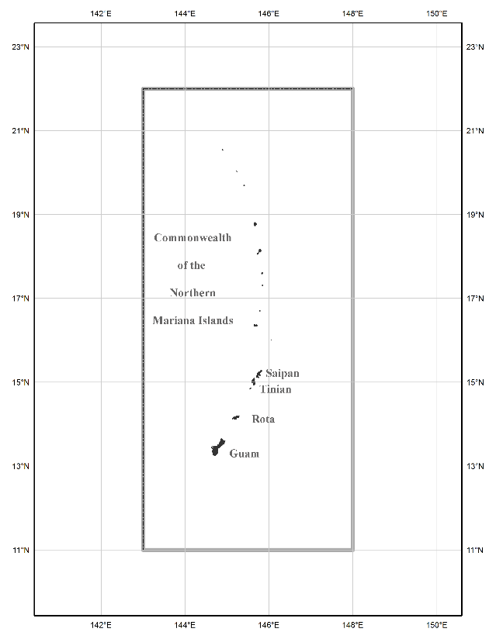
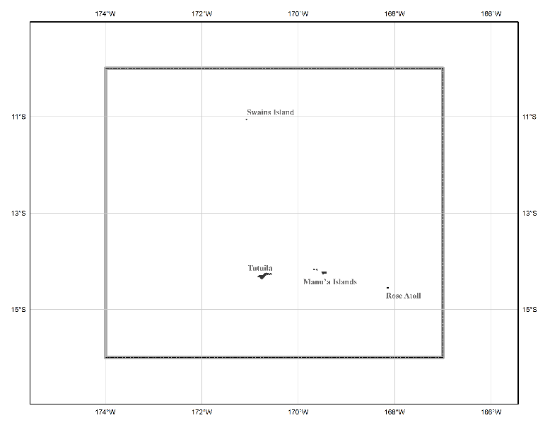
The three gridded regions
“North American region”
¼ of the Earth
“American Samoa region”
“Guam/CNMI region”

Slide 27
Converting NAD 83 and NAVD 88
geospatial data into
NATRF2022/PATRF2022/CATRF2022/MATRF2022
and NAPGD2022

Slide 28
Two options: NCAT and VDatum
Currently semi-independent programs
Being merged behind the scenes when calling identical routines, such as “NADCON 5.0”
NCAT will remain “purely geodetic”
VDatum will be “NCAT plus tidal datums”
Both will get “VERTCON 3.0” in late 2018
Both will run in 3 modes:
Web services, Browser interactive, Downloadable

Slide 29
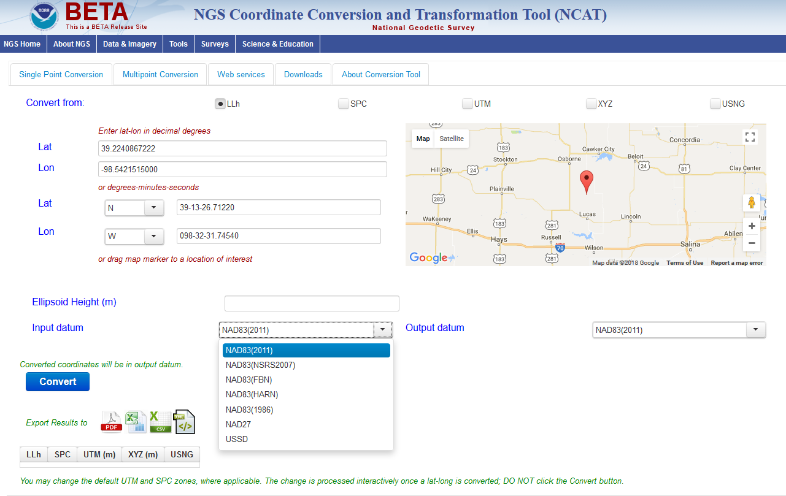
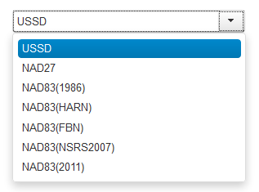
NGS Coordinate Conversion and Transformation Tool (NCAT)
Now with
NADCON 5!
beta.ngs.noaa.gov/NCAT/

Slide 30
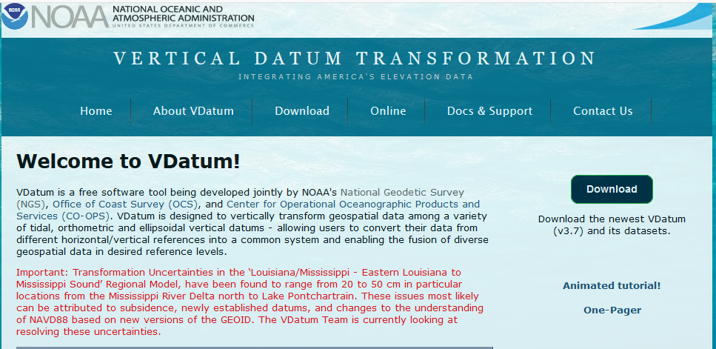
VDatum
vdatum.noaa.gov

Slide 31
Thank you!

Slide 32
Questions?

Slide 33
Extra Slides

Slide 34
So much more…
OPUS-Projects being expanded to replace Bluebooking
Leveling, RTK, Gravity
An entire new database being built
All historic GPS data back to 1997 being reprocessed into the TRFs
A new leveling manual to work in a GPS/geoid “vertical datum”

Slide 35
So much more…
VERTCON 3 under construction
More GIS friendly products, services and tools being built
Replacement for NGS 58 (“GPS derived ellipsoid heights”) manual nearly complete

Slide 36
NAD 83 (2011)
Allowable Regions:
CONUS
Alaska
Hawaii
PR/VI
AS
Guam/CNMI
St. Paul
St. George
St. Lawrence
Notes:
φ, λ, h
xyz2plh
plh2xyz
SPC83
a,f (GRS 80)
NAD 83
X, Y, Z
SPC
USNG
NAD 83
UTMS
a,f (GRS 80)
USNG
UTM
USNG
NAD 83

Slide 37
X, Y, Z
φ, λ, h
φ, λ, h
Region: CONUS
NADCON 5 connections in RED
2022
X, Y, Z
SPC
UTM
USSD
USNG
UTM
φ, λ, h
φ, λ, h
NAD 27
NAD 83 (2011)
X, Y, Z
SPC
X, Y, Z
SPC
USNG
UTM
USNG
UTM
NAD 83 (NSRS2007)
φ, λ, h
NAD 83 (1986)
φ, λ, h
NAD 83 (FBN)
NAD 83 (HARN)
φ, λ, h
X, Y, Z
SPC
X, Y, Z
SPC
φ, λ, h
USNG
UTM
USNG
UTM
X, Y, Z
SPC
X, Y, Z
SPC
USNG
UTM
USNG
UTM

Slide 38
Intra-frame velocity model
Shown on this slide are CORS-implied velocities after removing the rotation of the
North American plate. NATRF2022 coordinates will change through time by these
amounts. These time-dependent changes will be captured in the IFVM.
Note scale difference between West (10 mm/yr) and east (2 mm/yr)

Slide 39
A simple IFVM model is applied…
The simplest IFVM is already available: Interpolation of 3-D velocities from CORS stations
Removing this simple IFVM resolves nearly all velocities seen in the previous slide
Eastern CONUS will largely be resolved
Western CONUS has some anomalies
NGS is engaged in research to provide the highest quality IFVM without our abilities, possibly enveloping:
InSAR
Geodynamic

Slide 40
Episodic Mass Movement
M9.2 -> Geoid change of 1.5 cm
Notes:
Rare, but worth monitoring, large earthquakes or volcanic eruptions can move enough mass locally to cause the geoid to make a permanent local shift.

Slide 41
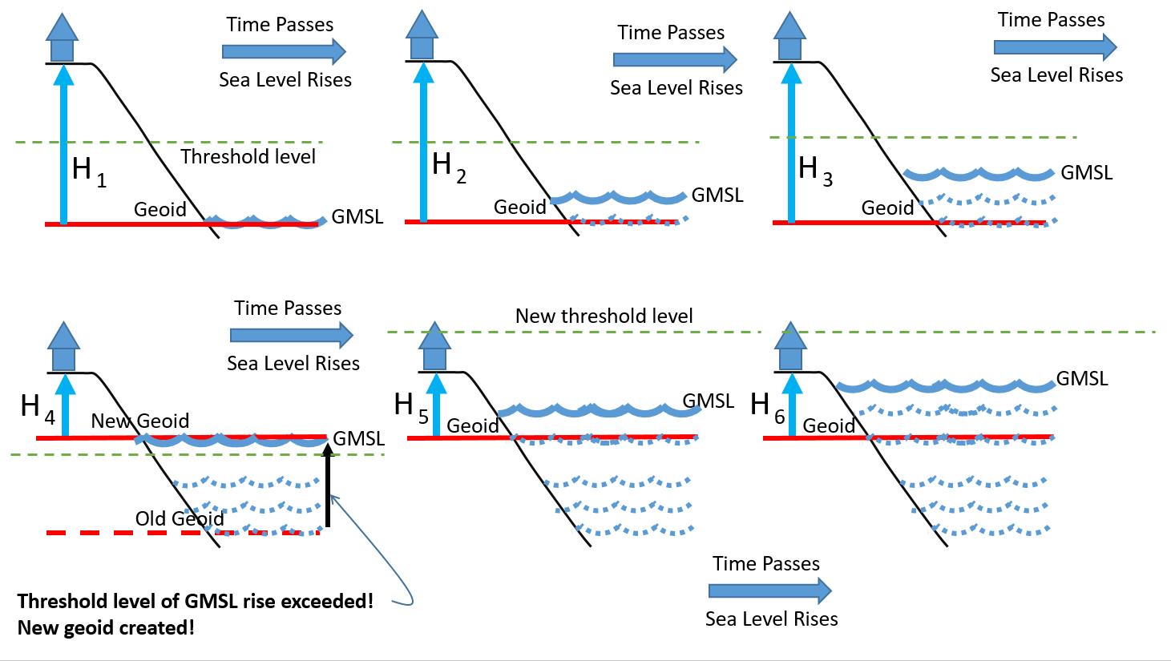
Choosing a new geoid as GMSL changes

Slide 42
Plate-(pseudo)fixed frames
NAD 83(2011) minus NAD 83(NSRS2007)
NAD 83(NSRS2007)
Epoch 2002.0
NAD 83(2011)
Epoch 2010.0
If NAD 83 were truly “plate
fixed” then an 8 year
epoch change would not
yield the systematic
plate rotation seen here.
(*)TRF2022 will determine
a new Euler Pole rotation
for each of 4 plates.
(*)=NA, C, T or P

Slide 43
NAD 83’s non-geocentricity
Earth’s Surface
h_{NAD83}
φ_{NAD83} – φ_{IGSxx}
λ_{NAD83} – λ_{IGSxx}
h_{NAD83} – h_{IGSxx}
all vary
smoothly by latitude
and longitude
h_{IGSxx}
IGSxx origin
same
GRS-80
ellipsoid
~2.2 m
NAD 83 origin

Slide 44
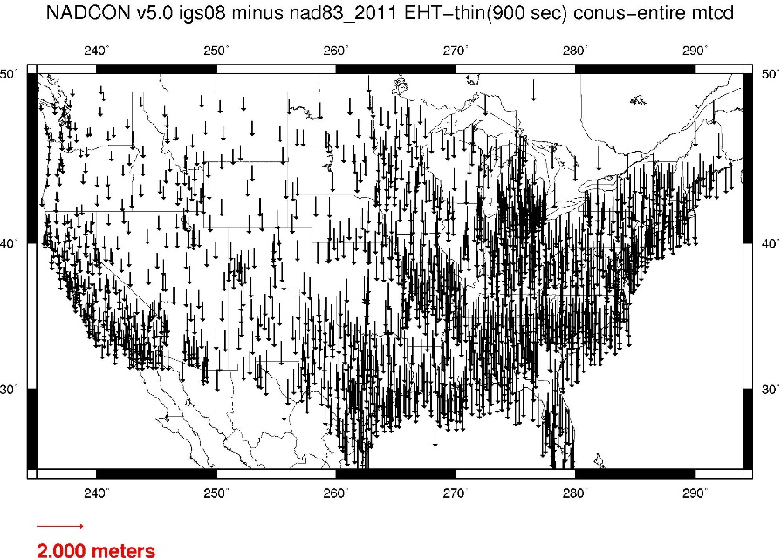
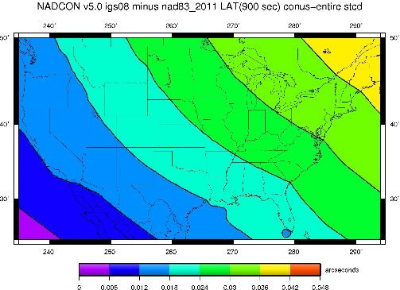
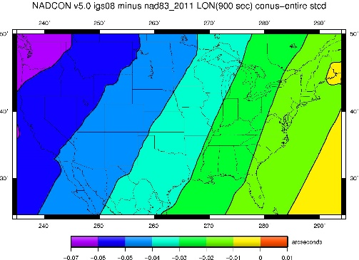
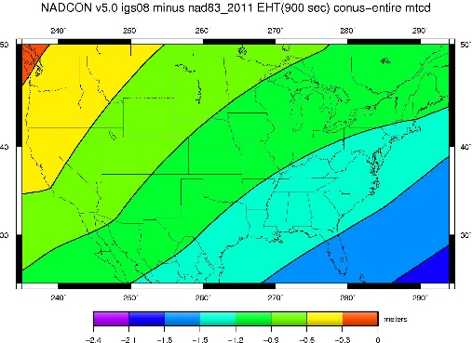
Fixed-Epoch Transformation NAD 83 to “2022”

Slide 45
ICT2 (Kansas)

Slide 46
ICT2 (Kansas)
Note the time-dependent movement of this Kansas point in latitude in NATRF2022! Such movement will be captured in the IFVM.

Slide 47
ICT2 (Kansas)
However, in longitude, this CORS is fairly stable in NATRF2022! Still, any deviation from stability would be in the IFVM.

Slide 48
ICT2 (Kansas)
All vertical motion is captured in the IFVM.

Slide 49
PRMI (Puerto Rico)

Slide 50
PRMI (Puerto Rico)

Slide 51
PRMI (Puerto Rico)

Slide 52
PRMI (Puerto Rico)

Slide 53
BRW1 (N. Alaska)

Slide 54
BRW1 (N. Alaska)

Slide 55
BRW1 (N. Alaska)

Slide 56
BRW1 (N. Alaska)

Slide 57
KOD6 (S. Alaska)

Slide 58
KOD6 (S. Alaska)

Slide 59
KOD6 (S. Alaska)

Slide 60
KOD6 (S. Alaska)

Slide 61
KOK5 (Hawaii)

Slide 62
KOK5 (Hawaii)

Slide 63
KOK5 (Hawaii)

Slide 64
KOK5 (Hawaii)

Slide 65
ASPA (Am. Samoa)

Slide 66
ASPA (Am. Samoa)

Slide 67
ASPA (Am. Samoa)

Slide 68
ASPA (Am. Samoa)

Slide 69
ASPA (Am. Samoa)

Slide 70
Mariana rotation
Snay (2003) used only one CORS (“GUAM”) to determine the Mariana rotation
But 2 sites at a minimum are needed to uniquely determine a plate’s rotation
“CNMI” (since decommissioned) was forced to equal “GUAM” to solve the problem
Ill-posed, yet the values behave reasonably for GUAM.
Less reasonable for newer CORS “CNMR”

Slide 71
GUAM (Guam)

Slide 72
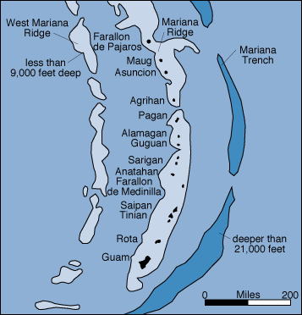
GUAM (Guam)

Slide 73
GUAM (Guam)

Slide 74
GUAM (Guam)

Slide 75
GUAM (Guam)

Slide 76
CNMR (CNMI)

Slide 77
CNMR (CNMI)

Slide 78
CNMR (CNMI)

Slide 79
CNMR (CNMI)

Slide 80
CNMR (CNMI)

Slide 81
Each frame will get 3 parameters
Euler Pole Latitude
Euler Pole Longitude
Rotation rate (radians / year)
This will be used to compute
time-dependent TRF2022
coordinates from time-dependent
IGS coordinates.

Slide 82
Time-Dependencies as a service: NATRF2022 and actual survey epochs
NAD 83 forcibly combined data spanning many years (using HTDP with no vertical modeling) to compute and find one height at one epoch.
NATRF2022 will compute coordinates at survey epoch to show actual motion.
Even gridding surrounding CORS yields better subsidence rates than you have today.
NAD 83 best estimate of dh/dt: +2.8 mm / year
NATRF2022 best estimate of dh/dt: -4.2 mm / year
CORS best estimate of dh/dt: -2.2 mm / year
Notes:
Potential outline and speaker assignments; can be adjusted as needed.

Slide 83
Time Dependencies as a service: Intra-plate motions

Slide 84
So…what is “Geopotential”
Geo: Earth
Potential: Gravity Potential Energy
Geopotential: Gravity Potential Energy Field that surrounds the Earth.

Slide 85
Surely you remember this page from your high school physics textbook?
For example: Choosing
which “W ” value is “the geoid”
0

Slide 86
Gravity vs Gravitation
Warning: Getting in the weeds…
Q: But you said “Gravity” potential energy, yet that textbook said “Gravitational” potential energy…
A: Very observant!
Gravitation: Masses attracting each other
Gravity: Gravitation plus Centrifugal
Gravity is what we actually feel on a rotating planet

