Slide 1
BETA OPUS-Projects: The Next Generation of OPUS-Projects
September 13, 2018
Mark Schenewerk
mark.schenewerk@noaa.gov
816-994-3067

Slide 2
Overview of this webinar.
5 min : OPUS-Projects in five minutes.
20 min : Motivation for and background of BETA OPUS-Projects.
25 min : Submission outline and BETA OPUS-Projects tips.
September 13, 2018
BETA OPUS-Projects: The Next Generation of OPUS-Projects

Slide 3
Tip 0
The BETA OPUS-Projects gateway web page URL is: https://beta.ngs.noaa.gov/OPUS-Projects/
There is no formal training for BETA OPUS-Projects yet - that is another group's task and they’re preparing that material now - however, a “Quick-start Introduction to BETA OPUS-Projects” video (mp4) is available. It’s about 3½ hours in length and includes a “live” demo. The URL for the video is: ftp://ftp.ngs.noaa.gov/pub/corbin/Beta OPUS Projects webinar material/
September 13, 2018
BETA OPUS-Projects: The Next Generation of OPUS-Projects

Slide 4
OPUS-Projects in five minutes.
September 13, 2018
BETA OPUS-Projects: The Next Generation of OPUS-Projects

Slide 5
The BETA OPUS-Projects gateway webpage.
OPUS-Projects gives users web-based access to simple management and processing tools for GPS survey projects involving multiple occupations of multiple marks.
September 13, 2018
BETA OPUS-Projects: The Next Generation of OPUS-Projects

Slide 6
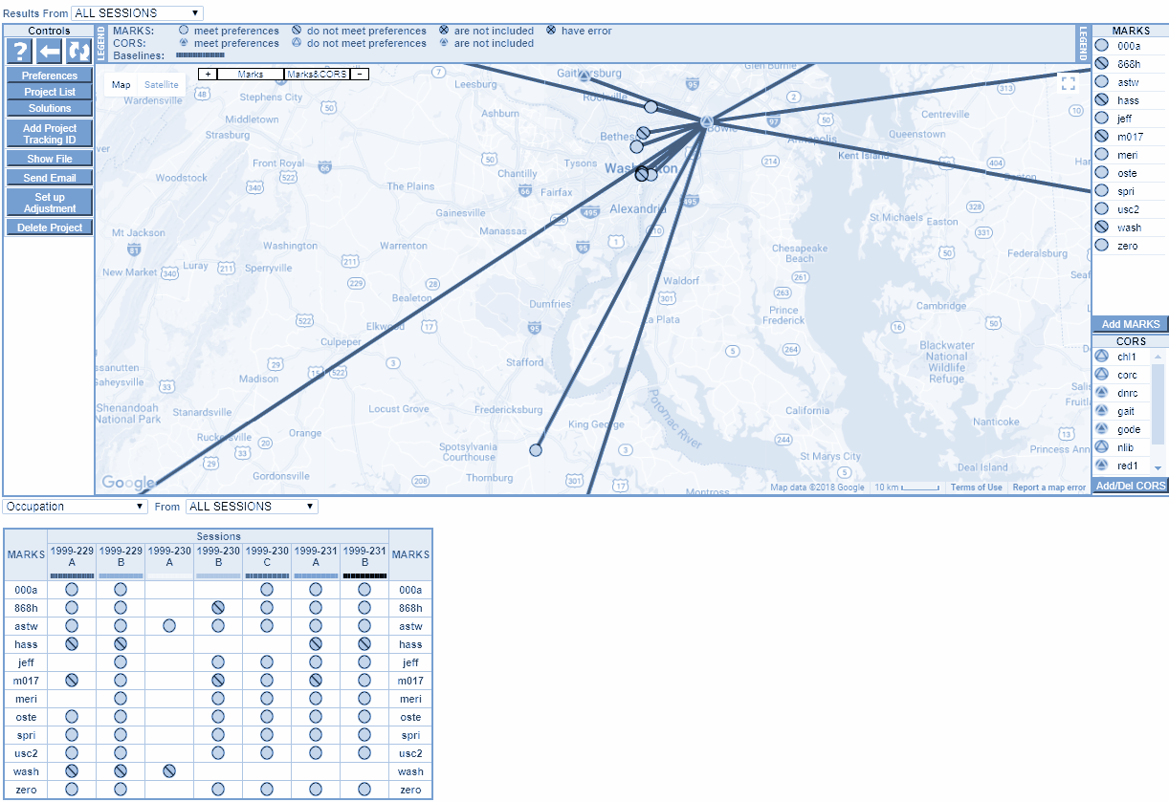
A survey project’s manager web page. (1 of 2)
When you access the web pages for your survey project, OPUS-Projects offers friendly and intuitive graphical user interfaces (GUIs) built around interactive maps.
September 13, 2018
BETA OPUS-Projects: The Next Generation of OPUS-Projects

Slide 7
A survey project’s manager web page. (2 of 2)
It displays results in graphs and tables using icons and colors as quality control cues thereby providing quick, visual summaries of your project’s status and its processing results.
September 13, 2018
BETA OPUS-Projects: The Next Generation of OPUS-Projects

Slide 8
What OPUS-Projects can do for you.
Data uploading through OPUS.
Visualization and management aids.
Customizable data processing via the PAGES software suite.
Tasks are mostly or completely automated meaning:
You don’t need to know how to download, maintain or run programs or even what programs need to be run.
You don’t need to know about the minutiae of ephemerides and reference frames and geophysical models.
And now, with BETA OPUS-Projects, if you choose to do so, it simplifies the process of submitting results for publication.
September 13, 2018
BETA OPUS-Projects: The Next Generation of OPUS-Projects

Slide 9
What OPUS-Projects won’t do for you.
OPUS-Projects does not make a project plan obsolete.
OPUS-Projects does not make field logs obsolete.
OPUS-Projects does not make mark descriptions obsolete.
OPUS-Projects does not make mark photos obsolete.
OPUS-Projects does not make obstructed marks GNSS-able.
OPUS-Projects does not make bad data good.
OPUS-Projects does not make processing decisions as well as you.
OPUS-Projects does not quality control results as well as you.
September 13, 2018
BETA OPUS-Projects: The Next Generation of OPUS-Projects

Slide 10
Motivation for and background of BETA OPUS-Projects.
September 13, 2018
BETA OPUS-Projects: The Next Generation of OPUS-Projects

Slide 11
Steps to prepare a submission. (1 of 4)
Plan project then request a project tracking number.
Perform survey:
data files
photos
descriptions
etc.
Process data using vendor or third-party software.
Construct bluebook files using software and editor.
Run ADJUST.
Review and publish to IDB.
September 13, 2018
BETA OPUS-Projects: The Next Generation of OPUS-Projects

Slide 12
Steps to prepare a submission. (2 of 4)
Plan project then request a project tracking number.
Perform survey:
data files
photos
descriptions
etc.
Process data using vendor or third-party software.
Construct bluebook files using software and editor.
Run ADJUST.
Review and publish to IDB.
For many of you, these steps are your job: to design and complete surveys.
September 13, 2018
BETA OPUS-Projects: The Next Generation of OPUS-Projects

Slide 13
Steps to prepare a submission. (3 of 4)
Plan project then request a project tracking number.
Perform survey:
data files
photos
descriptions
etc.
Process data using vendor or third-party software.
Construct bluebook files using software and editor.
Run ADJUST.
Review and publish to IDB.
But these steps might seem daunting:
Prepare your data for your vendor’s or some other third-party software, learn to use that software and understand how best to do so.
Prepare the results for a submission, learn to use the NGS software and understand how best to do so.
September 13, 2018
BETA OPUS-Projects: The Next Generation of OPUS-Projects

Slide 14
Steps to prepare a submission. (4 of 4)
Plan project then request a project tracking number.
Perform survey:
data files
photos
descriptions
etc.
Process data using vendor or third-party software.
Construct bluebook files using software and editor.
Run ADJUST.
Review and publish to IDB.
NGS tries to simplify these last two steps using BETA OPUS-Projects:
automating most of the tasks.
streamlining data processing.
displaying visual quality control cues.
performing most of the required formatting of results. A.K.A. bluebooking.
September 13, 2018
BETA OPUS-Projects: The Next Generation of OPUS-Projects

Slide 15
The elephant in the room.
bluebook [bloo bo͝ok] noun The NGS Bluebook is a set of strongly structured data formats. While its origins go back to the late 1970s and early 1980s, it has been updated and adapted to changes in technology over the years.
bluebooking [bloo bo͝okiNG] verb To format surveying results following the NGS Bluebook specifications for submission to the Integrated Database (IDB).
September 13, 2018
BETA OPUS-Projects: The Next Generation of OPUS-Projects

Slide 16
Bluebooking has been integral to NGS tasks.
Bluebooking is inseparably connected to the IDB.
Pros
It has been the standard for submissions to the IDB for decades.
There are programs tailored specifically to these formats.
Folks who use it are used to it.
It has served its purposes very well.
Cons
It uses 1960’s technology.
Its detail and complexity are intimidating.
It is time intensive to create the files.
It is difficult if not impossible to adapt for the future.
September 13, 2018
BETA OPUS-Projects: The Next Generation of OPUS-Projects

Slide 17
A bluebook file format example: the b-file.
000010*AA*HZTLOBS NGS NATIONAL GEODETIC SURVEY 20130114
000020*10*BOUNDARY MON STRICKLAND NC SC HEIGHT MODERNIZATION 2013 (OP: gps2912f)
000030*12*201301201301MS MARK SCHENEWERK 4NCAA
000040*13*NAD 83(2011) GRS 80 63781370002982572221
000050*25*0001R0143ABLUFMS 004 003
000060*26*BB 0143A -> OP 2013-014-A
000070*27*00011301141641 2000
000080*27*00011301142001 2000
⋮
001900*70*007055 Trimble NavigationDUAL CARRIER PHASE PPSNETR5 4742K10896
001910*70*008055 Trimble NavigationDUAL CARRIER PHASE PPSNETR5 4744K11096
001920*70*009055 Trimble NavigationDUAL CARRIER PHASE PPSNETR5 4829K57356
001930*72*001 AOAD/M_T NONE KW5-0201
001940*72*010 TRM57971.00 NONE 30973141
001950*72*011 TRM57971.00 NONE 30976660
⋮
002040*80*0001BLUFF 34173468578N079034455052W NC
002050*86*0001 20756G N88 -338086 -13052A ANAD_83(2011)
002060*80*0002BOUNDARY MON STRICKLAND NC SC 34173269930N079034661580W NC
002070*86*0002 20728G N88 -338076 -13071A ANAD_83(2011)
002080*80*0004GUY 34164773356N078595524668W NC
⋮
September 13, 2018
BETA OPUS-Projects: The Next Generation of OPUS-Projects

Slide 18
Bluebooking is on the way out.
Both bluebooking and the IDB will be replaced in preparation for the release of the new reference frame in 2022.
But bluebooking and the IDB won’t disappear overnight. They will be in use until 2020 and exist afterwards as deprecated products.
September 13, 2018
BETA OPUS-Projects: The Next Generation of OPUS-Projects

Slide 19
We hope to turn this ...
Plan project then request a project tracking number.
Perform survey:
data files
photos
descriptions
etc.
Process data using vendor or third-party software.
Construct bluebook files using software and editor.
Run ADJUST.
Review and publish to IDB.
September 13, 2018
BETA OPUS-Projects: The Next Generation of OPUS-Projects

Slide 20
… into this.
Plan project then request a project tracking number.
Perform survey:
data files
photos
descriptions
etc.
Process data using vendor or third-party software.
Construct bluebook files using software and editor.
Run ADJUST.
Review and publish to IDB.
Upload to and process in OPUS.
September 13, 2018
BETA OPUS-Projects: The Next Generation of OPUS-Projects

Slide 21
What is BETA OPUS-Projects? (1 of 2)
In 2015, NGS began a project called “Deriving a valid path for OPUS-Projects GPS projects to be loaded to the NGS IDB.”
The project’s motivation: bluebooking is tedious and time-consuming.
The project’s goal: demonstrate that, with minimal changes to its GUI, OPUS-Projects can be extended to prepare in toto submissions to the IDB.
September 13, 2018
BETA OPUS-Projects: The Next Generation of OPUS-Projects

Slide 22
What is BETA OPUS-Projects? (2 of 2)
The end expression of this project is BETA OPUS-Projects.
BETA OPUS-Projects is the “last hurrah” of bluebooking - it’s bluebooking with all the bluebooking hidden.
BETA OPUS-Projects is also a “first step” to a new way of processing and publishing survey results.
September 13, 2018
BETA OPUS-Projects: The Next Generation of OPUS-Projects

Slide 23
What does being a BETA version mean?
beta version. A pre-release of software that is given out to a large group of users to try under real conditions. Beta versions have gone through alpha testing inhouse and are generally fairly close in look, feel and function to the final product; however, design changes often occur as a result. PC Magazine Encyclopedia (https://www.pcmag.com/encyclopedia/term/38567/beta-version)
September 13, 2018
BETA OPUS-Projects: The Next Generation of OPUS-Projects

Slide 24
What does BETA mean for NGS?
We’re asking for your input. Try BETA OPUS-Projects.
If you have experience submitting GPS survey results for publication, see if BETA OPUS-Projects seems easier.
If you don’t have experience, see if BETA OPUS-Projects makes you believe submitting is easy enough to try.
Please report any bugs.
Suggestions are welcome.
September 13, 2018
BETA OPUS-Projects: The Next Generation of OPUS-Projects

Slide 25
What does BETA mean for you?
If you’ve completed the OPUS-Projects training, then you’ll be recognized by BETA OPUS-Projects.
You’ll create new projects from BETA OPUS-Projects and upload data to those project using BETA OPUS.
If you have an existing project you’d like to work with, email me the project ID and I’ll copy it to beta.
The IDB team is accepting submissions from BETA OPUS-Projects.
September 13, 2018
BETA OPUS-Projects: The Next Generation of OPUS-Projects

Slide 26
Tip 1
The beta environment is completely independent of production, so it can take time for updates to the OPUS-Projects trained manager list and other databases to propagate to the beta environment.
The beta environment has one server instead of the multiple servers for production. This means increased times for processing results when the server is busy and times when service is unavailable during maintenance.
September 13, 2018
BETA OPUS-Projects: The Next Generation of OPUS-Projects

Slide 27
BETA OPUS-Projects enhancements.
BETA OPUS-Projects is largely backwards-compatible, but not identical to OPUS-Projects.
Online help.
Fewer email messages.
Add/Del CORS.
More information available when adding CORS.
Better integer fixing - particularly between CORS.
All marks have velocities.
Enhanced automated baseline selection within a session.
“Smart” windowing of data files to match sessions.
Can submit results for publication to the IDB.
September 13, 2018
BETA OPUS-Projects: The Next Generation of OPUS-Projects

Slide 28
Better control of CORS in your project.
BETA OPUS-Projects is largely backwards-compatible, but not identical to OPUS-Projects.
Online help.
Fewer email messages.
Add/Del CORS.
More information available when adding CORS.
Better integer fixing - particularly between CORS.
All marks have velocities.
“Smart” windowing of data files to match sessions.
Enhanced automated baseline selection within a session.
Can submit results for publication to the IDB.
September 13, 2018
BETA OPUS-Projects: The Next Generation of OPUS-Projects

Slide 29
Better data processing.
BETA OPUS-Projects is largely backwards-compatible, but not identical to OPUS-Projects.
Online help.
Fewer email messages.
Add/Del CORS.
More information available when adding CORS.
Better integer fixing - particularly between CORS.
All marks have velocities.
“Smart” windowing of data files to match sessions.
Enhanced automated baseline selection within a session.
Can submit results for publication to the IDB.
September 13, 2018
BETA OPUS-Projects: The Next Generation of OPUS-Projects

Slide 30
Better organization of your data.
BETA OPUS-Projects is largely backwards-compatible, but not identical to OPUS-Projects.
Online help.
Fewer email messages.
Add/Del CORS.
More information available when adding CORS.
Better integer fixing - particularly between CORS.
All marks have velocities.
“Smart” windowing of data files to match sessions.
Enhanced automated baseline selection within a session.
Can submit results for publication to the IDB.
September 13, 2018
BETA OPUS-Projects: The Next Generation of OPUS-Projects

Slide 31
Tip 2
A session is OPUS-Projects jargon for approximately simultaneous occupations of marks.
Changes to the session definition algorithm were required to meet submission guidelines.
If you choose to work with a project copied from production, assume your sessions will change. In this case we recommend starting by removing all existing session processing. This lets BETA OPUS-Projects redefine the sessions.
To make this “bitter pill” easier to swallow, remember that the processing algorithms have been improved too meaning that starting over might have other benefits.
September 13, 2018
BETA OPUS-Projects: The Next Generation of OPUS-Projects

Slide 32
Submission outline and BETA OPUS-Projects tips.
September 13, 2018
BETA OPUS-Projects: The Next Generation of OPUS-Projects

Slide 33
What is submitting for publication like?
Preparing results for publication has many requirements. BETA OPUS-Projects simplifies meeting these requirements, but it does not change them.
Furthermore:
HtMod projects must follow the NGS-58 & NGS-59 guidelines.
FAA projects must follow the AC-16 guidelines.
In the remaining slides, I’ll touch on some of the “extra” things you’ll need or need to do (see Prusky, 2018, “OP 4.0 GET STARTED”).
September 13, 2018
BETA OPUS-Projects: The Next Generation of OPUS-Projects

Slide 34
1) get an NGS project tracking number.
Why must you do this?
Including the tracking number in correspondence uniquely identifies the project facilitating communication.
It’s an opportunity to share information with NGS before sending teams into the field to collect data.
A form used to request a tracking number can be downloaded from https://geodesy.noaa.gov/project_tracking/external/. Also required:
A project sketch.
Any photos that help clarify aspects of the project plan.
September 13, 2018
BETA OPUS-Projects: The Next Generation of OPUS-Projects

Slide 35
Tip 3
Attaching a tracking number to a survey project in BETA OPUS-Projects “unlocks” its enhancements related to creating a submission for publication.
For BETA OPUS-Projects only, the “special” tracking number 0000 (four zeros) can be used to “unlock” all its enhancements except the control to submit for publication.
September 13, 2018
BETA OPUS-Projects: The Next Generation of OPUS-Projects

Slide 36
2) create your mark descriptions.
The publication guidelines require mark descriptions to be created using the WinDesc program. WinDesc offers a number of advantages:
defines a standardized description.
provides a GUI for entering the information.
offers easy access to IDB information.
has tools to help insure the information is complete and correct.
WinDesc is a PC program, not an online tool. We recognized that this is not optimal, but while this situation exists, BETA OPUS-Projects provides a means to upload the required files into your project. Once uploaded, BETA OPUS-Projects also provides additional quality control.
September 13, 2018
BETA OPUS-Projects: The Next Generation of OPUS-Projects

Slide 37
Tip 4
Mark descriptions must be created with WinDesc. Descriptions entered through the OPUS and OPUS-Projects input forms are ignored for submissions to the IDB.
September 13, 2018
BETA OPUS-Projects: The Next Generation of OPUS-Projects

Slide 38
Tip 5
Create your descriptions first and upload them to your project before processing! If marks are identified as recovered (previously published with permanent identifiers A.K.A. PIDs), BETA OPUS-Projects will replace those marks’ a priori coordinates with their published values if possible and appropriate.
September 13, 2018
BETA OPUS-Projects: The Next Generation of OPUS-Projects

Slide 39
Tip 6
BETA OPUS-Projects matches descriptions to marks using PIDs or coordinates. If a mark is new (not a recovery or, in other words has not been previously published) or has low-accuracy published coordinates, BETA OPUS-Projects might not be able to make a match. To address this issue:
If the mark has been published, associate its PID with the mark in BETA OPUS-Projects, then re-upload the description files.
Improve the coordinates in WinDesc and re-upload its files.
September 13, 2018
BETA OPUS-Projects: The Next Generation of OPUS-Projects

Slide 40
3) good field practices.
Durable, stable setting with good satellite visibility.
Two or more occupations of each mark are required for publication.
OPUS-Projects requires that each mark occupation be 2 or more hours in duration.
September 13, 2018
BETA OPUS-Projects: The Next Generation of OPUS-Projects

Slide 41
Tip 7
NGS has co-produced educational videos on this and other topics:
VIDEO: Best Practices for Minimizing Errors during GNSS Data Collection https://geodesy.noaa.gov/corbin/class_description/Reducing_Error_Sources/
LESSON: Foundations of Global Navigation Satellite Systems (GNSS) https://www.meted.ucar.edu/training_module.php?id=1216#.W47XjV5KiUl
September 13, 2018
BETA OPUS-Projects: The Next Generation of OPUS-Projects

Slide 42
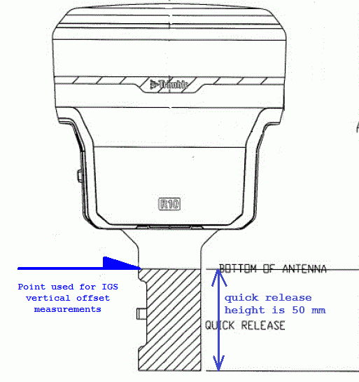
Tip 8
The antenna reference point (ARP) is the lowest non-removable part of the antenna. That point might not be obvious for some types of antennas. If you’re unsure, check the diagrams on the NGS antenna calibration web page.
September 13, 2018
BETA OPUS-Projects: The Next Generation of OPUS-Projects

Slide 43
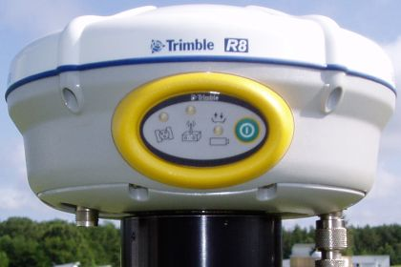
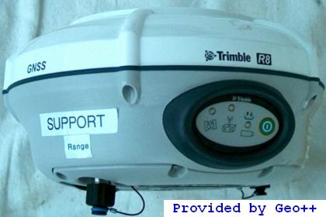
Tip 9
Some antenna types are difficult to distinguish from their siblings and, sometimes small or hidden differences can change the antenna correction model. If you’re unsure, talk to your vendor.
Trimble R8_GNSS
Trimble R8_GNSS3
September 13, 2018
BETA OPUS-Projects: The Next Generation of OPUS-Projects

Slide 44
4) field logs.
Electronic copies of field logs are required for submission.
Field logs are the ultimate reference for field work.
Documentation of the antenna types and serial numbers are required for publication.
Documentation of the receiver types and serial numbers are required for publication.
If required or desired, rubbings can be included with the field log files.
September 13, 2018
BETA OPUS-Projects: The Next Generation of OPUS-Projects

Slide 45
5) photos.
Three photos are required for submission:
CLOSE-UP - A photo taken directly above the survey mark clearly showing the mark, its condition and any stamping on the mark or logo cap.
EYE-LEVEL - A photo taken directly above the survey mark from eye level to show the monument and about 1 meter around the mark.
HORIZONTAL - A daylight photo showing the tripod or a target highlighting the mark’s location with reference objects, significant obstructions and possible multipath sources in view.
September 13, 2018
BETA OPUS-Projects: The Next Generation of OPUS-Projects

Slide 46
6) CORS
You’ll need to include a “long distance CORS” between 375 and 800 km from the center of your project.
Limit superfluous CORS using the OPUS-S upload options or by removing them using the BETA OPUS-Projects ADD/DEL tool.
Ensure all CORS included in the project have data for all occupations and that their short term plots indicate stability.
September 13, 2018
BETA OPUS-Projects: The Next Generation of OPUS-Projects

Slide 47
Tip 10
A good rule of thumb for CORS is to include 3 or 4 nearby CORS plus one “long distance CORS” in the project.
September 13, 2018
BETA OPUS-Projects: The Next Generation of OPUS-Projects

Slide 48
7) session processing. (1 of 2)
We suggest a single-hub network design if possible. That hub should appear in all sessions and be the only mark constrained in all session processing.
BETA OPUS-Projects will suggest a hub if it can do so with confidence; otherwise you will need to choose one.
September 13, 2018
BETA OPUS-Projects: The Next Generation of OPUS-Projects

Slide 49
7) session processing. (2 of 2)
If multiple hubs are necessary, then all hubs should be included in all sessions. Within each session, one hub should be constrained and all other marks, including the other hubs, should connect to it.
September 13, 2018
BETA OPUS-Projects: The Next Generation of OPUS-Projects

Slide 50
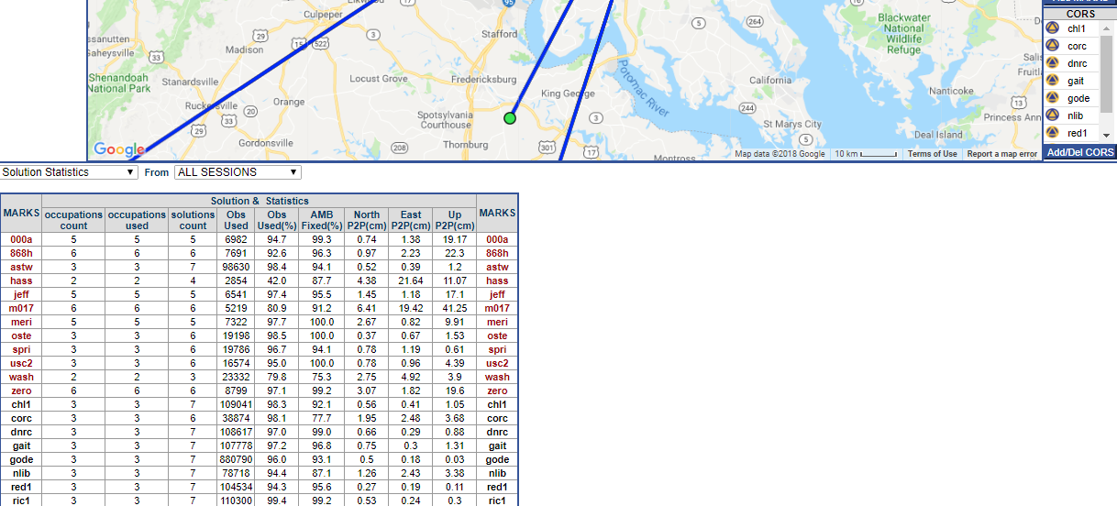
Tip 11
The time to address processing problems is during session processing. Use the Solution Statistics option from the pull down menu on the Manager Page to help with analysis. Re-evaluate performance after completing the preliminary network adjustment.
Poor session results.
September 13, 2018
BETA OPUS-Projects: The Next Generation of OPUS-Projects

Slide 51
Tip 12
There are reference and suggested guidance documents at ftp://geodesy.noaa.gov/pub/opus-projects/.
The “OPUS Projects Processing Guidance” suggests limiting baseline lengths no more than 100 km, but this guidance is evolving. Better to have a little longer baselines, than more hubs.
September 13, 2018
BETA OPUS-Projects: The Next Generation of OPUS-Projects

Slide 52
8) preliminary network adjustment.
3-D constrain only the hub.
If multiple hubs were necessary, fix the one nearest to the center of the project.
If poor results are indicated you may need to go back to session processing to correct problems. Be careful to ensure two occupations exist for all “surviving” marks.
September 13, 2018
BETA OPUS-Projects: The Next Generation of OPUS-Projects

Slide 53
9) free adjustment.
3-D constrain only the hub.
If multiple hubs were necessary, constrain the one nearest to the center of the project.
If large differences (residuals) are seen, you may need to go back to session processing to correct problems. Be careful to ensure two occupations exist for all “surviving” marks.
September 13, 2018
BETA OPUS-Projects: The Next Generation of OPUS-Projects

Slide 54
10) constrained adjustment.
3-D constrain all CORS except the “long distance CORS”.
3-D constrain all project marks with suitable published coordinates:
with two (cm) or three (mm) significant digits to the right of the decimal point shown on its datasheet.
in the NAD 83(2011) datum (shown on its datasheet).
September 13, 2018
BETA OPUS-Projects: The Next Generation of OPUS-Projects

Slide 55
Tip 13
Note f-test result. If this adjustment does not pass this statistical evaluation, it is an indication of poor control or poor uncertainties. It may be necessary to free (redetermine) control.
If large differences (residuals) are seen, it may be necessary to free (redetermine) control.
If redetermination of control is necessary and all else is equal, look to the more distant CORS first.
September 13, 2018
BETA OPUS-Projects: The Next Generation of OPUS-Projects

Slide 56
11) free vertical adjustment.
Constrain the hub horizontally only.
Vertically constrain the orthometric height for one published mark.
Leave all other marks unconstrained.
September 13, 2018
BETA OPUS-Projects: The Next Generation of OPUS-Projects

Slide 57
12) constrained vertical adjustment.
Horizontally constrain the hub.
Vertically constrain all project marks with suitable published orthometric heights:
with two (cm) or three (mm) significant digits to the right of the decimal point on its datasheet.
in the NAVD 88 datum (shown on its datasheet).
September 13, 2018
BETA OPUS-Projects: The Next Generation of OPUS-Projects

Slide 58
Tip 14
Note f-test result. If this adjustment does not pass this statistical evaluation, it is an indication of poor control or poor uncertainties. It may be necessary to free (redetermine) control.
If large differences (residuals) exist it may be necessary to free (redetermine) control.
If redetermination of control is necessary and all else is equal, look to the more distant CORS first.
September 13, 2018
BETA OPUS-Projects: The Next Generation of OPUS-Projects

Slide 59
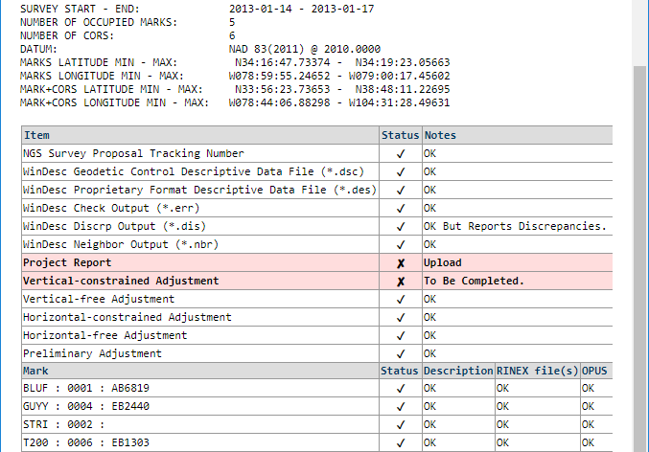
13) review and submit for publication.
On the project manager web page, there is a “Review and Submit to IDB” button. When clicked, the project is reviewed and a window appears displaying its status.
If and only if you and the project are ready, you can send a submission package to the IDB team using the “Submit for Publication” button at the top of the status window.
September 13, 2018
BETA OPUS-Projects: The Next Generation of OPUS-Projects

Slide 60
Tip 15
The “Review and Submit to IDB” button only initiates a review of the project’s status. Your results won’t be submitted until you confirm you’re ready by clicking the “Submit for Publication” button. So feel free to use this tool whenever you want to check the status of your project.
September 13, 2018
BETA OPUS-Projects: The Next Generation of OPUS-Projects

Slide 61
Useful URLs:
BETA OPUS upload web page: https://beta.ngs.noaa.gov/OPUS/
BETA OPUS-Projects gateway web page: https://beta.ngs.noaa.gov/OPUS-Projects/
A video (*.mp4) of one of the quick-start introductions to BETA OPUS-Projects is at ftp://ftp.ngs.noaa.gov/pub/corbin/Beta OPUS Projects webinar material/
OPUS-Projects training and reference documents. ftp://geodesy.noaa.gov/pub/opus-projects/
NGS Antenna calibration https://geodesy.noaa.gov/ANTCAL/index.xhtml
September 13, 2018
BETA OPUS-Projects: The Next Generation of OPUS-Projects

Slide 62
References:
Form to request a tracking number https://geodesy.noaa.gov/project_tracking/external/
Constrained Adjustment Guidelines https://geodesy.noaa.gov/PC_PROD/ADJUST/adjustment_guidelines.pdf
Input Formats and Specifications of the National Geodetic Survey Data Base (Note Chapter 4 and Annex N). https://www.ngs.noaa.gov/FGCS/BlueBook/
WinDesc https://www.ngs.noaa.gov/PC_PROD/pc_prod.shtml#WinDesc
PC Software Download - ADJUST AND UTILITIES https://geodesy.noaa.gov/PC_PROD/ADJUST/
September 13, 2018
BETA OPUS-Projects: The Next Generation of OPUS-Projects

Slide 63
References (continued):
NGS-58 & NGS 59 guidelines https://www.ngs.noaa.gov/PUBS_LIB/NGS-58.html https://www.ngs.noaa.gov/PUBS_LIB/NGS592008069FINAL2.pdf
AC 16 guidelines https://www.ngs.noaa.gov/AERO/AirportsGIS/AC16/
September 13, 2018
BETA OPUS-Projects: The Next Generation of OPUS-Projects

