Slide 1

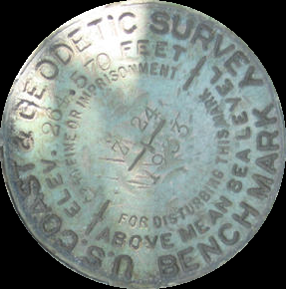
The Paradox of Static Vertical Flood Datums amid Changing Sea Levels
NORFMA 2017, Seaside, OR
September 28, 2017
Nic Kinsman
Alaska Regional Advisor, NGS
Notes:
Audience:
Anyone that has contracted data collection and been asked “what datum do you want that in”?
Anyone who has tried to combine multiple data sets from difference sources/time periods in a FIS update.
Anyone who has been asked by an underwriter to update an EC to the new BFE datum.
Benchmark shown is an artifact of simpler times – from “before the earth was in motion”
Agency name has changed
“Above mean sea level” is a misnomer
The stamped elevation has almost certainly changed
Nicole Kinsman is Alaska’s Regional Advisor at NOAA’s National Geodetic Survey (NGS). Based in Anchorage, she serves as Alaska’s point of contact for NGS and is available to provide technical guidance on geospatial positioning topics in support of activities such as mapping and charting, navigation, flood risk determination, transportation, land use and ecosystem management. She holds a PhD in Earth Sciences from UCSC, formerly managed the State of Alaska DGGS Coastal Hazards program for 5 years, and is an affiliated faculty member at the University of Alaska Fairbanks.

Slide 2
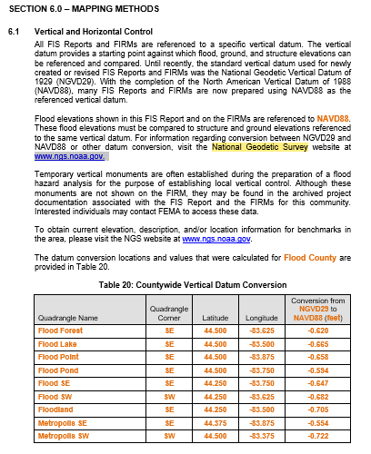
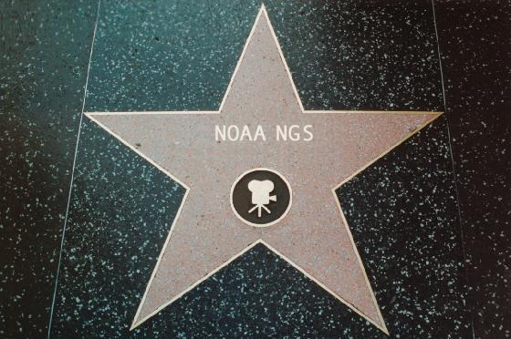
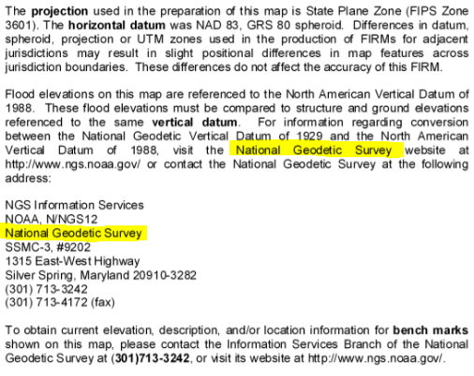
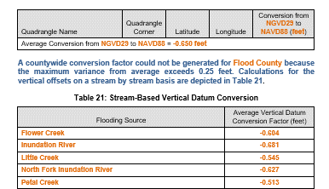
National Geodetic Survey
Notes:
You may recognize NGS from such illustrious appearances as section 6.1 of Template: Flood Insurance Study (FIS) Report (Nov 2016)
or the “NOTE THE USERS” section of your favorite FIRM

Slide 3
Today’s Topic:
When Vertical Datums let us Down
Insufficient Metadata
Inconsistent Access/Heights
‘Stale’ Elevations
… and what NGS is doing about it.
OUTLINE
Vertical Datums
Alaska Case Studies
Practical Guidance
Extra Resources
NAVD88 NAPGD2022

Slide 4

Vertical Datums
An overview of

Slide 5

A vertical datum is a reference surface that can be used to measure heights in a uniform way.
Sally
Jane
?
How much taller is Sally?

Slide 6
A vertical datum is a reference surface that can be used to measure heights in a uniform way.
Sally
Jane
?
How much taller is Sally?
Need to know how tall the hill is!
… you cannot compare heights that are measured from different planes of reference.

Slide 7

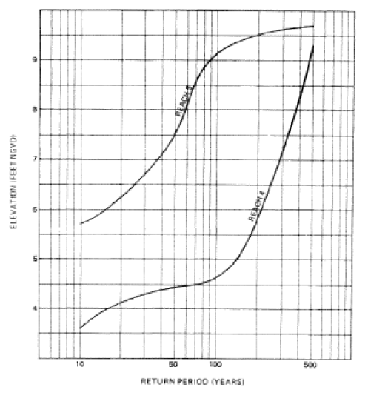
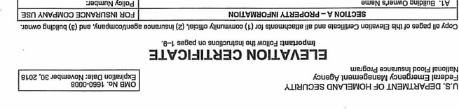
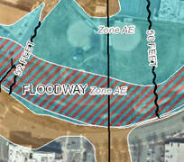
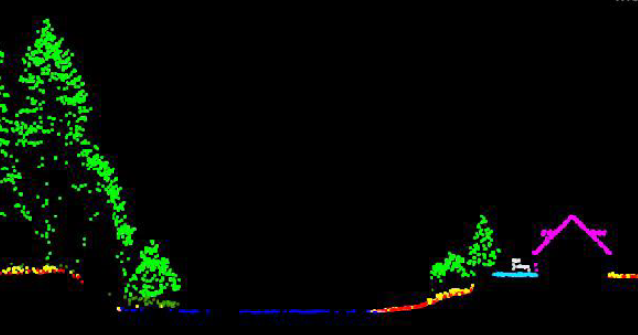
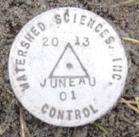
The National Spatial Reference System (NSRS)
A common and consistent geospatial framework to meet the economic, social, and environmental positioning needs of our Nation.
Foundational elements include:
Latitude • Longitude • Elevation • Gravity • Shoreline Position
+ changes over time
+
+
=
Reliable FIRMs require data from disparate sources and dates be consistently aligned
Notes:
NSRS is a consistent geospatial framework, common to all Federal agencies and other users
NSRS fuels informed decision-making for mapping and charting, navigation, flood risk determination, transportation, land use, and ecosystem management
Elements of NSRS include (but are not limited to): latitude, longitude, elevation, gravity, shoreline position + changes over time
Example of why we need consistent coordinates (illustrated):
Just in the making of a single FIRM, data collected at different points in time using different methods must be reliably aligned and combined with historical data (in both horizontal and vertical) to produce a final product in which all of this information is available in one place to assist the planner in appropriate flood mitigation.

Slide 8
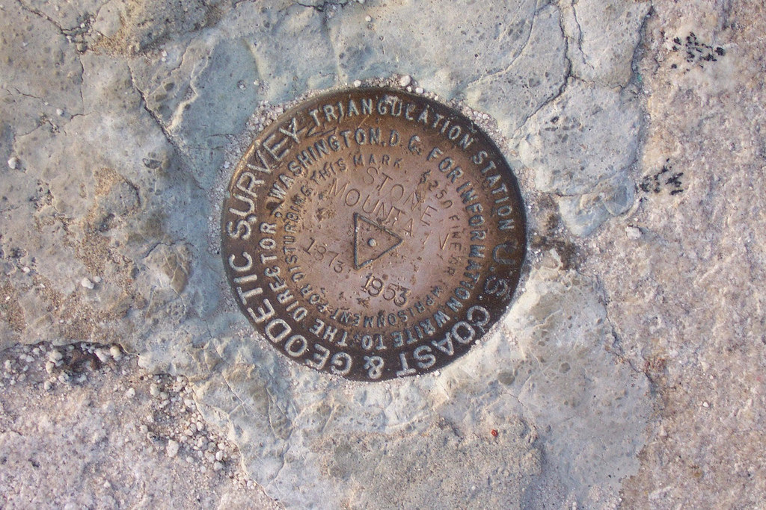
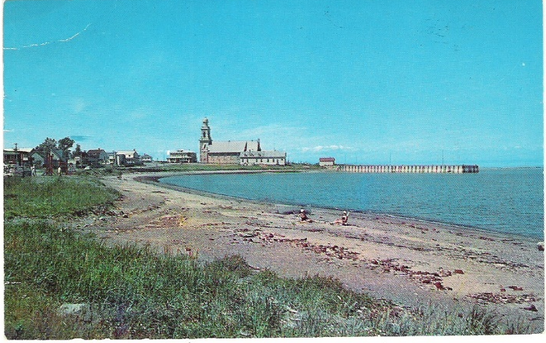
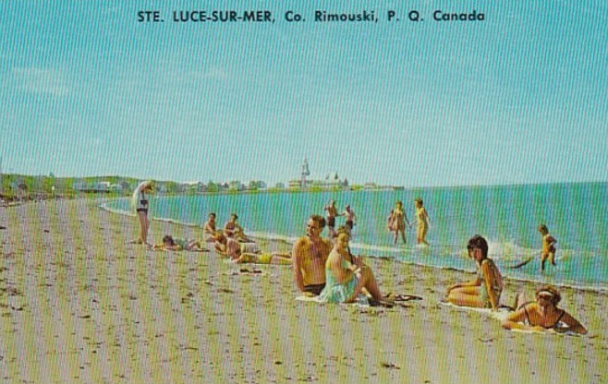
The NSRS of Today (simplified)
Primary elements:
Horizontal North American Datum of 1983 - NAD 83(2011) coordinates
Vertical North American Vertical Datum of 1988 - NAVD88 orthometric heights
These elements are geodetic datums that define the shape and size of the earth to enable precise positioning
System based on connections to published passive control
Notes:
Mark pictured: https://www.ngs.noaa.gov/cgi-bin/ds_mark.prl?PidBox=DG2533
The NAVD88 leveling network is held to “zero” at the level of local MSL in 1985 in Father Point in Rimouski, Quebec. The historical postcards are from Ste. Luce-Sur-Mer Beach, approximately 7km NE of Father Point.

Slide 9


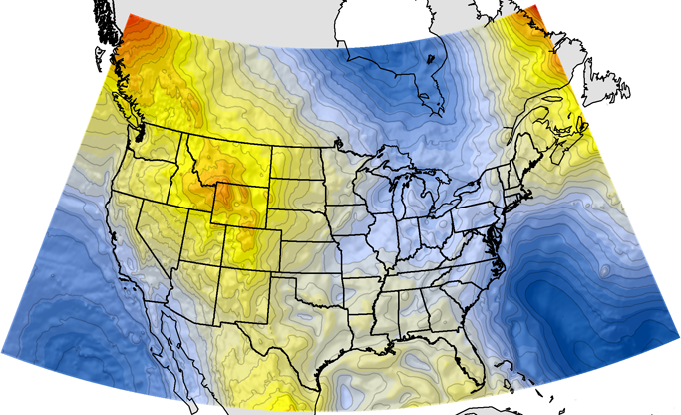
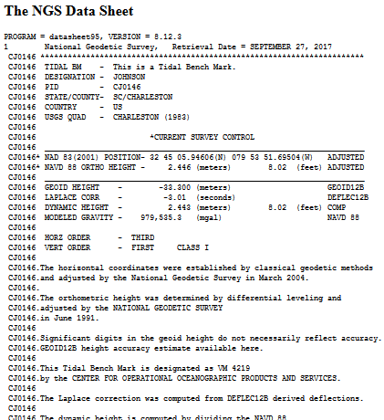
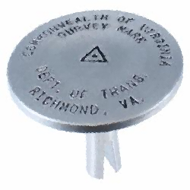
NGS Supports Access to NAVD88 Heights
GEOID12B
official path
Notes:
NGS defines, maintains, and provides access to the NSRS. For a reference system to be useful to the public it must be CONSISTENT (possess spaciotemporal reliability) and CONVENIENT (readily accessible by users). Consistency encompasses repeatability (different users with different equipment can obtain consistent coordinates).
Path (1) Since the NSRS is presently defined by a network of passive control, NGS provides primary access to the NSRS at published passive control (in IDB), at preset this remains the ‘official’ gateway to NSRS position.
Path (2) In recognition of increasing use of GPS/GNSS technology for precise positioning activities, NGS also supports GPS/GNSS-enabled access to the NSRS (via OPUS). → In an ideal (static) world, these two pathways lead you to the same coordinates.
For GPS/GNSS-enabled access to NSRS heights, NGS maintains geoid models.
***Geoid models are necessary to convert GPS measurements (ellipsoid-based) into real-world elevations***
The current geoid model (GEOID12B) that is used to access NSRS orthometric heights (NAVD88) is a hybrid geoid, a gravimetric geoid (USGG2012) that has been warped to align with published values on passive control.

Slide 10
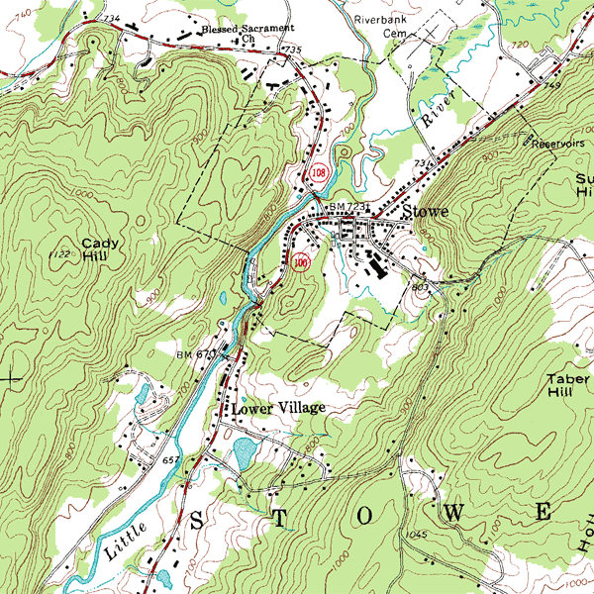
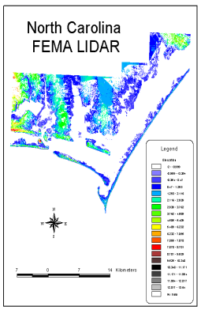
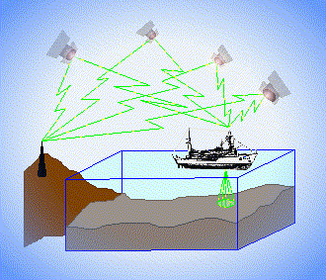
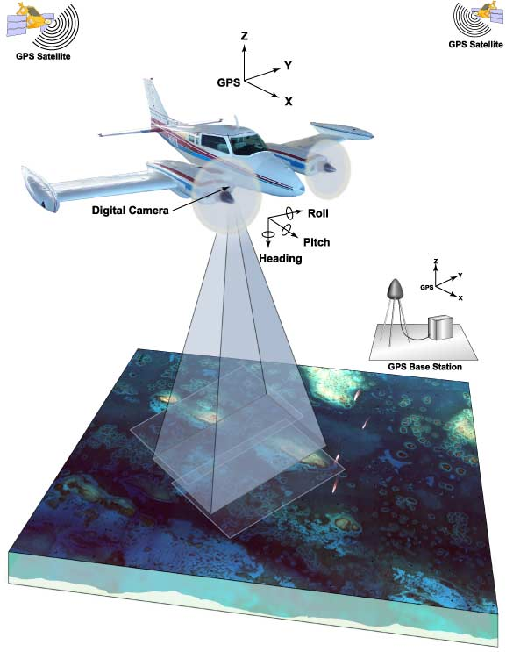
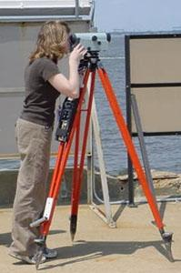
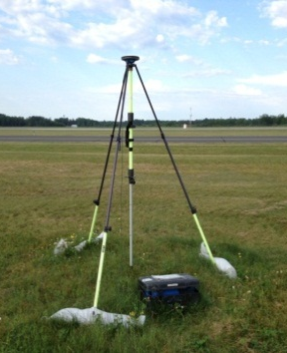
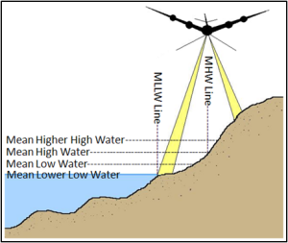
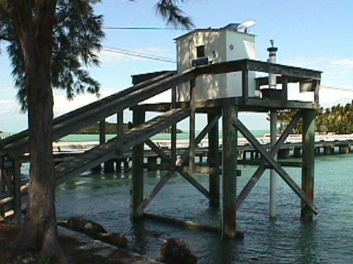
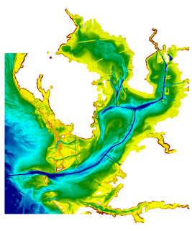
3 Categories of Vertical Datums
Orthometric
Ellipsoidal
Raw Hydrographic Surveys vertically referenced with RTK-GPS
USGS
Topography
FEMA Flood Insurance Rate Maps
Engineering and Development Site Surveys
Native GPS measurements
Raw Lidar
Tidal
NOAA Bathymetry (MLLW)
Shoreline Mapping (MHW) and Regulatory Boundaries at the Coast
Daily and Extreme Water Levels

Slide 11
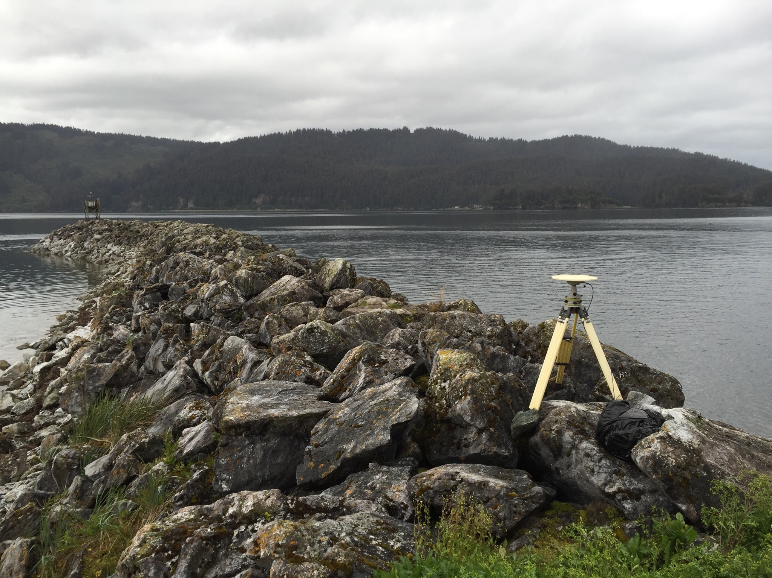
Alaska Case Studies
Illustrative
Notes:
Alaska is an illustrative end-member.
The issues posed by static datums shown in the following examples are measurable and apparent, but they are relevant to areas nationwide because these changes are happening everywhere (at slower and less-apparent rates) and they reinforce why NSRS modernization is critical for improved flood mapping, particularly in areas experiencing changes in local relative sea level.
As of July 2017:
Only 26 communities in Alaska participate in NFIP
Fairbanks, Anchorage, Juneau, Kenai Peninsula, Mat-Su Borough = largest participants

Slide 12

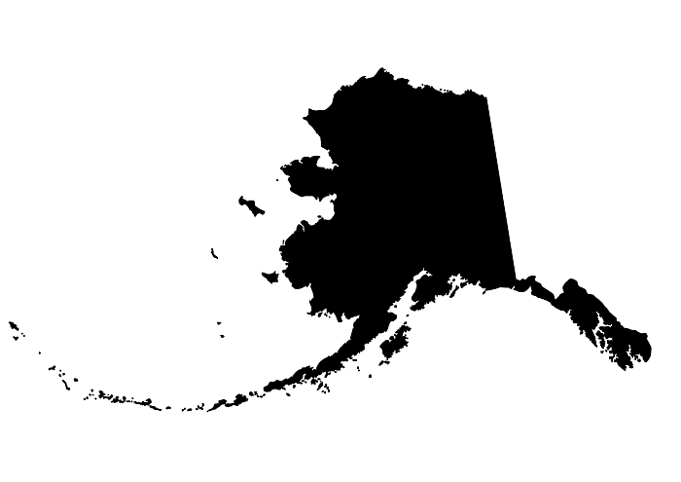
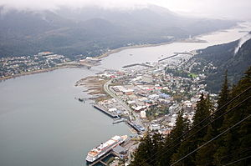
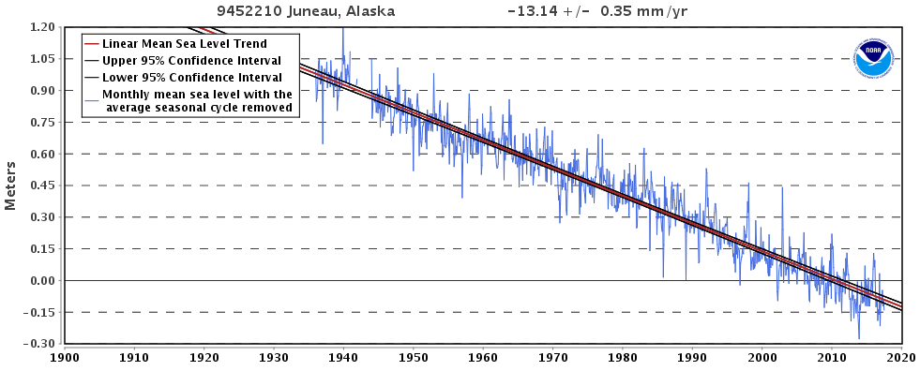
CaSe File: Juneau, AK
2015 Population:
32,756
Effective FIS: 2013
New FIS in Progress
Notes:
Juneau:
Negative RSL trend

Slide 13
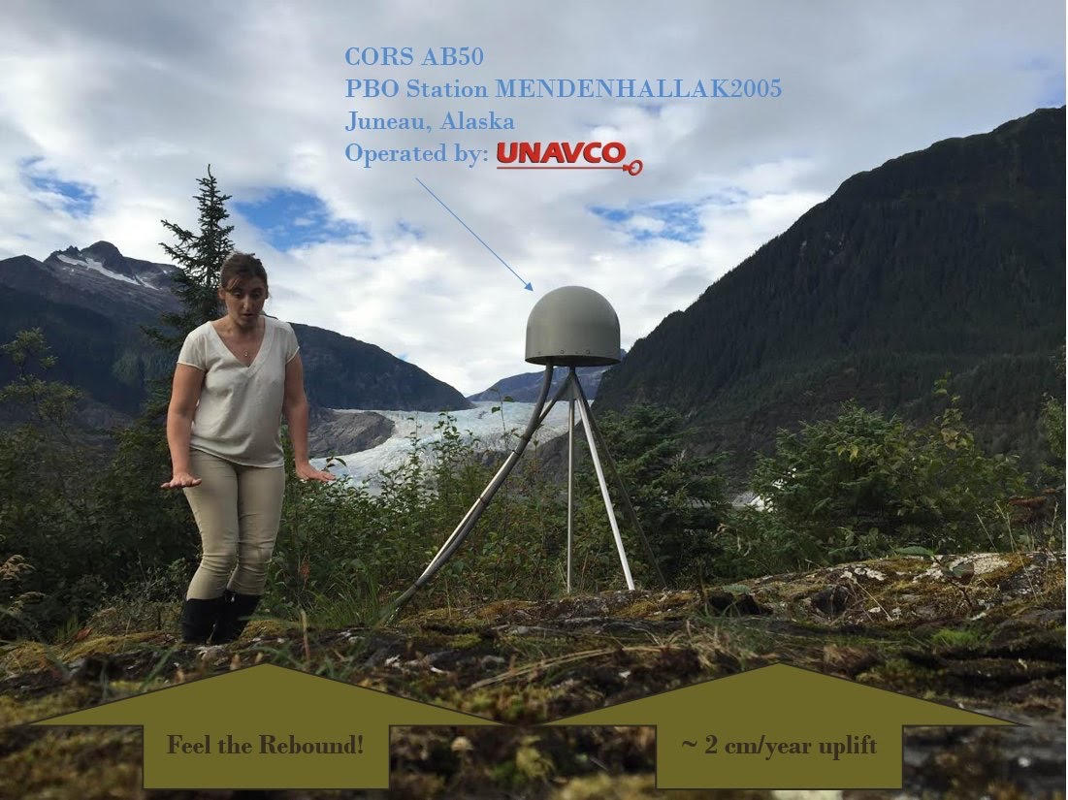
CaSe File: Juneau, AK
Notes:
Largest component due to isostatic rebound of the crust.
Rapid uplift monitored with continuous GNSS site at Mendenhall Glacier.

Slide 14
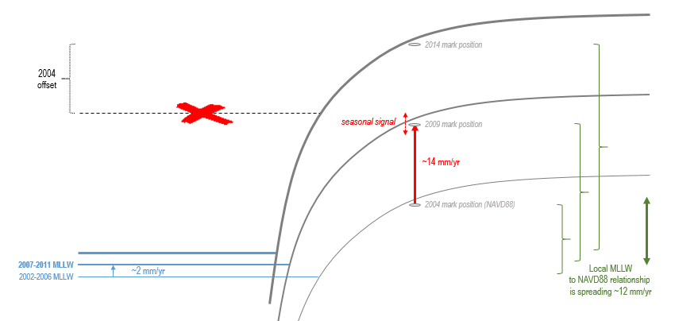
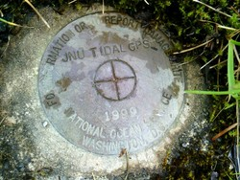
CaSe File: Juneau, AK
*** When and how you access or transform to NAVD88 matters ***
Notes:
**Juneau rates have been generalized for illustrative purposes in this figure**
Note:
Local sea level is rising
Land is rising faster
Vertical relationship between tidal and ‘terrestrial’ datums changes (increasing here) through time such that if you applied the 2004 relationship 10 years later, the expected position of local MLLW would be significantly off (shown with red x)
Thought experiment: Mark shown has an official NAVD88 height published in IDB in 2004. Just 10 years later, a surveyor uses this published height value to complete a NAVD88 elevation certificate. A lidar contractor delivers a new 2014 DEM for Juneau and uses the same mark for control with a NAVD88 height value based on a GPS occupation of the mark (processed with OPUS). Are the surveyor and the lidar contractor working in a consistent vertical datum?

Slide 15
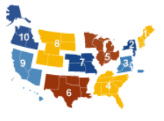

CaSe File: Juneau, AK
Extra care in combining data (lidar and ground survey) to a common datum in the FIS
Extra language in FIS to clearly indicate the NTDE/Datum used (good metadata)
Extra support for ECs and LOMAs/SOMAs
Conversion table for distribution to FPAs and surveyors
Development of job-aids and training materials for use in training classes targeted to FPMs and surveyors in areas where tidal datums are used as BFE datum
Notes:
As new FIS is in process for Juneau.
As such, STARR II (FEMA Region X Service Center) is taking extra measures to ensure a sound geospatial framework for the project.
Their request for me to present at NORFMA/ASFPM is part of these efforts.

Slide 16
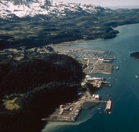
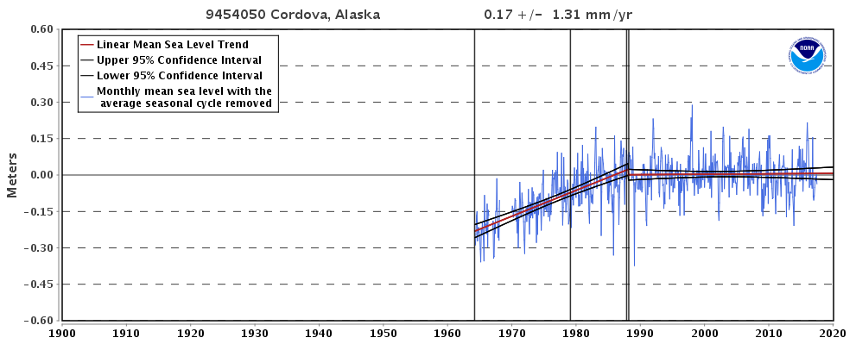
CaSe File: Cordova, AK
2010 Population: 2,239
Prior FIS: 1979-2015
New FIS Effective: 12/16/2015
Notes:
Cordova:
Complex RSL trend, positive to steady… why?
Note: record starts in 1964 (see next slide for answer).

Slide 17
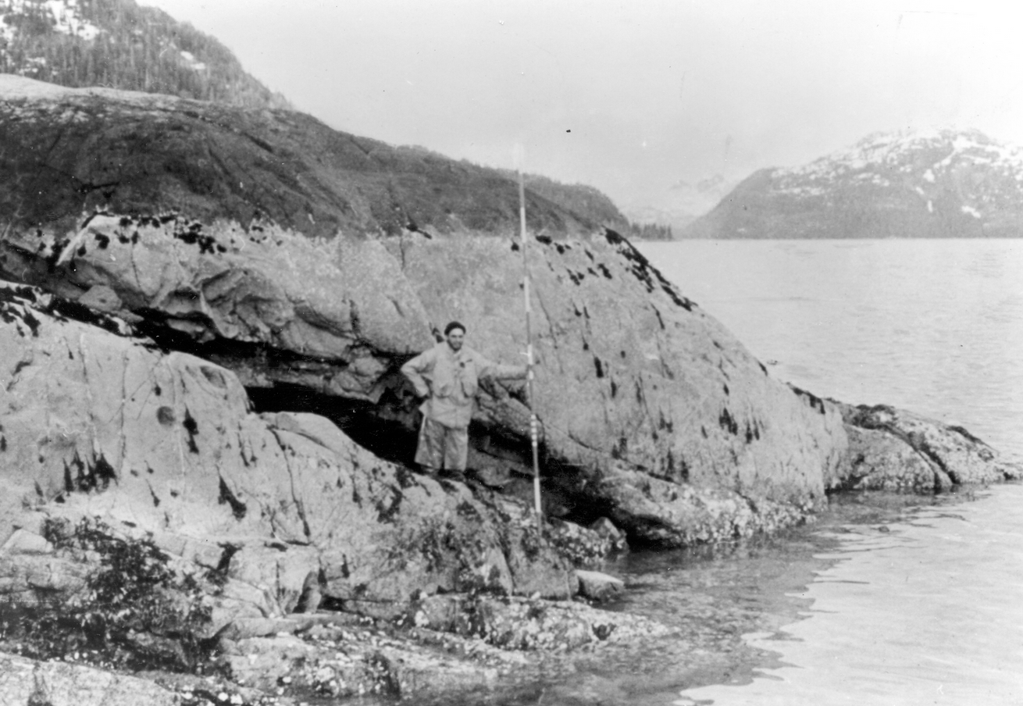
CaSe File: Cordova, AK
USGS Professional Paper 531-I
Notes:
Alaska Earthquake March 27, 1964. Barnacle line clearly marked by upper limit of light-gray barnacles and desiccated rockweed in dark patches and by the lower growth limit of dark-gray encrusting lichens of the splash zone. Uplift of 3.2 feet in Whale Bay in western Prince William Sound (not far from Cordova).
Photo was taken at 3-foot tide stage. June 22, 1964. Figure 6, U.S. Geological Survey Professional paper 543-I.
= Cordova experienced post-seismic adjustment following the 1964 quake = accelerated RSL rise (unfortunately coinciding with a period of major development in Cordova).

Slide 18


CaSe File: Cordova, AK
BFE in 1979 FIS/FIRM: “18 feet relative to MLLW”
(illustration not to scale)
Fred
Local MLLW in 1994 (1960-78 NTDE)
Fred obtains an Elevation Certificate in Cordova in 1994:
18.1’ MLLW (1960-78 tidal epoch) ← Above BFE
Notes:
Thought Experiment
*******NOTE: BFE in Cordova is relative to local MLLW, not NAVD88***********

Slide 19
CaSe File: Cordova, AK
BFE in 1979 FIS/FIRM: “18 feet relative to MLLW”
(illustration not to scale)
Susan
Fred
Local MLLW in 2004 (1983-2001 NTDE)
Fred obtains an Elevation Certificate in Cordova in 1994:
18.1’ MLLW (1960-78 tidal epoch) ← Above BFE
A decade later (2004), his next door neighbor Susan hires a surveyor to get an Elevation Certificate:
17.9’ MLLW (1983-2001 tidal epoch) ← Below BFE?
Notes:
Thought Experiment
Note: Susan’s house is actually up small hill from Fred’s

Slide 20
CaSe File: Cordova, AK
BFE in 1979 FIS/FIRM: “18 feet relative to MLLW”
(illustration not to scale)
Susan
Fred
Local MLLW in 2004 (1983-2001 NTDE)
Fred obtains an Elevation Certificate in Cordova in 1994:
18.1’ MLLW (1960-78 tidal epoch) ← Above BFE
A decade later (2004), his next door neighbor Susan hires a surveyor to get an Elevation Certificate:
17.9’ MLLW (1983-2001 tidal epoch) ← Below BFE?
Notes:
Thought Experiment:
Fred is “out” of flood zone due to his grandfathered elevation, but Susan in “in” (she is not really, because these elevations are not relative to the same FIS datum)
→ No one in this scenario paid attention to the tidal epoch of the MLLW datum
FEMA guidance says that “BFE stays fixed even if there is subsidence.” (a bit ambiguous if BEF is relative to a non-fixed datum)
Susan’s EC is NOT to the same datum as the BFE, but perhaps Susan’s EC reflects her true risk, and Fred just got lucky with timing?

Slide 21
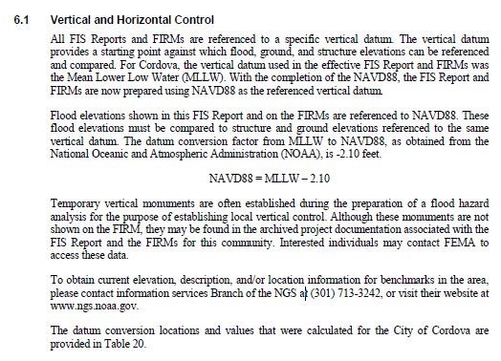
CaSe File: Cordova, AK
2015 FIS
Based on NOAA tidal BM records; this conversion value is for NAVD88 to Local MLLW (1983-2001)
Can this equation be used to update all Cordova MLLW Elevation Certificates to NAVD88?
Notes:
The Cordova 1979 FIS was updated in 2015.
The FIS was updated for BFEs relative to NAVD88, and a conversion value was provided that does not specify tidal epoch.
If this equation is used on Susan’s EC, her elevation is now ‘correct’
If this equation is applied to Fred’s EC, does he have a NAVD88 EC compliant with the new FIS?
How would the local Flood Plain Manager know the difference? ---- REINFORCES THE IMPORTANCE OF METADATA ----

Slide 22
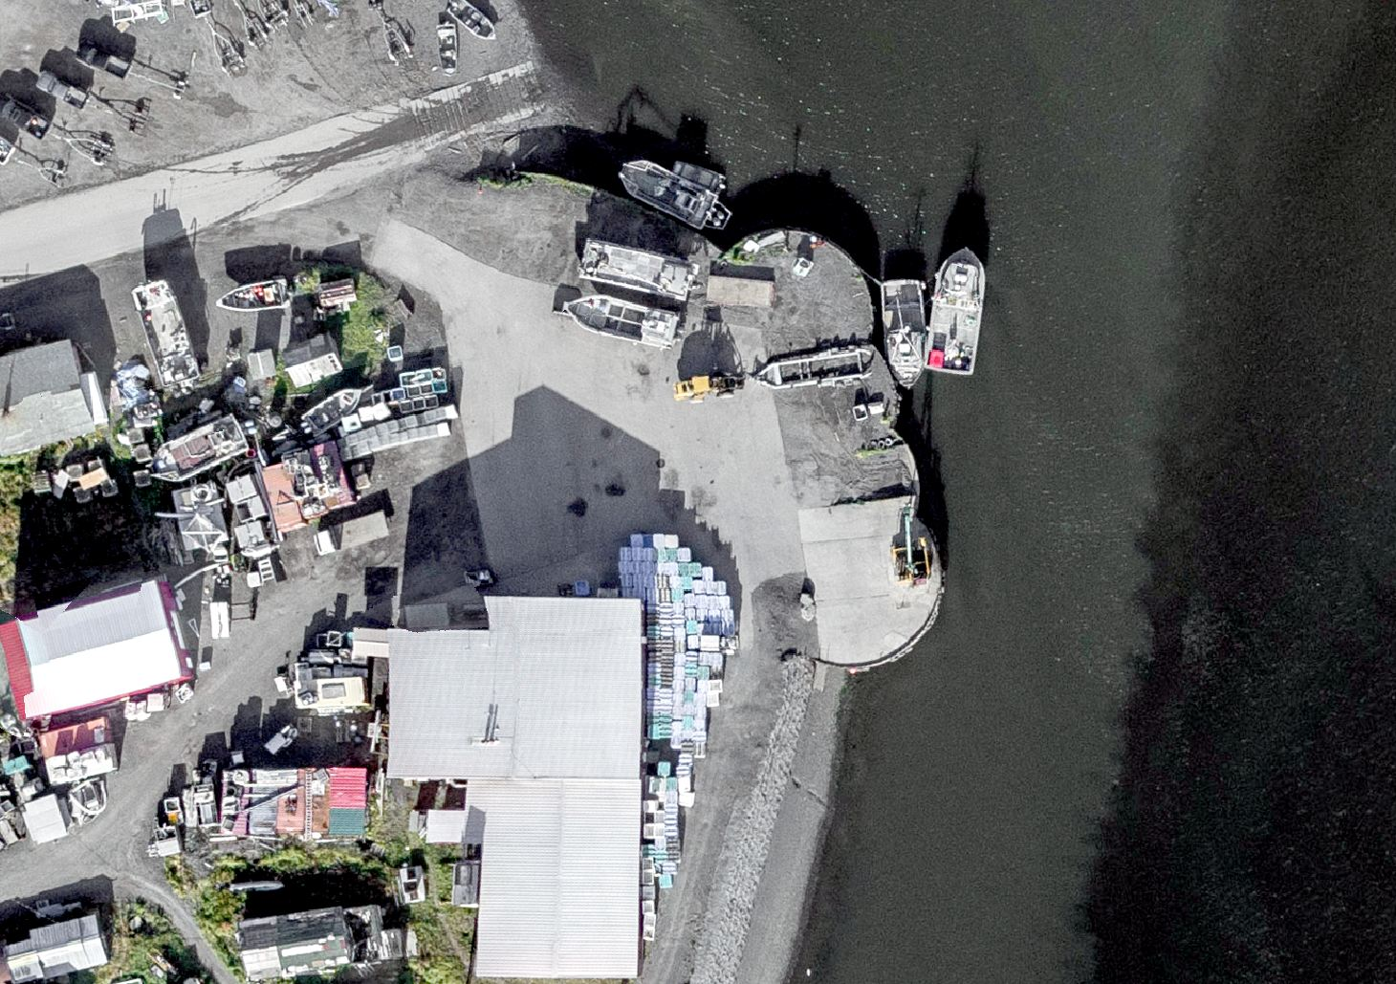
DOCUMENTATION OF DATUMS (metadata)
Practical Guidance on

Slide 23
Use Complete Nomenclature
NAD83
NAVD88
MLLW

Slide 24
Use Complete Nomenclature
NAD83(2011) epoch 2010.00
H. Datum
Realization/Adjustment
Reference Epoch
NAVD88 (GRS80, Geoid12B)
V. Datum
Reference Ellipsoid
Geoid Model
MLLW(9452210; 1960-78 #2128)
Tidal Datum
NOAA Tide Station
National Tidal Datum Epoch & Published Sheet Number
Notes:
Note: exact content and format may vary; these general recommendations are specific to projects with a vertical emphasis.
Also keep a record of source/date of survey whenever possible, even before 2022.

Slide 25

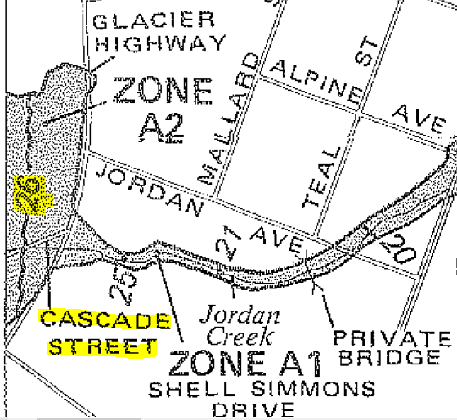
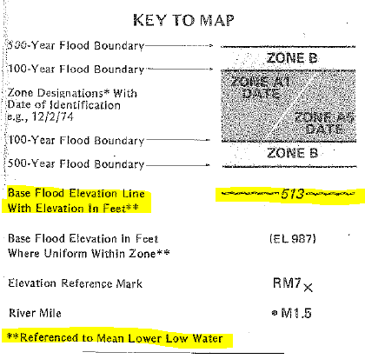
CaSe File: METADATA
1995 EC Form
1981 FIRM - JUNEAU
Notes:
Discuss:
Old form issue w/o enough metadata
This is very common issue in Alaska
Underwriter takes datum label on EC at face value
Conversion value may not exist OR may demonstrate that datum is mis-labeled by resulting in an unreasonable elevation
Defer to licensed surveyor for interpretation or property requires a re-survey

Slide 26
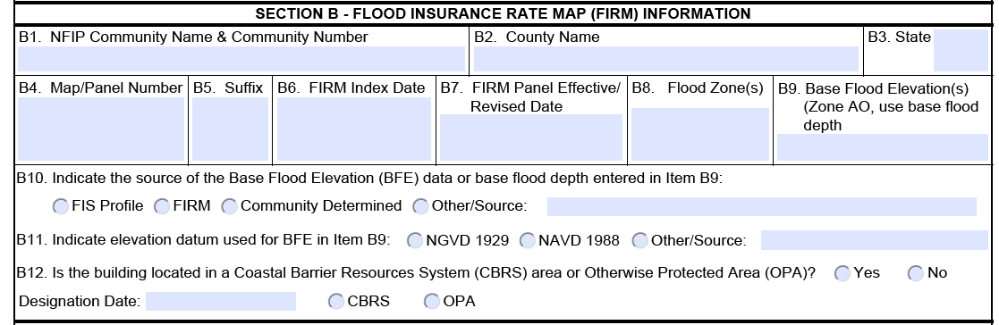
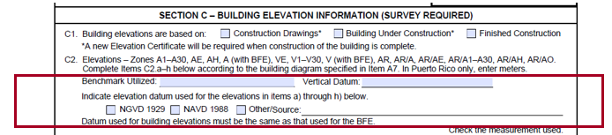
Section B & C – FIRM Information
Notes:
New EC
Note extra space to add information about source; if you look in the instructions, licensed professionals completing this form are not restricted to just this space and they may provide attachments if extra explanation is necessary.

Slide 27
Some pro tips:
If local passive control are used in the FIS, retain a record of:
  Monument stampings/locations
  PIDs or other unique IDs
  Positions at time of FIS survey (with complete metadata)
If you do any transformations, keep a record of the parameters and the name and version number if a tool was used (like VDatum)
In areas of uplift/subsidence, inquire about source/”vintage” of NAVD88 values
New EC guidance provides for the use of OPUS reports; OPUS Solutions of 4+ hours in duration on marks of significance can be archived w/ NGS as an ‘OPUS Shared Solution’ with minimal extra effort.

Slide 28

Training and Resources
Additional

Slide 29
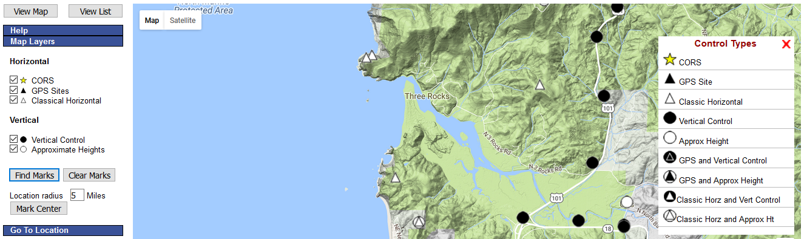
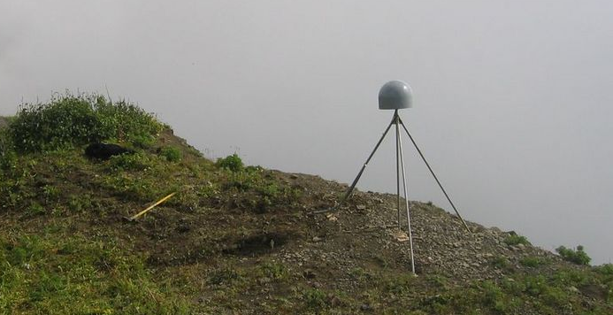
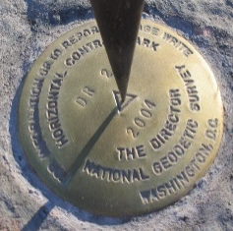
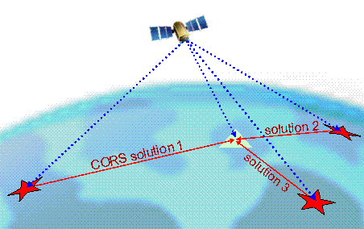
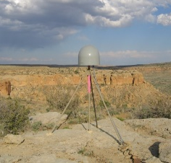
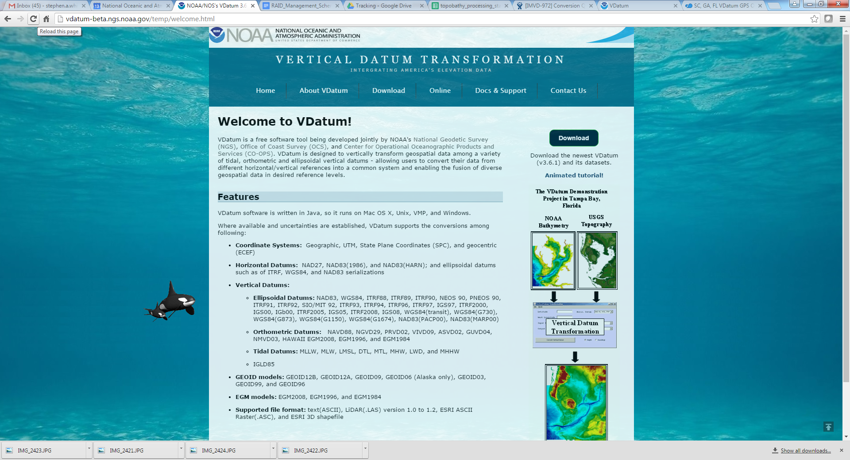
NGS Provides Tools to Access the NSRS
Integrated Database (IDB) of Published & OPUS Shared Control
Continuously Operating Reference Stations (CORS)
Online Positioning User Service (OPUS) Tool Suite
Coordinate Conversion and Transformation Tools (VDatum)
Notes:
The NGS Mission is to define, maintain, and provide access to the NSRS.
We provide access to users through a range of long-standing (e.g. IDB) and new (e.g. NADCON5) tools.

Slide 30
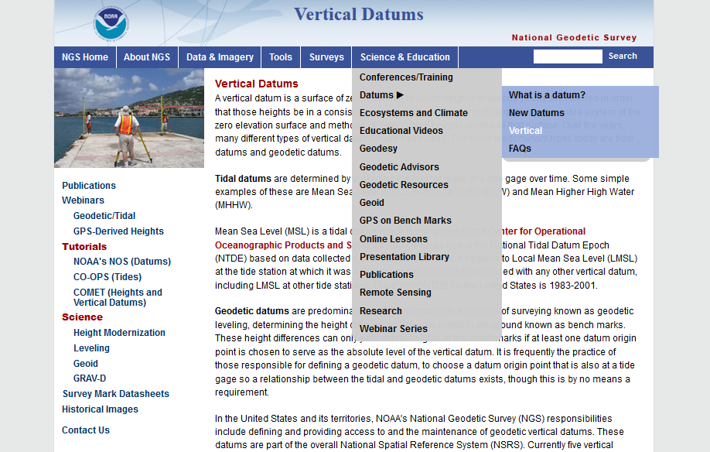
Online Resources from ngs.noaa.gov

Slide 31
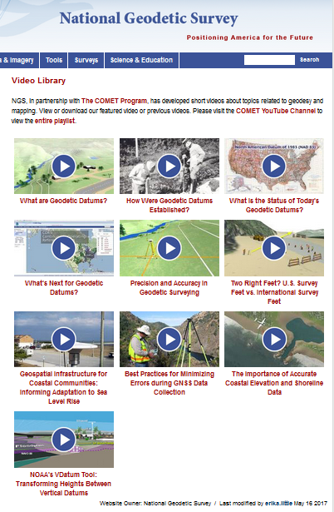

Educational Videos
& Online Tutorials
Videos are ~3-5 minutes
Vertical Datums Tutorial is ~1 hour

Slide 32

NGS Regional Advisor Program
Notes:
Consult with your local NGS life-line.

Slide 33

NAPGD 2022
Modernization of the National Spatial Reference System
Notes:
NGS is not pulling the rug out from under you, we are re-leveling and bracing the subfloor for longevity.

Slide 34

The NSRS of Tomorrow (2022)
Primary elements:
The geometric North American Terrestrial Reference Frame of 2022 (NATRF2022) plus the Caribbean, Pacific, and Mariana plates
The North American-Pacific Geopotential Datum of 2022 (NAPGD2022)
New reference system is:
Time-dependent and geocentric
Defined by relationships to a global/international ideal frame
Primarily accessed via GPS technology and a newly refined semi-dynamic geoid model
Notes:
As NGS continues to fulfil our primary mission of defining, maintaining, and providing access to the NSRS, we have recognized the need to modernize the current NSRS in tandem with advances in geodesy, geophysics, and technology (especially GPS/GNSS); and to meet evolving requirements and expectations of the NSRS. Decisions about how to best modernize the NSRS must achieve improved consistency (especially between passive and active control) and convenience while not fully departing from expected characteristics that are part of the fabric of how our Nation uses precise positions.
Additionally, (for better or worse) as a society we have also adopted an expectation that our spatial reference system is defined in a manner that provides some level of CONSTANCY (that objects considered to be stationary have fixed coordinates and/or heights). We have also come to expect that heights and depths are relative to some definition of sea level, and this COHERENCE with a natural equipotential surface also ensures that water will flow from higher to lower height values.
Horizontal and vertical datums will be replaced by geometric and geopotential reference systems that are time dependent
***Blueprints are available for detailed information on the proposed form of the new NSRS***
Notable Improvements (in no order):
Removes nation-wide tilt and bias in the present vertical datum
Time-dependency provides better ways to access to mark stability and use the NSRS to monitor gradual change such as subsidence or uplift
New vertical datum aligns with international neighbors such as Canada, facilitating precise positioning in border areas
GPS gateway opens consistent NSRS access to remote and isolated parts of the United States
More systematic ties between NAPGD2022 and tidal datums will significantly improve the quality of geospatial data in coastal environments with sea level trends
Direct relationships to ITRF/IGS improve the spatial framework for GNSS-based technology, such as UAS/UAVs
Image: GPS Block IIF Satellite (12 launched between 2010-2016; these platforms presently form the core of the active GPS constellation)

Slide 35


NGS Will Support Access to
NAPGD 2022 Heights
GEOID 2022
official path
Notes:
In 2022:
Active geodetic control (CORS) will replace passive geodetic control (bench marks)
GPS/GNSS will be the official gateway to the NSRS
GRAV-D project for a refined gravimetric geoid for the US that will enable access to orthometric heights w/in 2 cm accuracy using GPS/GNSS (no warp to published heights)
Passive control will continue to play important roles in precise positioning as:
- Calibration sites for GNSS technology, Real Time Network validation, and verification of datum transformation tool results,
- Sites for monitoring motion to enhance Intra-Frame Velocity Model (via repeat/campaign GNSS occupations),
- Convenience: passive control will continue to provide rapid access to NSRS positions in areas with limited GNSS coverage (e.g. cities, forests) or in the event of GNSS failure (e.g. geomagnetic storms).

Slide 36



NSRS Modernization: Vertical Change
GEOID12B (NAVD88)
Updates available online from the New Datums website and Modernization News
xGEOID17
Vertical offset of more than 1 meter
https://geodesy.noaa.gov/datums/newdatums/index.shtml

Slide 37

NOAA/FEMA Coordination
Cooperative Pilot Study (2011):
  National Geodetic Survey,
  North Carolina Floodplain Mapping Program,
  North Carolina Geodetic Survey, and
  Federal Emergency Management Agency
Key Outcomes:
Recommendation of FEMA implementation plan to account for coordinate and height shifts.
Improved relative positional accuracies and greater understanding of height uncertainties will enhance quality of flood mapping.

Slide 38



Ongoing NOAA/FEMA Coordination
Feedback on the New Datums
Kimberly Pettit, FEMA GIS Coordinator
Prepared with Paul Rooney
2017 Geospatial Summit
April 24 to 25, 2017
https://www.ngs.noaa.gov/geospatial-summit/presentations/fema.shtml
Assessment
Preparations to-date
Advantages and challenges
Concerns
Necessary transition tools, products, and services
Outreach priorities
watch online

Slide 39
What can you do?
Be aware and help spread the word about upcoming NSRS modernization:
  Proactively ask agencies, surveyors, and engineers about what preparations they are taking to learn about and prepare for the upcoming changes
Reach out to NGS for support as needed
Lead by example and exercise best metadata practices

Slide 40




Upcoming Presentations
November 12-14, 2017
Anchorage, AK
1 hour session on 2022 Datum Modernization
June 17-21, 2018
Phoenix, AZ
2 hour NSRS 101 class
30 minute session on Vertical Datum Modernization
2019 NGS
Geospatial Summit
Spring, 2019
Silver Spring, MD
Multiple Days

Slide 41


Thank You
Special thanks to:
Becca Fricke-Croft, CFM
Josha Crowley, PE, CFM, D.WRE
Mike Michalski, CO-OPS Datums Lead

