Slide 1

Modernizing the National Spatial Reference System
Dru Smith
NSRS Modernization Manager
NOAA’s National Geodetic Survey

Slide 2
“Modernizing the NSRS” means…
Replacing NAD 83
Replacing NAVD 88
Re-inventing Bluebooking
Improving the Geodetic Toolkit
Better Surveying Methodologies
Notes:
There are actually 3 “NAD 83”s, NAD 83(2011), NAD 83(PA11) and NAD 83(MA11)
There are also many more vertical datums than NAVD 88 in the NSRS, each one for specific states or territories that have no line of sight to CONUS/Alaska

Slide 3
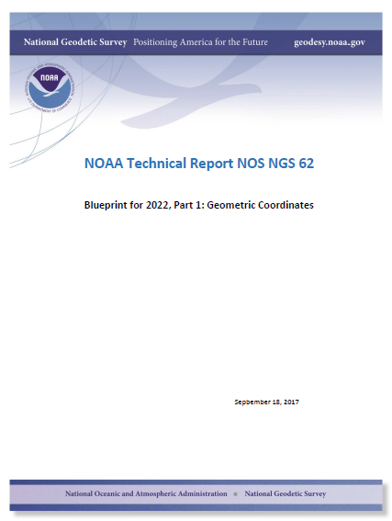
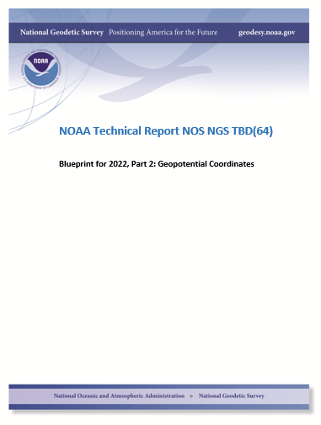
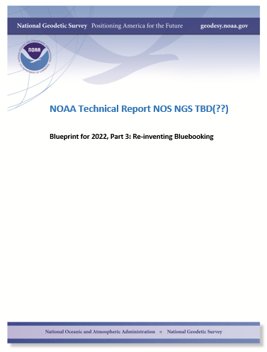
Modernizing the NSRS
The “blueprint” documents: Your best source for information
Geometric:
May 2017
(minor update Sep 2017)
Geopotential:
Oct 2017
Bluebooking:
Apr(?) 2018

Slide 4
Replacing the NAD 83’s
The Old:
NAD 83(2011)
NAD 83(PA11)
NAD 83(MA11)
The New:
The North American Terrestrial Reference Frame of 2022
(NATRF2022)
The Caribbean Terrestrial Reference Frame of 2022
(CATRF2022)
The Pacific Terrestrial Reference Frame of 2022
(PATRF2022)
The Mariana Terrestrial Reference Frame of 2022
(MATRF2022)

Slide 5
Replacing the NAD 83’s
Three plate-(pseudo)fixed frames will be replaced with four plate-fixed reference frames
  N. Amer., Pacific, Mariana, Caribbean(new!)
Remove long-standing non-geocentricity of NAD 83 frames
All four : identical to IGSxx at a TBD epoch
  2020.00?
All four : differ from IGSxx by plate rotation only
  Updated Euler Pole determination for rigid plate only

Slide 6
The TRFs
All are global frames (no “boundary”)
  This was true for the NAD 83’s also, BTW
  But each frame will rotate with one tectonic plate
    Put another way: “The frame rotates so your coordinates don’t have to”
All will have an Intra-Frame Velocity Model
  To capture any motions outside of tectonic rotation
    Residual horizontal motions
    All vertical (ellipsoid height) motions

Slide 7
The relation of five global reference
frames through time.
NATRF2022
MATRF2022
Rotations are not to scale
CATRF2022
Rotation of North American Plate
PATRF2022
Rotation of Pacific Plate
IGS frame
IGS frame through time
IGS frame
Rotation of Caribbean Plate
PATRF2022
CATRF2022
Rotation of Mariana Plate
NATRF2022
Time “t ” when
all four TRFs and the
IGS are identical.
(maybe 2020.0?)
MATRF2022
0
t=t - Δt
(“the past”)
t=t + Δt
(“the future”)
0
0

Slide 8
What does it mean to provide time-dependent coordinates in 5 frames?

Slide 9
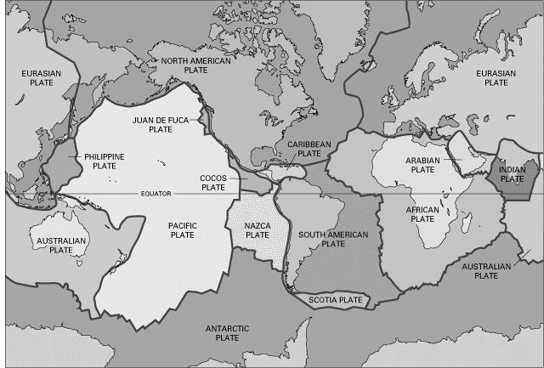
BSMK (North Dakota)

Slide 10
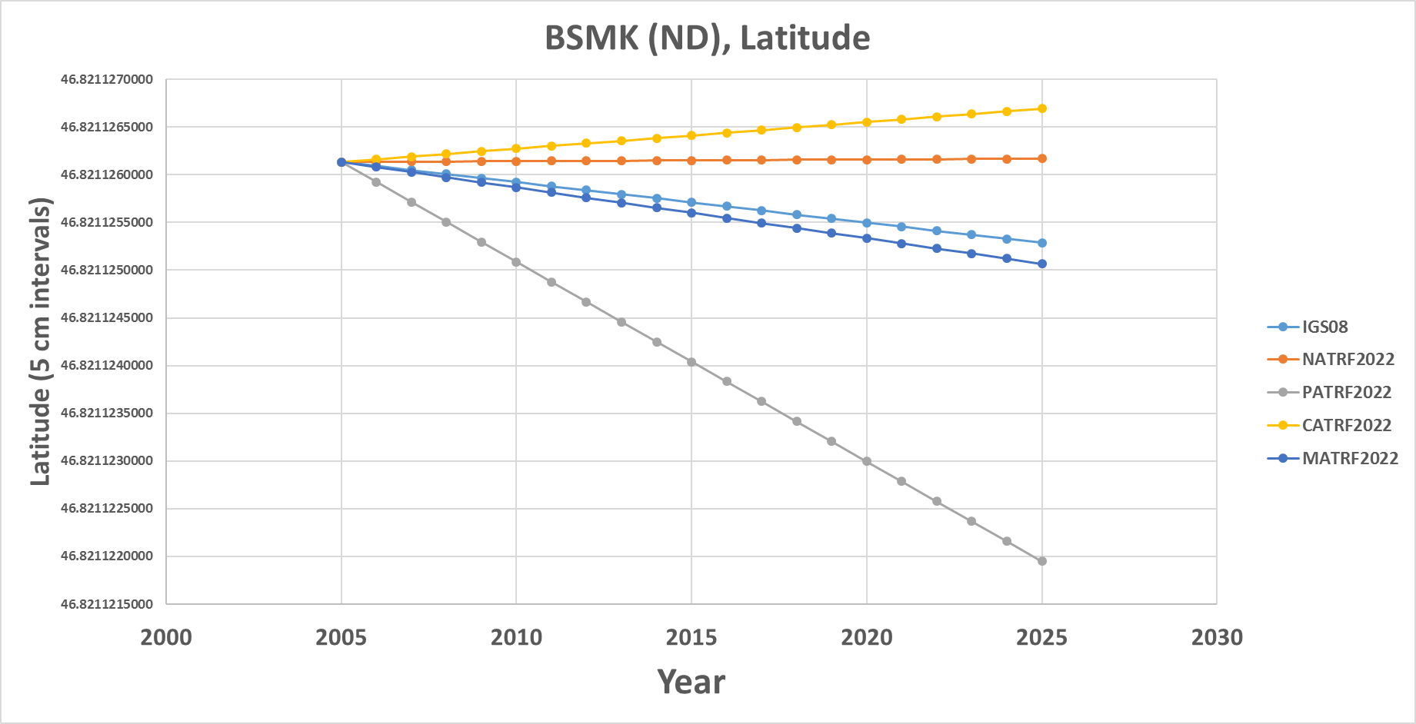
BSMK (North Dakota)
Let’s set t to 2005.0 for now…
Note the time-dependent coordinate in latitude in NATRF2022 is stable! That means the NATRF2022 IFVM for latitude will be ZERO for this point.
0

Slide 11
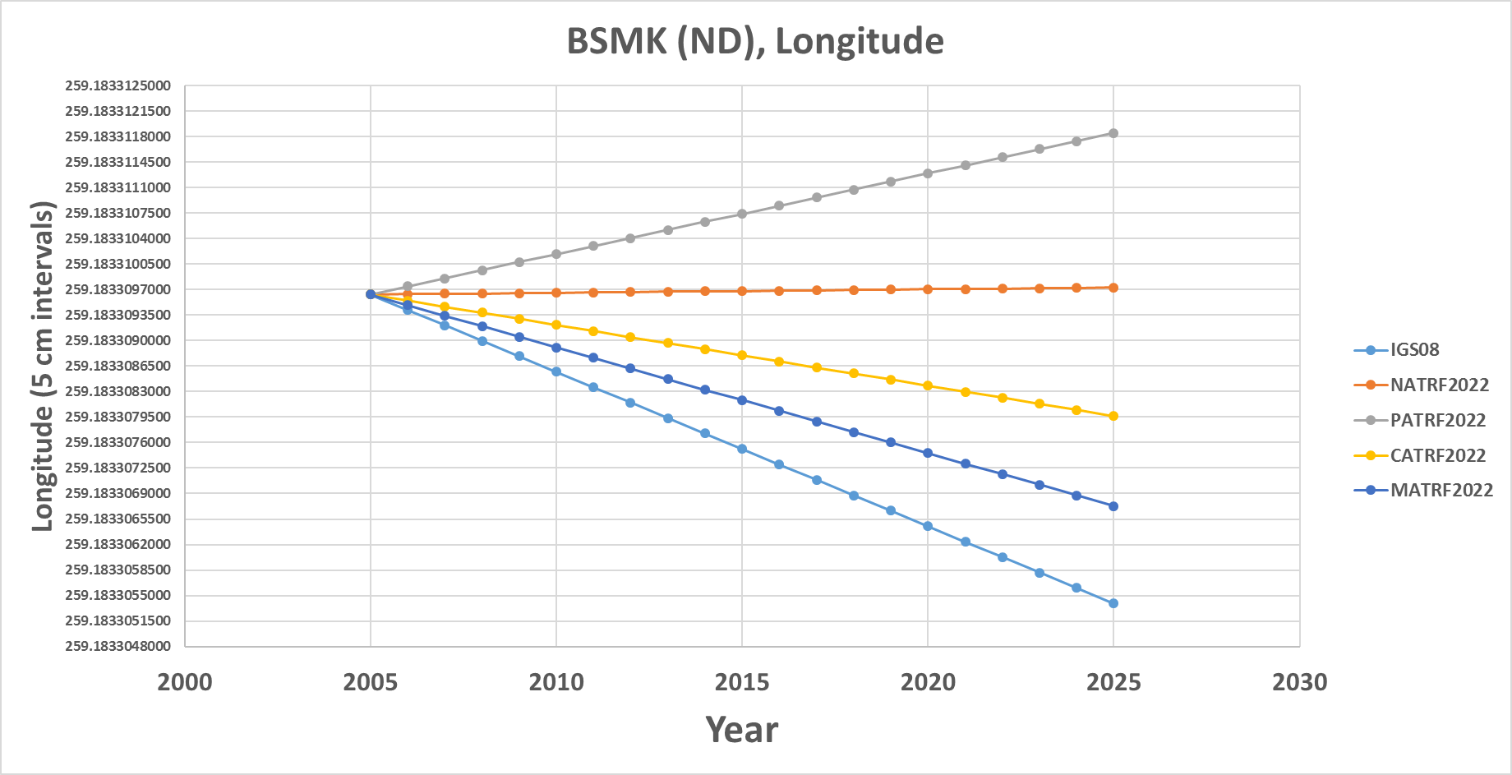
BSMK (North Dakota)
Similarly, the time-dependent coordinate in longitude in NATRF2022 is stable! That means the NATRF2022 IFVM for longitude will be ZERO for this point.

Slide 12
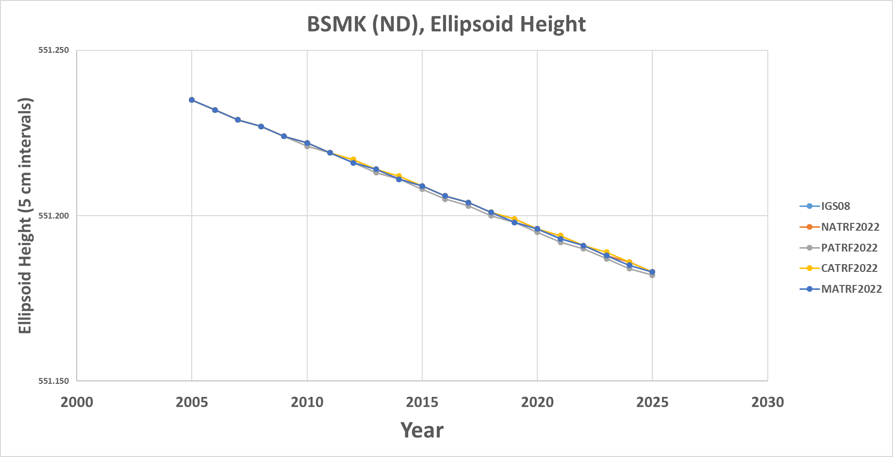
BSMK (North Dakota)
However, in every frame, this point is subsiding! That will be captured in the ellipsoid height component of the IFVM for each frame.

Slide 13
ICT2 (Kansas)

Slide 14
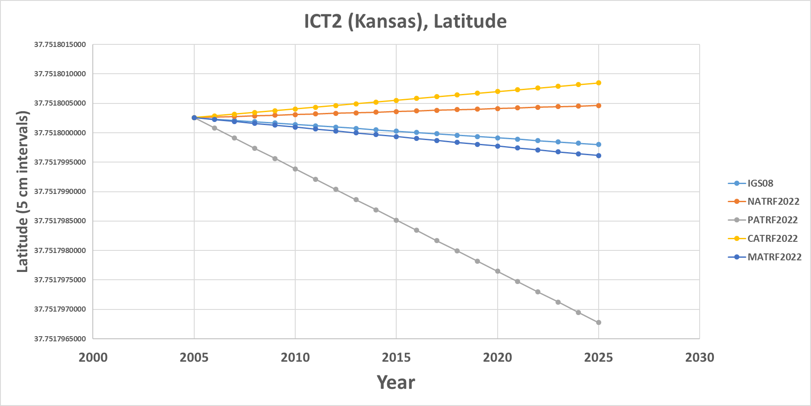
ICT2 (Kansas)
Note the time-dependent movement of this Kansas point in latitude in NATRF2022! Such movement will be captured in the IFVM.

Slide 15
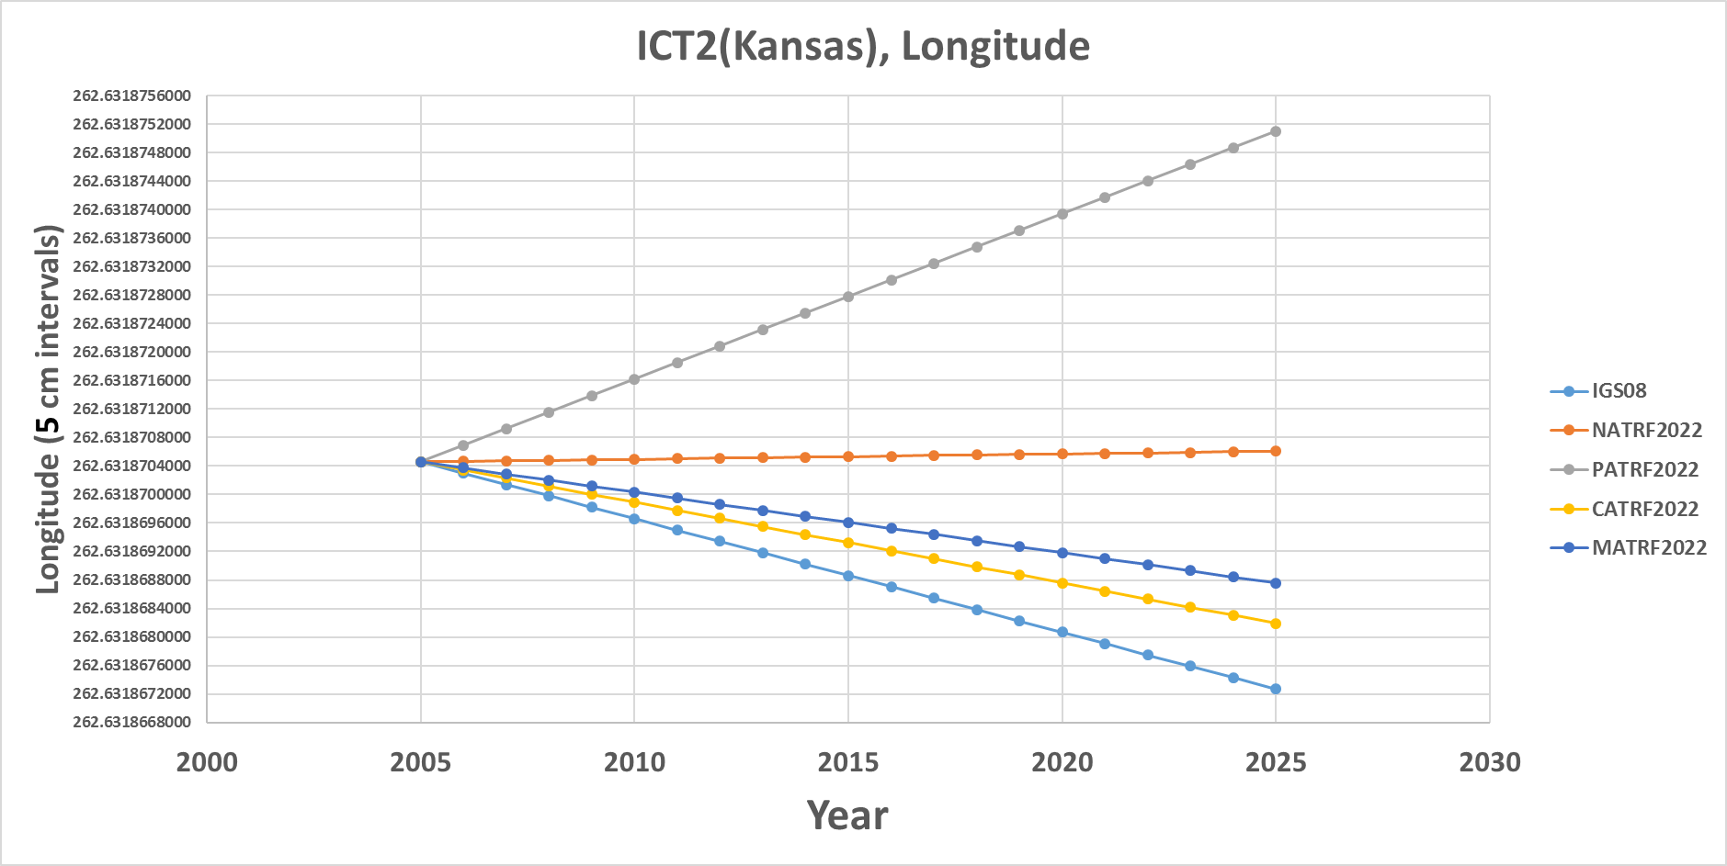
ICT2 (Kansas)
However, in longitude, this CORS is fairly stable in NATRF2022! Still, any deviation from stability would be in the IFVM.

Slide 16
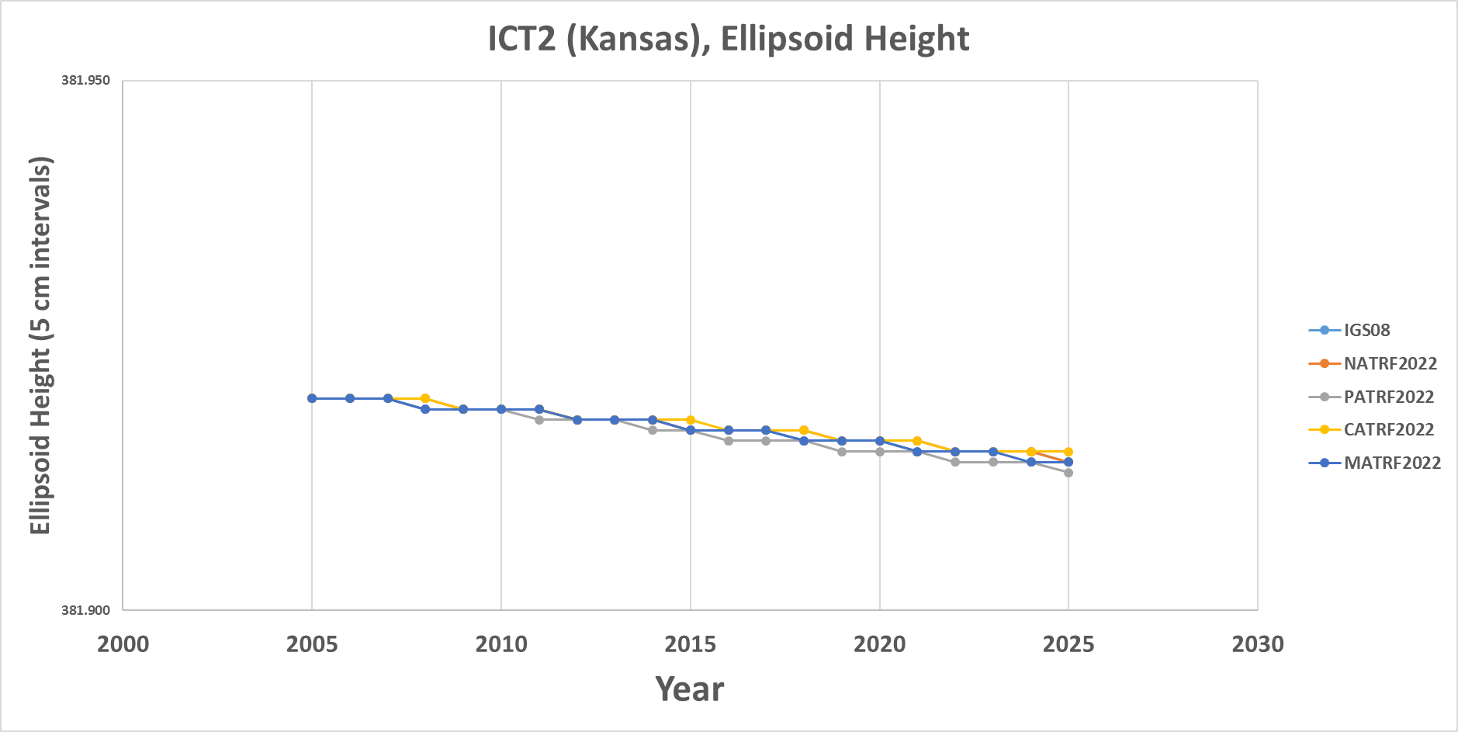
ICT2 (Kansas)
All vertical motion is captured in the IFVM.

Slide 17
PIN1 (S. California)

Slide 18
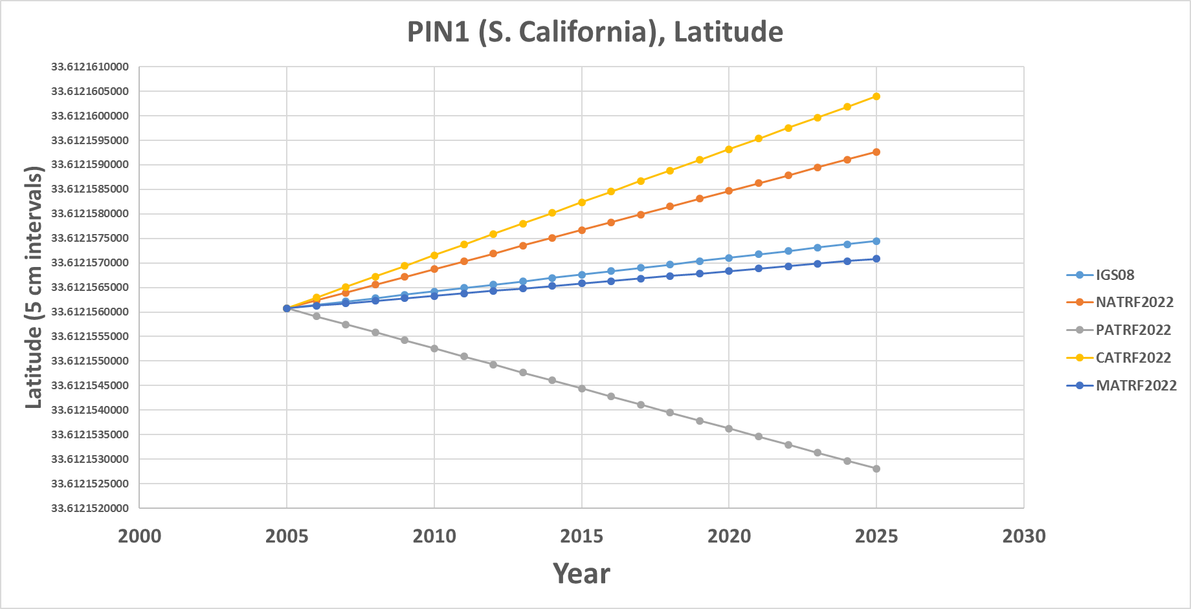
PIN1 (S. California)
In latitude, S. California neither behaves like the NA plate nor the Pacific plate. Both deviations from stability will be captured in each frame’s IFVM.

Slide 19
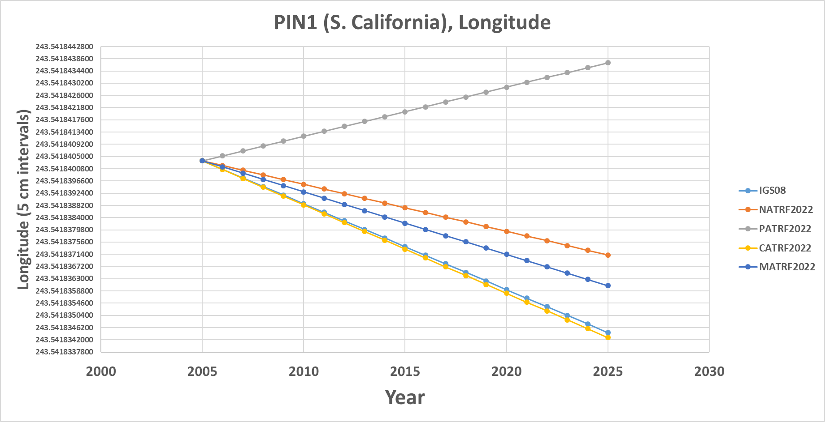
PIN1 (S. California)
In longitude, S. California neither behaves like the NA plate nor the Pacific plate. Both deviations from stability will be captured in each frame’s IFVM.

Slide 20
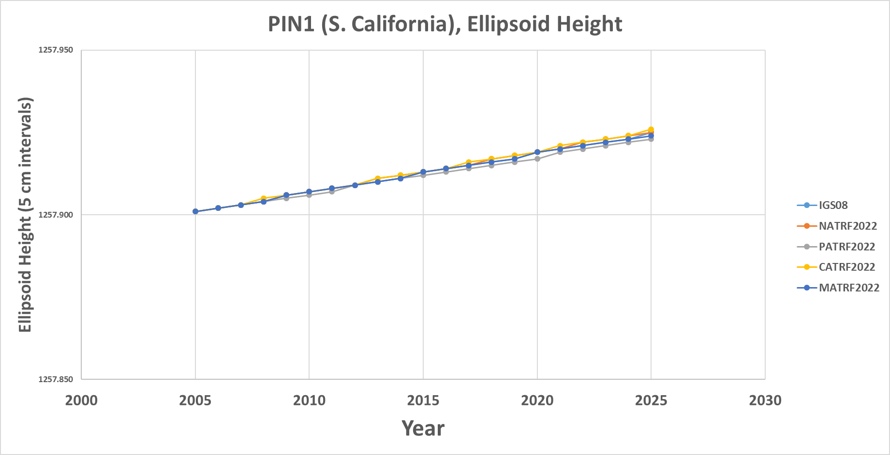
PIN1 (S. California)
In ellipsoid height, all frames are equal and the entire signal is captured in the IFVM.

Slide 21
Additional examples will be presented at the end if time allows

Slide 22
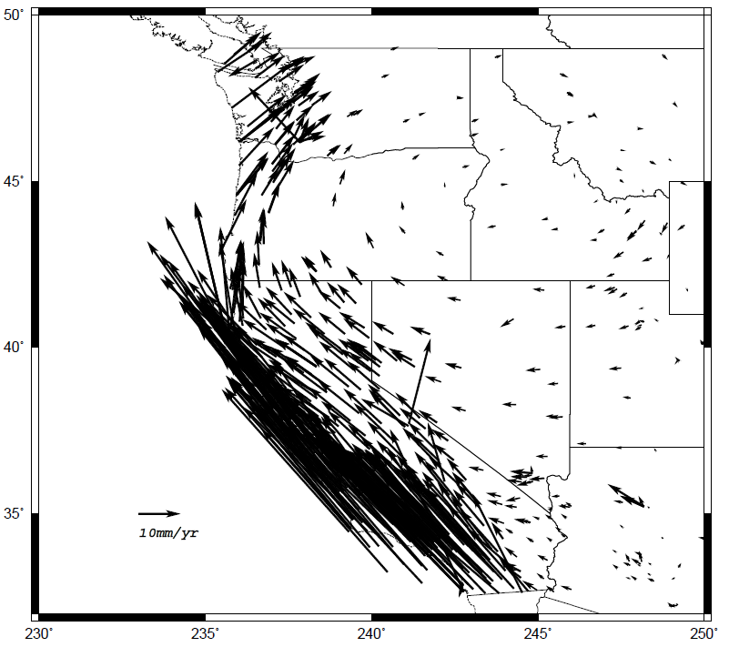
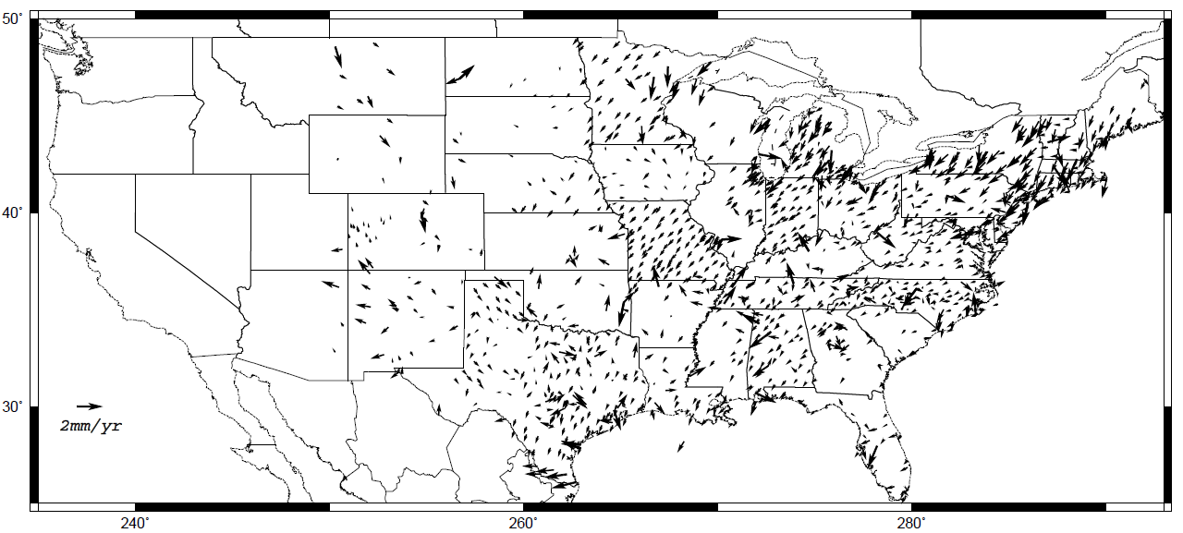
Intra-frame velocity model
Shown on this slide are CORS-implied velocities after removing the rotation of the
North American plate. NATRF2022 coordinates will change through time by these
amounts. These time-dependent changes will be captured in the IFVM.
Note scale difference between West (10 mm/yr) and east (2 mm/yr)

Slide 23
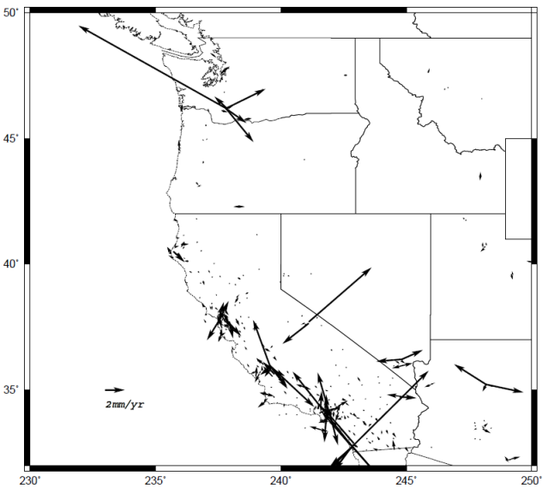
A simple IFVM model is applied…
The simplest IFVM is already available: Interpolation of 3-D velocities from CORS stations
Removing this simple IFVM resolves nearly all velocities seen in the previous slide
Eastern CONUS will largely be resolved
Western CONUS has some anomalies
NGS is engaged in research to provide the highest quality IFVM without our abilities, possibly enveloping:
  InSAR
  Geodynamic

Slide 24

Let’s change gears…

Slide 25
Replacing NAVD 88
  The Old:
  NAVD 88
  PRVD 02
  VIVD09
  ASVD02
  NMVD03
  GUVD04
  IGLD 85
  IGSN71
  GEOID12B
  DEFLEC12B
Orthometric
Heights
  The New:
  The North American-Pacific Geopotential Datum of 2022 (NAPGD2022)
  - Will include GEOID2022
Normal
Orthometric
Heights
Dynamic
Heights
Gravity
Geoid
Undulations
Deflections of
the Vertical

Slide 26
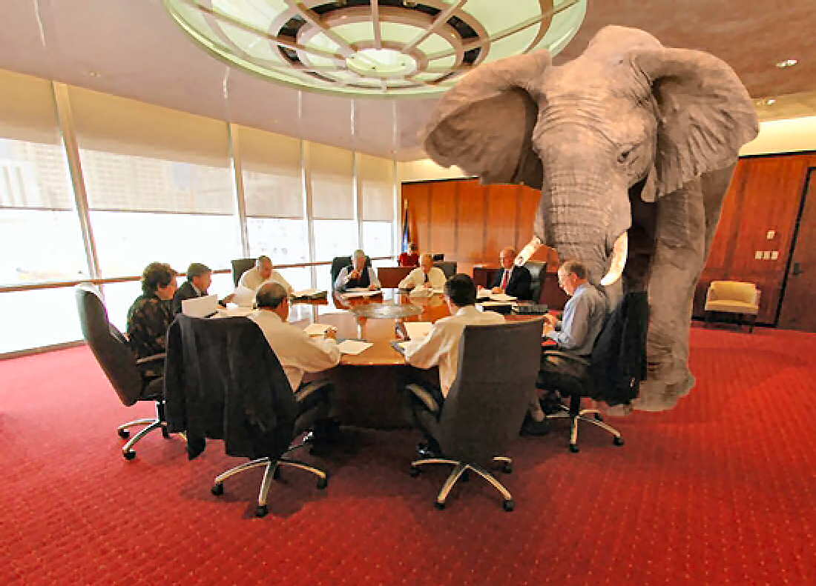
Geopotential Basics
Why isn’t this a vertical datum?
  Because it contains more than heights
    And therefore NGS wants to be accurate in its name

Slide 27
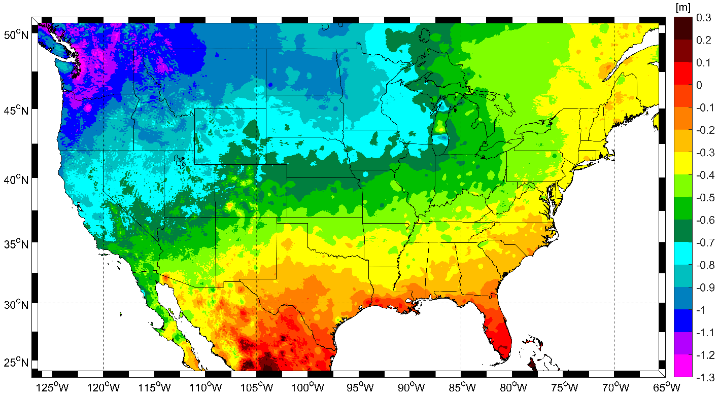
Expected changes to orthometric heights

Slide 28
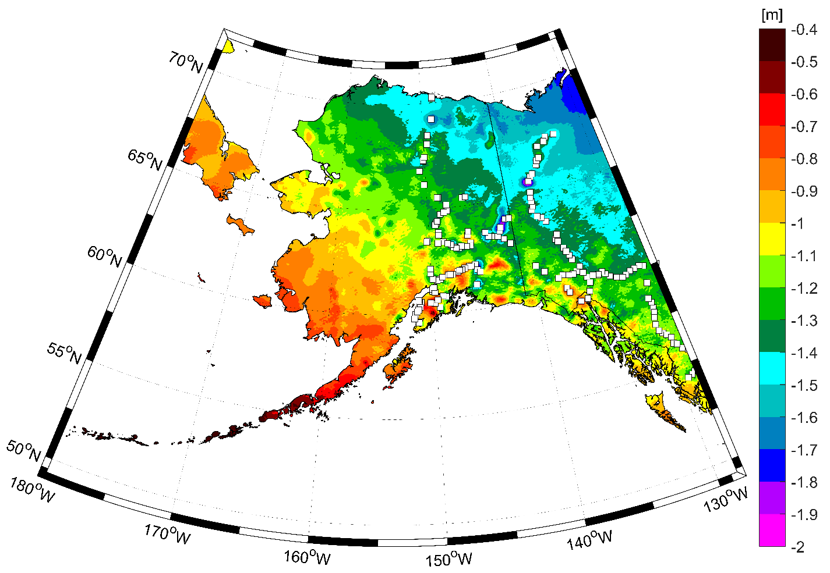
Expected changes to orthometric heights

Slide 29
Definitional Relationship
$H_{NAPGD2022}(t)≡h_{∗TRF2022}(t)−N_{GEOID2022}(t)$
Time-dependencies of ellipsoid heights
are captured in the IFVM
Time-dependencies of geoid undulations
are captured in the dynamic component
of GEOID2022 (“DGEOID2022”), which
will come from the geoid monitoring
service, or GeMS.

Slide 30
Geoid Monitoring Service
Goal: Track all changes to the geoid which would prevent 1 cm accuracy
Three aspects need to be tracked:
  Shape
  Size
  Global Sea Level Change

Slide 31
Geoid Shape
Like “squeezing a balloon”
Large mass changes
  Influx of mantle material under Hudson Bay causing the geoid to bulge 2 mm/year
Not crustal sloughing/compression
  Not enough mass entering/leaving an area to change the geoid

Slide 32
Geoid Size
Like “inflating a balloon”
Not likely to be an issue
  Reliant upon Earth gaining or losing enough total mass to inflate/deflate the geoid

Slide 33
Global Sea Level Change
Like “two balloons, one inside the other, and one day I pick the inside balloon as ‘the geoid’ and the next day I pick the outside balloon as ‘the geoid’
By definition, the geoid “best fits” GMSL
But GMSL changes rapidly, and this might disrupt users
Set “threshold” value to “jump” the geoid…

Slide 34
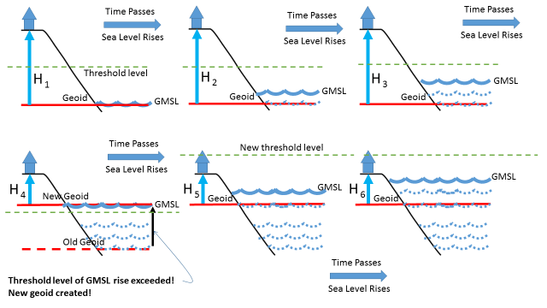
Choosing a new geoid as GMSL changes

Slide 35
High resolution products
All will be 1 x 1 arcminute grids
All will cover three finite regions of the globe
All will have a static and dynamic component
  Dynamic surface gravity not expected to be ready by 2022
GEOID2022
  Official converter of *TRF2022 ellipsoid heights into NAPGD2022 orthometric heights
DEFLEC2022
  Surface deflections of the vertical in N/S and E/W
GRAV2022
  Surface acceleration of gravity

Slide 36
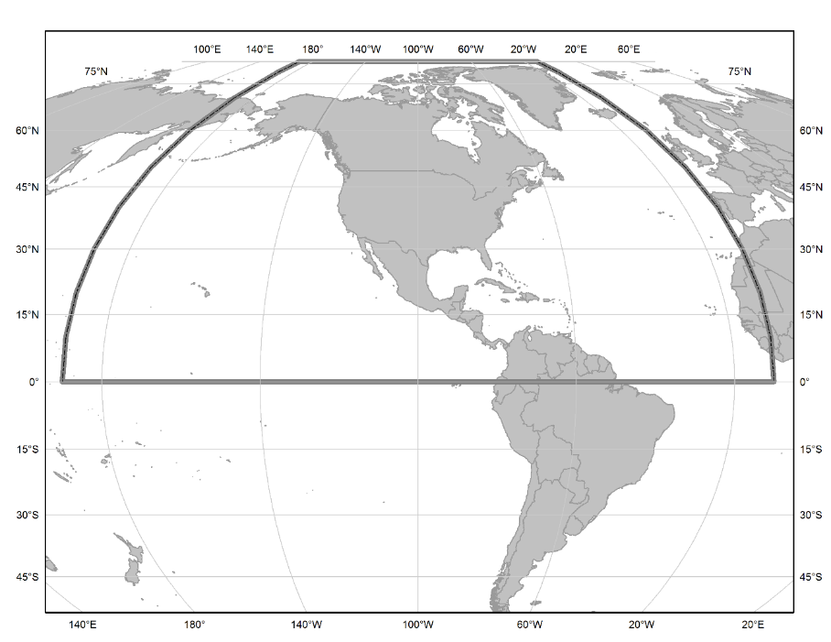
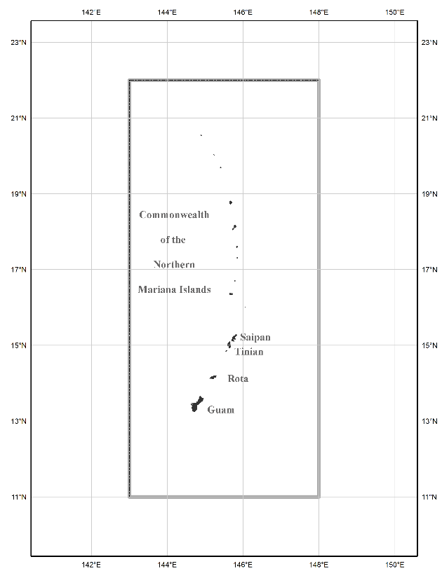
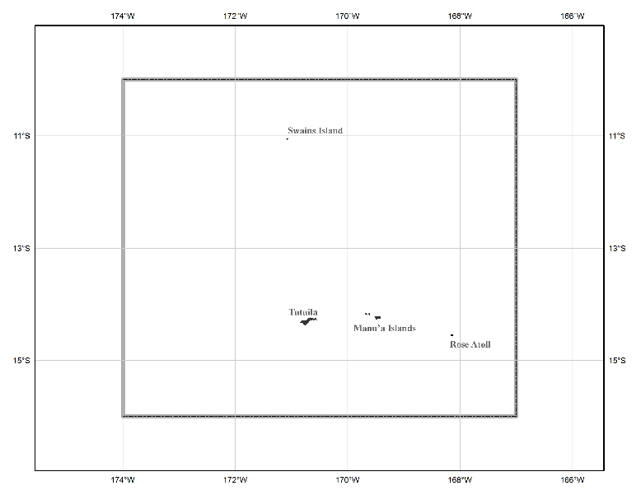
The three gridded regions
“North American region”
¼ of the Earth
“American Samoa region”
“Guam/CNMI region”

Slide 37
Let’s change gears one more time…

Slide 38
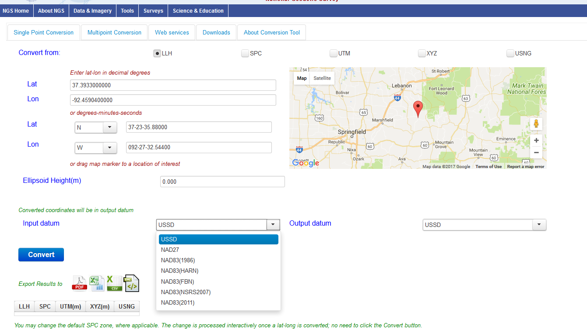
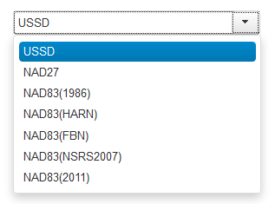
The new Geodetic Toolkit with NADCON 5.0
https://beta.ngs.noaa.gov/gtkweb/

Slide 39
NAD 83 (2011)
Allowable Regions:
CONUS
Alaska
Hawaii
PR/VI
AS
Guam/CNMI
St. Paul
St. George
St. Lawrence
Notes:
φ, λ, h
xyz2plh
plh2xyz
SPC83
a,f (GRS 80)
NAD 83
X, Y, Z
SPC
USNG
NAD 83
UTMS
a,f (GRS 80)
USNG
UTM
USNG
NAD 83

Slide 40
X, Y, Z
φ, λ, h
φ, λ, h
Region: CONUS
NADCON 5 connections in RED
2022
X, Y, Z
SPC
UTM
USSD
USNG
UTM
φ, λ, h
φ, λ, h
NAD 27
NAD 83 (2011)
X, Y, Z
SPC
X, Y, Z
SPC
USNG
UTM
USNG
UTM
NAD 83 (NSRS2007)
φ, λ, h
NAD 83 (1986)
φ, λ, h
NAD 83 (FBN)
NAD 83 (HARN)
φ, λ, h
X, Y, Z
SPC
X, Y, Z
SPC
φ, λ, h
USNG
UTM
USNG
UTM
X, Y, Z
SPC
X, Y, Z
SPC
USNG
UTM
USNG
UTM

Slide 41
So much more…
OPUS-Projects being expanded to replace Bluebooking
  Leveling, RTK, Gravity
An entire new database being built
All historic GPS data back to 1997 being reprocessed into the TRFs
A new leveling manual to work in a GPS/geoid “vertical datum”

Slide 42
So much more…
VERTCON 3 under construction
More GIS friendly products, services and tools being built
Replacement for NGS 58 (“GPS derived ellipsoid heights”) manual nearly complete

Slide 43
Thank you!

Slide 44
Questions?

Slide 45
Extra Slides

Slide 46
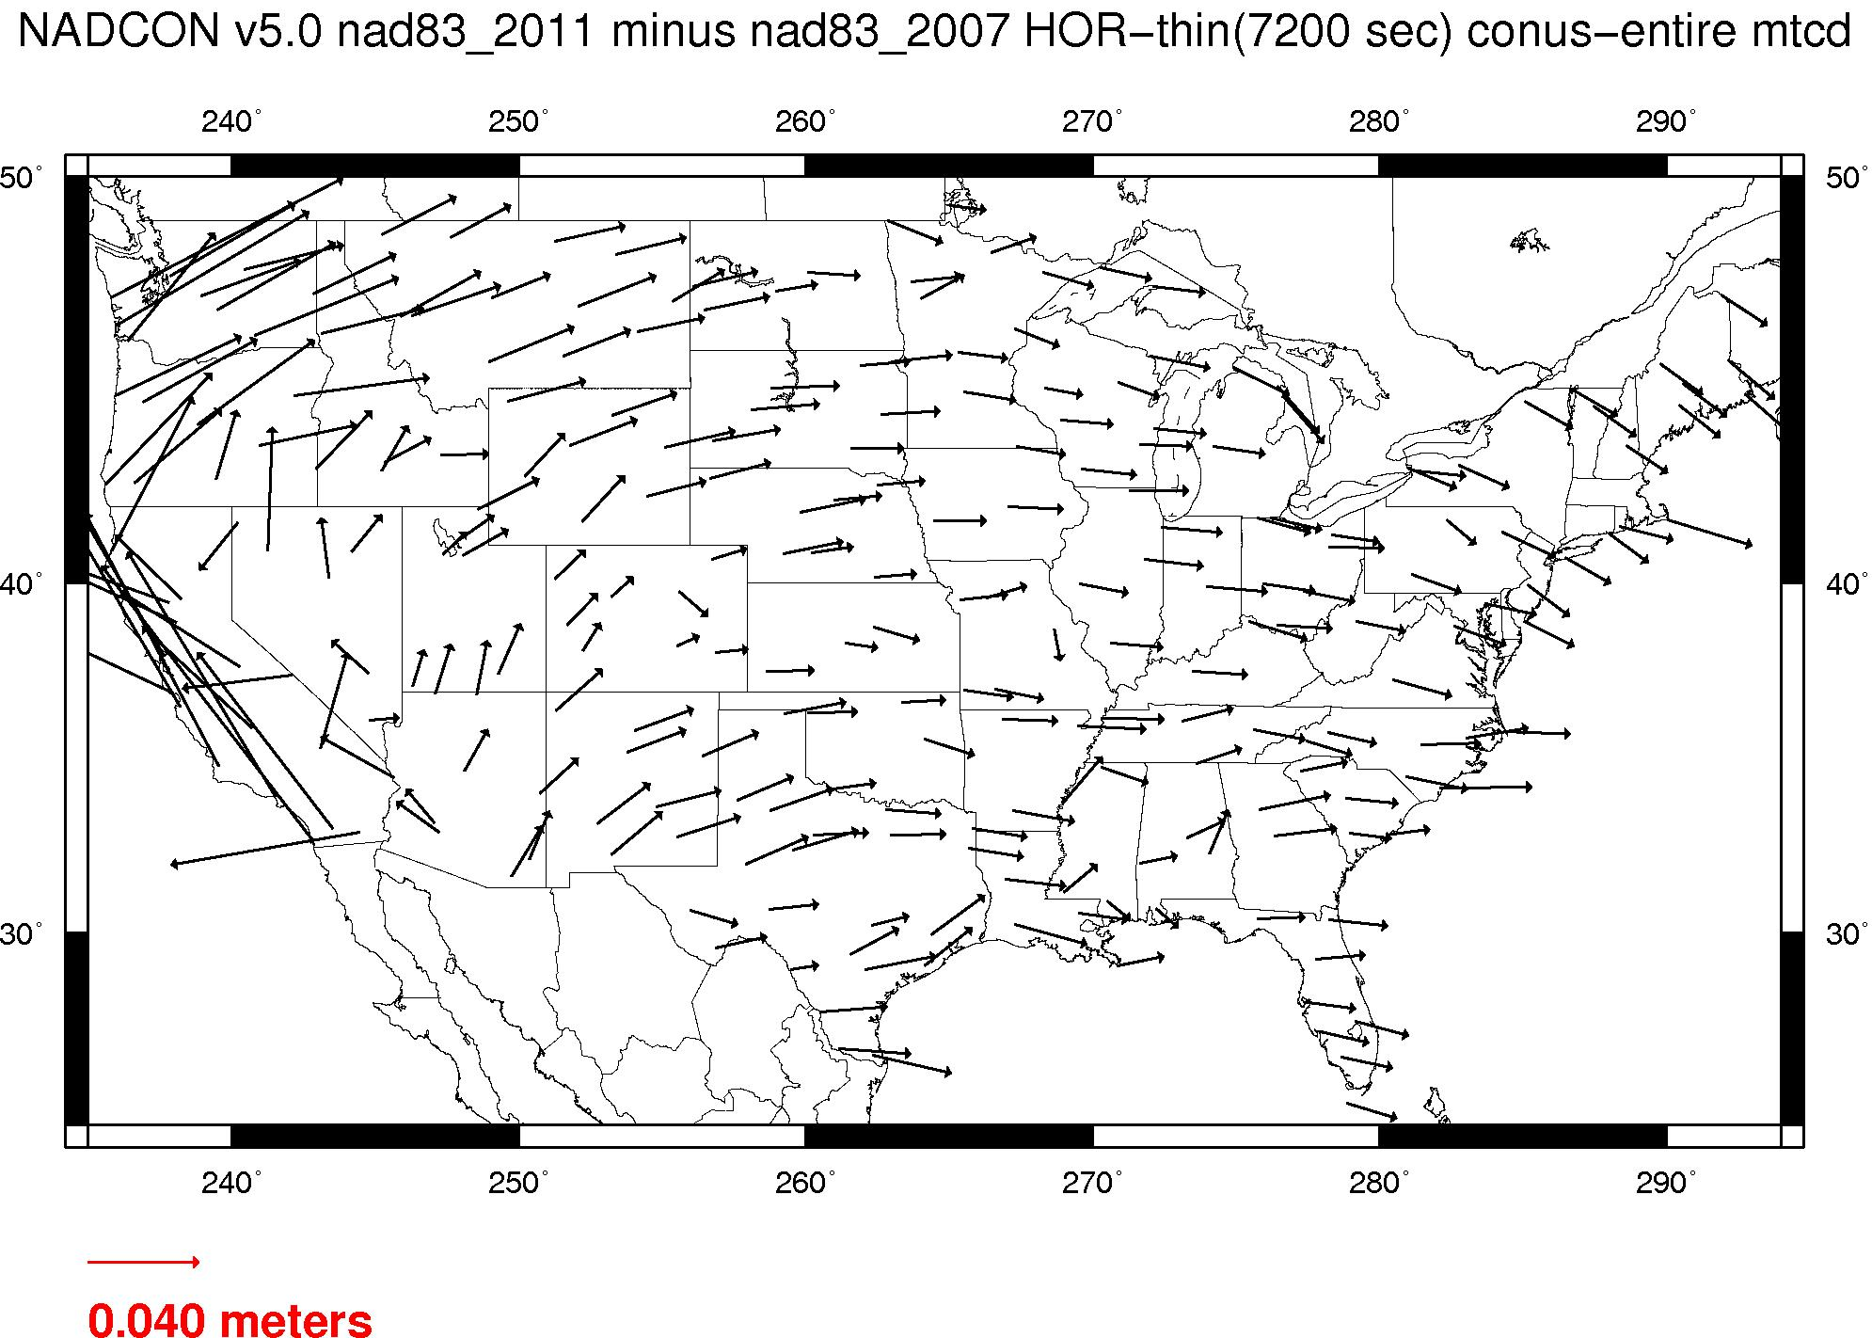
Plate-(pseudo)fixed frames
NAD 83(2011) minus NAD 83(NSRS2007)
NAD 83(NSRS2007)
Epoch 2002.0
NAD 83(2011)
Epoch 2010.0
If NAD 83 were truly “plate
fixed” then an 8 year
epoch change would not
yield the systematic
plate rotation seen here.
(*)TRF2022 will determine
a new Euler Pole rotation
for each of 4 plates.
(*)=NA, C, T or P

Slide 47
NAD 83’s non-geocentricity
Earth’s Surface
h_{NAD83}
φ_{NAD83} – φ_{IGSxx}
λ_{NAD83} – λ_{IGSxx}
h_{NAD83} – h_{IGSxx}
all vary
smoothly by latitude
and longitude
h_{IGSxx}
IGSxx origin
same
GRS-80
ellipsoid
~2.2 m
NAD 83 origin

Slide 48
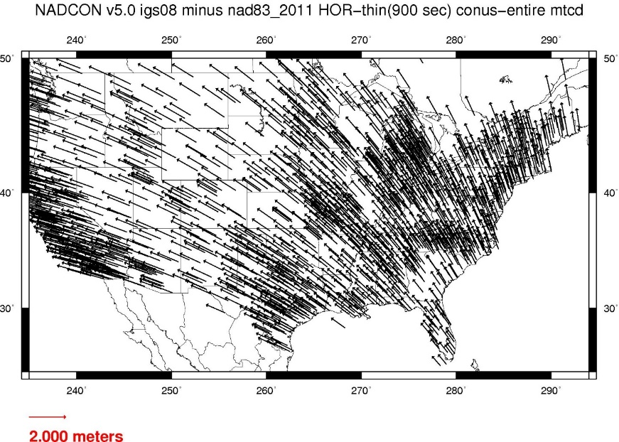
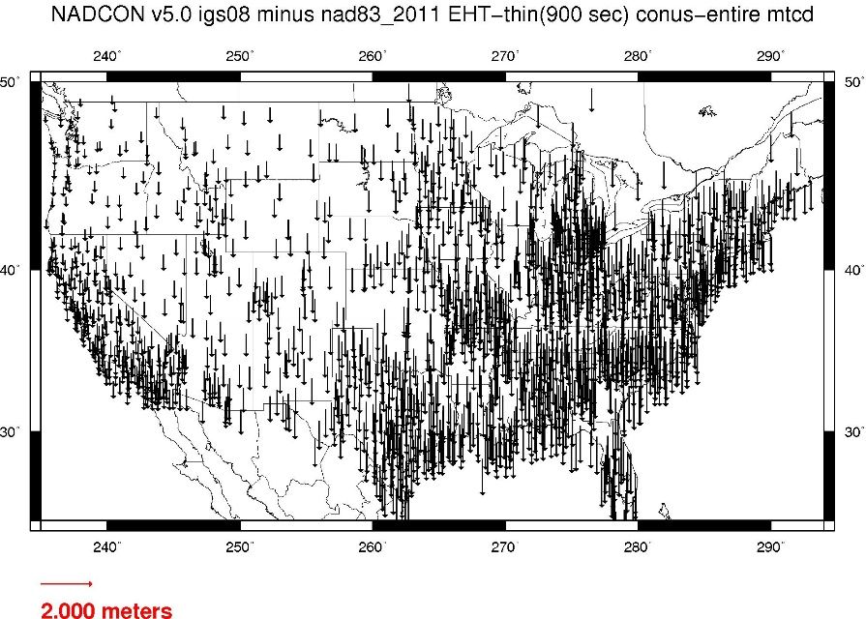
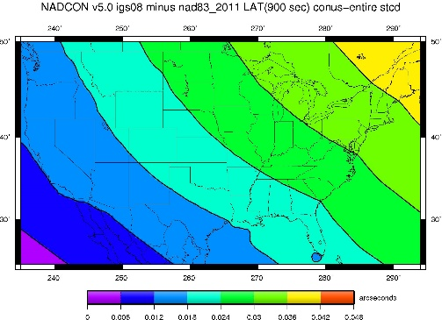
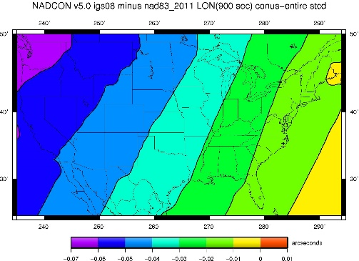
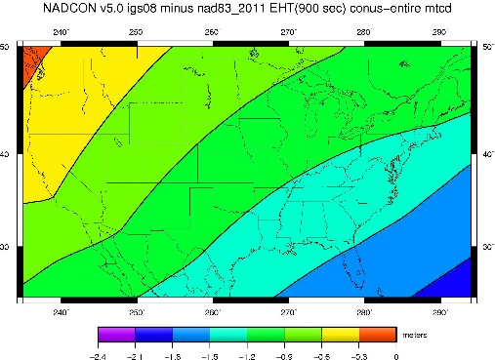
Fixed-Epoch Transformation
NAD 83 to “2022”

Slide 49
PRMI (Puerto Rico)

Slide 50
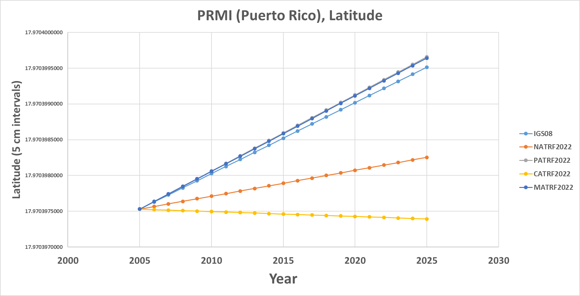
PRMI (Puerto Rico)

Slide 51
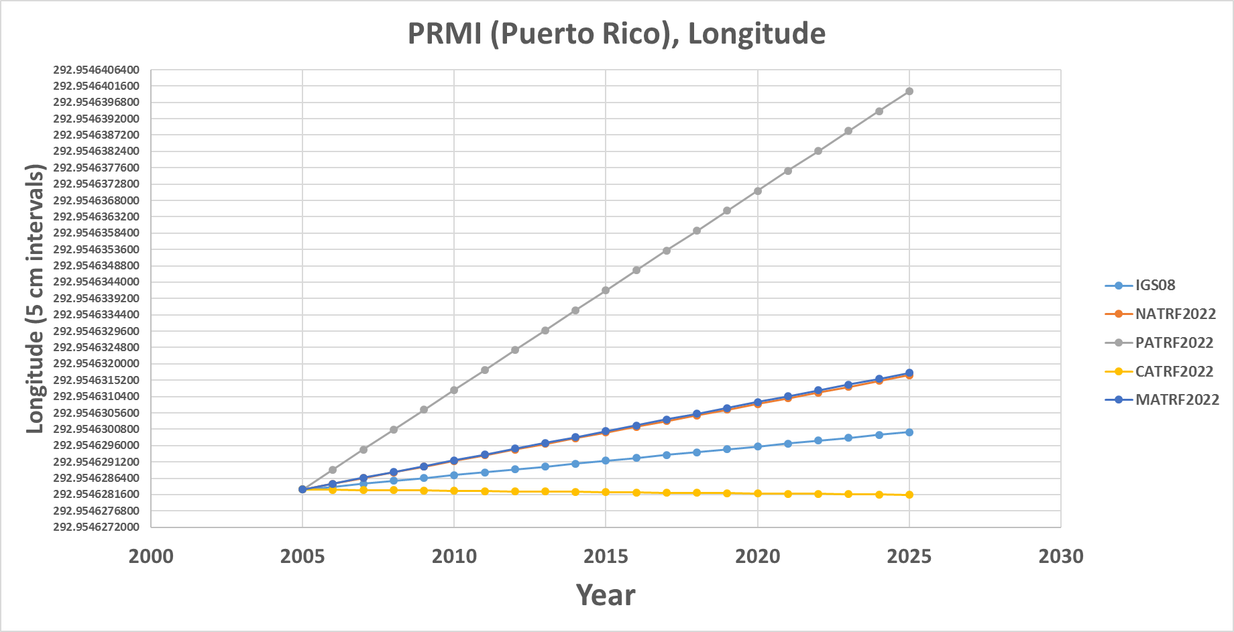
PRMI (Puerto Rico)

Slide 52
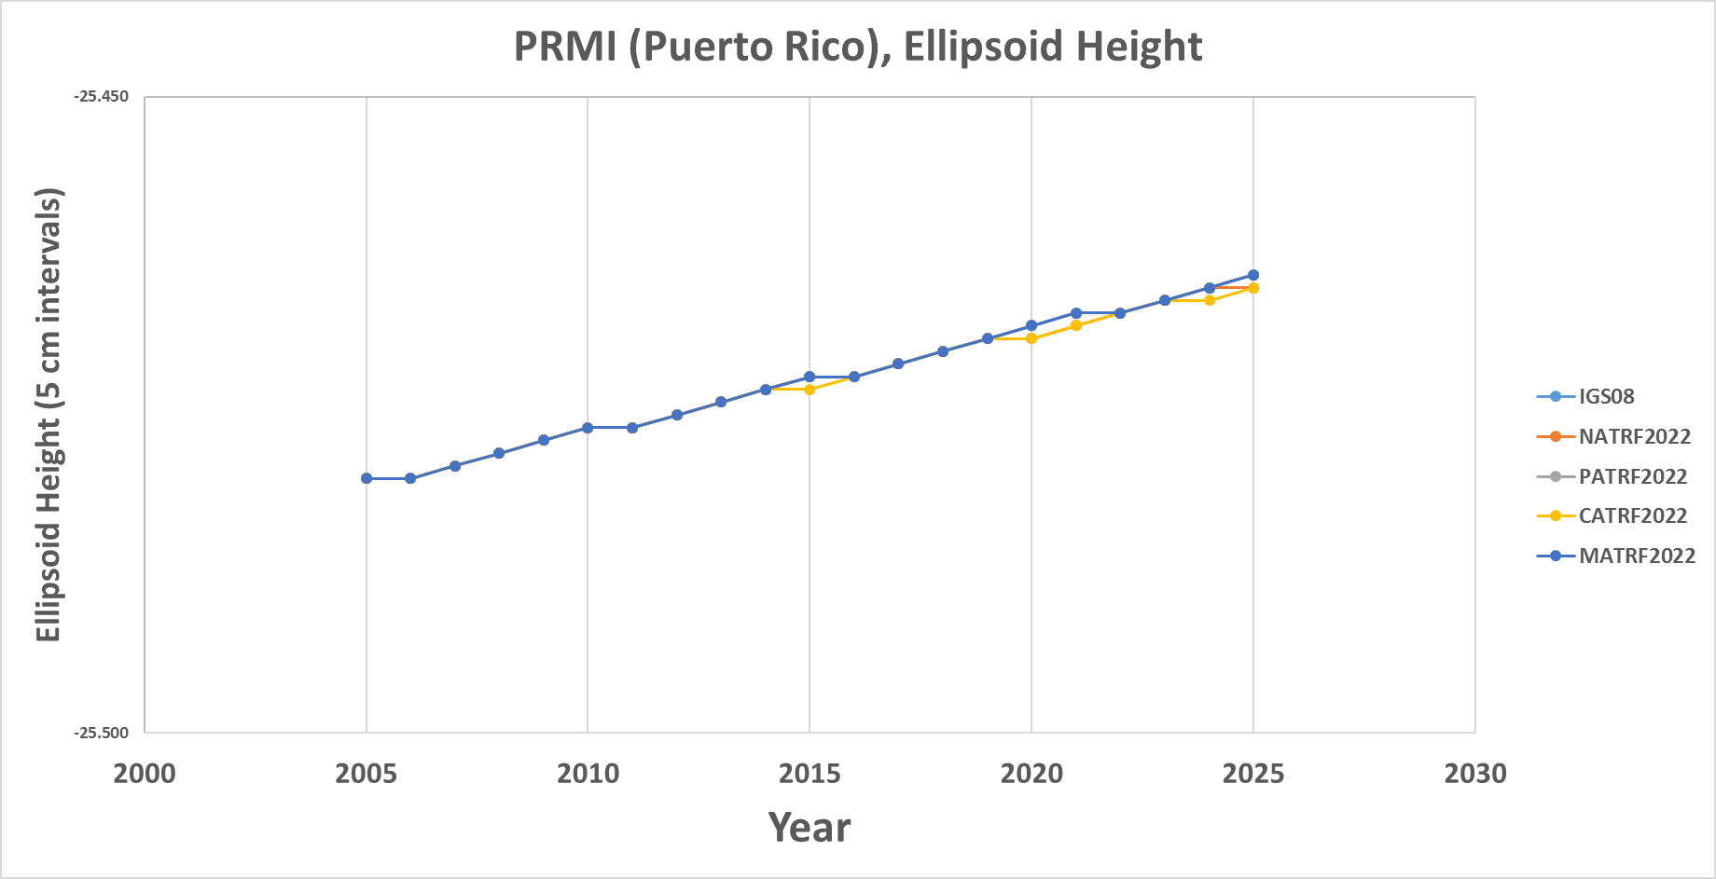
PRMI (Puerto Rico)

Slide 53
BRW1 (N. Alaska)

Slide 54
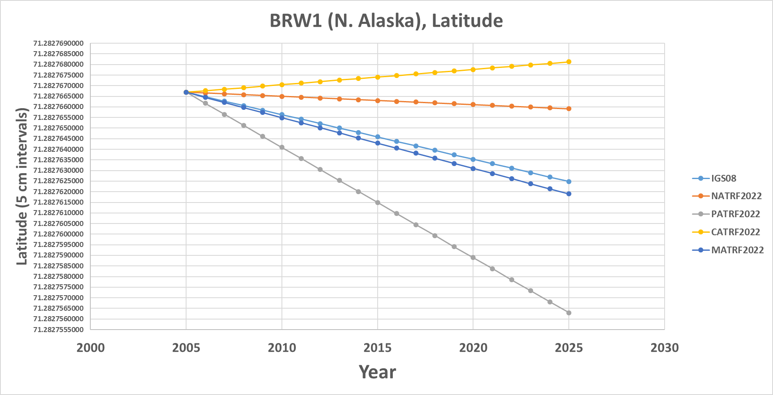
BRW1 (N. Alaska)

Slide 55
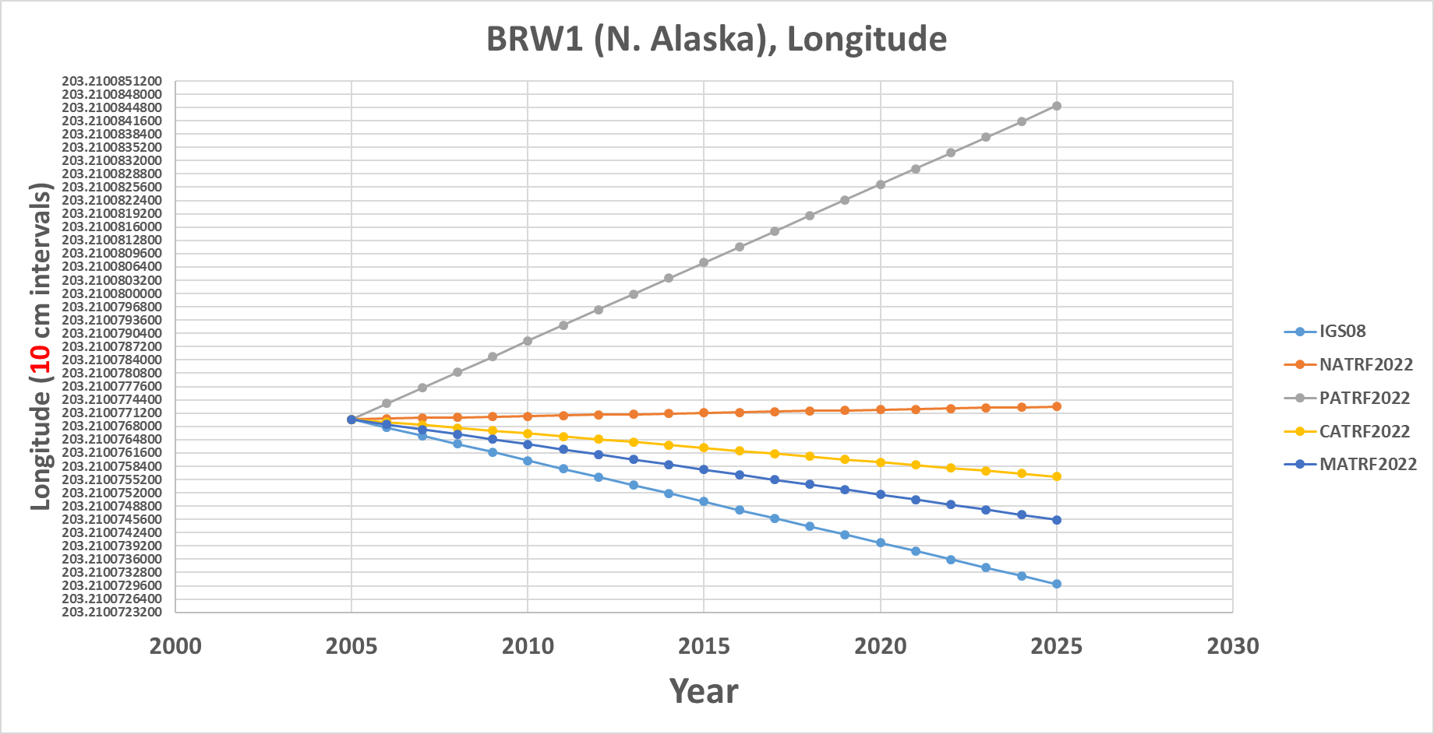
BRW1 (N. Alaska)

Slide 56
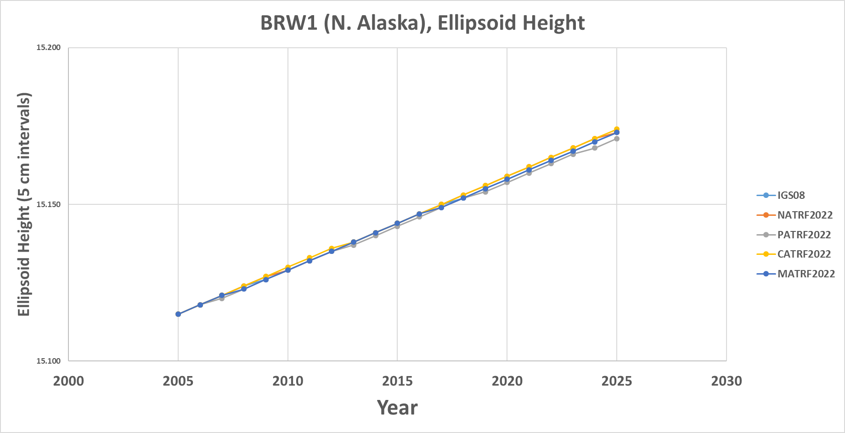
BRW1 (N. Alaska)

Slide 57
KOD6 (S. Alaska)

Slide 58
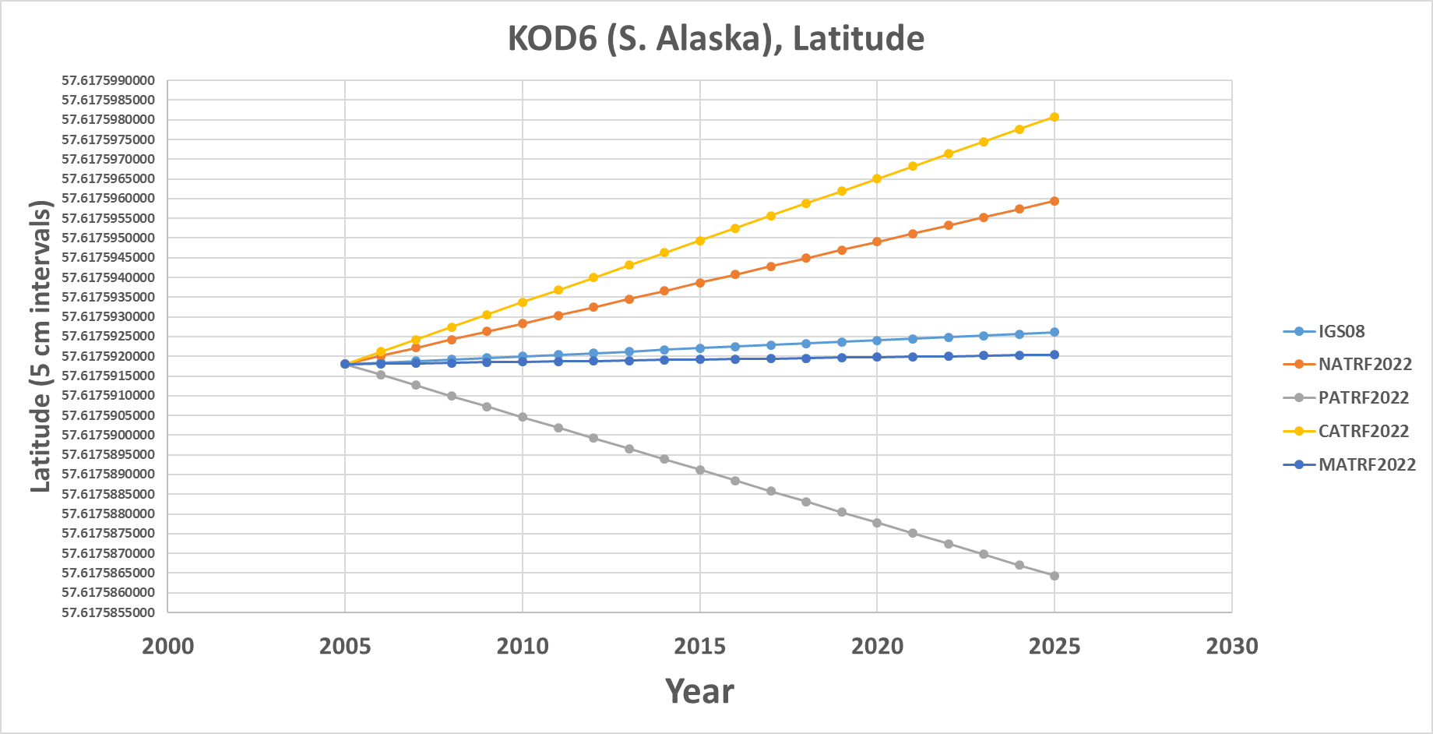
KOD6 (S. Alaska)

Slide 59
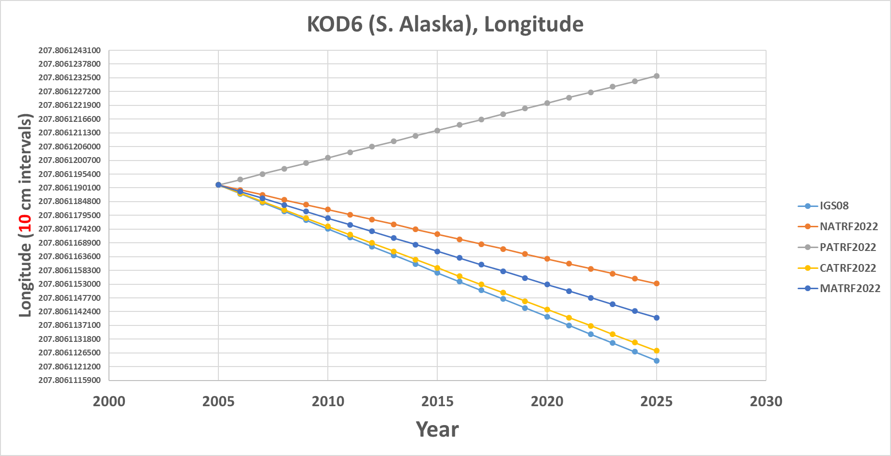
KOD6 (S. Alaska)

Slide 60
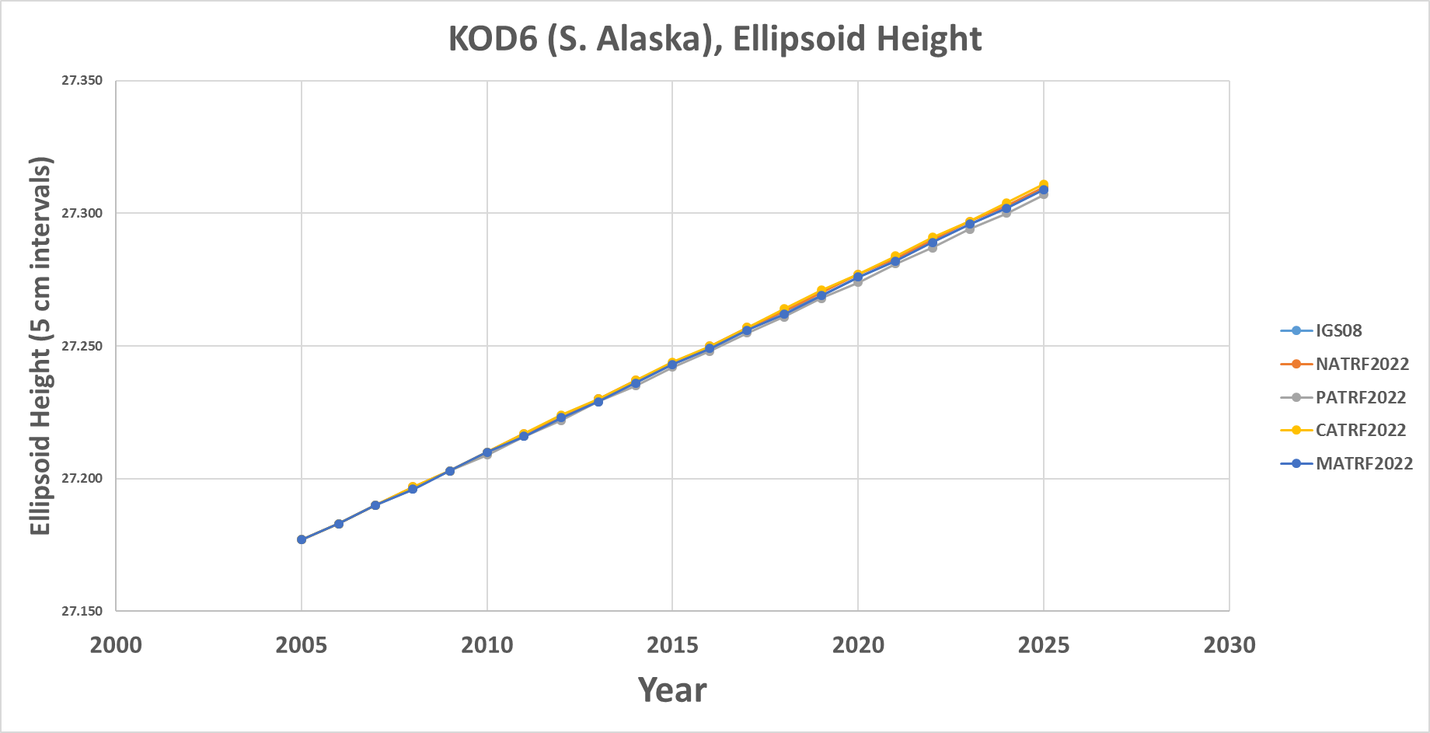
KOD6 (S. Alaska)

Slide 61
KOK5 (Hawaii)

Slide 62
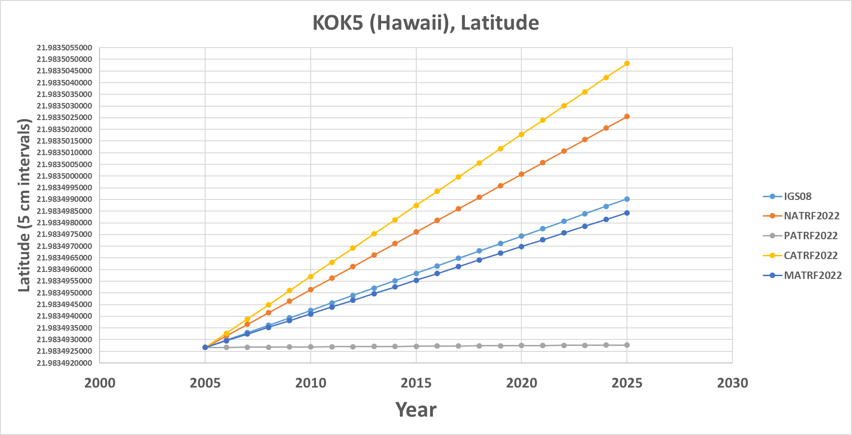
KOK5 (Hawaii)

Slide 63
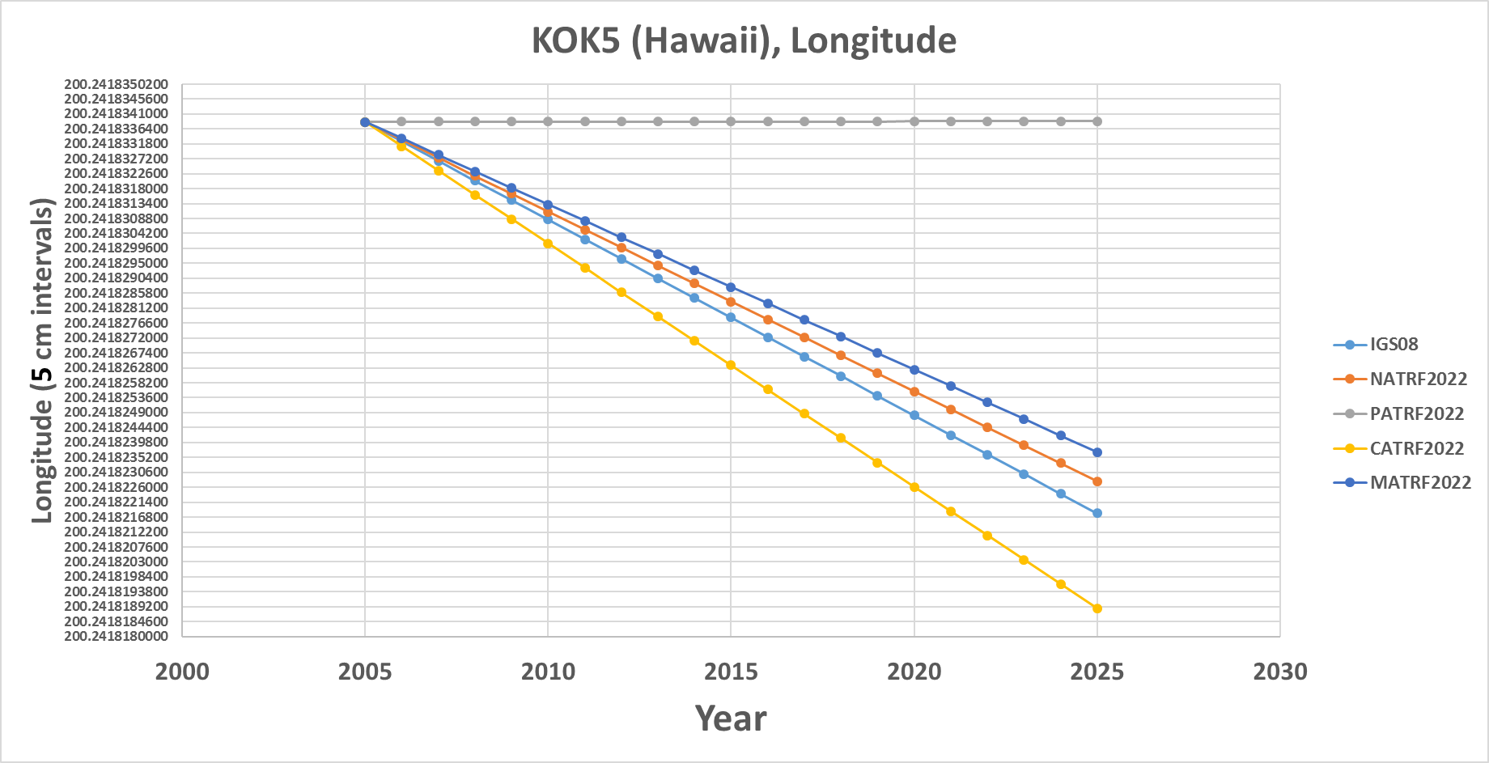
KOK5 (Hawaii)

Slide 64
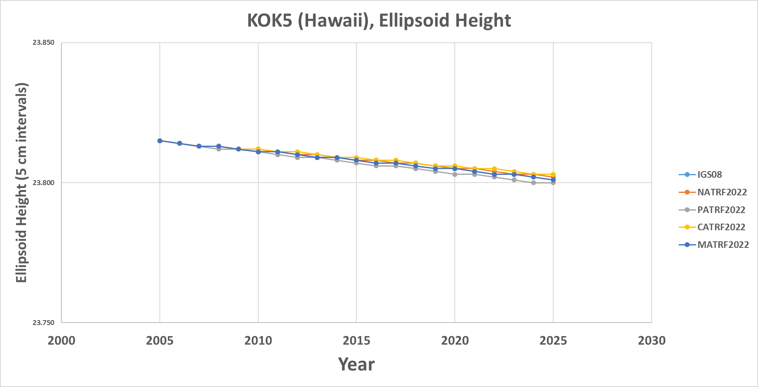
KOK5 (Hawaii)

Slide 65
ASPA (Am. Samoa)

Slide 66
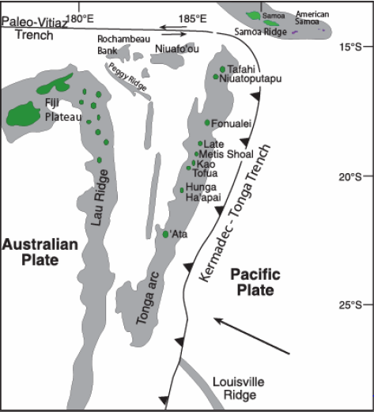
ASPA (Am. Samoa)

Slide 67
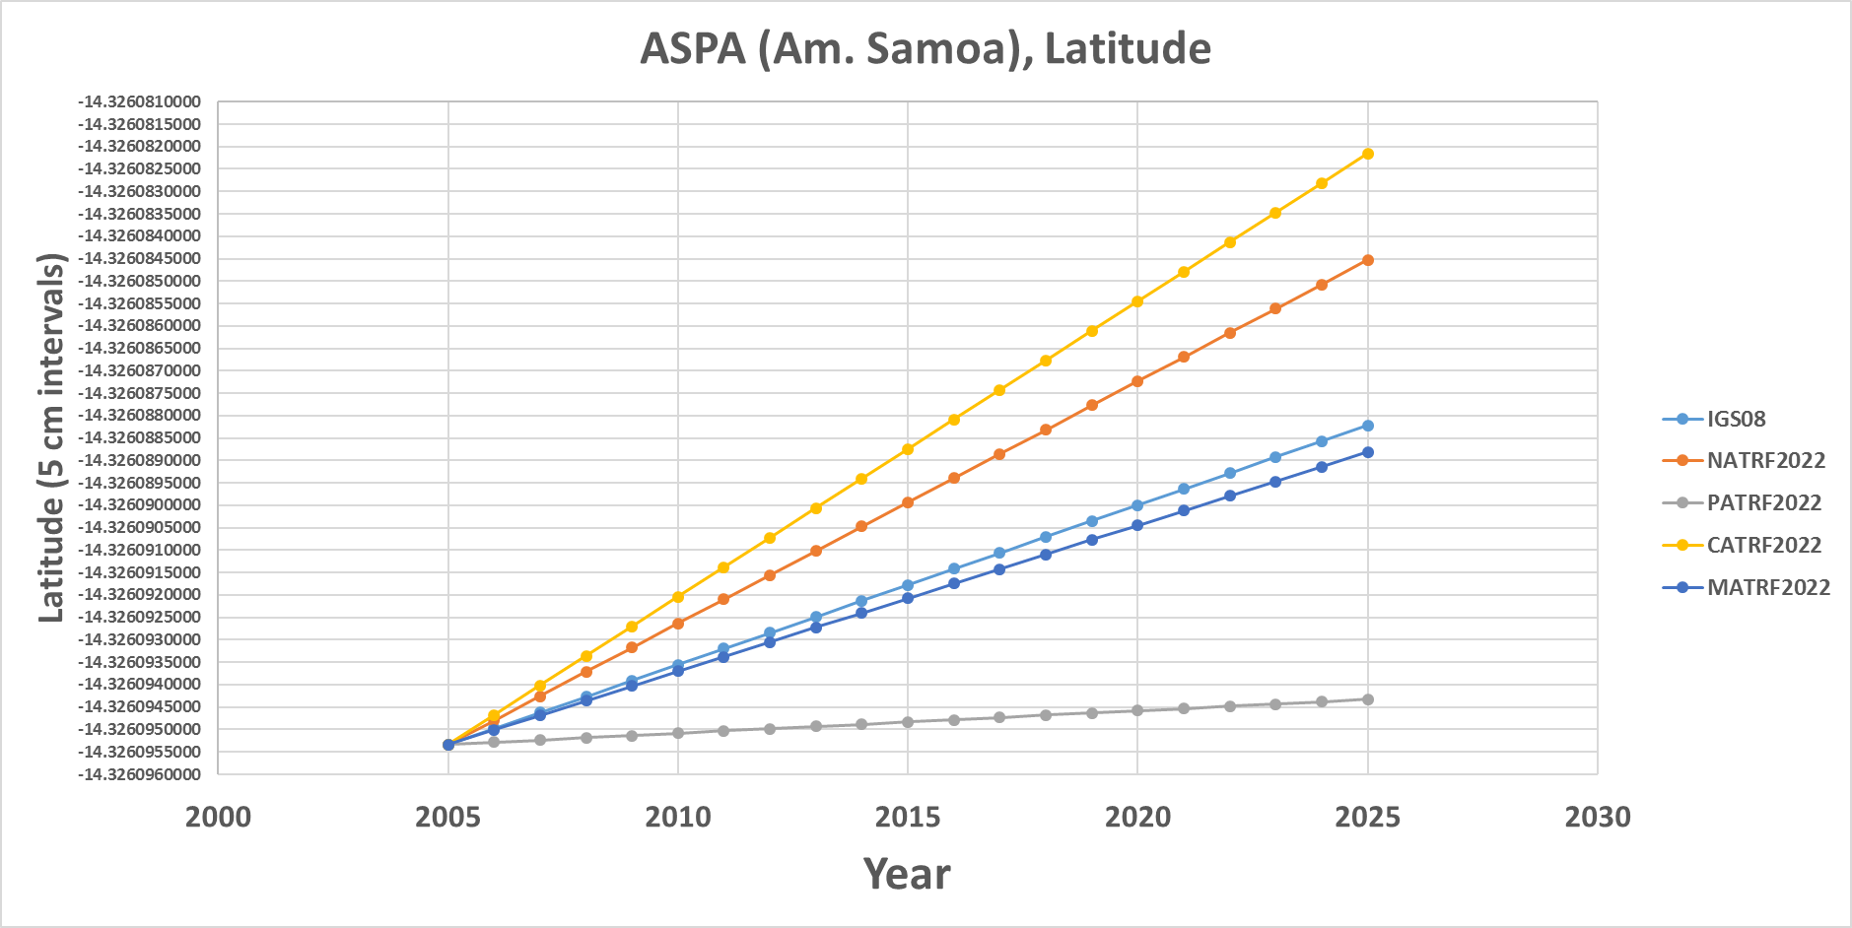
ASPA (Am. Samoa)

Slide 68
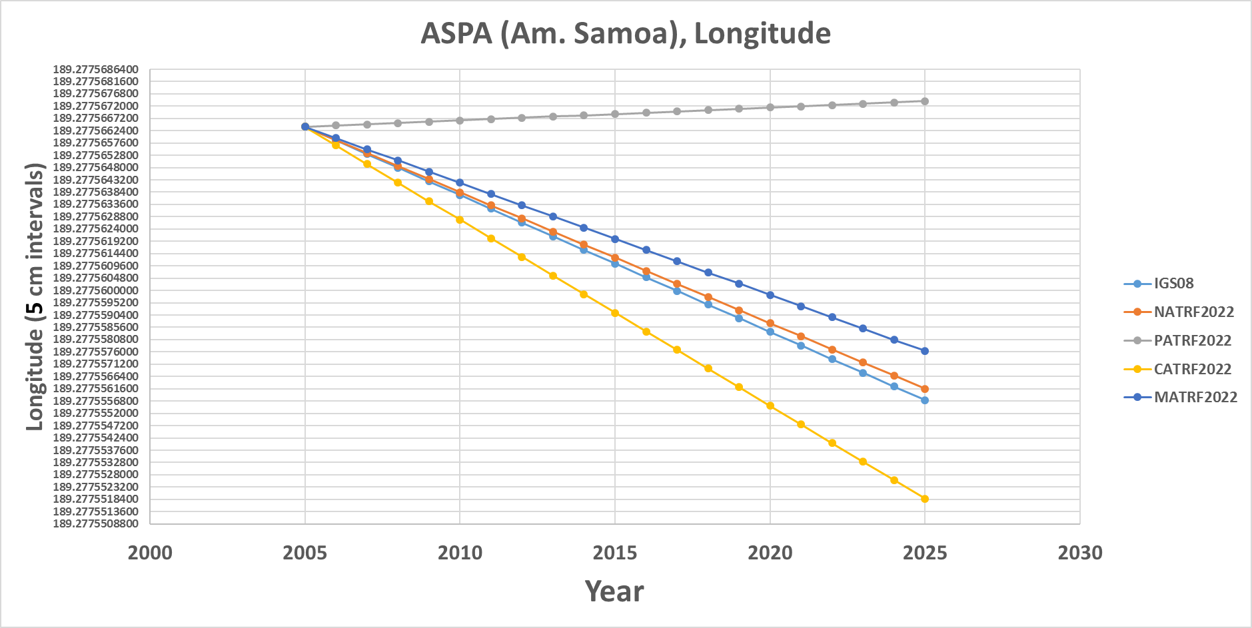
ASPA (Am. Samoa)

Slide 69
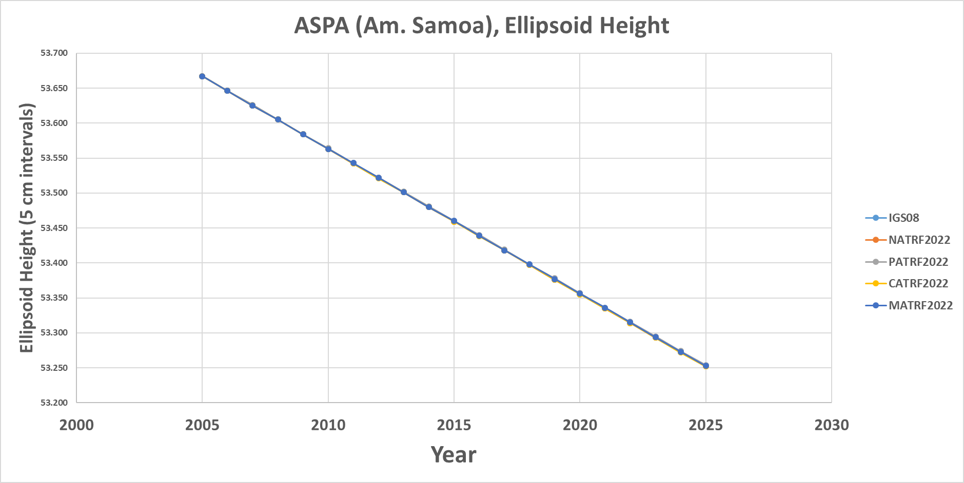
ASPA (Am. Samoa)

Slide 70
Mariana rotation
Snay (2003) used only one CORS (“GUAM”) to determine the Mariana rotation
  But 2 sites at a minimum are needed to uniquely determine a plate’s rotation
    “CNMI” (since decommissioned) was forced to equal “GUAM” to solve the problem
    Ill-posed, yet the values behave reasonably for GUAM.
    Less reasonable for newer CORS “CNMR”

Slide 71
GUAM (Guam)

Slide 72
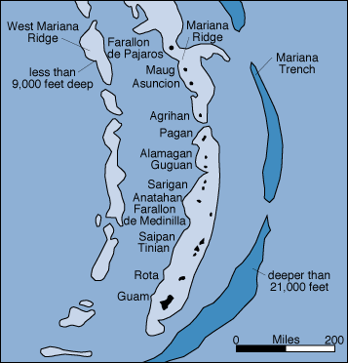
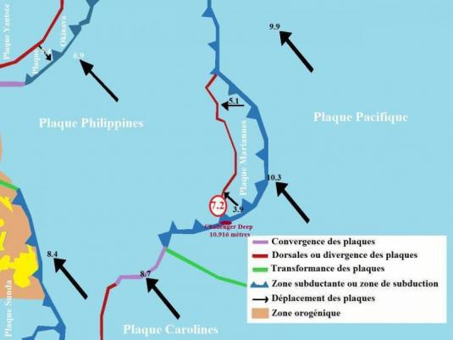
GUAM (Guam)

Slide 73
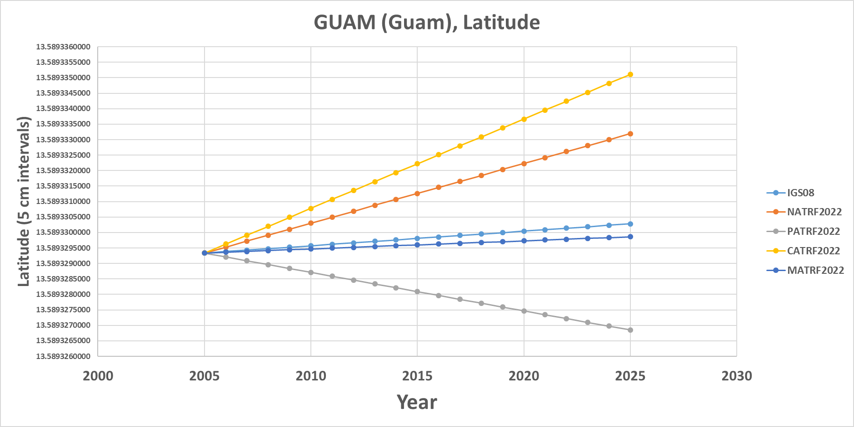
GUAM (Guam)

Slide 74

GUAM (Guam)

Slide 75

GUAM (Guam)

Slide 76
CNMR (CNMI)

Slide 77
CNMR (CNMI)

Slide 78

CNMR (CNMI)

Slide 79

CNMR (CNMI)

Slide 80

CNMR (CNMI)

Slide 81
Each frame will get 3 parameters
Euler Pole Latitude
Euler Pole Longitude
Rotation rate (radians / year)
This will be used to compute
time-dependent TRF2022
coordinates from time-dependent
IGS coordinates.

Slide 82

Time-Dependencies as a service:
NATRF2022 and actual survey epochs
NAD 83 forcibly combined data spanning many years (using HTDP with no vertical modeling) to compute and find one height at one epoch.
NATRF2022 will compute coordinates at survey epoch to show actual motion.
Even gridding surrounding CORS yields better subsidence rates than you have today.
NAD 83 best estimate of dh/dt: +2.8 mm / year
NATRF2022 best estimate of dh/dt: -4.2 mm / year
CORS best estimate of dh/dt: -2.2 mm / year
Notes:
Potential outline and speaker assignments; can be adjusted as needed.

Slide 83
Time Dependencies as a service:
Intra-plate motions

Slide 84
So…what is “Geopotential”
Geo: Earth
Potential: Gravity Potential Energy
Geopotential: Gravity Potential Energy Field that surrounds the Earth.

Slide 85


Surely you remember this page from your high school physics textbook?
For example: Choosing
which “W ” value is “the geoid”
0

Slide 86
Gravity vs Gravitation
Warning: Getting in the weeds…
Q: But you said “Gravity” potential energy, yet that textbook said “Gravitational” potential energy…
A: Very observant!
  Gravitation: Masses attracting each other
  Gravity: Gravitation plus Centrifugal
    Gravity is what we actually feel on a rotating planet

