Slide 1
Modernizing the National Spatial Reference System
Dru Smith
NSRS Modernization Manager
NOAA’s National Geodetic Survey

Slide 2
Overview
The National Spatial Reference System (NSRS) is the official coordinate system for all geospatial work done by the civilian federal government.
Current datums:
NAD 83 (latitude, longitude, ellipsoid height)
NAVD 88 (orthometric height)
IGLD 85 (dynamic heights: predominantly on the Great Lakes)
These datums are often adopted, even legislated, by states, counties and municipalities.
Notes:
There are actually 3 “NAD 83”s, NAD 83(2011), NAD 83(PA11) and NAD 83(MA11)
There are also many more vertical datums than NAVD 88 in the NSRS, each one for specific states or territories that have no line of sight to CONUS/Alaska

Slide 3
Federal Users of the NSRS
Notes:
Many of these users also sit on the Federal Geodetic Control Subcommittee, so there is a feedback loop between the providers of geodetic control (NGS) and the users of that control.

Slide 4
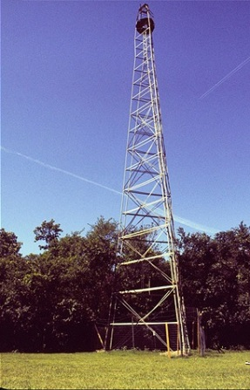
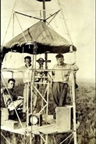
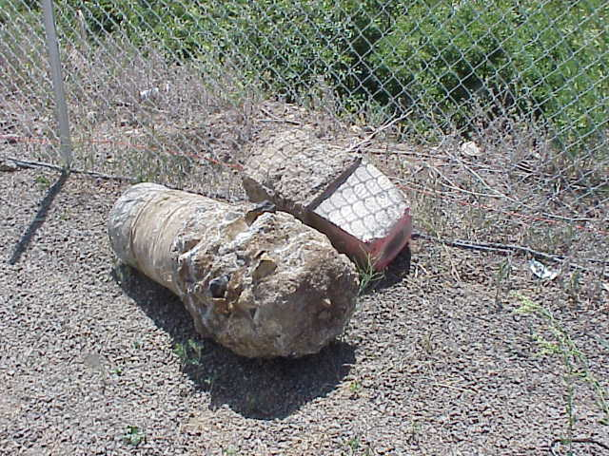
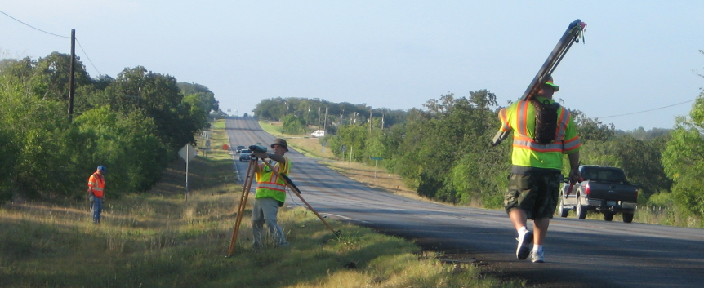
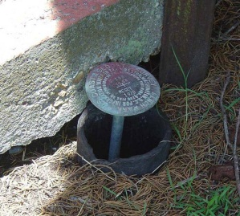
Why Modernize?
Older Methodology
Terrestrial, pre-space-geodesy, line-of-sight observations
Easily destroyed, unmonitored passive control marks
Notes:
Leveling and Traverse built NAVD 88 and NAD 83 and both required line of sight, and passive marks. This meant a lot of effort to put a coordinate on a point, but then such a coordinate could become stale without being checked regularly, and all that assumes the mark itself isn’t disturbed or destroyed.

Slide 5
Why Modernize?
Evidence of systematic errors
Decades of space geodetic observations
All of the datums contain systematic errors (decimeters to meters)
At scales larger than today’s accuracy capabilities (centimeters)
Origin (center of Earth) offset: 2+ meters
Zero elevation surface: 0.5 to 2+ meters
Notes:
The GRACE satellite has given NGS the ability to know the long-wavelength continent-wide geoid to a few centimeters. Combined with GPS derived ellipsoid heights (in the IGS / GRS 80 frame) of a few cm accuracy, and compared published NAVD 88 heights, it is easy to determine that both a bias and tilt exist in NAVD 88.

Slide 6
NGS Ten Year Plan 2013-2023
Goal 2: Modernize and Improve the National Spatial Reference System.
Objective 1: Replace NAD 83
Objective 2: Replace NAVD 88
Objective 3: Re-invent Bluebooking
Objective 4: Fix the Toolkit
Objective 5: Better Surveying
Notes:
Potential outline and speaker assignments; can be adjusted as needed.

Slide 7
Replacing the NAD 83’s
Three plate-(pseudo)fixed frames will be replaced with four plate-fixed reference frames
N. Amer., Pacific, Mariana, Caribbean(new!)

Slide 8
Plate-(pseudo)fixed frames
NAD 83(2011) minus NAD 83(NSRS2007)
NAD 83(NSRS2007)
Epoch 2002.0
NAD 83(2011)
Epoch 2010.0
If NAD 83 were truly “plate
fixed” then an 8 year
epoch change would not
yield the systematic
plate rotation seen here.
(*)TRF2022 will determine
a new Euler Pole rotation
for each of 4 plates.
(*)=NA, C, T or P

Slide 9
Replacing the NAD 83’s
Three plate-(pseudo)fixed frames will be replaced with four plate-fixed reference frames
N. Amer., Pacific, Mariana, Caribbean(new!)
Remove long-standing non-geocentricity of NAD 83 frames

Slide 10
NAD 83’s non-geocentricity
Earth’s Surface
h_{NAD83}
φ_{NAD83} – φ_{IGSxx}
λ_{NAD83} – λ_{IGSxx}
h_{NAD83} – h_{IGSxx}
all vary
smoothly by latitude
and longitude
h_{IGSxx}
IGSxx origin
same
GRS-80
ellipsoid
~2.2 m
NAD 83 origin

Slide 11
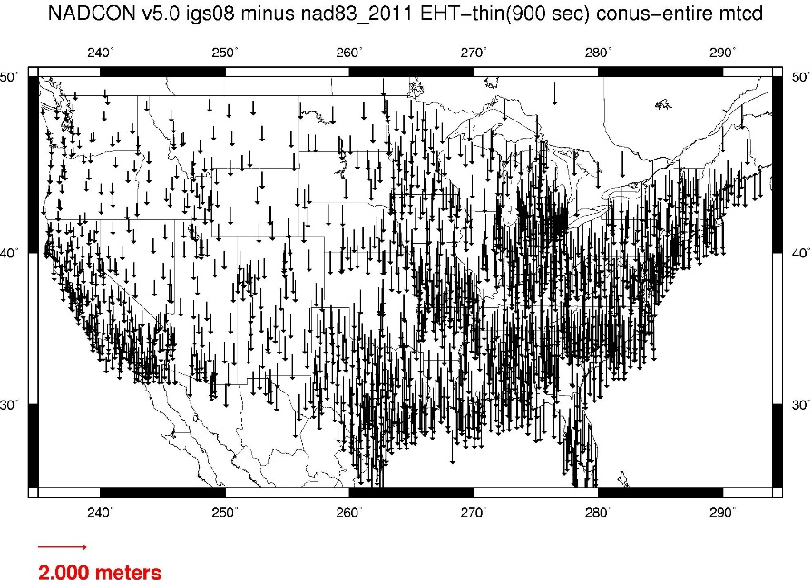
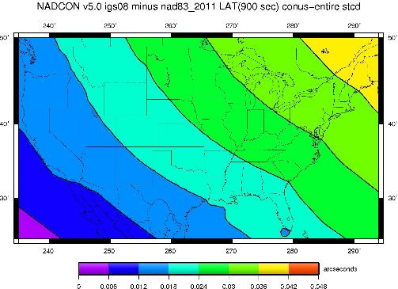
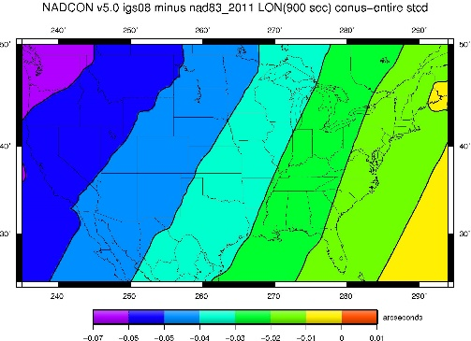
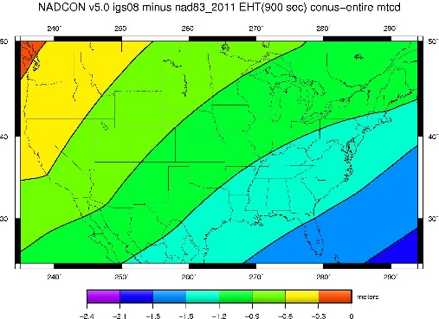
Fixed-Epoch Transformation NAD 83 to “2022”

Slide 12
Everything must shift

Slide 13
Everything must shift
RED: NAD 83 coastline against NAD 83 imagery
GREEN: Coastline shifted into NATRF2022 but
the imagery remains on NAD 83

Slide 14
Replacing the NAD 83’s
Three plate-(pseudo)fixed frames will be replaced with four plate-fixed reference frames
N. Amer., Pacific, Mariana, Caribbean(new!)
Remove long-standing non-geocentricity of NAD 83 frames
All four : identical to IGSxx at a TBD epoch
2020.00?
All four : differ from IGSxx by plate rotation only
Updated Euler Pole determination for rigid plate only

Slide 15
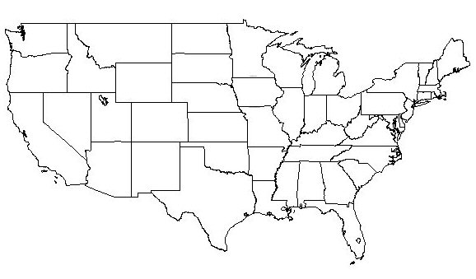
NATRF2022 frame is rigid and fixed to rigid part of the N.A. plate
Non-rigid part of the N.A. plate
(deformation)
area

Slide 16
NATRF2022 coordinates over time (Remember: The NATRF2022 frame is rigid)
Point on deforming part of plate
Point on rigid part of plate
λ
λ
t
t

Slide 17
NATRF2022 coordinates over time (Remember: The NATRF2022 frame is rigid)
Point on deforming part of plate
Point on rigid part of plate
λ
λ
t
t

Slide 18
NATRF2022 coordinates over time (Remember: The NATRF2022 frame is rigid)
Point on deforming part of plate
Point on rigid part of plate
λ
λ
t
t

Slide 19
NATRF2022 coordinates over time (Remember: The NATRF2022 frame is rigid)
Point on deforming part of plate
Point on rigid part of plate
λ
λ
t
t

Slide 20
Why isn’t NAVD 88 good
enough anymore?
Earth’s
Surface
H (NAVD 88)
H
NAVD 88 reference level
The Geoid
Errors in NAVD 88 : ~50 cm average,
100 cm CONUS tilt,
1-2 meters average in Alaska
NO tracking
Notes:
This slide shows what NGS now knows about the error in NAVD 88 itself. Using a continental geoid computed from the GRACE satellite, a bias and tilt in NAVD 88 has been computed using GPS derived ellipsoid heights on NAVD 88 bench marks. These are now known errors that exist in all NAVD 88 bench marks. This datum realization error, relative to the geoid, is over and above the errors from marks moving.

Slide 21
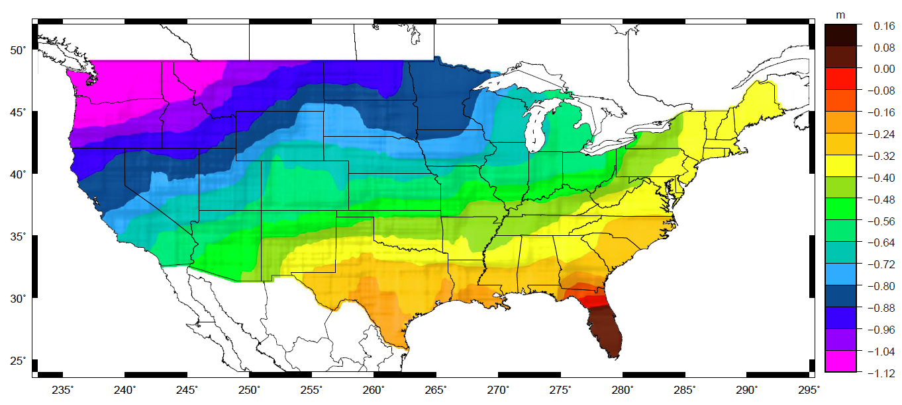
Why isn’t NAVD 88 good
enough anymore?
Approximate level of geoid mismatch known to exist in the NAVD 88 zero surface:
Notes:
This map reflects the sort of height changes that users could expect if NAVD 88 were replaced with a geoid-based vertical datum.
This is only a large scale approximation and should not be used as an absolute guide. Each benchmark might have its own level
Of mismatch, say from uplift or subsidence, not captured by this broad brush.
Also, this is the difference between the zero level of NAVD 88 and the actual geoid. The difference between NAD 83 ellipsoid heights and
ITRF/GRS-80 ellipsoid heights has NO influence on this graph and should not be part of the story.
Updated October 2010

Slide 22
Replacing NAVD 88 (et al)
Replacing leveling based datums with a gravimetric geoid model
Orthometric Heights (“above sea level”) will come from GNSS recievers
Based on an improved gravity field model from airborne surveys (GRAV-D)
Geoid will be time-dependent

Slide 23
Gravimetric Geoid Span

Slide 24
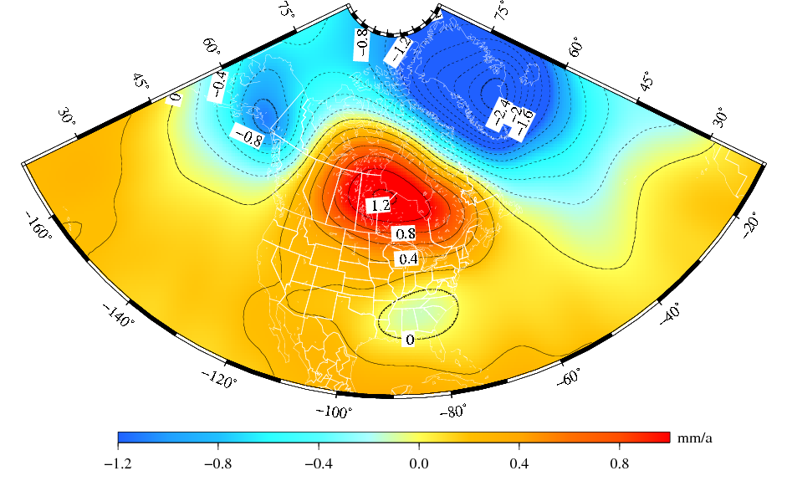
Time Dependency of Geoid
Deglaciation
The solution represents the effect due to total mass changes.
The solution uses a 400-km Gaussian filter.
Glacial Isostatic
Adjustment
Drought

Slide 25
NSRS Modernization
The Old:
NAD 83(2011)
NAD 83(PA11)
NAD 83(MA11)
The New:
The North American Terrestrial Reference Frame of 2022
(NATRF2022)
The Caribbean Terrestrial Reference Frame of 2022
(CTRF2022)
The Pacific Terrestrial Reference Frame of 2022
(PTRF2022)
The Mariana Terrestrial Reference Frame of 2022
(MTRF2022)

Slide 26
NSRS Modernization
The Old:
NAVD 88
PRVD 02
VIVD09
ASVD02
NMVD03
GUVD04
IGLD 85
IGSN71
GEOID12B
DEFLEC12B
Orthometric
Heights
The New:
The North American-Pacific Geopotential Datum of 2022 (NAPGD2022)
- Will include GEOID2022
Normal
Orthometric
Heights
Dynamic
Heights
Gravity
Geoid
Undulations
Deflections of
the Vertical

Slide 27
NSRS Modernization
The Old:
Bluebooking
(PAGES, ADJUST, B files, G files, FORTRAN)
The New:
OPUS-Projects for Everything
GPS
Leveling
Traverse
Gravity
RTK/RTN
More?

Slide 28
NSRS Modernization
The New: Time Dependencies as a service

Slide 29
NSRS Modernization
The New: Time Dependencies as a service

Slide 30
Summary: The NSRS in 2022…
Four semi-dynamic reference frames
Geoid/GPS based vertical datum
All data will be time tagged
All coordinates will come from GNSS surveys

Slide 31
Thank you!

Slide 32
Questions?

