Slide 1

Modernizing the National Spatial Reference System:
A 2017 update
Steve Hilla (GRD Chief)
Dru Smith (NSRS Modernization Manager)
Kevin Choi (CORS Branch Chief)
NOAA’s National Geodetic Survey

Slide 2
“Modernizing the NSRS” means…
Replacing NAD 83
Replacing NAVD 88
Re-inventing Bluebooking
Improving the Geodetic Toolkit
Better Surveying Methodologies
Notes:
There are actually 3 “NAD 83”s, NAD 83(2011), NAD 83(PA11) and NAD 83(MA11)
There are also many more vertical datums than NAVD 88 in the NSRS, each one for specific states or territories that have no line of sight to CONUS/Alaska

Slide 3
So…what’s new in 6 months?
NAMES!!

Slide 4
NSRS Modernization
The Old:
NAD 83(2011)
NAD 83(PA11)
NAD 83(MA11)
The New:
The North American Terrestrial Reference Frame of 2022
(NATRF2022)
The Caribbean Terrestrial Reference Frame of 2022
(CTRF2022)
The Pacific Terrestrial Reference Frame of 2022
(PTRF2022)
The Mariana Terrestrial Reference Frame of 2022
(MTRF2022)

Slide 5
NSRS Modernization
  The Old:
  NAVD 88
  PRVD 02
  VIVD09
  ASVD02
  NMVD03
  GUVD04
  IGLD 85
  IGSN71
  GEOID12B
  DEFLEC12B
Orthometric
Heights
  The New:
  The North American-Pacific Geopotential Datum of 2022 (NAPGD2022)
  - Will include GEOID2022
Normal
Orthometric
Heights
Dynamic
Heights
Gravity
Geoid
Undulations
Deflections of
the Vertical

Slide 6
So…what’s new in 6 months?
NAMES!!
Mathematical Decisions!!

Slide 7
Replacing the NAD 83’s
Three plate-(pseudo)fixed frames will be replaced with four plate-fixed reference frames
  N. Amer., Pacific, Mariana, Caribbean(new!)
Remove long-standing non-geocentricity of NAD 83 frames
All four : identical to IGSxx at a TBD epoch
  2020.00?
All four : differ from IGSxx by plate rotation only
  Updated Euler Pole determination for rigid plate only

Slide 8
NAD 83’s non-geocentricity
Earth’s Surface
h_{NAD83}
φ_{NAD83} – φ_{IGSxx}
λ_{NAD83} – λ_{IGSxx}
h_{NAD83} – h_{IGSxx}
all vary
smoothly by latitude
and longitude
h_{IGSxx}
IGSxx origin
same
GRS-80
ellipsoid
~2.2 m
NAD 83 origin

Slide 9
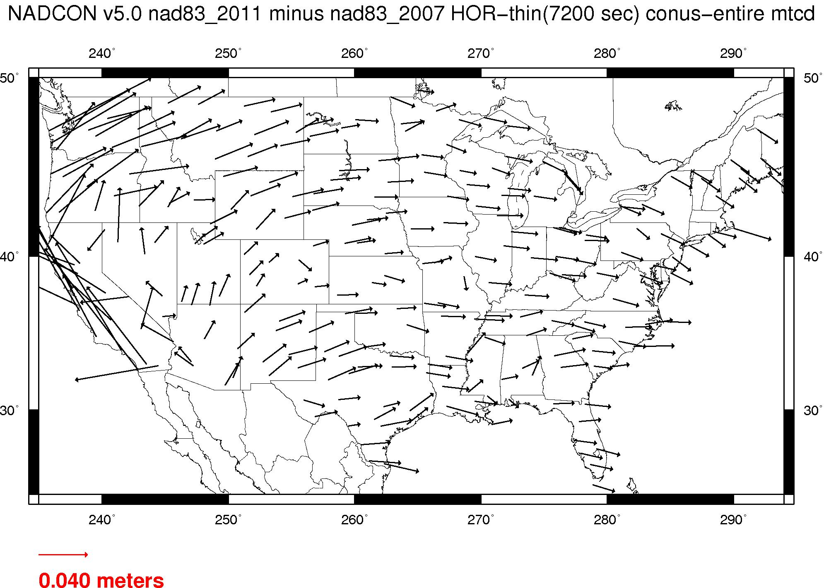
Plate-(pseudo)fixed frames
NAD 83(2011) minus NAD 83(NSRS2007)
NAD 83(NSRS2007)
Epoch 2002.0
NAD 83(2011)
Epoch 2010.0
If NAD 83 were truly “plate
fixed” then an 8 year
epoch change would not
yield the systematic
plate rotation seen here.
(*)TRF2022 will determine
a new Euler Pole rotation
for each of 4 plates.
(*)=NA, C, T or P

Slide 10
Each frame will get 3 parameters
Euler Pole Latitude
Euler Pole Longitude
Rotation rate (radians / year)
This will be used to compute
time-dependent TRF2022
coordinates from time-dependent
IGS coordinates.

Slide 11
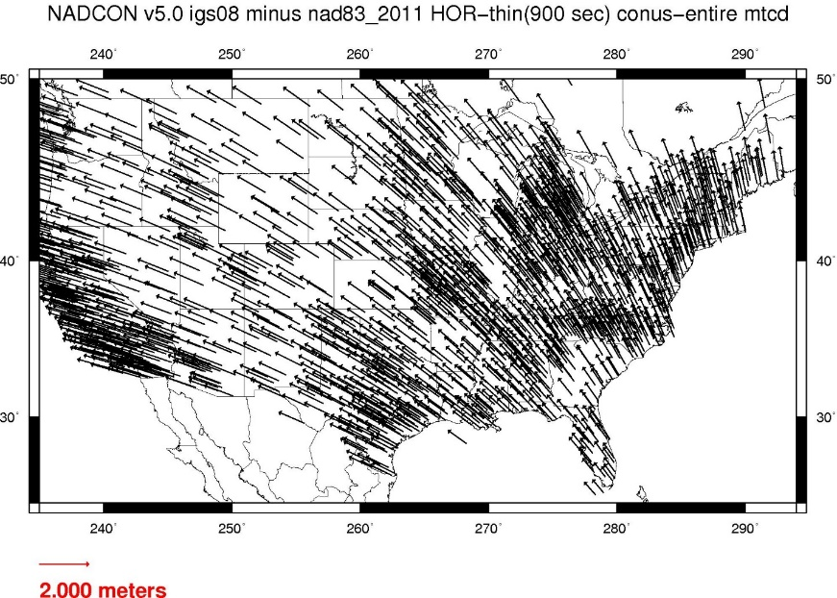
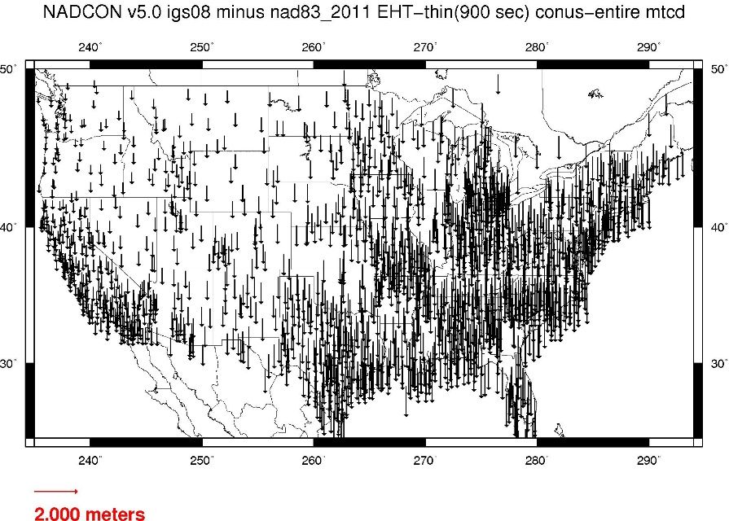
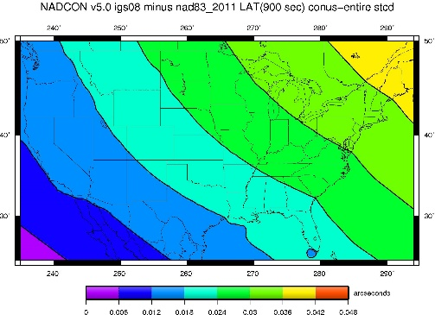
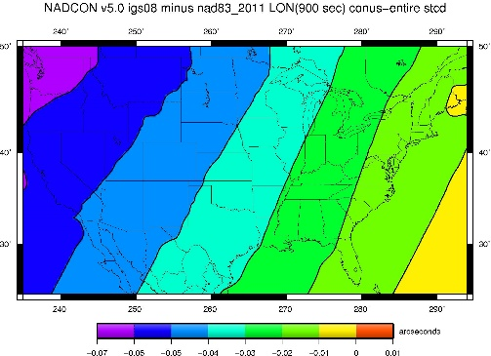
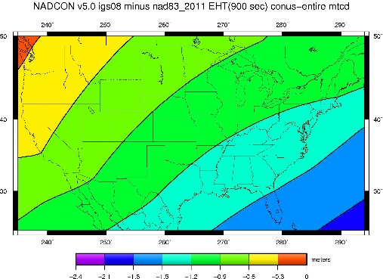
Fixed-Epoch Transformation
NAD 83 to “2022”

Slide 12
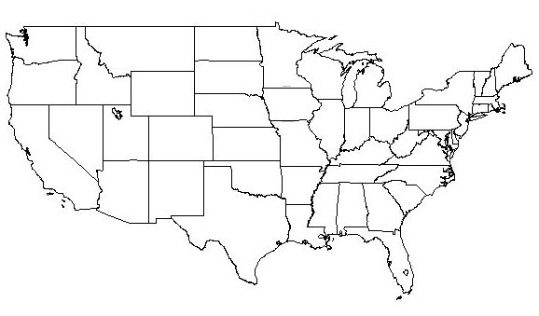
NATRF2022 frame is rigid and fixed to rigid part of the N.A. plate
Non-rigid part of the N.A. plate
(deformation)
area

Slide 13
NATRF2022 coordinates over time
(Remember: The NATRF2022 frame is rigid)
Point on deforming part of plate
Point on rigid part of plate
λ
λ
t
t

Slide 14
NATRF2022 coordinates over time
(Remember: The NATRF2022 frame is rigid)
Point on deforming part of plate
Point on rigid part of plate
λ
λ
t
t

Slide 15
NATRF2022 coordinates over time
(Remember: The NATRF2022 frame is rigid)
Point on deforming part of plate
Point on rigid part of plate
λ
λ
t
t

Slide 16
NATRF2022 coordinates over time
(Remember: The NATRF2022 frame is rigid)
Point on deforming part of plate
Point on rigid part of plate
λ
λ
t
t

Slide 17
So if not HTDP, then what?
NATRF2022 would account for most horizontal velocity over time
Remaining signal typically modeled by HTDP (now)
In future, a TBD velocity model would be applied to account for that and vertical
The simplest solution is gridded CORS velocities

Slide 18
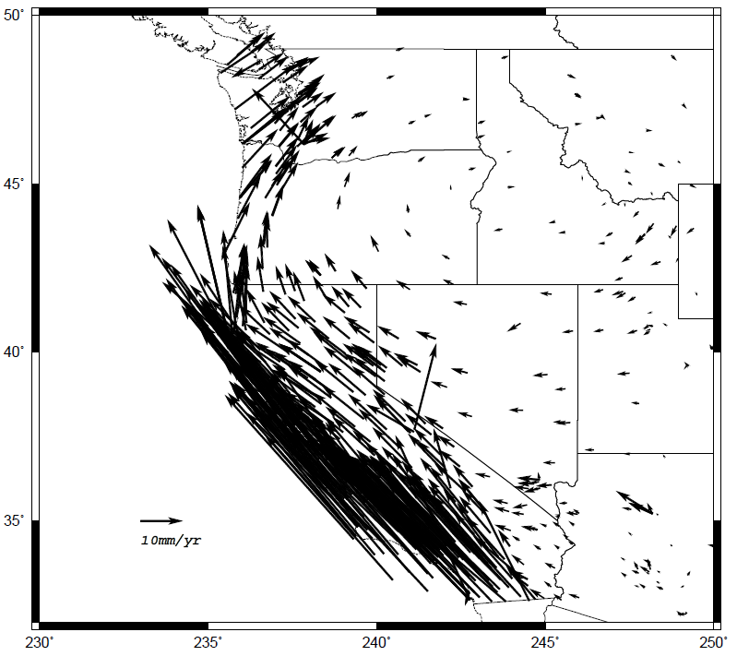
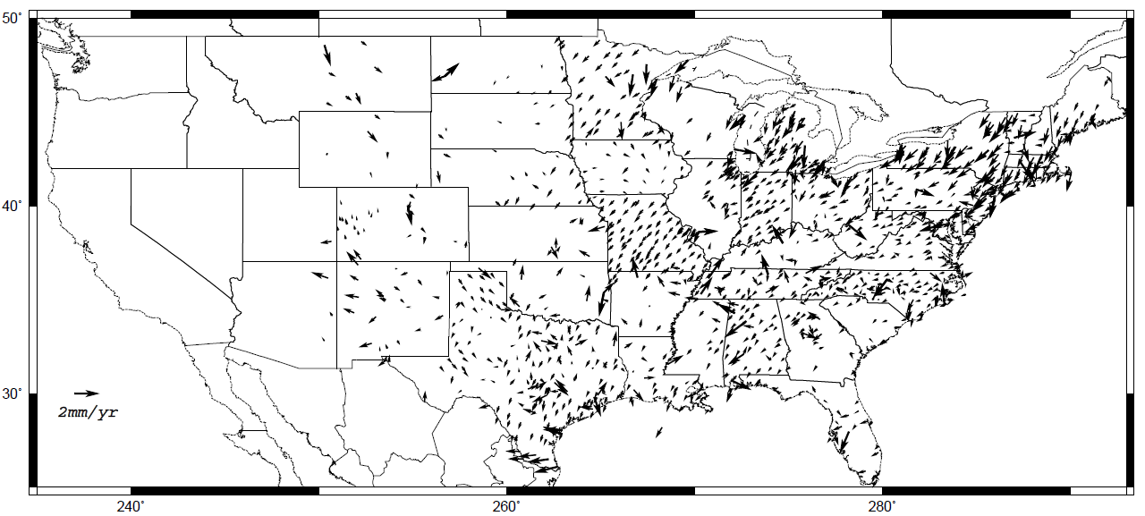
Horizontal velocities after Repro1
Note scale difference between West (10 mm/yr) and east (2 mm/yr)

Slide 19
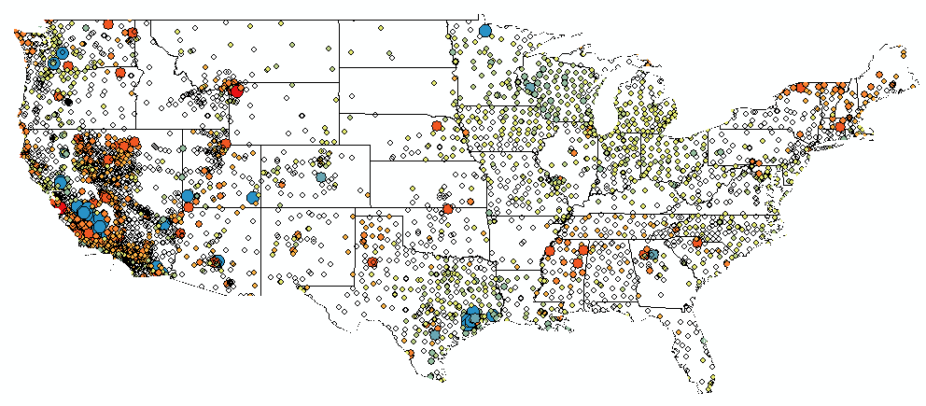
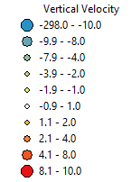
CORS Implied Vertical Velocities - Control
Courtesy Galen Scott

Slide 20
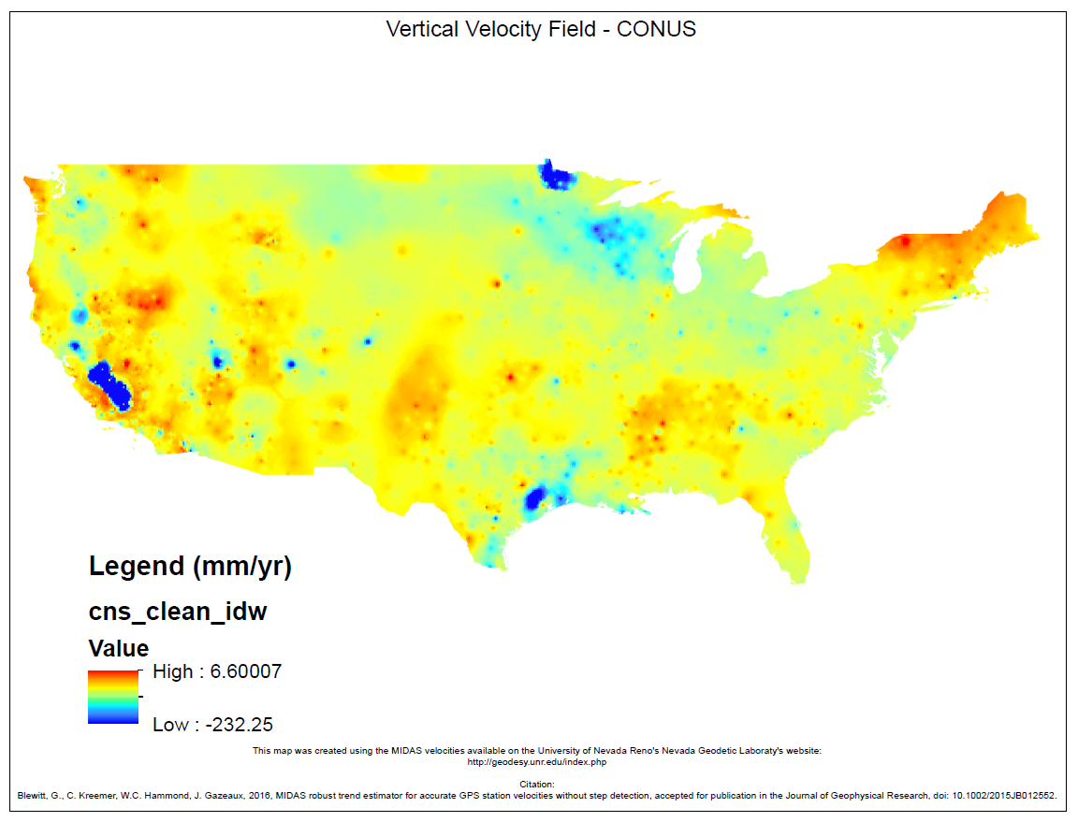
CORS Implied Vertical Velocities – Heat Map
Courtesy Galen Scott

Slide 21
How to use this information?
Assuming CORS spacing is sufficient – grid
  Yields horizontal (NEV & GIA) plus vertical signal
Vertical important for orthometric heights:
  H^{t} = (h^{t0} + (t-t₀)*dh/dt) - (N^{t0} + (t-t₀)*dN/dt)
    Where H^{t} is orthometric height at desired time
    h^{t0} is ellipsoidal height at epoch (maybe 2020.0)
    N^{t0} is geoid height at epoch
    dh/dt is change in ellipsoid height over time
    dN/dt is change in geoid height over time

Slide 22
What if this isn’t enough?
Will investigate sufficiency of gridded CORS
Concern is dynamic areas: horizontal & vertical
Will look at other models to evaluate
Cost versus benefit
  What we can easily do in-house and support
  increased complexity from outside models
Alternatively, users can model their own …

Slide 23
Replacing NAVD 88 (et al.)

Slide 24
Names
  The Old:
  NAVD 88
  PRVD 02
  VIVD09
  ASVD02
  NMVD03
  GUVD04
  IGLD 85
  IGSN71
  GEOID12B
  DEFLEC12B
Orthometric
Heights
  The New:
  The North American-Pacific Geopotential Datum of 2022 (NAPGD2022)
  - Will include GEOID2022
Normal
Orthometric
Heights
Dynamic
Heights
Gravity
Geoid
Undulations
Deflections of
the Vertical

Slide 25
NAPGD2022
Begins with a 3-D global geopotential model
Then, derivative products are built
  GEOID2022
  DEFLEC2022*
  NGRAV2022*
* Names not yet finalized

Slide 26
NAPGD2022: Pre-decisional items
NGS will acknowledge that the geoid is definitionally tied to global mean sea level
  This means that orthometric heights should, by definition, decrease as GMSL rises
  But NGS will not force users to adopt this particular change, but rather will offer it up as an optional correction to their orthometric heights

Slide 27
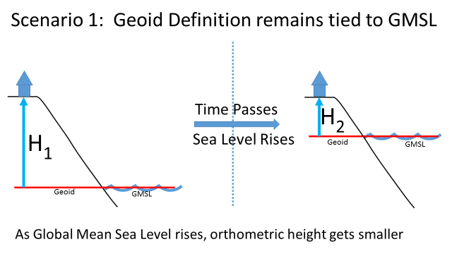
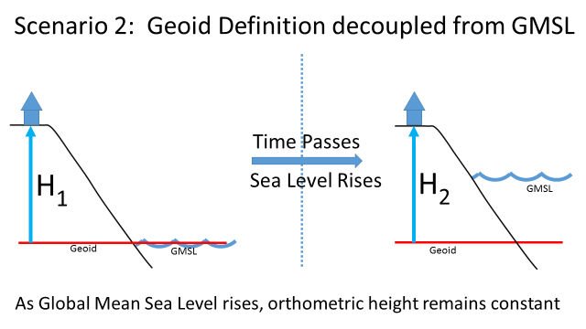
NGS will basically offer users
of OPUS the option to “turn on”
the impact seen in Scenario 1.
If they turn it “off”, they get
orthometric heights as per
Scenario 2.

Slide 28
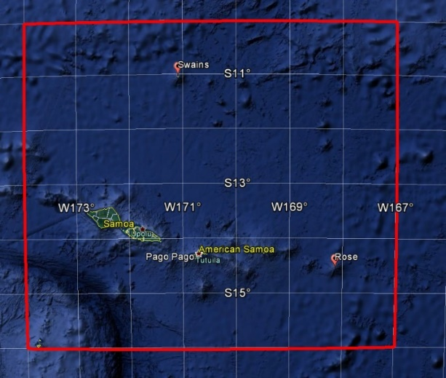
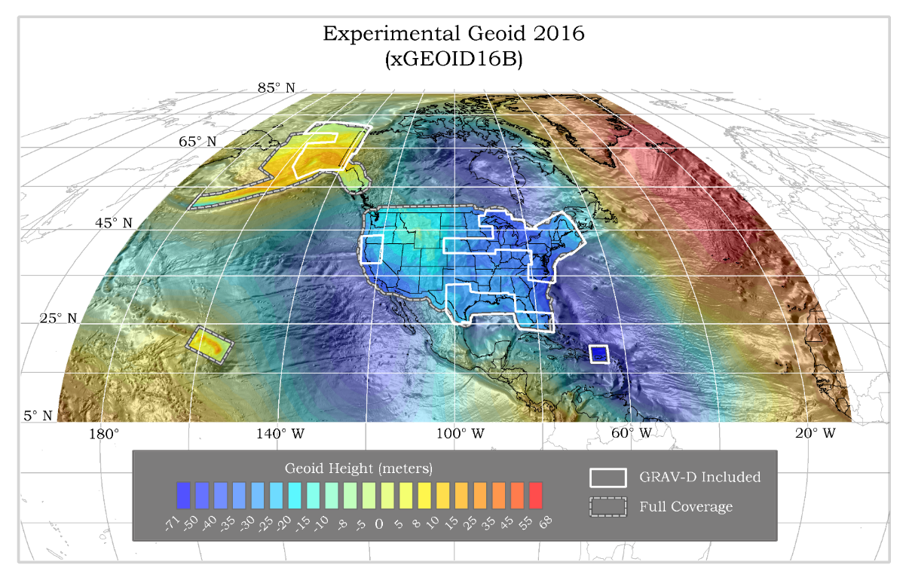
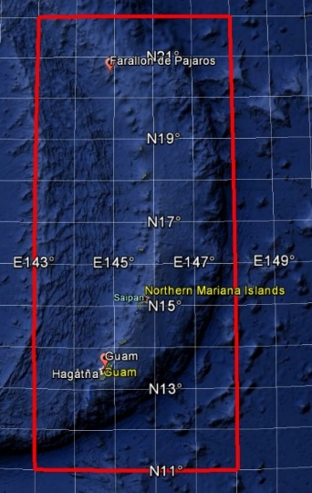
NAPGD2022: Pre-decisional items
GEOID2022 (et al) over American Samoa:
-16 to -10, 186-193
GEOID2022 (et al) over Guam/CNMI:
11-22, 143-148
GEOID2022 (et al.) over the North America/Pacific/Caribbean/Central America/Greenland region will range from
0 to 90 latitude and from 170 to 350 longitude.

Slide 29
NAPGD2022: Pre-decisional items
Three types of geoid change will be tracked
  Size, Shape, Change to W0
Time/Space span evaluated for cost/benefit ratio
Examples:
Issue | Type of Change | Temporal Period | Temporal Duration of Geoid Change | Spatial Impact | Magnitude of geoid change | Decision
Accretion of Space Dust | Size | Secular | Permanent | Global | 4x10⁻⁷ mm / y | Ignore
Earthquakes | Shape | Episodic | Permanent-ish | Local | Can be as large as a few cm | Study further
GMSL rise | W0 value | Secular | Permanent | Global | 1.7 mm / y | Provide as optional correction

Slide 30
Time Dependencies

Slide 31
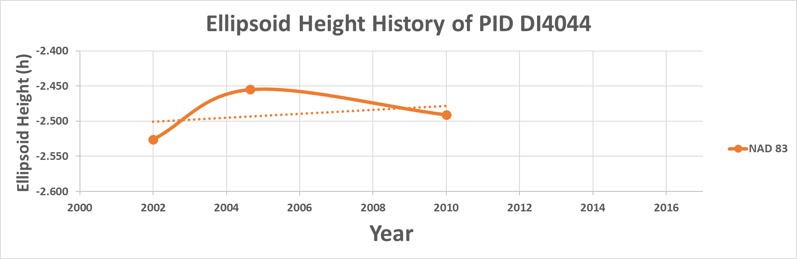


April 2017: How things stand
The current realization in Louisiana at this time: NAD 83(2011)
Point DI4044 has 3 different NAD 83 ellipsoid heights (plus one superseded),
each at an epoch that does not match the epoch of the occupations, yielding
an estimate of the subsidence uplift of the point of +2.8 mm/year.
What happens in NATRF2022, when actual survey epochs will be used?
1
2
4
3
Current best estimate of dh/dt: +2.8 mm / year
Notes:
Potential outline and speaker assignments; can be adjusted as needed.

Slide 32
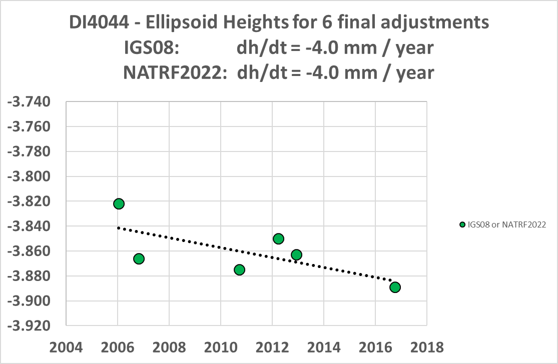
DI4044 – True Ellipsoid Height History

Slide 33
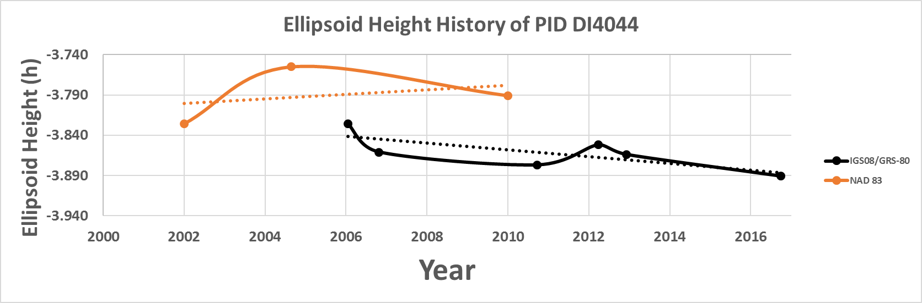
NATRF2022 and actual survey epochs
Point DI4044 was surveyed with GPS in 2006, 2006 (again), 2010, 2012 (in 2 parts which will be treated separately) and 2016. Computing the “h” values at the actual dates of the survey (using OPUS-S, then OPUS-Projects, and letting OPUS choose our CORS values) yields the following graph. IGS 08 serves as a proxy for NATRF2022 heights for now. (Note the NAD 83 values are shown with a bias of 1.38 meters so as to fit near the IGS08 values)
NAD 83 best estimate of dh/dt: +2.8 mm / year
NATRF2022 best estimate of dh/dt: -4.0 mm / year
Notes:
Potential outline and speaker assignments; can be adjusted as needed.

Slide 34
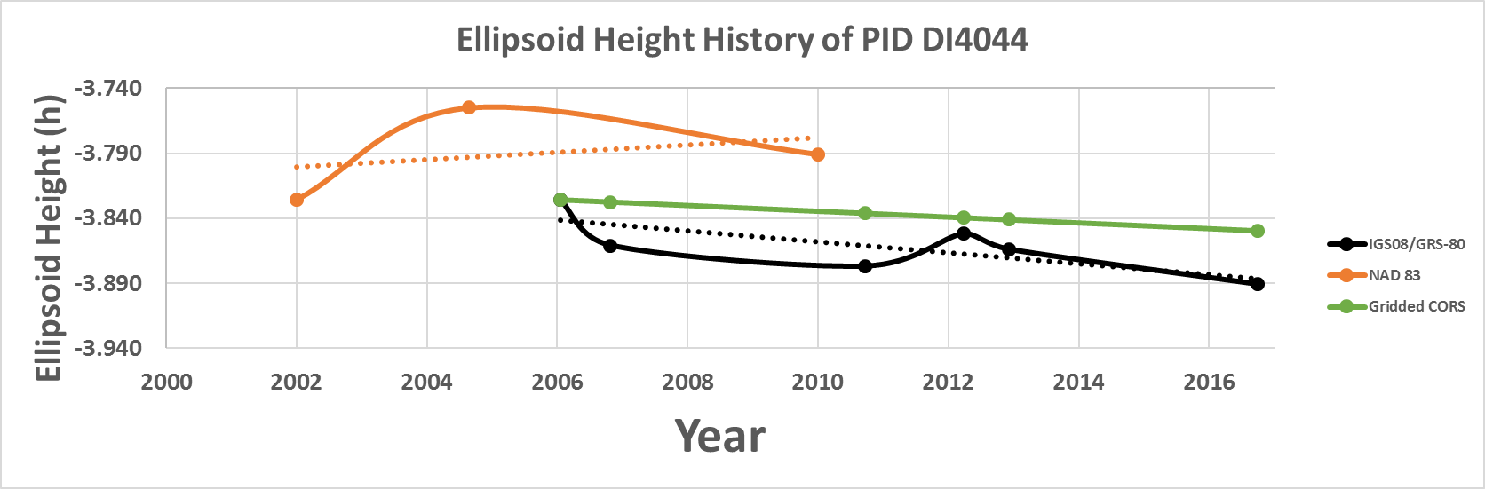
NATRF2022 and actual survey epochs
Further information can be added, such as gridding the surrounding
CORS velocities, for a coarse estimate of what is happening locally.
NAD 83 best estimate of dh/dt: +2.8 mm / year
NATRF2022 best estimate of dh/dt: -4.2 mm / year
CORS best estimate of dh/dt: -2.2 mm / year
Notes:
Potential outline and speaker assignments; can be adjusted as needed.

Slide 35
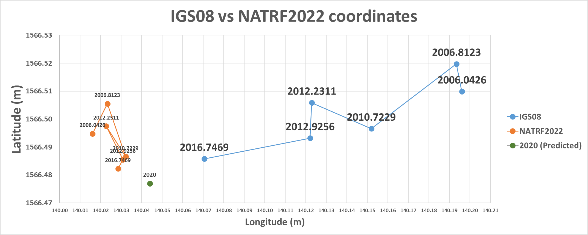
IGS08 vs NATRF2022
NATRF2022 coordinates will have the plate rotation removed, but still
exhibit their time-dependency, until
the Intra-frame velocity model is used to estimate a coordinate at an epoch of convenience.
IGS08 coordinates are dominated by the primary motion associated with the North American Plate rotation, as manifest at this lat/lon:
12.9 mm/y West
1.1 mm/y South

Slide 36
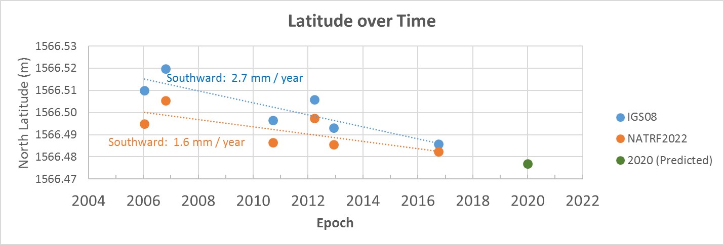
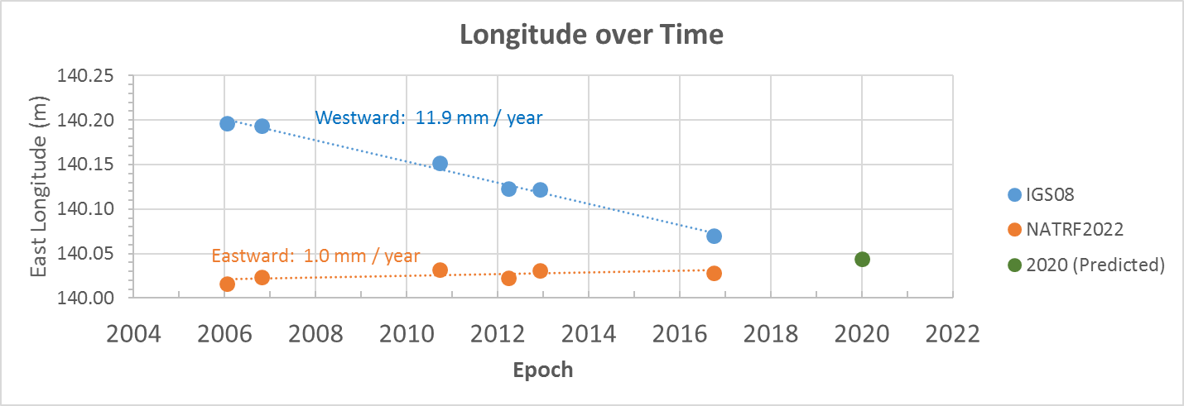
IFV implied by interpolating
from surrounding CORS:
Northward 0.4 mm / year:
Difference: 2.0mm/year
NA plate rotation:
South 1.1 mm/year
“Intra Frame Velocity”
IFV implied by interpolating
from surrounding CORS:
Eastward 0.3 mm / year
Difference: 0.7 mm / year
“Intra Frame Velocity”
NA plate rotation:
West 12.9 mm/year

Slide 37
So…what’s new in 6 months?
NAMES!!
Mathematical Decisions!!
NADCON 5.0!!

Slide 38
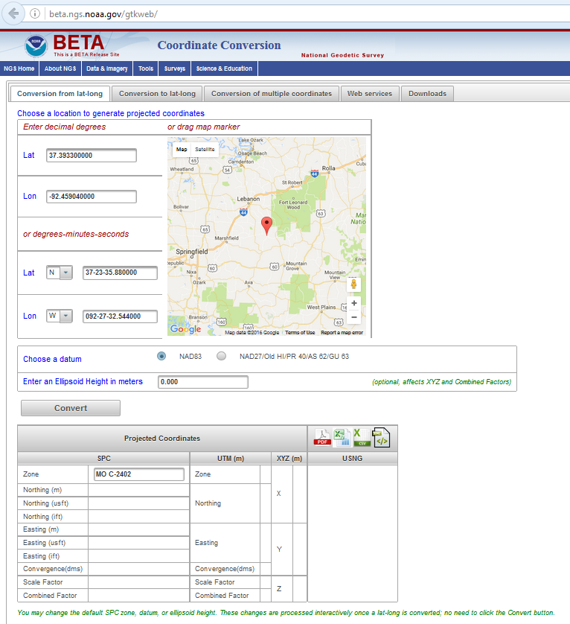
The new
Geodetic Toolkit
https://beta.ngs.noaa.gov/gtkweb/

Slide 39
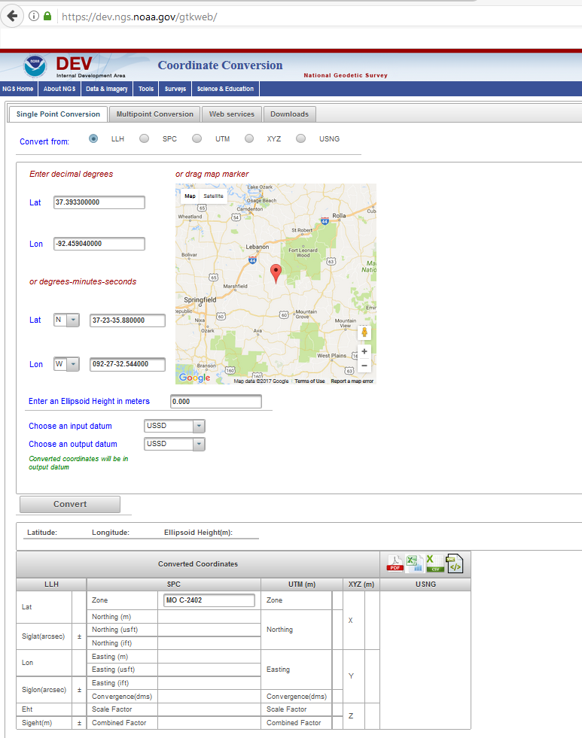

The new
Geodetic Toolkit with
NADCON 5.0
https://dev.ngs.noaa.gov/gtkweb/

Slide 40
NAD 83 (2011)
Allowable Regions:
CONUS
Alaska
Hawaii
PR/VI
AS
Guam/CNMI
St. Paul
St. George
St. Lawrence
Notes:
φ, λ, h
xyz2plh
plh2xyz
SPC83
a,f (GRS 80)
NAD 83
X, Y, Z
SPC
USNG
NAD 83
UTMS
a,f (GRS 80)
USNG
UTM
USNG
NAD 83

Slide 41
X, Y, Z
φ, λ, h
φ, λ, h
Region: CONUS
NADCON 5 connections in RED
2022
X, Y, Z
SPC
UTM
USSD
USNG
UTM
φ, λ, h
φ, λ, h
NAD 27
NAD 83 (2011)
X, Y, Z
SPC
X, Y, Z
SPC
USNG
UTM
USNG
UTM
NAD 83 (NSRS2007)
φ, λ, h
NAD 83 (1986)
φ, λ, h
NAD 83 (FBN)
NAD 83 (HARN)
φ, λ, h
X, Y, Z
SPC
X, Y, Z
SPC
φ, λ, h
USNG
UTM
USNG
UTM
X, Y, Z
SPC
X, Y, Z
SPC
USNG
UTM
USNG
UTM

Slide 42
Thank you!

Slide 43
Questions?

