Slide 1

Modernizing the geometric reference frame
Daniel R. Roman (acting Chief Geodesist)
Stephen Hilla (GRD Chief)
Kevin Choi (CORS Branch Chief)
NOAA’s National Geodetic Survey

Slide 2
Outline
Key Elements
Four New Frames
Euler Poles
NEV or IPV or IFV (hor. & vert.)
Velocity Models or DIY
NADCON 5.0
Poll Questions

Slide 3
Key Elements
Drawn from Blueprint Part 1 (forthcoming)
Will be tied to most recent ITRF (2020)
  Epoch date TBD – likely 2020.0
  Four Frames: North America, Pacific, Caribbean, and Mariana
At epoch date, all frames identical to ITRF
Then each frame rotates about an Euler pole
Velocity models describe motion in frame
Access to the four frames via OPUS tool

Slide 4
NSRS Modernization: Four New Frames
The Old:
NAD 83(2011)
NAD 83(PA11)
NAD 83(MA11)
The New:
The North American Terrestrial Reference Frame of 2022
(NATRF2022)
The Caribbean Terrestrial Reference Frame of 2022
(CTRF2022)
The Pacific Terrestrial Reference Frame of 2022
(PTRF2022)
The Mariana Terrestrial Reference Frame of 2022
(MTRF2022)

Slide 5
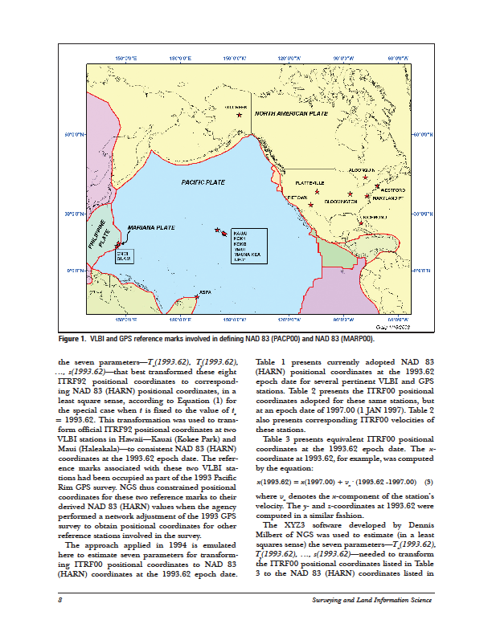
Four Frames/Plates in 2022
NATRF2022
MTRF2022
CTRF2022
PTRF2022
Image from Snay 2003

Slide 6
Replacing the NAD 83’s
Three plate-(pseudo)fixed frames will be replaced with four plate-fixed reference frames
  N. Amer., Pacific, Mariana, Caribbean(new!)
Remove long-standing non-geocentricity of NAD 83 frames
All four : identical to ITRFxx at a TBD epoch
  2020.00?
All four : differ from ITRFxx by plate rotation only
  Updated Euler Pole determination for rigid plate only

Slide 7
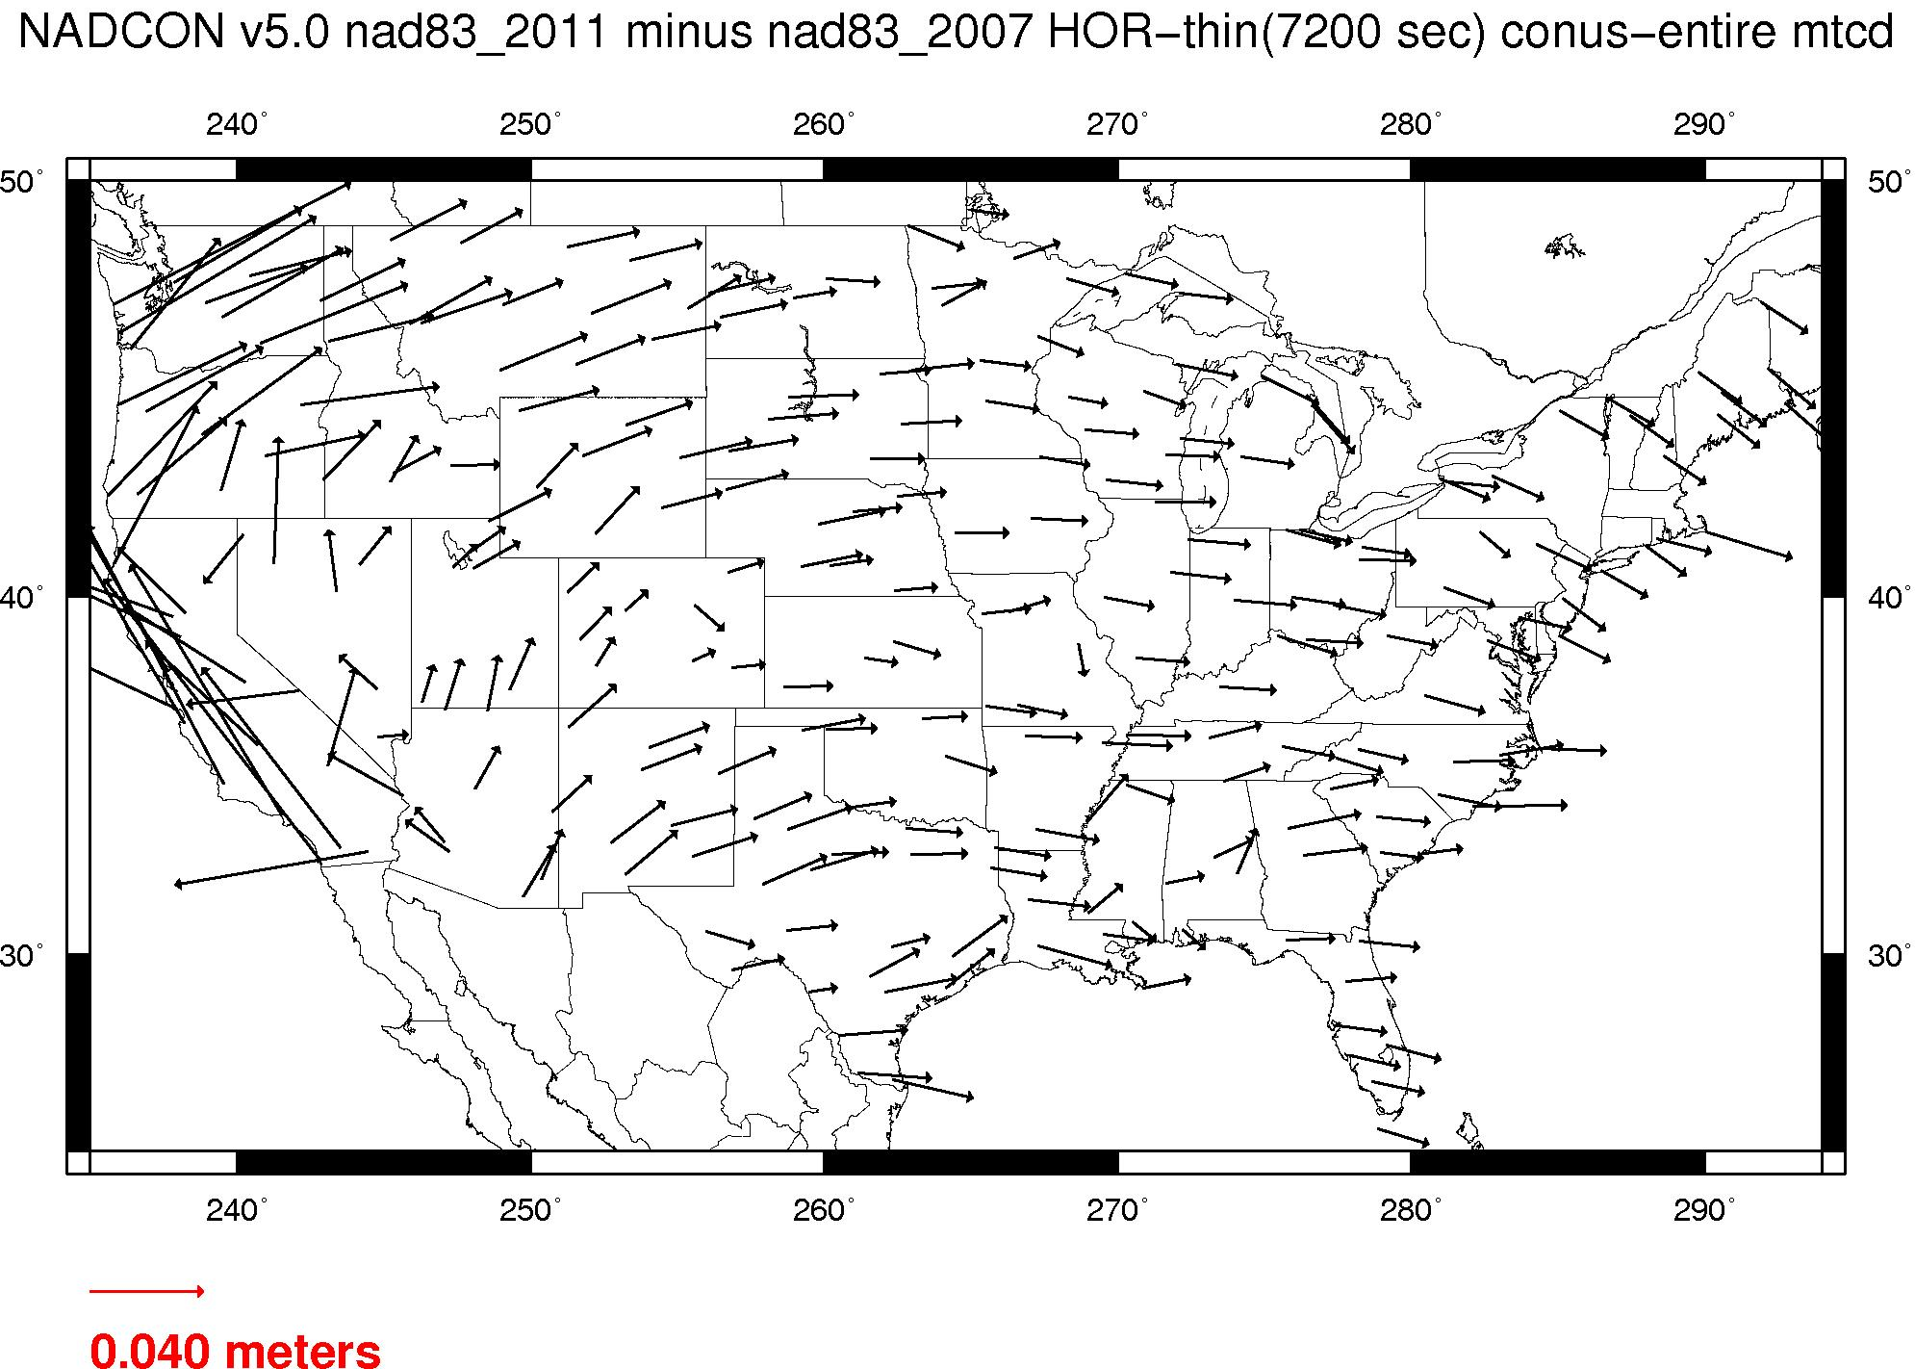
Plate-(pseudo)fixed frames
NAD 83(2011) minus NAD 83(NSRS2007)
NAD 83(NSRS2007)
Epoch 2002.0
NAD 83(2011)
Epoch 2010.0
If NAD 83 were truly “plate
fixed” then an 8 year
epoch change would not
yield the systematic
plate rotation seen here.
(*)TRF2022 will determine
a new Euler Pole rotation
for each of 4 plates.
(*)=NA, C, T or P

Slide 8
NAD 83’s non-geocentricity
Earth’s Surface
h_{NAD83}
φ_{NAD83} – φ_{ITRFxx}
λ_{NAD83} – λ_{ITRFxx}
h_{NAD83} – h_{ITRFxx}
all vary
smoothly by latitude
and longitude
h_{IGSxx}
ITRFxx origin
same
GRS-80
ellipsoid
~2.2 m
NAD 83 origin

Slide 9
Each frame will
get 3 parameters
Euler Pole Latitude
Euler Pole Longitude
Rotation rate (rad/yr)
Used to compute
time-dependent TRF2022
coordinates from time-dependent ITRF coordinates.

Slide 10
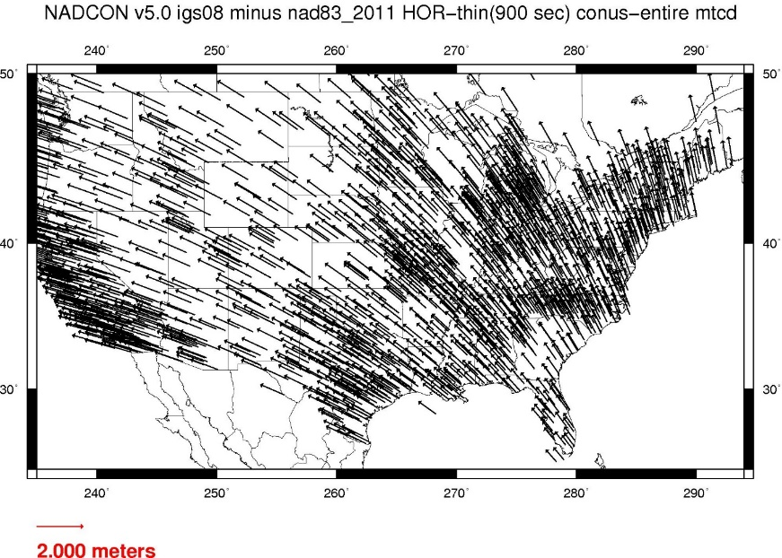
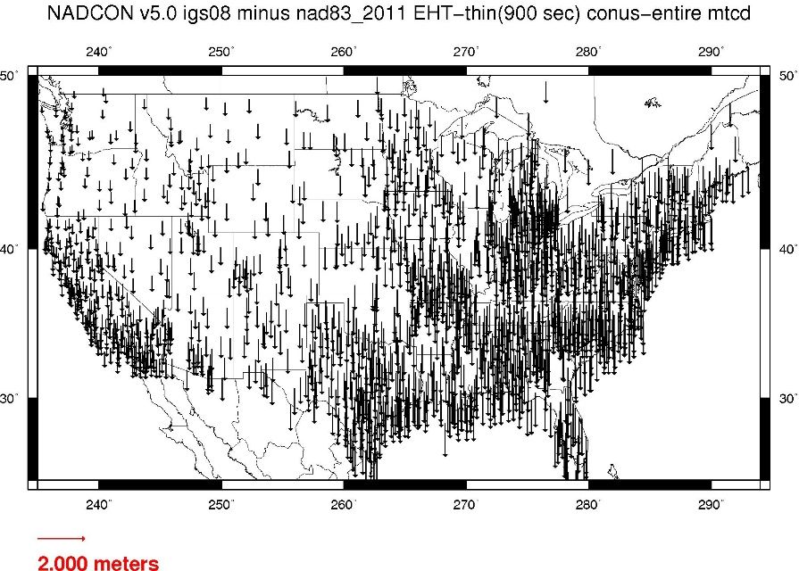
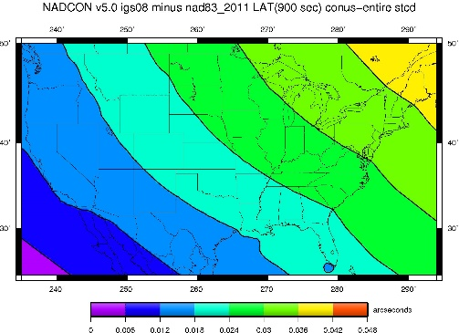
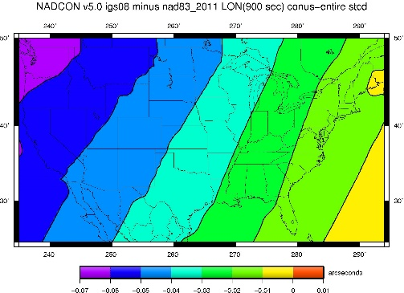
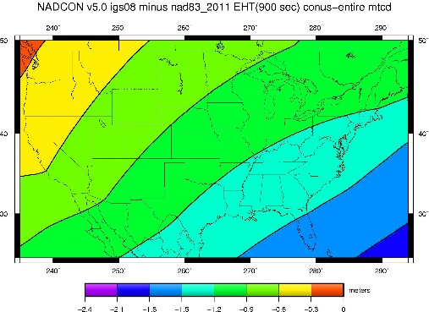
Fixed-Epoch Transformation
NAD 83 to “2022”

Slide 11
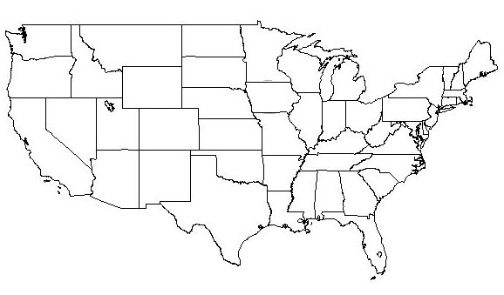
NATRF2022 frame is rigid and fixed to rigid part of the N.A. plate
Non-rigid part of the N.A. plate
(deformation)
area

Slide 12
NATRF2022 coordinates over time
(Remember: The NATRF2022 frame is rigid)
Point on deforming part of plate
Point on rigid part of plate
λ
λ
t
t

Slide 13
NATRF2022 coordinates over time
(Remember: The NATRF2022 frame is rigid)
Point on deforming part of plate
Point on rigid part of plate
λ
λ
t
t

Slide 14
NATRF2022 coordinates over time
(Remember: The NATRF2022 frame is rigid)
Point on deforming part of plate
Point on rigid part of plate
λ
λ
t
t

Slide 15
NATRF2022 coordinates over time
(Remember: The NATRF2022 frame is rigid)
Point on deforming part of plate
Point on rigid part of plate
λ
λ
t
t

Slide 16
NEV or IPV or IFV
Euler poles mostly account for horizontal vel.
  Remaining signal currently modeled by HTDP
  HTDP complicated to maintain and only horizontal
So if not HTDP, then what?
  A TBD velocity model needed for horizontal and vertical motions
  Non-Eulerian Velocity (NEV) or Intra-Plate Velocity (IPV) or Intra-Frame Velocity (IFV)
Simplest solution is to grid CORS velocities

Slide 17
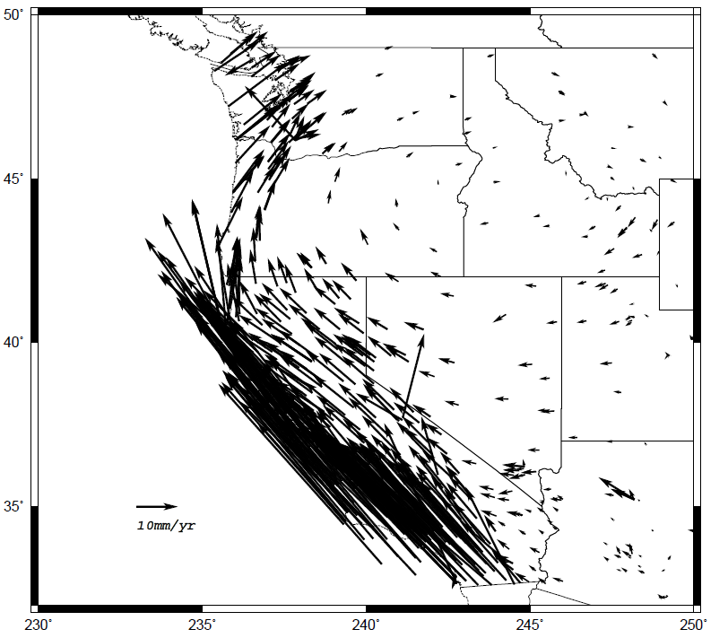
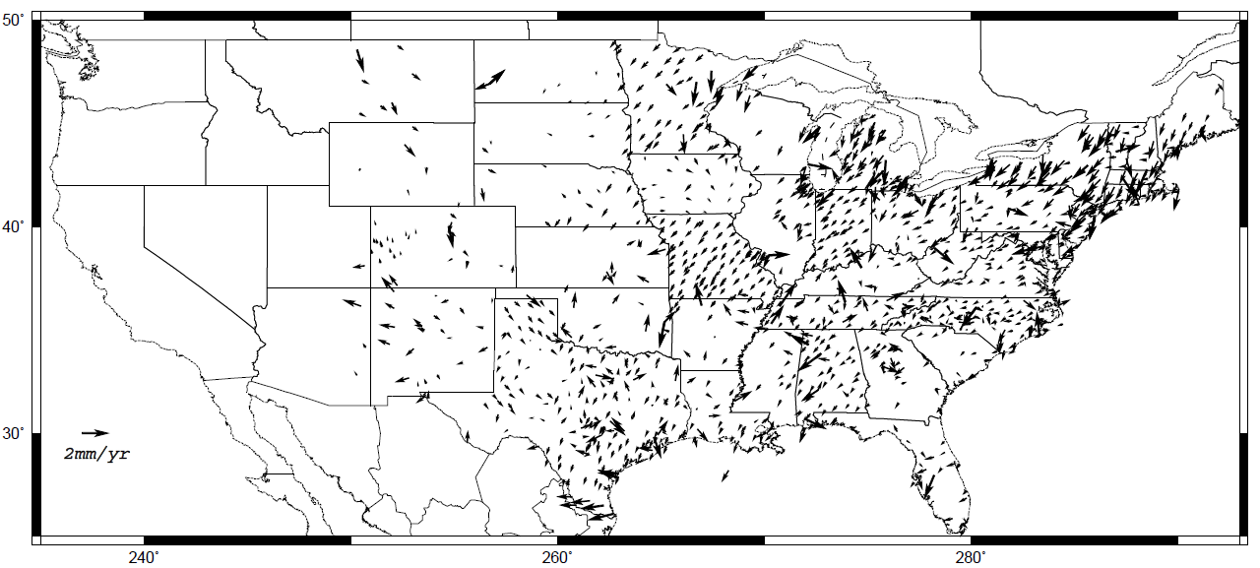
Horizontal velocities after Repro1
Note scale difference between West (10 mm/yr) and east (2 mm/yr)

Slide 18
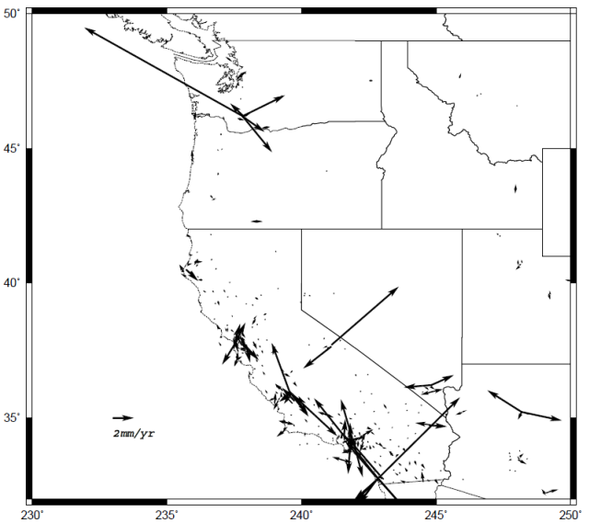
Residual Horizontal Velocities CONUS – gridded CORS
Eastern CONUS will largely be resolved
Western CONUS has some anomalies

Slide 19
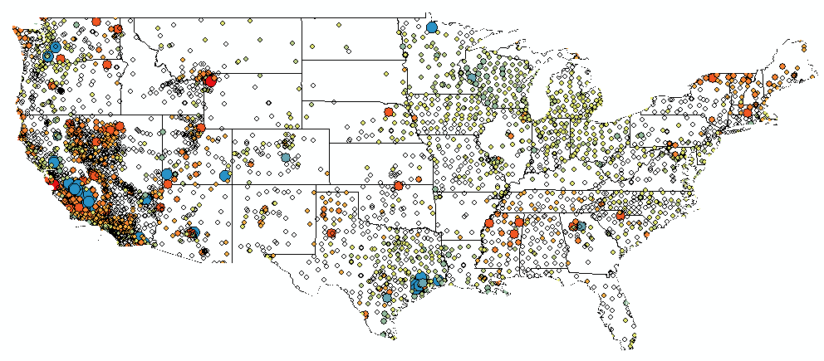
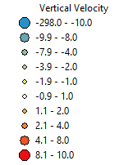
CORS Implied Vertical Velocities - Control
Courtesy Galen Scott

Slide 20
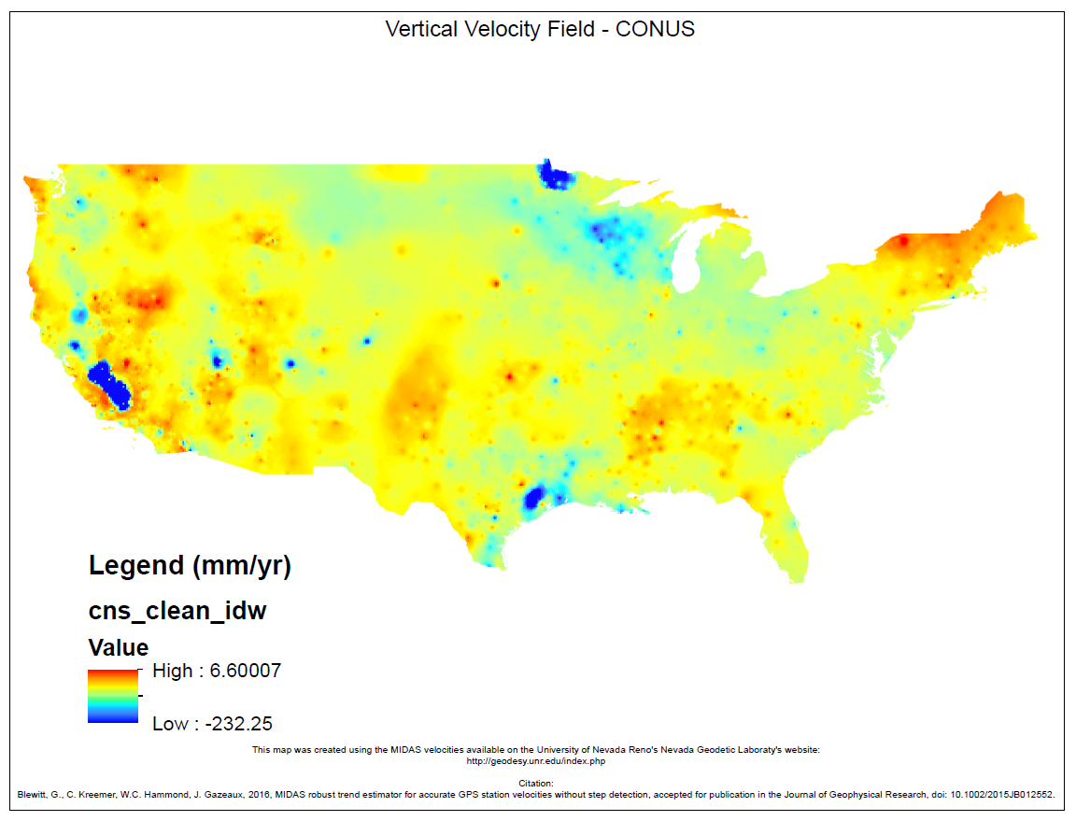
CORS Implied Vertical Velocities – Heat Map
Courtesy Galen Scott

Slide 21
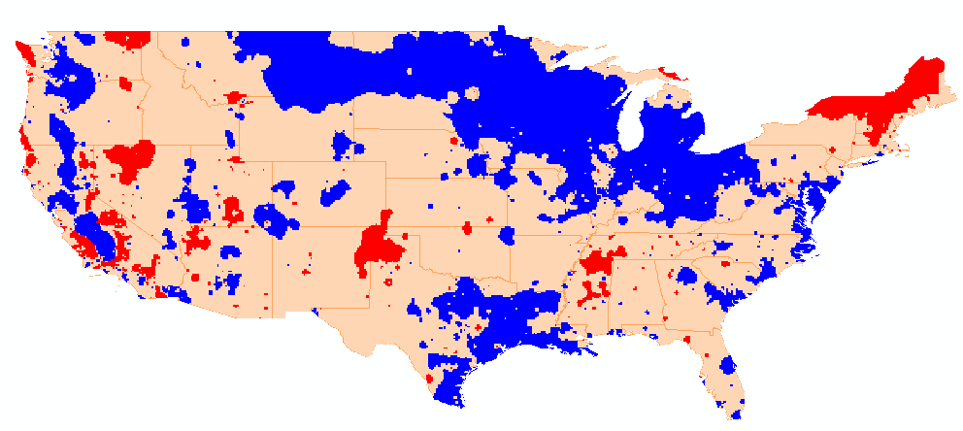
CONUS with 1+ mm/yr
Red is uplift, Blue is subsidence
Courtesy Galen Scott

Slide 22
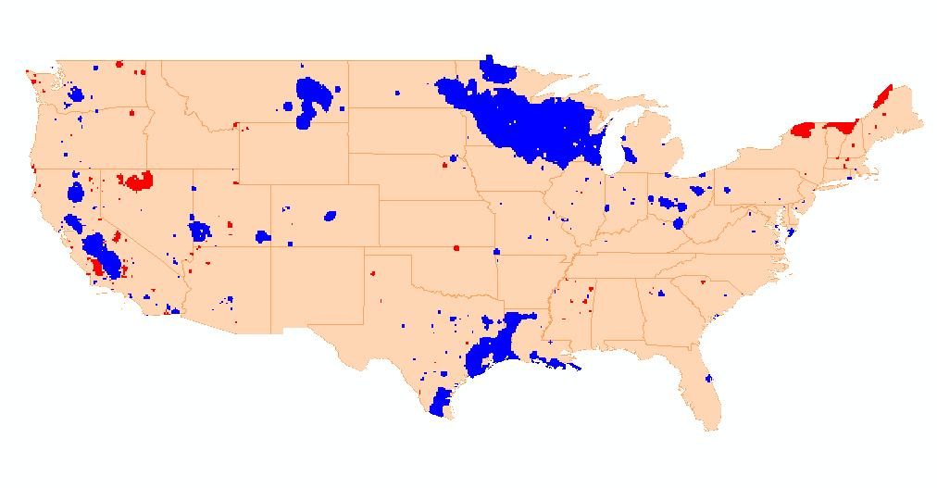
CONUS with 2+ mm/yr
Red is uplift, Blue is subsidence
Courtesy Galen Scott

Slide 23
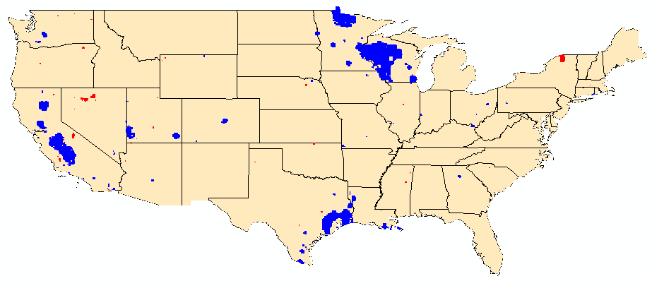
CONUS with 3+ mm/yr
Red is uplift, Blue is subsidence
Courtesy Galen Scott

Slide 24
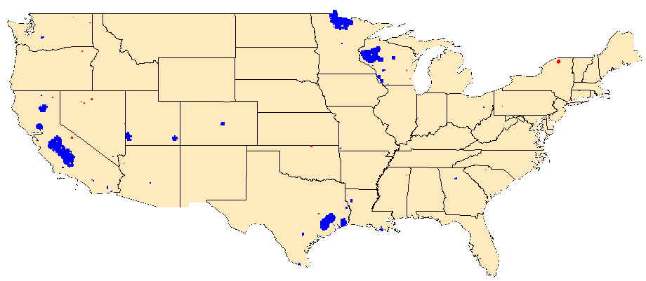
CONUS with 4+ mm/yr
Red is uplift, Blue is subsidence
Courtesy Galen Scott

Slide 25
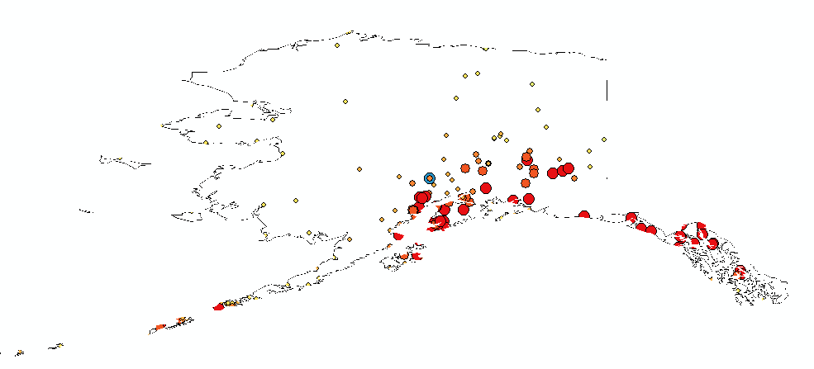
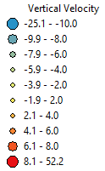
AK CORS Implied Vertical Velocities – Control
Courtesy Galen Scott

Slide 26
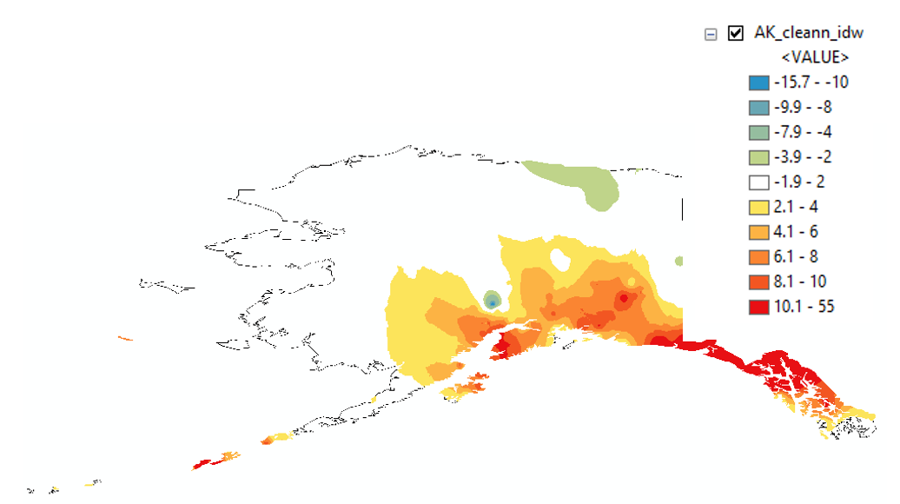
AK CORS Implied Vertical Velocities – Heat Map
Courtesy Galen Scott

Slide 27
How to use this information?
Assuming CORS spacing is sufficient – grid
  Yields horizontal (NEV & GIA) plus vertical signal
Vertical important for orthometric heights:
  H^{t} = (h^{t0} + (t-t₀)*dh/dt) - (N^{t0} + (t-t₀)*dN/dt)
    Where H^{t} is orthometric height at desired time
    h^{t0} is ellipsoidal height at epoch (maybe 2020.0)
    N^{t0} is geoid height at epoch
    dh/dt is change in ellipsoid height over time
    dN/dt is change in geoid height over time (GeMS)

Slide 28
Velocity Models or DIY
We will investigate sufficiency of gridded CORS
Concern is dynamic areas: horizontal & vertical
  Will gridded CORS work in Alaska?
  What if this isn’t enough?
Will look at other models to evaluate
Cost – benefit
  What we can easily do in-house and support
  increased complexity from outside models
Alternatively, users can model their own …

Slide 29
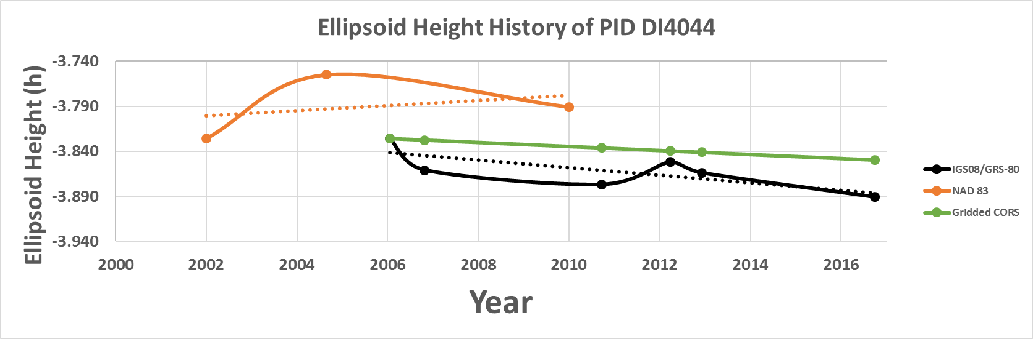
Time-Dependencies as a service:
NATRF2022 and actual survey epochs
NAD 83 forcibly combined data spanning many years (using HTDP with no vertical modeling) to compute and find one height at one epoch.
NATRF2022 will compute coordinates at survey epoch to show actual motion.
Even gridding surrounding CORS yields better subsidence rates than you have today.
NAD 83 best estimate of dh/dt: +2.8 mm / year
NATRF2022 best estimate of dh/dt: -4.2 mm / year
CORS best estimate of dh/dt: -2.2 mm / year
Notes:
Potential outline and speaker assignments; can be adjusted as needed.

Slide 30
Time Dependencies as a service:
Intra-plate motions

Slide 31
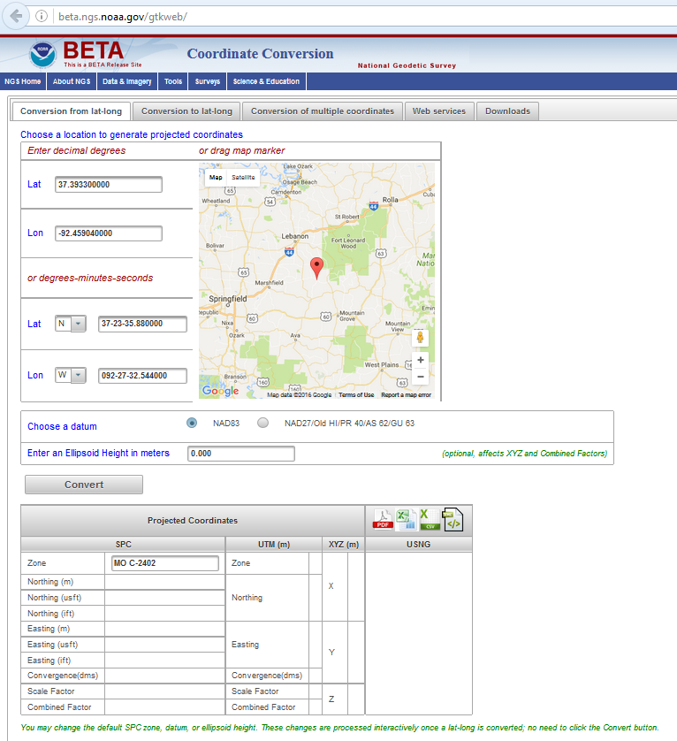
NADCON 5.0 in the new Geodetic Toolkit
https://beta.ngs.noaa.gov/gtkweb/

Slide 32
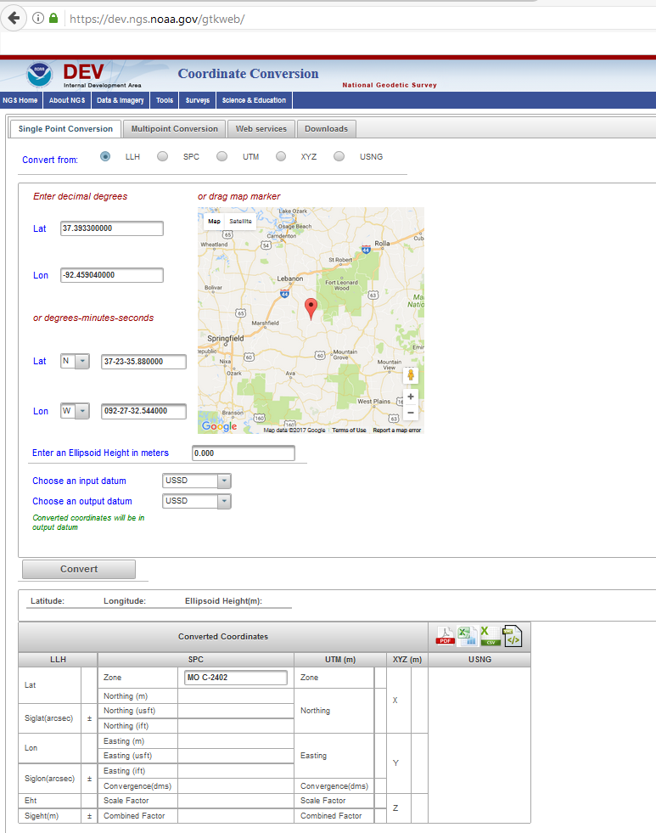

The new
Geodetic Toolkit with
NADCON 5.0
https://dev.ngs.noaa.gov/gtkweb/

Slide 33
NAD 83 (2011)
Allowable Regions:
CONUS
Alaska
Hawaii
PR/VI
AS
Guam/CNMI
St. Paul
St. George
St. Lawrence
Notes:
φ, λ, h
xyz2plh
plh2xyz
SPC83
a,f (GRS 80)
NAD 83
X, Y, Z
SPC
USNG
NAD 83
UTMS
a,f (GRS 80)
USNG
UTM
USNG
NAD 83

Slide 34
X, Y, Z
φ, λ, h
φ, λ, h
Region: CONUS
NADCON 5 connections in RED
2022
X, Y, Z
SPC
UTM
USSD
USNG
UTM
φ, λ, h
φ, λ, h
NAD 27
NAD 83 (2011)
X, Y, Z
SPC
X, Y, Z
SPC
USNG
UTM
USNG
UTM
NAD 83 (NSRS2007)
φ, λ, h
NAD 83 (1986)
φ, λ, h
NAD 83 (FBN)
NAD 83 (HARN)
φ, λ, h
X, Y, Z
SPC
X, Y, Z
SPC
φ, λ, h
USNG
UTM
USNG
UTM
X, Y, Z
SPC
X, Y, Z
SPC
USNG
UTM
USNG
UTM

Slide 35
Thank you!
Daniel R. Roman, acting Chief Geodesist Dan.Roman@noaa.gov
Dru A. Smith, NSRS Modernization Manager Dru.Smith@noaa.gov
Stephen Hilla, Chief Geosciences Research Division Steve.Hilla@noaa.gov
Kevin Choi, Chief CORS Branch Kevin.Choi@noaa.gov

Slide 36
Questions?

Slide 37
Poll Questions
Where do you primarily work?
  A) CONUS B) Alaska C) Caribbean D) Pacific
Do you work in Canada, Mexico, the Caribbean or the Pacific regions?
  A) completely B) Mostly C) Partially D) Not at all
How reliant are you on HTDP for your work?
  A) completely B) Mostly C) Partially D) Not at all

Slide 38
Poll Questions
What US datums do you primarily work in?
  A) NAD 27
  B) NAD 83 (original)
  C) NAD 83 (HARN/FBN)
  D) NAD 83 (NSRS2007)
  E) NAD 83 (2011)

Slide 39
Poll Questions
What other datums do you use?
  A) IGb08 B) IGS14 C) WGS 84
What level of horizontal accuracy do you need?
  A) mm-level B) cm-level C) dm-level D) m-level
What level of vertical accuracy do you need?
  A) mm-level B) cm-level C) dm-level D) m-level

Slide 40
Poll Questions
Terminology for velocity, which do you prefer?
  NEV – Non-Eulerian Velocity
  IPV – Intra-Plate Velocity
  IFV – Intra-Frame Velocity
Would a web service that calls NADCON 5.0 for conversions be helpful to you?
  A) completely B) Mostly C) Partially D) Not at all

Slide 41
Poll Questions
Do you prefer to have Frame names have same character length as NATRF2022?
  Current versus Proposed
  NATRF2022 NATRF2022
  CTRF2022 CATRF2022
  PTRF2022 PATRF2022
  MTRF2022 MATRF2022
  A) Keep current B) Use proposed C) No preference

Slide 42
Poll Questions
In which reference frame would you primarily work?
  CONUS
  Alaska
  Caribbean
  Pacific
Do you work in Canada, Mexico, the Caribbean or the Pacific regions (i.e., outside of the US)?
  Completely
  Mostly
  Partially
  Not at all

Slide 43
Poll Questions
How much do you rely on horizontal time dependent positioning (HTDP) software for your work?
  Completely
  Mostly
  Partially
  Not at all
If HTDP were replaced by a time-dependent 3D velocity model, would that be acceptable for your work?
  Yes
  No
  Maybe

Slide 44
Poll Questions
Which U.S. datums do you use most frequently?
  NAD 27
  NAD 83 (original)
  NAD 83 (HARN/FBN)
  NAD 83 (NSRS2007)
  NAD 83 (2011)
  None of the above
What other datums do you use?
  IGS08
  ITRF2014
  WGS-84
  None of the above

Slide 45
Poll Questions
What level of horizontal accuracy do you primarily need?
  mm-level
  cm-level
  dm-level
  m-level
What level of vertical accuracy do you primarily need?
  mm-level
  cm-level
  dm-level
  m-level

Slide 46
Poll Questions
Which terminology for velocity do you prefer?
  NEV – Non-Eulerian Velocity
  IPV – Intra-Plate Velocity
  IFV – Intra-Frame Velocity
  Unsure / no opinion
Would a web service that calls NADCON 5.0 for conversions be helpful to you?
  Completely
  Mostly
  Partially
  Not at all

Slide 47
Poll Questions
Pick your preferred character length for future Frame names:
  Current:
    NATRF2022 (9 characters)
    CTRF2022 (8 characters)
    PTRF2022 (8 characters)
    MTRF2022 (8 characters)
  Proposed:
    NATRF2022 (9 characters)
    CATRF2022 (9 characters)
    PATRF2022 (9 characters)
    MATRF2022 (9 characters)
  No preference

