Slide 1
Redefinition of the U.S. Vertical Datum: Replacing NAVD 88
Informational packet
including GRAV-D updates
Notes:
The purpose of this PPT file is to provide a single slideshow about the move toward a new vertical datum, including GRAV-D updates. It is meant to be distributed around NGS for use at a variety of speaking engagements. While the content of the slides should not be modified, the intention is for this to be very “compartmentalized” so that “chapters” of slides can be cut out if they are not important/relevant to the audience.

Slide 2
Outline
What is a vertical datum (3 slides)?
NGS’s role and authority vis-a-vis “vertical datums” (5 slides)
History of vertical datums in the USA (5 slides)
Why isn’t NAVD 88 good enough anymore? (4 slides)
Possible ways to fix NAVD 88 (6 slides)
What is GRAV-D? (6 slides)
Why GRAV-D? (4 slides)
What’s the status of GRAV-D? (8 slides)
How will I access the new vertical datum? (10 slides)
Additional Information (2 slides)
Notes:
This is a listing of the parts of subject matters to be covered. Cut out entire chapters if they are unimportant to your audience.
Updated October 2010.

Slide 3
What is a vertical datum (1 of 3)?
Many variations of the definition exist
Strictly speaking, a vertical datum is:
  A surface representing zero elevation
Traditionally, a vertical datum has been thought of in a more broad sense:
  A system for the determination of heights above a zero elevation surface

Slide 4
What is a vertical datum (2 of 3)?
A vertical datum always has two components:
  Its definition
    Parameters and other descriptors
  Its realization
    Its physical method of accessibility

Slide 5
What is a vertical datum (3 of 3)?
Example: North American Vertical Datum of 1988 (NAVD 88)
Definition: The surface of equal gravity potential to which orthometric heights shall refer in North America*, and which is 6.271 meters (along the plumb line) below the geodetic mark at “Father Point/Rimouski” (NGSIDB PID TY5255).
Realization: Over 500,000 geodetic marks across North America with published Helmert orthometric heights, most of which were originally computed from a minimally constrained adjustment of leveling and gravity data, holding the geopotential value at “Father Point/Rimouski” fixed.
Notes:
By fixing the geopotential value at the origin point, it was possible to ensure that the origins of IGLD 85 and NAVD 88 aligned.
*It should be pointed out that while the datum was defined in such a way as to be usable on the North American continent, it was never actually adopted in Canada. It can be used there, but it’s not their official civilian datum.
Note that the designation of the vertical control point at Father Point is “1250 G=NAVD 88 DATUM POINT” for PID# TY5255 and is not available from the publicly accessible NGSIDB.

Slide 6
NGS’s role and authority vis-a-vis “vertical datums” (1 of 5)
Coast and Geodetic Survey Act (Public Law 80-373) gives the Department of Commerce the right to (amongst numerous other things):
  “…conduct …geodetic control surveys…”
http://uscode.house.gov/download/pls/33C17.txt
Notes:
There is no single law that gives NGS its mandate. The mandate is drawn from multiple sources. The same can be said of NOAA itself which has no “organic” bill to give it a singular mandate.

Slide 7
NGS’s role and authority vis-a-vis “vertical datums” (2 of 5)
OMB Circular A-16 (revised):
Names DOC and NOAA as “lead agency” for Geodetic Control, and says:
  “All NSDI framework data and users' applications data require geodetic control to accurately register spatial data.”
“The National Spatial Reference System is the fundamental geodetic control for the United States.”
Notes:
The OMB circular A-16 is one of the clearest documents, outlining the roles of the multiple civilian mapping authorities.

Slide 8
NGS’s role and authority vis-a-vis “vertical datums” (3 of 5)
OMB Circular A-16 (revised):
Because NGS is the only agency inside DOC or NOAA that sets geodetic control, the NSRS responsibility falls to NGS. The NGS mission reflects this OMB-granted responsibility:
  NGS Mission: “To define, maintain, and provide access to the National Spatial Reference System to meet our nation’s economic, social, and environmental needs”
www.whitehouse.gov/omb/Circulars/a016/a016_rev.html
Notes:
The NSRS is broadly defined by NGS in the 10 year plan to include the horizontal and vertical datums, the national shoreline and a variety of other components.

Slide 9
NGS’s role and authority vis-a-vis “vertical datums” (4 of 5)
FGCS Federal Register Notice (Vol. 58, No. 120)
Affirms “NAVD 88 as the official civilian vertical datum for surveying and mapping activities in the United States performed or financed by the Federal Government.
“To the extent practicable, legally allowable, and feasible, require that all Federal agencies using or producing vertical height information undertake an orderly transition to NAVD 88.”
http://www.ngs.noaa.gov/PUBS_LIB/FedRegister/FRdoc93-14922.pdf
Notes:
The FGCS has members from multiple positioning and mapping agencies. This FRN from the FGCS therefore is a community agreed-upon mandate to themselves that the NGS-defined vertical datum should be used by every civil mapping authority.

Slide 10
NGS’s role and authority vis-a-vis “vertical datums” (5 of 5)
Summary:
  OMB A-16 establishes DOC/NOAA (implying NGS) as lead agency for NSDI geodetic control (the NSRS)
  NGS has defined the vertical datum portion of the NSRS as NAVD 88
  FGCS requires that all civilian federal surveying and mapping that uses heights be in NAVD 88
These regulations do not apply to DoD nor to state and local surveying, but these groups often do adopt NAVD 88

Slide 11
History of vertical datums in the USA (1 of 5)
Pre-National Geodetic Vertical Datum of 1929 (NGVD 29)
  The first geodetic leveling project in the United States was surveyed by the Coast Survey from 1856 to 1857.
  General adjustments of leveling data yielded datums in 1900, 1903, 1907, and 1912.
  NGS does not offer products which transform from these older datums into newer ones (though some users still work in them!)
Notes:
According to Dave Doyle, the USACE still maintains data relative to the 1912 4th General Adjustment!

Slide 12
History of vertical datums in the USA (2 of 5)
NGVD 29
  National Geodetic Vertical Datum of 1929
  Original name: “Sea Level Datum of 1929”
  “Zero height” held fixed at 26 tide gauges
  Did not account for Local Mean Sea Level variations from the geoid
    Thus, not truly a “geoid based” datum

Slide 13
History of vertical datums in the USA (3 of 5)
NAVD 88
  North American Vertical Datum of 1988
  One height held fixed at “Father Point” (Rimouski, Canada)
  …height chosen was to minimize 1929/1988 differences in USGS maps
  Thus, the “zero height surface” of NAVD 88 wasn’t chosen for its closeness to the geoid (but it was close…few decimeters)

Slide 14
History of vertical datums in the USA (4 of 5)
NAVD 88 (continued)
  Use of one fixed height removed local sea level variation problem of NGVD 29
  Use of one fixed height did open the possibility of unconstrained cross-continent error build up
  But the H=0 surface of NAVD 88 was supposed to be parallel to the geoid…(close again)

Slide 15
History of vertical datums in the USA (5 of 5)
NAVD 88 (continued)
  Defined only on the conterminous North American Continent
  Does not (and can not) exist for any place you can’t level to from Father Point, such as:
    Guam, American Samoa, Hawaii, Puerto Rico, American Virgin Islands, Commonwealth of the Northern Marianas, Aleutian Islands
Notes:
NAVD 88 is only good for points that could be leveled to when beginning at Father Point. Thus it’s useless for islands (except, say, the Florida Keys which could theoretically be leveled to across bridges, yuck).

Slide 16
Why isn’t NAVD 88 good
enough anymore? (1 of 4)
NAVD 88 suffers from use of bench marks that:
  Are almost never re-checked for movement
  Disappear by the thousands every year
  Are not funded for replacement
  Are not necessarily in convenient places
  Don’t exist in most of Alaska
  Weren’t adopted in Canada
  Were determined by leveling from a single point, allowing cross-country error build up
Notes:
Clarification on the word “convenient” – this is used to mean “there isn’t always a bench mark around when you need one – sometimes you have to find one far away and level from it to your site of interest”

Slide 17
Why isn’t NAVD 88 good
enough anymore? (2 of 4)
NAVD 88 suffers from:
A zero height surface that:
  Has been proven to be ~50 cm biased from the latest, best geoid models (GRACE satellite)
  Has been proven to be ~ 1 meter tilted across CONUS (again, based on the independently computed geoid from the GRACE satellite)

Slide 18
Why isn’t NAVD 88 good
enough anymore? (3 of 4)
Earth’s
Surface
H (NAVD 88)
H
NAVD 88 reference level
The Geoid
Errors in NAVD 88 : ~50 cm average,
100 cm CONUS tilt,
1-2 meters average in Alaska
NO tracking
Notes:
This slide shows what NGS now knows about the error in NAVD 88 itself. Using a continental geoid computed from the GRACE satellite, a bias and tilt in NAVD 88 has been computed using GPS derived ellipsoid heights on NAVD 88 bench marks. These are now known errors that exist in all NAVD 88 bench marks. This datum realization error, relative to the geoid, is over and above the errors from marks moving.

Slide 19
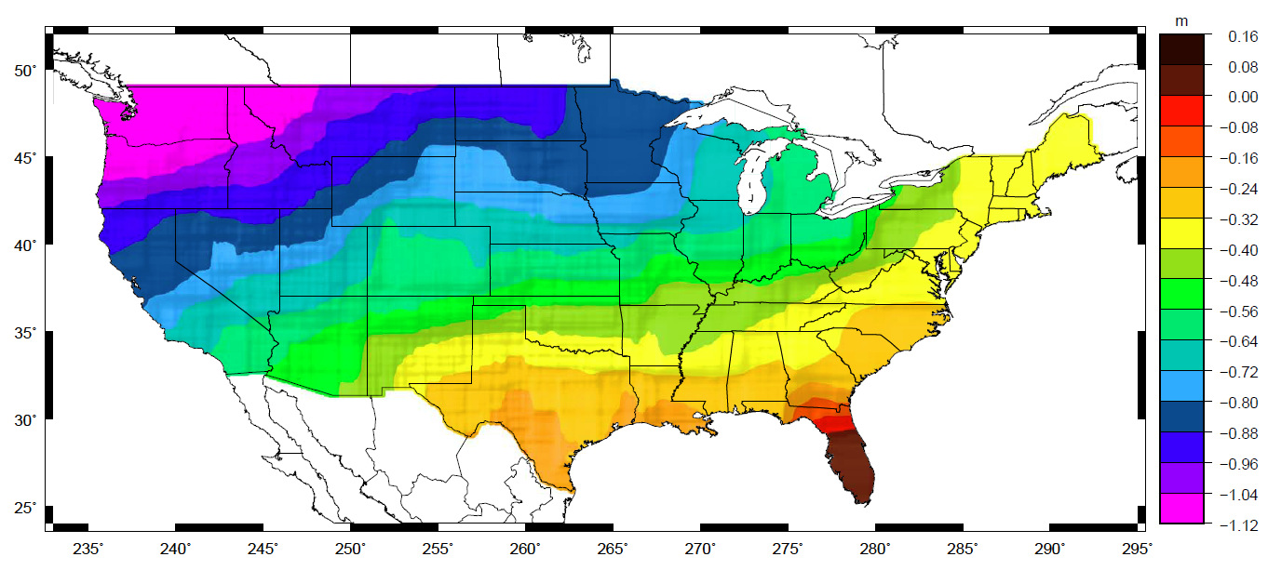
Why isn’t NAVD 88 good
enough anymore? (4 of 4)
Approximate level of geoid mismatch known to exist in the NAVD 88 zero surface:
Notes:
This map reflects the sort of height changes that users could expect if NAVD 88 were replaced with a geoid-based vertical datum.
This is only a large scale approximation and should not be used as an absolute guide. Each benchmark might have its own level
Of mismatch, say from uplift or subsidence, not captured by this broad brush.
Also, this is the difference between the zero level of NAVD 88 and the actual geoid. The difference between NAD 83 ellipsoid heights and
ITRF/GRS-80 ellipsoid heights has NO influence on this graph and should not be part of the story.
Updated October 2010

Slide 20
Possible ways to fix
NAVD 88 (1 of 6)
Short term fixes:
  Provide fast methods of expanding NAVD 88 in areas where it is needed
Long term fixes:
  Re-level some / all of NAVD 88
  Replace NAVD 88 bench marks

Slide 21
Possible ways to fix
NAVD 88 (2 of 6)
Short term fix: Height Modernization GPS surveys
  Have provided a fast way to disseminate NAVD 88 bench mark heights to new marks through the use GPS and a constrained least squares adjustment
  NOAA TM NOS NGS 58 and 59 guidelines
  Keeps NAVD 88 useful and accessible, but does not address the majority of problems of NAVD 88 itself

Slide 22
Possible ways to fix
NAVD 88 (3 of 6)
Long term fix: Re-level some/all of NAVD 88
Re-leveling NAVD 88 would cost
  between $200 Million and $2 Billion
This wouldn’t fix all of the problems associated with the use of bench marks though
Notes:
Re-leveling NAVD 88 won’t fix:
Sparseness of the bench marks
Continued subsidence or uplift of bench marks
Destruction of bench marks
Canada’s decision not to adopt NAVD 88
Whatever errors caused a continent-wide 1 meter build up in the leveling the first time around
This slide was updated June 2010.

Slide 23
Possible ways to fix
NAVD 88 (4 of 6)
Long term fix: Replace NAVD 88
Find a method of defining a vertical datum that seeks to fix all of the known issues with NAVD 88
Best option: Define the datum as a given geoid model and realize it through GNSS technology
  GRAV-D
Notes:
Why is this the best option? Because it addresses:
Different datums existing for CONUS, Hawaii, PR/VI (and, theoretically, Canada, Mexico, and the Caribbean and Central American countries)
Sparseness of bench marks
Error build up as one gets far from an origin point
Financial and personnel realities
Fragility of bench mark network

Slide 24
Possible ways to fix
NAVD 88 (5 of 6)
Long term fix: Replace NAVD 88 (continued)
GRAV-D Trade-offs: Datum is only realizable to 2 cm at best at any given point (GNSS error + geoid error)
  However, this is an improvement over NAVD 88 realization error
  The datum could then be disseminated locally through very precise geodetic leveling
Notes:
Although the idea of a GNSS/geoid vertical datum will mean realization errors generally no better than 2 cm at any given location, this is better than NAVD 88 which has leveling error build up away from Father point. Additionally, the ability to know the datum through a single GNSS receiver at any point of convenience will mean that leveling from existing bench marks to “bring in” the datum will no longer be necessary.
Nothing currently can replace geodetic leveling for precise local differential height dissemination. GRAV-D is not meant to replace leveling of that sort, but instead to provide immediate 2 cm access to the datum anywhere, so that (if necessary) leveling can then be performed very precisely off of that starting point to locations of interest.

Slide 25
Possible ways to fix
NAVD 88 (6 of 6)
Long term fix: Replace NAVD 88 (continued)
GRAV-D International Issues
  Canada has agreed to move to a geoid based vertical datum
    Negotiations with USA underway
  Mexico has no plans yet to move to a geoid based datum
  Central American, Caribbean: No policy to switch, but the datum will be freely available to them
Notes:
Although the idea of a GNSS/geoid vertical datum will mean realization errors generally no better than 2 cm at any given location, this is better than NAVD 88 which has leveling error build up away from Father point. Additionally, the ability to know the datum through a single GNSS receiver at any point of convenience will mean that leveling from existing bench marks to “bring in” the datum will no longer be necessary.
Nothing currently can replace geodetic leveling for precise local differential height dissemination. GRAV-D is not meant to replace leveling of that sort, but instead to provide immediate 2 cm access to the datum anywhere, so that (if necessary) leveling can then be performed very precisely off of that starting point to locations of interest.

Slide 26
What is GRAV-D? (1 of 6)
Gravity for the Redefinition of the American* Vertical Datum
An NGS project whose target is to redefine the official civilian vertical datum as the geoid, realized through the use of GNSS technology and a gravimetric geoid model over at least the United States and its territories
Notes:
*American = “of or pertaining to North or South America”
Updated Oct 2010

Slide 27
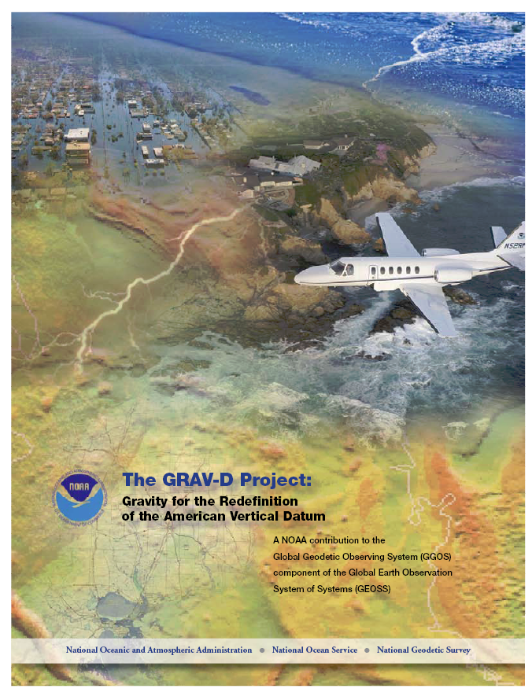
What is GRAV-D? (2 of 6)
Official NGS policy as of Nov 14, 2007
Airborne Gravity Snapshot
Absolute Gravity Tracking
Re-define the Vertical Datum of the USA by 2022 (at current funding levels)
Part of the NGS 10 year plan (2008-2018)
Target: 2 cm accuracy orthometric heights from GNSS and a geoid model
Notes:
Full funding was estimated at approximately $5.5M / year. Although full funding was not approved, partial funding was approved in 2010 at $3M/year. As such, the initially hoped for 2018 target date will almost certainly not be met.
Current best target for completion of airborne surveys and implementation of the new vertical datum is is 2022 (updated October 2010).

Slide 28
What is GRAV-D? (3 of 6)
GRAV-D means fast, accurate, consistent orthometric heights everywhere in the USA
GPS already gives fast accurate ellipsoid heights
If the geoid were modeled (and monitored) to highest accuracy…fast, accurate orthometric heights, anywhere, anytime
No need to use leveling to “bring in the datum”
Notes:
Monitoring of the geoid will be done through “Campaign II” of the GRAV-D plan. It will involve a combination of satellite derived geoid changes (such as from the GRACE mission or its follow-ons), geophysical modeling and a coordinated field campaign of absolute and relative gravimeters.
Updated October 2010.

Slide 29
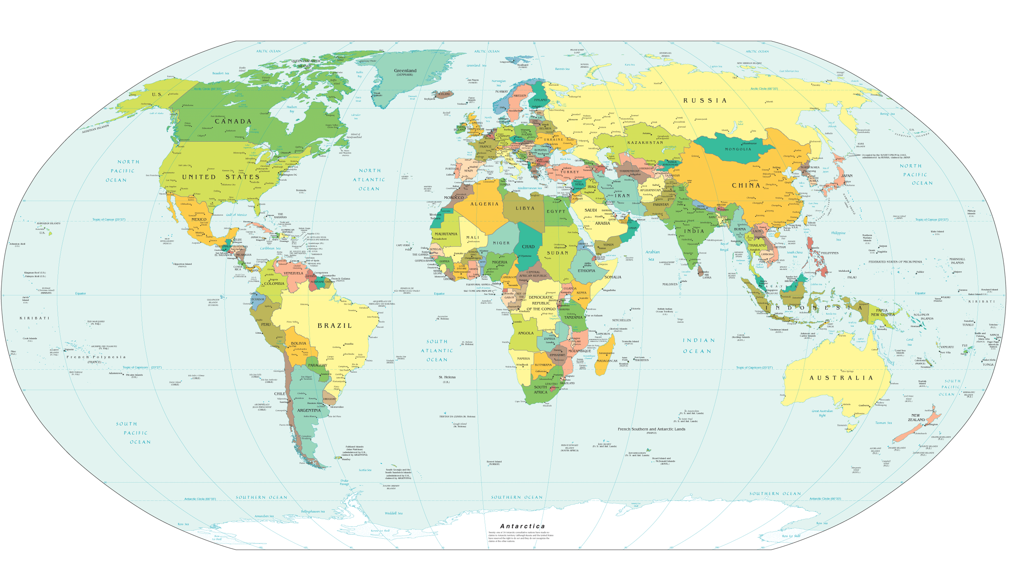
What is GRAV-D? (4 of 6)
Alaska
“CONUS”
Guam / Northern Marianas
Hawaii
Puerto Rico / Virgin Islands
American Samoa
GRAV-D
Planned
Coverage

Slide 30
What is GRAV-D? (5 of 6)
GRAV-D will mean:
  Primary access to the vertical datum will be through a GNSS receiver and a gravimetric geoid model
  One consistent vertical datum for all of North America
    CONUS, Alaska, Hawaii, PR, VI
    Available for adoption by
      Canada, Mexico, Caribbean, Central America

Slide 31
What is GRAV-D? (6 of 6)
GRAV-D will mean:
  As the H=0 surface, the geoid will be tracked over time to keep the datum up to date
  The reliance on bench marks will dwindle to:
    Secondary access to the datum
    Minimal NGS involvement
      Maintenance/checking in the hands of users
    Use at your own risk

Slide 32
Why GRAV-D? (1 of 4)
A relatively small workforce can update the geoid as compared to the large workforce needed to re-level bench marks
A 2 cm target accuracy anywhere that GNSS receivers can be used, kept up to date through monitoring CORS and the geoid, is better than the accuracy and accessibility of NAVD 88 today
It is cheaper than leveling
The geoid can’t be bulldozed out of usefulness
The effect of subsidence upon the realization will be known (and accounted for) by monitoring CORS and monitoring the geoid
Notes:
The 2 cm target accuracy is actually a gross overestimation of the combination of two error budget sources – 1 cm for GPS ellipsoid height error and 1 cm for geoid undulation error. Combining those two in an RMS sense would yield about 1.4 cm of total orthometric height error, if the geoid undulation error and ellipsoid height error are uncorrelated. The 2 cm number provides a slight buffer over the 1.4 cm value.
Also, it’s true that the availability of GNSS will be a limitation of this system. With multiple constellations, it is hoped that in urban canyons and forested regions this will partially be mitigated. In areas where GNSS is simply unachievable, then access to the vertical datum will need to be through GNSS as close to the work area as possible to set a beginning mark, followed by leveling to the area of interest.

Slide 33
Why GRAV-D? (2 of 4)
Geoid accuracy depends on quality of data and quality of theory
  Theory being revised by Y. Wang (IAG study group)
  Data being updated using airborne techniques
Airborne gravimetry is the best technique to:
  Cover the country quickly and consistently
  Connect terrestrial to near-shore oceanic data
  Fill in the gap between point-by-point terrestrial measurements and 200 x 200 km footprint satellite (GRACE) measurements

Slide 34
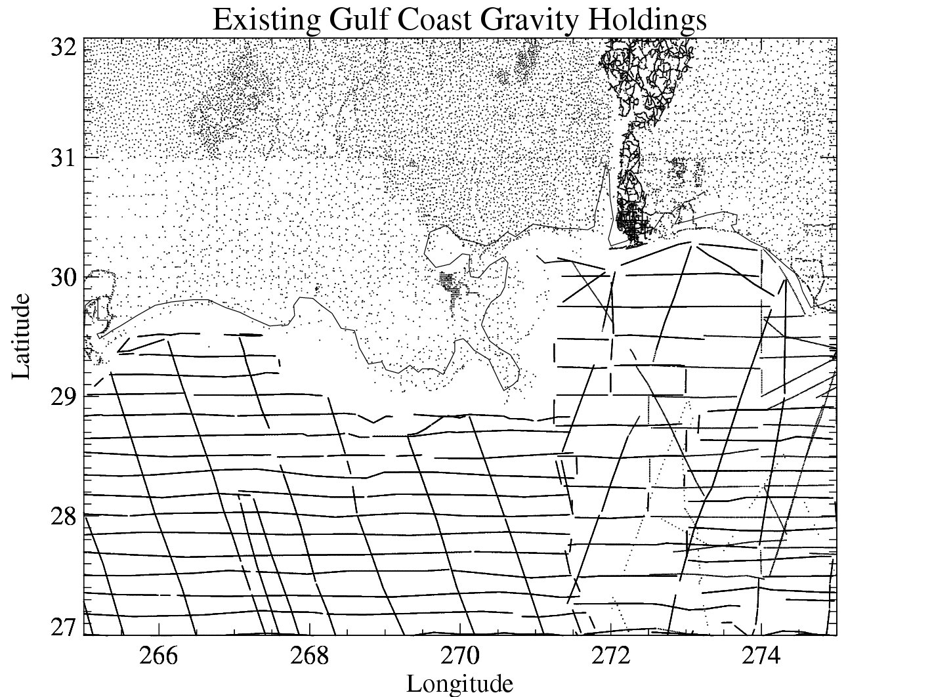
Why GRAV-D? (3 of 4)
20-100 km gravity gaps along coast
Airborne gravity is the only technique that can adequately connect existing terrestrial data to existing ship and altimetry data in the oceans and fill coverage gaps.
Airborne data will not replace existing data, but will be used as a baseline for correcting that data to be consistent across the
country.
Terrestrial gravity
Ship gravity
New Orleans

Slide 35
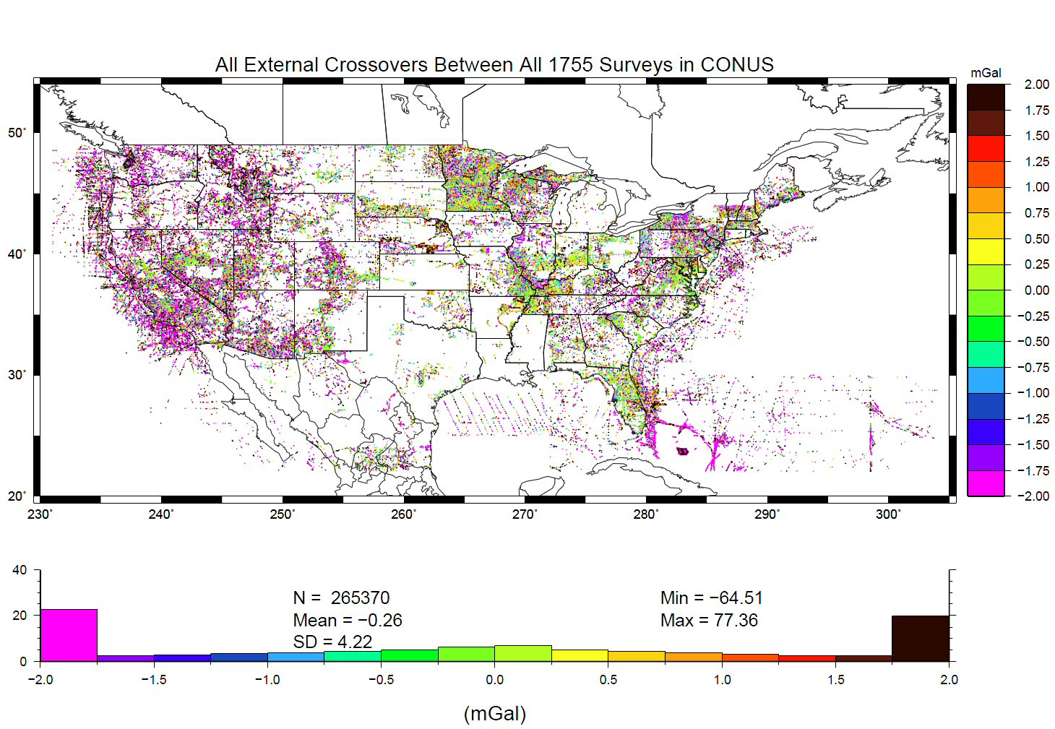
Why GRAV-D? (4 of 4)
Decades of disparate gravity surveys are inconsistent with one another
Airborne gravity will provide a baseline for removing these inconsistencies
%
Notes:
This slide shows “crossovers” between any of the 1755 terrestrial gravity surveys which NGS holds in its database. These are
basically mismatches between surveys that overlap one another, plotted at the point of overlap. Note that the color bar
is +/- 2 mGals, and how many surveys disagree with one another at that level. GRAV-D flights should yield about 2 mGal
accuracy surveys, and help reduce the level of disagreement to that range.
The vertical axis of the lower plot is “Percent of points with this level of crossover error” So while it is bell-shaped around -0.26 mGals, the “wings” at the >+2 or <-2 range contain a good 45-50% of all crossovers.
Added October 2010.

Slide 36
What is the status of GRAV-D?
(1 of 8)
2007:
  NGS Releases Draft of 10 year plan (first public reference to re-definition of vertical datum redefinition)
  NGS Acquires Airborne Gravimeter
  Final version of GRAV-D plan released
  Airborne Gravimeter operator training begins
2008:
  Survey AL08 (Alabama Gulf Cost tests)
  Survey AK08 (Anchorage Alaska; Hydropalooza)
  Survey LA08 (Louisiana Gulf Coast)
  NGS requests partnerships with 7 other federal agencies
    FEMA, USACE, NASA, ONR, FAA, USGS, NGA

Slide 37
What is the status of GRAV-D?
(2 of 8)
2009 Jan: Puerto Rico / Virgin Islands region flown (Survey PV09)
2009 May: In partnership with the USACE, the Western Gulf of Mexico coastline flown from Louisiana through Texas to the Mexican border (Surveys LA09, TX09)
2009 May: The White House releases President Obama’s FY2010 budget request which contains a $4 Million/year request for GRAV-D
  Congress approves $3 Million/year for GRAV-D beginning with the FY2010 budget

Slide 38
What is the status of GRAV-D?
(3 of 8)
2009 June: Socio-Economic Benefits Scoping study for CORS and GRAV-D released
  The benefits to the nation from completing GRAV-D are estimated to be $4.8 billion over 15 years, including $2.2 billion in avoidance costs from improved floodplain management.
  This is approximately a 1:100 cost-benefit ratio
2009 July-Aug: In partnership with NGA and the Naval Research Laboratory, the central Alaskan region is flown (Survey AK09)

Slide 39
What is the status of GRAV-D?
(4 of 8)
2010 June: South Central Alaska flown (Survey AK10)
2010 July-Oct: In collaboration with BLM, the North central Alaskan region is flown (Survey AK10-2)

Slide 40
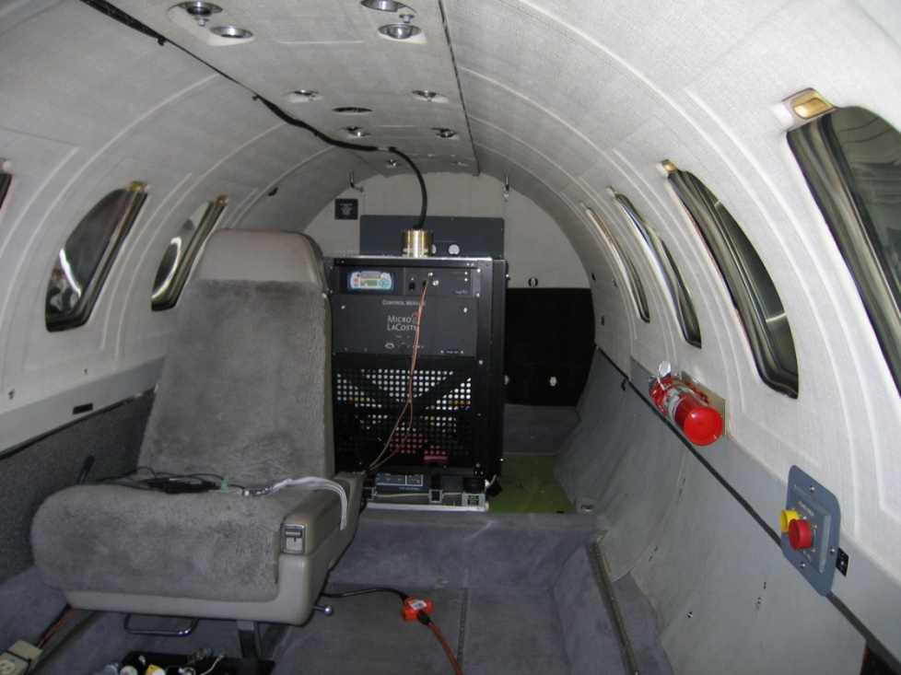

What is the status of GRAV-D?
(5 of 8)
The NGS airborne gravimeter (“TAGS”) mounted in the NOAA Cessna Citation and ready for flight
The NGS GRAV-D team and NOAA pilots at work in the Virgin Islands during January 2009
Notes:
The TAGS (Turnkey Airborne Gravity System) has now successfully been flown in a NOAA aircraft and a Naval Research Laboratory aircraft.

Slide 41
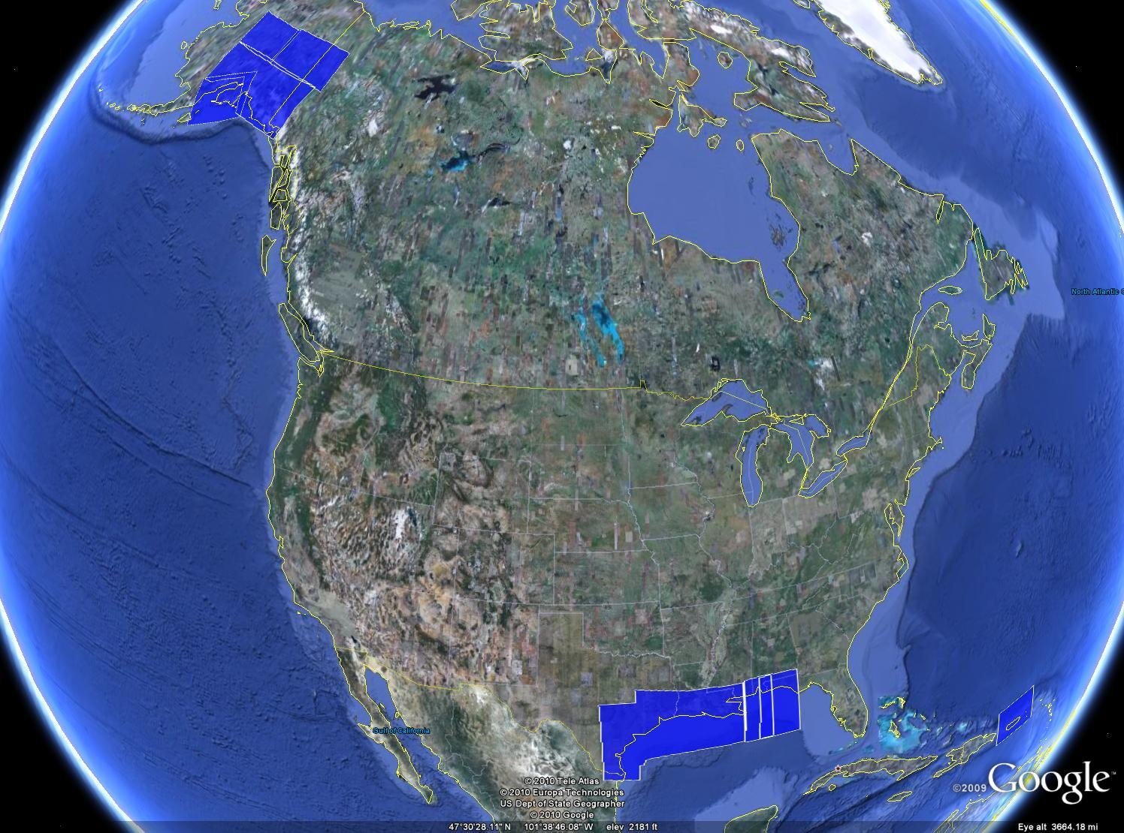
What is the status of GRAV-D?
(6 of 8)
NGA funded
NRL plane
As of
Oct 2010:
7.8% of
planned areas
have been flown
USACE funded
Notes:
So far: Gulf coast from Fla to Mexican border ; Puerto Rico and the Virgin Islands ; Anchorage ; Fairbanks, and much of central and south Alaska.
Updated October 2010

Slide 42
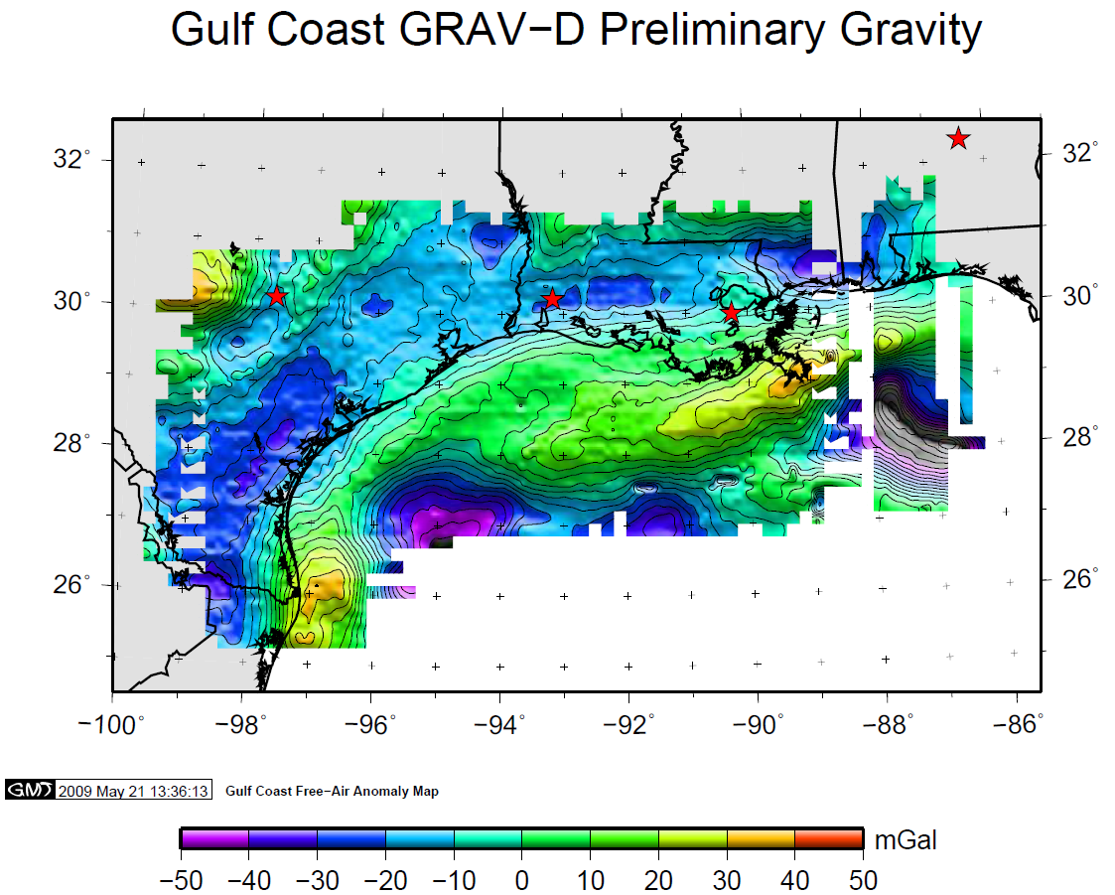
What is the status of GRAV-D?
(7 of 8)
Gravimeter operating well
Vendor-provided gravity
processing software
has unresolved artifacts
rendering it unusable for
final gravity processing
NGS has replaced this black-box
software with a new in-house
suite of software (“NEWTON 1.0)
in Summer 2010.
Gravity releases to begin with Gulf
Coast in Fall 2010
Next flights:
2010: Alaska, California coast
2011: Great Lakes
Notes:
A snapshot of gravity coming out of GRAV-D. While this plot shows gravity variations, these are highly correlated with geoid variations. As such, this plot gives an idea of the ups and downs of the gravity field that represent the difference between ellipsoid heights (from GPS) and orthometric heights.
Updated October 2010.

Slide 43
What is the status of GRAV-D?
(8 of 8)
Federal Geospatial Summit (Silver Spring, May 2010)
  Feedback from users will assist in transitioning to new vertical datum
Prototype “vertical datum access” tool is available through OPUS extended output
  Uses the best gravimetric geoid available that year
  Gives users a preview of how the new datum will be accessed and the ability to test “best possible” heights relative to NAVD 88 heights
Notes:
It will be necessary to work with the user community make sure the transition off of a purely benchmark-accessed vertical datum is smooth. The
OPUS tool will be how the future vertical datum will primarily be accessed.
Updated October 2010

Slide 44
How will I access the new
vertical datum? (1 of 10)
Primary access (NGS mission)
  Users with geodetic quality GNSS receivers will continue to use OPUS suite of tools
  Ellipsoid heights computed, and then a gravimetric geoid removed to provide orthometric heights in the new datum
  No passive marks needed
  But, could be used to position a passive mark
Notes:
Multiple questions come up about using the new vertical datum. Two examples are given in the next few slides. The first is the example of how the new datum will address subsidence, say for floodplain mapping. The second example is about how the datum will be accessible when there aren’t bench marks in the immediate region of interest. Both examples rely on this simple formula:
Get an ellipsoid height (h) from GNSS in the latest geometric datum (the replacement for NAD 83)
Remove the NGS provided geoid model (N)
The orthometric height in the new datum (H) is just H=h-N

Slide 45
How will I access the new
vertical datum? (2 of 10)
Secondary access (Use at your own risk)
  Passive marks that have been tied to the new vertical datum
  NGS will provide a “data sharing” service for these points, but their accuracy (due to either the quality of the survey or the age of the data) will not be a responsibility of NGS
Notes:
NGS will eventually stop making the claim that we “know” the heights of bench marks as the method of providing access to the vertical datum. What NGS will do is provide the orthometric height to a user on the day of their survey (and with the disclaimer that this height should not be taken as “known” for very long, due to the dynamic nature of the Earth). If possible, height changes (velocities) will be computed and provided to
assist in predicting heights in the future.
Updated October 2010.

Slide 46
How will I access the new
vertical datum? (3 of 10)
NAVD 88 conversion to new datum
  A conversion will be provided between NAVD 88 and the new datum
    Only where recent GNSS ellipsoid heights exist to provide modern heights in the new datum
Notes:
In areas where a brand new (relatively speaking) GNSS based ellipsoid height has been determined at an NAVD 88 bench mark, that data will allow for NGS to convert to the new datum. The more of these points that can be determined right near the time of the new datum’s release, the better will be the conversion.

Slide 47
How will I access the new
vertical datum? (4 of 10)
Example 1: Flood insurance survey
1954: Leveling Performed
to bench mark
House
1954-1991: Subsidence
House
BM
BM
1991: Original 1954 leveling data is used to compute the NAVD 88 height which is then published for this BM
H₈₈(published)
H₈₈(true)
NAVD 88 zero height surface
Obviously the true height relative to the NAVD 88
zero surface is not the published NAVD 88 height

Slide 48
How will I access the new
vertical datum? (5 of 10)
Example 1: Flood insurance survey
Using Existing Techniques:
Find bench mark (if you can)
Get published NAVD 88 height
Level off of bench mark
No account for subsidence!
House
BM
House
BM
H₈₈(published)
H₈₈(true)
NAVD 88 zero height surface

Slide 49
How will I access the new
vertical datum? (6 of 10)
Using Future Techniques:
Find bench mark if you wish, or
set a new one of your choosing
Use GNSS/OPUS to get an
orthometric height in the new datum
Level off of bench mark as needed
Subsidence is accounted for by CORS
and a geoid that are monitored
constantly!
Example 1: Flood insurance survey
House
BM
House
BM
H(2022?) from GNSS/geoid
NAVD 2022(?) zero height surface = geoid
Notes:
Updated to reflect current best known release date of 2022.
Updated October 2010.

Slide 50
How will I access the new
vertical datum? (7 of 10)
Example 2: “Bringing in” the datum
Point where I need
an orthometric height
Nearest level lines
are about 25 km and 50 km
away respectively. Bench marks
may or may not exist,

Slide 51
How will I access the new
vertical datum? (8 of 10)
Example 2: “Bringing in” the datum
Choice 1: Leveling
Will we live with a
spur or maybe check
in with another level
line?
Leveling for 50 km
Lucky day, we
find 6
undisturbed
Bench marks!
Leveling for 25 km
Luckily we find 1
undisturbed bench mark!
Now it’s time to bluebook the
data, submit to NGS, wait for
it to be processed and loaded….
And all this assumes the published
heights are correct to begin with…

Slide 52
How will I access the new
vertical datum? (9 of 10)
Example 2: “Bringing in” the datum
Choice 2: “Height Mod” survey
Create passive marks
around area of interest
Using progressive
GNSS surveys (NGS 59
Guidelines), transfer
orthometric heights to
Primary, Secondary and
Local marks
Now it’s time to bluebook the
data, submit to NGS, wait for
it to be loaded into the IDB….
And all this assumes the published
heights are correct to begin with…
Notes:
Note that even if this goes off as planned, there may still need to be leveling involved to check existing bench marks or possibly check the GPS results on these new points.

Slide 53
How will I access the new
vertical datum? (10 of 10)
Example 2: “Bringing in” the datum
Choice 3: Once GRAV-D is complete
Set up GNSS receiver over mark
Submit data to OPUS and
receive orthometric height
Feeling generous? Share your
results with others using the
NGS online database (no
bluebooking involved). If not,
take your height and walk
away.

Slide 54
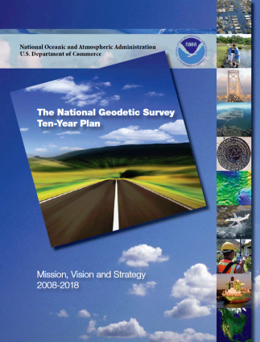

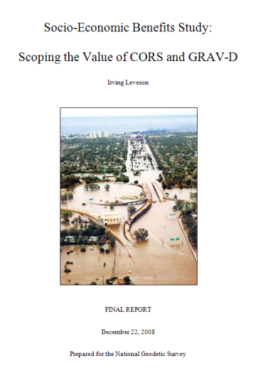
Additional Information(1 of 2)
The NGS 10 year plan (2008-2018)
http://www.ngs.noaa.gov/INFO/NGS10yearplan.pdf
The GRAV-D Project
http://www.ngs.noaa.gov/GRAV-D
Socio-Economic Benefits of CORS and GRAV-D
http://www.ngs.noaa.gov/PUBS_LIB/Socio-EconomicBenefitsofCORSandGRAV-D.pdf

Slide 55
Additional Information(2 of 2)
Contacts:
Always begin with your state advisor:
  http://www.ngs.noaa.gov/ADVISORS/AdvisorsIndex.shtml
NGS Information Center
  Phone: (301) 713-3242
  E-mail: ngs.infocenter@noaa.gov
Notes:
This PPT is the October 2010 update (by Dru Smith) to a set of slides that was originally created in November 2009 by Dru Smith.
Until such time as a project manager for the new vertical datum is announced, any updates to this PPT will be his responsibility.

