Slide 1
Modernizing the
National Spatial Reference System
163rd NOAA-USGS Coordination Meeting
May 9, 2022
Juliana Blackwell
Director, National Geodetic Survey

Slide 2
Modernization: The Bottom Line
ALL geospatial products:
- every survey
- every map
- every lidar point cloud
- every image
- every DEM
… WILL have NEW coordinates in the Modernized National Spatial Reference System (NSRS).
Furthermore, how you access the new coordinates will fundamentally change.
This presentation will cover some of what these changes will mean for hydrology.

Slide 3
Modernization: Who and What
The National Geodetic Survey, the federal agency responsible for establishing and maintain the positioning framework to support all federal civilian mapping and charting in the United States, is modernizing the National Spatial Reference System (NSRS).
•
What does this mean?
All horizontal and vertical datums in the NSRS (NAD 83, NAVD 88, etc.) will be updated with:
  Four (4) new Terrestrial Reference Frames of 2022
  North American-Pacific Geopotential Datum of 2022
New tools, products, services, and methodologies will be developed jointly to support the transition and access to an improved, modernized NSRS.

Slide 4
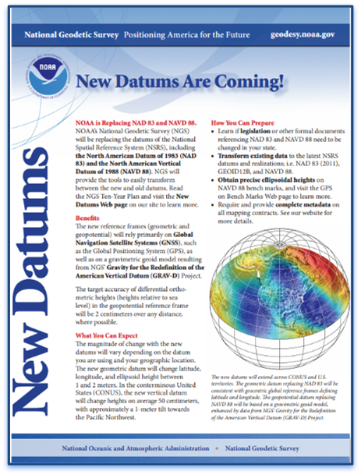
Why NSRS Modernization?
Today’s NSRS:
Current datums were built using old (pre-GPS) technology and data.
NAD 83 is not truly aligned with the center of the earth as we know it (off by ~2.2 m).
NAVD 88 relies on survey marks in the grounds, which are difficult to maintain.
Modernization will:
Improve accuracy, access, and alignment of our positioning systems.
Change your coordinates up to 1-2 meters, depending on your location.

Slide 5
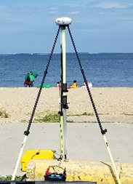
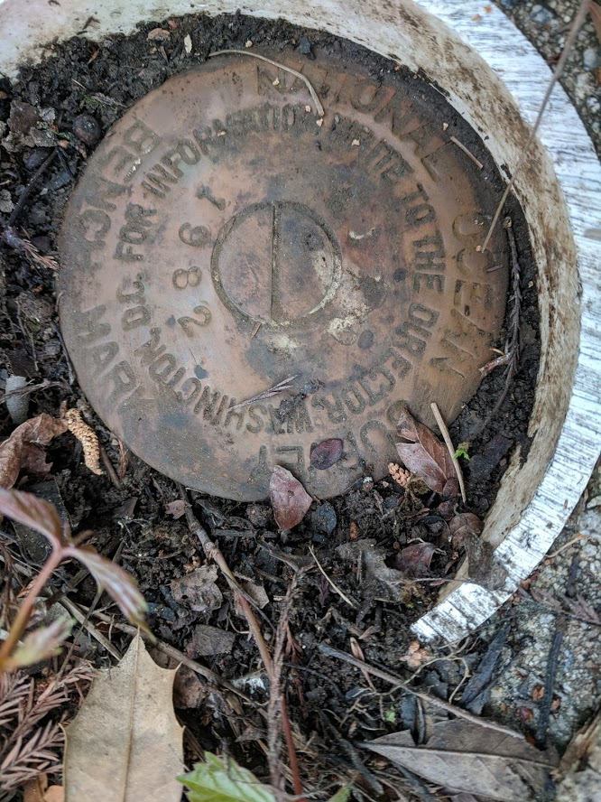

Why NSRS Modernization?
ACCESSIBILITY
Access will be primarily through GNSS
GNSS equipment is fast, inexpensive, reliable (and improving)
Reliance on finding survey control marks (“brass disks”) is reduced
ACCURACY
GNSS post-processed positions are accurate within centimeters
By processing multiple simultaneous occupations, you can get both local and network accuracy (even sub-cm!)
CONSISTENCY
Eliminates systematic errors in current datums
Aligns with global reference frames
Integrated system for both positions and heights (“elevations”)

Slide 6
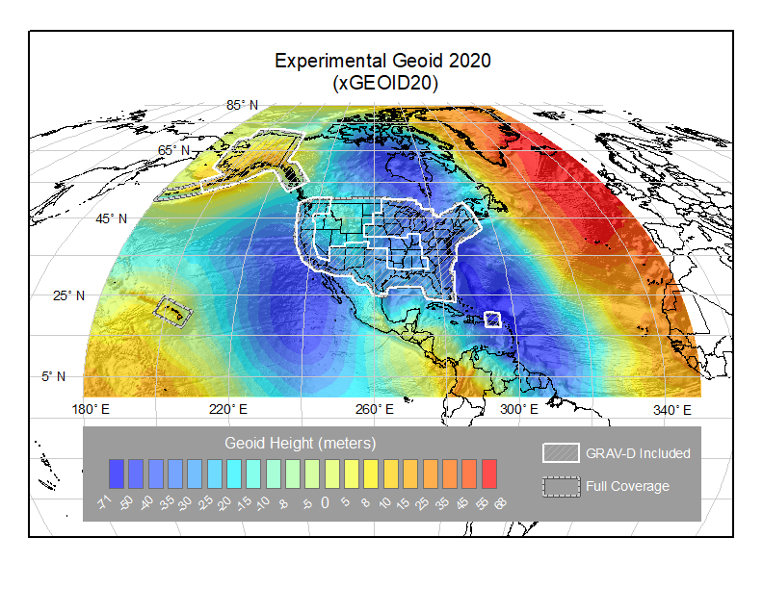
New NSRS: Coming Soon!
Four Terrestrial Reference Frames:
North American Terrestrial Reference Frame of 2022 (NATRF2022)
Caribbean Terrestrial Reference Frame of 2022 (CATRF2022)
Pacific Terrestrial Reference Frame of 2022 (PATRF2022)
Marianas Terrestrial Reference Frame of 2022 (MATRF2022)
One Geopotential Datum:
North American-Pacific Geopotential Datum of 2022 (NAPGD2022)

Slide 7
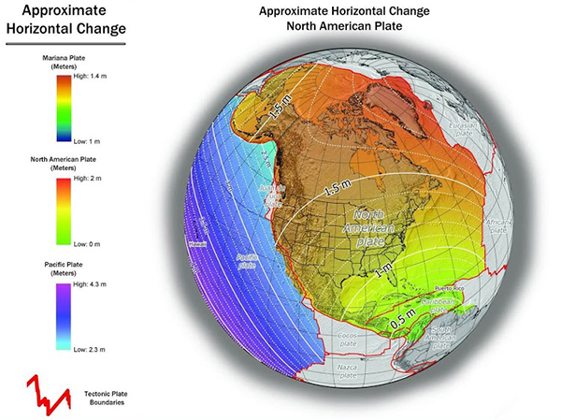
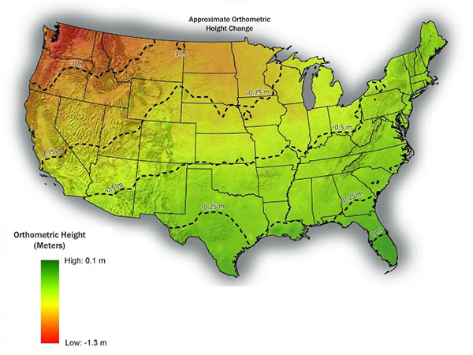
What modernization will mean to USGS
Positions and Heights will change

Slide 8
What modernization will mean to USGS
Impact
Every historic position (on a map, chart, survey, etc.) with an assumed accuracy of better than 1 meter will become obsolete.
This includes:
  3DEP Elevation Datasets
  National Hydrography Datasets
  Flood Insurance Rate Maps

Slide 9
Prepare for the Future
Learn more by visiting our New Datums web page
Check out our training opportunities:
- Both live and virtual trainings (NGS Testing & Training Center at Woodford, VA)
- Online recorded webinars (OPUS Projects, WinDesc, NGS Webinars, etc.)
- Online lessons (now with training certificates)
- Online videos
Become familiar with NGS models and tools
Access data workflows in collaboration with NGS
Reach out and provide feedback
Save original data (e.g. GNSS observation files, lidar point clouds, etc.)

Slide 10
Prepare for the Future
Review metadata and accuracy requirements for existing geospatial product lines
Consider how each of these products will be transitioned to the new datums. Three options*:
  re-observing
  re-adjusting
  transforming
Contact us!
  Regional Geodetic Advisors
  Galen Scott, Constituent Resource Manager (galen.scott@noaa.gov)
*Described in Blueprint 3 - Use Case: Transitioning Data to the Modernized NSRS

Slide 11
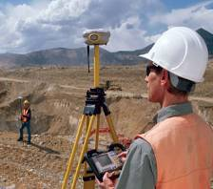
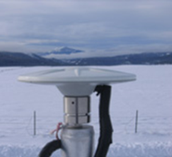
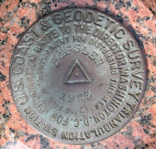
Prepare for the Future
Submit GNSS data as soon as possible to NGS for inclusion in the 2020 Reference Epoch Coordinate computations
  This will give a “fresh” set of GNSS-derived geometric coordinates
  It will also help build the vertical transformation tool to convert prior NAVD 88 coordinates into NAPGD2022

Slide 12
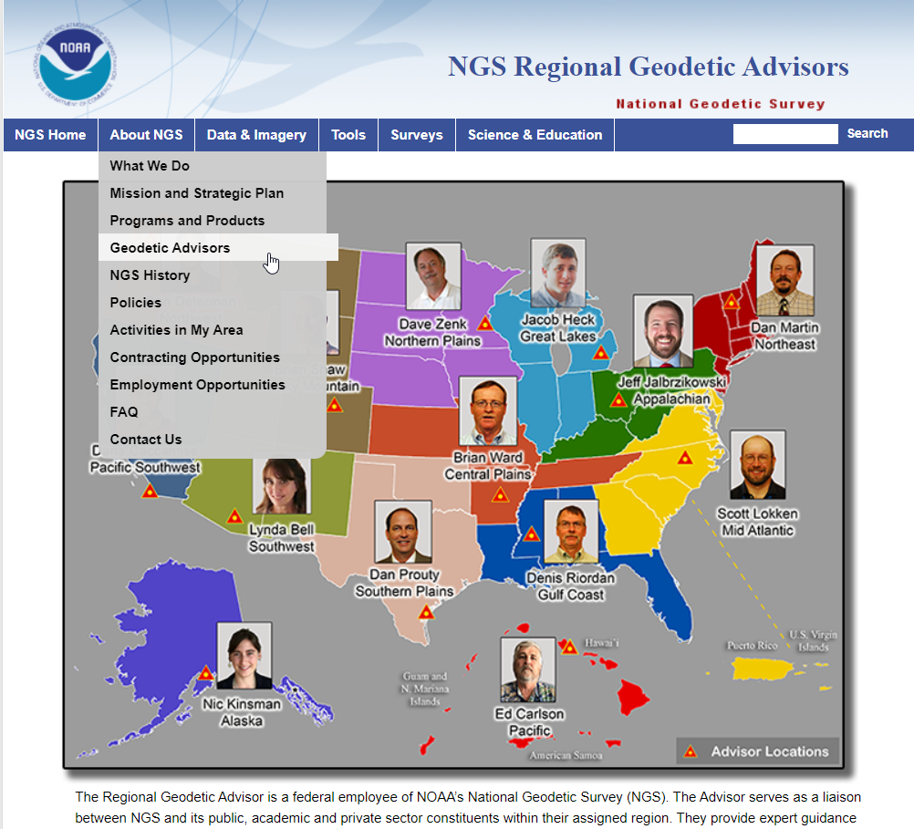
NGS Regional Advisor Program
All 50 States have a NGS Regional Geodetic Advisor
Advisors are your first responders to your geodetic survey questions and needs
Advisors also provide training (OPUS Projects, Leveling)

Slide 13
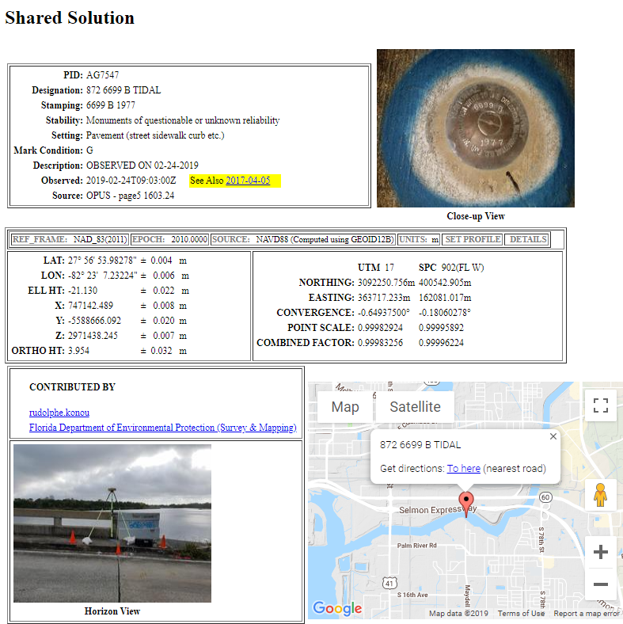
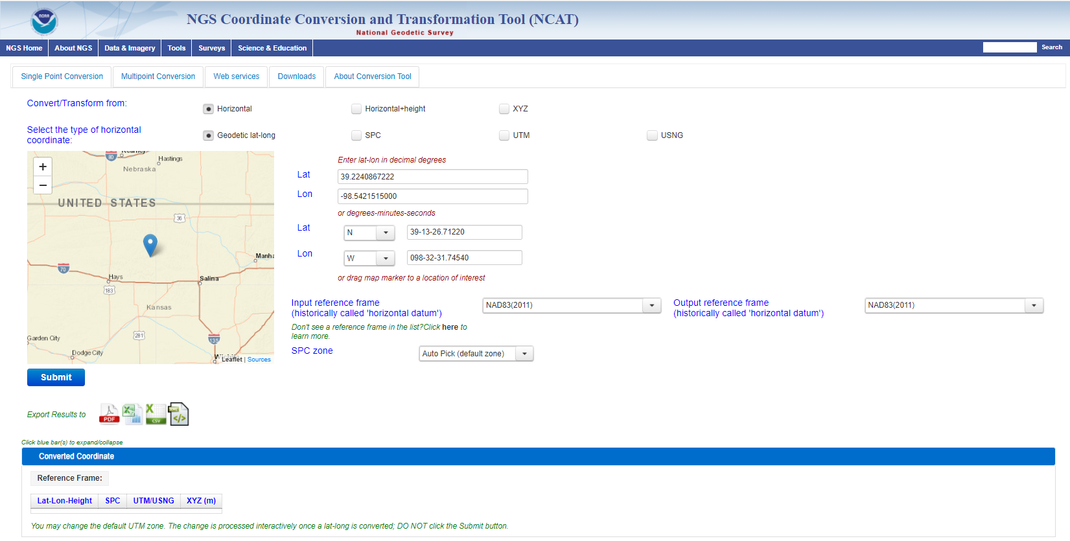
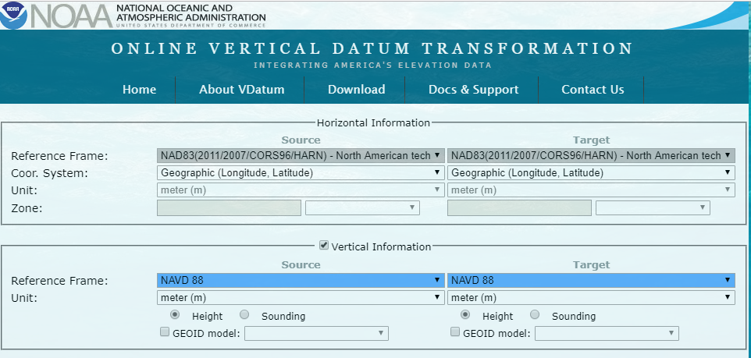
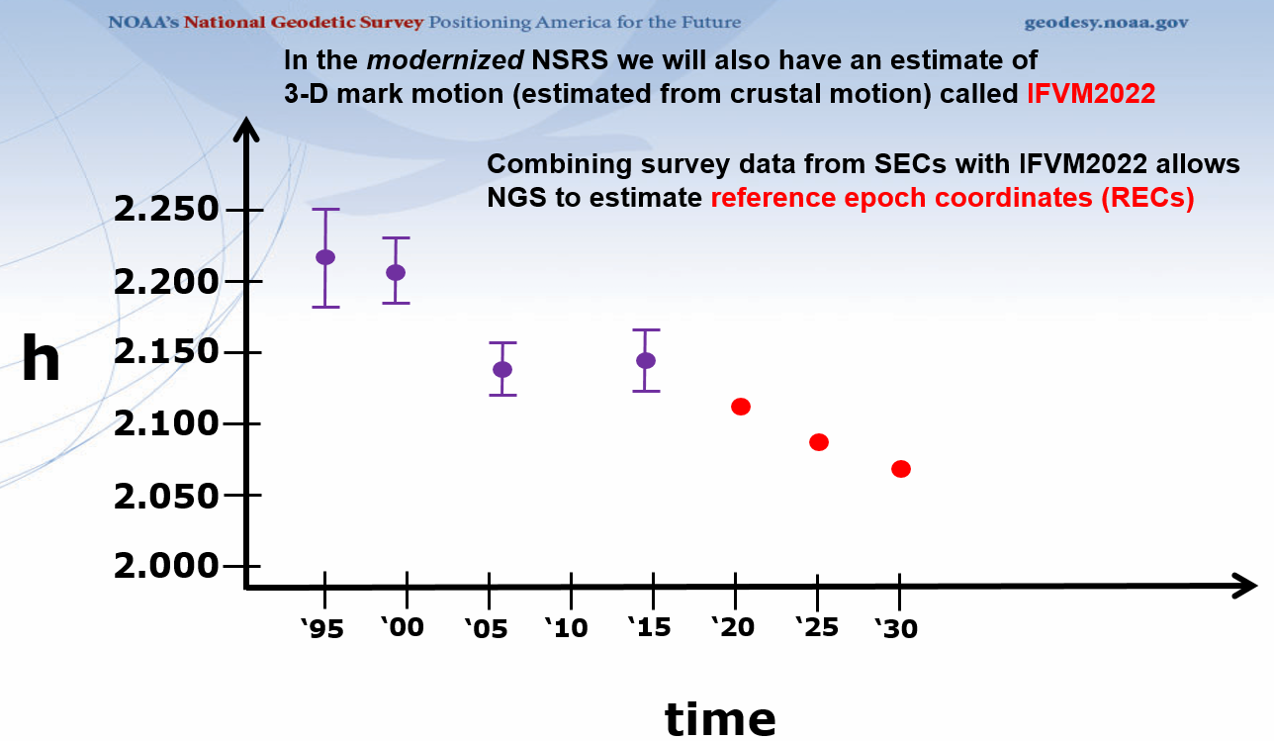
GPS on Bench Marks - What & Why?
GPS on Bench Marks is about preparing the country and our communities to take full advantage of the benefits of the Modernized NSRS, by collecting new GPS observations on bench marks with published NAVD 88 heights.
Primary GPSonBM Campaign Benefits:
2020.0 Reference Epoch Coordinates (REC’s)
Data for NAVD 88 – NAPGD2022 Transformation Tools
Build time series of observations in areas of motion
Added benefits:
Evaluate gravimetric geoid models
Check your RTN results
Update and maintain passive control marks
Identify marks suspected of movement

Slide 14
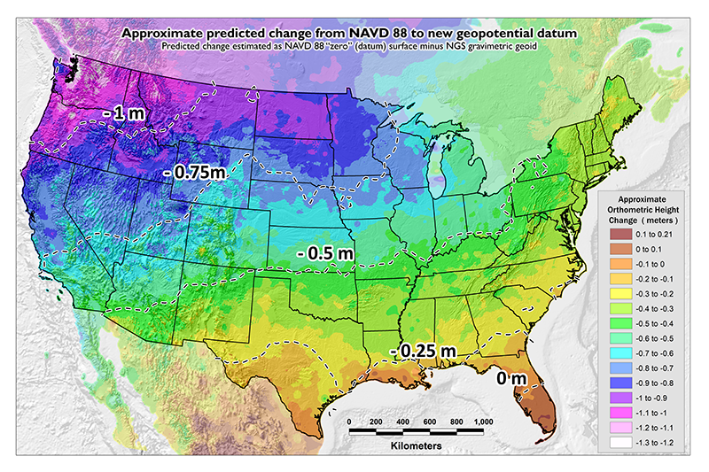
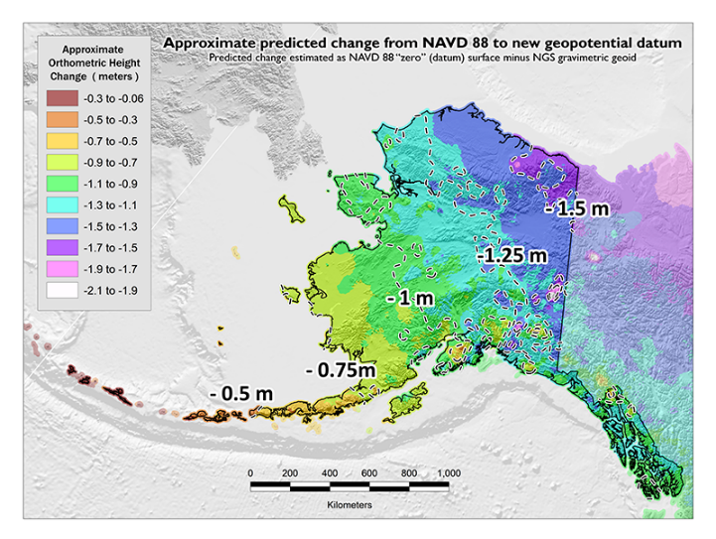
GPSonBM Measurements Connect
Current and Future Datums
The relationship between the old and new datums vary by location. GPSonBM data is used to measure that relationship. The accuracy of the transformations in any particular place will be directly related to the density of GPSonBM data available in that area.
  In moving from NAVD 88 to NAPGD2022, there will be a Shift: A one-time 0 to 2 meter jump in orthometric heights
  -From fixing biases and/or tilts in NAVD 88
PID: EZ0840
GPSonBM data is used to measure the Shift

Slide 15
Thank you

