Slide 1
The Coastal Mapping Program
and VDatum:
Impact of NSRS Modernization
Mike Aslaksen and Stephen White
April 25, 2016

Slide 2
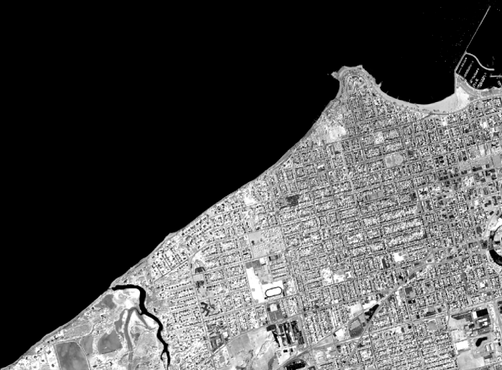
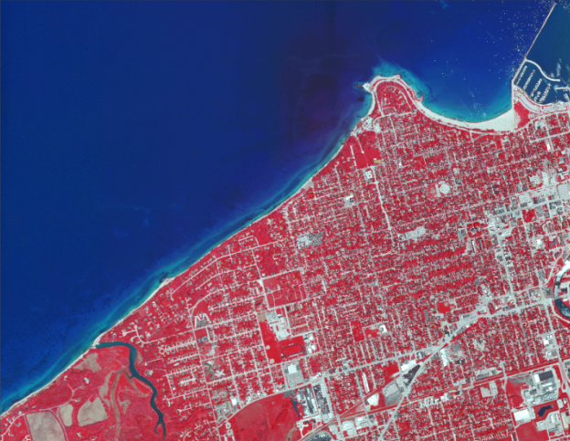
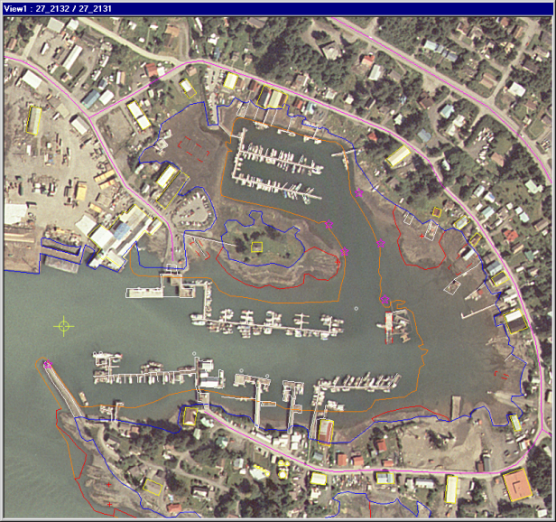
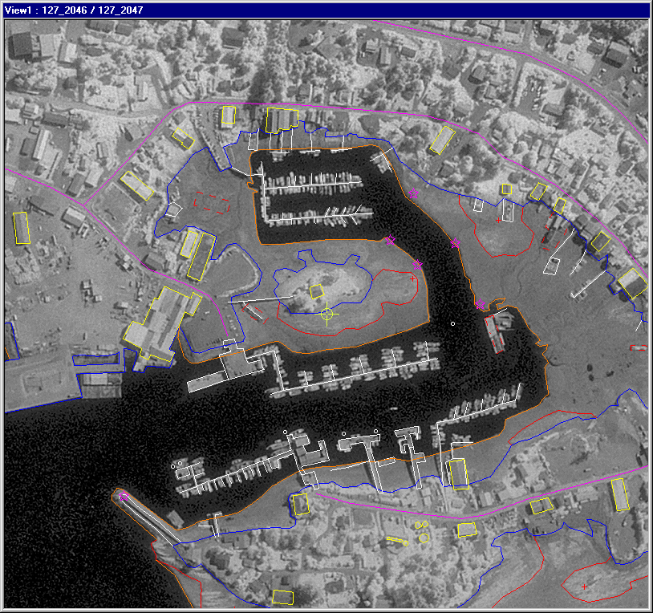
The Coastal Mapping Program
A congressional mandate to conduct remote sensing surveys of coastal regions of the United States and its possessions for demarcating the nation’s legal coastline.
Goals:
Provide the Nation With Accurate,
Consistent, Up-to-Date
National Shoreline
Acquire Nearshore
Elevation Data
Sources:
Lidar
Digital Cameras
High Resolution Satellites
Notes:
Support of other applications:
NOAA nautical charts
Used in defining the United States’ territorial limits
Coastal resource management
Storm surge and coastal flooding modeling
Coastal geomorphology studies
GIS analysis
Coastal Intelligence, Resiliency and Place-Based Conservation Applications
Integrated Ocean and Coastal Mapping : ! Map Once-Use Many Times !

Slide 3
Impact of NSRS Modernization
Operational Impacts:
Base stations, control/check points, direct georeferencing – consistency!
Proprietary sensor and exploitation software utilized to process data will need to support new reference frames
Shoreline Product Impacts:
Horizontal displacements – user dependent; minimal to charting (scale)
Tidal Datums not impacted, only roadmap for how we get to it - currently
National Tidal Datum Epoch update (~2020) will compound NSRS impact to shorelines going forward – this needs to be detailed and educated
Transitioning issues - horizontal transformations to shoreline will be needed if Nautical Charts are not updated to latest reference frames, metadata, SOWs, etc.
IOCM Products:
New products will be tied to latest reference frames
Older products will need to be transformed by delivery mechanism or RS/GIS software – ideally on-the-fly
Confusion of different reference frames and ensuring consistency
VDatum
Outreach
&
Education

Slide 4
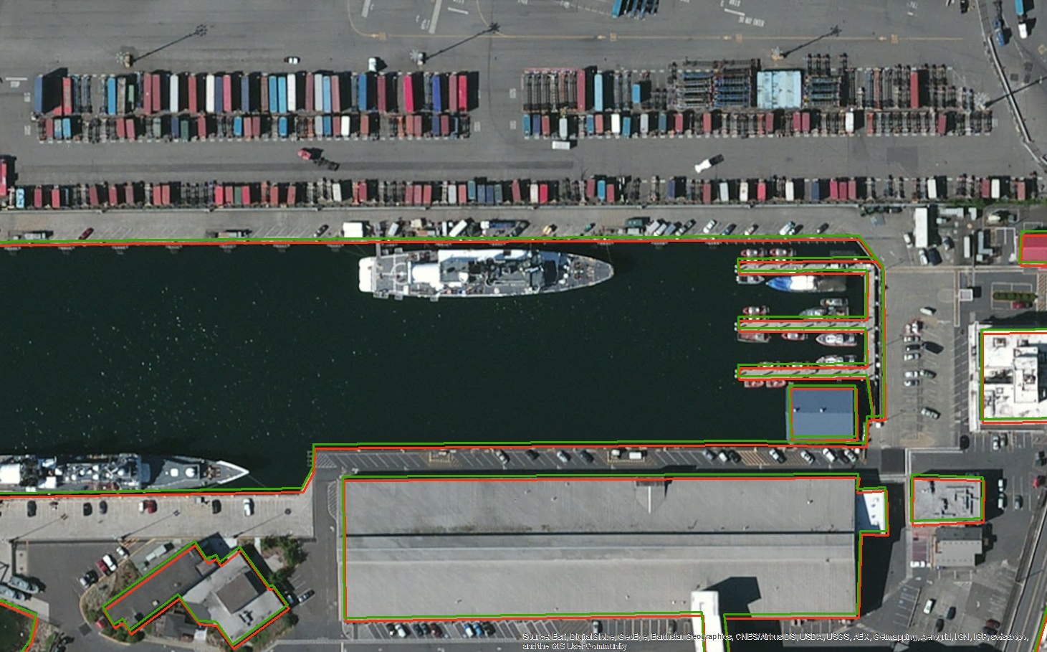
Changes to the NSRS: Horizontal
Seattle, WA
Easting Difference: 0.45 meters
Northing Difference: 1.33 meters

Slide 5
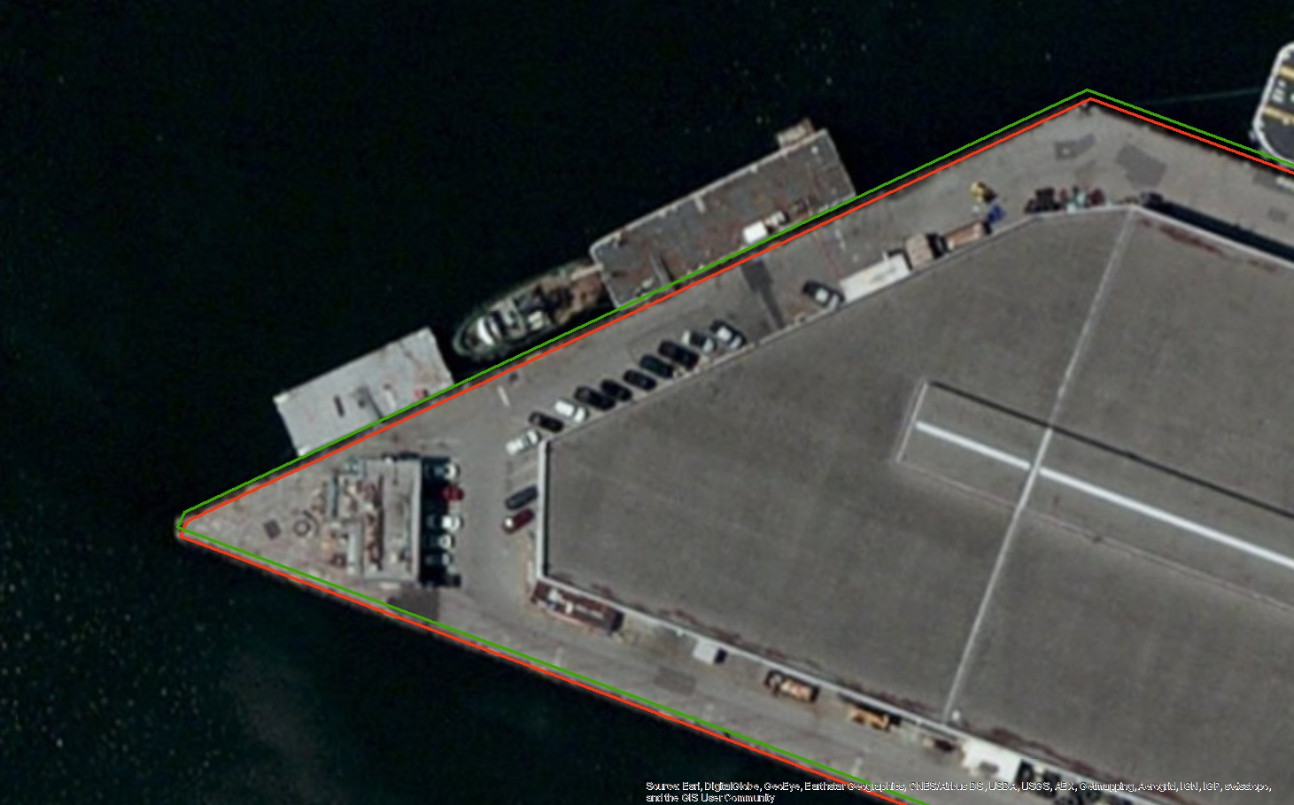
Changes to the NSRS: Horizontal
Long Beach, CA
Easting Difference: 0.41 meters
Northing Difference: 1.29 meters

Slide 6
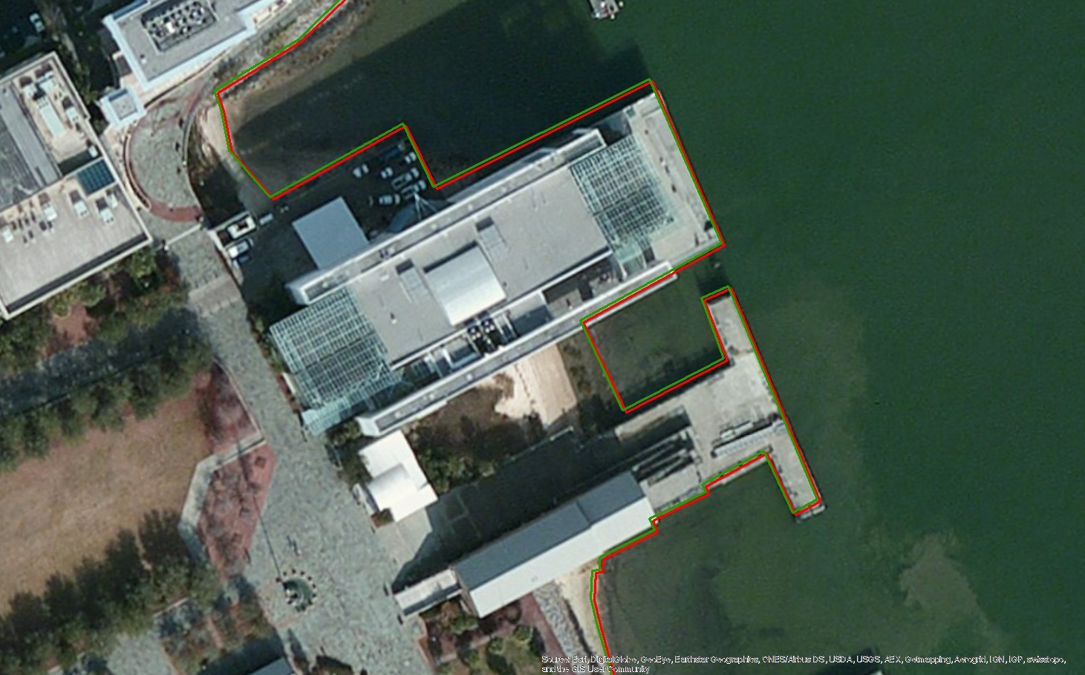
Changes to the NSRS: Horizontal
Charleston, SC
Easting Difference: 0.75 meters
Northing Difference: 0.46 meters

Slide 7
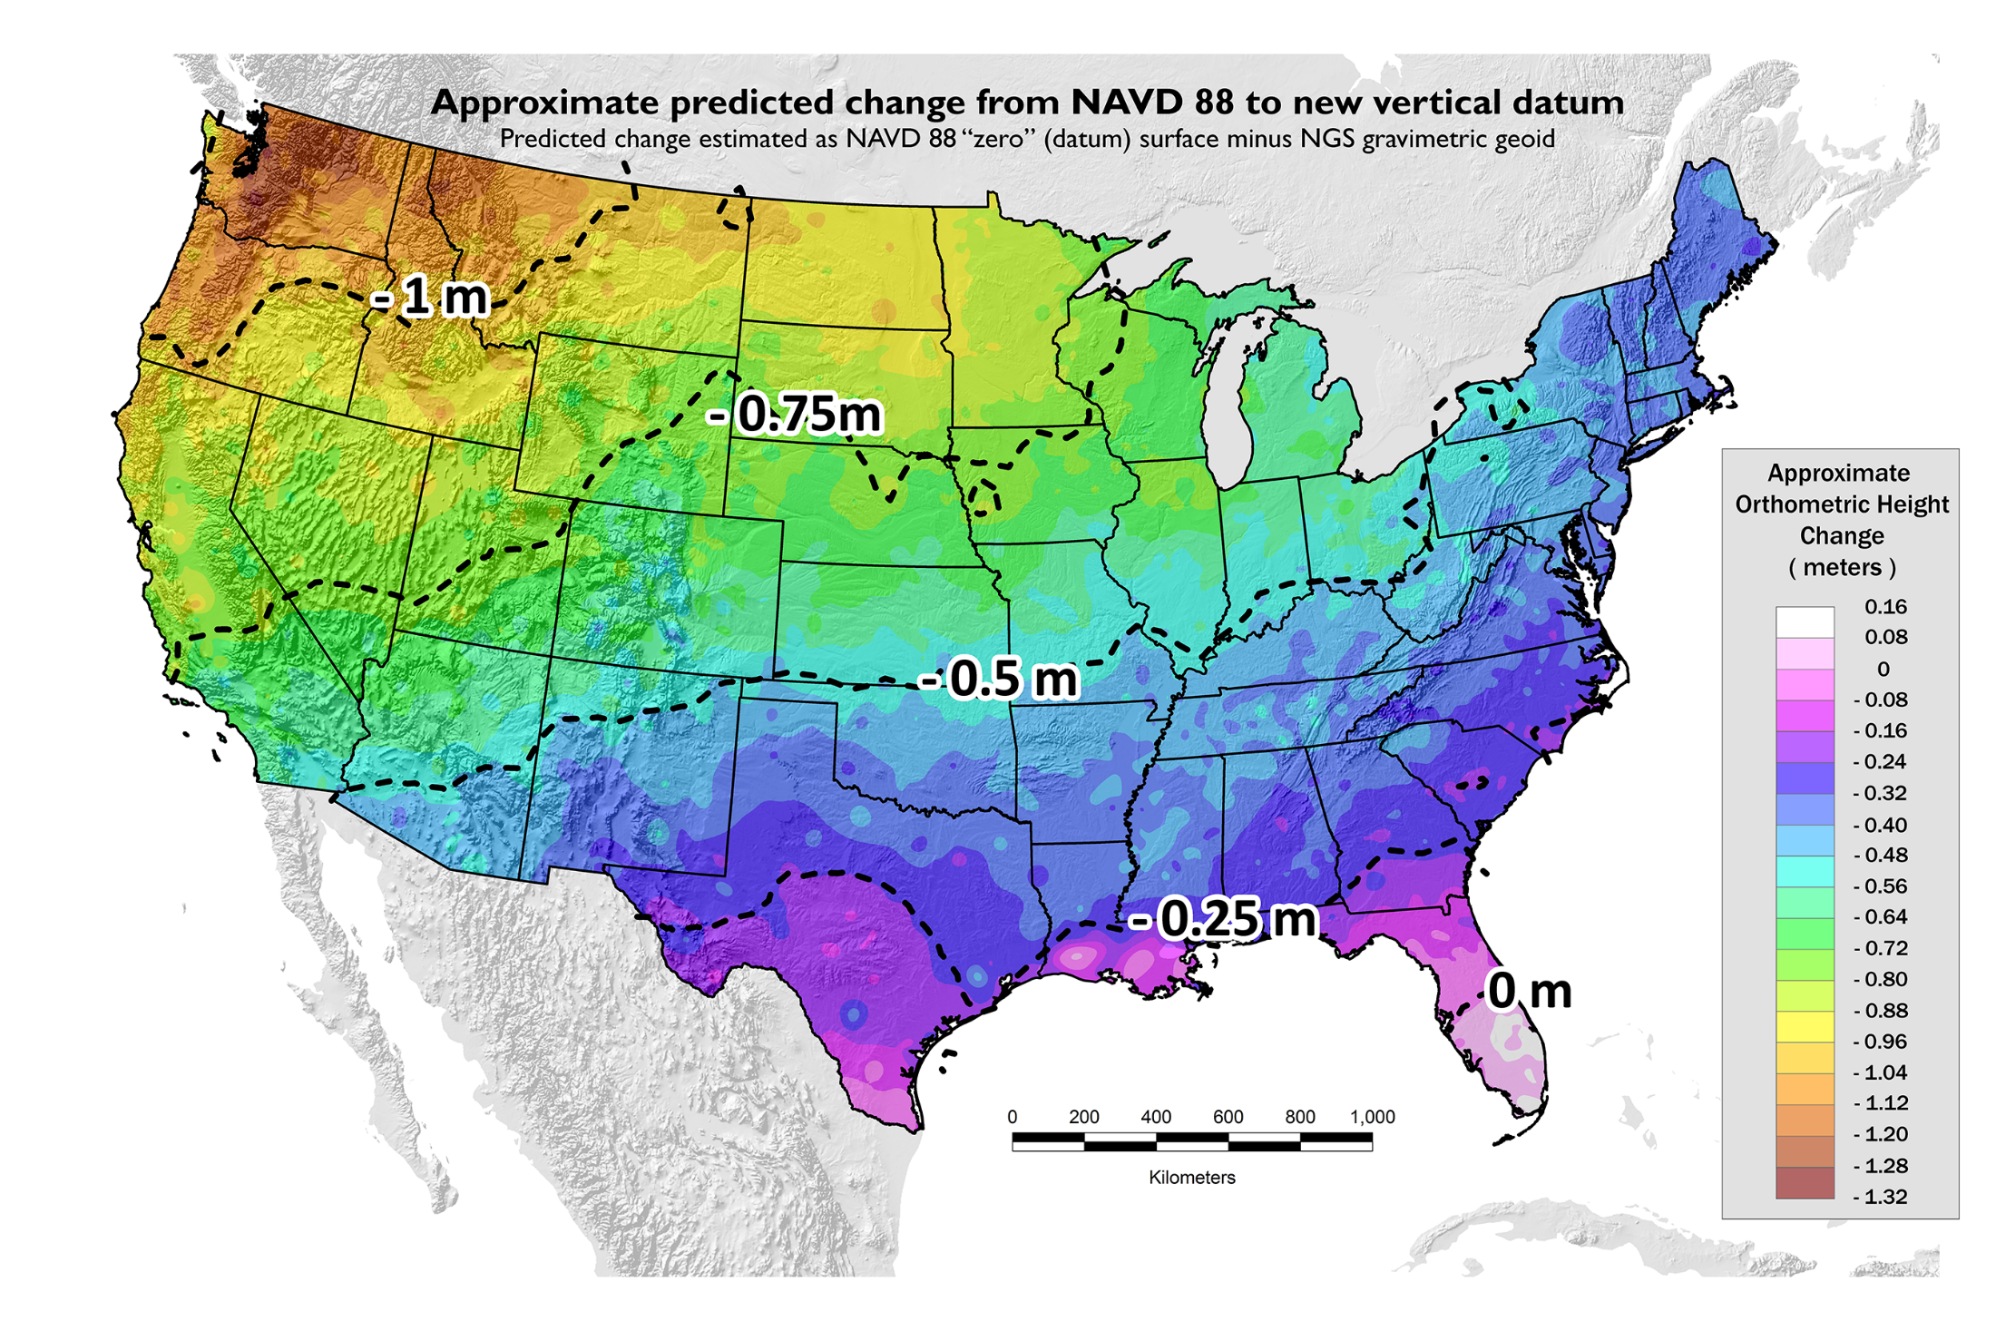
Puget Sound
Palm Beach

Slide 8
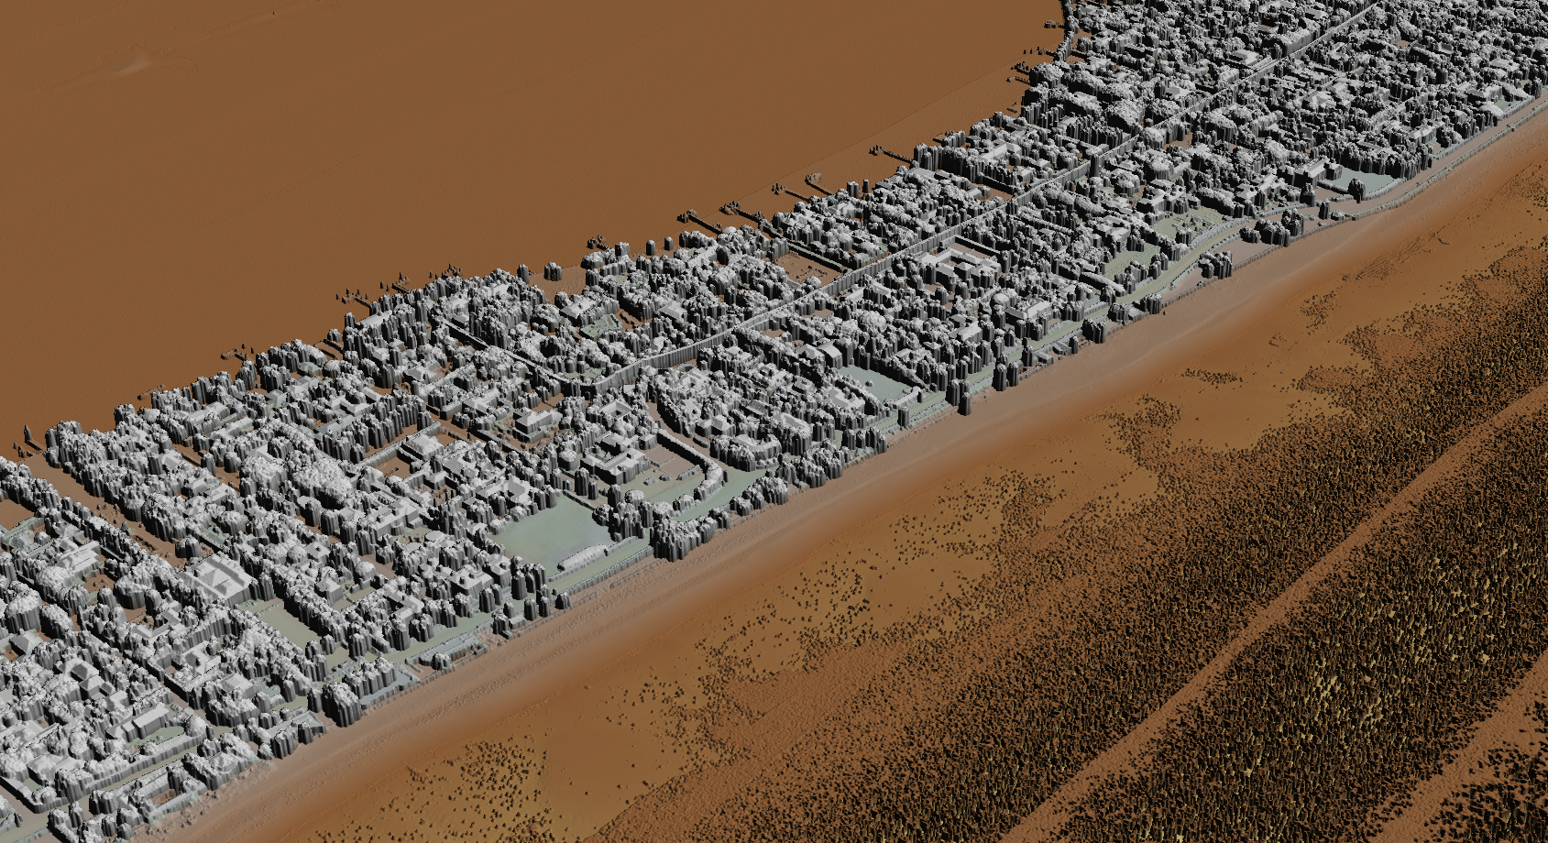
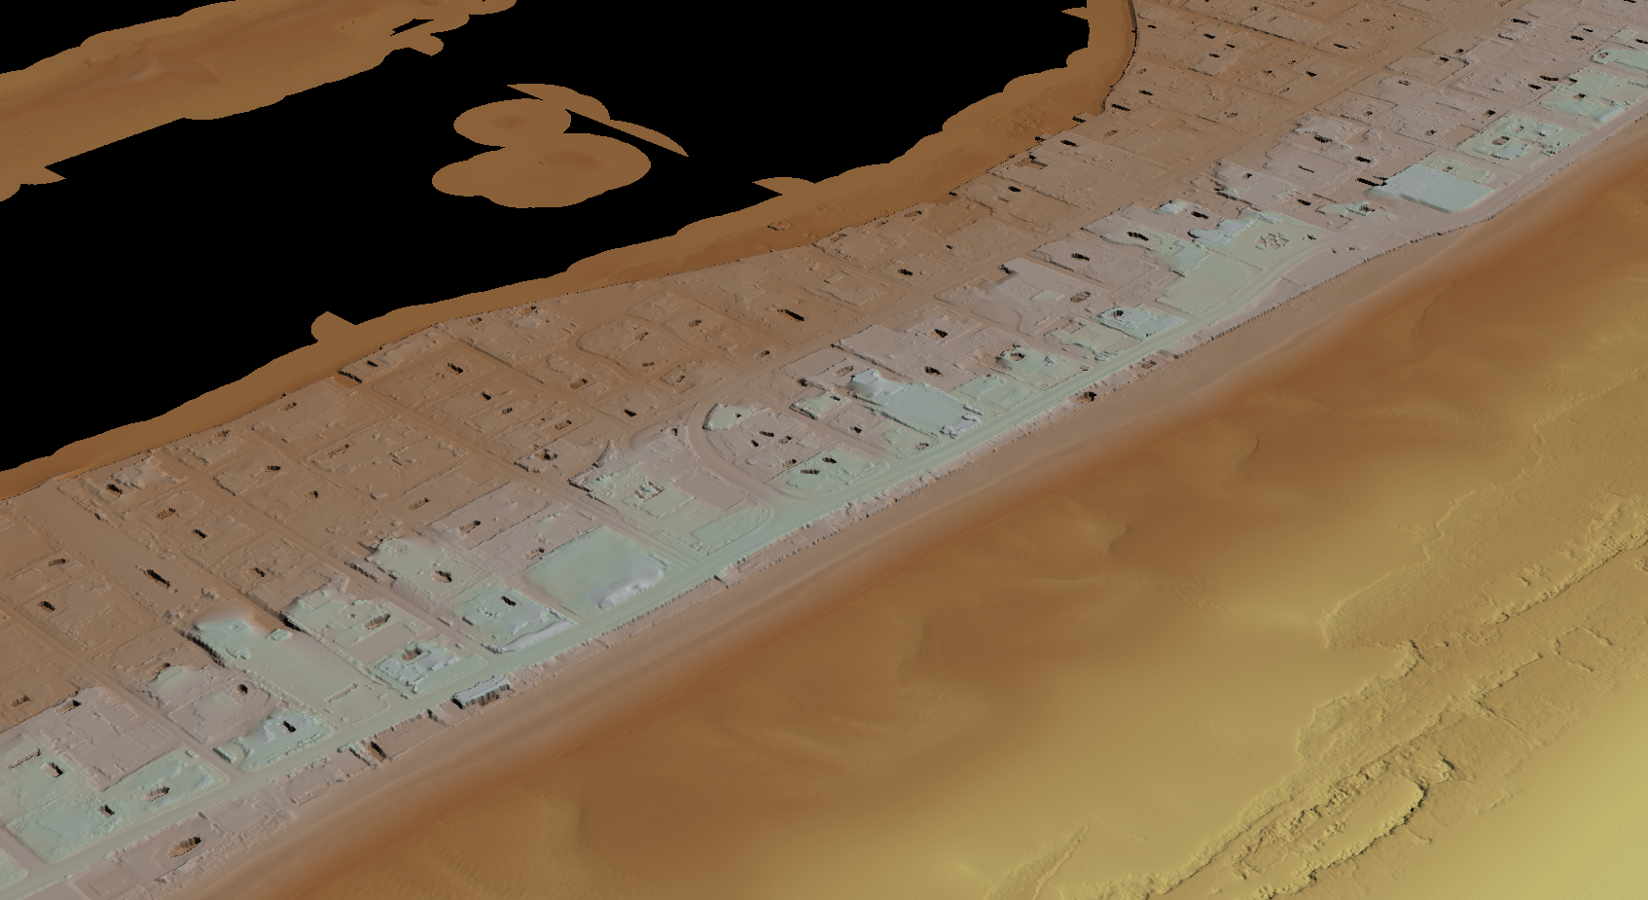
Palm Beach, FL
NGS/RSD Topobathy
General Bare Earth Routine
NGS/RSD Topobathy
NAD83 Ellipsoidal

Slide 9
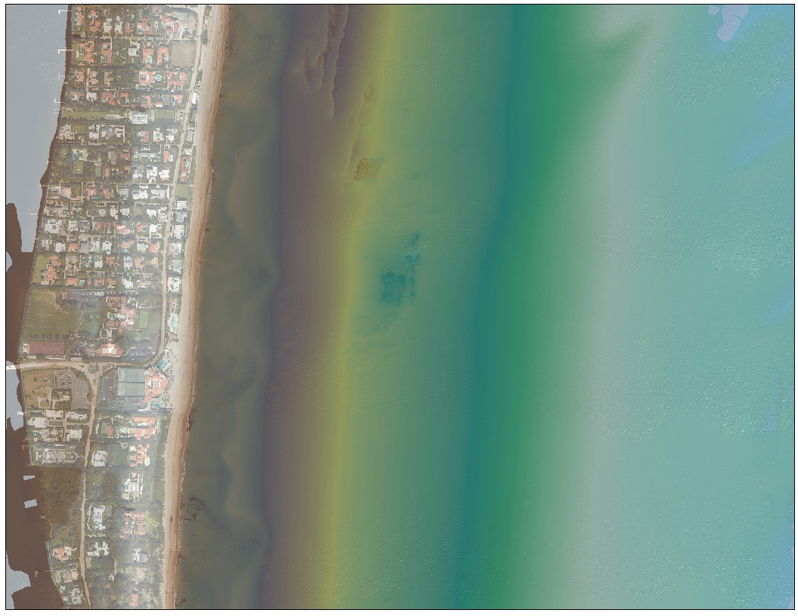
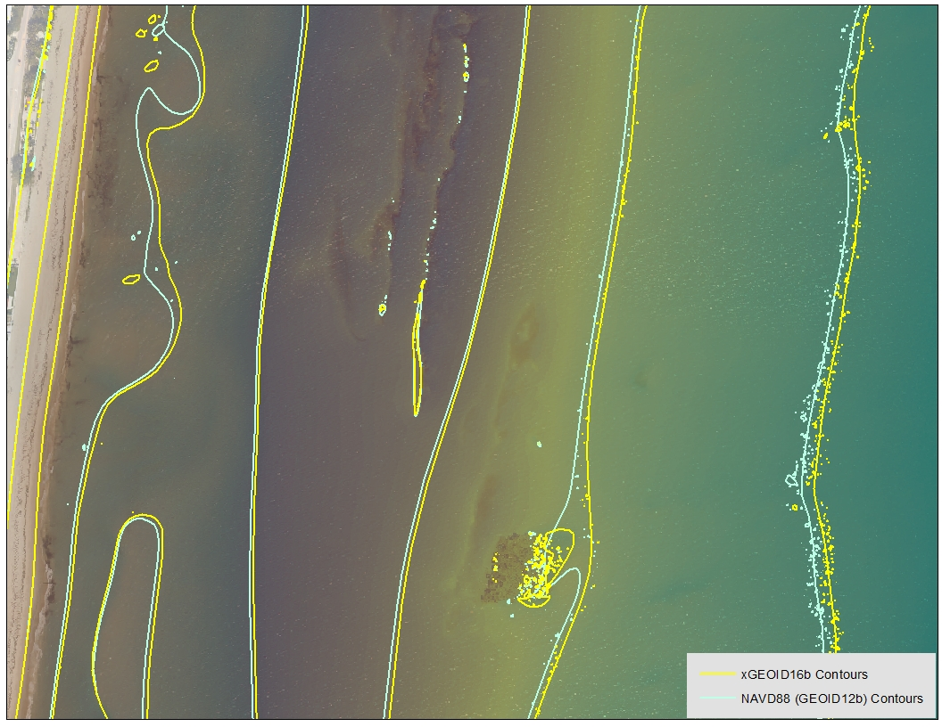
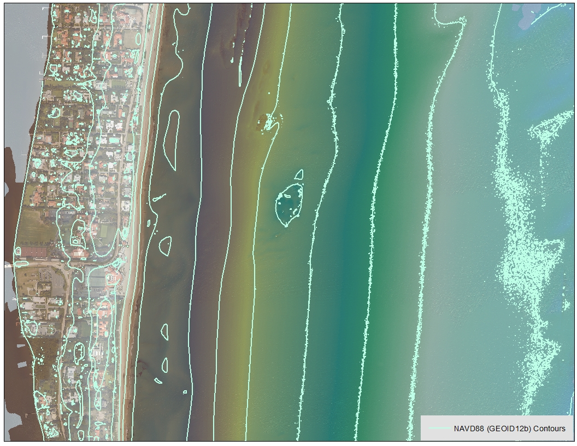
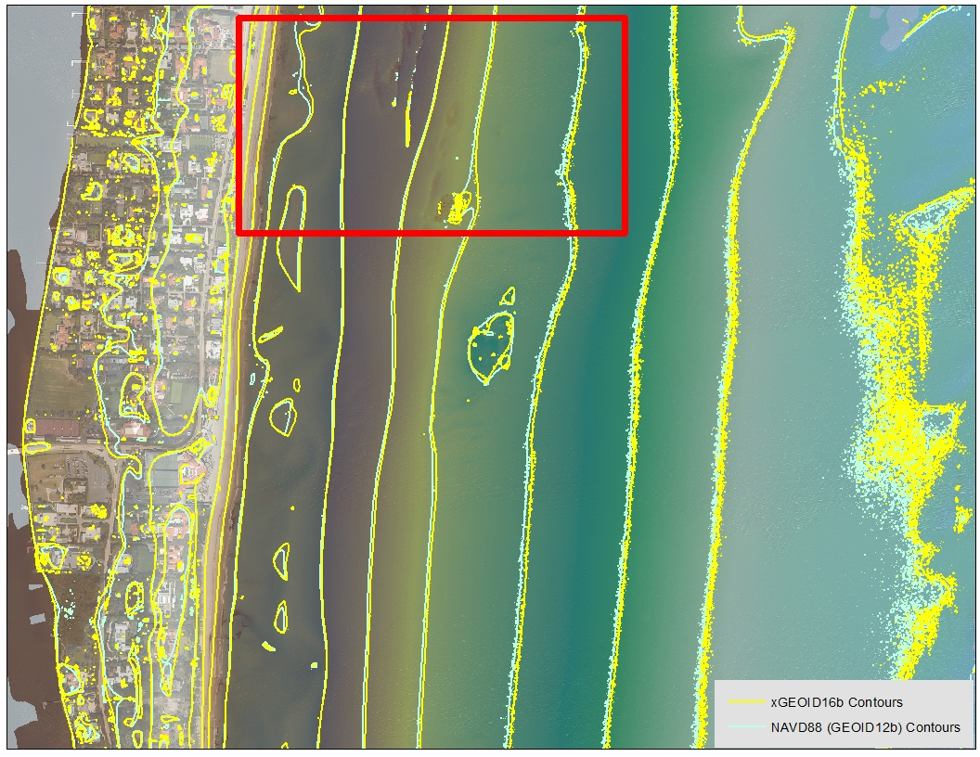
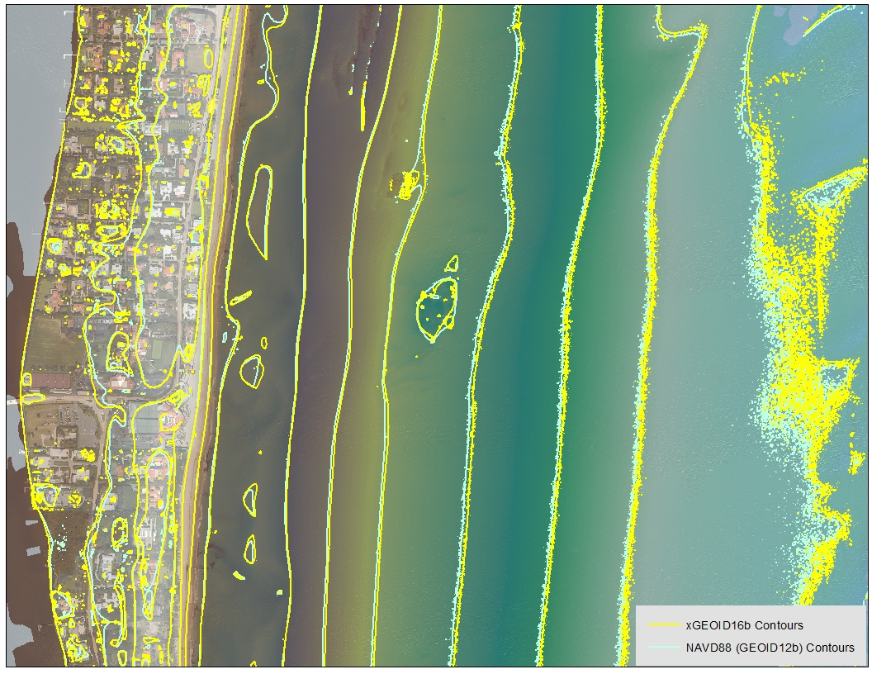
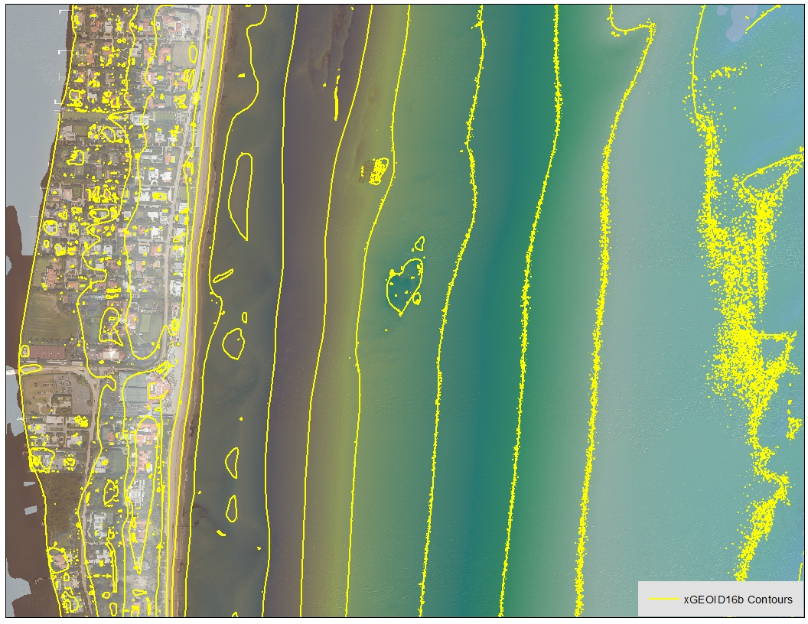
Palm Beach, FL
Approximately 6-10 meter offsets

Slide 10
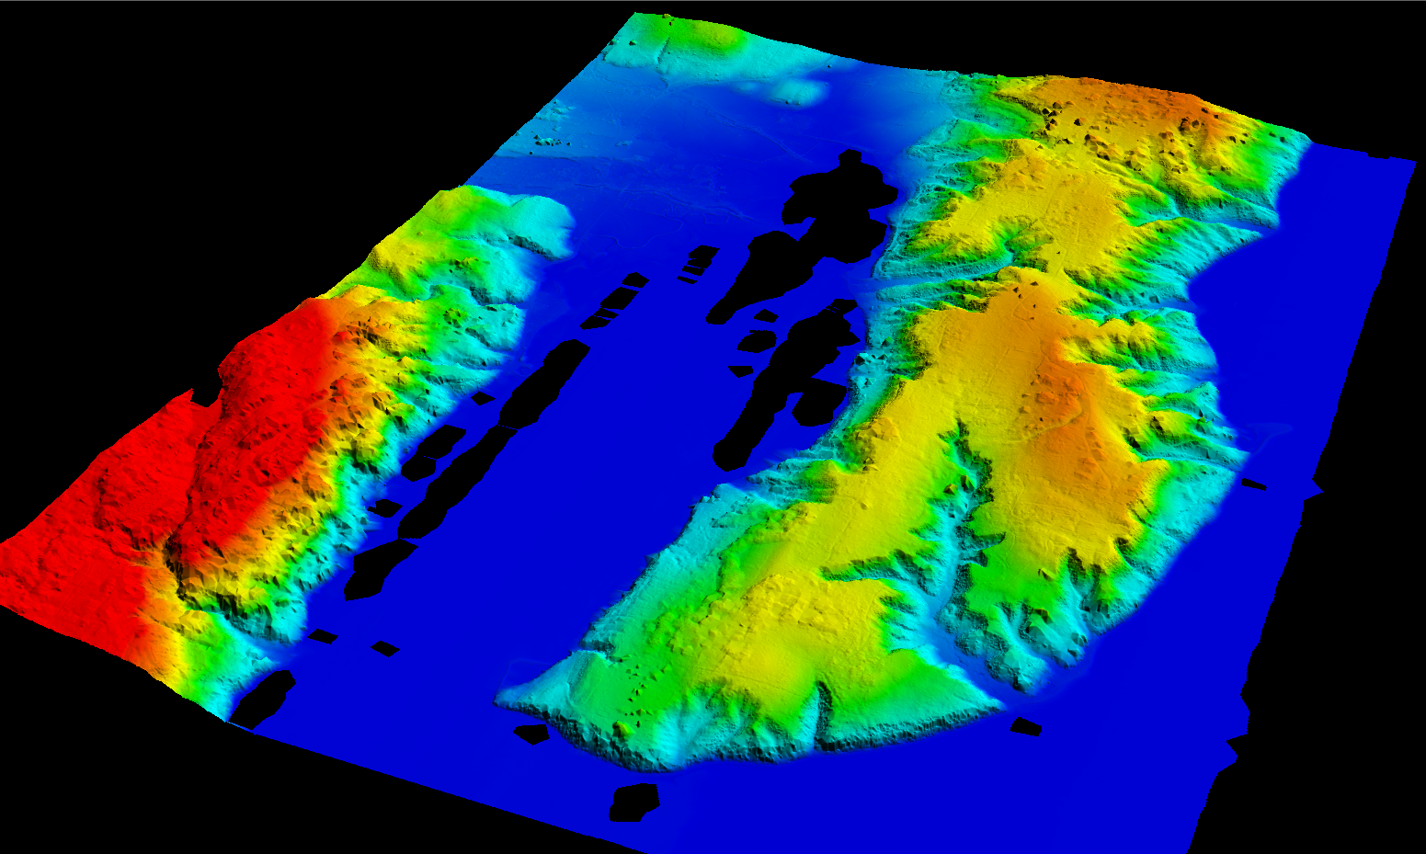
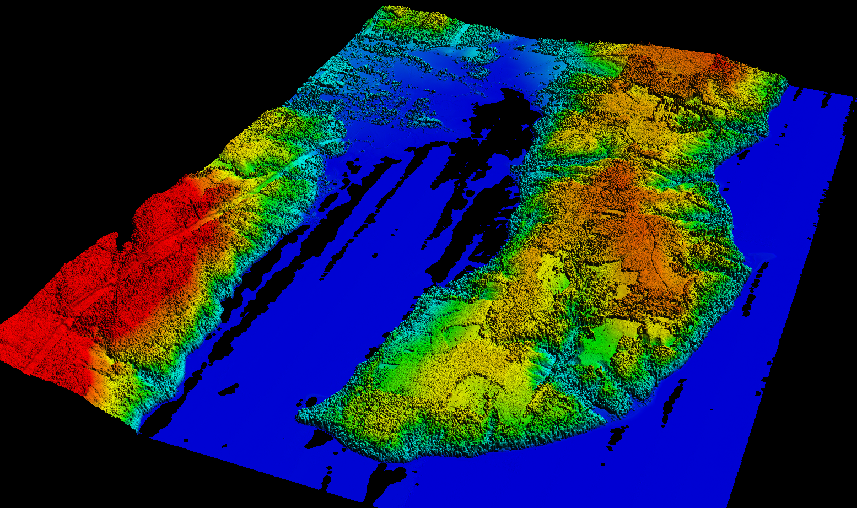
Puget Sound, WA
Puget Sound Lidar Consortium
General Bare Earth Routine
Puget Sound Lidar Consortium
NAD83 Ellipsoidal

Slide 11
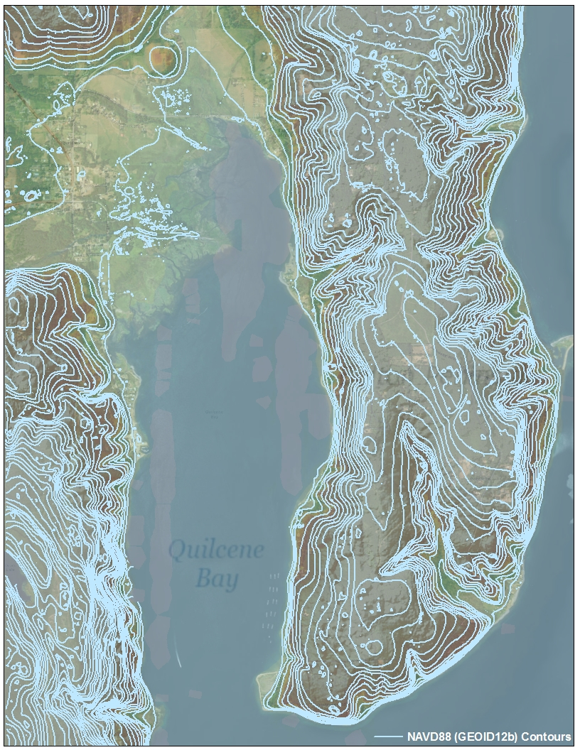
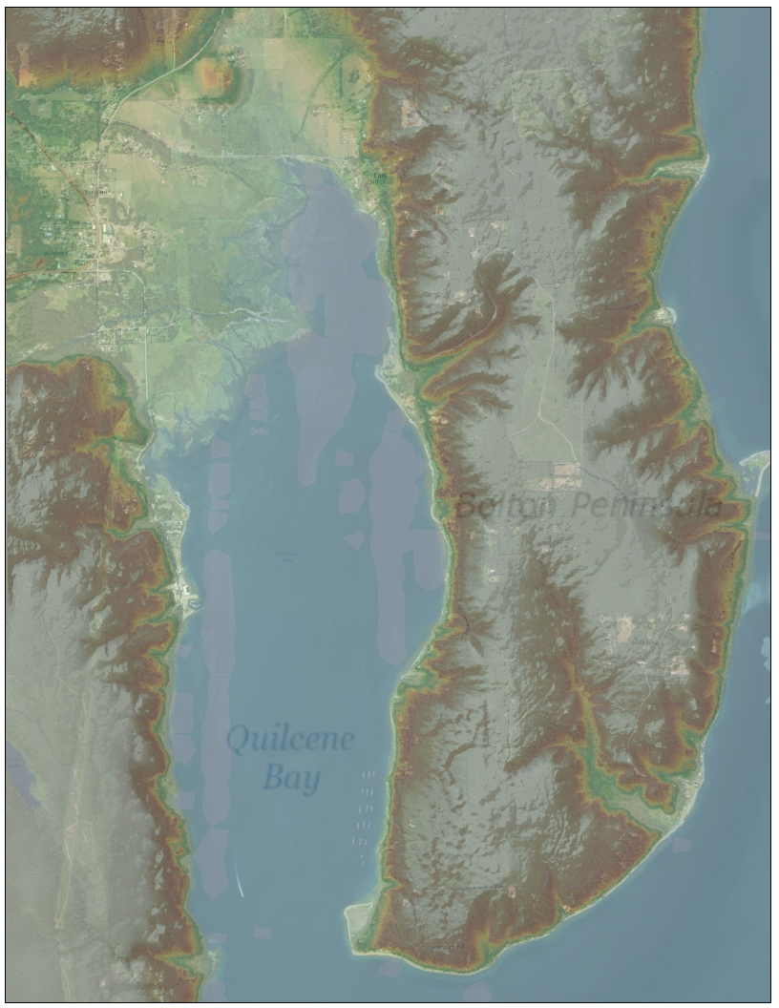
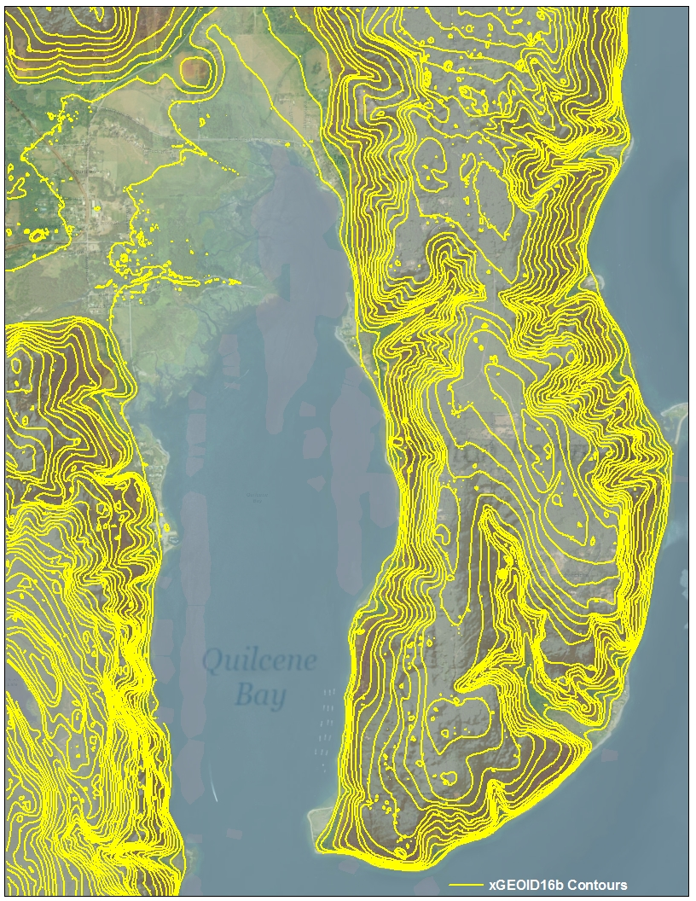
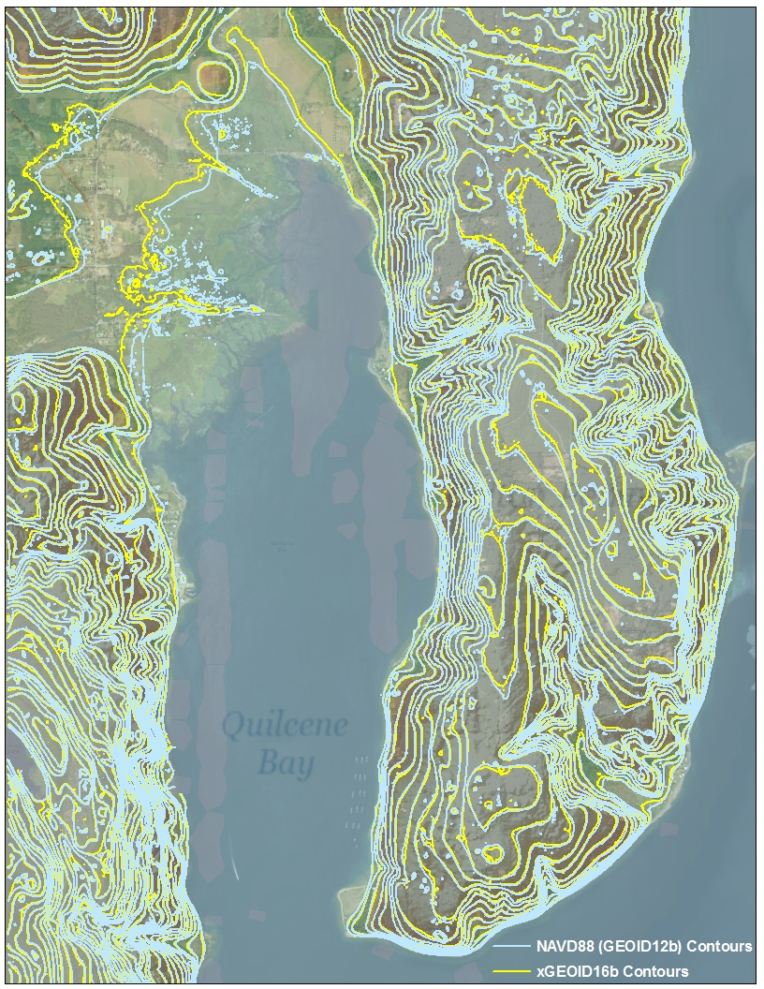
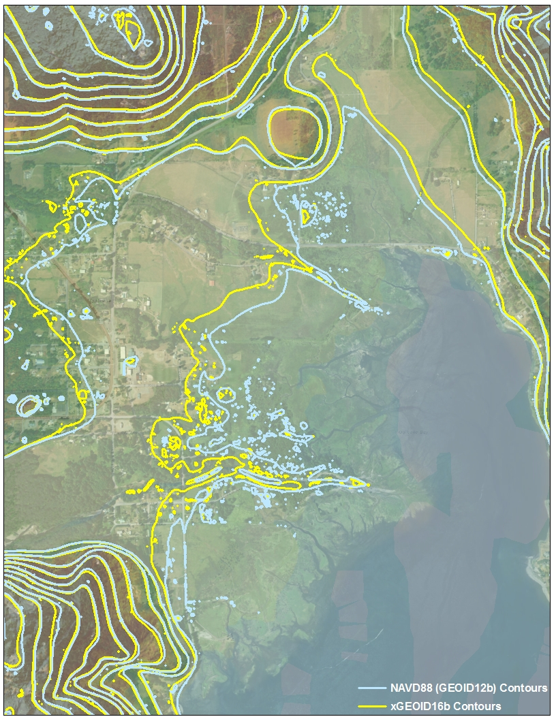
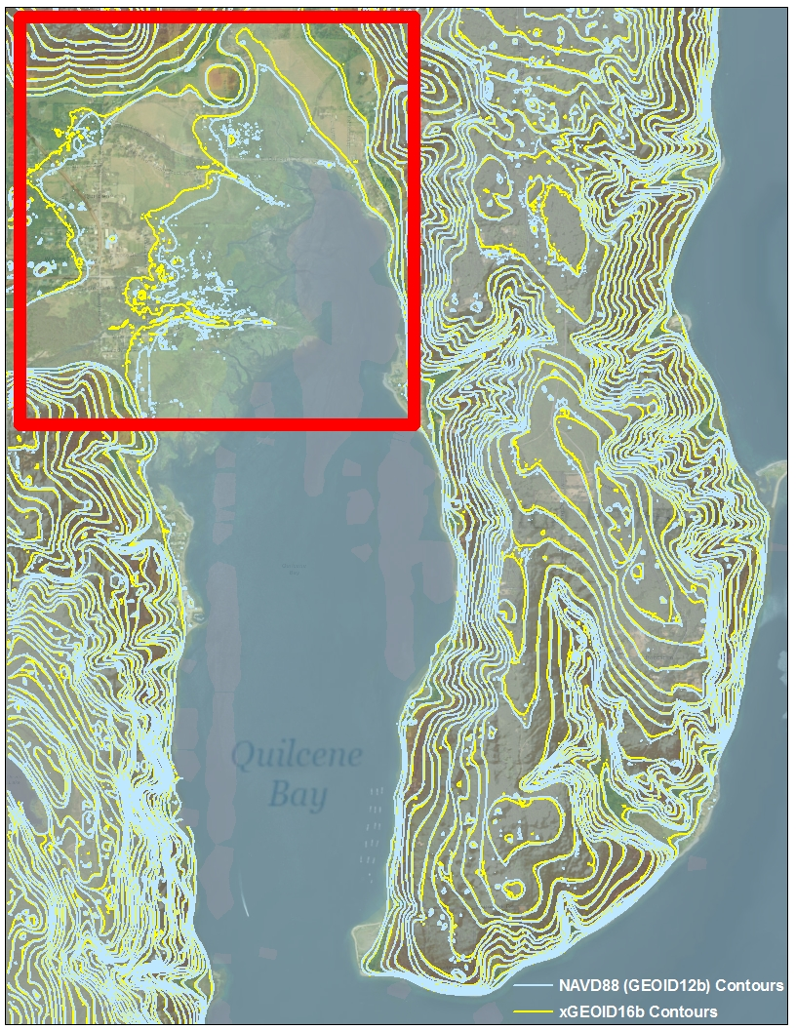
Puget Sound, WA
Approximately 80 meter offsets

Slide 12
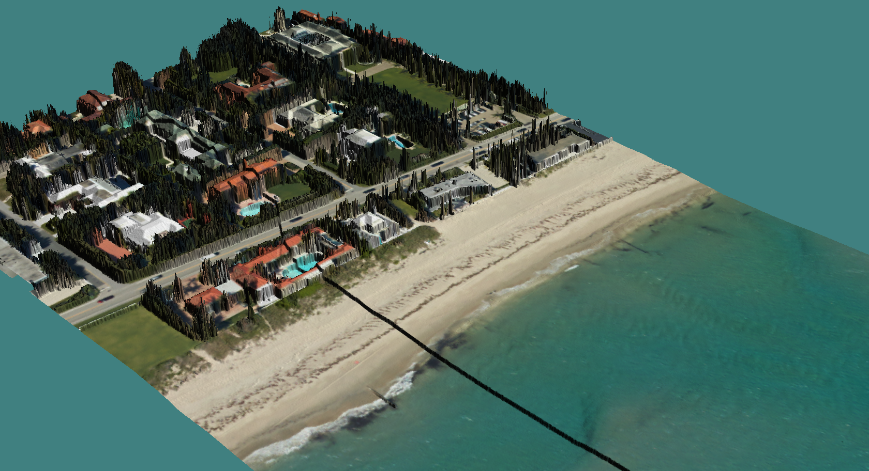
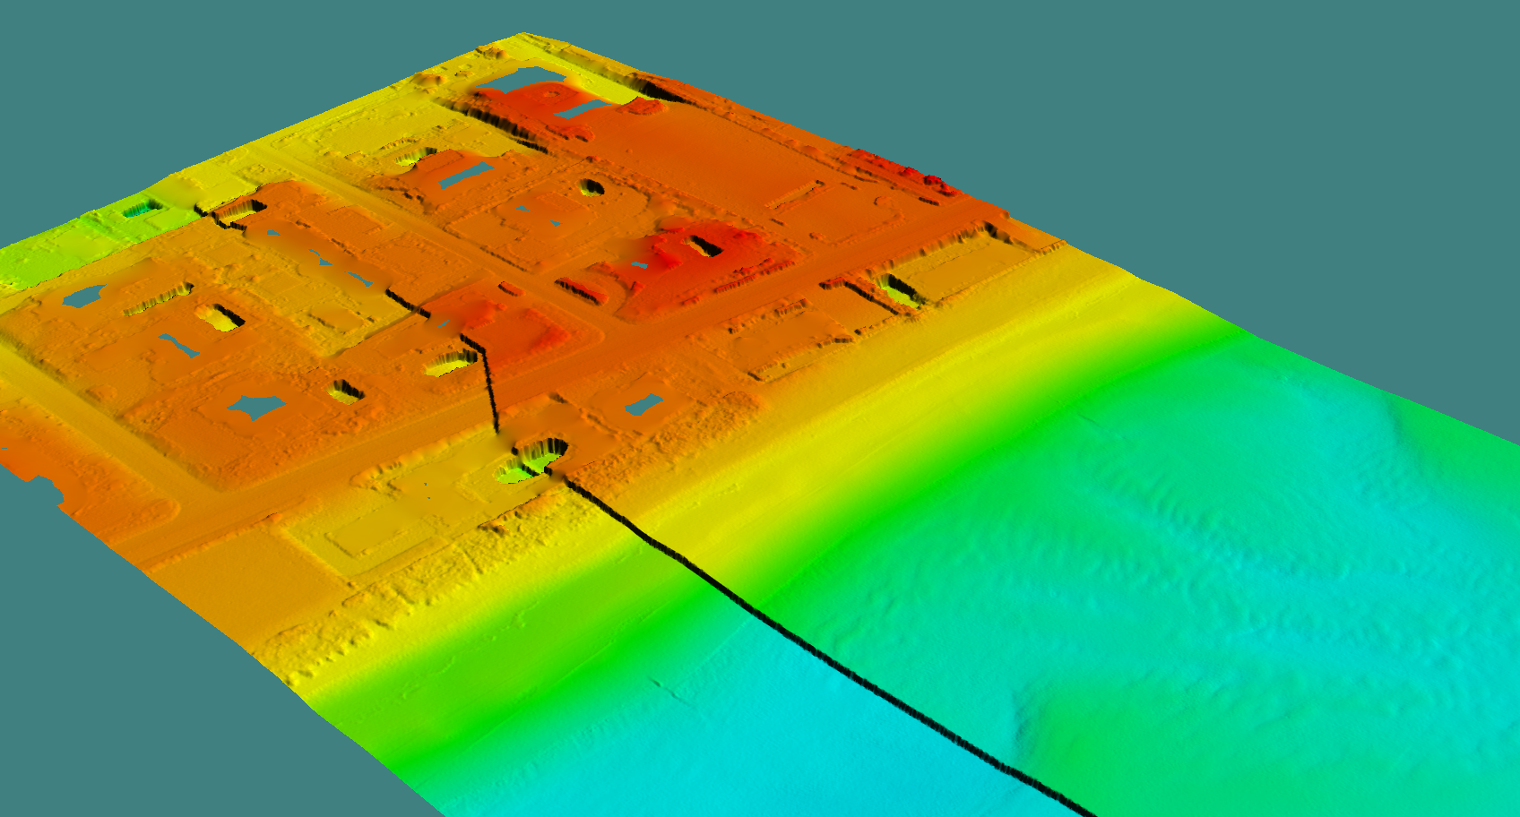
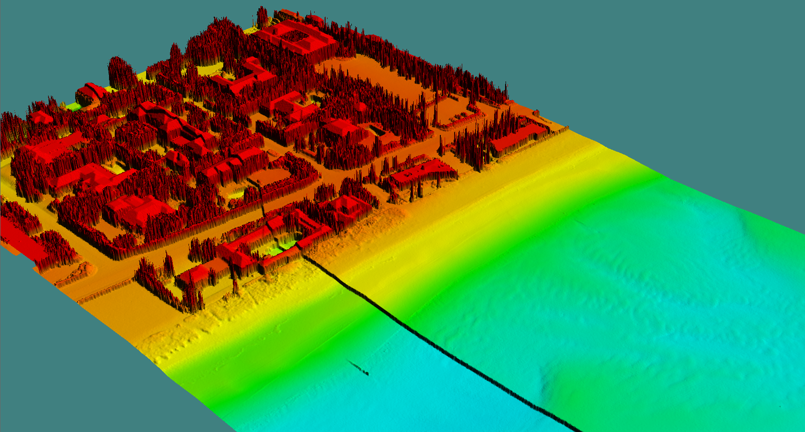
Applying the new GEOID incorrectly: Gridded Surfaces
Notes:
NAD83 and the new GEOID on one side and NAD83 and the old GEOID on the other side

Slide 13
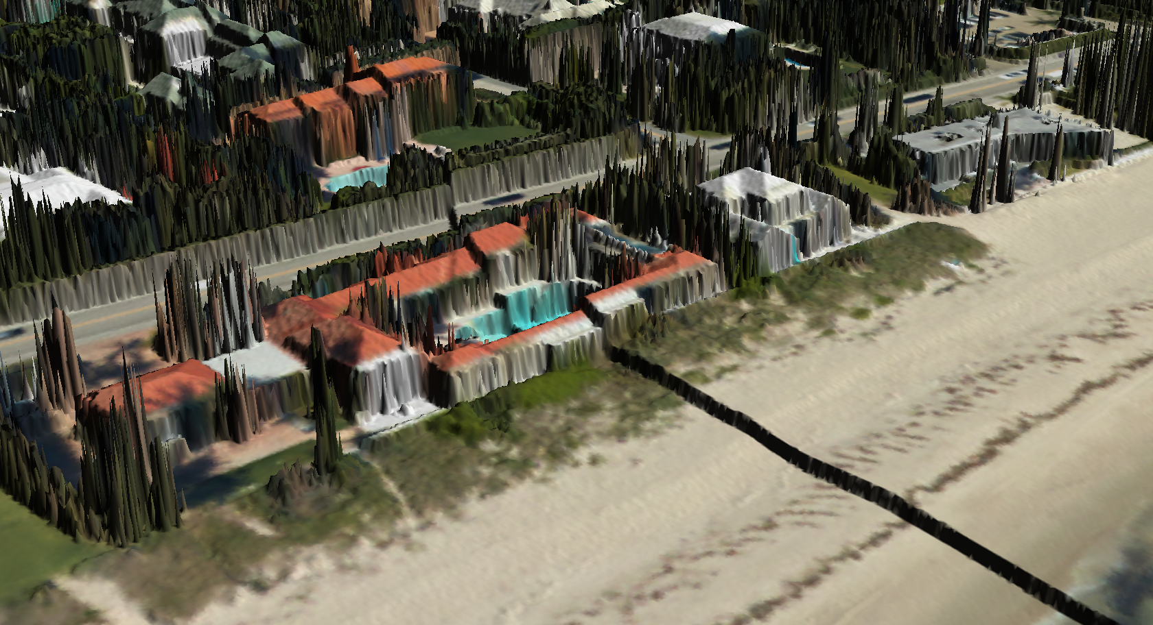
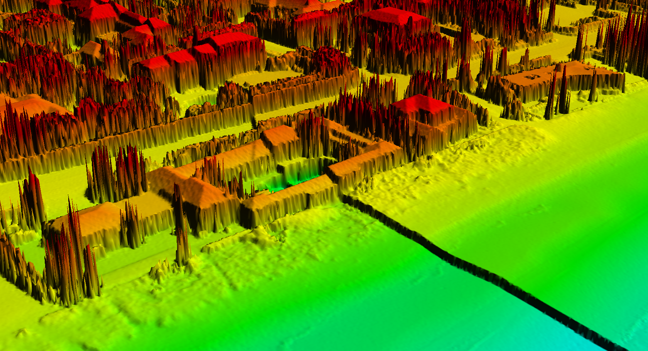
Applying the new GEOID incorrectly: Gridded Surfaces
Greater than 1 meter discrepancy
Notes:
NAD83 and the new GEOID on one side and NAD83 and the old GEOID on the other side

Slide 14
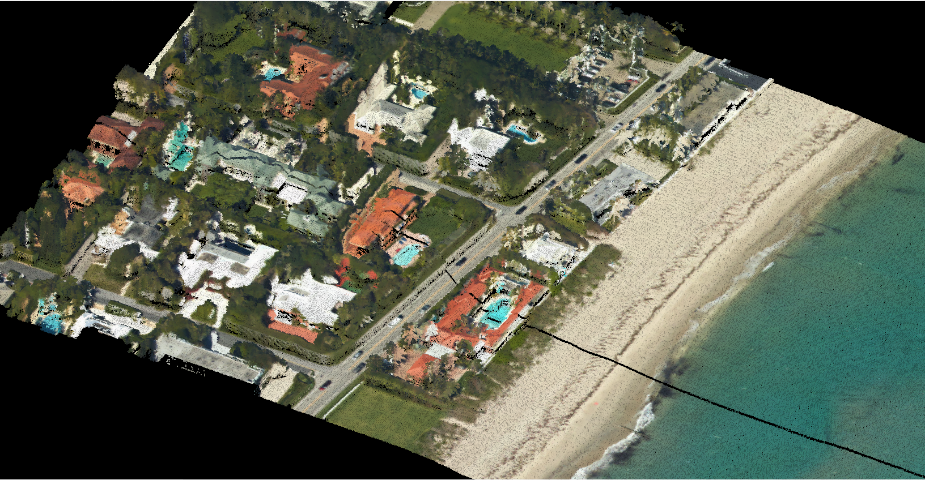
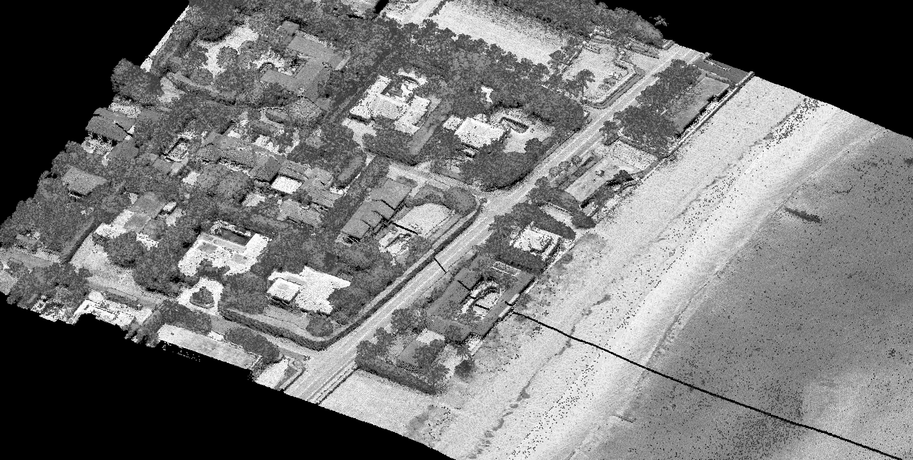
Applying the new GEOID incorrectly: Point Clouds
Notes:
NAD83 and the new GEOID on one side and NAD83 and the old GEOID on the other side

Slide 15
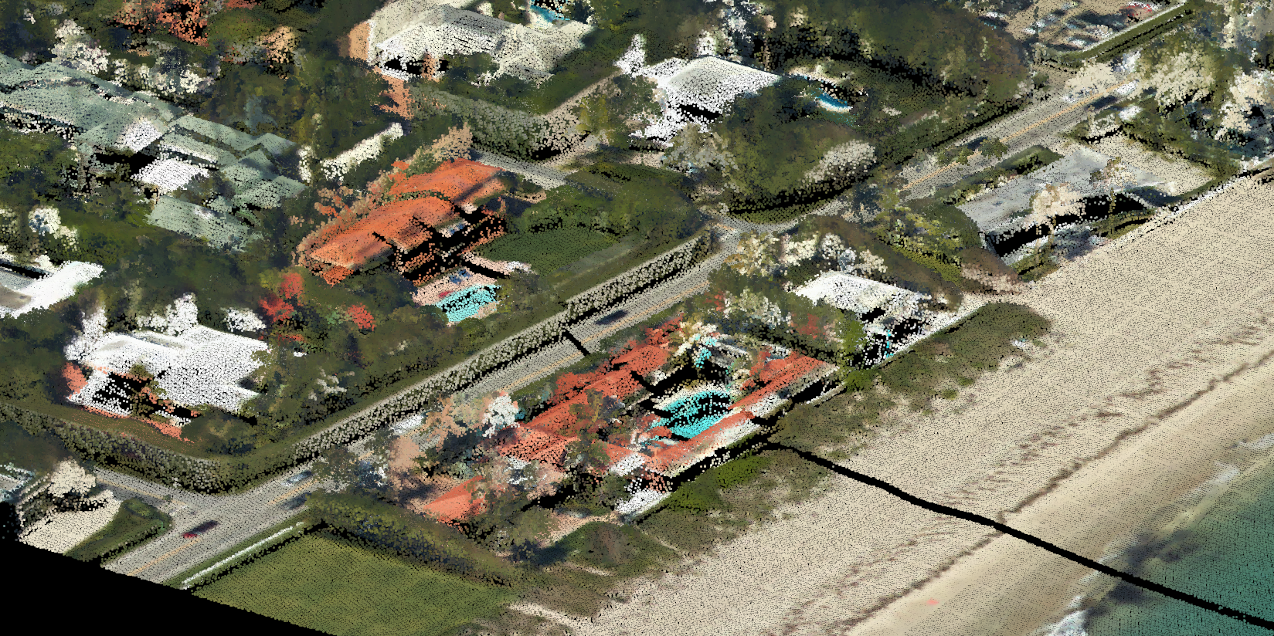
Point Cloud Discrepancies
There should not be a crack in the bottom of pool !!
Notes:
NAD83 and the new GEOID on one side and NAD83 and the old GEOID on the other side

Slide 16
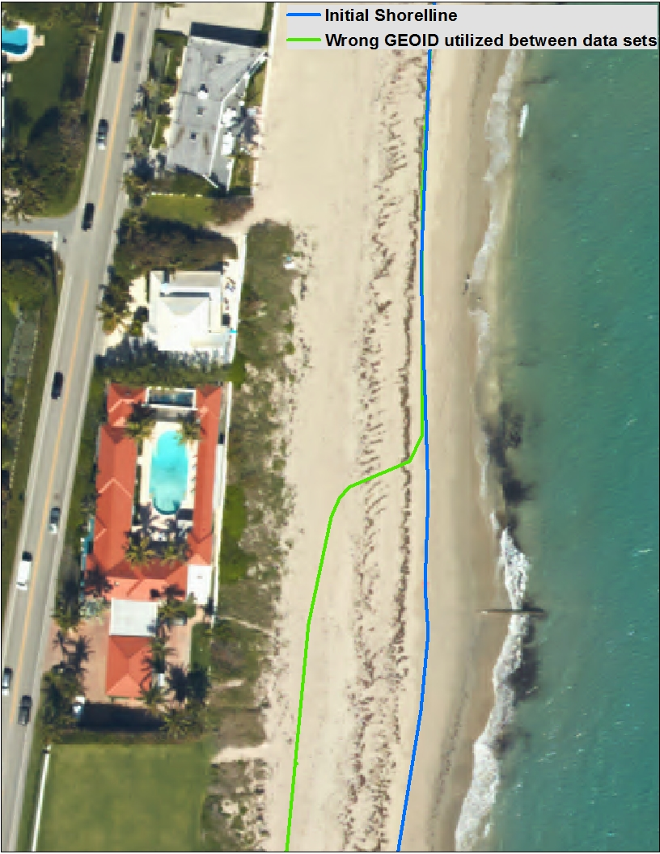
Applying the new GEOID incorrectly
4-6 Degree sloping beach
18m Offset
Notes:
NAD83 and the new GEOID on one side and NAD83 and the old GEOID on the other side

Slide 17
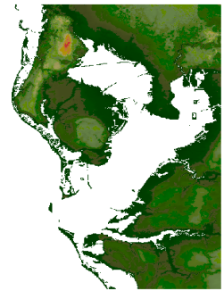
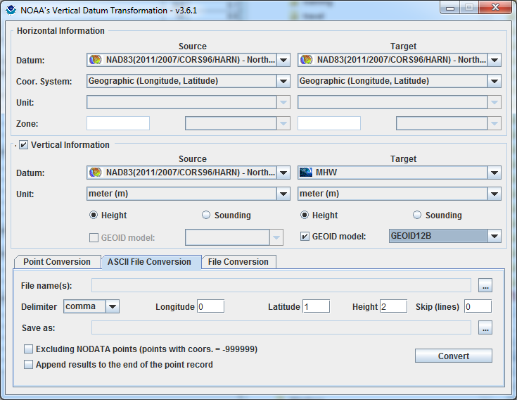
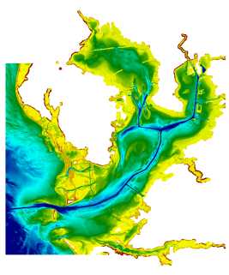
Development and Use of VDatum
Mapping the Land-Sea Interface: VDatum converts elevation data (heights and soundings) among different vertical datums
USGS Topography
NOAA Bathymetry
VDatum is a Java application developed jointly by :
National Geodetic Survey (NGS)
Office of Coast Survey (OCS)
Center for Operational Oceanographic
Products & Services (CO-OPS)
Notes:
Vertical Datum Transformation (VDatum) is a free software tool under development jointly by NOAA's National Geodetic Survey (NGS), Office of Coast Survey (OCS) and Center for Operational Oceanographic Products and Services (CO-OPS). VDatum is designed to vertically transform geospatial data among a variety of tidal, orthometric and ellipsoidal vertical datums - allowing users to convert their data from different vertical references to a common system , enabling the fusion of diverse geospatial data onto a preferred vertical datum.

Slide 18
Foundational Data
Observations
(Geodetic and Tidal)
Modeling
(Hydrodynamic and
TSS)
and Uncertainty Development
Software Development
and Outreach/
Training/
Coordination
VDatum

Slide 19
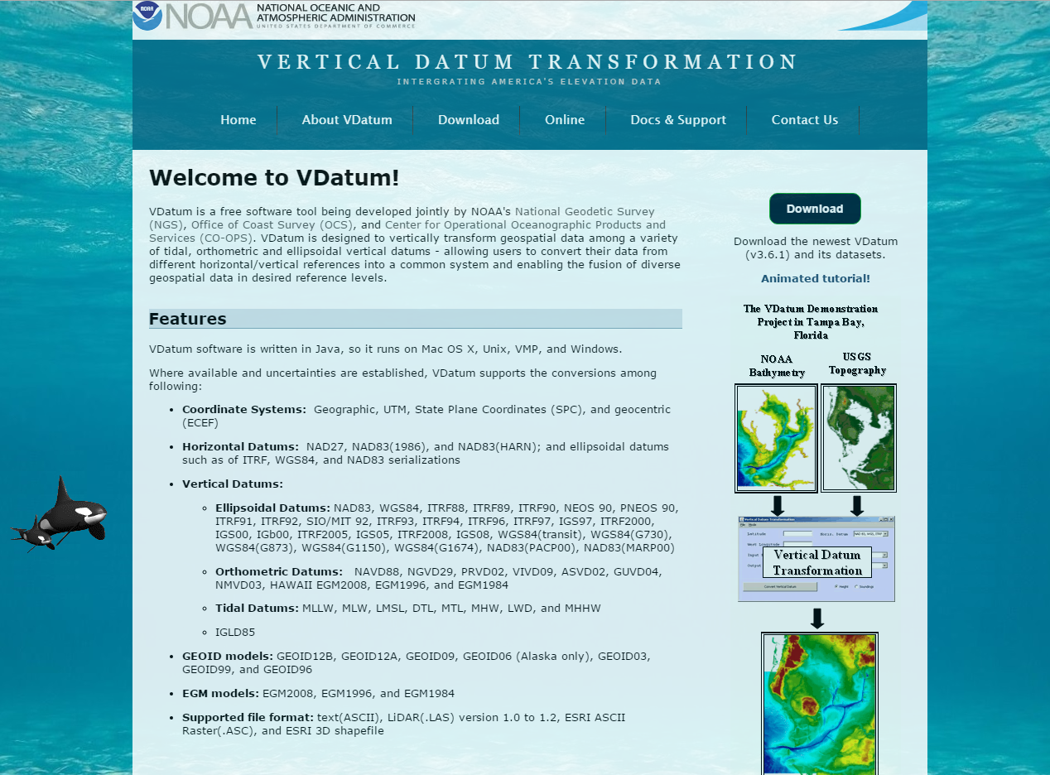
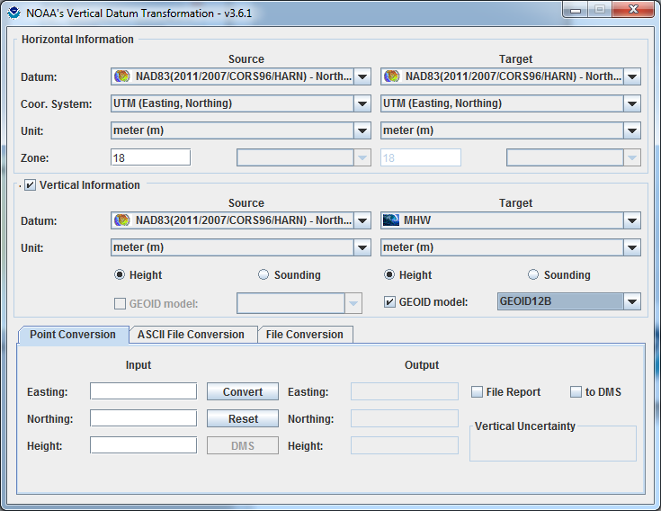
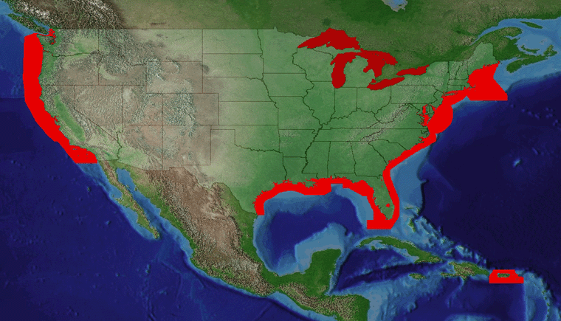
VDatum Website: vdatum.noaa.gov (Version 3.6 Released, May 13, 2016)

Slide 20
What’s Being Replaced with the Modernization of Reference Frames
Horizontal Vertical
NAD 83(2011)
NAD 83(PA11)
NAD 83(MA11)
NAVD 88
PRVD 02
VIVD09
ASVD02
NMVD03
GUVD04
IGLD 85
Latitude
Longitude
Ellipsoid Height
State Plane Coordinates
Heights
Approximate level of geoid mismatch known to exist in the NAVD 88 zero surface.
Does not include local subsidence issues

Slide 21
Vertical Datum Transformation “Roadmap”

Slide 22
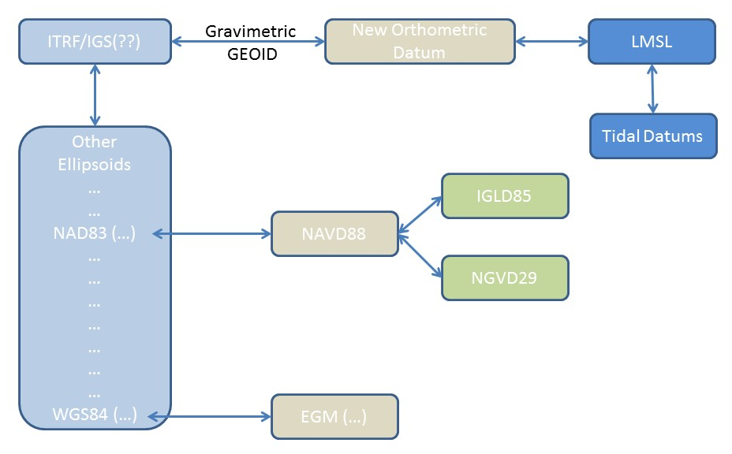
VDatum: Updated NSRS

Slide 23
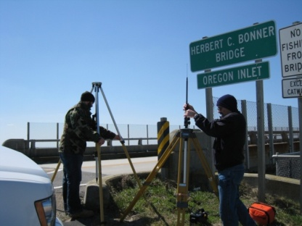
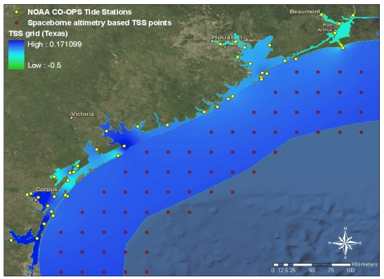
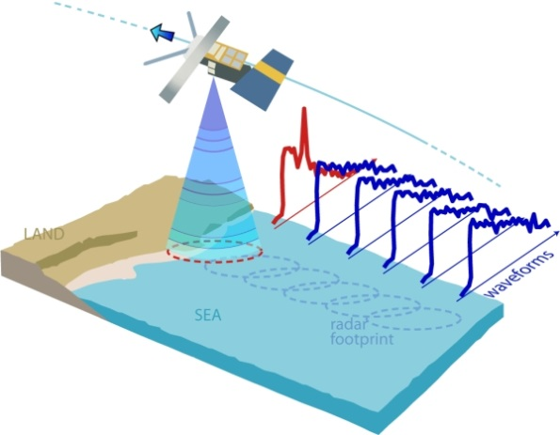
Future Enhancements: Next Generation TSS Development
A Must: GPS Campaign on benchmarks to determine new relationships
Wish List: GPS tide buoys to be utilized for data input and validation
Satellite Altimetry/Derived Products to better understand offshore TSS
Re-tracked coastal altimetry data to capture nearshore sea surface height signal

Slide 24
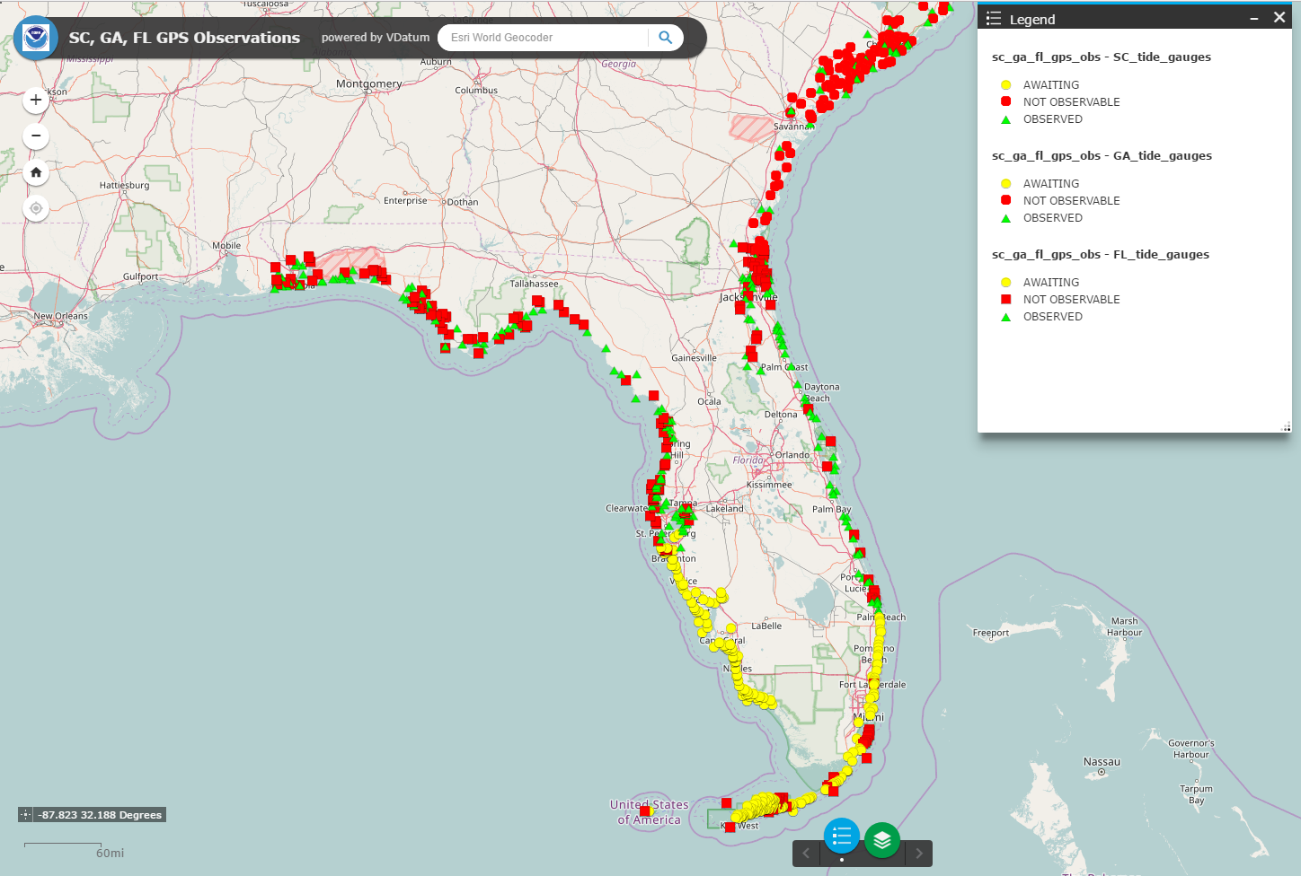
Foundational Data: Geodetic

Slide 25
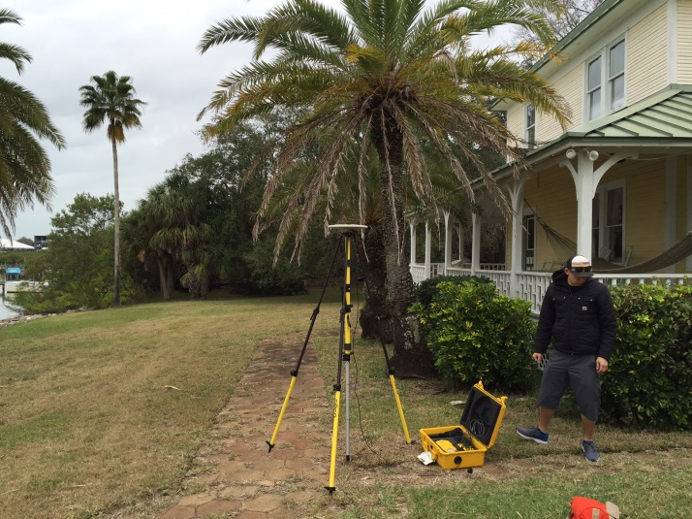
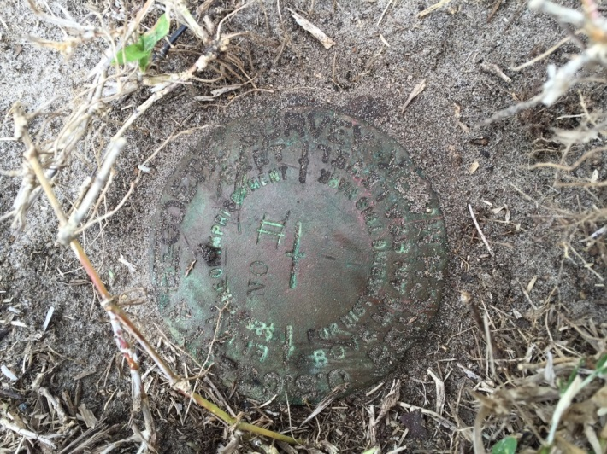
Foundational Data: Geodetic

Slide 26
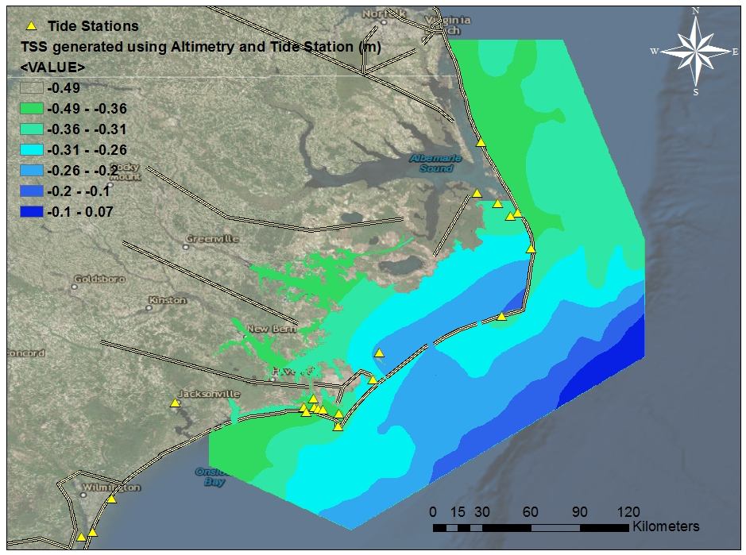
Future Enhancements: Next Generation TSS Development
Refined TSS grid created using the derived TSS points at CNES MSS points (Gaussian filtered), and newly determined geodetic relationships at tide stations

Slide 27
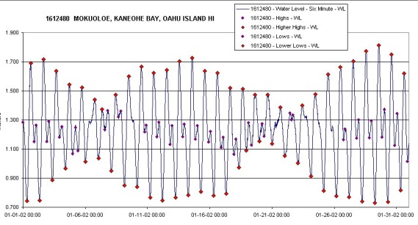
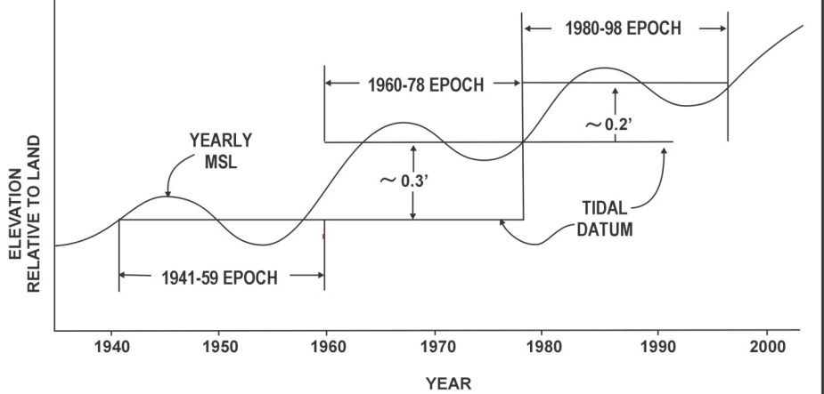
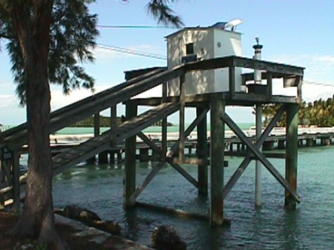
National Tidal Datum Epoch (NTDE)
Anticipated release 2022-2023 time frame
Next NTDE will be computed on period of (2002-2020)
Official time period of tidal observations that are used for primary datum calculations
Time it takes the Earth, Moon, & Sun to complete an epoch tidal cycle
19 year time period (Current NTDE is 1983-2001)
Considered for revision every ~20-25yrs
Includes the longest period tidal variations (18.6 year node cycle)
Averages out seasonal fluctuations
Provides a nationally consistent tidal datum network by accounting for seasonal and apparent environmental trends in sea level that affect the accuracy of tidal datums
1983-2001 EPOCH

Slide 28
MSL NTDE Differences: (83-01 vs. 60-78)

Slide 29
MHW NTDE Differences: (83-01 vs. 60-78)

Slide 30
MLLW NTDE Differences: (83-01 vs. 60-78)

Slide 31
Changes in VDatum
Implementing new ellipsoidal to orthometric roadmap NGS develops
Development of Next Generation TSS
Modernizing of Tidal Datum Fields for NTDE update

Slide 32
What we need from you:
Assistance collecting GPS on
tidal benchmarks
Problems (Software or Models)
Enhancements

Slide 33
Other Enhancements
Uncertainty in one standard derivation (m)
HTDP
NADCON5
IGLD85 Improvements
Spatially Varying Uncertainty

Slide 34
VDatum: Contact Us

Slide 35
Rip Current
Waves
Waves

Slide 36
Thank You!
Contact Information:
Email: vdatum.info@noaa.gov
Website: http://vdatum.noaa.gov
Stephen White
Email: stephen.a.white@noaa.gov
Phone: (301) 713-1428 x167

