Slide 1
VDatum
Vertical Datum Transformation Tool
Stephen A. White
(Program Manager)
January 11, 2018

Slide 2
Outline:
Brief Datum Tutorial
VDatum Applications
Obtaining and Utilizing VDatum Software
Enhancements
Future Directions

Slide 3

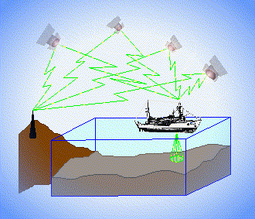
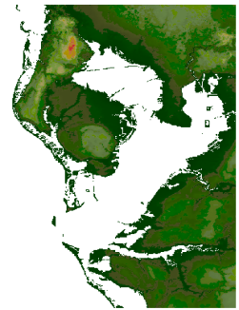
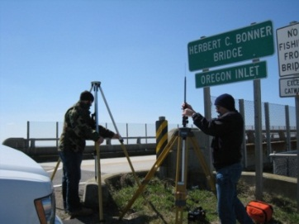
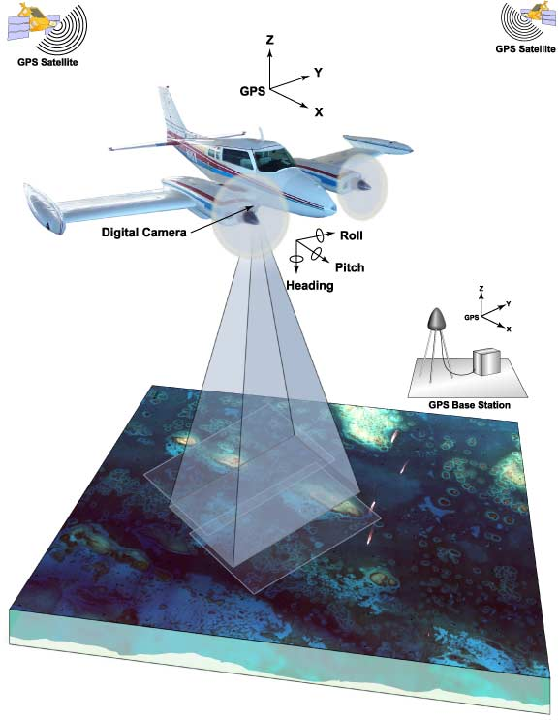
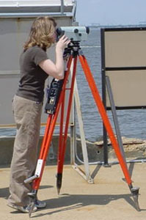
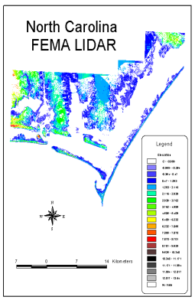
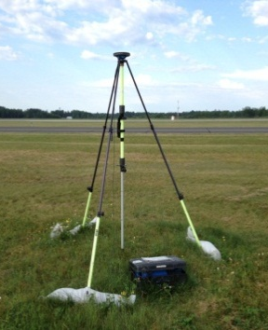
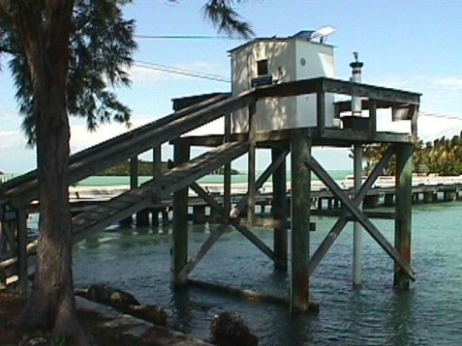
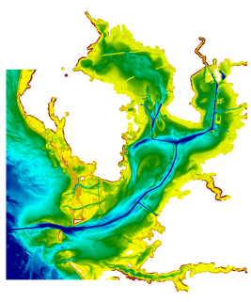
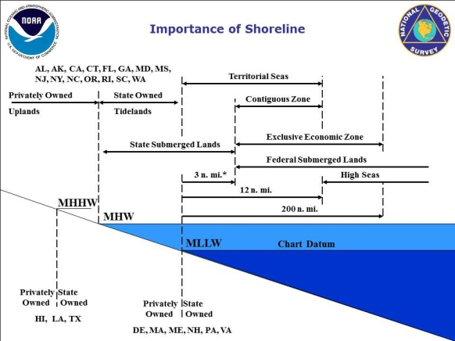
What Vertical Datum is My Data in?
Ellipsoidal Datums
Orthometric Datums
RTK-GPS vertical referencing
Hydrographic Surveys
?
USGS
Topography
GPS
Lidar
NOAA Bathymetry (MLLW)
Tidal Datums

Slide 4
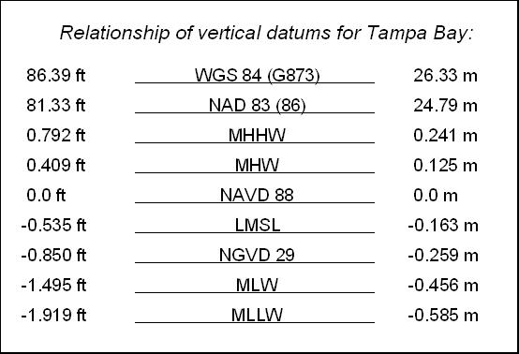
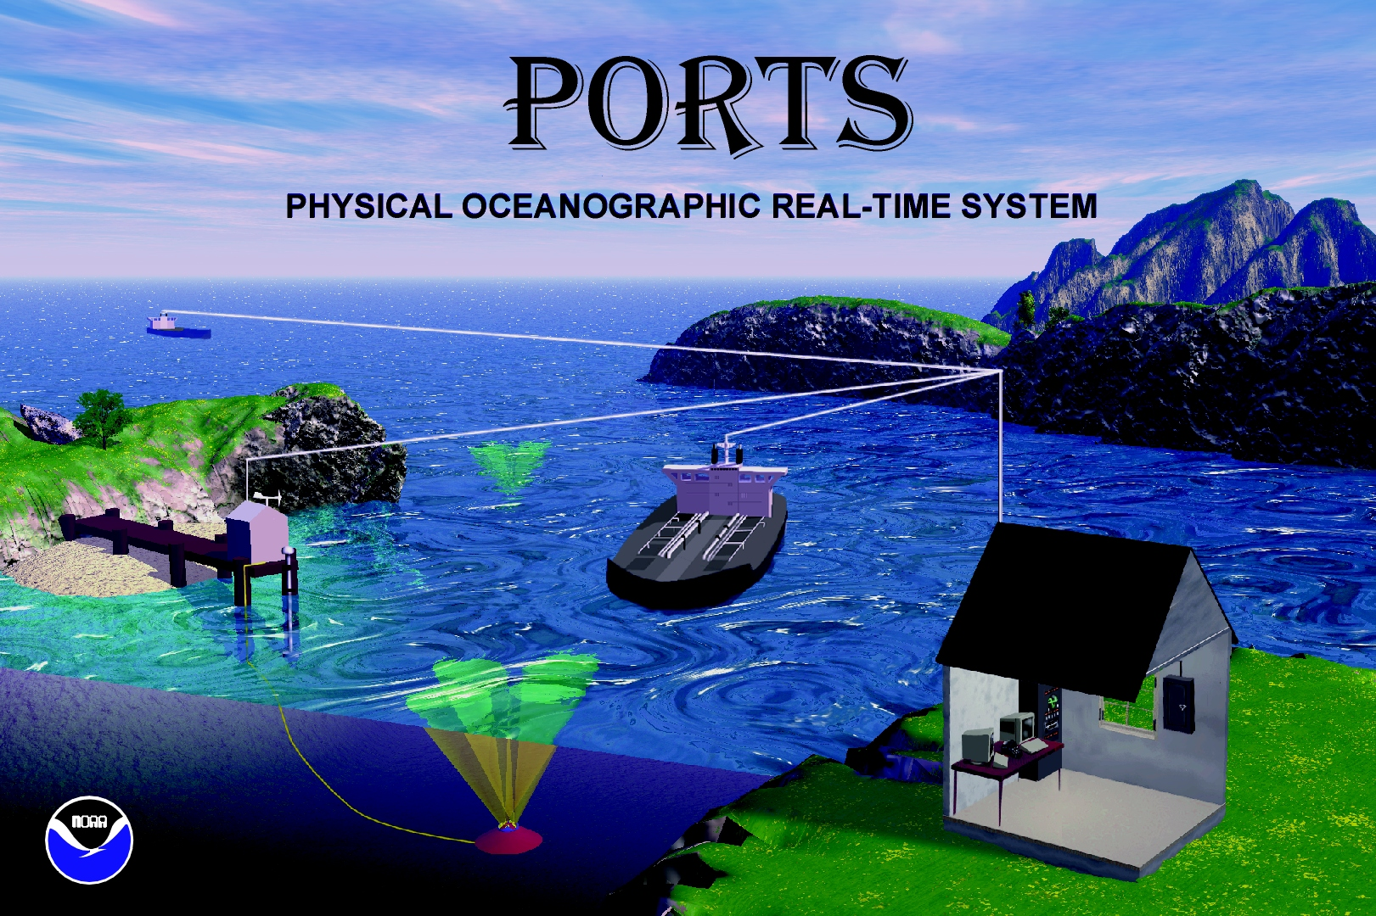
All elevation data is referenced to a vertical datum.
Ellipsoid Datums
BUT there are a many different vertical datums in use around the nation
ITRF,
WGS 84,
NAD 83 (NSRS)
```
Orthometric Datums
NAVD 88, NGVD 29
Tidal Datums
For elevation data sets to be blended together they must be referenced to same vertical datum.
MHHW, MHW, MTL, DTL, LMSL, MLW, MLLW

Slide 5
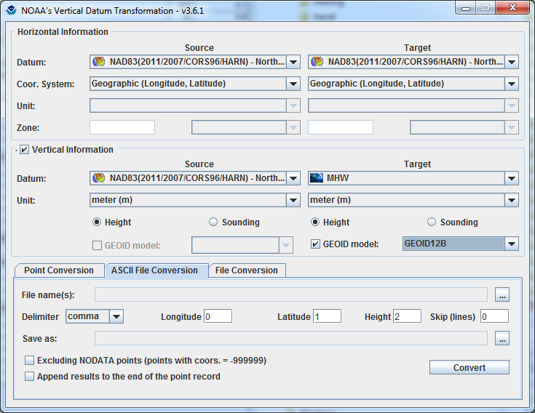
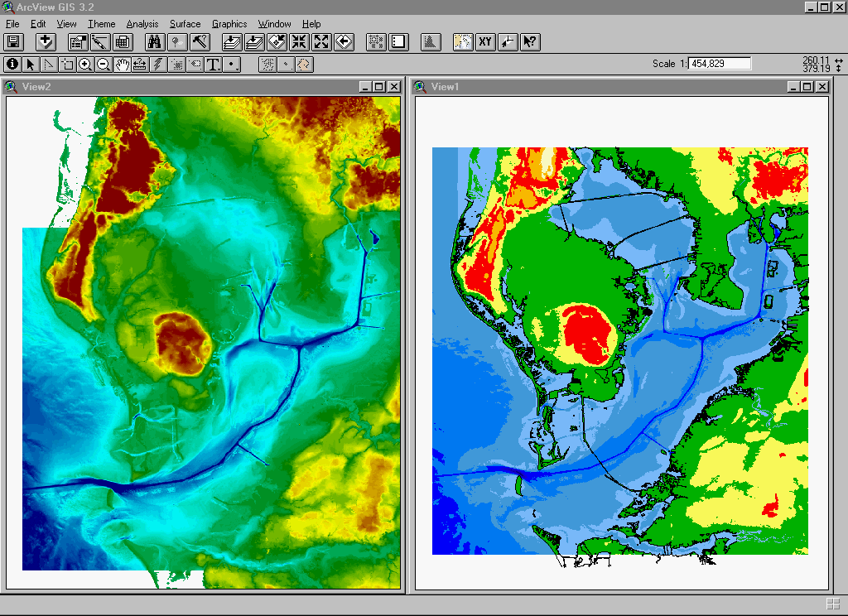
Development and Use of VDatum
Mapping the Land-Sea Interface: VDatum converts elevation data (heights and soundings) among different vertical datums
USGS Topography
NOAA Bathymetry
VDatum is a Java application developed jointly by :
National Geodetic Survey (NGS)
Office of Coast Survey (OCS)
Center for Operational Oceanographic
Products & Services (CO-OPS)
Notes:
Vertical Datum Transformation (VDatum) is a free software tool under development jointly by NOAA's National Geodetic Survey (NGS), Office of Coast Survey (OCS) and Center for Operational Oceanographic Products and Services (CO-OPS). VDatum is designed to vertically transform geospatial data among a variety of tidal, orthometric and ellipsoidal vertical datums - allowing users to convert their data from different vertical references to a common system , enabling the fusion of diverse geospatial data onto a preferred vertical datum.

Slide 6
Foundational Data
Observations
(Geodetic and Tidal)
Modeling
(Hydrodynamic and
TSS)
and Uncertainty Development
Software Development
and Outreach/
Training/
Coordination
VDatum

Slide 7
3 Categories of Vertical Datums:
3D/Ellipsoidal Datums:
  Realized through space-based systems, such as GNSS/GPS
Orthometric Datums:
  Based on a form of mean sea level
Tidal Datums:
  a standard elevation defined from water level observations during a specific phase of the tide

Slide 8
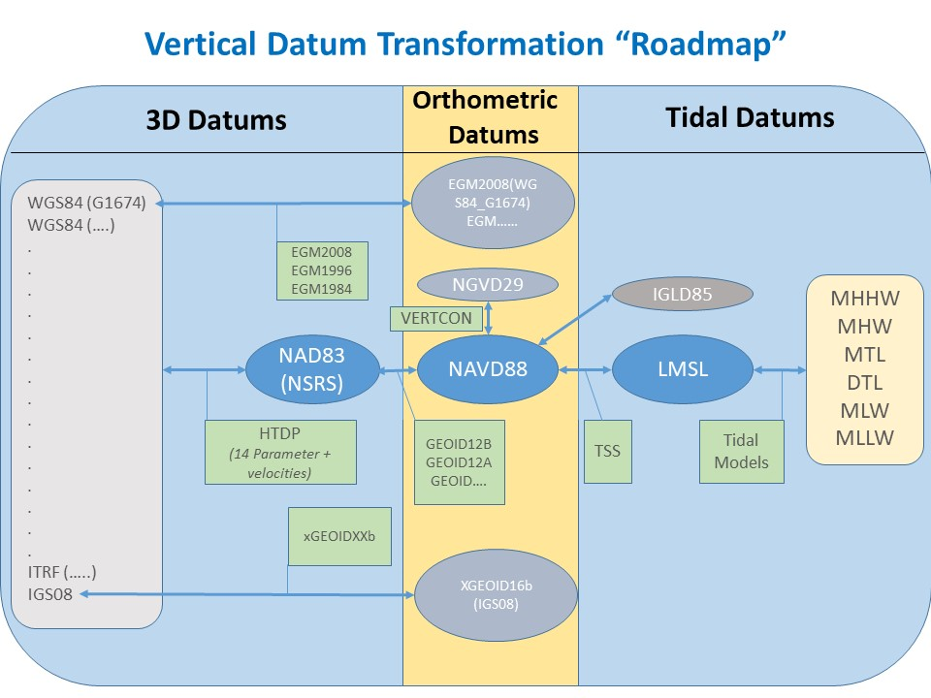

Slide 9
3D/Ellipsoid Datums
NAD83
(GRS 1980)
Calculation of geographic position on this irregular surface is very complex. A simpler model is needed.
This simplified mathematical surface is the ellipsoid.
An ellipsoid approximates the shape of the earth, a datum defines the position of the ellipsoid relative to the center of the earth. A datum provides a frame of reference for measuring locations on the surface of the earth.
Approximately
2 meters
Earth Mass
Center
WGS84
(WGS84)
The GRS80 ellipsoid’s origin is approximately 2m from WGS84 ellipsoid’s. The Clarke 1866 ellipsoid’s origin is approximately 236 m from WGS84 ellipsoid’s
14-parameter transformation
Notes:
The ellipsoid (in red) is a simplified mathematical surface that helps in positioning. GPS positions are based on the ellipsoid.

Slide 10
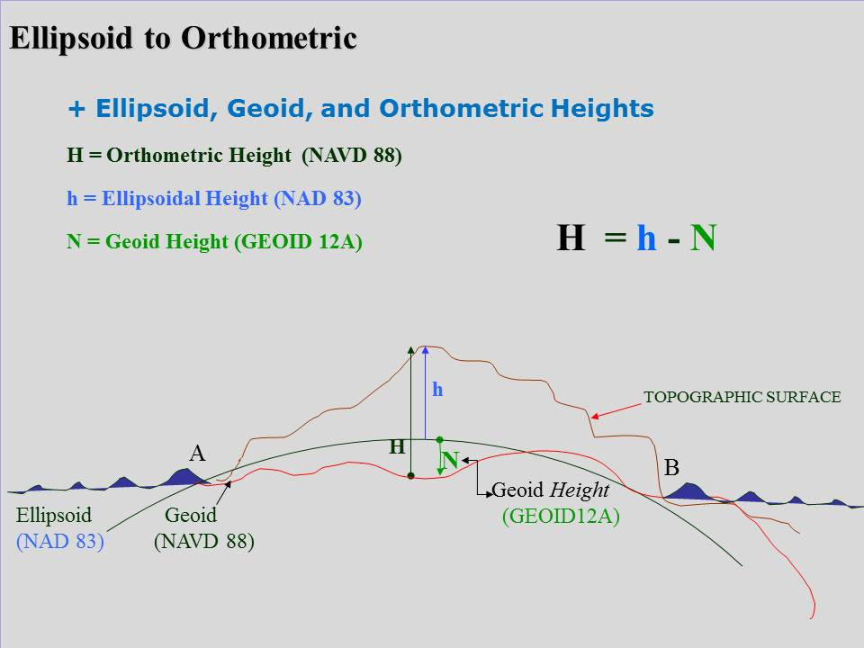
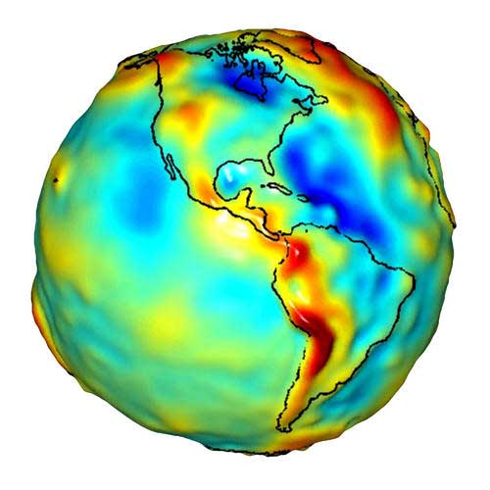
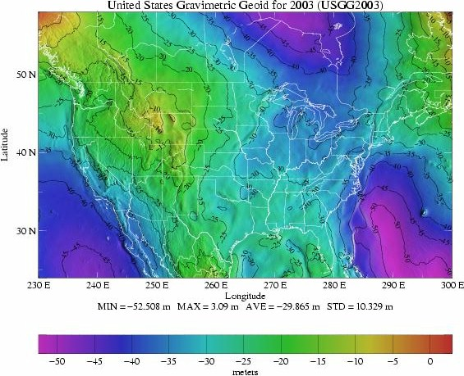
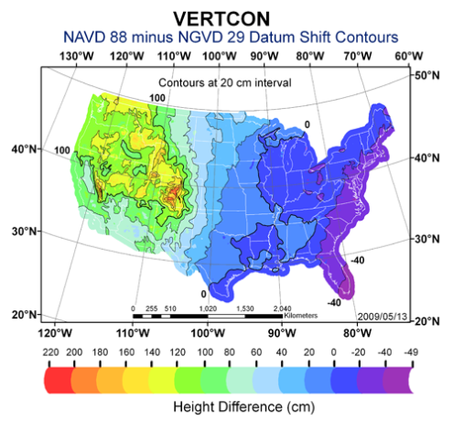
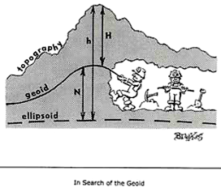
Orthometric Datums and the GEOID
NAVD88 is based on an adopted elevation at Point Rimouski (Father's Point). It uses Helmert orthometric heights as an approximation to true orthometric heights.
GEOID: “The equipotential surface of the Earth’s gravity field which best fits, in the least squares sense, (global) mean sea level.”
Can’t see the surface or measure it directly.
Can be modeled from gravity data as they are mathematically related.
biquadratic interpolation

Slide 11
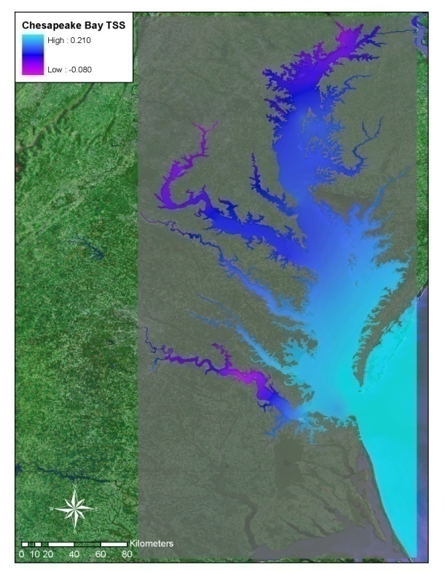
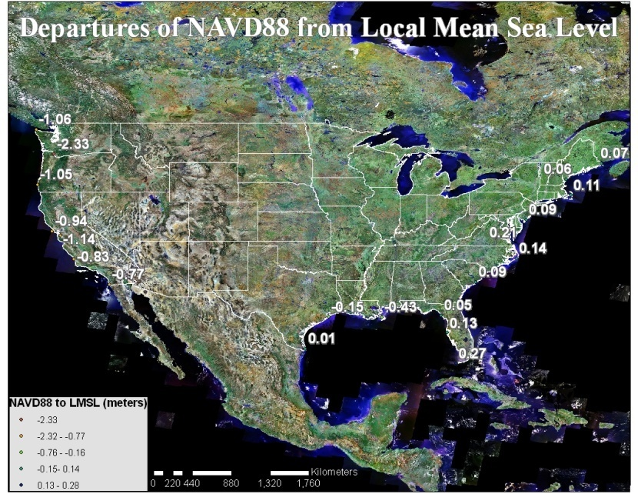
Topography of the Sea Surface
The Topography of the Sea Surface (TSS) is defined as the elevation of the North American Vertical Datum of 1988 (NAVD88) relative to local mean sea level (LMSL).
This grid provides compensation for the local variations between a mean sea level surface and the NAVD88 geopotential surface.
A positive value specifies that the NAVD88 reference value is further from the center of the Earth than the local mean sea level surface.
bilinear interpolation

Slide 12
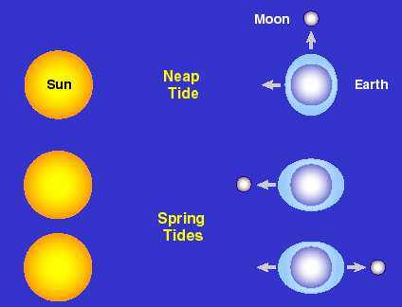
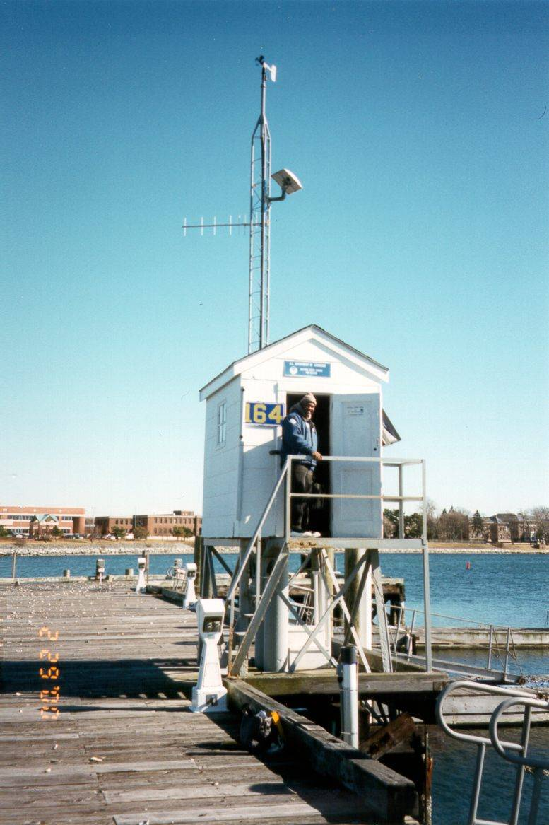
Tidal Datums
A vertical datum is called a tidal datum when it is defined by a certain phase of the tide.
National Tidal Datum Epoch (NTDE): is a specific 19-year period that spans the longest periodic tidal variations resulting from astronomical tide-producing forces.
The fundamental base from which most coastal and marine boundaries are determined.
Also important for referencing soundings and depicting shorelines on nautical charts.
National Water Level Observation Network (NWLON)
bilinear interpolation

Slide 13
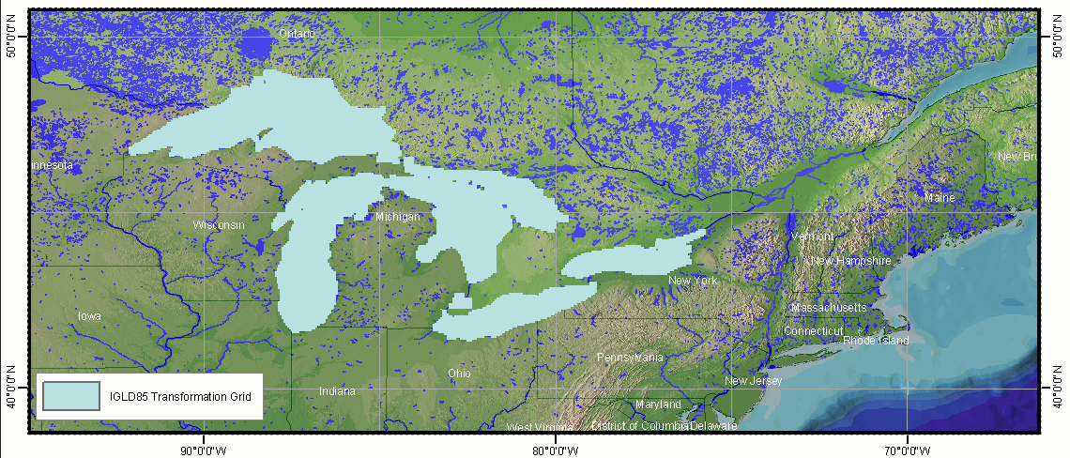
VDatum: IGLD85
Conversions between IGLD 85 and NAVD 88 are provided based on the NAVD 88 gravity model (http://www.ngs.noaa.gov/TOOLS/Navdgrav/navdgrav.html) and the hydraulic corrector model.

Slide 14
VDatum
Applications

Slide 15
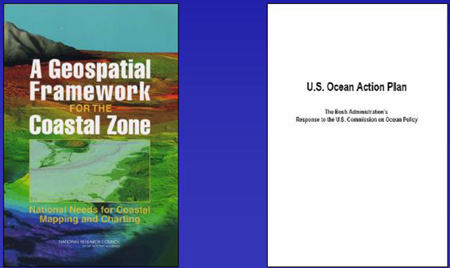
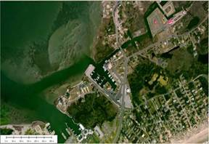
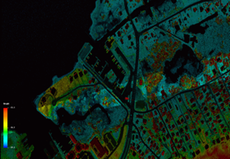
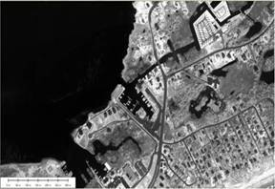
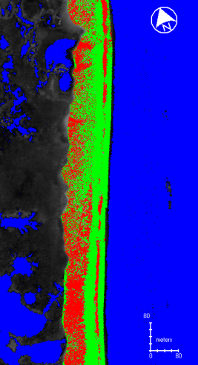
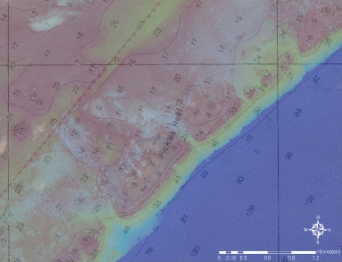
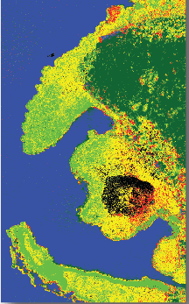
Integrated Ocean and Coastal Mapping (IOCM)
The practice of acquiring, managing, integrating and disseminating ocean and coastal geospatial mapping data in such a manner that permits these data and their derivative products to be easily accessed and used by and for the greatest range of users and purposes.
IOCM requires intra- and inter-agency coordination with a focus on streamlining operations, reducing redundancies, improving efficiencies, developing common standards, and stimulating innovation and technological development.
Notes:
These objectives of increasing intra- and interagency coordination and promoting multi-use of geospatial data are gaining a lot of traction.
One important driver was a 2004 National Research Council Report titled “A Geospatial Framework for the Coastal Zone: National Needs for Coastal Mapping and Charting.”
Key recommendation: increasing coordination and collaboration on ocean and coastal mapping across the federal gov.
Stimulated several other reports/initiatives, including the U.S. Ocean Action Plan. It turn, that led to the creation of the Interagency Working Group on Ocean and Coastal Mapping (IWG-OCM).
NRC Report
Consistent spatial framework for coastal data the allows a seamless transition from onshore to offshore
Increased collection and availability of data including land cover, shallow-water bathymetry, seafloor imagery, habitat distribution and classification standards
Easy access to up to date digital, geospatial data, imagery and mapping products
Compatibility among data formats – or standards and transformation protocols that allow each data exchange – and a means to evaluate data accuracy.
Increased inter- and intra-agency coordination, cooperation and communication.
U.S Ocean Action Plan
Develop and annual inventory of federal, federally-funded, and non-federal governmental ocean and coastal mapping programs and operations
Assess and report on common and shared needs for development of coordinated programs
Coordinate and leverage resources and efforts across the federal sector with industry, academic, NGO and non-federal government entities
Set priorities for standards development and developing strategies for promulgation of standards for data acquisition, data, metadata, tools and products
Develop shared and standardized mechanisms for processing, archiving, and distributing geospatial data, tools, products and services

Slide 16
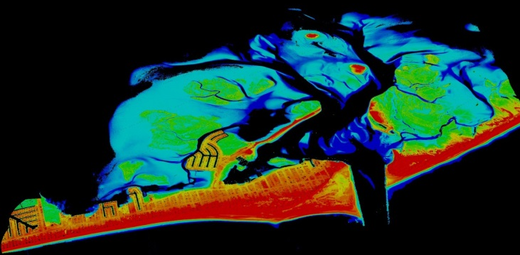
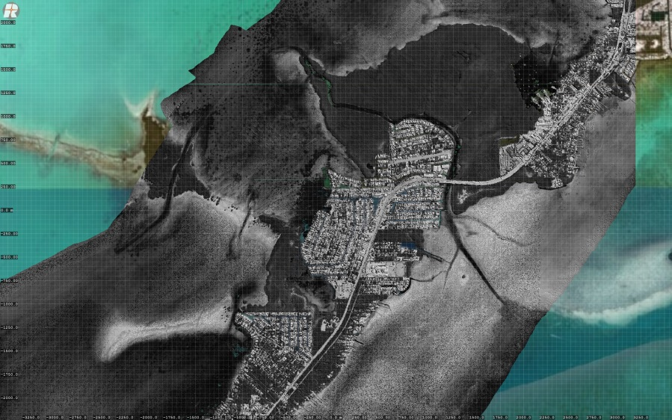
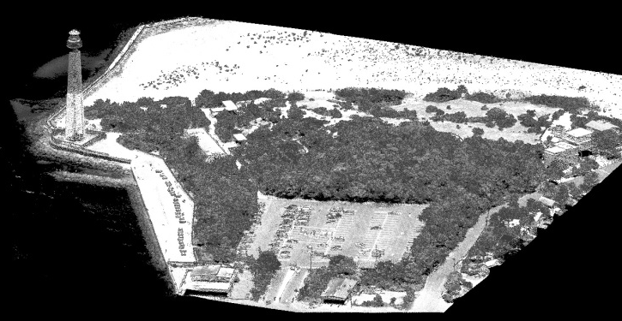
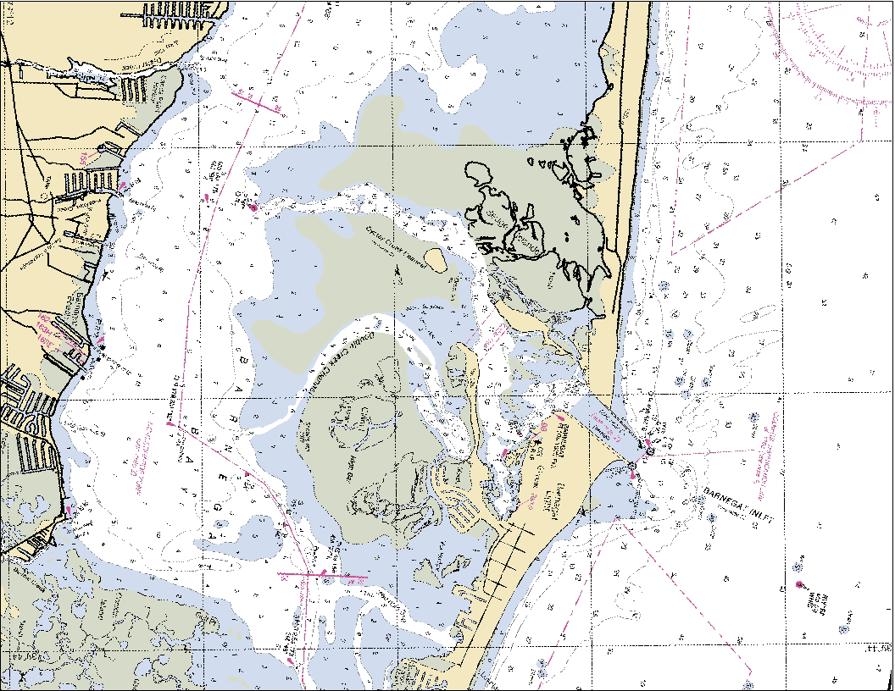
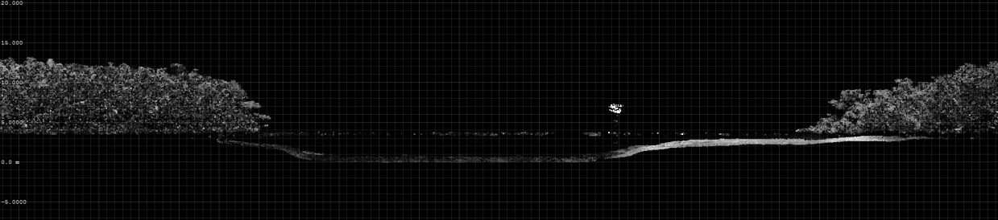
TopoBathy Lidar

Slide 17

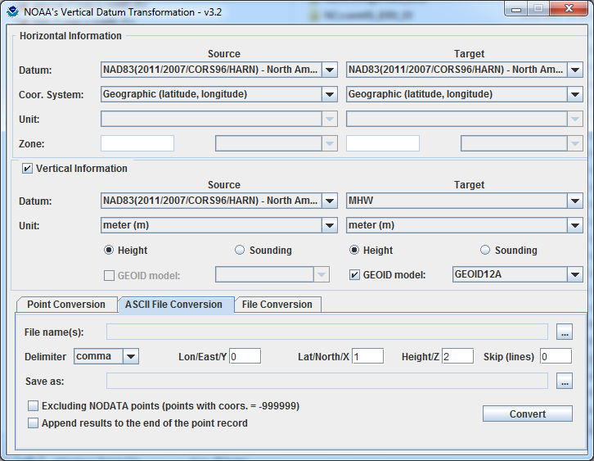
VDatum: Used to Create Digital Elevation Models
Topo/ Bathy
Digital Elevation Model
Topography
VDatum
Bathymetry
Applications for Seamless Bathy/Topo Datasets:
Inundation modeling from storm surge, tsunamis, and sea level rise.
Erosion, accretion, renourishment
Analyzing storm impacts
Determining setback lines
Determining local, state, and national boundaries
Navigation products and services
Habitat restoration
Shoreline Change Analysis
Analyzing environmental and natural resources
Permitting
Notes:
Merging data sets in coastal areas is important in a range of applications. VDatum enables spatial information from different environmental sectors to be mapped onto one uniform surface.

Slide 18
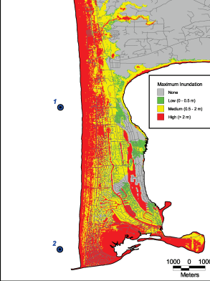
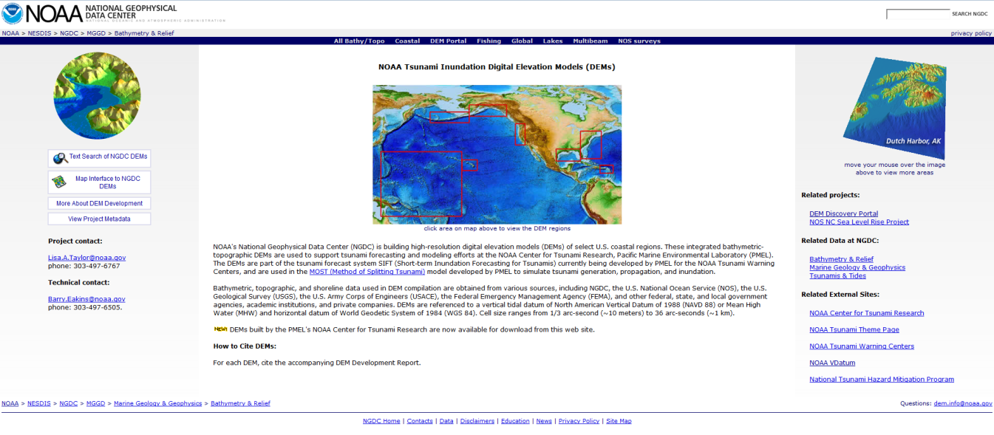
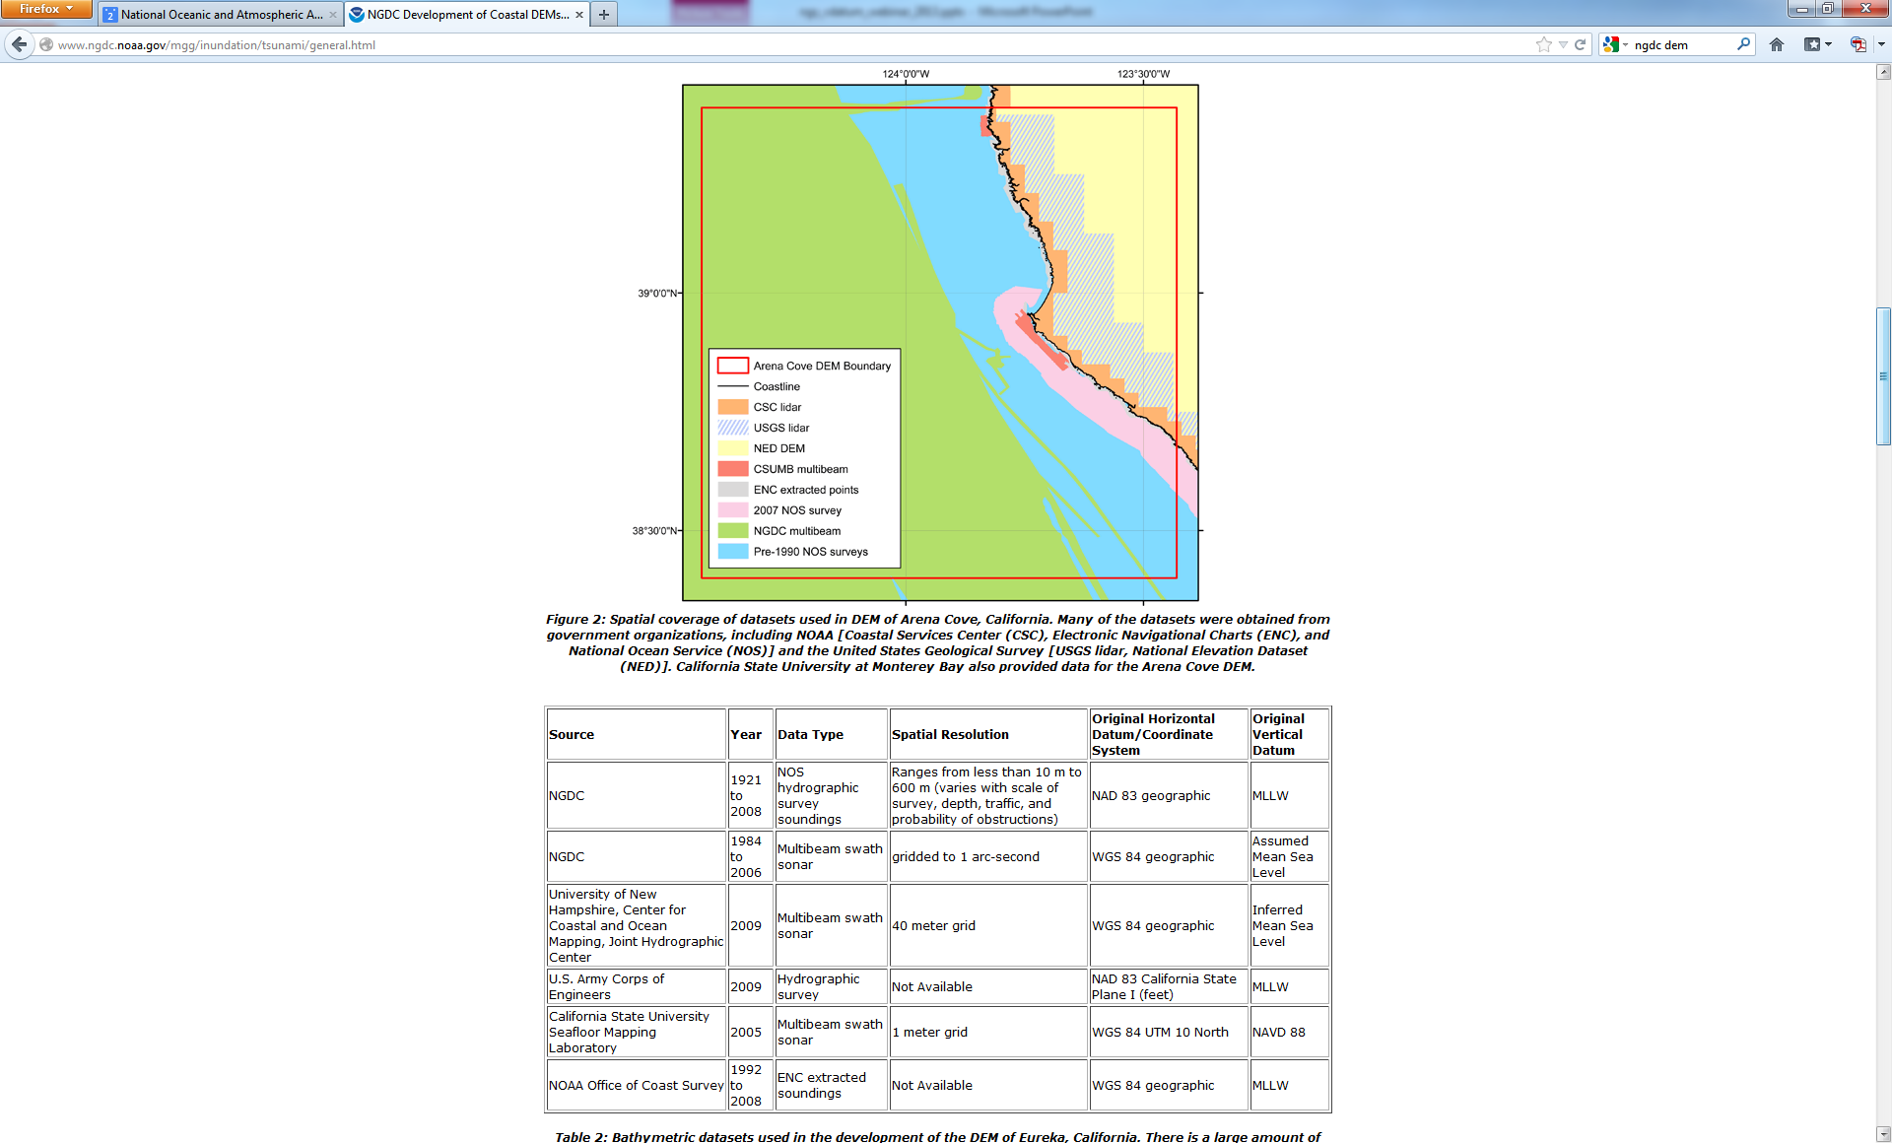
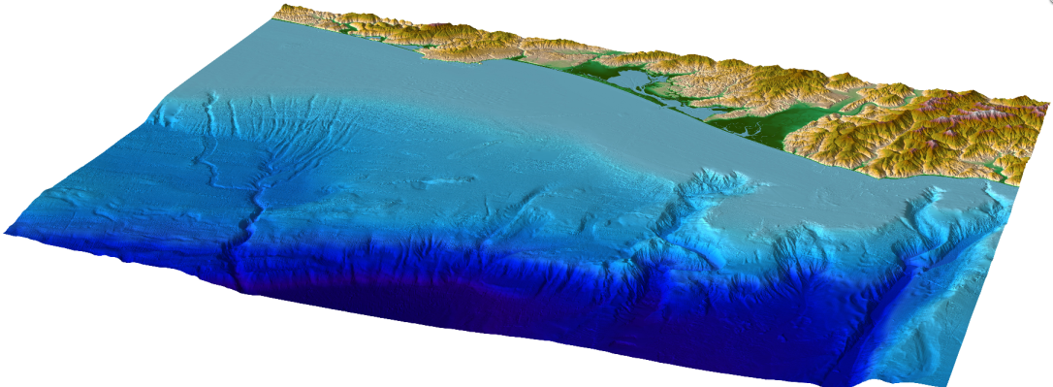
Utilizing VDatum for Digital Elevation Model Creation: Tsunami Inundation

Slide 19
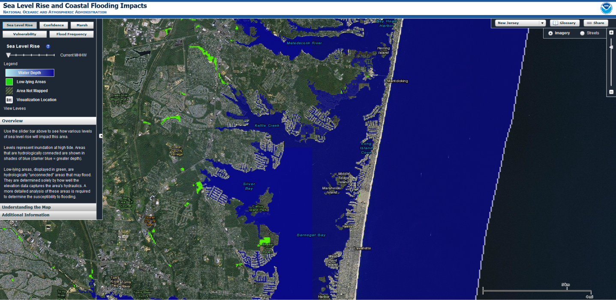
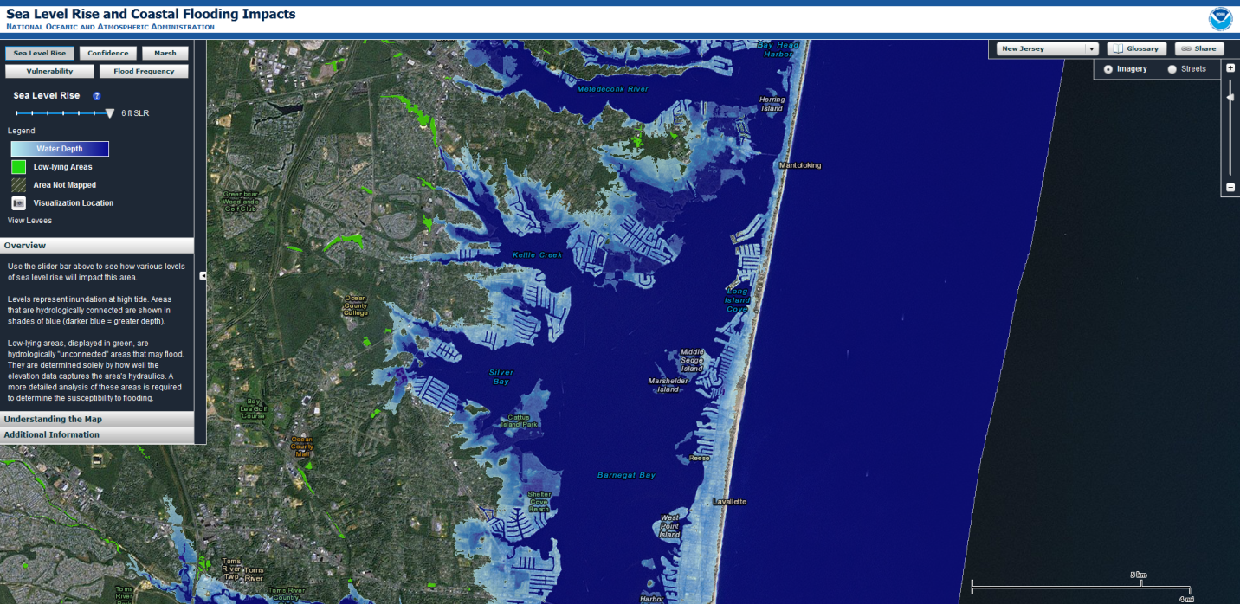
Sea Level Rise/Coastal Flooding

Slide 20
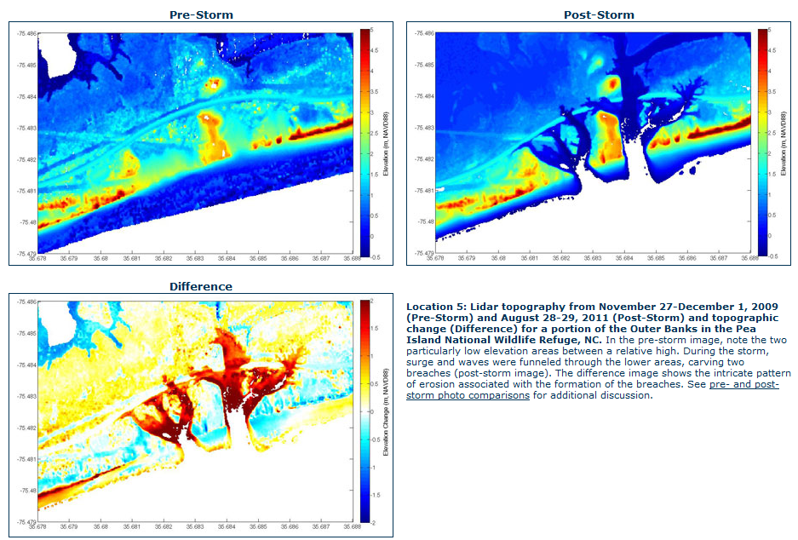
Emergency Response
Courtesy of USGS

Slide 21
Additional Applications
  Coastal Inundation/Sea Level Rise/Tsunami Modeling
  Erosion/Accretion/Shoreline
  Change
  Habitat/Wetland Restoration
  Dredging and Infrastructure Engineering (levees, jetties)
  Floodplain Mapping
  Topobathy DEM Creation
  Civil and Water Works Projects
  Easement and Setback Planning
  Marine Construction
  Coastal Engineering
  Coral Reef Mapping
  Analyzing Storm Impacts
  Real Estate Mapping
  Evacuation Route Mapping
  Site Management
  Insurance Studies
  Hazardous Waste Site Studies
  Groundwater mapping and modeling
  Feasibility Studies and Planning,
  Determining Local, State and National Boundaries
  Permitting
  Analyzing Environmental and Natural Resources
  Emergency Response
  ??? What Can You Imagine ???

Slide 22
Obtaining and Utilizing VDatum

Slide 23
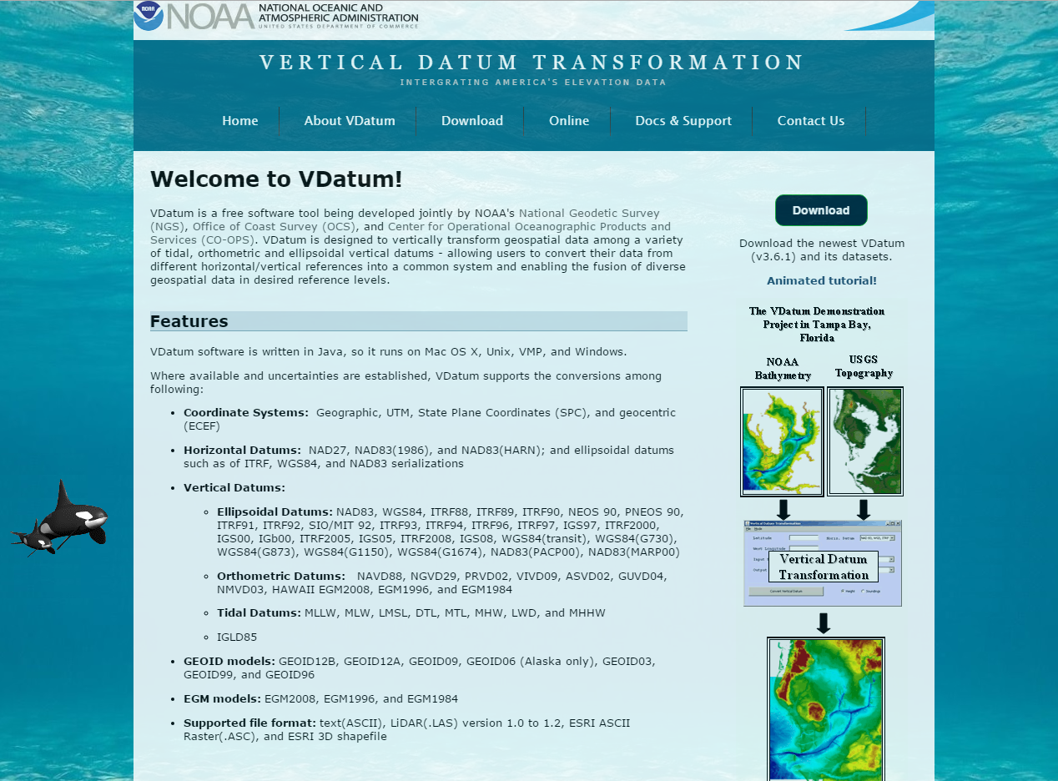
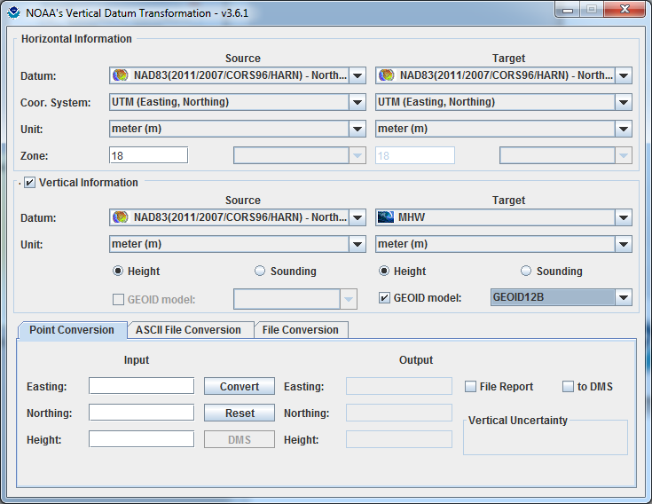
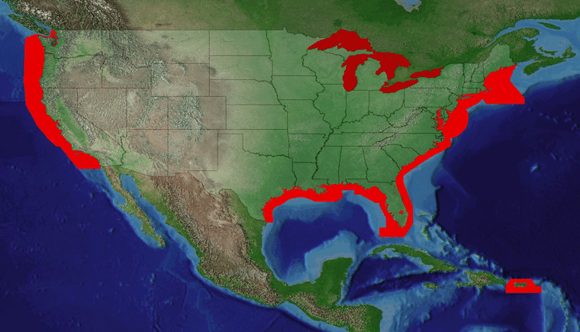
VDatum Website: vdatum.noaa.gov
(Version 3.7 Released, September 11, 2017)

Slide 24
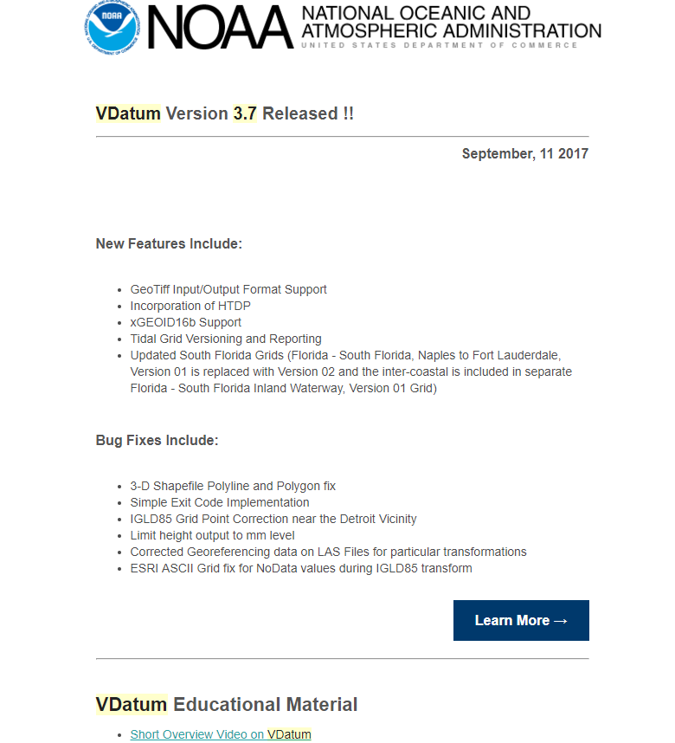
VDatum Version 3.7 Release

Slide 25
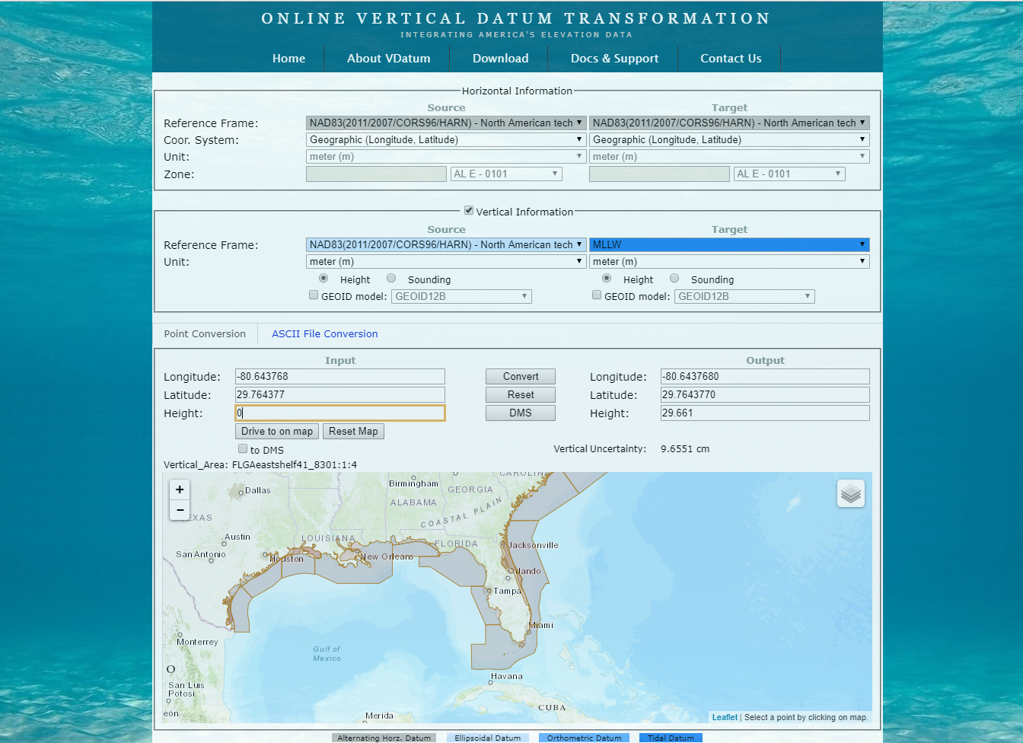

VDatum: Interfaces

Slide 26



VDatum: Documentation and Support

Slide 27

Utilizing VDatum: Horizontal

Slide 28

Utilizing VDatum: Vertical

Slide 29
Utilizing VDatum: Input

Slide 30

Utilizing VDatum: Input

Slide 31

Returned null value = -999999.0
Returned a valid conversion value
With exception of small buffer region near coastline, user-input points falling on “land” side of MHW shoreline are assigned a null value.
Orthometric and ellipsoidal conversions may still be made at land points, as only conversions involving tidal datums will be invalid inland of the buffer zone along coastline.
Notes:
Older regions ½ cell length
Now working with NGS to extend 1-3 grid cells

Slide 32


Utilizing VDatum: Input
File Name: ARRA-LFTNE_Maine_2010_06454966_utm.las
File Size: 137,992 kb
File Date: Thu Feb 21 10:57:06 2013
File Type: LAS
File Signature: LASF
File Source ID: 0
Global Encoding: 0
LAS Version: 1.2
System Identifier: vdatum.noaa.gov
Generating Software: vdatum 3.2
File Creation Date: February 24, 2012
Per-point Time: YES
Per-point RGB: NO
Georegistration
Coordinate System: NAD83 / UTM zone 19N
Vertical Citation: vert: MHW:m:height
Horizontal Units: Meters
Vertical Units: Meters

Slide 33

VDatum Uncertainty Modeling
See: vdatum.noaa.gov/docs/est_uncertainties.html

Slide 34





VDatum Uncertainty Modeling (cm)
(ITRFxx to the tidal datum, the transformation with the greatest uncertainty)
Uncertainties that are constant for all VDatum regions of the U.S.

Slide 35


Operational: Vertical Datum Transformation Uncertainty

Slide 36
VDatum
Enhancements

Slide 37

Online VDatum Application

Slide 38


HTDP

Slide 39

xGEOID Support

Slide 40

Geotiff (Null Value Enhancement)

Slide 41

LAS1.4, LAZ, and Classification Selection

Slide 42
What’s Next: Strategic Priorities
  Reducing Regional Model Uncertainty to <10cm
  Increasing Coverage
  Next Generation TSS Model (utilizing gravimetric GEOID transformation roadmap)
  Spatially Varying Uncertainty
  Software Development
  Communication and Outreach

Slide 43

Vertical Datum Uncertainties By Region

Slide 44


Foundational Data: Tidal

Slide 45

Foundational Data: Geodetic

Slide 46



Foundational Data: Geodetic

Slide 47




Southeast Alaska

Slide 48






Future Enhancements: Next Generation TSS Development
New GEOID: Coastal gravity field improvement
New Proposed Transformation Roadmap
based on a purely Gravimetric GEOID
A Must: GPS Campaign on bench marks to determine new relationships
Wish List: GPS tide buoys to be utilized for data input and validation
Satellite Altimetry/Derived Products to better understand offshore TSS
Re-tracked coastal altimetry data to capture nearshore sea surface height signal

Slide 49




Spatially Varying Uncertainty (Transition to Operations)
Statistical data assimilation is used to blend model results and data, also providing the associated uncertainty.
Initial results for the Chesapeake Bay are shown below:
Product (MHHW) spatial distribution after data assimilation
Uncertainty in one standard derivation (m)

Slide 50



Spatially Varying Uncertainty
NY Bight/ LIS
Gulf of Mexico

Slide 51




Software: Future Enhancements
    Bug Fixes
    Change Request
    SVU Implementation
    Directed Assistance for Datum Selection with enhanced Logic/Validation
    GIS Format Support
      ERDAS Imagine (IMG)
    NADCON5
  Columbia River Datum
  Mississippi Low Water Reference Plane 2007
  Web Services (API?)

Slide 52






VDatum
Production and Maintenance

Slide 53

What’s Being Replaced with the Modernization of Reference Frames
Horizontal Vertical
  NAD 83(2011)
  NAD 83(PA11)
  NAD 83(MA11)
  NAVD 88
  PRVD 02
  VIVD09
  ASVD02
  NMVD03
  GUVD04
  IGLD 85
Latitude
Longitude
Ellipsoid Height
State Plane Coordinates
Heights
Approximate level of geoid mismatch known to exist in the NAVD 88 zero surface.
Does not include local subsidence issues

Slide 54

Vertical Datum Transformation “Roadmap”

Slide 55

VDatum: Updated NSRS

Slide 56


Point Cloud Discrepancies
There should not be a crack in the bottom of pool !!
Notes:
NAD83 and the new GEOID on one side and NAD83 and the old GEOID on the other side

Slide 57

Applying the new GEOID incorrectly
4-6 Degree sloping beach
18m Offset
Notes:
NAD83 and the new GEOID on one side and NAD83 and the old GEOID on the other side

Slide 58

Current/Future Activities (NGS and VDatum)
  NGS Geodetic Toolkit: Several various independent tools/software (various computer languages)
    VDatum has been translating particular tools from FORTRAN/Others to JAVA over numerous years. (Can lead to discrepancies between tool results)
  NGS Toolkit Modernization
    NADCON5
    Vertical Transformations off of NADCON5 ??
    Others….(HTDP, IGLD85,…)
    NGS plans to build transformation modules that
    are consistent and can be integrated into other
    software (tools, web services, source code)
    VDatum will make available, the tidal version
    of these modules
    Strategically streamline above development with
    NGS Toolkit and Spatial Reference Modernization

Slide 59



National Tidal Datum Epoch (NTDE)
  Anticipated release 2025 time frame
  Next NTDE will be computed on period of (2002-2020)
Official time period of tidal observations that are used for primary datum calculations
  Time it takes the Earth, Moon, & Sun to complete an epoch tidal cycle
  19 year time period (Current NTDE is 1983-2001)
  Considered for revision every ~20-25yrs
  Includes the longest period tidal variations (18.6 year node cycle)
  Averages out seasonal fluctuations
  Provides a nationally consistent tidal datum network by accounting for seasonal and apparent environmental trends in sea level that affect the accuracy of tidal datums
1983-2001 EPOCH

Slide 60
Summary
The VDatum transformations tool from NOAA allows us to transform vertical datasets between ellipsoidal, orthometric and tidal datums...
Assuring data is transformed correctly
Enabling multiple uses for datasets across applications (Coastal Resilience, Intelligence, and place-based)
Permitting merging of disparate data sets to a common reference
And providing transformation uncertainty estimates for intelligent decision-making and analysis.

Slide 61

VDatum: Contact Us

Slide 62
Thank You!
Contact Information:
Email: vdatum.info@noaa.gov
Website: http://vdatum.noaa.gov
Stephen White
Email: stephen.a.white@noaa.gov
Phone: (240) 533-9588

