Slide 1

NGS Experimental Geoid Models
Wang YM, K Ahlgren, X Li, J Krcmaric
and R Hardy
National Geodetic Survey, NOAA, USA
2021 Geospatial Summit
Silver Spring, MD
May, 2021

Slide 2

Specifics of the experimental geoid
The experimental geoid (xGEOID) models have been computed annually since 2014. It will become GEOID2022 after completion of GRAV-D.
GRAV-D gravity data has been collected continuously since July 2008, 85.3% has been completed.
The xGEOID20 is the first joint model of NGS/CGS/INEGI.
The models covers three regions:
America-Pacific: (Lat: 0°N to 90°N, Lon: 170°E to 350°E)
Guam and CNMI: (Lat: 11°N to 22°N, Lon: 143°E to 148°E)
American Samoa: (Lat: 10°S to 16°S, Lon: 186°E to 193°E)

Slide 3
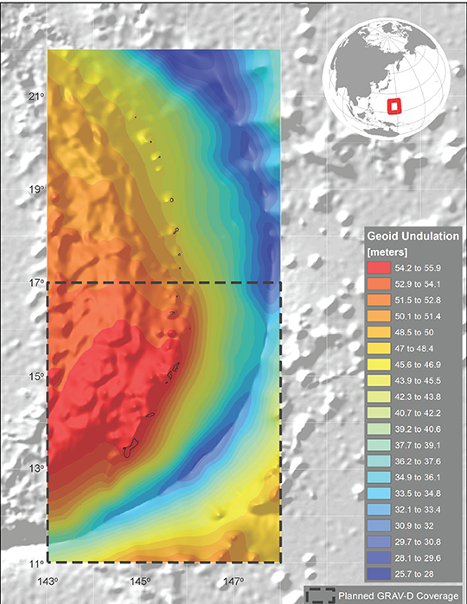
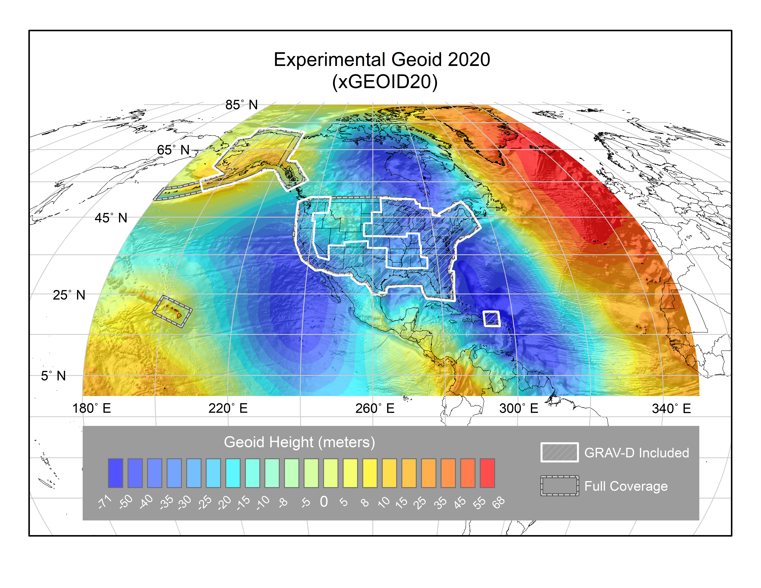
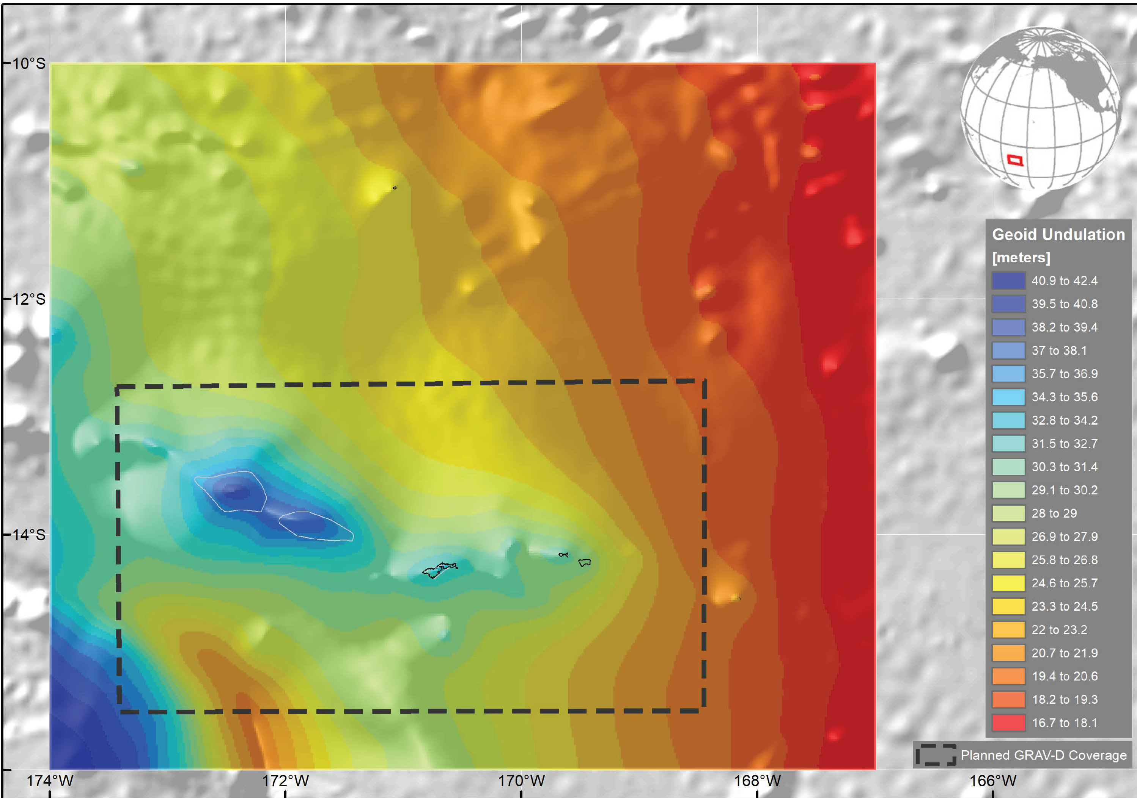
Coverage of NAPGD2022 Gravimetric Geoid Model (GEOID2022)
Guam and Northern Marianas Islands
North America and Pacific
American Samoa

Slide 4
Fundamental parameters
Reference ellipsoid: GRS80 (Blueprint for 2022, part II)
  Semi-major axis a = 6,378,137 m
  GM = 398,600,500,000,000 m³/s²
  ^{J}₂ = 108,263 x 10⁻⁸
  ω = 7,292,115 x 10⁻¹¹ /s
Reference frame: ITRF14
Tidal system: Non-tidal
W₀ = 62,636,856.0 m²/s²
SGEOID2022 (xGEOID22) will be static. The dynamic geoid DGEOID2022 by the Geoid Monitoring Service
Products: SGEOID/DGEOID grids (1’ x 1’), gravity grids (1’ x 1’),
Geoid accuracy grids (1’ x 1’)
Deflection of the vertical grids (1’ x 1’)
Accuracy of deflection of the vertical (1’ x 1’)

Slide 5
Geoid quality control
Three GSVS lines in flat, medium and high rugged mountains (GSVS11, 14 and 17) are the prime independent data sets
NGS lead the Colorado 1-cm geoid experiment participated by 14 groups from 13 countries. Results will be published in a Journal of Geodesy special issue in 2021.
The xGEOID20 models agree with the most accurate GSVS data better than the GPS on the benchmarks in the experiment area.
The GEOID2022 accuracies are expected to be 1-2 cm in flat areas, and 2-3 cm in mountainous region.

Slide 6
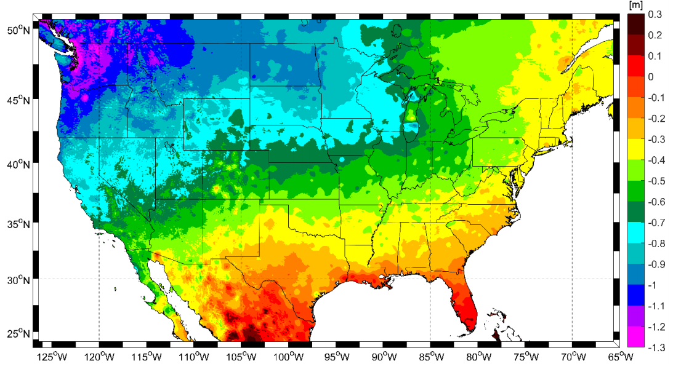
Possible height changes from NAVD88 (CONUS)

Slide 7
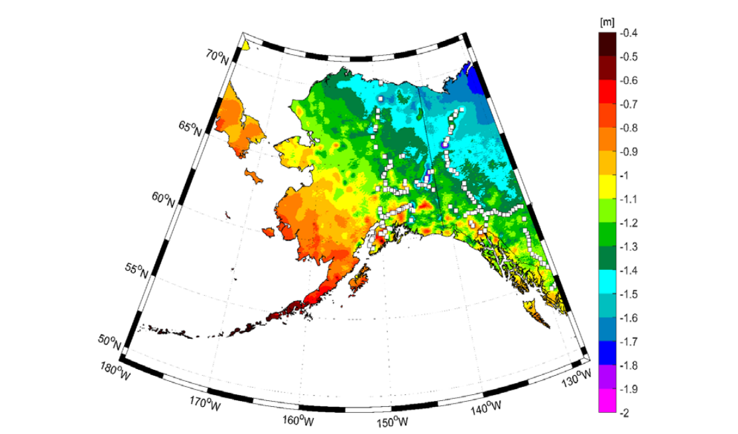
Possible height changes from NAVD88 (AK)

Slide 8
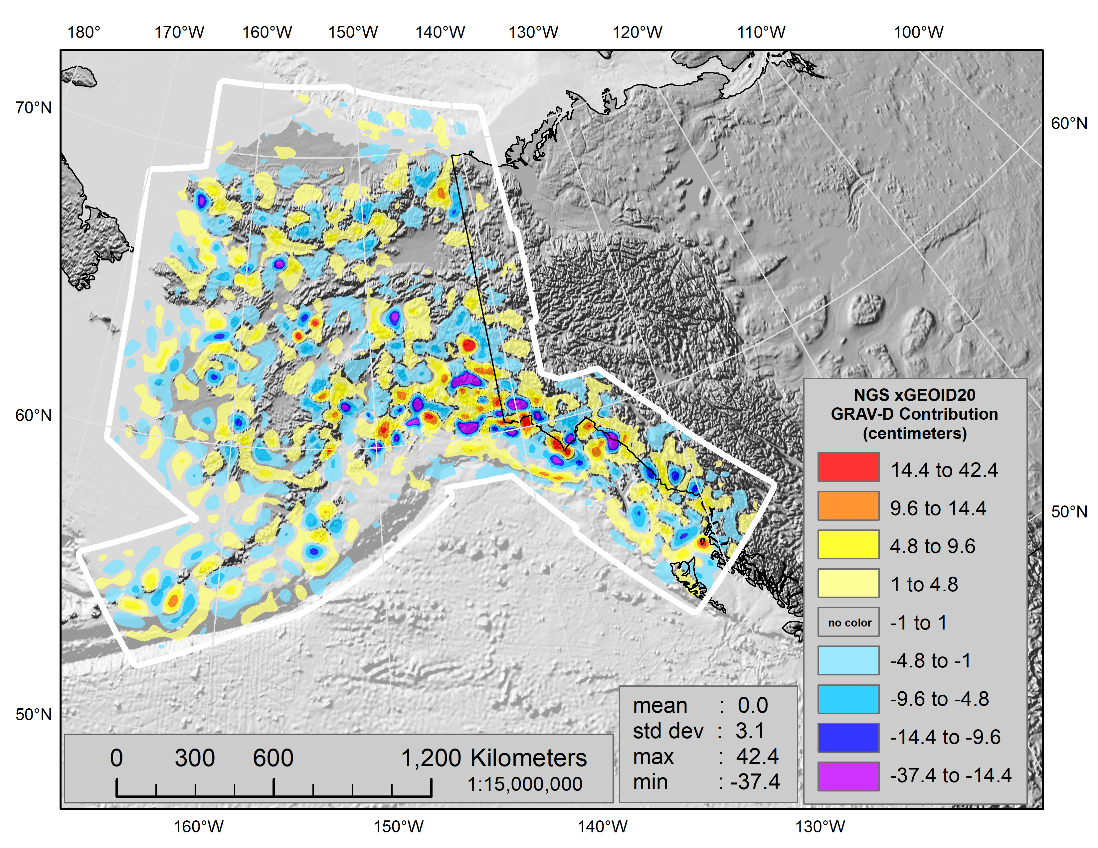
Contribution of GRAV-D to the geoid(demo)

Slide 9
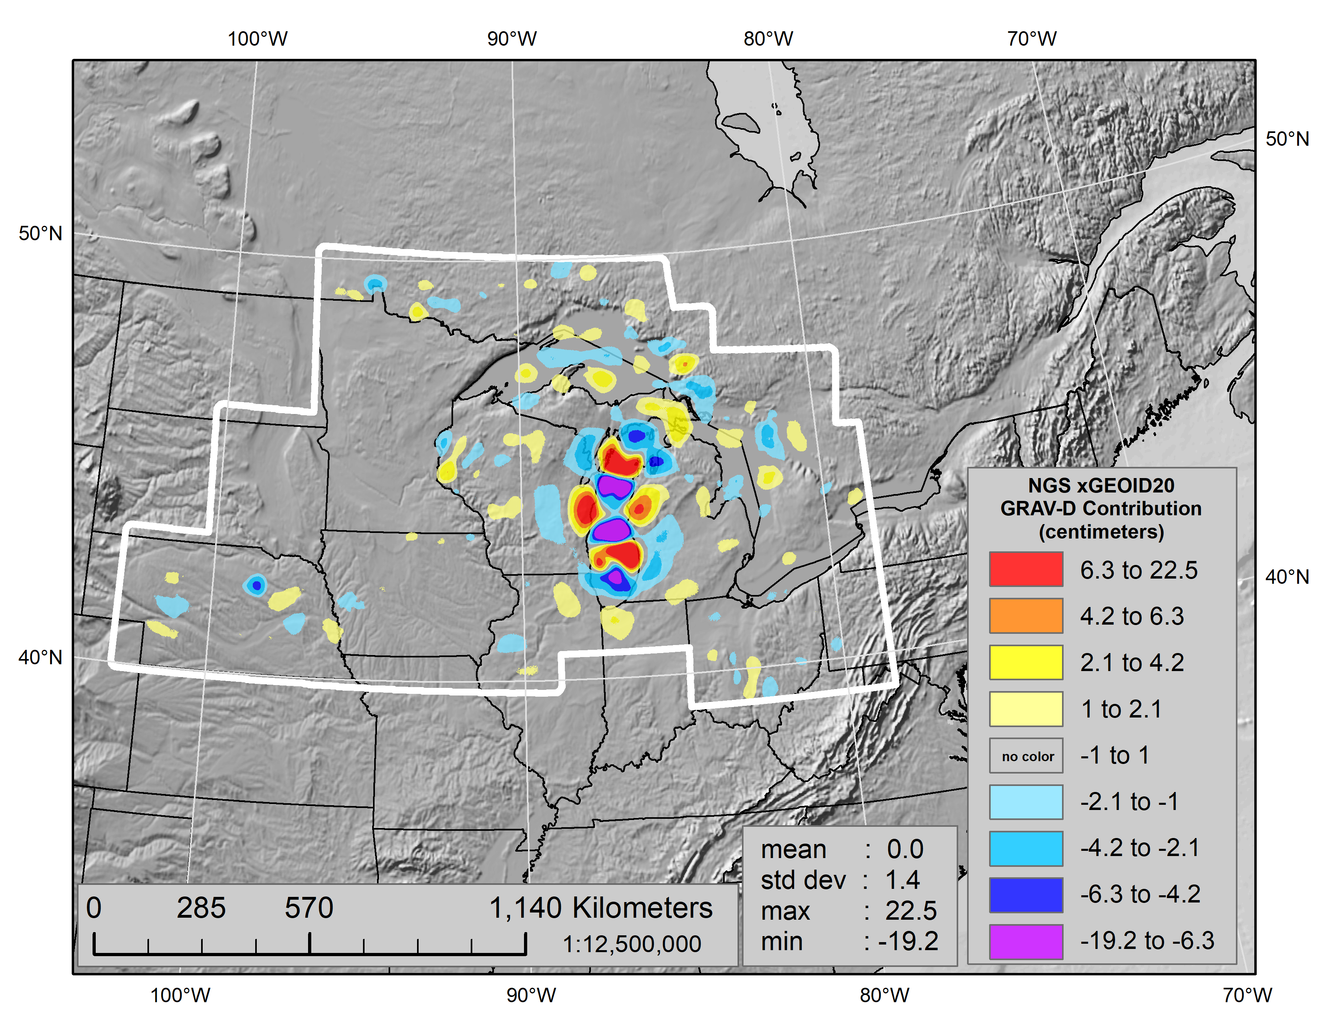

Contribution of GRAV-D to the geoid

Slide 10
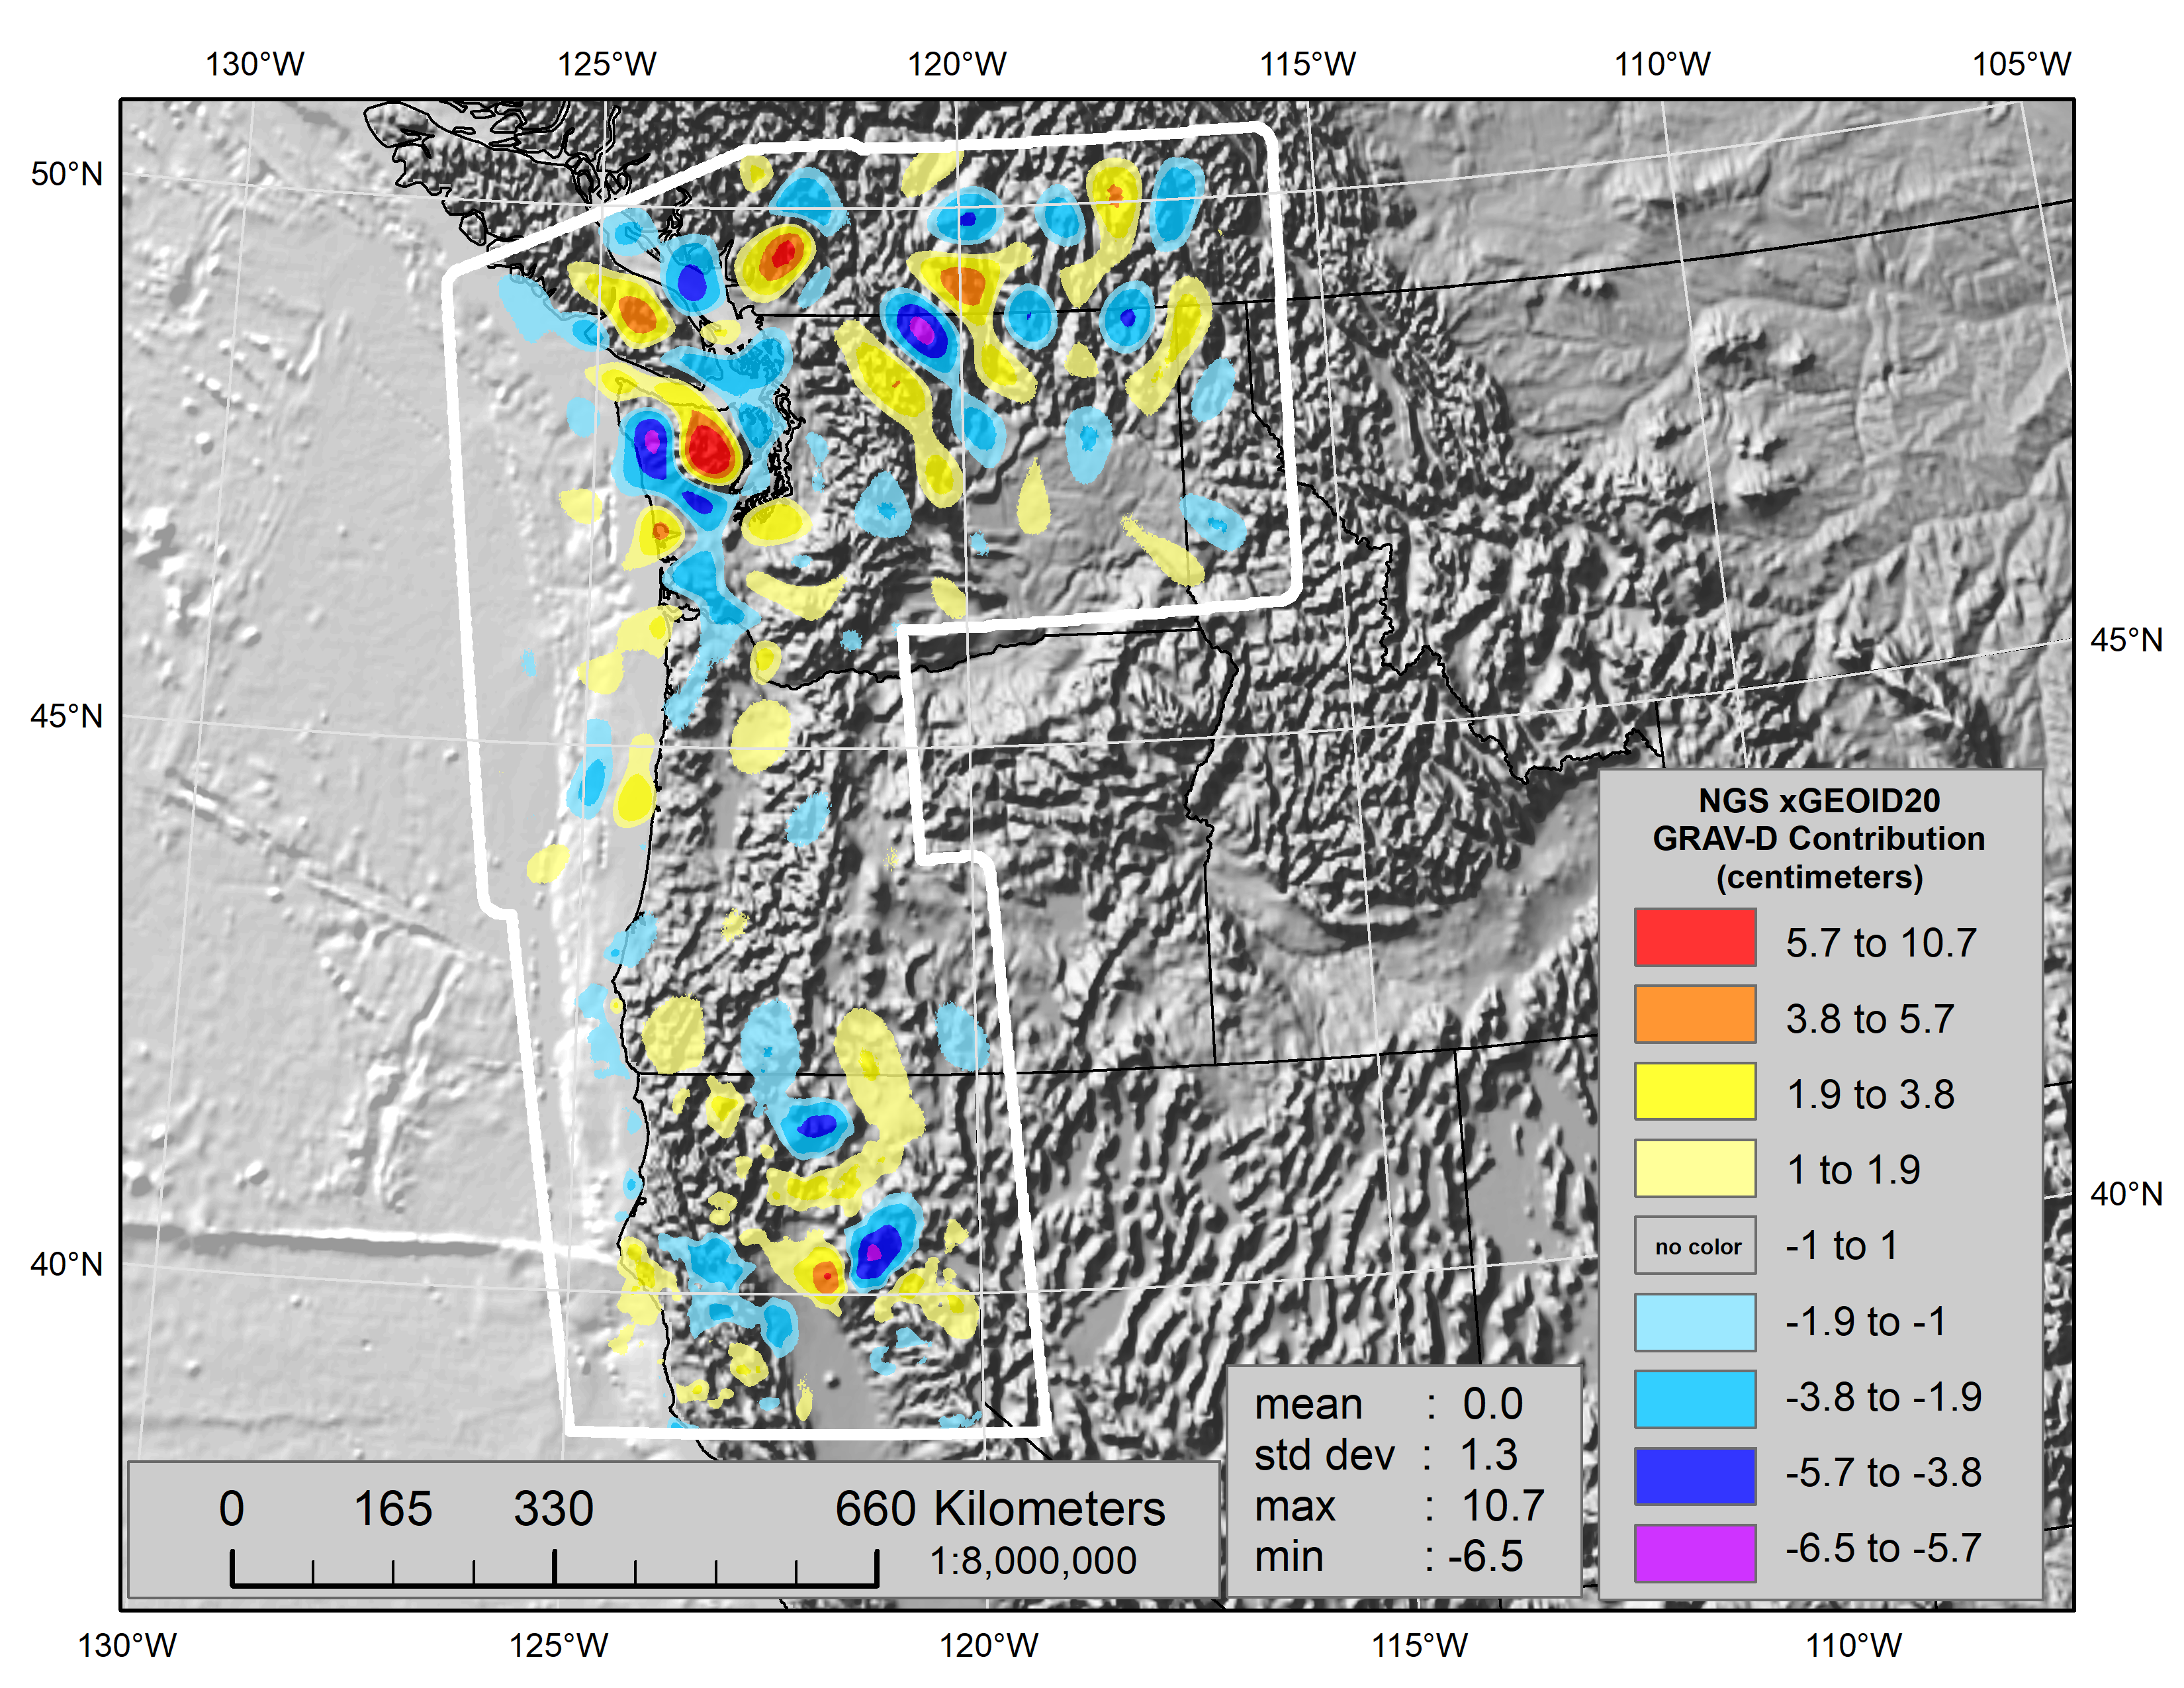
Contribution of GRAV-D to the geoid

Slide 11
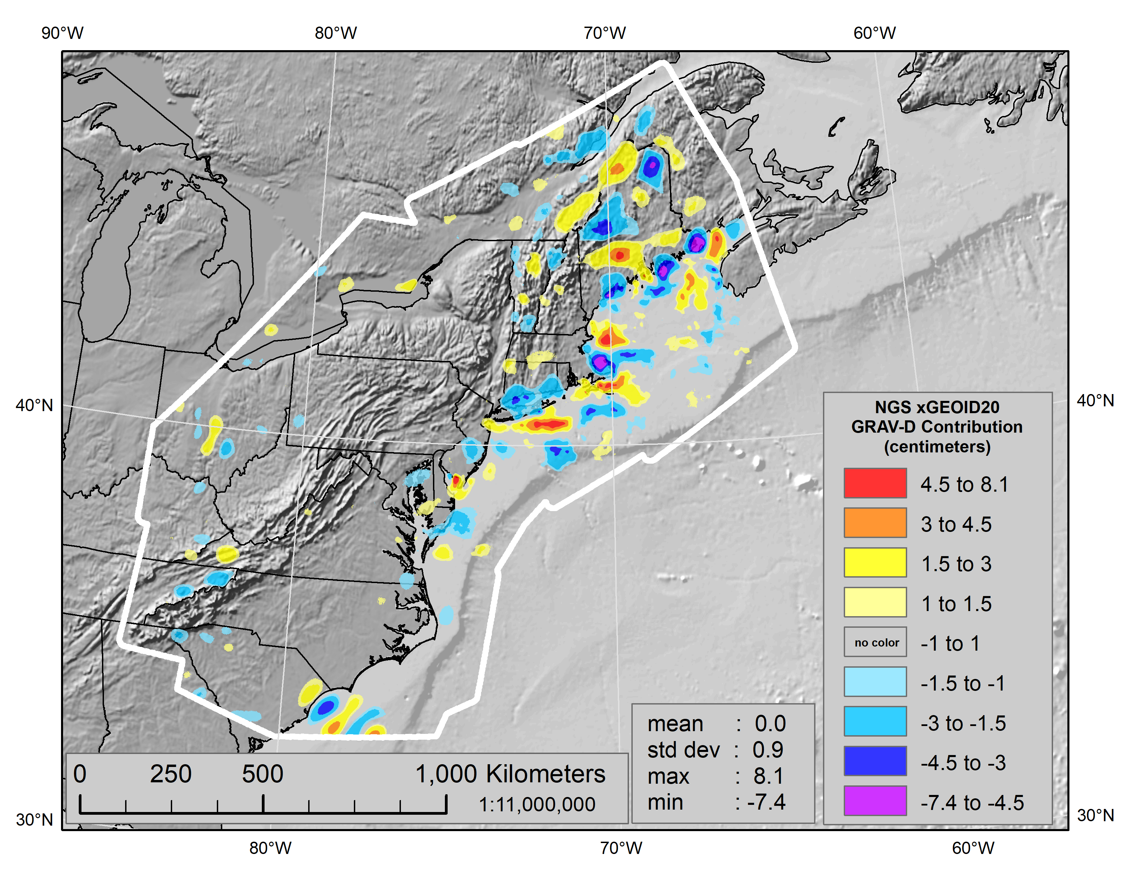
Contribution of GRAV-D to the geoid

Slide 12
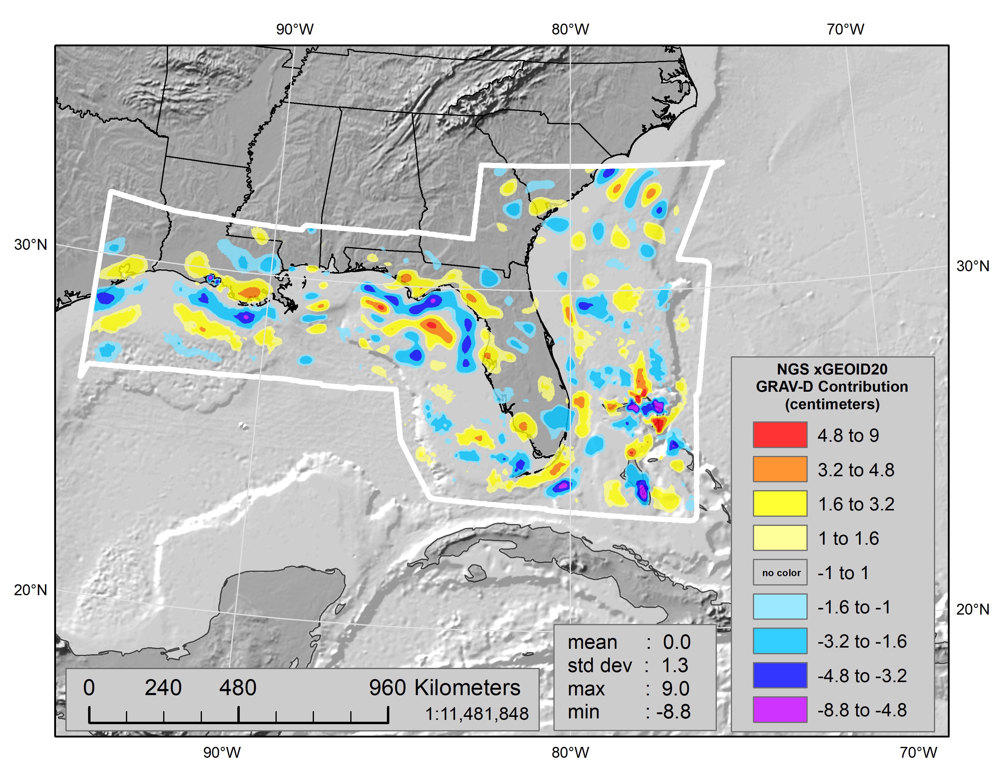
Contribution of GRAV-D to the geoid

Slide 13
NGS Web interactive computation
For the interested marks, the geoid and height changes can be computed at the NGS website:
https://beta.ngs.noaa.gov/GEOID/xGEOID20/computation.shtml

Slide 14
More information
More information can be found at NGS beta website
https://beta.ngs.noaa.gov/GEOID/xGEOID/
Questions?
Contact
Geoid team: ngs.geoid.team@noaa.gov
Dr. Yan Ming Wang: yan.wang@noaa.gov

