Slide 1
New Developments at the National Geodetic Survey
Dr. Mark Schenewerk
Mark.Schenewerk@noaa.gov
816-994-3009

Slide 2
Who is this guy?
I am Mark Schenewerk with the National Geodetic Survey (NGS).
I have a B.S. from the University of Missouri at Rolla and a
Ph.D. from the University of Illinois at Champaign-Urbana.
The NGS calls me a geodesist, but I’m actually an astronomer who happens to do things that look like geodesy.
I am the “father” of the PAGES processing software.
I’ve been (very) indirectly involved in OPUS since its inception and directly involved in some of the new development for the last two years.
2011-11-03
2

Slide 3
Outline
A little NGS history.
The NGS mission.
What the heck is geodesy?
Current NGS Activities.
  Aeronautical Survey Program
  National Shoreline
  Emergency Response Imagery
  NSRS
  GRAV-D And The Geoid
  CORS And OPUS
  Height Modernization
  Guidelines For Real Time GNSS Networks
  Standards, Training and Tools
2011-11-03
3

Slide 4
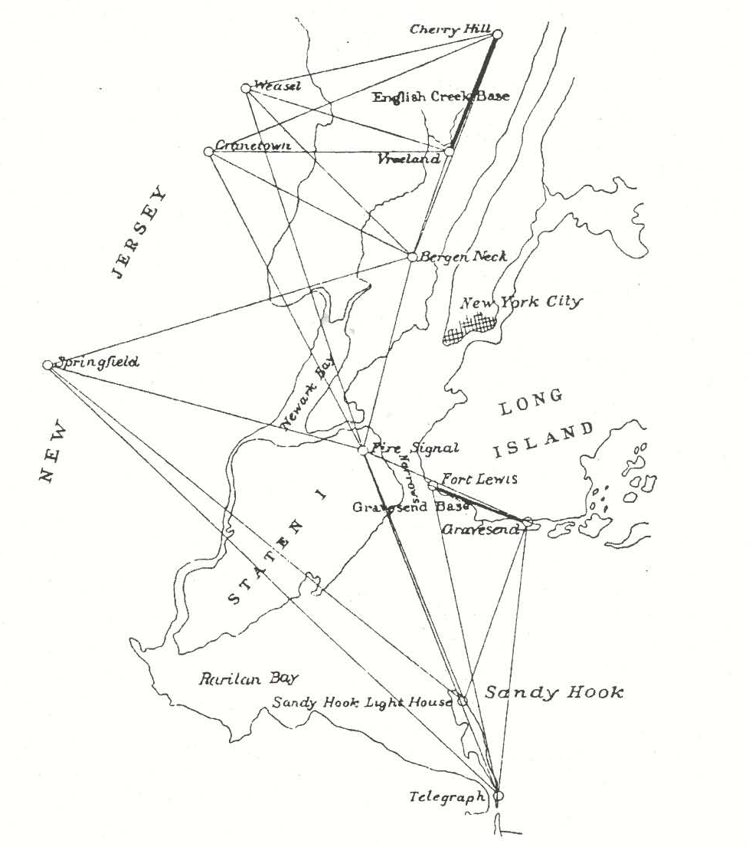
A Little NGS History
The National Geodetic Survey was established by President Thomas Jefferson in 1807 as the Survey of the Coast. Its mission was, and still is in part, to survey the U.S. coastline and create nautical charts of the coast to help increase maritime safety. http://www.geodesy.noaa.gov/web/about_ngs/history/
A sketch of New York Harbor showing the first field work of the Survey of the Coast (1816-1817).
2011-11-03
4

Slide 5
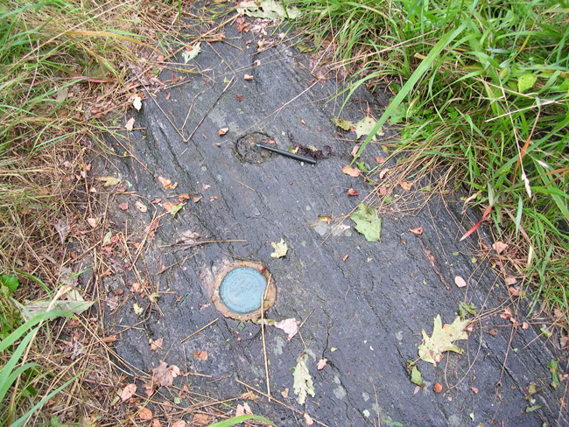
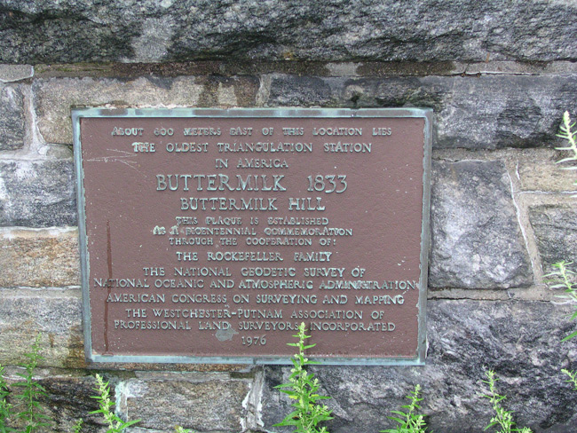
A Little NGS History
As the nation grew westward, the Survey of the Coast became
a principal participant in surveys of the U.S. interior. In response to this expanded role, the agency was given a new name in 1878, the U.S. Coast and Geodetic Survey (USC&GS).
Station BUTTERMILK, located at the tip of the pen in the photo on the left, was originally set in 1833 by Ferdinand Hassler. It is the oldest surviving triangulation survey mark in the United States.
2011-11-03
5

Slide 6

A Little NGS History
In 1970, when NOAA was formed, the USC&GS was reorganized into the National Ocean Survey (NOS) and became a NOAA
line office.
The geodetic portion
of the USC&GS was,
in turn, reorganized
into the National
Geodetic Survey
under the NOS.
2011-11-03
6

Slide 7
The NGS Mission
Define, maintain and provide access to the National Spatial Reference System to meet our nation's economic, social, and environmental needs.
2011-11-03
7

Slide 8
What does that mean?
NGS produces definitions, models and tools for:
Geodetic positional coordinates in the official U.S. datums:
      North American Datum of 1983 (NAD 83),
      North American Vertical Datum of 1988 (NAVD 88).
Geopotential.
Acceleration of gravity.
Deflection of the vertical.
Official national shoreline.
Global Navigation Satellite System (GNSS) orbits.
Orientation, scale, and offset information relating the NAD 83 to international terrestrial reference systems.
How these values change over time.
2011-11-03
8

Slide 9
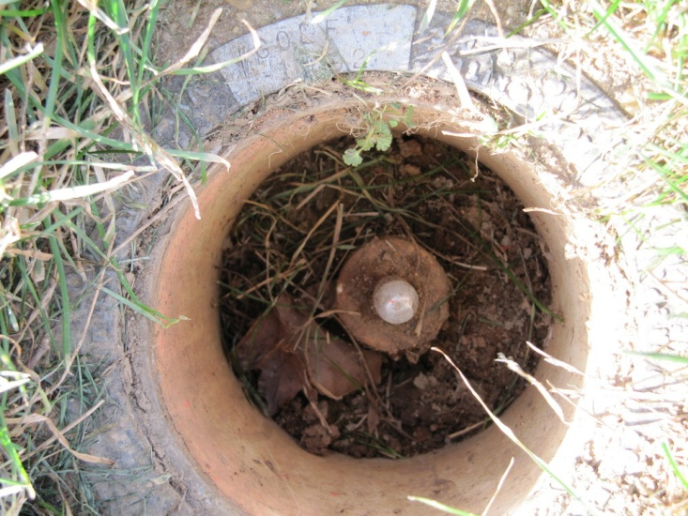
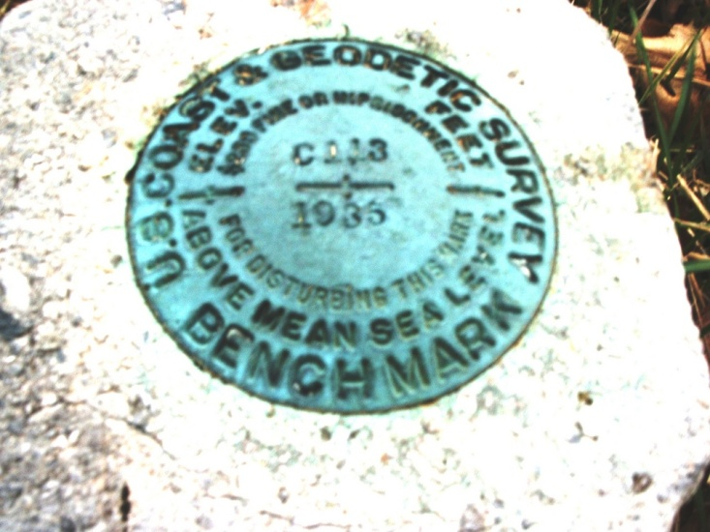
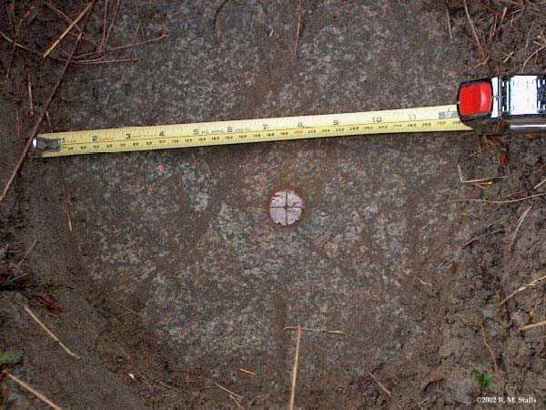
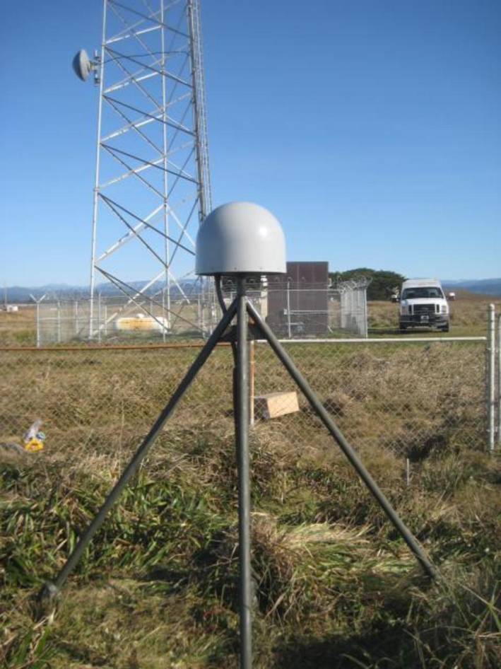
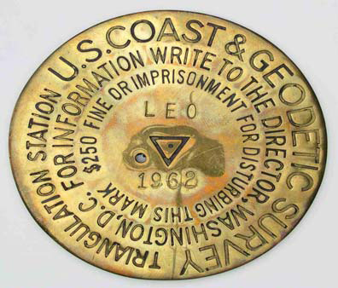
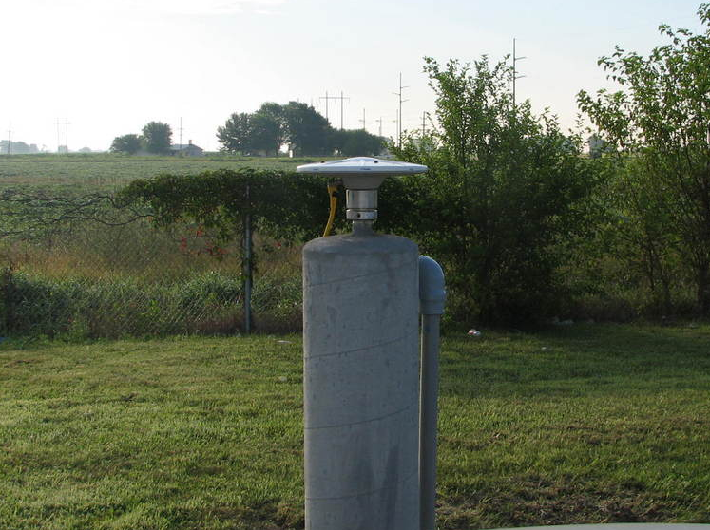
Seriously, dude, what does that mean?
NGS figures out where national and global reference points are …
2011-11-03
9

Slide 10

Seriously, dude, what does that mean?
NGS figures out where national and global reference points are …
Rod Driven to Refusal
in Sleeve
Leveling
Benchmark
Rod Driven to Refusal
GNSS on
Permanent
Tripod Pier
Triangulation
Benchmark
GNSS on
Permanent
Concrete Pier
2011-11-03
10

Slide 11
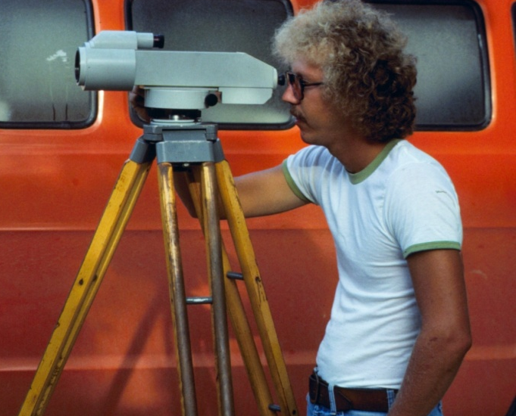
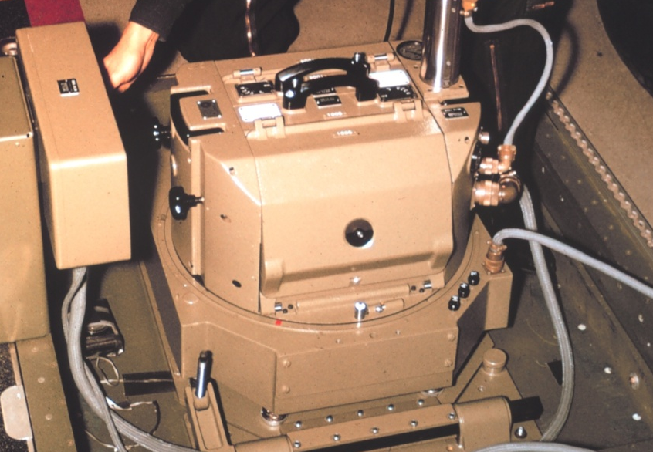
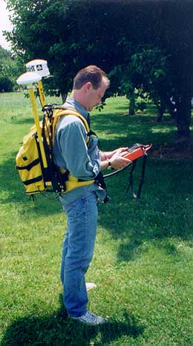
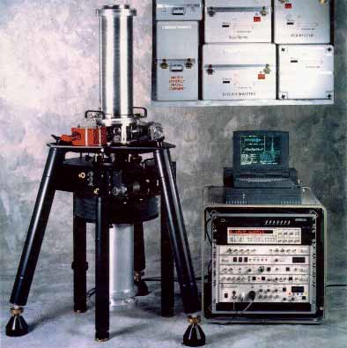
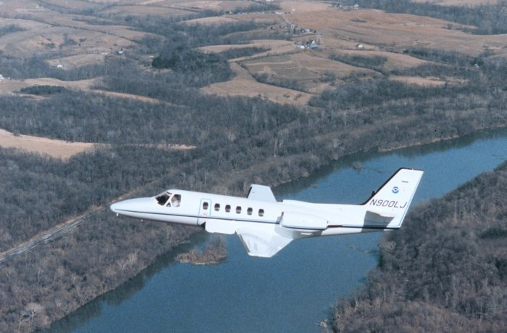
… then using stuff like this…
2011-11-03
11

Slide 12
… then using stuff like this…
Conventional
Leveling
Photogrammetry,
Gravimetry and LIDAR
Static and Kinematic
GNSS Surveying
Absolute
Gravimetry
Space-, Air- and Seaborne
Instrument Platforms
2011-11-03
12

Slide 13
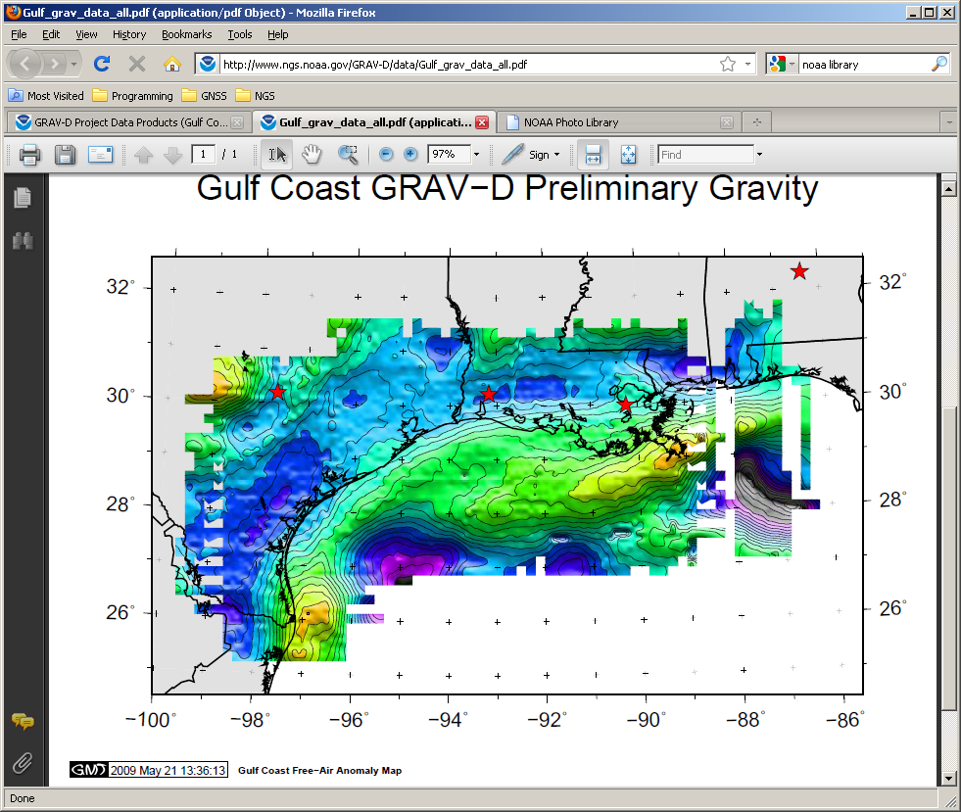
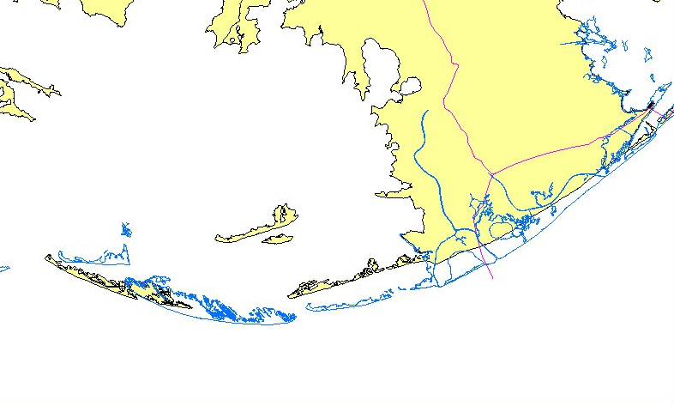
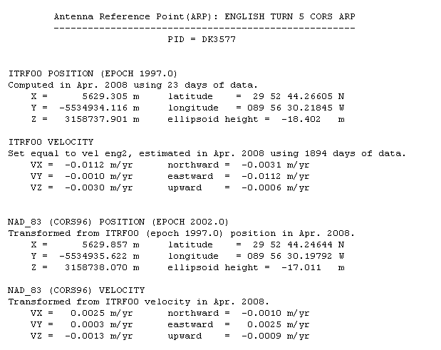
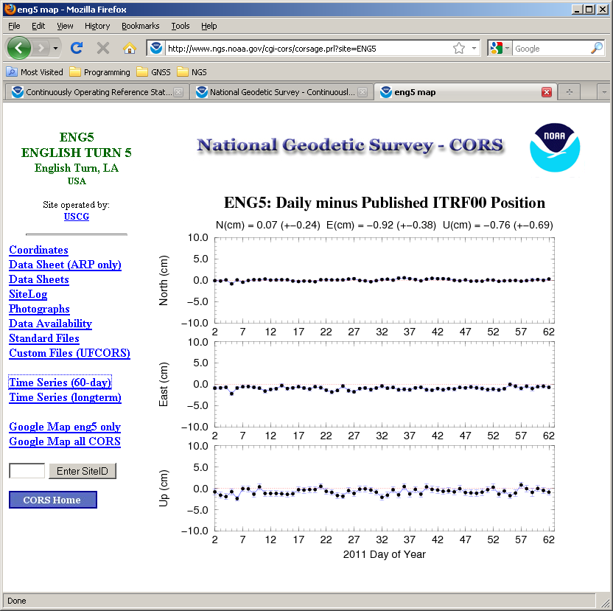
… it refines and extends those data …
2011-11-03
13

Slide 14
… it refines and extends those data …
Geoid and Other
Gravimetric Data
Shoreline Data
Coordinates and
Velocities of
Benchmarks
Change Over Time
2011-11-03
14

Slide 15
… ultimately improving upon the coordinates of the reference points.
2011-11-03
15

Slide 16
So is that geodesy?
Essentially yes! Geodesy is the science of measuring and monitoring the size and shape of the Earth.
Fundamentally, these tasks consist of measuring the relative positions of many points on the surface of the Earth as accurately as possible.
From these measurements, one can create a framework that defines the shape of some or all of the Earth. That framework can also provide the basis for a coordinate system.
Together, these points and frame comprise a datum enabling that others to measure intervening points.
2011-11-03
16

Slide 17
That seems simple enough…
… but remember when I said geodesists measure the size and shape of the Earth? It turns out that there are many ways to think of the shape of the Earth. Each is valid with a non-trivial use. Here, we’ll consider three:
Topography.
(the physical surface – the top of the land and the sea)
The geoid.
(an equipotential surface where the pull of gravity is a constant – water wouldn’t flow along this surface)
The ellipsoid.
(a simplified surface broadly mimicking the shape of the Earth, and centered on its center-of-mass)
2011-11-03
17

Slide 18
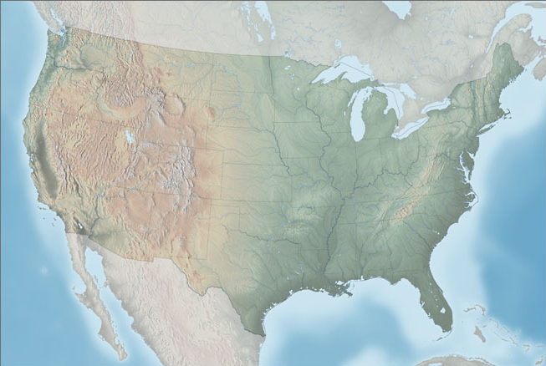
Topography
http://www.shadedrelief.com/physical/
As the Edgar Winter Group taught us, “the mountain is high, the valley is low.” Topography influences where we travel and build.
2011-11-03
18

Slide 19
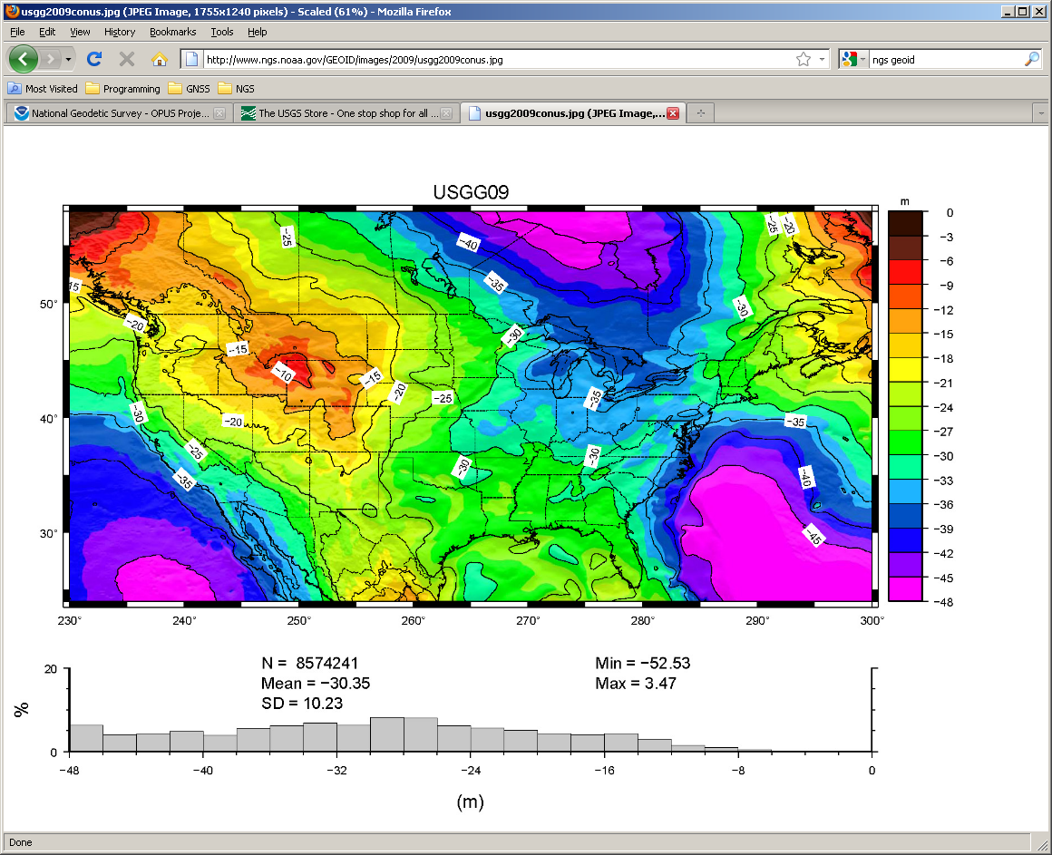
The Geoid
http://www.geodesy.noaa.gov/GEOID/USGG2009/
The geoid is a surface of constant gravitational potential energy. Things like to move from higher to lower gravitational potential, so a common practical use for the geoid is as a reference surface to measure how water will flow.
2011-11-03
19

Slide 20

The Ellipsoid
b
a
The ellipsoid is a convenience: a simple shape to represent the Earth. Being a
simple shape, it enables the use of simple formulas to describe the locations of points relative to this surface. Ellipsoids have been used in geodesy for many years but have greater importance, if that’s possible, in this age of satellite navigation.
2011-11-03
20

Slide 21
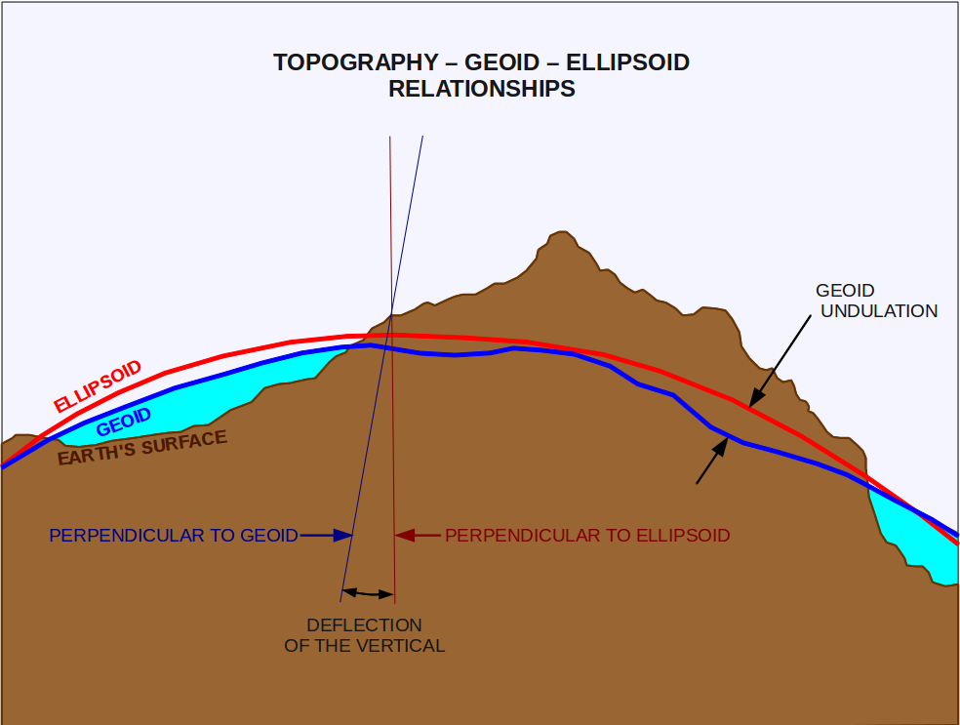
How are these surfaces related?
2011-11-03
21

Slide 22
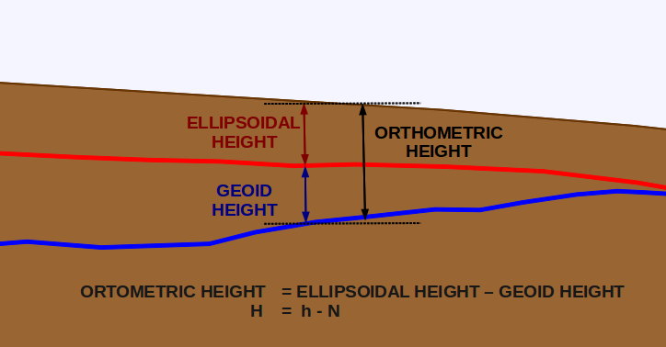
Orthometric, ellipsoidal and geoid heights.
SURFACE
ELLIPSOID
GEOID
Globally, geoid heights can range from about +75 to -100 meters. In the conterminous United States, geoid heights vary from -8 to -53 meters.
2011-11-03
22

Slide 23
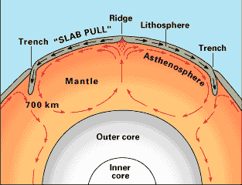
Why doesn’t the geoid follow topography?
On large- and mid-scales, there’s topography below as well as above the crust.
On mid- and small-scales, variations in bedrock and soil densities, aquifers mineral deposits, etc. create complex local variations.
http://pubs.usgs.gov/gip/dynamic/dynamic.html
2011-11-03
23

Slide 24
Well, still, that’s pretty simple…
… but remember when I said geodesists monitor the size and shape of the Earth? It turns out that everything is changing:
Earth orientation.
(the Earth’s rotational axis, rate of rotation and its center-of-mass change chaotically)
Plate tectonics.
(large blocks of the surface move relative to each other)
Isostatic post-glacial rebound.
(large areas are relaxing to their non-loaded positions after the last ice age)
Loading, subsidence and uplift.
(various processes cause areas to move down or up)
2011-11-03
24

Slide 25
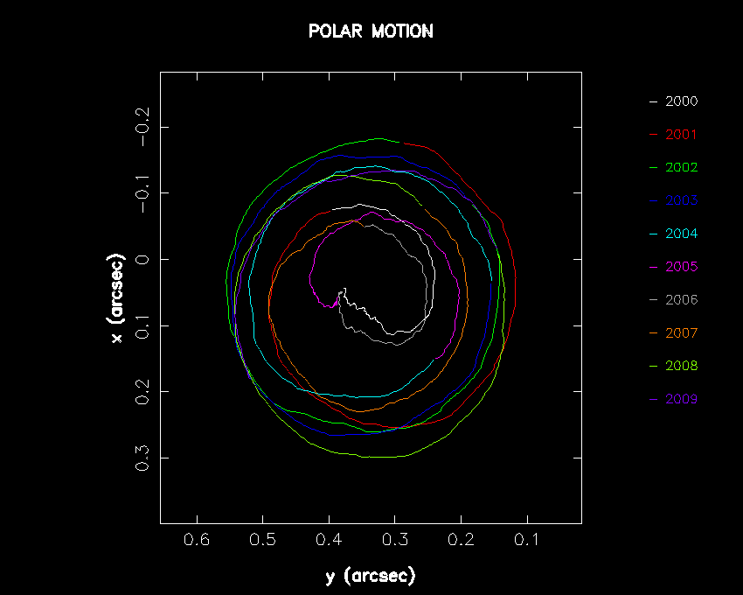
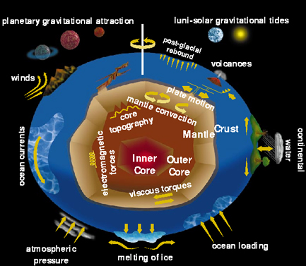
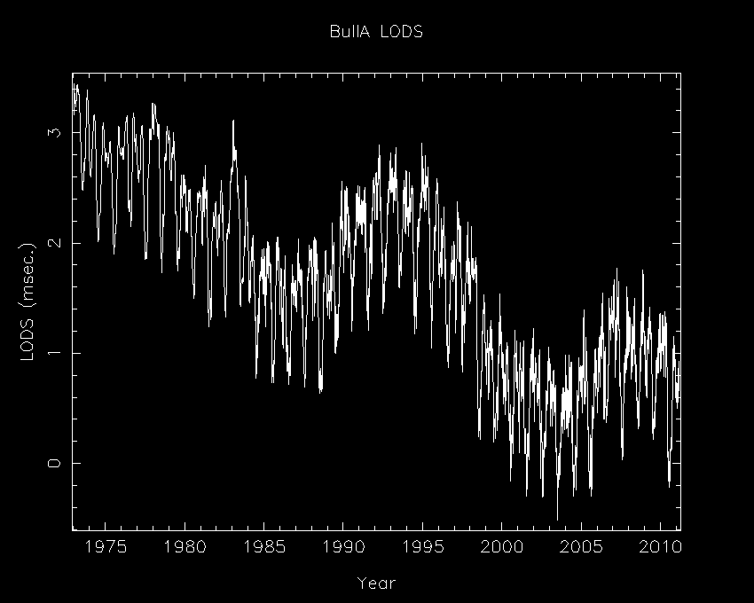
Earth Orientation
http://www.haystack.mit.edu/geo/science/earth/index.html ↑
http://maia.usno.navy.mil/whatiseop.html →
2011-11-03
25

Slide 26
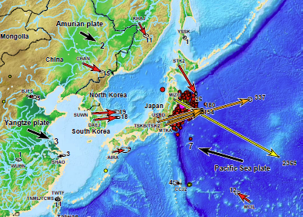
How can something like an earthquake change the Earth’s rotation?
Consider the recent 8.9 M earthquake near Japan.
Northeast Japan shifted eastward approximately
2.4 m and sank by 0.6 m. This shifted the Earth's spin axis by 17 cm and shortened the length-of-day by
1.6 μsec.
http://igscb.jpl.nasa.gov/pipermail/igsmail/2011/006359.html
http://www.nasa.gov/topics/earth/features/japanquake/earth20110314.html
26
2011-11-03

Slide 27
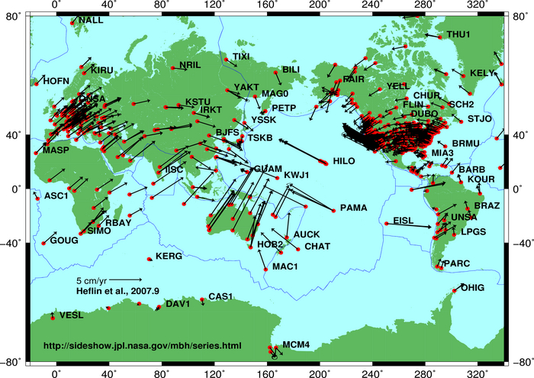
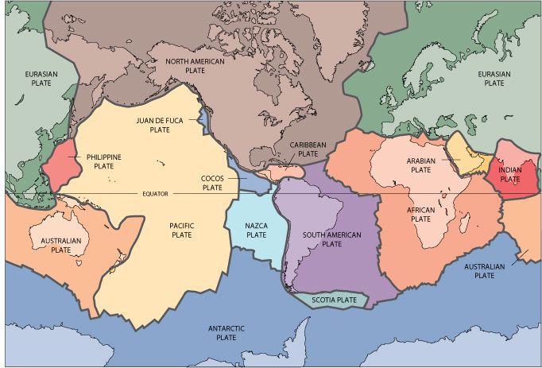
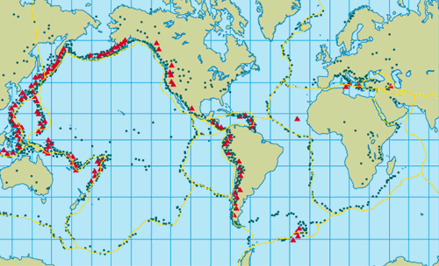
Plate Tectonics
.
Central America
orld
http://pubs.usgs.gov, http://sideshow.jpl.nasa.gov/mbh/all/images/global.jpg
& http://www.pbs.org
2011-11-03
27

Slide 28
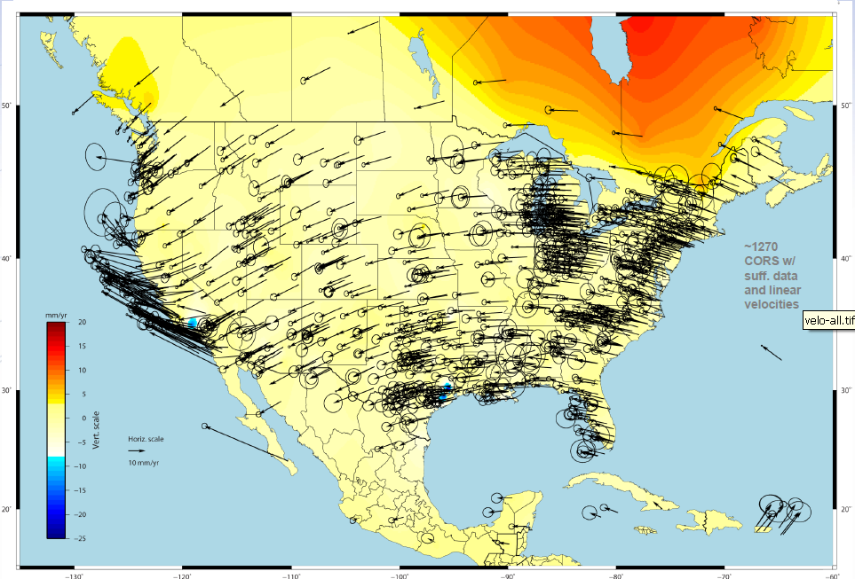
Isostatic Post-glacial Rebound
.
Central America
orld
http://geodesy.noaa.gov/web/science_edu/presentations_archive/files/mycs_webinar_08mar2011.pdf
2011-11-03
28

Slide 29
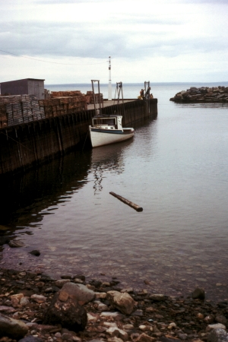
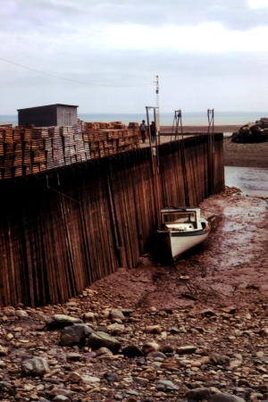
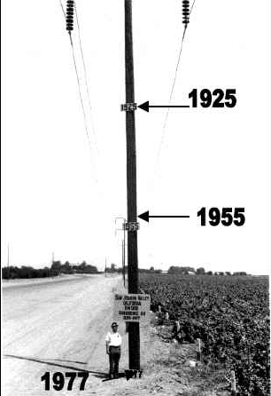
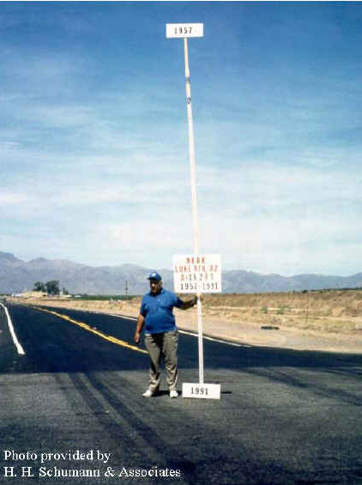
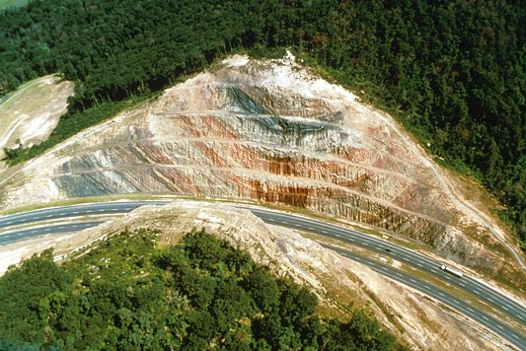
Loading, Subsidence and Uplift
.
Central America
orld
Bay of Fundy picture by S. Wantman http://en.wikipedia.org/wiki/Tide
Subsidence California Central Valley
Subsidence near Luke AFB, AZ
Sidling Hill, MD Photo by Paul Breeding, 1988
http://www.mgs.md.gov/esic/features/sidel.html
2011-11-03
29

Slide 30
Loading, Subsidence and Uplift
.
Central America
orld
Bay of Fundy picture by S. Wantman http://en.wikipedia.org/wiki/Tide
Subsidence California Central Valley
Subsidence near Luke AFB, AZ
Sidling Hill, MD Photo by Paul Breeding, 1988
http://www.mgs.md.gov/esic/features/sidel.html
2011-11-03
30

Slide 31
Loading, Subsidence and Uplift
.
Central America
orld
Bay of Fundy picture by S. Wantman http://en.wikipedia.org/wiki/Tide
Subsidence California Central Valley
Subsidence near Luke AFB, AZ
Sidling Hill, MD Photo by Paul Breeding,
http://www.mgs.md.gov/esic/features/sidel.html
2011-11-03
31

Slide 32
OK! OK! Geodesy is hard!
But what exactly does NGS do?
Let’s briefly discuss some of the current NGS programs.
Aeronautical Survey Program
National Shoreline
Emergency Response Imagery
National Spatial Reference System
Gravity for the Redefinition of the American Vertical Datum (GRAV-D) and the geoid
Continuously Operating Reference Site (CORS) Network
Online Positioning User Service (OPUS)
Height Modernization
Guidelines For Real Time GNSS Networks
Standards, Training and Tools
2011-11-03
32

Slide 33
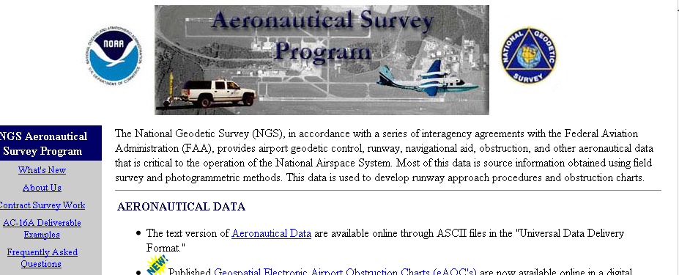
Aeronautical Survey Program
The NGS has been participating in airport surveys since the 1920’s. These surveys provide airport geodetic control, runway obstruction, and other aeronautical data that is critical to the Federal Aviation Administration for runway approach procedures and obstruction charts.
http://geodesy.noaa.gov/AERO/aero.html
2011-11-03
33

Slide 34
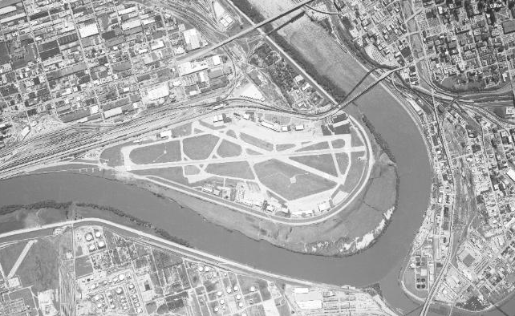
Aeronautical Survey Program
In addition, NGS staff participate in developing survey standards, guidelines, models, and tools to assist surveyors conducting these surveys.
AI4898 PACS - This is a Primary Airport Control Station.
AI4898 DESIGNATION - MKC F AI4898 PID - AI4898
AI4898 STATE/COUNTY- MO/CLAY
AI4898 USGS QUAD - NORTH KANSAS CITY (1997)
AI4898 AI4898 *CURRENT SURVEY CONTROL
AI4898 ___________________________________________________________________
AI4898* NAD 83(2007)- 39 08 02.56354(N) 094 35 19.83960(W) ADJUSTED
AI4898* NAVD 88 - 230.27 (meters) 755.5 (feet) GPS OBS
AI4898 EPOCH DATE - 2002.00
AI4898 X - -396,352.181 (meters) COMP
AI4898 Y - -4,938,221.615 (meters) COMP
AI4898 Z - 4,003,995.803 (meters) COMP
AI4898 LAPLACE CORR- -0.70 (seconds) DEFLEC09
AI4898 ELLIP HEIGHT- 197.758 (meters) (02/10/07) ADJUSTED
AI4898 GEOID HEIGHT- -32.52 (meters) GEOID09
AI4898 ___________________________________________________________________
2011-11-03
34

Slide 35
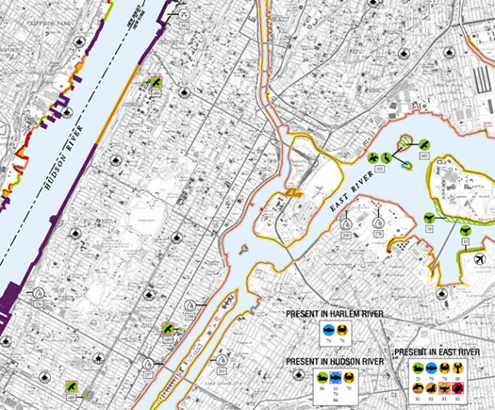
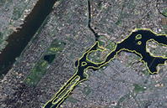
National Shoreline
As part of NOAA’s National Shoreline activities, the NGS provides stereo photogrammetry controlled by kinematic GNSS for:
Charts for navigation and harbor docking.
Storm surge, coastal flooding, and pollution trajectory modeling.
Land and marine geographic information systems.
Environmental analysis and monitoring.
http://shoreline.noaa.gov/
2011-11-03
35

Slide 36
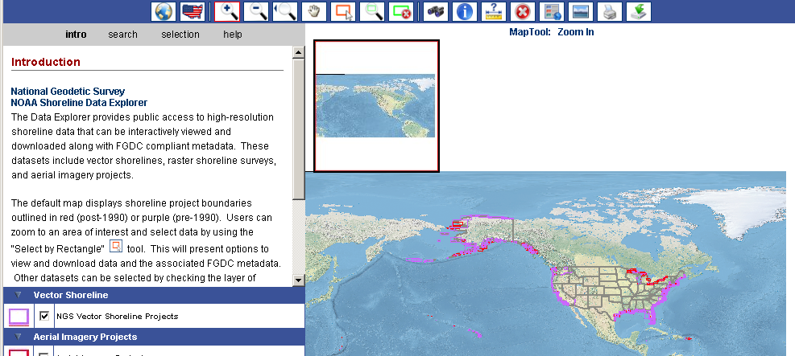
National Shoreline
Convenient on-line access to these high-resolution digital shoreline data from multi-temporal surveys of our nation's coastline is provide through the Shoreline Data Explorer provides. Shown here is the new beta version. http://beta.ngs.noaa.gov/shoreline_raster/
2011-11-03
36

Slide 37
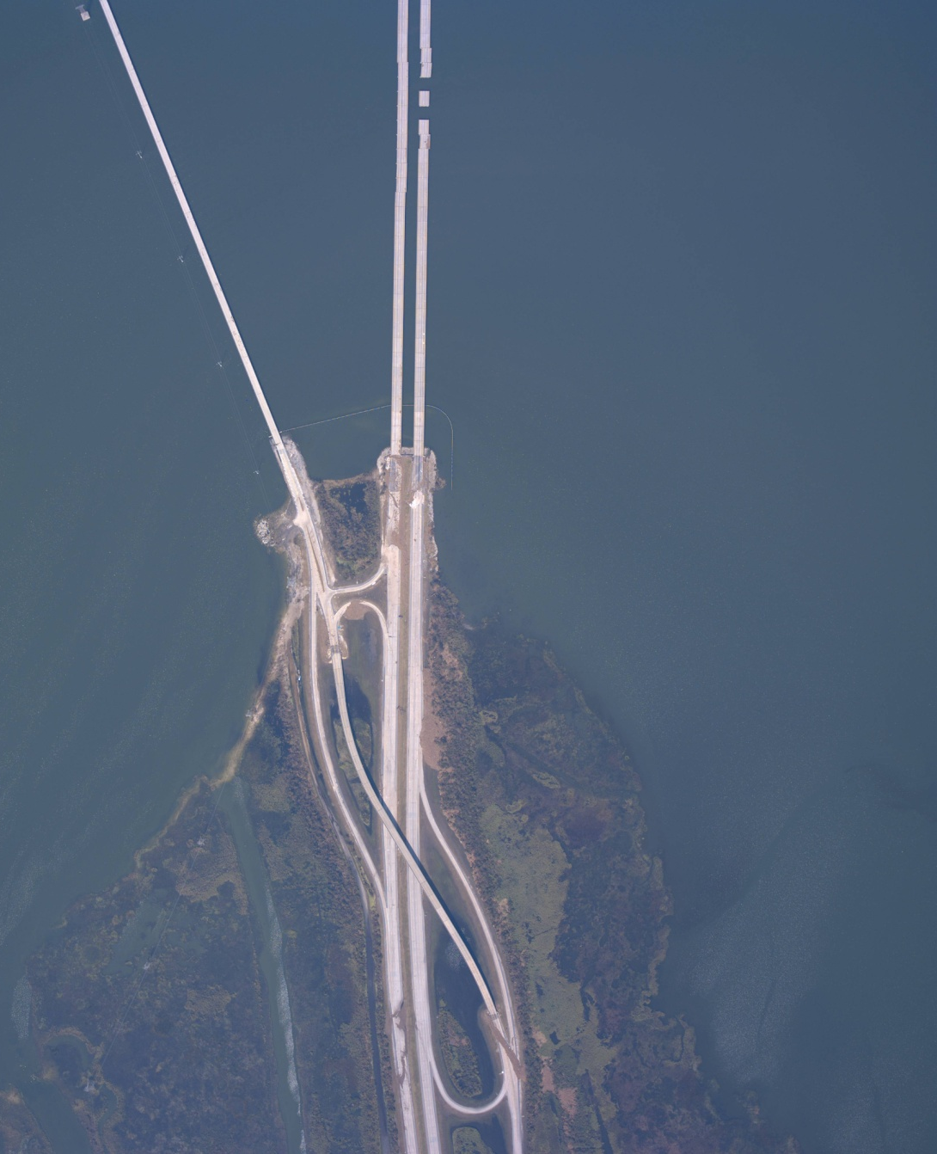

Emergency Response Imagery
Needless to say, if a catastrophe occurs, these data have to be updated. Often, the imagery is taken so soon after a catastrophe that it has also been used to:
Assist emergency responder planning.
Facilitate damage assessment.
Allow those displaced to see their homes and neighborhoods.
http://ngs.woc.noaa.gov/eri_page/
2011-11-03
37

Slide 38
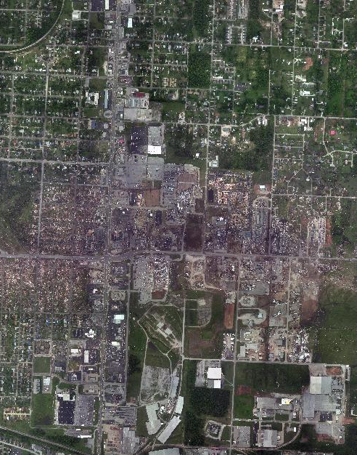
Emergency Response Imagery – Joplin, MO
In the last few years, imagery specifically for emergency response has been collected. An example is the Joplin, MO tornado of 2011.
FEMA requested and funded.
1494 images were collected on May 24th and May 26th.
2011-11-03
38

Slide 39
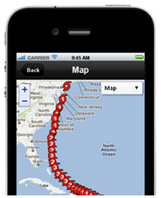
Mobile Web Application For Imagery
To help support this activity, NGS released a prototype mobile Web application for emergency responders to view imagery in the field.
The prototype can be used to access post-storm imagery for hurricane Irene and for the Joplin, MO tornado.
http://ngs.woc.noaa.gov/storms/irene/mobile/
2011-11-03
39

Slide 40
National Spatial Reference System (NSRS)
I’m using this as a “catch-all” even though this is the primary product of the NGS.
As mentioned in the introduction, NGS is responsible for the NAD 83 and NAVD 88. These are the current practical expression of the NSRS. These datums are composed of information for many marks across the all of North America.
The NGS also participates in the definition of the International Terrestrial Reference System with its reference frame, EOP, GNSS orbits, antenna models and other products.
http://www.iers.org and http://igscb.jpl.nasa.gov/
2011-11-03
40

Slide 41
What is the NSRS?
In a perfect world, the information for each mark should contain 3-D coordinates at a specific epoch, a velocity, an orthometric height, a deflection from the vertical, and so forth. In other words, everything someone would need understand a mark’s location in relation to the topographic, geoid and ellipsoid surfaces.
Over the years, countless surveyors have contributed their optical, leveling, gravimetric, GNSS, and many other kinds of surveying results to the NGS. These are accumulated in an integrated database. Information about the marks can be acquired on-line in the forms of datasheets.
2011-11-03
41

Slide 42
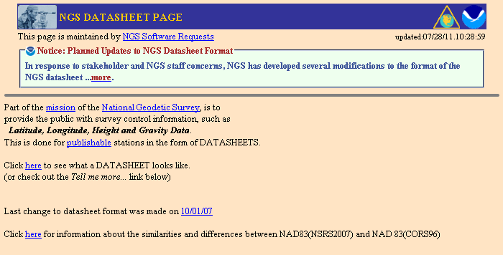
What is the NSRS?
Although their importance can’t be overstated, there is a lot more to the NSRS than datasheets as we’re about to find out. But this does give me a chance to point out the pending changes to the datasheet format.
2011-11-03
http://www.geodesy.noaa.gov/cgi-bin/datasheet.prl
42

Slide 43
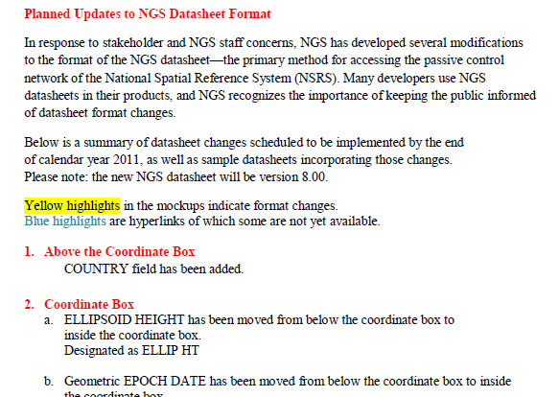
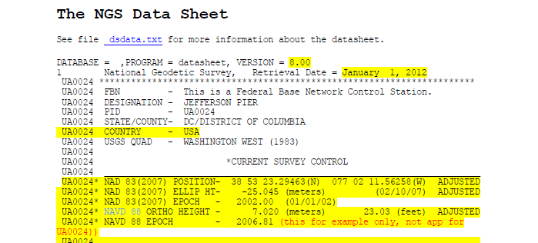
Planned Updates To The Datasheet Format
http://www.ngs.noaa.gov/web/surveys/datasheet/announcement.pdf
http://www.ngs.noaa.gov/web/surveys/datasheet/UA0024_bm.pdf
2011-11-03
43
Notes:
The announcement for the format change is on-line as well as several examples in the new format.

Slide 44
NSRS Evolution
The steady accumulation of measurements means that old marks are recovered extending the total time span over which they’ve been occupied and new marks are added.
Improving technologies means that higher quality measurements are being gathered at an increasing pace. Of particular note is the improvement in vertical measurements using GNSS.
These demand that the NGS periodically evaluate, filter and adjust these measurements into improved datums. In fact, one such cycle of improvement is underway now. Let’s look at some of the ways the NSRS is made available and some changes that are here or soon will be.
2011-11-03
44

Slide 45
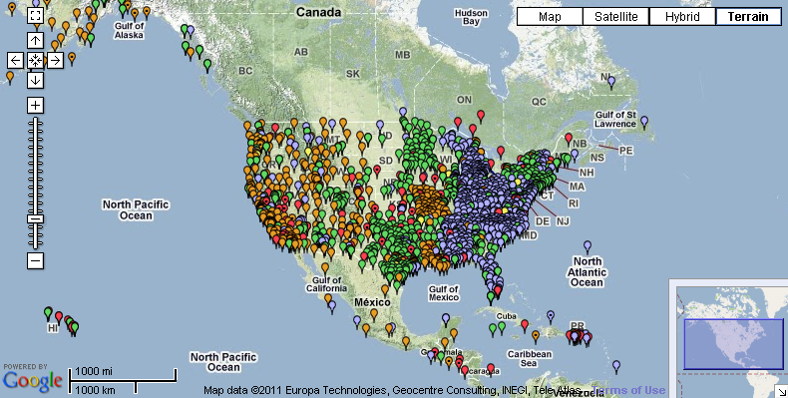
Continuously Operating Reference Site (CORS) Network
The NGS manages a network providing GNSS data in support of positioning, meteorology, space weather, and geophysical applications throughout the United States, its territories, and a few foreign countries.
2011-11-03
45

Slide 46
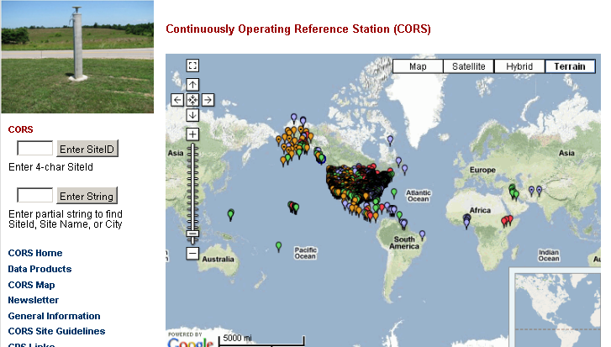
CORS Data And Information
Many, many partners freely share their GNSS data.
These data are available with a short latency.
The NGS acts as a data center offering a newsletter, data, coordinates, site equipment histories, photos and time series.
http://www.ngs.noaa.gov/CORS/
46
2011-11-03

Slide 47
CORS Network
Increasing with no end in sight.
2011-11-03
47
Notes:
Note the velocity curve. It takes measurements spanning about two and one-half years to determine the velocity of a mark. The CORS are continuously monitored and more than 1400 now have high accuracy velocities.

Slide 48
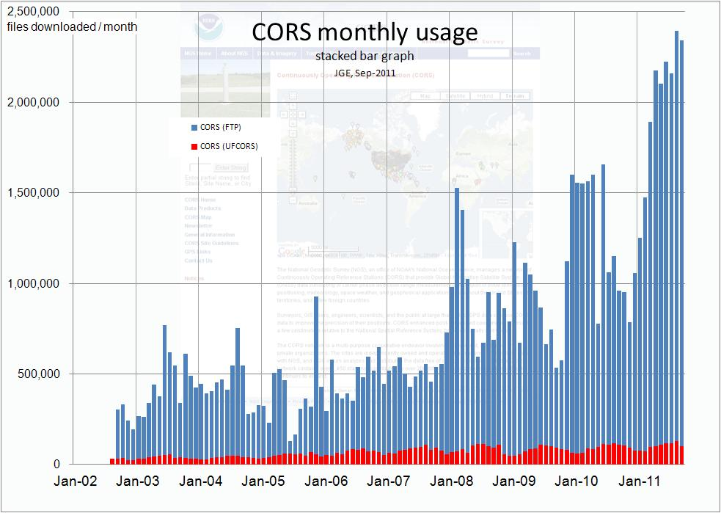
CORS Use
Increasing with no end in sight.
2011-11-03
48

Slide 49
CORS Coordinates
The CORS are monitored daily to help insure the correctness and continuity of their coordinates and other information.
As new CORS come on-line, their positions are computed relative to the entire network using a brief span of data, then the data, coordinates with a model velocity, hardware descriptions and other information are made available.
This method of including new CORS is more than adequate but not optimal.
2011-11-03
49
Notes:
Note that the model vertical velocity model is always zero.

Slide 50
CORS Coordinates
Periodically, the CORS information is reexamined, their data reprocessed and a network adjustment performed. The most recent example of this is the Multi-Year CORS Solution.
In April, 2011, the CORS team “completed” a full reanalysis of all data from the CORS and from a subset of available global sites producing a self-consistent set of coordinates, GPS satellite orbits and Earth Orientation Parameters (EOP).
Being an acronym loving organization, this is called the MYCS1.
http://geodesy.noaa.gov/CORS/coord_info/myear_FAQ.shtml
2011-11-03
50

Slide 51
CORS Coordinates
While the MYCS1 was being completed, a similar readjustment of the global network was underway orchestrated by the International GNSS Service (IGS). The result of this global readjustment is the IGS08 reference system.
http://igscb.jpl.nasa.gov. I would suggest starting with IGSMAIL‐6354, ‐6355 and ‐6356, all dated 2011‐03‐07.
The MYCS1 was included in and aligned to the IGS08 reference frame. This resulted in improved coordinates and velocities (where possible) for the CORS in the IGS08 frame.
2011-11-03
51

Slide 52
NAD 83 (2011)
From the improved IGS08 coordinates and velocities, improved CORS coordinates and velocities for the NAD 83 datum were defined. To distinguish this from earlier realizations, it is called the NAD 83 (2011).
The NAD 83 (2011) is not a new datum: the origin, scale and orientation are the same as in the previous realization.
In September 2011, the NGS formally released IGS08 and NAD 83 (2011) coordinates and velocities for the CORS.
http://geodesy.noaa.gov/CORS/coords.shtml
2011-11-03
52

Slide 53
NAD 83 (2011)
NAD 83 (2011) coordinates are available for sites located in the CONterminous United States (CONUS), Alaska and U.S. territories in the Caribbean.
Along with the NAD 83 (2011), the NAD 83 (MA11) frame is realized with respect to the fixed Marianas plate for sites in the Marianas Island chain, and the NAD 83 (PA11) with respect to the fixed Pacific plate for coordinates in Hawaii, American Samoa, the Marshall Islands and other U.S. territories residing on the Pacific plate.
2011-11-03
53

Slide 54

Horizontal Differences In CORS Positions
Horizontal difference in positions of NAD 83(2011) epoch 2002.00 minus NAD 83(CORS96) epoch 2002.00.
2011-11-03
54
Notes:
Approximately 2 cm error expected @ 2005.0 based on the uncertainties in the old solution.
Average horizontal shifts: ΔE =-0.18 (±1.86) cm ΔN = 0.14 (±1.07) cm.

Slide 55
Vertical Differences In CORS Positions
Vertical difference in positions of NAD 83(2011) epoch 2002.00 minus NAD 83(CORS96) epoch 2002.00.
2011-11-03
55
Notes:
Average vertical shift: ΔU = 0.71 cm (±2.11) cm.

Slide 56
NAD 83 (2011) And OPUS
The Online Positioning User Service (OPUS) also began offering results in the IGS08 and NAD 83(2011) reference frames in September, 2011.
http://geodesy.noaa.gov/OPUS/
Although the NAD 83 (2011) is not a new datum, the CORS coordinates used by OPUS in generating its results are different. NGS recognizes that this change poses a challenge. To help users confidently switch to the new reference frame realizations, OPUS now offers the choice to have its results reported in the IGS08 and NAD 83(2011) or in the previous ITRF2000 and NAD 83 (CORS96).
But users are strongly encouraged to switch to the improved datum as soon as possible. This transition period will end after a few months.
2011-11-03
56

Slide 57
NAD 83 (2011) And Passive Control Marks
In addition, 80,000+ passive control marks are being readjusted to provide the best possible consistency with the improved CORS coordinates and velocities. Known as the National Adjustment of 2011 (NA2011), these results will be released by the end of 2011.
This adjustment use same vectors as NA 2007.
However, they’ll be tied to CORS coordinates derived from the MYCS1.
NA 2011 results will provide more consistency between CORS/OPUS solutions and passive control.
http://geodesy.noaa.gov/web/news/NA2011_Project.shtml
http://geodesy.noaa.gov/web/surveys/NA2011/NA2011_FAQ.shtml
2011-11-03
57

Slide 58
NA 2011
A new hybrid geoid model (likely named GEOID12) is being produced too and will be released shortly after or in conjunction with the NA2011 results. More on this in a bit.
2011-11-03
58

Slide 59



Online Positioning User Service (OPUS)
OPUS provides simplified access to high-accuracy NSRS coordinates via a Web service. The service requires minimal user input and results are emailed to the user within a few minutes. Every month, thousands of users automatically compute accurate NSRS positions from their GPS data, the CORS network and standard NGS models using OPUS.
2011-11-03
59

Slide 60

If you haven’t visited OPUS recently, here’s the “front page” with the choice of the older or improved reference frames.
http://www.ngs.noaa.gov/OPUS/
60
2011-11-03

Slide 61

OPUS Use
Increasing with no end in sight.
2011-11-03
61

Slide 62

OPUS Use
Increasing with no end in sight.
2011-11-03
62

Slide 63
OPUS-Projects
OPUS-Projects gives users Web-based access to simple visualization, management and processing tools for multiple sites and multiple occupations. These tools include:
The advantages of data uploading through OPUS.
Data visualization and management aids.
Enhanced data processing using the PAGES suite.
Solution visualization aids.
Although still in BETA development, OPUS-Projects is available now. Check our Corbin Training Center Web site for information about workshops.
http://www.geodesy.noaa.gov/corbin/
2011-11-03
63

Slide 64

What exactly does OPUS-Projects do?
Once a project is created, field crews can upload their data to the project using OPUS. The field crews will still receive their OPUS reports, but so will the project manager helping him or her to better oversee the project while the data are taken.
2011-11-03
64

Slide 65

Tell me more.
Furthermore, the project manager can immediately begin working with the data: review reports, edit mark descriptions, add CORS data and process “sessions”, i.e. collections of project data that overlap in time.
2011-11-03
65

Slide 66

What about publishing?
Once the sessions are processed, a network adjustment can be performed giving a self-consistent solution for all marks and all occupations. If desired, this result can be published to OPUS.
2011-11-03
66

Slide 67
Do we really need another OPUS flavor?
The practical answer is probably yes.
The NGS and other groups have a history of project’s whose specifications can’t be entirely supported by OPUS.
The academic answer is probably yes.
As good as OPUS does, and that is very good, sacrificing simplicity for flexibility can improve results.
2011-11-03
67

Slide 68

How do I get started?
The Training Center maintains a list of OPUS-Projects Manager Training Workshops as well as many other valuable training tools. http://www.ngs.noaa.gov/corbin/calendar.shtml
2011-11-03
68

Slide 69


Gravity for the Redefinition of the American Vertical Datum (GRAV-D)
The NGS has initiated an ambitious program to re-define the vertical datum of the United States by the
year 2021. GRAV-D consists of three major campaigns:
A high-resolution “snapshot” of gravity in the United States.
A low-resolution “movie” of gravity changes.
Regional partnership surveys.
http://www.geodesy.noaa.gov/GRAV-D/
2011-11-03
69

Slide 70



Is GRAV-D necessary?
We have the NAVD 88:
is very good and very essential.
is defined by and accessed through passive marks that are used every day.
has 600,000+ marks.
2011-11-03
70

Slide 71

Is GRAV-D necessary?
But the NAVD 88:
contains marks that are moved or destroyed.
doesn’t represent all motions adequately:
post-glacial rebound, subsidence, tectonics, frost-heave.
  references all heights to one height: Point au Pere (Father Point) in
  Rimouski,
  Canada. This
  means that the
  H=0 level is
  close to but not
  the geoid’s.
has a bias across
the CONUS.
Difference: NAVD 88 – datum derived from GRACE
2011-11-03
Min = 0.17 m Max = 1.88 m Ave = 0.98 m Std. Dev. = 0.37 m
71
Notes:
1-2 m bias in Alaska.

Slide 72

Is GRAV-D necessary?
But the NAVD 88:
  references all heights to one height: Point au Pere (Father Point) in Rimouski, Canada.
  This means that the NAVD 88’s H=0 level is close to but not the geoid’s H=0 level.
2011-11-03
72
Notes:
It turns out that MSL is a close approximation to another surface, defined by gravity, called the geoid, which is the true zero surface for measuring elevations. Because we cannot directly see the geoid surface, we cannot actually measure the heights above or below the geoid surface. We must infer where this surface is by making gravity measurements and by modeling it mathematically. For practical purposes, we assume that at the coastline the geoid and the MSL surfaces are essentially the same. Nevertheless, as we move inland we measure heights relative to the zero height at the coast, which in effect means relative to MSL.
Definition: NGVD29 – The National Geodetic Vertical Datum of 1929…
The Sea Level Datum of 1929 was the vertical control datum established for vertical control surveying in the United States of America by the General Adjustment of 1929. The datum was used to measure elevation or altitude above, and depression or depth below, mean sea level (MSL).
Mean sea level was measured at 26 tide gauges: 21 in the United States and 5 in Canada. The datum was defined by the observed heights of mean sea level at the 26 tide gauges and by the set of elevations of all bench marks resulting from the adjustment. The adjustment required a total of 66,315 miles (106,724 km) of leveling with 246 closed circuits and 25 circuits at sea level.
Since the Sea Level Datum of 1929 was a hybrid model, it was not a pure model of mean sea level, the geoid, or any other equipotential surface. Therefore, it was renamed the National Geodetic Vertical Datum of 1929 (NGVD 29) in 1973. The NGVD 29 was subsequently replaced by the North American Vertical Datum of 1988 (NAVD 88) based upon the General Adjustment of the North American Datum of 1988.

Slide 73
Enter The Age of Space-based Geodesy
The GNSS era has made inexpensive, fast, accurate ellipsoid heights possible (almost) everywhere.
This fuels a desire for inexpensive, fast, accurate orthometric heights.
Leveling is still the best, but …
  It is costly in time and money.
  Errors accumulate over large distances.
  Leveling in limited areas is viable, but leveling the country probably will not be done again.

Slide 74
What does GRAV-D provide?
Bang for the buck! This is a predominantly airborne campaign designed to survey the U.S., including its territories, by 2017 at a cost of about 39 million dollars.
Includes an initial “snapshot” for creating a baseline data set followed by long term monitoring of temporal changes.
Supports NGS policy of re-define the U.S. Vertical Datum by creating a new gravimetric geoid.
2011-11-03
74

Slide 75


What do I get out if it?
Other sources, such as the Gravity Recovery and Climate Experiment (GRACE) and Gravity Field and Steady-State Ocean Circulation Explorer (GOCE), provide the “large-scale” shape of the global gravity field.
GRAV-D provides the “mid-scale” shape across the continental U.S. and its territories.
Existing and new partnership surveys provide the “fine-scale” detail where needed and practical.
When combined, these will yield unprecedented information about the gravity field.
2011-11-03
75

Slide 76
GRAV-D Processing Update
Alabama (‘08) and 2008 Alaska survey already delivered to Geoid team (Newton v1.1).
Next major version of aerogravity processing software is complete (Newton 1.2).
Newton 1.2 data for Alabama and Louisiana will be delivered to geoid team by month’s end; other surveys will quickly follow.
LA/AL airborne gravity data was released September 5 via a Web page designed to share this type of data.
http://www.ngs.noaa.gov/web/news/Gravity_Data_Released.shtml
Still partnering for flights; seeking a dedicated plane.
2011-11-03
76

Slide 77
GRAV-D Survey Plans
FY 2011 (14.72% of the country completed):
  Alaska
  California/Oregon coastline
  Eastern Great Lakes Region
FY 2012:
  Great Lakes region
  Washington State
  California
FY 2013:
  Finish Great Lakes
  TBD
2011-11-03
77
Notes:
GRAV-D will provide a means of normalizing all the biases and other problems and bridge the gap between the satellite data and the surface data.

Slide 78



Alaska FY11
West Coast FY11-12
(FY11 Already
Flown)
FY11-13 Great Lakes Plan
FY10 = Green
FY11 = Blue
FY12 = Orange
FY13 = White
2011-11-03
78

Slide 79

Geoid Slope Validation Survey of 2011
The NGS will engage in a variety of testing methods prior to the 2022 date when the gravimetric geoid will serve as the reference surface for a new vertical datum. The first such test is the Geoid Slope Validation Survey of 2011, or GSVS11.
The final line chosen was a 300 km stretch of mostly U.S. highways running north/south between Austin, Texas and Corpus Christi, Texas. A 2 1/2 month survey campaign ran from mid-July until late September, 2011.
http://www.ngs.noaa.gov/GEOID/GSVS11/index.shtml
2011-11-03
79

Slide 80
Geoid Slope Validation Survey of 2011
A variety of factors had to be considered when designing the final survey line:
It had to be under existing GRAV-D surveys, in order to test the impact of the aerial gravity on the gravimetric geoid model.
It had be at least 200 km long in order to compare directly to satellite-only (GRACE and/or GOCE) geoid models.
It had to be topographically "low" (near the geoid), safe, relatively straight, in an area of few trees (for GPS work) and during a time of year of clear skies (for camera work).
2011-11-03
80

Slide 81

Geoid Slope Validation Survey of 2011
As its name implies, this survey will test the accuracy of differential geoid undulations between points ("geoid slopes") from the NGS's gravimetric geoid models. The basis for comparison will be independently computed geoid slopes from two methods:
Differential orthometric heights and differential ellipsoid heights from leveling and GPS campaigns, respectively (both minimally constrained).
Astro-Geodetic deflections of the vertical from observations with the Swiss DIADEM camera.
2011-11-03
81

Slide 82
Gravity → Geoid
Let’s start this section with some background in geoid modeling.
Developing a Gravimetric Geoid
  Reference model covers global aspects in some global reference frame (i.e., USGG2009 is in ITRF00).
  Point gravity data enhance to fill in finer detail.
  Elevation models account for shortest wavelengths.
Developing a Hybrid Geoid
  Start from gravimetric geoid.
  Well distributed & accurate control data (i.e. GNSS benchmarks or GNSSBMs).
  Everything on the same datum (NAD 83)
2011-11-03
82
Notes:
Reference models: EGM96, EGM2008, various GRACE- and GRACE/GOCE-based models from around the world
Point gravity data: over two million individual points also including satellite altimeter-implied gravity and shipborne observations
Elevation models: many available including National Elevation Models and Shuttle Radar Topography Mission
For hybrid modeling, GNSSBMs are MUCH sparser and not equitably distributed: up to 100-200 km between points
This means that changes in the gravimetric geoid impact hybrid geoid much more greatly in the sparser regions
Also, a new hybrid model is required every time a major change is made in the passive geometric coordinates (NA2011 upcoming)

Slide 83
2011-11-03
83
Notes:
EGM2008 uses the GRACE gravity field, which is believed to be cm-level accurate at scales greater than about 400 km.
Significant features (meter-level) are present in these differences. These represent great changes between the older and newer reference models.
Note the 50 cm sinusoidal signal (red to green) through Texas, Arkansas, and Kentucky.
Smith and Milbert previously documented this a problem in EGM96.
This directly impacted comparisons between gravimetric geoids based on the different reference models (e.g. USGG2003 and USGG2009)
Expectations are for much smaller scale and reduced magnitude changes from subsequent satellite gravity missions (GOCE) - though some changes are still expected!

Slide 84

2011-11-03
84
Notes:
84
This shows the extent of the gravity data that went info the USGG2009
Terrestrial data onshore; shipborne and altimetric data offshore.
Note the disparity in coverage. This is further reason for GRAV-D.

Slide 85

Residual Gravity Data For CONUS
2011-11-03
85
Notes:
Residual gravity data in and around CONUS. About 2700 residuals with absolute value > 40 mGal were excluded, most of which belong to an old airborne gravity survey in north-east North Carolina, mistakenly classified in the NGS database as a surface survey.
Note systematic effects:
in Rockies – mix of Dark Brown and Deep Purple pretty much evenly
In middle Plain states: slightly yellowish trend

Slide 86
Long Wavelength (deg 2-120) Gravity Errors
2011-11-03
86
Notes:
Residuals formed using EGM2008 (121-2160) and residual terrain model (RTM) from 3”-1’. Remaining signal is mainly indicative of long wavelength (degree 2-120) errors present in NGS data.
Doesn’t look like much – only a quarter milligal, right?

Slide 87
Long Wavelength (deg 2-120) Geoid Errors
2011-11-03
87
Notes:
Associated geoid signal with previous long wavelength gravity errors
However, this is very much a systematic effect and leads to a huge signal

Slide 88
Internal Crossovers Between 1489 Surveys
2011-11-03
88
Notes:
About 1000 ICOE greater than 40 mgal were excluded here – old aerogravity data
Tends to be blotchy because these can ONLY be over the region of each survey
So we looked to see how well the data behave WITHIN any given survey

Slide 89
External Crossovers Between 1489 Surveys
2011-11-03
89
Notes:
Note errors in Illinois, Minnesota – these are big enough GRACE/GOCE should help – first click
What about smaller features though – second click –features of this scale and magnitude have caused multi-dm errors in the Gulf Coast
Keep in mind, these aren’t all the errors – just the ones expected based on data analysis

Slide 90
244 Surveys With Significant Biases
2011-11-03
90
Notes:
The bias from the residuals formed WRT EGM2008 was greater than the SD
Again, there are many obvious surveys that GRACE/GOCE would catch – first click
… but many smaller ones that would otherwise have been missed leaving significant errors – second click
Again, these are just the ones I expect to find – not necessarily all of those that exist.

Slide 91

2011-11-03
91
Notes:
Visually, this is identical to USGG2003 or even GEOID09.

Slide 92
2011-11-03
92
Notes:
One difference in USGG2009, was that more points were dropped.
Most of these rejected points were in the northern Rockies – hence, the big shift there.
Offshore of the East coast and in Hudson Bay, you see the differences caused by shifting altimetric anomaly models (GSFC00.1 to DNSC08).
92

Slide 93
USGG2009 Summary
Based in ITRF 00
  Converts from ITRF 00 to selected geoid surface
  Does not convert between NAD 83 and NAVD 88
Best for scientific applications
  It’s geocentric and has data offshore
  Tied to universally accepted global model (GRACE)
Significant changes from USGG2003
  Multi-dm to meter level
2011-11-03
93
Notes:
Transition to GEOID09 development.
Rehash hybrid geoid development
- start from the USGG2009 model
- then look at any changes in the GPS-derived ellipsoid heights on leveled bench marks (GNSSBM’s).

Slide 94
Hybrid Geoids
Earth’s Surface
h
h
h
h
h
H
H
Ellipsoid
H
H
N
H
N
N
N
N
Hybrid Geoid =~ NAVD 88
NGS Gravimetric Geoid
Gravimetric Geoid systematic misfit with benchmarks
Hybrid Geoid biased to fit local benchmarks
e = h – H - N
2011-11-03
94
Notes:
to transform from the NGS gravimetric geoid to NAVD 88 is more complicated
Gravimetric geoid is from derived from gravity measurements
NAVD 88 bench marks are adjusted using a sea level height at Point au Pere (Father Point) in Rimouski, Canada
There is going to be a slight difference between the two. If we want to use geoid to compute NAVD 88 heights, it must be consistent with the NAVD 88
Therefore we “bias” the geoid to be consistent with the NAVD 88 using high accuracy GPS on NAVD 88 bench marks.
Use Least Squares Collocation to determine the systematic components while allowing for random GPS observation errors (2-5 cm standard).
-Use the control points (GNSSBM’s) to define a surface that can be interpolated to make internally consistent predictions (precision versus accuracy).
As you can easily see, the quality and distribution of the control, data will directly impact the quality of the predictions.
also note that the error vector residual (e) is a function of all the errors sources: from the GPS observations (usually random, but each HARN could have systematic errors), the gravimetric geoid height model (errors in gravity & terrain data as well as theoretical/processing errors can contribute here) as well as any errors in the NAVD 88 network.

Slide 95



1003 rejections based on:
S: State adviser
h: ell ht err (NRA)
H: ortho ht err
N: geoid err (misfit)
D: duplicate
GNSSBM @ 1999: 6,169 total 0 Canada STDEV 9.2 cm (2σ)
GNSSBM @ 2003: 14,185 total 579 Canada STDEV 4.8 cm (2 σ)
GNSSBM @ 2009: 18,867 total 576 Canada STDEV 3.0 cm (2 σ)
2011-11-03
95
Notes:
These are the control data used to make xGEOID06a, GEOID03 and GEOID99 (GPS on bench marks: GNSSBM’s).
Improvements in distribution are primarily due to data in Canada.
The bulk of the increase comes in one state: Minnesota (603 => 4161).
Note the inequitable distribution.
You could practically grid the GNSSBM’s in South Carolina or Minnesota and get a good result.
Other places are not so fortunate…
Also note that this shows distribution but not quality of the points.
Some regions (e.g., Texas) have systematic quality problems (due to subsidence) that impact the GNSSBM’s and the derived hybrid geoids.
Current techniques rely on creating models of the systematic effects at multiple wavelengths. If the spatial density doesn’t support the shorter wavelength models, then the quality of predictions will commensurately be reduced.
Note that a hyper-dense survey isn’t necessary to achieve optimal results. Later discussion on Minnesota will emphasize this.

Slide 96

2011-11-03
96
Notes:
… and, low and behold, there were big changes here – mainly due to NA 2007
Note significant problems in CA, NE, MN,and AL.

Slide 97

2011-11-03
97
Notes:
This primarily accounts for NAVD 88 trend.
The shift from ITRF 00 to NAD 83 is not accounted for here – that adds another meter or so trend surface.

Slide 98

2011-11-03
98

Slide 99

Houston –Galvest.
Region
LA Subsid.
Region
2011-11-03
99
Notes:
Note significant differences between the models.
Most are attributable to changes in the ellipsoidal coordinates (NSRS 2007). See similarities with that slide.
A lot of the signal differences in the western state are due to changes in the underlying gravimetric geoid (USGG2009).
Louisiana is mainly a function of redefining the ellipsoidally determined orthometric heights.

Slide 100
GEOID09 Summary
Converts between NAD 83 and NAVD 88
  Most useful for the surveying community
Built from the GPS solutions on leveled BM’s
  Starts from USGG2009 but warps to fit NAVD 88
  Systematic errors in NAVD 88 are passed to model
GEOID09 is precise to 3 cm at 95% conf. level
It is just as inaccurate as NAVD 88
(meter-level bias/trend)
2011-11-03
100

Slide 101
What’s coming down the pike?
2011-11-03
101

Slide 102
USGG2012
Similar techniques as for USGG2009
  Use a modified kernel to force fit to reference
GOCE to supplement GRACE for reference
3”-5’ residual terrain model (RTM) will be used
Probably no aerogravity yet
  Need to assess behavior at survey edges
  Intend to use cleaned terrestrial data
2011-11-03
102

Slide 103
USGG2012 Summary
USGG2012 regions will be same as USGG2009
  CONUS, AK, HI, PR/VI, Am. Samoa, Guam, & CNMI
  Likely based in ITRF2008
Incorporating GRAV-D aerogravity still pending
W₀ value currently being decided upon
  Common datum for U.S.A., Canada, & IGLD 15
  Based on best fit to MSL in around North America
2011-11-03
103

Slide 104
GEOID12
Driven in part by USGG2012
Mainly driven by NA 2011
  Ellipsoidal heights will change again
  Form part of the residual in hybrid geoid modeling
  Significant, systematic changes in ellipsoid require a new hybrid geoid to be generated
The aim is to deliver NA 2011 by the end of 2011
Look for GEOID12 shortly after NA 2011 release
2011-11-03
104

Slide 105




Height Modernization
HtMod is an NGS initiative focusing on establishing accurate, reliable heights using GNSS technology in conjunction with traditional leveling, gravity, and modern remote sensing.
The NGS provides:
Education and outreach.
Guidelines.
HtMod activity information.
A place to share results.
http://www.geodesy.noaa.gov/heightmod/
2011-11-03
105

Slide 106

Height Modernization
If you’re interested but unfamiliar with height modernization, the height modernization Web site can be used to read publications and find out what is going on where you live and access publications. (Note: Some states participate in two
regions because their characteristic geography, needs, or geodetic control networks fit more than one region.)
2011-11-03
106

Slide 107
Height Modernization Information
http://www.geodesy.noaa.gov/heightmod/
NOAA Technical Memorandum NOS NGS-58
Guidelines for Establishing GPS-derived Ellipsoidal Heights (Standards: 2 cm and 5 cm) Version 4.3
NOAA Technical Memorandum NOS NGS-59
Guidelines for Establishing GPS-derived Orthometric Heights (Standards: 2 cm and 5 cm) are available.
Bench Mark Reset Procedures
The NGS Bench Mark Reset Guidelines provide the necessary information to preserve elevation data for a soon-to-be disturbed or soon-to-be destroyed bench mark.
2011-11-03
107

Slide 108

Height Modernization Wants You …
… to contribute.
Do you want better orthometric heights in your region?
Participate in HtMod projects.
Include these concepts in your project planning where possible.
Contribute your data and results.
Get the word out to others.
Make comments. Share ideas.
2011-11-03
108

Slide 109

RTN Guidelines For GNSS Positioning
60+ contributors including:
NGS Advisors
DOTs
State Geodetic Surveys
GNSS Manufacturers
Academia
BLM and NPS
Note the word “guideline.” This will not specify or define a standard, but will help administrators and users to be aware of all the issues involved with this new technology.
2011-11-03
http://www.ngs.noaa.gov/PUBS_LIB/NGS.RTN.Public.v2.0.pdf
109
Notes:
Bill Henning (william.henning@noaa.gov) is the contact for and one of the authors of these guidelines. He has kindly provided much of the content for this section.

Slide 110

Why consider real time technology?
I doubt I have to make this argument,
but for you:
It is fast meaning it is cost-effective.
Its accuracy is suitable for many applications.
The technology is constantly improving.
It isn’t going away.
My competitors are using it.
The NGS recognizes that this is a significant surveying tool now and for the future. Our strategic plan goal #1: modernize the 3-D geometric reference system. This includes defining and implementing “a process for RTN operators to ensure their networks are compliant with the NSRS.”
http://www.ngs.noaa.gov/INFO/tenyearfinal.shtml
2011-11-03
110

Slide 111
Why worry about real time technology?
Hardware: Can I access a network or base station? Will my equipment be compatible?
Coordinates: How do I insure my results are consistent with the NSRS? How do I insure my results are consistent with the last time I was here?
Metadata: Do I have the information I need? Am I providing the information needed?
2011-11-03
111

Slide 112
Old Curse: May You Live In Interesting Times
The transition from passive to active monumentation is a movement from 3-D positioning towards 4-D positioning.
In addition to documenting coordinates, datum, date of field survey, GNSS gear used, ...
… we need to be aware of (and get in the habit of documenting) the datum epoch, changes at the reference stations, changes in our equipment and at least some other time dependent phenomena.
2011-11-03
112

Slide 113
Better RTN Positioning
ADMINISTRATOR DOWN:
Alignment to the NSRS, coordinates, coordinate monitoring, network spacing, site requirements, communication, personnel, cost/benefit analysis, partners.
USER UP:
Best field techniques, GNSS knowledge, knowing datum requirements, knowing accuracy requirements, calibrations, data management.
RTN
2011-11-03
113

Slide 114
NGS Goals For RTN’s
All real time positioning services available in the U.S. provide coordinates that are consistent with the NSRS, and hence, with each other.
Reference stations contained in each RTN meet prescribed criteria in terms of stability and data quality.
User equipment can operate with services from different RTN’s to the greatest extent possible. NGS promotes the use of RTCM format data via NTRIP communication protocol application.
Use of best methods for RTN users (detailed suggestions may be advanced).
2011-11-03
114

Slide 115
Single-base
Passive Monument
User operated
Spread spectrum radios
(line of sight)
UHF radios (3-5 mi)
Data modems
Cell phones (< 30 mi)
Base Station Options For Real Time
Network System
Provider operated
Data modems
Cell phones
Single-Base
Active reference station
(24/7/365)
User or provider operated
Data modems
Cell phones
2011-11-03
115

Slide 116
RTN In The USA
≥80 RTN in the U.S.A.
Academic/scientific
Spatial reference centers
DOTs
Machine Guidance
Counties
Cities
State Geodetic Surveys
Manufacturers
Vendors
Agriculture
Ma & Pa networks
2011-11-03
116

Slide 117
RTN In The USA
TRIMBLE
TRIMBLE
LEICA
LEICA
LEICA
TOPCON
TRIMBLE
TRIMBLE
LEICA
TRIMBLE
TOPCON
LEICA
TRIMBLE
TOPCON
TRIMBLE
2011-11-03
117
Notes:
OVERLAPPING RTN-
NSRS?, HOMOGENEOUS?, USES ALL GNSS GEAR?

Slide 118

RTN Station Coordinates
Numerous techniques have been suggested.
What’s a RTN operator to do?
Network adjustment with all CORS fixed.
Network adjustment with all CORS weighted.
Average of 10 days of OPUS solutions using
24 hour data sets.
OPUS + HARN.
Best fit to one master station.
2011-11-03
118

Slide 119
Aligning RTN Stations To The NSRS
Contribute a sub-network of the RTN to the CORS network:
  3 stations If RTN < 30 stations.
  10% if RTN ≥ 30 stations.
Process at least 10 days of GPS data from all RTN stations in a simultaneous network adjustment while “constraining” several CORS coordinates with weights of 1 cm in each horizontal dimension and 2 cm in the vertical dimension.
(OPUS-Projects looks promising for the future.)
For each reference station in the RTN, use OPUS to test for the continued consistency of the adopted positional coordinates and velocity on a daily basis. Revise the station’s adopted coordinates and/or velocity if the tests reveal a need to do so. (OPUS-Projects looks promising for the future.)
2011-11-03
119

Slide 120
Suggestions For RTN Station Velocities
INITIALLY: use the HTDP (Horizontal Time-Dependent Positioning) software to predict velocities for new RTN stations. Note that the predicted vertical velocity will be zero.
AFTER 3 YEARS: use GNSS data from the RTN stations to produce a time series of the station’s coordinates, then use this time series to estimate a velocity for the RTN stations.
2011-11-03
120

Slide 121
RTN Changes
Err on the side of too much (clear) documentation.
As challenging a question as what are the coordinates is when should coordinates be updated?
Station velocities should be kept in the metadata.
  Remember that vertical movement is more “interesting.” Only CORS with more than 2½ year of data have measured vertical velocities.
Remember that some motions are linear, some cyclical and some neither.
2011-11-03
121

Slide 122


Example: Using OPUS To Monitor RTN
English Turn CORS
ENG2 experiences subsidence at a rate of approximately 6 mm/yr.
2011-11-03
122

Slide 123

Example: RTN Station Repeatability Plot
Coordinate repeatability plots are an intuitive way to demonstrate confidence in stations coordinates.
Here we see an example station repeatability 60‐day plot for the CORS GAIT.
OPUS-Projects can provide this now. Other OPUS tools may follow.
2011-11-03
123
Notes:
Use this type of information for CORS and OPUS too.

Slide 124

earthquake
2002 2003 2004 2005 2006 2007 2008
2002 2003 2004 2005 2006 2007 2008
seasonal variation
2002 2003 2004 2005 2006 2007 2008
2011-11-03
124
Notes:
Here the vertical coordinate clearly shows an event as well as annual variation.

Slide 125

Standards, Training and Tools
Project descriptions and specifications, educational and outreach materials are available on-line.
http://www.geodesy.noaa.gov/PUBS_LIB/
2011-11-03
125

Slide 126

Standards, Training and Tools
The Corbin Training Center provides training to improve the geodetic positioning and remote sensing capabilities of the NGS and its partners.
http://www.geodesy.noaa.gov/corbin/
2011-11-03
126

Slide 127

Standards, Training and Tools
In the state advisor program, an NGS employee or partner resides in the participating state to support the state’s geodetic, charting, mapping, remote sensing, geographic and land information programs.
http://www.geodesy.noaa.gov/ADVISORS/AdvisorsIndex.shtml
2011-11-03
127

Slide 128
Standards, Training and Tools
Wyoming State Coordinator
Michael D. Londe, Ph.D
Geodesist, Information Management and Technology Group
BLM / WY 957
5353 Yellowstone RD
Cheyenne, WY 82009
Telephone: (307) 775-6209
Cell: (307) 630-5094
Fax: (307) 775-6173
2011-11-03
128

Slide 129

Standards, Training and Tools
A variety tools are available for on-line use and free download through the Geodetic Tool Kit.
http://www.geodesy.noaa.gov/TOOLS/
2011-11-03
129

Slide 130
New Developments at the National Geodetic Survey
Dr. Mark Schenewerk
Mark.Schenewerk@noaa.gov
816-994-3009

