Slide 1

NGS Geoids, OPUS, NCAT, etc.
WVSPS Annual Convention
February 2020
Jeff Jalbrzikowski, P.S., GISP, CFS
Appalachian Regional Geodetic Advisor
jeff.jalbrzikowski@noaa.gov
240-988-5486

Slide 2
My Background
Licensed Surveyor in OH, PA, and WV (PS)
Certified GIS Professional (GISP)
Certified Floodplain Surveyor (CFS)
BS in Surveying & Mapping, Univ. of Akron
Came to NGS from USACE Pittsburgh District
  primary experience is engineering surveys, including structural deformation, hydrographic/bathymetric, terrestrial lidar, GNSS control, local/legacy datum resolution

Slide 3
So much more to NSRS Modernization!
New version of PAGES
  Multi-Constellation → GPS, Galileo, GLONASS, Beidou, QZSS, etc.
  Target: 15 minute occupations
OPUS expansion plan
  RTK/RTN: 2020 rollout, already mentioned
  Leveling, Classical (Total Station), Gravity: 2020-2025
  Fully integrated (GPS projects with leveling and gravity? No problem!)
  Ease of submission to NGS for inclusion in the NSRS
New Mark Recovery Tool
  mentioned earlier, search: “NGS mark recovery” and go to Beta
Fully integrated toolkit
  NCAT and VDatum

Slide 4
Using the modernized NSRS
OPUS
  Guidance (such as pre-selected CORSs and assistance in locating marks in project areas)
  Users will decide what control to hold fixed and what epochs they wish to set for the adjustment
    “Preliminary coordinates”
  If submitted to NGS (aka “Shared”), we will harvest your raw GNSS data and use it to compute Final Discrete coordinates

Slide 5
NGS Mission
To define, maintain and provide access to the National Spatial Reference System (NSRS) to meet our Nation’s economic, social, and environmental needs.

Slide 6
Not just new datums…
  NSRS Modernization
-OPUS enhancements/additions
-new types of coordinates
-new methods for establishing control
-streamlined Bluebooking
-retire the US Survey Foot

Slide 7
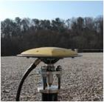
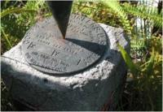
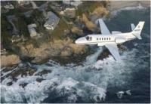
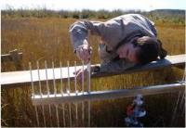
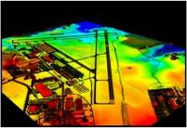
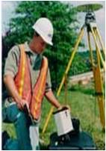
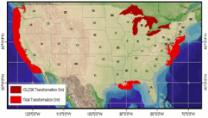
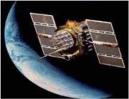
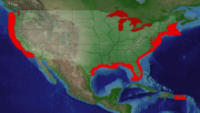
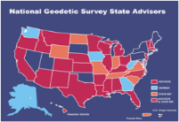
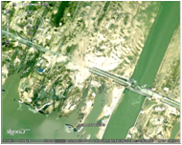
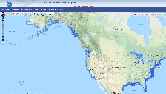
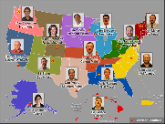
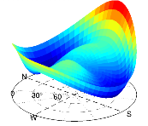
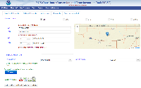
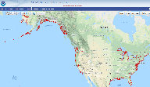
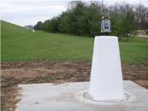
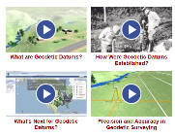
NGS Overview
Modernizing the NSRS
CORS
NHMP
GRAV-D
ECO
NGS Products and Services
ASP
OPUS
VDatum
Orbit Data
National Shoreline
Geodetic Advisors
ERI
Antenna Calibrations
NCAT
CUSP
CBL
Outreach

Slide 8
NGS Overview
Modernizing the NSRS
CORS
NHMP
GRAV-D
ECO
NGS Products and Services
ASP
OPUS
VDatum
Orbit Data
National Shoreline
Geodetic Advisors
ERI
Antenna Calibrations
NCAT
CUSP
CBL
Outreach

Slide 9
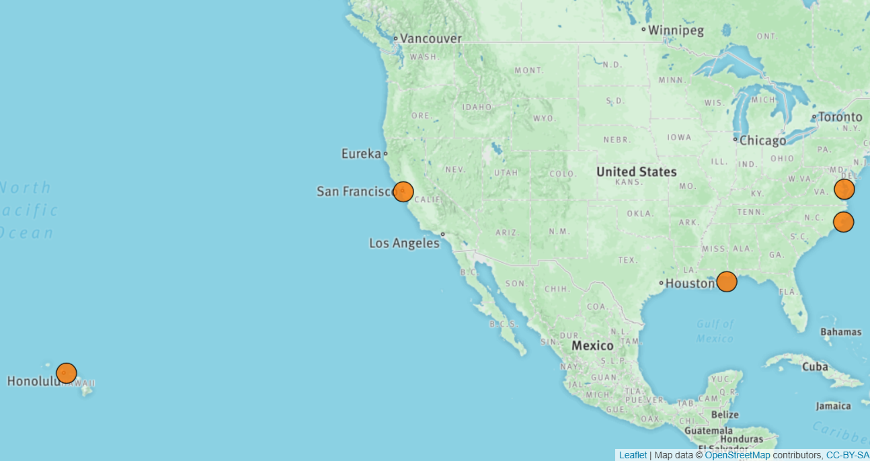
Ecosystem and Climate Operations

Slide 10
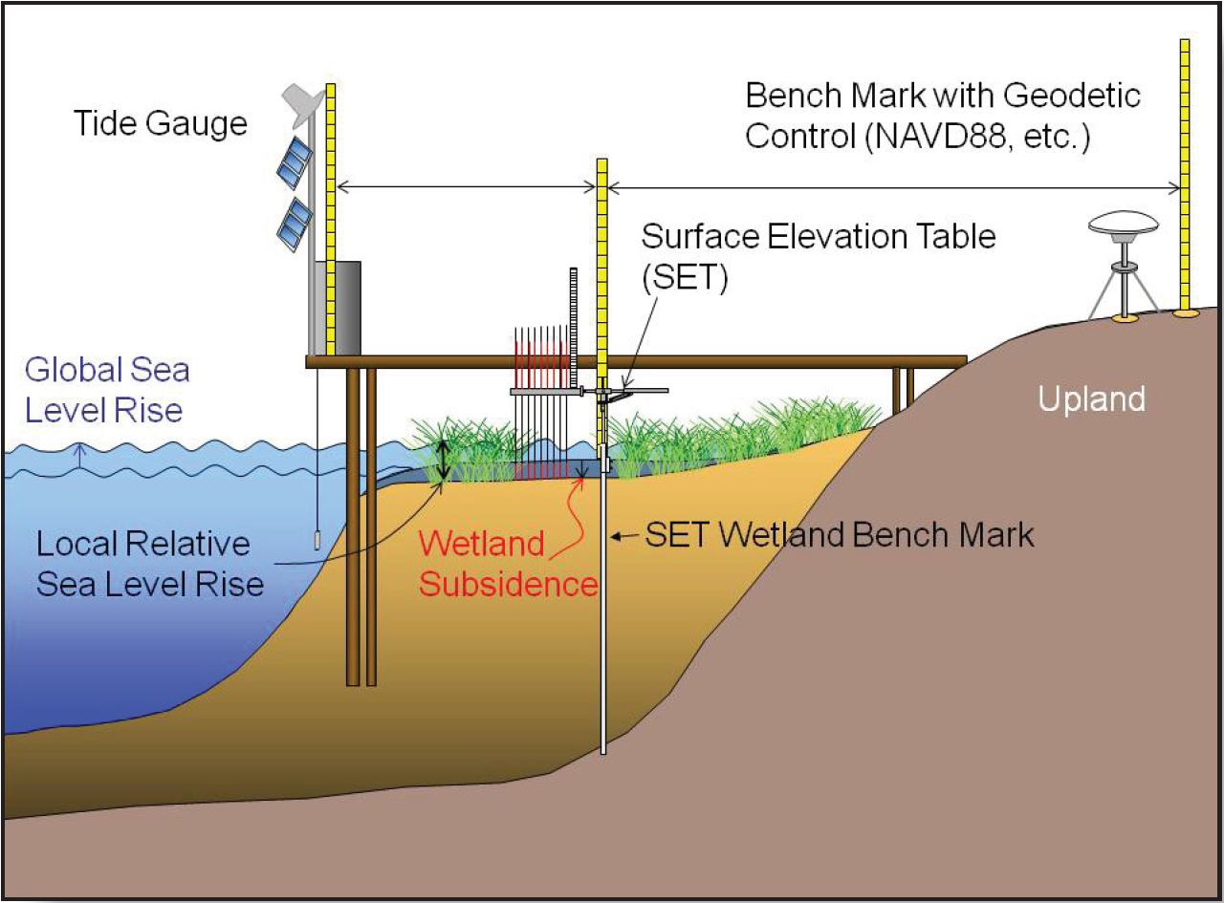
Ecosystem and Climate Operations

Slide 11
NGS Overview
Modernizing the NSRS
CORS
NHMP
GRAV-D
ECO
NGS Products and Services
ASP
OPUS
VDatum
Orbit Data
National Shoreline
Geodetic Advisors
ERI
Antenna Calibrations
NCAT
CUSP
CBL
Outreach

Slide 12
Aeronautical Survey Program
Interagency Program: FAA and NGS
  Primary Airport Control Station (PACS) and Secondary Airport Control Stations (SACS)
  Airports GIS (AGIS)
  Airport Obstruction Charts (AOC)
Primary function of NGS is to serve as QA and subject-matter expert for ASP surveys that are contracted by airports

Slide 13
NGS Overview
Modernizing the NSRS
CORS
NHMP
GRAV-D
ECO
NGS Products and Services
ASP
OPUS
VDatum
Orbit Data
National Shoreline
Geodetic Advisors
ERI
Antenna Calibrations
NCAT
CUSP
CBL
Outreach

Slide 14
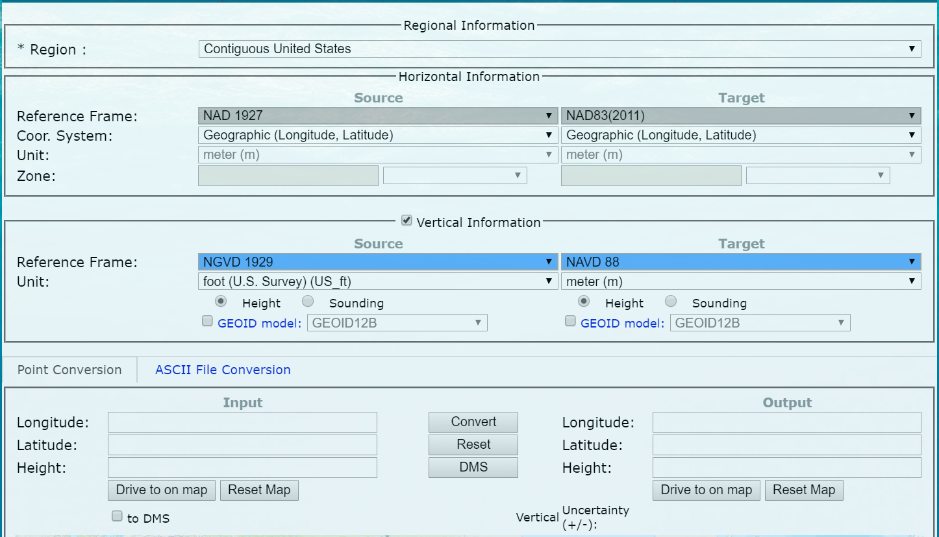
NOAA VDatum - online

Slide 15
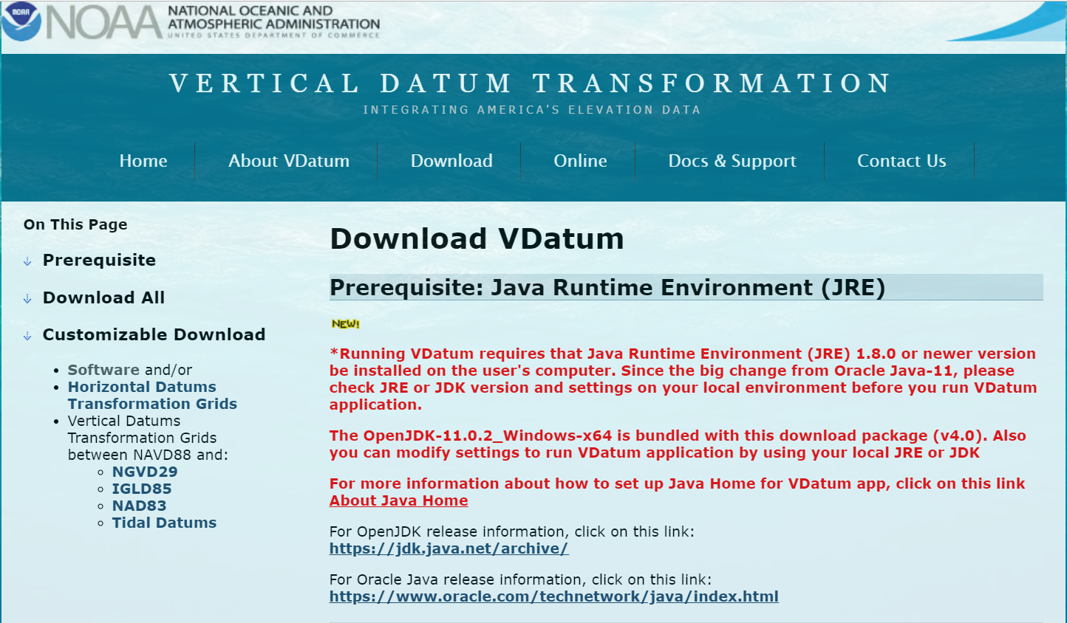
NOAA VDatum - download

Slide 16
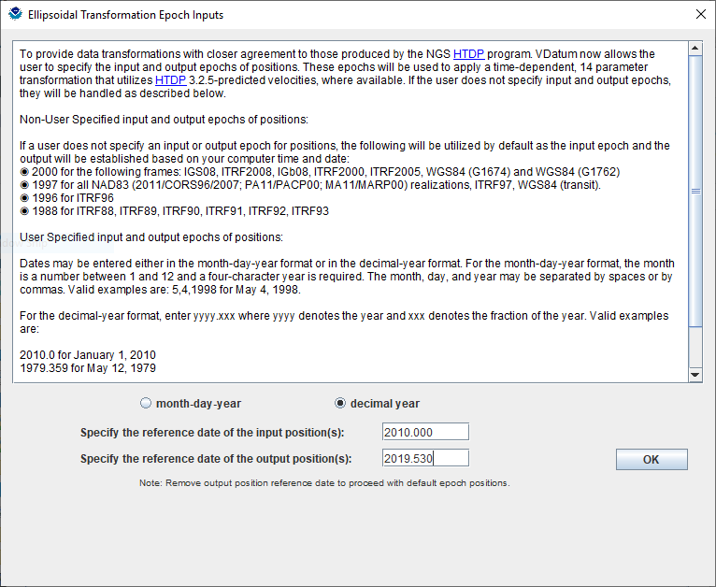
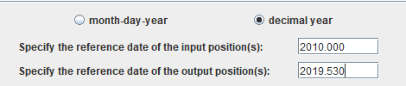
NOAA VDatum - download

Slide 17
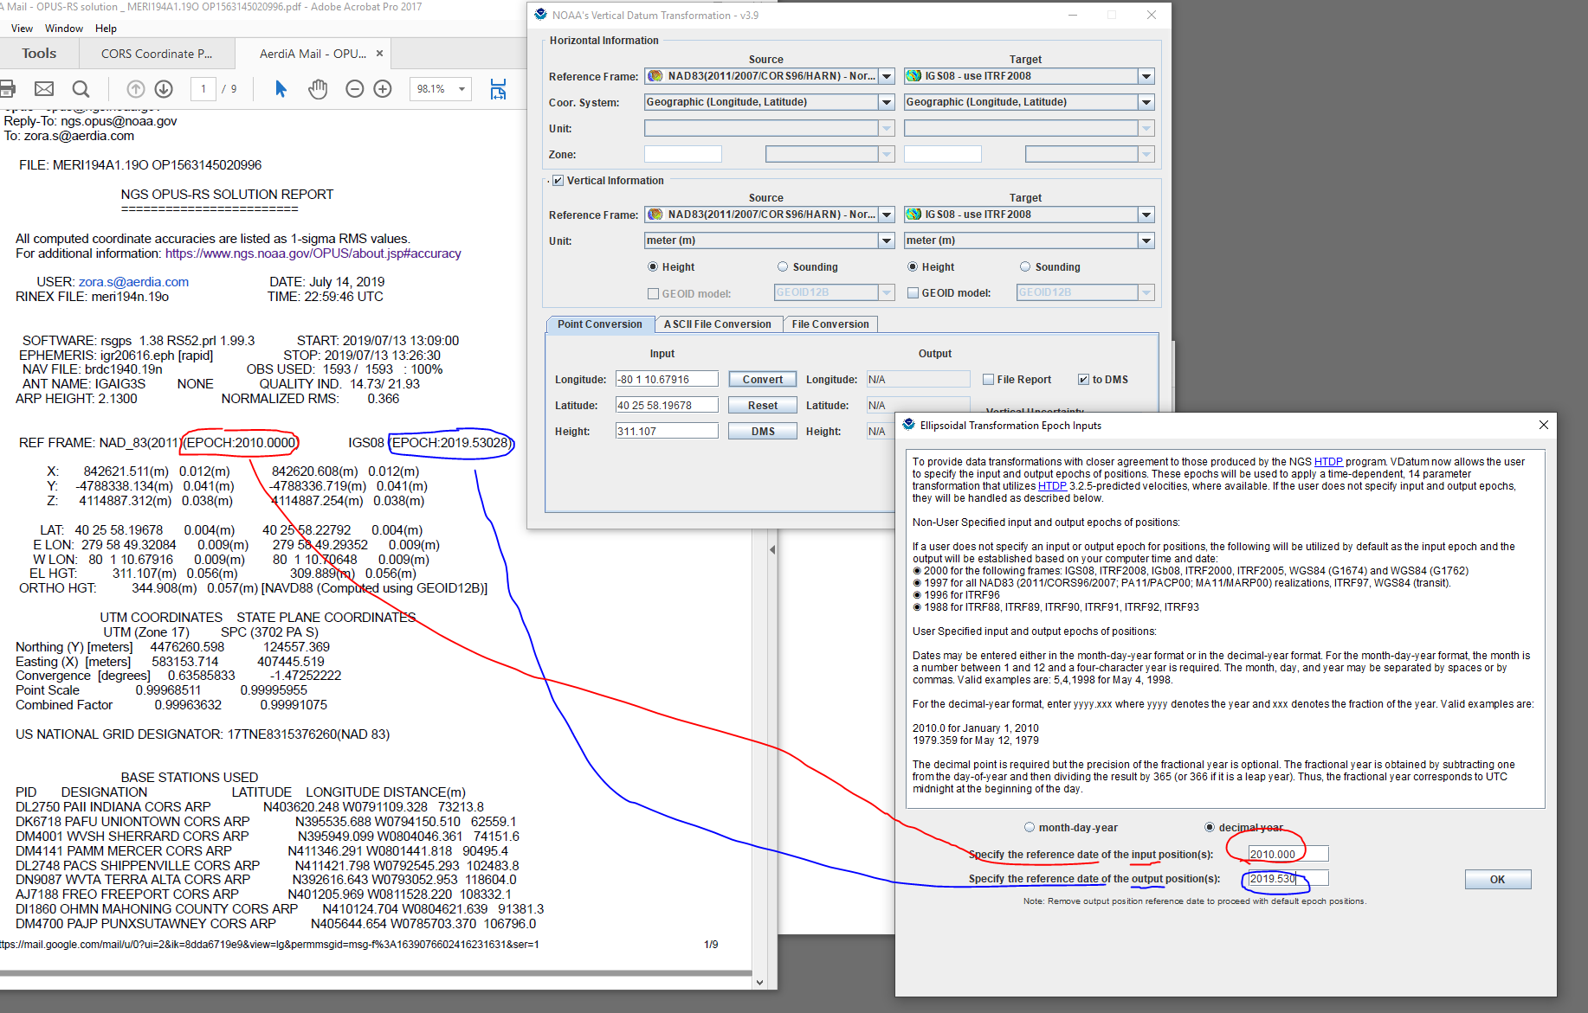

Slide 18
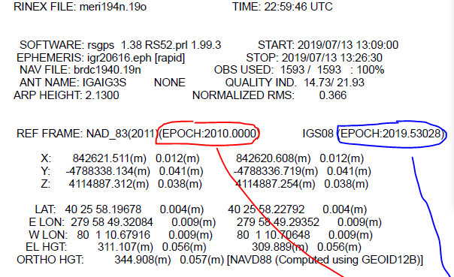

Slide 19
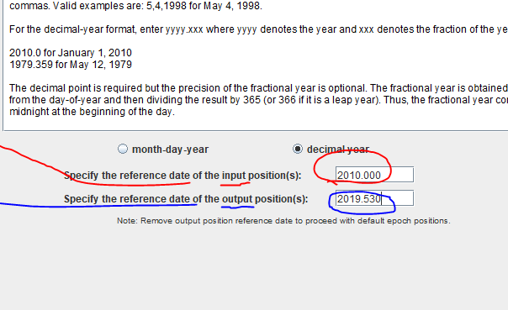

Slide 20
NOAA VDatum Website
vdatum.noaa.gov

Slide 21
NGS Overview
Modernizing the NSRS
CORS
NHMP
GRAV-D
ECO
NGS Products and Services
ASP
OPUS
VDatum
Orbit Data
National Shoreline
Geodetic Advisors
ERI
Antenna Calibrations
NCAT
CUSP
CBL
Outreach

Slide 22

GPS Orbit Data aka Ephemerides
NGS orbit analysis and computation is performed together with, and as a component of, the International GNSS Service (IGS)
  IGS coordinates the collection of satellite tracking data
  these orbits are what give us post-processed accuracy
Designated with this responsibility by the Civil GPS Service Interface Committee (CGSIC)
If you’re using OPUS, it’s all behind-the-curtain!

Slide 23
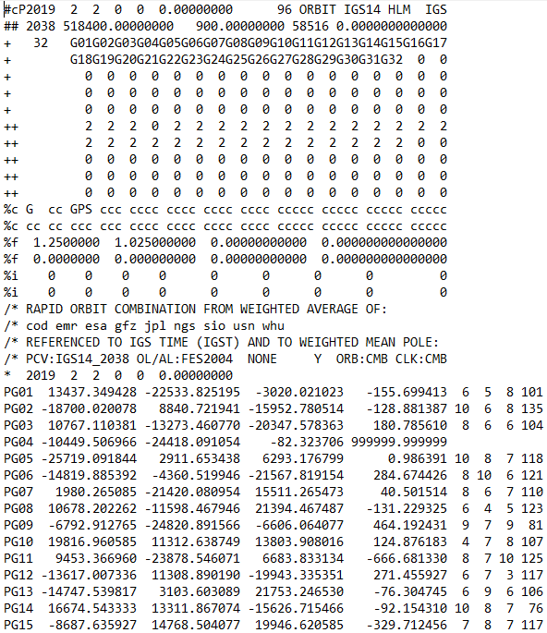
.sp3 file
Link to NGS GPS Calendar

Slide 24
NGS Overview
Modernizing the NSRS
CORS
NHMP
GRAV-D
ECO
NGS Products and Services
ASP
OPUS
VDatum
Orbit Data
National Shoreline
Geodetic Advisors
ERI
Antenna Calibrations
NCAT
CUSP
CBL
Outreach

Slide 25
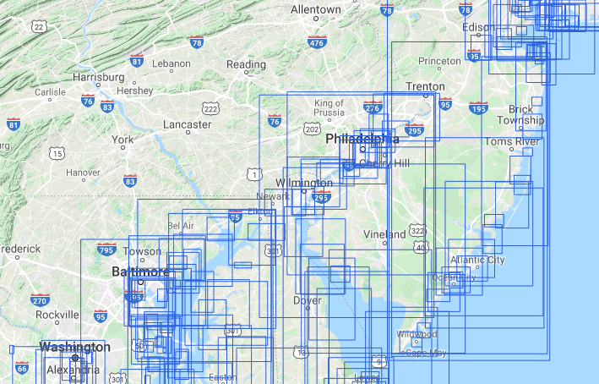
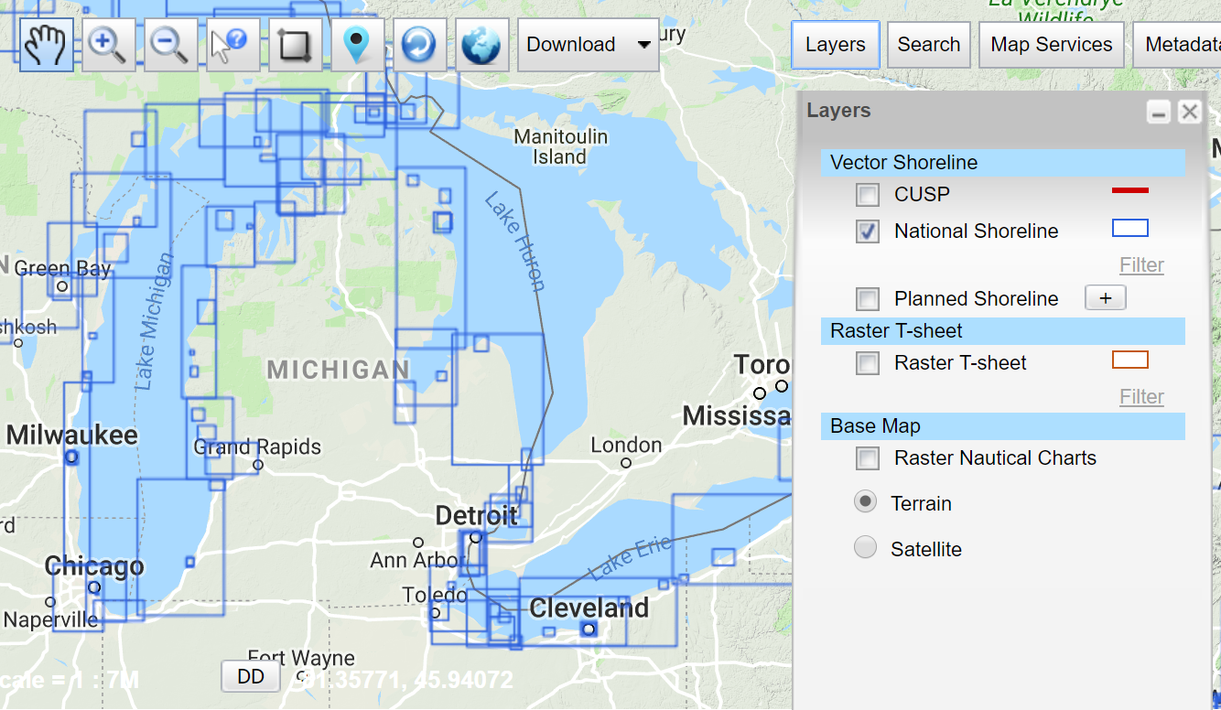
National Shoreline
The official shoreline for the Nation, in support of NOAA’s nautical charting mission
Available for download as shapefile in Mean High Water and Mean Lower Low Water datum
Organized by “Project Area” – the blue boxes
hyperlink to the National Shoreline homepage

Slide 26
NGS Overview
Modernizing the NSRS
CORS
NHMP
GRAV-D
ECO
NGS Products and Services
ASP
OPUS
VDatum
Orbit Data
National Shoreline
Geodetic Advisors
ERI
Antenna Calibrations
NCAT
CUSP
CBL
Outreach

Slide 27
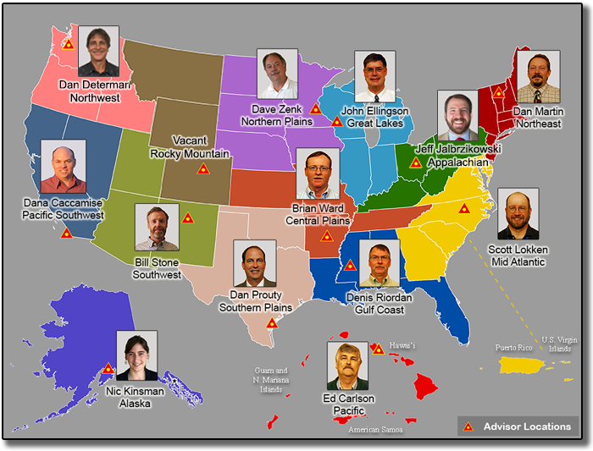
https://www.ngs.noaa.gov/ADVISORS/

Slide 28
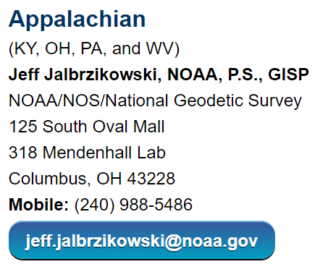
Regional Geodetic Advisor Program
www.ngs.noaa.gov/ADVISORS/
query any major search engine: “ngs advisors”

Slide 29
State Geodetic Coordinators
Not an NGS employee, rather:
  State/Commonwealth government
    RTN (aka “VRS”) Manager
    DOT survey lead
    Geospatial Information Officer
  Academia
    Professor or Program Director
  Professional society representative
Serves as a liaison between the State’s geospatial community and the NGS

Slide 30
NGS Overview
Modernizing the NSRS
CORS
NHMP
GRAV-D
ECO
NGS Products and Services
ASP
OPUS
VDatum
Orbit Data
National Shoreline
Geodetic Advisors
ERI
Antenna Calibrations
NCAT
CUSP
CBL
Outreach

Slide 31
Emergency Response Imagery
Mission of our Remote Sensing Division
Pre-Storm and Post-Storm photos are taken mostly along the coastal CONUS, and some other disasters natural or human
Supports Dept. of Homeland Security (DHS) and other emergency management organizations (FEMA, State, local, etc.)

Slide 32
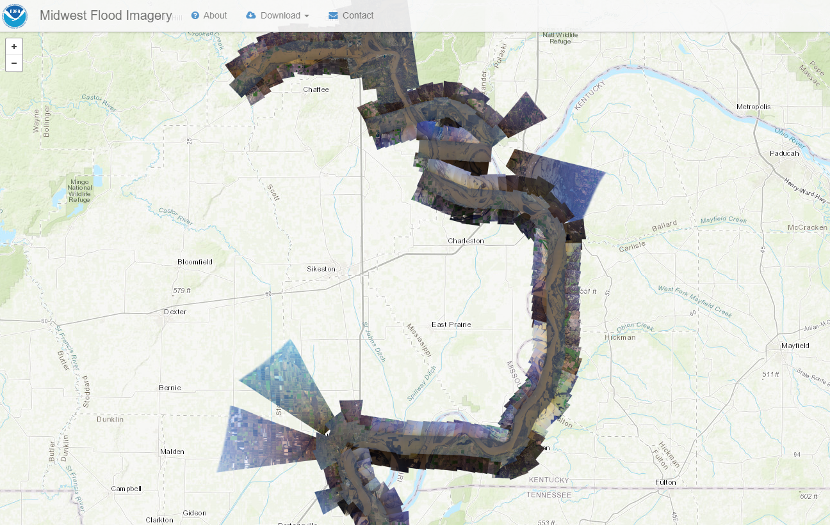
Emergency Response Imagery

Slide 33
NGS Overview
Modernizing the NSRS
CORS
NHMP
GRAV-D
ECO
NGS Products and Services
ASP
OPUS
VDatum
Orbit Data
National Shoreline
Geodetic Advisors
ERI
Antenna Calibrations
NCAT
CUSP
CBL
Outreach

Slide 34
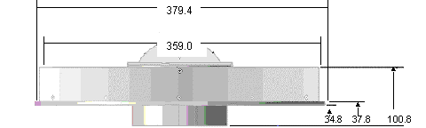
Phase Center Offset - conceptual
Orange dot = mean point of signal reception
Blue dot = Antenna Reference Point (ARP)
Red line = Phase Center Offset (PCO)

Slide 35
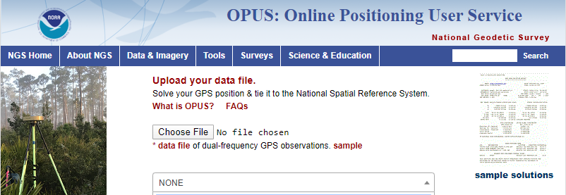
Phase Center Offset
The PCO is one reason it is important to select the correct antenna for OPUS upload!
choose
carefully!
if you have questions… drop me a line

Slide 36
NGS Overview
Modernizing the NSRS
CORS
NHMP
GRAV-D
ECO
NGS Products and Services
ASP
OPUS
VDatum
Orbit Data
National Shoreline
Geodetic Advisors
ERI
Antenna Calibrations
NCAT
CUSP
CBL
Outreach

Slide 37
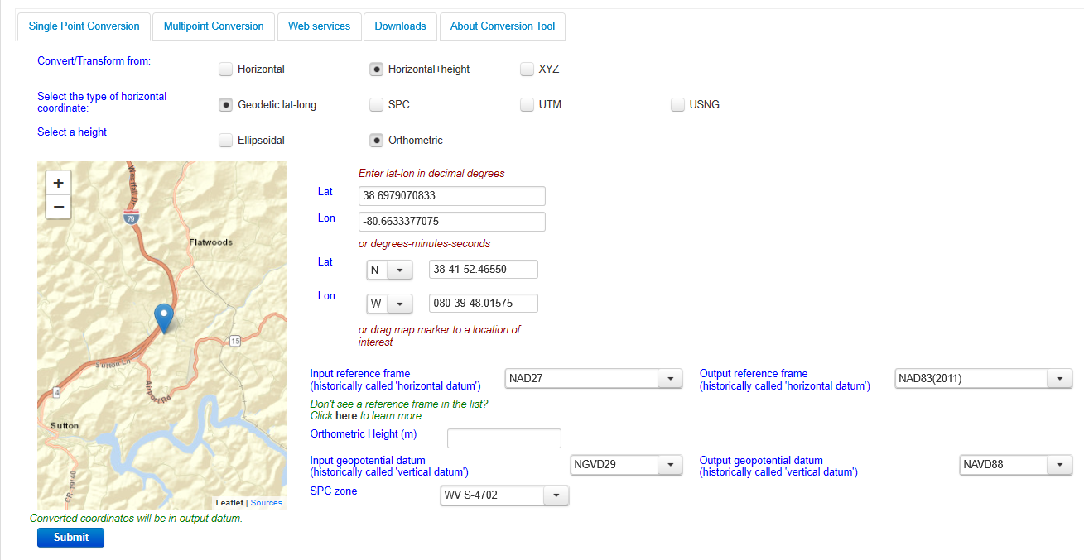
NGS Coordinate Conversion And Transformation Tool (NCAT)

Slide 38
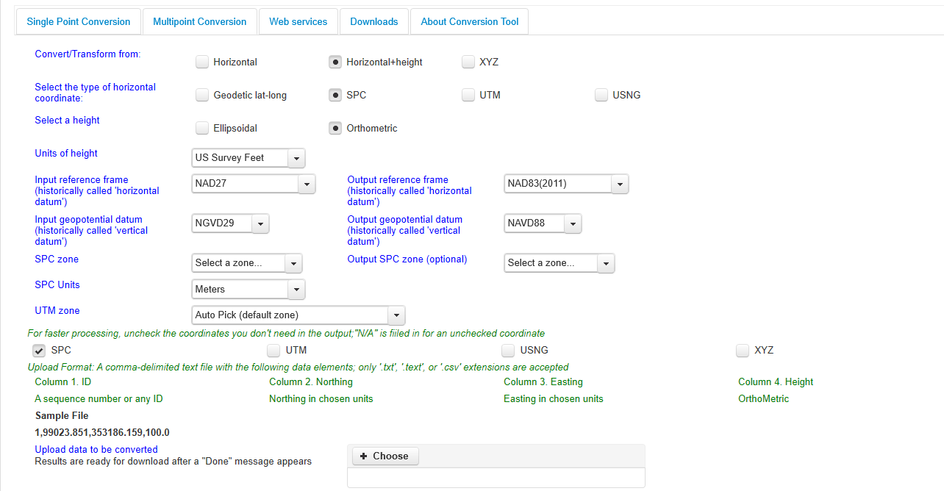
NGS Coordinate Conversion And Transformation Tool (NCAT)

Slide 39
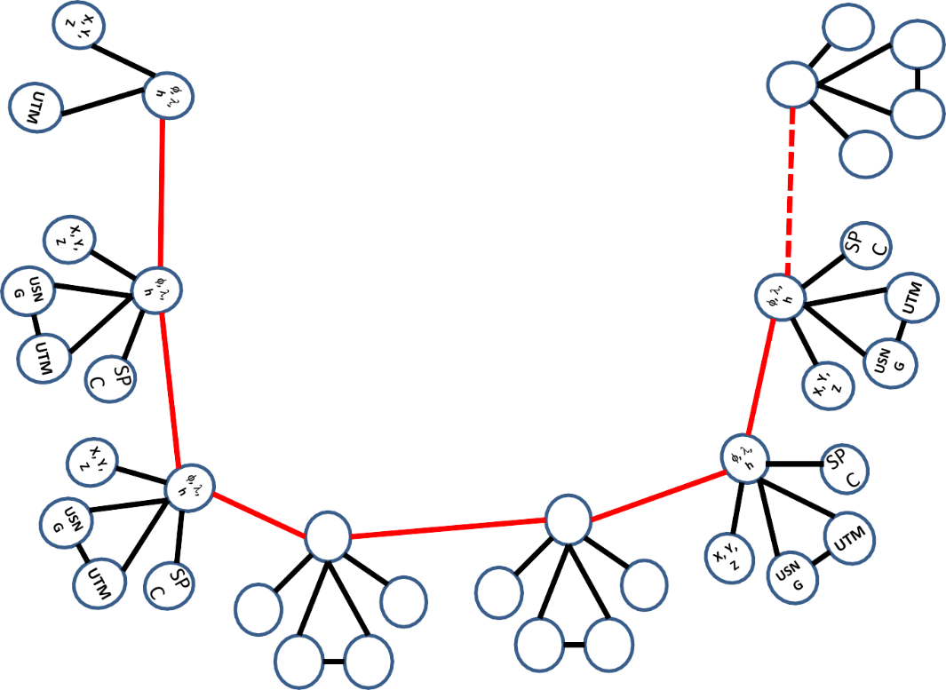
Coordinate Transformation Tool
SP
C
UTM
(NCAT / NADCON 5.0)
2022
φ, λ, h
USSD
USN
G
Relating coordinates: then & now
NAD 83 (2011)
X, Y,
Z
NAD 27
NAD 83 (NSRS2007)
NAD 83 (1986)
NAD 83 (FBN)
φ, λ, h
NAD 83 (HARN)
φ, λ, h
SP C
X, Y, Z
SP C
X, Y, Z
USN G
USN G
UTM
UTM

Slide 40
NGS Overview
Modernizing the NSRS
CORS
NHMP
GRAV-D
ECO
NGS Products and Services
ASP
OPUS
VDatum
Orbit Data
National Shoreline
Geodetic Advisors
ERI
Antenna Calibrations
NCAT
CUSP
CBL
Outreach

Slide 41
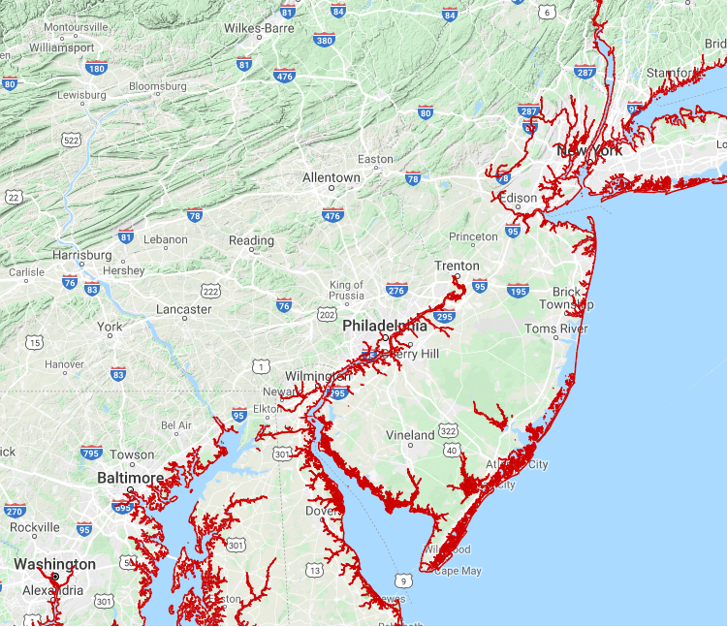
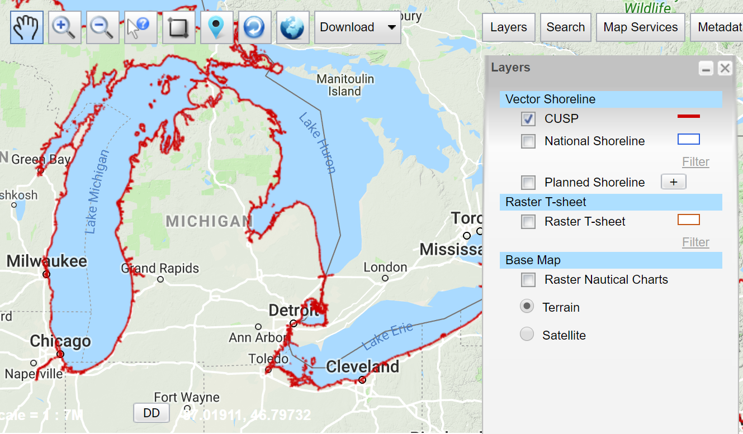
Continually Updated Shoreline Product
Just as the name says… it’s dynamic
Available for download as shapefiles
Developed by image interpretation and/or vertical modeling using water level stations (tide or lake gages)
Referenced to a computed Mean High Water
hyperlink to the CUSP homepage

Slide 42
NGS Overview
Modernizing the NSRS
CORS
NHMP
GRAV-D
ECO
NGS Products and Services
ASP
OPUS
VDatum
Orbit Data
National Shoreline
Geodetic Advisors
ERI
Antenna Calibrations
NCAT
CUSP
CBL
Outreach

Slide 43
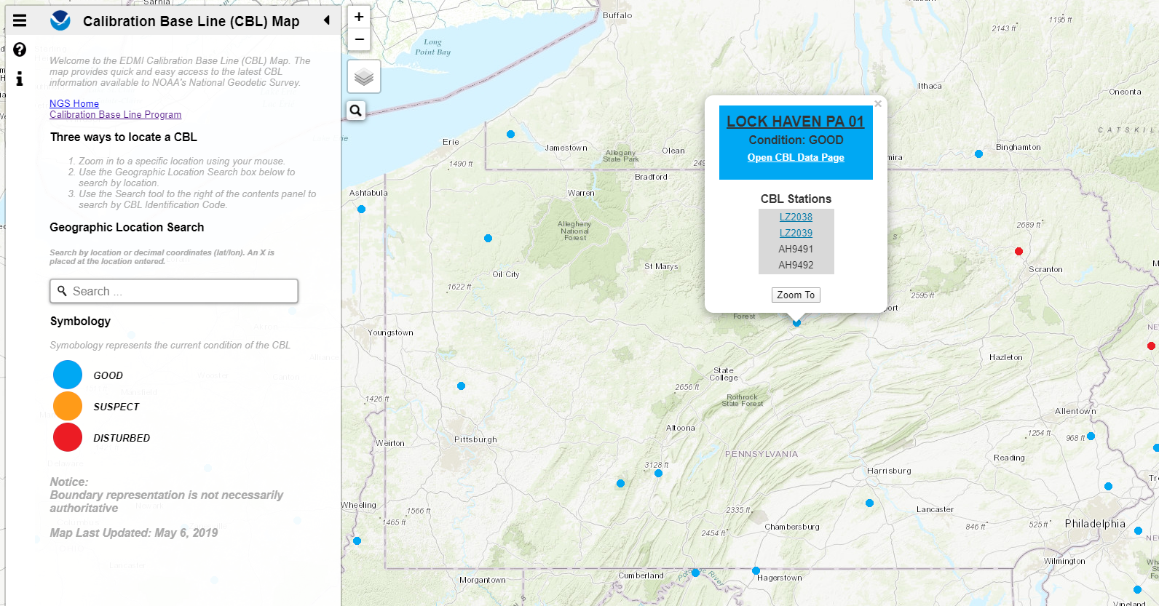
Beta CBL Map Viewer
https://www.ngs.noaa.gov/CBLINES/

Slide 44
NGS Overview
Modernizing the NSRS
CORS
NHMP
GRAV-D
ECO
NGS Products and Services
ASP
OPUS
VDatum
Orbit Data
National Shoreline
Geodetic Advisors
ERI
Antenna Calibrations
NCAT
CUSP
CBL
Outreach

Slide 45
Cooperative program for Operational Meteorology, Education, and Training
Meteorology… why?
The origin of the program was the National Weather Service, also a NOAA office
It expanded to various NOAA missions, including NGS

Slide 46
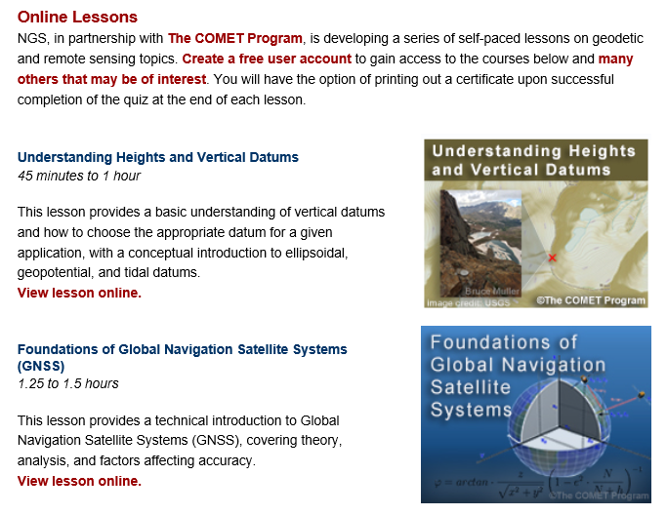
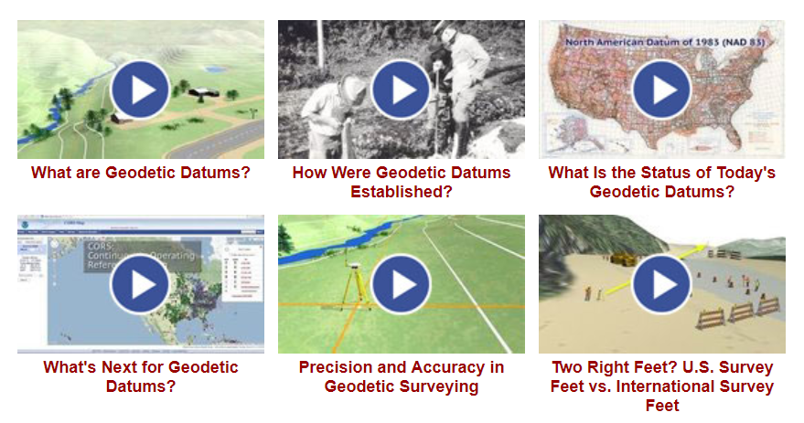
Outreach & Educational Resources

Slide 47
Geoids and Gravity

Slide 48
Geoids and Gravity
or
“Ramblings on the geoid”

Slide 49
One textbook geoid definition
“Equipotential surface of the Earth’s gravity field that approximates Mean Sea Level more closely.”
-GPS for Land Surveyors, by Jan Van Sickle, 4th ed., CRC Press, Taylor & Francis Group, 2015, p. 314.
equi-huh?
More closely than what?

Slide 50
Two more geoid definitions
“The equipotential surface of the Earth's gravity field which best fits, in a least squares sense, global Mean Sea Level.”
-website of the National Geodetic Survey
A surface of constant geopotential.
-some lecture notes of mine…

Slide 51
My favorite verbage
  “The geoid is the equipotential surface that most closely coincides with the undisturbed mean sea level (and its continuation through the continents).”
    - Sjöberg, L. E., & Bagherbandi, M. (2017). Gravity Inversion and Integration, Theory and Applications in Geodesy and Geophysics. Springer.
  equipotential – equal potential
  potential – as in energy… or gravitational pull

Slide 52
Gravitational Pull
It is not uniform, both strength and direction vary.
Can be defined by a vector
-distance (from ellipsoid) and direction

Slide 53
Equipotential Surface
A modeled surface to represent the location of equal gravitational force.
It’s an undulating surface, hence the phrase “geoid undulation” often used.
Gravity is acting perpendicular to every point on this surface.

Slide 54
Equipotential Surface
… coincides with the undisturbed mean sea level…

Slide 55
Equipotential Surface
There are an infinite number of equipotential surfaces.
We use the term geoid to refer to one of those surfaces that aligns to a best-known global mean sea level.

Slide 56
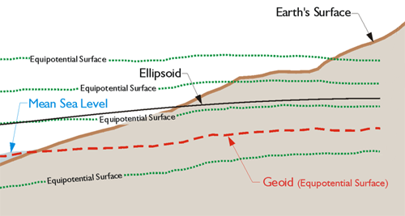
Equipotential Surface
-GPS for Land Surveyors, by Jan Van Sickle, 4th ed., CRC Press, Taylor & Francis Group, 2015, p. 180. (slightly edited)

Slide 57

Geopotential

Slide 58
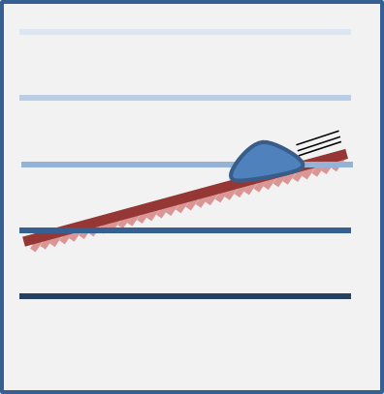
Geopotential

Slide 59
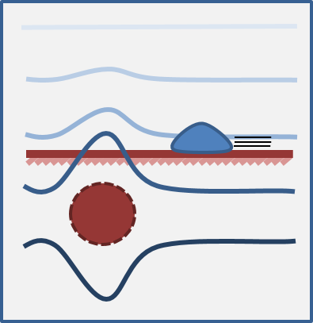
Geopotential

Slide 60
Geopotential
In all scenarios, the water only flows when it has a path to lower geopotential – this is always a combination of gravity and height.
(-∫g dH)

Slide 61
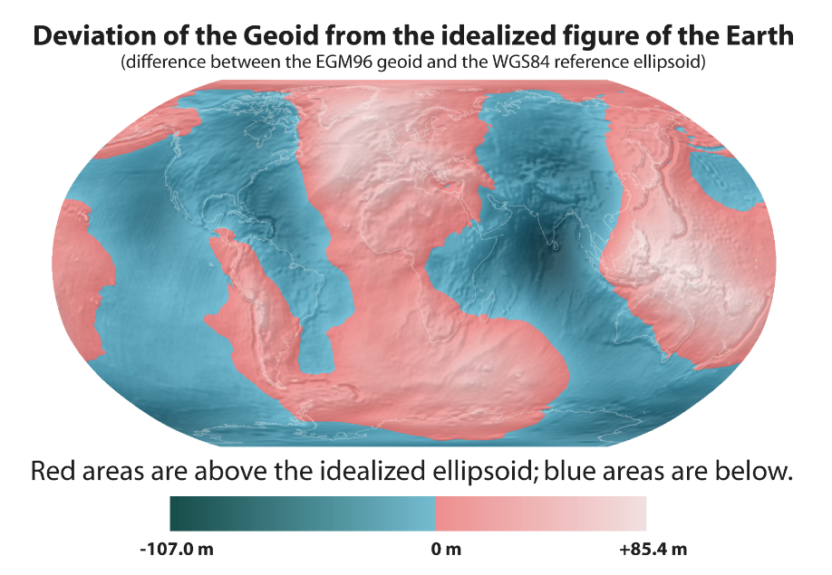
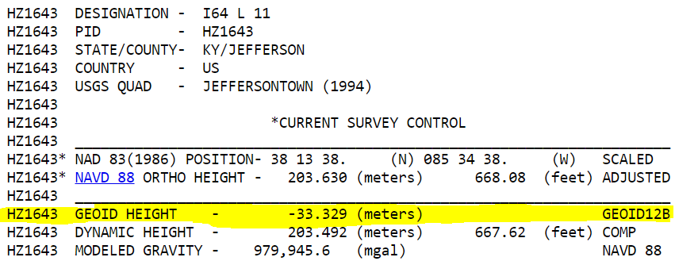

Slide 62
Orthometric Heights
-GPS for Land Surveyors, by Jan Van Sickle, 4th ed., CRC Press, Taylor & Francis Group, 2015, p. 180. (slightly edited)

Slide 63
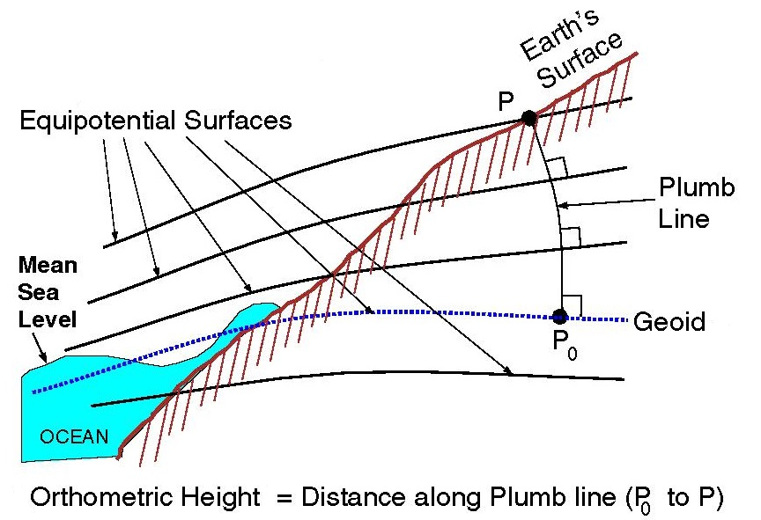

Slide 64
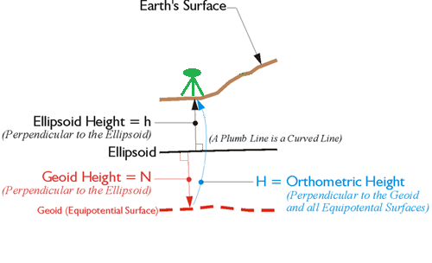
Orthometric Heights
H = h + N

Slide 65

Orthometric Heights
H = h + N

Slide 66

Orthometric Heights
Deflection of the Vertical
DoV (symbolized ε)
ε
H = h + N
ε
-GPS for Land Surveyors, by Jan Van Sickle, 4th ed., CRC Press, Taylor & Francis Group, 2015, p. 180. (slightly edited)

Slide 67


Slide 68



Slide 69
Gravimetric → Hybrid
  Gravimetric geoid is created from “scratch” with various types of gravity data
      USGG2003, USGG2009, USGG2012, xGEOID19
  Hybrid geoid is simply a gravimetric geoid warped to fit some vertical datum… like NAVD88
      GEOID03, GEOID09, GEOID12B, GEOID18

Slide 70
Gravimetric → Hybrid
      USGG2003, USGG2009, USGG2012, xGEOID19
      GEOID03, GEOID09, GEOID12B, GEOID18
best fit to NAVD88
best fit to NAVD88
best fit to NAVD88
best fit to NAVD88

Slide 71
Which NAD83 with which geoid?
GEOID18
GEOID12B
NAD83(2011) →
NAD83(2007) →
NAD83(HARN/FBN)
NAD83(CORS96)
GEOID09
GEOID06 (AK only)
GEOID03
GEOID99
GEOID96

Slide 72





















EGM08
Evolution of recent NGS geoid models
USGG2012 GEOID12A/B
GRAV-D
2008
2012
2014
GOCO03s GOCO05S
2015
2016
xGeoid14B
GRACE
xGeoid15B
xGeoid16B
+
GOCE

Slide 73


Slide 74
NGS Overview
Modernizing the NSRS
CORS
NHMP
GRAV-D
ECO
NGS Products and Services
ASP
OPUS
VDatum
Orbit Data
National Shoreline
Geodetic Advisors
ERI
Antenna Calibrations
NCAT
CUSP
CBL
Outreach

Slide 75
Online Positioning User Service
  OPUS Rapid Static (OPUS-RS)
      dual frequency receiver data
      static sessions only
      30 seconds epoch rate (aka recording interval)
      15 minutes to 2 hours of GPS data
  OPUS Static (OPUS-S)
      same requirements as above
      2 to 48 hours of GPS data
  OPUS Projects (OP) → also Beta OPUS Projects
      adds session processing and network adjustment
      training by NGS required; typically 12 hours
      upload to OPUS with a “Project ID” keyed in Options

Slide 76

30 seconds epoch rate

Slide 77



OPUS-RS – 15 min to 2 hours
Rapid-static: OPUS first creates an atmospheric delay model from surrounding CORS data.
  -Atmospheric model

Slide 78
How does OPUS-RS work?
Selects three to nine “best” CORS based upon:
    Having common satellite visibility with the user data.
    50 < distance <250 km from the user's mark.
    Orientation relative to the user's mark.
The star represents the user’s
mark; the triangles are CORS.
No CORS farther than 250 km
from the user's mark will be
included.
A minimum of three, and
no more than nine CORS are used.
s
>250km
250km

Slide 79

How does OPUS-RS work?
In addition, user's mark must be no more than 50 km from the (convex) polygon created by the selected CORS.
If the user’s mark is more than 50 km outside this
polygon, alternate CORS will be considered.
If none can be found, the processing will abort.

Slide 80
OPUS-S – 2 to 48 hours
  -Best 3 of 5 baselines
baseline 5
baseline 4
baseline 1
baseline 3
baseline 2

Slide 81
“peak to peak” error ranges, explained:
LAT: 59 42 33.45847 0.003(m)
W LON: 151 27 27.92482 0.007(m)
EL HGT: 503.684(m) 0.032(m)
ORTHO HGT: 494.346(m) 0.055(m)
baseline 5
position:
averaged from the 3 most coherent baselines
ranges:
a bounding box enclosing 3 most coherent baselines
LON range
for ORTHO HGT, geoid model uncertainty is added
LAT range
ORTHO HGT range
CORS baseline 1
EL HGT range
=
baseline 3
baseline 4
baseline 2
2 outermost baselines are ignored
JGE, 2015

Slide 82
Static vs. Rapid Static
 | Static | Rapid Static
Input | 2-48 hours | 15 minutes-2 hours
Output | normal, extended, XML Shared, Projects | normal, extended, XML
Accuracy (95%confidence) | 1-2 cm horizontal 3-6 cm ellipsoidal height | 1-2 cm horizontal 4-8 cm ellipsoidal height
Network Geometry | 3 CORS, preferably within 1000 km of rover | 3-9 CORS, surrounding & within 250 km of rover
Availability | global | 90% of CONUS (subject to geometry, above)

Slide 83

RMSE of Horizontal Results

Slide 84
RMSE of Vertical Results

Slide 85
OPUS Projects – 2 to 48 hours
  -Control network via OPUS

Slide 86
OPUS Projects
Web-based access, nothing to download
Visualize/map your OPUS Solutions
Manage multiple Projects at once
Processing for multiple marks and multiple occupations, or repeat occupations of single mark
Advantages include:
Data uploading through OPUS
Process using PAGES… without learning PAGES (GUI)
Graphic visualization versus text Solution Reports
Support for Bluebooking!

Slide 87

OPUS Projects – enter a Project ID
Project ID
for OP

Slide 88
Why complicate OPUS?
OPUS
Session
Adjustment
CORS3
CORS5
CORS2
CORS1
CORS4
solution HATFIELD
solution MCCOY

Slide 89
Why complicate OPUS?
OPUS
Session
Adjustment
CORS3
CORS5
CORS2
CORS1
CORS4
solution HATFIELD
solution MCCOY
session 001

Slide 90
Why complicate OPUS?
OPUS
Session
Adjustment
CORS3
CORS5
CORS2
CORS1
CORS4
solution HATFIELD
solution MCCOY
session 001
session 002
session N

Slide 91
Why complicate OPUS?
OPUS
Session
Adjustment
CORS3
CORS5
CORS2
CORS1
CORS4
solution HATFIELD
solution MCCOY
session 001
session 002
session N
network adjustment

Slide 92
Typical OP Network Diagram
CORS
CORS
"Hub” design recommended
Hub CORS to marks ≤ ~100 km
Use multiple CORS
Add one very long baseline from Hub to CORS, to improve tropospheric modeling
OPUS-Projects does session baseline processing
24hr
Hub
24hr
CORS
>2hr
>2hr
24hr
CORS

Slide 93


What’s in it for you?
OPUS solutions = pretty good… but each treated as independent and assumes “perfect” CORS
Sessions = simultaneously-observed marks processed together in sessions increases consistency
Adjustments = interlinking sessions through least squares increases accuracy

Slide 94
OPUS-Projects can’t work magic.
  does not make a project plan obsolete.
  does not make field logs obsolete.
  does not make mark descriptions obsolete.
  does not make mark photos obsolete.
  does not make remove sky obstructions.
  does not make bad data good.
  does not make processing decisions as well as you.
  does not quality control processing results as well as you, the Professional Surveyor

Slide 95
Bluebooking a Project now
geodesy.noaa.gov/ project_tracking/
GPS survey
data files
photos
descriptions
etc.
Process data using vendor software or PAGE-NT.
Construct bluebook files using software and editor.
Run ADJUST.
review and publish to IDB

Slide 96
Bluebooking with OPUS Projects in the future
geodesy.noaa.gov/ project_tracking/
GPS survey
data files
photos
descriptions
etc.
Process data using vendor software or PAGE-NT.
Construct bluebook files using software and editor.
Run ADJUST.
review and publish to IDB
Available now!
(with certain caveats)
Upload to OPUS-Projects
Process in OPUS-Projects

Slide 97
But wait… there’s more!
Coming soon…

Slide 98

Hybrid Control Networks = Static + RTK/RTN
OPUS for RTK/RTN-GNSS

Slide 99
“What’s the benefit?” they say…
OPUS for RTK/RTN-GNSS
Run least squares adjustment(s) of the combined Static and RTN vectors
Hold NCN CORS (and possibly other published coordinates) in adjustments
Check quality of results
Submit survey project to NGS for review and publication in national database
…you’ll be able to Bluebook RTK/RTN data!

Slide 100
What happened to GPSonBM?
The program continues!
All submittals up until 31 Dec 2021 will be incorporated into the NAVD88→NAPGD2022 Transformation Tool
How do I get a mark included?
  collect/submit 2+ OPUS Shared Solutions
Tracking map (AGOL)
  NGS committed to biweekly updates

Slide 101

Mark Recovery – mobile browser compatible
use your smartphone to submit recovery
Any major search engine:
  “NGS survey mark recovery”
beta.ngs.noaa.gov/cgi-bin/recvy_entry_www.prl
Try it out! Give us feedback!
NGS.Feedback@noaa.gov

Slide 102


Mark Recovery – mobile browser compatible

Slide 103
www.ngs.noaa.gov
beta.ngs.noaa.gov

Slide 104
https://www.ngs.noaa.gov/ADVISORS/
-use any major search engine: “NGS advisors”
Jeff Jalbrzikowski, P.S., GISP, CFS
Appalachian Regional Geodetic Advisor
jeff.jalbrzikowski@noaa.gov
240-988-5486

