Slide 1

NGS Experimental Geoid Models
Wang YM, X Li, K Ahgren and J Krcmaric
National Geodetic Survey, NOAA, USA
2019 Geospatial Summit
Silver Spring, MD
May, 2019

Slide 2

Summary
GRAV-D gravity data has been collected continuously since July 2008.
An experimental geoid (xGEOID) has been computed annually since 2014.
Data from three GSVS lines are the primary independent data sets for validating geoid models.
Starting from xGEOID19, the model will be a joint model between NGS, CGS and INEGI.
The models covers three regions:
America-Pacific: (Lat: 0° to 90°, Lon: 170°E to 350°E)
Guam and CNMI: (Lat: 11° to 22°, Lon: 143°E to 148°E)
American Samoa: (Lat: -10° to -16°, Lon: 186°E to 193°E)

Slide 3
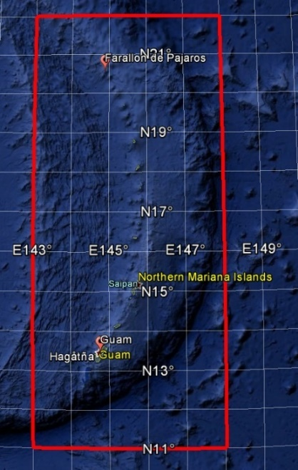
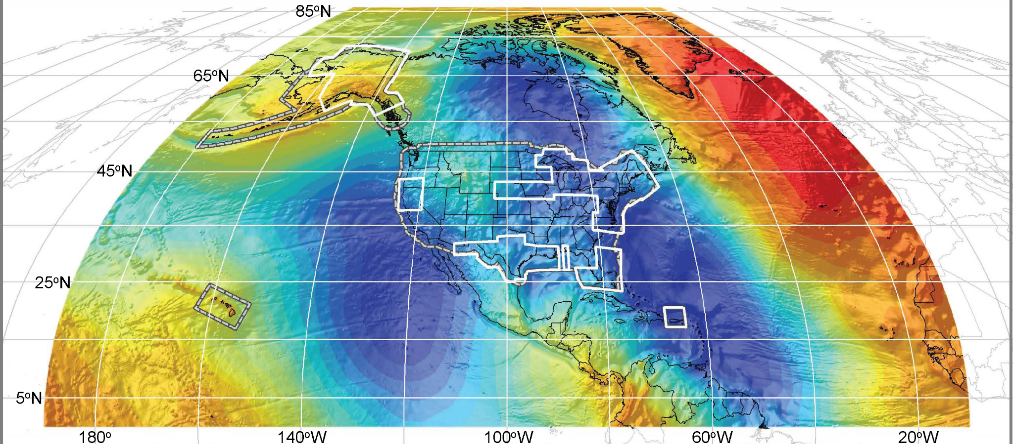
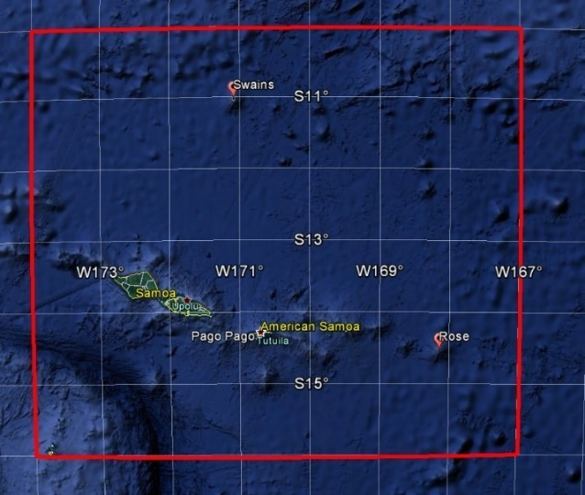
Coverage of NAPGD2022 Gravimetric Geoid Model (GEOID2022)
Guam and Northern Marianas Islands
North America and Pacific
American Samoa

Slide 4
xGEOID Model Specifications
Reference ellipsoid: GRS80
Semi-major axis a = 6,378,137 m
GM = 398,600,500,000,000 m³/s²
^{J}₂ = 108,263 x 10⁻⁸
ω = 7,292,115 x 10⁻¹¹ /s
Reference frame: ITRF14
Tidal system: Non-tidal
W₀ = 62,636,856.0 m²/s²
SGEOID2022 (xGEOID22) will be static. The time-varying geoid determined by the Geoid Monitoring Service
Products: Geoid grids (1’ x 1’)
Geoid accuracy estimates (1’ x 1’)
Deflection of the vertical (1’ x 1’)
Accuracy of deflection of the vertical (1’ x 1’)

Slide 5
Data used for xGEOID19
GOCO05S satellite gravity model
NGA 1,633,376 points terrestrial gravity data
NGS 135,290 points over land (supplemental/fill-in)
3" digital elevation model (SRTM, ASTER and CDEM)
GRAV-D airborne gravity data ~75% of US territories
Altimetric gravity anomaly DTU13 (1’ x 1’)

Slide 6
Possible height changes from NAVD88 (CONUS)

Slide 7
Possible height changes from NAVD88 (AK)

Slide 8
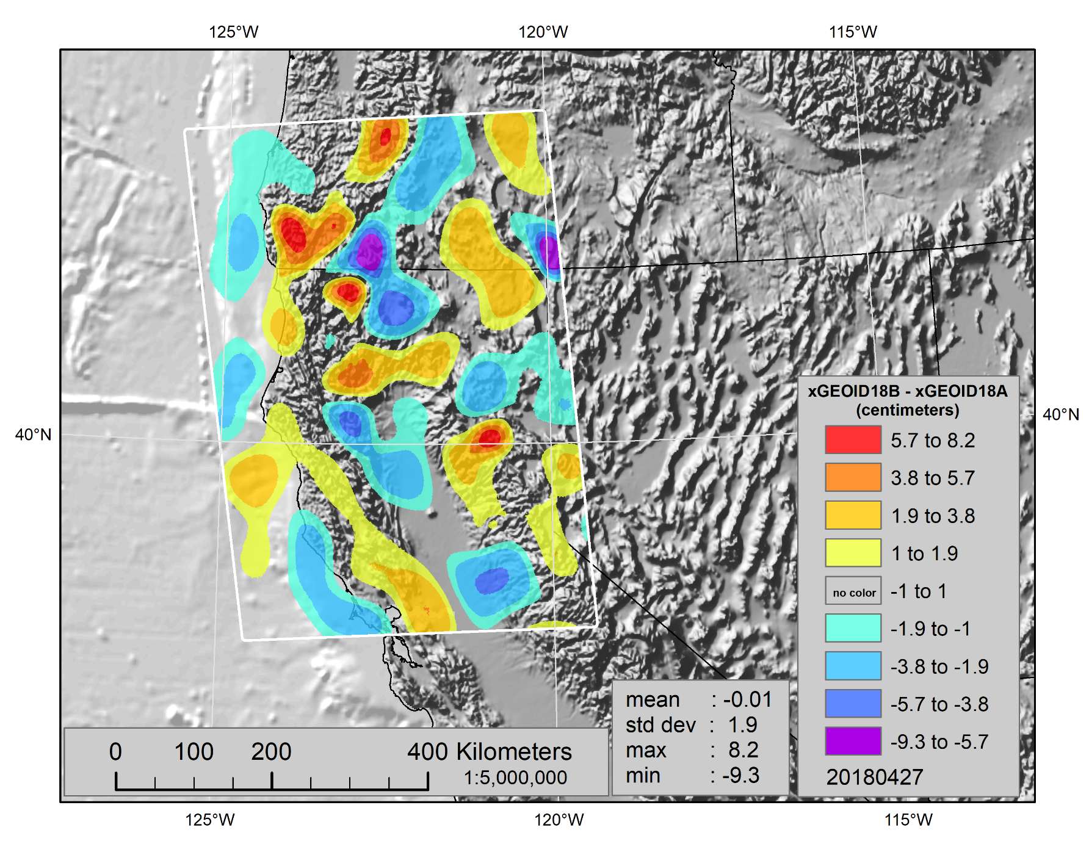
Contribution of GRAV-D to the geoid

Slide 9
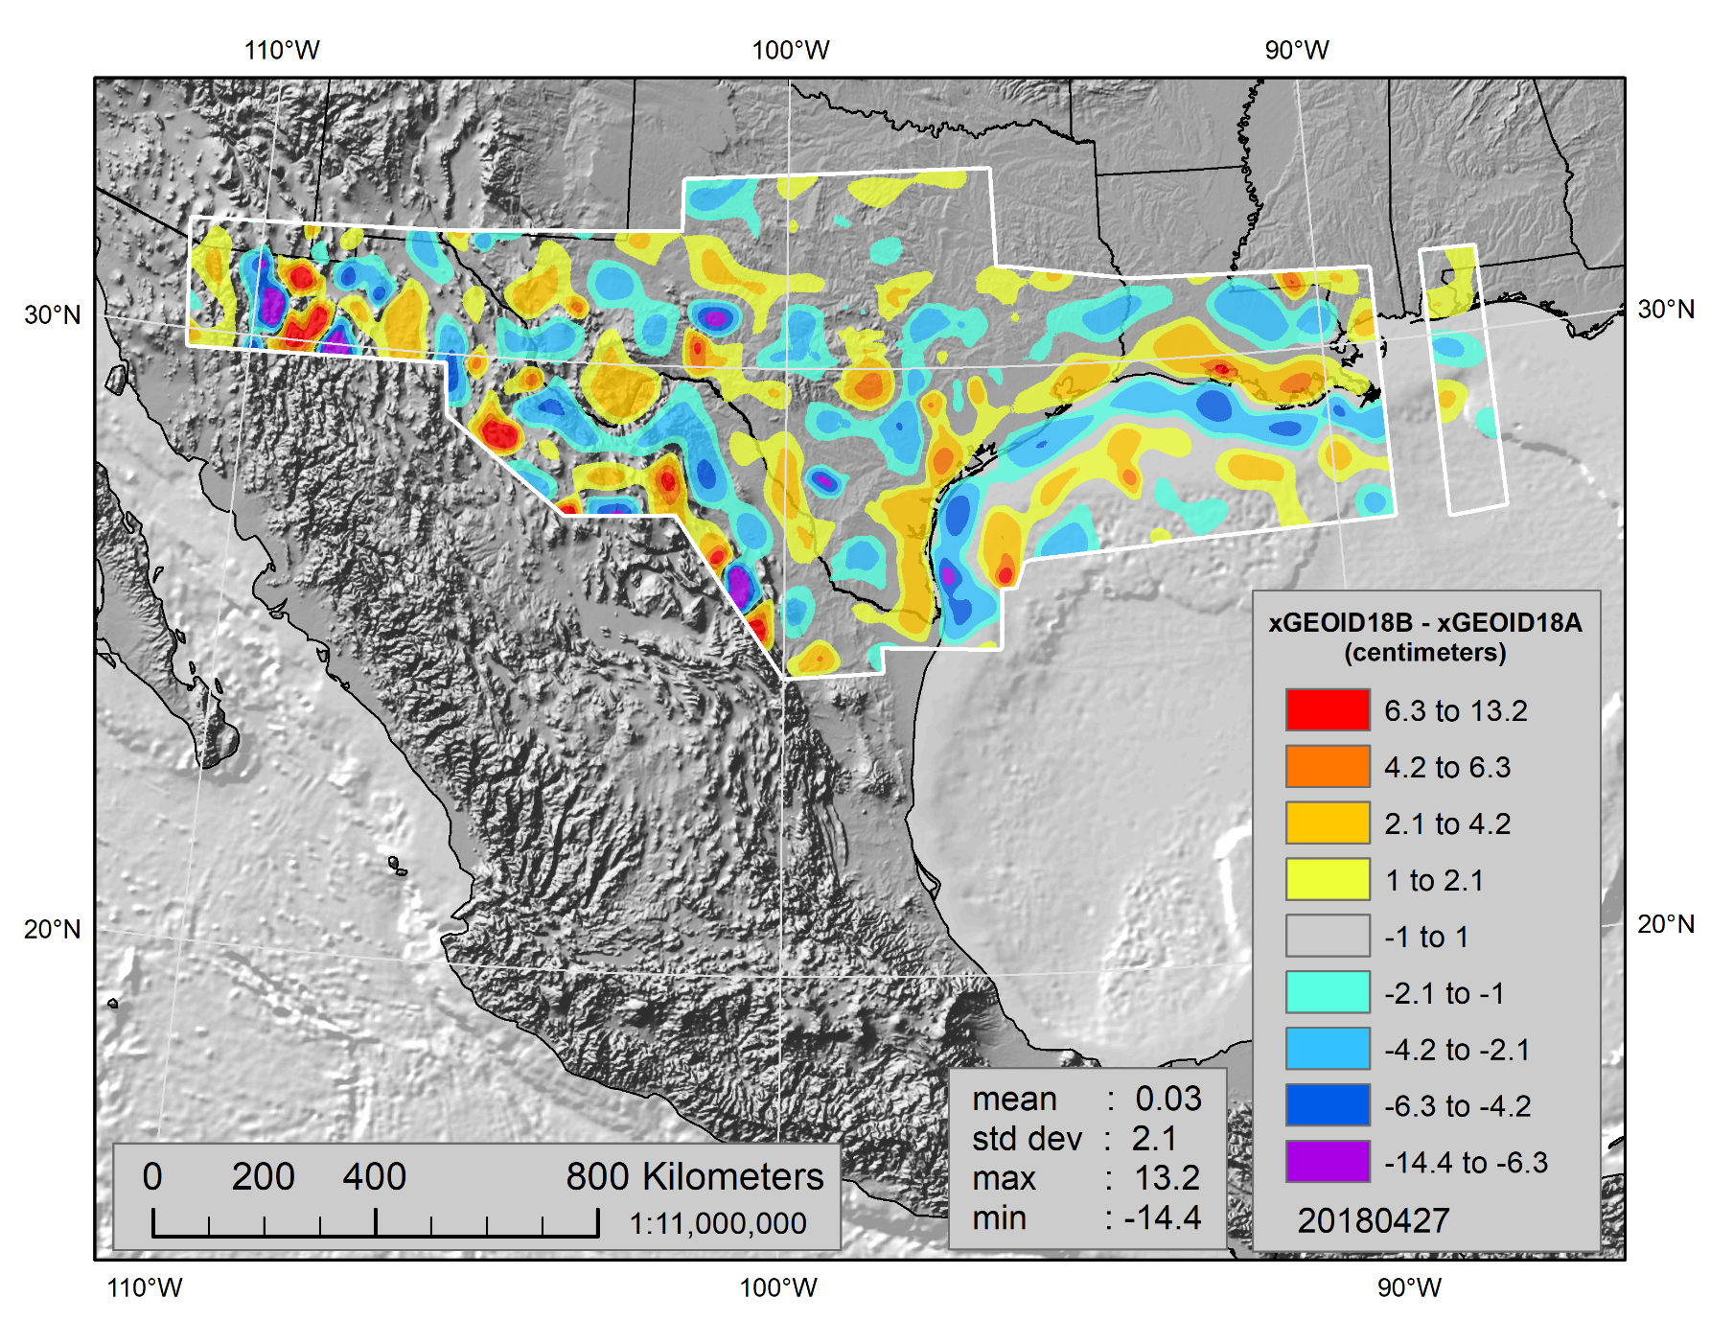
Contribution of GRAV-D to the geoid

Slide 10
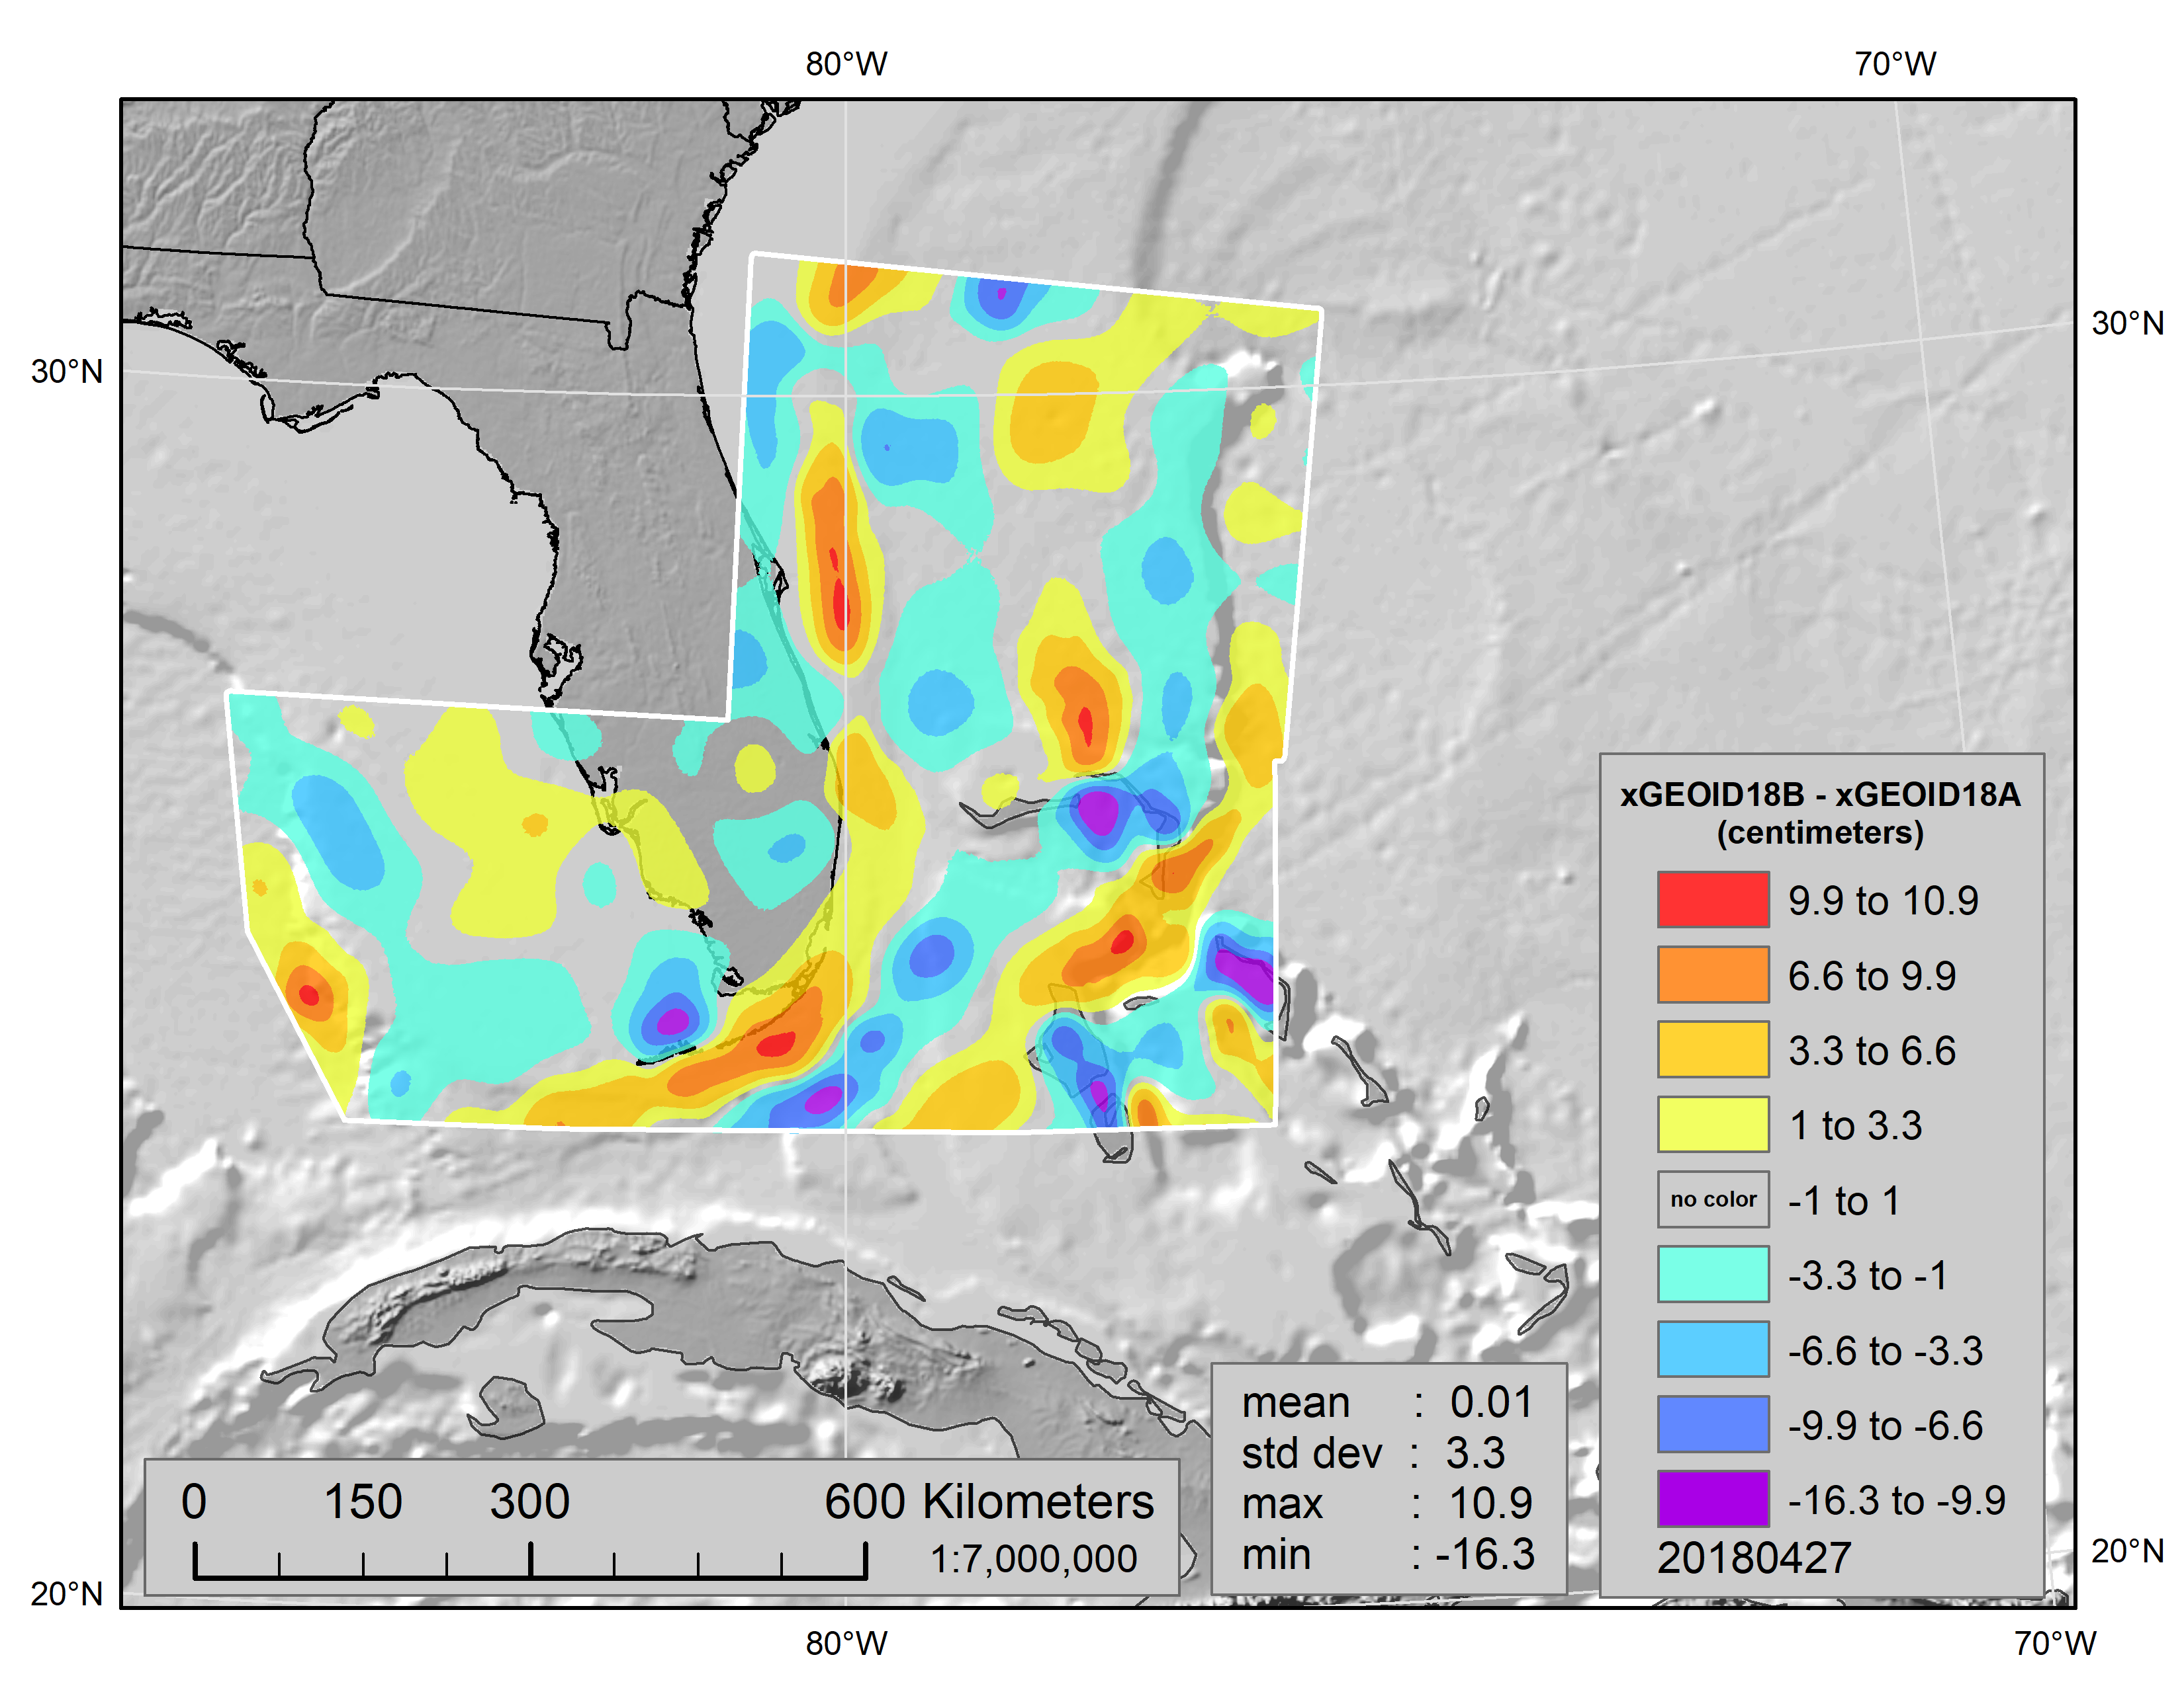
Contribution of GRAV-D to the geoid

Slide 11
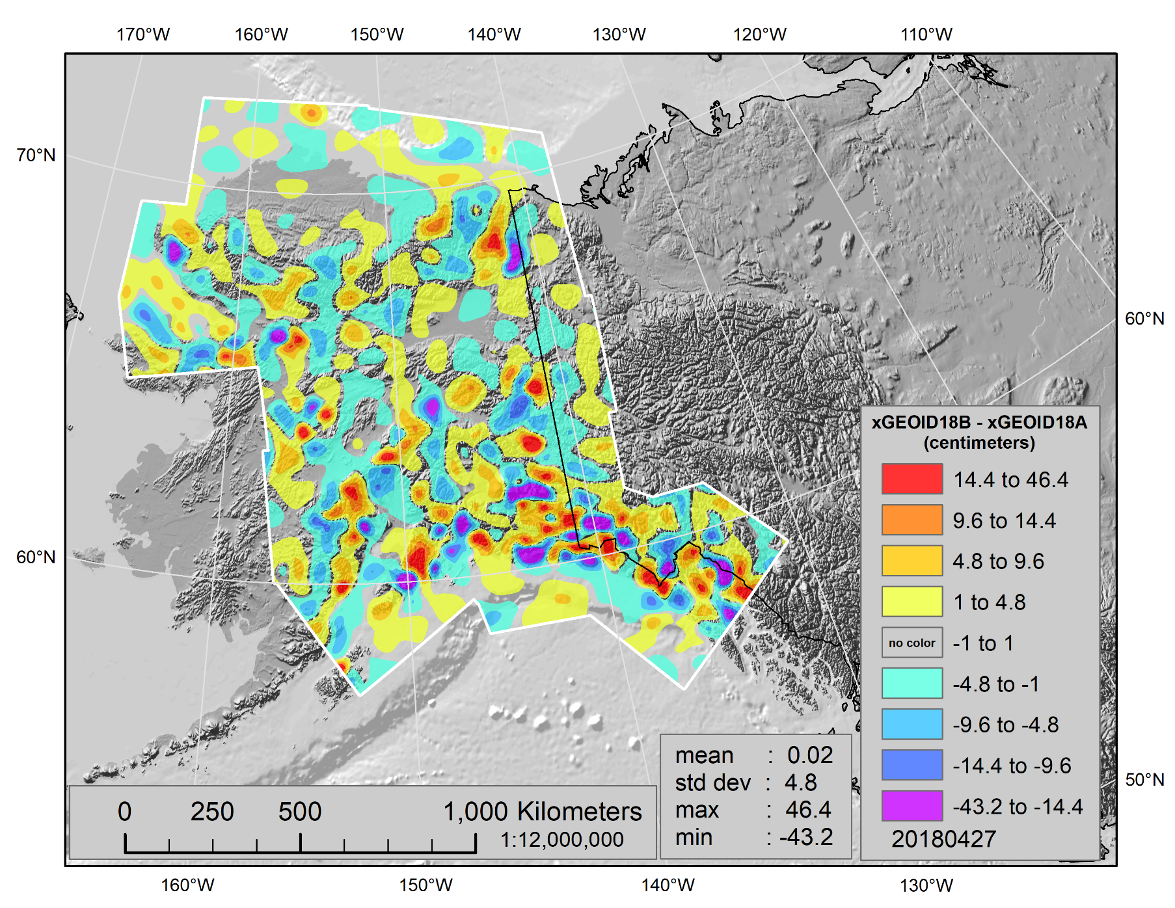
Contribution of GRAV-D to the geoid

Slide 12
NGS Web interactive computation
https://dev.nosngs.noaa/GEOID/xGEOID18/computation.shtml

Slide 13
Example: Output of interactive computation
Note: The GRS80 ellipsoid is used for both NAD83 and IGS08.
Your input in NAD83 (2011) epoch 2010.00:
Latitude Longitude Ellipsoid Height Station
40 24 32.85015 121 31 46.45612 1968.8 Lassen Peak CA
Your Result in IGS08 epoch 2022.00:
Latitude Longitude Ellipsoid Height
40 24 32.86167 121 31 46.52267 1968.307
The geoid height of GEOID12B (with respect to NAD83): -23.940 m
The orthometric height in NAVD88 (based on GEOID12B): 1992.740 m
Estimated orthometric height in North American-Pacific Geopotential Datum of 2022 (NAPGD2022)
based on different geoid models (all heights in meters):
Geoid Model Geoid Height Ortho Height Ortho(model)-NAVD88(GEOID12B)
USGG2012 -23.598 1991.905 -0.835
xGEOID18A -23.707 1992.014 -0.726
xGEOID18B -23.712 1992.019 -0.721
--------------------------------------------------------------------------------------------

Slide 14
More information
More information can be found at NGS beta website
https://beta.ngs.noaa.gov/GEOID/xGEOID/
Questions?
Contact
Geoid team: ngs.geoid.team@noaa.gov
Dr. Yan Ming Wang: yan.wang@noaa.gov

