Slide 1


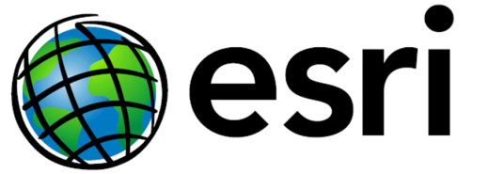
Achieving great heights
with NOAA tools
VDatum: Vertical Datum Transformation Tool
and
LOCUS: Leveling Online Calculations User Service
Michael L. Dennis, RLS, PE
michael.dennis@noaa.gov
SURVEY SUMMIT
The ACSM Annual Conference
July 7-12, 2011 ● San Diego, CA
San Diego Convention Center
®
ACSM

Slide 2
The beauty and the mystery of…
HEIGHTS

Slide 3
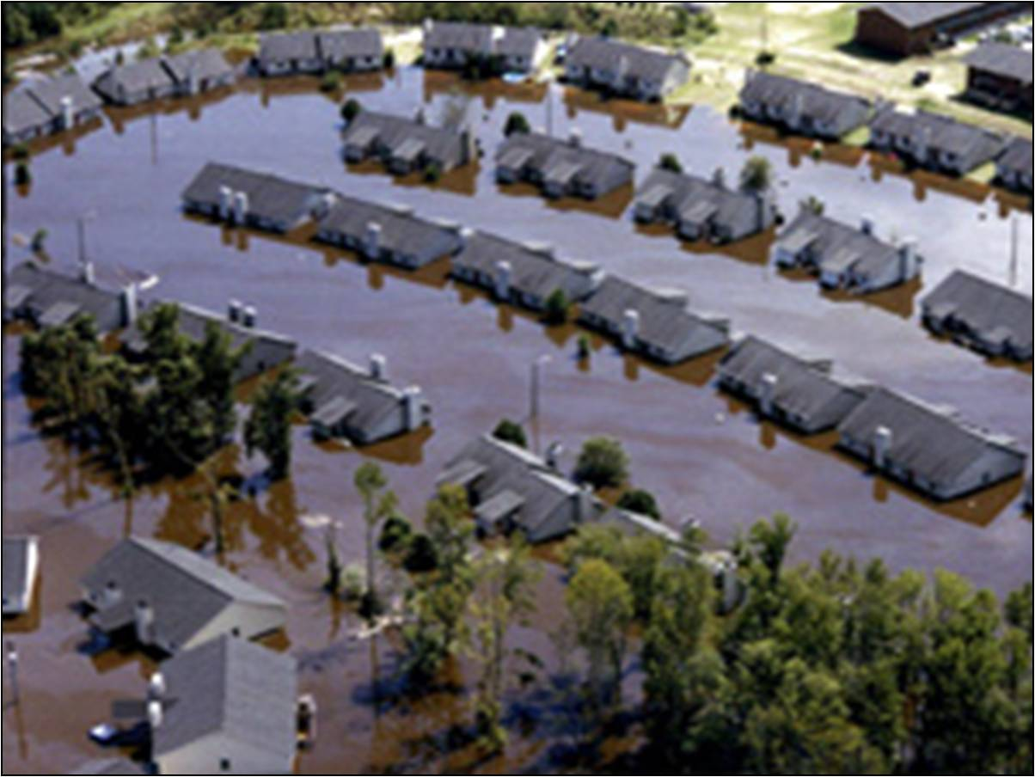
Heights are not merely fascinating…
Physical
Heights Matter!
Notes:
An example of the need for height modernization. Several states, along with North Carolina, have launched major efforts to update vertical positions with height modernization. On September 15, 1999, Hurricane Floyd dropped 21 inches of rain on North Carolina, damaging more than 67,000 homes and destroying nearly 8,000. Many of the homeowners did not have flood insurance, because their residences were built on land that had not been designated as flood prone on the Federal Emergency Management Agency’s (FEMA) Flood Insurance Rate Maps (FIRMs).

Slide 4
Heights are complicated
Heights to suit your every need (and mood)!
  Ellipsoid, geoid, orthometric, dynamic, normal, tidal, leveled, etc.
VDatum
  Converting between height types and datums
LOCUS
  Heights from correction and adjustment of leveling data
What we’re going to talk about
  Why these tools were made
  What they do
  Where to find them
  …but not so much on How to use them

Slide 5
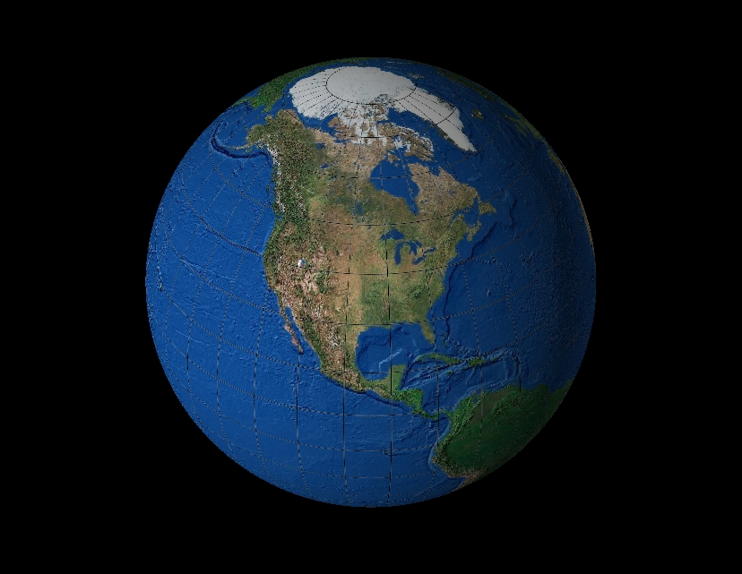
“The Figure of the Earth”
Best-fit spherical
Earth model
Too big by 9 miles at the poles
San Diego
Too small by 4 miles at the equator
Earth mass center
Too small by 4 miles at the equator
Mean
Earth radius,
R ≈ 3959 miles
Equatorial plane
Geoid
(“mean sea level”)
Too big by
9 miles at the poles

Slide 6
Earth model: Ellipsoid of revolution
Best-fit ellipsoid
(e.g., GRS-80, WGS-84)
a = 6,378,137.000 m ≈ 3963 mi
b = 6,356,752.314 m ≈ 3950 mi
Ellipsoid flattening
f = (a – b)/a ≈ 0.335%
1/f ≈ 298.25722
San Diego
b = semi-minor axis
(polar radius)
Earth mass center
a = semi-major axis
(radius of equatorial plane)
Equatorial plane
Ellipsoid fits geoid to
within about ±100 m worldwide
Geoid
(“mean sea level”)

Slide 7
The ellipsoid, the geoid, and you
Deflection of the vertical
You are here
Earth surface
Ellipsoid height, h
Orthometric height, H
Alaska
Mean
sea level
Geoid height, N_{G}
Ellipsoid
Geoid
h ≈ H + N_{G}
h = H + N_{G}
Note: Geoid height is negative everywhere in the coterminous US
(but it is positive in most of Alaska)

Slide 8
But wait – there’s more!
Physical heights
  Orthometric heights
    Helmert (NAVD 88), Niethammer, Mader, New Brunswick, etc.
  Dynamic heights
  Normal heights
  Normal orthometric heights (e.g., NGVD 29)
  Leveled heights
Geoid heights
  Gravimetric? “Hybrid”? Quasi-geoid?
Ellipsoid heights
  referenced to many different datums
Thank heavens for good ol’ mean sea level! …?

Slide 9

VERTICAL TIDAL DATUMS
Height only has meaning when referenced to some starting point.
Local MSL “elevation”
Mean Higher High Water
Mean High Water
Local Mean Sea Level
Mean Low Water
Mean Lower Low Water
Notes:
Elevation only has meaning when referenced to a starting point.
In this case, the starting point is LMSL for the elevation value at the top of the hill.

Slide 10
Maritime Boundaries
AL, AK, CA, CT, FL, GA, MD, MS, NJ, NY, NC, NH, OR, RI, SC, WA
Territorial Sea
Privately Owned
Uplands
State Owned
Tidelands
Contiguous Zone
US EEZ
(fisheries)
Exclusive Economic Zone (international)
State Submerged Lands
Outer Continental Shelf
3 n. mi.*
High Seas
12 n. mi.
MHHW
24 n. mi.
MHW
200 n. mi.
MLLW
Chart Datum
Privately
Owned
State
Owned
Privately
Owned
State
Owned
HI, LA, TX
* TX, the Gulf Coast of FL, and Puerto Rico claim submerged lands to 3 marine leagues or 9 n. mi
DE, MA, ME, PA, VA
Notes:
Elevation only has meaning when referenced to a starting point.
In this case, the starting point is LMSL for the elevation value at the top of the hill.

Slide 11
Bringing it all together
How are all these different heights related?
  Physical, tidal, geoid, and ellipsoid (geometric) heights
  Ellipsoid ht = Orthometric ht + Geoid ht
  Global MSL = Geoid surface (geoid ht = 0)
  Local MSL = Global MSL + Topography of the Sea Surface (TSS)
  Tidal datums = Local MSL + Tide models
Models are used to relate these heights

Slide 12
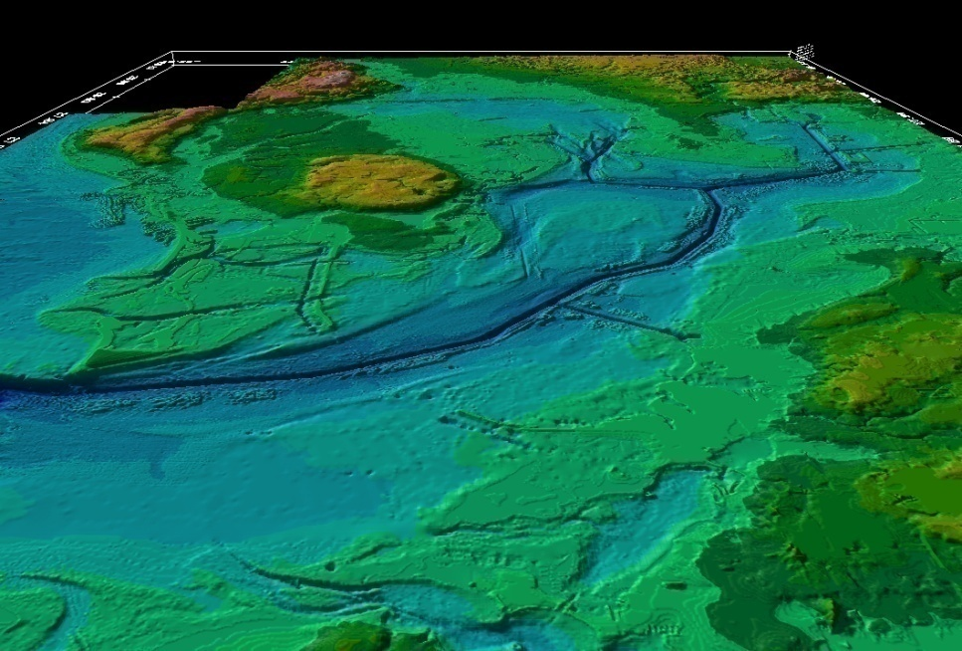
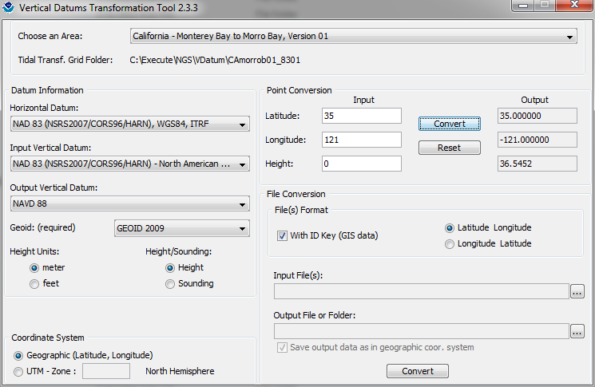
Development and Use of VDatum -
a Vertical Datum Transformation Tool
NOAA’s
National Geodetic Survey
Office of Coast Survey
Center for Operational Oceanographic Products & Services
Mapping the Land-Sea Interface
Notes:
Vertical Datum Transformation (VDatum) is a free software tool under development jointly by NOAA's National Geodetic Survey (NGS), Office of Coast Survey (OCS) and Center for Operational Oceanographic Products and Services (CO-OPS).
VDatum is designed to transform geospatial data among a variety of tidal, orthometric and ellipsoidal datums - allowing users to convert their data from different references to a common system ,
This helps to enable the fusion of a diversity of geospatial data onto a preferred vertical datum.

Slide 13
Tri-Office VDatum Team
NGS
Doug Brown- Program Manager
Eric Berkowitz (Development)
Steve Randall (Development & Operations)
Stephen White (Development)
Chris Parrish (Development)
Tom Soler (Development)
Bang Le (Development & Operations)
Joe Evjen (Operations)
Inseong Jeong (Development)
OCS
Maureen Kenny – Development Team Lead
Ed Myers (Development)
Kurt Hess (Development)
Corey Allen (Operations)
Julia Skory (Development)
Jiangtao Xu (Development)
Zizang Yang (Development)
CO-OPS
Manoj Samant – Operations Team Lead
Steve Gill (Development)
Jerry Hovis (Development & Operations)
Lijuan Huang (Operations)
David MacFarland (Operations)
Mike Michalski (Development & Operations)
Laura Rear-McLaughlin (Operations)
Hua Yang (Operations)
David Wolcott (Production)
James Taylor (Production)
Notes:
The slide shows the people from each office who are in some way involved in the VDatum Program (as of January 2011).

Slide 14
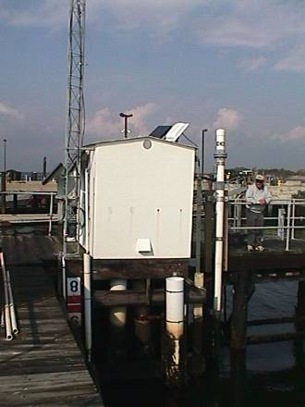
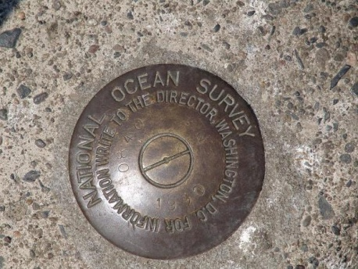
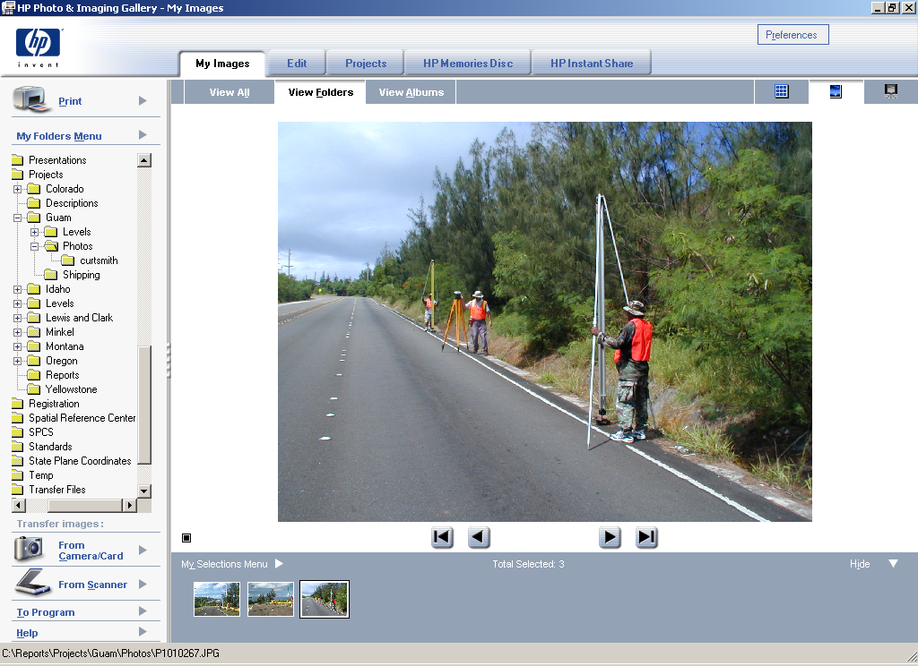
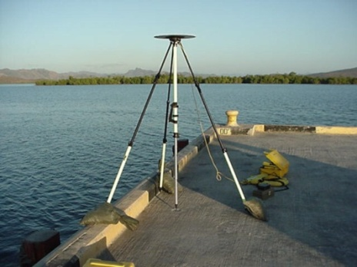
Vertical Datums - 3 height systems
A surface to which heights are referred.
Tidal Datums (Tide Stations)
  Defined by observation of tidal variations over a specified epoch of time
    Mean Lower Low Water (MLLW)
    Mean Sea Level (MSL)
Orthometric Datums (Leveling)
  Related to the geoid
  Heights from differential leveling
    North American Vertical Datum 1988 (NAVD 88)
Ellipsoidal (3-D) Datums (GPS)
  Related to an ellipsoidal model of the Earth
  Heights directly from GPS
    North American Datum 1983 (NAD 83)
Notes:
This is the first of 6 slides that provide background on datum as a lead into a more detailed discussion of VDatum…
Most of the transformations offered by the VDatum tool are for vertical datums.
A vertical datum is a level surface to which elevations are referred, usually, MSL but may also include MLLW for charting purposes, MHW for shoreline delineation, or any arbitrary surface.
Tidal datums are defined by the observation of tides over a 19 year period. MLLW and MSL are tidal datums.
Orthometric datums are associated with the geoid model of the Earth and traditionally acquired by differential leveling. NAVD 88 is an orthometric datum.
Ellipsoidal datums are related to the ellipsoidal model of the Earth with heights derived from GPS. NAD 83 is an ellipsoidal datum.
The slide illustrates examples of each type of datum.

Slide 15

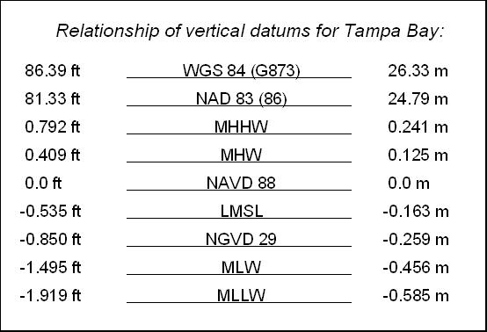
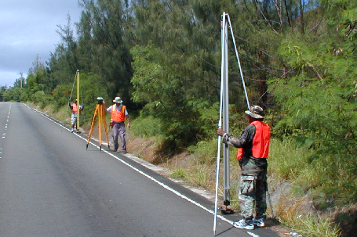
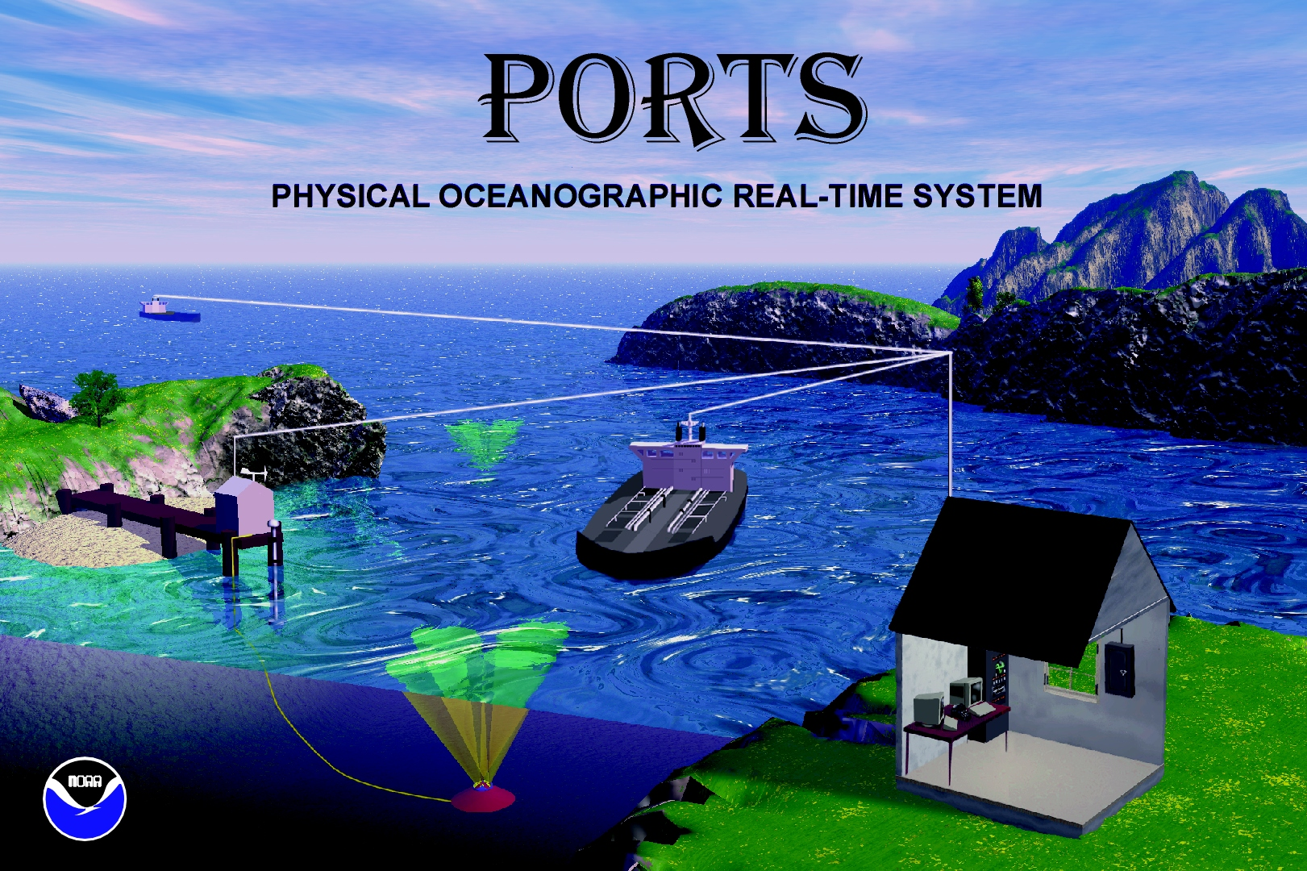
Vertical Datum Relationships
3-D Datums
NAD 83, ITRF xx, IGSxx, “WGS 84”
Ellipsoidal Datums
NAVD 88, NGVD 29
Orthometric Datums
MHHW,MHW, MTL, DTL, MLW, MLLW
For height datasets to be blended together they must be referenced to same vertical datum.
Tidal Datums
Notes:
There are many ways to describe heights. Here are illustrated different “elevations” for the exact same point dependent on the measurement type and reference datum.

Slide 16
Vertical Datum Transformation “Roadmap”
Orthometric datums
Ellipsoidal (geometric) datums
Tidal datums
WGS 84 (G1150)
Calibrated Helmert Transformations
WGS 84 (G873)
NGVD 29
WGS 84 (G730)
Tide Models
MHHW
WGS 84 (orig.)
ITRF2000
VERTCON
MHW
ITRF97
ITRF96
NAD83 (CORS96)
NAVD 88
LMSL
MTL
ITRF94
ITRF93
DTL
ITRF92
ITRF91
MLW
ITRF90
GEOID99,
GEOID03,
GEOID09
MLLW
ITRF89
TSS
(Topography of the Sea Surface)
ITRF88
SIO/MIT 92
NEOS 90
PNEOS 90
Notes:
This is the VDatum “roadmap”, which illustrates how different datums are transformed from one to another.
Helmert Transformations are used to transform between 3D ellipsoidal datums.
A GEOID model is used to transform data on NAD83 to an orthometric datum like NAVD 88.
A model of the “Topography of the Sea Surface” is used to transform NAVD 88 to LMSL.
A corrected tide model is used to transform from LMSL to a variety of other tidal datums.

Slide 17
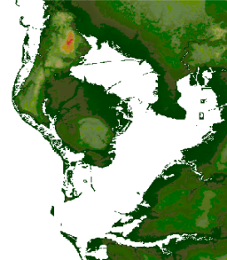
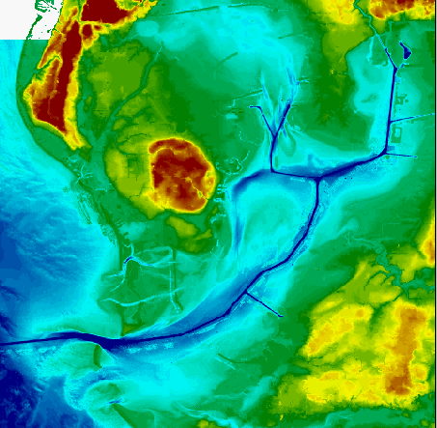
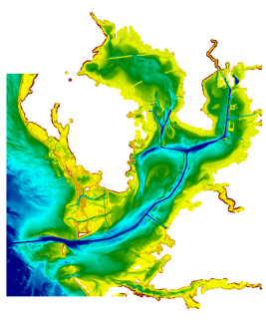
VDatum Used to Create Digital Elevation Models
VDatum
Bathy/Topo
Digital Elevation Model
Topography
Bathymetry
Applications for Seamless Bathy/Topo Datasets:
Inundation modeling from storm surge, tsunamis, and sea level rise.
Erosion, accretion, renourishment
Analyzing storm impacts
Determining setback lines
Determining local, state, and national boundaries
Navigation products and services
Habitat restoration
Shoreline change analysis
Analyzing environmental and natural resources
Permitting
Notes:
Merging data sets in coastal areas is important in a range of applications, which are shown at the bottom of the slide.
VDatum enables spatial information from different environmental sectors such as topographic and bathymetric data to be mapped onto one uniform surface.
This is why VDatum is considered an enabler of IOCM.

Slide 18
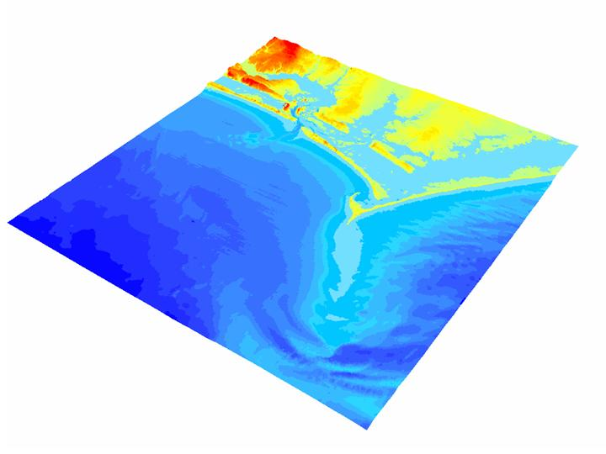
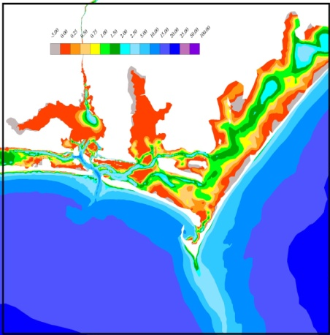
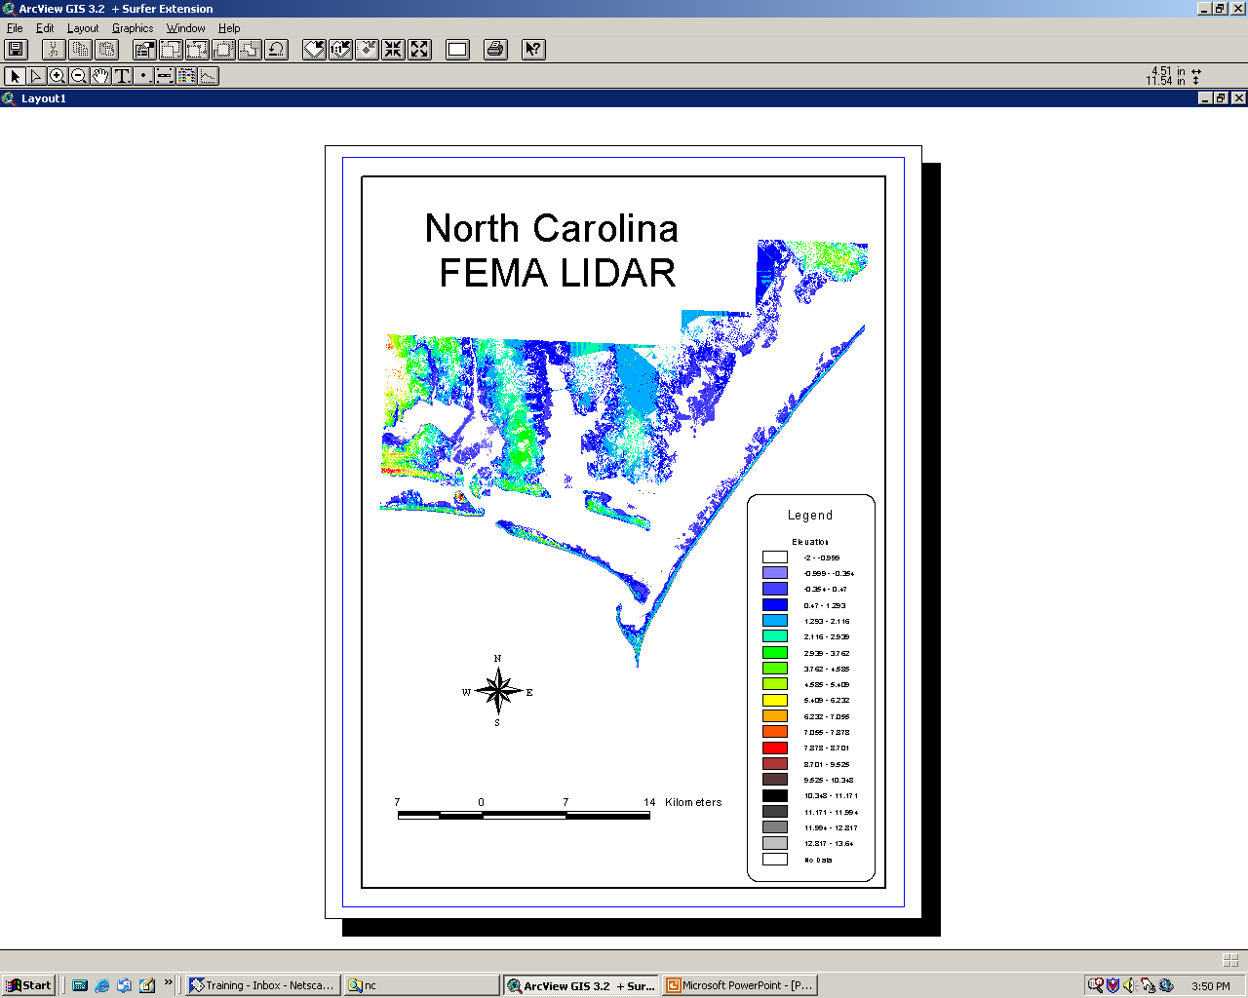
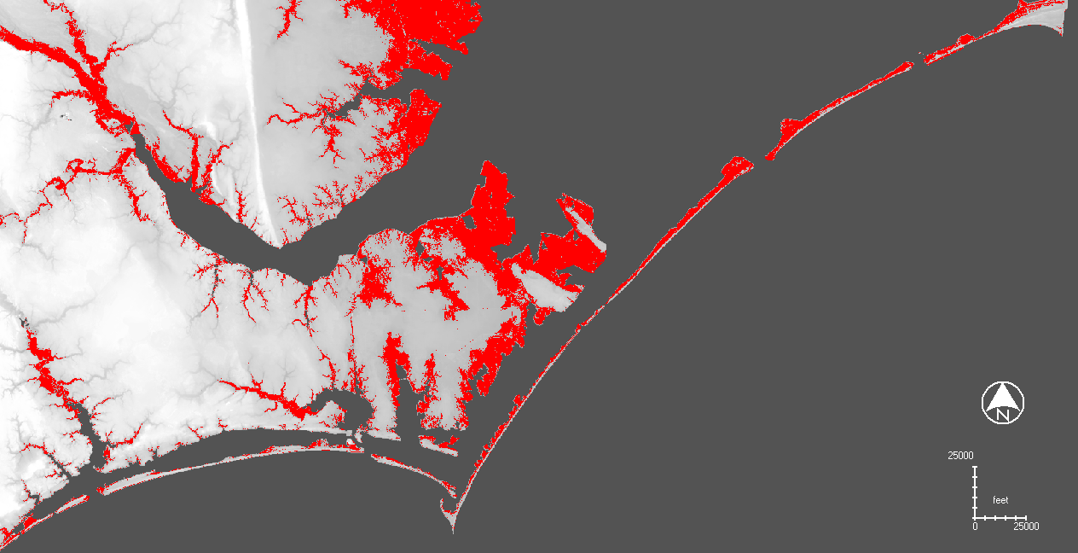
North Carolina Sea Level Rise Project –
a VDatum application
Create an integrated bathy/topo DEM
to assess sea level rise
NOAA
Bathymetry
Land
Elevations
Areas inundated
with a 1.0 m SLR
Notes:
This is an example of where VDatum was used to merge existing spatial datasets including NOAA bathymetry & FEMA Lidar along the NC coast.
The VDatum tool allowed the vertical datum issues to be resolved and for the creation of a seamless model of topography and bathymetry.
Using this model, sea level rise scenarios can be analyzed.

Slide 19
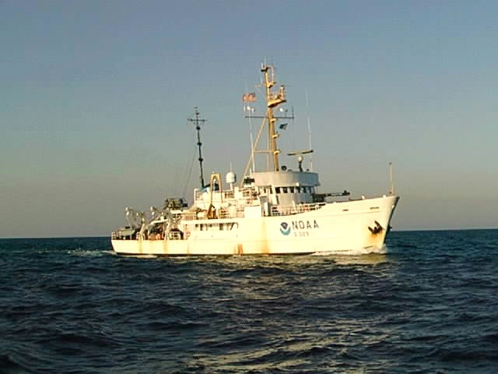
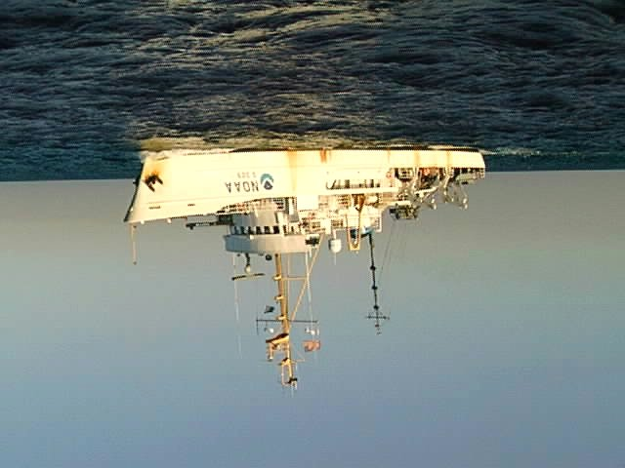

Surveying on the Ellipsoid
Advantages
  Eliminate labor intensive tidal zoning
  Reduce vertical uncertainty from heave, dynamic draft
Ellipsoid
MEASURED
KNOWN
using
VDatum
KNOWN
MLLW
COMPUTED
(depth MLLW)
MEASURED
Notes:
Surveying on the Ellipsoid is an important application of VDatum for NOAA, the Corps of Engineers and other hydro surveying organizations.
It holds the promise of acquiring hydrographic survey depths using kinematic GPS for vertical referencing.
In other words, it will allow hydrographic surveyors to determine the water depths related to a charted tidal datum directly from GPS observations, without having to determine the chart datum from measuring discrete tides.
By surveying on the ellipsoid, uncertainties resulting from vessel heave and dynamic draft can also be accounted for.

Slide 20
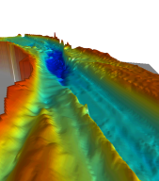
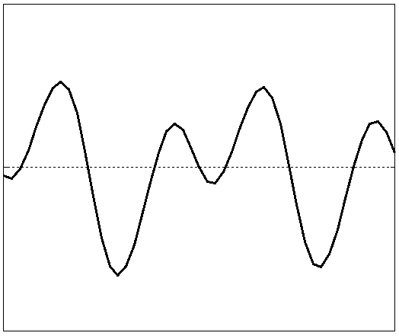
Steps to VDatum
Assess tidal & geodetic needs (CO-OPS)
Acquire base observational data (Tri-Office)
Model tidal datum variations across region (OCS)
Build topography of the sea surface (NGS)
Build grid of all transformations (OCS + NGS)
Determine uncertainty of model (OCS + NGS)
Notes:
This is the first of several slides devoted to production of a VDatum model…
Developing a VDatum model is NOT an easy process.
It starts with assessing the tidal and geodetic needs for developing a VDatum model of a specific region.
Based on the assessment, observational data are collected.
This includes tide guage data over a period of at least a month
… and GPS observations of BMs tied to the tide guages,
… and updates to the geoid model based on any GRAV-D data available.

Slide 21
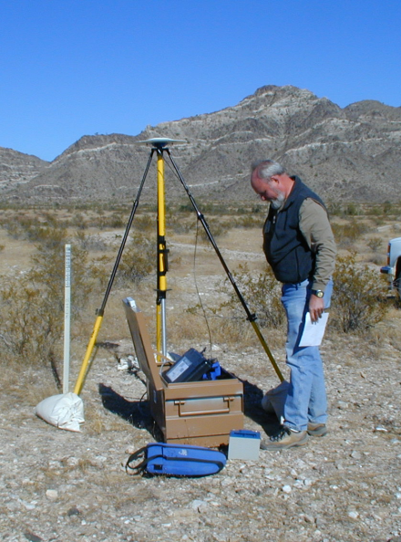

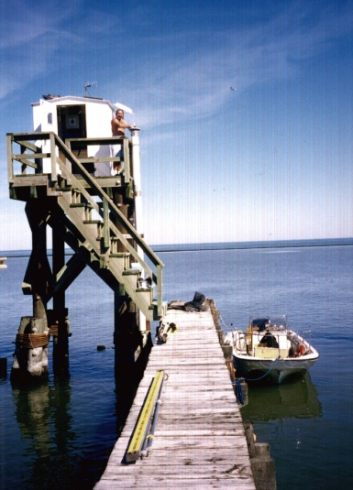
Base Observational Data
GPS observations
Leveling data
Gravity data
Water level data
Notes:
This illustrates the base observational data and the manner in which it is collected

Slide 22
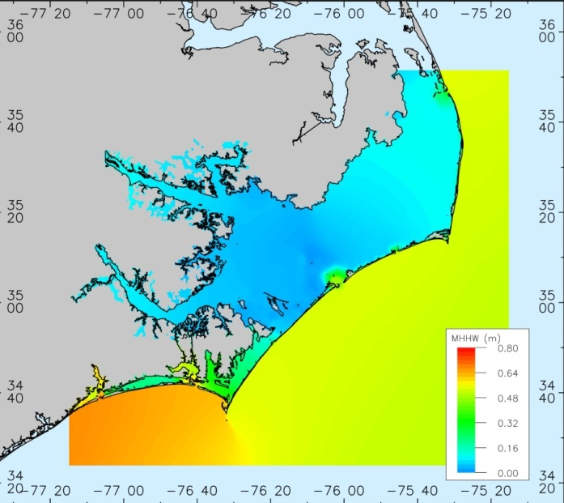
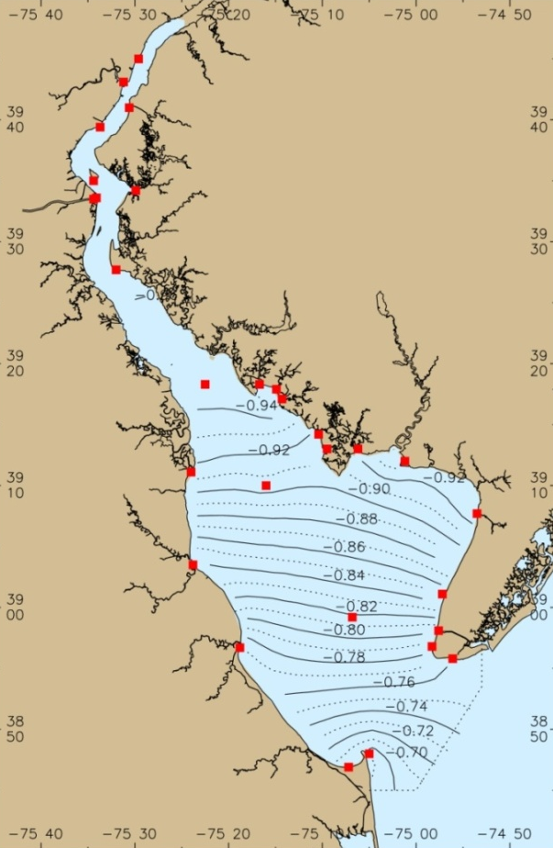
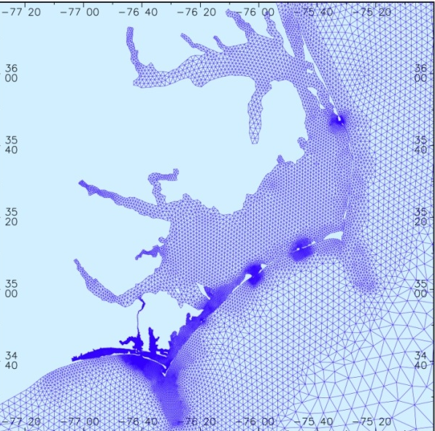
Computing Tidal Datum Variations and Datum Fields
1. Hydrodynamic Model
2. TCARI: Tidal Constituent
And Residual Interpolation
MSL to MHHW
MSL to
MLLW
Solves dynamic equations of water flow - used when tide information is sparse (more accurate)
Spatial interpolation –
used when historical tide
information is dense
Notes:
The next step in the production process is computing tidal datum variations.
Tidal datum variations can be modeled using two basic approaches:
Using hydrodynamic models to simulate a time series of water levels from which high and low waters can be extracted.
Mean values of the highs and lows can then used to create a 2-dimensional field of any particular tidal datum.
Hydrodynamic models can be used across a wide variety of tidal ranges but are computationally intensive.
(2) The 2nd approach is using the Tidal Corrector Application software (TCARI) , which simply interpolates datums between locations of tide stations to create a 2-dimensional field.
TICARI works best in long, narrow embayments where there are many tide stations in the area, like Delaware Bay.

Slide 23
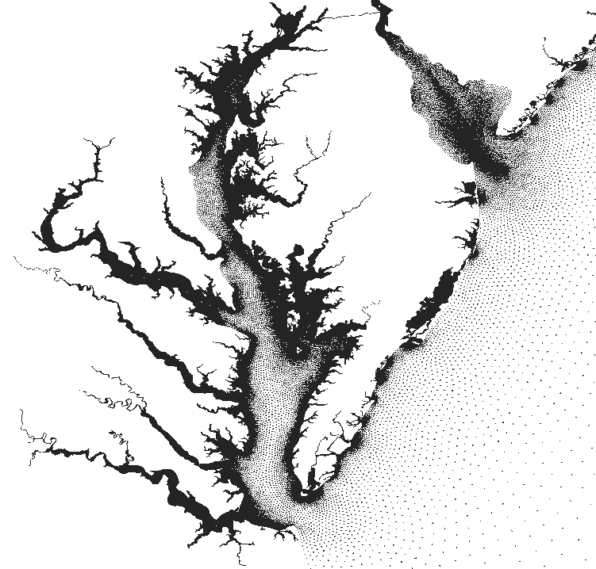
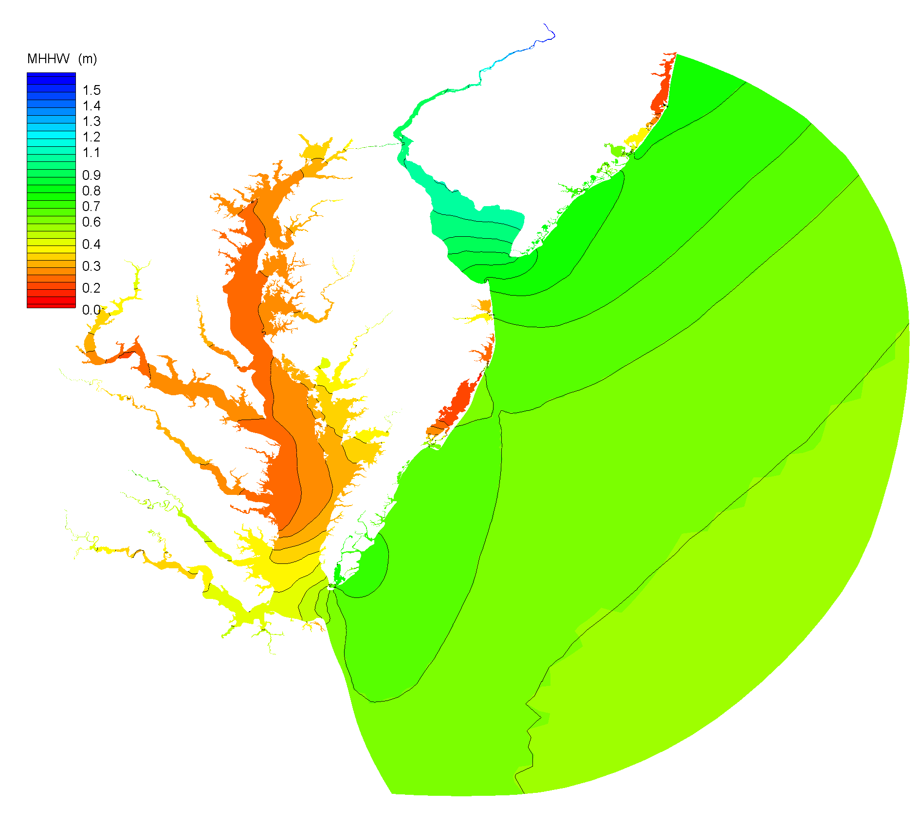
Generation of Tidal Datum Fields
ADCIRC model is used to generate time series of the tides at each grid point.
Final tidal datum fields are corrected to match observations at CO-OPS water level stations.
Corrections are made using TCARI, an interpolation tool based on solution of Laplace’s equation.
Higher High Water
Tidal datums are computed from the time series at each grid point.
High Water
Low Water
Lower Low Water
Notes:
The generation of the tidal datum fields (e.g., MHW, MLW, and MLLW) is currently
done through a blended approach, using a hydrodynamic model referred to as “ADCIRC”
and the TCARI program.
The ADCIRC model is used to generate a time series of the tides at each point in the field.
… and tidal datums are computed from the time series at each point.
Discrepancies between the model results and datums derived from CO-OPS tide guage
observations are interpolated with TCARI and applied to the model results to achieve
error corrected tidal datums.

Slide 24
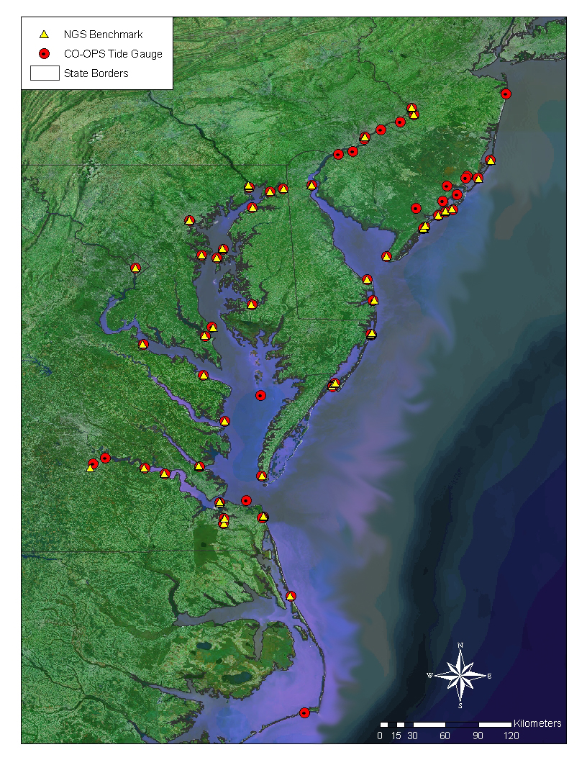
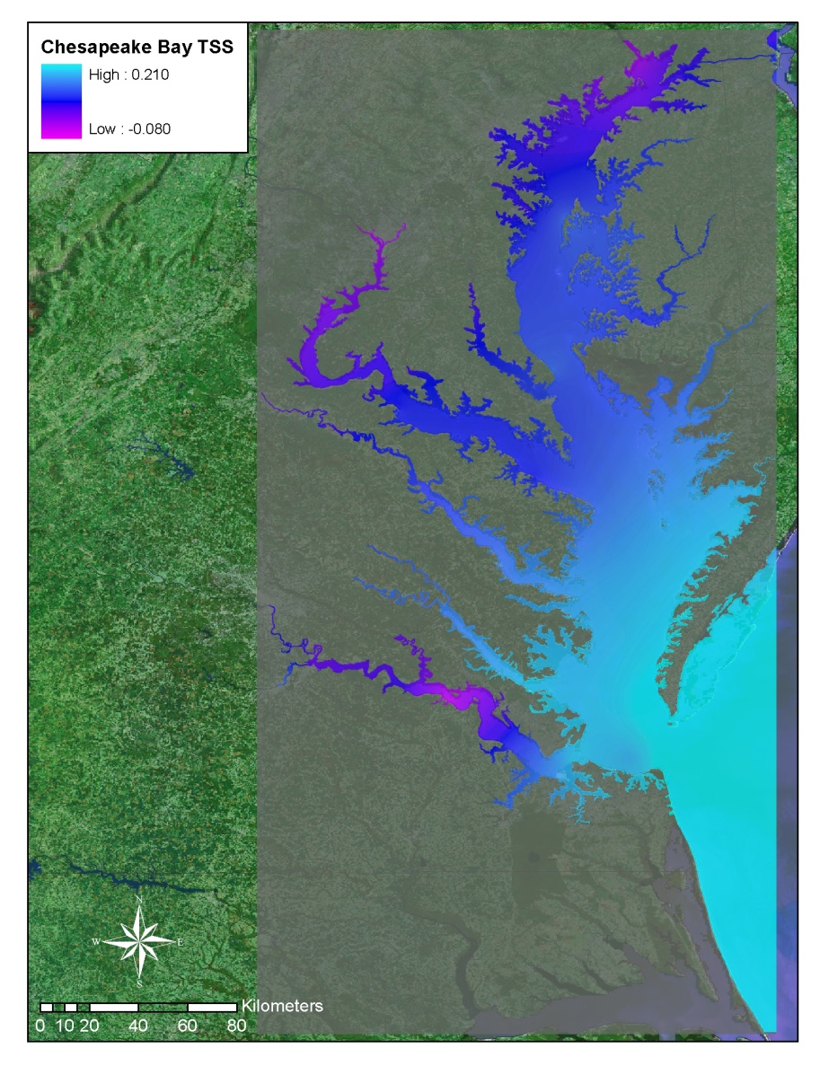
Topography of the Sea Surface
Defined as the difference between NAVD 88 and local mean sea level
Observed NAVD88-MSL differences at benchmark locations are spatially interpolated using a minimum curvature algorithm
Notes:
Developing the Topography of the Sea Surface (TSS) is the next step.
It is defined as the elevation of the North American Vertical Datum of 1988 (NAVD88) relative to local mean sea level (LMSL).
In the VDatum Road Map, this grid allows for the transformation of NAVD 88 based data to LMSL over the region.
A positive value specifies that the NAVD88 reference value is further from the center of the Earth than the local mean sea level surface.

Slide 25
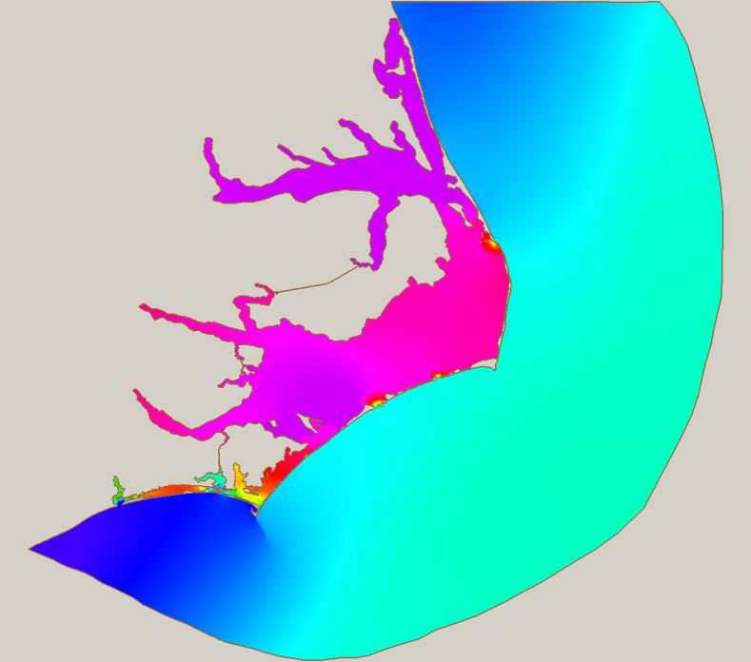
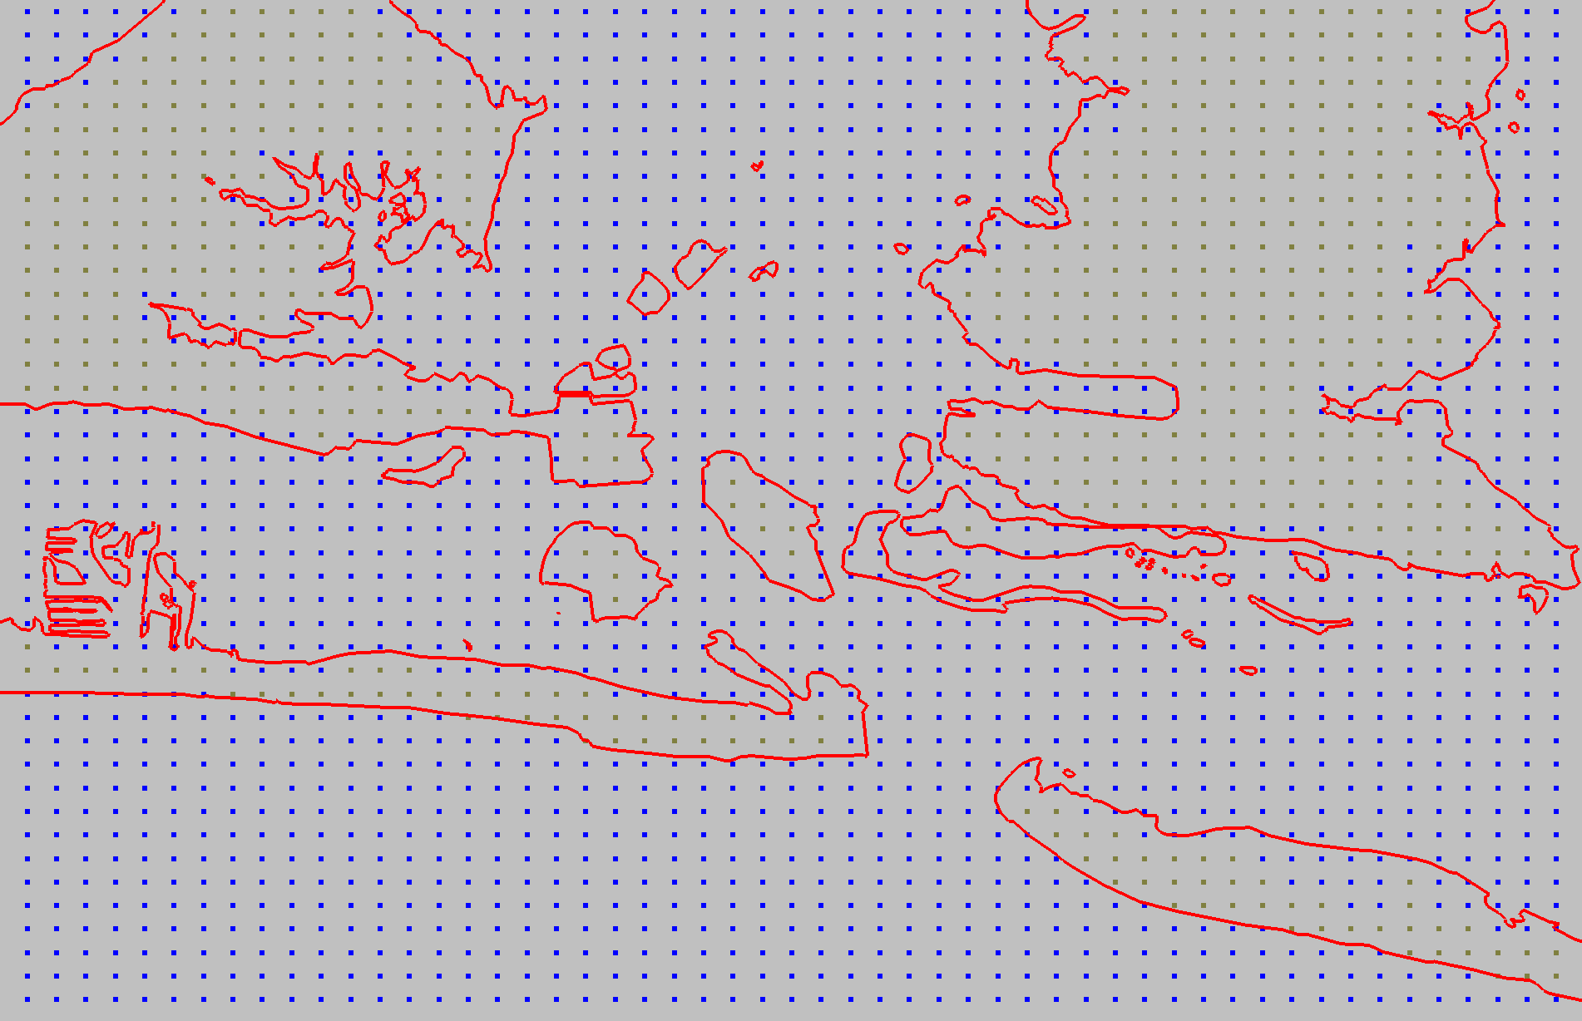
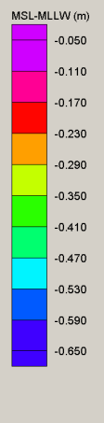
Building a grid of all transformations
Modeled Tidal Datum Fields
VDatum Marine Grid
Datum transformations provided on regularly structured grids to VDatum:
Modeled tidal datum fields
Topography of the Sea Surface (NAVD 88 – to – LMSL field): spatially interpolated using benchmark data and a minimum curvature algorithm
VERTCON transformations between NAVD 88 and NGVD 29
Geoid models
NADCON horizontal datum transformations
Notes:
Referring back to the Road Map… everything except Helmert transformations (between ellipsoid 3-D reference systems) are put on a grid ->
The orthometric and tidal datums are transformed on regularly structured grids as illustrated by on the right.
The modeled tidal datums and TSS are placed on a marine grid or “null” mask. The null areas are where the land appears on the marine grid and used to denote where transformations of these datums are not allowed.

Slide 26
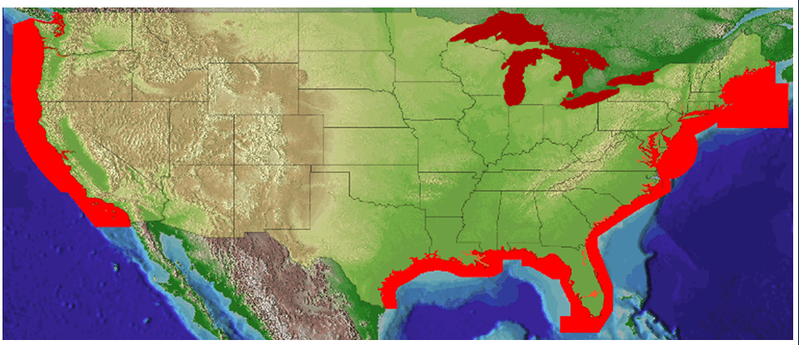
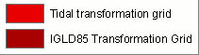
Current VDatum Availability
Notes:
This map illustrates where we have VDatum coverage at present.
The model of the Texas coast is scheduled for release not later than March.
The model for Northern New England is scheduled for release not later than June.
Another model that is in development will cover PR and VI, scheduled for release in the Q1 of FY12.
Transformations to IGLD 85 are available on the VDatum Website.

Slide 27
How accurate is VDatum?
A very important question for ALL transformations!
  Answer: It depends…
Accuracy analysis separated into 3 components:
  Ellipsoidal (geometric) transformations
    E.g., NAD 83 ←→ “WGS 84” (aka ITRF, IGS)
  Vertical datum transformations
    E.g., NAVD 88 ←→ NGVD 29, NAD 83 h ←→ NAVD 88 H
  Tidal datum transformations
    E.g., NAVD 88 ←→ Local MSL
    E.g., Local MSL ←→ MHHW, MHW, MLW, MLLW, DTL, etc.
Uncertainties in geodetic and tidal datums, TSS models

Slide 28
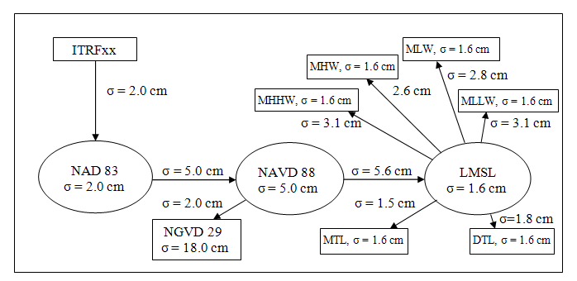
Uncertainty has been calculated for
transformations across the full process (at 1σ)
Chesapeake Bay Region
Ellipsoid
Orthometric
Tidal
Notes:
Users of VDatum must be aware of the uncertainties, or errors, in computed heights in the models.
Errors in VDatum may arise from inaccuracies in either the gridded fields used in the datum transformations, such as GEOID03 , or the MSL to MHHW tidal transformation,
… or inaccuracies may result from the source observational data used to create VDatum, such as the elevation of the tidal datums or the height of the North American Vertical Datum of 1988 (NAVD 88).
The standard deviation (Greek letter sigma) is used to quantify the uncertainty in both the vertical datums and the transformations between them. Standard deviation is a simple measure of the average size of the errors in a data set (when errors are normally distributed)

Slide 29
First Order leveling*
Second Order leveling*
First Order leveling*
1.4 cm
2 cm
1.4 cm
Third Order leveling*
VDatum Example: Chesapeake Bay
4 cm
LMSL
Vdatum Tool
4 cm
11.2 cm
3.6 cm
NAD83
NAVD88*
LMSL
ITRF_XX
11.8 cm
4 cm*
6.3 cm
Real-Time GNSS
6.2 cm
Tidal Observations
7 cm
Geoid
Other tidal datums
Rapid Static 15m
4 cm
2 cm
Rapid Static 1hr
Static 4hr
*Assuming no error in base
* Local accuracy
Error Estimates for Datum transformations (2 σ)

Slide 30
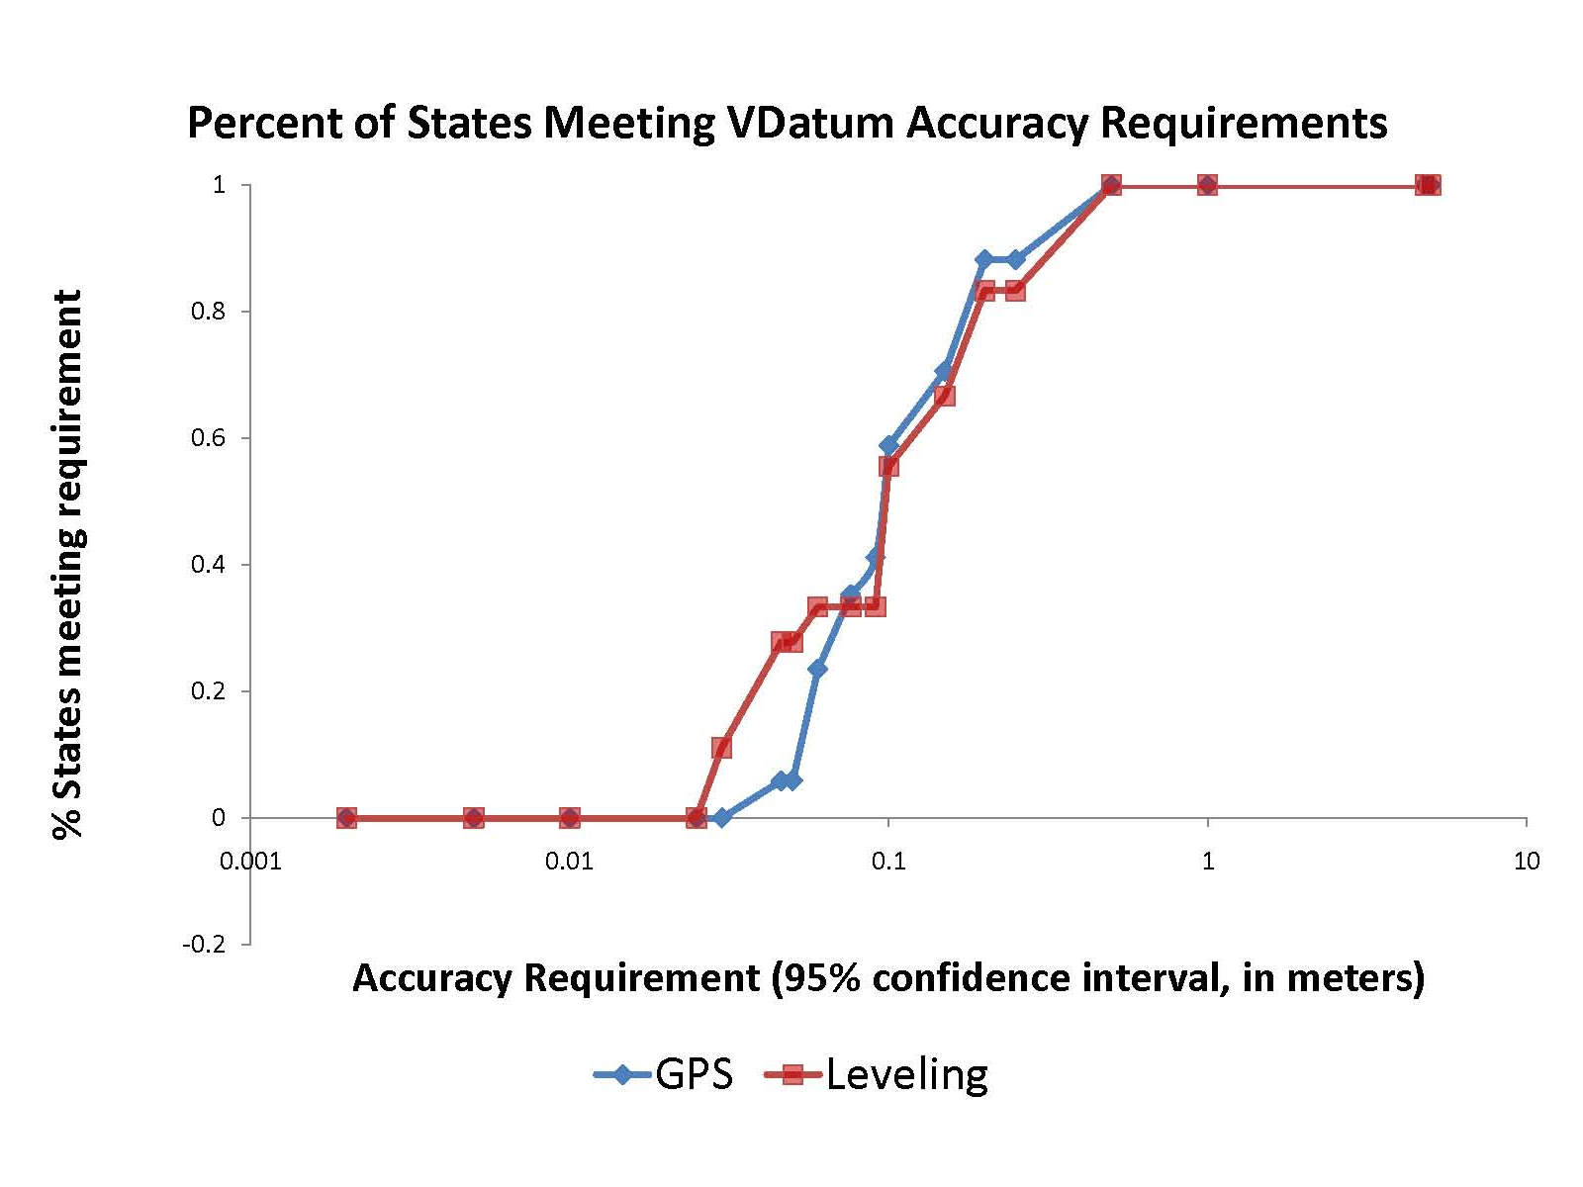
0.5 m
0.03 m

Slide 31
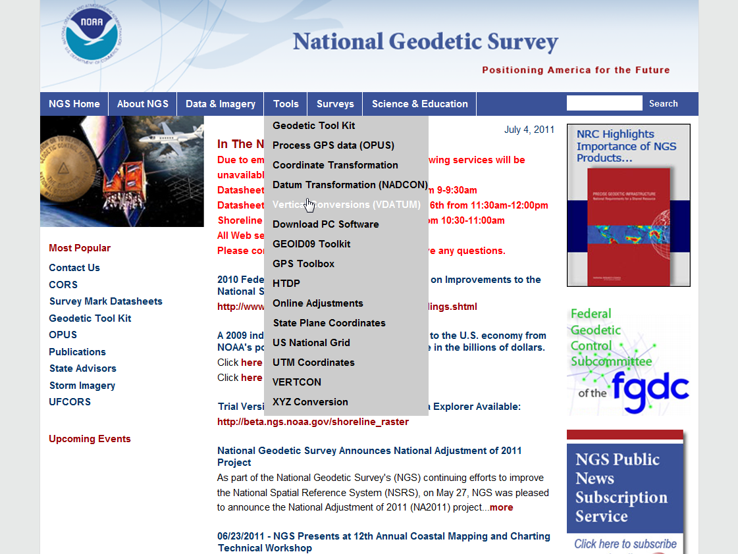
geodesy.noaa.gov
VDatum is cool!
Where and how do I get it?

Slide 32
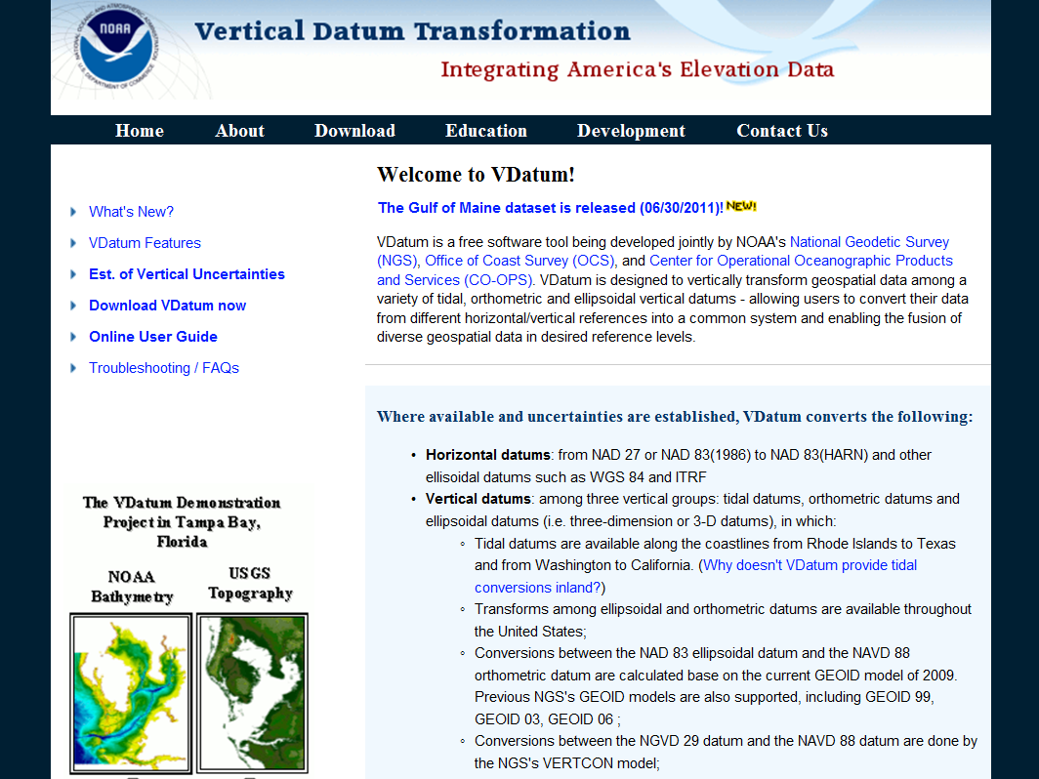
vdatum.noaa.gov

Slide 33
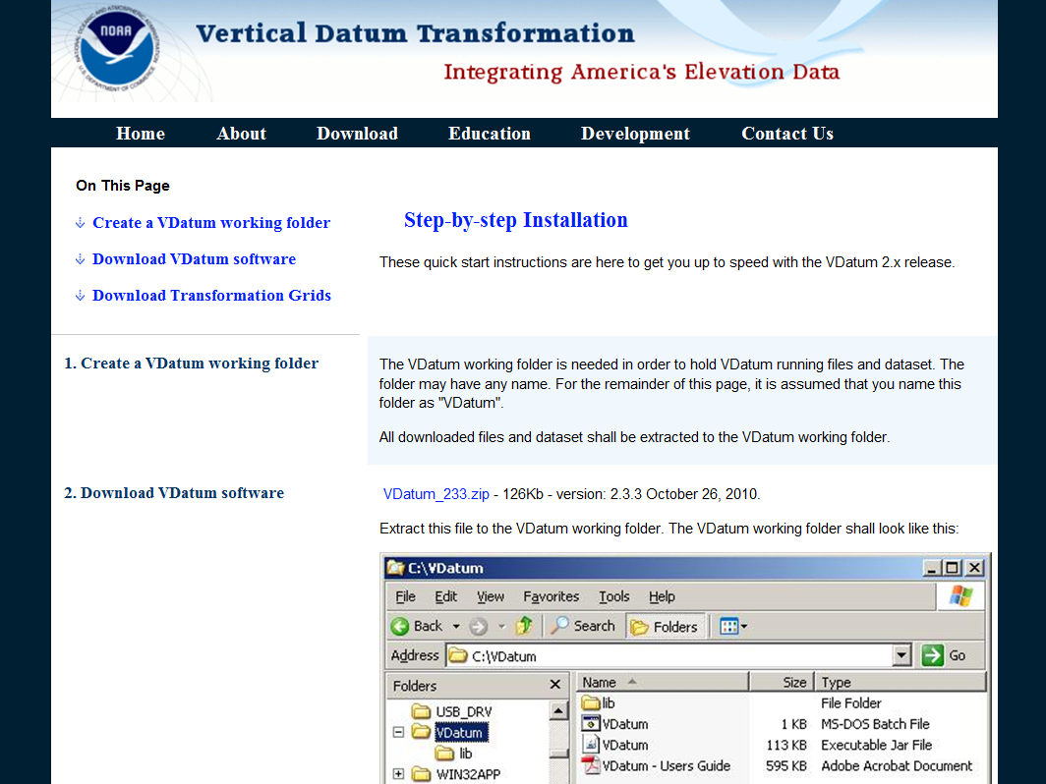
Beta version 3.0 now available for downloading

Slide 34
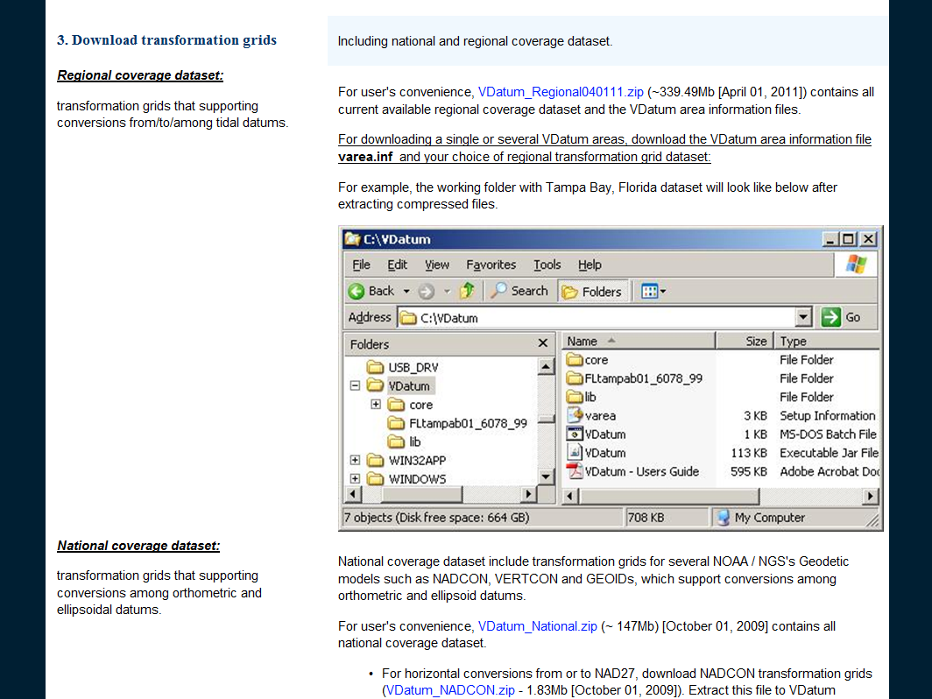
Need this for tidal datum transformations
Need this geoid, NADCON, and VERTCON grids

Slide 35
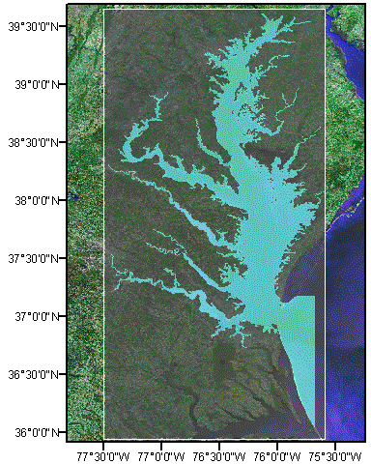
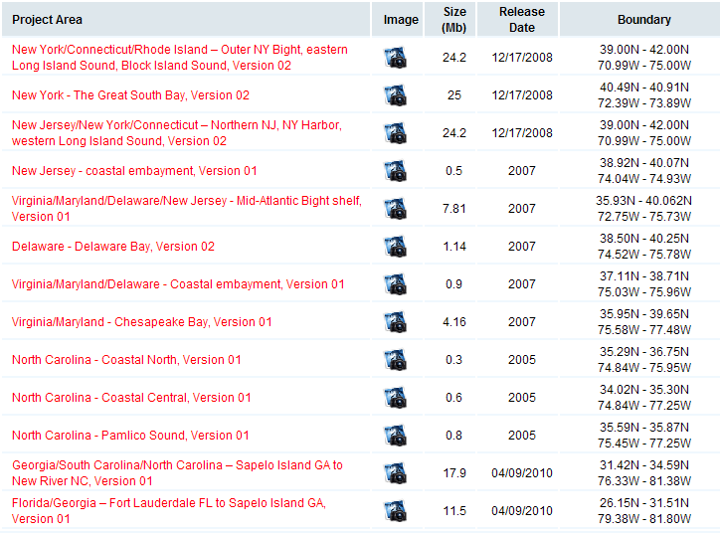
Notes:
This illustrates the VDatum project area for Chesapeake Bay.

Slide 36
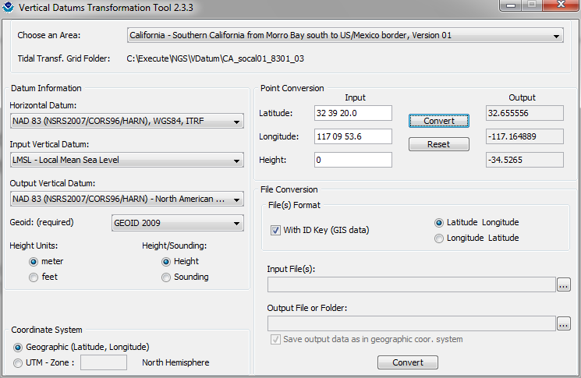
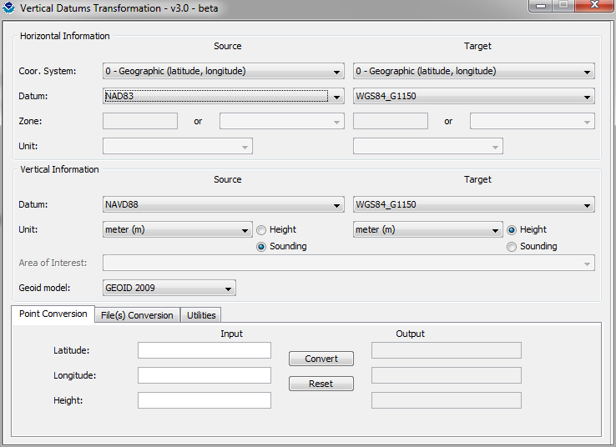
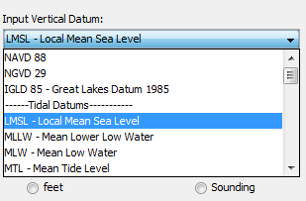
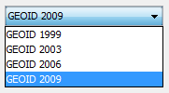
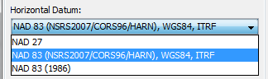
Choose input and output vertical datums:
Choose a geoid model
Choose a horizontal datum
Run as single point, batch, or insert into programming
Notes:
This is the user interface for doing transformations of data from one datum to another!
The user selects the horizontal datum, chooses a geoid model and then clicks on the input and output vertical datums.

Slide 37


Slide 38
VDatum Program Plan
  2011 – Texas & New England (MA ME) Models
  2011 – Updates to existing models (GA & NC)
  2012 – Puerto Rico/Virgin Islands Model
  Requirements analysis to determine maintenance schedule
  Insufficient base data in AK & HI for model development
Notes:
This is the VDatum Model Development Schedule for the near future.
It includes some updates to existing models with GPS surveys of tidal bench marks in GA (completed) and NC. This new geodetic information will be “backfitted” into new versions of the models.
The VDatum Team is wrapping up a requirements analysis, and based on the results, it will determine the schedule for maintenance of models over the next 5 years and how soon we develop initial models for Alaska, HI and the Pacific territories.

Slide 39

Improvements to VDatum
Currently in Development
Methods to validate VDatum uncertainties (e.g., GPS buoys)
Methods to extend uncertainty away from stations
Evaluating extending VDatum tidal datums further inland
Maintenance for tidal datum epoch; geoid and ellipsoid updates
Outreach and training (training ongoing with USACE)
Metadata
Future Developments
New web-based tools for interacting with VDatum results
Improvements to downloadable software
New gravimetric geoid for North America
Addition of 3-D ellipsoidal datum transformations
Notes:
These are some planned improvements toward making VDatum fully operational:
The first bullet is further evaluation of errors connected to transformations and to source data (e.g., NAVD 88) with GPS buoys as a platform for investigating these errors -- a focus during FY11.
The second bullet is to extend uncertainty estimates away from the tide stations. The idea being to provide users with standard deviations and methods to compute uncertainty for transformations in the offshore area of the model.
The third bullet is to consider extending VDatum tidal models further inland. A focus for FY12.
The next bullet is to develop maintenance procedures to ensure VDatum models are accurate and current.
Other improvements in the future include:
Developing GIS compatible output (with CSC assist),
Designing improved an Web interface
Implementing automatic QC measures
Incorporating the new GRAV-D derived gravimetric based geoid in all VDatum calculations

Slide 40
And now for something completely different…

Slide 41

LOCUS
Leveling Online Calculations User Service

Slide 42

What is LOCUS?
LOCUS (Leveling Online Calculations User Service)
Provides tools for users to submit vertical observation data, either from an optical or digital instrument, perform the necessary reductions, apply the needed constraints, and compute heights through a standard least squares adjustment process.

Slide 43
Leveling is simple…
right?
Rod 1
Setup of Leveling, Δn = B – F and S = S_{B} + S_{F}
Rod 2
Backsight
Foresight
B
F
Δn
S_{B}
S_{F}
S
Notes:
Leveling; a very simple form of surveying. Transferring elevation through the use of an observing instrument and calibrated rods with a backsight and a foresight measurement.

Slide 44

Leveled Height Differences
B
Topography
A
C
Notes:
Leveling is a very “simple” survey practice - determining elevation differences through use of conventional leveling procedures – through backsight minus foresight measurements between points A to B and B to C.
Differential leveling surveys, being a “piecewise” metric measurement technique, accumulate local height differences (dh).
But, being a piecewise metric measurement system, we must also be aware and account for factors affecting our understanding and use of height interpretations.
Traditionally, orthometric heights can be considered as a distance (elevation difference) above a reference surface or datum.

Slide 45
Leveling
A more complex process than you might expect
  i.e., if you want UNIQUE and MEANINGFUL heights
Geodetic leveling requires:
  Exacting field procedures
  Many corrections
  Accounting for affect of variation in gravity
  Adjustment of redundant observations
What if some of this could be automated?

Slide 46
From pig ear to silk purse
Leveling corrections
  Rod temperature. Expansion/contraction of rod
  Collimation. Instrument line of sight not exactly horizontal
  Refraction. Bending of light rays as pass through air
  Astronomic. Effect of Sun & Moon on equipotential surface
  Rod scale. Departure from true length; requires calibration
  Magnetic. Deflection of compensator in some instruments
Gravity (“orthometric correction”… sort of)
  Conversion of corrected leveled height differences to geopotential differences using surface gravity
And last but not least (squares)
  Rigorous adjustment of corrected geopotential differences

Slide 47

GRACE Gravity Model 01
- Released July 2003
Image credit:
University of Texas Center
for Space Research and NASA
Notes:
To fully appreciate the reasoning for many of strict requirements for geodetic leveling we must begin with understanding what are orthometric heights.
A realistic “view” of our very irregular shaped Earth as depicted in this gravity model determined from space borne gravity measurements by GRACE, gravity recovery and climate experiment.
Every time we set up and plumb our level equipment we are then determining our horizon through the optics of the instrument perpendicular to the attraction of gravity at that point. Now, envision about 26 setups per mile and hundreds and thousands of setups over distances covering a County, each perpendicular to the attraction at that point on our irregular shaped, curved Earth and you can begin to get the feeling that leveling must be much more than a “simple” routine of backsights minus foresights.

Slide 48
Geoid
Geopotential
surfaces
Ellipsoid
surface
Gravity vector
(aka “plumbline”),
pointing “up”
The relationships between the ellipsoid surface (solid red), various geopotential surfaces (dashed blue), and the geoid (solid blue). The geoid exists approximately at mean sea level (MSL). Not shown is the actual surface of the earth, which coincides with MSL but is generally above the geoid.
Notes:
Looking at a side view of the irregular shaped Earth and the relationships between surfaces of equal potential (equipotential or geopotential surfaces), perpendicular to the attraction of gravity at that point. Note these geopotential surfaces are not geometrically parallel due to the variations in the earth’s irregular gravity field. Also, the geopotential surfaces converge (become closer together) at the poles due in large part to Earth’s rotation.
As you run levels across theses surfaces the equipment is plumbed per the attraction of gravity at that point. Our assumption is that our horizontal field of view can be corrected for a nice consistent Earth curvature when in fact a correction for conditions affecting us at a particular point must be accounted for.
Running levels north and south require more correction for the convergence of the geopotential surfaces than when running levels east and west.
The red oval illustrates the reference ellipsoid for our space based coordinate system and, though a close approximation of the size and shape of the Earth, is an entire, unrelated reference surface when determining GPS-derived ellipsoid heights.

Slide 49
The trouble with leveling…
What is the
“elevation”
here?
H_{C} = ?
Δn_{AC} ≠ Δn_{BC}
Level surface
Level surface
Leveled height
differences, Δn
Level surface
H_{C}
Level surface
Level surface
Level surface at geoid
(“mean sea level”)
H_{A} = 0
H_{B} = 0

Slide 50
…and with orthometric heights
H_{D} ≠ H_{E}
H_{C}
…even though they are on the same level surface
Level surface
Level surface
Level surface
H_{E}
H_{D}
Level surface
Level surface
Level surface at geoid
(“mean sea level”)
H_{A} = 0
H_{B} = 0

Slide 51
Leveling not so simple after all
What if some of leveling could be automated?
  Corrections, conversion to geopotential, adjustment
  Input: Good leveling data, correctly formatted
  Output: Adjusted heights (with accuracies)
OPUS: Online Positioning User Service
  GPS processing software, orbits, models
  Input: Good GPS data, antenna type and height
  Output: Adjusted geodetic positions (with accuracies)
Philosophically, LOCUS similar to OPUS
    OPUS first released in 2000
    LOCUS (beta) out now; official release October 2011 (v1.0)

Slide 52



Slide 53


Additional software needed
Translev: Format and check digital leveling observation data and generate NGS vertical “Bluebook” (*.hgz) files
WinDesc: Create, edit, and format NGS survey control description (*.dsc) files

Slide 54


geodesy.noaa.gov/FGCS/BlueBook
Input: NGS vertical bluebook file (*.hgz)
Analogous to RINEX for GNSS:
Standardized ASCII observation data format (per Federal Geodetic Control Subcommittee)
Can convert digital level files to *.hgz format using Translev

Slide 55



Slide 56

Available Vertical Datums
88 NAVD 88
29 NGVD 29
AS American Samoa of 02 (ASVD02)
G1 Guam of 63 (GUVD63)
GU Guam of 04 (GUVD04)
LT Local Tidal
NM Northern Marianas of 03 (NMVD03)
PR Puerto Rico of 02 (PRVD02)

Slide 57


Slide 58

Geopotential number, C
(gpu)
Orthometric height, H
(m)
H = Orthometric height
C = Geopotential number
= Mean gravity on plumbline
Note: For consistent units, multiply
C in gpu by 10 (to get m²/s²)

Slide 59
LOCUS output
Adjusted orthometric heights
  And geopotential numbers
ASCII text file output
  Constraints report (final results, statistics)
    A more detailed version of output printed to screen
    Includes final results, statistics, loop closure analysis
  More information in additional output files
    Error and warning messages
    Corrections applied, equipment calibration info
    Detailed info on level runs, additional statistics

Slide 60

Life with LOCUS
The Surveyor does the following:
1. Do the leveling and create descriptions (*.dsc) and observations (*.hgz) file (NGS Bluebook format)
2. Submits *.hgz file to LOCUS to compute and adjust leveling observations
3. Gets reliable heights of new bench marks

Slide 61
Life with LOCUS
The Surveyor does NOT:
1. Become an NGS contributor of geodetic data
2. Submit information about instruments and calibrations of rods for entry into NGS database
3. Get new bench marks published in NGS database
Note: When instrument and rod information are not in NGS database, these corrections not made, but LOCUS will still give results (with warnings)

Slide 62
LOCUS Project Plan… and Vision
Beta version 1.0 under development
  July 2011: Begin final internal review by NGS
    August 2011: Release for public comment
  October 2011: Release version 1.0
Future developments
  Add features/refine LOCUS for version 2.0 release
Vision
  Simplify and automate as much of the leveling computation process as possible
  Add ability to do network (multi-line) adjustments
  Provide streamlined means for users to Bluebook

Slide 63


Resources
Resources…
geodesy.noaa.gov
Training
  http://www.ngs.noaa.gov/web/science_edu/training/
  Leveling workshops given throughout US
  Corbin Training Center, near Fredericksburg, VA
Publications
  NGS NOS 3, “Geodetic Leveling” (1981)
  NGS NOS 34, “Corrections Applied by the National Geodetic Survey to Precise Leveling Observations” (1982)
  NGS Benchmark Reset Procedures (2010)
  NGS NOS 3, “Geodetic Leveling” (1981)
  NGS NOS 34, “Corrections Applied by the National Geodetic Survey to Precise Leveling Observations” (1982)
  NGS Benchmark Reset Procedures (2010)

Slide 64
Conclusions
VDatum: “Integrating America’s Elevation Data”
  A tool for converting and combining spatial data referenced to different datums
  Focus is vertical, but also “horizontal” (geometric)
  Accuracies well-documented
LOCUS: Automated geodetic leveling calculations
  Perform corrections, gravity conversions, adjustment
  Determination heights from leveling (and accuracies)
Both make heights more accessible and reliable

Slide 65
Questions? Comments?
VDatum: Doug Brown
  douglas.brown@noaa.gov, 301-713-3222 x166
LOCUS: Jeff Olsen
  jeff.olsen@noaa.gov, 301-713-3215 x124
Interested in LOCUS v1.0 beta testing?
  Will begin for public in late July/early August
  Send an email to Jeff Olsen expressing interest
    Or give me your contact information after this presentation

