Slide 1
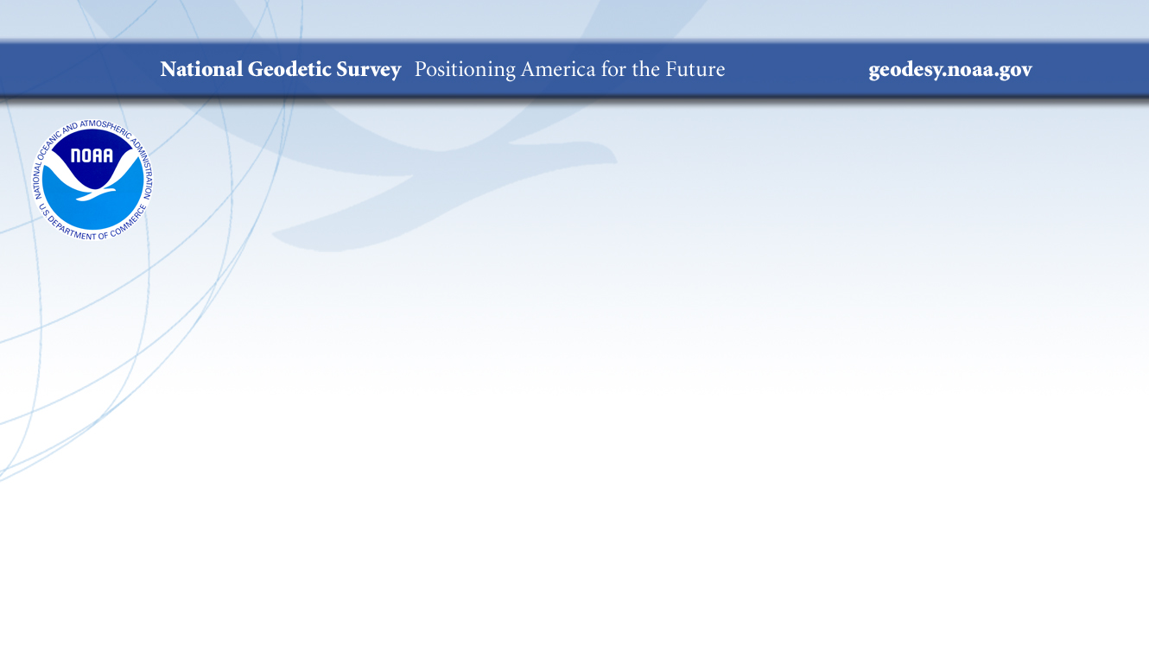
What We’ve Learned from Three Geoid Slope Validation Surveys
NGS Geospatial Summit
May 4, 2021
Derek van Westrum
Kevin Ahlgren
Observations and Analysis Division
NOAA – National Geodetic Survey
Boulder, Colorado, USA
derek.vanwestrum@noaa.gov

Slide 2

Motivation and Outline
So, NGS will replace the current US vertical datum, NAVD88, with a gravimetric geoid. How do we quantify its relative accuracy?
Quick Review: Gravimetric Geoid
  Geopotential → geoid
  From GNSS to orthometric heights
How do we determine the geoid?
  GRAV-D → models
How do we know this will all work?
  Ground truth tests: the Geoid Slope Validation Surveys
  Techniques
  Pictures
  Results
Conclusions

Slide 3
Quick Aside: Understanding “Geo-Potential”
h
The resting water has “potential” energy just by being high up on this cliff.
Energy = mgh
That potential energy can turn into real (kinetic) energy by falling.
Energy = ½ mv² (= mgh)
Think of the Earth as creating a “gravity field” that masses experience. I’ve drawn potential “field lines”
Potential = gh
Gravity x Height is “Geopotential”. This is what water “feels”.
Notes:
Mention that the geoid is not an ellipsoid shape, but lumpier. Only 170m_pp though!

Slide 4
Understanding “Geopotential” Part 2
Imagine pouring water onto a dry lake bed. If everything is level it will simply pool up. It would “like” to get to lower potential (darker lines), but the lake bed is in the way.
If the lake bed is tilted (it’s now the side of a hill), the water can move towards lower potential (towards darker lines). Water appears to flow because of a change in height
If the lake bed appears flat, but there is a mass anomaly under one end, the resulting geopotential difference causes water to flow to lower potential (again, from light to dark lines). It appears to flow because of gravity.
In all scenarios, water only flows when it has a path to lower geopotential – this is always a combination of gravity and height, g x H. The “combination” of g X H that best matches sea level is known as the geoid
Notes:
Mention that the geoid is not an ellipsoid shape, but lumpier. Only 170m_pp though!

Slide 5

“You” are Here
Earth’s Surface
Ellipsoid Height, h
From GPS
Orthometric Height, H
Mean Sea
Level
Alaska
Ellipsoid
Geoid Height, N
From NGS
Geoid
h - N = H
Note: Geoid height is negative in coterminous US, but is positive in most of Alaska

Slide 6
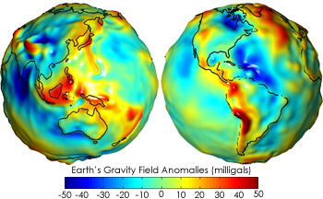

How we get N Everywhere? Step 1: GRAV-D
Getting N_{G} isn’t trivial…
  You’ve got to know the difference in true surface gravity from what you’d expect if the earth was a perfect ellipsoid. This is referred to as the gravity anomaly, ∆g.
  Then solve Stokes’ integral:
  Which also means you need to know ∆g over the entire surface of the earth (or, at least a continental-sized chunk of it…)
  (R is the mean radius of the earth, ɣ₀ is mean surface gravity on an equivalent ellipsoidal earth, S is an analytic (geometrical) function of position.)

Slide 7
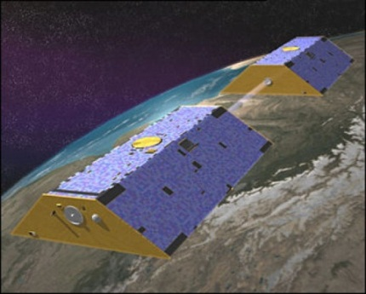
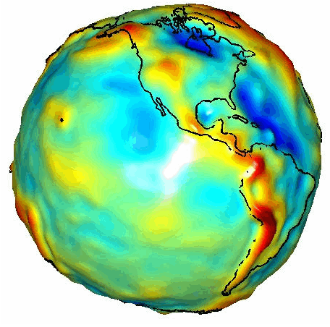
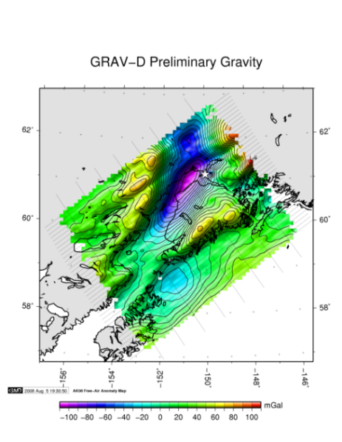
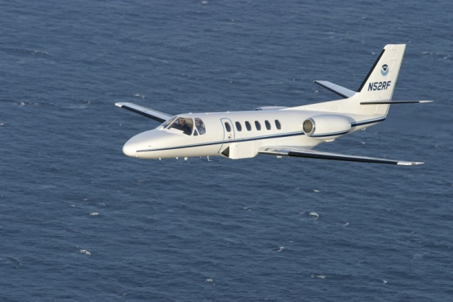
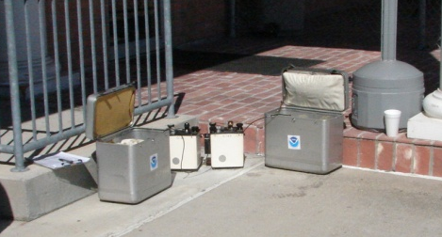
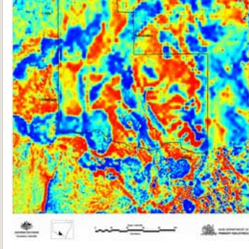
Step 1 Cont.: How to Build a Gravity Field, Δg
Long Wavelengths
(≥ 250 km)
GRACE/GOCE/Satellite Altimetry
+
Intermediate Wavelengths
(500 km to 20 km)
Airborne Measurement
+
Short Wavelengths
(< 100 km)
Surface Measurement and
Predicted Gravity from Topography

Slide 8
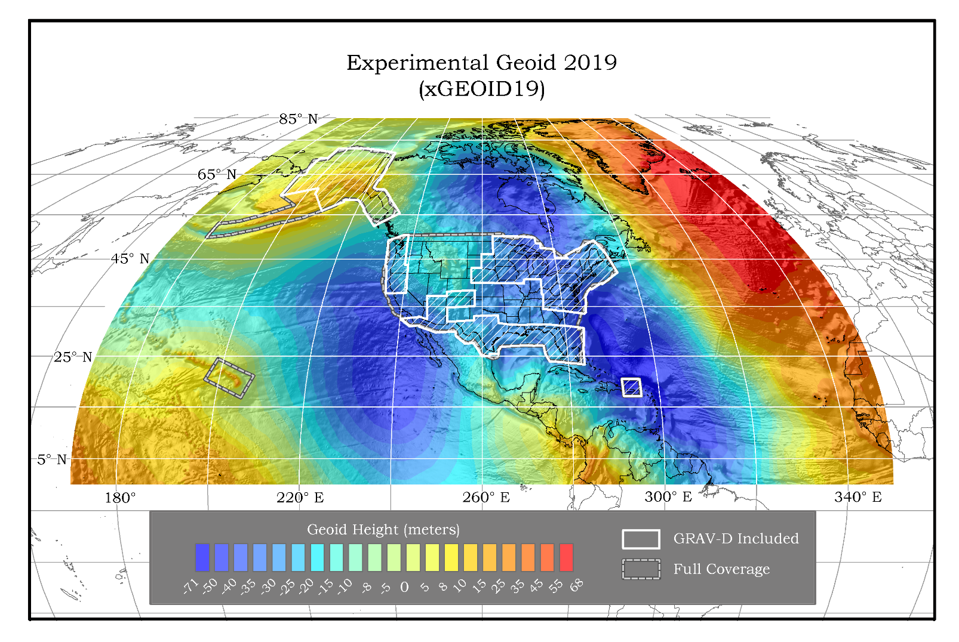
Step 2: Blending the Gravity Sources From Different Length Scale, and Doing the Math, Gives us the Geoid:
The gravity data from satellites, airborne, corrected surface data, and terrain predictions will be blended into a gravity anomaly field, ∆g, and then used to calculate geoid undulations, N_{G}.
Methods for blending will be tested to prepare for 2022
Available on the Website: http://beta.ngs.noaa.gov/GEOID/xGEOID/

Slide 9
But How do We Know This Whole Geoid Scheme Will Work? This is Where “Slope Validation” Surveys Come In
The overall “height” of the geoid can “easily” be set to best match sea level (there are an infinite number of geopotential surfaces), but getting the overall shape right is critical (the undulations). So, to assess the quality of a model, it is actually more useful to look at the changes in the shape of the geoid over various distance scales (i.e. looking at slopes).
Method 1:
Leveling & Gravity provide terrain-corrected geodetic heights (“Rise”)
GNSS provides horizontal distance (“Run”)
Slope_{i} = Rise_{i} / Run_{i}
Ellipsoid
Geoid
Geoid Slope
Rise 3
Rise 2
Run 2
Run 3
Run 1
Rise 1

Slide 10
Slopes (cont.)
Method 2:
GNSS provides ellipsoidal position (lat, lon)
Deflection of Vertical measured directly with Astro-geodetic Camera (difference from normal to ellipsoid and local plumb line)
Camera knows what stars it “should” see normal to the ellipsoid at a specific time and location. DoV is difference between that and with what is actually “straight up”
Slope = Vector sum of North and East deviations of camera axis
Ellipsoid
Geoid
Geoid Slope

Slide 11
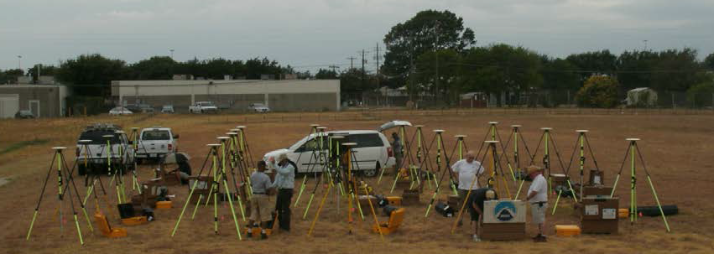
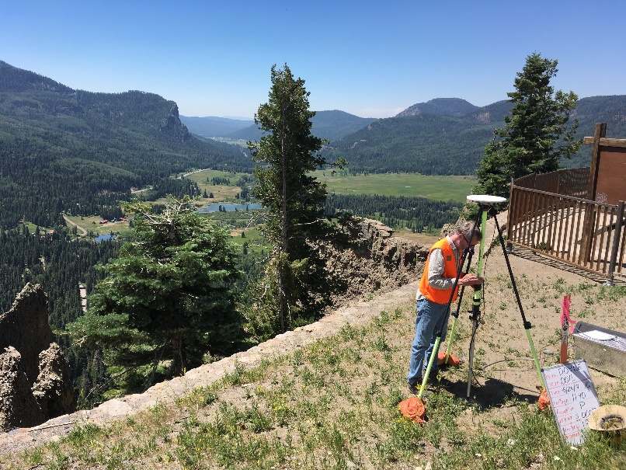
Survey Techniques: Long Period GPS
Calibrated, fixed-height antennas, all identical models
In Colorado 2017:
  24 complete sets of equipment (2 parties, 10 sets each)
  Each party observed 5 new stations each day (one party moving east and the other west)
  24 hours & 16+ hours of observation each day
  Project processed with OPUS Projects

Slide 12
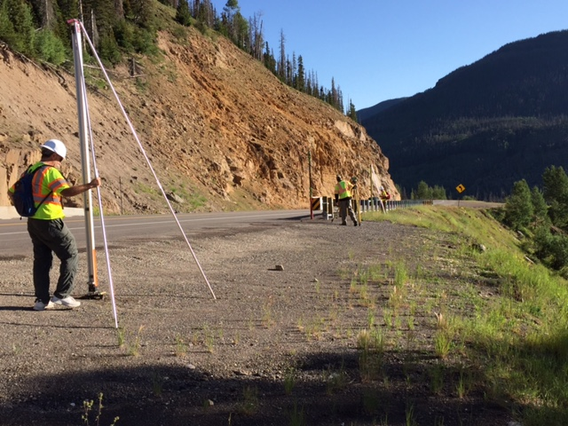
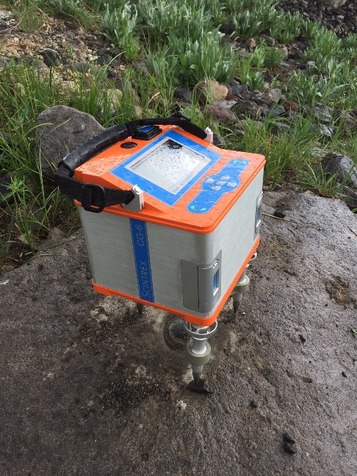
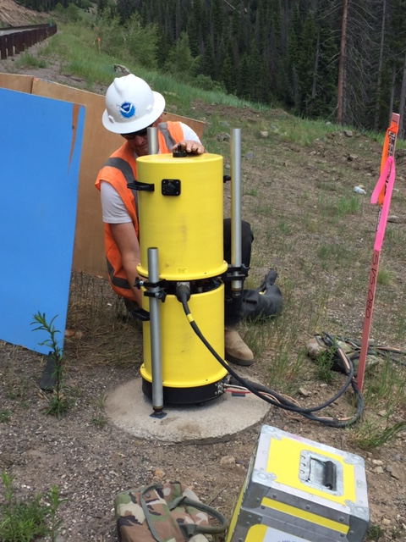
Survey Techniques: Leveling and Gravity
The entire survey lines were leveled (double-run). Geodetic heights provided at each benchmark.
Leveling and gravity are both needed for orthometric height determination. Usually gravity is modeled, but in this case was actually measured at every point.
  Absolute gravity (A10 and/or FG5).
  Vertical gravity gradient (CG6). Uncertainty: ~1%

Slide 13
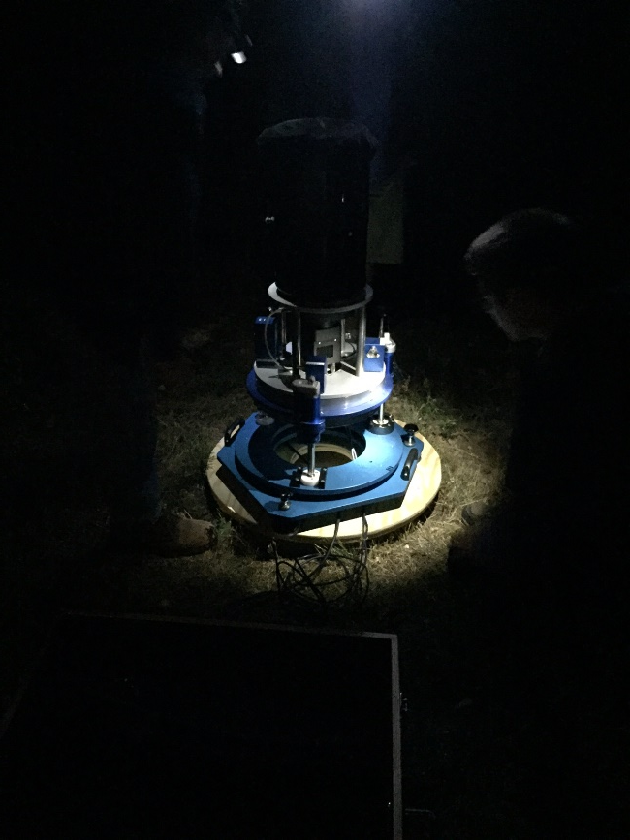
Survey Techniques: Deflection of the Vertical (DoV)
Precision tilt meters provide alignment “level” to the geoid.
Celestial almanacs provide predicted alignment with star field (relative to ellipsoid).
The difference between the two vectors (broken into orthogonal components) are the Deflections of the Vertical (or “slopes”).
In Colorado, 2017:
  223 stations (14 repeat observations)
  39 nights
  ~6 stations/night
  Observing with Swiss CODIAC (COmpact DIgital Astrometric Camera), courtesy Technical University of Zurich (ETH Zurich).

Slide 14
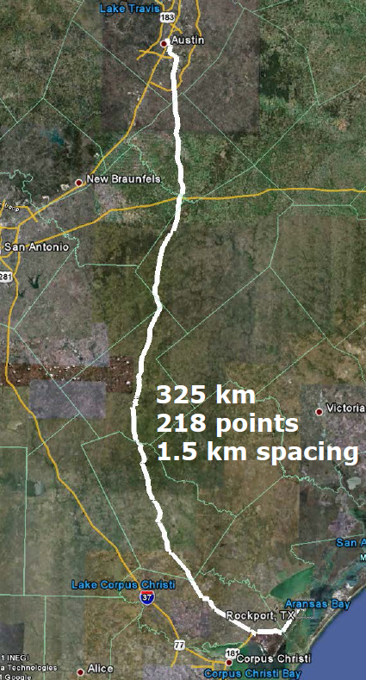
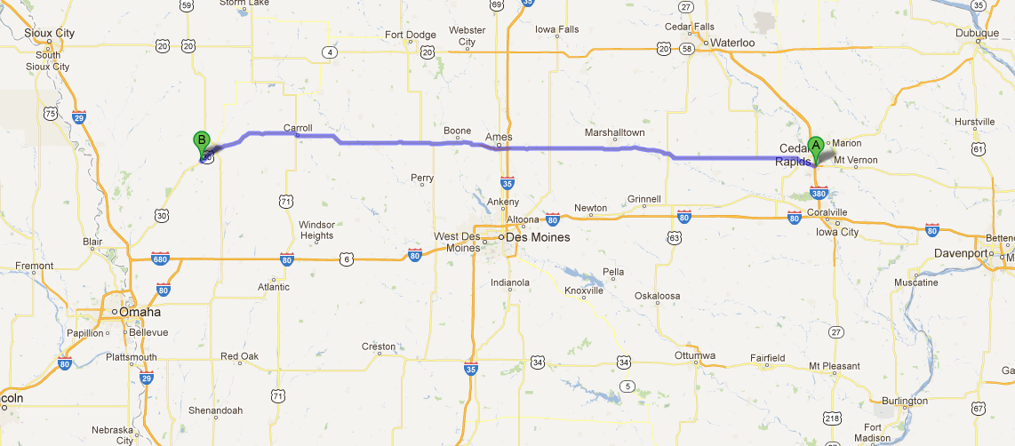
GSVS #1: Texas 2011
The First Two GSVSs
Flat, close to the geoid
GSVS #2: Iowa 2014
Higher elevation and geologically interesting terrain (traversing the Midcontinent Rift System).

Slide 15
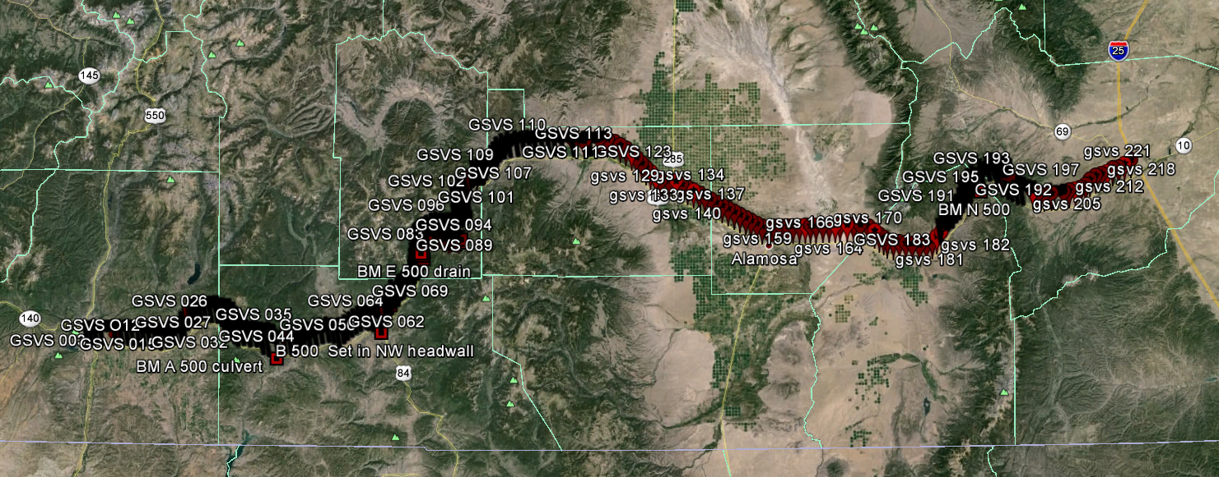
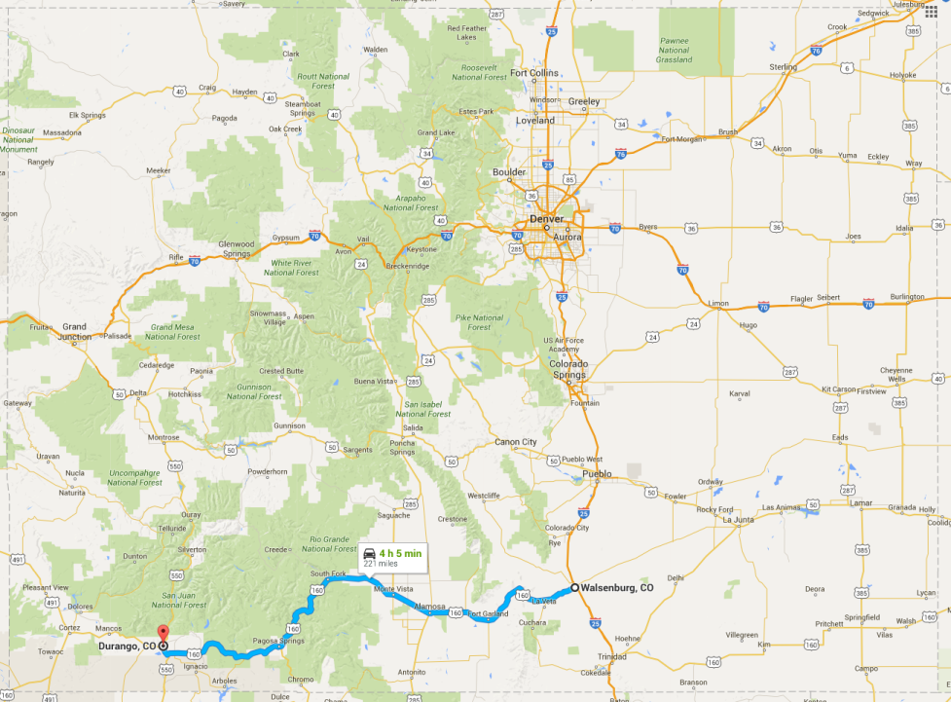
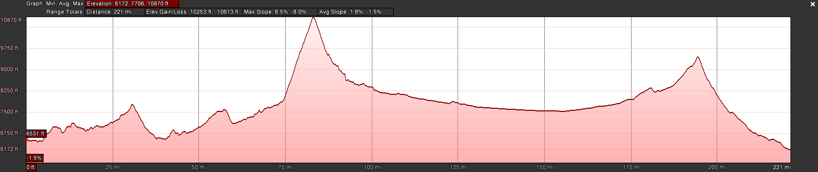
GSVS#3: Colorado 2017
The third (and likely final) GSVS took place along US160, from Durango to Walsenburg, in southern Colorado in the summer of 2017.
High elevation and rugged topography. “Worst case” for geoid modeling.
Variation from 1800m to 3300m, over two passes. 222 bench marks, 350km.

Slide 16
Data Processing
GPS
  Each station processed individually and then combined in an OPUS-Projects network solution.
  Uncertainty on Processed Ellipsoid Heights: <5 mm RMS
Leveling
  First order, Class 2 procedures. Double-run
  Uncertainty on relative height differences: 0.7mm/√km, or 1.3cm on the longest distance scales
Gravity
  Two independent A10 (absolute) observations on each bench mark. Vertical gravity gradient (each bench mark) used to reduce gravity value to bench mark height
  Uncertainty: <10 µGal
DoV
  Surface DoVs collected on each bench mark with 10% repeated.
  Auriga software processed celestial data, and CODIAC used to correct for tilts.
  Uncertainty in surface DoVs: <0.05”

Slide 17
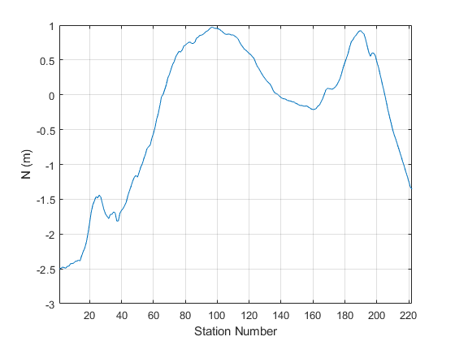
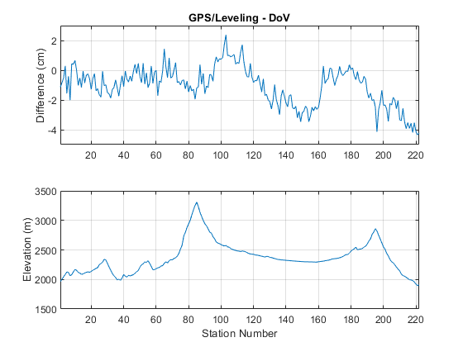
Observed Results (Colorado)
This is the difference between the geoid curves determined from leveling and DoV
Relative Geoid Undulations (Spirit Leveling)
This is the “red geoid curve” under the survey route, determined from leveling
And the elevation for reference…
A consistent set of (Helmert) orthometric corrections are added to “raw” undulations for both GPS/Leveling and DoV
The undulation results from GPS/L are otherwise completely independent of those from the DoV observations.
Standard deviation of the difference in the two techniques – a measure of the ground truth uncertainty – is ±1.3cm

Slide 18


We’ve Got Slopes, Now the Validation Part…
Okay, so we now that we trust our “ground truth” of geoid slopes, let’s compare this to what the models predict
ΔBC
ΔBC
ΔBC
ΔAC
ΔAC
ΔAC
ΔAB
ΔAB
ΔAB
Geoid Undulations
Stn A
Stn B
Stn C
Ground Truth
ΔAC_{”error”} $≈$ ΔAC – ΔAC
= Δ(ΔAC)
Model 1
Model 2
ΔAC_{”error”} $≈$ ΔAC – ΔAC = Δ(ΔAC)
We can now get the [difference between truth and model] for the [geoid height difference between any two stations].

Slide 19
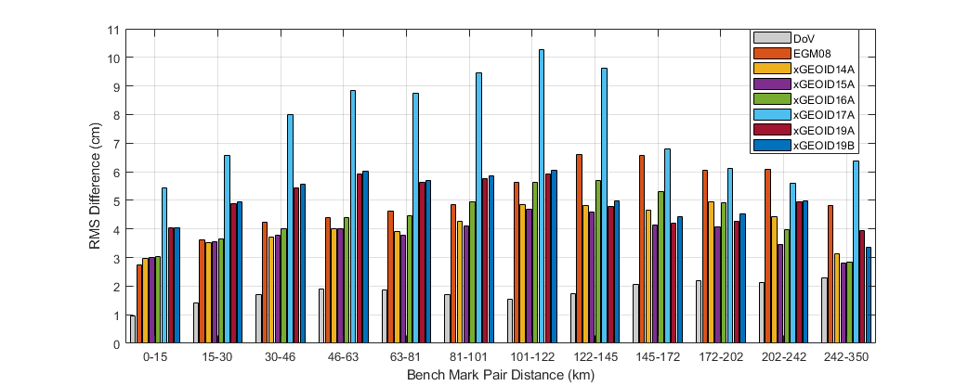
More Validating…
We compute these “differences of differences” over all pairs of adjacent stations (separated by 1.5 km)
We do it again for all pairs of stations separated by 2, 5, 10, 20, 50, 100, 200, up to 300km.
In Colorado, we had 222 bench marks → 24531 pairs!
We now bin the diffs of diffs into roughly 30km groups and take the standard deviation of the double difference in each group

Slide 20
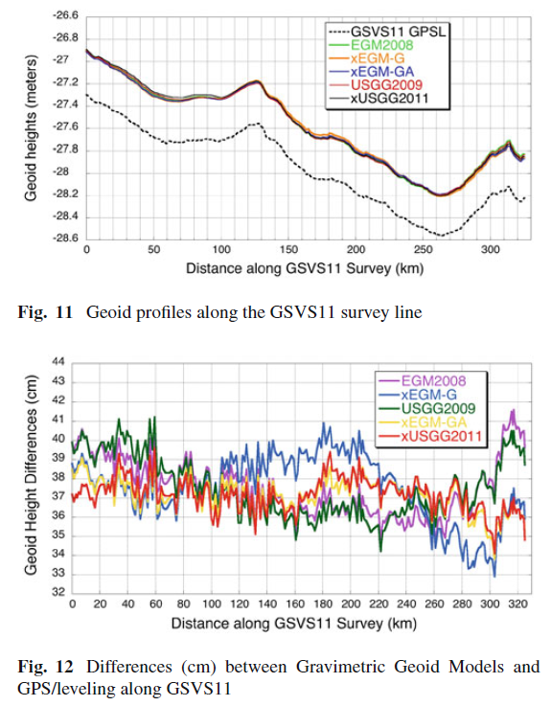
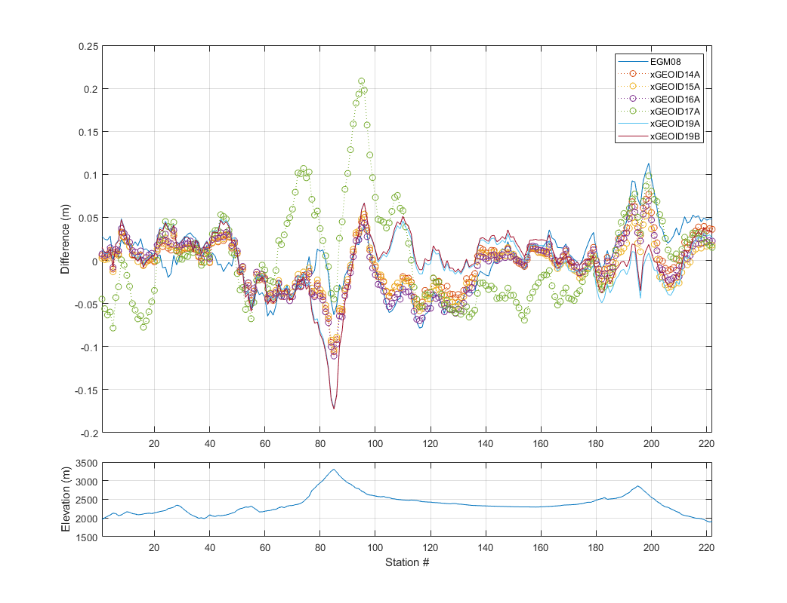
Validation!
Texas 2011
Texas and Iowa GSVS both confirmed 1-2cm geoid accuracy, as expected.
Colorado clocked in at about 3-5 cm, which isn’t too shabby in the worst terrain we’ve got!
Iowa 2014
Colorado 2017
Smith et al., Confirming regional 1 cm differential geoid accuracy from airborne gravimetry: the Geoid Slope Validation Survey of 2011, Journal of Geodesy, 2013.
Wang, et al., The Geoid Slope validation Survey 2014 and GRAV-D airborne gravity enhanced geoid comparison results in Iowa, J Geod, 2017.
van Westrum D, Ahlgren K, Hirt C, Guillaume S, A Geoid Slope Validation Survey (2017) in the Rugged Terrain of Colorado, USA., Journal of Geodesy, 2021.

Slide 21
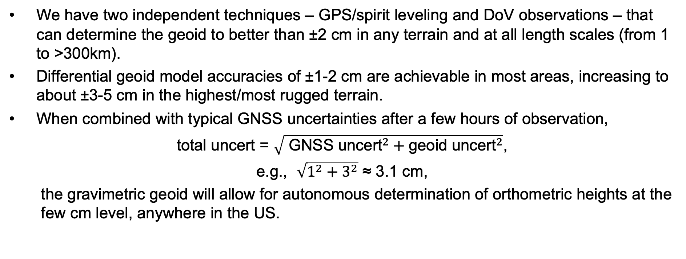
Conclusions
We have two independent techniques – GPS/spirit leveling and DoV observations – that can determine the geoid to better than ±2 cm in any terrain and at all length scales (from 1 to >300km).
Differential geoid model accuracies of ±1-2 cm are achievable in most areas, increasing to about ±3-5 cm in the highest/most rugged terrain.
When combined with typical GNSS uncertainties after a few hours of observation,
total uncert = $\sqrt{ {\text{GNSS} \text{uncert}}^{2}+{\text{geoid} \text{uncert}}^{2}}$,
e.g., $\sqrt{{\text{1}}^{2}+{\text{3}}^{2}}$ ≈ 3.1 cm,
  the gravimetric geoid will allow for autonomous determination of orthometric heights at the few cm level, anywhere in the US.

Slide 22
Thank you for your attention!
Derek van Westrum
derek.vanwestrum@noaa.gov

