Slide 1

How NGS is Modernizing the National Spatial Reference System
Jacob Heck
Great Lakes Regional Geodetic Advisor
NOAA/National Geodetic Survey

Slide 2
Who is NGS?
The National Geodetic Survey (1970–present)
  U.S. Coast and Geodetic Survey (1878–1970)
  U.S. Coast Survey (1836–1878)
  U.S. Survey of the Coast (1807–1836)
Nation’s Oldest Scientific Agency
U.S. Government Executive Branch
  Department of Commerce
      National Oceanic and Atmospheric Administration (NOAA)
        National Ocean Service (NOS)
          National Geodetic Survey (NGS)

Slide 3
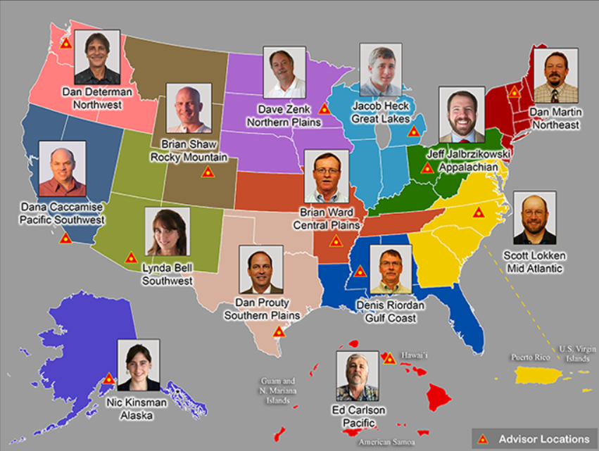
Regional Geodetic Advisor Program
www.ngs.noaa.gov/ADVISORS/

Slide 4
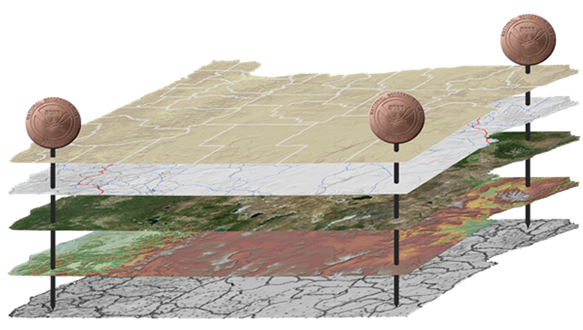
The National Spatial Reference System (NSRS)
NGS defines, maintains and provides access to the NSRS to meet our Nation’s economic, social & environmental needs
North American Datum of 1983 (NAD 83)
North American Vertical Datum of 1988 (NAVD 88)
Latitude • Longitude • Elevation • Gravity • Shoreline Position
+ changes over time
Today’s NSRS

Slide 5
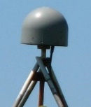
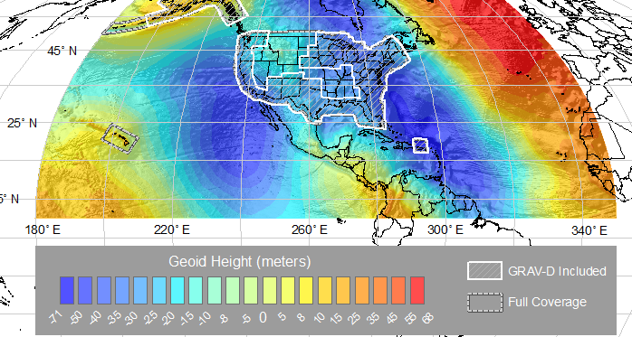
The National Spatial Reference System (NSRS)
NGS defines, maintains and provides access to the NSRS to meet our Nation’s economic, social & environmental needs
Latitude • Longitude • Elevation • Gravity • Shoreline Position
+ changes over time
North American Terrestrial Reference Frame (NATRF 2022)
Caribbean Terrestrial Reference Frame (CATRF 2022)
Pacific Terrestrial Reference Frame (PATRF 2022)
Marianas Terrestrial Reference Frame (MATRF 2022)
North America and Pacific Geopotential Datum (NAPGD2022)
Tomorrow’s NSRS

Slide 6
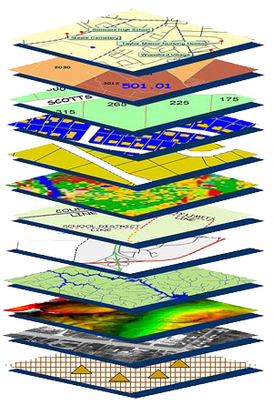
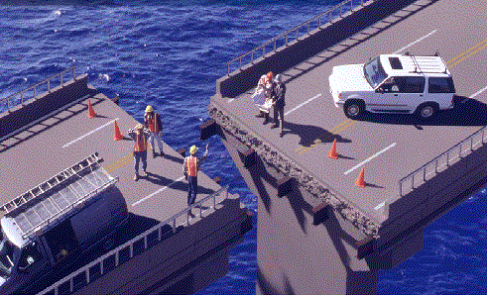
Accurate positioning begins
with accurate coordinates
geodetic control (the NSRS) is the foundation for all geospatial products.
without Geodetic Control as a “base map” layer, GIS applications will not work properly
Source: Zurich-American Insurance Group

Slide 7
Find the coordinates of point A
Somewhere on Earth…
You are presented with this problem…
Without any other information, the problem is unsolvable.
A

Slide 8
Find the coordinates of point A
Wouldn’t it be fantastic if someone just provided you with a coordinate system?
Unfortunately, the Earth doesn’t come with lines of latitude and longitude just drawn all over it…
“The Earth is not a globe”
4
3
A
(x=1.8,y=2.6)
2
1
1
2
3
4

Slide 9
Find the coordinates of point A
But what if someone gave you enough other points with pre-determined coordinates?
With a little measuring and trigonometry, you could certainly determine the coordinates of point A!
These “other points with pre-determined coordinates” are “geodetic control”
C (x=2.7,y=3.9)
A
B (x=3.1,y=1.4)
D (x=0.8,y=0.9)

Slide 10
Find the coordinates of point A
Although the coordinate axes are not visible, their location and scale are implied by the given coordinates of the points B, C, and D.
It is often the job of surveyors, mappers and other geospatial professionals to determine the coordinates of many points on Earth.
It is the job of NGS to provide the geodetic control to the nation to make those jobs possible.
4
C (x=2.7,y=3.9)
3
2
B (x=3.1,y=1.4)
1
D (x=0.8,y=0.9)
1
2
3
4

Slide 11
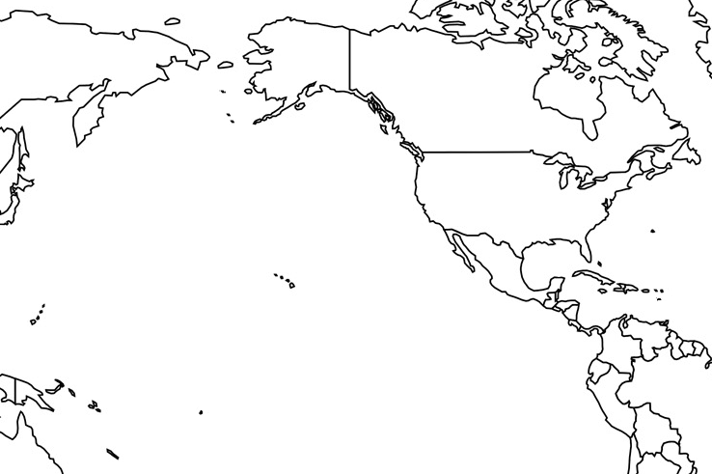
Horizontal Datums of the NSRS
St. Paul I.
St. Paul 1897
St. Paul 1952
NAD 83(1986)
NAD 83(2002:AK)
NAD 83(NSRS2007)
NAD 83(2011) epoch 2010.00
St. Lawrence I.
St. Lawrence 1952
NAD 83(1986)
NAD 83(2002:AK)
NAD 83(NSRS2007)
NAD 83(2011) epoch 2010.00
St. Matthew I.
St. Matthew 1952
Alaska
NAD 27
NAD 83(1986)
NAD 83(2002:AK)
NAD 83(NSRS2007)
NAD 83(2011) epoch 2010.00
St. George I.
St. George 1897
St. George 1952
NAD 83(1986)
NAD 83(2002:AK)
NAD 83(NSRS2007)
NAD 83(2011) epoch 2010.00
CONUS
U.S. Standard Datum
NAD 27
NAD 83(1986)
NAD 83(“HARN”)
NAD 83(“FBN”)
NAD 83(NSRS2007)
NAD 83(2011) epoch 2010.00
Hawaii
Old Hawaiian Datum
NAD 83(1986)
NAD 83(1993:HI)
NAD 83(PA11) epoch 2010.00
CNMI
Guam 1963
NAD 83(1993:GU)
NAD 83(2002:GU)
NAD 83(MA11) epoch 2010.00
Puerto Rico
Puerto Rico 1940
NAD 83(1986)
NAD 83(1993:PR)
NAD 83(1997:PR)
NAD 83(2002:PR)
NAD 83(NSRS2007)
NAD 83(2011) epoch 2010.00
U.S. Virgin Islands
Puerto Rico 1940
NAD 83(1986)
NAD 83(1993:PR)
NAD 83(1997:PR)
NAD 83(2002:PR)
NAD 83(NSRS2007)
NAD 83(2011) epoch 2010.00
Guam
Guam 1963
NAD 83(1993:GU)
NAD 83(2002:GU)
NAD 83(MA11) epoch 2010.00
American Samoa
American Samoa 1962
NAD 83(1993:AS)
NAD 83(2002:AS)
NAD 83(PA11) epoch 2010.00

Slide 12
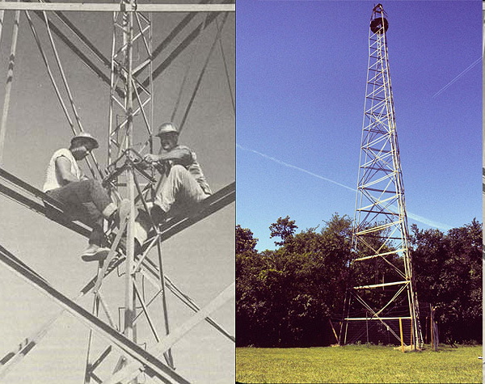
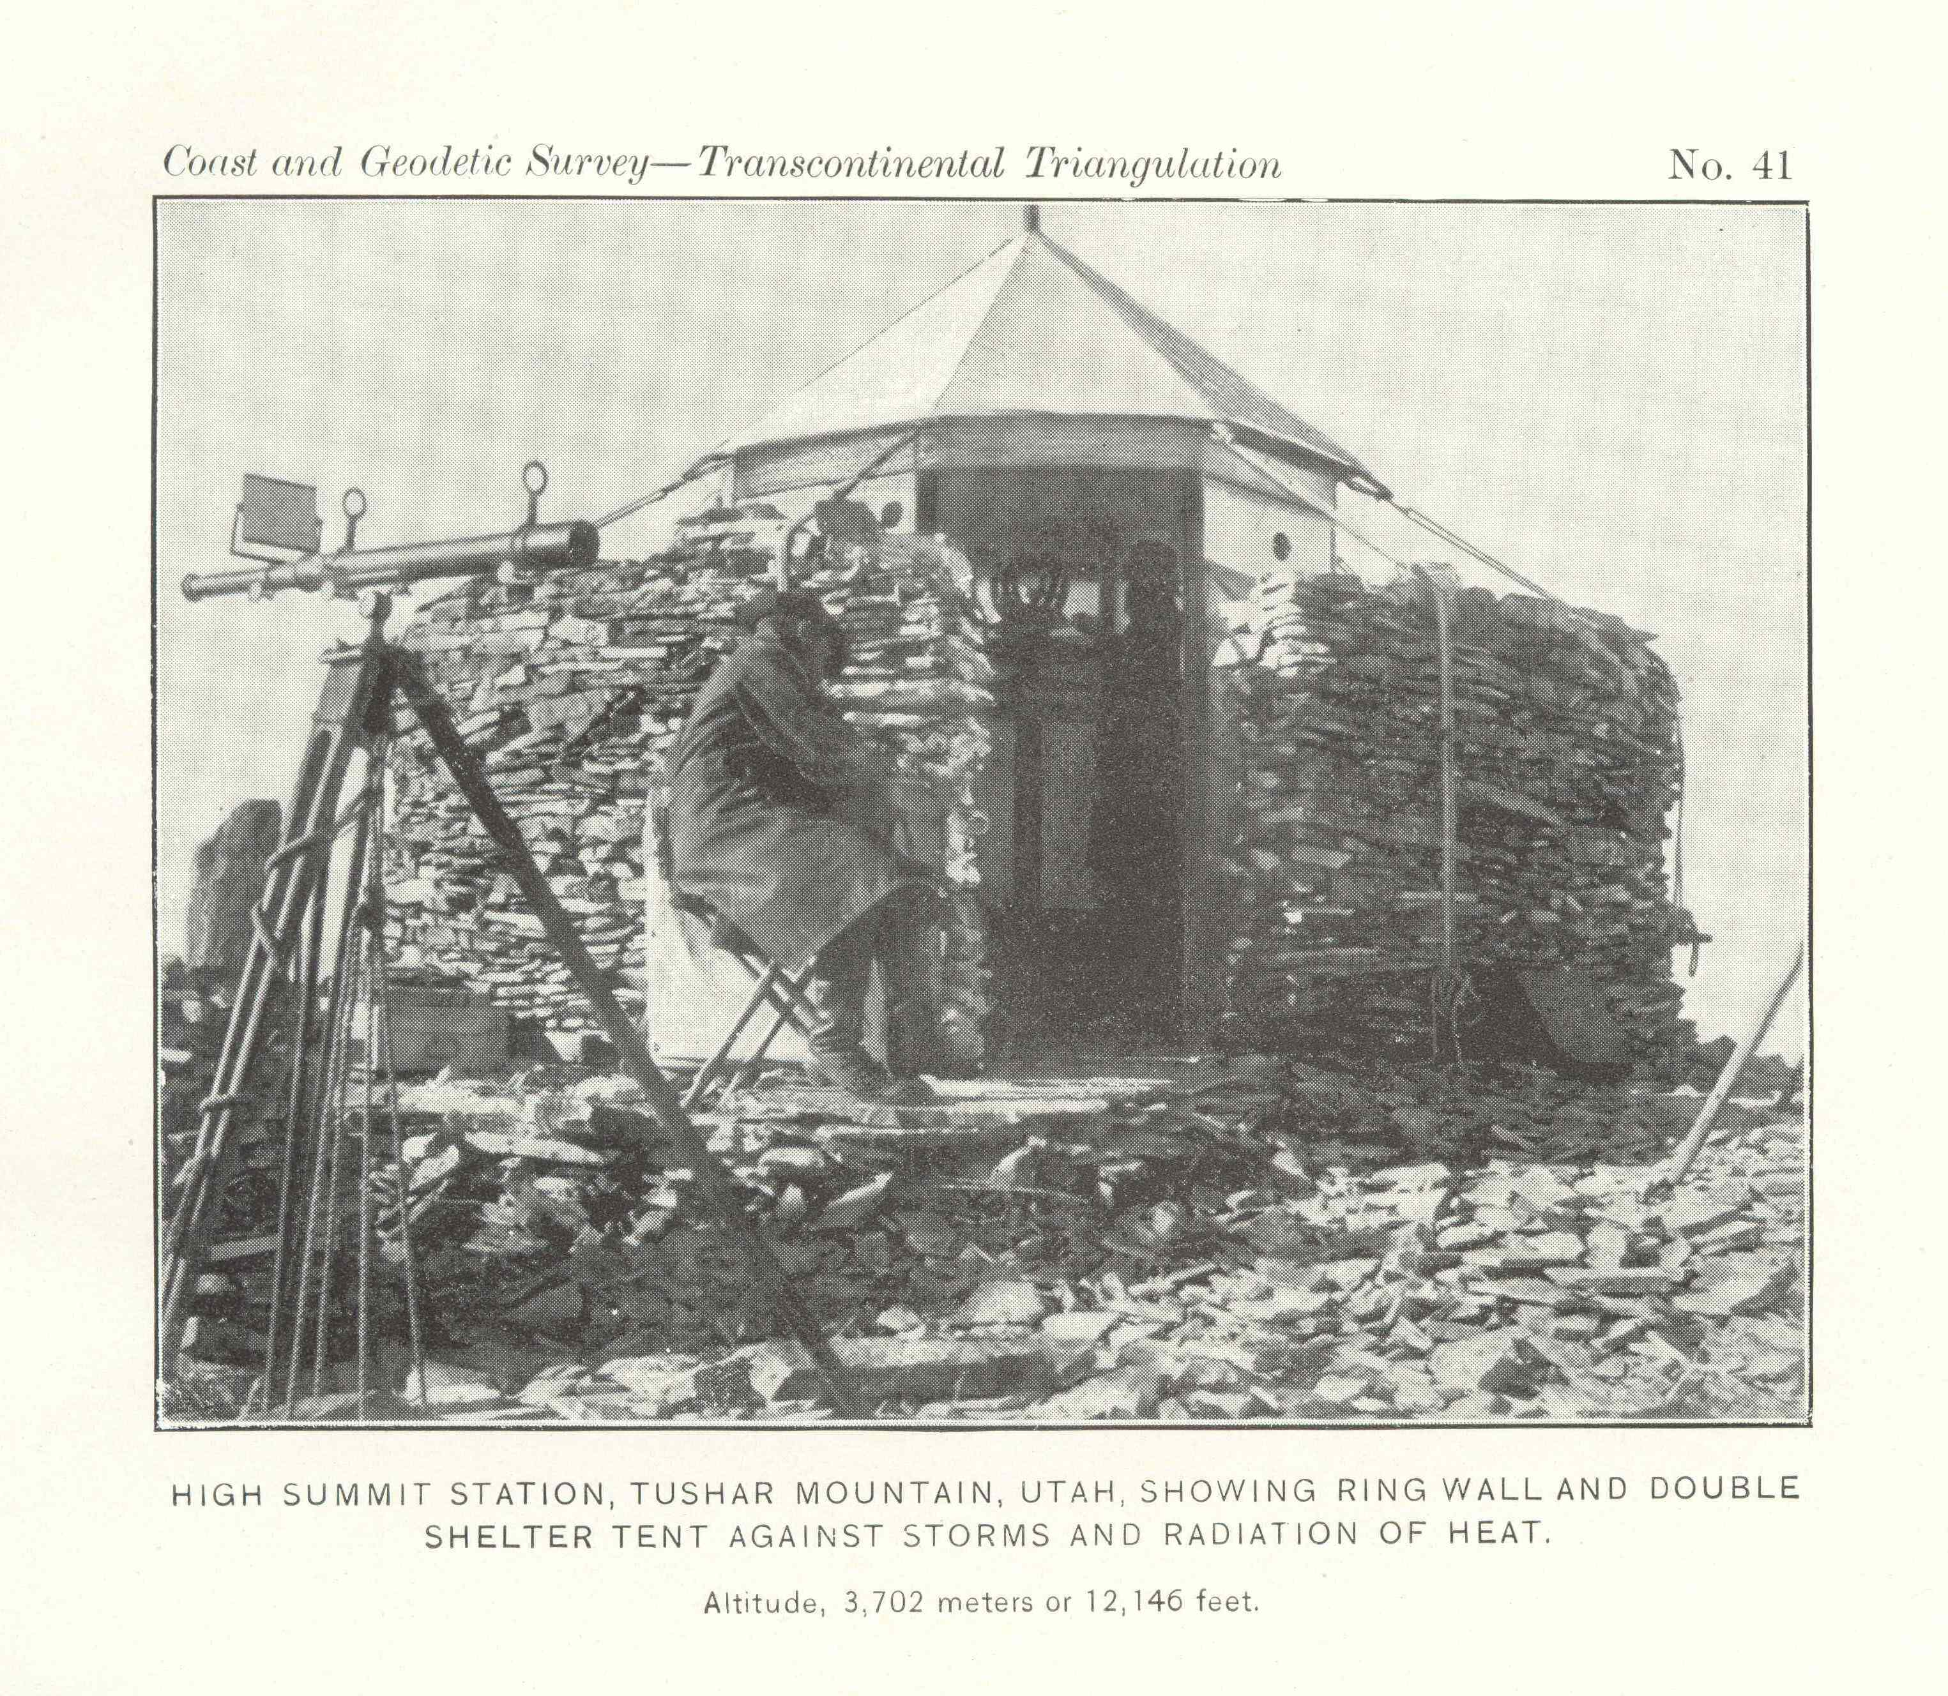
STEEL BILBY TOWER

Slide 13
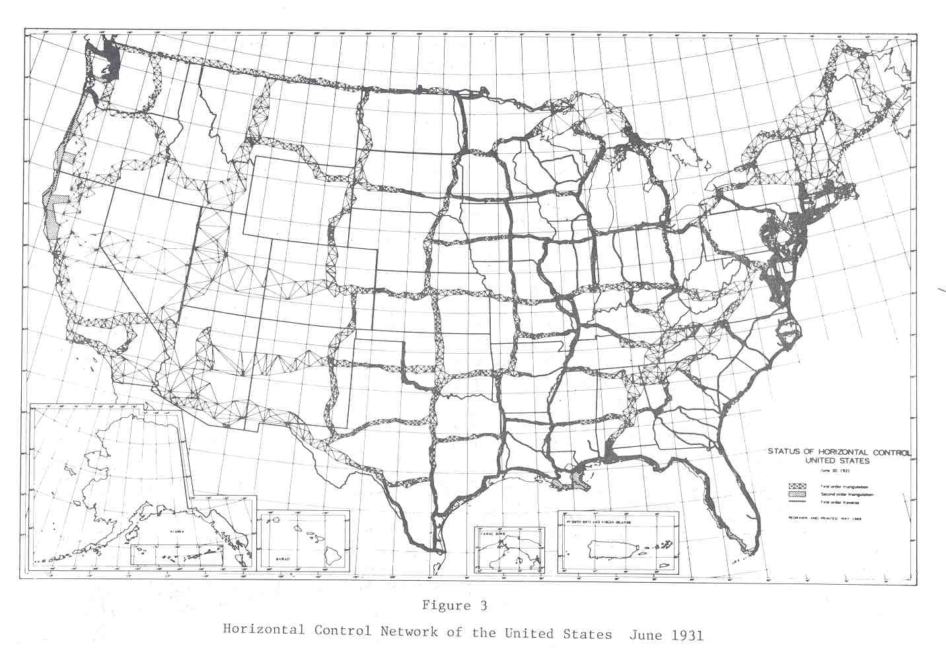

Slide 14
Replacing the NAD 83s
The Old | The New
NAD 83 (2011) | NATRF2022 - The North American Terrestrial Reference Frame of 2022
NAD 83 (2011) | CATRF2022 - The Caribbean Terrestrial Reference Frame of 2022
NAD 83 (PA11) | PATRF2022 - The Pacific Terrestrial Reference Frame of 2022
NAD 83 (MA11) | MATRF2022 - The Mariana Terrestrial Reference Frame of 2022

Slide 15
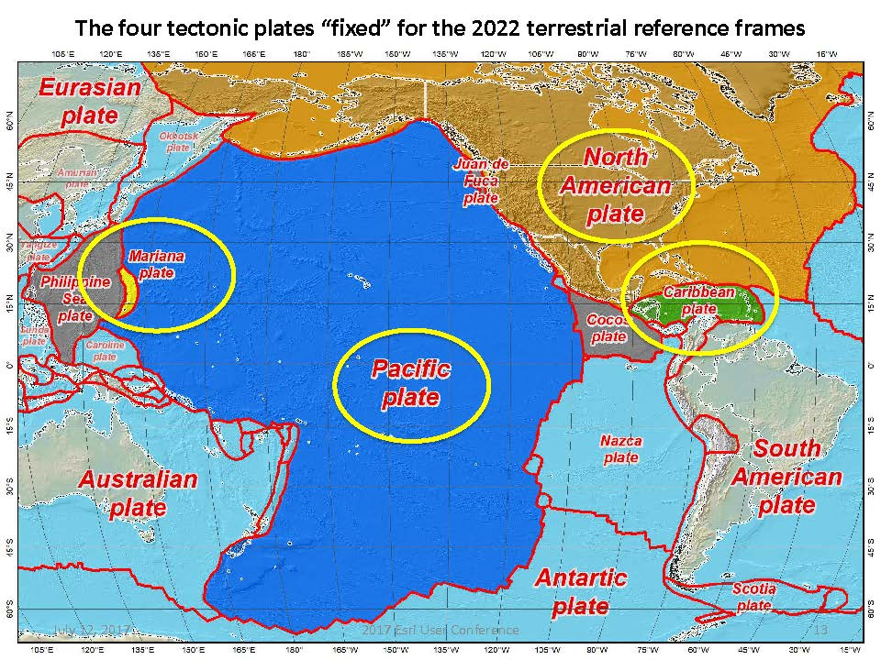
Four Tectonic Plates

Slide 16
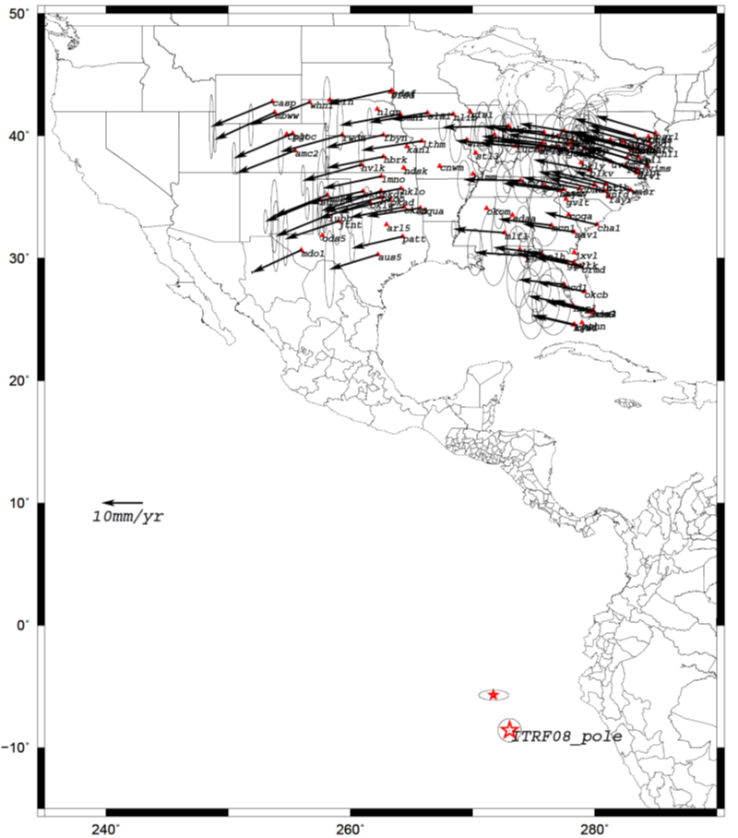
Euler Poles and “Plate-Fixed”
  In the ITRF, many tectonic plates have a dominant motion: rotation
  Euler Pole - point about which a plate rotates (yellow star)
NATRF2022 Euler Pole

Slide 17
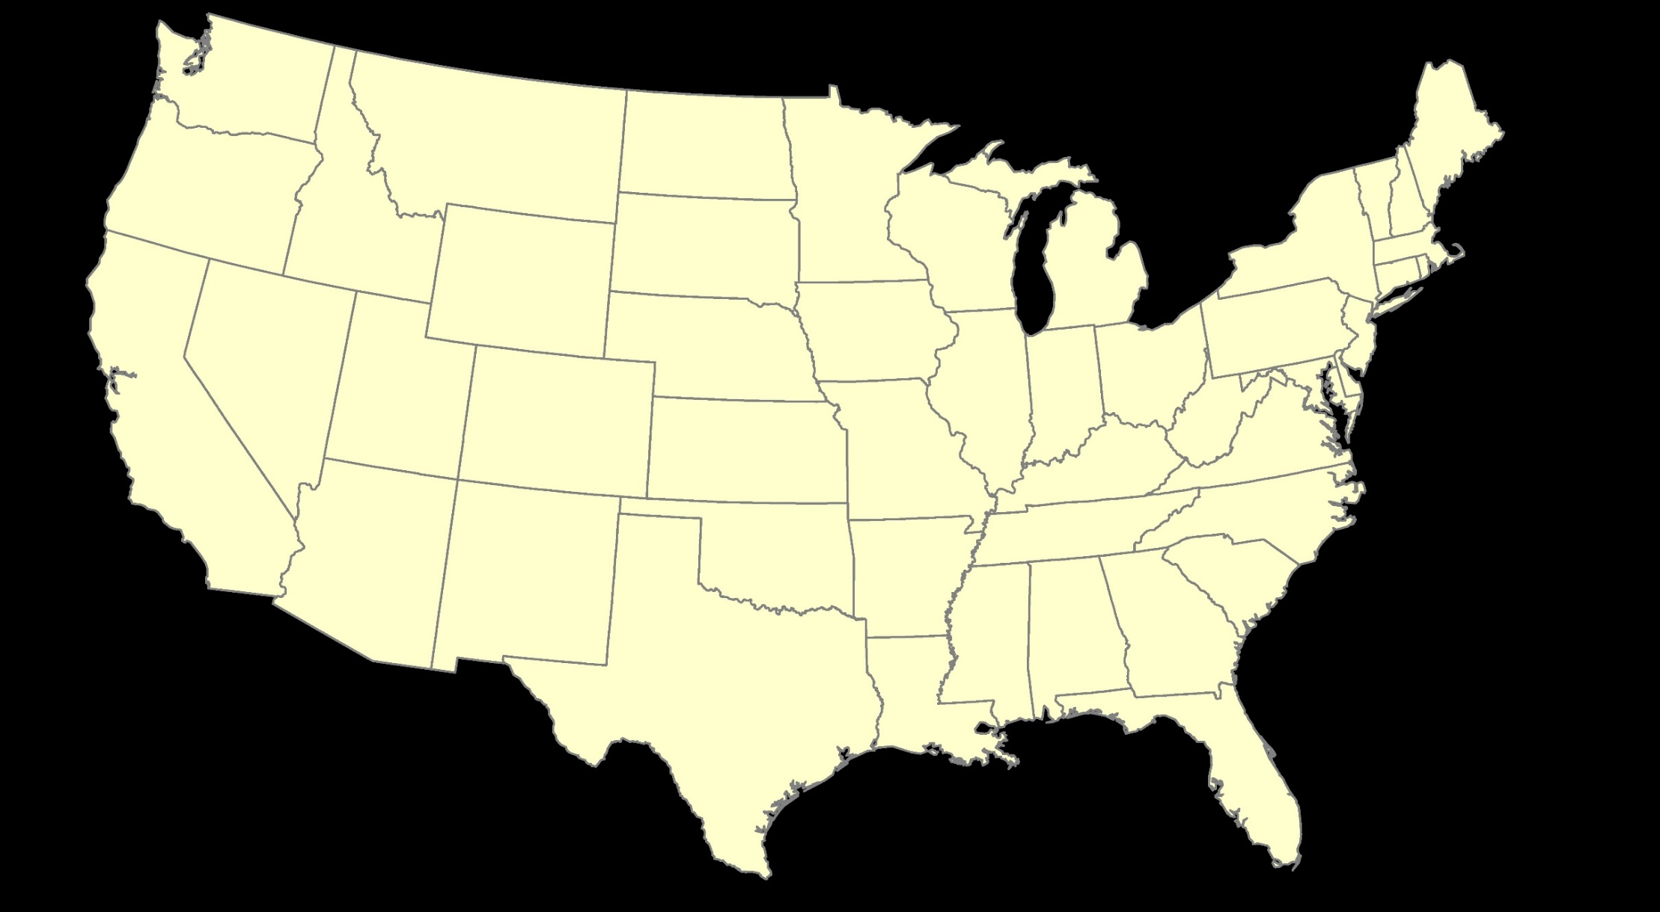
ITRF2020: Constant Frame, Rotating Plate

Slide 18


“Plate-Fixed”
NATRF2022: Constant Frame, Rotating Plate

Slide 19

ITRF2020 or NATRF2022

Slide 20
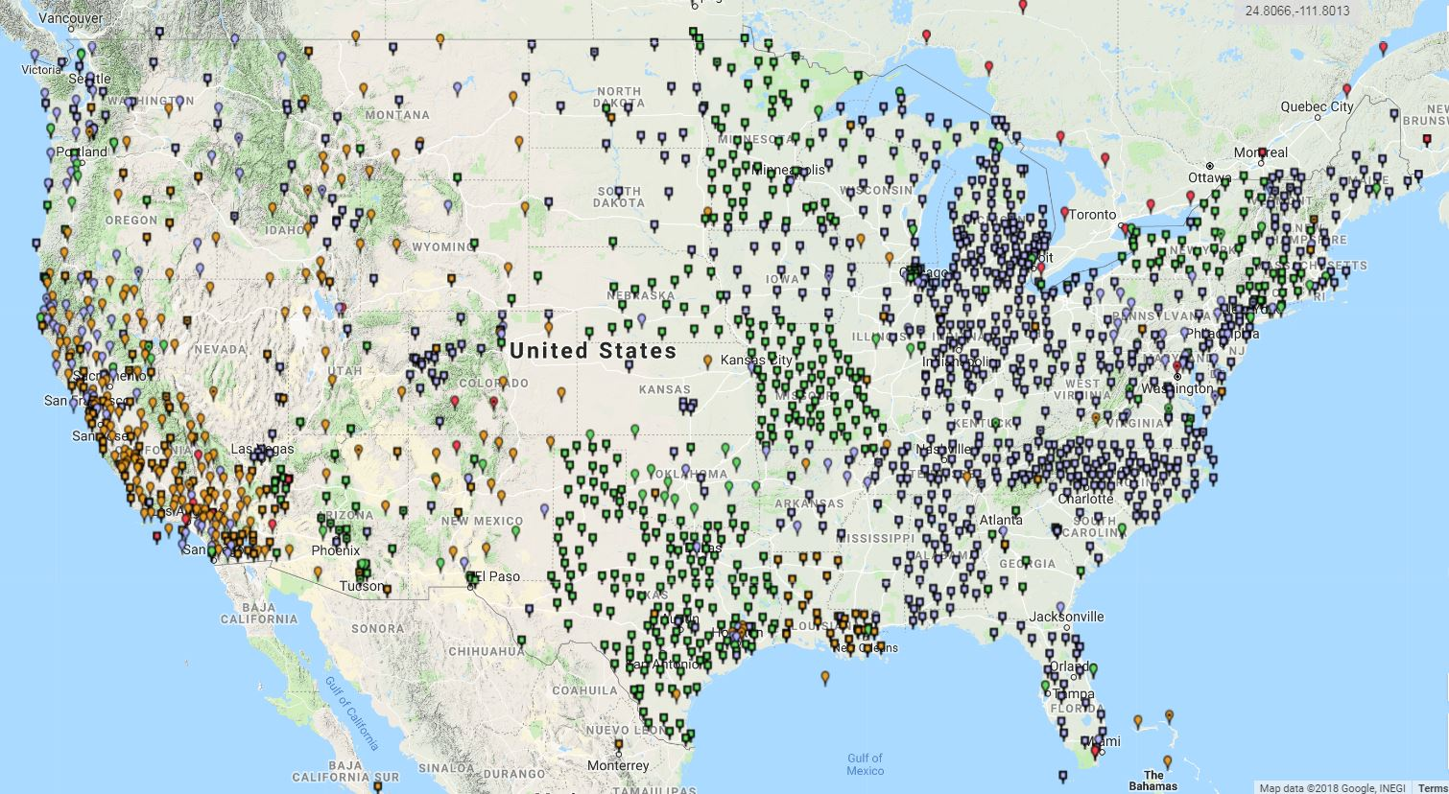
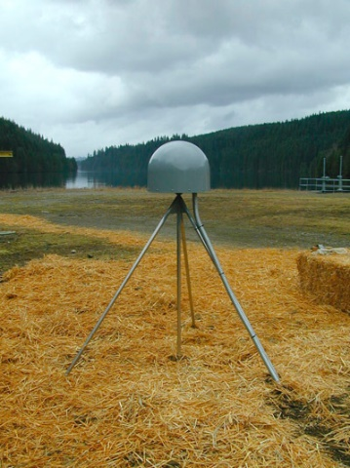
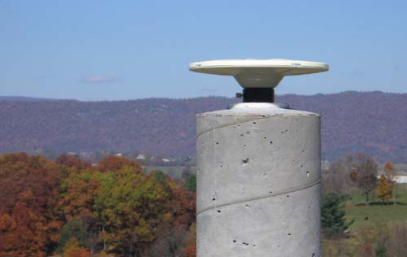
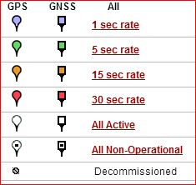
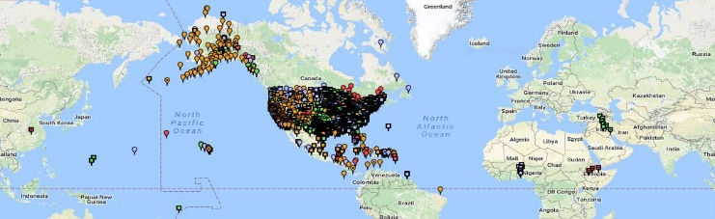
Continuously Operating Reference Station (CORS) Network
2000 sites
225 organizations

Slide 21
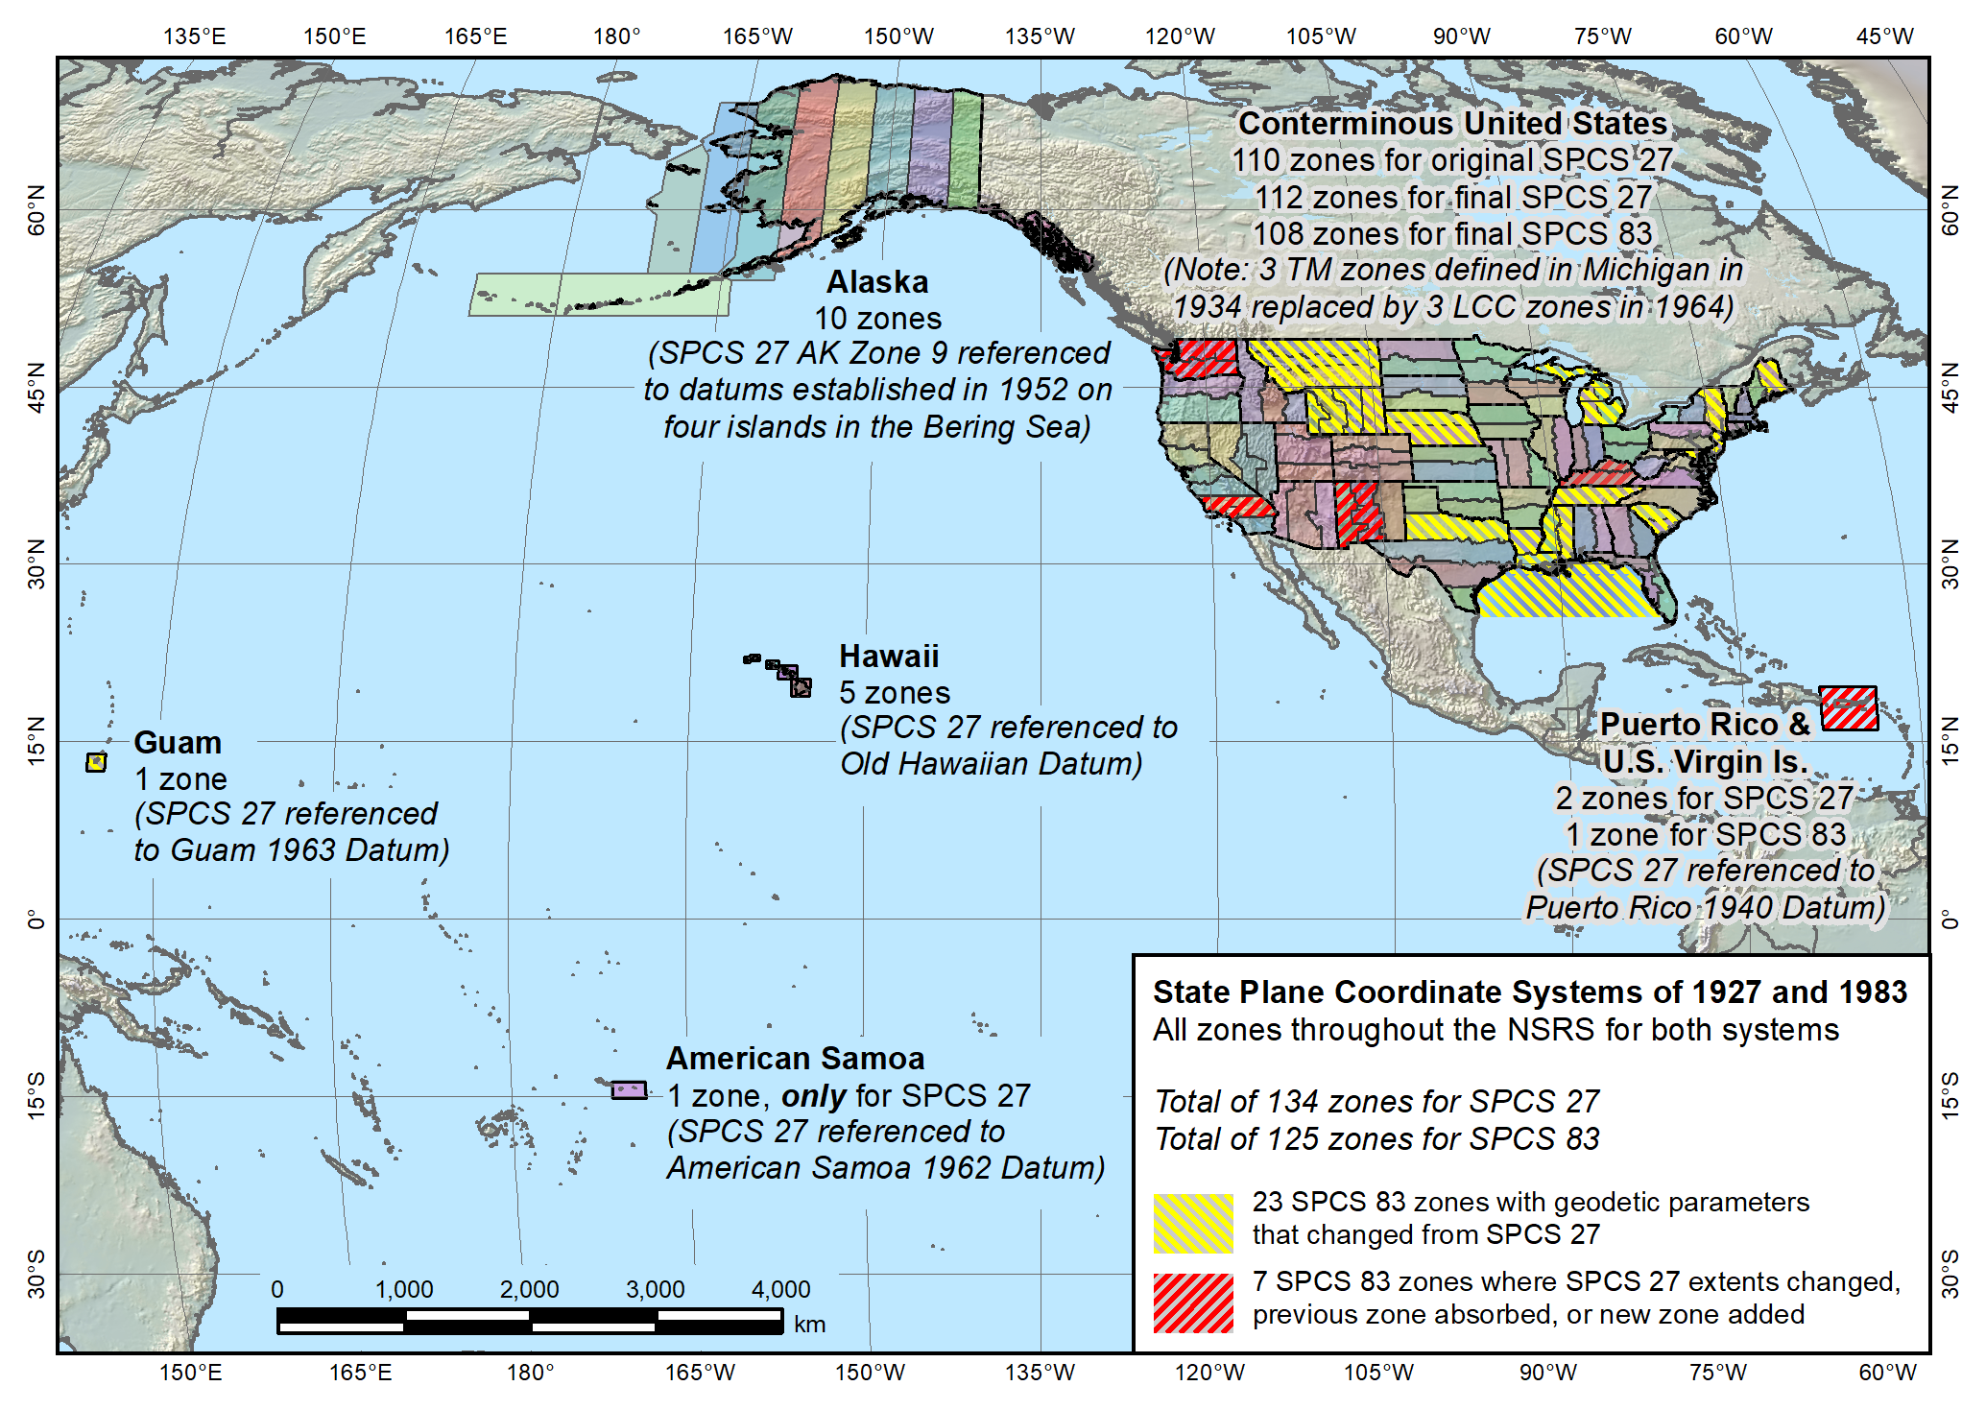
State Plane Coordinate System of 1983 (SPCS 83)

Slide 22
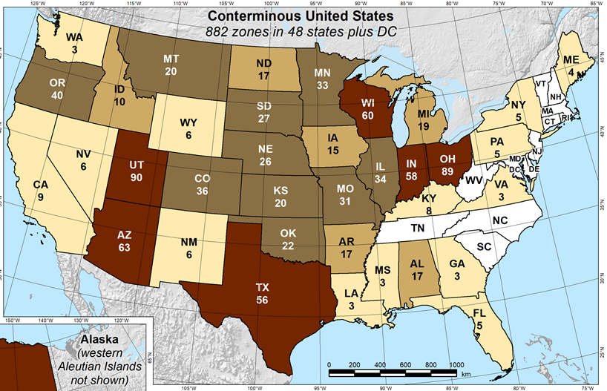
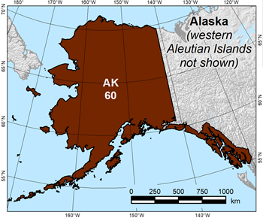
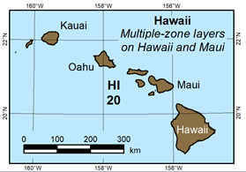
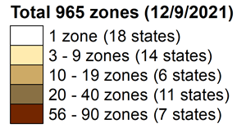
State Plane Coordinate System of 2022 (CONUS, Alaska and Hawaii)
Three territory zones not shown:
    Puerto Rico and U.S Virgin Islands
  American Samoa
  Guam and Commonwealth of the
  Northern Mariana Islands
https://geodesy.noaa.gov/SPCS/

Slide 23
Vertical Datums of the NSRS
St. Paul I.
- None -
St. Lawrence I.
- None -
St. Matthew I.
- None -
Alaska
NGVD 29
NAVD 88
St. George I.
- None -
CONUS
NGVD 29
NAVD 88
Hawaii
- None -
CNMI
NMVD 03
Puerto Rico
PRVD 02
U.S. Virgin Islands
VIVD 09
American Samoa
ASVD 02
Guam
GVD 63
GUVD 04

Slide 24
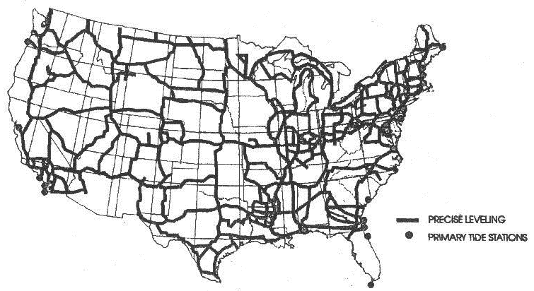
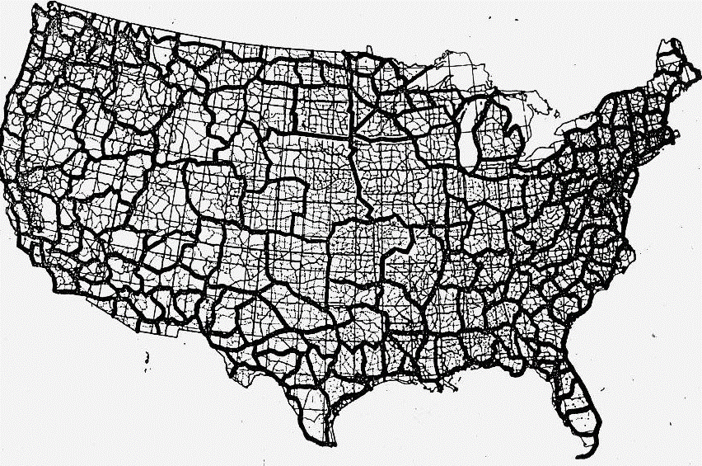
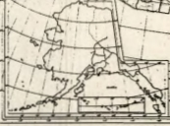
NGVD 29
NAVD 88

Slide 25
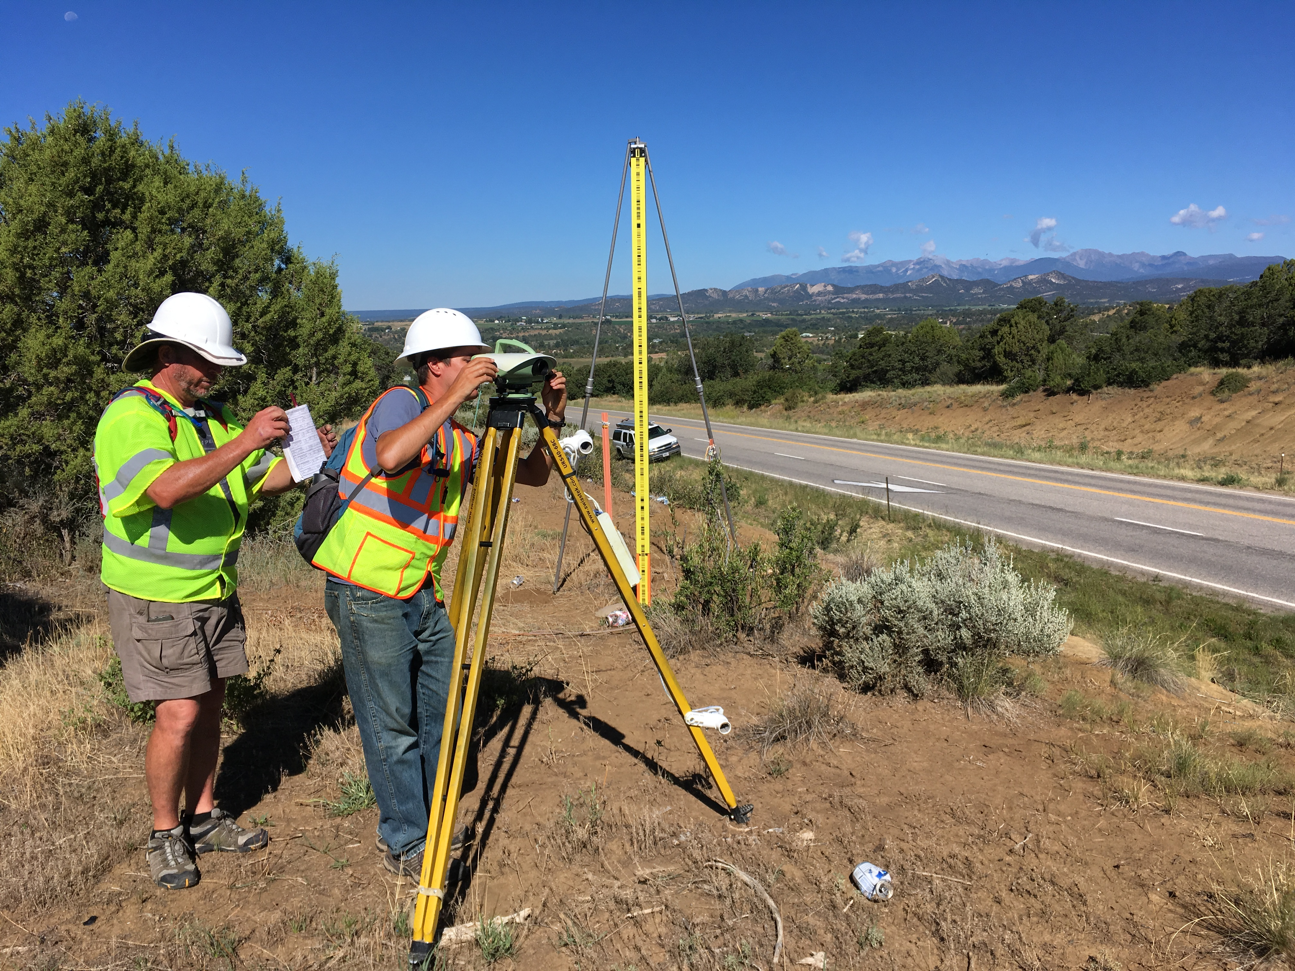
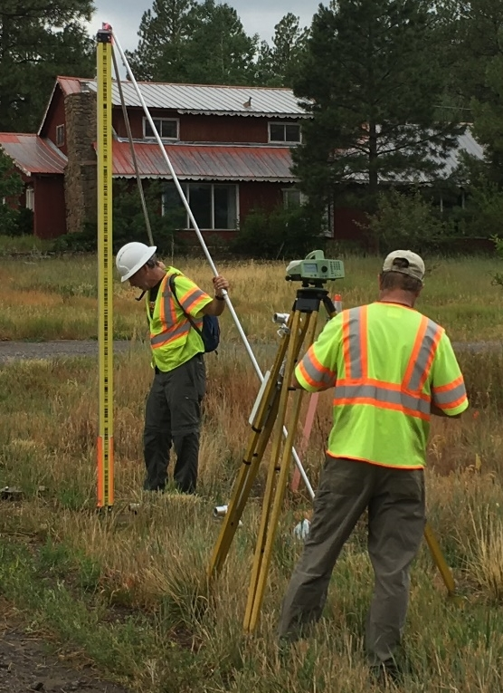
Leveling

Slide 26
Replacing NAVD 88
  The Old:
  NAVD 88
  PRVD 02
  VIVD09
  ASVD02
  NMVD03
  GUVD04
  IGLD 85
  IGSN71
  GEOID18
  DEFLEC18
  The New:
  The North American-Pacific
  Geopotential Datum of 2022
  (NAPGD2022)
  - Will include geoid model GEOID2022
  - Surface gravity model GRAV2022
  - Deflection of the vertical model DEFLEC2022
Orthometric
Heights
Normal
Orthometric
Heights
Dynamic
Heights
Gravity
Geoid
Undulations
Deflections of
the Vertical

Slide 27
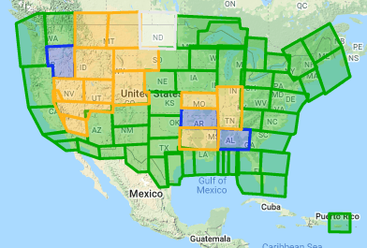
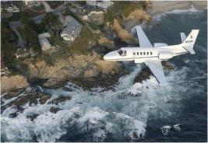
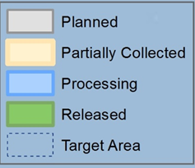
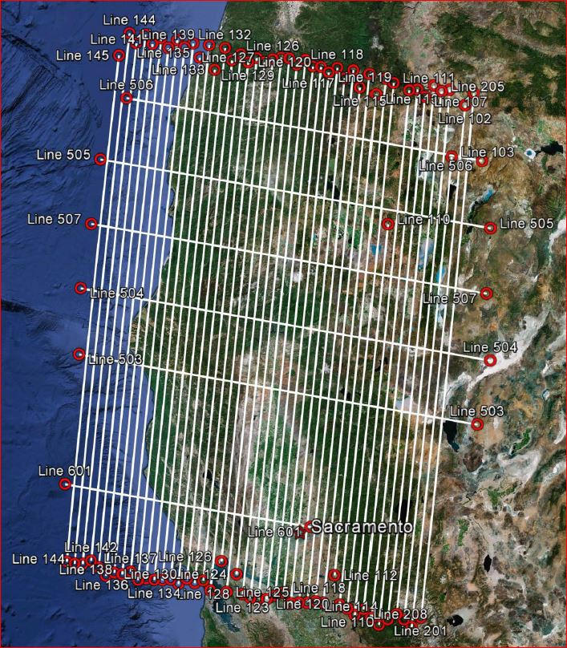
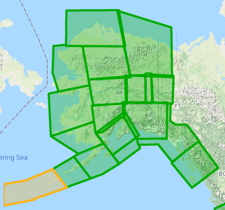
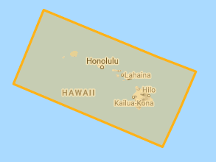
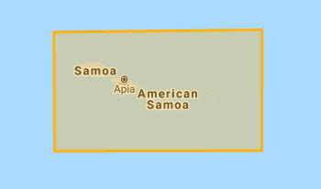
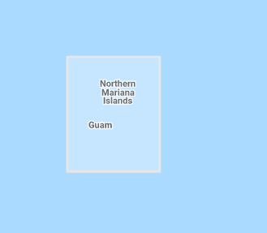
Gravity for the Redefinition of the American Vertical Datum (GRAV-D)
10 km data lines
70 km cross lines
20,000 ft altitude
230 kt flight speed
Alaska
Hawaii
American Samoa
Guam & CNMI

Slide 28
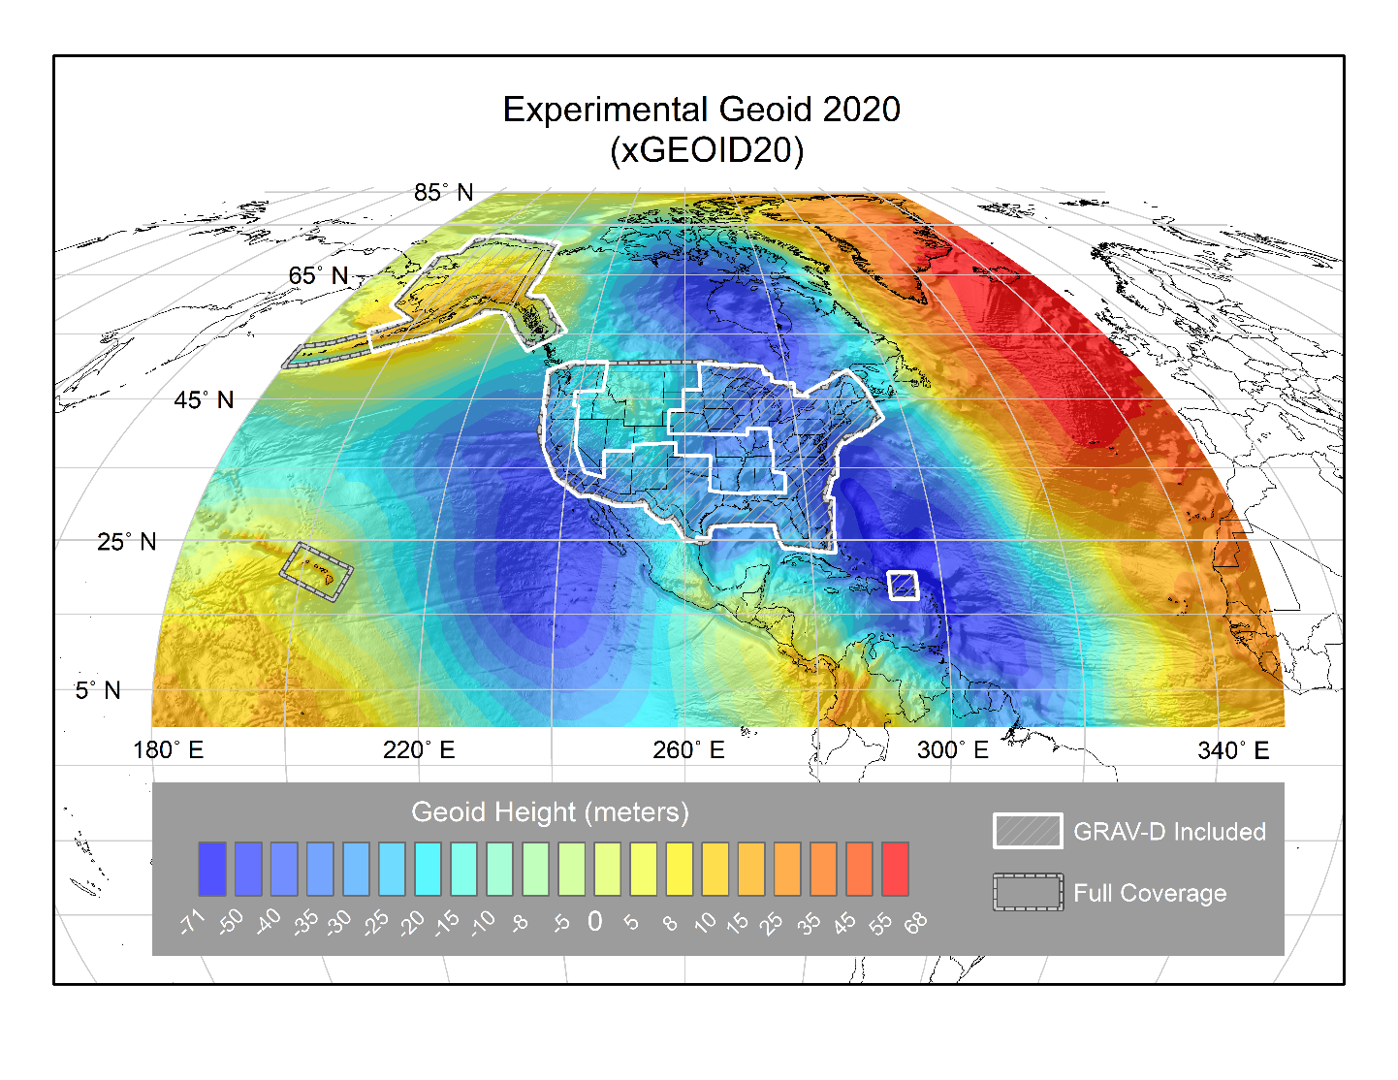

Slide 29


Slide 30
NSRS Modernization: Delay
It’s official: we are delayed beyond 2022
How long is the delay?
    Unknown. Years.
Will names change?
    No, “GEOID2022”, “NATRF2022”, etc. will remain the same

Slide 31
NGS ArcGIS Online Resources
Feature Services
Raster Tile Services
NGS Datasheets
NOAA CORS Network
GPS on Benchmarks Priority List
(4 layers - marks, hexagons)
GEOID18 GPS on Benchmarks
GEOID12B GPS on Benchmarks
OPUS Shared Solutions
Mark Recoveries Submitted to NGS
GEOID18 Height (CONUS, PRVI)
GEOID18 Difference (CONUS, PRVI)
GEOID18 Uncertainty (CONUS, PRVI)
GEOID18 Improvements (CONUS, PRVI)

Slide 32
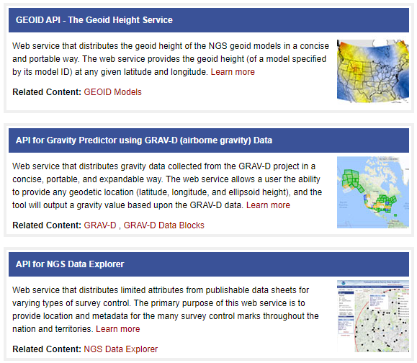
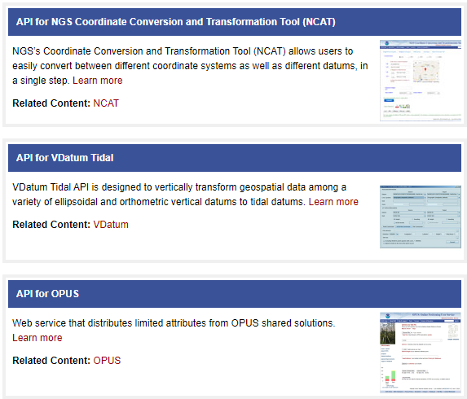
Application Programming Interfaces (APIs)
https://geodesy.noaa.gov/web_services/

Slide 33
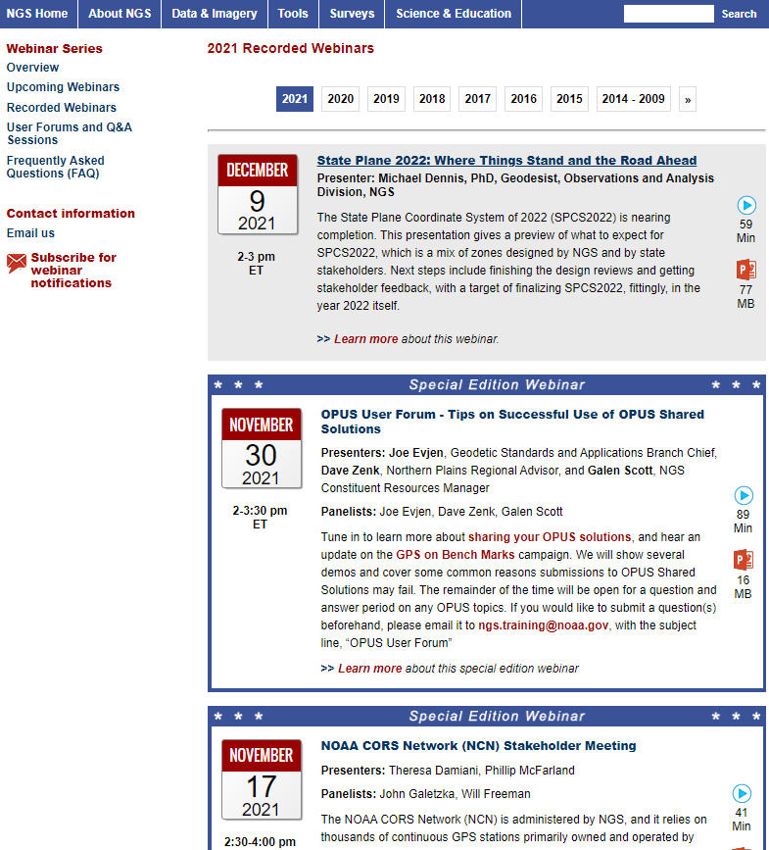
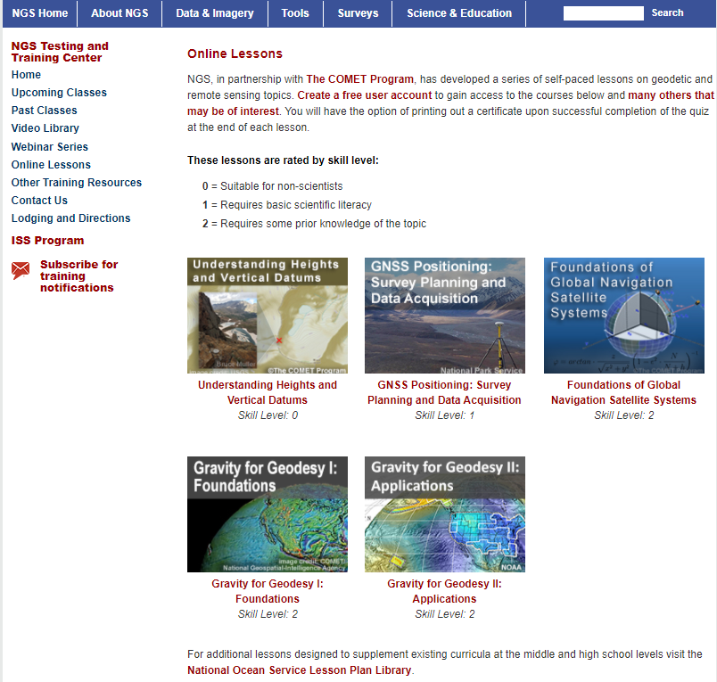

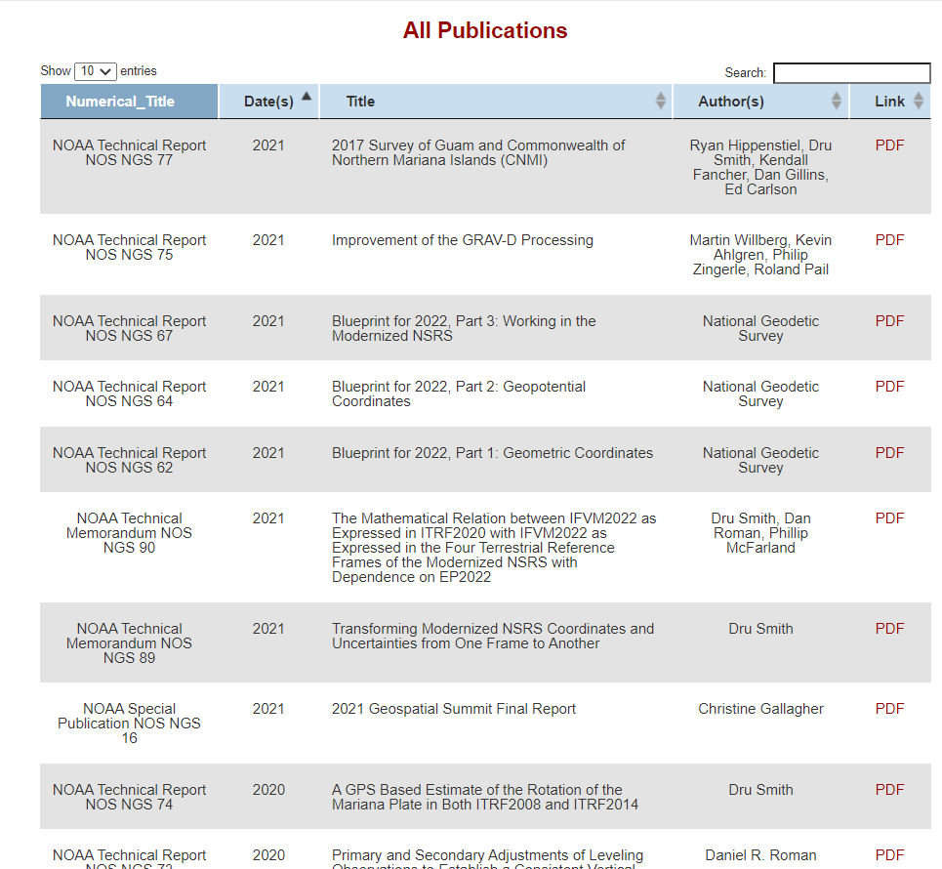
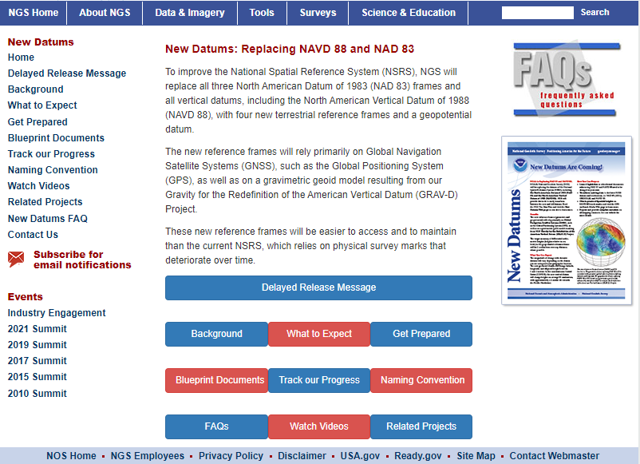
Online Resources
Monthly webinar series
  All webinars are recorded and available online
Online lessons
Video library
Publication library
NSRS Modernization News

Slide 34
Thank You!
Jacob Heck, Ph.D., P.S.
Great Lakes Regional Geodetic Advisor (WI, MI, IN,IL)
U.S. National Geodetic Survey, NOAA
jacob.heck@noaa.gov
c/o NOAA Great Lakes Environmental Research Laboratory
4840 S. State Road
Ann Arbor, MI 48108
For more information, visit https://geodesy.noaa.gov

Slide 35
Extra Slides

Slide 36
National Spatial Reference System (NSRS)
Geometric Geodesy
Physical Geodesy
Horizontal Datums/Geometric Reference Frames
Latitude
Longitude
Ellipsoid Height
State Plane Coordinates
Geopotential Datums
Orthometric Height
Dynamic Height
Surface Gravity
Leveling
Main Components: latitude, longitude, height, origin, scale, gravity, and orientation

Slide 37
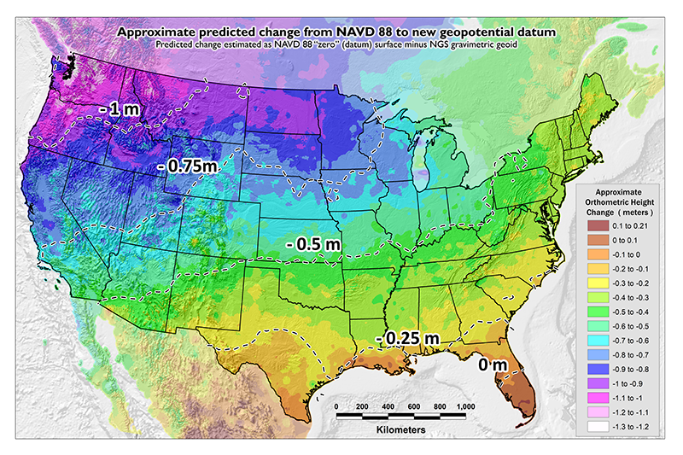
NAVD 88 (epoch ?) to
NAPGD2022 Epoch 2020.00 (estimate)

Slide 38
The Geoid, and Heights
h
= H
+ N
h: ellipsoidal height
H: orthometric height
N: geoid undulation
Topography
h
H
The geoid
N
A chosen
ellipsoid

Slide 39
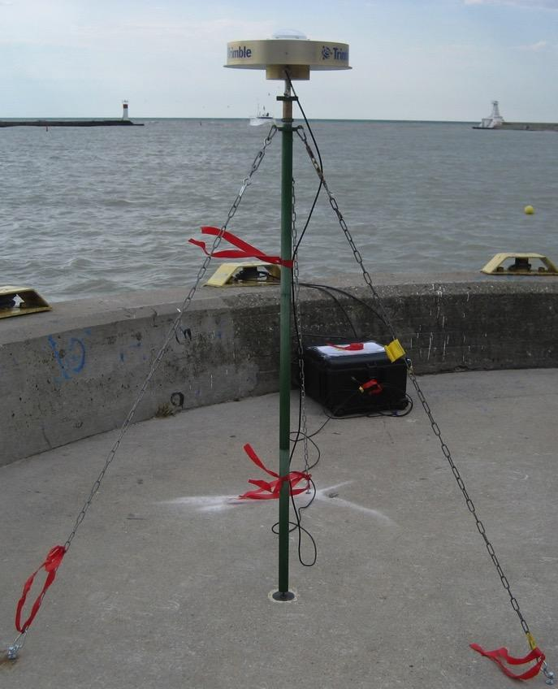
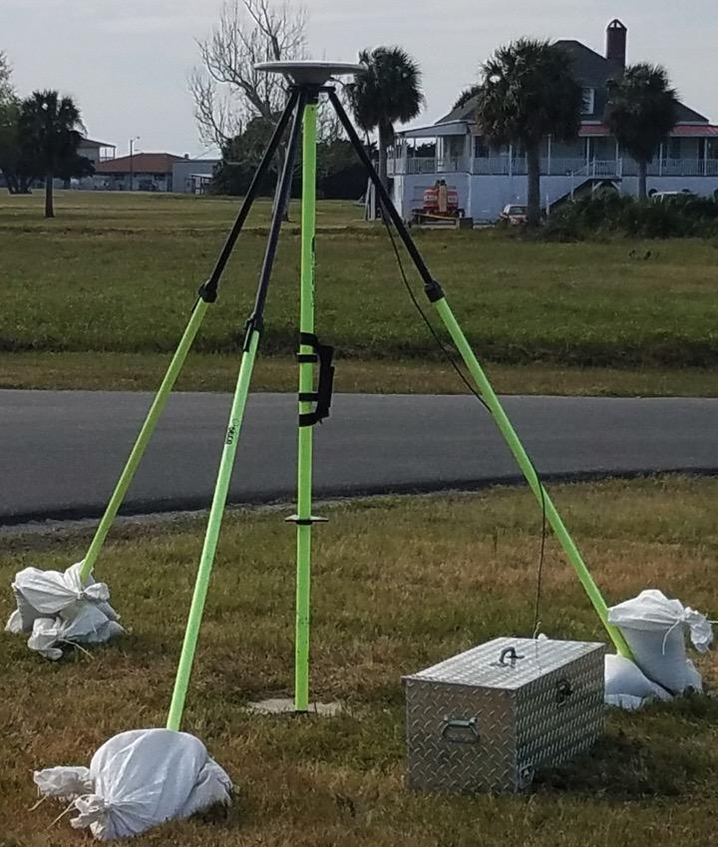
Typical GNSS Setups

Slide 40
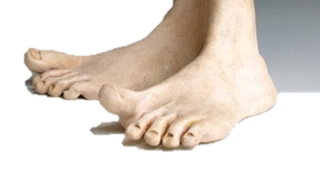
A tale of two feet
Two versions of “foot” in current use:
“Old” U.S. survey foot
“New” international foot
‭1 ft = 0.3048006096…‬ m
1 ft = 0.3048 m exactly
differ by
2 parts per million (ppm) or ~0.01 ft/mile
  A real problem with real costs

Slide 41
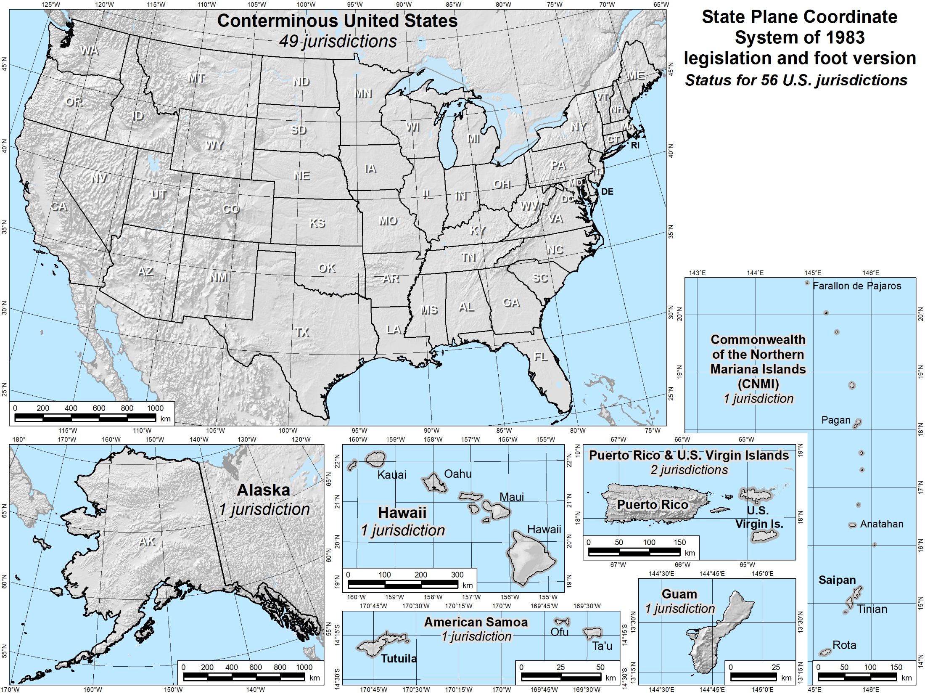
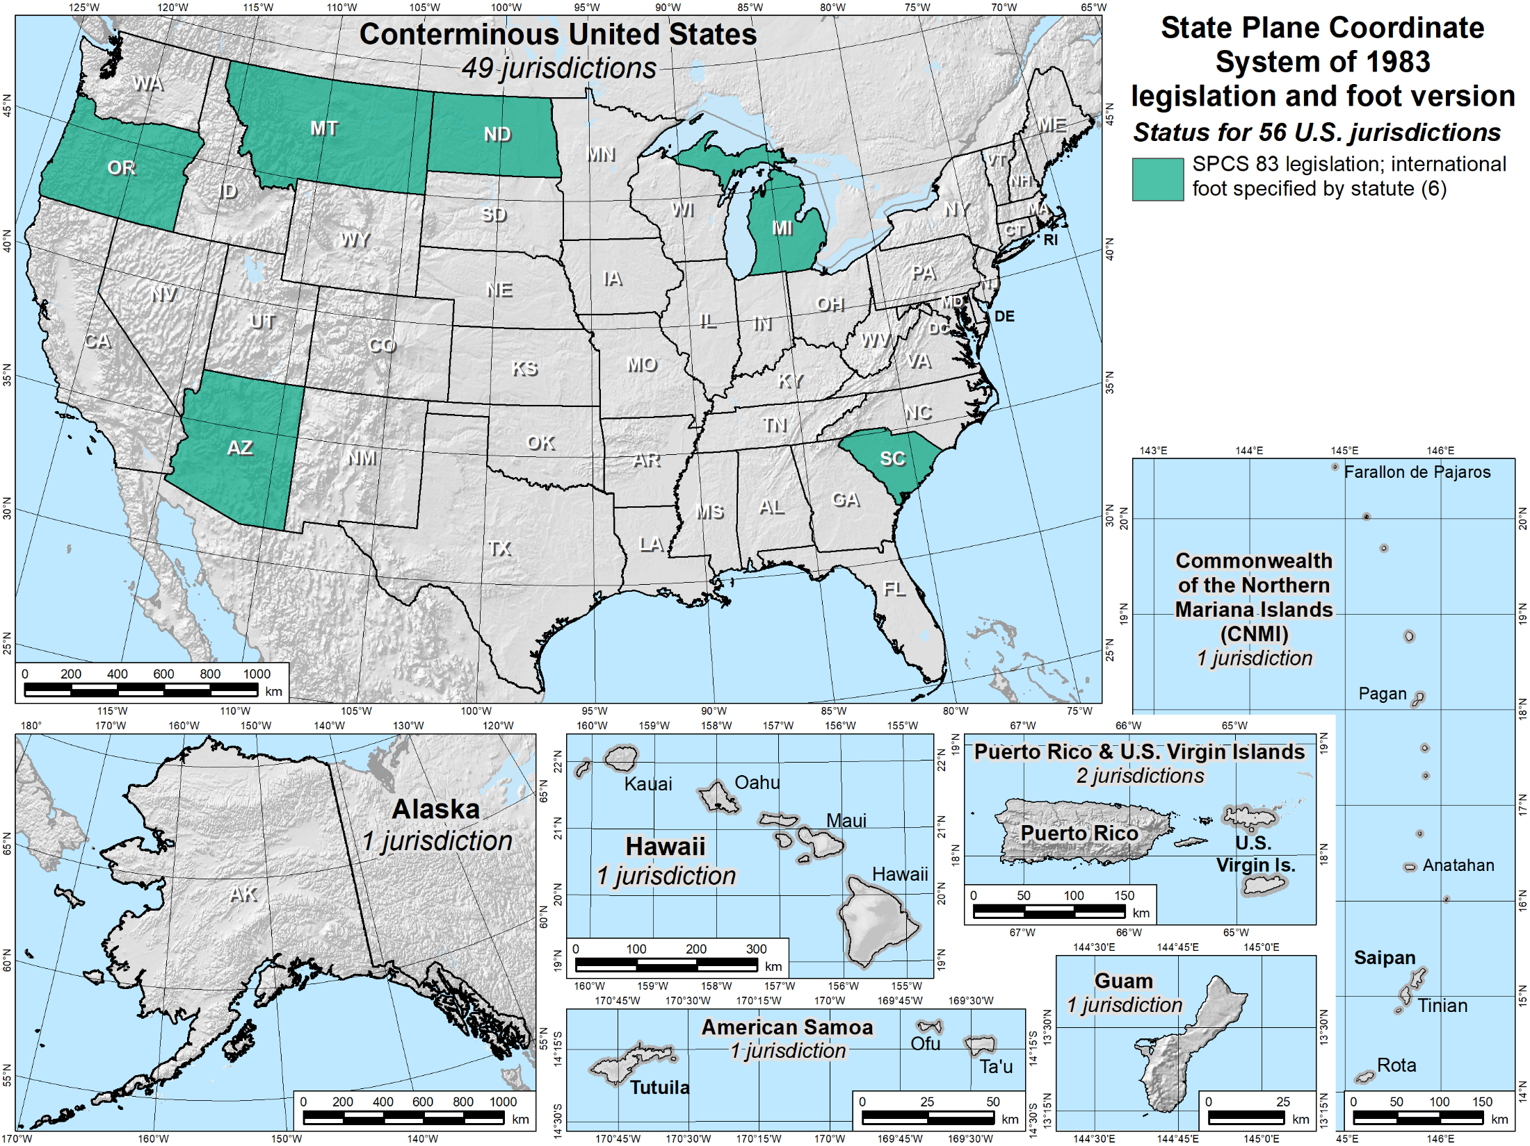
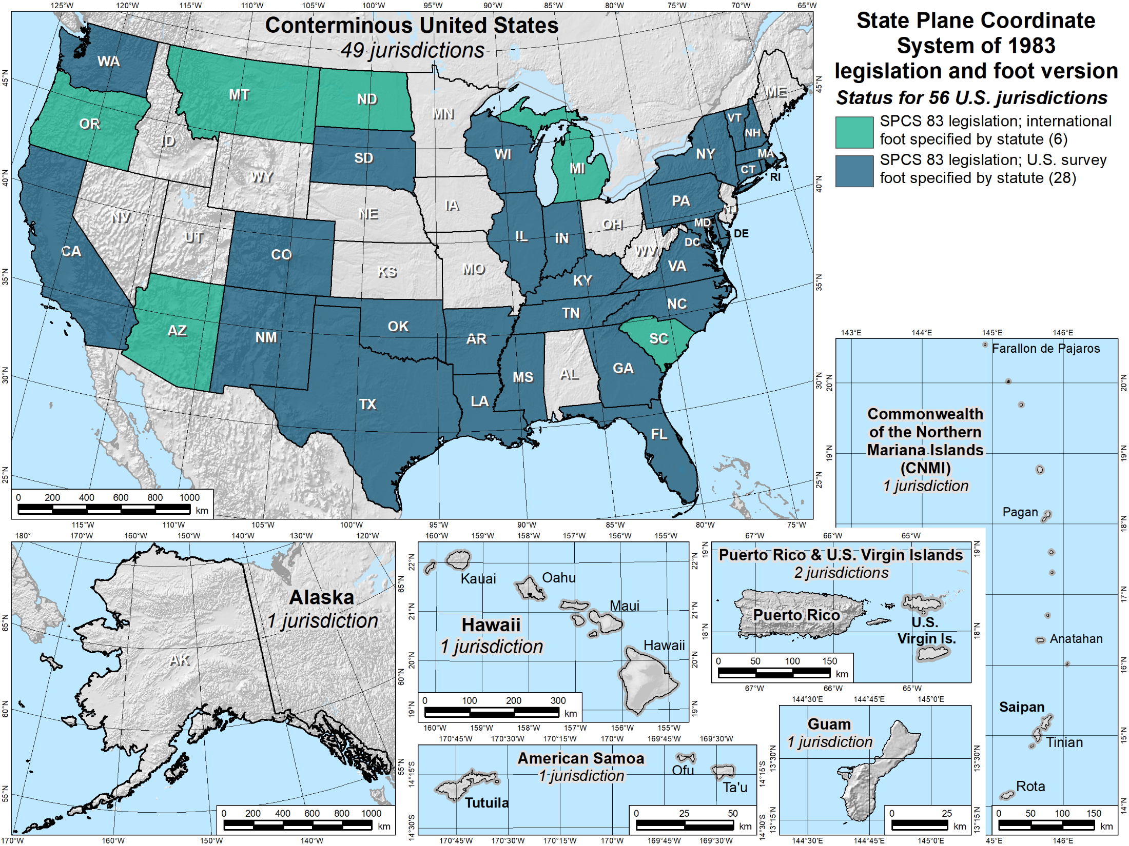





Slide 42
Bye, bye, U.S. survey foot…
In modernized NSRS, NGS will support only one definition of the “foot”
  Previously called the “international foot”
  Now, just the “foot”
  1 foot = 0.3048 meter (exact)
However
  Recommend using term “international foot” when there is potential for confusion with other foot
  NGS will continue to support U.S. survey foot for legacy applications (e.g., SPCS 83 and 27)
For more information on the foot: https://www.youtube.com/watch?v=b_NL8NHFlIU

Slide 43


What is Geodesy?
Geodesy (geodetic control) is a foundational science that defines position & height
Why is Geodesy important?
The Earth is an irregular surface and is difficult to model. Accurate positions are required for a wide variety of applications
(e.g. monitoring climate change impacts/sea level change)

Slide 44









Horizontal
Vertical

