Slide 1


Using Real-time Networks in the Northeast
New York State Association of Professional Land Surveyors
January 20, 2016
Dan Martin
Northeast Regional Geodetic Advisor
Dan.martin@noaa.gov
240-676-4762

Slide 2
“Human knowledge is doubling every 10 years. The scientific knowledge produced between 1987 and 1997 is greater than that produced in all mankind’s history”.
Michio Kaku- renowned theoretical physicist
THE CHANGE FROM LABOR INTENSIVE TO TECHNOLOGY!

Slide 3
Real Time Kinematic (RTK)
Method of phase differential GNSS
Solve for integer ambiguity on the fly
Broadcast correctors/data
  UHF radio, or cellular connection via internet
Requires a minimum of five SV
Limited distance from base (10-20 km)
Accuracy can be 1 cm…can also be a meter!

Slide 4
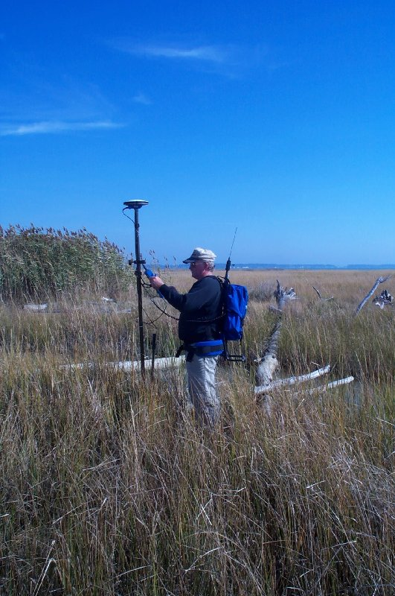
WHAT’S HAPPENING IN MY ROVER?
….SO YOU THOUGHT RT POSITIONING IS EASY?
WHAT YOUR ROVER IS DOING FOR “A FEW SECONDS” -

Slide 5
HOW DOES RTK WORK?
∆ X,Y,Z FROM BASE (REMEMBER “GIGO”)
MULTILATERATION - TIME (SEC.) · C (SPEED OF LIGHT) (M/SEC.)= DISTANCE from satellite
MUST RESOLVE CARRIER CYCLE INTEGER COUNT AMBIGUITIES (# cycles · wave length + partial cycle = distance)
MUST ACCOUNT FOR FACTORS AFFECTING THE PATH OF THE SIGNAL
DUAL FREQUENCY ENABLES “ON THE FLY” RESOLUTION OF THE AMBIGUITIES & EASIER CYCLE SLIP DETECTION
THAN L1 ONLY
FREQUENCY COMBINATIONS AND DIFFERENCING CONTRIBUTE TO MITIGATING THE ERROR BUDGET

Slide 6
Integer Ambiguity
Integer Ambiguity is the unknown number of full wavelengths from the reference satellite to the antenna phase center
Must be solved for to achieve centimeter accuracy
Receiver keeps track of the subsequent number of wavelengths and the partial fractional wavelength measurements (phase)

Slide 7
THE INTEGER AMBIGUITY
WGS 84
X,Y,Z
Resolving the integer ambiguity allows phase
measurements to be related to distances
Nλ
Δλ = First Partial Wavelength
Nλ = Integer Ambiguity
Distance
Δλ
Distance = Nλ + Δλ

Slide 8
THE CYCLE COUNT COOKBOOK-
USING DIFFERENCING TO ELIMINATE OR REDUCE COMMON ERRORS IN THE RECEIVER AND SATELLITE
RECEIVER HARDWARE DELAYS
SATELLITE HARDWARE DELAYS
RECEIVER CLOCK BIAS
SATELLITE CLOCK BIAS
ELIMINATED WITH DIFFERENCING
IONO DELAY
TROPO DELAY
SAME AS BASE WITH SINGLE BASE
INTERPOLATED WITH RTN
MEASUREMENT NOISE (HIGHER GRADE RECEIVERS = LESS NOISE)
MULTIPATH
NOT ELIMINATED WITH DIFFERENCING

Slide 9
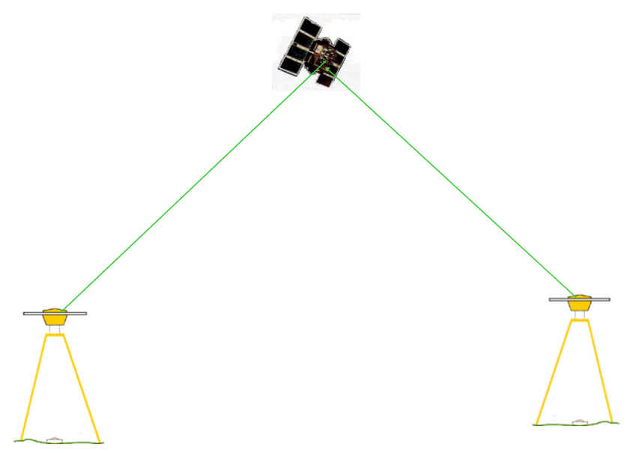
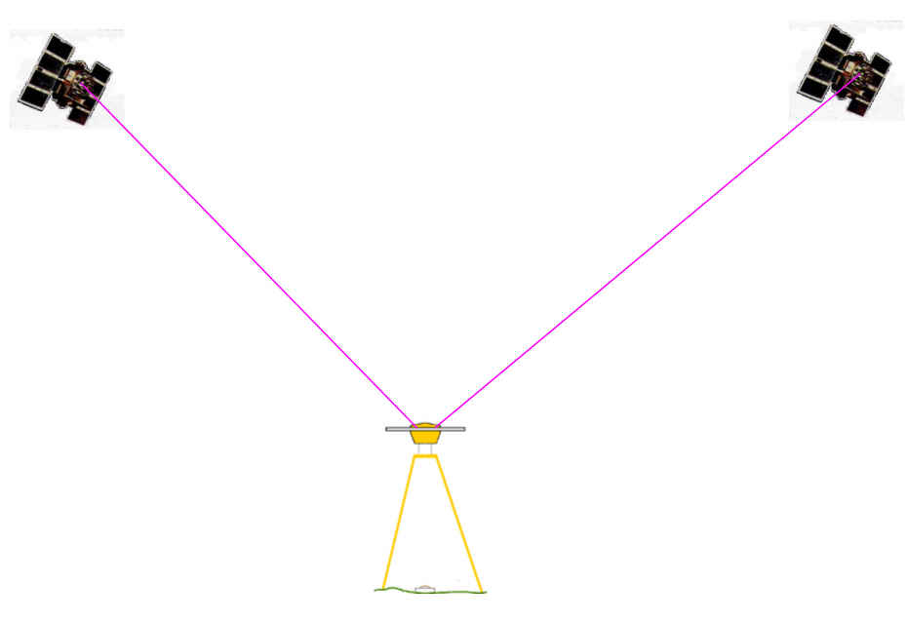
SINGLE DIFFERENCE
OR
Two satellites, one receiver same epoch,
eliminates receiver clock error,
receiver hardware error
Two receivers, one satellite, same epoch.
Eliminates satellite clock error,
satellite hardware error

Slide 10
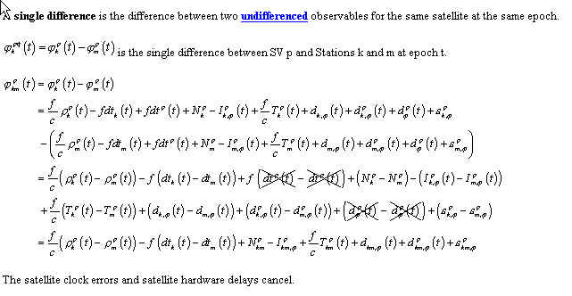
SINGLE DIFFERENCE

Slide 11
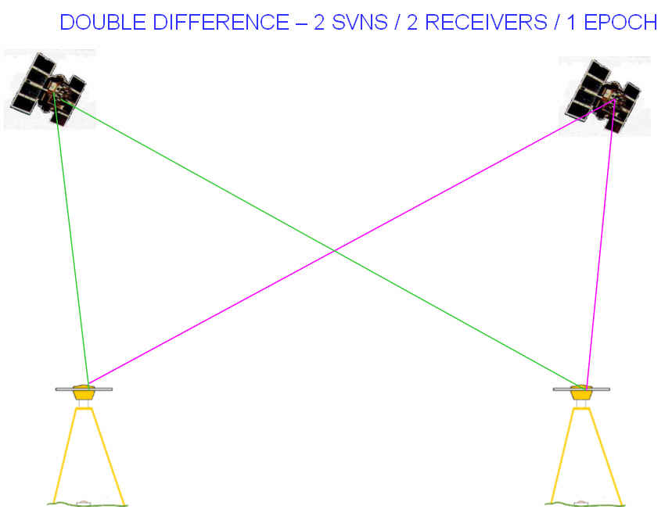
DOUBLE DIFFERENCE
Double differencing: two receivers, two satellites, same epoch (two Single Differences). Eliminates receiver clock error, receiver hardware error, reduces other errors.

Slide 12
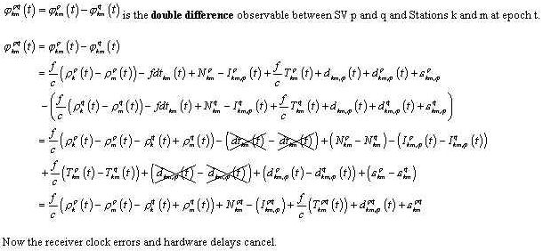
DOUBLE DIFFERENCE
= difference between two single differences of two receivers and TWO satellites at the same epoch

Slide 13
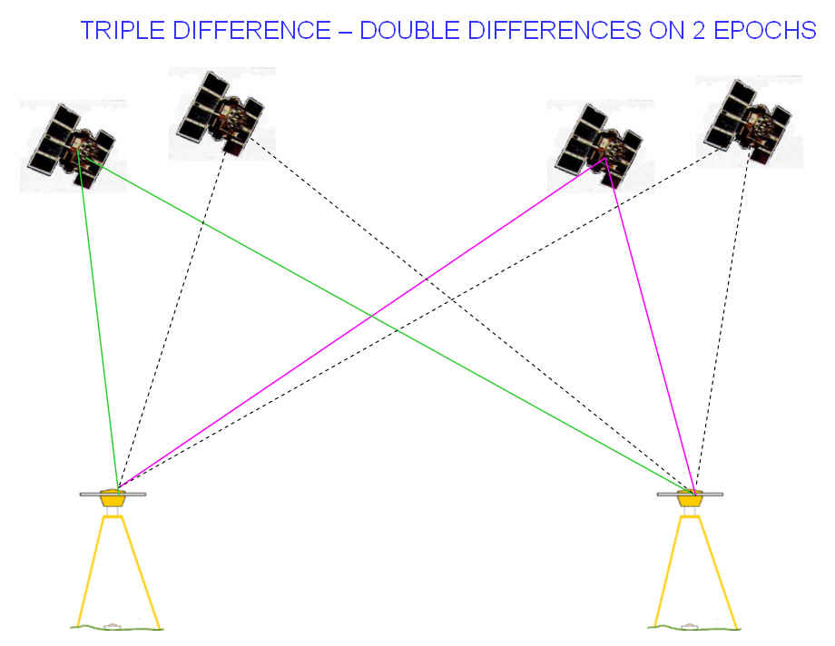
TRIPLE DIFFERENCING
Triple difference – difference of two double differences at two epochs for two satellites and two receivers. Detects cycle slips

Slide 14
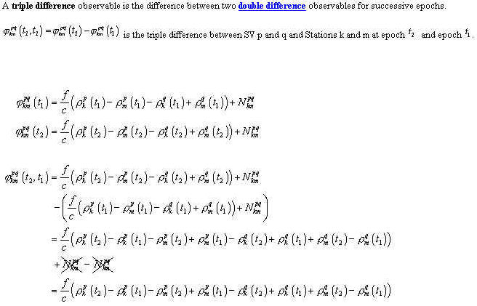
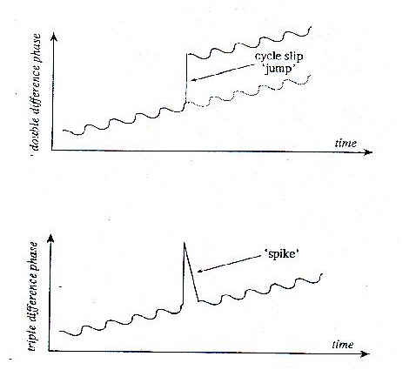
TRIPLE DIFFERENCE
Cancels Double Difference integer cycles

Slide 15
CYCLE SLIPS
Cycle slip detection/correction of dual-frequency data is easier than for single frequency data.
Cycle slip detection/correction of differenced data is easier than for one-way (undifferenced) phase data, because of the elimination of the clock biases.
Cycle slip detection/correction of static data is easier than the case of kinematic data.
Cycle slip detection/correction of short baseline data (<30km) is easier than for long baseline data.
Cycle slip detection/correction of data in the post-mission mode is easier than for the case of real-time data processing.
…In fact, it is the computational efficiency of the
ambiguity search process rather than the
performance that distinguishes the different
ambiguity resolution techniques.

Slide 16

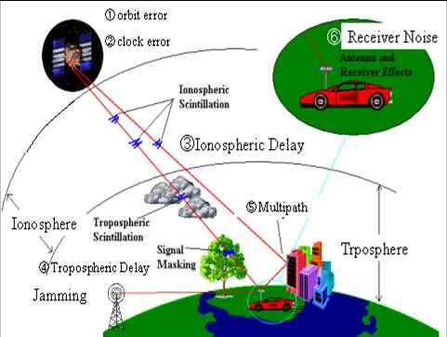
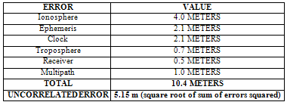
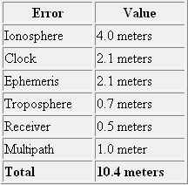
AFFECTS ON RT PROCESSING

Slide 17
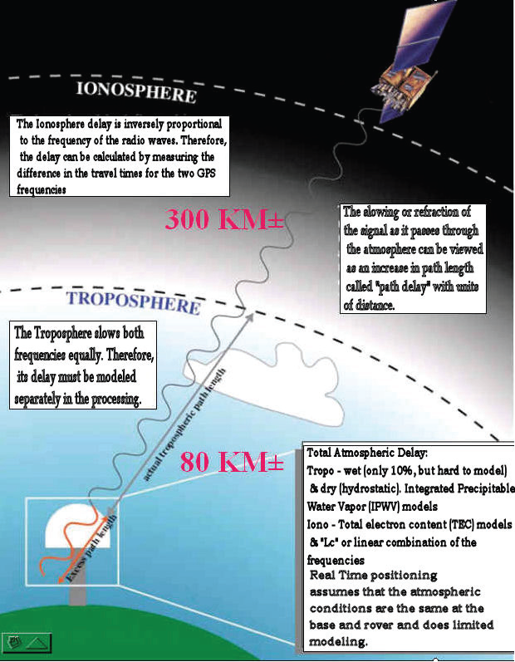
IONO & TROPO LAYERS AND THEIR EFFECT ON THE GNSS SIGNAL-
“DISPERSIVE” &
“GEOMETRICAL” EFFECTS

Slide 18
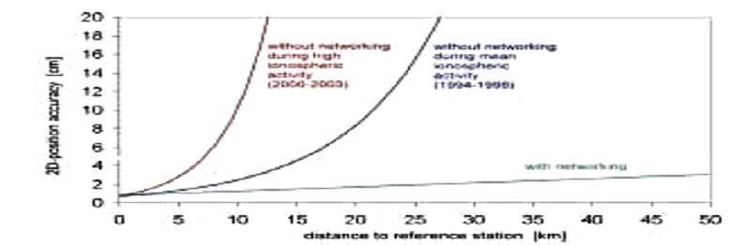
IONOSPHERIC EFFECTS ON POSITIONING
AVERAGE IONO- NO NETWORK
HIGH IONO- NO NETWORK
2D PRECISION/ACCURACY (CM)
SINGLE BASE
RTK @ 10 KM
(2000-2002)
(1994-1995)
NETWORK SOLUTION
@ 30 KM
WITH NETWORK
DISTANCE TO REFERENCE STATION (KM)
(SOURCE-BKG- GERMANY)

Slide 19
TROPOSPHERE DELAY
  The more air molecules, the slower the signal (dry delay)
    High pressure, Low temperature
    90% of total delay
    relatively constant and EASY TO CORRECT FOR
  The more water vapor in the atmosphere the slower the signal (wet delay)
    High humidity
    10% of total delay
    Highly variable and HARD TO CORRECT FOR
Ionosphere
troposphere
10 KM
GREATER THAN 10 KM

Slide 20
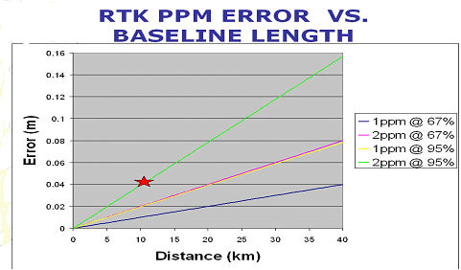
IONO, TROPO, ORBIT CONTRIBUTE TO PPM ERROR
REMEMBER GNSS EQUIPMENT MANUFACTURERS’ SPECS!

Slide 21
RTK

Slide 22
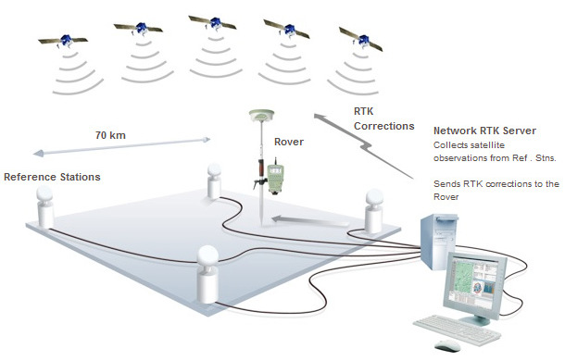
Network RTK
Image courtesy of Leica

Slide 23
Real Time Network (RTN)
Attempts to remove the distance dependent errors associated with “traditional” RTK
Manufacturers may use different approaches, but generally they are all effective.
Can provide integrity measures for both base/network and rover.

Slide 24
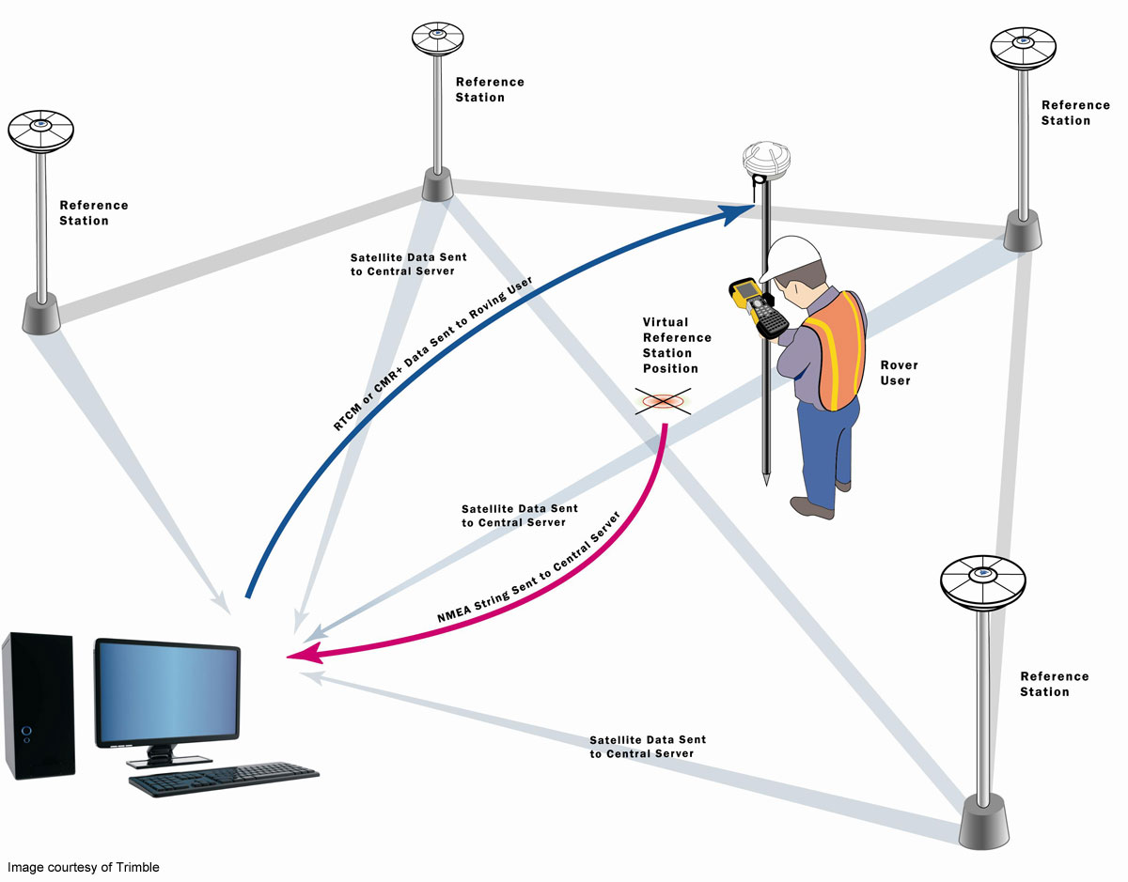
VRS

Slide 25
VRS
A raw data stream is sent from each reference station (low latency) to the network server Central Processing Center (CPC). All (or clusters of) reference stations may be used.
The network data is used to compute models of ionospheric, tropospheric, and orbital errors (live high-precision orbit data may be introduced, like Ultra-Rapid Orbit).

Slide 26
The rover sends its generalized location to the network server to “request” corrections for its vicinity.
The actual errors on the baselines are derived in centimeter level accuracy using fixed carrier-phase observations.
Linear or more sophisticated error models are used to predict the errors at the rover location.
A non-physical (virtual) reference location is derived as an origin for the high confidence modeled values at or near the rovers vicinity.

Slide 27
The observed positions (or vectors) are referenced to a physical station while utilizing the improved corrections from the non-physical station.
The models are updated constantly, and as conditions may change, or if the rover moves far enough from the non-physical location, and new non-physical location can be initiated automatically and without delay to the rover
The rover receives only standard formats (RTCM).

Slide 28
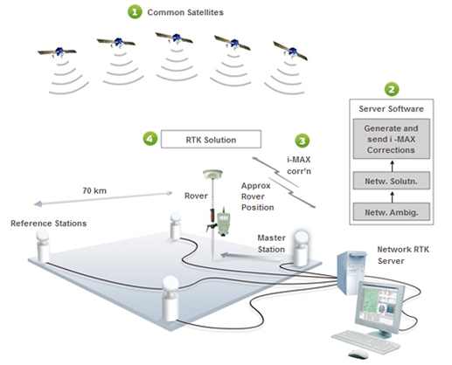
Individual Master Auxiliary (i-MAX)
Image courtesy of Leica

Slide 29
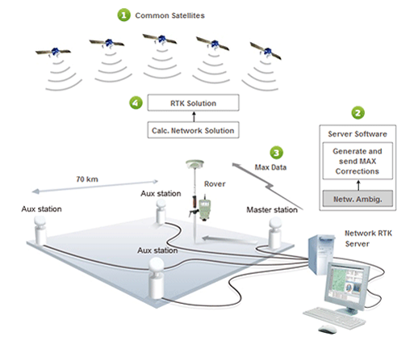
Master Auxiliary (MAX)
Image courtesy of Leica

Slide 30
MAX
Reference stations continually transmit raw data (low latency) to the network servers.
Network estimation process to reduce stations to a common ambiguity level.
Either a pre-defined cluster or cell of stations (e.g., as few as 3, or as many as, say, 30) is accessed, or optionally the rover sends its position, and a set of stations is selected based on proximity to that location.
Derivation of RTCM 3.1 Network
Messages for the master station, and
offset messages for each auxiliary
station are broadcast or transmitted to

Slide 31
Derivation of RTCM 3.1 Network Messages for the master station, and offset messages for each auxiliary station are broadcast or transmitted to the rover.
Rover (client-side processing) computes the high precision rover position.

Slide 32
Different Networks
NYSNET (NY)– Leica Network
VECTOR (VT) – Trimble Network
ME -Trimble Single Base (network soon)
MA – Leica Network
CT – Trimble Network
KeyNet – Trimble
SmartNet – Leica
TopNet – Topcon
Boyd Instrument (Topcon)

Slide 33
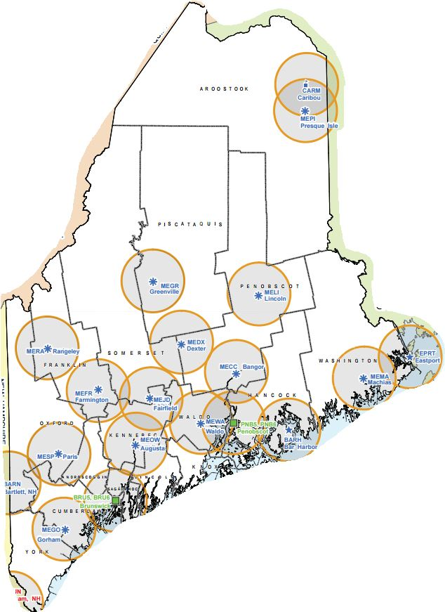
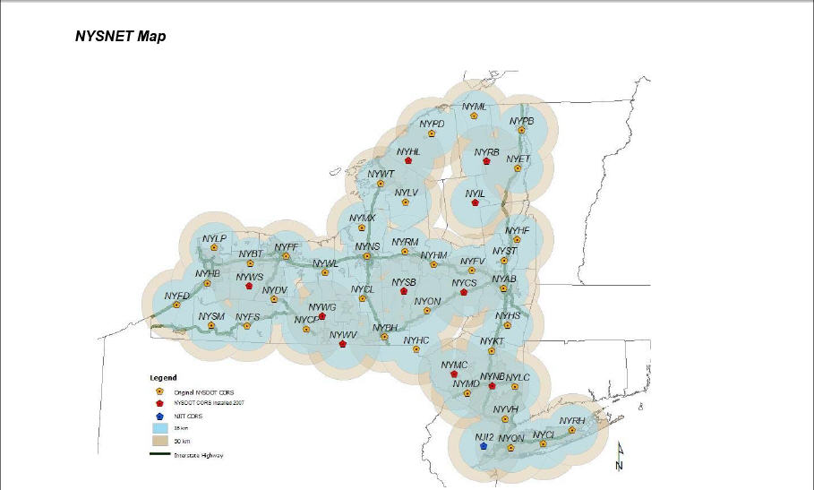
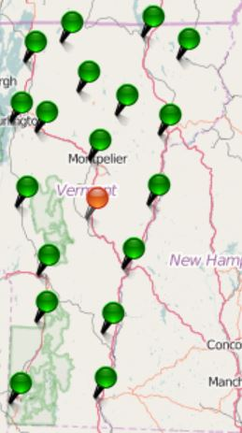
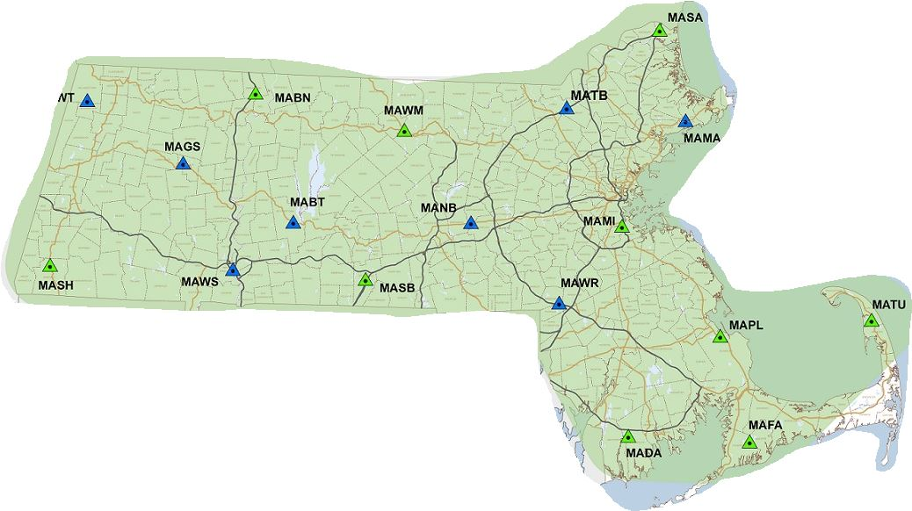
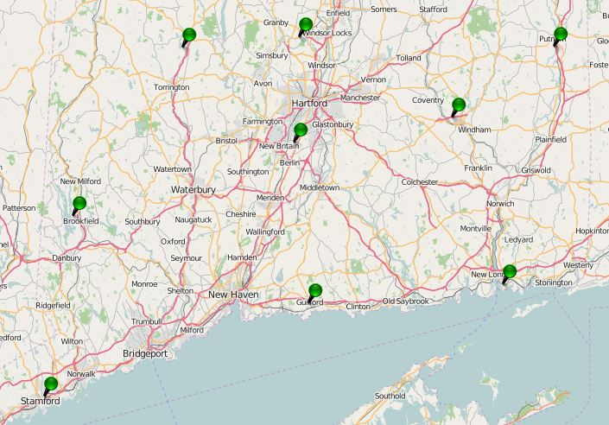
Real Time Networks

Slide 34
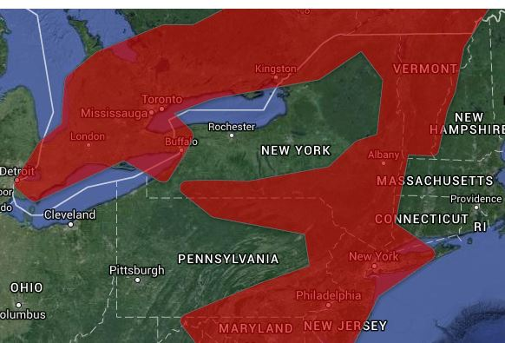
SmartNet (Leica)

Slide 35
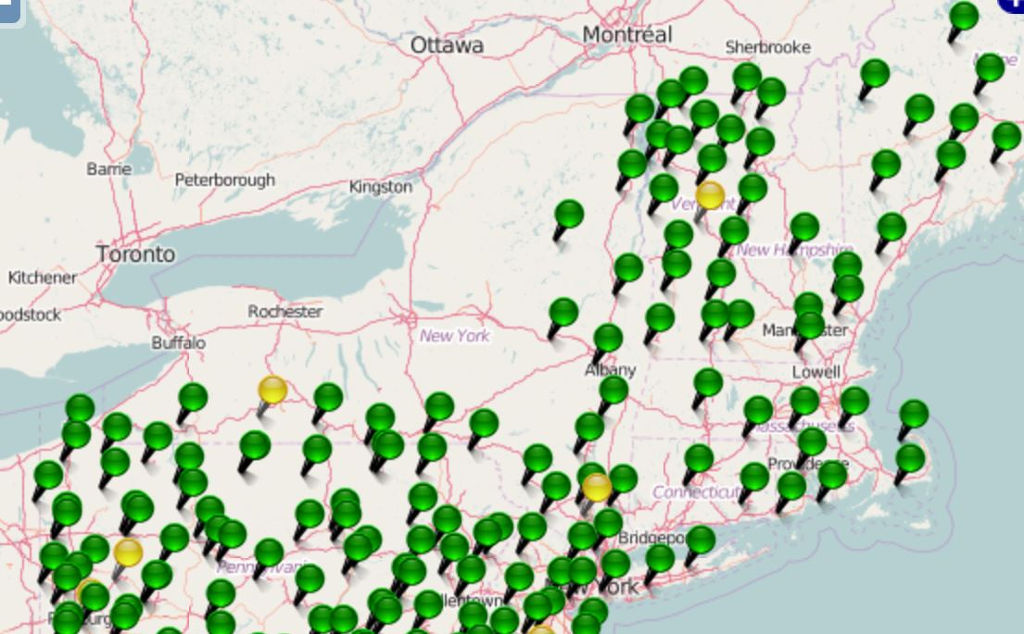
KeyNet GPS (Keystone Precision)

Slide 36
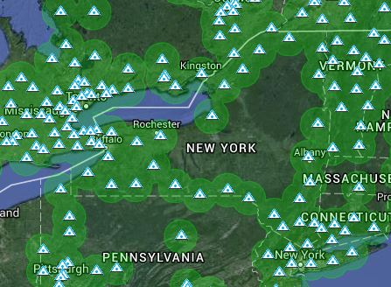
TopNet (Topcon)

Slide 37
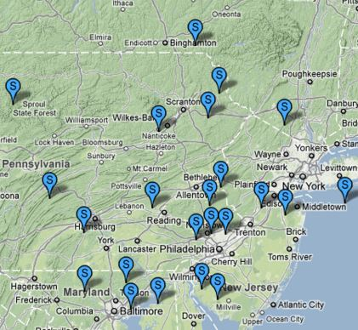
Boyd Instrument

Slide 38
Equipment Needed
Conventional RTK
Network RTK or RTN
Base
Radio
Antenna
Batteries
Repeater??? w/antenna and batteries
Rover
Rover
Cellular data or wifi connection
Data plan for cellular

Slide 39
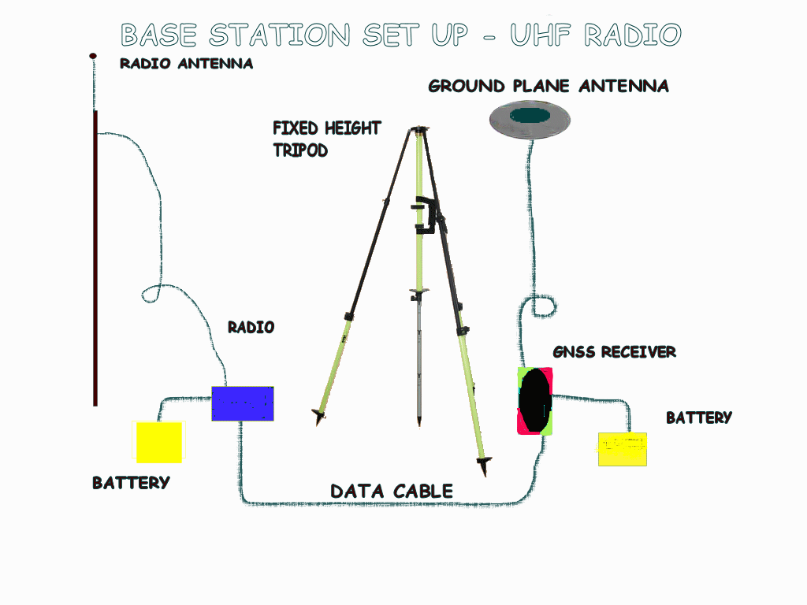
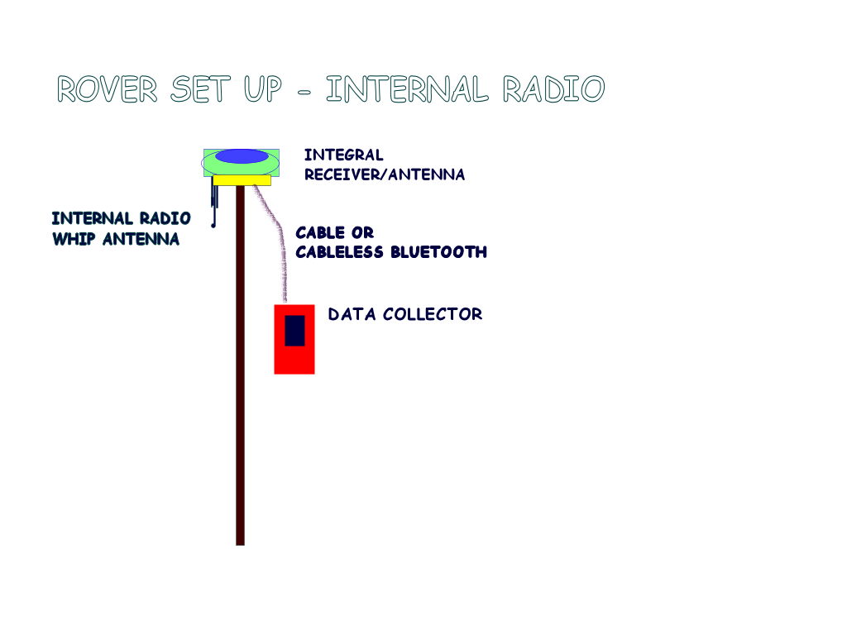


RTK vs. RTN
Cell technology
-Half the equipment or double the production
-No monument reconnaissance/
recovery
- No set/break down time
-No base baby sitting
RTN
Plus:
Easy alignment to the NSRS
No ppm (1ST ORDER) ERROR
Extended range
Homogeneous Data
Easy datum updates
RTK

