Slide 1
Using OPUS-Projects to Submit GPS Surveys to NGS
Mark Schenewerk
mark.schenewerk@noaa.gov
816-994-3067

Slide 2
Presentation outline.
Who is this guy?
Then and now: a little history just for fun.
Now and later:
Beta OPUS-Projects: the next generation OPUS-Projects.
Backwards compatibility to the current OPUS-Projects.
An overview of the Beta OPUS-Projects web app highlighting non-trivial differences to the GUI.
Timeline to complete this project.
What’s next after this project?
Questions.
April 13, 2017
Using OPUS-Projects to Submit GPS Surveys to NGS
Notes:
09/18/2018 modification by Ramesh Srigiriraju: 2 references to OP2IDB were replaced with Beta OPUS-Projects to reflect new project name.

Slide 3
Who is this guy?
B.S. from the University of Missouri at Rolla. Ph.D. from the University of Illinois at Champaign-Urbana.
The NGS calls me a geodesist, but I’m actually an astronomer who happens to do things that look like geodesy.
I am the “father” of the PAGES processing software.
I’ve been indirectly involved in OPUS since its inception in 2002.
I am the “father” of the OPUS-Projects web application.
April 13, 2017
Using OPUS-Projects to Submit GPS Surveys to NGS

Slide 4
Then and now: a little history.
The National Geodetic Survey can directly trace its heritage back to the Survey of the Coast established by President Thomas Jefferson in 1807.
The responsibilities of the Survey of the Coast expanded with our nation. In 1878, the Survey of the Coast was renamed to the U.S. Coast and Geodetic Survey to better describe its functions.
When the National Oceanic and Atmospheric Administration (NOAA) formed in 1970, the U.S. Coast and Geodetic Survey became part of NOAA and was reorganized into the National Geodetic Survey (NGS) and the Office of Coast Survey (OCS).
April 13, 2017
Using OPUS-Projects to Submit GPS Surveys to NGS

Slide 5
The NGS mission.
The NGS still surveys the U.S. coastline as we did in 1807, but must (by mandate and necessity) do more. Today the NGS mission can be better (and formally) described as: Define, maintain and provide access to the National Spatial Reference System (NSRS) to meet our nation's economic, social, and environmental needs.
April 13, 2017
Using OPUS-Projects to Submit GPS Surveys to NGS

Slide 6
The NSRS.
You’ll note that we slipped in a little jargon: reference system. A reference system is everything necessary to determine the coordinates of a point.
The most commonly used part of a reference system is the reference frame. A reference frame is the physical expression of a reference system, i.e. the coordinates, velocity, etc. of a select set of points.
But a reference system also includes:
Data, physical and corrective models, and software.
And the means to use the reference system.
Guidelines.
Continuously Operating Reference Stations (CORS).
Software.
Education and outreach.
April 13, 2017
Using OPUS-Projects to Submit GPS Surveys to NGS
Notes:
NATRF2022, etc.
GNSS, leveling, etc. data.
Geophysical and corrective models (orbits & antcal).
Guidelines (publications like NGS-58/59).
Continuously Operating Reference Stations (CORS)
Software (OPUS).
Education and outreach (webinars, workshops & summits).

Slide 7
NGS Ten Year Plan 2013-2023.
As it has throughout its history, the technology used by the NGS and its stakeholders has evolved.
For this reason, the NGS Ten Year Plan includes Goal 2: Modernize and Improve the National Spatial Reference System.
Objective 1: Replace NAD 83
Objective 2: Replace NAVD 88
Objective 3: Re-invent Bluebooking
Objective 4: Fix the Toolkit
Objective 5: Better Surveying
April 13, 2017
Using OPUS-Projects to Submit GPS Surveys to NGS

Slide 8
NGS Ten Year Plan 2013-2023.
As it has throughout its history, the technology used by the NGS and its stakeholders has evolved.
For this reason, the NGS Ten Year Plan includes Goal 2: Modernize and Improve the National Spatial Reference System.
Objective 1: Replace NAD 83
Objective 2: Replace NAVD 88
Objective 3: Re-invent Bluebooking
Objective 4: Fix the Toolkit
Objective 5: Better Surveying
April 13, 2017
Using OPUS-Projects to Submit GPS Surveys to NGS

Slide 9
The 1920’s.
The NAD 27 / NGVD 29 were released.
Nineteenth Amendment was ratified (1920).
First commercial radio broadcasts (1920).
Winnie the Pooh was published (1926).
First flight of a liquid-fueled rocket (1926).
Penicillin was discovered (1928).
Sliced bread appeared in stores (1928).
Car radio invented (1929).
Plate tectonics had been hypothesized.
https://en.wikipedia.org/wiki/1920s
April 13, 2017
Using OPUS-Projects to Submit GPS Surveys to NGS
Notes:
Plate tectonics had been hypothesized in the early twentieth century, but wouldn’t be commonly accepted until the late 1950s.

Slide 10
The 1980’s.
The NAD 83 / NAVD 88 were released.
Mount St. Helens erupts (1980).
MS-DOS and the first “affordable” PCs (1981).
First commercial cell phone (1983).
Microsoft Windows operating system (1985).
Space shuttle Challenger explodes (1986).
CDs outsell vinyl records for the first time (1988).
First genetically modified crops (1988).
GPS and GLONASS became available.
http://www.nationalgeographic.com.au/history/the-80s-timeline.aspx
April 13, 2017
Using OPUS-Projects to Submit GPS Surveys to NGS
Notes:
GPS and GLONASS were available, but the constellations were incomplete until the start of the next decade.

Slide 11
The 2020’s.
The NATRF2022 will be released. see “Modernizing the National Spatial Reference System” and others in the NGS presentation library: https://geodesy.noaa.gov/web/science_edu/presentations_library/.
“You see, something’s going to happen. Something wonderful.” Dave Bowman from “2010: The Year We Make Contact”
April 13, 2017
Using OPUS-Projects to Submit GPS Surveys to NGS

Slide 12
Now my story really begins ...
The NGS is preparing for the next big step: a new reference system.
NAD 83 / NAVD 88 / hybrid geoid
NATRF2022 / gravimetric geoid
Publications & Training
Publications & Training
CORS
Update
Adapt
Replace
CORS
OPUS
OPUS
Bluebooking
Re-invented
Bluebooking
Integrated
Database
Geospatial
Database
April 13, 2017
Using OPUS-Projects to Submit GPS Surveys to NGS

Slide 13
Plans are in place and we’re moving forward ...
NAD 83 / NAVD 88 / hybrid geoid
NATRF2022 / gravimetric geoid
Publications & Training
Publications & Training
CORS
Update
Adapt
Replace
CORS
OPUS
OPUS
Bluebooking
Re-invented
Bluebooking
Integrated
Database
Geospatial
Database
April 13, 2017
Using OPUS-Projects to Submit GPS Surveys to NGS

Slide 14
… but re-inventing bluebooking has proven to be hard.
NAD 83 / NAVD 88 / hybrid geoid
NATRF2022 / gravimetric geoid
Publications & Training
Publications & Training
CORS
Update
Adapt
Replace
CORS
OPUS
OPUS
Bluebooking
Re-invented
Bluebooking
Integrated
Database
Geospatial
Database
April 13, 2017
Using OPUS-Projects to Submit GPS Surveys to NGS

Slide 15
Define bluebooking?
bluebook [bloo bo͝ok] noun The NGS Bluebook is a set of strongly structured data formats. While its origins go back to the late 1970s and early 1980s, it has been updated and adapted to changes in technology over the years. See also: Input Formats and Specifications of the National Geodetic Survey Data Base. https://www.ngs.noaa.gov/FGCS/BlueBook/
bluebooking [bloo bo͝okiNG] verb To format surveying results following the NGS Bluebook specifications for submission to the Integrated Database (IDB).
April 13, 2017
Using OPUS-Projects to Submit GPS Surveys to NGS

Slide 16
What is bluebooking?
Here’s a snippet from a GPS survey b-file:
And here’s a snippet from a GPS survey g-file:
Description files are binary and cannot be directly shown here.
001260*72*007 TRM57971.00 NONE 1441004436
001270*72*008 TRMR8_GNSS NONE 4742140440
001280*72*009 TRMR8_GNSS NONE 4903163658
001290*80*000100U A 45444339095N107394147536W MT
001300*86*0001 917859K N88 -145516 903308A ANAD 83(2011)
001310*80*000200U B 45444340228N107391267987W MT
001320*86*0002 913707K N88 -145556 899152A ANAD 83(2011)
AXX2010010120100101 ZT
B20121128000020121128235910 page5 v1603.24IGS 202 1 2 27NGS 20170331IFDDPF
IIGS08_1918 IGS 20161009
C00010007 -192456435 31 251316299 85 174597232 87 R3332A00UAA3332ABIL5
C00020007 -198398077 49 253174484 137 174624654 145 R3332A00UBA3332ABIL5
C00030007 -188537798 38 250002712 105 174490580 110 R3332A00UCA3332ABIL5
D 1 2 8648044 1 3 -8394568 1 4 1387570 1 5 1106639 1 6 -1045842
April 13, 2017
Using OPUS-Projects to Submit GPS Surveys to NGS
Notes:
If you’re as old as I, these snippets should remind you of punchcards. That’s because punchcards are part of the heritage of the bluebooking standards:
Every column is significant.
Order of lines is sometimes significant.
Alphanumeric codes often represent human-readable information to “simplify” reading by the computer.

Slide 17
Bluebooking is integral to NGS tasks.
Pros
It has been the standard for submissions to the IDB for decades.
Many programs are tailored specifically to these formats.
Folks are used to it.
It has served its purposes very well.
Cons
It uses 1960’s technology.
Its detail and complexity are intimidating.
It is time intensive for you.
Difficult if not impossible to adapt for the future.
April 13, 2017
Using OPUS-Projects to Submit GPS Surveys to NGS

Slide 18
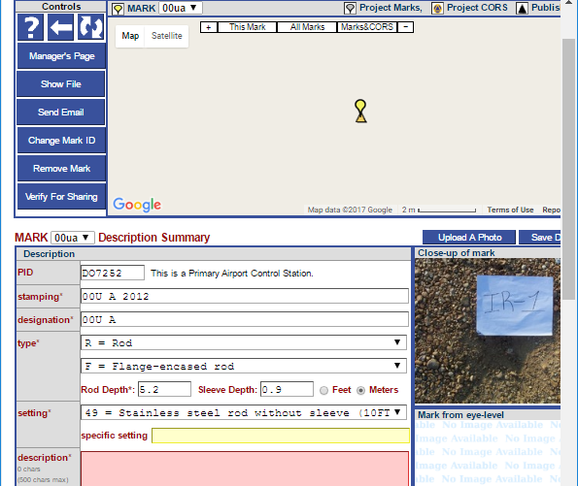
What does re-inventing bluebooking mean?
You do this.
You do this.
Here there be dragons.
We see this.
We see this.
April 13, 2017
Using OPUS-Projects to Submit GPS Surveys to NGS
Notes:
Re-inventing bluebooking means going from users creating and NGS interpreting strongly formatted reports to users entering information in much more human-friendly ways and NGS receiving that information formatted in much more flexible formats like XML.
But how to do this with minimal disruption to everyone involved in publication to the IDB?

Slide 19
What is Beta OPUS-Projects?
In 2015, NGS began a project called “Deriving a valid path for OPUS-Projects GPS projects to be loaded to the NGS IDB.”
That title is a mouthful, so I call it Beta OPUS-Projects.
The project plan in two sentences:
Bluebooking is tedious and time-consuming.
Demonstrate that, with minimal changes to its web-based Graphical User Interface (GUI), OPUS-Projects can be extended to prepare in toto submissions to the IDB.
April 13, 2017
Using OPUS-Projects to Submit GPS Surveys to NGS
Notes:
In short: demonstrate that OPUS-Projects can “feed” the IDB.
09/18/2018 modification by Ramesh Srigiriraju: 2 references to OP2IDB were replaced with Beta OPUS-Projects to reflect new project name.

Slide 20
Why do this?
This makes your life easier now: Machines work for you rather than you work for machines.
This makes your life easier later: Bluebooking and many of the other changes required for the new NSRS will be hidden behind the GUI.
April 13, 2017
Using OPUS-Projects to Submit GPS Surveys to NGS

Slide 21
Final comments …
Beta OPUS-Projects is the first of several related projects.
Beta OPUS-Projects facilitates creating a submission for publication to the IDB by simplifying some tasks and doing others for you automatically; however, the guidelines and requirements for creating that submission have not changed.
Therefore, the existing submission documentation and guidelines remain valuable resources.
https://www.ngs.noaa.gov/web/surveys/photo_submissions/
https://www.ngs.noaa.gov/PC_PROD/ADJUST/adjustment_guidelines.pdf
https://geodesy.noaa.gov/datasheets/
April 13, 2017
Using OPUS-Projects to Submit GPS Surveys to NGS
Notes:
09/18/2018 modification by Ramesh Srigiriraju: 2 references to OP2IDB were replaced with Beta OPUS-Projects to reflect new project name.

Slide 22
… and a quick apology.
I’ll now highlight some of the enhancements to be found in the “look and feel” of Beta OPUS-Projects.
From here on, I assume familiarity with the use of OPUS-Projects.
April 13, 2017
Using OPUS-Projects to Submit GPS Surveys to NGS
Notes:
As mentioned in the description of this webinar, this is not OPUS-Projects training. The GUI will not be shown or explained in its entirety. So those of you with limited OPUS-Projects experience, focus upon getting a sense of what NGS is trying to do by creating an OPUS-Projects-like interface.
09/18/2018 modification by Ramesh Srigiriraju: 1 reference to OP2IDB was replaced with Beta OPUS-Projects to reflect new project name.

Slide 23
Backwards compatibility.
Some folks won’t want to submit their results for publication or their projects won’t be appropriate to submit. For them, we’ve preserved the current OPUS-Projects appearance and functionality with two exceptions.
However, we have enhanced a few functions.
In the next few slides, we discuss the exceptions and enhancements before proceeding to the changes supporting submissions to the IDB.
April 13, 2017
Using OPUS-Projects to Submit GPS Surveys to NGS

Slide 24
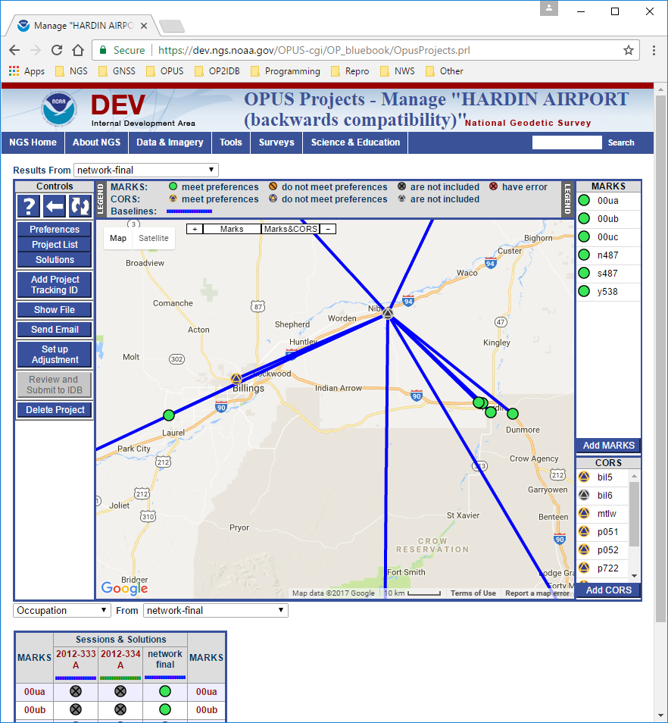
Manager’s page: solution type display.
April 13, 2017
Using OPUS-Projects to Submit GPS Surveys to NGS
Notes:
The table at the bottom of the manager’s web page is a graphical representation of mark occupations. Its row and column headers also serve as navigation shortcuts to other web pages about the project.
Now, that table can be changed to give representations of solution statistics and results quality in addition to occupation information. These summaries should simplify quality control for the project manager by highlighting “interesting” results rather than making the manager navigate through many web pages to gather that information.

Slide 25
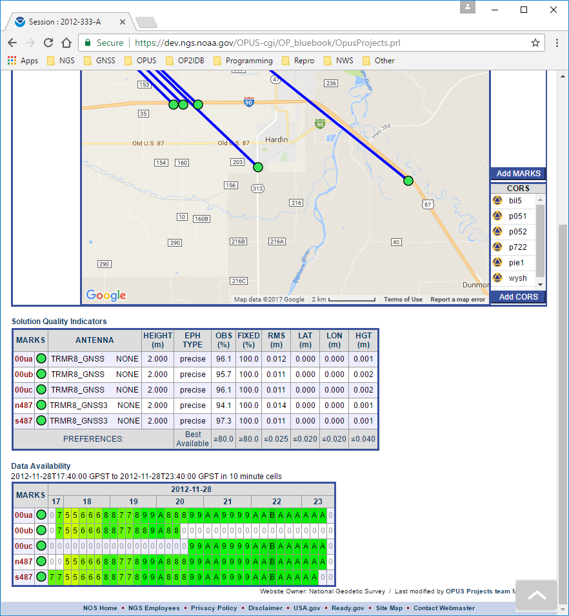
Manager’s page: session consolidation.
April 13, 2017
Using OPUS-Projects to Submit GPS Surveys to NGS
Notes:
OPUS-Projects now defines sessions by the shortest occupation in a time span. For example, 00ub and 00uc were not occupied at the same time so they would have been the “seeds” for two sessions.
But the project occupied three other marks, uu0a, n487 and s487, continuously during the 00ub and 00uc occupations. This suggests that the project intended that this be one session.
As long as there is no conflict, occupations like this will be combined into a single session in Beta OPUS-Projects.
09/18/2018 modification by Ramesh Srigiriraju: 1 reference to OP2IDB was replaced with Beta OPUS-Projects to reflect new project name.

Slide 26
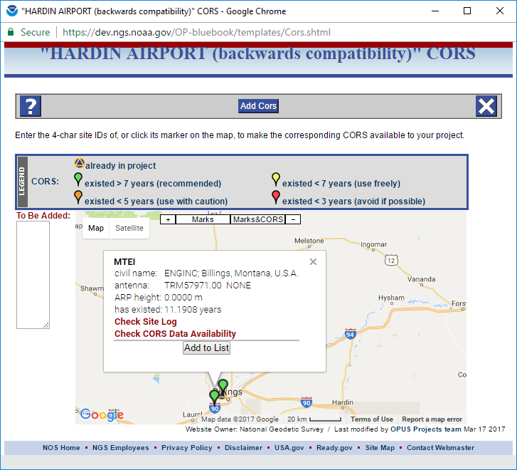
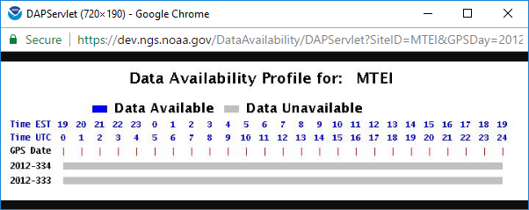
Add CORS: data availability and site log.
April 13, 2017
Using OPUS-Projects to Submit GPS Surveys to NGS
Notes:
We’re also working on an improved algorithm for color-coding or otherwise indicating if CORS are available for the project. These changes should make CORS selection more informed and much easier.

Slide 27
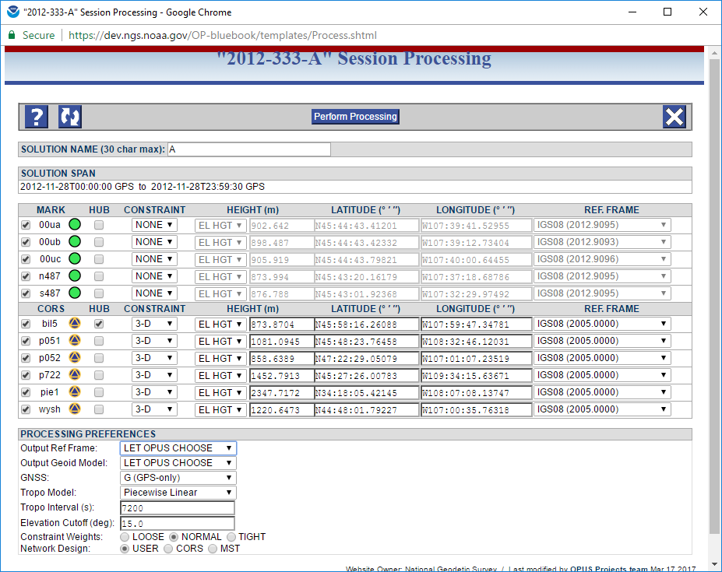
Session processing setup: HUB suggestion.
April 13, 2017
Using OPUS-Projects to Submit GPS Surveys to NGS
Notes:
The project “knows” which marks are available, have published coordinates, etc.. It will use that information to suggest hub marks and constraints.
The user is still free to make the choices they want or need, but the setup defaults should be closer to fulfilling those needs.

Slide 28
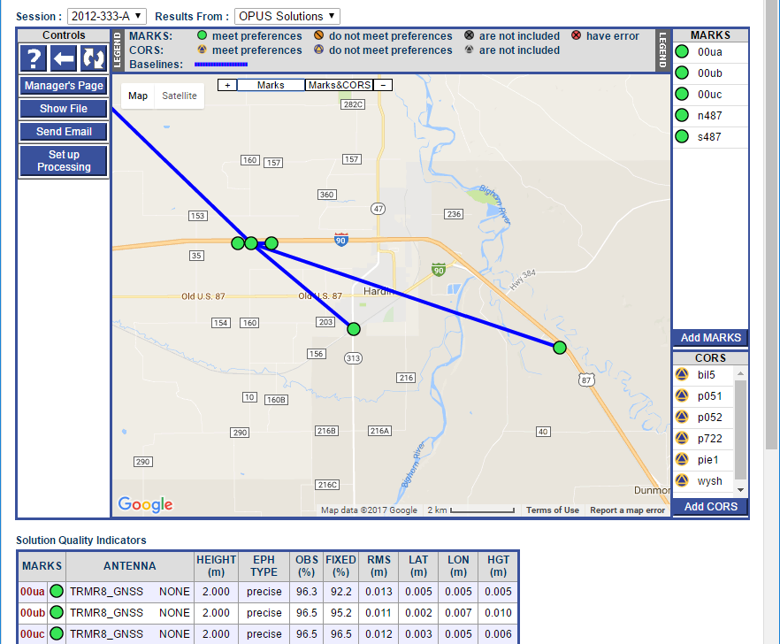
Session processing setup: HUB weighting.
April 13, 2017
Using OPUS-Projects to Submit GPS Surveys to NGS
Notes:
In OPUS-Projects, like OPUS, the CORS are emphasized as marks to be hubs and to be constrained.
In Beta OPUS-Projects, that emphasis is reduced making alternate network designs, like those required by Ht Mod projects, possible.
In this example, 00ua, the primary airport control for this project can act as the hub for the other user marks because it is nearby and, while its data does not span 24 hrs, it does span their marks’ datasets offering complete co-location. Not evident in this figure is the fact that the CORS hub, bil5, still connects to other CORS because distances are greater, but all CORS data files overlap by the full 24 hrs.
09/18/2018 modification by Ramesh Srigiriraju: 1 reference to OP2IDB was replaced with Beta OPUS-Projects to reflect new project name.

Slide 29
Session processing: remove TRI design.
April 13, 2017
Using OPUS-Projects to Submit GPS Surveys to NGS
Notes:
The TRI network created “closed baseline loops” from all included marks. But this creates numerical problems because redundant baselines are included. Using some numerical slight-of-hand, OPUS-Projects could solve this matrix, but at the cost of corrupting statistical results.
Although much desired by some, the TRI network design causes more problems than it solves and has been eliminated as an option.

Slide 30
Accessing the new features (in the future).
The first step in preparing a submission to the IDB is the NGS online survey project proposal form. After entering a brief description of the survey project, you’re provided a project tracking ID to facilitate communication about your project including its submission.
Intentionally, there are many similarities between this form and the OPUS-Projects Create form.
When Beta OPUS-Projects is released to production, the online survey project proposal form will be the way you create an OPUS-Project project for processing your GNSS data.
April 13, 2017
Using OPUS-Projects to Submit GPS Surveys to NGS
Notes:
09/18/2018 modification by Ramesh Srigiriraju: 1 reference to OP2IDB was replaced with Beta OPUS-Projects to reflect new project name.

Slide 31
Accessing the new features (now).
We’re now in a transitional stage with Beta OPUS-Projects.
Beta OPUS-Projects uses that tracking ID to “tag” projects in preparation for submission to the IDB, but project creation through the survey proposal form isn’t available.
For now, there are two ways to associate a project tracking ID with your Beta OPUS-Projects project.
April 13, 2017
Using OPUS-Projects to Submit GPS Surveys to NGS
Notes:
09/18/2018 modification by Ramesh Srigiriraju: 3 references to OP2IDB were replaced with Beta OPUS-Projects to reflect new project name.

Slide 32
Create form: NGS tracking ID.
April 13, 2017
Using OPUS-Projects to Submit GPS Surveys to NGS
Notes:
One you enter the project tracking ID, the project information associated with that ID is retrieved and the rest of the form completed for you.

Slide 33
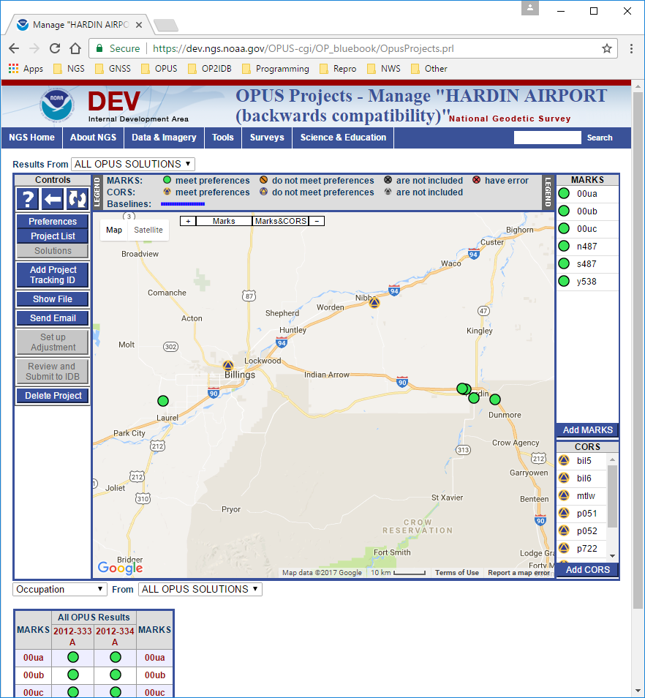
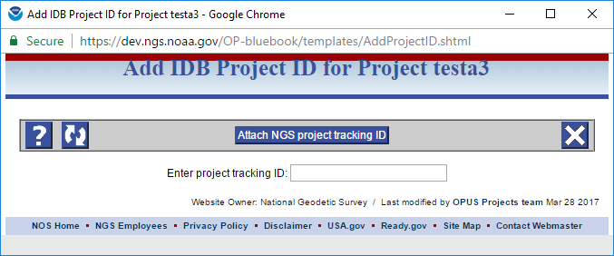
Manager’s page: NGS tracking ID.
April 13, 2017
Using OPUS-Projects to Submit GPS Surveys to NGS
Notes:
For projects already in OPUS-Projects, manager’s will be able to enter the project tracking ID after-the-fact making it possible to submit those projects for publication in the IDB if they meet publication requirements.

Slide 34
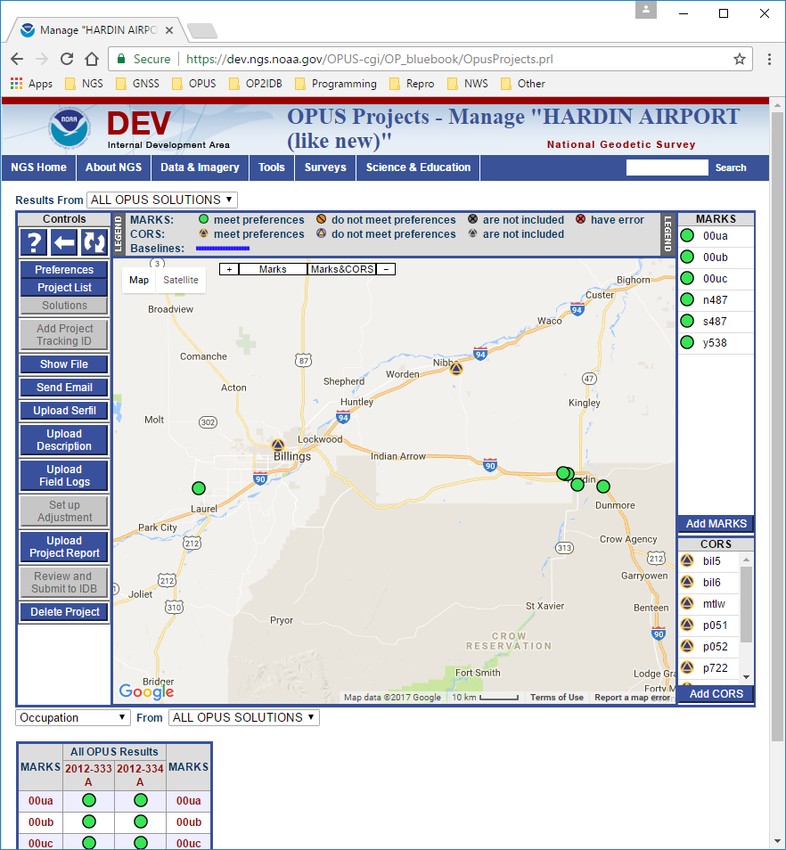
Manager’s page: new controls
April 13, 2017
Using OPUS-Projects to Submit GPS Surveys to NGS
Notes:
When a project tracking ID is attached to a project, controls specific to creating a submission become available.

Slide 35
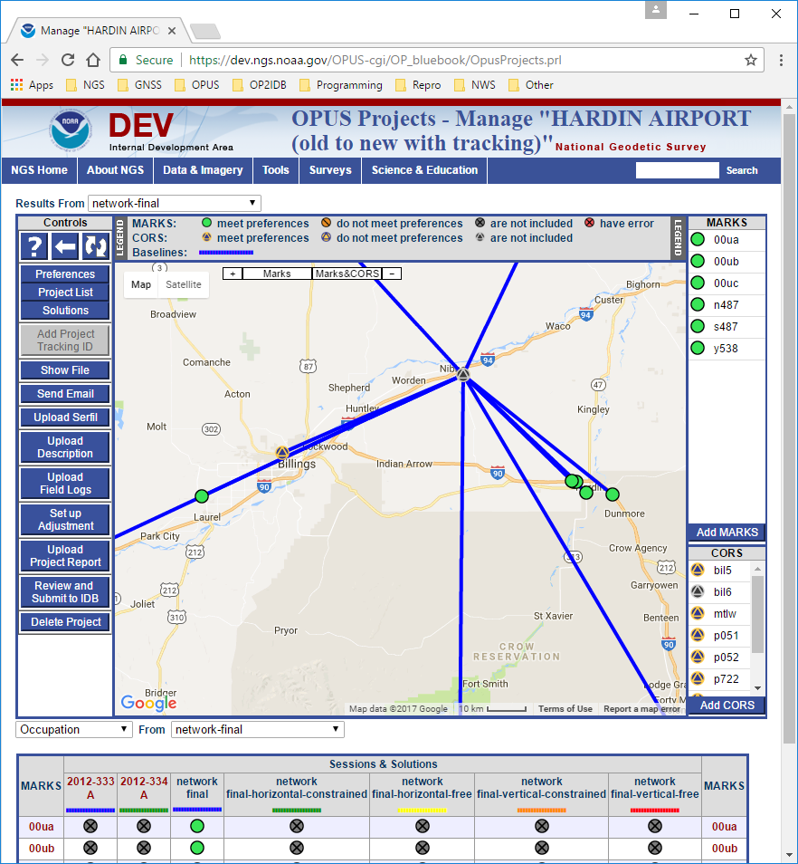
Manager’s page: Upload Serfil.
April 13, 2017
Using OPUS-Projects to Submit GPS Surveys to NGS
Notes:
A serfil is file holding a table of station serial numbers (SSNs) used in bluebooking with the four character mark IDs now in common use.
OPUS-Projects will create this table for you, but some users have their own preferences, or some programs, like WinDesc, will do this for you. WinDesc is survey project description creation software sanctioned for and required by the submission guidelines.
By allowing externally created serfils to be uploaded to a project, OPUS-Projects made suitable for these external sources.

Slide 36
Manager’s page: Upload Description.
April 13, 2017
Using OPUS-Projects to Submit GPS Surveys to NGS
Notes:
Description files created by WinDesc are required for publication at this time.
WinDesc is a Microsoft Windows program available through the NGS web site. While it could be made available through a web interface, the effort required to do so are beyond the scope of this project.
Therefore, a means to upload the WinDesc description files is provided.
In a future version of OPUS-Projects, online as well as WinDesc creation should be possible.

Slide 37
Manager’s page: Upload Field Logs.
April 13, 2017
Using OPUS-Projects to Submit GPS Surveys to NGS
Notes:
Publication requires electronic copies (scanned paper or PDF forms) of the field logs. The manager can upload a ZIP file of those copies, or load them mark-by-mark from their project web pages.

Slide 38
Manager’s page: Upload Project Report.
April 13, 2017
Using OPUS-Projects to Submit GPS Surveys to NGS
Notes:
And, of course, a project report is required for publication. An electronic copy of that report can be uploaded and stored with the project.

Slide 39
Manager’s page: Review and Submit to IDB.
April 13, 2017
Using OPUS-Projects to Submit GPS Surveys to NGS
Notes:
When all processing is complete and all files are uploaded, the project manager can click the “Review and Submit to IDB” button. A popup window will appear with a table confirming that all necessary components of a submission exist in the project and the project results are complete. If so, a button is enable that will create the submission. An action summary report will be sent to the user and the submission package sent on to the IDB team.

Slide 40
Manager’s page: Setup Adjustment.
April 13, 2017
Using OPUS-Projects to Submit GPS Surveys to NGS
Notes:
The most significant changes for Beta OPUS-Projects occur in the Setup Adjustment form.
09/18/2018 modification by Ramesh Srigiriraju: 1 reference to OP2IDB was replaced with Beta OPUS-Projects to reflect new project name.

Slide 41
Adjustments
Five adjustment types are listed and required for a submission.
Other: for backwards compatibility, a standard OPUS-Projects adjustment.
Horizontal-free: constrain a single set of horizontal coordinates and a single ellipsoid height coordinate.
Horizontal-constrained: fix all currently published positions and ellipsoid heights.
Vertical-free: fix one position and one published orthometric height.
Vertical-constrained: constrain all previously adjusted orthometric heights and one NAD 83 adjusted position.
April 13, 2017
Using OPUS-Projects to Submit GPS Surveys to NGS

Slide 42
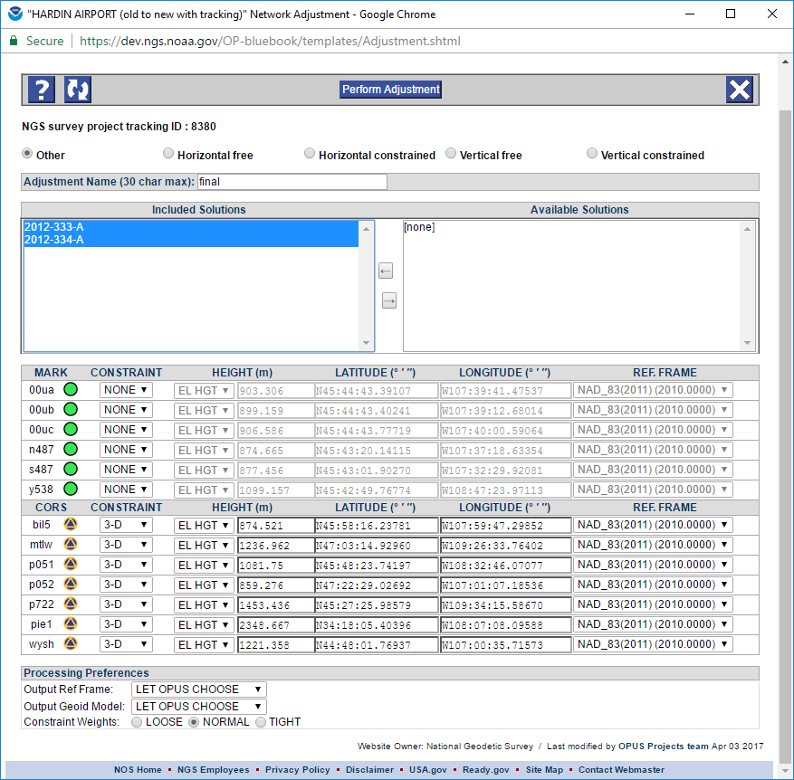
Adjustment setup: Other
April 13, 2017
Using OPUS-Projects to Submit GPS Surveys to NGS
Notes:
The adjustment type is selected on the form. Adjustments types must be completed in the left-to-right order shown on the form. Subsequent adjustment types are disabled until the earlier ones are completed.
The Other adjustment type is computed from the session solutions as production OPUS-Projects does. The remaining types all use ADJUST program, and are derived from an earlier adjustment as per the submission requirements.
Only the appropriate “source” for an adjustment is offered as a selection. In this case, the session solution results.
The constraint defaults offered are appropriate for the adjustment type based upon project information and previous processing. These defaults can, of course, be changed, but should be quite reasonable.

Slide 43
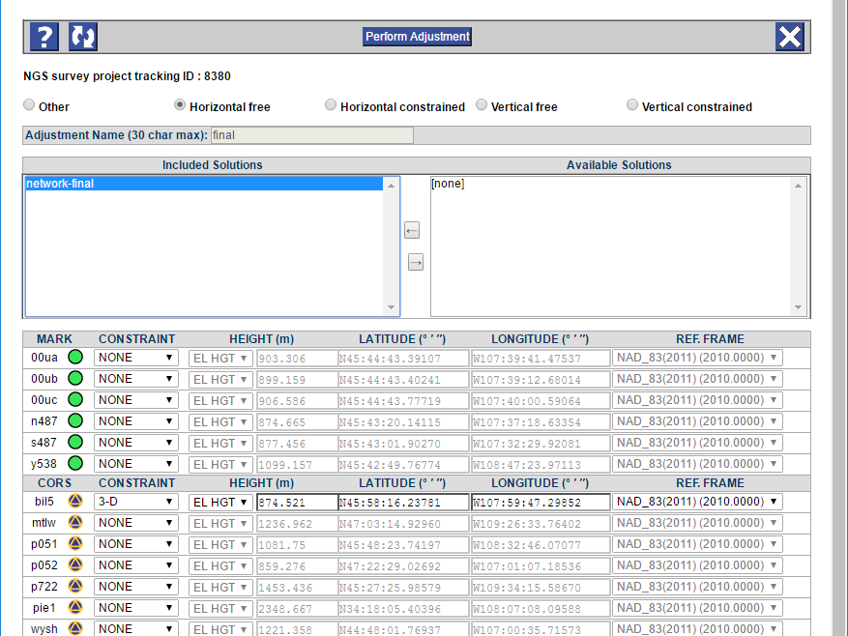
Adjustment setup: horizontal-free
April 13, 2017
Using OPUS-Projects to Submit GPS Surveys to NGS
Notes:
The horizontal-free, A.K.A. minimally constrained adjustment constrains only one set of horizontal coordinates and one ellipsoidal height. This is a “final test” to confirm that no outliers exist in the session processing results. It also computes the appropriate scaling for the horizontal and vertical components of the GPS vectors to be applied before beginning the subsequent adjustments.
Again, the constraint defaults are appropriate to the adjustment type. In the case of a horizontal-free adjustment, the CORS hub is offered as the mark to be constrained by default.

Slide 44
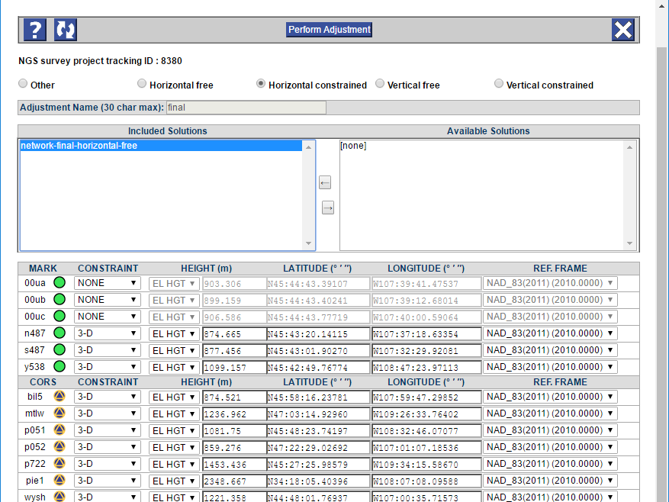
Adjustment setup: horizontal-constrained
April 13, 2017
Using OPUS-Projects to Submit GPS Surveys to NGS
Notes:
Horizontal-constrained holds all marks with published coordinates. This adjustment “creates” the NAD 83 coordinates derived from this survey.

Slide 45
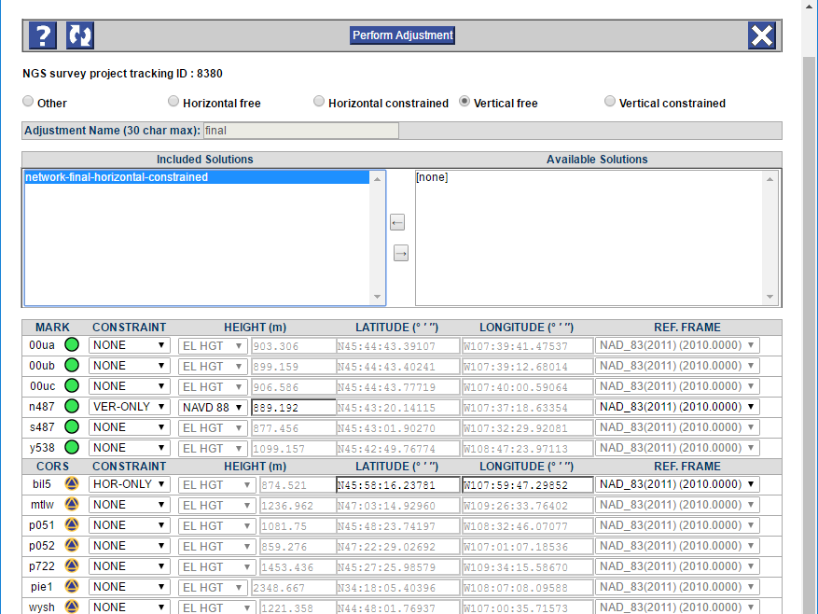
Adjustment setup: vertical-free
April 13, 2017
Using OPUS-Projects to Submit GPS Surveys to NGS
Notes:
A vertical-free adjustment performs a similar function for the vertical adjustment as the horizontal-free does for the horizontal adjustment.
One pair of horizontal coordinates and one published orthometric height are held. Note that, once again, reasonable defaults are suggested.

Slide 46
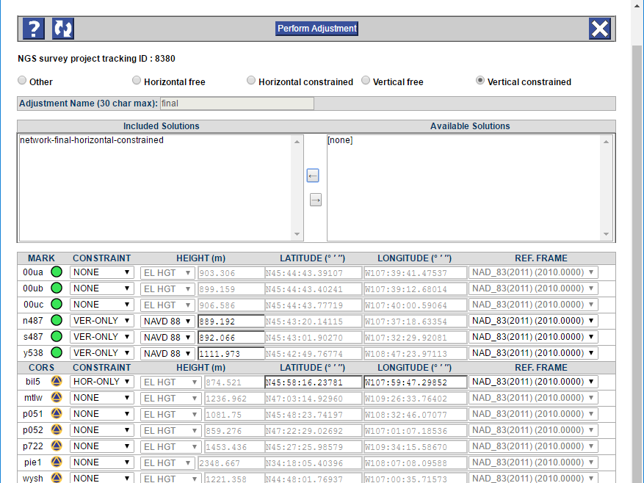
Adjustment setup: vertical-constrained
April 13, 2017
Using OPUS-Projects to Submit GPS Surveys to NGS
Notes:
The vertical-constrained is, for the vertical, similar to horizontal-constrained for the horizontal.
In this case, all mark with published orthometric heights are offered as the defaults as needed and expected. One pair of horizontal coordinates must be constrained and a reasonable default is offered.

Slide 47
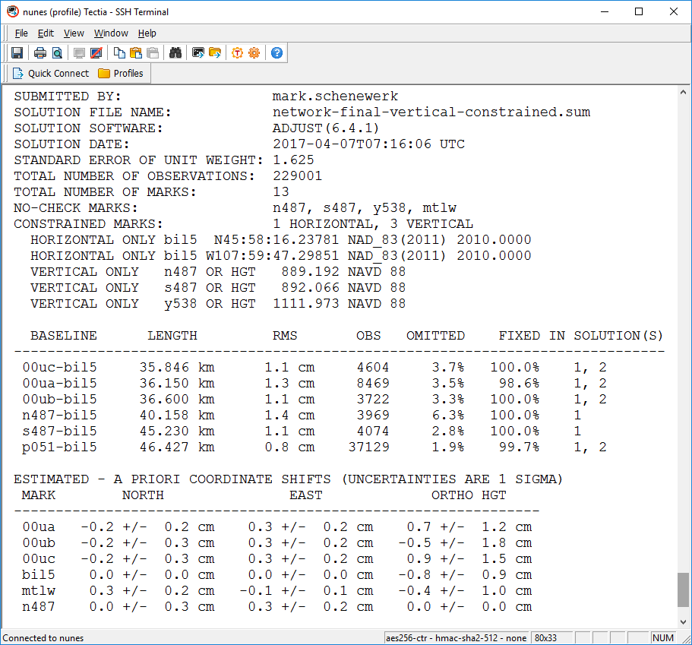
Changes to the OPUS-like adjustment report.
April 13, 2017
Using OPUS-Projects to Submit GPS Surveys to NGS
Notes:
We’ll diverge briefly to talk about changes to the adjustment reports. The ADJUST program output file will be included in the processing attachments or available through the “Show File” control. Also attached to the email is an OPUS-like summary report. In that summary, additional tables appear to help with quality control.

Slide 48
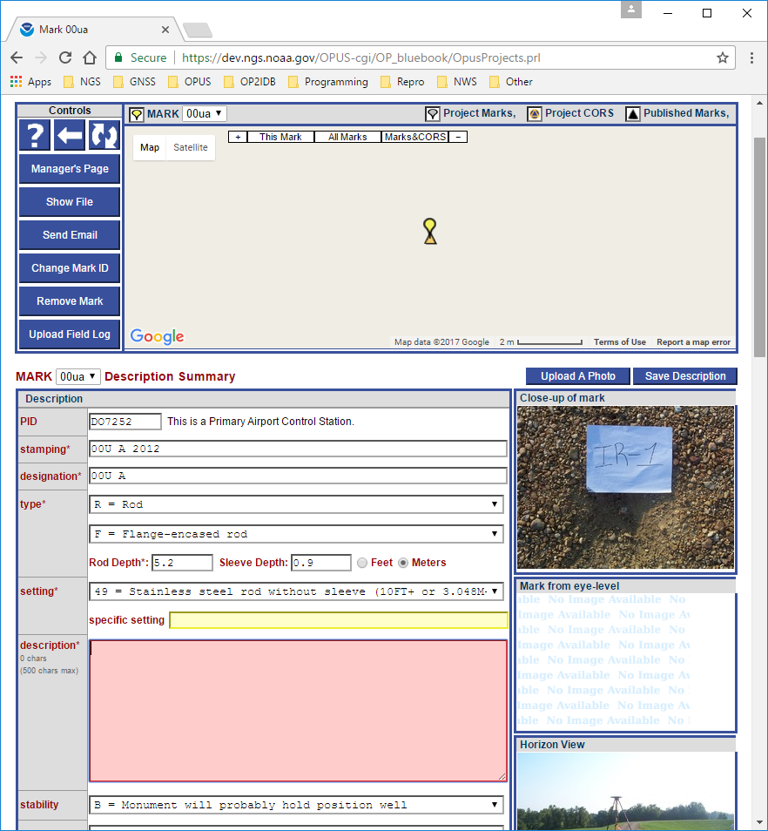
Individual mark page: Upload Field Log.
April 13, 2017
Using OPUS-Projects to Submit GPS Surveys to NGS
Notes:
The next largest number of changes appear on the individual mark web pages.
As mentioned earlier, a control to upload electronic copies of the field logs for this mark exists.

Slide 49
Individual mark page: eye-level photo.
April 13, 2017
Using OPUS-Projects to Submit GPS Surveys to NGS
Notes:
Submissions require three photos, not two as for OPUS sharing, so the ability to upload and review that third photo.
Not easily shown in this format, but when WinDesc descriptions are uploaded, the description summary is completed for each mark.
I’ve intentionally deleted some required items to show how missing information is flagged.

Slide 50
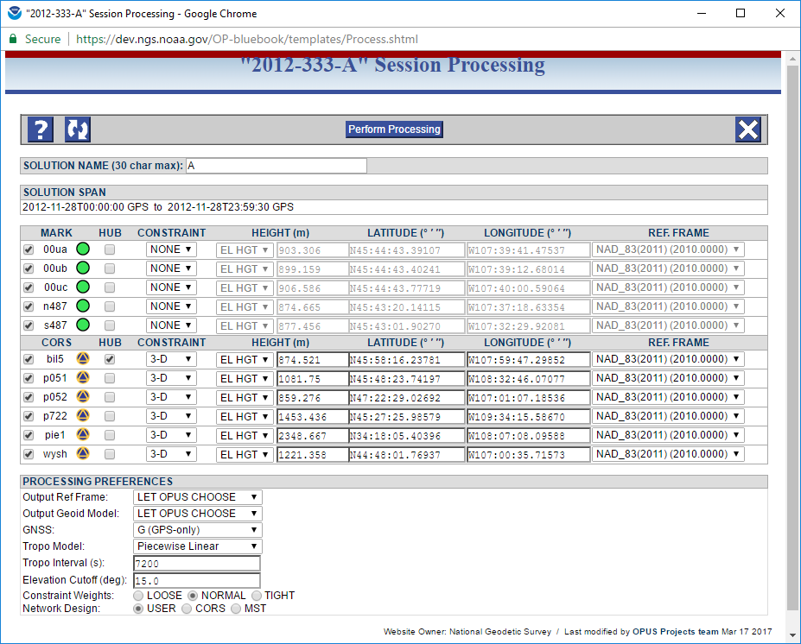
Session processing setup: constraint defaults.
April 13, 2017
Using OPUS-Projects to Submit GPS Surveys to NGS
Notes:
The fewest changes occur on the session web pages. The only one I’ll note is “better” defaults are offered for the hub and constraints.

Slide 51
Remaining timeline for the project.
Release for internal tests and comments (DEV) early June.
Release for external comments (BETA) no sooner than July.
Project close-out in September.
April 13, 2017
Using OPUS-Projects to Submit GPS Surveys to NGS

Slide 52
What’s next?
A follow-on project will take Beta OPUS-Projects to production.
The NGS is shifting its focus to the changes implied by the new National Spatial Reference System in 2022.
Make OPUS, including OPUS-Projects, use the new geospatial database.
Create an OPUS-like GUI for leveling.
Combined the GNSS and leveling GUIs.
???
April 13, 2017
Using OPUS-Projects to Submit GPS Surveys to NGS
Notes:
09/18/2018 modification by Ramesh Srigiriraju: 1 reference to OP2IDB was replaced with Beta OPUS-Projects to reflect new project name.

Slide 53
Thank you!
Questions or comments?
April 13, 2017
Using OPUS-Projects to Submit GPS Surveys to NGS

