Slide 1
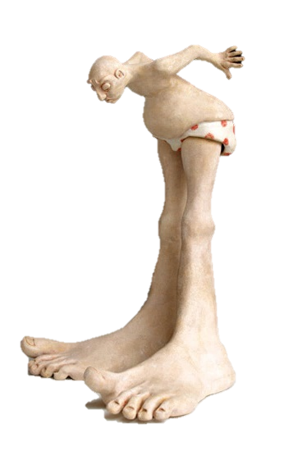
Putting the Best “Foot” Forward
Ending the Era of the U.S. Survey Foot
Michael L. Dennis, PhD, RLS, PE
SPCS2022 Project Manager
NGS Webinar Series
December 12, 2019

Slide 2
A story revisited
Previous webinar April 25, 2019
  Fate of the U.S. Survey Foot after 2022:
  A Conversation with NGS
Plan for today
  Overview (and review)
  Examples of foot “mix-up” problems
  Federal Register Notice and public input
  Question, comments, and concerns
  The path forward

Slide 3
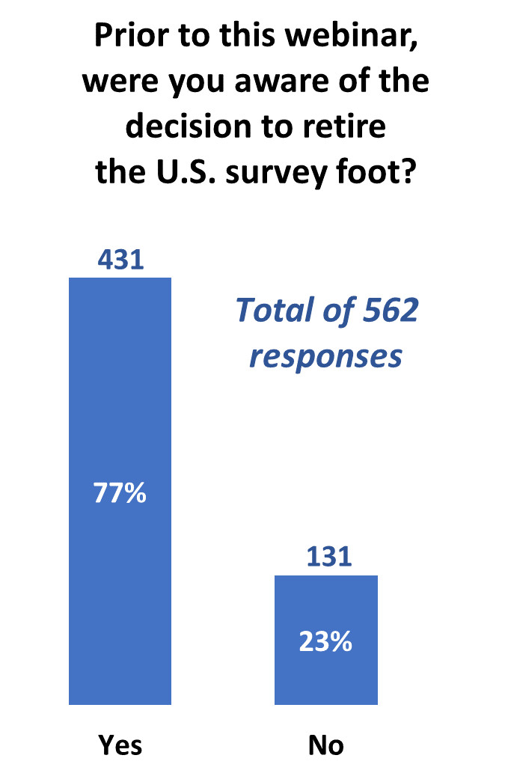
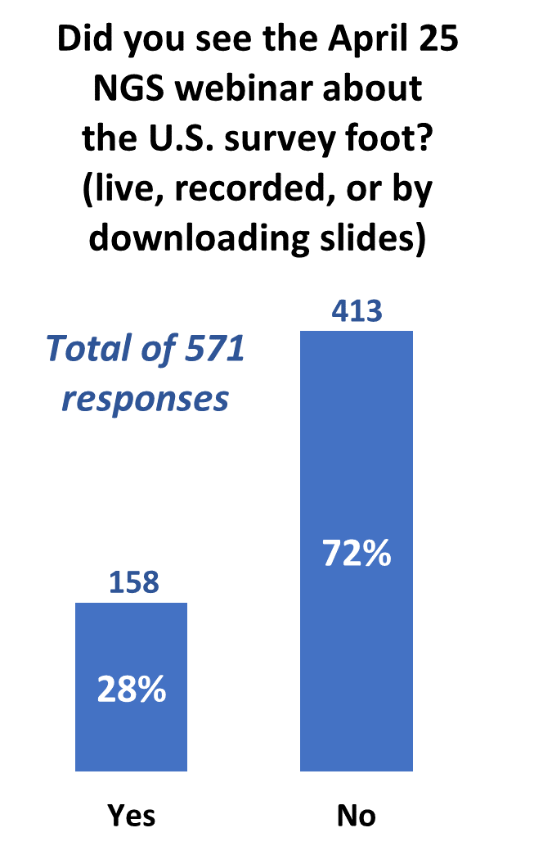
Poll questions

Slide 4
A tale of two feet
Two versions of “foot” in current use:
“Old” U.S. survey foot
“New” international foot
‭1 ft = 0.3048006096…‬ m
1 ft = 0.3048 m exactly
differ by
2 parts per million (ppm) or 0.01 ft/mile
  A real problem with real costs
Notes:
It’s likely everyone watching this webinar knows about the problem: there are two nearly identical versions of the foot in current use in the U.S.;
They differ by 2 parts per million (ppm), or only 0.01 ft per mile, or slightly more than a tenth of an inch in a mile.
Despite (or actually because of) the very small difference, it has become a REAL problem with REAL costs.

Slide 5
A tale of two feet
Who uses U.S. survey feet?
  Surveyors exclusively, in most (not all) states
  But it impacts everyone
Notes:
Surveyors are really the only users of the U.S. survey foot (sft). They are also among the very few who even know of its existence. In schools and colleges they only teach students about the official international foot (ift) – without specifying that it is often called the “international foot.” In addition, because people use the products created by surveyors, they end up using the sft without even knowing it.

Slide 6
The Central Issue as a Series of 6 Facts . . .

Slide 7
The central issue as a series of 6 facts
Only Congress has power to fix standards

Slide 8
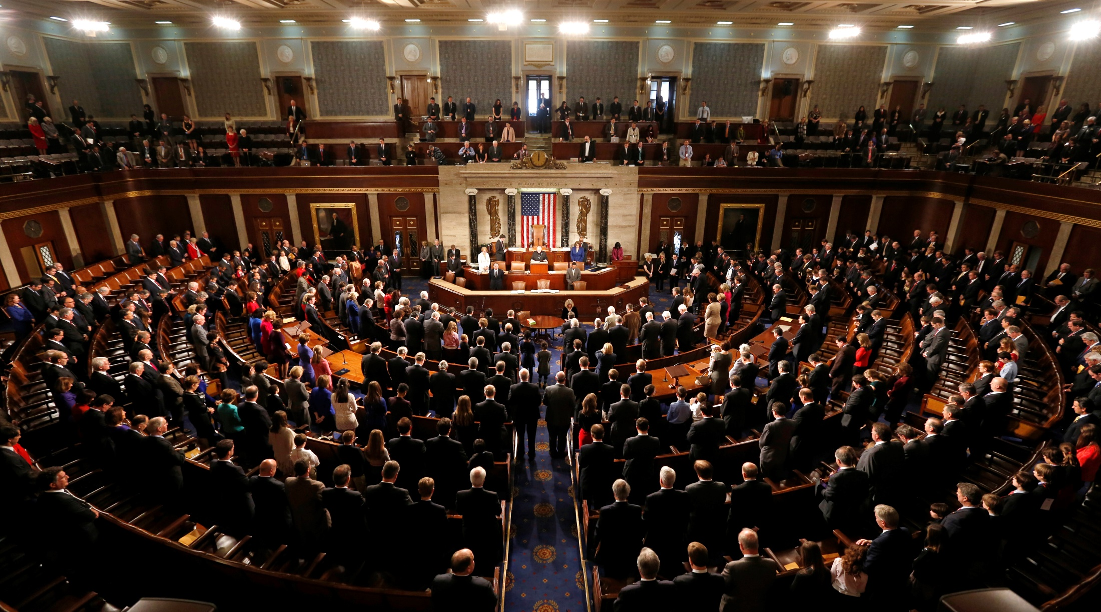
Congress is the Authority
Notes:
The ultimate authority on standards of weights and measures is the U.S. Congress.

Slide 9
Congress is the Authority
Per the U.S. Constitution
(Article I, Section 8, Clause 5)
“The Congress shall have
Power … To coin Money …
and fix the Standard
of Weights and Measures”
Why? To avoid the “toothbrush problem”
Notes:
The authority of Congress is given in the U.S. Constitution, Article I, Section 8, Clause 5.
Congress delegated its power to the Office of Weights and Measures in the Department of the Treasury.
NBS then got this authority as the successor to the Weights and Measures, and NBS became part of DOC.
Why was something like standards of weights and measures so important that it was specifically listed as a congressional power in the Constitution?
Because standards for weights and measures are tightly connected to commerce, including coining of money. We’re going to come back to this near the end of the presentation.
In short, it was to avoid the “toothbrush problem”…

Slide 10

The trouble with standards…
Without uniformity, standards are useless
Image from beyondplm.com
Notes:
It does no good to have a bunch of conflicting standards. That’s the same as having no standards at all.

Slide 11
The central issue as a series of 6 facts
Only Congress has power to fix standards
Congress delegated standards authority

Slide 12




Who is responsible for standards?
Today:
National Institute of Standards and Technology
Notes:
Today, the National Institute of Standards and Technology (NIST) is responsible for defining and establishing standards. It is within their authority.
NIST is a bureau of the Department of Commerce (DOC)
The National Oceanic and Atmospheric Administration (NOAA) is also a bureau of DOC.
The National Geodetic Survey (NGS) is a program office in NOAA. It’s actually within the National Ocean Service (NOS) in NOAA.
It may seem odd to show NGS here along with NIST, but there is a reason for it, as you will soon see.

Slide 13


Who is responsible for standards?
Before 1901:
U.S. Coast and Geodetic Survey
Office of Standard Weights and Measures
Superintendent of C&GS also Superintendent
of Office of Standard Weights & Measures
Notes:
Responsibility for standards was different before 1901.
In 1901, the National Bureau of Standards (NBS) was created, which later became in NIST (in 1988)
Department of Commerce was created in 1903, when NBS became part of it (initially in Department of the Treasury).
Before 1901, standards of weights and measures was handled by the U.S. Coast & Geodetic Survey (C&GS), the predecessor of NGS.
Operated under the authority of the Department of the Treasury, in the Office of Standard Weights and Measures.
Superintendent (same as “Director” today) of C&GS was also Superintendent of Weights and Measures – so that is the connection to NGS! But there is a later connection as well, which is also the reason we currently have two foot definitions.

Slide 14
The central issue as a series of 6 facts
Only Congress has power to fix standards
Congress delegated standards authority
Mendenhall Order fixes foot to meter

Slide 15
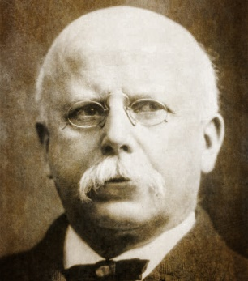
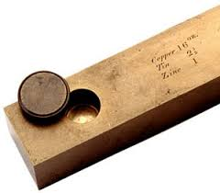
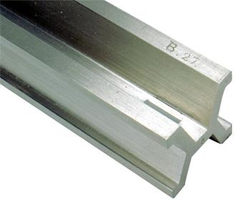

Out of chaos, order
1893
The Mendenhall Order
Thomas Mendenhall
Superintendent C&GS and Office
of Weights & Measures (1889-1894)
The U.S. officially became metric
Embraced meter
Abandoned British Imperial Yard
Declared foot defined by meter:
1 foot = 1200/3937 meter
Provided tables of conversions
e.g., Gunter’s chain = 20.1168 m
66 ift EXACTLY
65.999868 sft
Notes:
The Mendenhall Order (1893): When the U.S. officially became metric.
Officially adopted meter as basis of length, where 1 foot = 1200/3937 meter (per 1866 act of Congress), and with meter represented by Meter Bars No. 21 and 27.
Completely abandoned British Imperial Yard as basis for length (as represented by Bronze Bar No. 11).
Declared in Appendix 6 of C&GS Bulletin No. 26, including conversion tables.
Interesting to note that conversion showed 1 Gunter’s chain = 20.1168 m
That is EXACTLY 66 ift (vs. 65.999868 sft)
This is just a coincidence due to rounding, but it shows that for the precision of the chain, the distinction between the ift and sft is immaterial…

Slide 16
The central issue as a series of 6 facts
Only Congress has power to fix standards
Congress delegated standards authority
Mendenhall Order fixes foot to meter
New foot defined (old named “U.S. survey foot”)

Slide 17
A new foot for a new century
1 foot = 0.3048 meter exactly (1 yard = 0.9144 m)
New foot definition adopted by NASA predecessor
National Bureau of Standards created
Adopted as “new” foot for entire U.S.
1901
1933
1952
1959
With one little exception…
New foot definition adopted by ANSI predecessor
Notes:
With increasing measurement precision and global trade, it became necessary to adopt a more precise definition of the foot, and one that agreed with international usage.
A motivation for a new definition of the foot was in gage-block standardization for precise machine shop work used by industry. It was a practical solution to a practical problem. Note this has nothing whatsoever to do with surveying.
The new (international) foot definition was 1 ft = 0.3048 m (exact), and is the same to this day (it will not change). The adoption of the ift was a gradual process (as such things often are):
1933. Adopted by American Standards Association, now American National Standards Institute (ANSI).
1952. Adopted by National Advisory Committee for Aeronautics, now National Aeronautics and Space Administration (NASA).
1954. Adopted International Nautical Mile as exactly 1852 m. This is not related specifically to ift, but shows overall move toward adopting “exact” (non-ratio) relationships to the meter.
1959. NSB officially adopts ift for the entire U.S., with one little notable exception…

Slide 18
The central issue as a series of 6 facts
Only Congress has power to fix standards
Congress delegated standards authority
Mendenhall Order fixes foot to meter
New foot defined (old named “U.S. survey foot”)
Temporarily keep old foot for geodetic surveys

Slide 19
New foot Federal Register Notice
1959
Any data expressed in feet derived from and published as a result of geodetic surveys within the United States will continue to bear the following relationship as defined in 1893:
1 foot = 1200/3937 meter
The foot unit defined by this equation shall be referred to as the U.S. Survey Foot and it shall continue to be used, for the purpose given herein

Slide 20
The central issue as a series of 6 facts
Only Congress has power to fix standards
Congress delegated standards authority
Mendenhall Order fixes foot to meter
New foot defined (old named “U.S. survey foot”)
Temporarily keep old foot for geodetic surveys
Mandated end of old foot with new datum

Slide 21
New foot Federal Register Notice
1959
“Any data expressed in feet derived from and published as a result of geodetic surveys within the United States will continue to bear the following relationship as defined in 1893:
1 foot = 1200/3937 meter
The foot unit defined by this equation shall be referred to as the U.S. Survey Foot and it shall continue to be used, for the purpose given herein

Slide 22
New foot Federal Register Notice
1959
“Any data expressed in feet derived from and published as a result of geodetic surveys within the United States will continue to bear the following relationship as defined in 1893:
1 foot = 1200/3937 meter
The foot unit defined by this equation shall be referred to as the U.S. Survey Foot and it shall continue to be used, for the purpose given herein, until such a time as it becomes desirable and expedient to readjust the basic geodetic survey networks in the United States, after which the ratio of a yard, equal to 0.9144 meter, shall apply.”
https://geodesy.noaa.gov/PUBS_LIB/FedRegister/FRdoc59-5442.pdf
Signed by NBS and C&GS directors, approved by Secretary of Commerce, June 25, 1959
Notes:
Federal Register Notice (1959) establishing ift and (temporary) sft
Official adoption of ift (1 ft = 0.3048 m) nationwide.
Temporary exception granted for geodetic surveys (including State Plane coordinates), to accommodate C&GS.
Mandates that ift shall be adopted after readjustment of U.S. geodetic network. This is not a “recommendation” or a “suggestion.” At the time this was published, “shall” was used in legal documents as mandatory (nowadays the usage of “shall” as mandatory is discouraged in legal documents).
Co-issued and signed by NBS and C&GS directors.
This FRN delayed full adoption of the ift, and promoted continued use of the sft for all surveying (not just geodetic surveys), and it is how we got into the situation we are in today.

Slide 23
The central issue as a series of 6 facts
Only Congress has power to fix standards
Congress delegated standards authority
Mendenhall Order fixes foot to meter
New foot defined (old named “U.S. survey foot”)
Temporarily keep old foot for geodetic surveys
Mandated end of old foot with new datum
No question that federal government has authority to do this. But it is nonetheless better to persuade than coerce.
Notes:
Let’s step away from surveying and consider the Big Picture.
This is about much more than surveying. When reading about the U.S. history of weights and measures, the words “science” and “industry” are often used together. And together they mean commerce. Business. Trade. Efficiency. Money. That’s really what this is about. All of those things are facilitated by uniform standards (and compromised without standards).
As stated earlier, change is an integral part of progress. We cannot stand still.
This is also about the law, because there is a powerful legal basis for weights and measures. We did not get here by accident.

Slide 24
What are the choices?
Notes:
Let’s step away from surveying and consider the Big Picture.
This is about much more than surveying. When reading about the U.S. history of weights and measures, the words “science” and “industry” are often used together. And together they mean commerce. Business. Trade. Efficiency. Money. That’s really what this is about. All of those things are facilitated by uniform standards (and compromised without standards).
As stated earlier, change is an integral part of progress. We cannot stand still.
This is also about the law, because there is a powerful legal basis for weights and measures. We did not get here by accident.

Slide 25
What are the choices?
Do nothing (i.e., NGS stays “metric” only)
  States choose whatever foot they want
  But feet will creep back into NGS products & services
Officially adopt U.S. survey foot for specific things
  U.S. survey foot for surveying and mapping
  International foot for engineering (and everything else)
Use international foot for everything
  Support only 1 foot = 0.3048 meter after 2022, period
Use U.S. survey foot for everything (highly unlikely)
Go entirely metric (good luck with that!)

Slide 26
A NIST and NGS decision
Only one foot after 2022 (1 foot = 0.3048 meter)
  Make official through NIST
  NO option for U.S. survey foot in modernized NSRS
NGS will help with the transition
  Will fully support backward compatibility
  Will give “correct” foot for SPCS 83 and SPCS 27
  Automatically done by NGS products and services
Guiding ideas
  NSRS2022 is best opportunity to make change
  Of all changes in 2022, this is the least significant
  Will make things better
  About the future, not the past
Notes:
NGS and NIST have decided that there be only ONE official definition of the foot after 2022.
Considering getting rid of word “international”, and just call it the “foot” (that is how it is handled in some software, such Esri’s). People just seem to not like the “international” label. Maybe call if the “American freedom foot.” But seriously, dropping a descriptor solidifies the idea that there is only one foot in the U.S. Keeping the descriptor implies there is more than one foot.
Have NO option for sft after 2022. It will only be used for the past (legacy applications).
NGS will help!
We will try to make the change as simple and painless as possible.
Our products and services will automatically support backward compatibility.
Idea here is that we are trying to make things better by fixing a long-standing problem for the future (not the past). Yes, there will be some difficulties. But at least they will diminish over time. If we do nothing, these problems will never go away.
If you think changing from sft to ift is a big problem, then perhaps you don’t quite understand the other changes that are coming in 2022:
The change from sft to ift is really just a small (2 ppm) scale change. That is smaller than the change in scale for SPCS2022 zones, and that is only PART of the change that will occur for State Plane.
Coordinates in NSRS2022 will change with time. In fact, the entire frame will be time-dependent. Assumptions about control coordinates never changing will have to be abandoned.
The “vertical” datum will be replaced with a geopotential datum based on a gravimetric geoid (rather than leveling). This, too, will have a time-dependent component.
There will be changes in how GNSS, leveling, and total station survey surveys are performed, reduced, processed, and adjusted.
By comparison, the change from sft to ift is so miniscule that it is well within the noise of the other changes.
In short, if you think the change in foot definition is too difficult, then its hard to see how you could deal with these other much larger and vastly more complex changes.

Slide 27
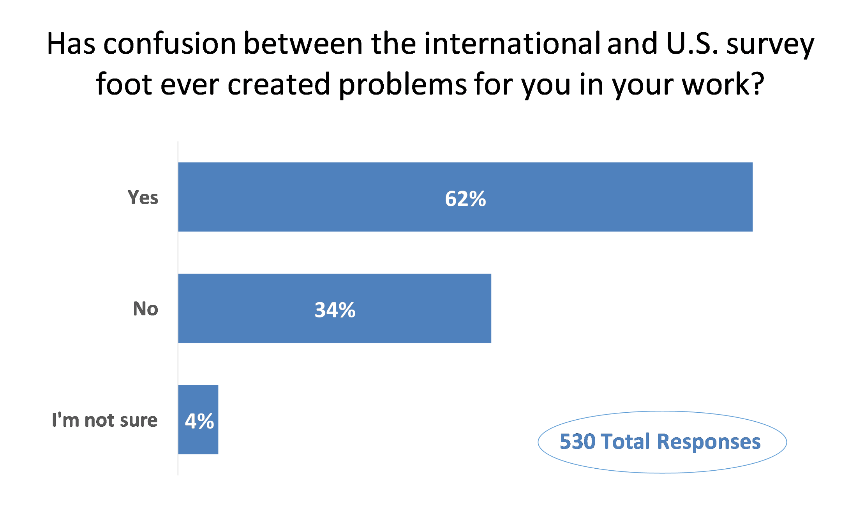
Poll question
Poll question from April 25 webinar

Slide 28
Examples of foot “mix-ups”
Planes, trains, and automobiles
  In (or out of) the flight path
  Slowing down high speed and light rail
  Highway alignment in wrong place
Statute, schmatute: you’ll use the foot we choose
Machine (out of) control
Different feet for different directions
Constant vigilance costs money
Loose lips sink ships: liability
Notes:
In (or out of) the flight path. The worst outcome on a project that I was involved in was dealing with a high rise building. The building was in the glide-plane approach to a major international airport. An out-of-state firm performed some work on the project and had performed all the work in State Plane using U.S. survey feet (even though State Plane is international feet by statute in the state where the airport was located). Both sources of data were combined into a single analytical area. This caused enough of an error in the calculations to impact the ultimate height of the building (that had been planned to be built at maximum height). It was compounded in a few different ways. First, the absolute State Plane position being off a few feet and also the glide slope distance being calculated incorrectly over about 2.5 miles. The end result was a delay in the project and a redesign resulting in the loss of a floor. I do not recall the total cost, but do recall it had a permanent impact on the project as a whole because of the loss of space in the final product.
Slowing down high speed and light rail. I know of three large engineering projects where unit of length confusion has been an issue. We worked on all of these, but I believe that the issues arose in the engineering and construction disciplines. One was the California High Speed Rail project, the other a light rail project. The third was a tunnel project in Portland, OR, where the contractor was unaware that Oregon uses the international foot. Fortunately my geodetic verification survey caught the issue early enough for them to take remedial action
Highway alignment in wrong place. A roadway alignment is surveyed in international feet using a low distortion projection and laid onto a global image under the assumption the survey is the US ft. definition. Locally all alignment points fit well vs. record distance and bearings. However when cast onto the global image map the roadway alignment is 12 feet north and 45 feet east of the roadway on the image. The roadway construction plans that use global aerial images as a background cannot be completed until the surveyed line work is in coincidence with the global image.
Statute, schmatute: you’ll use the foot we choose. Arizona: even the US Park Service uses the USFT. Michigan: we use the international foot and it works fine except that some federal agencies report their state plane coordinates in US survey foot. Hawaii: use U.S. survey foot, but military bases there use international foot.
Machine (out of) control. A trail route was surveyed and designed by a major consulting firm, using the Washington Plane Coordinate System for horizontal control and construction. Their survey crew set the centerline control for the construction contractor. The contactor wanted to use machine control, and the consulting firm gave them a copy of the coordinates. The contractor then gave the coordinates to another company to make a digital surface model (DSM). The DSM was loaded in the computer for the machine control on the grader. When they started machine control work the centerline was 2.24 feet east of where the consulting form’s surveyors had staked it. The consulting firm’s surveyors were blamed at first. Then they asked the firm that created the DSM which definition of a foot they had used. The DSM was made for the contractor using Oregon statute’s International Foot definition; the consulting firm used the Washington statute’s U.S. Survey Foot definition for the design.
Different feet for different directions. Projects that use international feet horizontally but U.S. survey feet for elevations. On Hopi Reservations, and state of Montana.

Slide 29
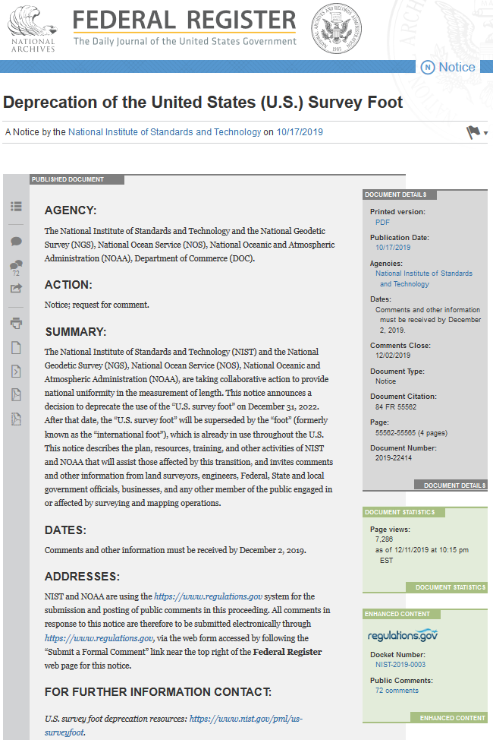
Federal Register Notice (Oct 17, 2019)
All comments can be viewed by anyone!

Slide 30
FRN public comments
Comment period Oct 17 – Dec 2, 2019
  Objective: make transition as smooth as possible
  Find out if anything overlooked
72 public comments received
  Most from individuals, some from organizations
  Many useful, thoughtful, and detailed
  Most in favor of switch to international foot

Slide 31
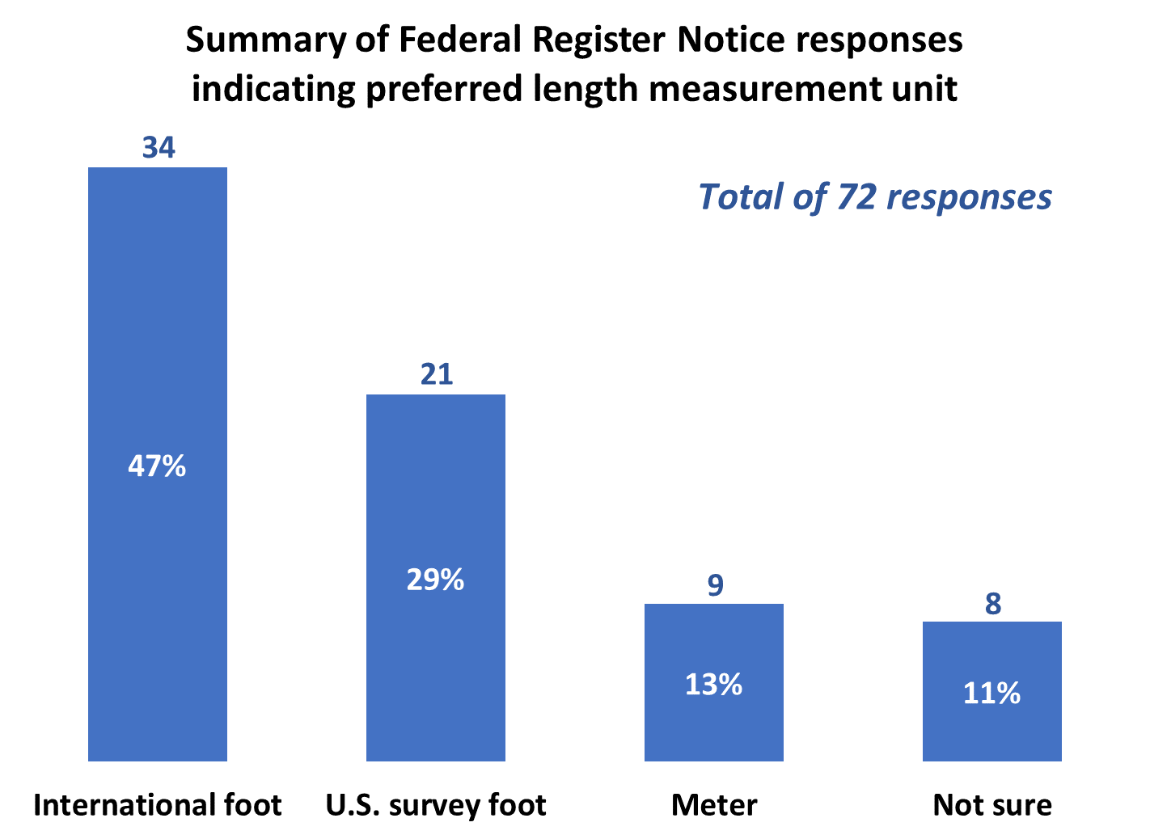
FRN public comments

Slide 32
Questions, comments, and concerns
Keep name “international foot”?

Slide 33


What’s in a name?
U.S. survey vs. international foot
  “U.S. survey” sounds patriotic, surveyor-centric
  “International” has faint whiff of socialism, New World Order
Idea: Drop word “international”
  Instead call it the:
  American
  Freedom
  Foot
Notes:
What’s in a name? That which we call a “foot” by any other word would smell as… sweet? Maybe that’s not he best analogy for the foot…
“U.S. survey foot” sounds patriotic, is surveyor-centric…
“International foot” sounds like a New World Order, UN sanctioned sort of thing, with perhaps a whiff of socialism…
Is the name really part of the problem? I hope note, but emotion does play a role. We are not entirely rational creatures after all (myself included).

Slide 34

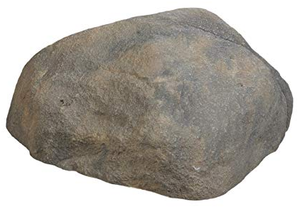
The one, true “foot”
In the future, simply call it the “foot”…?
  No modifier, since only one foot after 2022
  1 foot = 0.3048 meter, period
When someone says, the “Rock”
  You know exactly what they mean
But still possibility for
confusion…
This is also a rock

Slide 35
Two names for a single foot?
Continue using “international” modifier after 2022
  Idea: allow both names going forward
  Highly recommended if it helps clarify
However, keep following in mind:
  Only new foot supported in modernized NSRS after 2022
  A vast majority of people unaware of the two feet
  Over time “international” modifier will fade away
  Many applications already use just “foot”
    E.g., AutoDesk, Esri, hand calculators, online converters

Slide 36
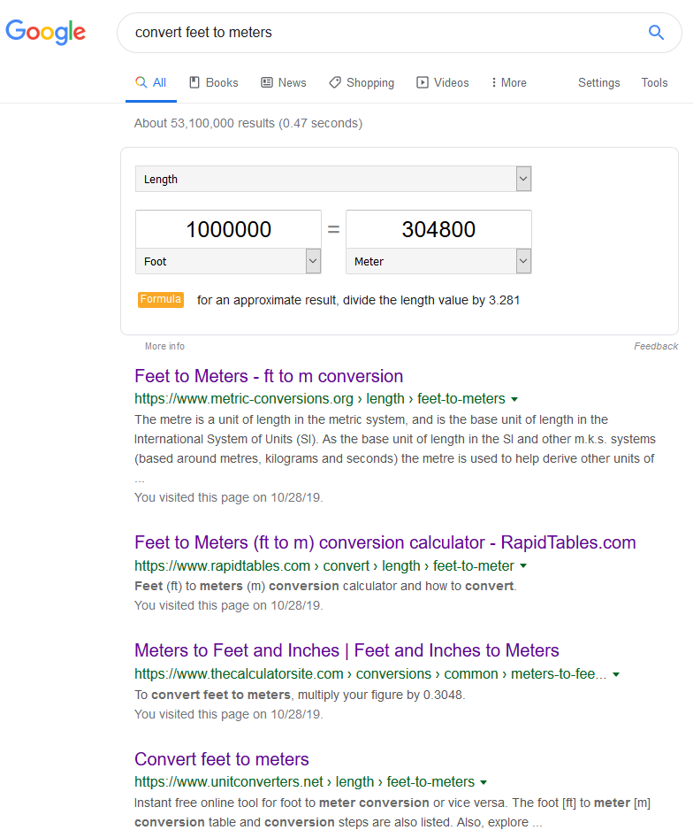
Google “convert feet to meters”
First 33 converters:
  Only international foot used
  All just “foot” conversions (international and U.S. survey foot names not mentioned)
34th result (4th page) first to mention U.S. survey foot (but does NOT use name “international foot”)
25th and 29th results (3rd page) used approximate conversions!

Slide 37
Questions, comments, and concerns
Keep name “international foot”?
What about other units defined with old feet?

Slide 38
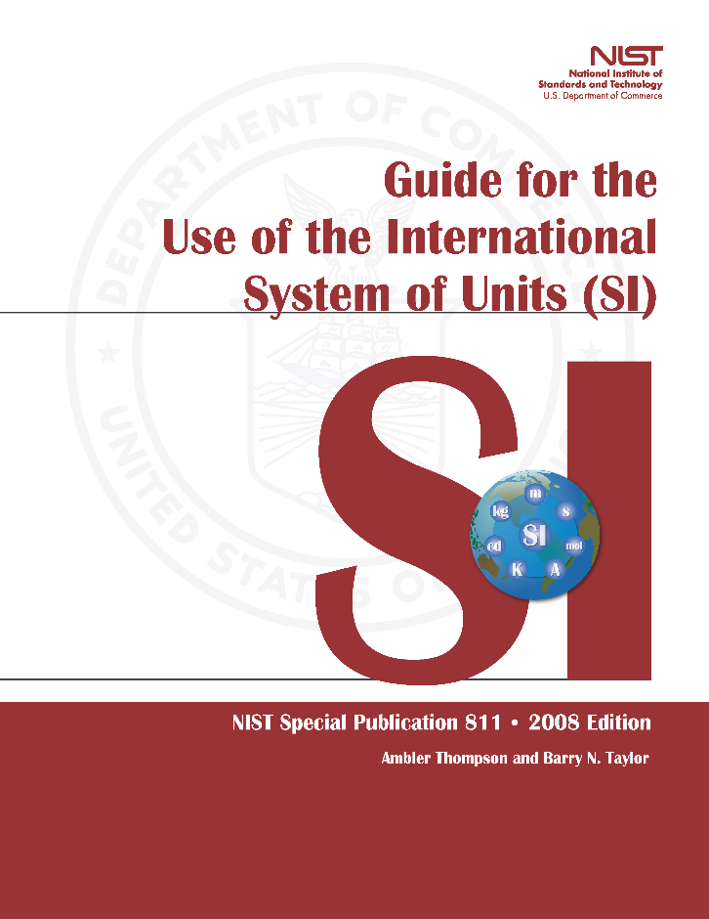
Units, defined
NIST Special Publication 811 (2008)
“Guide for the Use of the SI”
U.S. survey foot still used
  But never officially permanently adopted
  Includes conversions for both
  types of feet
  Some conversions only defined
  for U.S. survey foot
  Will be updated for new foot definition

Slide 39
New definitions for “old” units
Unit of measure based on feet | “U.S. survey foot” (approximate) | “foot” (exact)
foot (ft) | 0.304 800 6… m | 0.304 8 m
mile (mi) | 1609.347… m | 1609.344 m
chain (ch) | 20.116 84… m | 20.116 8 m
link (li) | 0.201 168 4… m | 0.201 168 m
rod (rd), pole, perch | 5.029 21… m | 5.029 2 m
furlong (fur) | 201.168 4… m | 201.168 m
fathom | 1.828 804… m | 1.828 8 m
acre (ac) | 4046.872 609 9… m² | 4046.856 422 4 m²

Slide 40
Questions, comments, and concerns
Keep name “international foot”?
What about other units defined with old feet?
But most states now use U.S. survey foot!

Slide 41
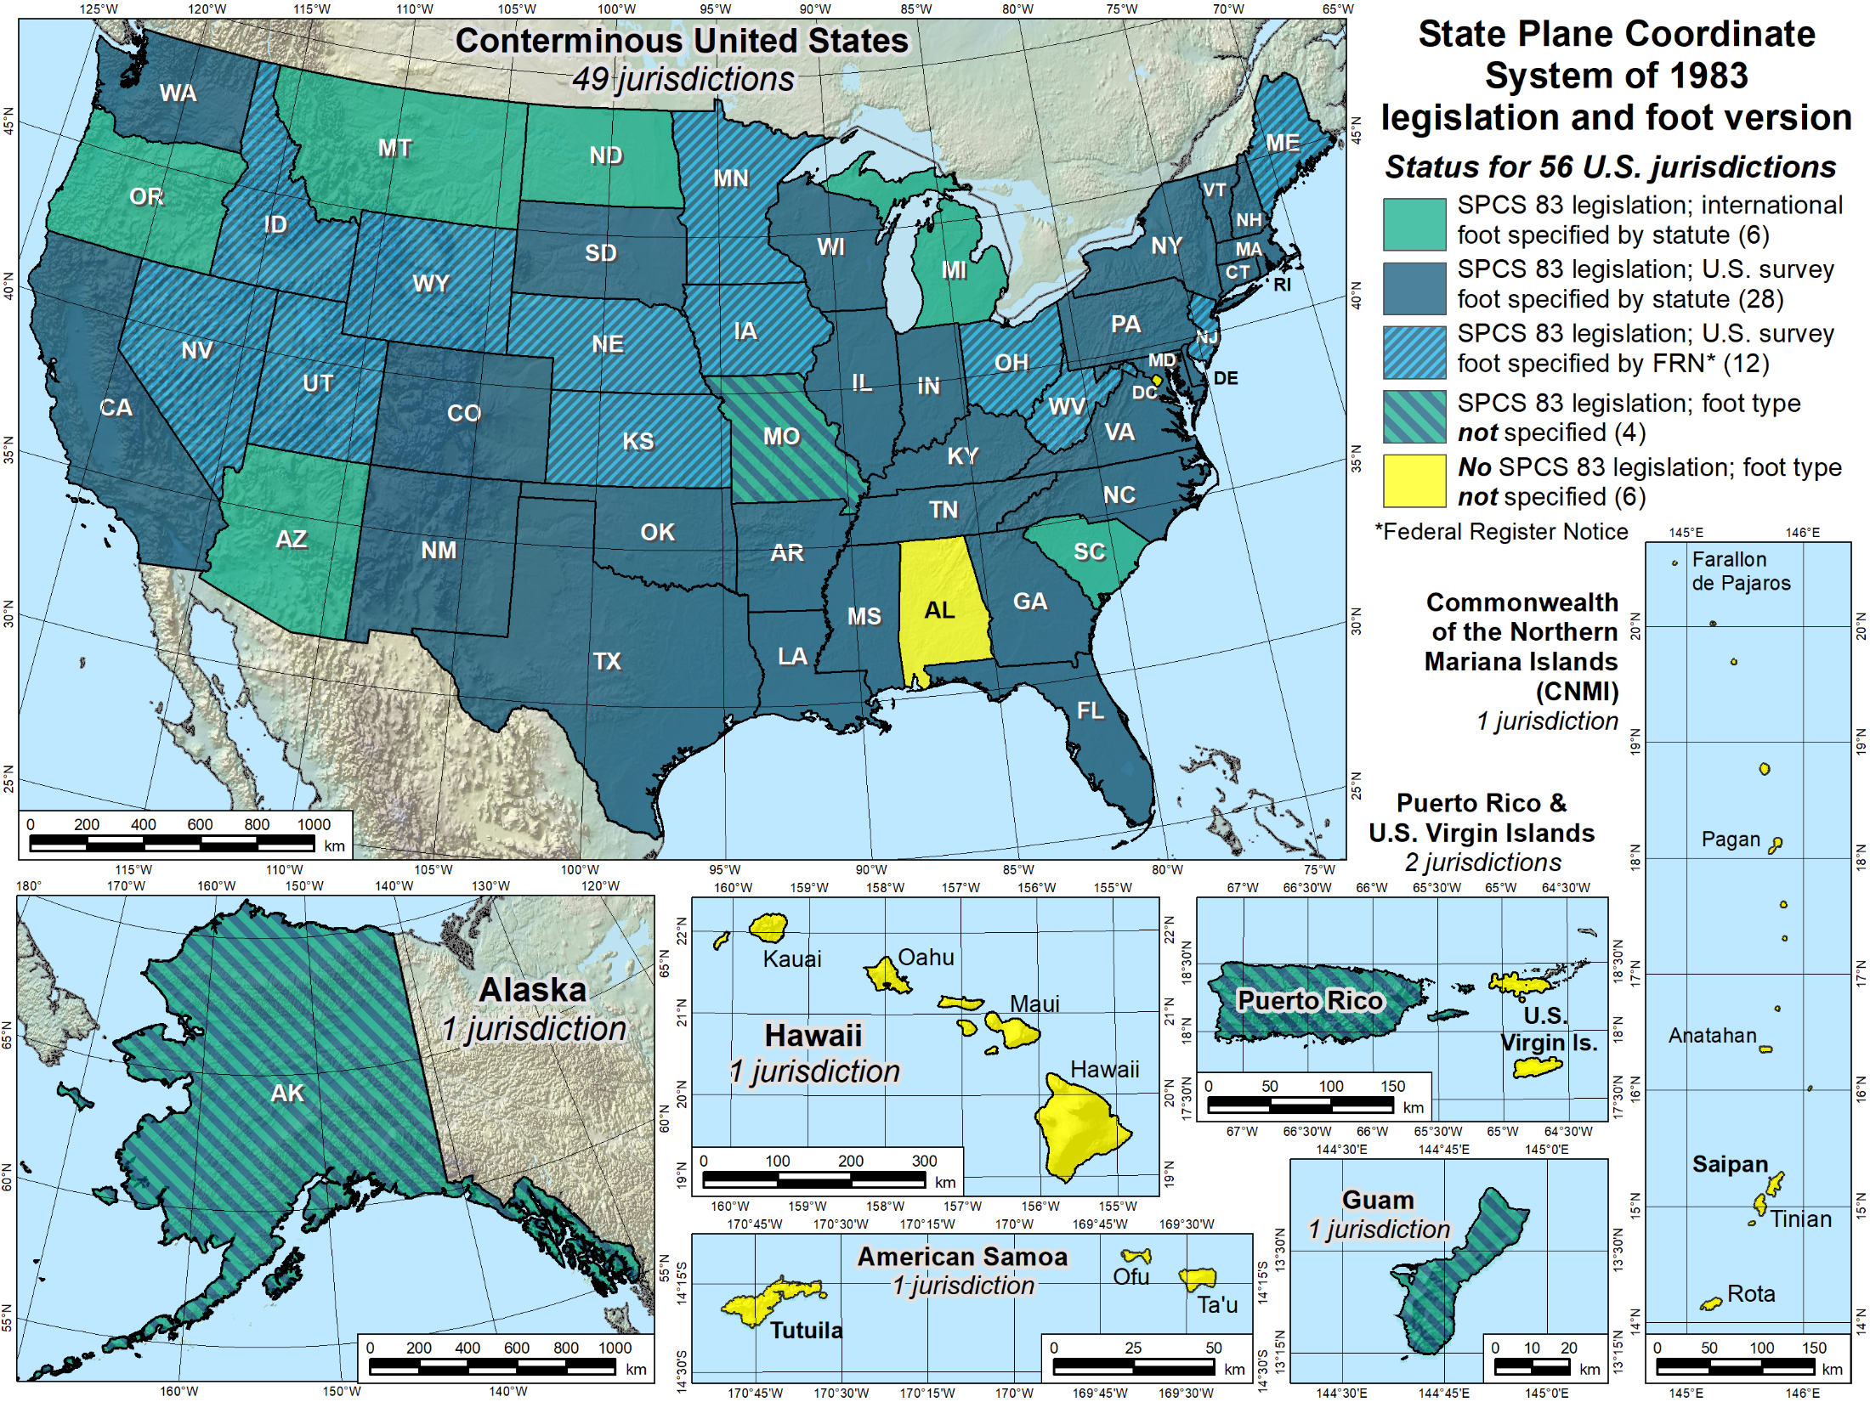

Slide 42
The U.S. survey foot will never go away
Foot status for SPCS 83 in 56 U.S. jurisdictions
  U.S. survey foot: 28 by statute, 12 by FRN
  International foot: 6 by statute
  Neither: 10 jurisdictions
But surveying is only small part of economy
  Vast majority uses new foot
  Foot type inconsistent even within states where adopted
U.S. survey foot will be supported for legacy products
  For all SPCS 27 zones
  For SPCS 83 zones that currently use U.S. survey foot
SPCS2022 will only support international foot
  2 ppm difference in length is very small
  Less than scale difference with SPCS 83 for nearly all zones

Slide 43
Questions, comments, and concerns
Keep name “international foot”?
What about other units defined with old feet?
But most states now use U.S. survey foot!
BLM requires U.S. survey foot

Slide 44
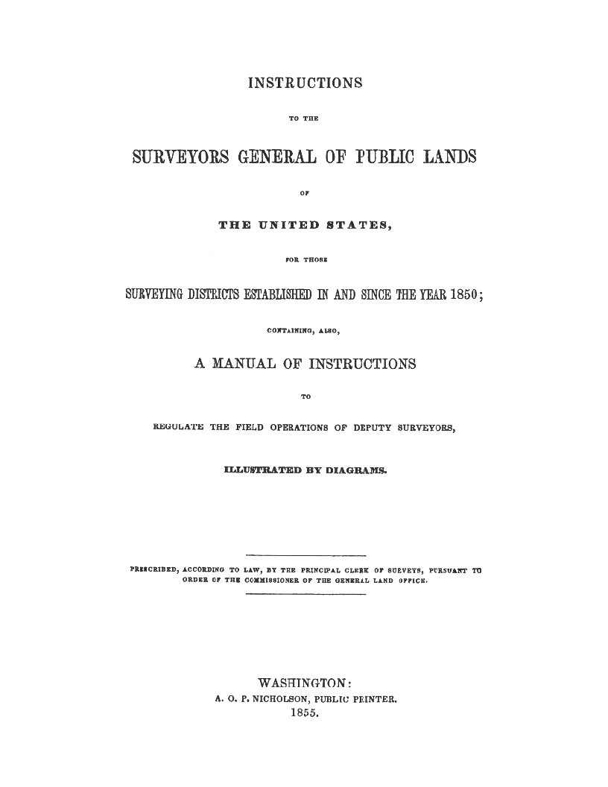
BLM officially uses U.S. survey foot
First three manuals predate 1893 Mendenhall Order
  Before: 1855, 1881, 1890
  After: 1894, 1902, 1930, 1947, 1973, 2009
Foot definition changed during life of manual

Slide 45
Questions, comments, and concerns
Keep name “international foot”?
What about other units defined with old feet?
But most states now use U.S. survey foot!
BLM requires U.S. survey foot
Impact on property conveyance or value?

Slide 46
Coordinates, distances, and area
Foot issue is a coordinate problem
Deeds are concerned with distances
Bigger issues with distances than type of foot
  U.S. survey vs. int’l foot: ±2 ppm = ±0.01 ft per mile
Inversed coordinates are “distances,” but…
  Scale of projected distance varies along line
  What about horizontal “ground” distances?
  What is a horizontal “ground” distance, anyway?
Notes:
The sft/ift issue is really a coordinate problem, whereas deeds are concerned with distances.
Of course, a coordinate is a distance, but it is a special type of distance, from an origin of a coordinate system that is usually very far from a survey site (especially for State Plane and UTM systems).
The distances on a deed are almost always short (usually less than 1 mile), and are given between real or computed objects that represent or reference property corners.
There are much bigger issues with distances than whether it is given in ift or sft.
The ift and sft differ by 2 ppm = 0.01 ft/mile. That difference is smaller than the accuracy of a boundary survey. I would argue that there is probably not a single boundary survey in the U.S. that has been performed to that accuracy, for all the distances on the survey. That’s an easy statement to make, because most surveys include some truly short distances (note that 2 ppm is 0.0001 ft in 200 ft). Also, the foot definition varied by much more than 2 ppm before 1893, so this becomes even less relevant for records prior to 1893.
In many areas, surveyors must contend with versions of the “same” unit that differ vastly more than the ift and sft. This includes different versions of the chain, but also the “arpent” (with versions that differ by up to 7 ft/mile), the “vara” (can vary by up to 30 ft/mile), and especially the “rod” or “pole” or “perch”, which can vary tremendously, up to 1760 ft/mile. So clearly surveyors must understand the context of the distances given on a deed, in situations that far exceed the difference between ift and sft.
For long distances (greater than a mile), bigger problems come into play than the 2 ppm difference between ift and sft. In such cases, what is even meant by a horizontal ground distance? Does it curve with the Earth? If so, how is that calculated (there is more than one way)? If it is a projected distance (e.g. State Plane), how much does the combined factor vary along the line? What is the difference in the height of the line end points? These types of issues typically introduce more than 2 ppm systematic differences in “distance.” In other words, the ift/sft is nit really relevant for long distances, either.

Slide 47
Coordinates, distances, and area
Boundary surveys are not accurate (or precise) to ±2 ppm
If same surveyor measures same parcel twice with same equipment, will not get same distances or area within ±2 ppm
  Doesn’t matter whether parcel is 1 or 1,000 acres
  Difference is 25 square inches per acre (5 in × 5 in)
  That’s 0.000 004 acre per acre, more or less

Slide 48
Questions, comments, and concerns
Keep name “international foot”?
What about other units defined with old feet?
But most states now use U.S. survey foot!
BLM requires U.S. survey foot
Impact on property conveyance or value?
Why not just go metric?

Slide 49
Why not just go metric?
Good news: you CAN “go metric”!
  Legalized by Congress for commerce in 1866
  All you have to do is convince your client…
But to work, everything must be metric
  Every. Thing.
  More good news: gas will be cheaper!
  vs.
  Where would you buy gas?
3
.
2
4
9
0
.
8
5
9
REGULAR
REGULAR
Notes:
For those who aren’t sure, this is intended as a joke! Gas cost of course would be the same. Actually, there is something sneaky going on here: the price per liter is a wee bit more expensive. The converted price from $3.249 per gallon is $0.8583 per liter, so the gas station is making (slightly) more money!

Slide 50
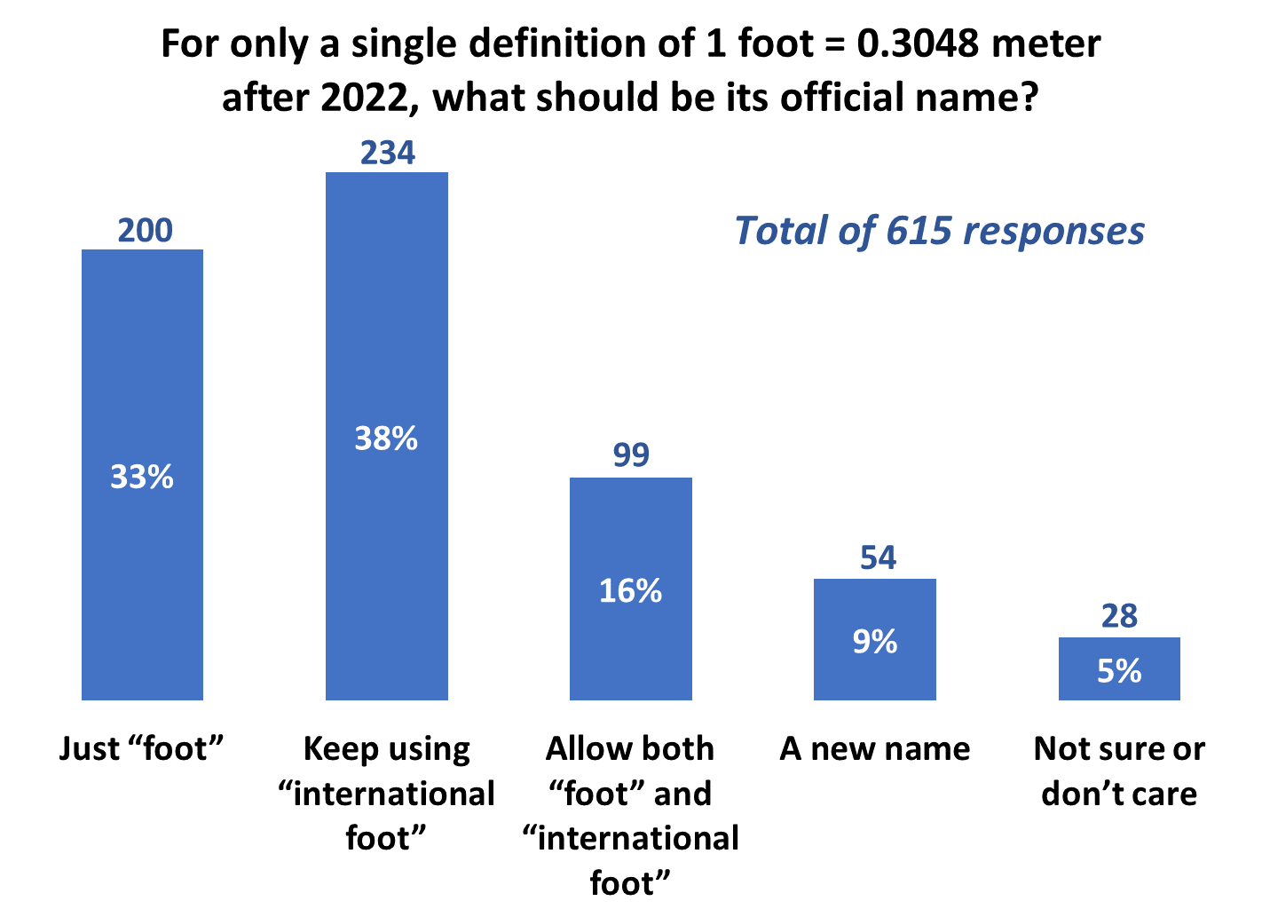
Poll question

Slide 51
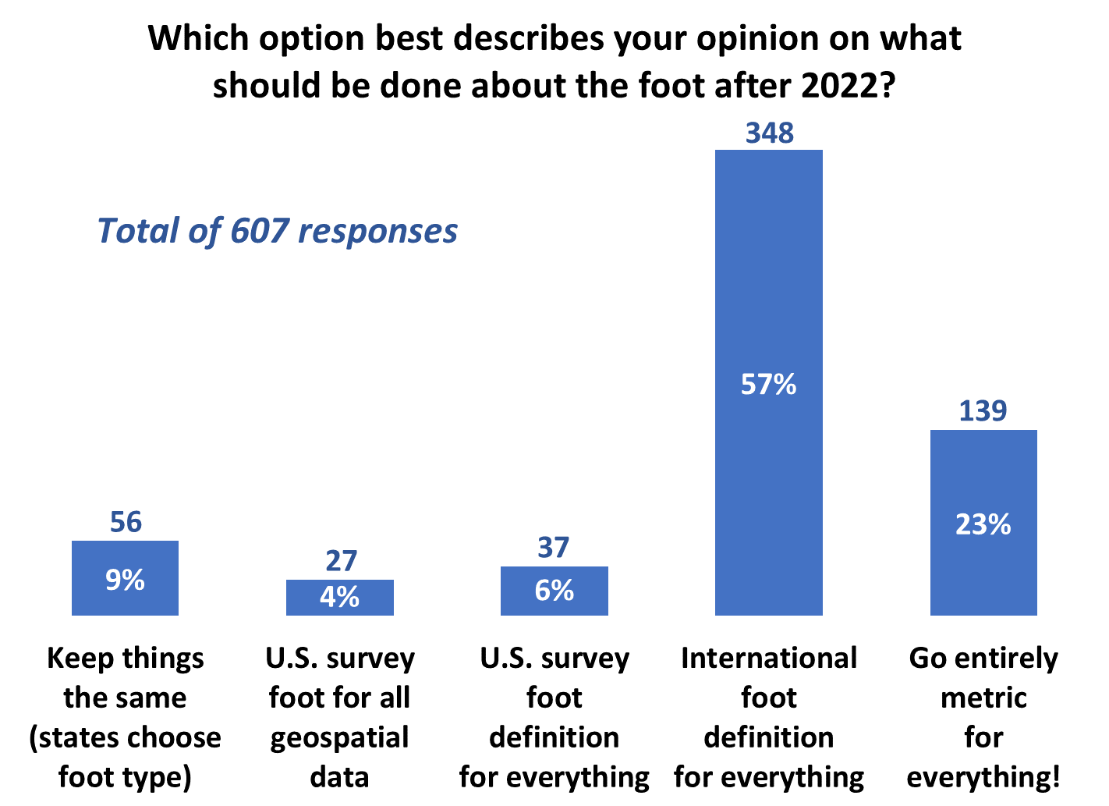
Poll question

Slide 52
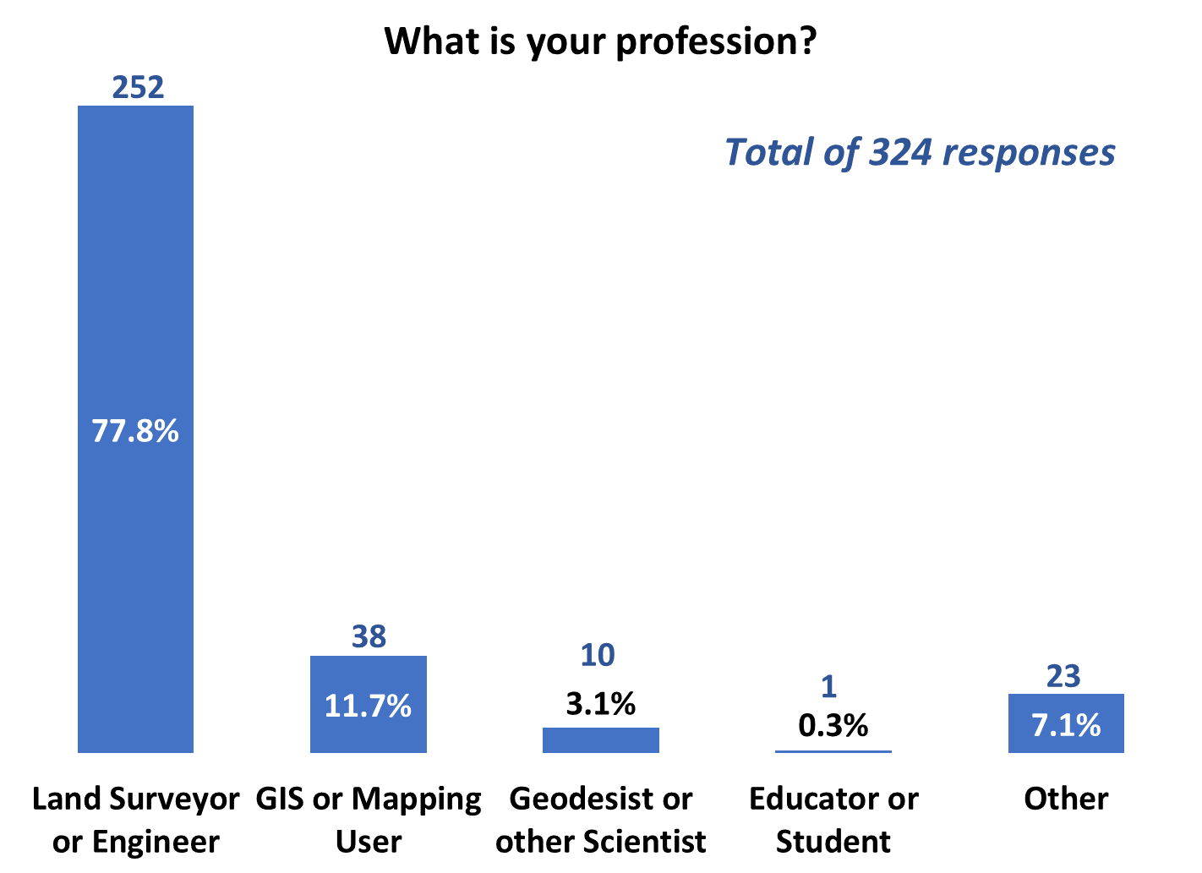
Poll question

Slide 53
Latest news and resources
In the news
  Associated Press article tomorrow (Dec 13)
  NSPS “News & Views” and “Surveyor Says” podcasts
FRN public comments
  Toward an orderly transition with minimum disruption
  FRN by end of June 2020 will announce change
Web resources
  NIST website at www.nist.gov/pml/us-surveyfoot

Slide 54
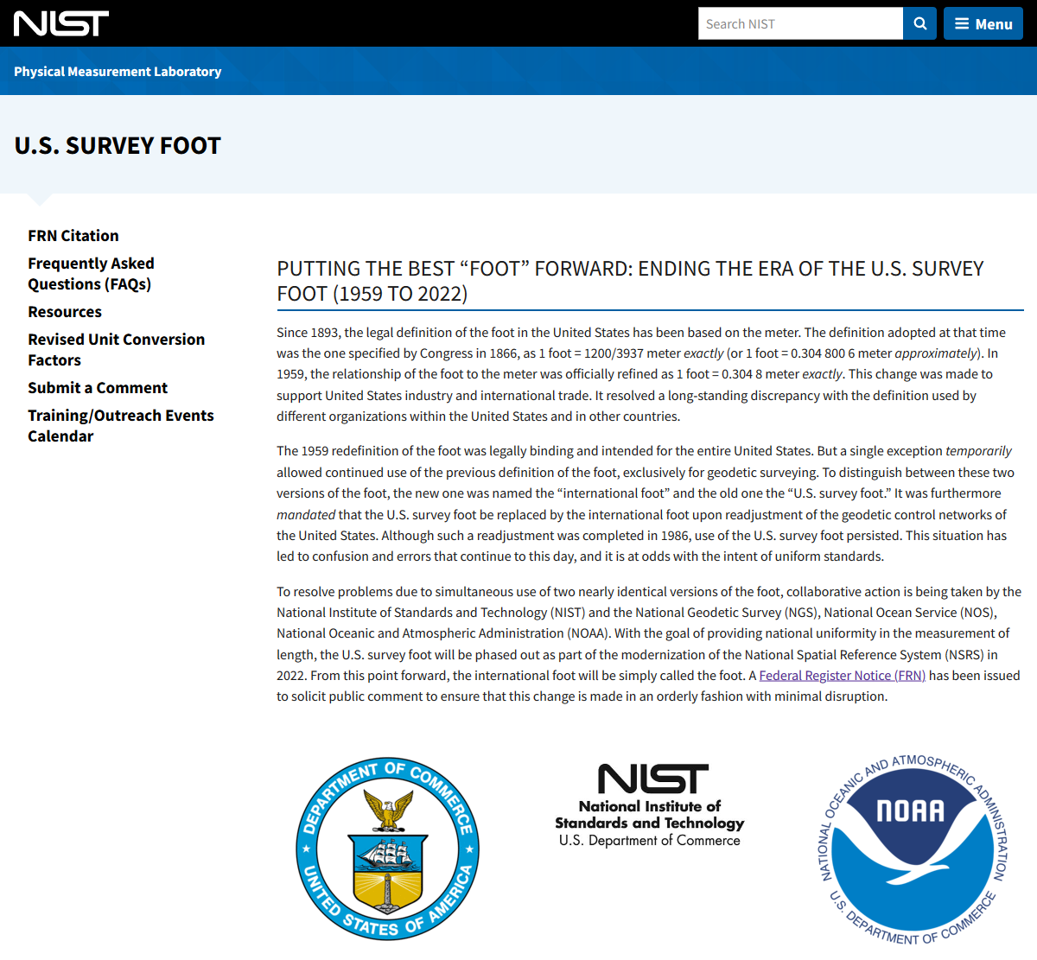

www.nist.gov/pml/us-surveyfoot

Slide 55
Latest news and resources
In the news
  Associated Press article tomorrow (Dec 13)
  NSPS “News & Views” and “Surveyor Says” podcasts
FRN public comments
  Toward an orderly transition with minimum disruption
  FRN by end of June 2020 will announce change
Web resources
  NIST website at www.nist.gov/pml/us-surveyfoot
  Legislation template and examples at geodesy.noaa.gov/datums/newdatums/GetPrepared.shtml

Slide 56
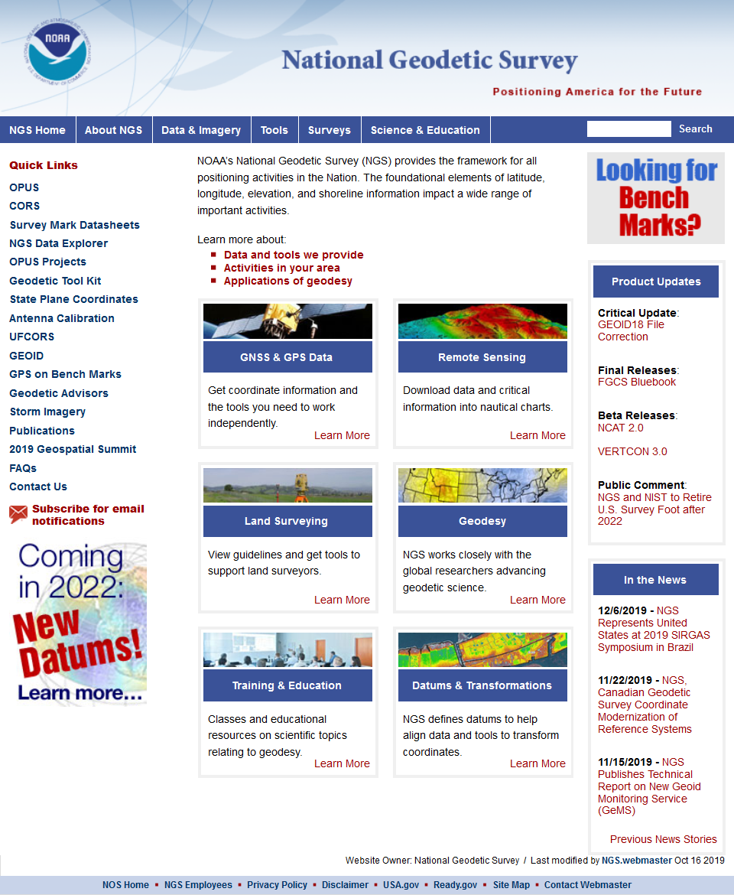
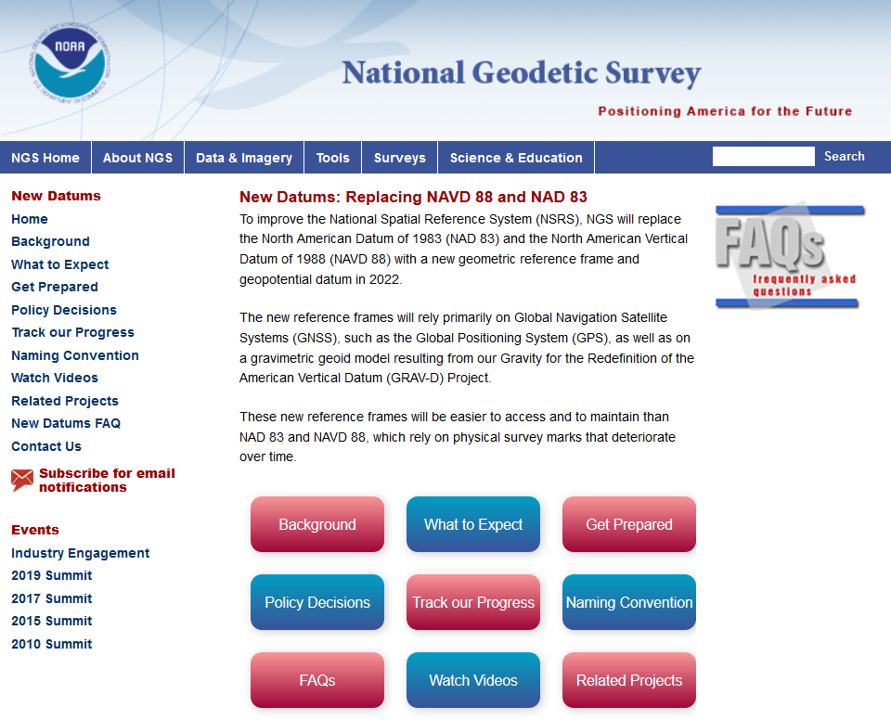
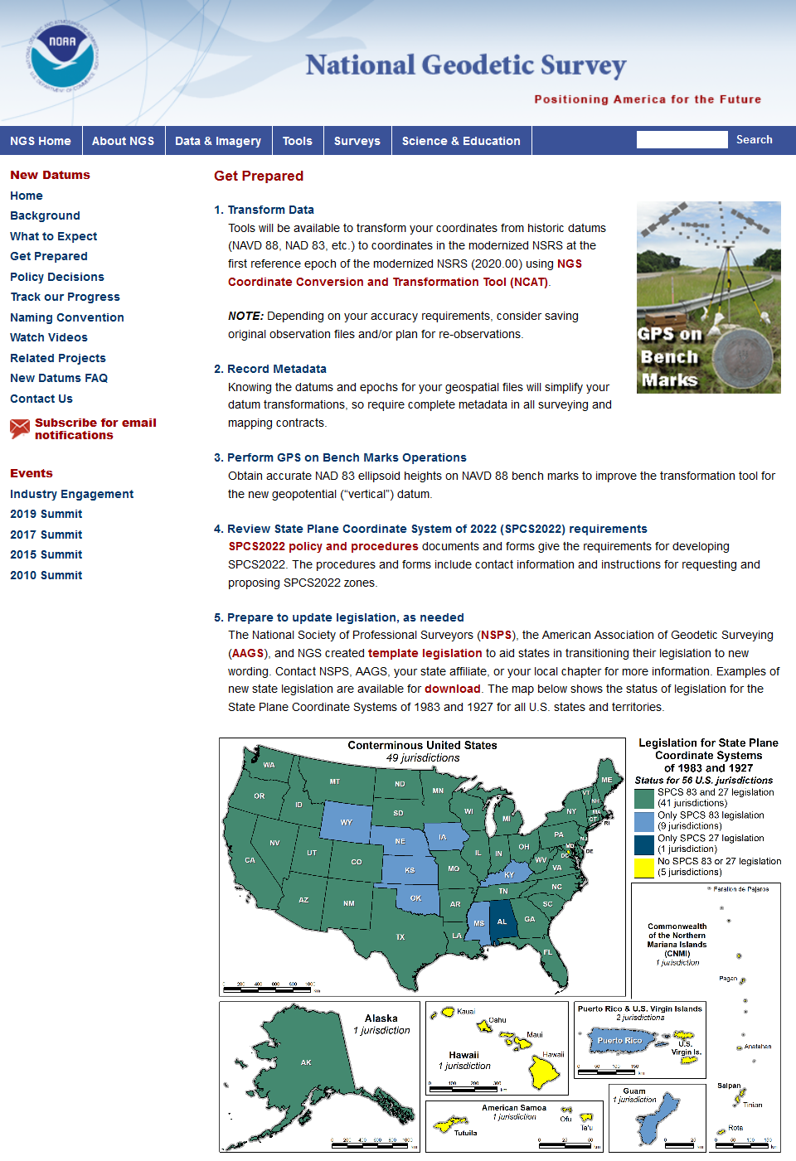
geodesy.noaa.gov

Slide 57
The path to the future
The foot problem created for convenience
  Intended as temporary, for geodetic work only
  Boundary surveys were not considered
Keeping U.S. survey foot is “anti-standard”
  U.S. survey foot currently in standards “limbo”
  Single definition efficient, clean, and right thing to do
NGS created problem, will help fix it
  Fully support backward compatibility
  Will make simple and painless as possible
  Foot change minor compared to other 2022 changes
Remember, this is about the future

