Slide 1
Uncovering the Treasure of Geospatial Infrastructure and Preparing the Next Generation for the Geospatial Knowledge Information Revolution
Juliana Blackwell
Director, National Geodetic Survey
National Oceanic and Atmospheric Administration

Slide 2
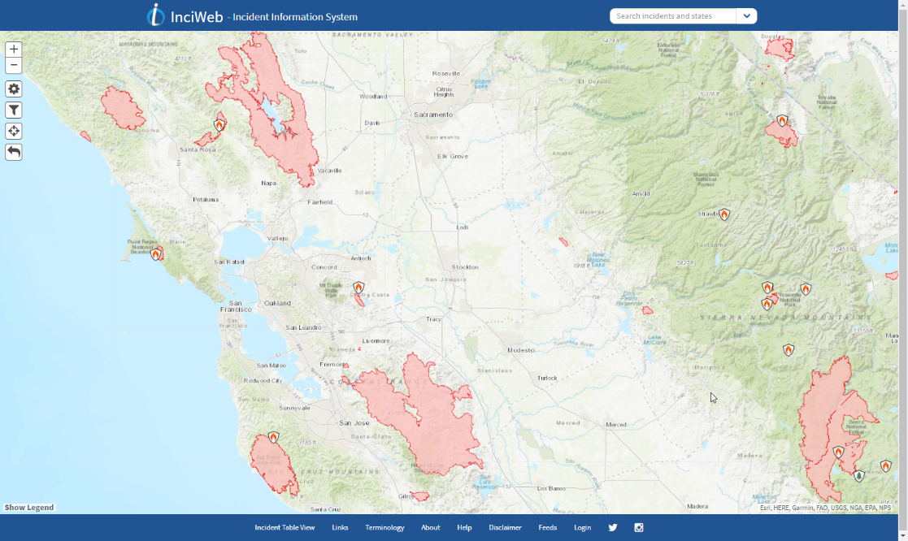
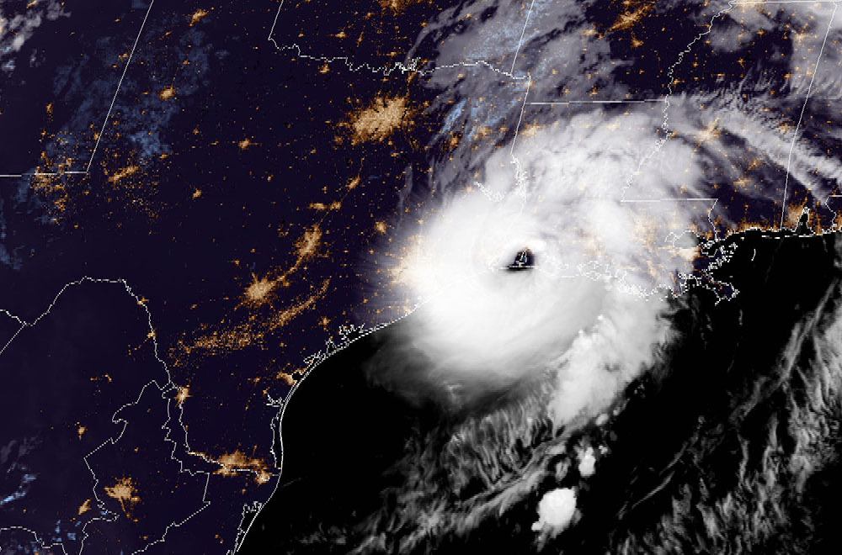
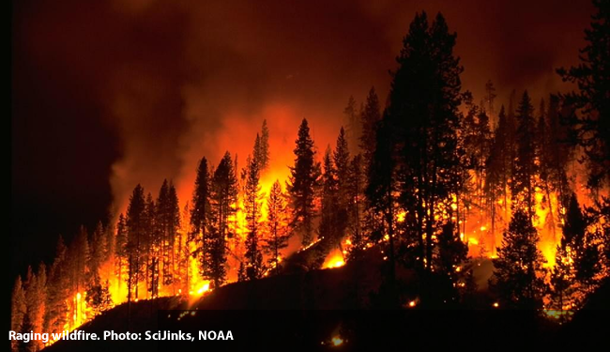
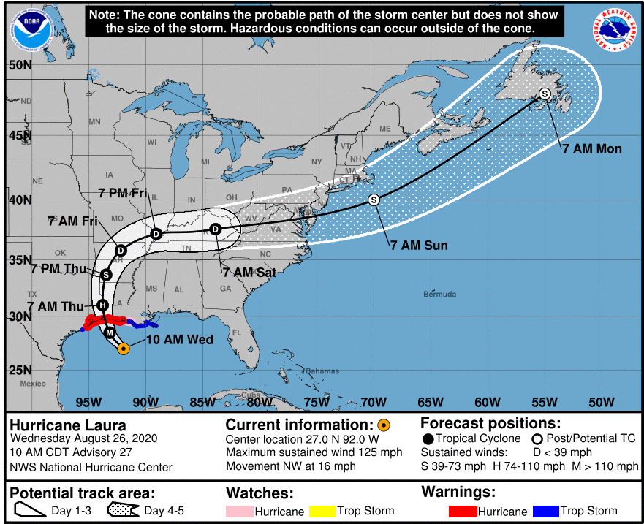
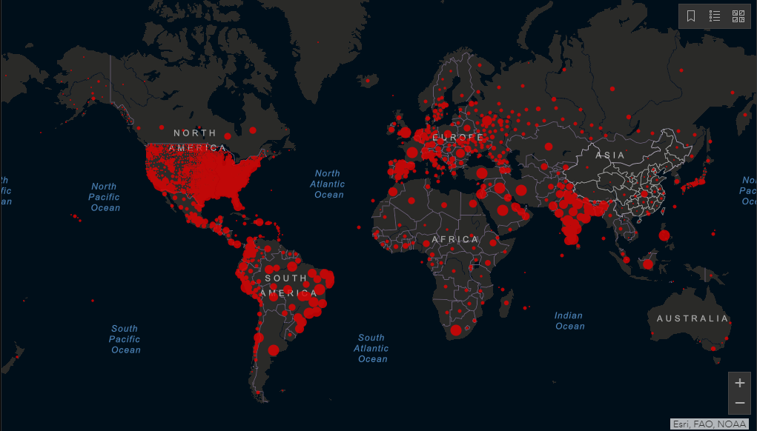

2020
Hurricane Laura, seen here by GOES EAST on August, 27, 2020, at 2 A.M. ET.

Slide 3
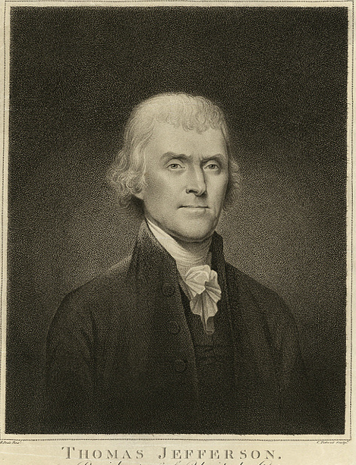
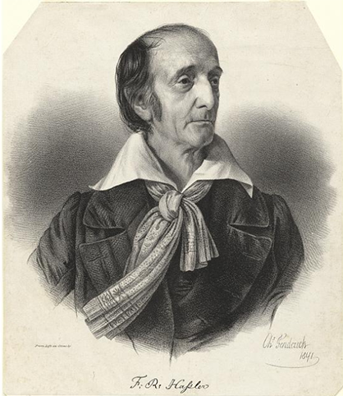


NOAA and NGS
Our Nation’s First Civilian Science Agency
1807
Thomas Jefferson
Survey of the Coast
1811
Ferdinand Hassler
Superintendent
1836
U.S. Coast
Survey
1878
U.S. Coast and
Geodetic Survey
1970
NOAA is established

Slide 4
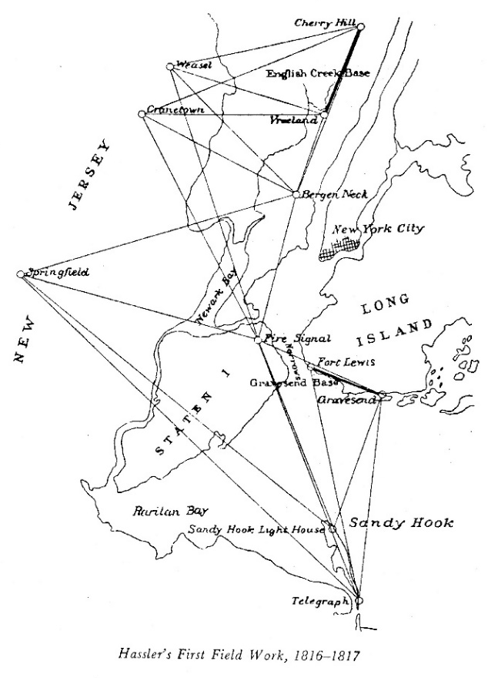
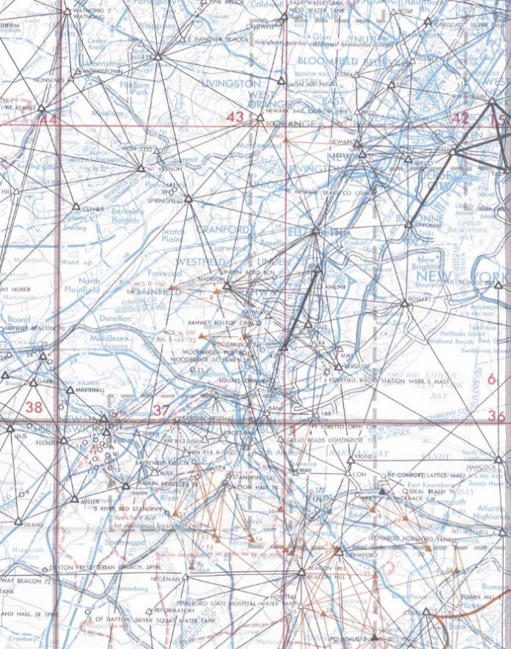
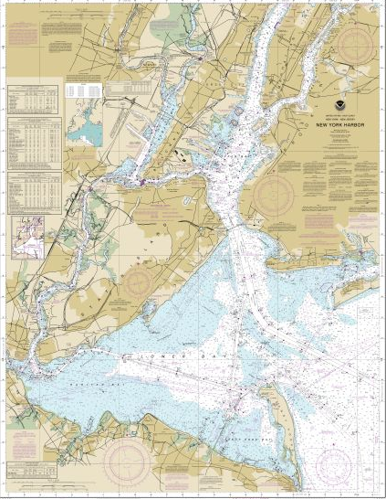
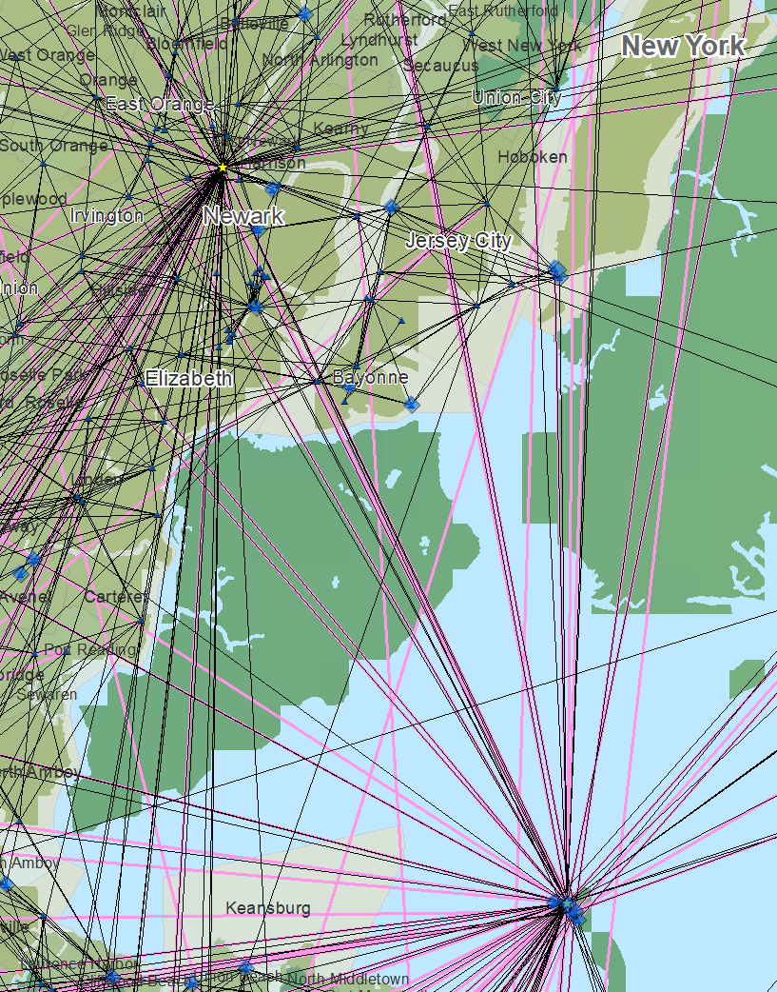
The importance of geodesy the hidden treasure
Geodesy is the science of accurately measuring and understanding the Earth’s geometric shape, orientation in space, and its gravity field — as well as the changes of these properties with time.
1816-1817
1969
Today

Slide 5
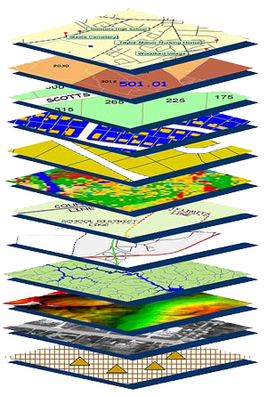

NGS mission
To define, maintain and provide access to the National Spatial Reference System (NSRS) to meet our Nation’s economic, social, and environmental needs.
The NSRS is a consistent coordinate system that defines latitude, longitude, height, scale, gravity, orientation, and shoreline throughout the United States.
The NSRS consists of datums, geodetic control, models, tools, and expertise.

Slide 6
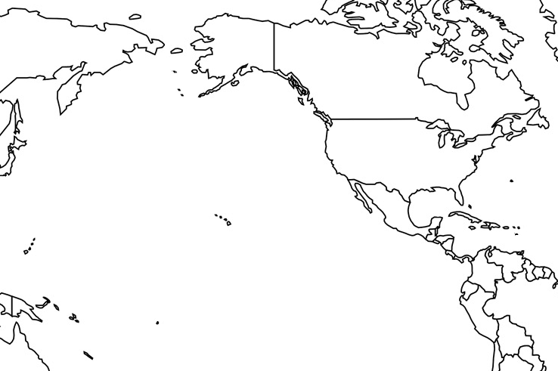
Horizontal Datums of the NSRS
St. Paul I.
St. Paul 1897
St. Paul 1952
NAD 83(1986)
NAD 83(2002:AK)
NAD 83(NSRS2007)
NAD 83(2011) epoch 2010.00
St. Lawrence I.
St. Lawrence 1952
NAD 83(1986)
NAD 83(2002:AK)
NAD 83(NSRS2007)
NAD 83(2011) epoch 2010.00
St. Matthew I.
St. Matthew 1952
Alaska
NAD 27
NAD 83(1986)
NAD 83(2002:AK)
NAD 83(NSRS2007)
NAD 83(2011) epoch 2010.00
St. George I.
St. George 1897
St. George 1952
NAD 83(1986)
NAD 83(2002:AK)
NAD 83(NSRS2007)
NAD 83(2011) epoch 2010.00
CONUS
U.S. Standard Datum
NAD 27
NAD 83(1986)
NAD 83(“HARN”)
NAD 83(“FBN”)
NAD 83(NSRS2007)
NAD 83(2011) epoch 2010.00
Hawaii
Old Hawaiian Datum
NAD 83(1986)
NAD 83(1993:HI)
NAD 83(PA11) epoch 2010.00
CNMI
Guam 1963
NAD 83(1993:GU)
NAD 83(2002:GU)
NAD 83(MA11) epoch 2010.00
U.S. Virgin Islands
Puerto Rico 1940
NAD 83(1986)
NAD 83(1993:PR)
NAD 83(1997:PR)
NAD 83(2002:PR)
NAD 83(NSRS2007)
NAD 83(2011) epoch 2010.00
Puerto Rico
Puerto Rico 1940
NAD 83(1986)
NAD 83(1993:PR)
NAD 83(1997:PR)
NAD 83(2002:PR)
NAD 83(NSRS2007)
NAD 83(2011) epoch 2010.00
Guam
Guam 1963
NAD 83(1993:GU)
NAD 83(2002:GU)
NAD 83(MA11) epoch 2010.00
American Samoa
American Samoa 1962
NAD 83(1993:AS)
NAD 83(2002:AS)
NAD 83(PA11) epoch 2010.00

Slide 7
Vertical Datums of the NSRS
St. Paul I.
- None -
St. Lawrence I.
- None -
St. Matthew I.
- None -
Alaska
NGVD 29
NAVD 88
St. George I.
- None -
CONUS
NGVD 29
NAVD 88
Hawaii
- None -
CNMI
NMVD 03
Puerto Rico
PRVD 09
U.S. Virgin Islands
VIVD 09
American Samoa
ASVD 02
Guam
GVD 63
GUVD 04

Slide 8
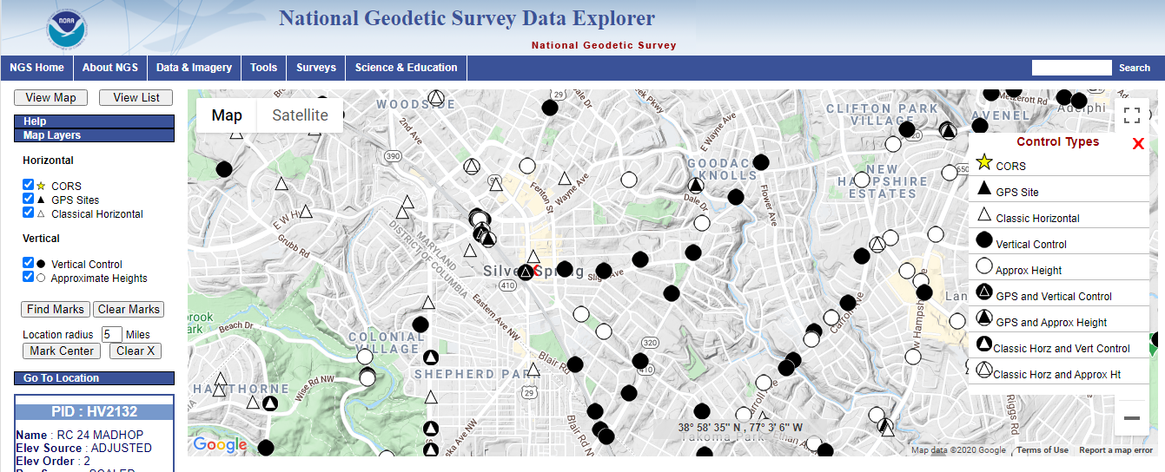
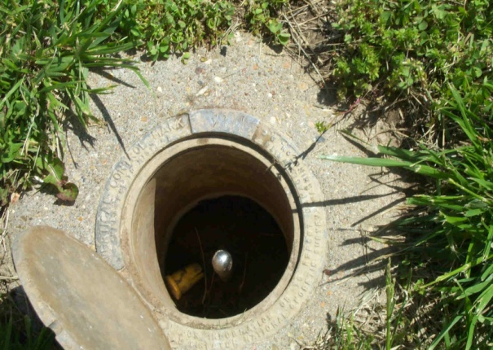
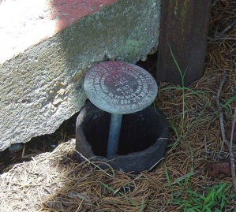
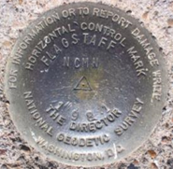
Survey mark network

Slide 9
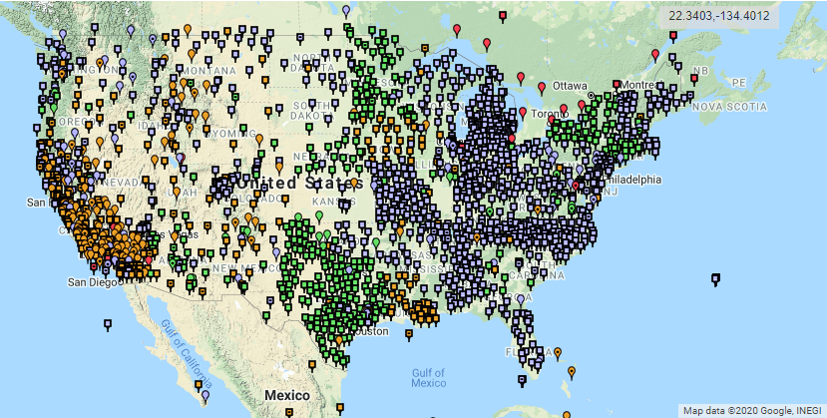
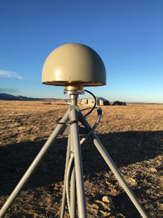
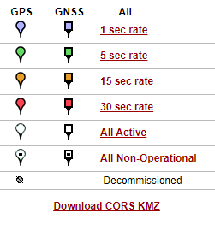
NOAA CORS Network
2000+ sites
~225 organizations

Slide 10
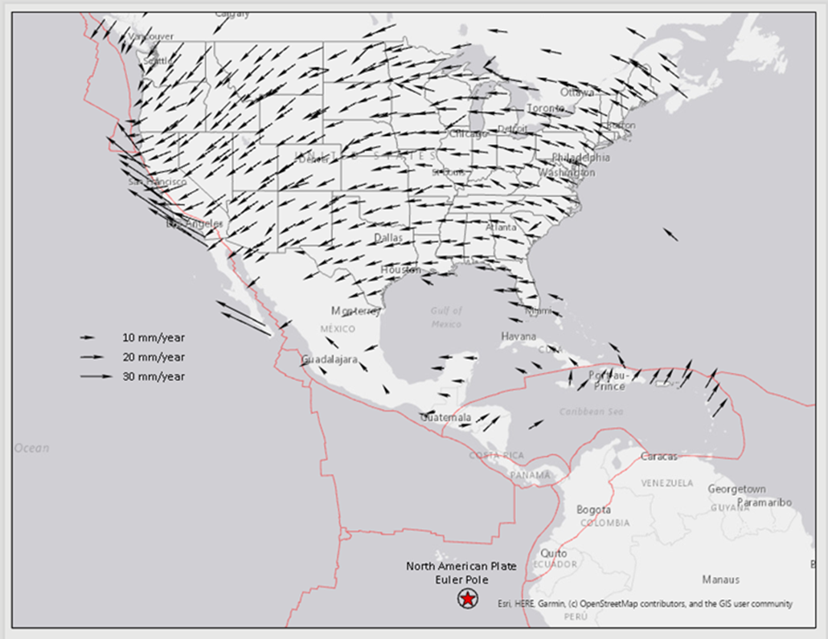
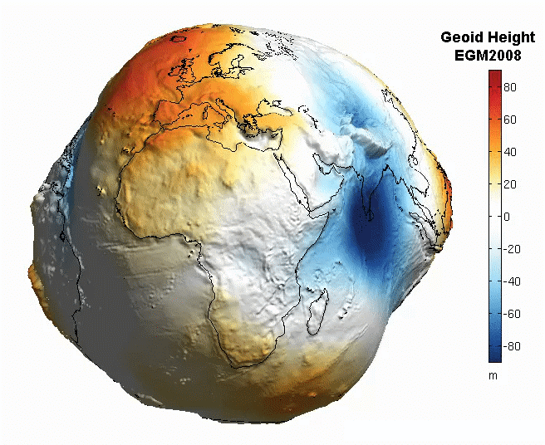
The earth is infinitely complex

Slide 11
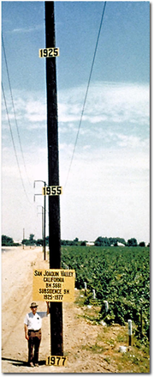
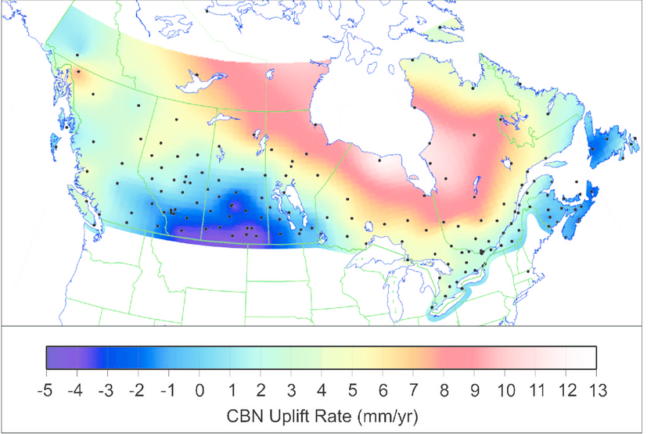
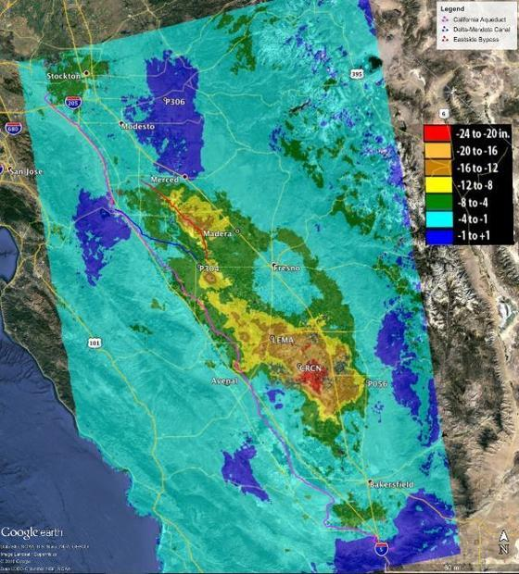
Vertical motion
Hudson Bay uplifting
8 -13 mm/year
May 2015
to
Sept 2016
San Joaquin subsiding
20-24” in 16 months
8.5 meters
in 50 years

Slide 12
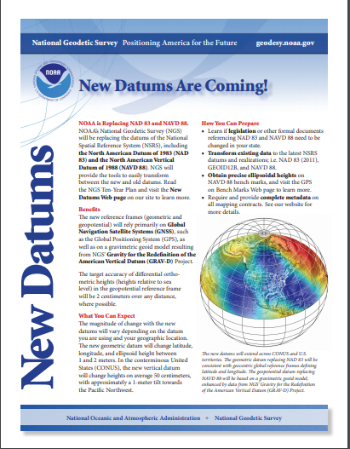
Modernize for future generations
Current datums were built using old (pre-GPS) technology and data.
NAD 83 is not truly aligned with the center of the earth as we know it (off by ~2.2 m).
NAVD 88 relies on survey marks in the ground which are difficult to maintain.
Geospatial information, automated transportation systems, real-time positioning require improved accuracy, access, and alignment -- nationally and globally.

Slide 13
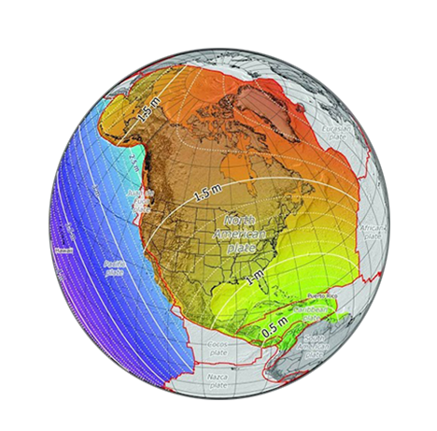
Modern nsrs – what to expect
Approximate Horizontal Change
~1 to 1.5 meters North America
~2.5 to 4 meters in Pacific

Slide 14
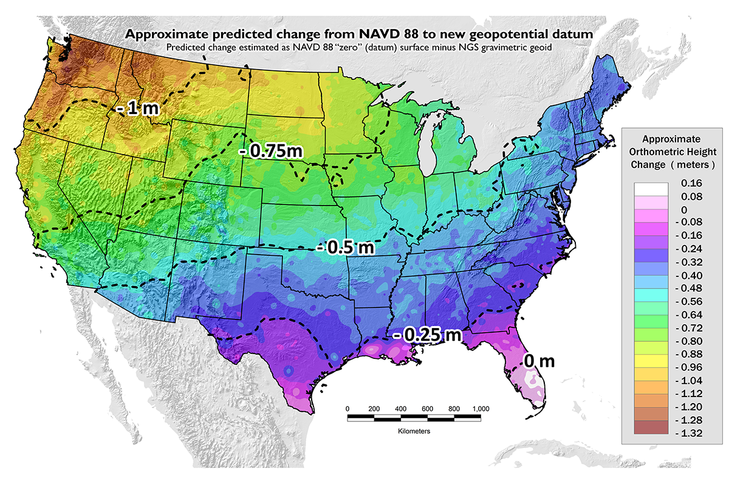
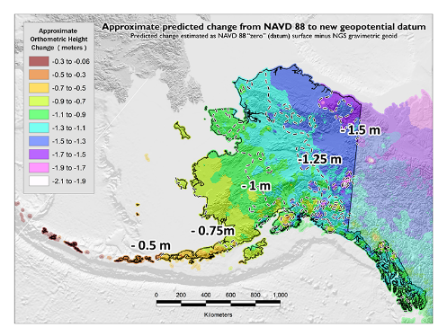
Modern nsrs – what to expect
Approximate Vertical Change
0 to 1.3 meters in CONUS
0 to 2.1 meters in Alaska

Slide 15
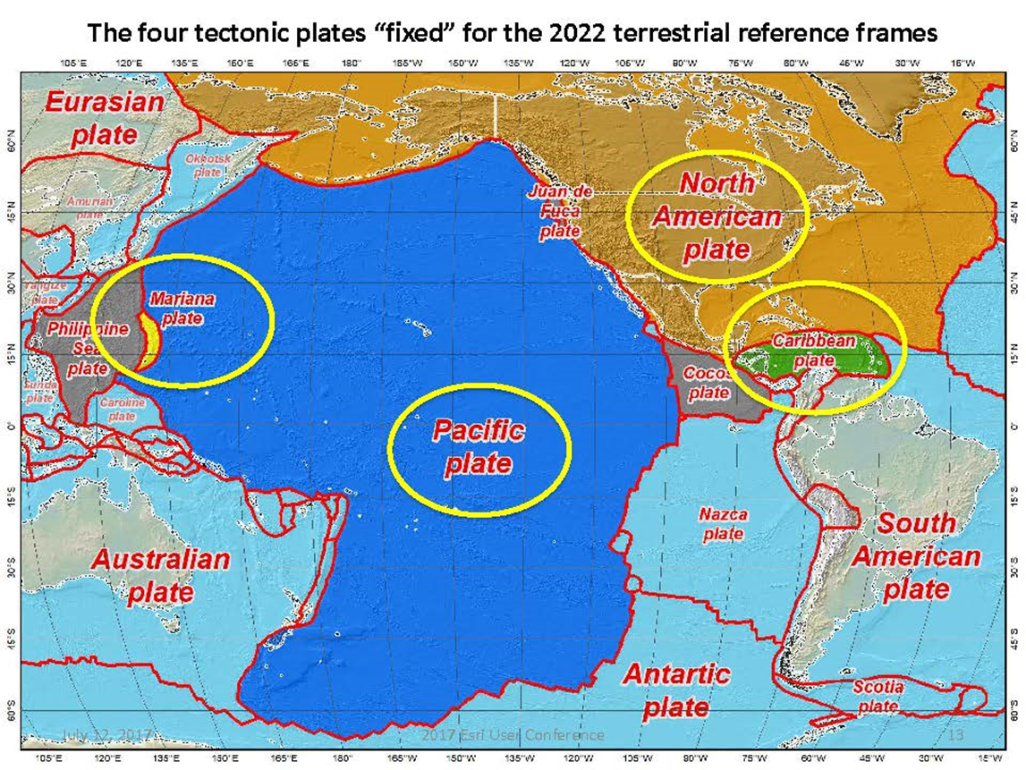
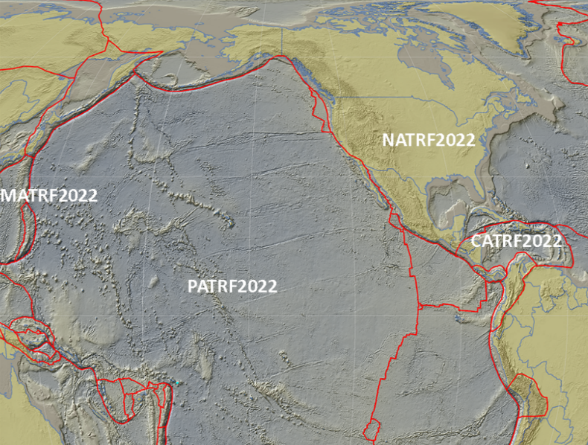
Future – “reference frames”
Tectonic plate based:
North America [NATRF2022]
Caribbean [CATRF2022]
Pacific [PATRF2022]
Mariana [MATRF2022]

Slide 16
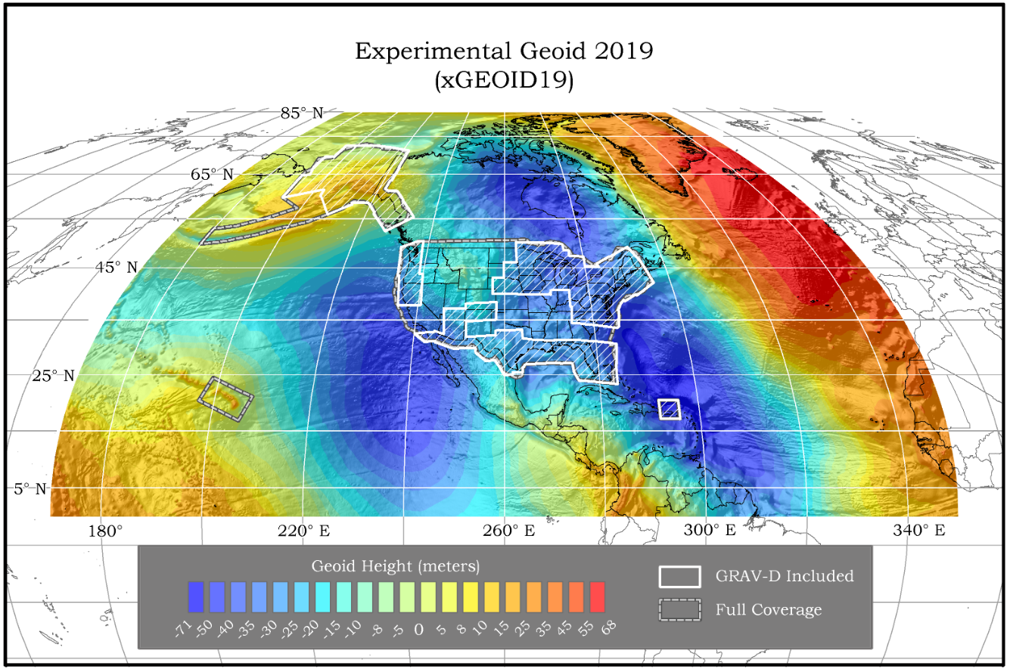
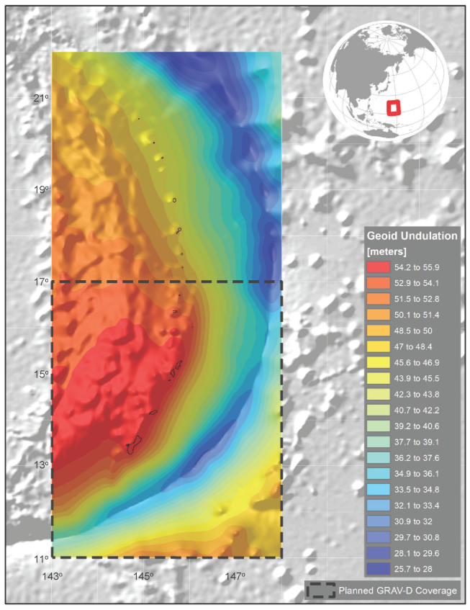
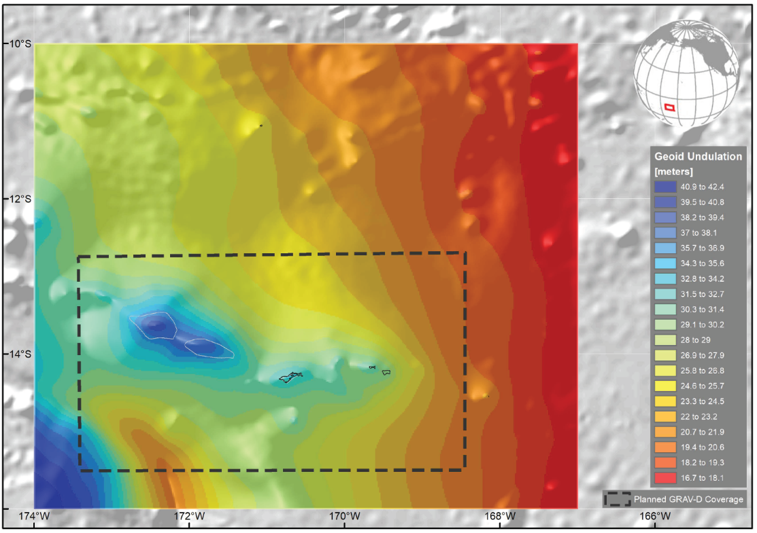
Future – “Geopotential Datum”
NAPGD2022
Guam/CNMI
American Samoa
¼ Earth’s Surface
16

Slide 17
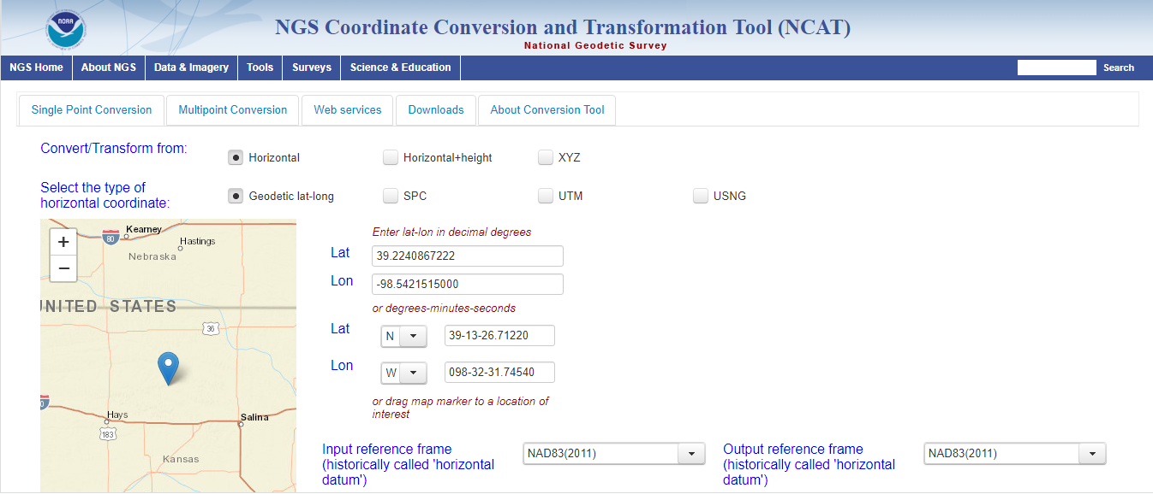
Software tools

Slide 18
Expertise
Build future workforce
Support university engagement
Advance diversity and inclusion
Expand partner network
Educate stakeholders
Embrace technology

Slide 19
Educational resources
NGS Training Center
https://geodesy.noaa.gov/web/science_edu/training/
Educational Videos
https://geodesy.noaa.gov/datums/newdatums/WatchVideos.shtml
NGS Webinar Series
https://geodesy.noaa.gov/web/science_edu/webinar_series/
Geospatial Summit (2019 recorded sessions)
https://geodesy.noaa.gov/geospatial-summit/
Presentation Library
https://geodesy.noaa.gov/web/science_edu/presentations_library/

Slide 20

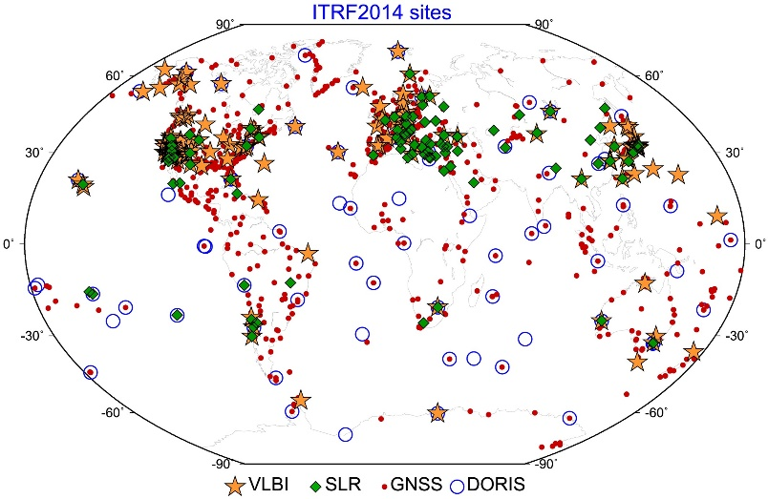

global alignment

Slide 21
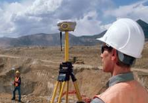
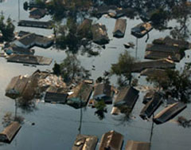
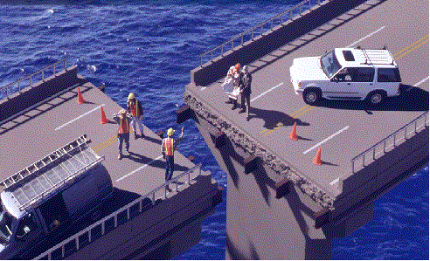

What life will be like in the future
Revolutionize professional surveying
No more need for installing and locating bench marks
Absolute, consistent positioning autonomously, anywhere
Vastly improved flood plain mapping
Water flows due to differences in gravity
Critically important in low-lying, flat communities
Impacts on infrastructure
Any application requiring precise positioning -- bridges, tunnels, railways, agriculture, navigation -- will be easier and more accurate
Fundamental support for new technologies
“Smart Highways” for autonomous vehicles

