Slide 1



National Geodetic Survey
Highlights
William Stone
NGS Southwest Region (UT, NV, AZ, NM) Geodetic Advisor
NOAA’s National Geodetic Survey
geodesy.noaa.gov
william.stone@noaa.gov
505-277-3622 x252
UCLS Conference
February 10, 2012
St. George

Slide 2
Today’s Topics
Continuously Operating Reference Stations (CORS)
Multi-Year CORS Solution (new CORS network coords)
NAD83 (2011) epoch 2010.00 (new passive network coords)
Online Positioning User Service (OPUS)
NGS Ten-Year Plan (new datums)
Geoid Slope Validation Study 2011
DSWorld, Datasheet changes, Real-time Networks, etc.
            Let’s Talk…
Notes:
This is a listing of the parts of subject matters to be covered. Cut out entire chapters if they are unimportant to your audience.

Slide 3
National Geodetic Survey Highlights – suggested links
1. National Geodetic Survey home page: http://geodesy.noaa.gov/;
Starting point for information about NGS and its products and services
2. Continuously Operating Reference Stations (CORS): http://geodesy.noaa.gov/CORS/;
Data access, metadata, and miscellaneous site information for the network of permanent GNSS sites
3. Online Positioning User Service (OPUS): http://geodesy.noaa.gov/OPUS/;
Automated processing of your GPS observations (note: Until the early 2012 release of the NAD83(2011) epoch 2010.00 realization for the passive control network, users can choose between two NAD83 realizations – NAD83(2007) and NAD83(2011) epoch 2010.00 – for their solutions)
4. Published CORS Coordinates: http://geodesy.noaa.gov/CORS/coords.shtml;
Detailed information about published CORS coordinates and reference frames, including the recent release of NAD83(2011) epoch 2010.00 and IGS08 epoch 2005.00 coordinates for all sites, along with the corresponding IGS08 GNSS antenna calibration models
5. Multiyear CORS Solution (MYCS): http://geodesy.noaa.gov/CORS/coord_info/myear_FAQ.shtml;
Questions/answers about the recent five-year effort to compute a new set of CORS coordinates, resulting in the latest nationwide geometric datum realization – NAD83(2011) epoch 2010.00
6. National Adjustment of 2011: http://geodesy.noaa.gov/web/surveys/NA2011/;
Detailed information, including FAQs, about the in-progress effort to adjust the GPS-observed passive control network to the NAD83(2011) epoch 2010.00 framework established by the CORS/MYCS
7. The National Geodetic Survey Ten-Year Plan: http://geodesy.noaa.gov/INFO/NGS10yearplan.pdf;
NGS document that lays out a “mission, vision, and strategy” for NGS and the evolution of the National Spatial Reference System over the 2008-2018 time period (and probably longer), including plans for the national geometric and geopotential datums of the future
8. NGS Geoid Slope Validation Survey of 2011: http://geodesy.noaa.gov/GEOID/GSVS11/index.shtml;
Description of research survey methodology to assess the accuracy of differential geoid undulations between points using NGS gravimetric geoid models vs. GPS, leveling, and other technologies
9. NGS Presentation Library: http://geodesy.noaa.gov/web/science_edu/presentations_library/;
Posting of various presentations by NGS personnel, including William Stone’s 2012 UCLS presentation

Slide 4
U.S. Department of Commerce
National Oceanic & Atmospheric Administration
National Geodetic Survey
Mission: To define, maintain & provide access to the
National Spatial Reference System (NSRS)
to meet our Nation’s economic, social & environmental needs
National Spatial Reference System
& time variations
      Latitude
      Longitude
      Height
  Scale
  Gravity
  Orientation
Notes:
- NSRS benefit to the nation = $2.5B/year
est. 300K precision GPS users worldwide (2008); ¼ in US
- Very exciting to us at NGS to see how it has evolved over the years – now cm-accuracy capability / tracking with time

Slide 5
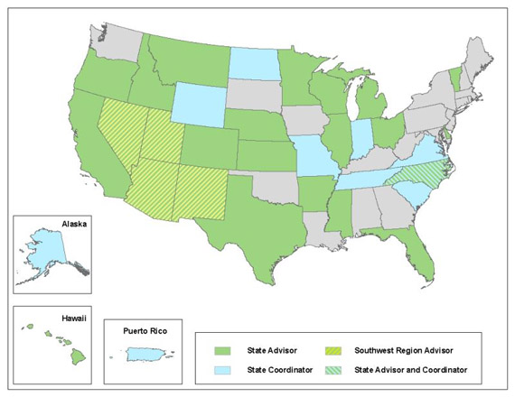
NGS Geodetic Advisors
SW Region
(AZ,NV,NM,UT)
Bill Stone
Colorado
Pam Fromhertz
Idaho/Montana
Curt Smith
Wyoming
Mike Londe (BLM)
Geodetic Advisor Contact Info: http://geodesy.noaa.gov/ADVISORS/AdvisorsIndex.shtml

Slide 6
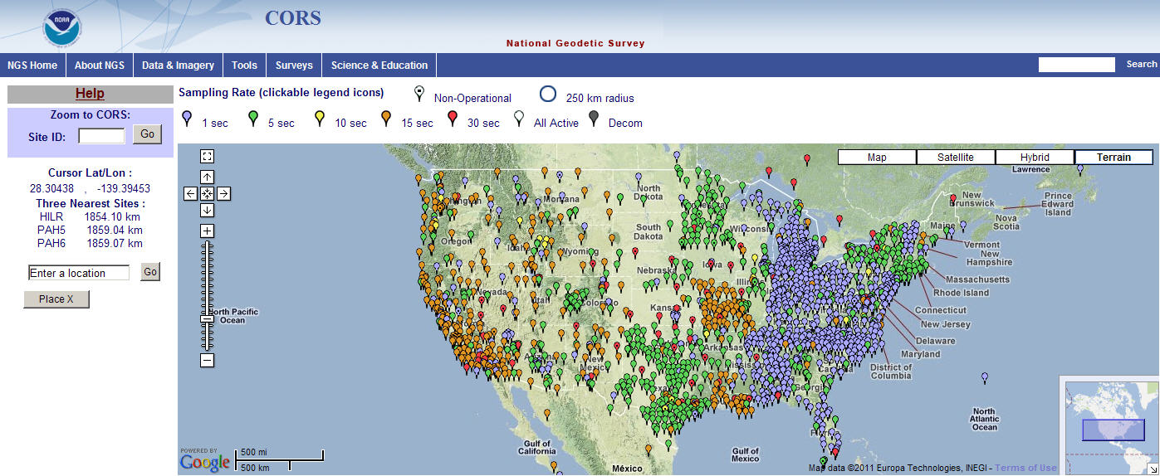
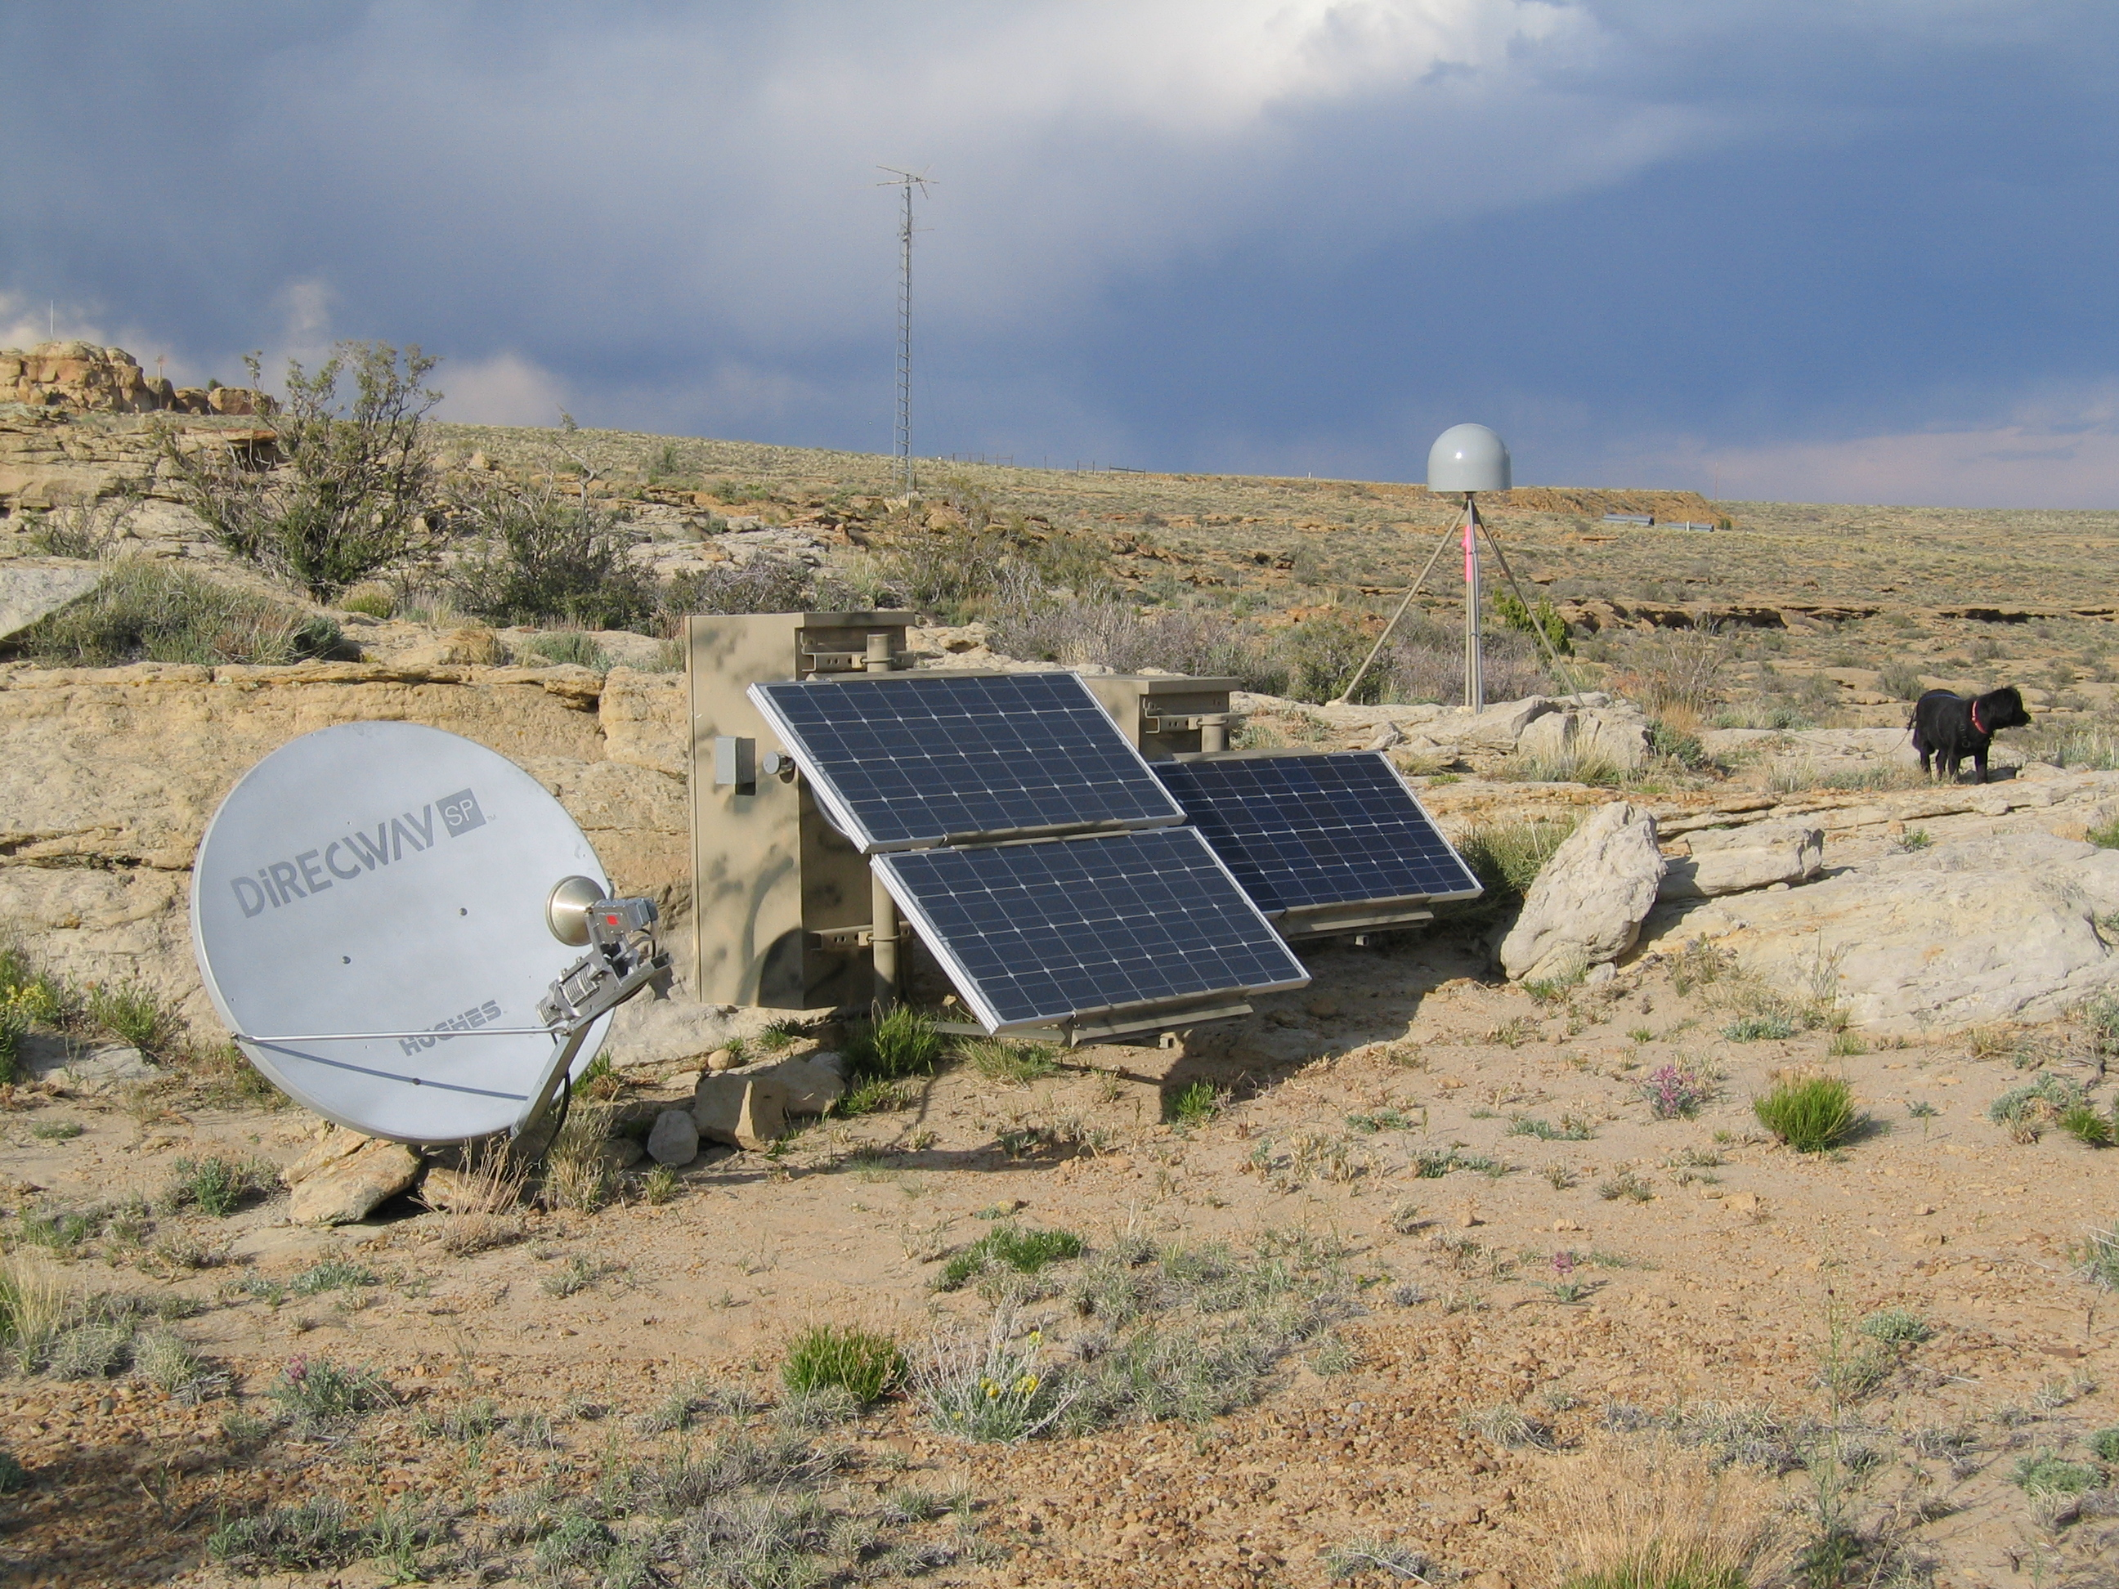
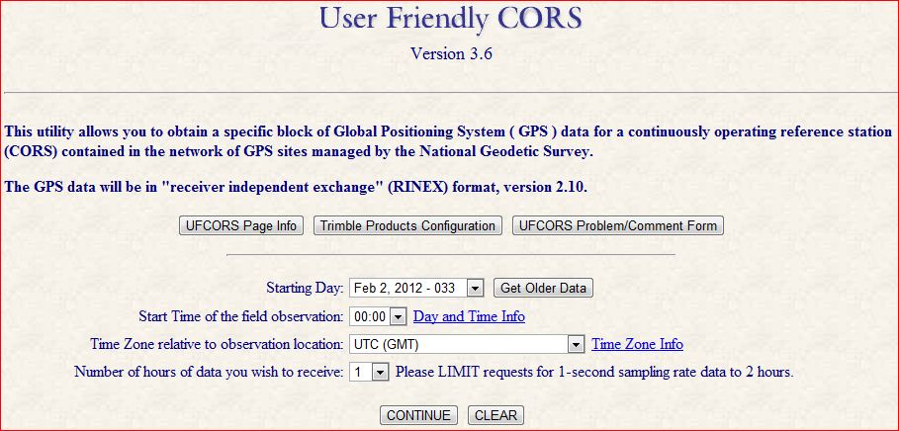
Continuously Operating Reference Stations (CORS)
1700+ GPS/GNSS Stations
200 organizations

Slide 7
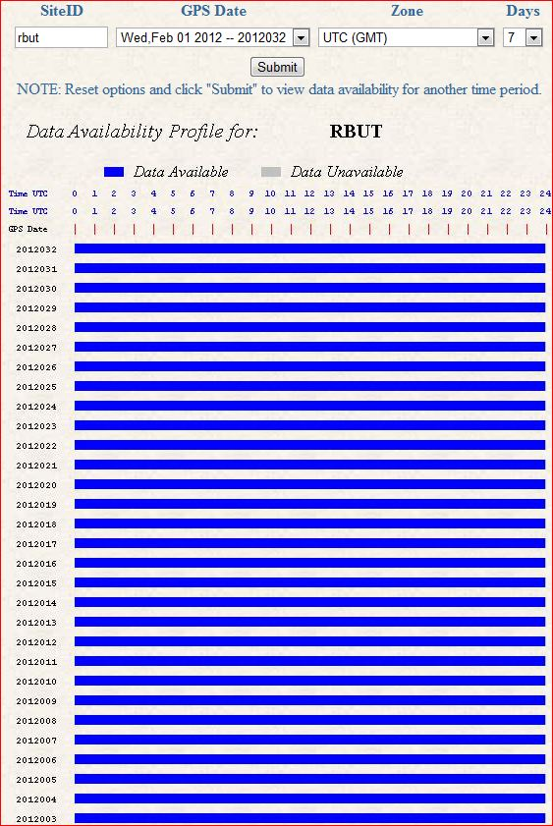
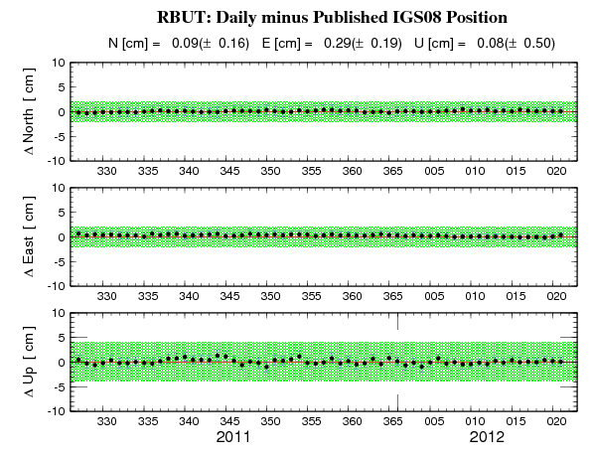
Red Butte, UT (RBUT) CORS Plots
Data Availability
60-day Time Series

Slide 8
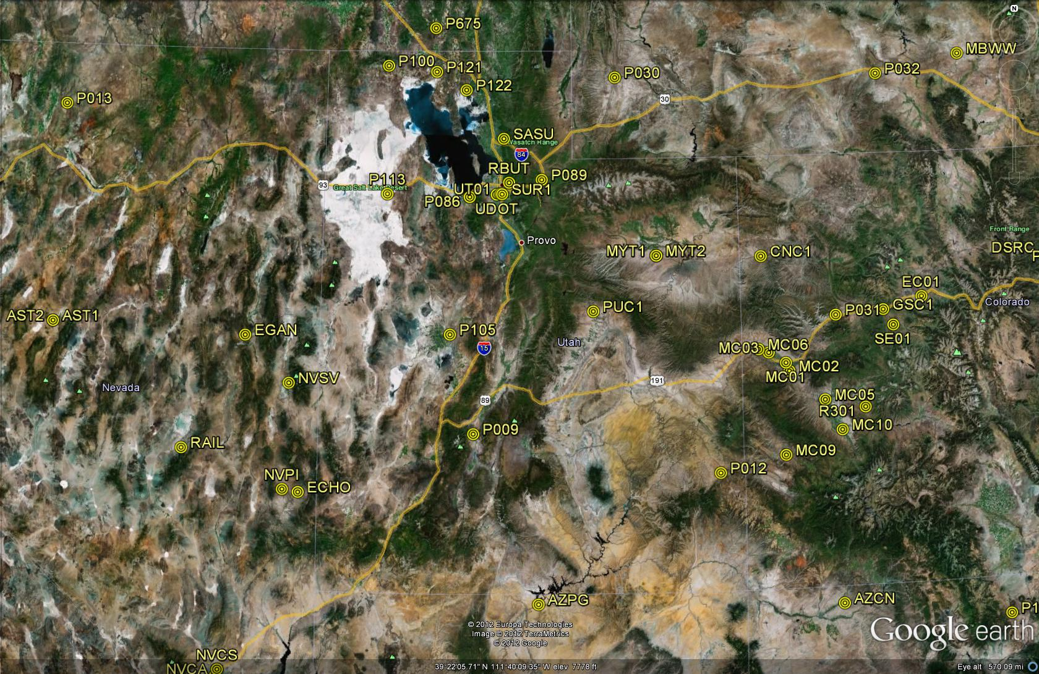
Utah CORS Network

Slide 9
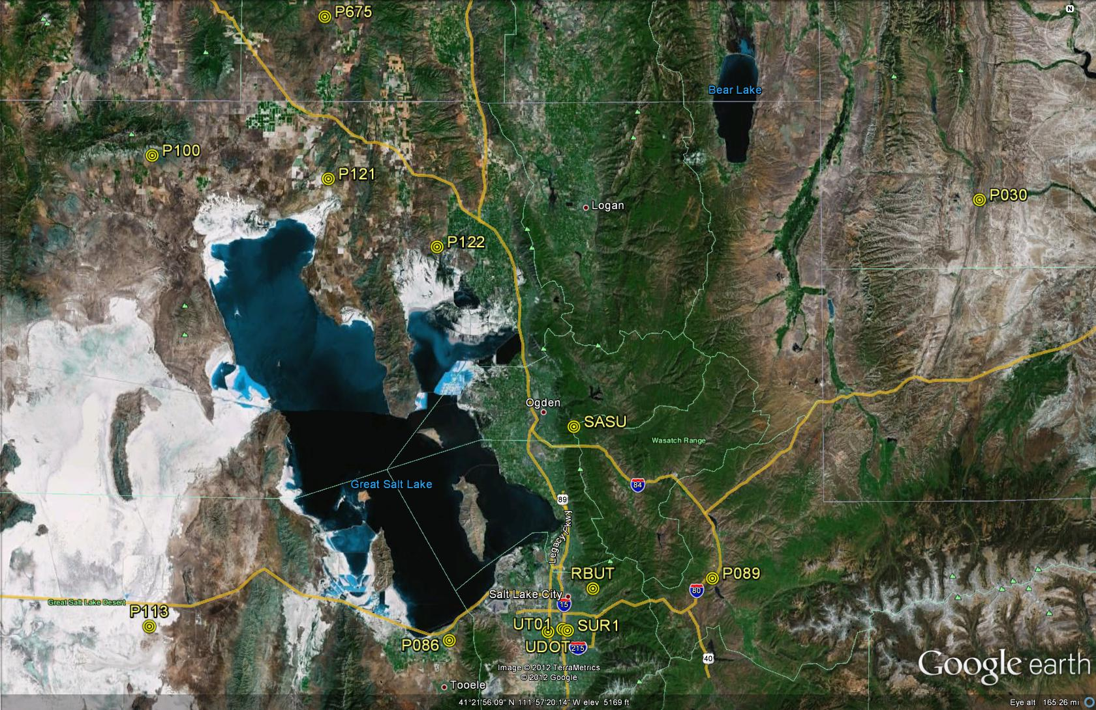
Great Salt Lake Area CORS Network

Slide 10
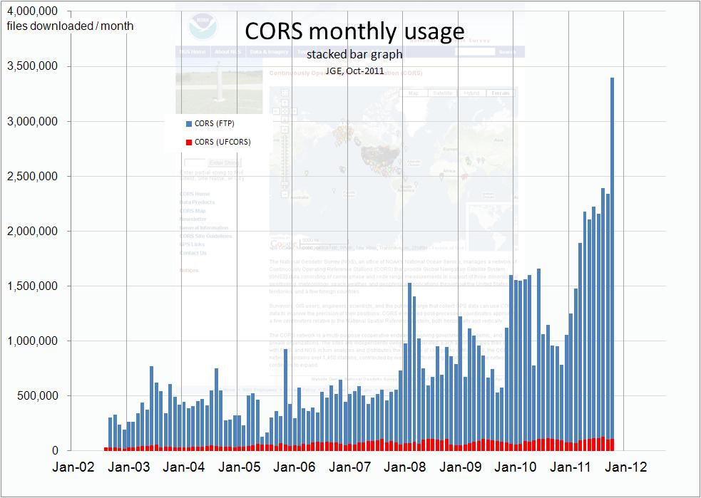

Slide 11

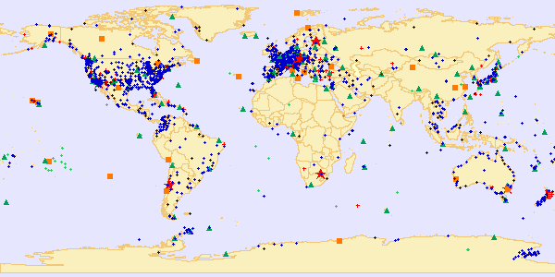
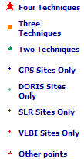
International Terrestrial Reference Frame (ITRF)
space-based techniques: VLBI, DORIS, SLR, GNSS
Current version: ITRF2008 (epoch 2005.0)
International Earth Rotation and Reference System Service(IERS)
(http://www.iers.org)

Slide 12
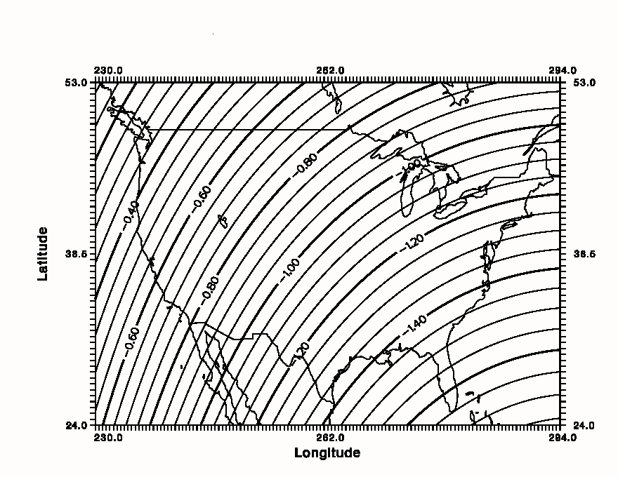
Simplified Concept of NAD 83 vs. ITRF
In Southwest US - NAD83 & ITRF
differ by
ABOUT 1 meter H & V
h_{NAD83}
h_{ITRF}
Earth’s
Surface
ITRF 00
Origin
2.2 meters
Ellipsoid for both NAD83 and ITRF:
Geodetic Reference System 1980 (GRS80)
a = 6,378,137.000 meters (semi-major axis)
1/f = 298.25722210088 (flattening)
NAD 83
Origin
WGS84 (G1150) ~ ITRF2000
Notes:
ITRF (International Terrestrial Reference Frame) just has an origin; take NAD83 shaped ellipsoid centered at the ITRF origin to derive ITRF97 ellipsoid heights.
Ellipsoid heights NAD83 vs. ITRF97 - Defined origins are best estimate of the center of mass; NAD83 is not geocentric. Move origin; move ellipsoid surface as illustrated.
Ellipsoid height differences reflect the non-geocentricity of NAD83.

Slide 13
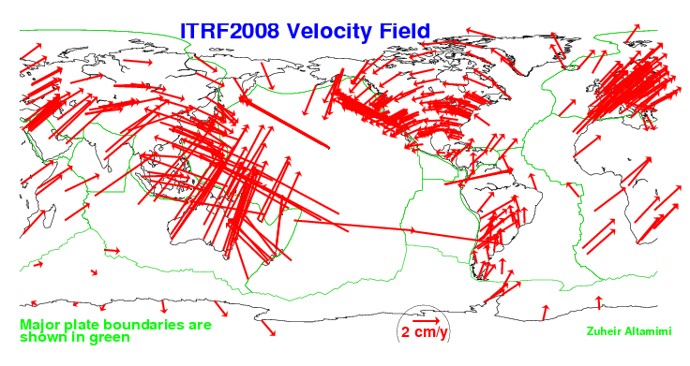
Global Velocity Field - ITRF2008

Slide 14
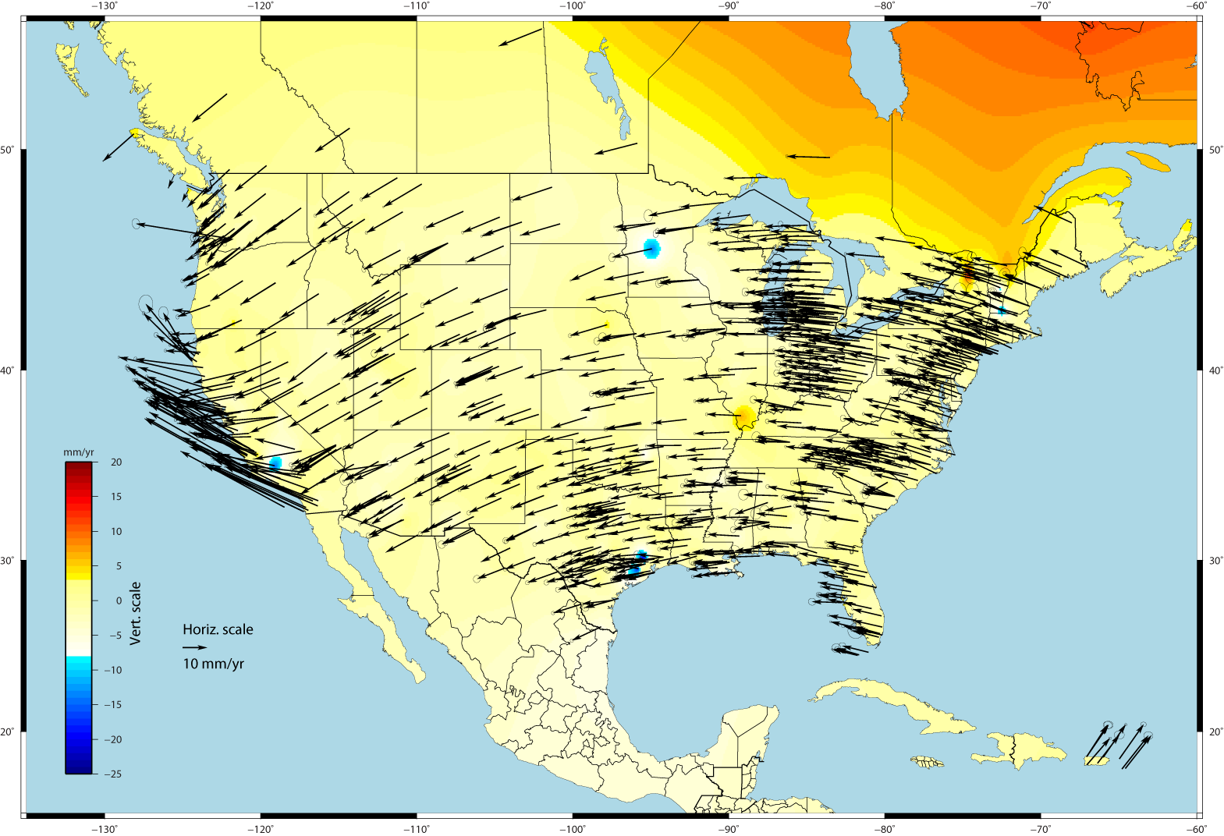
U.S. CORS Velocity Field – ITRF2008 (IGS08 epoch 2005.0)

Slide 15
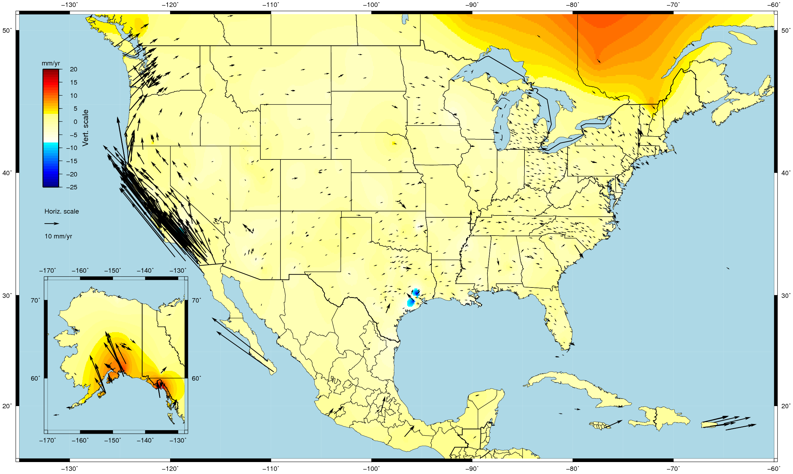
U.S. CORS Velocity Field - NAD83(2011) epoch 2010.0

Slide 16
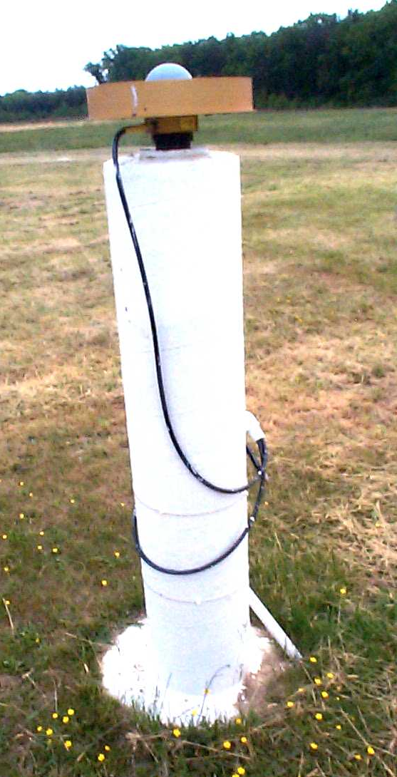
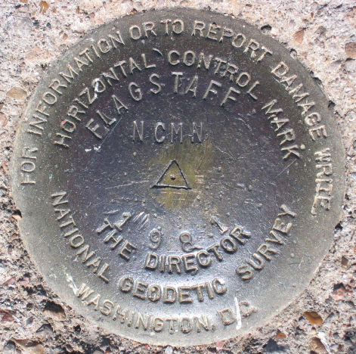
Introducing… NAD 83(2011) epoch 2010.00
Multi-Year CORS Solution (MYCS)
  Reprocessed all CORS GPS data Jan 1994-Apr 2011
  2264 CORS & global stations
  NAD 83 computed by transformation from ITRF08(IGS08)
National Adjustment of 2011 (NA2011)
  New adjustment of GNSS passive control
  GNSS vectors tied (and constrained) to CORS
  NAD 83(2011) epoch 2010.00
  Approximately 80,000 stations and
  more than 400,000 GNSS vectors
SAME Datum Realization for CORS and passive marks
This is NOT a new datum! (still NAD 83)
The name: NAD 83(2011) epoch 2010.00
  “2011” is datum tag → year adjustment complete
  “2010.00” is “epoch date” (January 1, 2010)
    Date associated with coordinates of control station
  Frame fixed to North American tectonic plate
    Includes CA, AK, Puerto Rico, US Virgin Islands

Slide 17
Why a Multi-Year CORS Solution?
Consistent coordinates and velocities from combined solution
  Previous a mix of station and velocity sources, few ties to global frame
  Previous vertical velocities of zero for most CORS
Aligned with most recent realization of global frame (IGS08)
  IGS08 epoch 2005.0 (previously ITRF00 at epoch 1997.0)
  NAD 83 epoch 2010.0 (previously NAD83 (CORS96) at epoch 2002.0)
Major processing algorithm, modeling, metadata improvements
  Conformance with current international conventions (IERS)
Absolute phase center antenna calibrations
  Both ground (receiving) and satellite (transmitting) antennas
  Previous (CORS96) used relative calibrations (significant change)
Highly accurate and consistent CORS coordinates and velocities determined using Best Available Methods
  Needed because CORS network is foundation of NSRS

Slide 18
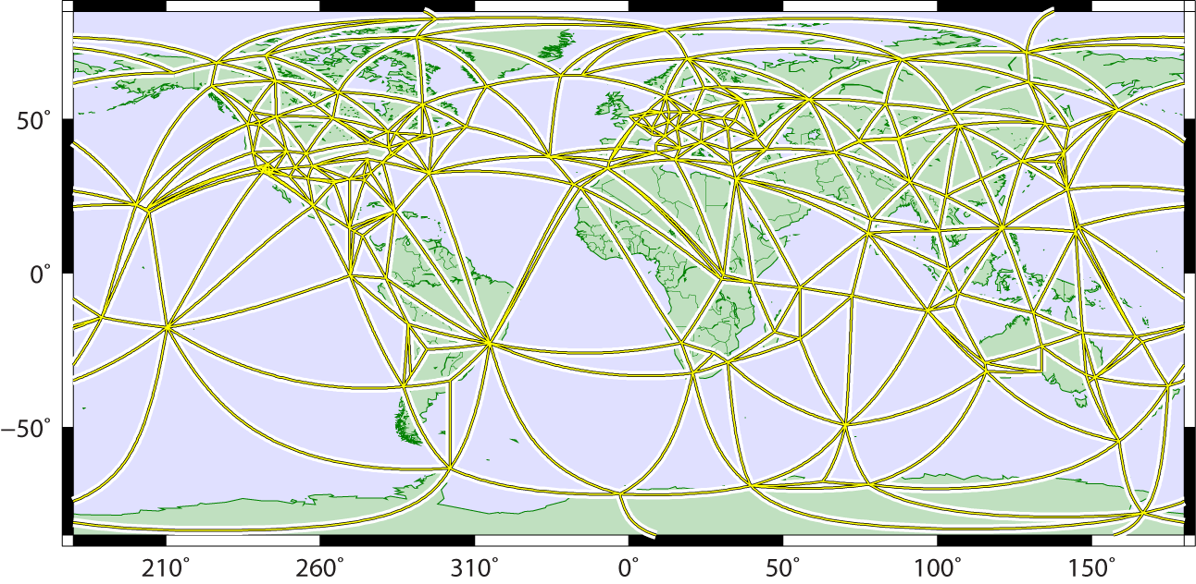
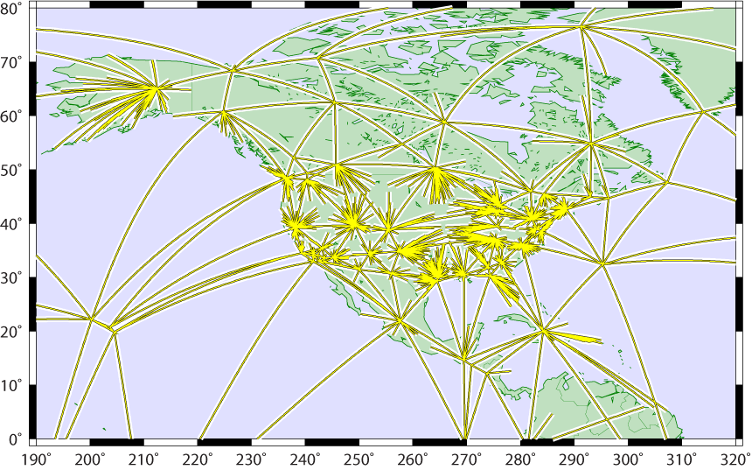
Maintaining Coordinate Accuracy - the Multi-Year CORS Solution
5 years in the making
global tracking network used for estimating:
  satellite orbits (15-min intervals)
  terrestrial framework
    Earth Orientation (EOPs)
    global station positions (weekly averages)
Global
U.S. CORS tied to global framework via single baselines radiating from global stations
  minimizes frame distortions from local effects in dense regional networks
1994-2010.5 tracking history
90 billion double-difference eqs.
switch to absolute antenna cals.
Global+CORS

Slide 19
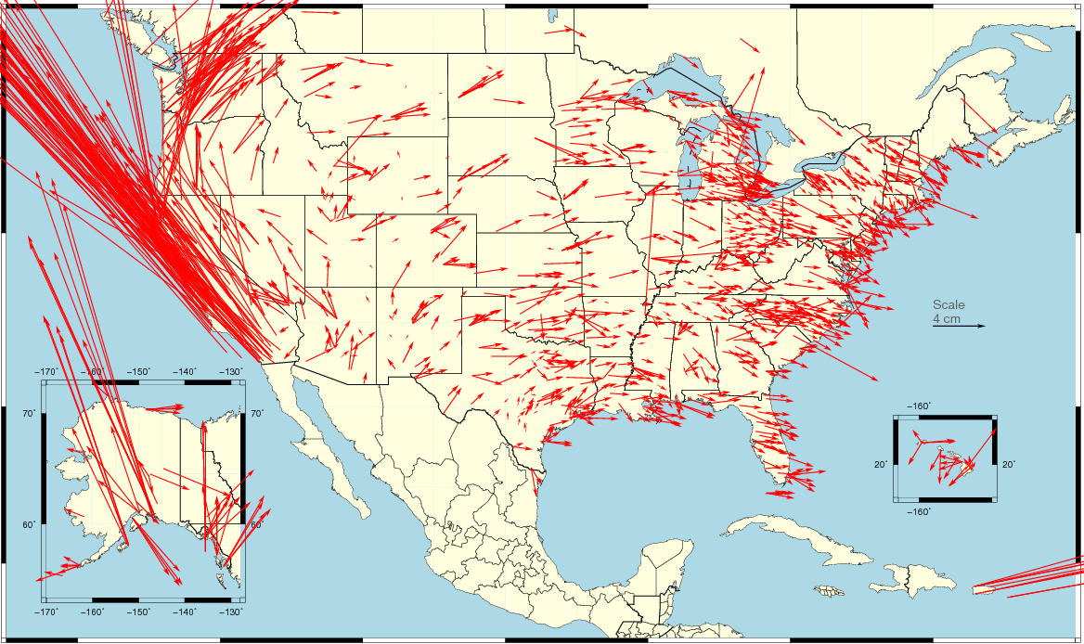
Changes in Horizontal NAD 83 Positions
NAD 83(2011) epoch 2010.0 – NAD 83(CORS96) epoch 2002.0
Avg. shifts: ΔE = 0.05cm ± 5.25cm ΔN = 2.12cm ±6.08cm
  combination of position and velocity differences
  due mostly to updated velocities (including up to 8 more years of data)
ID+MT+ND+SD+WY
1.7E / 0.5N cm
WA+OR
4.4E / 5N cm
East
1.4E / -0.2N cm
CA+NV
-10.8E / 14.4N cm
UT+CO+NM+AZ
0.5E /1.0N cm

Slide 20
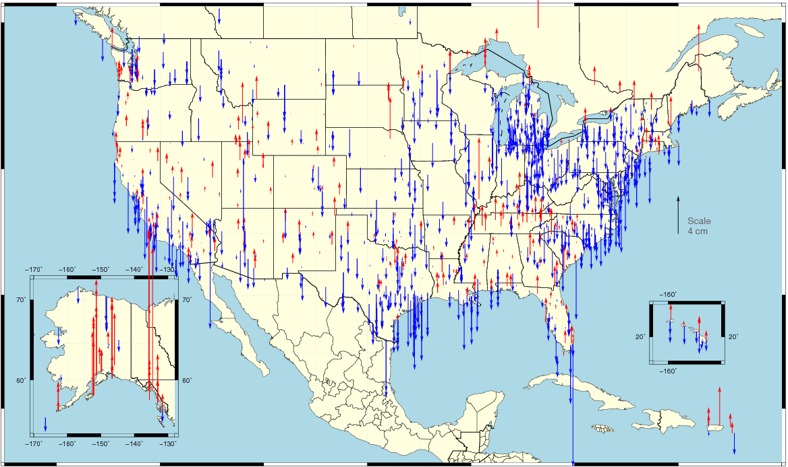
Changes in Vertical NAD 83 Positions
NAD 83(2011) epoch 2010.0 – NAD 83(CORS96) epoch 2002.0
Avg. shifts: ΔU = -0.66cm ±2.24cm
  combination of position and velocity differences from additional data, tectonics
  assuming vertical velocity ≈ 0.00 in NAD 83(CORS96)

Slide 21
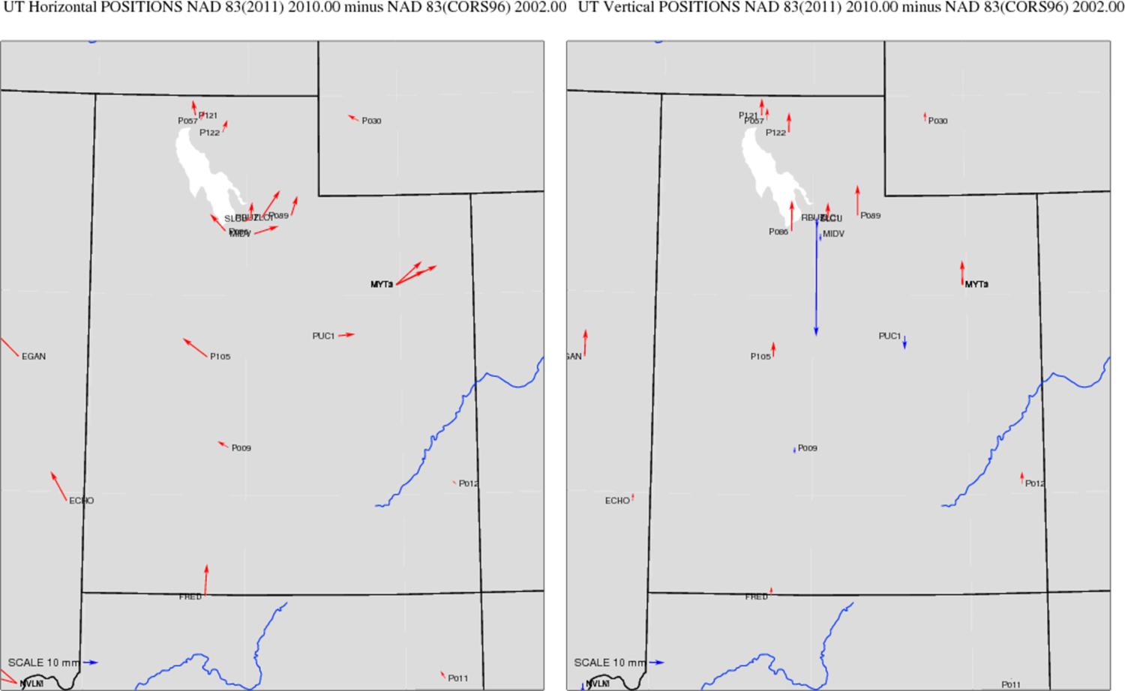
Changes in Horizontal & Vertical NAD 83 Positions - UTAH
NAD 83(2011) epoch 2010.0 – NAD 83(CORS96) epoch 2002.0

Slide 22
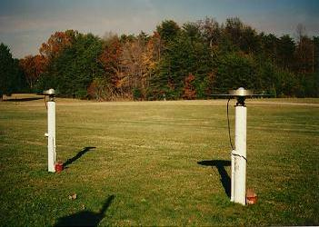
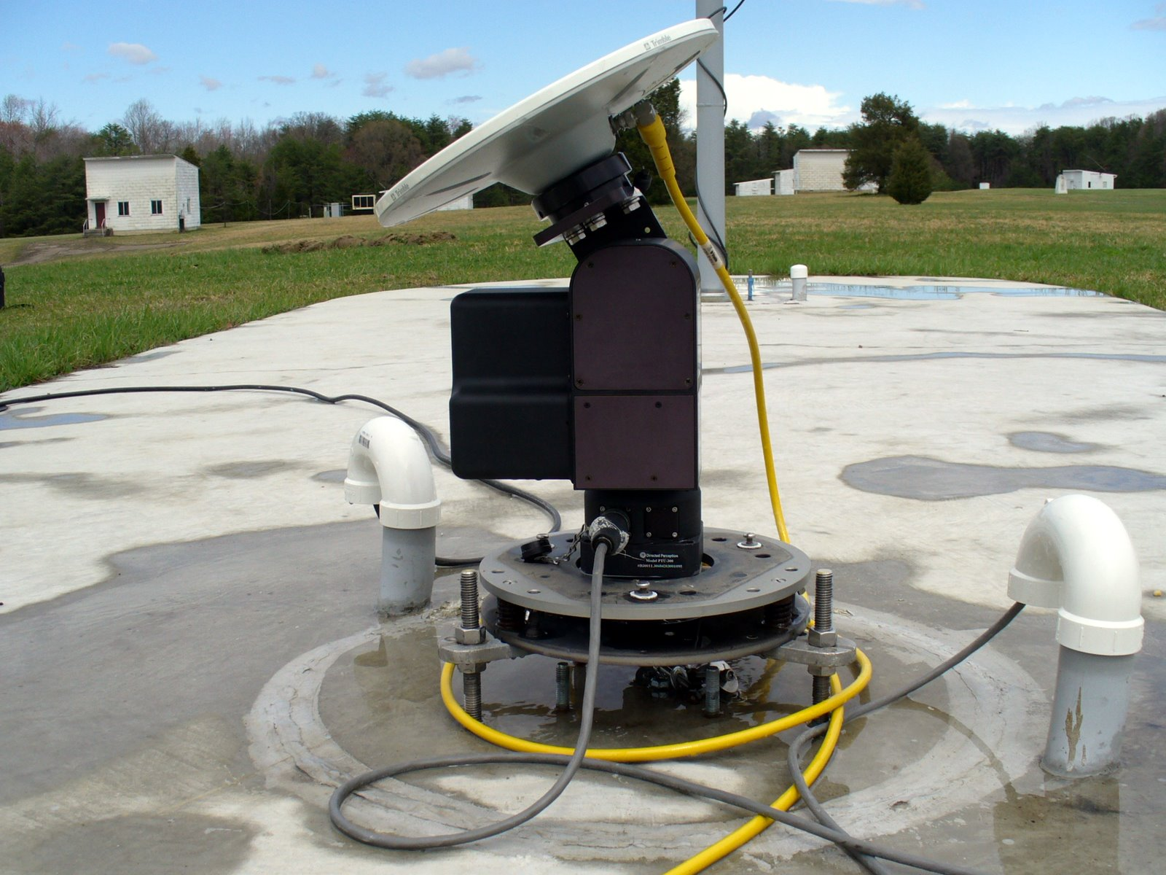
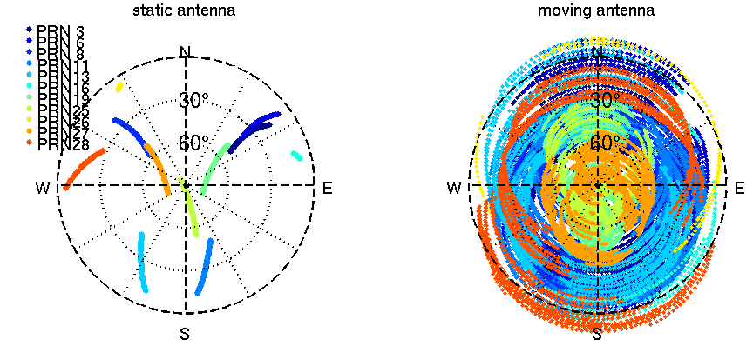
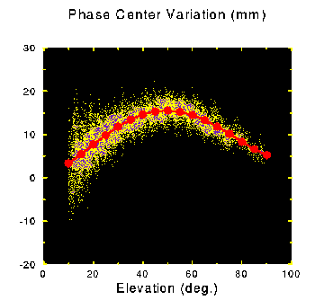
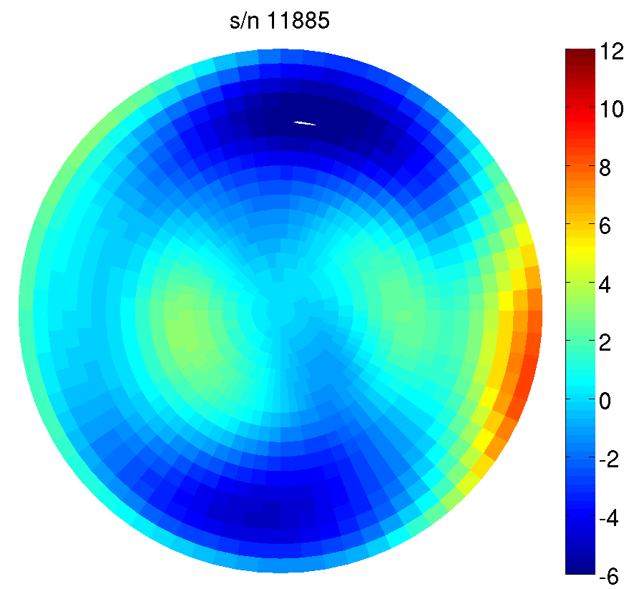
NGS Antenna Calibration –
Relative vs. Absolute GNSS Antenna Calibration
relative
absolute
2 hours
GPS tracking

Slide 23
What’s different about the CORS coordinates?
Change to absolute antenna calibrations
  Use absolute cal. in your processing: DON’T MIX!
Better because 8 more years of:
  International CGPS sites
  CORS data: about 1600 total, ~1000 w/ >2.5 yrs history
  Orbit determination sophistication
  CORS velocity data
Better Horizontal Time-Dependent Positioning (HTDP) software modeling for CORS w/ <2.5 yrs history
Better processing algorithms

Slide 24
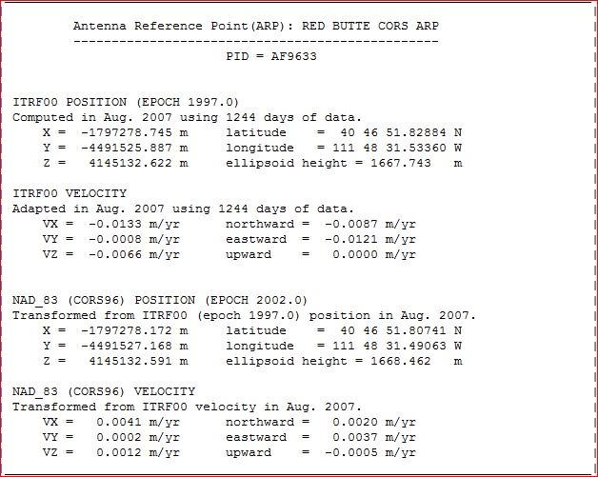
CORS Reference Frame Changes Due to MYCS –
available now
> IGS08 epoch 2005.0
IGS08 = International GNSS Service 2008
(GPS-only realization of ITRF2008)
> NAD83 (2011) epoch 2010.0
NAD83 (2011) = North American Datum 1983
(2011 Realization)

Slide 25
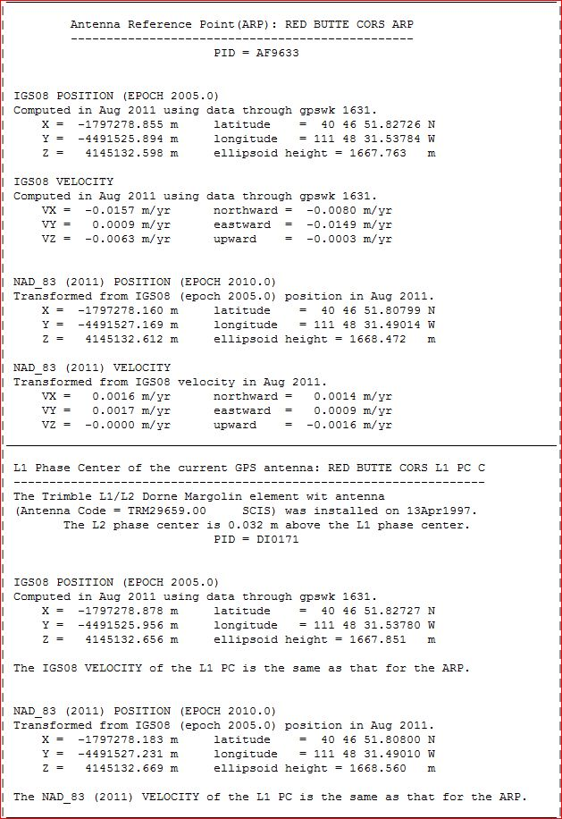
CORS Coordinates – New Reference Frames
IGS08 = International GNSS Service 2008
(GPS-only realization of ITRF2008)
NAD83 (2011) = North American Datum 1983
(2011 Realization)

Slide 26
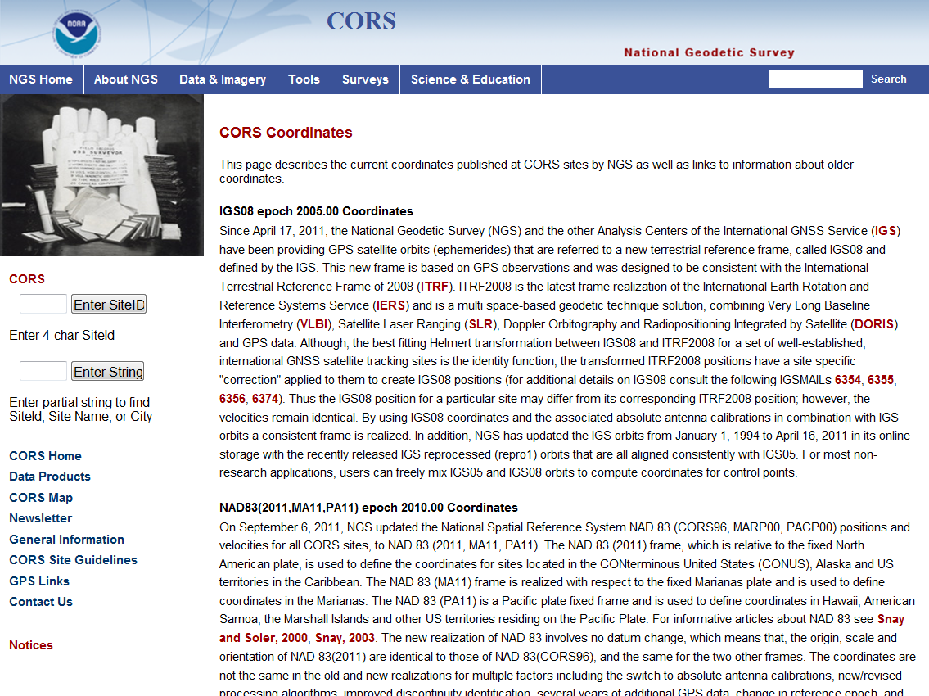
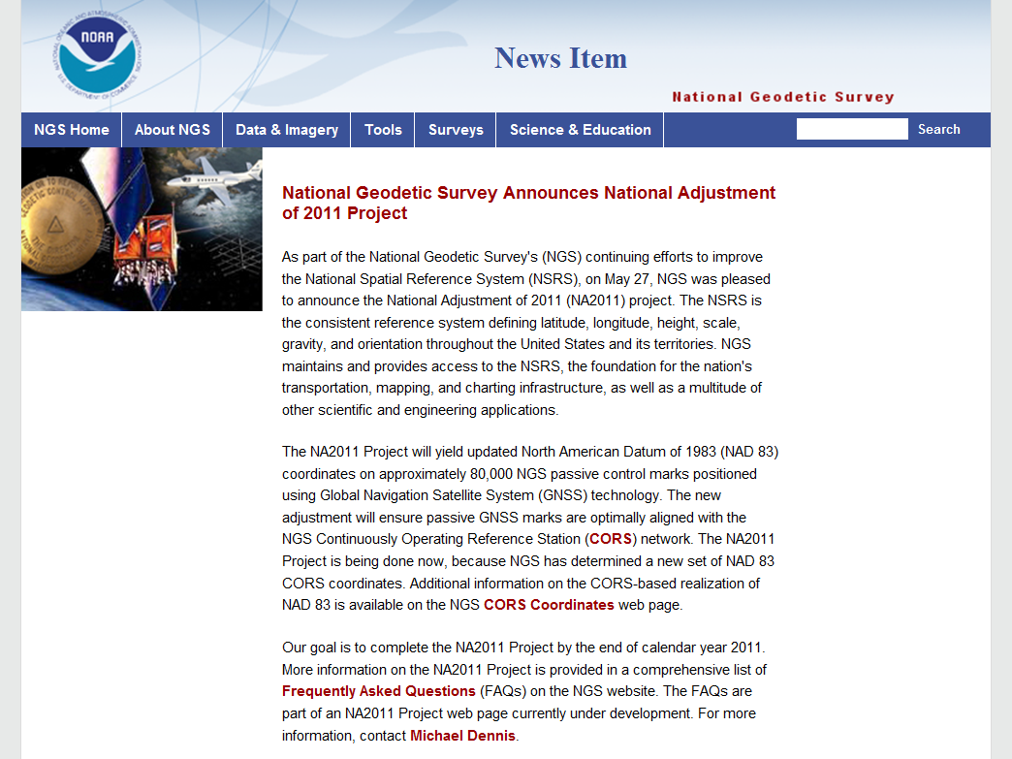

Slide 27
Why a new national adjustment of the passive network?
Optimally align passive control with new CORS
Add >1000 projects submitted since 2007 adjustment
  Also observations for Hawaii, other Pacific islands
Network and local accuracies on all stations
  Including future submitted projects
More consistent results in tectonically active areas
  More current data, better tectonic modeling
Better computations and analysis techniques
  e.g., improved outlier detection
  Incorporation of lessons learned from previous national adjustment

Slide 28
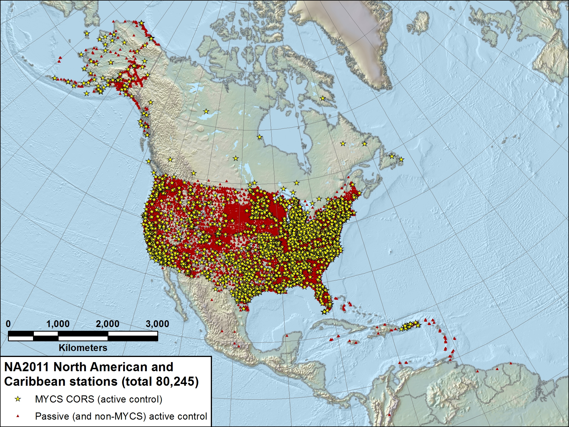

Slide 29
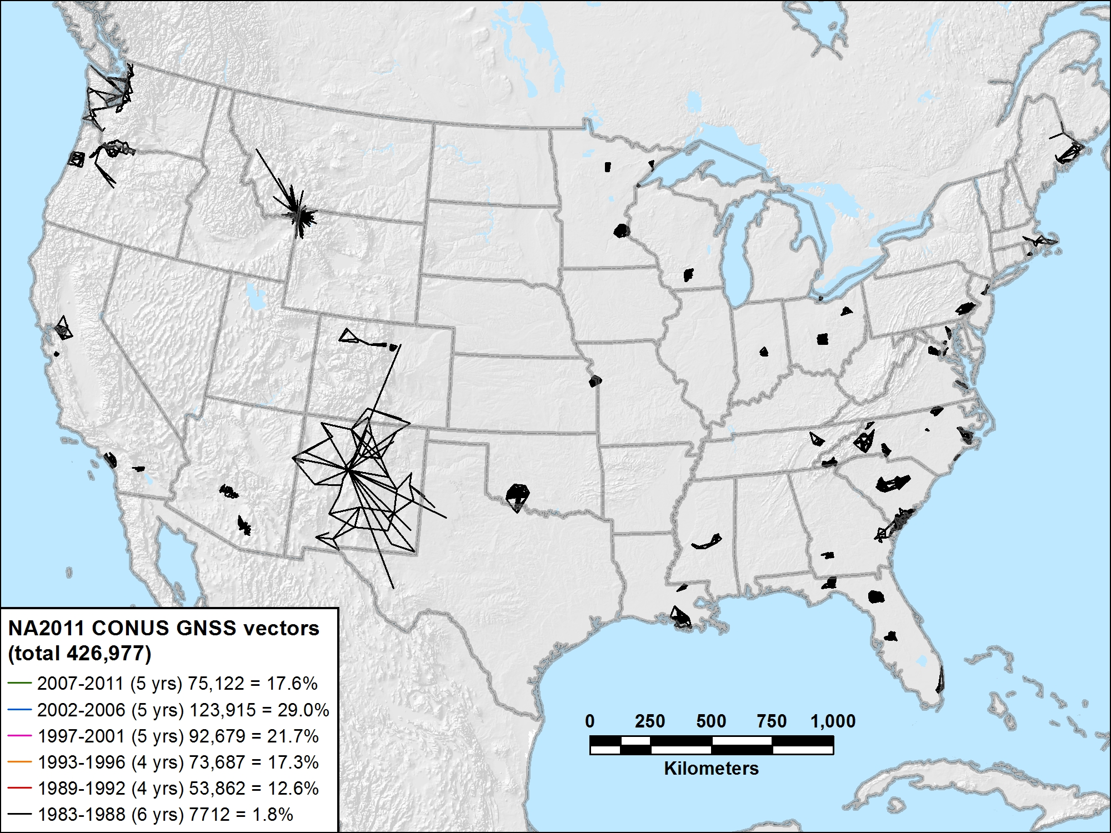
NA2011 CONUS 1983-1988 (6 yrs) 7712 vectors (1.8%)

Slide 30
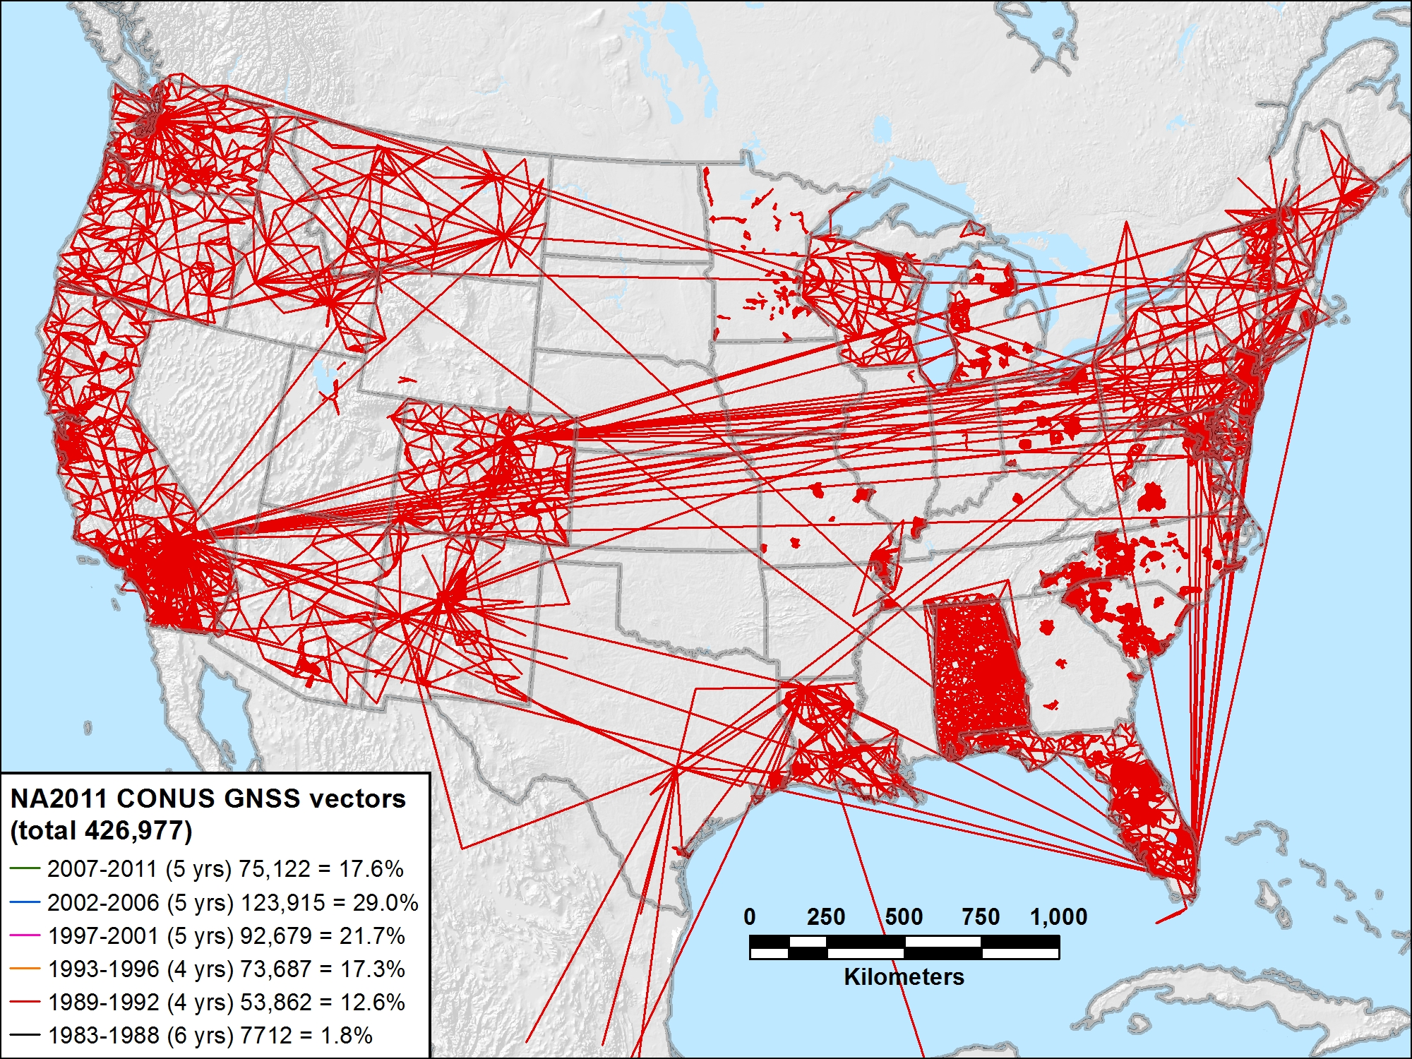
NA2011 CONUS 1989-1992 (4 yrs) 53,862 vectors (12.6%)

Slide 31
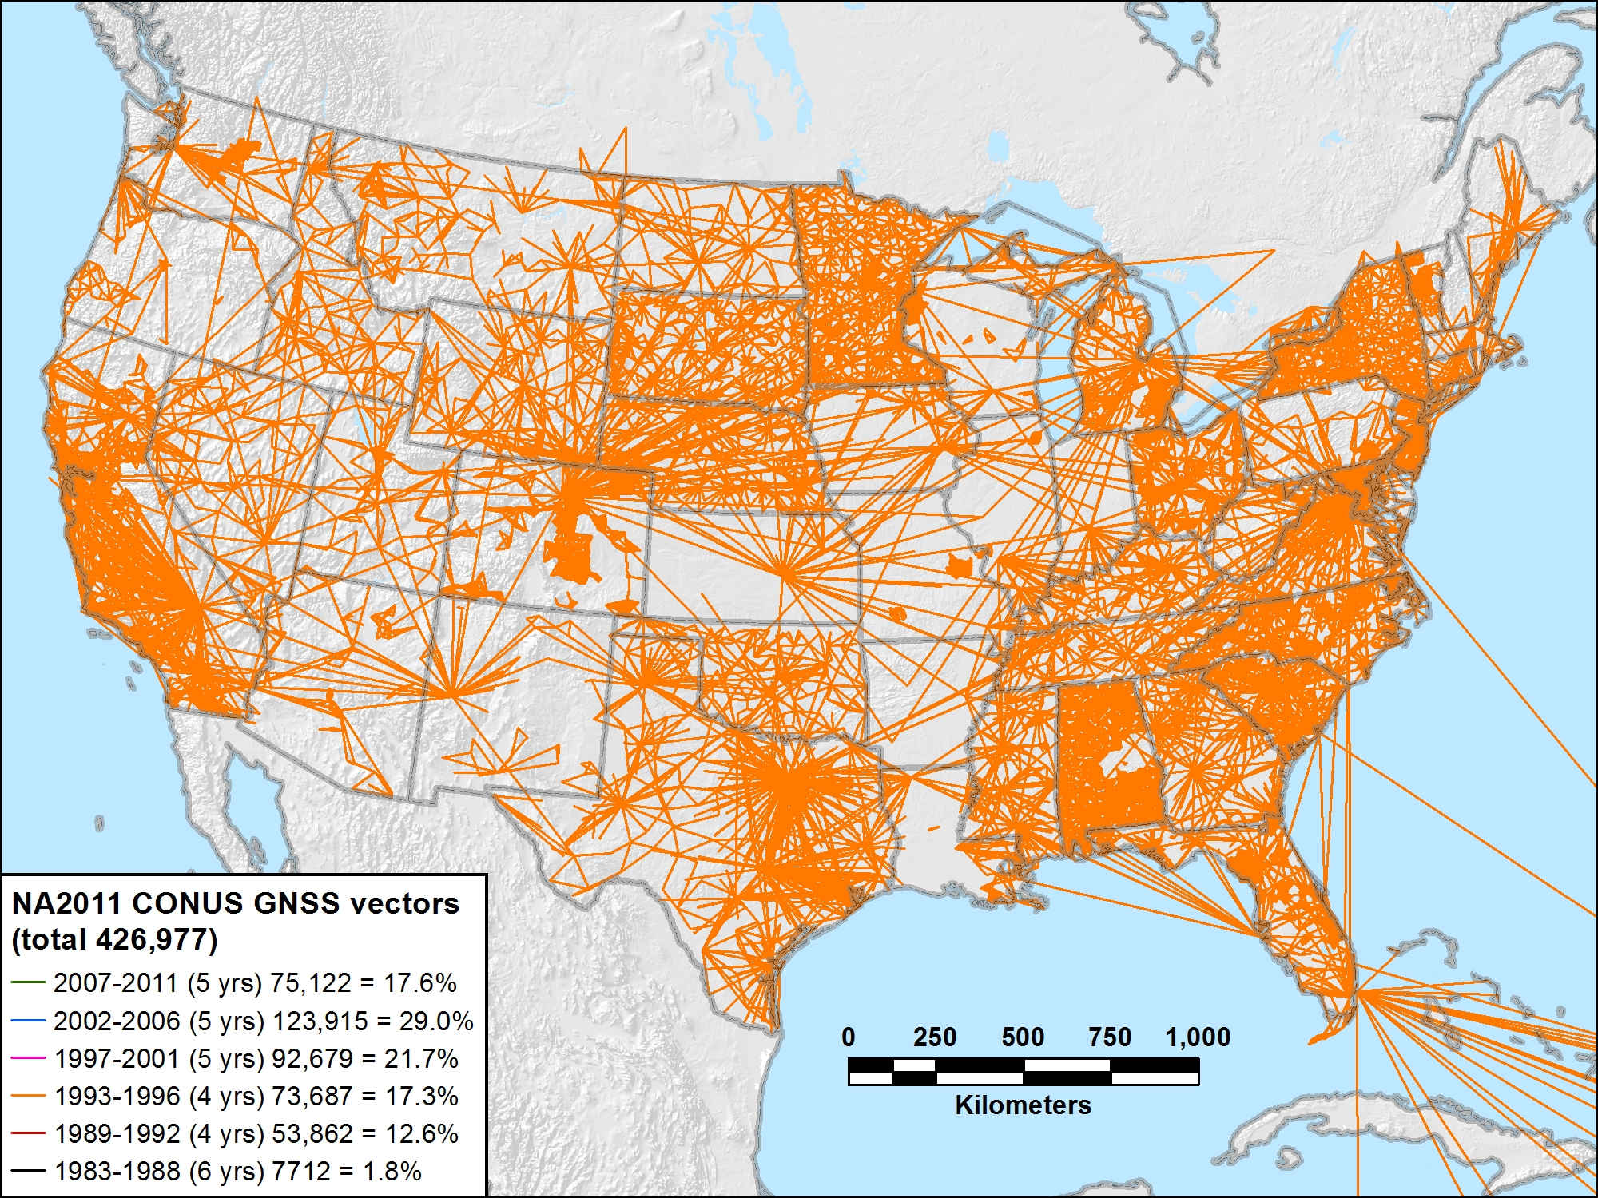
NA2011 CONUS 1993-1996 (4 yrs) 73,687 vectors (17.3%)

Slide 32
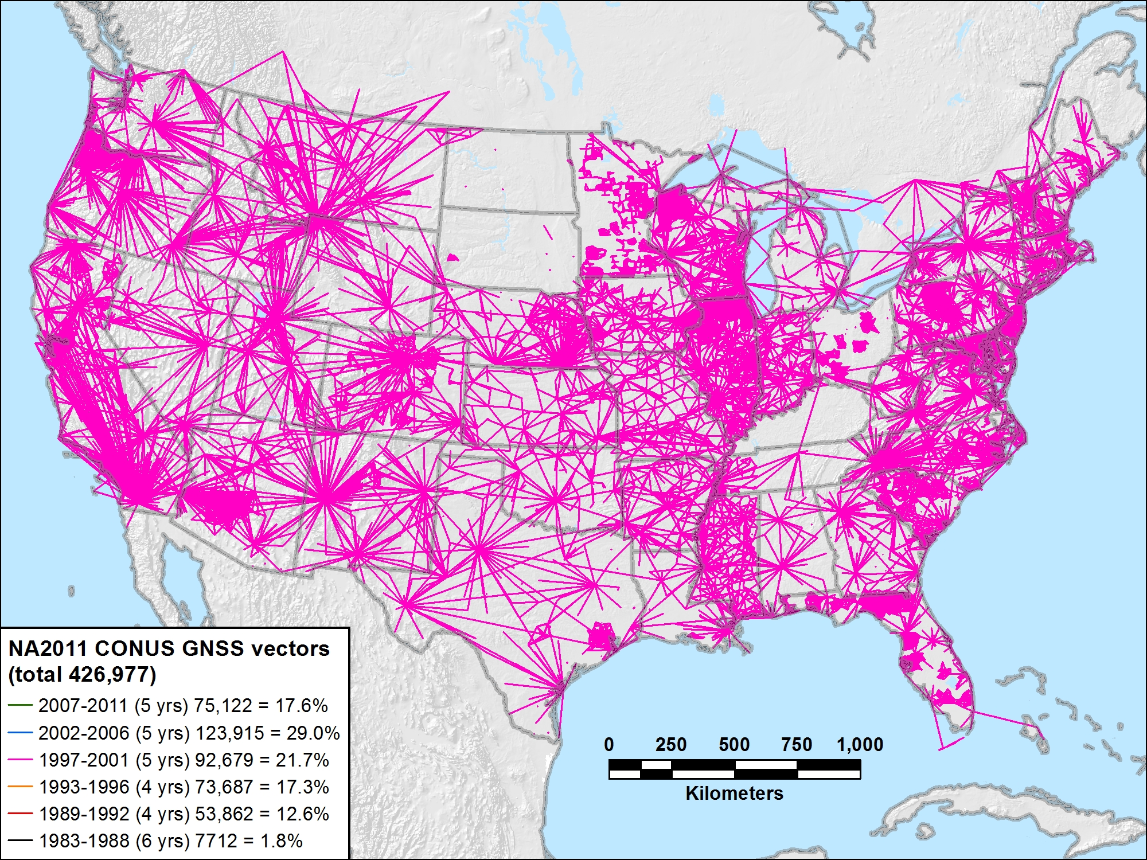
NA2011 CONUS 1997-2001 (5 yrs) 92,679 vectors (21.7%)

Slide 33
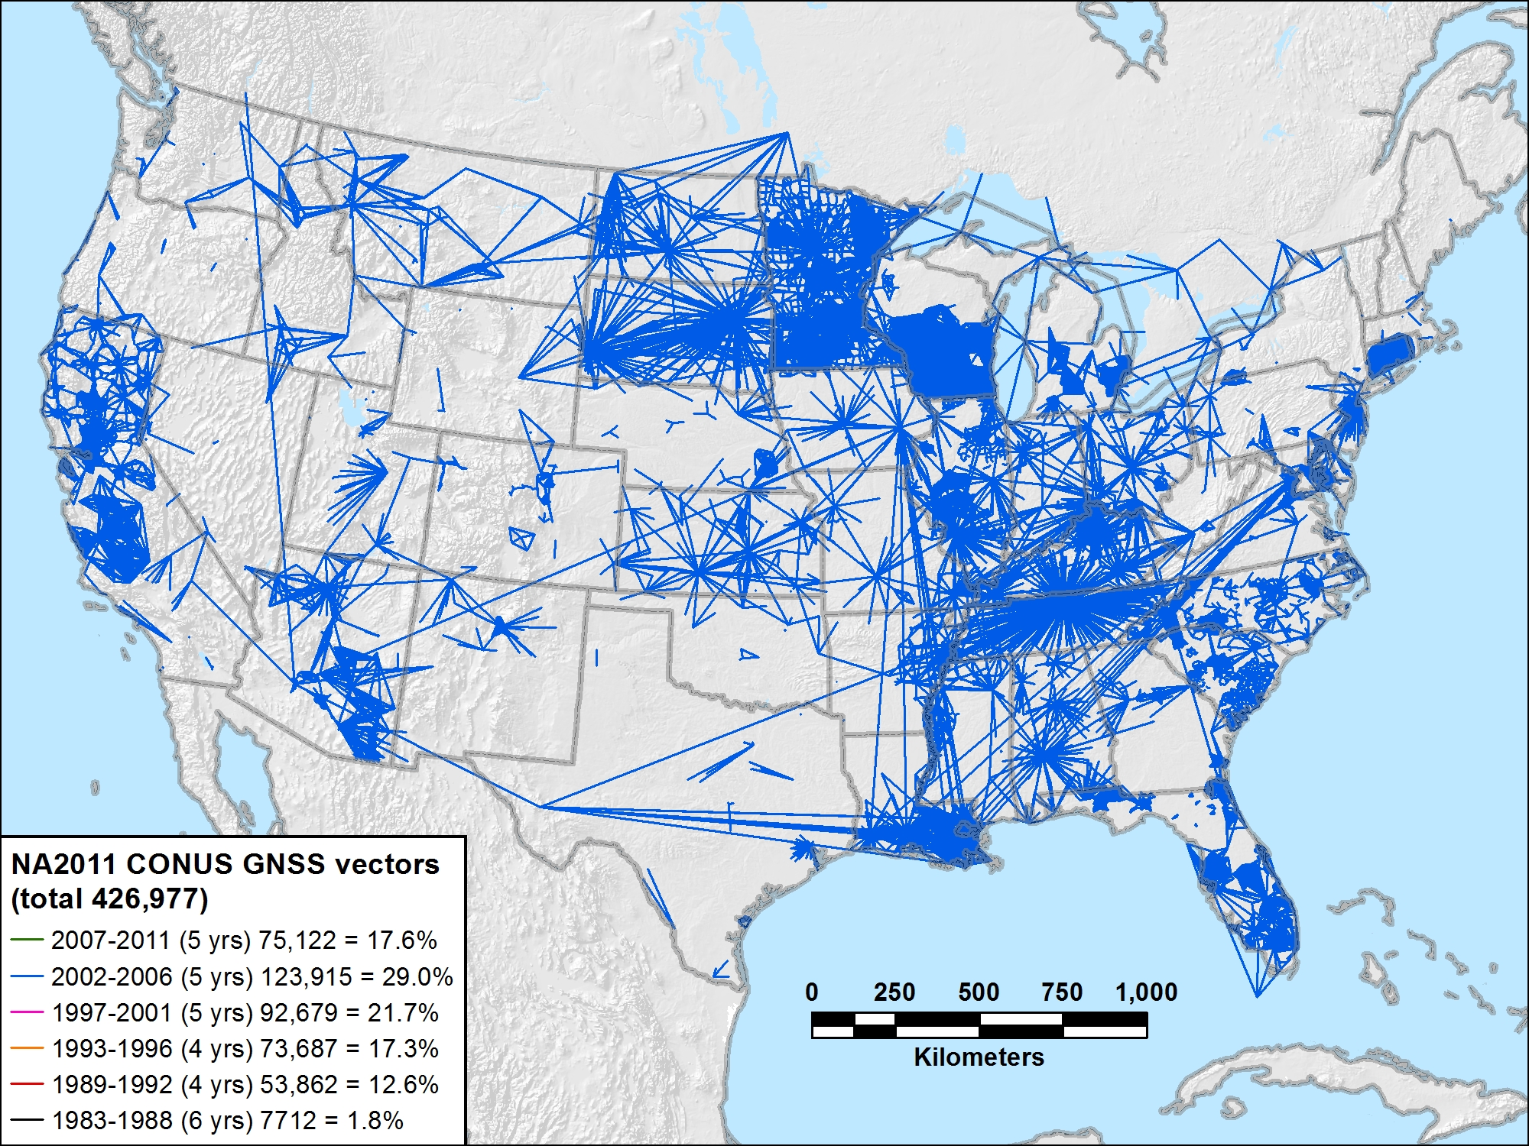
NA2011 CONUS 2002-2006 (5 yrs) 123,915 vectors (29.0%)

Slide 34
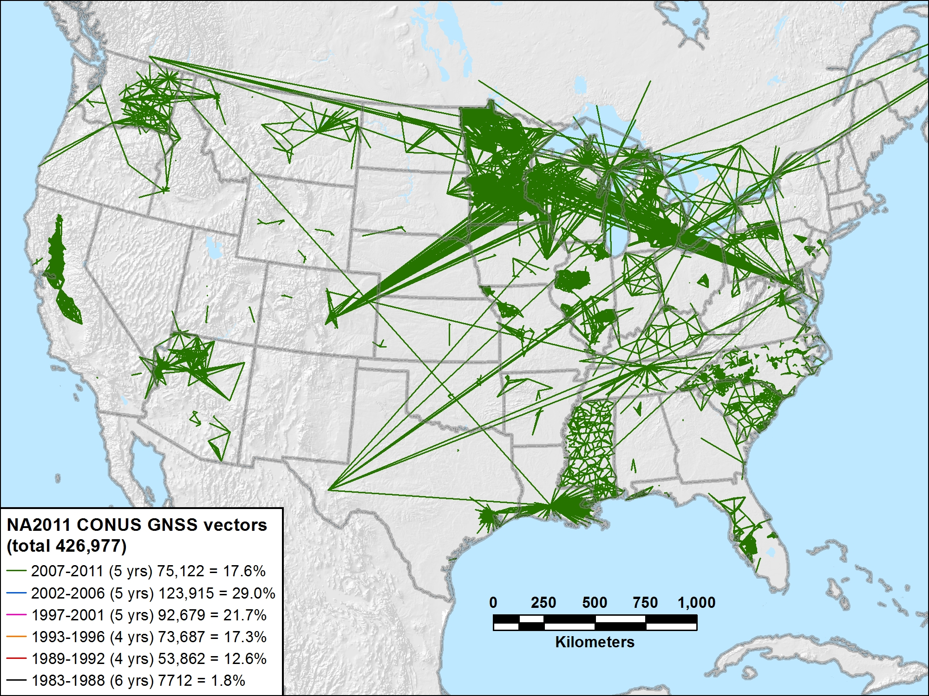
NA2011 CONUS 2007-2011 (5 yrs) 75,122 vectors (17.6%)

Slide 35
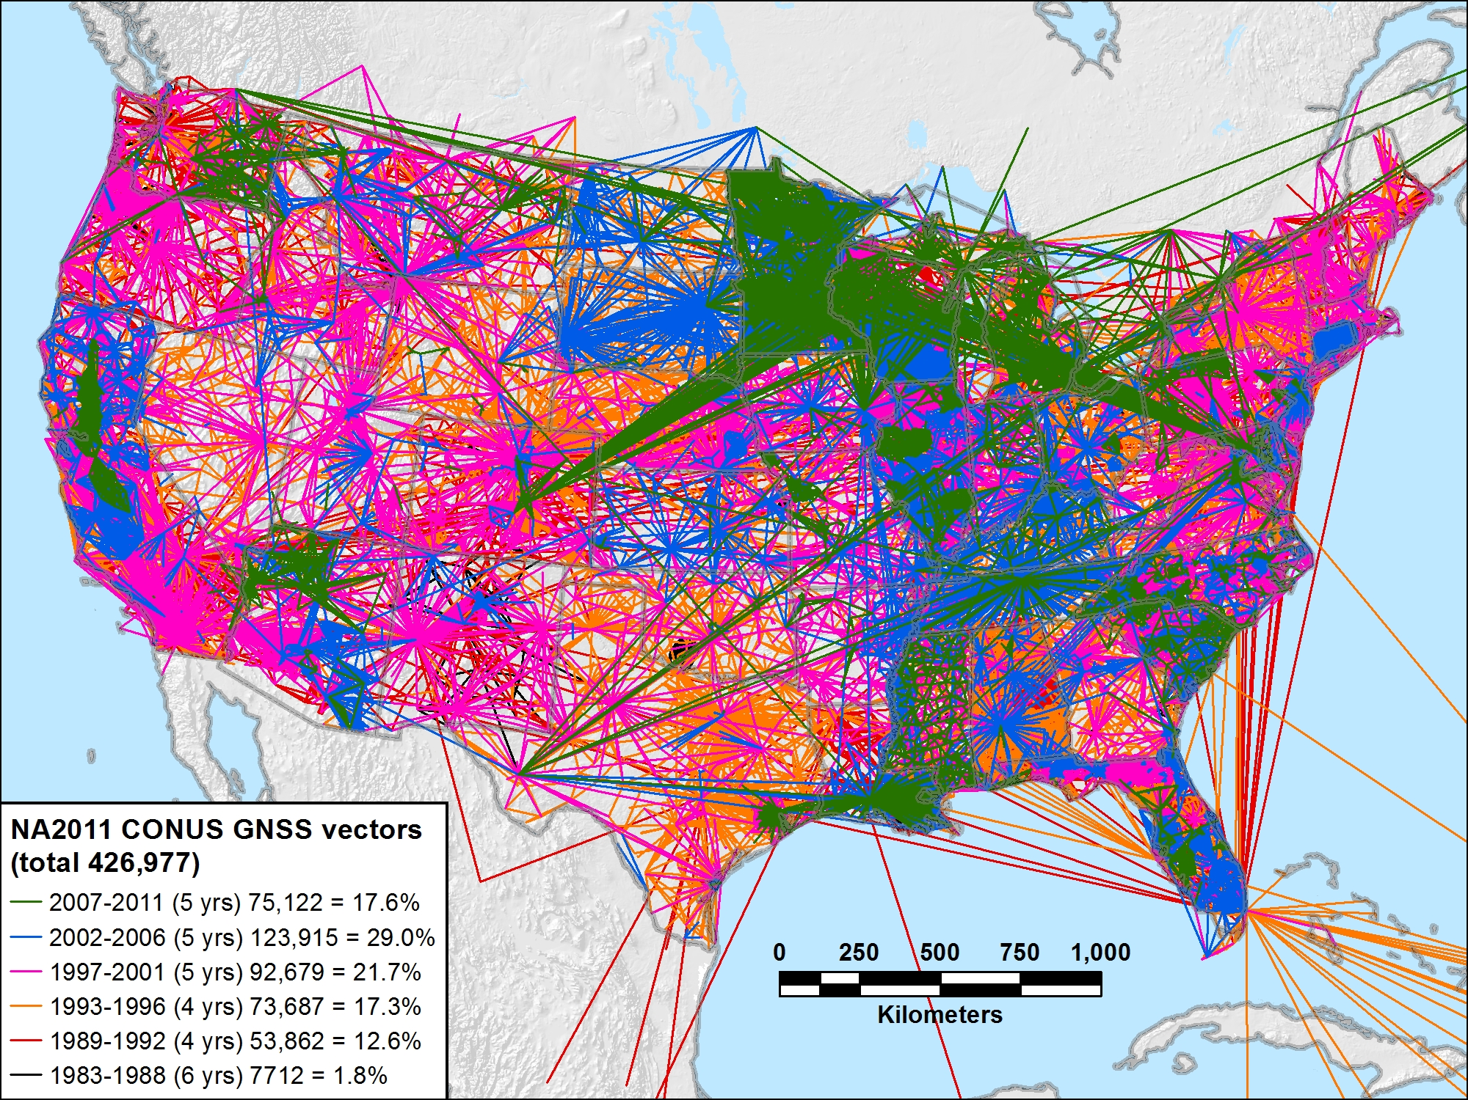
NA2011 CONUS 1983-2011 (29 yrs) 426,977 vectors (100.0%)

Slide 36
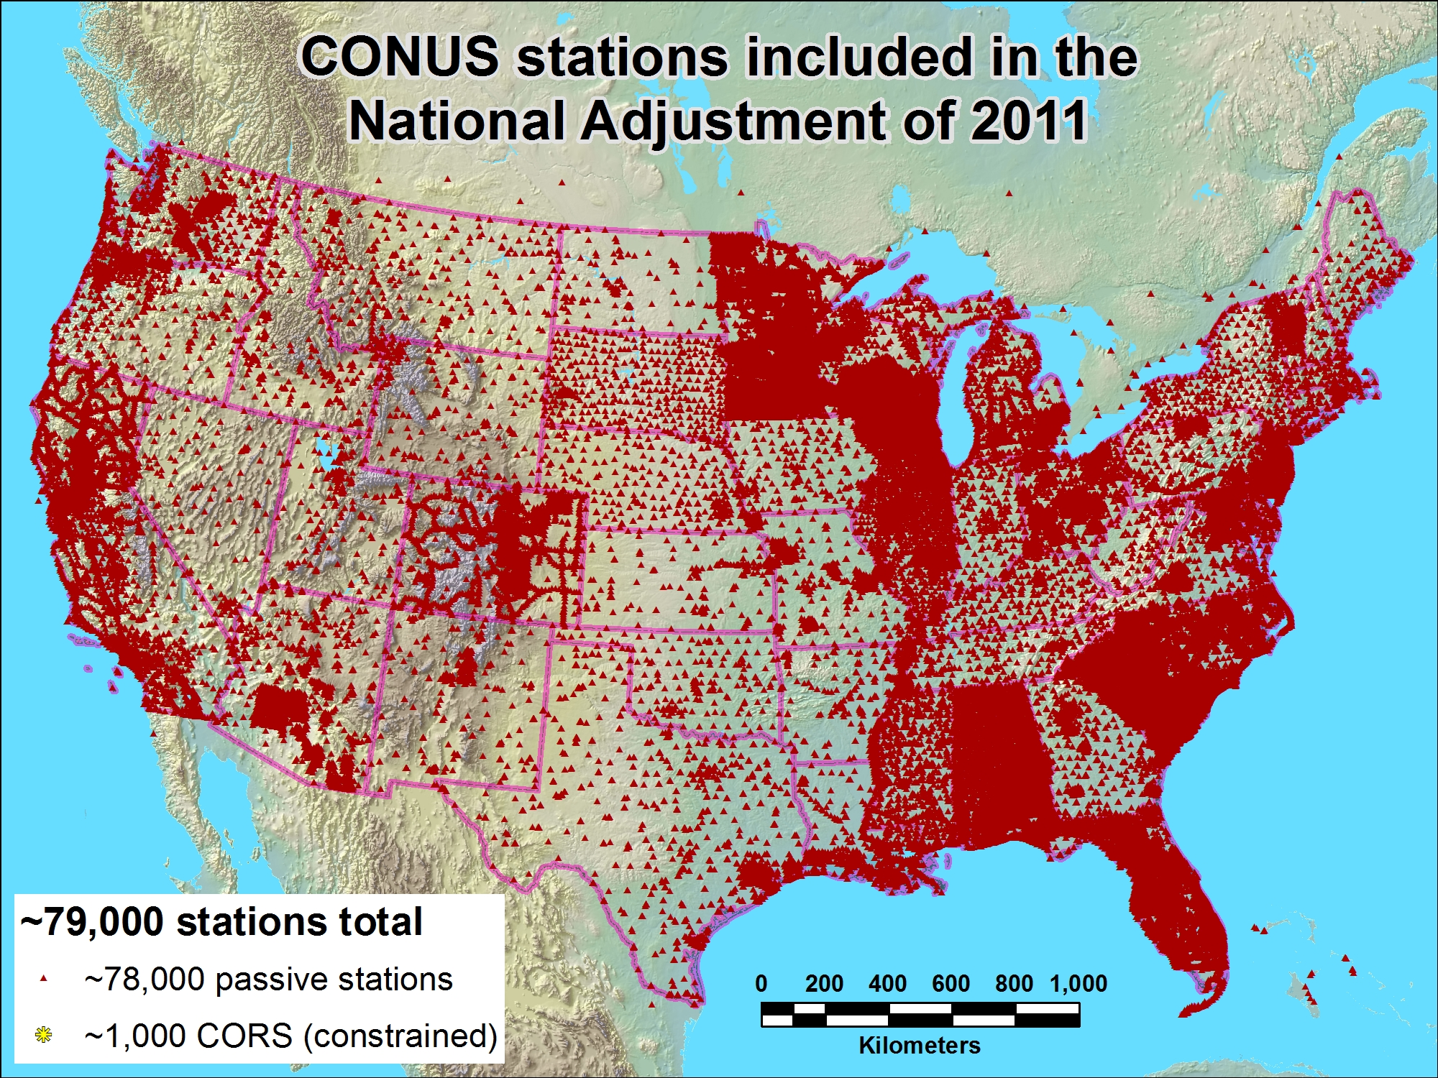
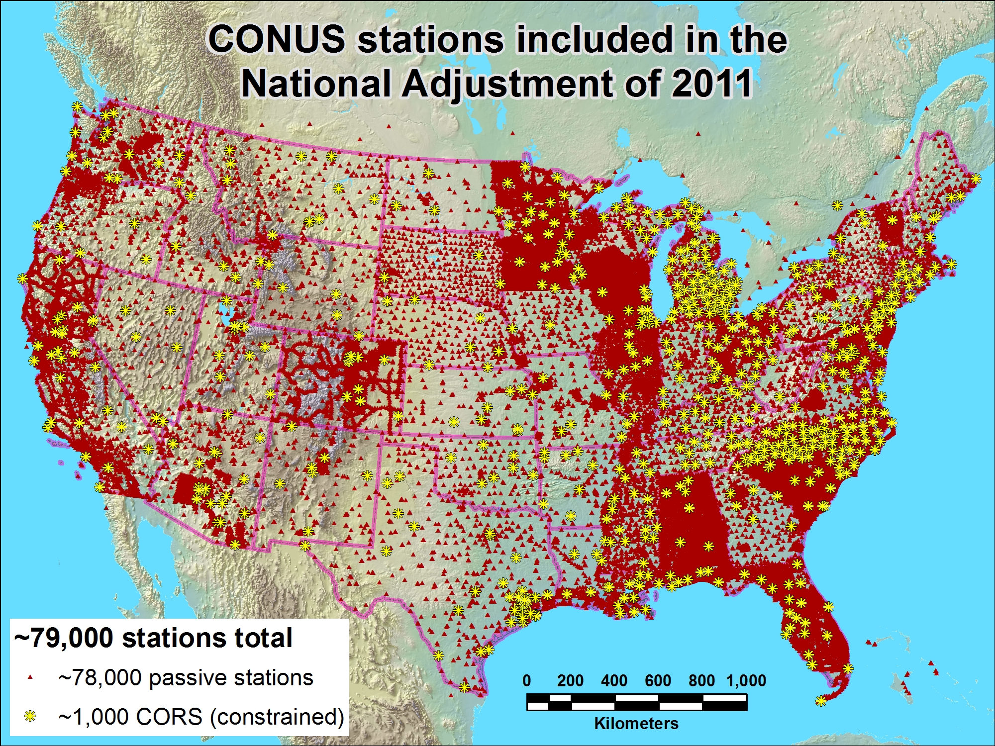

Slide 37
NA2011 Project Status
Expect overall coordinate change approx same as MYCS
  Horizontal: Mean ~2 cm (±8 cm), median ~0 cm
  Vertical: Mean ~ -1 cm (±2 cm), median ~ -1 cm
  This is for change in realization and reference epoch
    NAD 83(CORS96) epoch 2002.00 → NAD 83(2011) epoch 2010.00
New NAD 83 coordinate transformation tools
  NAD 83(HARN) ←→ (NAD83(2007)/CORS96) ←→ NAD83(2011)
  Both horizontal coordinates and ellipsoid heights
  Currently under study and development by NGS
    Prelim high res (1 arc-minute) grids completed for HARN / NSRS2007
    Includes error grid to give users estimate of accuracy

Slide 38
When will it all be done?
Multi-Year CORS Solution
  Officially released coordinates September 2011
  Will publish in NGS database simultaneously with NA2011
National Adjustment of 2011
  Goal: Complete in March 2012, publish early April 2012
  Final data added to NA2011 network mid-Dec 2011
OPUS (Online Positioning User Service)
  Dual solutions (CORS96 and MYC) are available until NA2011 complete
NAD 83(HARN)←→(NSRS2007/CORS96) coordinate transformation tool
  Expect completion soon
  Will create (NSRS2007/CORS96) ←→(2011) tool after NA2011 complete
New hybrid geoid model (GEOID12)
  Use NAD 83(2011) ellipsoid heights on leveled NAVD 88 benchmarks
  Plan release same time as NA2011

Slide 39
Near-future (possible) plans
Might perform national vertical adjustment
  Constrain vertically to NAVD 88 benchmarks
    Perform as simultaneous nationwide adjustment
  GNSS-derived orthometric heights
    NAD 83(2011) ellipsoid heights with GEOID12
    NOT a readjustment of NAVD 88 leveling

Slide 40

More information…
geodesy.noaa.gov

Slide 41

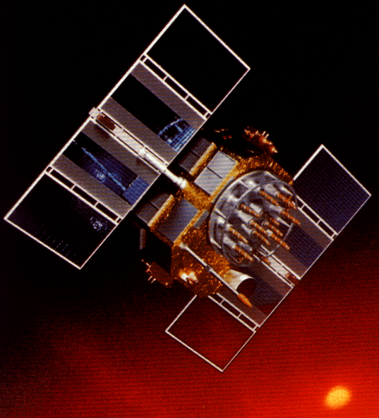
Questions?
National Adjustment of 2011 &
Multi-Year CORS Solution
…and some questions for you:
What accuracy meets your positioning needs?
How well aligned should passive control be with CORS?
Should a “threshold” position change value be used to determine when new coordinates are published?
How frequently should control coordinates be updated?

Slide 42
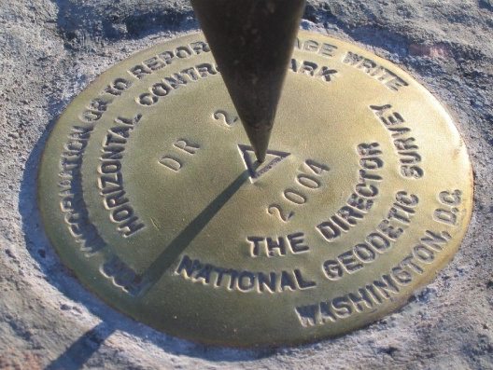
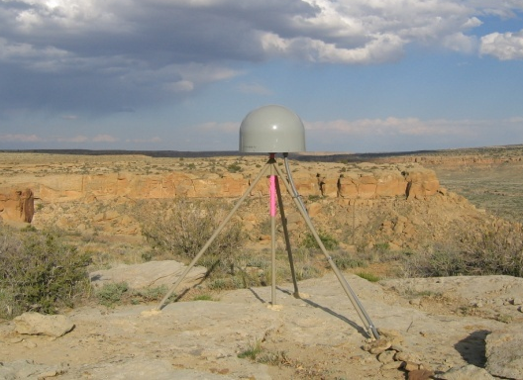
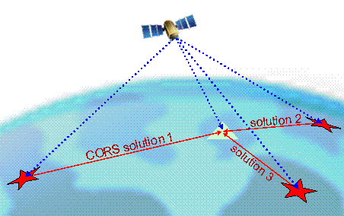
Online Positioning User Service (OPUS)
>15 min of L1/L2 GPS data >>> www.ngs.noaa.gov/OPUS
Processed automatically on NGS computers
Solution via email - in minutes
Fast, easy, consistent access to NSRS

Slide 43
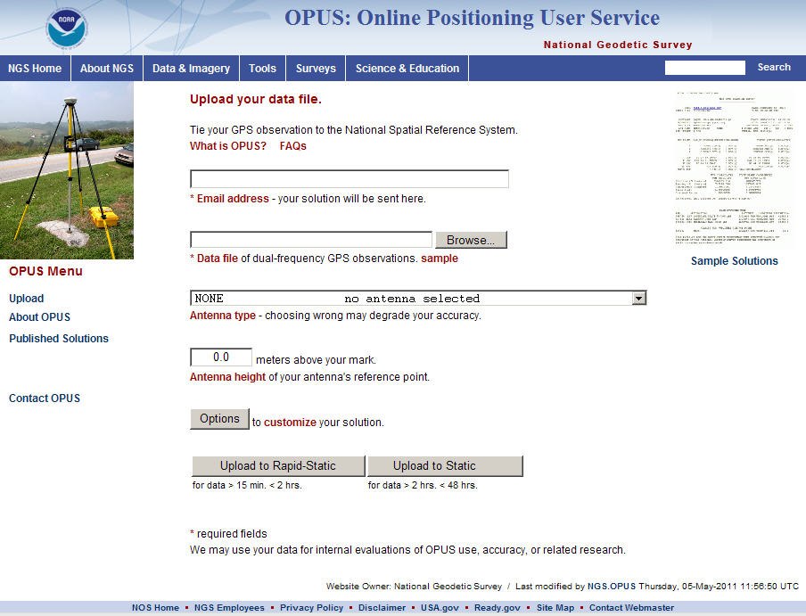
e-mail
GPS file
antenna
antenna height
(OPTIONS)
OPUS-RS or OPUS-Static
(15 min-2 hr) (2-48 hr)

Slide 44
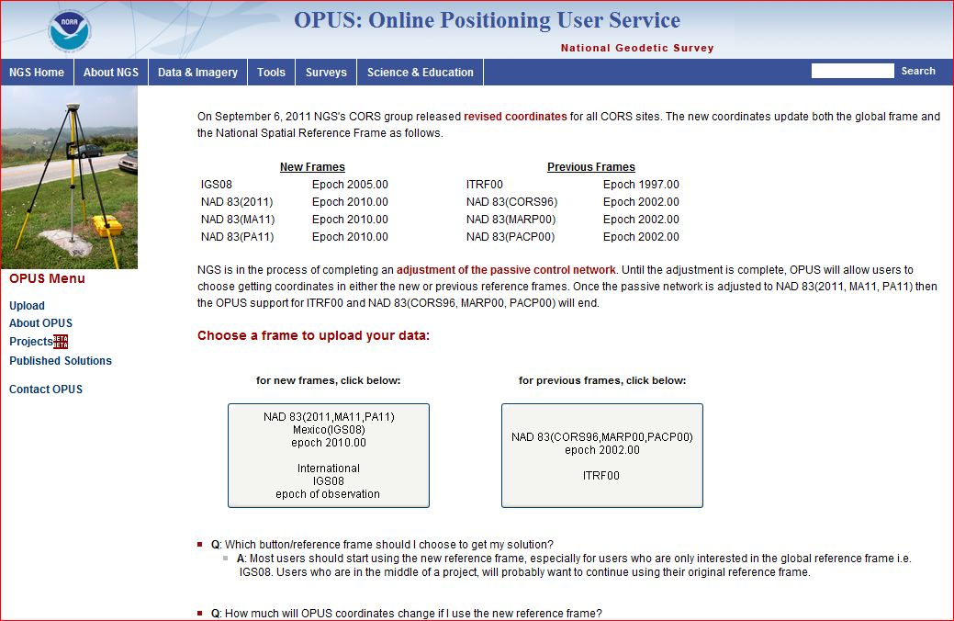
OPUS – choose your flavor
(reference frame)

Slide 45
How Does OPUS-RS Work?
OPUS-RS selects three to nine “best” CORS based upon:
    Having common satellite visibility with the user data.
    Having distances from the user’s site <250 km.
This is shown here graphically.
The star represents the user’s
site. The triangles are CORS.
No CORS farther than 250 km
from the user’s site will be
included.
The three CORS minimum is shown.
No more than nine are used.
s
>250km
250km
Choi, 2010, personal communication.

Slide 46
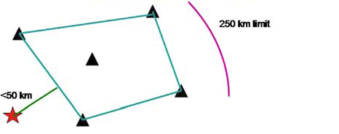
How Does OPUS-RS Work?
In addition, user’s site must be no more than 50 km from the (convex) polygon created by the selected CORS.
Again in this figure, the star represents the user’s site; the
triangles are CORS. Five CORS and their resulting polygon are shown in this example.
If the user’s site, the star, is
more than 50 km outside
this polygon, alternate
CORS will be considered.
If none can be found,
the processing will abort.
Schwarz et al., “Accuracy assessment of the National Geodetic Survey's OPUS-RS utility”, 2009, GPS Solutions, 13(2), 119-132.

Slide 47
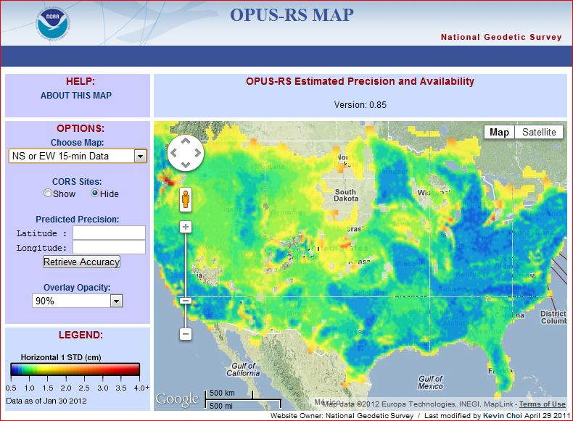

Slide 48
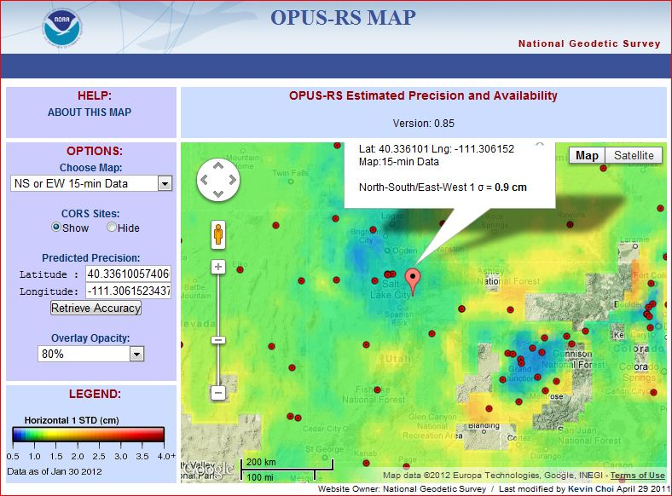

Slide 49


Slide 50


Slide 51


Slide 52

OPUS –
Datasheet Publishing
Publishing Criteria:
NGS-calibrated GPS antenna
> 4 hour data span
> 70% observations used
> 70% fixed ambiguities
< 0.04m H peak-to-peak
< 0.08m V peak-to-peak
Uses:
  GPS on BMs
  PLSS / GCDB
  Data archive
  Data sharing

Slide 53

OPUS-Published Stations

Slide 54

OPUS-Published Stations in Utah

Slide 55
OPUS – Projects

Slide 56



Process the session’s data.

Slide 57

And at the bottom are summary plots and tables for comparison of different solutions.
The orange parts of the plots indicate regions outside the thresholds set by the project manager.

Slide 58

INCLUSION OF IGS SITES
Distant IGS sites
  Provide accurate reference frame
  Transfer IGS(NSRS) reference frame to local area
  Improve troposphere determination and heights

Slide 59

59
Notes:
Mark 2123 page (top).
Note that this is the page the manager sees. Others will see a slightly different presentation.

Slide 60

OPUS-Projects WORKSHOP/TRAINING
Check here for upcoming OPUS-Projects Workshops

Slide 61

CORS: GPS Bibliography

Slide 62

CORS Monograph
CORS and OPUS for Engineers: Tools for Surveying and Mapping Applications
Edited by Tomás Soler and sponsored by ASCE and NGS
Publication is available on the ASCE website
Is useful to OPUS users working in many different types of GPS applications
Notes:
American Society of Civil Engineers
CORS and OPUS for Engineers describes new global positioning system (GPS) technologies and procedures that are immediately relevant to civil engineering professionals engaged in high-accuracy positioning. This collection of 22 articles, half new and half previously published in peer-reviewed journals, assembles the latest thinking on the use of two advanced services-CORS and OPUS-for obtaining accurate positional coordinates. Created and managed under the auspices of the National Geodetic Survey, the CORS (continuously operating reference stations) network contains more than 1,600 permanent, geodetic-quality receivers that collect GPS data around the clock at locations distributed throughout the United States, its territories, and a few foreign countries. These data are then made freely available to the public via the Internet. OPUS (online positioning user service) is a free, automated, Web-based utility that provides its users with accurate and reliable positional coordinates in a timely fashion by processing each user's GPS data with corresponding data from the CORS network. Together, CORS and OPUS form the backbone of today's high-accuracy, three-dimensional positioning activities.
Both theoretical and empirical, this collection is a must-have for practitioners and researchers involved in surveying, GIS, remote sensing, and mapping applications that utilize GPS technology.

Slide 63



see The American Surveyor vol 8 (no. 5,6,7)

Slide 64


Slide 65

National Geodetic Survey Ten-Year Plan
Approved January, 2008
Refines mission, vision, & strategy for the future of NGS actions
Emphasis on outside capacity
  Modernize the Geometric (“Horizontal”) Datum
  Modernize the Geopotential (“Vertical”) Datum
  Migrate the Coastal Mapping Program >>> Integrated Ocean & Coastal Mapping
  Evolve Core Capabilities
  Increase Agency Visibility
Available at: geodesy.noaa.gov

Slide 66
Why New Datums?
NAD 83
  non-geocentric, i.e. inconsistent with GNSS positioning
  NAD 83 coordinates of the CORS network are inconsistent with passive marks
  Lack of velocities, i.e. NAD 83 does not report station motion for passive marks
NAVD 88
  cross-country build up of errors (“tilt” or “slope”) from geodetic leveling
  Passive marks inconveniently located and vulnerable to disturbance and destruction
  A 0.5 m bias in the NAVD 88 reference surface from the geoid surface best approximating global mean sea level
  Subsidence, uplift, freeze/thaw, and other crustal motions invalidate heights of passive marks, and can make it difficult to detect such motions.
  Passive marks without adequate geophysical models make it difficult to reliably detect sea level change
  Changes to Earth’s gravity field cause changes in orthometric heights, but NAVD 88 does not account for those changes (because it is based on a static gravity model)
  The gravity model and modeling techniques used to determine NAVD 88 are not consistent with those currently used for geoid modeling

Slide 67

New geometric datum minus NAD 83 (horizontal)

Slide 68

New geometric datum minus NAD 83
(ellipsoid height)

Slide 69
And now….. the rest of the story.
Orthometric Heights
(a.k.a. NAVD 88 elevations)
“By 2018, a new geopotential datum (for orthometric and dynamic heights) is defined and realized through the combination of GNSS technology and gravity field modeling.”
In other words, orthometric heights will NOT be based on leveling data and they too will change.
2022

Slide 70

GEOID09:
relates NAD83 (ellipsoid heights) to NAVD88 (orthometric heights)
GEOID09:
+/- 2.8cm @ 95%

Slide 71


Gravity for the Redefinition of the American Vertical Datum (GRAV-D)
Replace the Vertical Datum of the USA by 2022 (at today’s funding) with a gravimetric geoid accurate to 1 cm
Orthometric heights accessed via GNSS accurate to 2 cm
Three thrusts of project:
  Airborne gravity survey of entire country and its holdings
  Long-term monitoring of geoid change
  Partnership surveys
Working to launch a collaborative effort with the USGS for simultaneous magnetic measurement
Gravity and Heights are
inseparably connected
Notes:
GRAV-D is the NGS project designed to replace NAVD88 with a vertical datum based upon a gravimetric geoid accurate to 1 cm. Heights above this datum will be accessed via GNSS measurements. Three thrusts of project. Launch USGS collaboration for simultaneous mag measurement.

Slide 72

Problems with Gravity Holdings
Terrestrial gravity
20-100 km gravity gaps along coast
Field is not sampled uniformly
Data range in age and quality, some w/o metadata
Some surveys have systematic errors
Data gaps in littoral areas
Ship gravity
New Orleans

Slide 73


GRAV-D Status
In FY 11 airborne surveys were conducted in Alaska, California/Oregon, and the Great Lakes
15.60% of the country completed
Potential locations for flights in FY 12 include southern portions of Alaska, the Great Lakes, Texas
TX and AL data available, all Gulf of Mexico data to be released by Q3
Data and metadata at: http://www.ngs.noaa.gov/GRAV-D/data_products.shtml
Potential FY 2012
FY 2011
FY 2010
Pre-FY 2010
Data Released

Slide 74

GRAV-D Goals
2 cm accuracy orthometric heights -
  from GNSS (1 cm) + geoid model (1 cm)
fast, accurate, consistent orthometric heights -
everywhere in the USA

Slide 75


Slide 76
How to Plan for the Future
Move to newest realization, i.e. NAD 83(2011) epoch 2010.00
  NAD 83(HARN) <-> NAD 83(NSRS2007) &
  NAD 83(NSRS2007) <-> NAD 83(2011) tools under development
Obtain precise ellipsoid heights on NAVD 88 bench marks (OPUS-DB, contact NGS Geodetic Advisor)
  Improves hybrid geoid models and provides “hard points” in new vertical datum
Move off of NGVD 29 to NAVD 88
  Understand the accuracy of VERTCON in your area
Move away from passive marks to GNSS
  Especially move off of classical passive control
Require/provide complete metadata for all mapping contracts
  How did they get the positions/heights? Document it!!

Slide 77

Floodplain Mapping Pilot Project
Goals:
  Analyze how FEMA floodplain mapping will be affected by the release of the new datums
  Provide recommendations for FEMA, cooperating partners and NGS
Selected one stream with existing detailed study in coastal area
Two Part Method:
  Converted data to “proxy” datums
    ITRF 2005/GRS80 State Plane 3200 USGG2009
  Analyzed impacts to floodplain mapping
    Derived products (DEM creation from LiDAR)
    Watershed size difference
    Floodplain boundary and Base Flood Elevation change
    Bridge height sensitivity
Notes:
Release of new geometric and geopotential datums around 2022, big question: how will that affect users? Pilot project conducted to evaluate – hopefully first of many. Goal was to describe how floodplain mapping will be affected by release and recommendations for future research, planning
Floodplain mapping: focused on Elevation (LiDAR and NED) + Flood Data (hydrology, survey cross sections). Conducted in NC coastal area, detailed study available with automated mapping process and obstructions removed to reduce engineering judgment (~38 miles or 61 km)
Conducted in two main section: conversion of data and impacts to floodplain mapping
Part A: Coordinate Transformation
Original: NAD 83 HARN State Plane 3200 Geoid 99
Transformed: ITRF 2005/GRS80 State Plane 3200 USGG2009
Part B: Impacts on Floodplain Mapping
Derived products (DEM creation from LiDAR)
Difference in watershed size (hydrologic modeling)
Floodplain boundary and BFEs
Bridge height sensitivity (benchmark heights)
Mapping method: elevation surface from LiDAR combined with water surface from cross sections (base flood elevation height determined from engineer models at cross sections)

Slide 78

Pilot Project: Conclusions
Significant coordinates shift
Horizontal: 2.716 ft/0.828 m
Vertical: -0.947 ft/-0.289 m
Larger impact on higher accuracy elevation data
DEMs derived from LiDAR can be transformed directly for hydrology, may use same models
Minimal changes in the floodplain, will depend on the location, the mapping method, and engineering judgment
Existing models will need to be revised to use ground data collected in new datums
While this study provides the first look at the expected effects, additional studies are warranted prior to the 2022 modernization
The development of an implementation plan is extremely important for FEMA and other agencies
Important to have a clear message and communication to constituents
Full Report: http://www.ngs.noaa.gov/PUBS_LIB/Floodplain_Pilot_Project_Final.pdf
Notes:
Biggest challenges will be using old data with new data – need methods, procedures for transformation and clear guidance on how and when to perform
As technology improves and elevation data becomes more accurate, the new datums will have a greater impact
Previous NGS news stories, official release will take you to this link, which is the full pdf report

Slide 79

Geoid Slope Validation Survey
Austin
Observe geoid shape (slope) using multiple independent terrestrial survey methods
  GPS + Leveling
  Deflections of the Vertical
Compare observed slopes (from terrestrial surveys) to modeled slopes (from gravimetry or satellites)
  With / Without new GRAV-D airborne gravity
325 km
218 points
1.5 km apart
Rockport
Notes:
But will this method produce a sufficiently accurate geoid?
This summer, we conducted an experiment to determine the accuracy of our geoid. We selected a line that extended 325 km from downtown Austin, Texas (North end) to Rockport, Texas (South end). There were 218 official survey points along the line, with an average spacing of 1.5 km between them. We compared the slope of the geoid along the line determined with GPS + leveling with deflections of the vertical as measured by the ETH Zurich DIADEM zenith camera. We also compared the observed geoid slope with slopes calculated from various geoid models to evaluate the their quality. As for NGS models, we tested geoids that both included and didn’t include new GRAV-D airborne gravity.

Slide 80
Surveys Performed
GPS: 20 identical units, 10/day leapfrog, 40 hrs ea.
Leveling: 1st order, class II, digital barcode leveling
Gravity: FG-5 and A-10 anchors, 4 L/R in 2 teams
DoV: ETH Zurich DIADEM GPS & camera system
LIDAR: Riegl Q680i-D, 2 pt/m² spacing, 0.5 km width
Imagery: Applanix 439 RGB DualCam, 5000’ AGL
Other: RTN, short-session GPS, extra gravity marks around Austin, gravity gradients

Slide 81





GPS
LIDAR/
Imagery
DoV
Gravity
Leveling
Notes:
These are just a small sampling of the field crews in action. Not shown are the RTN, FG-5, short-session GPS, relative gravity and mark setting crews.

Slide 82
The “1 cm
geoid”
Notes:
This slide is a companion to the previous one, but the h-H errors have been removed, in an RMS sense, from the total h-H-N errors, leaving, ostensibly, gravimetric geoid errors only. As seen previously, the airborne geoid is the best performer, by far. In fact, as a general statement, it could be said that USGG2012x02, an airborne gravity data enhanced geoid model, is effectively at the 1 cm differential geoid undulation accuracy level across all distances, in the region of GSVS11.

Slide 83
Geoid Slope Survey Conclusions
Including airborne gravity data improves geoid slope accuracy at nearly all distances <325 km
The NGS geoid in the TX survey meets the 1 cm accuracy objective only if airborne data are included
  No other model achieved 1 cm accuracy
Gravimetric geoid models and GPS are a viable alternative to long-line leveling
Notes:
The Survey verified that the inclusion of the GRAV-D airborne survey improved the geoid slope accuracies at all distances measured by the survey.

Slide 84
Future Milestones of the NSRS
Multi-Year CORS Solution (MYCS) –
  Completed and available, but not yet fully implemented
National Adjustment (geometric) of passive control
  Underway, expected completion by April 2012
Hybrid Geoid Model (GEOID12) using new ellipsoid heights
  Underway, expected completion by April, 2012
Simultaneous release of MYCS, NAD 83(2011) epoch 2010.00, and GEOID12
National Adjustment (vertical) of GPS passive marks
  Under consideration
  This is not adjusting the leveling network
Adoption of new datums
  Vertical, requires completion of GRAV-D
  Geometric, could happen at any time but will be delayed until definition of new vertical datum is complete
  Crystal ball says completion in 2022 (Good luck to you all!)

Slide 85

Upcoming Event
2012 Geospatial Summit on Improvements
to the National Spatial Reference System
Sunday, July 22
& Tuesday, July 24, 2012
San Diego, California

Slide 86


LightSquared PNT Working Group Report
www.pnt.gov/interference/lightsquared/

Slide 87

geodesy.noaa.gov

Slide 88


NGS Real-time Guidelines: Single-base and Network

Slide 89


OPERATIONAL PROTOTYPE SCORS –
19 STATIONS STREAMING GNSS OBSERVABLES IN RTCM 3.0 FORMAT

Slide 90

HOW WILL NGS VALIDATE RTN NSRS COMPLIANCE?
NGS 2011 STRATEGIC PLAN / 1.7 & 1.8:
“Develop guidelines for both the administration and use of real-time GNSS networks and especially for ensuring that these networks are compatible with the NSRS.”
TOP DOWN: OPUS POSITIONS ON RTN REFERENCE STATIONS AT APPROPRIATE INTERVALS COULD PRODUCE GRAPHICS THAT WOULD SHOW BIASES AT A GLANCE.
NGS ON-LINE TOOL
RTN
2. USER UP: PHYSICAL MONUMENTATION, ESTABLISHED WITH BEST TECHNOLOGY, COULD BE USED AS FIDUCIAL STATIONS
TO HELP THE USER VERIFY THAT RTN ARE PRODUCING ACCURATE COORDINATES.

Slide 91


NGS Datasheet
Geodetic values
Accuracy estimates
Source information
Grid coordinates
Superseded control
Monumentation
Photographs
Description/Recovery

Slide 92

DSWORLD Software-
available at geodesy.noaa.gov
SEARCH STATIONS
State / County
State / Designation
Lat /Long / Radius
Project ID
Control Type
  (H, V, Order)
VIEW PUBLISHED OPUS
  SOLUTIONS
SUBMIT TO NGS
Photos
HandHeld GPS
Recovery Reports
GOOGLE EARTH DISPLAY

Slide 93


Slide 94


Slide 95
Datasheet Changes
(coming soon)
ellipsoid height
  moved to coordinate box
geoid model specified
  for GPS-derived ortho ht.
N/E network accuracies
  >> H accuracy
local accuracies included

Slide 96

Datasheet Format Changes
Move ell ht and epoch info into top box, add datum tags
Note when GPS Ortho Ht computed with previous geoid model, and provide that model ht
Better way to quantify accuracies

Slide 97
Announcing…
A New NGS Datasheet Format

Slide 98
Announcing…
A New NGS Datasheet Format

Slide 99
Announcing…
A New NGS Datasheet Format

Slide 100


NGS Geodetic Tool Kit &
Geodetic Software Download
datum/coordinate conversion
time-dependent positioning
datasheet utilities
geodetic utilities
geoid modeling
    gravity prediction
    network adjustment
    GPS project analysis
    project submission

Slide 101

Horizontal Time Dependent Positioning (HTDP) – new version

Slide 102




NGS Training Center

Slide 103


Slide 104


