Slide 1
Implementing Geometric and Geophysical Datums for the United States in 2022 (Paper 7610)
Daniel R. Roman, Ph.D.
Session TS02G – Datum Definition

Slide 2
Replacing NAD 83 in 2022

Slide 3
NAD 83 => Geometric Reference Frame
Primary access shifts from bench marks to GNSS/OPUS
Datum Offset w.r.t. IGS/IWGS84
Bench marks tied to new reference frame and secondary
Implementation in 2022
Notes:
NAD 83 geocenter based on calculations using old Transit system – resulted in 2.2 m offset from current best estimates.
WGS84 and IGS solutions have progressively iterated to closer solutions. NAD 83 remains fixed though (state legislatures).
Currently realized through bench mark (passive) control. Collected over decades and of varying quality.

Slide 4
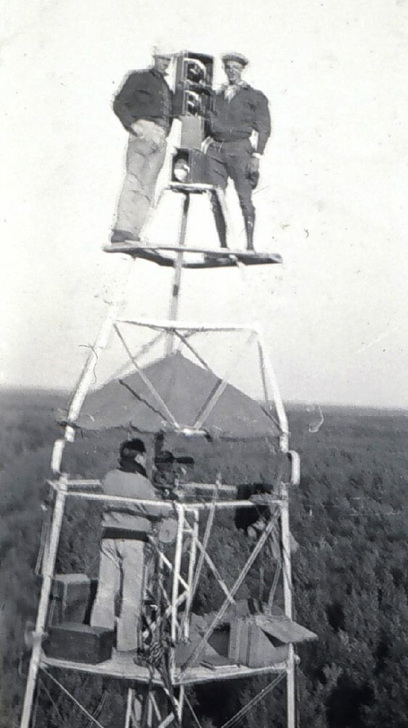
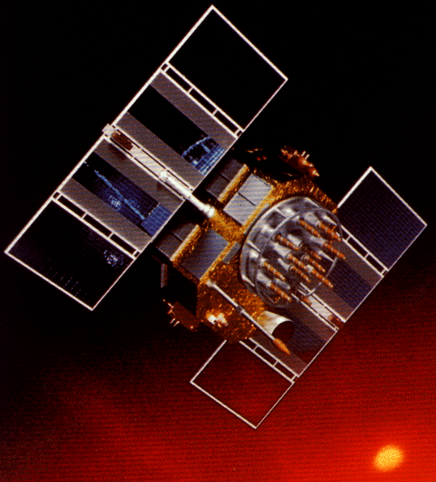
A brief history of NAD 83
Original realization completed in 1986
  Consisted (almost) entirely of classical (optical) observations
“High Precision Geodetic Network” (HPGN) and “High Accuracy Reference Network” (HARN) realizations
  Most done in 1990s, essentially state-by-state
  GNSS based, with classical obs. incl. in adjustments
  Did NOT use CORS as constraints
National Re-Adjustment of 2007
  NAD 83(CORS96) and (NSRS2007)
  Simultaneous nationwide adjustment (GNSS only)
New realization: NAD 83(2011) epoch 2010.00
Notes:
Remember, in large part, the existing datum NAD83 pre-dates the satellite geodesy era. The bulk of observations in the original NAD 83 were angles and distances measured with theodolites and iron bars, later electronic distance measurements. The last-minute addition of some early transit doppler measurements allowed us to look forward and anchor the frame not in Kansas, but at the (then measured) center of the earth.
The lack of doppler control over Russia and south Atlantic laid the foundation for the 2 meter offset in geocenter.

Slide 5
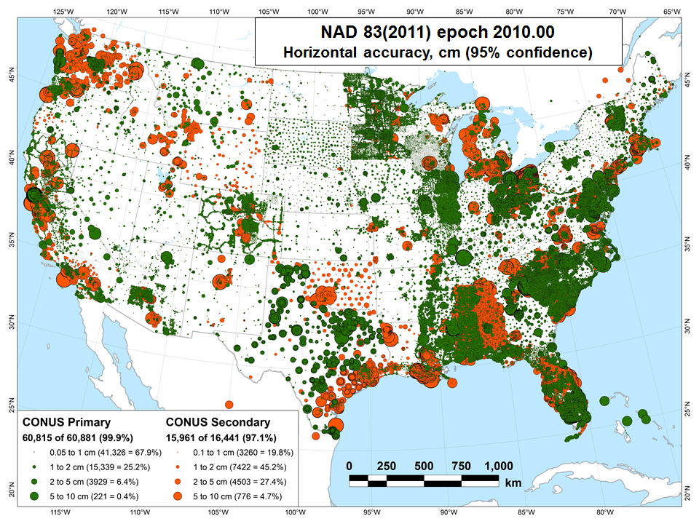

Slide 6
Simplified Concept of NAD 83 vs. ITRF2008
h₈₃
h₀₈
Earth’s
Surface
ITRF2008
Origin
2.2 meters
NAD 83
Origin
Notes:
ITRF (International Terrestrial Reference Frame) just has an origin; take NAD83 shaped ellipsoid centered at the ITRF origin to derive ITRF97 ellipsoid heights.
Ellipsoid heights NAD83 vs. ITRF97 - Defined origins are best estimate of the center of mass; NAD83 is not geocentric. Move origin; move ellipsoid surface as illustrated.
Ellipsoid height differences reflect the non-geocentricity of NAD83.

Slide 7
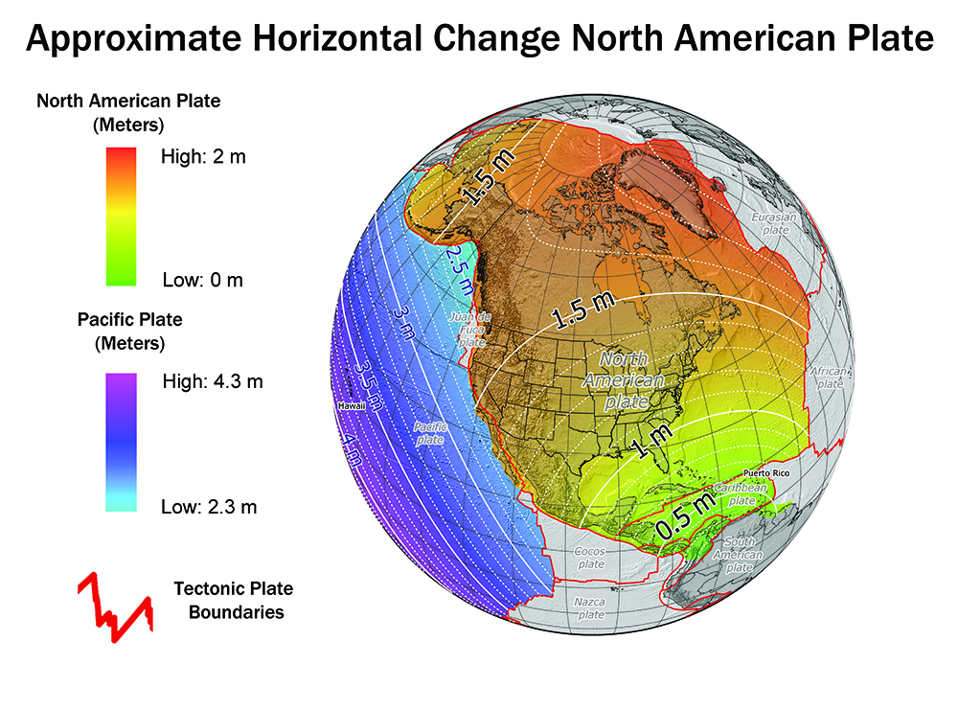
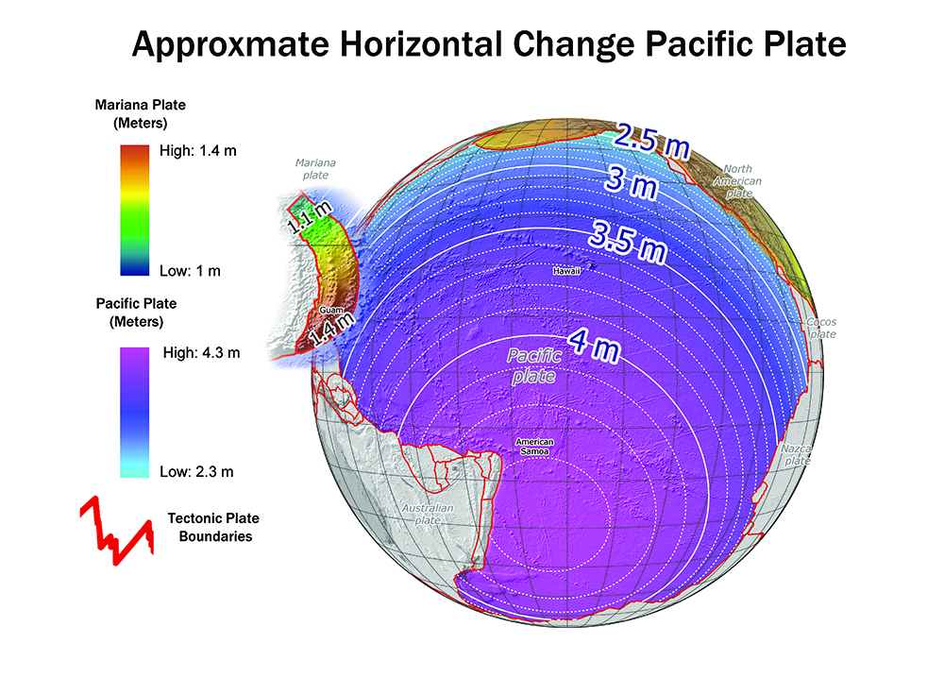
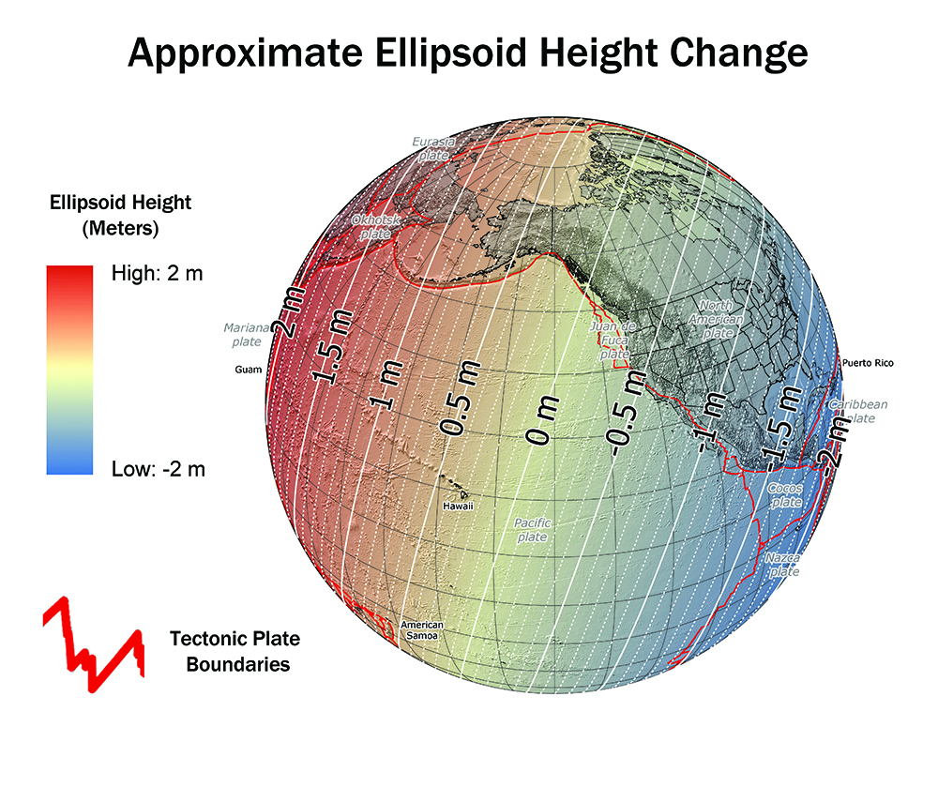
How will the new datums affect you?
The new geometric reference frame will change latitude, longitude,
and ellipsoid height in CONUS and AK between 1 and 2 meters.
Notes:
Picture: Map reflects the type of height improvements users could expect if NAVD 88 were replaced with a geoid-based vertical datum. (This is only a large scale approximation and should not be used as an absolute guide. Each benchmark might have its own level of mismatch, for example from uplift or subsidence, not captured by this broad brush. Also, this is the difference between the zero level of NAVD 88 and the actual geoid. The difference between NAD 83 ellipsoid heights and ITRF/GRS-80 ellipsoid heights has NO influence on this graph and should not be part of the story.)
The new datums will be accessed via GNSS technology versus benchmarks
New vertical datum to be released in 2022 will be based upon a gravimetric geoid
Airborne gravity data for the geopotential datum collected by the Gravity for the Redefinition of the American Vertical Datum (GRAV-D) Project will allow for blending of data from satellite, altimetric, and surface sources.
Estimated Differences Between “Old” and “New” Datums:
Geometric Datum
Horizontal: 0.8 to 1.5 m in CONUS
Ellipsoidal heights: -0.2 to -1.6 m CONUS; AK 0 to 1.3 m
Geopotential Datum
Approx. +0.1 m (Florida) to -1.3 m (Washington)
More than 2 meters of change in Alaska

Slide 8
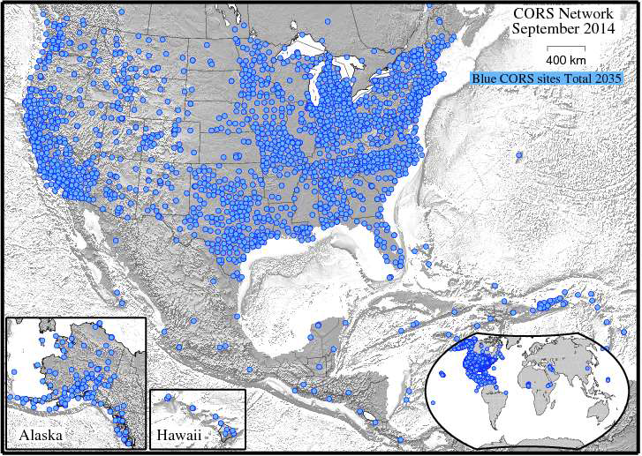
Notes:
CORS
NOAA’s National Geodetic Survey (NGS) manages a network of Continuously Operating Reference Stations (CORS) that provide Global Navigation Satellite System (GNSS) data to support three-dimensional positioning, meteorology, space weather, and geophysical applications throughout the United States, its territories, and a few foreign countries.
The CORS network is a multi-purpose cooperative endeavor involving over 200 government, academic, and private organizations.
As of June, 2014, there were over 1900 operational CORS in the NOAA CORS Network
CORS enables users to determine (with the proper tools and equipment) centimeter-level positions with respect to the NSRS, by simultaneously processing their own GNSS data with data from the CORS Network.
Co-located with tide stations, CORS can contribute to local and global sea-level rise calculations by measuring land subsidence relative to water levels.
CORS data can also used to monitor and predict the distribution of moisture and electrons in the atmosphere, as well as produce ionosphere models of total electron content (TEC) that impact GNSS-derived position accuracy.
A 2009 socioeconomic scoping study, estimated CORS benefits to the nation are $750 million per year.

Slide 9
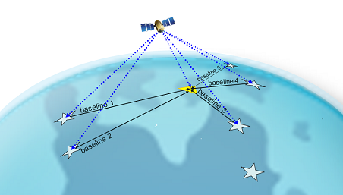

Online Positioning User Service (OPUS)
http://www.geodesy.noaa.gov/OPUS//
Fast, easy, consistent
access to NSRS
Over 2.8 millions solutions processed since 2002
Processed automatically on NGS computers
Solution via email in minutes
Notes:
The Online Positioning User Service (OPUS) is one of the most popular in the NGS suite of geodetic tools.
Every month, users voluntarily upload tens of thousands of GPS data files; each is automatically processed using standard NGS data and models to compute an accurate position.
OPUS requires minimal user input and uses software which computes coordinates for NGS’ Continuously Operating Reference Station (CORS) network. The resulting positions are accurate and consistent with other National Spatial Reference System users.

Slide 10
Implementation
Foundation CORS tied to IGS solutions
Stacking/Reprocessing yields consistent CORS coordinates
Bench Marks are then adjusted to fit CORS control
GNSS/OPUS derived positions supersede bench mark values
Velocities applied to revert back to common epoch (2022.0)
Effectively provides “fixed” plate & state plane coordinates
Permits use for RTK positioning at current epoch

Slide 11
Replacing NAVD 88 in 2022

Slide 12
NAVD 88 => Geopotential Reference Frame
Primary access shifts from bench marks to GNSS & geoid
Datum Offset w.r.t. global gravity models from satellite data
Bench marks tied to new reference frame and secondary
Implementation in 2022

Slide 13
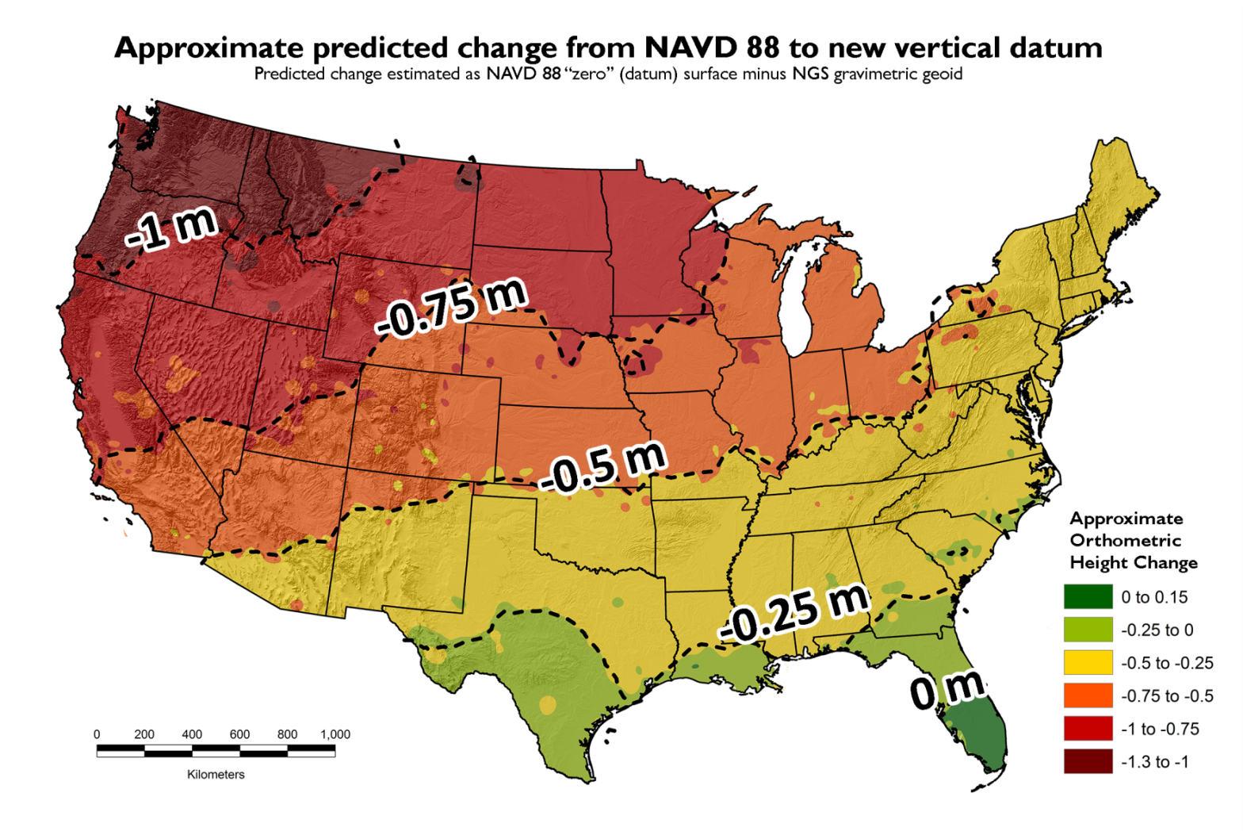
How will the new datums affect you?
The new vertical (geopotential) datum will change heights
50 cm on average with a 1m tilt towards the Pacific Northwest.
Notes:
Picture: Map reflects the type of height improvements users could expect if NAVD 88 were replaced with a geoid-based vertical datum. (This is only a large scale approximation and should not be used as an absolute guide. Each benchmark might have its own level of mismatch, for example from uplift or subsidence, not captured by this broad brush. Also, this is the difference between the zero level of NAVD 88 and the actual geoid. The difference between NAD 83 ellipsoid heights and ITRF/GRS-80 ellipsoid heights has NO influence on this graph and should not be part of the story.)
The new datums will be accessed via GNSS technology versus benchmarks
New vertical datum to be released in 2022 will be based upon a gravimetric geoid
Airborne gravity data for the geopotential datum collected by the Gravity for the Redefinition of the American Vertical Datum (GRAV-D) Project will allow for blending of data from satellite, altimetric, and surface sources.
Estimated Differences Between “Old” and “New” Datums:
Geometric Datum
Horizontal: 0.8 to 1.5 m in CONUS
Ellipsoidal heights: -0.2 to -1.6 m CONUS; AK 0 to 1.3 m
Geopotential Datum
Approx. +0.1 m (Florida) to -1.3 m (Washington)
More than 2 meters of change in Alaska

Slide 14
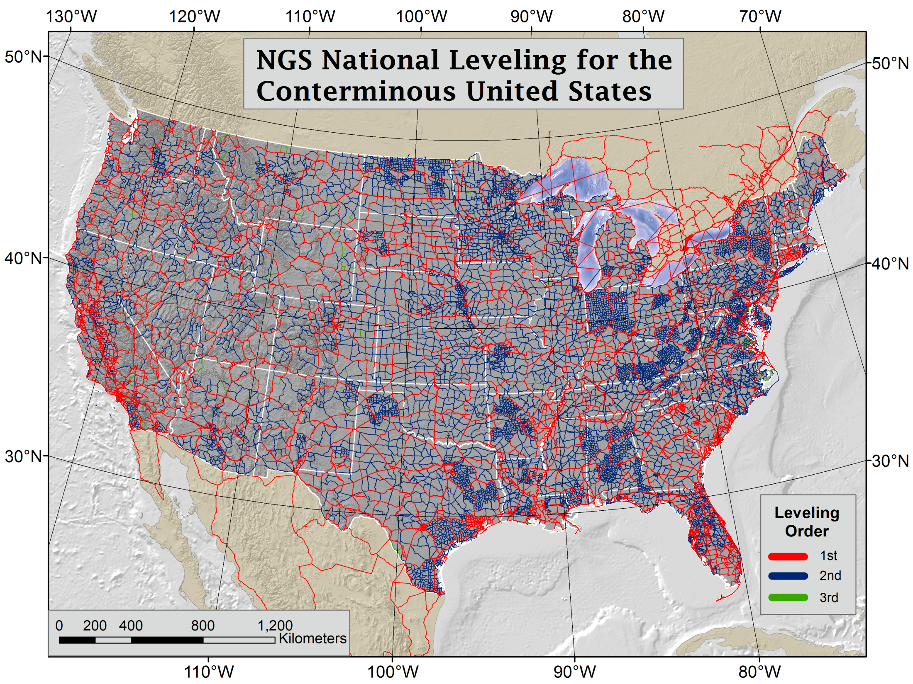

Slide 15
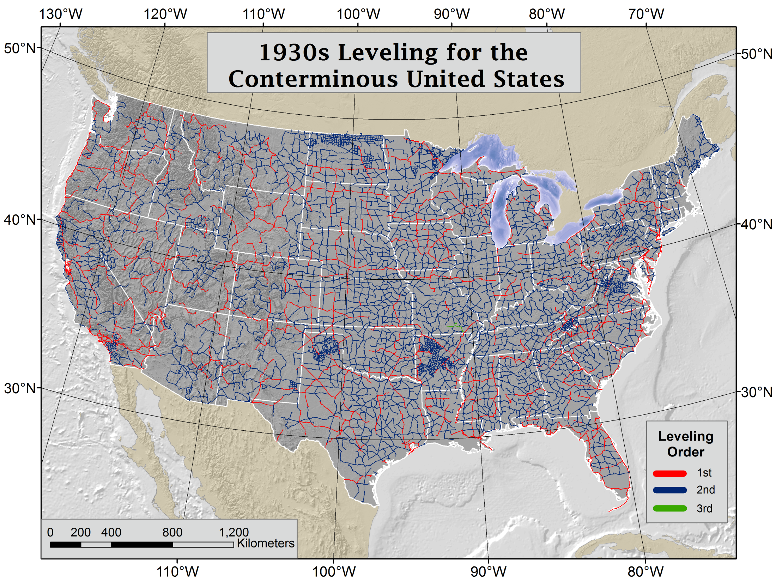
Notes:
Explanation of 1930s leveling by Dave Doyle:
Why more activity in the 30s. First of all it was both triangulation as well as leveling. The development of the portable Bilby Steel Tower in 1927 was a major advancement in the ability of USC&GS to conduct triangulation. With Roosevelt's election in 1933 and his initiative of the New Deal there was improved funding for many of the C&GS programs. As to specifically the leveling there were actually two parts - 1) new hires and improved funding for the full array of C&GS surveying and charting programs and 2) the instigation of the Civil Works Administration (CWA) which set up geodetic surveying programs in virtually all 48 states some of which are still in place today (NC, NJ and SC). The CWA surveying programs were funded by congress and the monies passed through C&GS but they had little control beyond that. Each state had their own coordinator and in some cases thousands of marks were set and surveyed. For example go into the archives and look for two red books "Geodetic Survey of Georgia." There was a really significant amount of traverse and leveling that was conducted under the CWA effort - regrettably virtually all of it was never submitted to C&GS for inclusion in the national reference frame - while many of the marks still exists only a very small percentage were ever later tied in by C&S/NGS field parties into the reference frame. In most cases the marks used were inscribed U.S. Coast & Geodetic Survey and State Survey.

Slide 16
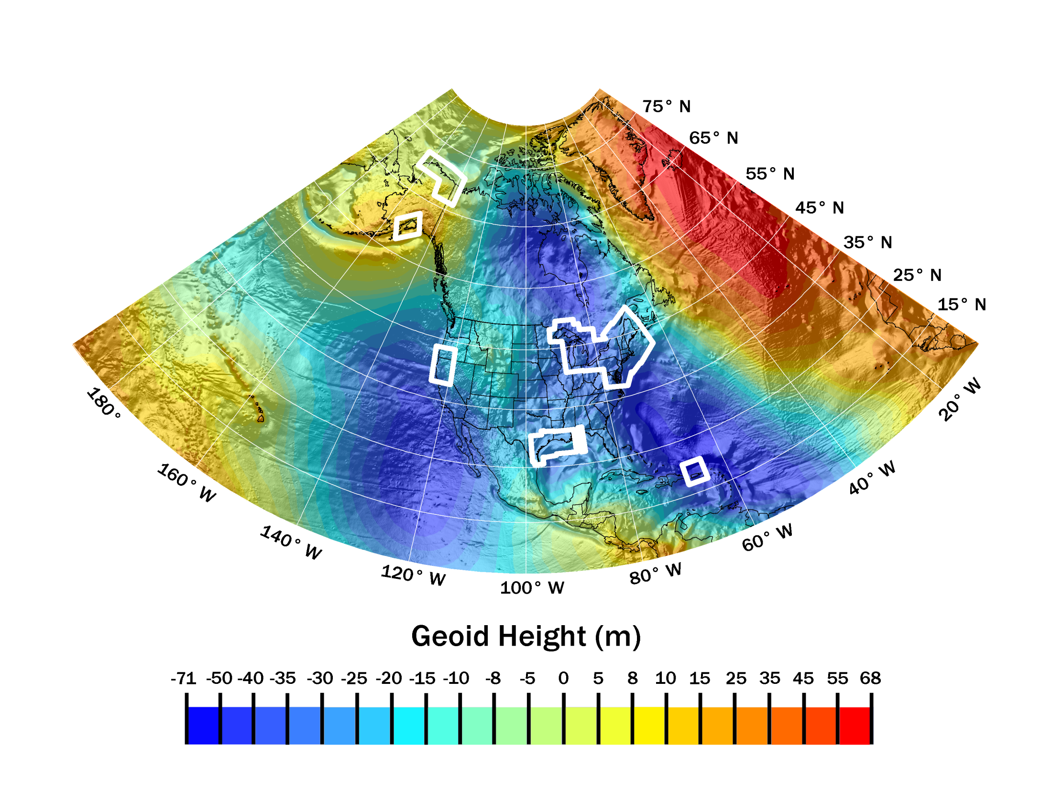
Experimental Geoid 14B with Aerogravity Blocks
Notes:
NEW VERTICAL DATUM (Rationale)
The technology to make accurate vertical heights measurements with GNSS technology
To provide vertical access to formerly prohibitive places
To allow monitoring of physical or geophysical datum deformation
A move away from differentially leveled passive control as the defining mechanism of the reference surface
To be consistent with the shift in the geometric reference frame/ellipsoid (2022)
Improvement in our technical abilities in reference surface realization (geopotential gravimetric reference surface - 1cm accuracy of geoid (GNSS/GRAV-D))
The new geopotential reference surface will be aligned with the geometric reference frame/ellipsoid (i.e., no hybrid geoid)
xGEOID14B
**NOT FOR ANY OFFICIAL USES**
Only for your information in estimating height changes at points you use.
These heights aren’t exactly the same as will be adopted in 2022, but are similar. Why?
GRAV-D isn’t complete yet and the data gaps affect the geoid model, even in areas with GRAV-D data
Geoid modeling methods continually improving and will be better by 2022, thus changing the heights.
Additional terrestrial and/or satellite data will likely become available by 2022.
First time CONUS + AK + Islands on same geoid

Slide 17
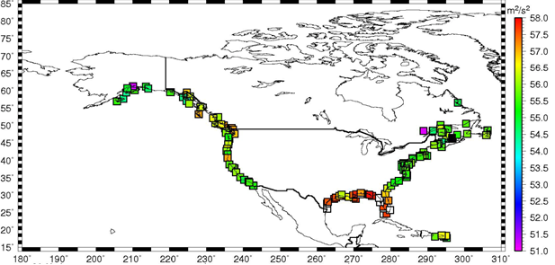
W₀ = 62,636,856.00 m²/s²

Slide 18
Implementation
Airborne gravity collection continues through 2020
Airborne data normalized to satellite data
Surface gravity normalized to satellite/airborne
Spectrally merged data available either as grid or maybe SHM
Geometric coordinates determined using GNSS/OPUS
Gravimetric geoid model interpolated for conversion
Geometric and geopotential velocities can be applied

Slide 19
Summary
NAD 83 and NAVD 88 both have inherent datum defects
Both have inherent quality issues from age of data
Both will be replaced by remote sensing derived data
Physical heights will be derived from geometric and a geoid
Geometric frame will follow on IGS solution closest to 2022
Geopotential frames will incrementally finish in 2022
Both new reference frames will provide global consistency

Slide 20
Questions?
Daniel R. Roman, Ph.D.
Chief, Spatial Reference System Division/GRAV-D P.I.
National Geodetic Survey, NOS, NOAA dan.roman@noaa.gov
1315 East-West Highway, N/NGS2 +1-301-713-3200 (changing soon)
Silver Spring MD 20910 U.S.A. www.geodesy.noaa.gov

